Slide 1
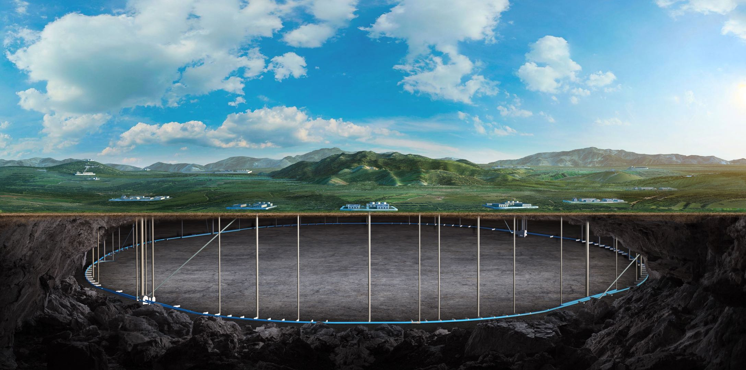
Longitudinal and transverse polarimeter
Yuting Wang
July 25, 2023

Slide 2
Compton polarimeter (LPOL & TPOL)
The Compton analyzing power for longitudinally polarized electrons depends only on the backscattered photon energy.
$$\frac{{d^{2}σ}_{z}}{du dφ}=ξ_{3}ς_{z}\frac{r_{e}^{2} u}{κ{\left(1+u\right)}^{3}}(u+2)(1−\frac{2u}{κ})$$
The transverse analyzing power depends both on the backscattered photon energy and the azimuthal angle between the electron direction and the backscattered photon.
$\frac{{d^{2}σ}_{x}}{du dφ}=−ξ_{3}ς_{x}\frac{2r_{e}^{2} u}{κ{\left(1+u\right)}^{3}}\sqrt{\frac{u}{κ}\left(1−\frac{u}{κ}\right)}\cos{φ}$,
$\frac{{d^{2}σ}_{y}}{du dφ}=−ξ_{3}ς_{y}\frac{2r_{e}^{2} u}{κ{\left(1+u\right)}^{3}}\sqrt{\frac{u}{κ}\left(1−\frac{u}{κ}\right)}\sin{φ}$,
The beam polarization (longitudinal & transverse) will dictate the type of the detector required. For measurements of the longitudinal polarization, the photon detector need only measure the total energy of the backscattered photon, but for the transverse case, one must measure the position as well [1,2,3].
[1] B. Sobloher. Polarisation and Polarimetry at HERA, arXiv:1201.3836v1
[2] Jenny List, Annika Vauth, Benedikt Vormwald, A Quartz Cherenkov Detector for Compton-Polarimetry at Future e+e- Colliders, arXiv:1502.06955v2
[3] M. Woods, The scanning Compton polarimeter for the SLD experiment, arXiv:hep-ex/9611005v1

Slide 3
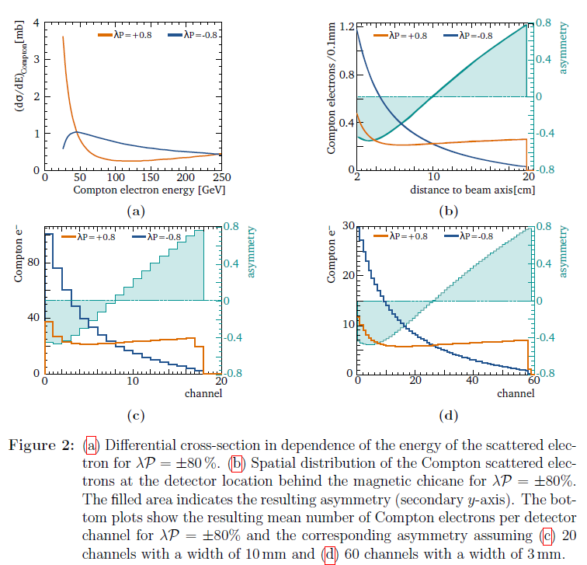
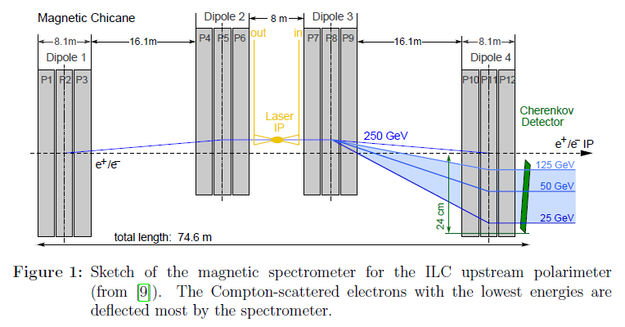
Compton polarimeter for the ILC
A quartz Cherenkov detector for such Compton polarimeters. (LPOL)
The baseline solution is a gas Cherenkov detector consisting of 20 channels, each 1 cm wide.
The rate asymmetry with respect to the laser helicity is determined in each channel i as $A_{i}=\frac{N_{i}^{R}−N_{i}^{L}}{N_{i}^{R}+N_{i}^{L}},$ where $N_{i}^{R,L}$ are the count rates in channel i for right and left-handed laser polarization.
$\frac{δp}{p}≤0.25\%$

Slide 4
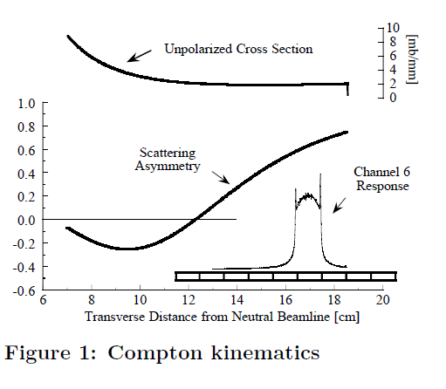
Compton polarimeter for the SLD
After the Compton Interaction Point (CIP), the electrons pass through a dipole spectrometer; a nine-channel Cherenkov detector then measures electrons in the range 17 to 30 GeV. (LPOL)
The counting rates in each Cherenkov channel are measured for parallel and anti-parallel combinations of the photon and electron beam helicities.
$\frac{δp}{p}≤0.5\%$

Slide 5
Compton polarimeter for the HERA
Three different polarimeters, which measured both transverse and longitudinal polarizations.
The cross section for the Compton scattering is sensitive to transverse and longitudinal components $ς_{y,z}$.
$$\frac{d^{2}σ}{dE dφ}=Σ_{0}\left(E\right)+ξ_{1}Σ_{ξ1}\left(E\right)\cos{2φ}\left(E\right)+ξ_{3}ς_{x}Σ_{x}\left(E\right)\cos{φ}+ξ_{3}ς_{y}Σ_{y}\left(E\right)\sin{φ}+ξ_{3}ς_{z}Σ_{z}\left(E\right).$$
The polarization is then measured using the asymmetry of the cross sections, when switching the laser polarization between left and right helicity states.
It measured the tiny spatial asymmetry between the left and right laser helicity states caused by the transverse polarization.
It measured the sizable asymmetries in the energy distributions of the backscattered Compton photons when switching between the left and right laser helicity states.

Slide 6
Compton polarimeter for the HERA

Slide 7
Compton polarimeter for the HERA

Slide 8
Thanks

