Slide 1
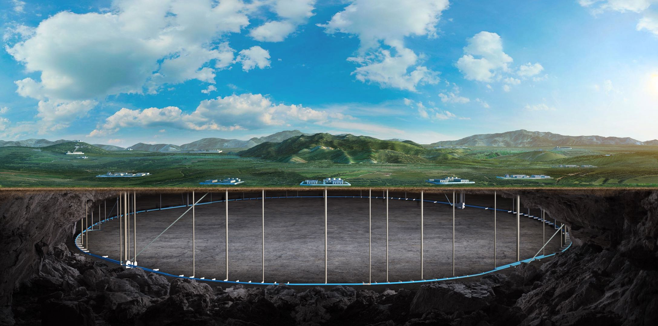
CEPC MDI cost
Sha Bai
CEPC day, 16 August 2023

Slide 2
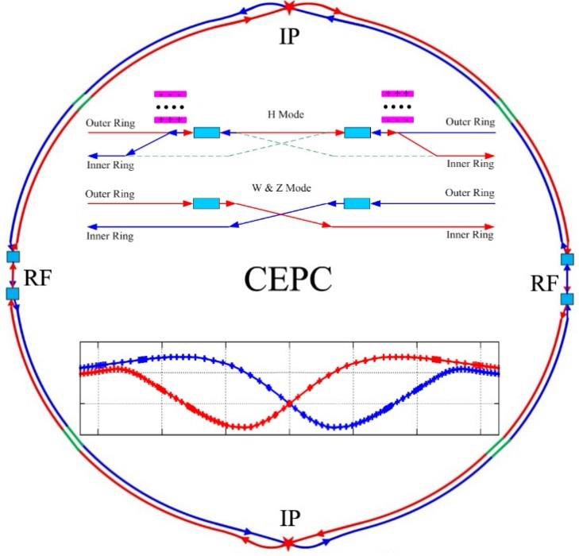
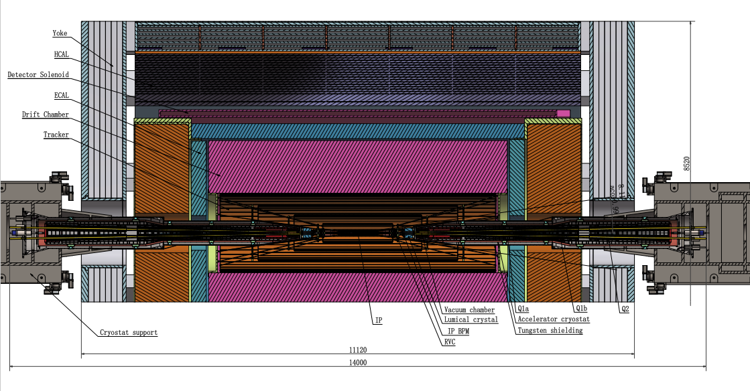
MDI layout and IR design
CEPC collider ring ~ 2 IPs
Machine Detector Interface (MDI) ~ ±7m around the IP.
The accelerator components inside the detector within the conical space of opending angle: acos0.99.
Vacuum chamber ~ ±0.7m around IP belongs to detector, while beyond to ~7m belongs to accelerator
MDI accelerator components: SC magnets, anti-solenoid, cryostat, RVC, supporting system, IR vacuum chamber……
Detector components and cost are not included in this talk.

Slide 3
MDI TDR parameters
 | range | Peak field in coil | Central field gradient | Bending angle | length | Beam stay clear region | Minimal distance between two aperture | Inner diameter of beam pipe | Outer diameter of beam pipe | Critical energy (Horizontal) | Critical energy (Vertical) | SR power (Horizontal) | SR power (Vertical)
L* | 0~1.9m |  |  |  | 1.9m
Crossing angle | 33mrad
MDI length | ±7m
Detector requirement of accelerator components in opening angle | 8.11˚
Q1a/Q1b |  | 3.5/2.7T | 142/85T/m |  | 1.21m | 14.9/18.2mm | 62.71/105.28mm | 20/23mm | 26/29mm | 724.7/663.1keV | 396.3/263keV | 212.2/239.23W | 99.9/42.8W
Q2 |  | 3.7T | 96.7T/m |  | 1.5m | 24.48mm | 155.11mm | 32mm | 38mm | 675.2keV | 499.4keV | 472.9W | 135.1W
Lumical | 0.94~1.11m |  |  |  | 0.16m
Anti-solenoid before Q1a |  | 8.8T |  |  | 1.1m
Anti-solenoid Q1 |  | 3T |  |  | 2.5m
Anti-solenoid Q2 |  | 3T |  |  | 1.5m
Beryllium pipe |  |  |  |  | ±85mm |  |  | 20mm
Last B upstream | 64.97~153.5m |  |  | 0.77mrad | 88.5m |  |  |  |  | 33.3keV
First B downstream | 44.4~102m |  |  | 1.17mrad | 57.6m |  |  |  |  | 77.9keV
Beampipe within QDa/QDb |  |  |  |  | 1.21m |  |  |  |  |  |  | 1.19/1.31W
Beampipe within QF1 |  |  |  |  | 1.5m |  |  |  |  |  |  | 2.39W
Beampipe between QD0/QF1 |  |  |  |  | 0.3m |  |  |  |  |  |  | 26.5W

Slide 4
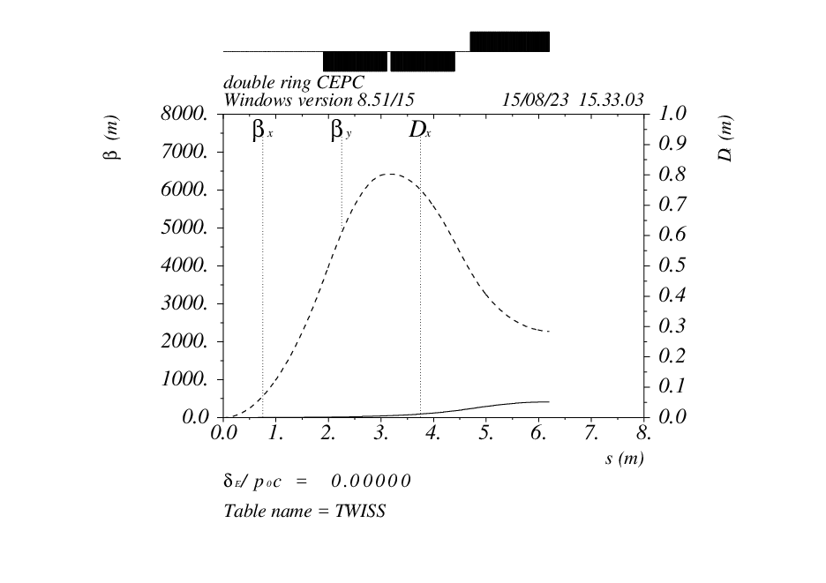
MDI TDR Optics
Q2
IP
Q1a
Q1b
MDI SC magnets: Q1a, Q1b, Q2
L_{Q1a}=L_{Q1b}=1.21m, L_{Q2}=1.5m
No bending magnets and sextupoles
IP βx=0.3m βy=0.001m

Slide 5
IR Superconducting magnets
TDR requirements of Interaction Region quadrupole magnets for Higgs
In order to reduce the magnet size, energy and cost, the anti-solenoid is divided into a total of 29 sections with different inner coil diameters.
These sections are connected in series, but the current of some sections of the anti-solenoid can be adjusted using auxiliary power supplies.
Magnet | Central field gradient (T/m) | Magnetic length (m) | Width of GFR (mm) | Outer diameter of beam pipe (mm) | Dipole field | Minimal distance between two aperture beam lines (mm)
Q1a | 142.3 | 1.21 | 14.92 | 26 | <30 Gs | 62.71
Q1b | 85.4 | 1.21 | 18.17 | 29 | <30 Gs | 105.28
Q2 | 96.7 | 1.5 | 24.48 | 38 | <30 Gs | 155.11

Slide 6
Magnet system
Component | type | unit | number | Unit price | price
Superconducting combined function magnets |  | Set | 4 | 950 | 3800
Q1a, Q1b, Q2 |  | Set | 4 | 140/150/200 | 1960
Anti-solenoid | Max 8.6T, 5.1m | One | 4 | 240 | 960
Corrector coil |  | Set | 4 | 50 | 200
Assembly and inspection |  | One | 4 | 50 | 200
Cryogenic horizontal test |  | One | 4 | 70 | 280
Quench detection and protection |  | One | 4 | 50 | 200

Slide 7
Magnet Power Supplies
Component | type | unit | number | Unit price | price
MDI-SC magnet power |  |  |  |  | 516
SCQ-1 | 2200A/12V | Set | 8 | 22 | 176
SCQ-2 | 1800A/12V | Set | 4 | 20 | 80
Anti-solenoid | 1800A/12V | Set | 4 | 20 | 80
Corrector | 120A/14V | Set | 72 | 2.5 | 180

Slide 8
Cryogenics system
Components | Unit | Number | Unit price | Total price
MDI-Cryogenics |  | 4 | 1250 | 5000
Cryostat |  |  |  | 380.00
Assembly | Set | 1 | 180 | 180.00
Measurement | Set | 1 | 100 | 100.00
Testing | Set | 1 | 80 | 80.00
Molecular pump unit (dry pump front stage | Set | 1 | 20 | 20.00
Current lead |  |  |  | 870.00
Current lead tower | Set | 1 | 200 | 200.00
Low temperature valve box | Set | 1 | 120 | 120.00
Measurement | Set | 1 | 80 | 80.00
Testing | Set | 1 | 100 | 100.00
Molecular pump unit (dry pump front stage | Set | 1 | 20 | 20.00
Current lead helium flow controller and related devices | Set | 1 | 200 | 200.00
Control | Set | 1 | 150 | 150.00

Slide 9
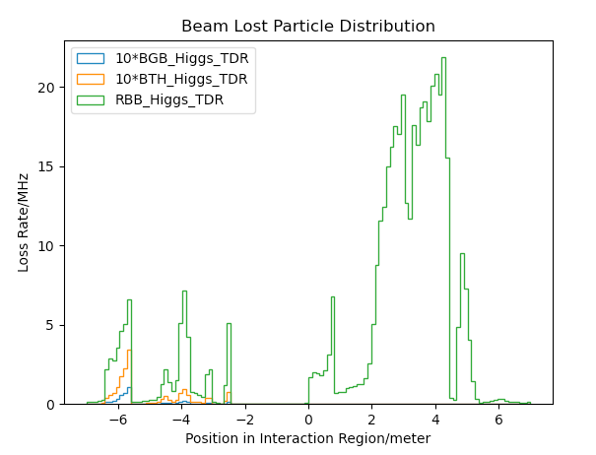
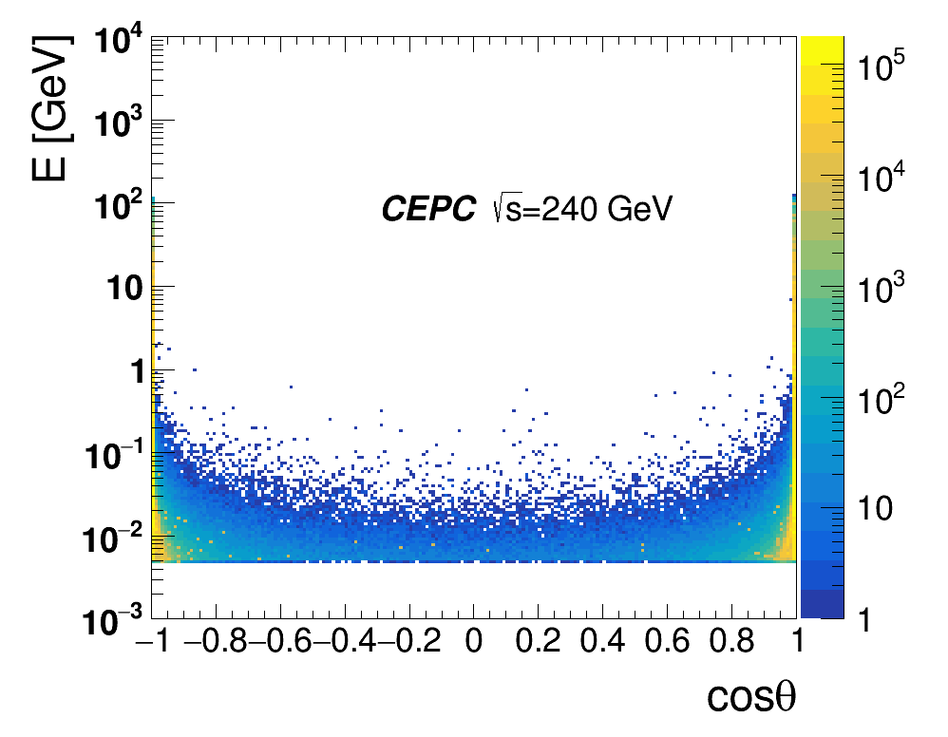
Radiation background
Including Radiative Bhabha scattering, Beam-Gas scattering, Beam Thermal Photon scattering.
Beam loss background from Beamstrahlung almost no in upstream IP, but mainly from pair-production distribution.
name | Position | Distance to IP/m | Beta function/m | Horizontal Dispersion/m | Phase | BSC/2/m | Range of half width allowed/mm
APTX1 | D1I.785 | 44611 | 20.7 | 0.12 | 164.00 | 0.006 | 1~6
APTX2 | D1I.788 | 44680 | 20.7 | 0.12 | 164.25 | 0.006 | 1~6
APTY1 | D1I.791 | 44745 | 105.37 | 0.12 | 165.18 | 0.0036 | 0.156~3.6
APTY2 | D1I.794 | 44817 | 113.83 | 0.12 | 165.43 | 0.0036 | 0.156~3.6
APTX3 | D1O.5 | 1729.66 | 20.7 | 0.06 | 6.85 | 0.00182 | 1~6
APTX4 | D1O.8 | 1798.24 | 20.7 | 0.12 | 7.10 | 0.00182 | 1~6
APTY3 | D1O.10 | 1832.52 | 20.7 | 0.25 | 7.22 | 0.00182 | 0.069~3.3
APTY4 | D1O.14 | 1901.1 | 20.7 | 0.25 | 7.47 | 0.00182 | 0.069~3.3
APTX5 | DMBV01IRU0 | 56.3 | 196.59 | 0 | 362.86 | 0.01178 | 2.9~11.78
Pair-Production Distribution
Beam loss particle distribution with collimator design.
Collimator design meet requirements of beam-stay-clear region, impedance, phase etc on.
4 sets of collimators were implemented per IP per Ring(16 in total)
2 sets are horizontal(4mm radius), 2 sets are vertical(3mm radius).
One more upstream horizontal collimator sets were implemented to mitigate the Beam-Gas background

Slide 10
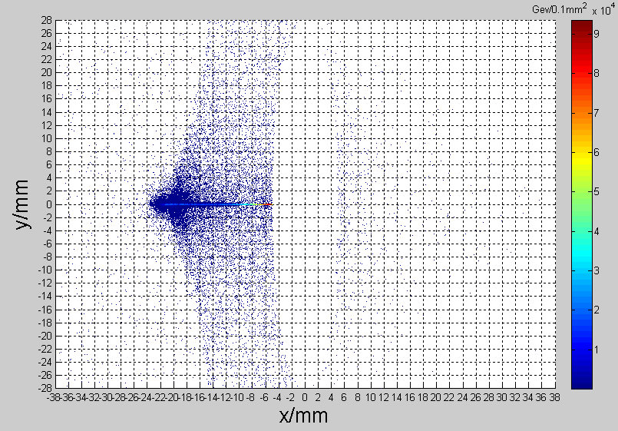
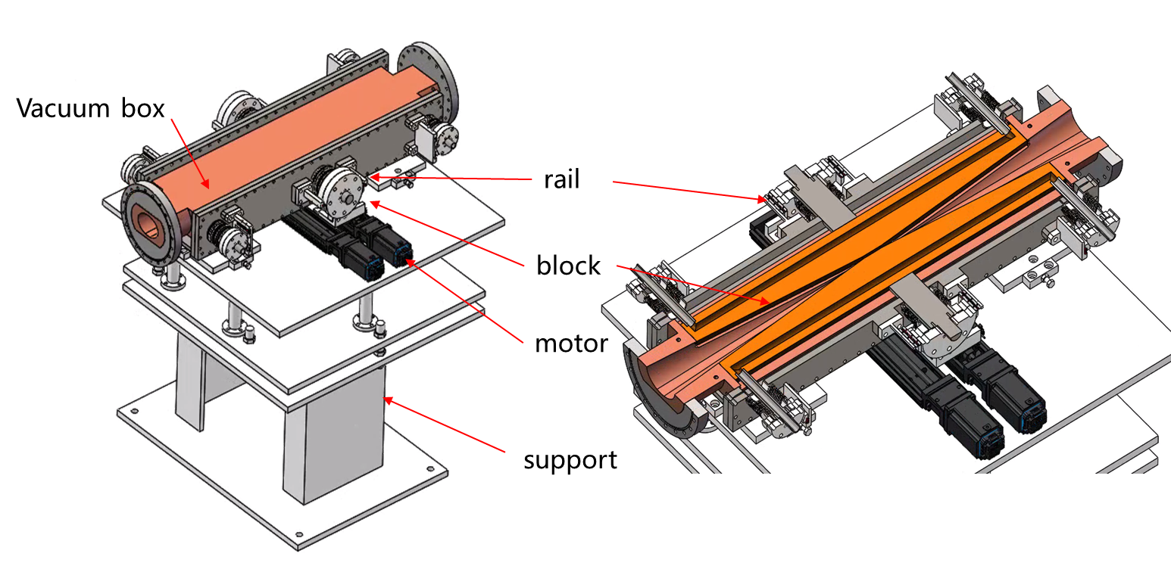
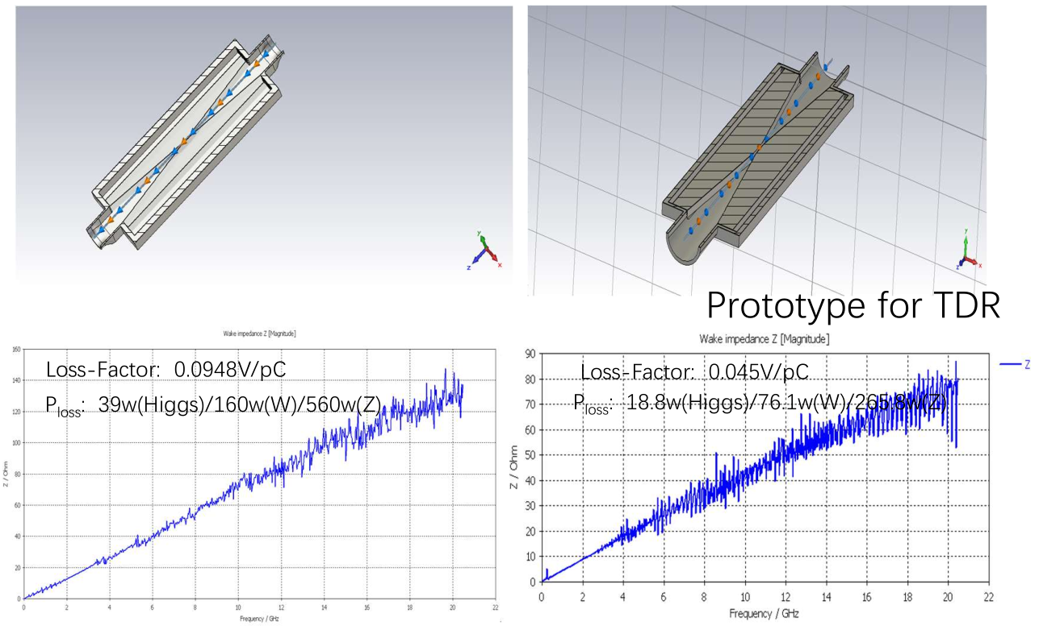
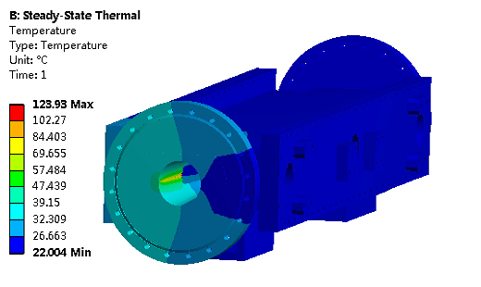
Movable collimators
Located in straight section between two dipoles, the length is 800 mm.
SR power: 7.5kW @Higgs, 30MW
Particle deposition:
Jaw material: Cu
Total heat generation: 91.6 W
Maximum temperature raise by particle-material reaction: 2℃
Highest temperature: 124 ℃

Slide 11
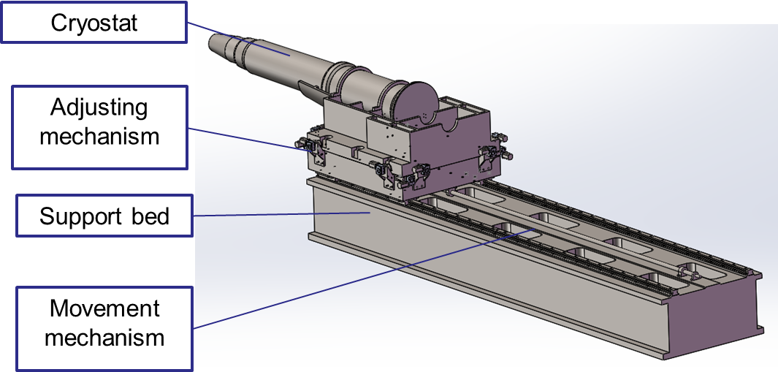
SC magnet support system
After the optimization of the supports in the cryostat, the total weight of the cryostat and the devices inside is 2790 Kg.
The cryostat is about 5.6m long. The cantilever length is 5283mm.
The resolution requirement of the adjusting mechanism < 5 μm.
Thermal shield
Helium vessel
Q2
Vacuum vessel
Q1b
Q1a
Anti-solenoid
Support rods

Slide 12
Mechanical system
component | Type | number | Unit price | price
MDI-mechanics |  |  |  | 2704
Movable collimator | collimator | 40 | 50 | 2000
Supporting system | SPT-SC | 4 | 141 | 564
RVC |  | 4 | 35 | 140

Slide 13
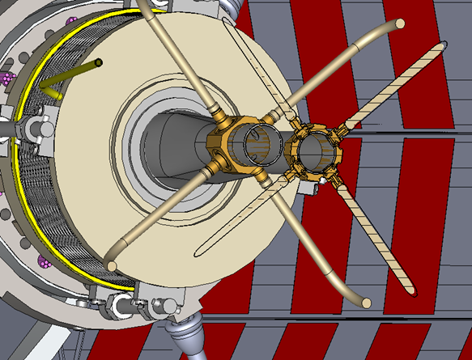
IP BPM
Considering response time and calibration difficulty, two 4 button electrodes BPM in double pipe and one 2 button electrodes BPM in single pipe at each side of CEPC IR are adopted.
2 button electrodes BPM for measuring the arrival time.

Slide 14
Instrumentation
component | Type | number | Unit price | price
MDI-instrumentation |  |  |  | 156
IP-BPM (4 button electrodes) | electronics | 8 | 7 | 104
 | Cable | 8 | 1
 | Probe | 8 | 5
IP-BPM (2 button electrodes) | electronics | 4 | 7 | 52
 | Cable | 4 | 1
 | Probe | 4 | 5

Slide 15
Vacuum system
component | Type | number | Unit price | price
MDI-vacuum |  |  |  | 40
Vacuum chamber | pipe | 8 | 5 | 40
Vacuum chamber ~ ±0.7m around IP belongs to detector, while beyond to ~7m belongs to accelerator

Slide 16
MDI cost summary
Components | Type | Number | Unit price | price | Total price
Magnets | Superconducting combined function magnets | 4 | 490 | 1960 | 3800
 | Anti-solenoid | 4 | 240 | 960
 | Corrector coil | 4 | 50 | 200
 | Assembly and inspection | 4 | 50 | 200
 | Cryogenic horizontal test | 4 | 70 | 280
 | Quench detection and protection | 4 | 50 | 200
Magnet Power Supplies | SCQ-1 | 8 | 22 | 176 | 516
 | SCQ-2 | 4 | 20 | 80
 | Anti-solenoid | 4 | 20 | 80
 | Corrector | 72 | 2.5 | 180
Mechanics | Movable collimator | 40 | 50 | 2000 | 2704
 | Supporting system | 4 | 141 | 564
 | RVC | 4 | 35 | 140
Instrumentation | 4 button BPM | 8 | 13 | 104 | 156
 | 2 button BPM | 4 | 13 | 52
Cryogenics system | Cryostat | 4 | 380 | 1520 | 5000
 | Current lead | 4 | 870 | 3480
Vacuum system | Vacuum chamber | 8 | 5 | 40 | 40
 |  |  |  |  | 12216

Slide 17
Summary
CEPC MDI components fit well with the requirements of accelerator physics.
Detector components and cost are not included.
Control and vacuum system are counted in the collider ring.
The MDI cost included all accelerator hardwares, while without the common system (alignment, radiation protection, utilities, civil engineering).

Slide 18
Thanks

