Slide 1



CEPC LINAC COST
Cai MENG
16. Aug. 2023, Beijing, CEPC Accelerator TDR Cost Review

Slide 2
Content
Parameters and layout of the CEPC Linac
Cost of the CEPC Linac
  Linac
  Damping Ring
Summary

Slide 3
Design Parameters / Requirement List
Parameter | Symbol | Unit | Baseline
Energy | E_{e-}/E_{e+} | GeV | 30
Repetition rate | f_{rep} | Hz | 100
Bunch number per pulse |  |  | 1 or 2
Bunch charge |  | nC | 1.5 (3)
Energy spread | σ_{E} |  | 1.5×10⁻³
Emittance | ε_{r} | nm | 6.5
Bunch spacing is 69.2 ns

Slide 4
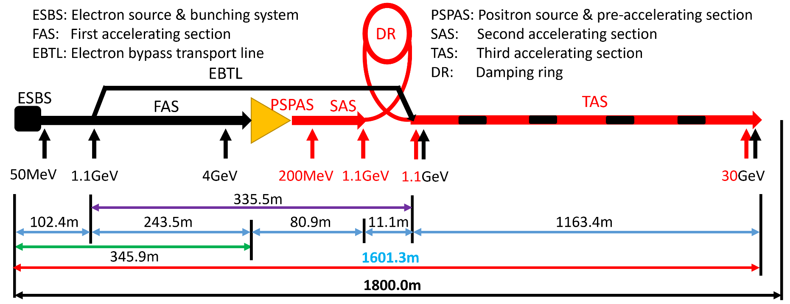
Introduction: ：Layout of the CEPC Linac
Layout
  The tunnel is 1.8km
  The circumference of the damping ring is 147m

Slide 5
Hardware systems (1)
Power source
S-band power source (number, power, frequency) | 34, 80MW, 2860MHz
C-band power source (number, power, frequency) | 236, 50MW, 5720MHz
Solid-state power source (number, power, frequency) | 1, 20kW, 158.89MHz
 | 1, 20kW, 476.67MHz
Accelerating structure
Large-aperture S-band accelerating structure (number, gradient, length) | 16, 22MV/m, 2.0m
Normal S-band accelerating structure (number, gradient, length) | 8, 27MV/m, 3.1m
 | 85, 22MV/m, 3.1m
C-band accelerating structure (number, gradient, length) | 470, 40~45MV/m, 1.8m
Subharmonic buncher (number, voltage, length) | 1, 10 kV, 0.8m
 | 1, 120kV, 0.5m
C-band deflecting cavity (number, voltage, length) | 1, 20MV, 1.8m

Slide 6
Hardware systems (2)
Electron and positron beam switching time within 3.5s
  Magnet power supply switching within 3 s
Magnet |  | PS
Solenoid (number, aperture, field, length) | 4, 90mm, 400Gs, 80mm | 4
 | 17, 210mm, 800Gs, 110mm | 17
 | 1, 118mm, 600Gs, 80mm | 1
 | 15, 400mm, 0.5T, 1m | 15
Quadrupole (number, aperture, gradient, length) | 22, 34mm, 22T/m, 100mm | 11
 | 87, 34mm, 24T/m, 200mm | 49
 | 44, 34mm, 26T/m, 400mm | 44
 | 104, 24mm, 50T/m, 300mm | 52
 | 52, 24mm, 50T/m, 600mm | 52
 | 6, 60mm, 10T/m, 100mm | 3
 | 3, 60mm, 10T/m, 200mm | 3
 | 36, 150mm, 7.9T/m, 300mm | 18
 | 18, 150mm, 7.9T/m, 600mm | 18
Dipole (number, gap, field, length) | 1, 35mm, 0.33T, 262mm | 1
 | 4, 24mm, 1.0T, 5.847m, bidirectional power supply | 4
 | 5, 60mm, 0.42T, 698mm, bidirectional power supply, switching within 3s | 5
 | 5, 35mm, 1.0T, 698mm | 5
 | 4, 35mm, 1.0T, 1.047m, power supply switching within 3s, vertical bending | 4
Corrector (number, gap, field, length) | 1, 50mm, 10Gs, 30mm | 2
 | 1, 136mm, 50Gs, 400mm | 2
 | 25, 150mm, 50Gs, 100mm | 50
 | 2, 50mm, 10 Gs, 24mm | 2
 | 100, 34mm, 450Gs, 100mm | 100
 | 146, 24mm, 0.25T, 200mm | 146

Slide 7
Hardware systems (3)
Beam position, beam profile, bunch charge
7 energy analyzing station (7 beam dump), not included in cost
Beam diagnostics
BPM (number, aperture, resolution, length) | 150, 30/20mm, 10μm, 0.2m
ICT (number, aperture, length) | 63, 35mm, 40mm
PR (number, aperture, resolution, length) | 30, 35mm, 20μm, 0.3m
Beam dump
Number, energy, beam size, bunch charge, repetition rate | 1, 60MeV, 2mm*1mm, 10nC, 1Hz
 | 1, 4GeV, 0.5mm*0.5mm, 10nC, 1Hz
 | 1, 250MeV, 1.5mm*1.5mm, 5nC, 1Hz
 | 1, 1.1GeV, 0.5mm*0.5mm, 5nC, 1Hz
 | 1, 6GeV, 0.5mm*0.3mm, 3nC, 1Hz
 | 2, 30GeV, 0.3mm*0.3mm, 3nC, 1Hz
 | 1, 250MeV, 1.5mm*1.5mm, 5nC, 100Hz

Slide 8
Hardware systems (4)
Damping ring
Name | Type | Number | Length (m) | Value
B0 | dipole | 40 | 0.7 | Gap 38 mm, Field 1.3 T
Br | dipole | 40 | 0.248 | Gap 38 mm, Field 1.3 T
Qarc | quadrupole | 96 | 0.2 | Gap 44 mm, Field 17 T/m
QRF | quadrupole | 8 | 0.2 | Gap 38 mm, Field 30 T/m
SF | sextupole | 36 | 0.1 | Gap 38 mm, Field 94 T/m²
SD | sextupole | 36 | 0.1 | Gap 38 mm, Field 140 T/m²
CORR | corrector | 60 | 0.07 | Gap 40 mm, Field 20 Gs
DRLAM | Lambertson | 2 | 0.5 | Field 0.88 T
DRkicker | kicker | 2 | 1.4 | Field 0.028 T
MBPM | BPM | 40 | 0.1 | Button BPM, Resolution 20µm @ 5mA
RFC | cavity | 2 | 1.4 | 650MHz, 1.25MV/cavity

Slide 9
Cost：Linac
System | Components | Number | Unit Cost | Cost | Total Cost
 |  |  | （10,000￥） |  | （10,000￥）
RF system | Electron Source | 1 | 310.00 | 310.0 | 68245.6
 | Positron Source | 1 | 470.00 | 470.0
 | S-band RF | 34 | 387.28 | 13167.6
 | C-band RF | 236 | 230.08 | 54298.0
RF power source | S-band PS | 34 | 335.00 | 11390.0 | 81010.0
 | C-band PS | 236 | 295.00 | 69620.0
Magnets | Solenoid | 37 |  | 499.0 | 4338.0
 | Dipole | 19 |  | 344.0
 | Quadrupole | 372 |  | 2577.0
 | Corrector | 275 |  | 618.0
 | Field measurement devices | 2 | 150.00 | 300.0
Magnet power supplies | Power supply | 583 |  | 1596.6 | 2069.3
 | Cable （m） | 59200 |  | 256.7
 | DCCT | 610 |  | 150.0
 | Equipment Cabinet | 110 | 0.60 | 66.0
Vacuum system |  |  |  | 14736.4 | 14736.4
Instrumentation | BPM | 150 | 13.00 | 1950.0 | 5010.0
 | ICT | 63 | 40.00 | 2520.0
 | PR | 30 | 18.00 | 540.0
Control system |  |  |  | 5287.0 | 5287.0
Mechanical systems | Vacuum device support | 5589 |  | 804.6 | 2602.5
 | Support | 968 |  | 1797.9
 |  |  |  |  | 183298.8
总造价(RMB)
  18.33亿元
CDR 9.33亿

Slide 10
Cost: Damping ring
总造价
  0.583亿元
Components | Type | Number | Unit Price | Price | Total price
Magnets | Dipoles | 80 | 6/4 | 400 | 1528.0
 | Quadrupoles | 104 | 5 | 520
 | Sextupoles | 72 | 4 | 288
 | Correctors | 60 | 2 | 120
 | Field meas. devices | 2 | 100 | 200
Vacuum | Beam pipe | 150 | 0.4 | 60 | 707.5
 | Bellows | 75 | 1.5 | 112.5
 | Ion pump | 100 | 1.5 | 150
 | Molecular pump | 2 | 10 | 20
 | Gate valve | 10 | 0.5 | 5
 | Roughing valve | 25 | 2 | 50
 | Gauge/Residual gas analyzer/Assembly | 8/8/1 | 10/10/150 | 310
Mechanical supports | Dipole support | 80 | 1.5/1.0 | 100 | 320.0
 | Quadrupole support | 104 | 1.8/1.0 | 162
 | Vacuum support/BI support | 335/41 | 0.08/0.2/0.15 | 58
Beam Instrumentation | Beam position monitor | 40 | 13 | 520 | 760.0
 | Average beam current monitor (DCCT) | 1 | 70 | 70
 | Tune measurement | 1 | 170 | 170
RF | Cavity/Waveguide/LLRF/Vacuum | 2 | 350/90/40/45 | 700/180/80/90 | 1050.0
RF Power Source | Solid state amplifier | 2 | 175 | 350 | 350.0
Power Supplies | PS/Cable/DCCT/Cabinet |  |  |  | 444.5
Control |  |  |  |  | 456.0
Injection & Extraction | Kicker/Septum/Field Measurement | 2/2/1 |  | 212.6 | 212.6
 |  |  |  |  | 5828.6

Slide 11
Cost: Linac + Damping ring
Components | LINAC | DR | Total
 |  |  | （10,000￥）
RF system | 68245.6 | 1050.0 | 69295.6
RF power source | 81010.0 | 350.0 | 81360.0
Magnets | 4338.0 | 1528.0 | 5866.0
Magnet power supplies | 2069.3 | 444.5 | 2513.8
Vacuum system | 14736.4 | 707.5 | 15443.9
Instrumentation | 5010.0 | 760.0 | 5770.0
Control system | 5287.0 | 456.0 | 5743.0
Mechanical systems | 2602.5 | 320.0 | 2922.5
Injection & Extraction | 0.0 | 212.6 | 212.6
 | 183298.8 | 5828.6 | 189127.4
总造价
  18.91亿元
CDR 9.33亿

Slide 12
Summary
The total cost of the Linac, including the damping ring but not including the transport line between the Linac and DR, is 1.891 billion RMB.

Slide 13
Thank you for your attention!

Slide 14
Components | LINAC | DR | Total | CDR
RF system | 68245.6 | 1050.0 | 69295.6 | 35564 | 33731.6
RF power source | 81010.0 | 350.0 | 81360.0 | 32190.0 | 49170.0
Magnets | 4338.0 | 1528.0 | 5866.0 | 2597 | 3269
Magnet power supplies | 2069.3 | 444.5 | 2513.8 | 2050.0 | 463.8
Vacuum system | 14736.4 | 707.5 | 15443.9 | 6380 | 9063.9
Instrumentation | 5010.0 | 760.0 | 5770.0 | 6400.0 | -630.0
Control system | 5287.0 | 456.0 | 5743.0 | 5793 | -50
Mechanical systems | 2602.5 | 320.0 | 2922.5 | 1307.0 | 1615.5
Injection & Extraction | 0.0 | 212.6 | 212.6 | 0 | 212.6
 | 183298.8 | 5828.6 | 189127.4 | 92281.0 | 96846.4

Slide 15
Cost: Linac + Damping ring + TL
Total
  19.05亿
Components | LINAC | DR | TL | Total
RF system | 68245.6 | 1050.0 |  | 69295.6
RF power source | 81010.0 | 350.0 |  | 81360.0
Magnets | 4338.0 | 1528.0 | 532.0 | 6398.0
Magnet power supplies | 2069.3 | 444.5 | 352.4 | 2866.3
Vacuum system | 14736.4 | 707.5 | 228.4 | 15672.3
Instrumentation | 5010.0 | 760.0 | 96.0 | 5866.0
Control system | 5287.0 | 456.0 |  | 5743.0
Mechanical systems | 2602.5 | 320.0 | 122.2 | 3044.7
Injection & Extraction | 0.0 | 212.6 |  | 212.6
 | 183298.8 | 5828.6 | 1331.0 | 190458.4

Slide 16
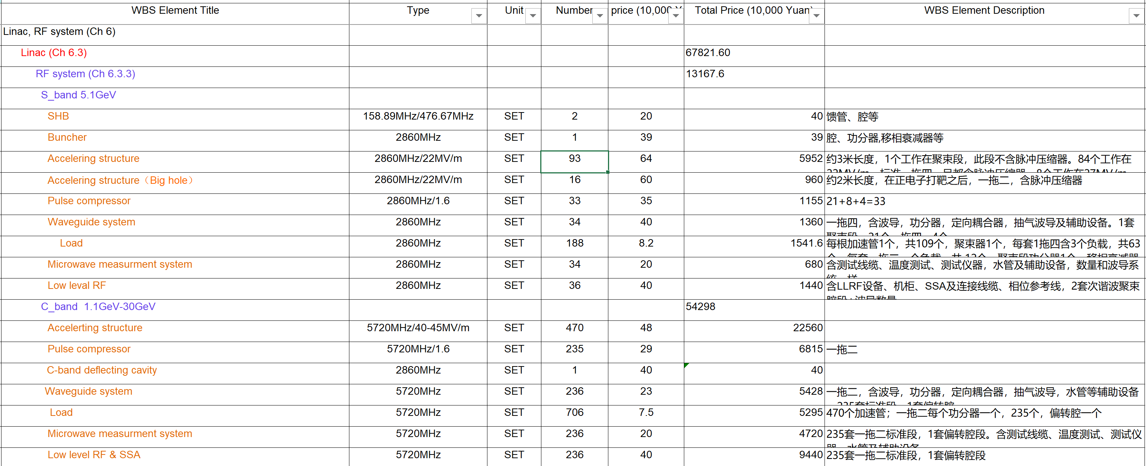

Slide 17
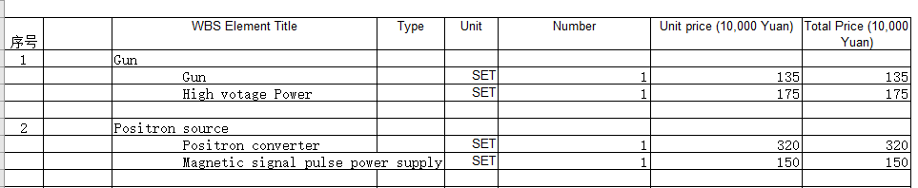

Slide 18
RF power source (Ch 6.5.2) |  |  |  |  | 81010
Klystron | 2860MHz/80MW | SET | 34 | 120 | 4080
Modulator | 400kV/500A | SET | 34 | 180 | 6120
Load and auxiliary power supply |  | SET | 34 | 20 | 680
Klystron gain amplifier | 2860MHz/1000W | SET | 34 | 15 | 510
Klystron | 5720MHz/50MW | SET | 236 | 110 | 25960
Modulator | 350kV/400A | SET | 236 | 150 | 35400
Load and auxiliary power supply |  | SET | 236 | 20 | 4720
Klystron gain amplifier | 5720MHz/1000W | SET | 236 | 15 | 3540

Slide 19
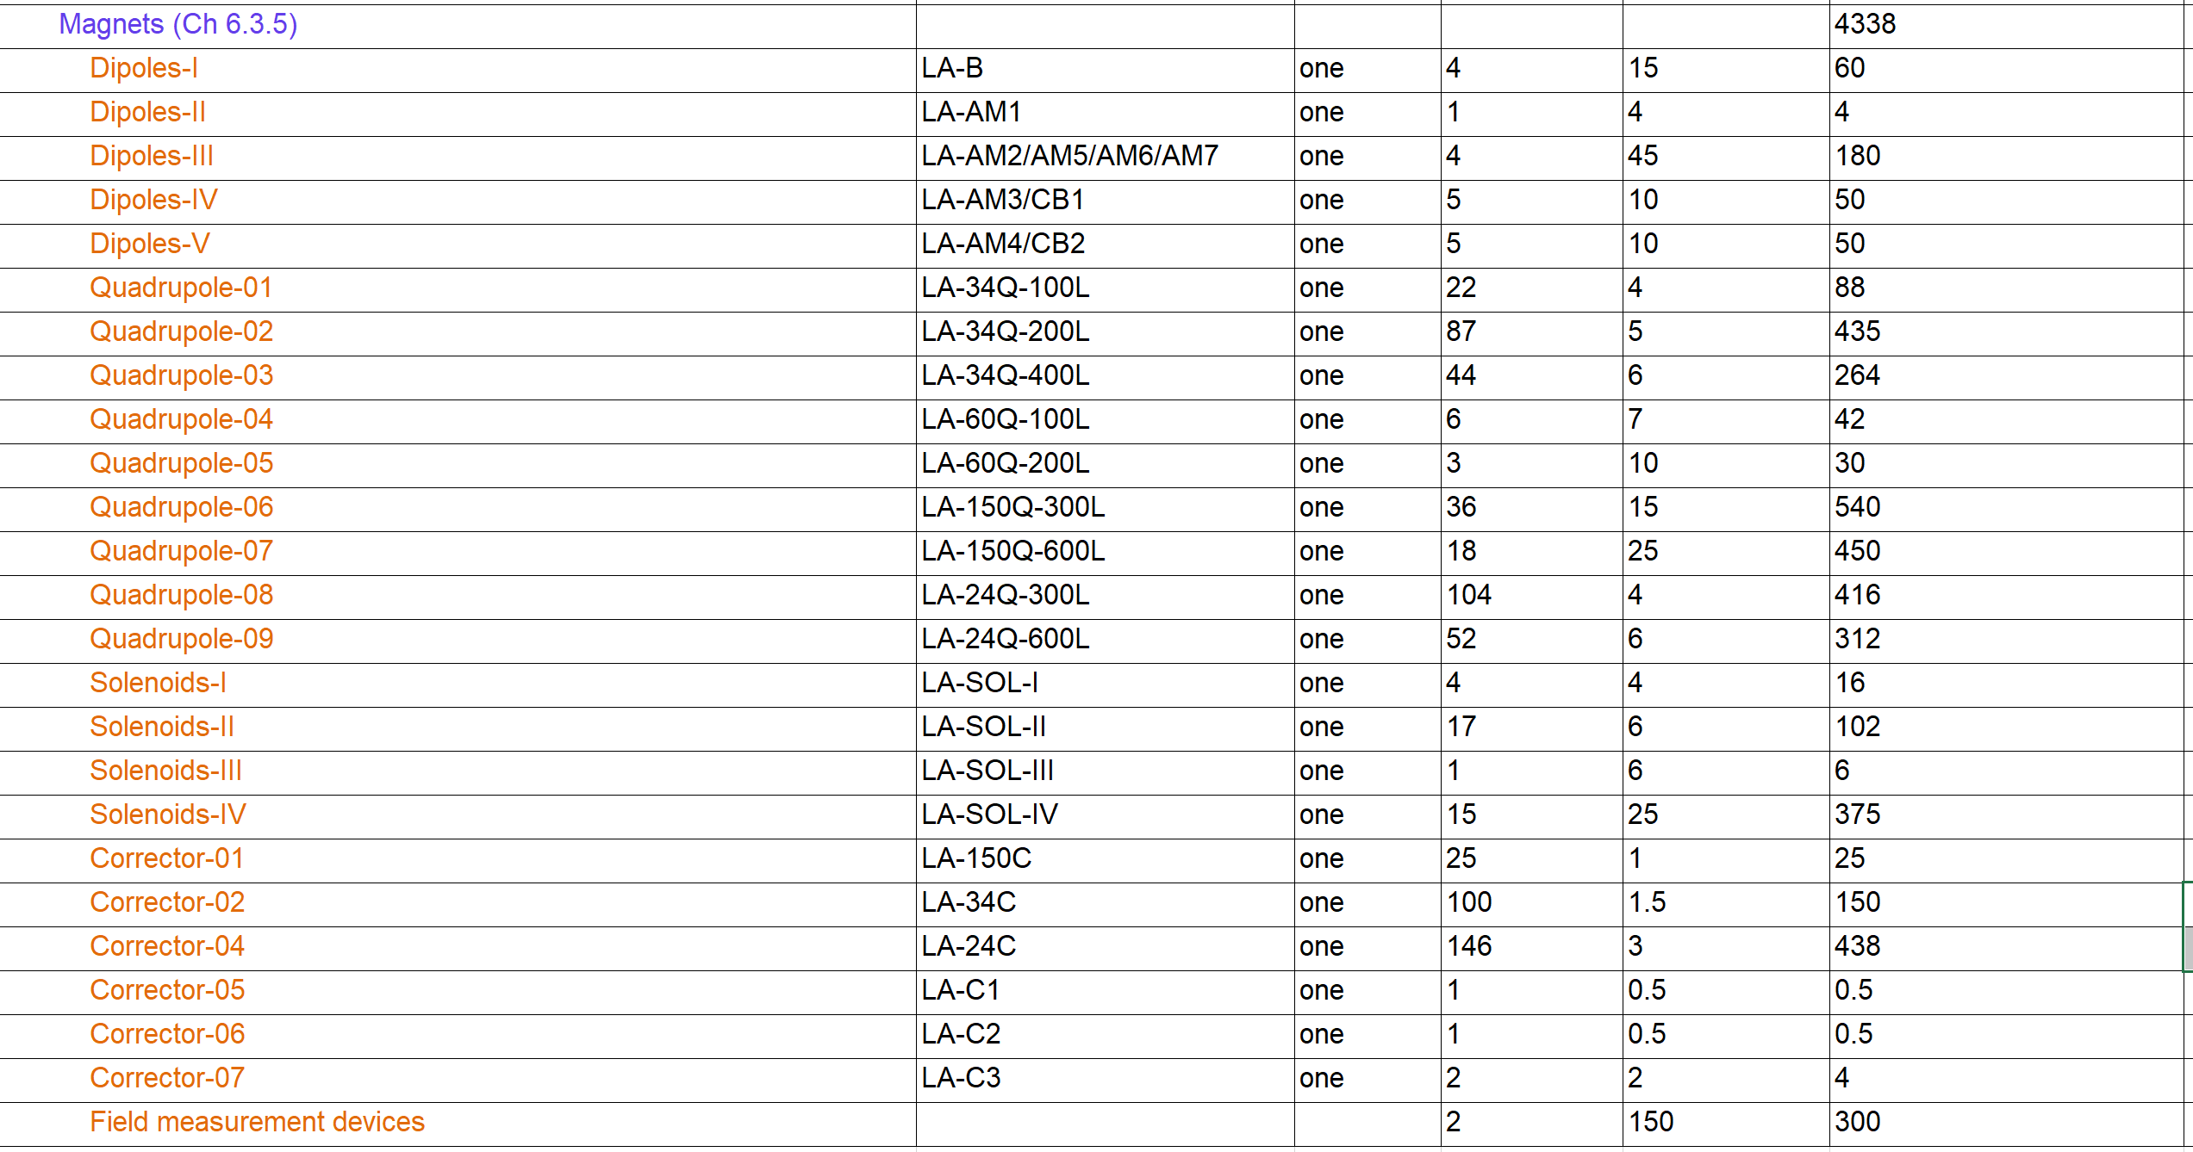

Slide 20
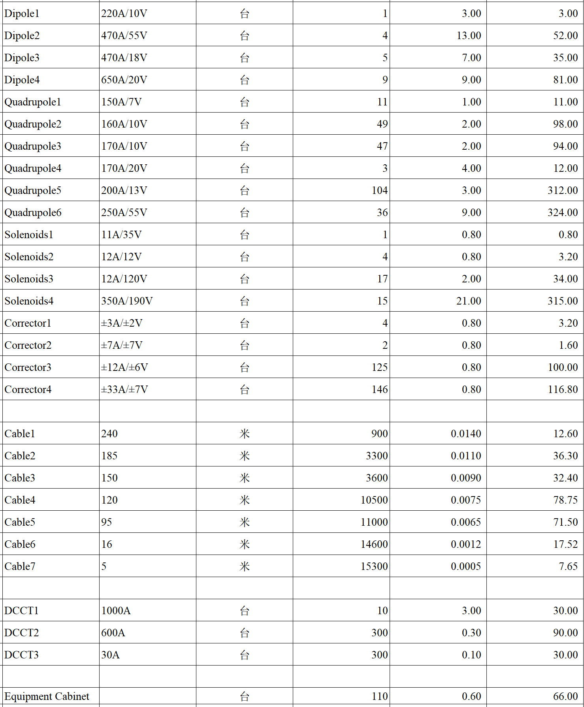

Slide 21
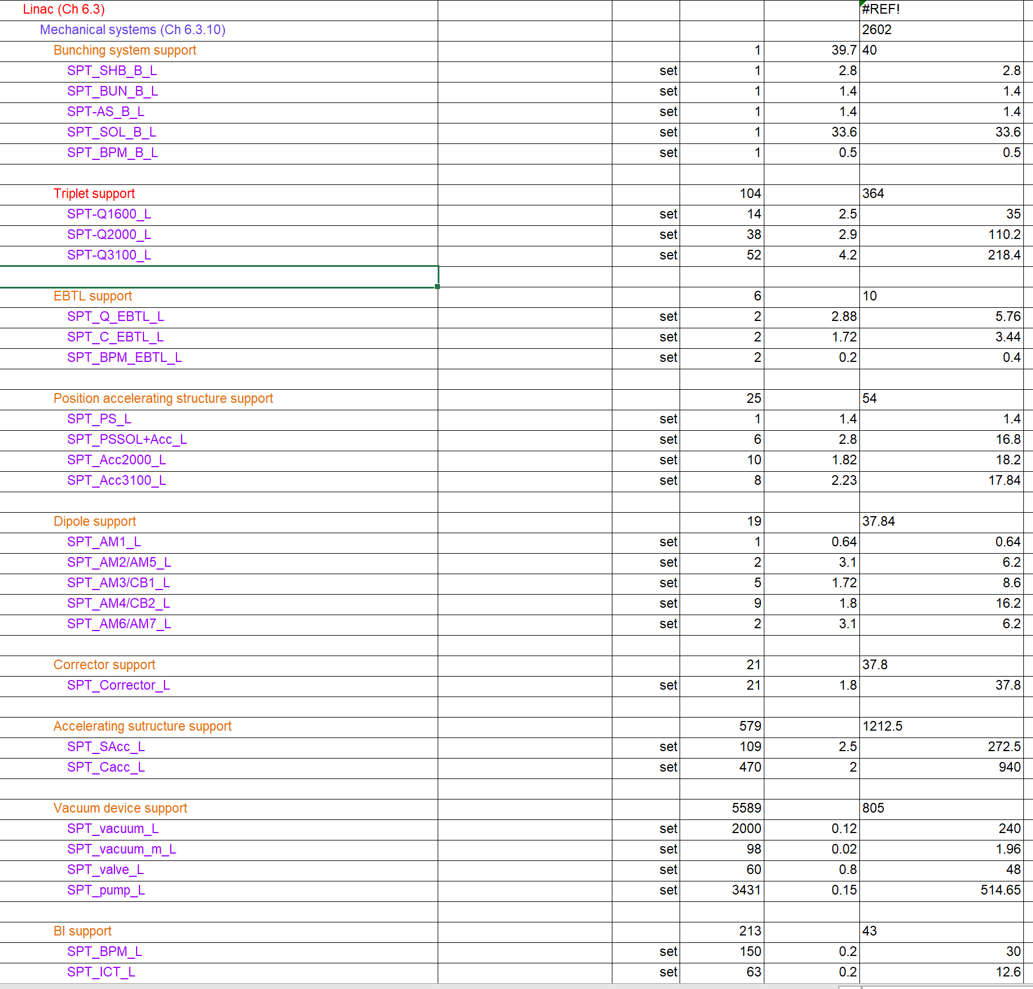

Slide 22
 |  |  |  | CDR |  |  |  | TDR |  |  |  | TDR-CDR
No. | Classification | Device | Unit | Specification | Quantity | Unit price / (CNY 10,000) | total Price / (CNY 10,000) | Specification | Quantity | Unit price / (CNY 10,000) | total Price / (CNY 10,000) | / (CNY 10,000) | Note
31 | LINAC | Beam pipe | m | 304 | 1500 | 0.2 | 300 | 316L | 931 | 0.3 | 279.3 | -21 | 磁导率：1.02～1.05，磁铁内1.02，个别1.05
32 |  | Manifold for SIP | one |  | / |  |  | 316L | 3431 | 0.3 | 1029.3 | 1029 | CDR是含在真空盒中
33 |  | Manifold for Gauge & RGA | one |  | / |  |  | 316L | 1352 | 0.3 | 405.6 | 406 | CDR是含在真空盒中
 |  | Manifold for Gauge & RGA | one |  | / |  |  | 316L | 1352 | 0.3 | 405.6 | 406 | CDR是含在真空盒中
34 |  | Bellows | one | 304 | 1760 | 0.3 | 528 | 316L | 4094 | 0.3 | 1228.2 | 700
35 |  | Sputtering Ion pump | one | 100L/s | 1310 | 2 | 2620 | 100L/s | 3431 | 2 | 6862 | 4242 | 数量考虑了波导、束调管、能量倍增器等的需求
36 |  | Molecular pump | one | 400L/s | 10 | 10 | 100 | 400L/s | 10 | 10 | 100 | 0
37 |  | Gate valve | one | CF40 | 30 | 15 | 450 | CF40 | 30 | 15 | 450 | 0
38 |  | Gate valve | one | CF25 | / |  |  | CF25 | 30 | 15 | 450 | 450
39 |  | Roughing valve | one | CF63 | 90 | 1 | 90 | CF63 | 178 | 1 | 178 | 88 | VAT进口阀门
40 |  | Vacuum gauge | one | CCG | 611 | 2 | 1222 | CCG | 1352 | 2 | 2704 | 1482 | 数量考虑了波导、束调管、能量倍增器等的需求
41 |  | Residual gas analyzer | one | RGA | 10 | 10 | 100 | RGA | 10 | 10 | 100 | 0
42 |  | Helium leak detector | one | He | 5 | 30 | 150 | He | 5 | 30 | 150 | 0
43 |  | Vacuum connectors | one |  | 1 | 300 | 300 |  | 1 | 600 | 600 | 300
44 |  | Vacuum heating | one |  | 1 | 50 | 50 |  | 1 | 50 | 50 | 0
45 |  | Vacuum control | one |  | 1 | 100 | 100 |  | 1 | 100 | 100 | 0
46 |  | Vacuum cleaning | one |  | 1 | 50 | 50 |  | 1 | 50 | 50 | 0
 |  | Total |  |  |  |  | 6060 |  |  |  | 14736.4 | 8676 | 能量增加20GeV

