Slide 1
Transport Line Cost
崔小昊
2023/08/15

Slide 2
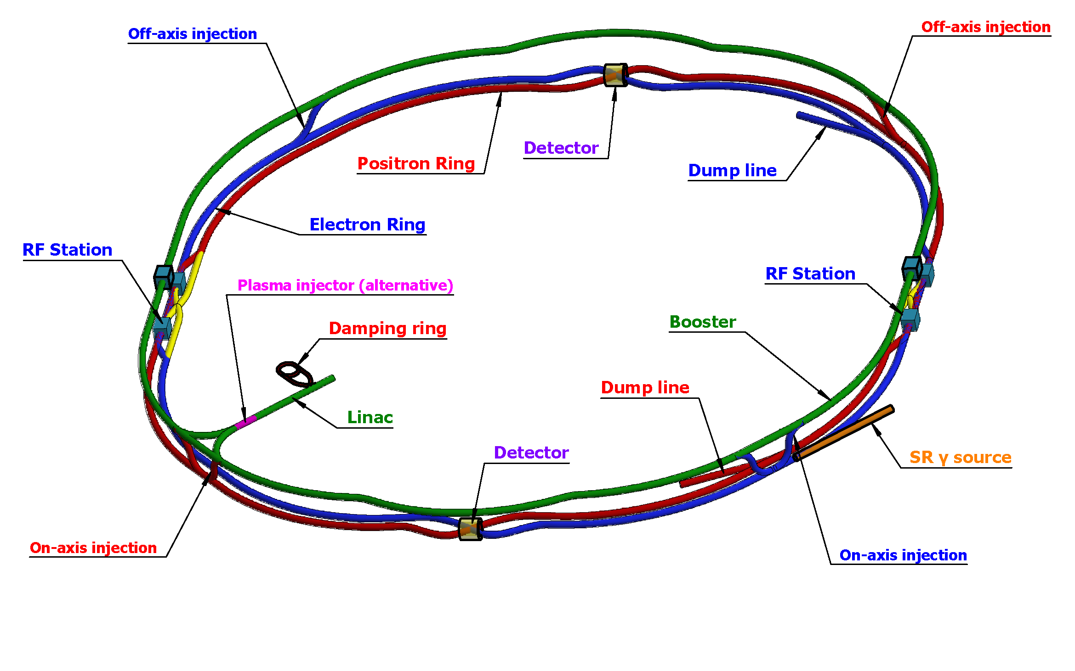
Introduction
Linac & Damping ring
(2 transport lines)
Linac & Booster
(2 transport lines)
Booster & Collider
(6 transport lines)

Slide 3
1. Linac & Damping Ring
系统 | 报价 (万） |  |  | 总价 （万）
磁铁 | 266
电源 | 176.22
真空 | 114.2
机械 | 61.08
束测 | 39
RF | 178
RF Power Source | 235
 |  |  |  | 1069.5

Slide 4
1. Linac & Damping Ring
系统 | 报价 (万） |  |  | 总价 （万）
磁铁 | 266
电源 | 176.22
真空 | 114.2
机械 | 61.08
束测 | 57
RF | 178
RF Power Source | 235
 |  |  |  | 1087.5

Slide 5
Details:
System | Name | Number | Unit price (10000 Yuan) | Total Price (10000 Yuan)
Magnet |  |  |  | 266
 | Dipoles | 14 | 15 | 210
 | Quadrupoles | 14 | 4 | 56
Power Supply |  |  |  | 176.22
 | Dipole | 2 | 19.00 | 133
 | Quadrupole | 28 | 0.80 | 22.4
 | Cable1 | 700 m | 0.0140 | 9.8
 | Cable2 | 1680 m | 0.0012 | 2.02
 | DCCT1 | 10 | 0.30 | 3
 | DCCT2 | 30 | 0.10 | 3
 | 机柜 | 5 | 0.6 | 3

Slide 6
System | Name | Number | Unit price (10000 Yuan) | Total Price (10000 Yuan)
Instrument |  |  |  | 57
 | BPM pick-ups | 3 | 2 | 6
 | BPM cable | 15 | 1 | 15
 | BPM electronics | 3 | 6 | 18
 | Beam Profile | 1 | 18 | 18
Vacuum |  |  |  | 114.2
 | Beam pipe | 120 | 0.3 | 36
 | Bellows | 24 | 0.3 | 7.2
 | Ion pump | 24 | 1.5 | 36
 | Gate valve | 2 | 10 | 20
 | Roughing valve | 6 | 0.5 | 3
 | Vacuum gauge | 6 | 2 | 12

Slide 7
System | Name | Number | Unit price (10000 Yuan) | Total Price (10000)
Mechanical |  |  |  | 61.08
 | SPT_D2000_LTD | 14 | 1.7 | 23.8
 | SPT_Q300_LTD | 24 | 1 | 24
 | SPT_BPM_LTD | 3 | 0.2 | 0.6
 | SPT_vacuum_LTD | 60 | 0.12 | 7.2
 | SPT_vacuum_m_LTD | 14 | 0.02 | 0.28
 | SPT_pump_LTD | 24 | 0.15 | 3.6
 | SPT_valve_LTD | 2 | 0.8 | 1.6
RF |  |  |  | 178
RF Power
 | Klystron | 1 | 80 | 80
 | Modulator | 1 | 120 | 120
 | Load and auxiliary power supply | 1 | 20 | 20
 | Klystron gain amplifier | 1 | 15 | 15

Slide 8
2. Linac to Booster e+/e-
For one line
系统 | 报价 |  |  | 总价
磁铁 | 1136
电源 | 1123.64
真空 | 1327.5
机械 | 367.25
束测 | 182
 |  |  |  | 4136.39

Slide 9
Details:
System | Name | Number | Unit price (10000 Yuan) | Total Price (10000 Yuan)
Magnet |  |  |  | 1136
 | Dipoles | 18 | 30 | 540
 | Dipoles | 2 | 160 | 320
 | Quadrupoles | 40 | 6 | 240
 | Correctors | 12 | 3 | 36
Power Supply |  |  |  | 1123.64
 | Dipole PS1 | 60 | 11 | 660
 | Dipole PS2 | 4 | 25 | 100
 | Quadrupole PS | 120 | 0.7 | 84
 | Corrector PS | 54 | 0.7 | 37.8
 | Cable1 | 12800 | 0.014 | 179.2

Slide 10
System | Name | Number | Unit price (10000 Yuan) | Total Price (10000 Yuan)
Instrument |  |  |  | 182
 | Pick-ups | 14 | 2 | 28
 | Cable | 70 | 1 | 70
 | Electronics | 14 | 6 | 84
Vacuum |  |  |  | 1327.5
 | Beam pipe | 1500 | 0.3 | 450
 | Bellows | 300 | 0.3 | 90
 | Ion pump | 300 | 1.5 | 450
 | Gate valve | 15 | 10 | 150
 | Roughing valve | 75 | 0.5 | 37.5
 | Vacuum gauge | 75 | 2 | 150

Slide 11
System | Name | Number | Unit price (10000 Yuan) | Total Price (10000 Yuan)
Mechanical |  |  |  | 367.25
 | SPT_D5000_LTB | 10 | 2.7 | 27
 | SPT_D3000_LTB | 2 | 2.025 | 4.05
 | SPT_D4000_LTB | 32 | 2.7 | 86.4
 | SPT_Q1000_LTB | 38 | 1.5 | 57
 | SPT_Q2000_LTB | 24 | 1.7 | 40.8
 | SPT_BPM_LTB | 14 | 0.2 | 2.8
 | SPT_vacuum_LTB | 750 | 0.12 | 90
 | SPT_vacuum_m_LTB | 110 | 0.02 | 2.2
 | SPT_pump_LTB | 300 | 0.15 | 45
 | SPT_valve_LTB | 15 | 0.8 | 12

Slide 12
3. Booster & Collider
For one off-axis line
系统 | 报价 |  |  | 总价
磁铁 | 340
电源
真空 | 208.4
机械 | 80.84
束测 | 104
 |  |  |  | 733.24

Slide 13
3. Booster & Collider
For one on-axis line
系统 | 报价 |  |  | 总价
磁铁 | 552
电源
真空 | 208.4
机械 | 80.84
束测 | 104
 |  |  |  | 945.24

Slide 14
Details:
System | Name | Number | Unit price (10000) | Total Price (10000)
Magnet |  |  |  | 552
 | Dipoles | 2 | 30 | 60
 | Dipoles | 2 | 180 | 360
 | Quadrupoles | 7 | 16 | 112
 | Correctors | 5 | 4 | 20
Vacuum |  |  |  | 208.4
 | Beam pipe | 240 | 0.3 | 72
 | Bellows | 48 | 0.3 | 14.4
 | Ion pump | 48 | 1.5 | 72
 | Gate valve | 2 | 10 | 20
 | Roughing valve | 12 | 0.5 | 6

Slide 15
System | Name | Number | Unit price (10000) | Total Price (10000)
Mechanical |  |  |  | 80.84
 | SPT_D5000_CTB | 12 | 2.7 | 32.4
 | SPT_Q1000_CTB | 12 | 1.5 | 18
 | SPT_Q2000_CTB | 3 | 1.7 | 5.1
 | SPT_BPM_CTB | 8 | 0.2 | 1.6
 | SPT_vacuum_CTB | 120 | 0.12 | 14.4
 | SPT_vacuum_m_CTB | 27 | 0.02 | 0.54
 | SPT_pump_CTB | 48 | 0.15 | 7.2
 | SPT_valve_CTB | 2 | 0.8 | 1.6

Slide 16
System | Name | Number | Unit price (10000) | Total Price (10000)
Instrument |  |  |  | 104
 | Pick-ups | 8 | 2 | 16
 | Cable | 40 | 1 | 40
 | Electronics | 8 | 6 | 48

Slide 17
4. Summary
输运线 | 数量 | 价格 （万） | 总价 （万）
Linac to Damping Ring | 1 | 1069.5
Damping Ring to Linac | 1 | 1087.5
Linac to Booster | 2 | 4136.39
Booster to Collider Off-Axis | 2 | 733.24
Booster to Collider On-Axis | 4 | 945.24
 |  |  | 15677.2

Slide 18
Thank You!

