Slide 1
CEPC Cryogenic System
TDR Cost
Rui Ge, Mei Li
On behalf of the CEPC cryogenic group
August, 2023
Notes:
1

Slide 2
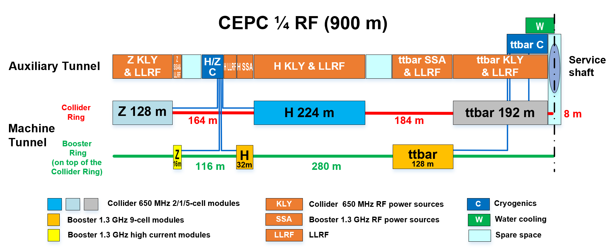
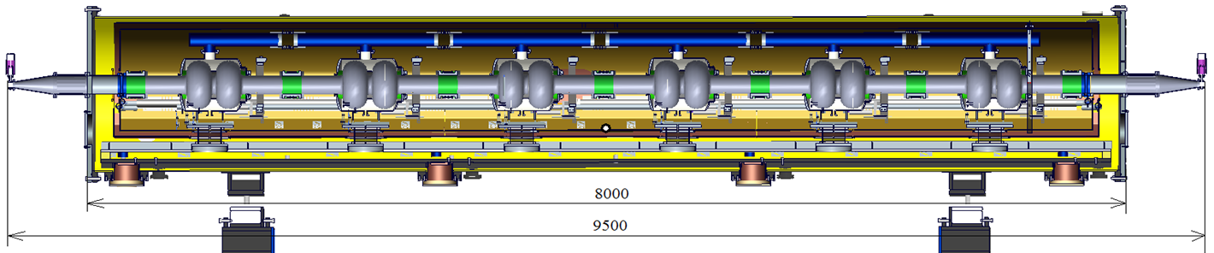
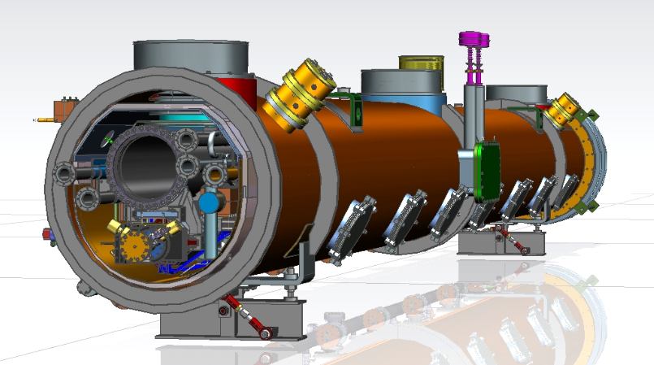
CEPC Cryogenic System Brief Introduction
Cryomodules for Higgs 30 / 50 MW
  30 MW Higgs:
Collider: 192 650 MHz 2-cell cavities in 32 modules (6 cav / CM)
Booster: 96 1.3 GHz 9-cell cavities in 12 modules (8 cav / CM)
  50 MW Higgs:
Collider: add 24 modules, in total 56 650 MHz modules
Booster: 96 1.3 GHz 9-cell cavities in 12 modules (8 cav / CM)

Slide 3
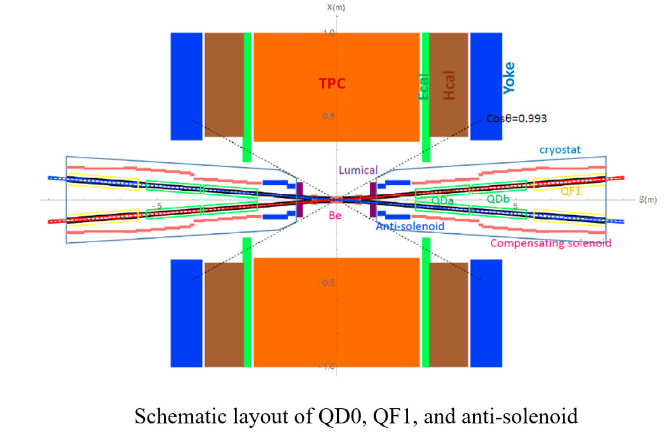
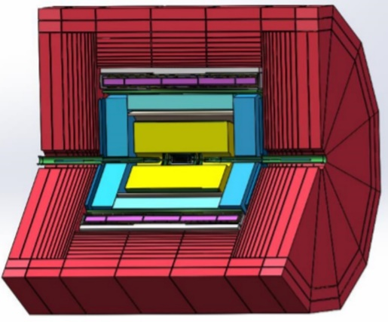
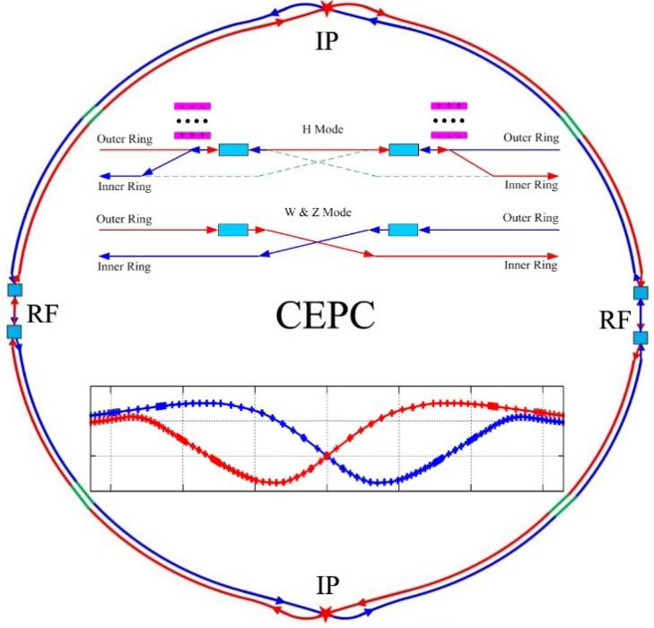
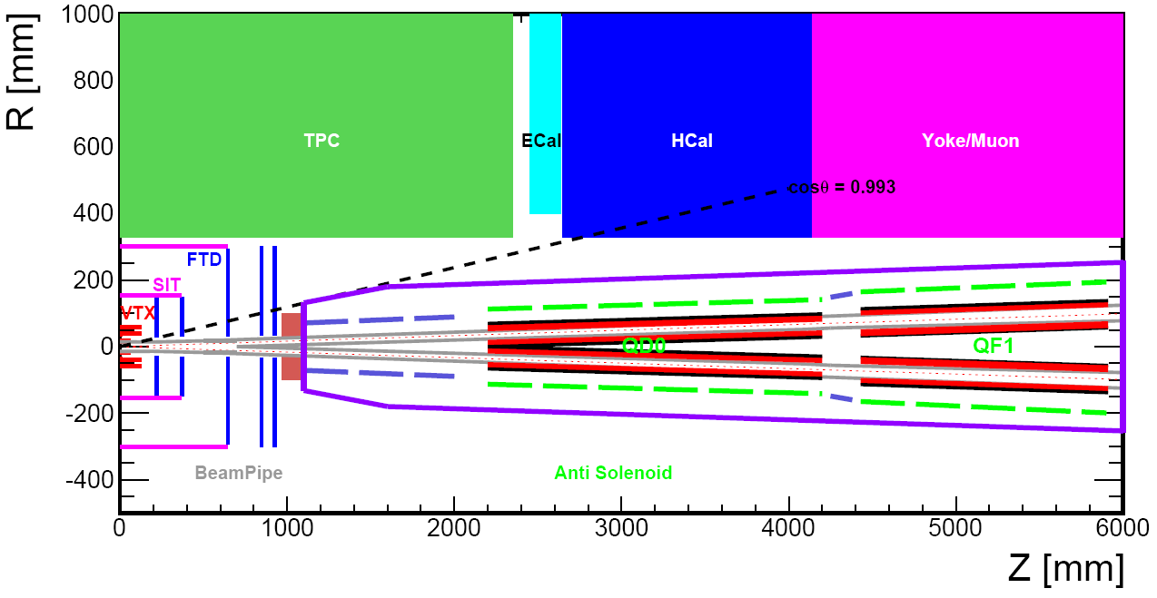
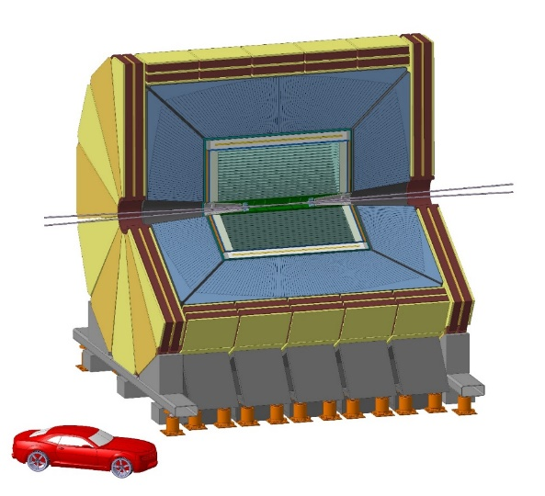
CEPC Cryogenic System Brief Introduction
SC magnets cryogenic system overview
LTS Solenoid
LTS Solenoid ：
Solenoid located outside calorimeter
Inner diameter 7.2 m, length 7.4 m
Central field：3 T
Superconductor：NbTi
Operation temperature：4.2 K
HTS Solenoid
IDEA detector
HTS Solenoid ：
Solenoid located inside calorimeter/less material
Inner diameter 4 m, length 6 m
Central field：2 T
Superconductor：YBCO
Operation temperature：20 K
From Zhu Ying-shun
Zhu Zian，Wang Meifen

Slide 4
Different Modes Cost OUTLINE
Stage | RF scheme | Cryogenic requirement | Total cost / million yuan | Comment
 |  | （2K）
1 | Higgs 30 MW | Collider: 32×650 MHz 6x2-cell CM | 894.7 | CDR 842 million yuan，4*15kW@4.5K refrigerator，FULLCRYO company current quotation 130 million yuan/each（CDR 18kW 120 million yuan/each
 | Collider：192×2-cell cavity | Booster: 12×1.3 GHz 8x9-cell CM
 | Booster：96×9-cell cavity
2 | Higgs 50 MW | Collider: new add 24×650 MHz 6x2-cellCM | 922.3 | No refrigerator changes; cryogenic TL and new 24 VBs cost increase
 | Collider：new add 144×2-cell cavity | Booster: HOM power increases, dynamic heat load increases
 | Booster：No hardware changes
3 | 30 MW Z upgrade | Collider: new add 60×650 MHz 1x1-cell CM | 1021.4
 | Collider：new add 60×High flow intensity 1-cell cavity | Booster: HOM power increases, dynamic heat load increases
 | Booster：No hardware changes
4 | 50 MW Z upgrade | Collider: new add 40×650 MHz 1x1-cell CM | 1053.4
 | Collider: new add 40×High flow intensity 1-cell cavity | Booster: HOM power increases, dynamic heat load increases
 | Booster：No hardware changes
5 | 30 MW ttbar upgrade | Collider: new add 48×650 MHz 4x5-cell CM | 2753.6 | ttbar 30/50MW 12*15kW@4.5K refrigerator
 | Collider：new add 192×High Q 5-cell cavity | Booster new add 32×1.3 GHz 8x9-cell CM
 | Booster：new add 256× High Q 9-cell cavity
6 | 50 MW ttbar upgrade | No hardware changes; HOM power increases, dynamic heat load increases | 2753.6 | No hardware changes
 | Collider：No hardware changes
 | Booster：No hardware changes
 | SC magnets scheme | Cryogenic requirement | Cost/million yuan
IP | IP region 4×IR SC magnets (4.5K) | 4.5K | 132.6 | CDR 213.6 million yuan
Detector | 2 detectors | 2 cryostat | 137
TDR CEPC cryogenic system baseline cost（Higgs30MW）894.7+132.6=1027 million yuan(not include detector)
（CDR 1060 million yuan）

Slide 5
Higgs 30MW Cost Details
CEPC cryogenic system cost review-SRF—Higgs 30 MW
 |  | TDR scheme
name | specification | number | Unit price (10,000 ¥) | Total price (10,000 ¥)100 km | comment | type
 |  |  |  | 89470.00
15KW@4.5K refrigerator | 15KW@4.5K | 4 | 13000 | 52000.00 |  | Domestic, developed
Liquid helium storage tank | 10000 liters | 4 | 200 | 800.00 |  | Domestic, purchased
Main distribution valve box |  | 4 | 800 | 3200.00 |  | Domestic, developed
Connection valve box |  | 32 | 60 | 1920.00 | Cryostat auxiliary valve box | Domestic, developed
Multiple cryogenic transfer line | Multiple channel | 1100 | 2.5 | 2750.00 |  | Domestic, developed
Medium helium gas storage | 20Bar，100m3 | 52 | 80 | 4160.00 |  | Domestic, purchased
High pressure high purity helium storage tank | 200Bar，25m3 | 4 | 350.00 | 1400.00 |  | Domestic, purchased
High pressure impure helium storage tank | 200Bar，25m3 | 4 | 250 | 1000.00 |  | Domestic, purchased
High-pressure helium recovery compressor | 200bar，100m3/h | 8 | 230 | 1840.00 |  | Domestic, purchased
High-pressure helium purifier | 200m3/h | 4 | 300 | 1200.00 |  | Domestic, purchased
Pure helium gas | Purity 5N9 | 80000 | 0.015 | 1200.00 |  | Domestic, purchased
Control system |  | 4 | 500.00 | 2000.00 |  | Domestic, developed
Isolation vacuum system |  | 4 | 500 | 2000.00 |  | Domestic, purchased
Room temperature transfer line |  | 4 | 1000 | 4000.00 |  | Domestic, purchased
Tools and consumables |  | 4 | 500 | 2000.00 |  | other
installation construction |  | 4 | 1000 | 4000.00 |  | other
2K valve box |  | 8 | 500 | 4000.00 | Includes 8 heat exchangers | Domestic, developed

Slide 6
Higgs 50MW Cost Details
On the basis of Higgs𝟑𝟎MW, additional cost required: 27.6 million yuan
CEPC cryogenic system cost review-SRF—Higgs 50 MW
 |  | TDR scheme
name | specification | number | Unit price (10,000 ¥) | Total price (10,000 ¥) 100 km | comment | type
 |  |  |  | 92230.00
15KW@4.5K refrigerator | 15KW@4.5K | 4 | 13000 | 52000.00 |  | Domestic, developed
Liquid helium storage tank | 10000 liters | 4 | 200 | 800.00 |  | Domestic, purchased
Main distribution valve box |  | 4 | 800 | 3200.00 |  | Domestic, developed
Connection valve box |  | 56 | 60 | 3360.00 | Cryostat auxiliary valve box | Domestic, developed
Multiple cryogenic transfer line | Multiple channel | 1500 | 2.5 | 3750.00 |  | Domestic, developed
Medium helium gas storage | 20Bar，100m3 | 56 | 80 | 4480.00 |  | Domestic, purchased
High pressure high purity helium storage tank | 200Bar，25m3 | 4 | 350.00 | 1400.00 |  | Domestic, purchased
High pressure impure helium storage tank | 200Bar，25m3 | 4 | 250 | 1000.00 |  | Domestic, purchased
High-pressure helium recovery compressor | 200bar，100m3/h | 8 | 230 | 1840.00 |  | Domestic, purchased
High-pressure helium purifier | 200m3/h | 4 | 300 | 1200.00 |  | Domestic, purchased
Pure helium gas | Purity 5N9 | 80000 | 0.015 | 1200.00 |  | Domestic, purchased
Control system |  | 4 | 500.00 | 2000.00 |  | Domestic, developed
Isolation vacuum system |  | 4 | 500 | 2000.00 |  | Domestic, purchased
Room temperature transfer line |  | 4 | 1000 | 4000.00 |  | Domestic, purchased
Tools and consumables |  | 4 | 500 | 2000.00 |  | other
installation construction |  | 4 | 1000 | 4000.00 |  | other
2K valve box |  | 8 | 500 | 4000.00 | Includes 8 heat exchangers | Domestic, developed

Slide 7
ttbar 50MW Cost Details
CEPC cryogenic system cost review-SRF—ttbar 50 MW
name | specification | number | Unit price (10,000 ¥) | Total price (10,000 ¥) 100 km | comment
Cryogenic system |  |  |  | 275360.00
15KW@4.5K refrigerator | 15KW@4.5K | 12 | 13000 | 156000.00 | Domestic, developed
Liquid helium storage tank | 10000 liters | 12 | 200 | 2400.00 | Domestic, purchased
Main distribution valve box |  | 12 | 800 | 9600.00 | Domestic, developed
Connection valve box |  | 142 | 80 | 11360.00 | Domestic, developed
Multiple cryogenic transfer line | Multiple channel | 6000 | 3 | 18000.00 | Domestic, developed
Medium helium gas storage | 20Bar，100m3 | 96 | 80 | 7680.00 | Domestic, purchased
High pressure high purity helium storage tank | 200Bar，25m3 | 12 | 350 | 4200.00 | Domestic, purchased
High pressure impure helium storage tank | 200Bar，25m3 | 12 | 250 | 3000.00 | Domestic, purchased
High-pressure helium recovery compressor | 200bar，100m3/h | 24 | 230 | 5520.00 | Domestic, purchased
High-pressure helium purifier | 200m3/h | 12 | 200 | 2400.00 | Domestic, purchased
Pure helium gas | Purity 5N9 | 240000 | 0.015 | 3600.00 | Domestic, purchased
Control system |  | 12 | 500 | 6000.00 | Domestic, developed
Isolation vacuum system |  | 12 | 500 | 6000.00 | Domestic, purchased
Room temperature transfer line |  | 12 | 1000 | 12000.00 | Domestic, purchased
Tools and consumables |  | 12 | 500 | 6000.00 | other
installation construction |  | 12 | 1000 | 12000.00 | other
2K valve box |  | 12 | 800 | 9600.00 | Domestic, developed

Slide 8
Higgs 50MW Heat Loads
Higgs Mode 50MW | Unit | Collider |  |  | Booster
 |  | 40-80K | 5-8K | 2K | 40-80K | 5-8K | 2K
Predicted module static heat load | (W/module) | 300 | 60 | 12 | 140 | 20 | 3
Predicted module HOM static heat load | (W/module) | 2.4 | 1.2 | 0.1 | 0 | 0 | 0
Predicted module Input coupler static heat load | (W/module) | 6 | 3 | 0.3 | 16 | 8 | 0.8
Predicted module dynamic heat load (RF) | (W/module) | 0 | 0 | 40.1 | 0 | 0 | 40.9
Predicted module HOM dynamic heat load | (W/module) | 4.8 | 2.4 | 0.4 | 9.6 | 4.8 | 0.8
Predicted module Input coupler dynamic heat load | (W/module) | 85.8 | 21.5 | 3.6 | 256 | 25.6 | 3.2
Module dynamic heat load | W | 90.6 | 23.9 | 44.1 | 265.6 | 30.4 | 44.9
Each Module total heat load | W | 399 | 88.1 | 56.5 | 421.6 | 58.4 | 48.7
Cryomodule number | - | 56 | 56 | 56 | 12 | 12 | 12
EVB heat loss | W | 50 | 10 | 5 | 50 | 10 | 5
EVB number | - | 56 | 56 | 56 | 12 | 12 | 12
MDVB heat loss | W | 50 | 30 | 10 | 50 | 30 | 10
MDVB number | - | 4 | 4 | 4 | 4 | 4 | 4
Total cryogenic transfer line length | m | 936 | 936 | 936 | 168 | 168 | 168
cryogenic transfer line heat loss per meter | W/m | 2 | 0.5 | 0.3 | 2 | 0.5 | 0.3
Total cryogenic transfer line heat loss | W | 1872 | 468 | 280.8 | 336 | 84 | 50.4
Total heat load | kW | 27.216 | 6.0816 | 3.7648 | 6.1952 | 1.0248 | 0.7348
Overall net cryogenic capacity multiplier |  | 1.54 | 1.54 | 1.54 | 1.54 | 1.54 | 1.54
4.5K equiv. heat load with multiplier | kW | 4.85 | 8.43 | 28.58 | 1.10 | 1.42 | 5.58
4.5K equiv. heat load with multiplier | kW | 41.86 |  |  | 8.10
Total 4.5K equiv. heat load with multiplier | kW | 49.96
Installed power (COP(219W/1W)) | MW | 9.17 |  |  | 1.77
选择4×15kW@4.5K制冷机

Slide 9
ttbar 50MW Heat Loads
 | ttbar 50MW | Unit | Collider |  |  |  |  |  |  | Unit | Booster
 |  |  | 40-80K | 5-8K | 2K |  |  |  |  |  | 40-80K | 5-8K | 2K
5-cell | Predicted module static heat load | (W/module) | 300 | 60 | 12 | new 1.3GHz | Predicted module static heat load | new 1.3GHz | Predicted module static heat load | (W/module) | 140 | 20 | 3
 | Predicted module HOM static heat load | (W/module) | 1.6 | 0.8 | 0.1 |  | Predicted module HOM static heat load |  | Predicted module HOM static heat load | (W/module) | 0 | 0 | 0
 | Predicted module Input coupler static heat load | (W/module) | 4 | 2 | 0.2 |  | Predicted module Input coupler static heat load |  | Predicted module Input coupler static heat load | (W/module) | 16 | 8 | 0.8
 | Predicted module dynamic heat load (RF) | (W/module) | 0 | 0 | 252.08 |  | Cavity dynamic heat load |  | Cavity dynamic heat load | (W/module) | 0 | 0 | 11.25
 | Predicted module HOM dynamic heat load | (W/module) | 3.2 | 1.6 | 0.3 |  | Predicted module HOM dynamic heat load |  | Predicted module HOM dynamic heat load | (W/module) | 0.3 | 0.2 | 0
 | Predicted module Input coupler dynamic heat load | (W/module) | 60.5 | 15.1 | 2.5 |  | Predicted module input coupler dynamic heat load |  | Predicted module input coupler dynamic heat load | (W/module) | 11.5 | 1.1 | 0.1
 | 5 cell: Module dynamic heat load | W | 63.7 | 16.7 | 254.88 |  | 1.3 GHz 8x9-cell：Module dynamic heat load |  | 1.3 GHz 8x9-cell：Module dynamic heat load | W | 11.8 | 1.3 | 11.35
 | 5 cell: Each Module total heat load | W | 369.3 | 79.5 | 267.18 |  | new 1.3 GHz 8x9-cell：Each Module total heat load |  | new 1.3 GHz 8x9-cell：Each Module total heat load | W | 167.8 | 29.3 | 15.15
 | 5 cell: Cryomodule number | - | 48 | 48 | 48 |  | new 1.3 GHz 8x9-cell：Cryomodule number |  | new 1.3 GHz 8x9-cell：Cryomodule number | - | 32 | 32 | 32
 | 5 cell：EVB heat loss | W | 50 | 10 | 5 |  | EVB heat loss |  | EVB heat loss | W | 50 | 10 | 5
 | 5 cell：EVB number | - | 48 | 48 | 48 |  | EVB number |  | EVB number | - | 32 | 32 | 32
2-cell | Predicted module static heat load | (W/module) | 300 | 60 | 12 | original 1.3GHz | Predicted module static heat load | original 1.3GHz | Predicted module static heat load | (W/module) | 140 | 20 | 3
 | Predicted module HOM static heat load | (W/module) | 2.4 | 1.2 | 0.1 |  | Predicted module HOM static heat load |  | Predicted module HOM static heat load | (W/module) | 0 | 0 | 0
 | Predicted module Input coupler static heat load | (W/module) | 6 | 3 | 0.3 |  | Predicted module Input coupler static heat load |  | Predicted module Input coupler static heat load | (W/module) | 16 | 8 | 0.8
 | Predicted module dynamic heat load (RF) | (W/module) | 0 | 0 | 126.78 |  | Cavity dynamic heat load |  | Cavity dynamic heat load | (W/module) | 0 | 0 | 4.5
 | Predicted module HOM dynamic heat load | (W/module) | 1.9 | 0.9 | 0.2 |  | Predicted module HOM dynamic heat load |  | Predicted module HOM dynamic heat load | (W/module) | 0.1 | 0 | 0
 | Predicted module Input coupler dynamic heat load | (W/module) | 34 | 8.5 | 1.4 |  | Predicted module input coupler dynamic heat load |  | Predicted module input coupler dynamic heat load | (W/module) | 6.7 | 0.7 | 0.1
 | 2 cell：Module dynamic heat load | W | 35.9 | 9.4 | 128.38 |  | 1.3 GHz 8x9-cell：Module dynamic heat load |  | 1.3 GHz 8x9-cell：Module dynamic heat load | W | 0.1 | 0.1 | 4.6
 | 2 cell：Each Module total heat load | W | 344.3 | 73.6 | 140.78 |  | 1.3 GHz 8x9-cell：Each Module total heat load |  | 1.3 GHz 8x9-cell：Each Module total heat load | W | 162.8 | 28.7 | 8.4
 | 2 cell：Cryomodule number | - | 56 | 56 | 56 |  | 1.3 GHz 8x9-cell：Cryomodule number |  | 1.3 GHz 8x9-cell：Cryomodule number | - | 12 | 12 | 12
 | 2 cell：EVB heat loss | W | 50 | 10 | 5 |  | EVB heat loss |  | EVB heat loss | W | 50 | 10 | 5
 | 2 cell：EVB number | - | 56 | 56 | 56 |  | EVB number |  | EVB number | - | 12 | 12 | 12
 | MDVB heat loss | W | 100 | 50 | 20 |  | MDVB heat loss |  | MDVB heat loss | W | 100 | 50 | 20
 | MDVB number | - | 8 | 8 | 8 |  | MDVB number |  | MDVB number | - | 8 | 8 | 8
 | Total cryogenic transfer line length | m | 968 | 968 | 968 |  | Total cryogenic transfer line length |  | Total cryogenic transfer line length | m | 712 | 712 | 712
 | cryogenic transfer line heat loss per meter | W/m | 2 | 0.5 | 0.3 |  | cryogenic transfer line heat loss per meter |  | cryogenic transfer line heat loss per meter | W/m | 2 | 0.5 | 0.3
 | Total cryogenic transfer line heat loss | W | 1936 | 484 | 290.4 |  | Total cryogenic transfer line heat loss |  | Total cryogenic transfer line heat loss | W | 1424 | 356 | 213.6
 | Total heat load | kW | 44.94 | 9.86 | 21.68 |  | Total heat load |  | Total heat load | kW | 11.75 | 2.48 | 1.18
 | Overall net cryogenic capacity multiplier |  | 1.54 | 1.54 | 1.54 |  | Overall net cryogenic capacity multiplier |  | Overall net cryogenic capacity multiplier |  | 1.54 | 1.54 | 1.54
 | 4.5K equiv. heat load with multiplier | kW | 5.19 | 13.67 | 106.83 |  | 4.5K equiv. heat load with multiplier |  | 4.5K equiv. heat load with multiplier | kW | 1.36 | 3.43 | 5.81
 | 4.5K equiv. heat load with multiplier | kW | 125.69 |  |  |  |  |  |  | kW | 10.60
 | Total 4.5K equiv. heat load with multiplier | kW | 136.29
 | Installed power (COP(219W/1W)) | MW | 27.53 |  |  |  |  |  | Installed power (COP(219W/1W)) | MW | 2.32
选择12×15kW@4.5K制冷机

Slide 10
IR SC magnets Cost Details
CEPC cryogenic system cost review-SC magnets
TDR scheme
name | specification | unit | number | Unit price (10,000 ¥) | Total price (10,000 ¥)100 km | comment
 |  |  |  |  | 13260.00
700W@4.5K helium refrigerator | 700W@4.5K | Set | 2 | 1000 | 2000.00 | Domestic, developed
Liquid helium storage tank | 3000 liters | Set | 2 | 80 | 160.00 | Domestic, purchased
Main distribution valve box |  | Set | 2 | 600 | 1200.00 | Domestic, developed
Connection valve box |  | Set | 4 | 100 | 400.00 | Domestic, developed
Multiple cryogenic transfer line | Multiple channel | m | 40 | 1.5 | 60.00 | Domestic, developed
Medium helium gas storage | 16Bar，100m3 | Set | 4 | 80 | 320.00 | Domestic, purchased
High pressure high purity helium storage tank | 200Bar，25m3 | Set | 2 | 350 | 700.00 | Domestic, purchased
High pressure impure helium storage tank | 200Bar，25m3 | Set | 6 | 250 | 1500.00 | Domestic, purchased
High-pressure helium recovery compressor | 200bar，100m3/h | Set | 4 | 230 | 920.00 | Domestic, purchased
High-pressure helium purifier | 100m3/h | Set | 2 | 150 | 300.00 | Domestic, purchased
Pure helium gas | Purity 5N9 | m3 | 80000 | 0.015 | 1200.00 | Domestic, purchased
Control system |  | Set | 2 | 400 | 800.00 | Domestic, developed
Isolation vacuum system |  | Set | 2 | 600 | 1200.00 | Domestic, purchased
Room temperature transfer line |  | Set | 2 | 600 | 1200.00 | Domestic, purchased
Tools and consumables |  | Set | 2 | 300 | 600.00 | other
installation construction |  | Set | 2 | 350 | 700.00 | other

Slide 11
Summary
CEPC cryogenic system- SRF side：
TDR should be based on the principle that Higgs 30MW funding is as low as possible, and the overall scheme should cover H50MW. 4*15kW@4.5K refrigerator selected;
894.7 million yuan (CDR: 842.0 million yuan);
CEPC cryogenic system-SC magnets side:
IR Magnets, CDR 213.6 million yuan, TDR six-stage magnets work at room temperature, the refrigeration power is reduced;.
TDR 132.6 million yuan;
Detector magnets, 137 million yuan
TDR CEPC cryogenic system baseline cost（Higgs30MW）894.7+132.6=1027 million yuan(not include detector)（CDR 1060 million yuan）
Thanks for Your Attention！

Slide 12
Higgs 30MW Cost Details
CEPC项目经费预算表-超导腔侧(单位：万元)--Higgs30MW
 |  |  |  | CDR方案 |  |  |  |  | TDR 方案
编号 | 设备名称 | 规格型号 | 单位 | 数量 | 单价 （万元） | 总价（万元） 100公里 | 设备名称 | 规格型号 | 数量 | 单价 （万元） | 总价（万元） 100公里 | 差额（万元） | 备注 | 类型
2.3 | 低温系统 |  |  |  |  | 84200.00 |  |  |  |  | 89470.00 | 5270.00
2.3.1 | 18KW@4.5K制冷机 | 18KW@4.5K | 台 | 4 | 12000 | 48000.00 | 15KW@4.5K制冷机 | 15KW@4.5K | 4 | 13000 | 52000.00 | 4000.00 |  | 国产，研制
2.3.2 | 液氦储罐 | 10000升 | 台 | 4 | 200 | 800.00 | 液氦储罐 | 10000升 | 4 | 200 | 800.00 | 0.00 |  | 国产，购置
2.3.3 | 主分配阀箱 |  | 台 | 4 | 300 | 1200.00 | 主分配阀箱 |  | 4 | 800 | 3200.00 | 2000.00 |  | 国产，研制
2.3.4 | 连接阀箱 |  | 台 | 52 | 150 | 7800.00 | 连接阀箱 |  | 32 | 60 | 1920.00 | -5880.00 | 恒温器辅助阀箱 | 国产，研制
2.3.5 | 多通道低温管线 | 多路 | m | 4000 | 0.8 | 3200.00 | 多通道低温管线 | 多路 | 1100 | 2.5 | 2750.00 | -450.00 |  | 国产，研制
2.3.6 | 中压氦气储罐 | 20Bar，100m3 | 台 | 32 | 80 | 2560.00 | 中压氦气储罐 | 20Bar，100m3 | 52 | 80 | 4160.00 | 1600.00 |  | 国产，购置
2.3.7 | 高压高纯氦气储罐 | 200Bar，25m3 | 组 | 4 | 350 | 1400.00 | 高压高纯氦气储罐 | 200Bar，25m3 | 4 | 350.00 | 1400.00 | 0.00 |  | 国产，购置
2.3.8 | 高压不纯氦气储罐 | 200Bar，25m3 | 组 | 4 | 250 | 1000.00 | 高压不纯氦气储罐 | 200Bar，25m3 | 4 | 250 | 1000.00 | 0.00 |  | 国产，购置
2.3.9 | 高压氦气回收压缩机 | 200bar，100m3/h | 台 | 8 | 230 | 1840.00 | 高压氦气回收压缩机 | 200bar，100m3/h | 8 | 230 | 1840.00 | 0.00 |  | 国产，购置
2.3.10 | 高压氦气纯化器 | 200m3/h | 台 | 4 | 300 | 1200.00 | 高压氦气纯化器 | 200m3/h | 4 | 300 | 1200.00 | 0.00 |  | 国产，购置
2.3.11 | 纯氦气 | 纯度5N9 | m3 | 80000 | 0.015 | 1200.00 | 纯氦气 | 纯度5N9 | 80000 | 0.015 | 1200.00 | 0.00 |  | 国产，购置
2.3.12 | 控制系统 |  | 套 | 4 | 500 | 2000.00 | 控制系统 |  | 4 | 500.00 | 2000.00 | 0.00 |  | 国产，研制
2.3.13 | 隔热真空系统 |  | 套 | 4 | 500 | 2000.00 | 隔热真空系统 |  | 4 | 500 | 2000.00 | 0.00 |  | 国产，购置
2.3.14 | 常温管路 |  | 套 | 4 | 1000 | 4000.00 | 常温管路 |  | 4 | 1000 | 4000.00 | 0.00 |  | 国产，购置
2.3.15 | 工具，消耗品等 |  | 套 | 4 | 500 | 2000.00 | 工具，消耗品等 |  | 4 | 500 | 2000.00 | 0.00 |  | 其他
2.3.16 | 安装施工 |  | 套 | 4 | 1000 | 4000.00 | 安装施工 |  | 4 | 1000 | 4000.00 | 0.00 |  | 其他
2.3.17 | 设备2K阀箱 |  | 台 | 0 | 0 | 0.00 | 设备2K阀箱 |  | 8 | 500 | 4000.00 | 4000 | 含8个大换热器 | 国产，研制

Slide 13
IR SC magnets Cost Details
CEPC项目经费预算表(单位：万元)对撞区超导磁铁：大型制冷机方案
 | CDR scheme |  |  |  |  |  | TDR scheme(六级磁铁优化后)
编号 | 设备名称 | 规格型号 | 单位 | 数量 | 单价 （万元） | 总价（万元） 100公里 | 设备名称 | 规格型号 | 单位 | 数量 | 单价 （万元） | 总价（万元） 100公里 | 差额（万元） | 备注
2.3 | 低温系统 |  |  |  |  | 21360.00 |  |  |  |  |  | 13260.00 | 8100
2.3.1 | 4KW@4.5K制冷机 | 4KW@4.5K | 台 | 2 | 3000 | 6000.00 | 700W@4.5K制冷机 | 700W@4.5K | 台 | 2 | 1000 | 2000.00 | -4000.00 | 国产，研制
2.3.2 | 液氦储罐 | 10000升 | 台 | 2 | 100 | 200.00 | 液氦储罐 | 3000升 | 台 | 2 | 80 | 160.00 | -40.00 | 国产，购置
2.3.3 | 主分配阀箱 |  | 台 | 2 | 200 | 400.00 | 主分配阀箱 |  | 台 | 2 | 600 | 1200.00 | 800.00 | 国产，研制
2.3.4 | 连接阀箱 |  | 台 | 36 | 100 | 3600.00 | 连接阀箱 |  | 台 | 4 | 100 | 400.00 | -3200.00 | 国产，研制
2.3.5 | 多通道低温管线 | 多路 | m | 4000 | 0.8 | 3200.00 | 多通道低温管线 | 多路 | m | 40 | 1.5 | 60.00 | -3140.00 | 国产，研制
2.3.6 | 中压氦气储罐 | 16Bar，100m3 | 台 | 8 | 80 | 640.00 | 中压氦气储罐 | 16Bar，100m3 | 台 | 4 | 80 | 320.00 | -320.00 | 国产，购置
2.3.7 | 高压高纯氦气储罐 | 200Bar，25m3 | 组 | 2 | 350 | 700.00 | 高压高纯氦气储罐 | 200Bar，25m3 | 组 | 2 | 350 | 700.00 | 0.00 | 国产，购置
2.3.8 | 高压不纯氦气储罐 | 200Bar，25m3 | 组 | 6 | 250 | 1500.00 | 高压不纯氦气储罐 | 200Bar，25m3 | 组 | 6 | 250 | 1500.00 | 0.00 | 国产，购置
2.3.9 | 高压氦气回收压缩机 | 200bar，100m3/h | 台 | 4 | 230 | 920.00 | 高压氦气回收压缩机 | 200bar，100m3/h | 台 | 4 | 230 | 920.00 | 0.00 | 国产，购置
2.3.10 | 高压氦气纯化器 | 100m3/h | 台 | 2 | 150 | 300.00 | 高压氦气纯化器 | 100m3/h | 台 | 2 | 150 | 300.00 | 0.00 | 国产，购置
2.3.11 | 纯氦气 | 纯度5N9 | m3 | 40000 | 0.015 | 600.00 | 纯氦气 | 纯度5N9 | m3 | 80000 | 0.015 | 1200.00 | 600.00 | 国产，购置
2.3.12 | 控制系统 |  | 套 | 2 | 400 | 800.00 | 控制系统 |  | 套 | 2 | 400 | 800.00 | 0.00 | 国产，研制
2.3.13 | 隔热真空系统及辅助 |  | 套 | 2 | 300 | 600.00 | 隔热真空系统及辅助 |  | 套 | 2 | 600 | 1200.00 | 600.00 | 国产，购置
2.3.14 | 常温管路及常温阀 |  | 套 | 2 | 300 | 600.00 | 常温管路及常温阀 |  | 套 | 2 | 600 | 1200.00 | 600.00 | 国产，购置
2.3.15 | 工具，消耗品等 |  | 套 | 2 | 300 | 600.00 | 工具，消耗品等 |  | 套 | 2 | 300 | 600.00 | 0.00 | 其他
2.3.16 | 安装施工 |  | 套 | 2 | 350 | 700.00 | 安装施工 |  | 套 | 2 | 350 | 700.00 | 0.00 | 其他

