Slide 1



Cost of CEPC auxiliary facilities
Huang Jinshu
12-16. June. 2023, Hongkong, CEPC Accelerator TDR International Review

Slide 2
Content
Introduction
Auxiliary facilities
  Electric engineering
  Cooling water system
  HVAC
  Compressed air system
  Fire protection and water supply
Summary

Slide 3
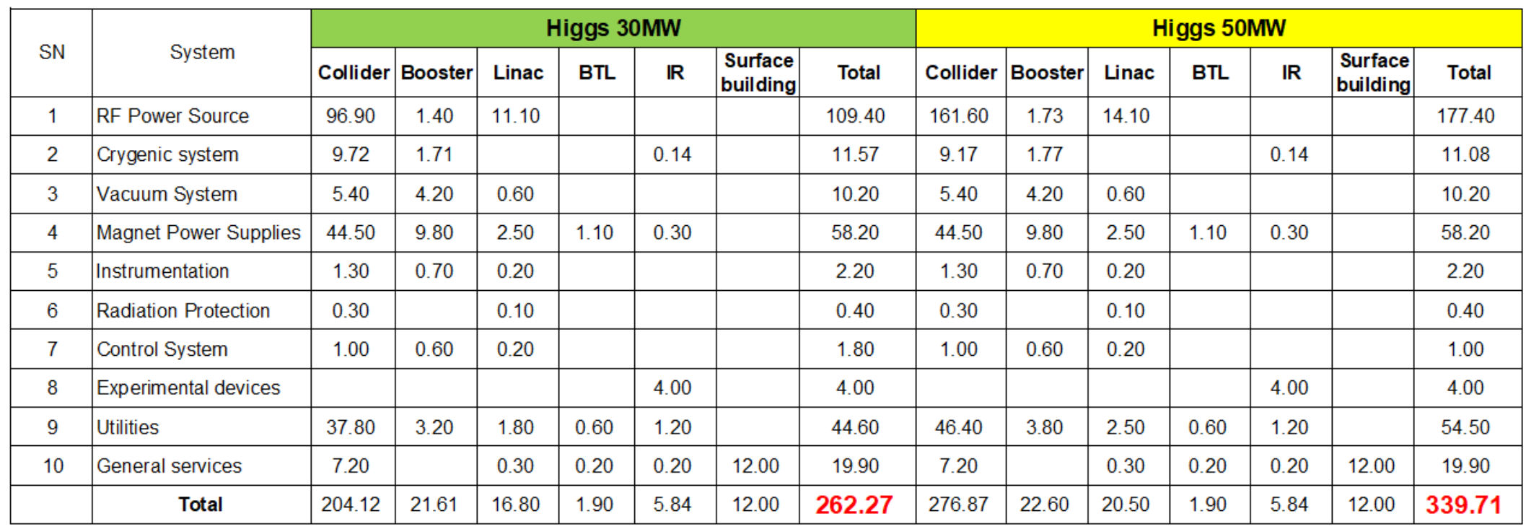
Electric engineering
Power consumption of CEPC
  Higgs

Slide 4
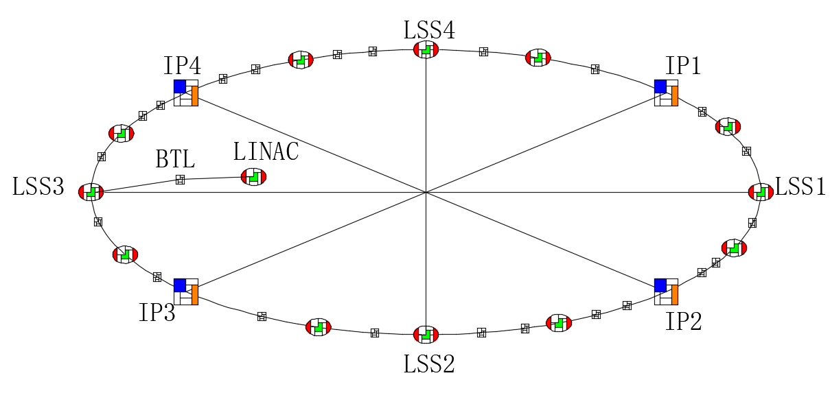
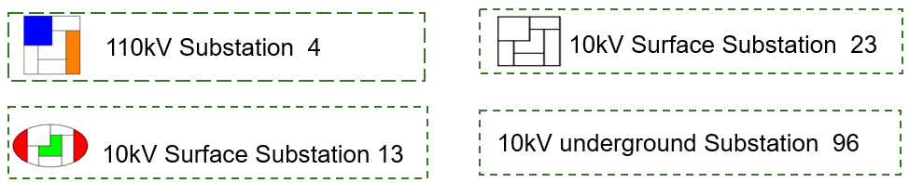
Electric engineering
Power supplies and schemes
  220kV/110kV Master substation
    2 substations
    Rated capacity of transformer: 2*210MVA (220/110kV/10kV).
  110kV/10kV step-down substations
    4 substations respectively located in IP1~IP4.
    Total rated capacity of transformer: 680MVA.
  10kV step-down substations
    132 substations
      Surface 10kV loop : 36
      Underground 10kV loop ：96 substations (10/0.4kV ) along the ring tunnel.
    Total rated capacity of transformer: 328.3MVA.

Slide 5
Electric engineering
  10kV step-down substations
Rated capacity of 10kV/0.4kV transformer: 328.3MVA
 | Subsation Name | Num. of Subsation | Diagram of 10kV | Circuit Num. | Load of 10kV Subsation | Scale of Substation（0.4kV） | Location of Subsation
1 | IP1，IP3 10kV Substiaon | 6 | Single Bus section | 3 incoming 24 outgoing | 28.8MW(10kV） 2.5MW（0.4kV） | 2x3150kVA | Nearby 1# &2#RF Power Tunnel 1#~2# Power Hall
2 | IP2，IP4 10kV Substiaon | 2 | Single Bus 2 section | 2 incoming 26 outgoing | 3.8MW(10kV) 4.6MW(0.4kV) | 4x2000kVA | 1# & 2# IR Equipment Hall 3#~4# Power Hall
3 | LSS1~LSS4 10kV Substiaon | 4 | Single Bus 2 section | 3 incoming 10 outgoing | 3.8MW(10kV) 2.7MW(0.4kV) | 2x2500kVA | 5#~8# Power Hall
4 | LINAC 10kV Substiaon （24# ） | 1 | Single Bus 2 section | 2 incoming 10 outgoing | 6MW(10kV) 4.5MW | 2x2500kVA | LINAC Gallery
5 | 1#~23# grounding 10kV Substiaon | 23 | Single Bus 2 section | 2 incoming 10 outgoing | 1MW | 2x1250kVA | Surface Substaion
6 | 1#~96# Auxiliary Tunnel | 96 | Single Bus 2 section | 2 incoming 2 outgoing | 0.8MW | 2x1000kVA | Auxiliary Tunnel

Slide 6
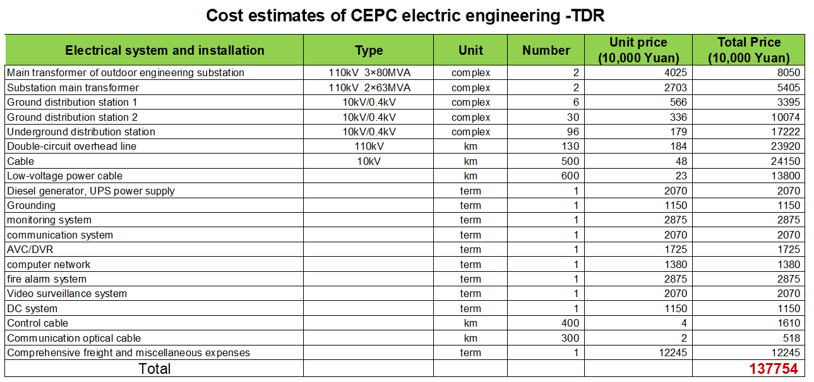
Electric engineering

Slide 7
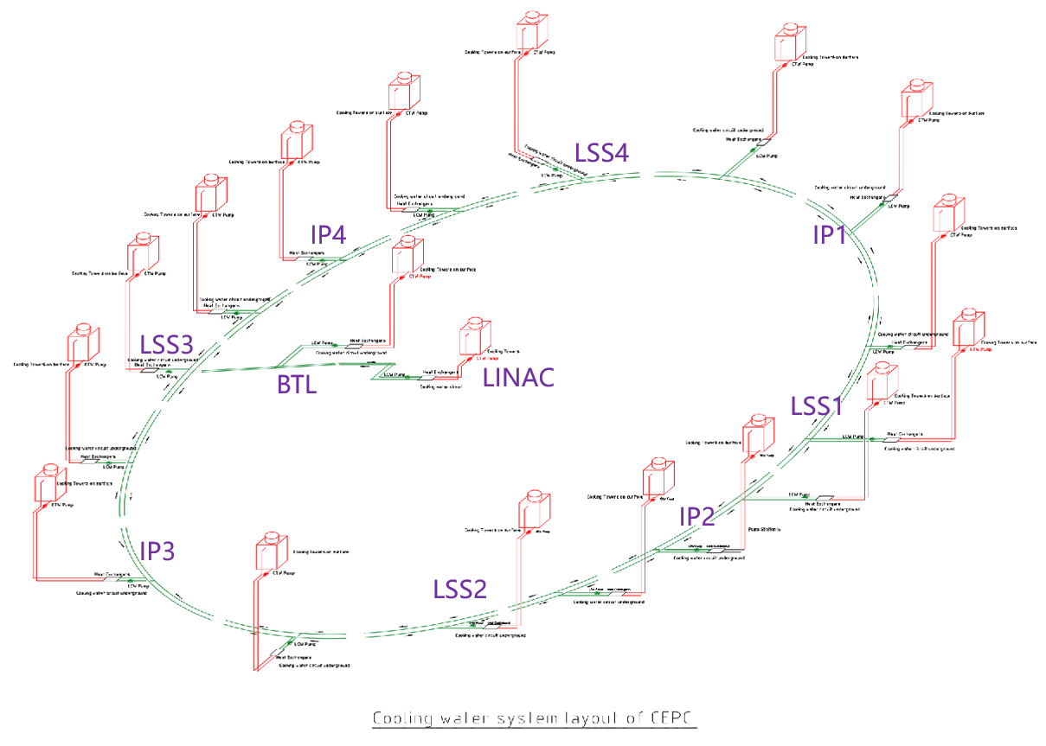
Colling water system
Key requirements and parameters
  Total heat load : 280.48MW
  Total flow rate of LCW: 31982m³/h
  Total flow rate of CTW: 48234m³/h
  DW：Single DW unit can produce 3~5t/h deionized water with the effluent quality meets the following standards.
  Storage capacity of low-level radioactive wastewater ：5100m³
  Centralized water supply station: 18

Slide 8
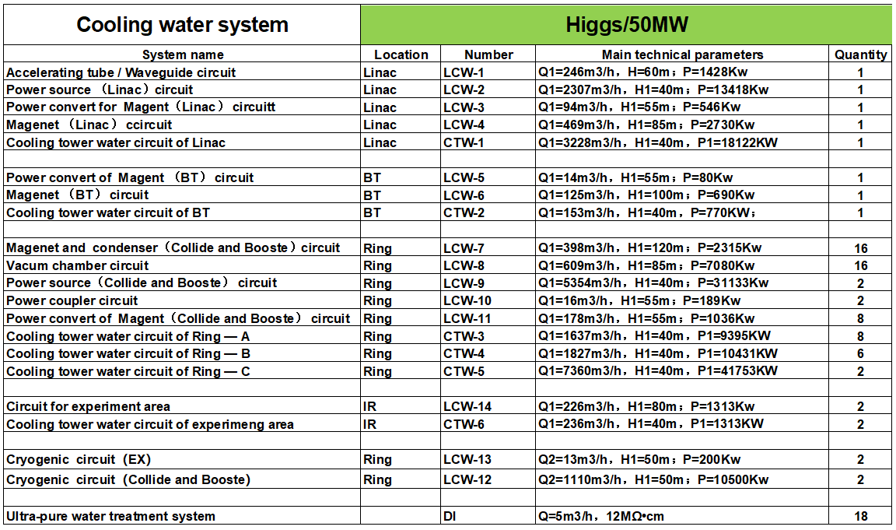
Colling water system
Subsystem partition
  56 closed-loop of LCW
  20 CTW subsystems
  18 DW subsystems
The division of LCW subsystem depends on the demand of water-used equipment:
  Temperature
  Pressure,
  Water quality,
  Radiation dosage
  Location
Subsystem partition of Cooling water system

Slide 9
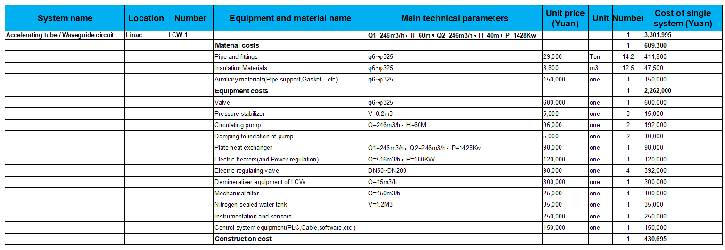
Colling water system
Cost of Subsystem partition
Take accelerating tube and waveguide circuit as an example.

Slide 10
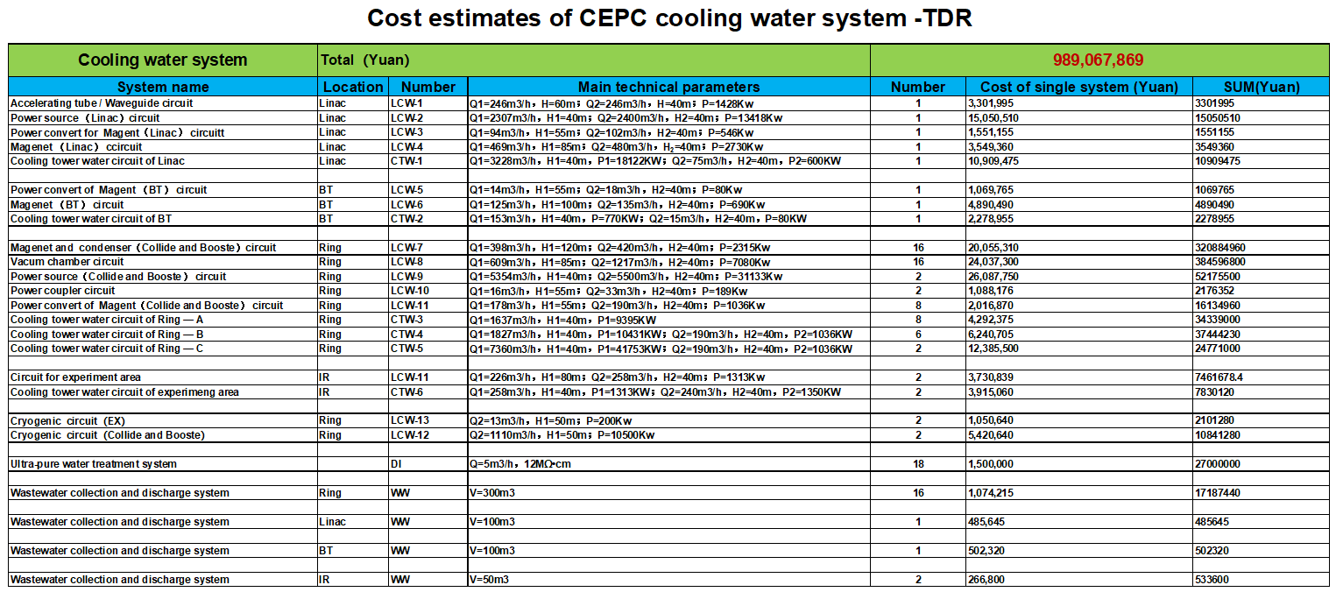
Colling water system

Slide 11
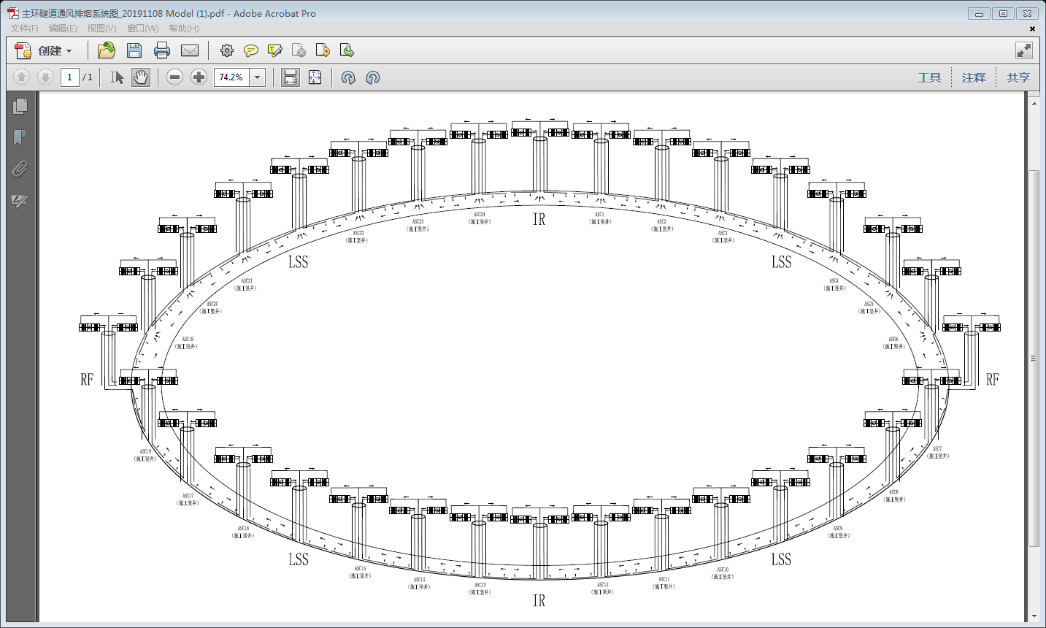
Heating Ventilation and Air Conditioning
Estimated cooling loads of HVAC
  Ring tunnel: 14MW
  Service buildings: (200W/m²) 28MW
  Total: 42MW
Coolant for air conditioning: chilled water
Design parameter | Unit | quantity
Total cooling load | MW | 42
Total chilled water flow rate | m³/h | 7223
Total cooling tower water flow rate | m³/h | 8667
Total capacity of cooling towers | MW | 50
Air-conditioning system in tunnel
  The ring tunnel is divided into 32 independent sections.
  Each shaft serves as a ventilation and exhaust channel for the underground main ring tunnel, and a ventilation pipe and a smoke exhaust pipe are arranged therein.

Slide 12
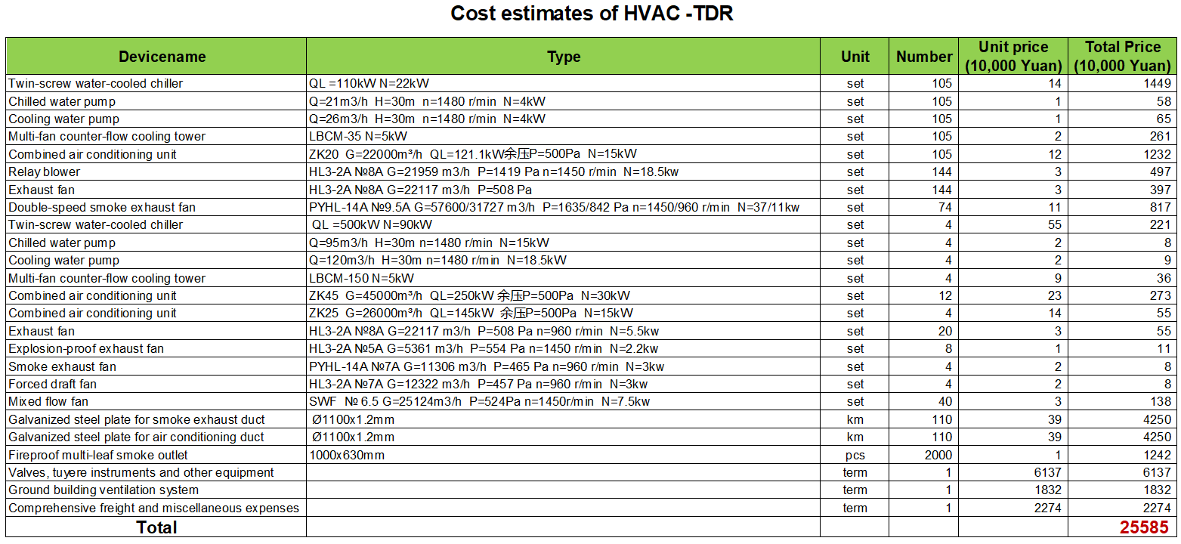
Heating Ventilation and Air Conditioning

Slide 13
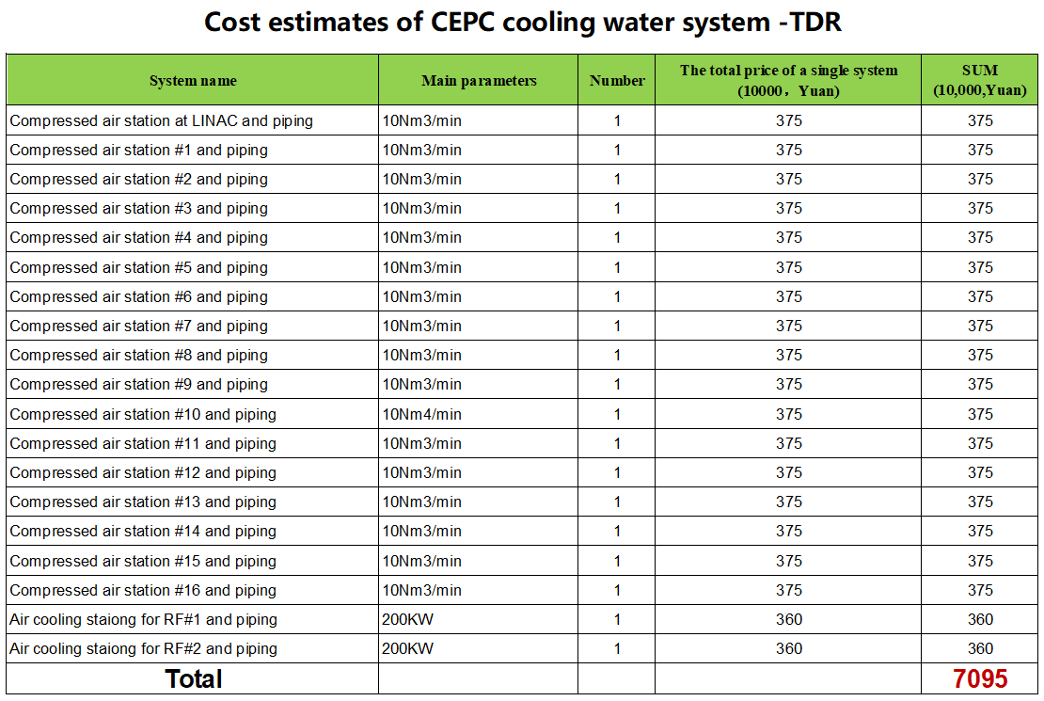
Compressed air system
Key requirements and parameters
    Centralized compressed air station: 18
  -- Operating Pressure： 0.6~0.8MPa
  -- Single Plant Capacity：10Nm3/h
  -- Particle Removal Efficiency: ≥99.97%
  -- Pressure Dewpoint Temp.: -40℃
  -- Oil Content: ≤0.01ppm
    Centralized air cooling station: 2

Slide 14
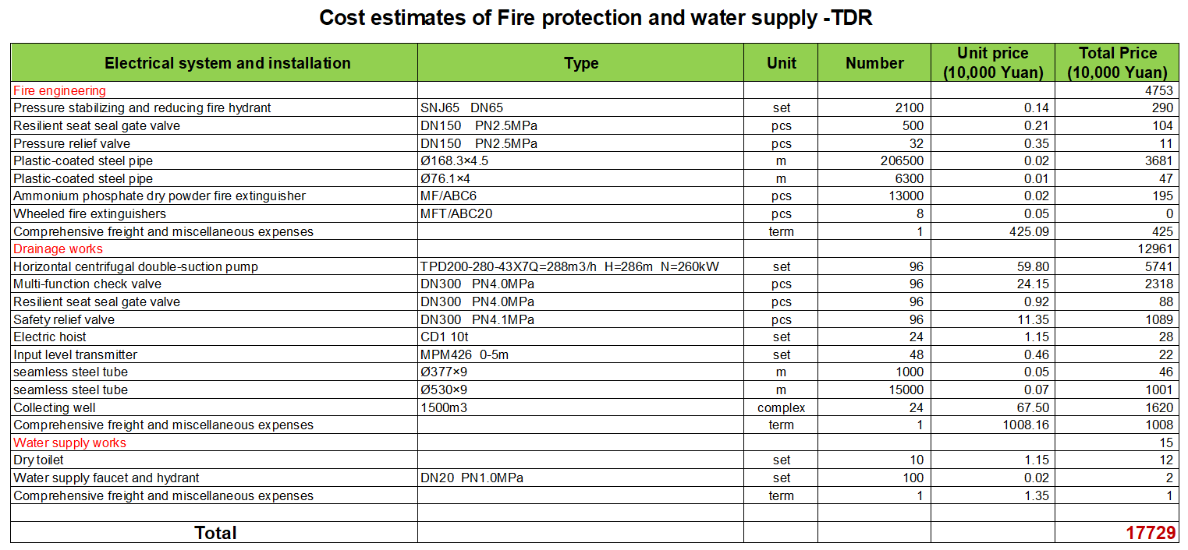
Fire protection and water supply

Slide 15
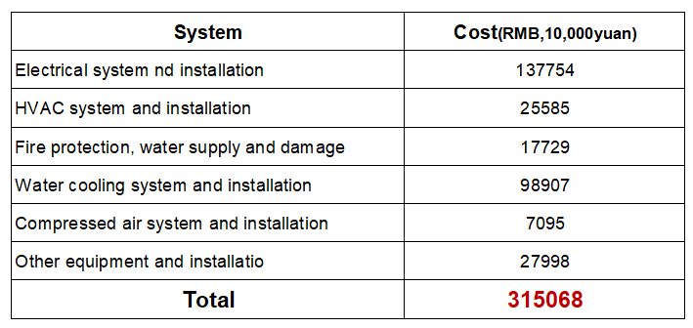
Summary
    The cost of CEPC auxiliary facility are compiled according to the design scheme in the TDR.
    Reserves and any unforeseen installation costs are charged at a rate of 10%.
    In recent years, the prices of major materials have fluctuated greatly, which has brought great difficulties to the preparation of the cost.

Slide 16
  Thank you for your attention!

Slide 17
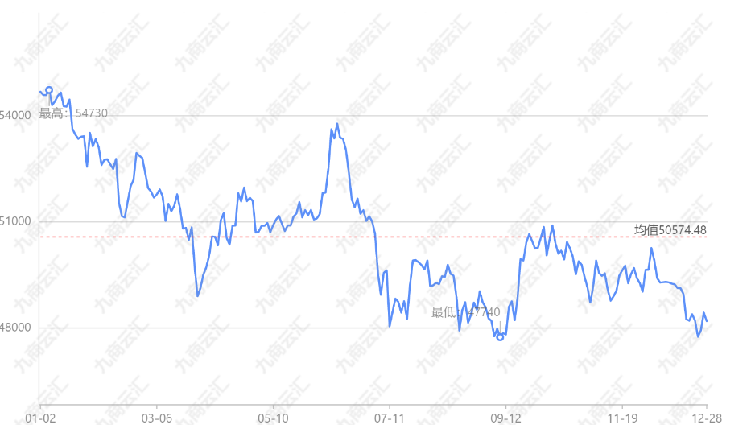
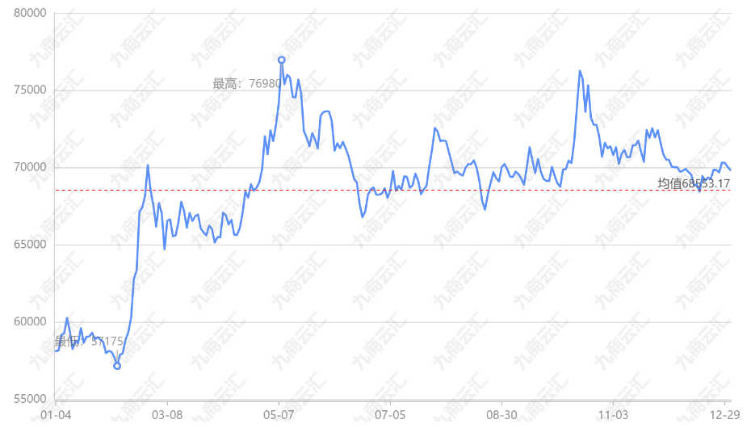
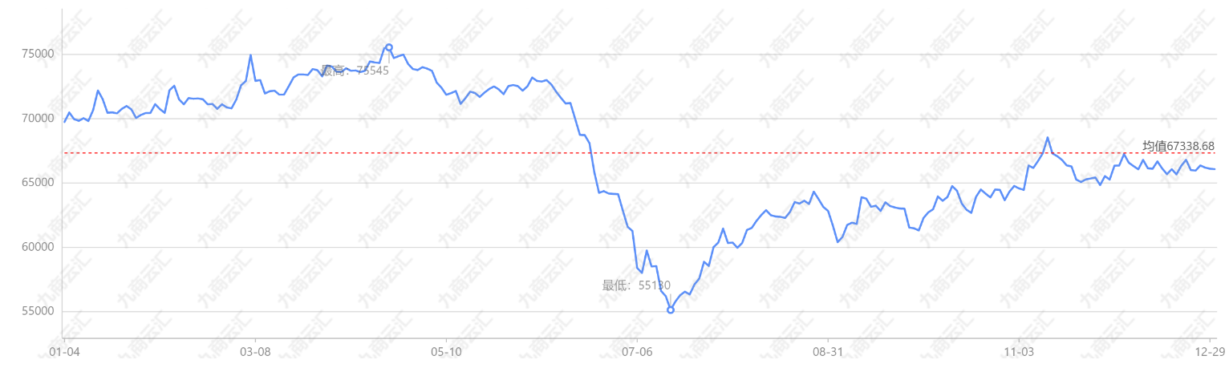
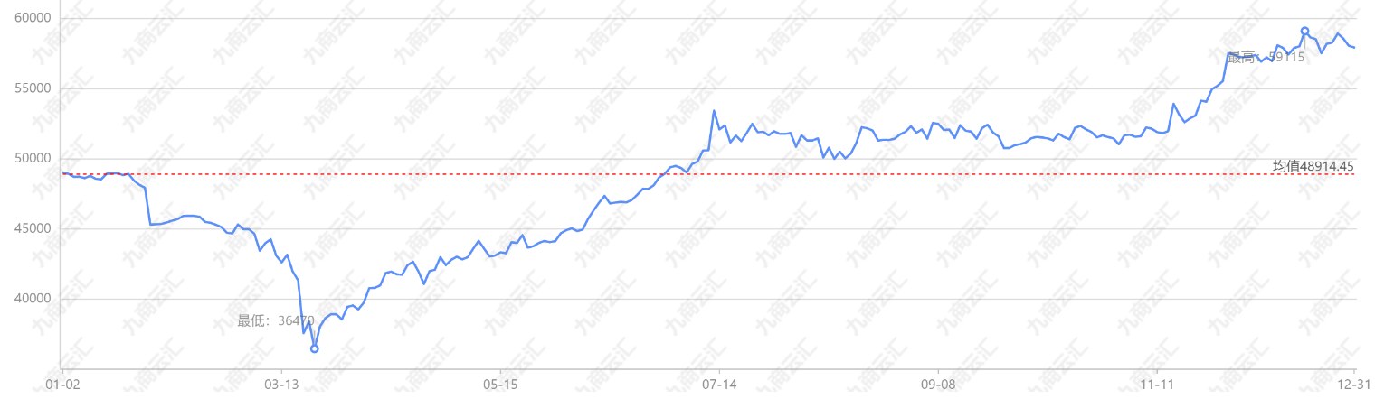
Back-up
Copper-2018
Copper-2021
Copper-2020
Copper-2022

Slide 18
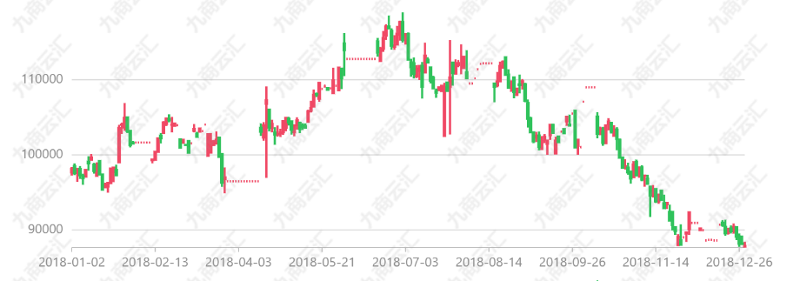
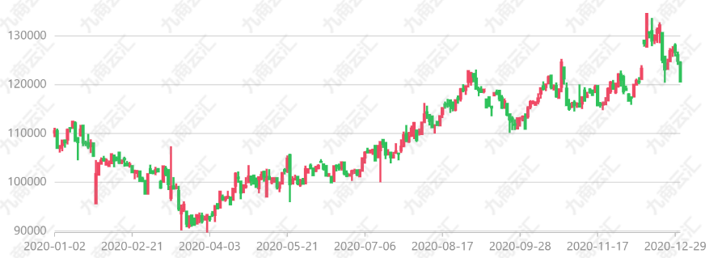
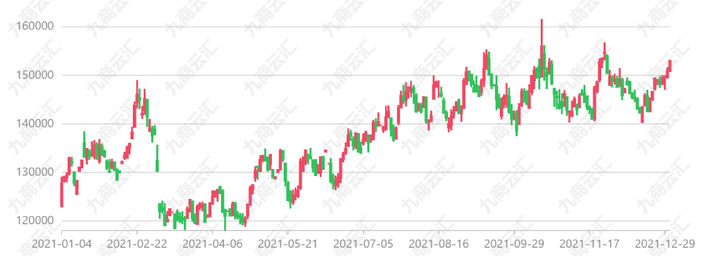
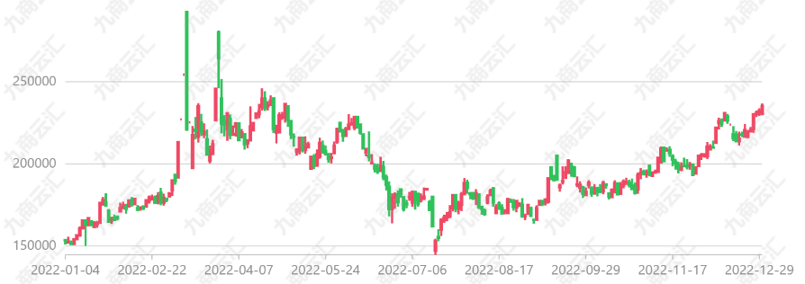
Back-up
NI-2018
NI-2020
NI-2021
NI-2022

