Slide 1



Cost Estimation for the Magnets
of CEPC Injector
Wen Kang, Xuwen Dai
12-16. June. 2023, Hongkong, CEPC Accelerator TDR International Review

Slide 2
Content
Total magnets and cost of CEPC injector
Some consideration for the magnet cost reduction
Cost analysis of the magnets for CEPC booster
Detailed magnet cost lists of injector
Summary

Slide 3
Total magnets and cost of CEPC injector
The injector of CEPC accelerators includes: one 30GeV linac, one 1.1GeV damping ring(DR) for the positron, one 30GeV to 120GeV(185GeV) booster, Ten transport lines connecting the linac, damping ring, booster and collider.
 | Number | Cost (M Yuan)
Magnets for linac | 703 | 43.4
Magnets for DR | 316 | 15.3
Magnets for booster | 19624 | 1541
Magnets for TL | 296 | 48.3
Total | 20939 | 1648

Slide 4
Some considerations for the magnet cost reduction
The total length of all magnets for the CEPC injector is 74.4km, of which all the magnets for the booster is 73.3km long, so the cost of the magnets is a significant concern in the design and production, particularly for the magnets of the booster.
The cost of the magnets is mainly composed of two parts, the cost of material and the cost of fabrication. So the cost could be carefully analysed and reduced in these two aspects at both stages of the design and production.
In principle, the more common material is used, the cheaper magnet is; the simpler structure is adopted, the easier fabrication is, and the cheaper magnet is.

Slide 5
Some considerations for the magnet cost reduction
At the stage of the magnet design
To choose a reasonable magnet design scheme. A good magnet design scheme should be easily produces, meanwhile it should be made by the material that could be easily achieved.
To optimize magnetic field design and mechanical structure of the magnet. An optimized design of the magnet should have a cross section as small as possible and a mechanical structure as simple as possible
To investigate an economical technical route for the magnet production. A good production technical route could shorten the fabrication time and improve the production efficiency of the magnets.

Slide 6
Some considerations for the magnet cost reduction
At the stage of the magnet production
The research and development of the prototype magnets as well as the first batch of magnets are important, it could verify the magnet design and finalize the magnet fabrication procedure.
For mass production of the magnets, some kind of automatic or semi-automatic production lines could be constructed and used, which could efficiently produce magnets 24 hours a day.
Due to large number of magnets, it is considered to construct the magnet production lines near the CEPC construction site so that a mount of the expense for magnet delivery could be saved.

Slide 7
Some considerations for the magnet cost reduction
At the stage of the magnet design
The workshop of IHEP has much experiences in production of the magnets, it could set up enough professional goups of magnet production if the CEPC start to construct.

Slide 8
Cost analysis of the magnets for CEPC booster
Since the magnets of the booster is 98.5% of the magnets for CEPC injector, the cost analysis is focused on the magnets for the booster. There are 19624 magnets equipped with the booster, the main specifications of the magnets are listed in the table.
 | Number | Length | Min. field | Max. field
Dipoles | 14866 | 4.7m | 95Gs | 564Gs
Quadrupoles | 3458 | 2m/1m/0.7m | 2.0T/m | 15.86T/m
Sextupoles | 100 | 0.4m | 18T/m² | 217T/m²
Correctors | 1200 | 0.58m | 20Gs | 200Gs

Slide 9
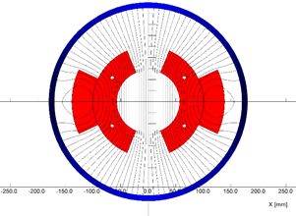
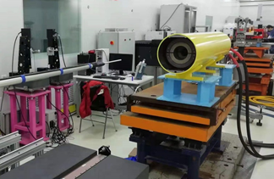
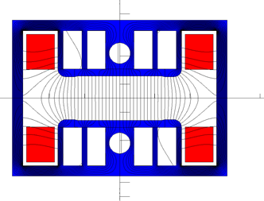
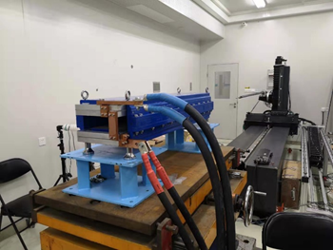
Cost analysis of the magnets for CEPC booster-Dipoles
In CDR stage, the min. working field of the dipole magnet is 29Gs for 10GeV injection energy. Only Cosine Thelta(CT) coil dipole magnet without iron cores could be used for the booster.
In TDR stage, in order to reduce the cost and power loss of the dipole magnets, the injection energy of the booster was increased to 30GeV, so the cheapest iron-core dipole magnet made by non-oriented lamination could be used for the booster.

Slide 10
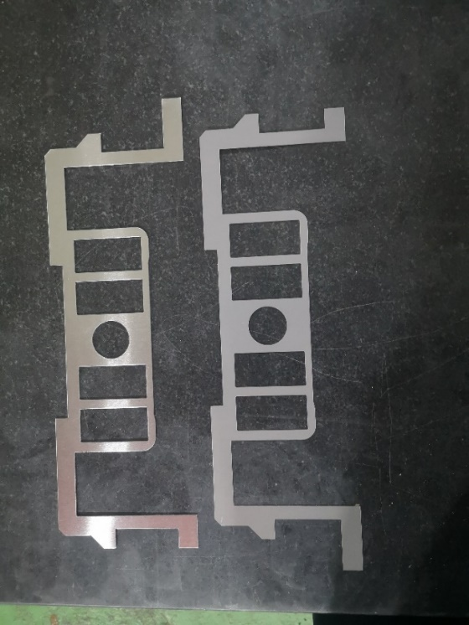
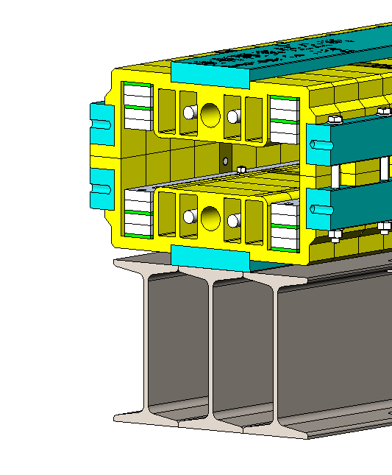
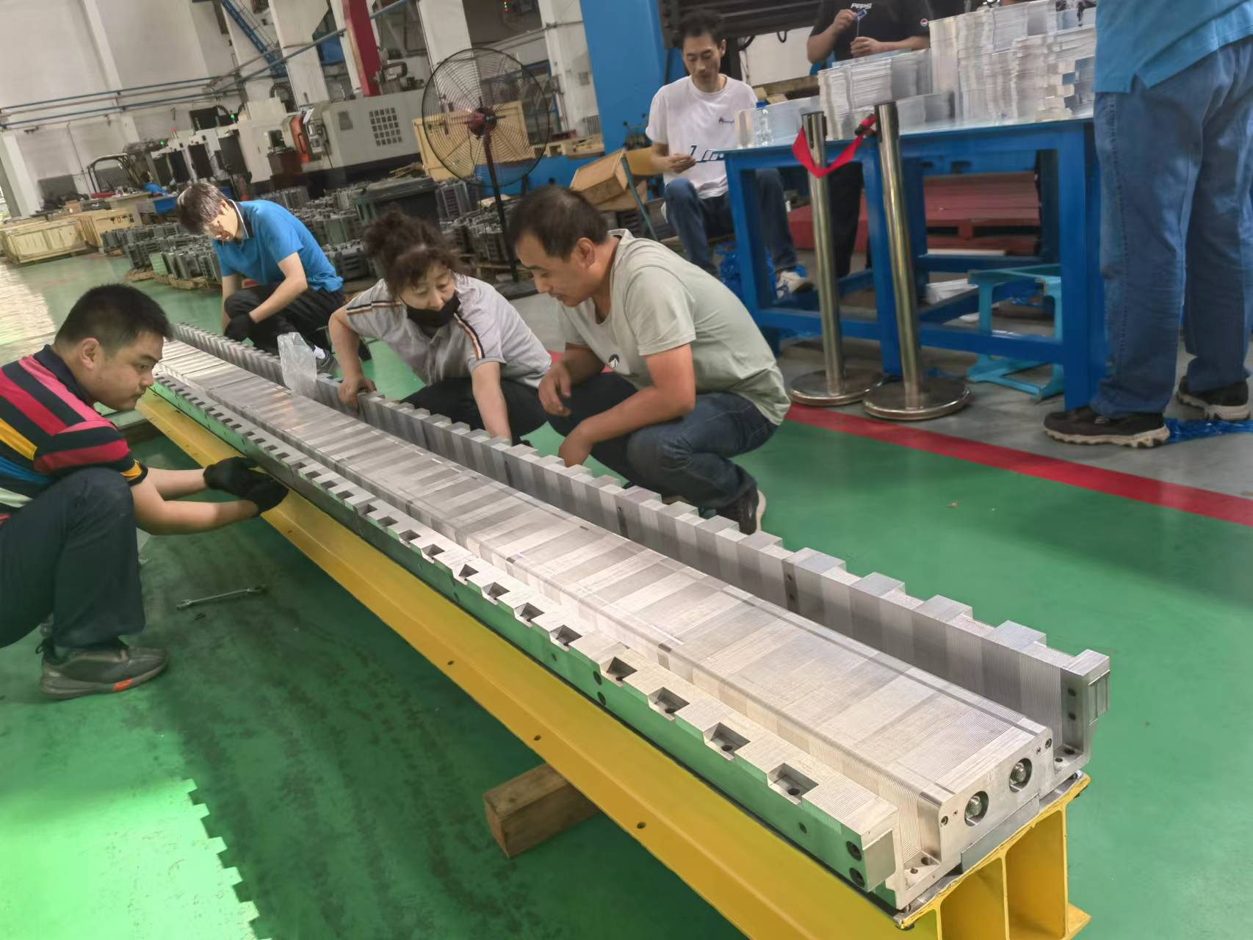
Cost analysis of the magnets for CEPC booster-Dipoles
The measures to reduce cost of the cores,
The dipole magnets have a H-type structure, which could be split into two halves.
By using the technologies of core dilutions, each half core is stacked by the silicon steel laminations and aluminum laminations with the ratio of 1:1. The return yoke of the core is made as thin as possible and some holes are punched in the pole areas of the laminations.

Slide 11
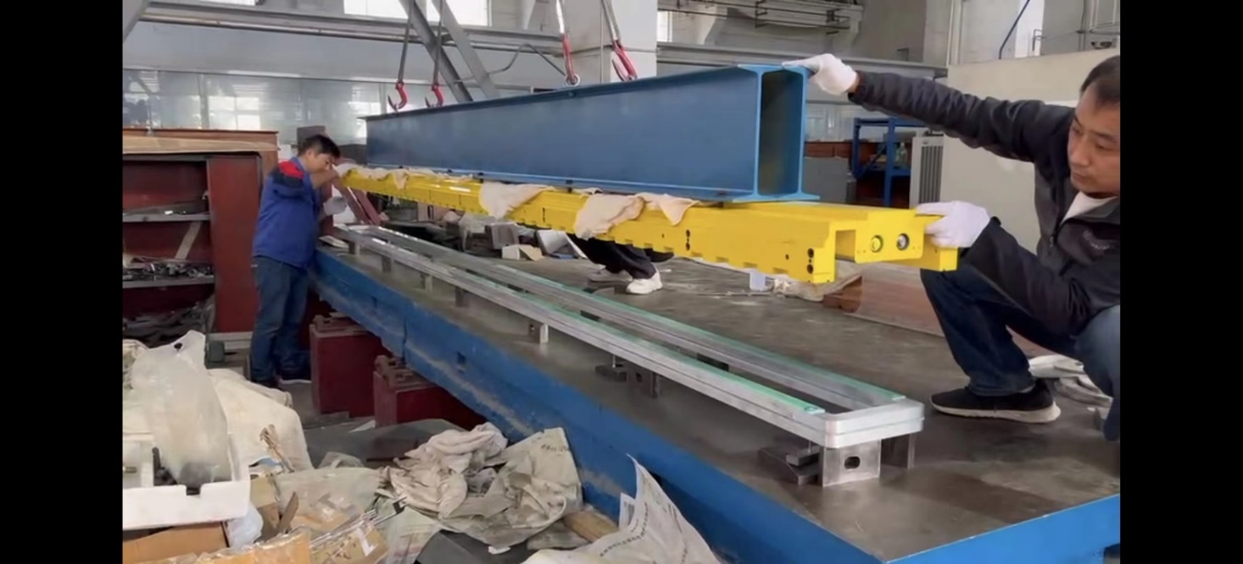
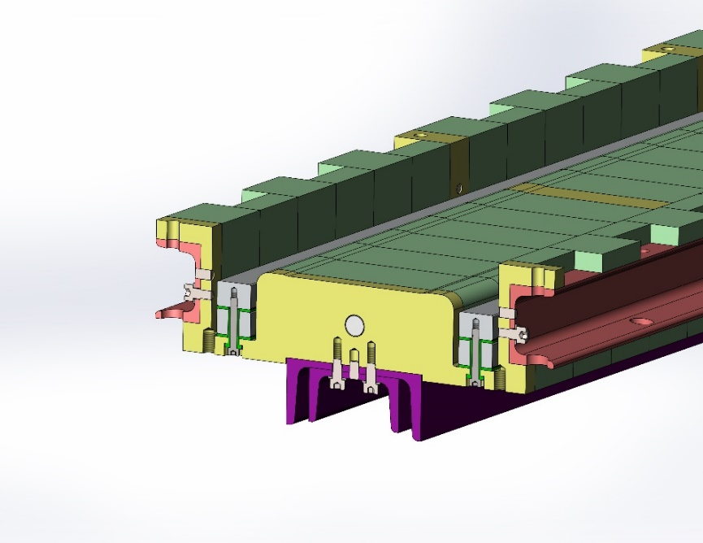
Cost analysis of the magnets for CEPC booster-Dipoles
The measures to reduce cost of the coils,
The coils of the magnet are simply formed with several pieces of the aluminum bars without water cooling
Unlike the conventional vacuum epoxy casting, the insulation either between the turns or between coil and iron-core are simply made by G10 plates.
By using some kind of special structure, the coils can be simply fixed on the iron cores.

Slide 12
Cost analysis of the magnets for CEPC booster-Dipoles
There are three kinds of dipole magnets, one is pure dipole magnet, the other two are dipole-sextupole combined magnets. The main parameters related to the cost of the magnets are listed. Three kinds of magnets have same size and
Magnet name | BST-63B | BST-63B-SF | BST-63B-SD
Quantity | 10832 | 2017 | 2017
Aperture [mm] | 63 | 63 | 63
Max. Field [Gs|T/m²] | 564|0 | 564|16.04 | 564|-19.14
Min. Field [Gs|T/m²] | 95|0 | 95|2.67 | 95|-3.19
Turns per pole | 2 | 2 | 2
Max. current[A] | 714 | 791 | 764
Size of conductor [mm*mm] | 25*40-Al | 25*40-Al | 25*40-Al
Core height [mm] | 280 | 280 | 280
Core width [mm] | 400 | 400 | 400
Core Length [mm] | 4700 | 4700 | 4700
Weight of steel laminations [ton] | 2.80 | 2.80 | 2.80
Weight of Al laminations [ton] | 0.70 | 0.70 | 0.70
Weight of coil conductor [ton] | 0.27 | 0.27 | 0.27

Slide 13
Cost analysis of the magnets for CEPC booster-Dipoles
Cost analysis for the CEPC booster dipole magnets (Three kinds of magnets have same size and weight)
Magnet name | Dipoles
Quantity | 14866
Cost of steel laminations[10k Yuan] | 2.5
Cost of Al laminations[10k Yuan] | 0.9
Cost of coil conductors[10k Yuan] | 0.6
Total cost of material[10k Yuan] | 4.0
Cost of fabrication[10k Yuan] | 3.5
Cost of one magnet[10k Yuan] | 7.5
Total cost of all magnets[10k Yuan] | 111495
Price of non-oriented steel laminations：8500 RMB per ton@Avg.(2018-2023)
Price of Al laminations：14000 RMB per ton@Avg.(2018-2023)
Price of alumimium solid conductors：25000 RMB per ton@Avg.(2018-2023)

Slide 14
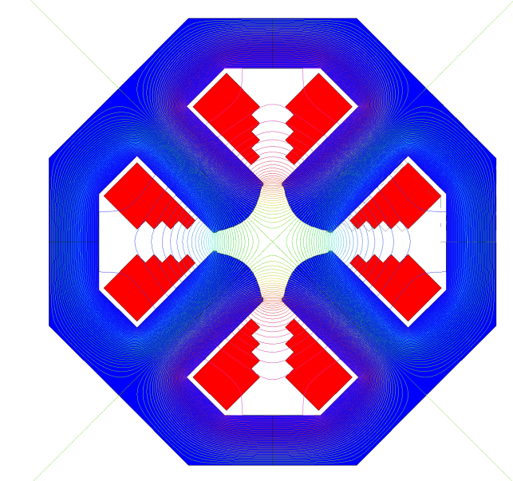
Cost analysis of the magnets for CEPC booster-Quadrupoles
There are 3,458 quadrupole magnets for the booster, which are categorized into three families according to their effective length. Three families of the magnets have a same cross-sectional shape.
The quadrupole magnets will be assembled from four identical quadrants for coil installation.
The iron cores are made of silicon steel laminations. In order to reduce the cost, the coils are wound by the hollow aluminium conductors instead of the hollow copper conductors.
Thanks to the relatively low gradient, the pole root of the quadrupole magnets is rectangular rather than tapered. This allows for a cheaper core with simple cross-sectional shape, and a cheaper coil with simple racetrack structure.

Slide 15
Cost analysis of the magnets for CEPC booster-Quadrupoles
The main parameters related to the cost of the quadrupole magnets
Magnet name | BS-63Q-2000L | BS-63Q-1000L | BS-63Q-700L
Quantity | 1144 | 296 | 2018
Aperture [mm] | 63 | 63 | 63
Max. Field [T/m] | 12.88 | 15.86 | 12.03
Min. Field [T/m] | 2.15 | 2.64 | 2.01
Turns per pole | 20 | 20 | 20
Max. current[A] | 257 | 316 | 240
Min. current[A] | 42.8 | 52.7 | 40.0
Size of conductor [mm*mm] | 10×10D6-Al | 10×10D6-Al | 10×10D6-Al
Core height [mm] | 450 | 450 | 450
Core width [mm] | 450 | 450 | 450
Core Length [mm] | 2000 | 1000 | 700
Weight of steel laminations [ton] | 5.91 | 2.95 | 2.07
Weight of coil conductor [ton] | 0.1 | 0.05 | 0.04

Slide 16
Cost analysis of the magnets for CEPC booster-Quadrupoles
The cost analysis for the CEPC booster dipole magnets
Magnet name | BS-63Q-2000L | BS-63Q-1000L | BS-63Q-700L
Quantity | 1144 | 296 | 2018
Cost of steel laminations[10k Yuan] | 5.0 | 2.5 | 1.8
Cost of coil conductors[10k Yuan] | 0.6 | 0.3 | 0.2
Cost of other material[10k Yuan] | 0.3 | 0.15 | 0.15
Cost of accessories[10k Yuan] | 0.15 | 0.15 | 0.15
Total cost of material[10k Yuan] | 6.05 | 3.1 | 2.3
Cost of fabrication[10k Yuan] | 10.2 | 5.1 | 4.2
Cost of one magnet[10k Yuan] | 16.25 | 8.2 | 6.5
Total cost of all magnets[10k Yuan] | 18590 | 2427 | 13217
Price of non-oriented steel laminations：8500 RMB per ton@Avg.(2018-2023)
Price of hollow alumimium conductors：60000 RMB per ton@Avg.(2018-2023)

Slide 17
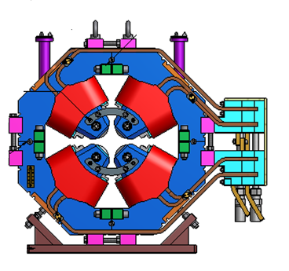
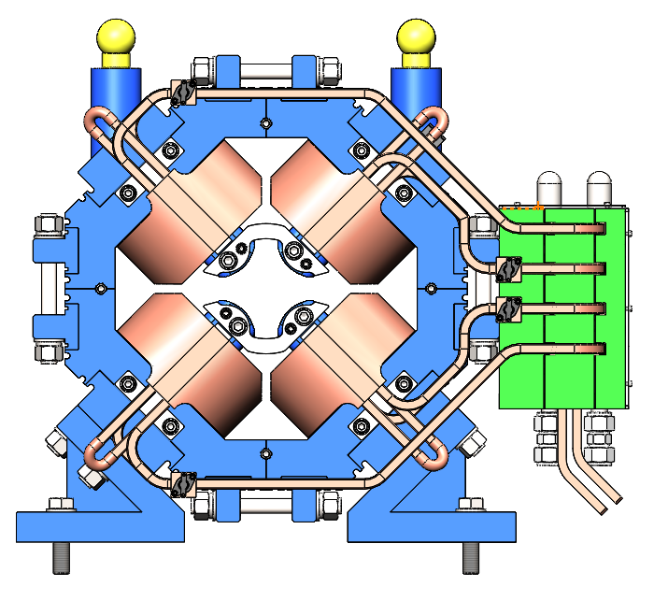
Cost analysis of the magnets for CEPC booster-Quadrupoles
The cost of a similar magnet produced for HEPS booster.
The procurement price of a 500mm long quadrupole magnet produced for High Energy Photo Source(HEPS) booster is 68k Yuan. The cost estimation of the 700mm long quadrupole magnet for CEPC booster is 65k Yuan, which is a little lower by using simpler structure and cheaper material although the weight is a little heavier.
Magnet name | HEPS | CEPC
Aperture [mm] | 56 | 63
Max. Field [T/m] | 24.0 | 12.03
Conductor [mm] | 10×10D6 Cu | 10×10D6 Al
Height [mm] | 550 | 480
Width [mm] | 550 | 480
Length [mm] | 500 | 700
Weight[ton] | 1.14 | 1.23

Slide 18
Cost analysis of the magnets for CEPC booster-Sextupole, Corrector
Since the requirements of the sextupoles and correctors are similar to the magnets for HEPS booster, the cost of these magnets is estimated according to the procurement price of the similar magnets for HEPS booster.
Magnet name | BS-63S | BST-63C
Quantity | 100 | 1200
Aperture diameter[mm] | 63 | 63
Max. field [T|T/m²] | 216.9 | 0.02
Min. field [T|T/m²] | 18.1 | -
Coil turns per pole | 8 | 24
Max. current[A] | 120.4 | 22.5
Conductor size[mm] | 6×6D3-Cu | 5.5×5-Cu
Core length[mm] | 400 | 580
Core width & height[mm] | 300 | 250/200
Magnet weight[kg] | 120 | 240
Cost of one magnet[10k Yuan] | 5 | 3
Total cost of all magnets[10k Yuan] | 500 | 3600

Slide 19
Cost of of the magnets for CEPC linac
The total 703 magnets of linac are group into 24 types, the cost of all magnets and their field measurement devices is 43.4M Yuan.
 | Type | Number | Cost (M Yuan)
Solenoids | 4 | 37 | 5.0
Dipoles | 5 | 19 | 3.4
Quadrupoles | 9 | 372 | 25.8
Correctors | 6 | 275 | 4.3
Field measurement devices | 2 | 3 | 3.0

Slide 20
Detailed cost lists of all magnets for CEPC linac
The total cost of all magnets for CEPC linac is 43.4M Yuan, the detailed cost for each kind of magnet is listed.

Slide 21
Cost of of the magnets for CEPC DR
The total 316 magnets of DR are group into 6 types, the cost of all magnets and the field measurement devices is 15.3M Yuan.
 | Type | Number | Cost (M Yuan)
Dipoles | 2 | 80 | 4.0
Quadrupoles | 2 | 104 | 5.2
Sextupoles | 1 | 72 | 2.9
Correctors | 1 | 60 | 1.2
Field measurement devices | 2 | 2 | 2.0

Slide 22
Detailed cost lists of all magnets for CEPC DR
The total cost of all magnets for CEPC transport lines is 15.3M Yuan, the detailed cost for each kind of magnet is listed.

Slide 23
Cost of the magnets for CEPC transport lines
The total 296 magnets of the transport lines are group into 8 types, the cost of all magnets and the field measurement devices is 48.3M Yuan.
 | Type | Number | Cost (M Yuan)
Dipoles | 5 | 92 | 32.0
Quadrupoles | 3 | 148 | 12.3
Correctors | 2 | 56 | 2.0
Field measurement devices | 2 | 2 | 2.0

Slide 24
Detailed cost lists of all magnets for CEPC transport lines
The total cost of all magnets for CEPC transport lines is 48.3M Yuan, the detailed cost for each kind of magnet is listed.

Slide 25
Summary
There are nearly 21000 magnets in the CEPC injector(linac, DR, booster and transport lines), most of them are equipped with the booster. The total cost of the magnets for injector is 1646M Yuan, of which the magnets for the booster is 1541M Yuan.
Since the dipole magnets of the booster work at very low field, their cost could be reduced dramatically by using the technologies of core dilution, cheaper material as well as the automatic production lines.
To reduce the cost, the quadrupole magnets of the booster are optimized to have a simple and cheap structure due to its relatively low gradient. In addition, the coils of the magnets are wound by the cheaper hollow aluminium conductors.
The other magnets for the CEPC injector are conventional magnets, so their cost is comparable to the similar magnets produced for other accelerator projects, such as HEPS and BEPCII.

Slide 26
Thank you for your attention!
12-16. June. 2023, Hongkong, CEPC Accelerator TDR International Review

