Slide 1
Vacuum system of CEPC
Based on the TDR for the linac/damping ring vacuum system
Yongsheng Ma
2023.8.16

Slide 2
outline
Vacuum System
Linac
Damping ring, Transport line
Collider, Booster
Cost evaluation
Conclusion

Slide 3
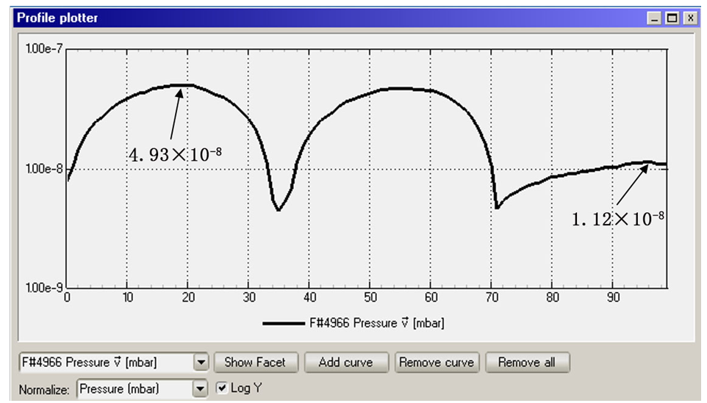
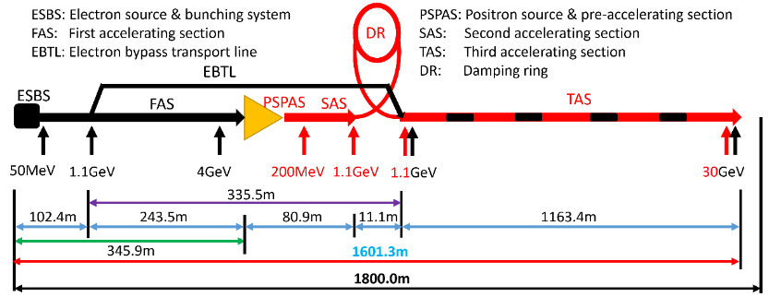
Linac vacuum system
The Linac vacuum system with a length of 2100m is divided into 59 sections. it consists of electron gun, bunching system, accelerating structures .
Sputter ion pumps: 3431; Vacuum gauges: 1352; Gate valves: 60
Section | Static pressure /Torr | Dynamic pressure /Torr
E-gun | <1×10⁻⁹ | <2×10⁻⁸
Buncher | <5×10⁻⁸ | <2×10⁻⁷
Accelerating structure | <5×10⁻⁸ | <2×10⁻⁷
Waveguide | <5×10⁻⁸ | <5×10⁻⁷
Most of the components are made of oxygen-free copper .
The thermal outgassing rate is 1×10⁻¹¹ Torr·l/s·cm².
Notes:
conventional technology

Slide 4
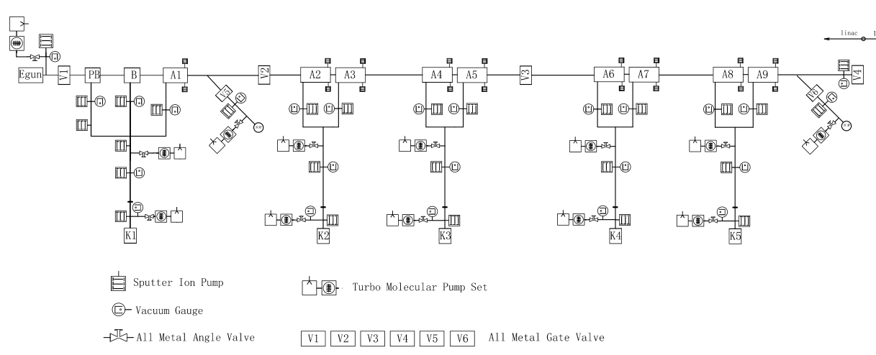
Linac Vacuum system
 | 真空计、离子泵、真空管等数量统计表
序号 | 直线元件 | 直线元件数量 | 真空计 | 离子泵 | 波纹管 | 闸板阀 | 粗抽阀
1 | 加速结构 | 581 | 581 | 1162 | / | 48 | 145
2 | 束调管 | 271 | 271 | 271 | / | / | /
3 | 波导长度 | 4065 | 407 | 1626 | / | / | /
4 | 真空管 | 931 | 93 | 372 | 663 | 11 | 33
 |  | 合计 | 1352 | 3431 | 4094 | 59 | 178
相关系统 | 名称 | 数量 | 孔径/间隙(mm) | 长度/m | 总长/m | 备注(仅粗略估计)
Linac | 波纹管 | 7 | 30 | 0.05645 | 0.39515 | 此波纹管数量仅包括磁铁与加速结构之间的连接，对于EBTL及直线末端预留的长真空盒之间的波纹管连接未考虑
 |  | 350 |  | 0.09500 | 33.25
 |  | 3 |  | 0.09645 | 0.28935
 |  | 4 |  | 0.10950 | 0.438
 |  | 234 |  | 0.13922 | 32.57748
 |  | 62 |  | 0.1495 | 9.269
 | 磁铁相关真空盒 |  | 20-30 | 335 | 334.76102 | 阀门及泵未统计 （加速结构的数量见微波系统）
 | EBTL段长真空盒,（电子bypass） |  | 30 | 335 | 335
 | 直线末端长真空盒 |  | 20/30 | 185 | 185
 | 合计 |  |  |  | 930.98

Slide 5
 | Classification | length/m | 说明
transport line | linac to booster | 3000 | 直线到booster的输运线，正负电子各1500米；
 | booster to colider | 960 | booster到主环的输运线，离轴注入正负电子各240米；在轴注入正负电子各240米。
 | colider to booster | 480 | 主环到booster的输运线，正负电子各240米
 | damping ring | 240 | 进出各120
 | total length | 4680
Damping ring, Transport line
DR | Classification | length/m
 | 标准弧区真空盒长度 | 119.0
 | 直线节 | 14.0
 | 高频代用 | 0.0
 | 高频 | 3.0
 | 注入引出 | 2.8
 | 离子泵接口三通 | 1.5
 | 波纹管 | 1.5
 | BPM | 4.0
 | 真空转接 | 1.5
 | total length | 147.3

Slide 6
Collider, Booster
 | Classification | length/m
booster | 标准弧区真空盒长度 | 78426
 | 直线节 | 11100
 | 高频代用 | 5910
 | 高频 | 96
 | 注入引出 | 198
 | 离子泵接口三通 | 1250
 | 波纹管 | 850
 | BPM | 240
 | 真空转接 | 1930
 | total length | 100000
collider | Classification | length/m
 | 标准弧区真空盒长度 | 78426
 | 直线节 | 4000
 | 高频代用 | 5648
 | 对撞区 | 7000
 | 高频 | 352
 | 注入引出 | 286
 | Manifold for SIP | 1333
 | RF shielded bellows | 2057
 | BPM | 300
 | 对撞点1 | 12
 | 对撞点2 | 12
 | 真空转接 | 574
 | total length | 100000

Slide 7
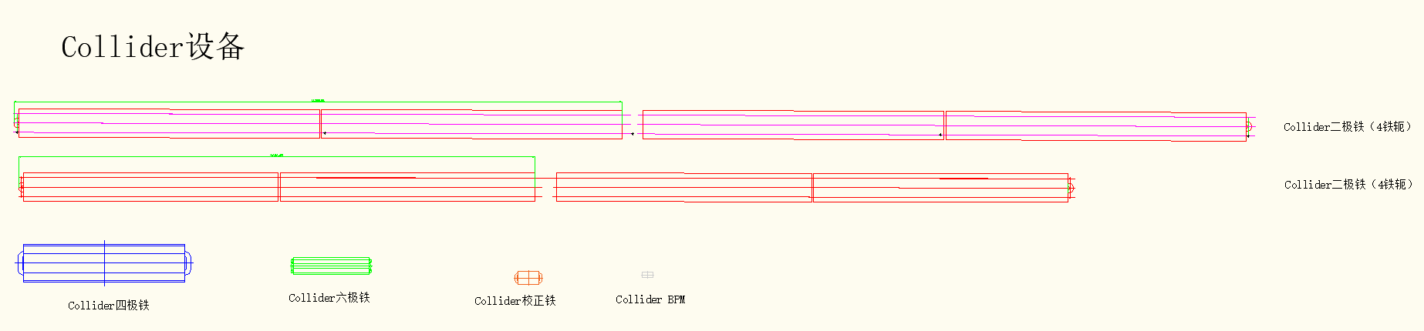
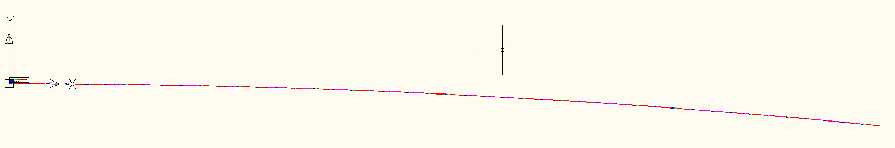
Configuration of Vacuum chamber in collider
Wang YW
LI MX
collider 真空盒的数量与长度统计：根据磁铁长度与布局得到
 | 根据磁铁分类 | 组合数量 | 真空盒长度 |  | 标准单元数量 | 真空盒总数量 | 合计长度 | 备注
标准单元 | 二级铁组合A | 30 | 11.5 | 米 | 64 | 3840 | 44160 | 磁铁组合放2根真空盒
 | 二级铁组合B | 16 | 9.8 | 米 | 64 | 2048 | 20070.4 | 磁铁组合放2根真空盒
 | 四六级铁组合 | 16 | 6.5 | 米 | 64 | 1024 | 6656 | 磁铁组合放1根真空盒
 | 四级，校正铁组合 | 31 | 3.8 | 米 | 64 | 1984 | 7539.2 | 磁铁组合放1根真空盒
弧区汇总 |  |  |  |  |  | 8896 | 78425.6
直线节 |  | 4000 | 11 |  |  | 364 | 4000
高频代用 |  | 5648 | 11 |  |  | 513 | 5648
对撞区 |  | 7000 | 5.5 |  |  | 513 | 7000
直线节汇总 |  |  |  |  |  | 1391 | 16648
合计 |  |  |  |  |  | 10287 | 95074

Slide 8
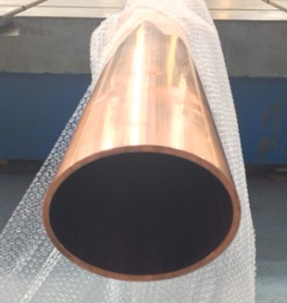
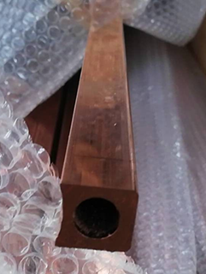
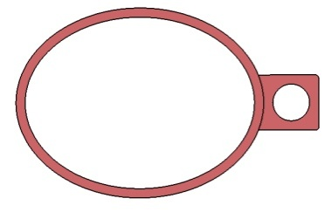
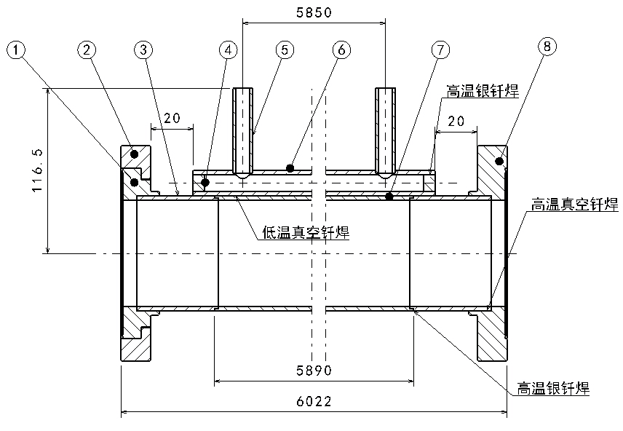
Technique process Cu vacuum chamber
Cu beam pipe and water cooling channel are extruded respectively, and brazed together.
Stainless steel material is used for flanges, and there is a rotatable flange at an end of vacuum chamber.
The flanges and beam pipe are welded by high temperature brazing solder, and low temperature brazing solder are used between the beam pipe and water cooling channel.
Vacuum chamber
Beam pipe +
Cooling channel

Slide 9
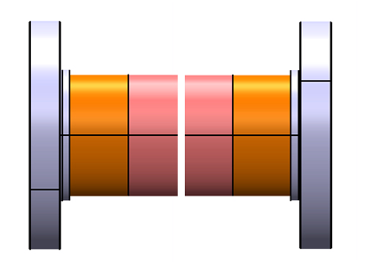
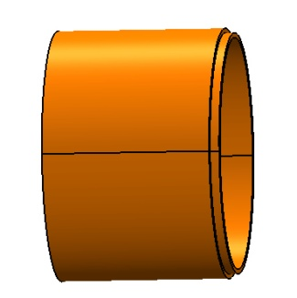
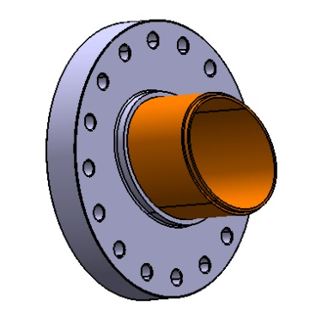
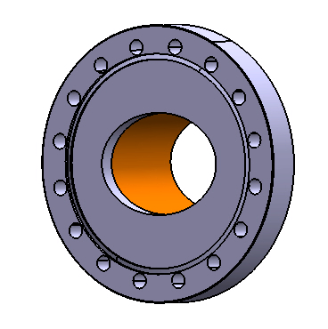
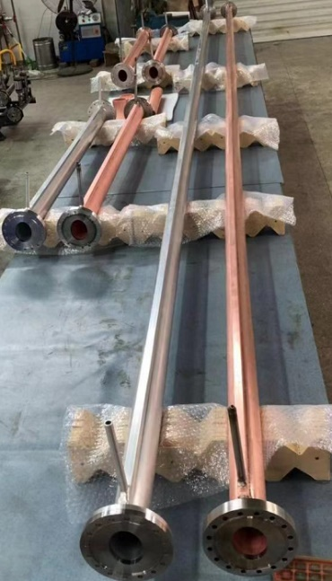
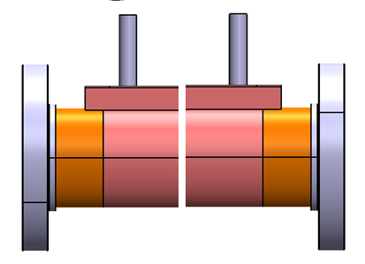
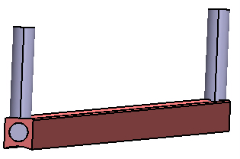
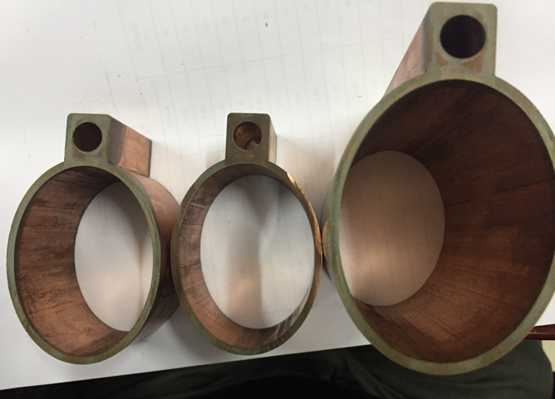
Technique process of Cu vacuum chamber
Leak detection
Transition tube machining
Brazing
Knife edge machining of flange
Silver brazing or EBW
Leak detection
Leak tests for hydraulic pressure and vacuum
Welding between beam pipe and cooling channel with a low temperature brazing solder
Welding of fittings for cooling channel
Cleaning, leak detection, baking and pumping down

Slide 10
Cost explanation of Collider vacuum chambers
 |  | Collider d56 arc beam pipe |  |  |  | Collider d56 Straight section beam pipe |  | Note
No. | Classification | Unit | Unit price / (CNY 10,000) | Quantity | total Price / (CNY 10,000) | Quantity | total Price / (CNY 10,000)
1 | Tube blank | meter | 0.20 | 78426 | 15685 | 16648 | 3330
2 | Flange | one | 0.10 | 17792 | 1779 | 2781 | 278
3 | Manufacturing | one | 0.80 | 8896 | 7117 | 1391 | 1112 | Number of arc beam vacuum chambers is 8896,and S S is 1391
4 | Welding | one | 1.10 | 8896 | 9786 | 1391 | 1530
5 | Accessory of water pipe | one | 0.05 | 8896 | 445 | 1391 | 70
6 | Cleanning | meter | 0.05 | 78426 | 3921 | 16648 | 832
7 | Transportion | one | 0.10 | 8896 | 890 | 1391 | 139
8 | Tax | one | 0.33 | 8896 | 2891 | 1391 | 452 | 13%
 | Total |  |  |  | 42398 |  | 7725 | 50122.5
The total length of copper vacuum chambers of collider is 95 074 meters

Slide 11
Collider cost
 |  |  |  | CDR |  |  |  | TDR |  |  |  | TDR-CDR
No. | Classification | Device | Unit | Specification | Quantity | Unit price / (CNY 10,000) | total Price / (CNY 10,000) | Specification | Quantity | Unit price / (CNY 10,000) | total Price / (CNY 10,000) | / (CNY 10,000) | Note
1 | Collider | arc beam pipe_positron | ring | D56/C10100 | 1 | 64000 | 64000 | D56/C10100 | 1 | 42398 | 42398.0 | -21602 | 简化真空盒结构，将真空链接件单独列出
2 |  | arc beam pipe_electron | ring | Al-6060 | 1 | 32000 | 32000 | D56/C10100 | 1 | 42398 | 42398.0 | 10398 | 电子环铝升级为铜，简化真空盒结构
3 |  | Straight section beam pipe | m | 304 | 40000 | 0.2 | 8000 | 304L | 2 | 7725 | 15449.2 | 7449 | 将不锈钢更改为铜
4 |  | Manifold for SIP | one |  | / |  |  |  | 13333 | 0.3 | 4000.0 | 4000 | CDR是含在真空盒中
5 |  | Manifold for Gauge & RGA | one | 304 | / |  |  | 304L | 4840 | 0.3 | 1452.0 | 1452 | CDR是含在真空盒中
6 |  | NEG coating | m | Ti-Zr-V | 100000 | 0.15 | 15000 | Ti-Zr-V | 200000 | 0.15 | 30000.0 | 15000 | 电子环增加NEG镀膜
7 |  | Ion pump | one | 50-100L/s | 22300 | 1..5 | 33450 | 50-100L/s | 13333 | 1.5 | 20000.0 | -13450 | 按照Higgs 30MW最低配置，同时NEG镀膜降低泵的数量
8 |  | Molecular pump | one | 200L/s | 300 | 10 | 3000 | 200L/s | 300 | 10 | 3000.0 | 0
9 |  | Gate valve | one | DN63 | 1040 | 15 | 15600 | DN63 | 1040 | 15 | 15600.0 | 0
10 |  | Roughing valve | one | CF63 | 3120 | 1 | 3120 | CF63 | 3120 | 1 | 3120.0 | 0
11 |  | RF shielded bellows | one | DN63 | 24000 | 1.5 | 36000 | DN63 | 20573 | 1.5 | 30859.6 | -5140 | 真空盒数量变动引起RF屏蔽波纹管数量减少
12 |  | Vacuum gauge | one | CCG | 4320 | 2 | 8640 | CCG | 4320 | 2 | 8640.0 | 0
13 |  | Residual gas analyzer | one | RGA | 520 | 10 | 5200 | RGA | 520 | 10 | 5200.0 | 0
14 |  | Helium leak detector | one | He | 100 | 30 | 3000 | He | 100 | 30 | 3000.0 | 0
15 |  | Cooling tube | m | 10mm | 200000 | 0.005 | 1000 | 10mm | 200000 | 0.005 | 1000.0 | 0
16 |  | Vacuum heating | m | 220v | 200000 | 0.01 | 2000 | 220v | 200000 | 0.1 | 20000.0 | 18000 | CDR计算有误，增加1.8亿
17 |  | Vacuum control |  |  |  |  | 2000 |  | 1 | 2000 | 2000.0 | 0
18 |  | Vacuum cleaning |  |  |  |  | 1000 |  | 1 | 1000 | 1000.0 | 0
 |  | Total |  |  |  |  | 233010.0 |  |  |  | 249116.7 | 16107 | 合计增加1.61亿元

Slide 12
Booster cost
 |  |  |  | CDR |  |  |  | TDR |  |  |  | TDR-CDR
No. | Classification | Device | Unit | Specification | Quantity | Unit price / (CNY 10,000) | total Price / (CNY 10,000) | Specification | Quantity | Unit price / (CNY 10,000) | total Price / (CNY 10,000) | / (CNY 10,000) | Note
19 | Booster | Arc beam pipe | m | Al6060 | 80000 | 0.4 | 32000 | Al6060 | 1 | 27367 | 27367.3 | -4633 | 简化真空盒结构
20 |  | Straight section beam pipe | m | 304 | 20000 | 0.2 | 4000 | 316L | 1 | 5540 | 5540.0 | 1540 | 不锈钢改为铝合金
21 |  | Manifold for SIP | one |  | / |  |  | 316L | 8400 | 0.3 | 2520.0 | 2520 | CDR是含在真空盒中
22 |  | Manifold for Gauge & RGA | one |  | / |  |  | 316L | 2420 | 0.3 | 726.0 | 726 | CDR是含在真空盒中
23 |  | Bellows | one | 304 | 12000 | 0.3 | 3600 | 316L | 12000 | 0.3 | 3600.0 | 0
24 |  | Ion pump | one | 50-100L/s | 8400 | 1.5 | 12600 | 50-100L/s | 8400 | 1.5 | 12600.0 | 0
25 |  | Gate valve | one | DN63 | 520 | 10 | 5200 | DN63 | 520 | 10 | 5200.0 | 0
26 |  | Roughing valve | one | CF63 | 1560 | 1 | 1560 | CF63 | 1560 | 1 | 1560.0 | 0
27 |  | Vacuum gauge | one | CCG | 2160 | 2 | 4320 | CCG | 2160 | 2 | 4320.0 | 0
28 |  | Residual gas analyzer | one | RGA | 260 | 10 | 2600 | RGA | 260 | 10 | 2600.0 | 0
29 |  | Vacuum control | one |  |  |  | 1000 |  |  |  | 1000 | 0
30 |  | Vacuum cleaning | one |  |  |  | 500 |  |  |  | 500 | 0
 |  | Total |  |  |  |  | 67380 |  |  |  | 67533.3 | 153

Slide 13
LINAC cost
 |  |  |  | CDR |  |  |  | TDR |  |  |  | TDR-CDR
No. | Classification | Device | Unit | Specification | Quantity | Unit price / (CNY 10,000) | total Price / (CNY 10,000) | Specification | Quantity | Unit price / (CNY 10,000) | total Price / (CNY 10,000) | / (CNY 10,000) | Note
31 | LINAC | Beam pipe | m | 304 | 1500 | 0.2 | 300 | 316L | 931 | 0.3 | 279.3 | -21 | 磁导率：1.02～1.05，磁铁内1.02，个别1.05
32 |  | Manifold for SIP | one |  | / |  |  | 316L | 3431 | 0.3 | 1029.3 | 1029 | CDR是含在真空盒中
33 |  | Manifold for Gauge & RGA | one |  | / |  |  | 316L | 1352 | 0.3 | 405.6 | 406 | CDR是含在真空盒中
 |  | Manifold for Gauge & RGA | one |  | / |  |  | 316L | 1352 | 0.3 | 405.6 | 406 | CDR是含在真空盒中
34 |  | Bellows | one | 304 | 1760 | 0.3 | 528 | 316L | 4094 | 0.3 | 1228.2 | 700
35 |  | Sputtering Ion pump | one | 100L/s | 1310 | 2 | 2620 | 100L/s | 3431 | 2 | 6862 | 4242 | 数量考虑了波导、束调管、能量倍增器等的需求
36 |  | Molecular pump | one | 400L/s | 10 | 10 | 100 | 400L/s | 10 | 10 | 100 | 0
37 |  | Gate valve | one | CF40 | 30 | 15 | 450 | CF40 | 30 | 15 | 450 | 0
38 |  | Gate valve | one | CF25 | / |  |  | CF25 | 30 | 15 | 450 | 450
39 |  | Roughing valve | one | CF63 | 90 | 1 | 90 | CF63 | 178 | 1 | 178 | 88 | VAT进口阀门
40 |  | Vacuum gauge | one | CCG | 611 | 2 | 1222 | CCG | 1352 | 2 | 2704 | 1482 | 数量考虑了波导、束调管、能量倍增器等的需求
41 |  | Residual gas analyzer | one | RGA | 10 | 10 | 100 | RGA | 10 | 10 | 100 | 0
42 |  | Helium leak detector | one | He | 5 | 30 | 150 | He | 5 | 30 | 150 | 0
43 |  | Vacuum connectors | one |  | 1 | 300 | 300 |  | 1 | 600 | 600 | 300
44 |  | Vacuum heating | one |  | 1 | 50 | 50 |  | 1 | 50 | 50 | 0
45 |  | Vacuum control | one |  | 1 | 100 | 100 |  | 1 | 100 | 100 | 0
46 |  | Vacuum cleaning | one |  | 1 | 50 | 50 |  | 1 | 50 | 50 | 0
 |  | Total |  |  |  |  | 6060 |  |  |  | 14736.4 | 8676 | 能量增加20GeV

Slide 14
Damping ring & transport line cost
 |  |  |  | CDR |  |  |  | TDR |  |  |  | TDR-CDR
No. | Classification | Device | Unit | Specification | Quantity | Unit price / (CNY 10,000) | total Price / (CNY 10,000) | Specification | Quantity | Unit price / (CNY 10,000) | total Price / (CNY 10,000) | / (CNY 10,000) | Note
47 | Damping | Beam pipe | m | 304 | 120 | 0.2 | 24 | Al6060 | 150 | 0.4 | 60 | 36 | 真空盒材料改为铝合金
48 |  | Bellows | one | 304 | 60 | 0.2 | 12 | 316L | 75 | 1.5 | 112.5 | 101 | 磁导率要求，材料改为316L
49 |  | Ion pump | one | 30L/s | 80 | 1.5 | 120 | 30L/s | 100 | 1.5 | 150 | 30
50 |  | Molecular pump | one | 400L/s | 2 | 10 | 20 | 400L/s | 2 | 10 | 20 | 0
51 |  | Gate valve | one | CF63 | 4 | 10 | 40 | CF63 | 8 | 10 | 80 | 40
52 |  | Roughing valve | one | CF35 | 10 | 0.5 | 5 | CF35 | 10 | 0.5 | 5 | 0
53 |  | Vacuum gauge | one | CCG | 6 | 2 | 12 | CCG | 25 | 2 | 50 | 38
54 |  | Residual gas analyzer | one | RGA | 2 | 10 | 20 | RGA | 8 | 10 | 80 | 60
55 |  | Vacuum connectors | one |  | 1 | 67 | 67 |  | 1 | 150 | 150 | 83
 |  | Total |  |  |  |  | 320 |  |  |  | 705.5 | 388 | 增加 388万元
56 | transport line | Beam pipe | m |  |  |  |  | 316L | 4680 | 0.3 | 1404 | 1404 | 内径D56
57 |  | Bellows | one |  |  |  |  | 316L | 936 | 0.3 | 280.8 | 281
58 |  | Ion pump | one |  |  |  |  | 100L/s | 936 | 1.5 | 1404 | 1404
59 |  | Roughing valve | one |  |  |  |  | CF35 | 234 | 0.5 | 117 | 117 | 按20米分布
60 |  | Gate valve | one |  |  |  |  | CF35 | 47 | 10 | 468 | 468
61 |  | Vacuum gauge | one |  |  |  |  | CCG | 234 | 2 | 468 | 468 | 按20米分布
 |  | Total |  |  |  |  |  |  |  |  | 4141.8 | 4142 | 4141.8
62 | Installation |  |  |  |  |  |  |  |  | 3% | 10087.1
 |  | Total |  |  |  |  |  |  |  |  | 346323

Slide 15
Conclusion - Total cost CDR Vs TDR
NEG coating will be applied to both e-, e+ ring;
Vacuum system budget of TDR increased by CNY 294.7 million
accelerator | CDR | TDR | TDR-CDR
 | total Price / (CNY 10,000) | total Price / (CNY 10,000) | total Price / (CNY 10,000)
Collider | 233010.0 | 249116.7 | 16106.7
Booster | 67380.0 | 67533.3 | 153.3
LINAC | 6060.0 | 14736.4 | 8676.4
Damping | 320.0 | 707.5 | 387.5
Transport line | \ | 4141.8 | 4141.8
Installaton | \ | 10087.1 | 10087.1
Total | 306770.0 | 346323 | 39552.8

Slide 16
Thank You

Slide 17
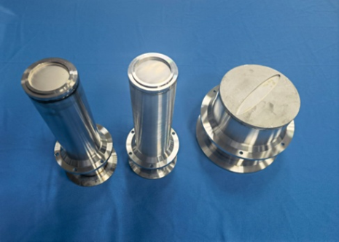
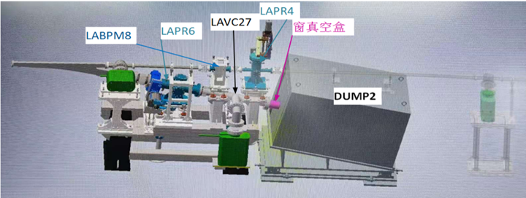
Dump chambers and membrane windows for Linac
The elliptical Ti thin membrane window of 170×10 mm with a thickness of 0.1 mm was welded on the s. s. plate with a diameter of 183 mm and a thickness of 5mm.
membrane windows
Membrane windows
The thickness of Ti window is 0.1mm
Deformation test under vacuum: elliptical window is 0.4mm, circle window is 2.3mm;
ultimate vacuum<5 ×10⁻⁸Pa。
Notes:
材料的选择→加工工艺→样件试制→检漏→变形测量→极限真空测试
对0.1mm厚的钛膜进行电子束焊和钎焊试验；
钛窗真空下变形实验，椭圆窗0.4mm，圆窗2.3mm，打压1MPa未发现有漏；
极限真空小于5 ×10⁻⁸Pa。

Slide 18
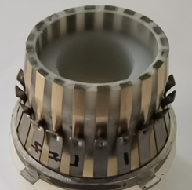
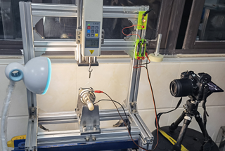
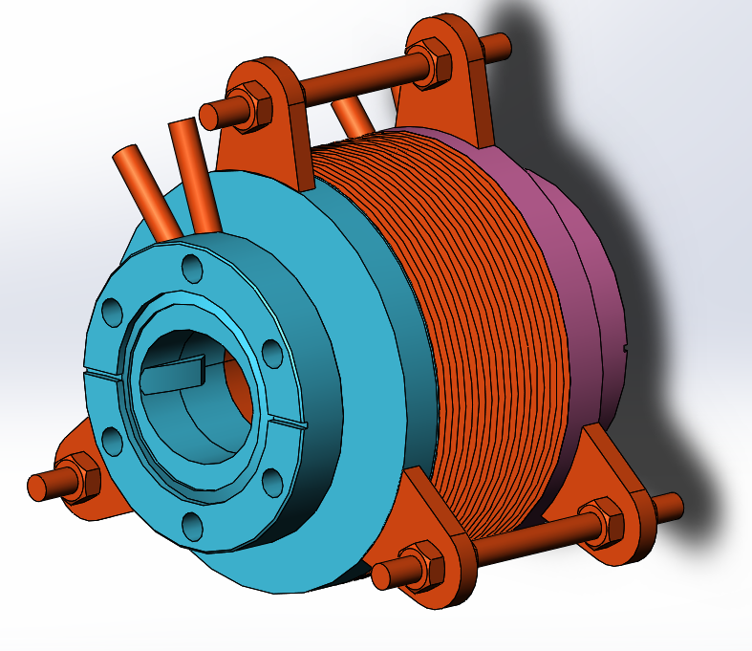
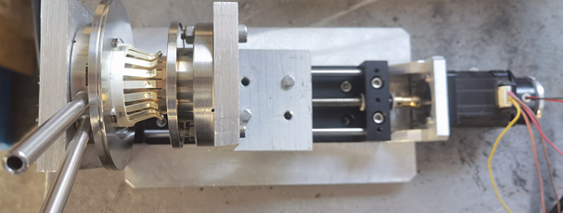
RF shielding bellows of damping ring
Total length | Expansion | Contraction | Ellipse cross section | Contact pressure | Maximum radial offset
70-100mm | 5mm | 10mm | 36mm×30mm | 125±25g | 2mm
Mask is designed on the upstream of RF bellows to absorb the SR
The all RF bellows will be produced by domestic company in China

Slide 19
The main components of vacuum system and its price increase
Device | Specification | Unit | Quantity | Unit price / (CNY 10,000) | Total price / (CNY 10,000) | Note
arc beam pipe——copper | D56/C18150 | one | 188851 | 2.8 | 10 1603 | Collider
Ion pump |  | one | 26790 | 1.5 | 4 2296 | All
RF shielded bellows | DN63 | one | 21350 | 1.5 | 3 2026 | All
Arc beam pipe | Al6060 | m | 80000 | 0.4 | 3 2000 | All
NEG coating | Ti-Zr-V | m | 200000 | 0.15 | 3 0000 | Booster
Gate valve | CF63 |  | 1665 | 15 | 2 2148 | All
Vacuum heating | 220v | m | 200000 | 0.1 | 2 0000 | collider
Straight section beam pipe &Vacuum connectors |  |  | 61622 | 0.2 | 1 2691 | Collider &Booster
Residual gas analyzer |  |  | 798 | 10 | 7980 | All
Roughing valve |  |  | 5135 | 1 | 5038 | All
Bellows | 304L | one | 15328 | 0.3 | 4598 | All
Helium leak detector |  |  | 105 | 30 | 3150 | All
Molecular pump | 200L/s | one | 300 | 10 | 3000 | All
Total price of vacuum system is 3 368 Million CNY |  |  |  |  | 316530

Slide 20
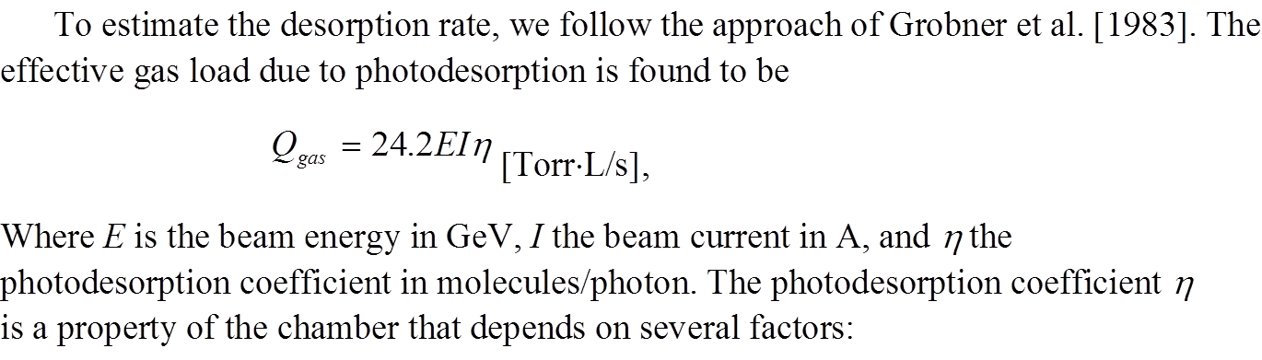
SR power and gas load of damping ring
 | E | I | ρ | Psr | PL | PSD | q _{th} | Q _{gas} | Q _{LSR}
 | Gev | A | m | MW | W/m | molecules/photon | Torr·L/s·cm² | Torr·L/s | Torr·L/s·m
damping ring | 1.1 | 0.024 | 2.87 | 0.00 | 60.12 | 2.00E-06 | 1.28E-06 | 7.09E-08 | 1.1
50MW 下最差真空度--公式计算 2E-6 热放气率按1E-11
 |  | 离子泵间距 | 热放气率 | 每米热气载 | 总长度 | 单位长度 | 总放气量 | 有效抽速 | Pave--总压 | Pmax--总压
 | D/cm | L/cm | TorrL/scm² | TorrL/sm | 流导 L/s |  | TorrL/scm² | S L/s | Torr | Torr
damping | 3 | 200 | 1E-11 | 9.42E-09 | 1.6335 | 3.267 | 8.53E-11 | 15 | 1.9E-08 | 2.3E-08

