Slide 1
CEPC instrumentation and beam diagnostics
2023.08.16

Slide 2
Requirement List of the Collider Beam Instrumentation
Item |  | Method | Parameter | Amounts
Beam position monitor | Closed orbit | Button electrode BPM | Measurement area (x × y)：±20mm×±10mm Resolution：<1um Measurement time of COD：< 4 s | 4252
 | Bunch by bunch | Button electrode BPM | Measurement area (x × y)：±40mm×±20mm Resolution：0.1mm
Bunch current |  | BCM | Measurement range：10mA / per bunch Relatively precision：1/4095 | 2
Average current |  | DCCT | Dynamic measurement range：0.0~1A Linearity：0.1 % Zero drift: <0.05mA | 2
Beam size |  | Double slit interferometer x ray pin hole | Resolution:0.2 µm | 4
Bunch length |  | Streak camera Two photon intensity interferometer | Resolution:1ps@10ps | 2
Tune measurement |  | Frequency sweeping method | Resolution:0.001 | 2
 |  | DDD | Resolution:0.001
Beam loss monitor |  | PIN-diode | Dynamic range:120 dB Maximum counting rates≥10 MHz | 5800
Feedback system |  | TFB | Damping time<=1ms | 4
 |  | LFB | Damping time<=12ms | 4

Slide 3
Requirement List of the Booster Beam Instrumentation
Item | Method | Parameter | Amounts
Beam position monitor | Button electrode BPM | Measurement area (x × y)：±20mm×±10mm Resolution：<20um(turn by turn) | 2408
Bunch current | BCM | Measurement range：10mA / per bunch Relatively precision：1/4095 | 2
Average current | DCCT | Dynamic measurement range：0.0~1A Resolution:50uA@0.6-8mA Linearity：0.1 % Zero drift: <0.05mA | 2
Beam size | Double slit interferometer x ray pin hole | Resolution:0.2 µm | 2
Bunch length | Streak camera Two photon intensity interferometer | Resolution:1 ps | 2
Tune measurement | Frequency sweeping method | Resolution:0.001 | 2
 | DDD | Resolution:0.001
Beam loss monitor | Optical fiber | Space resolution:0.6m | 670
Feedback system | TFB | Damping time<=3ms | 2
Feedback system | LFB | Damping time<=35ms（50ms） | 4

Slide 4
Requirement List of the Linac & damping ring Beam Instrumentation
 | Item | Method | Parameter | Amounts
Linac | Beam position | Stripline BPM | Resolution ：30um | 150
 | Beam current | ICT | 2.5%@1nC-10nC | 63
 | Beam profile | YAG/OTR | Resolution: 30um | 30
 | Beam emittance | Q+PR | 10% | 3
 | Beam energy & spread | AM+PR | 0.1% | 3
Damping ring | Average current | DCCT | Resolution :50uA@0.1mA-30mA | 1
 | Beam position | Button BPM | Resolution : 20um @ 5mA TBT | 40
 | Tune measurement | Frequency sweeping | Resolution:0.001 | 1

Slide 5
Beam instrumentation related R&D
The R&D activities based on lepton accelerator beam measurement mainly include the following three aspects.
  The design and fabrication of HEPS beam instrumentation
  The maintenance and upgrade of BEPCII beam instrumentation
  The R&D of CEPC beam instrumentation

Slide 6
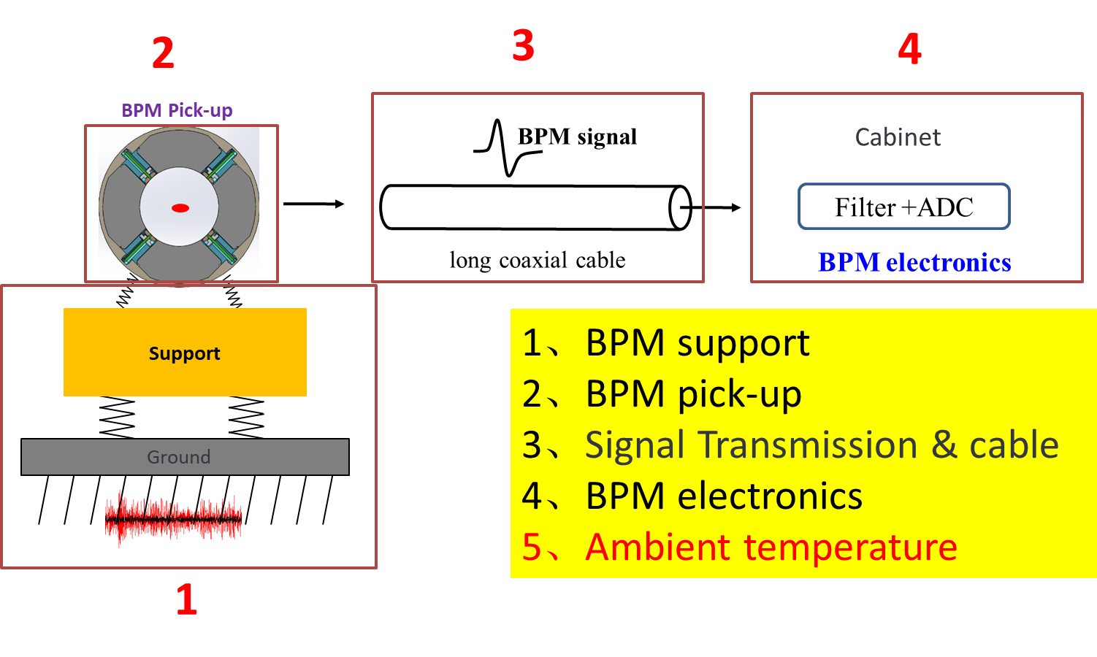
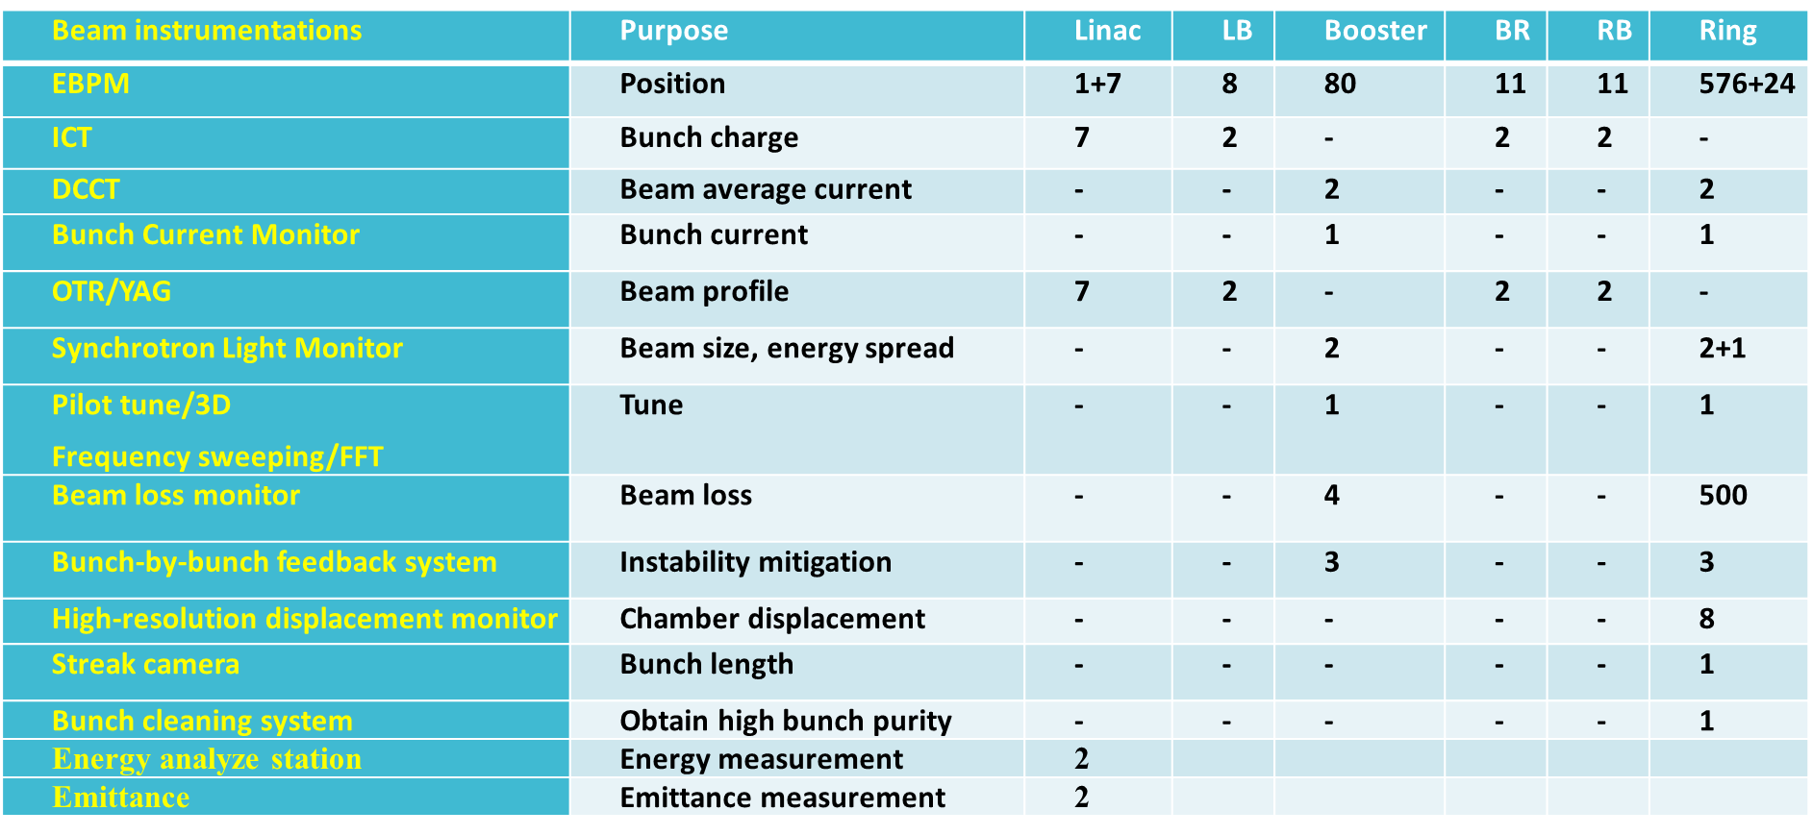
Beam instrumentation related R&D
We designed, manufactured, and calibrated the whole beam diagnostics system for HEPS, including the linac, booster, and storage ring.
In particular, we performed a detailed analysis of factors affecting the resolution of beam position monitor, and through various measures, we achieved the design goals for HEPS BPM, which are higher than those for CEPC.

Slide 7
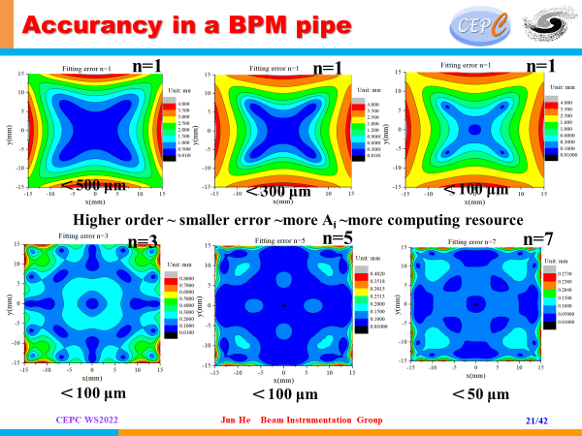
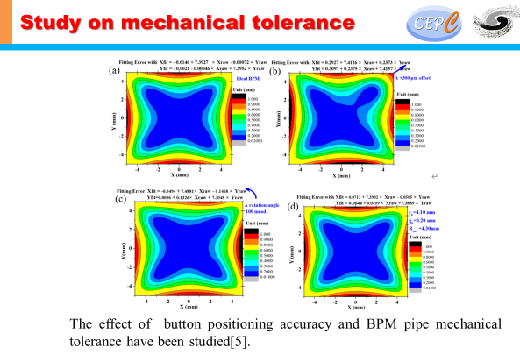
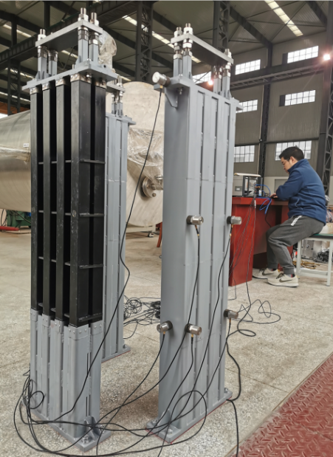
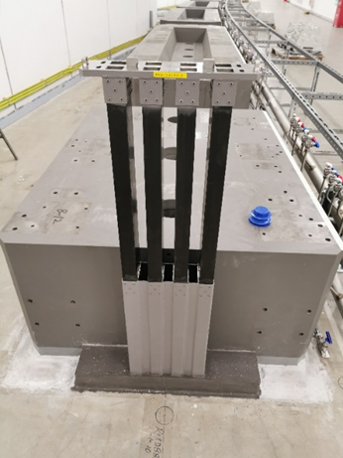
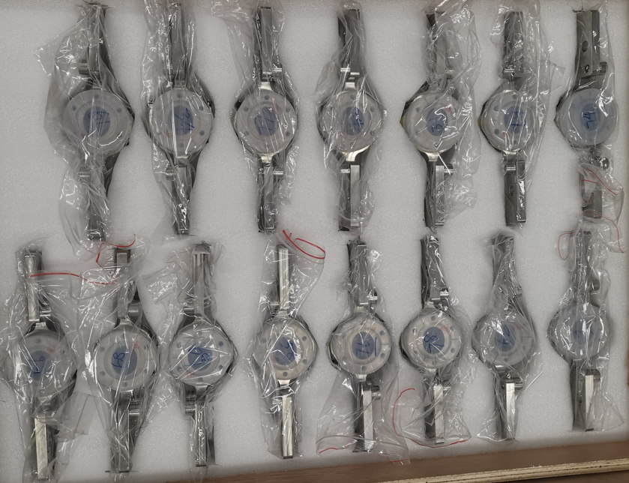
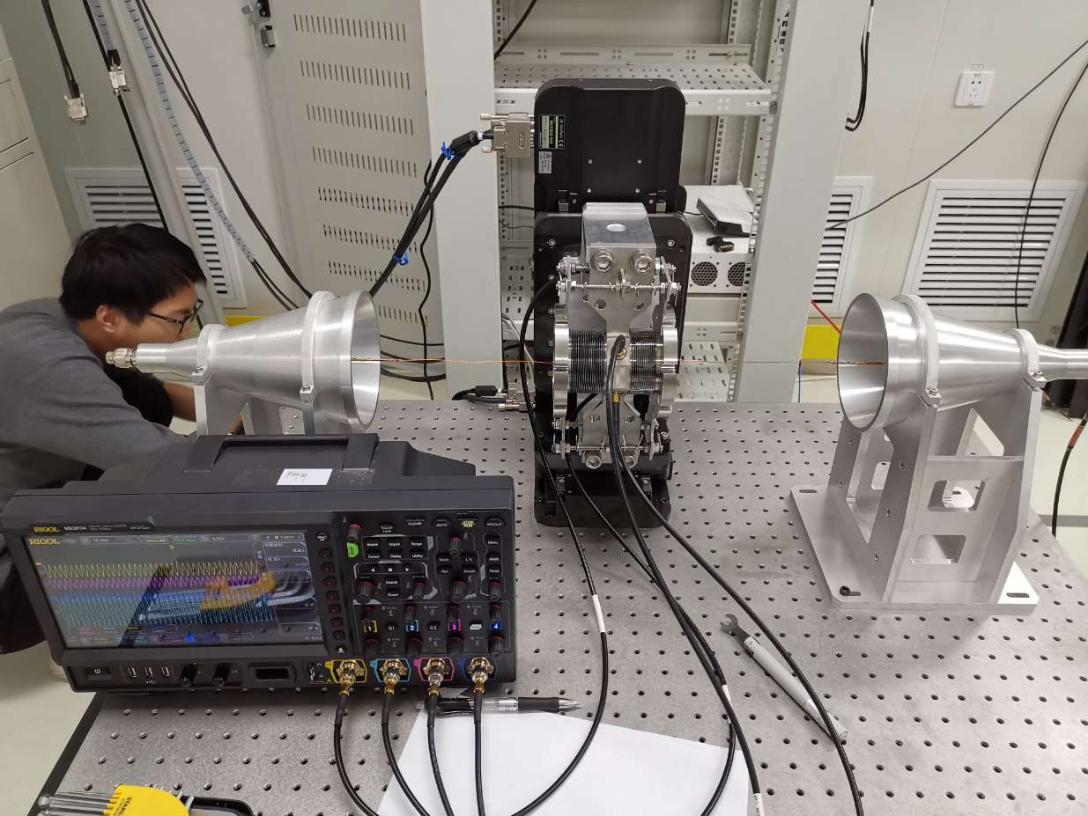
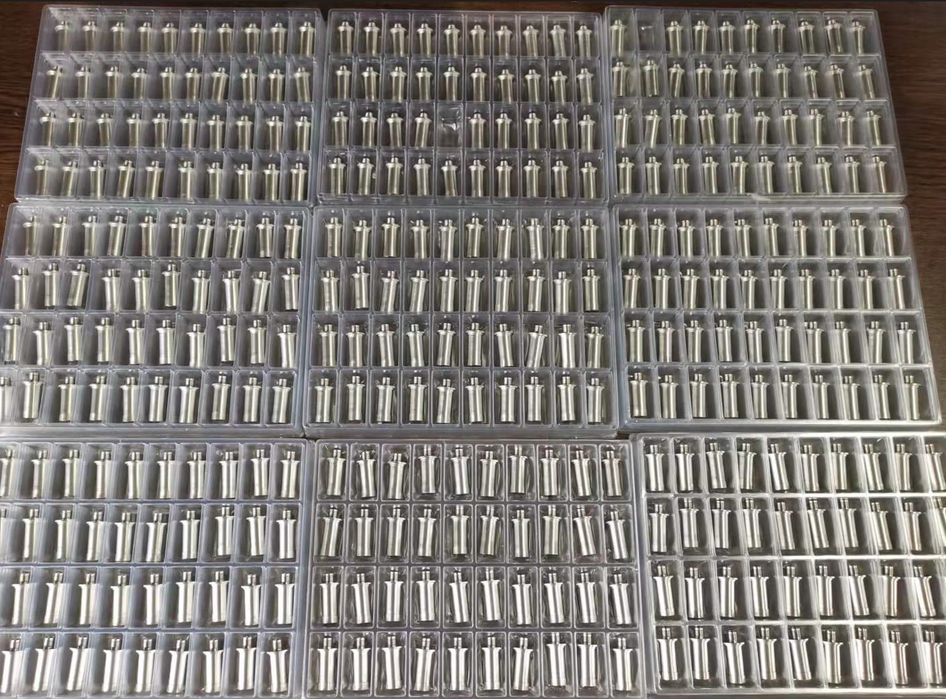
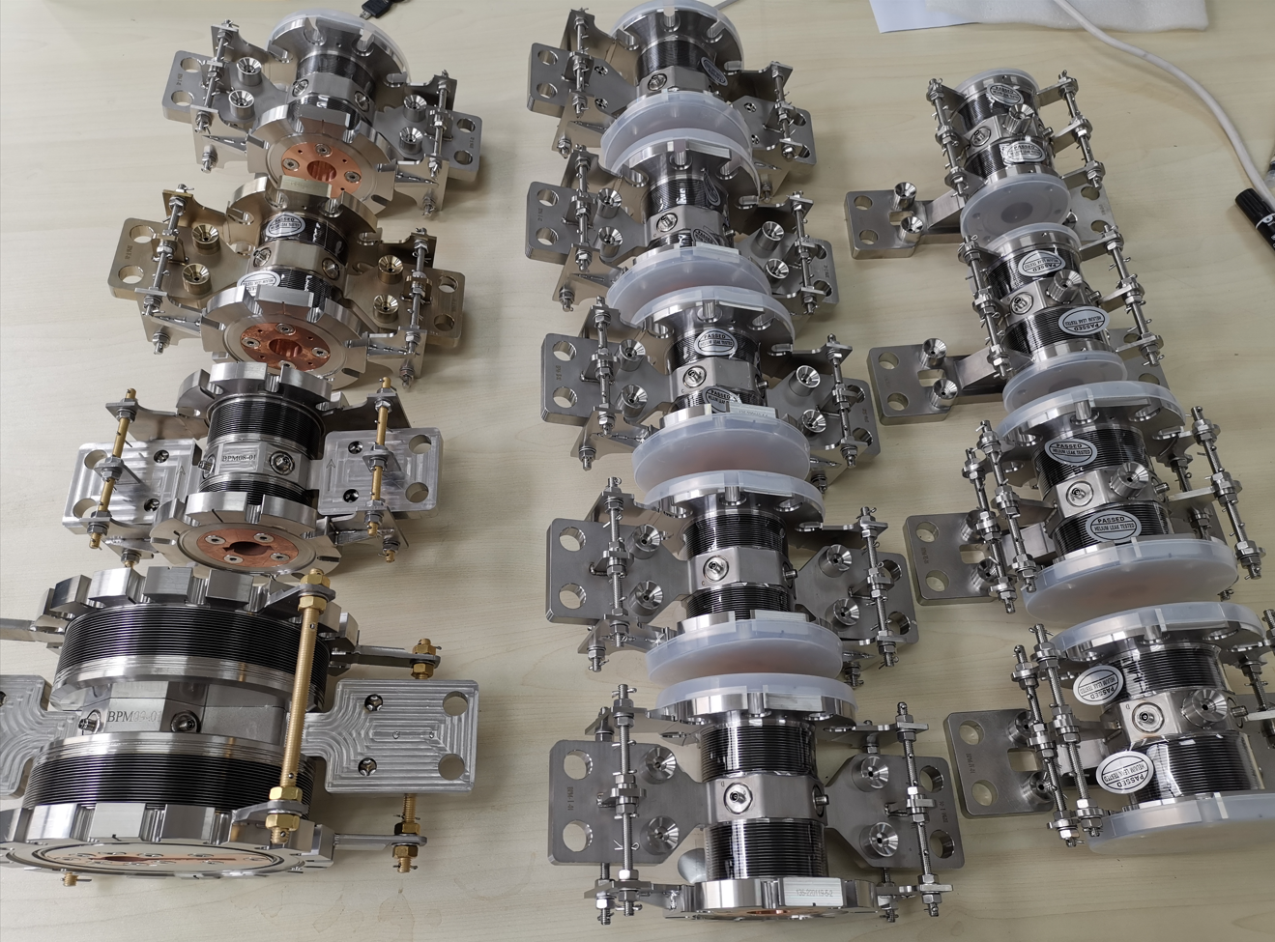
Beam instrumentation related R&D
We have developed button pick-ups BPM for HEPS.
Goubau line based wire calibration system were set to check BPM PU

Slide 8
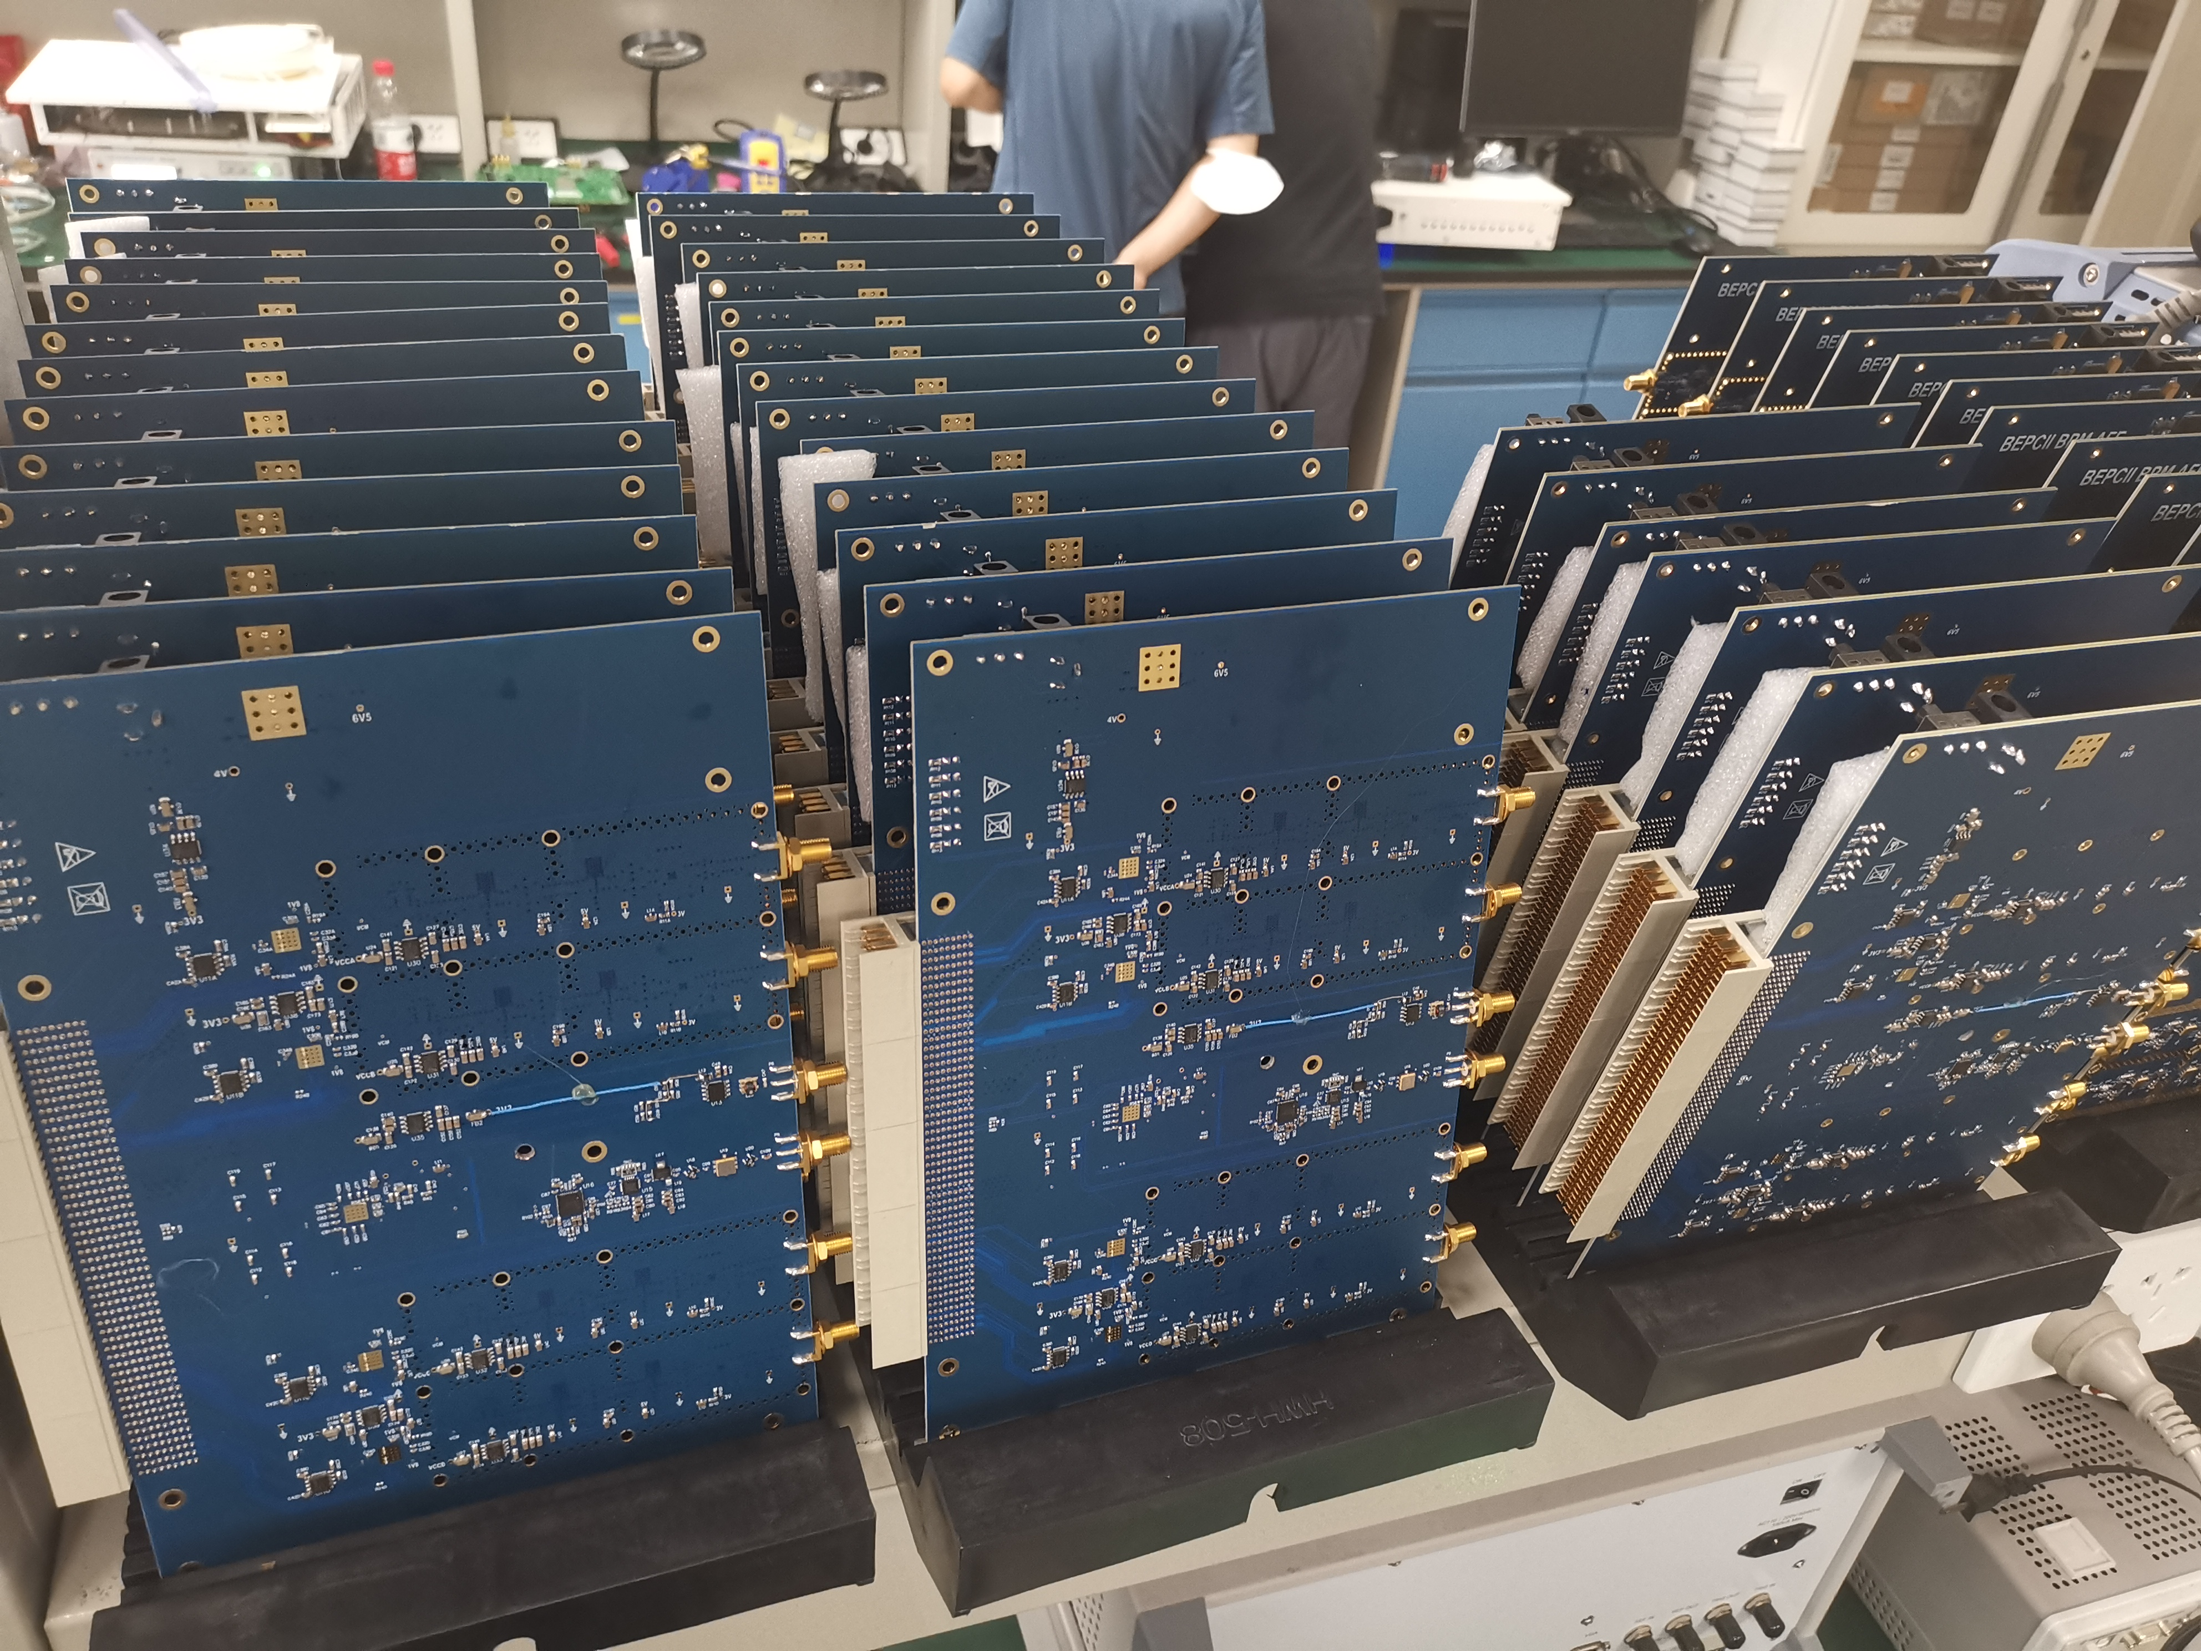
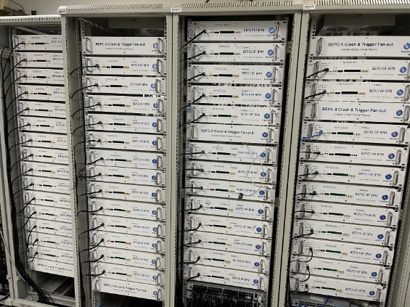
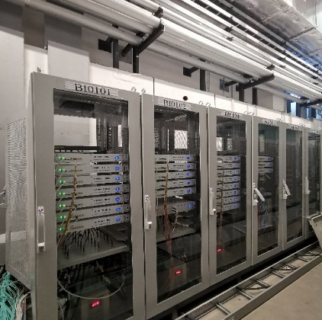
BPM electronics application
We successfully solved the issue of mass production of BPM electronics and the home-made BPM electronics were used in BEPCII collider ring operation and HEPS linac commissioning
There will be ~600 sets self-developed BPM electronics in HEPS storage ring.

Slide 9
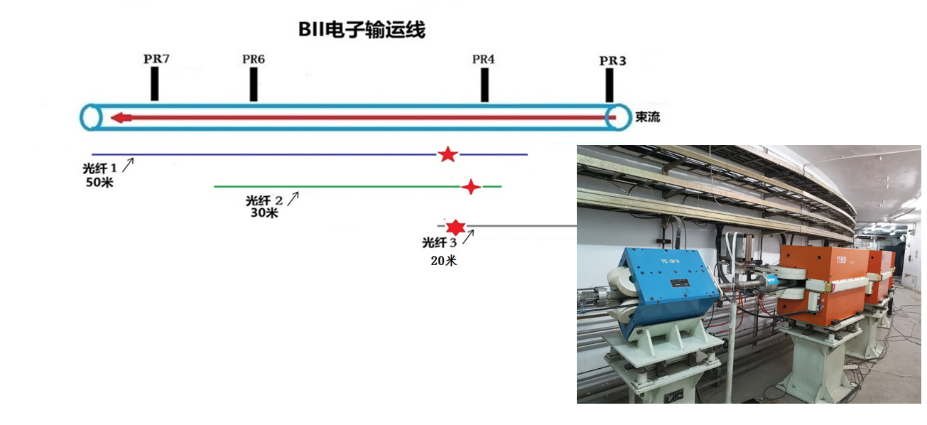
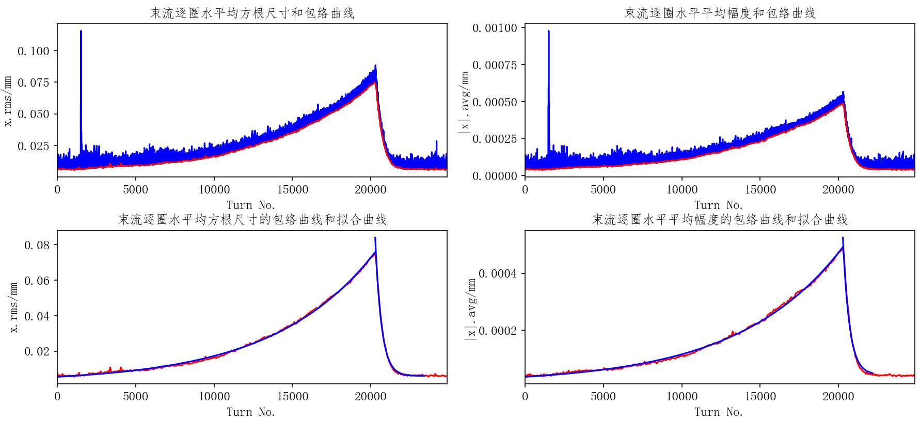
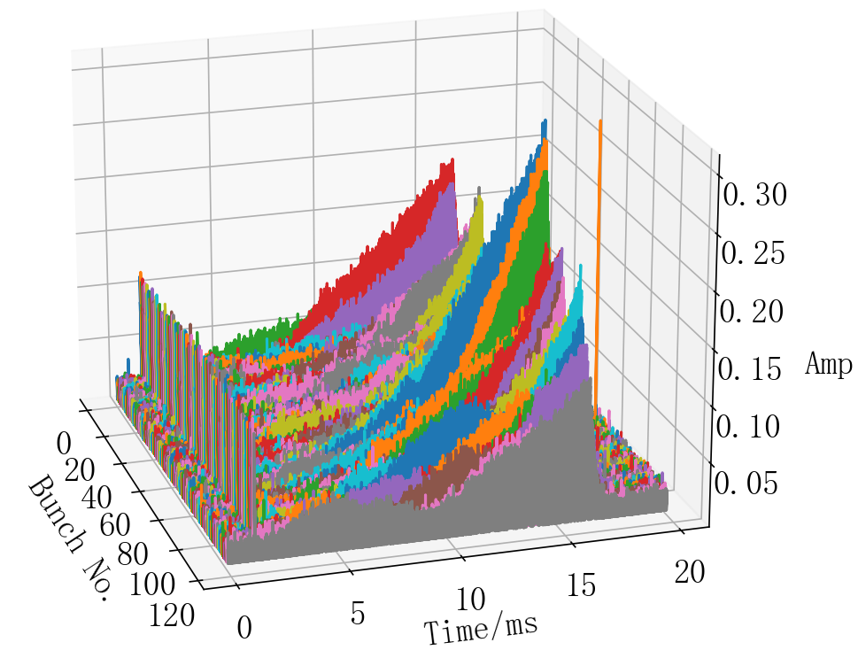
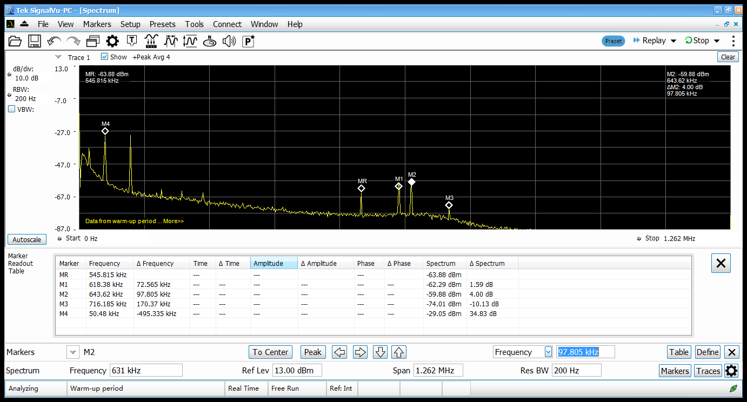
Beam instrumentation related R&D
Optical fiber based BLM test in BEPCII
Bunch by bunch electronics are used to measure beam oscillation
The 3D tune measurement system beam test in BEPCII

Slide 10
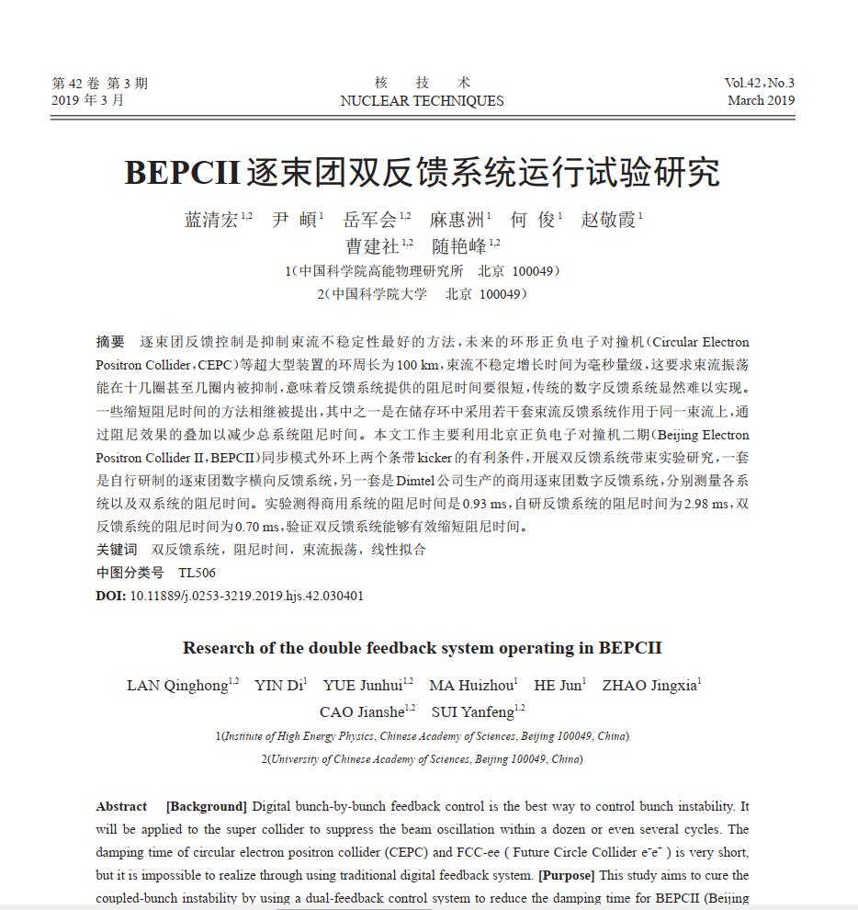
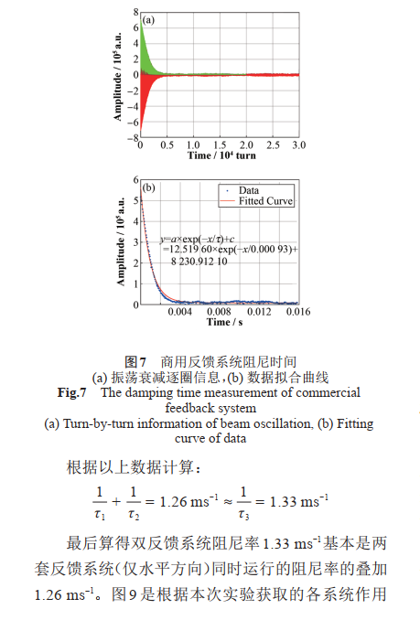
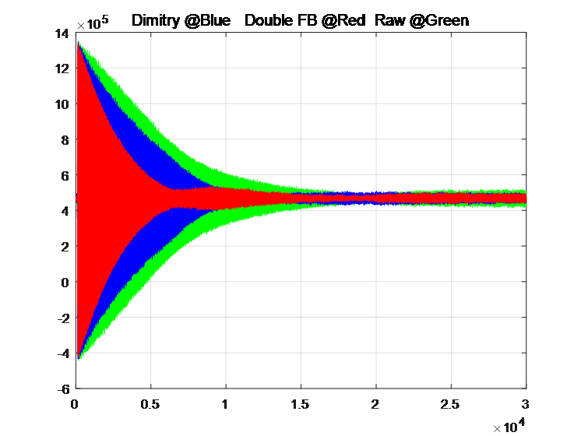
Beam instrumentation related R&D
Multi-feedback systems can be used to improve the performance of particle accelerators. At BEPCII, the double feedback technique was successfully implemented, and the results showed that the damping times are almost equal to the sum of the two feedback systems. This demonstrates the effectiveness of multi-feedback systems in improving the stability and performance of particle accelerators in one direction.
The damping time of two TFBs

Slide 11
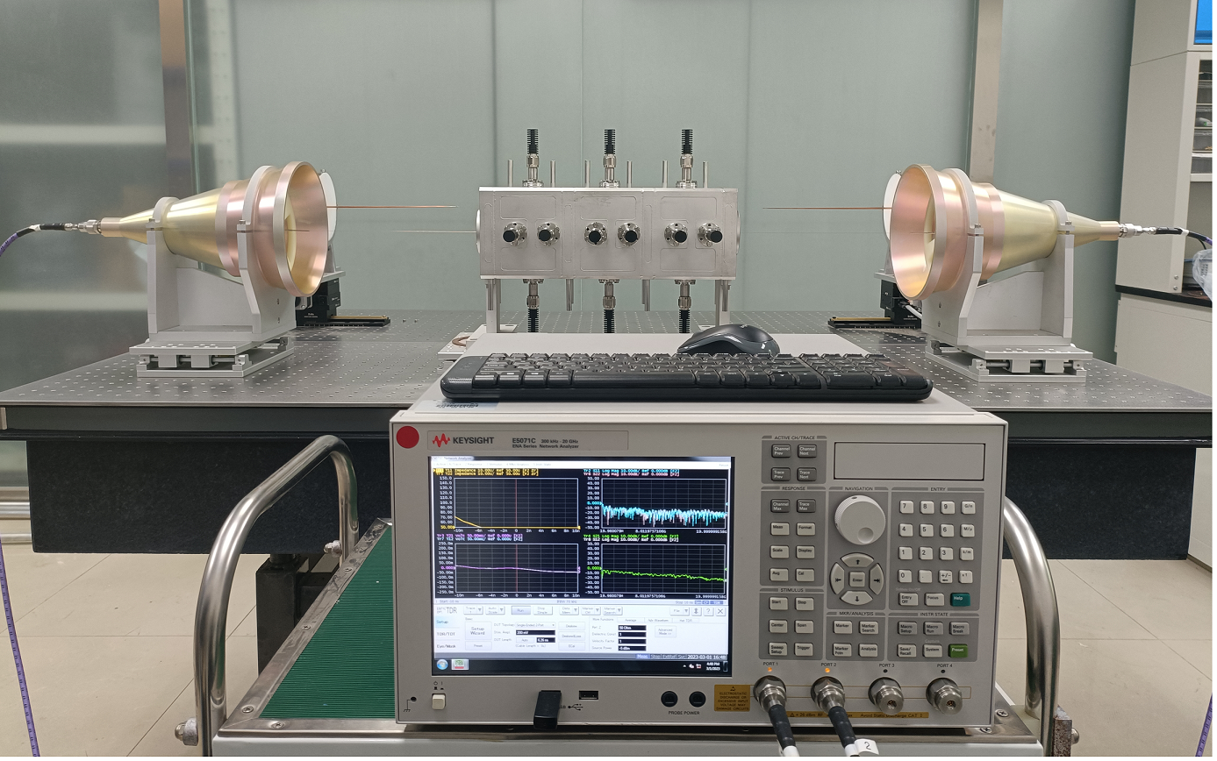
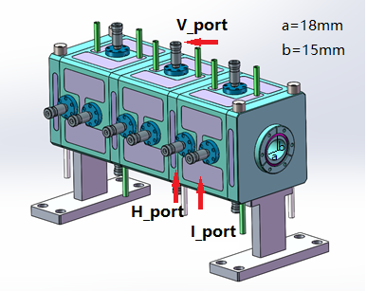
Beam instrumentation related R&D
Study of feedback system kicker
Resonant strip-line type longitudinal kicker

Slide 12
The price of beam position monitor
Pick-ups（ Stainless steel block+4 feedthroughs）
  Open tender procurement for BPM (without feedthroughs) pick-ups of HEPS. (2 types totally 700 sets with 2 RF shielding belows, ¥ 28000/set and ¥19000/set)
  Open tender procurement for BPM feedthroughs of HEPS. (3000 sets in total, ~3100/set)
  For CEPC BPM pick-ups without RF shielding below, the price ¥ 3100*4+7600=20000
Cable
  There are 100 auxiliary tunnels for 100 km ring, so the average length of cable ~250-270m。For the LMR 400 cable price is 38-40/m, the cable is about ¥ 10000/set
Electronics
  We have finished the BPM electronics prototype
  ~200 sets of BPM electronics have been used in BEPCII and HEPS.

Slide 13
Cost of beam instrumentation in the collider ring
Element | Type | Unit | Number | Unit price (10,000 Yuan) | Total Price (10,000 Yuan)
Instrumentation Total Cost |  |  |  |  | 65691
Beam position monitor | 4-button
Pick-ups | Button type | one | 4252 | 2 | 8504
Cable | LMR-400 | one | 21260 | 1 | 21260
Electronics |  | one | 4252 | 6 | 25512
Beam current monitor (AC)
Pick-ups and front end electronics | Button type pick-up | one | 2 | 10 | 20
Read out electonics | Bunch by bunch electronics | one | 2 | 60 | 120
Beam current monitor (DC)
Detector | Bergoz-Dcct | one | 4 | 30 | 120
Read out electonics | Bergoz | one | 4 | 30 | 120
Cable | Bergoz | one | 4 | 10 | 40
Bunch length monitor
Streak camera | Hamamatsu | one | 2 | 300 | 600
Optical platform |  | one | 4 | 80 | 320
Beam profile monitor
X ray camera |  | one | 2 | 50 | 100
Optical path and components |  | one | 2 | 100 | 200
Beam loss monitor
Pin diodes | Bergoz | one | 5800 | 0.5 | 2900
Read out electonics | Bergoz | one | 1450 | 1.5 | 2175
Tune monitor |  |  |  |  | 0
Electronics |  | one | 2 | 40 | 80
Power amplifier | Bonn BSA | one | 8 | 15 | 120
Kicker | Stripline | one | 2 | 30 | 60
Transverse feedback
Electronics & Kicker | Dimtel IGP & Stripline | one | 4 | 80 | 320
Amplifier | Bonn BSA | one | 16 | 15 | 240
Longitudinal feedback
Electronics & Kicker | Dimtel IGP & Pillbox cavity | one | 4 | 80 | 320
Amplifier | Milmega | one | 16 | 35 | 560
Synchronous light extraction area |  | one | 4 | 500 | 2000

Slide 14
Cost of beam instrumentation in the booster
Element | Type | Unit | Number | Unit price (10,000 Yuan) | Total Price (10,000 Yuan)
Total cost |  |  |  |  | 37113
Beam position monitor | 4-button
Pick-ups | button | one | 2408 | 2 | 4816
Cable | LMR-400 | one | 12040 | 1 | 12040
Electronics |  | one | 2408 | 6 | 14448
Beam current monitor (AC)
Pick-ups and front end electronics |  | one | 2 | 10 | 20
Read out electonics |  | one | 2 | 60 | 120
Beam current monitor (DC)
Detector | Bergoz-Dcct | one | 2 | 30 | 60
Read out electonics | Bergoz | one | 2 | 30 | 60
Cable | Bergoz | one | 2 | 10 | 20
Bunch length monitor
Streak camera | Hamamatsu | one | - | -
Optical platform | Daheng | one | 2 | 80 | 160
Beam profile monitor
X ray camera |  | one | 2 | 50 | 100
Optical path and components | Daheng | one | 2 | 100 | 200
Beam loss monitor
Optical fiber |  | one | 670 | 2.7 | 1809
Read out electonics | Self developed | one | 1340 | 1 | 1340
Tune monitor
Electronics |  | one | 2 | 40 | 80
Power amplifier | Bonn BSA | one | 8 | 15 | 120
Kicker | Stripline | one | 2 | 30 | 60
Transverse feedback
Electronics | Dimtel IGP & Stripline | one | 4 | 40 | 160
Kicker | Bonn BSA | one | 2 | 30 | 60
Longitudinal feedback
Electronics | Dimtel IGP & Pillbox cavity | one | 4 | 60 | 240
Kicker | Milmega | one | 2 | 100 | 200
Synchronous light extraction area |  | one | 2 | 500 | 1000

Slide 15
Cost of beam instrumentation in linac
Element | Type | Unit | Number | Unit price (10,000 Yuan) | Total Price (10,000 Yuan)
Total cost |  |  |  |  | 5010
Beam position monitor
Pick-ups | Striple line | one | 150 | 2 | 300
Cable | LMR-400 | one | 750 | 1 | 750
Electronics |  | one | 150 | 6 | 900
Bunch charge monitor
ICT | Bergoz | one | 63 | 30 | 1890
Electronics | Bergoz | one | 63 | 10 | 630
Beam profile monitor
Mechanical part |  | one | 30 | 10 | 300
Control unit and read out electronics |  | one | 30 | 8 | 240

Slide 16
Cost of beam instrumentation in damping ring
WBS Element Title | Type | Unit | Number | Unit price (10,000 Yuan) | Total Price (10,000 Yuan)
Total cost |  |  |  |  | 760
Beam position monitor
Pick-ups | Button | one | 40 | 2 | 80
Cable | LMR-400 | one | 200 | 1 | 200
Electronics |  | one | 40 | 6 | 240
Average beam current monitor (DCCT)
Detector | Bergoz | one | 1 | 30 | 30
Read-out electronics | Bergoz | one | 1 | 30 | 30
Cable |  | one | 1 | 10 | 10
Tune measurement
Electronics |  | one | 2 | 40 | 80
Amplifier | Bonn BSA | one | 4 | 15 | 60
Kicker |  | one | 1 | 30 | 30

Slide 17
Cost of beam instrumentation in transport lines
WBS Element Title | Type | Unit | Number | Unit price (10,000 Yuan) | Total Price (10,000 Yuan)
Total cost |  |  |  |  | 1960
Booster to Collider e+ Transport Line (Ch 4.2.5, 4.3.8)
Instrumentation
Beam position monitor
Pick-ups | Stripline | one | 16 | 2 | 32
Cable | LMR-400 | one | 80 | 1 | 80
Electronics |  | one | 16 | 6 | 96
Booster to Collider e- Transport Line (Ch 4.2.5, 4.3.8)
Instrumentation |  |  |  |  | 876
Beam position monitor
Pick-ups | Stripline | one | 16 | 2 | 32
Cable | LMR-400 | one | 80 | 1 | 80
Electronics |  | one | 16 | 6 | 96
Collider to Booster e+ Transport Line (Ch 4.2.5, 4.3.8)
Instrumentation
Beam position monitor
Pick-ups | Stripline | one | 8 | 2 | 16
Cable | LMR-400 | one | 40 | 1 | 40
Electronics |  | one | 8 | 6 | 48
Collider to Booster e- Transport Line (Ch 4.2.5, 4.3.8)
Instrumentation
Beam position monitor
Pick-ups | Stripline | one | 8 | 2 | 16
Cable | LMR-400 | one | 40 | 1 | 40
Electronics |  | one | 8 | 6 | 48
Linac to Booster e+ Transport Line (Ch 5.2.3, 5.3.7)
Instrumentation
Beam position monitor
Pick-ups | Stripline | one | 14 | 2 | 28
Cable | LMR-400 | one | 70 | 1 | 70
Electronics |  | one | 14 | 6 | 84
Linac to Booster e- Transport Line (Ch 5.2.3, 5.3.7)
Instrumentation
Beam position monitor
Pick-ups | Stripline | one | 14 | 2 | 28
Cable | LMR-400 | one | 70 | 1 | 70
Electronics |  | one | 14 | 6 | 84
Linac to Damping Ring e+ Transport Line (Ch 6.2.3, 6.4.7)
Instrumentation
Beam position monitor
Pick-ups | Stripline | one | 3 | 2 | 6
Cable | LMR-400 | one | 15 | 1 | 15
Electronics |  | one | 3 | 6 | 18
Beam profile monitor
Mechanical part |  | one | 1 | 10 | 10
Control unit and read out electronics |  | one | 1 | 8 | 8
Damping Ring to Linac e+ Transport Line (Ch 6.2.3, 6.4.7)
Instrumentation
Beam position monitor
Pick-ups | Stripline | one | 3 | 2 | 6
Cable | LMR-400 | one | 15 | 1 | 15
Electronics |  | one | 3 | 6 | 18

Slide 18
TDR Csot VS. CDR Cost
 | CDR cost | TDR cost | Difference（10000 yuan）
Collider ring | 53915 | 65691 | 11776¹
Booster | 31470 | 37114 | 5644²
Linac, damping ring and transport lines | 6400 | 7730 | 1330³
Total | 91785 | 110535 | 18750
1, The number of BPMs in the collider ring has increased by 1352 units.
2, The number of BPMs in the collider ring has increased by 600 units.
3, The energy of the linear accelerator increases from 10 GeV to 30 GeV ; Changes in beam diagnostics equipment caused by changes in injection methods.

Slide 19
The factors will influence the cost in the future
Technological advancements
Raw material costs
Thank you for attention！

