Slide 1
Arxiv number: 2009.04697

Slide 2
- Imaginary time method -
the imaginary-time correlation function for a mesonic state
For pions $Γ_{M}$ characterize the mesonic state. In Schoedinger picture, the above correlation function can be rewritten, by setting $τ^{′}=0$ and $E_{vac}=0$, as
The one-meson states $\left|M_{l}\right\rangle$ is the eigenstate of the Hamiltonian, with energy $E_{l}$.

Slide 3
- Imaginary time method -
$τ→+∞$, only the lowest energy state can survive.
By investigate the large $τ$ behavior of correlation function, the ground state energy, which is the static meson mass, can be obtained.
On the other hand, the correlation function can be calculated from the generating functional $W\left[J\right]=\ln{Z\left[J\right]}$
for charged pions;
for neutral pion.

Slide 4
- Imaginary time method -
The Lagrangian of two flavor NJL model
When a uniform magnetic field is introduced, the vector potential is chosen as
The action reads
$ξ$ denotes the gauge selected, e.g.
$ξ=0$, symmetric gauge
$ξ=±1$, Landau gauge
For charged pion, the inverse of quark propagator
and for neutral pion,

Slide 5
- Imaginary time method -
In mean field approximation,
the saddle point value
J-dependent part
Using the derivative expansion

Slide 6
- Neutral pion -
For neutral pion,
and the propagator for quarks
Schwinger phase
Schwinger phase is gauge dependent and breaks the translation invariance, while the remaining part is gauge and translational independent.

Slide 7
- Neutral pion -
For neutral pion,
with the quark bubble
For neutral pion, Schwinger phase cancels, and after the Fourior transformation
with
For comparison, the pole mass obtained from RPA is also shown

Slide 8
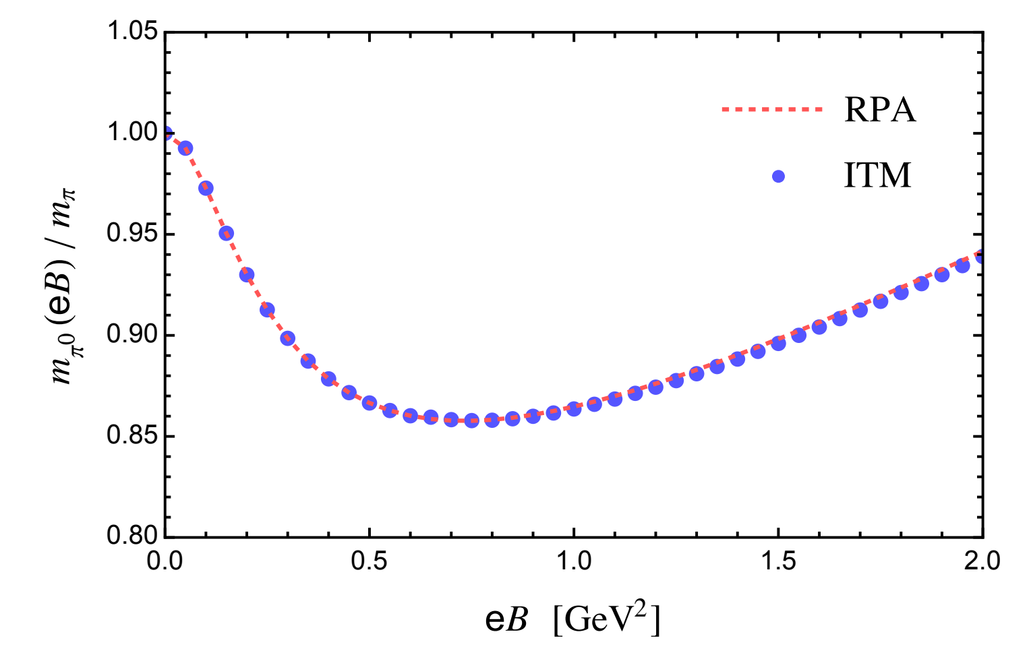
- Neutral pion -

Slide 9
- Charged pions -
For charged pions,
with the quark bubble
The Schwinger phase takes the form
The correlation function is given by

Slide 10
- Charged pions -
To separate the Schwinger phase, we define the following reduced generating functional
with the reduced polarization function
and the reduced sources are given by

Slide 11
- Charged pions -
It can be proven that
The contribution of Schwinger phase has been extracted!
Follow the similar procedure as in neutral pion case:
The full correlation function of charged pions reads
Integrating the correlation function out in the coordinate space

Slide 12
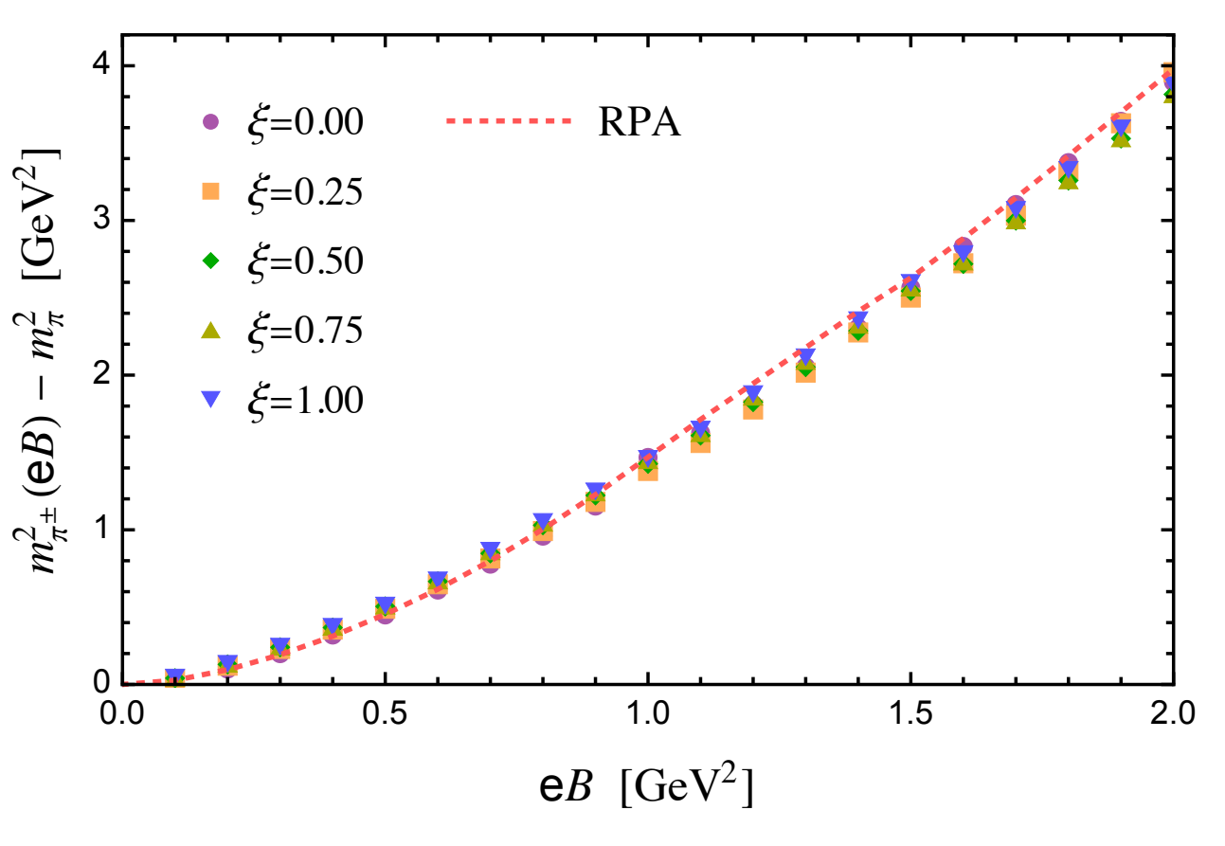
- Charged pions -
Charged pion mass does not change with different gauge parameter $ξ$, and the results match perfectly with the RPA results (which discards the Schwinger phase)

