Slide 1

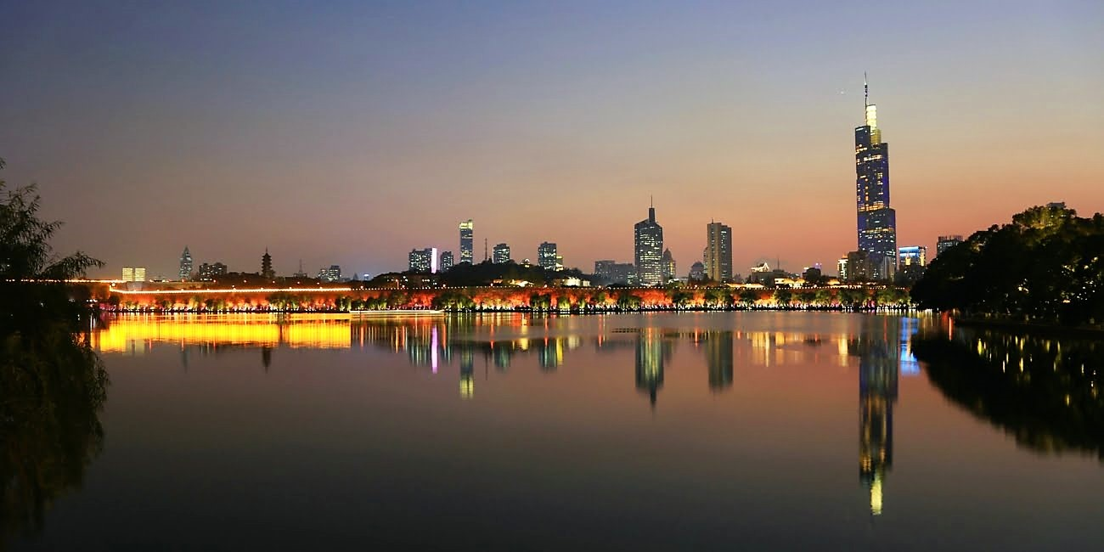
Craig Roberts … http://inp.nju.edu.cn/
Grant no. 12135007
Welcome to Nanjing
欢迎来到南京
Strong QCD from Hadron Structure Experiments - VI

Slide 2
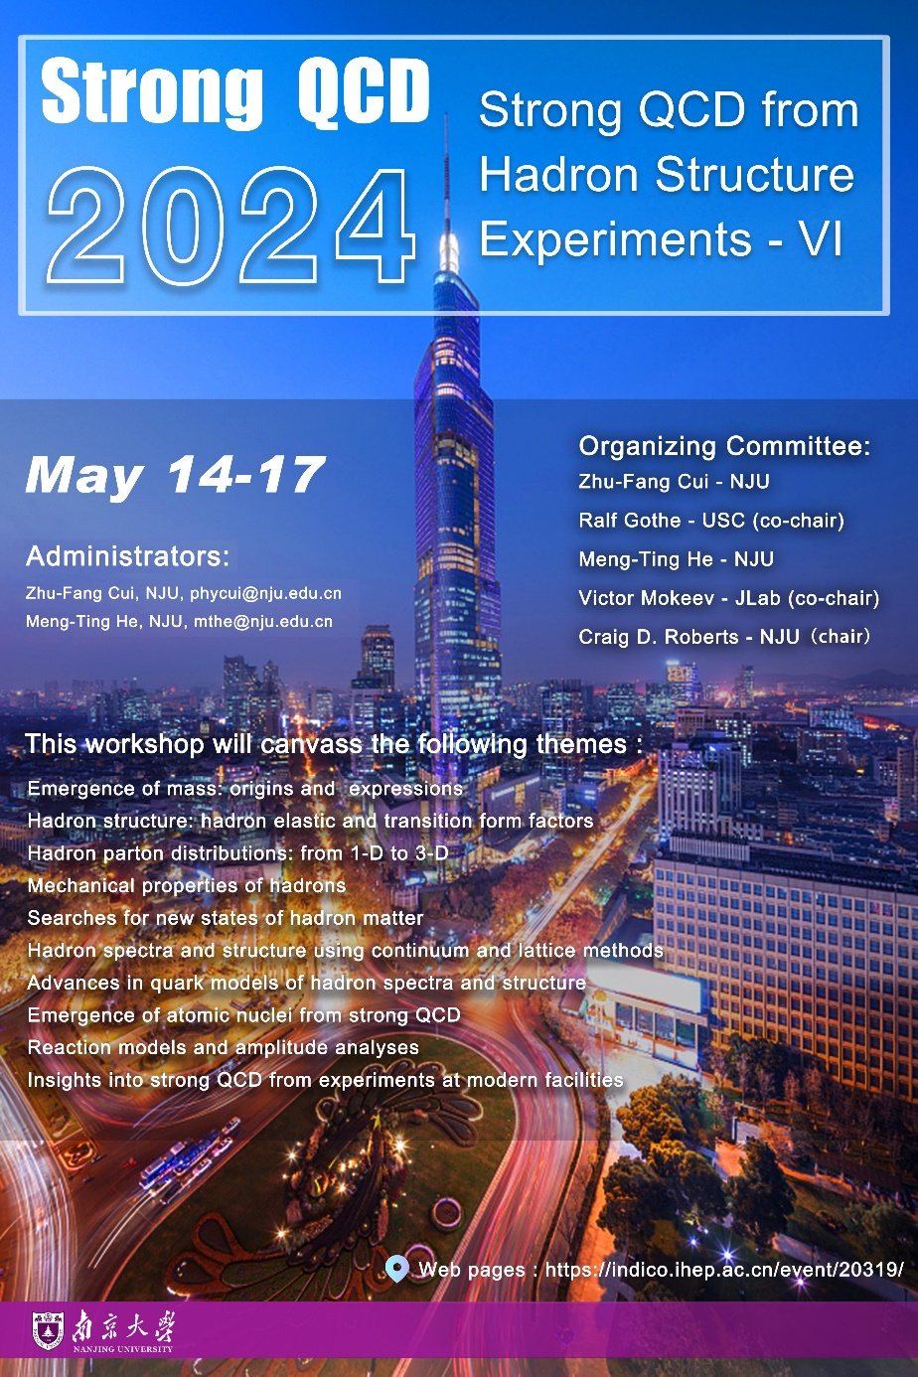
Strong QCD from Hadron Structure Experiments - VI
Internet
  eduroam
  Local:
    NJU-WLAN or NJU_WLAN
      locate http://p2.nju.edu.cn
      user name: SQCD_VI
      password: NICE2024
Group photo at first break – Just outside this building
Workshop badges are sufficient to enter campus during the workshop week.
Lunch and Dinner are provided at on-campus restaurant
  We’ll show you the way

Slide 3
Strong QCD from Hadron Structure Experiments - VI
Any questions, look for someone with a purple badge.
If they can't help, they will find someone who can.
Tonight’s discussion will be held in the Library Lecture Room
  Near to this building (200m)
  Guidance/assistance will be provided
Nanjing is safe. Exploring will be easy & without risk
Example = Nanjing City Wall
  Entrance near Ji Ming Si Temple (good vegetarian food)
  Originally 35.267 kms; 25.09 kms remain today
  Most ancient city wall still standing in the world today

Slide 4

Jiangsu Physical Science Research Center
Jiangsu Province is establishing and funding a basic research centre/fund
All areas of physics will be supported
Managed by Provincial Government and Nanjing Universities, with a central role being played by NJU School of Physics
Expect to issue first call for proposals within 18 months

Slide 5
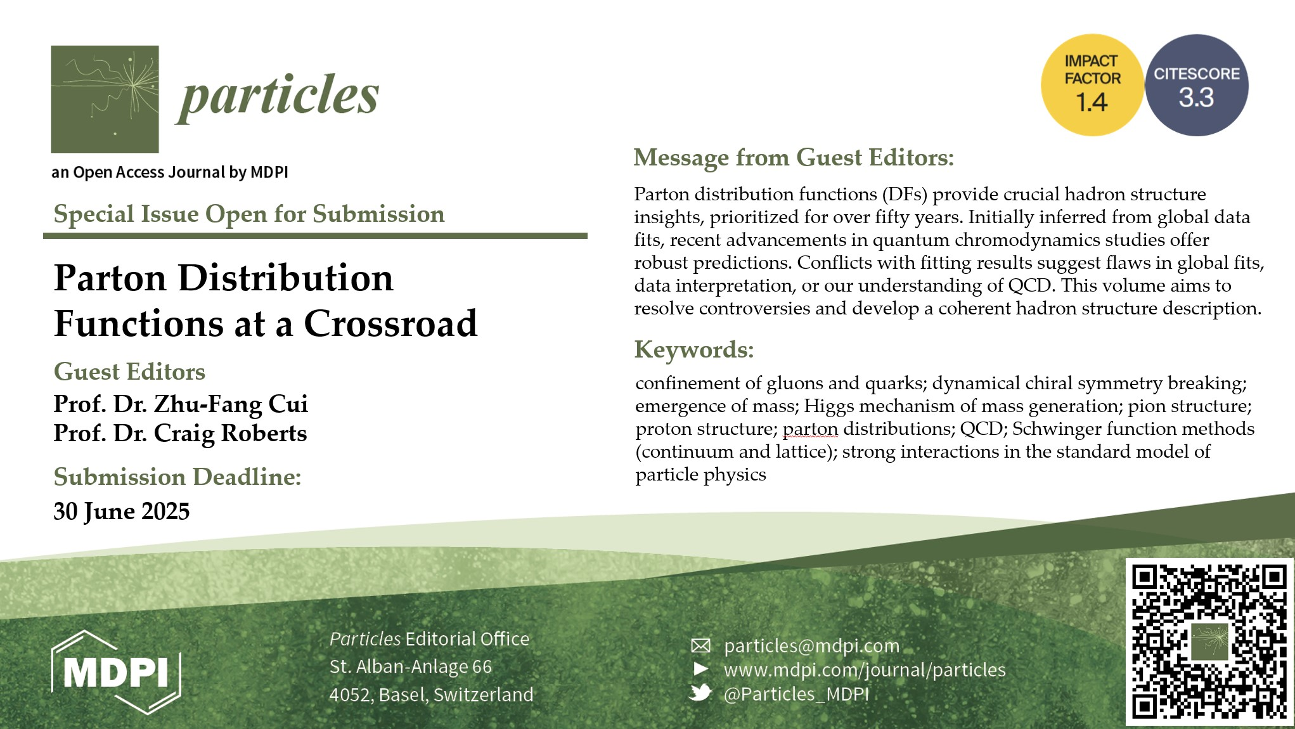
Special Issue of PARTICLES with Selected Contributions from the Workshop
If you’re interested in contributing, please contact Cui or I for more information

Slide 6
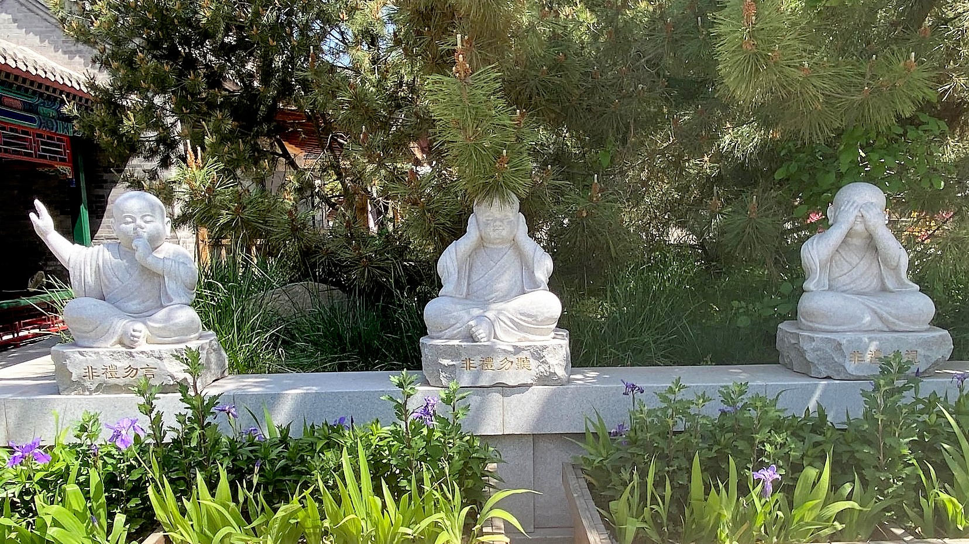
Grant no. 12135007
Let’s Begin

