Slide 1

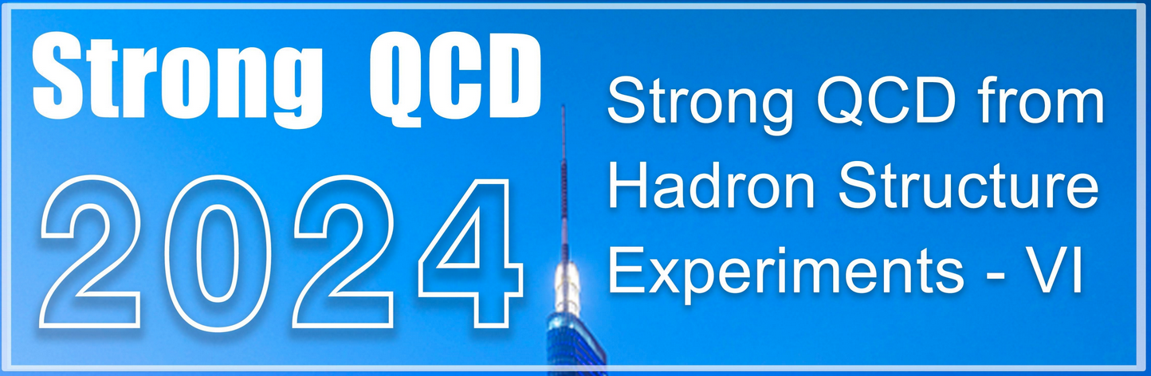




New Tools to Probe the
Structure of Baryon Resonances
E45
PHY-2012826
PHY-2310034
Philip Cole Lamar University
May 15, 2024

Slide 2
Nucleon Resonance Structure
Employing pion and electron beams for insight into the
spectrum/structure of N*s
through their two-pion decays
Electron beams
E45
pion beams
The Emphasis of this Talk is on New Tools using
π^{+/−} & e⁻ Beams and through PWA and Coupled Channels
PHY-2012826
PHY-2310034
Philip Cole Lamar University
May 15, 2024

Slide 3
The meeting will canvass topics that include but are not limited to the following:
  Emergence of mass: origins and expressions
  Hadron structure: ground and excited states of hadrons and transition form factors
  Hadron parton distributions: from 1-D to 3-D
  Mechanical properties of hadrons: insight from experimental data and impact on understanding of strong QCD
  Searches for new states of hadron matter, including systems with heavy quarks
  Hadron spectra and structure using continuum and lattice Schwinger function methods
  Advances in quark models of hadron spectra and structure
  Emergence of atomic nuclei from strong QCD
  Reaction models and amplitude analyses for extraction of QCD-interpretable quantities from experimental data
  Towards understanding of quark hadronization from electroproduction off nuclei experiments
  Insights into strong QCD from experiments at modern facilities, e.g., EIC (USA), EiCC (China) and CEBAF@22 GeV (USA)

Slide 4
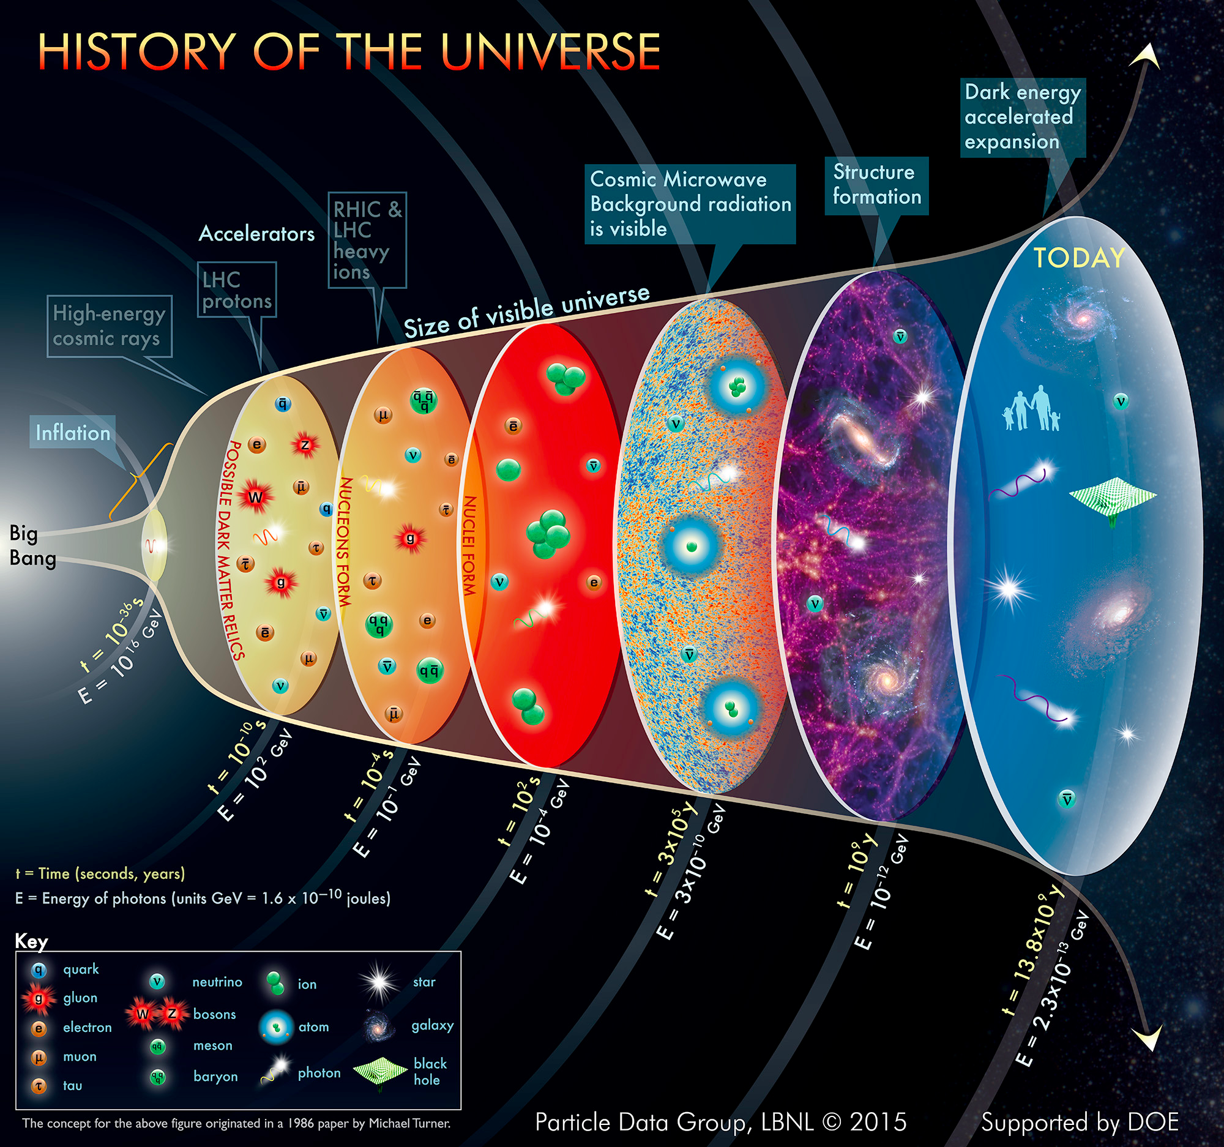
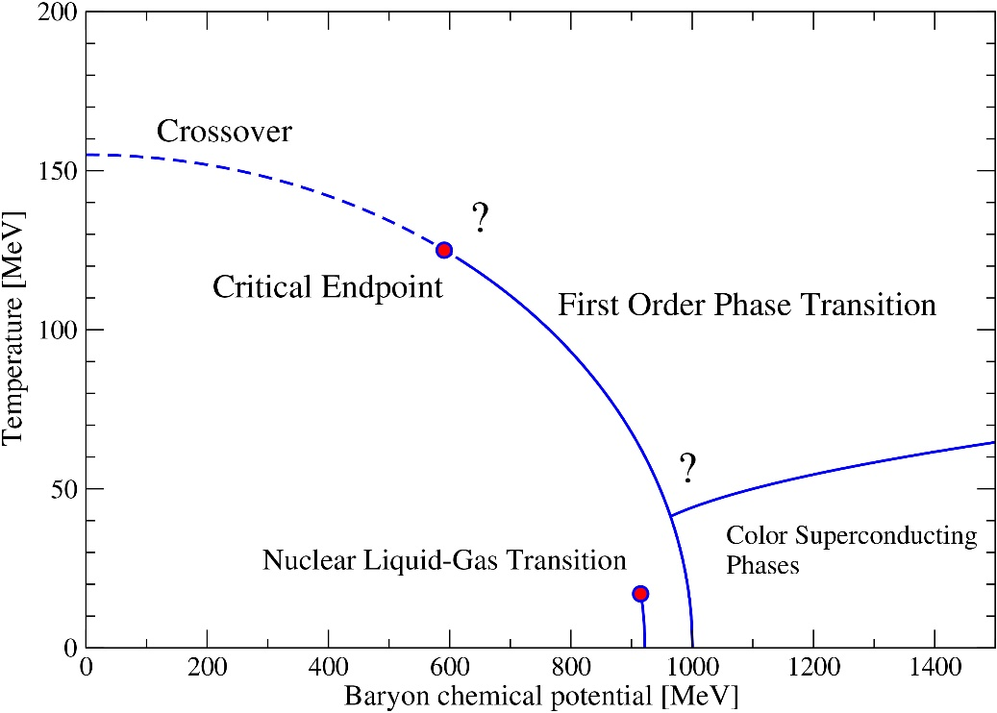
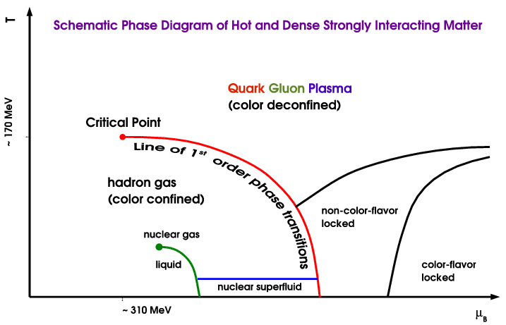
N* in the History of the Universe
QCD Phase Diagram
Quark Gluon Plasma
(color deconfined)
N*
Hadron Gas
(color confined)
N*
Particle Data Group 2014
EPJ A Highlight - Confirming the validity of the Silver-Blaze property for QCD at finite chemical potential
Dramatic events occur in the microsecond old Universe.
The transition from the QGP to the hadronic phase is dominated by excited baryons.
A quantitative comparison between LQCD and Hadron gas model requires more excited states than found to date => missing baryons.
(A. Majumder and B. Muller, PRL 105, 250222 (2010))

Slide 5
Nathan Isgur – 2000 (rephrasing a bit)
Why N*s are important
  The first is that nucleons are the stuff of which our world is made.
  The second reason is that nucleons and N* are are the most fundamental three-body systems in Nature. If we don’t understand how QCD builds each state in the complete spectrum, then our understanding of the strong QCD regime remains incomplete.
  The third reason is that studies of N/N* structure address the challenging open questions in the Standard Model on emergence of hadron mass and the nature of confinement
The Need: Insight into the N* parameters from observables in experiments with both electromagnetic and hadronic probes. The critical piece of the data for the global coupled-channel analyses absolutely requires the Nππ final states.

Slide 6
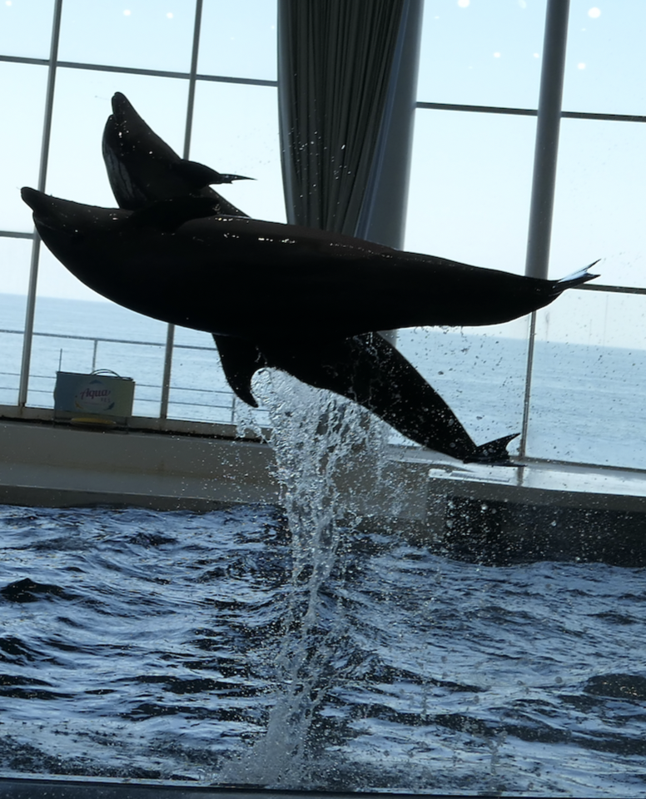
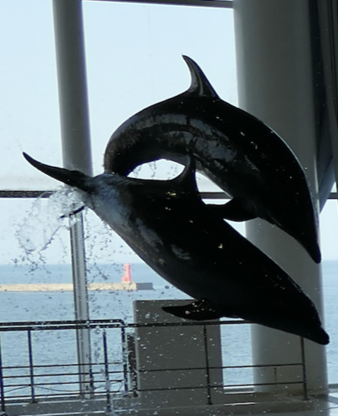
A Coupled-Channels Approach

Slide 7
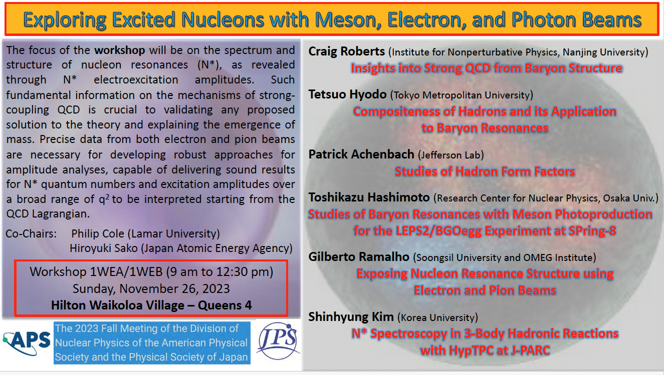
Over 40 people attended on a Sunday morning for our workshop in Hawaii (first day and the sun was shining and the water was nice)

Slide 9
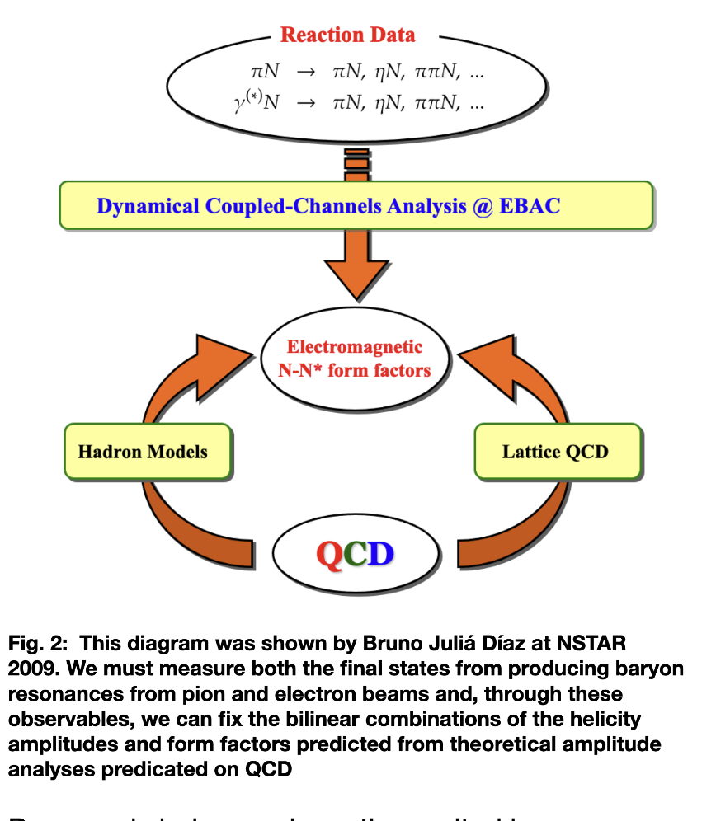
Pion and electron beams are crucial for
Coupled-Channels Analysis
This was presented at
NSTAR-2009
Bruno Julia Diaz
Beijing, PRC

Slide 10
Establishing N* parameters within a global coupled channel analyses of the data of experiments with electromagnetic &hadronic probes
πN
ππN
→ N* → ηN
KΛ KΣ
Accounting for the FSI within coupled channel approaches is vital to gain insight into the N* spectrum/structure in a way consistent with the restrictions imposed by a general unitarity condition.
e⁻N
πN
T
πΝ→πΝ
T
ηΝ→πΝ
T
γΝ→πΝ
T
ρΝ→πΝ
T
σΝ→πΝ
T
ΚΛ→πΝ
T
ΚΣ→πΝ
T
πΝ→ηΝ
T
ηΝ→ηΝ
T
γΝ−>ηΝ
T
ρΝ→ηΝ
T
σΝ→ηΝ
T
ΚΛ→ηΝ
T
ΚΣ→ηΝ
T
πΝ→γΝ
T
ηΝ→γΝ
T
γΝ→γΝ
T
ρΝ→γΝ
T
σΝ→γΝ
T
ΚΛ→γΝ
T
ΚΣ−>γΝ
T=
T
πΝ→ρΝ
T
ηΝ→ρΝ
T
γΝ→ρΝ
T
ρΝ→ρΝ
T
σΝ→ρΝ
T
ΚΛ→ρΝ
T
ΚΣ→ρΝ
T
πΝ→σΝ
T
ηΝ→σΝ
T
γΝ→σΝ
T
ρΝ→σΝ
T
σΝ→σΝ
T
ΚΛ→σΝ
T
ΚΣ→σΝ
T
πΝ→ΚΛ
T
ηΝ→ΚΛ
T
γΝ→ΚΛ
T
ρΝ→ΚΛ
T
σΝ→ΚΛ
T
ΚΛ→ΚΛ
T
ΚΣ→ΚΛ
T
πΝ→ΚΣ
T
ηΝ→ΚΣ
T
γΝ→ΚΣ
T
ρΝ→ΚΣ
T
σΝ→ΚΣ
T
ΚΛ→ΚΣ
T
ΚΣ→ΚΣ

Slide 11
A Campaign – across continents and NP subfields
Meeting Ground between
Theory and Experiment
From our PIRE proposal of 2016 – continuation of the 2009 US/PRC one

Slide 12
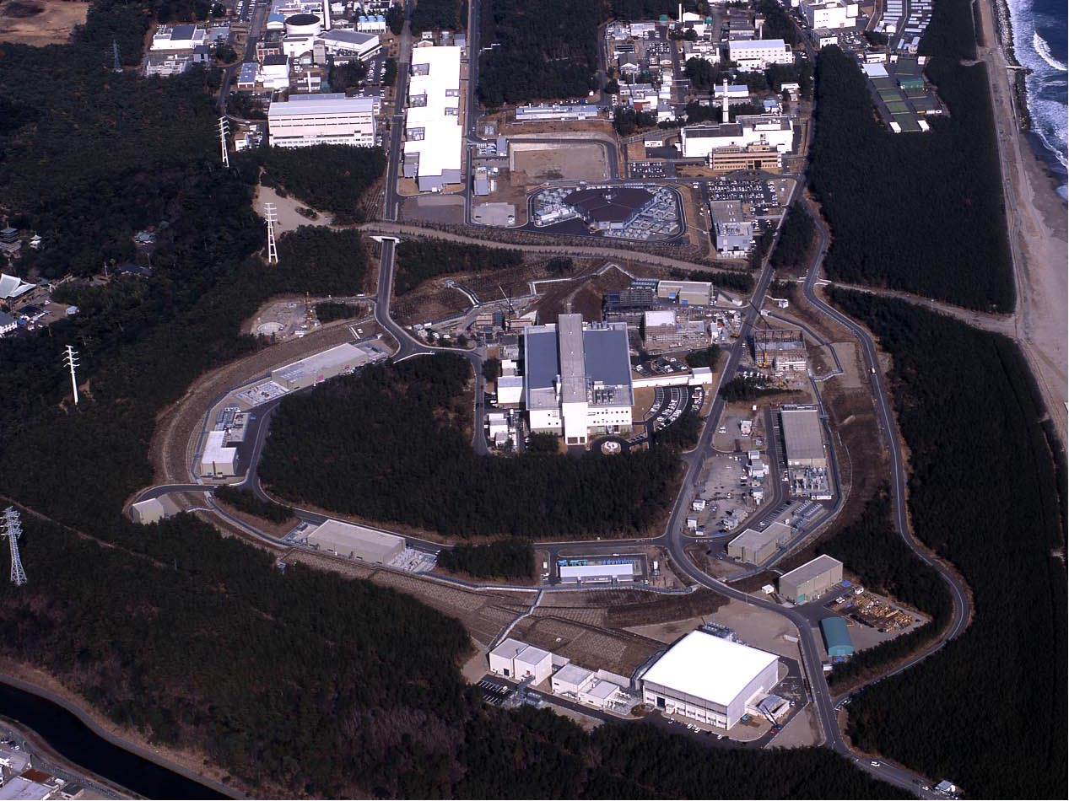
Let’s talk Pion Beams First
J-PARC Accelerator Complex
400 MeV LINAC
3 GeV Synchrotron
Neutrino Beams (T2K experiment)
Materials and Life Experimental Facility
MR Synchrotron (30 GeV)
5
Bird’s eye photo in January of 2008
Hadron Exp. Facility
J-PARC (MW proton synchrotron)
SQCD VI | (Nanjing University) | May 15, 2024 | P.L. Cole

Slide 13
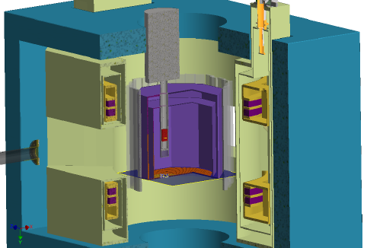
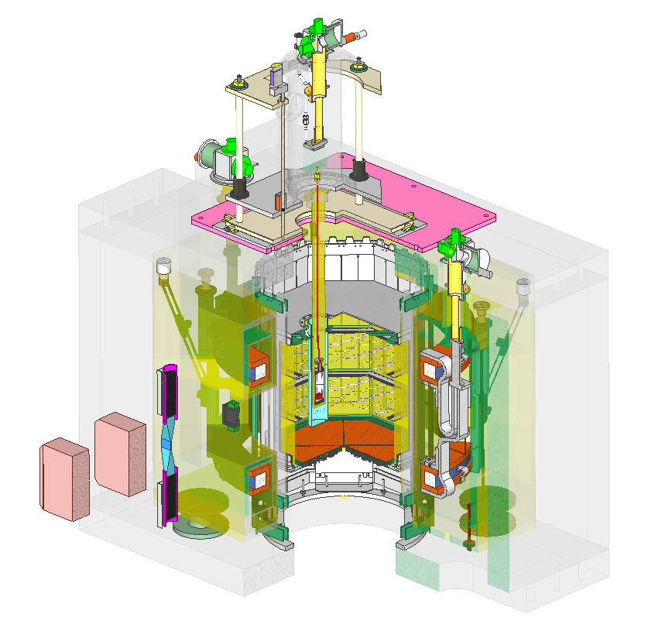
Hyperon Spectrometer for E45
Measurement of (π,2π) in large acceptance TPC (HypTPC)
π⁺⁻ beam on liquid-H₂ target
π⁻p→π⁺π⁻n, π⁰π⁻p
π⁺p→π⁰π⁺p, π⁺π⁺n
2 charged particles + 1 neutral particle
→missing mass
πN→KY (2-body reaction)
π⁻p→K⁰Λ,
π⁺p→K⁺Σ⁺ (I=3/2, Δ*)
Superconducting
Helmholtz magnet
Trigger with HTOF
LH₂ target
π beam
HypTPC
13

Slide 14
J-PARC E45
Let’s talk about Pion Beams
Studies of baryon resonances in (π,2π) reactions
Goals
Establish N* and Δ* resonances up to 2 GeV/c²
Search for new baryon states
  e.g. hybrid baryons (qqqg)
Deeper understanding of non-perturbative QCD
π
π
π
N*
N
N
Notes:
J-PARC P45実験はバリオン共鳴を(π、2π）反応で測定する実験ですが、目的としては、以下のような３つのものがあります。
まず、バリオン共鳴の性質を正確に測定することです。
依然として実験的に確立されていない共鳴状態が多く残っており、
また（π、2π）反応は1970年代に測定されて以来データが不足してこの実験が重要です。
次に、理論との比較により非摂動QCDのより深い理解につながり
また、ハイブリッドバリオン等の新たなバリオン状態の探索も行いたいと思っております。

Slide 15
Baryon spectroscopy :
Physics of broad and overlapping resonances
Width: a few hundred MeV.
Resonances are highly overlapped in energy except Δ(1232).
→Partial Wave Analysis
to extract hidden resonances
Measure cross sections as a function of
Incident pion energy
Scattering angle
In broad range (with fine bins)
to extract resonance poles
π⁺p
N(1440):Roper
N(1535)
π⁻p
Resonances in PDG
D.H.Perkins, Introduction to High Energy Physics
Notes:
バリオン分光は幅が広く重なり合った共鳴の物理である
う特徴があります。それぞれの共鳴状態を
測定するのは質量のスペクトルだけでは不可能で複雑なPWAを行う必要があります。

Slide 16
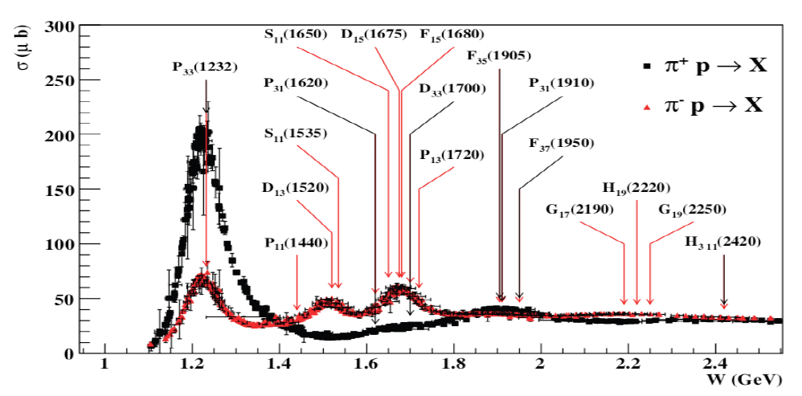
Baryon resonances (N*s and Δ*s)
σ (mb)
N*s are broadly overlapping
Notes:
Delta++/Delta0 cross section ratio is 3. Mention CR-coefs + Qual Prob.

Slide 17
E45 expected data summary
E45(proposal)
π- beam
π+ beam
HADES
only π⁻ beam
√s~1.5 GeV run done
Plan for √s~1.7 GeV
No continuous energy scan
√s(GeV) | p(GeV/c) | N(π+π-n) (/spill) | N(π0π-p) (/spill) | Hours(π-) | N(π+π+n) (/spill) | N(π0π+p) (/spill) | Hours(π+)
2.15 | 1.98 | 655.1 | 380.4 | 4.4 | 1162.2 | 281.5 | 5.9
2.13 | 1.92 | 655.1 | 380.4 | 4.4 | 1162.2 | 281.5 | 5.9
2.10 | 1.87 | 655.1 | 380.4 | 4.4 | 1162.2 | 281.5 | 5.9
2.08 | 1.81 | 655.1 | 380.4 | 4.4 | 929.8 | 281.5 | 5.9
2.05 | 1.75 | 655.1 | 380.4 | 4.4 | 929.8 | 281.5 | 5.9
2.03 | 1.70 | 655.1 | 380.4 | 4.4 | 929.8 | 281.5 | 5.9
2.00 | 1.65 | 655.1 | 380.4 | 4.4 | 929.8 | 281.5 | 5.9
1.97 | 1.58 | 655.1 | 380.4 | 4.4 | 929.8 | 281.5 | 5.9
1.94 | 1.52 | 655.1 | 380.4 | 4.4 | 929.8 | 281.5 | 5.9
1.91 | 1.46 | 655.9 | 409.1 | 4.1 | 925.5 | 267.1 | 6.2
1.87 | 1.38 | 654.2 | 383.7 | 4.3 | 961.9 | 240.1 | 6.9
1.83 | 1.30 | 608.6 | 358.4 | 4.7 | 901.9 | 183.4 | 9.1
1.79 | 1.22 | 609.4 | 380.4 | 4.4 | 806.4 | 125.1 | 13.3
1.76 | 1.15 | 679.6 | 443.8 | 3.8 | 696.5 | 125.9 | 13.2
1.73 | 1.10 | 770.9 | 497.9 | 3.3 | 704.9 | 110.7 | 15.1
1.70 | 1.05 | 858.8 | 521.5 | 3.2 | 753.1 | 131.0 | 12.7
1.68 | 1.02 | 902.7 | 530.8 | 3.1 | 800.4 | 151.3 | 11.0
1.66 | 0.98 | 917.9 | 513.1 | 3.2 | 825.0 | 155.5 | 10.7
1.64 | 0.94 | 885.0 | 567.2 | 2.9 | 829.2 | 149.6 | 11.1
1.62 | 0.91 | 787.8 | 448.0 | 3.7 | 807.2 | 149.6 | 11.1
1.60 | 0.87 | 690.6 | 412.5 | 4.0 | 724.4 | 127.6 | 13.1
1.57 | 0.81 | 584.9 | 394.7 | 4.2 | 584.9 | 394.7 | 4.2
1.54 | 0.77 | 540.1 | 407.4 | 4.1 | 383.7 | 60.9 | 27.4
1.52 | 0.74 | 515.6 | 408.3 | 4.1 | 280.6 | 47.3 | 0.0
Total(h) |  |  |  | 96.7 |  |  | 218.6
Total(d) |  |  |  | 4.027851 |  |  | 9.1
HADES
Proposed
HADES
Completed

Slide 18
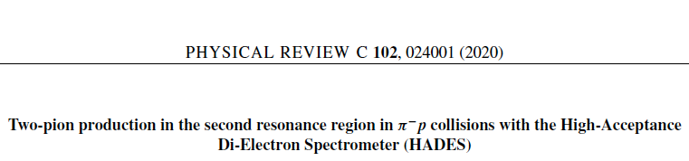
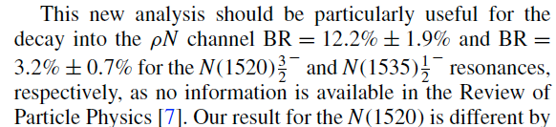
Two-pion production for the
N(1520) and N(1535)

Slide 19
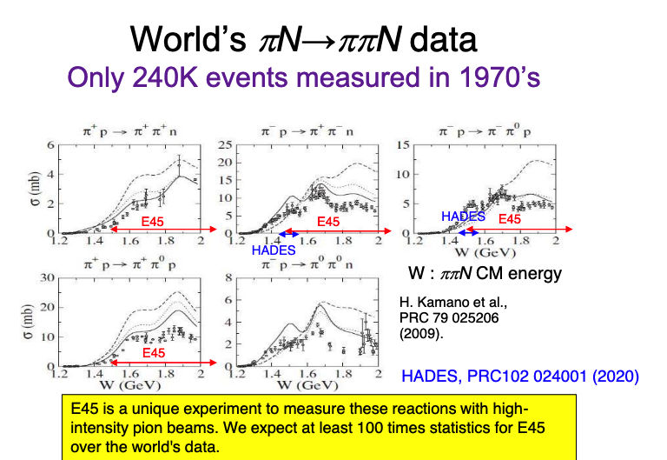
Why

Slide 20
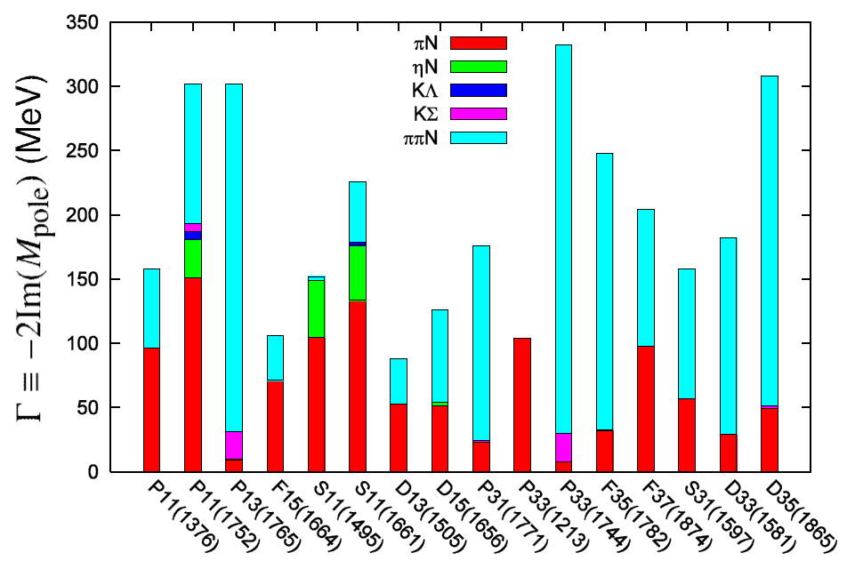
Importance of ππN Decay
There are many N* and Δ* resonances which couple to ππN dominantly
H. Kamano, et al. PRC 79 025206 (2009)
Width of N* resonances (MeV)
Δ(1600)***
N(1680)****
N(1520)****
Δ(1232)****
Δ(1905)****
N(1535)****
N(1710)***
N(1650)****
N(1675)****
N(1440)****
N(1720)****
Δ(1700)****
Δ(1750)*
Δ(1950)****
Δ(1930)***
Δ(1620)****
Notes:
20

Slide 21
PDG data for N* and Δ* resonances
Many resonances have not been established experimentally.
****
Established
***
* **
Most of the N*s so far were
measured from
πN◊ππN data necessary to resolve remaining resonances
γN → ππN
PDG 2020
JLab is difficult to access to Δ(1600)
(Tony Thomas)
In some PWA, m=1.4-1.5 GeV/c² (only 0.2-0.3 GeV higher than the ground state) ^{[1]}
[1] e.g. R. A. Arndt et al., PRC 74, 045205 (2006)
Notes:
21

Slide 22
Beam time request and expected statistics
π beam rate : 10⁶ / spill (2s)
Liquid H₂ target : 5 cm thick
TPC acceptance : 40%
(π,2π) cross section : ~2 mb (π⁺p→π⁺π⁺n)
160 events / spill
・ πp CM energy (W) : 1.50 – 2.15 GeV (p= 0.73 – 2.0 GeV/c)
・No. of bins : π⁻ beam : 24 (energy) x 20 (angle)
π⁺ beam : 23 (energy) x 20 (angle)
・No. of events / bin : 32 K
30M events in 15 days (to run in 2026)
Enhances world’s ππN data statistics (0.24M) by a factor of 130
Notes:
22

Slide 23
J-PARC E45 Collaboration
H. Sako, K. Imai, S. Hasegawa, S. Sato, K. Tanida, Y. Ichikawa , T. Hashimoto (Japan Atomic Energy Agency)
P. Cole (Lamar Univ.)
K. Joo, S. Diehl, A. Kim. U. Shrestha, R. Capobianco, V. Klimenko,
J. Richards, N. Trotta, T. Hayward, P. Simmerling, R. Santos (Univ Connecticut)
C. Djalali (Ohio Univ.)
J.K. Ahn, S.H. Kim, W.S. Jung, S.B. Yang, B.M. Kang, S.W. Choi, H.I. Lee, (Korea Univ)
S.J. Lee
S. Nakamura, M. Niiyama (Kyoto Univ.)
H. Fujioka (Tokyo Inst. Tech.)
T. Takahashi, K. Ozawa, H. Sugimura (KEK)
K. Nakazawa, H. Ekawa (RIKEN)
S. H. Hwang (KRISS)
S. H. Hayakawa, J. Yoshida (Tohoku Univ.)
T. Ishikawa (ELPH, Tohoku Univ.)
B. Briscoe, I. Strakovsky, R. Workman (George Washington Univ.)
L. Guo (Florida International Univ.)
T.S.-H. Lee (Argonne National Lab.)
T. Sato, Y. Nakada (Osaka Univ.)
K. Shirotori, S. Y. Ryu, H. Kamano (RCNP, Osaka Univ.)
Y. Azimov (Petersburg Nuclear Physics Institute)
V. Shklyar (Univ. Giessen)
A. Svarc (Ruder Boskovic Institute)
S. Ceci (RBI-Zagreb)
M. Hadzimehmedovic, H. Osmanovic (Univ. Tulza)

Slide 24
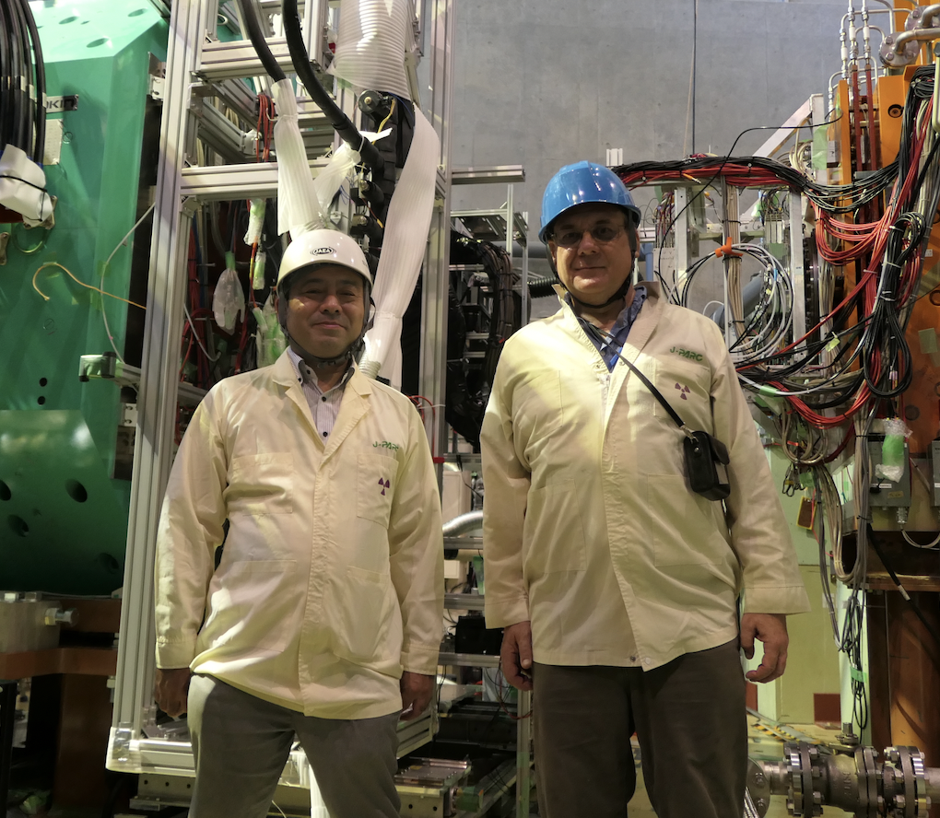
E45 Location at J-PARC

Slide 25
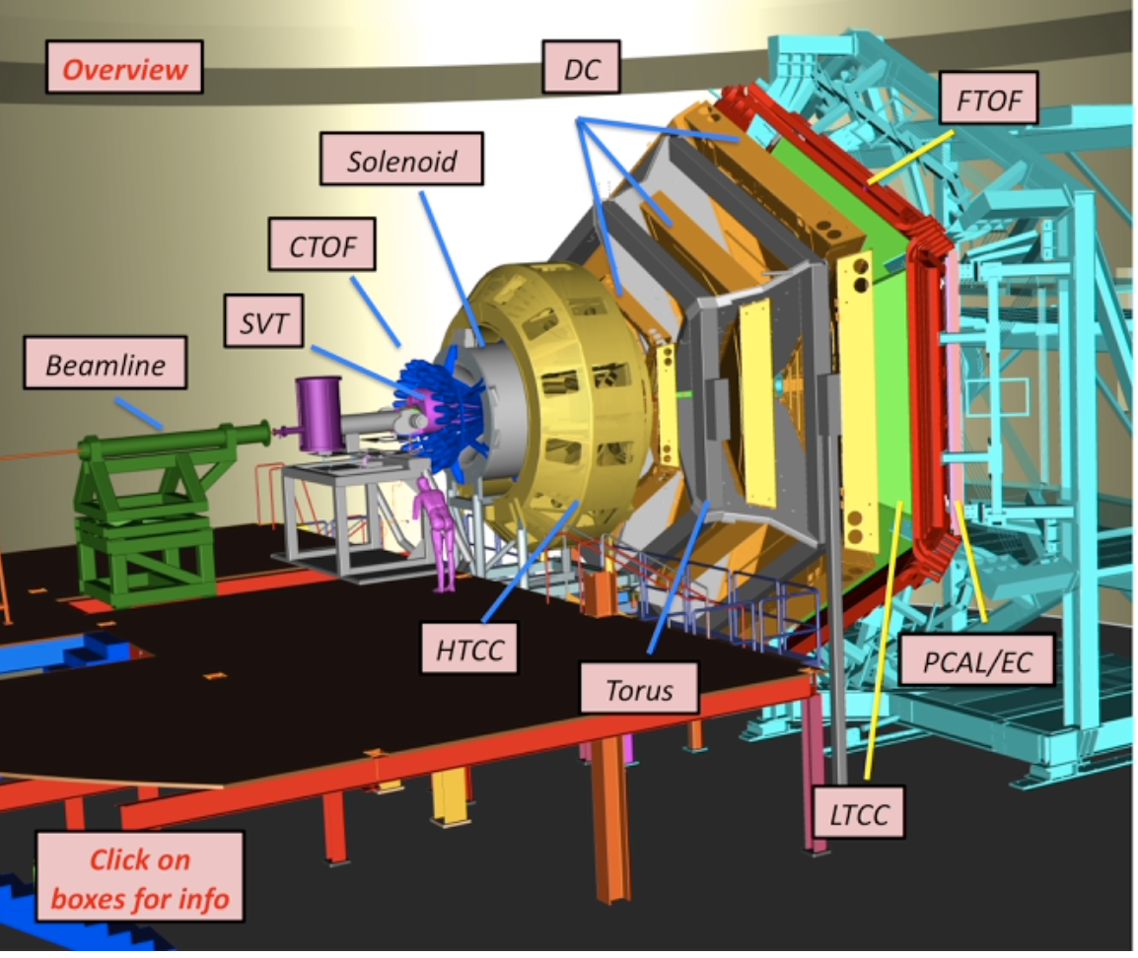
CLAS12 – electron beams

Slide 26
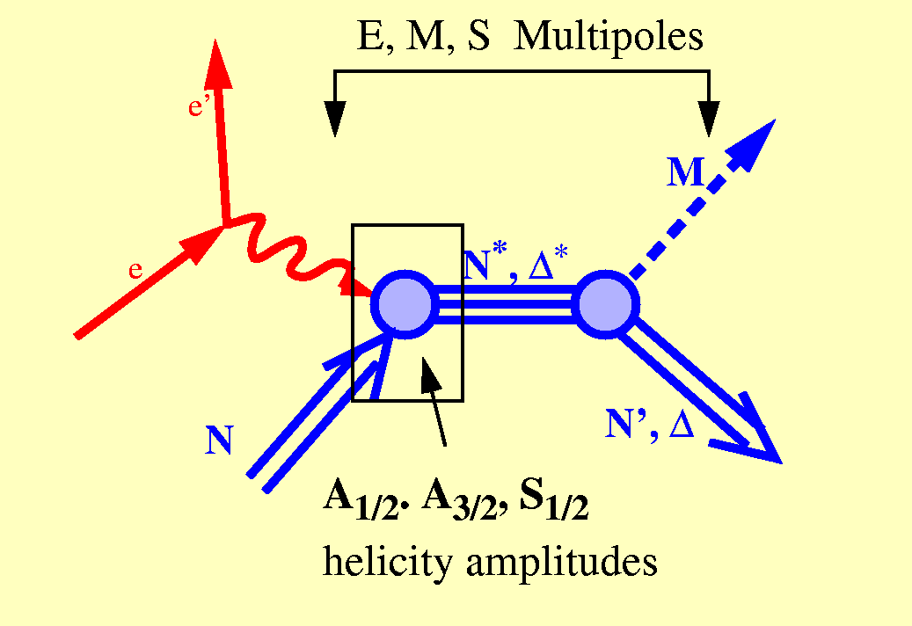
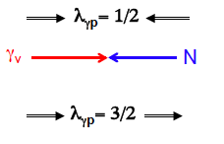
Electroproduction
The helicity amplitudes are related to the matrix elements of the electromagnetic current via:
Transverse
  A_{1/2}
  A_{3/2}
Longitudinal
  S_{1/2}
A_{½}: <N*,S_{z}*=+½|ε_{μ}⁽⁺⁾J^{μ}_{em}|N,S_{z}=−½>
A_{3/2}: <N*,S_{z}*=+3/2|ε_{μ}⁽⁺⁾J^{μ}_{em}|N,S_{z}=+½>
S_{½}: <N*,S_{z}*=+½|ε_{μ}⁽⁰⁾J^{μ}_{em}|N,S_{z}=+½>
Notes:
EBAC: dynamical coupled channel analysis is based on the world data set on piN. gammaN, and gamma*N and constrained by unitarity. (to Npi, Neta, N2pi)
This allows the extraction of the meson-baryon contributions under minimal model assumptions

Slide 27
Structure of excited baryons
  effective degrees of freedom
  transition charge densities
  running quark mass
  => nature of states
N(1680)5/2⁺
[56,2⁺]₂
2
V.D. Burkert et al
L_{3q}
[70,1⁻]₁
N(1675)5/2⁻
N(1520)3/2⁻
N(1535)1/2⁻
e’
π, η, ππ, K
e
γ_{v}
1
N*,△*
Q
N
N, Y
[56,0⁺]₀
A_{1/2}, A_{3/2}, S_{1/2}
E₁₊, M₁₊, S₁₊
Δ(1232)3/2⁺
N(940)1/2⁺
N(1440)1/2⁺
N(1710)1/2⁺
[70,0⁺]₀
0
0
1
N [ħω]
2
I.G. Aznauryan et al., Analysis of p(e,e’Nπ); V.I. Mokeev et al., Analysis of p(e,e’pπ⁺π⁻)
Notes:
The N* spectrum teaches us about the underlying symmetries, to access the internal structure we need to probe the nucleon with virtual photons that measure the resonance strength versus the time-distance scale. What one measures are the helicity amplitudes A1/2, A3/2, and S1/2 or equivalent electromagnetic multipoles. I will focus on 3 states highlighted here.

Slide 28
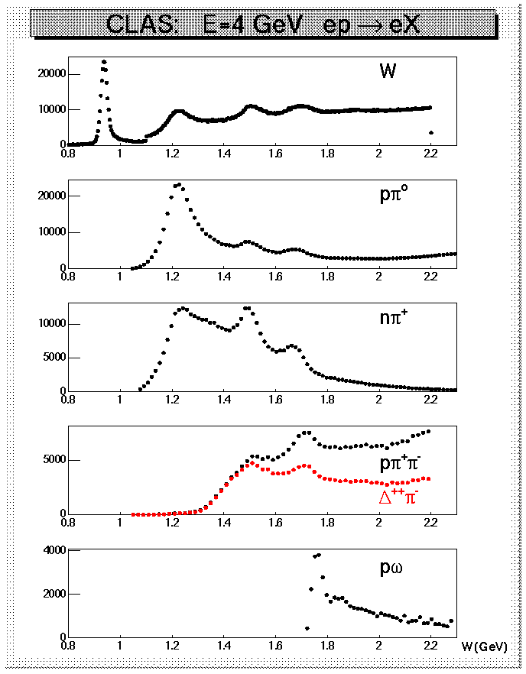
Why Nπ/Nππ electroproduction channels are important
CLAS data on meson electroproduction at Q² < 4.0 GeV²
  Nπ/Nππ channels are the two major contributors in N* excitation region;
  these two channels combined are sensitive to almost all excited proton states;
  they are strongly coupled by πN→ππN final state interaction;
  may substantially affect exclusive channels having smaller cross sections, such as ηp, KΛ, and KΣ.
Therefore, knowledge on Νπ/Νππ electroproduction and πΝ → ππΝ mechanisms are key for the entire
N* Program (Spectrum and Structure)

Slide 29
Roper Resonance in 2002 and 2023
V. D. Burkert, Baryons 2016
V.D. Burkert, eprint::2212.08980 [hep-ph],
D.S. Carman, R.W. Gothe, V.I. Mokeev, and C.D. Roberts, Particles 6, 416 (2023)

Slide 30
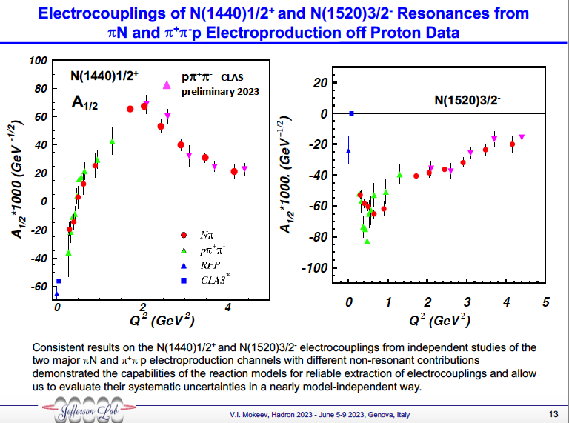

Slide 31
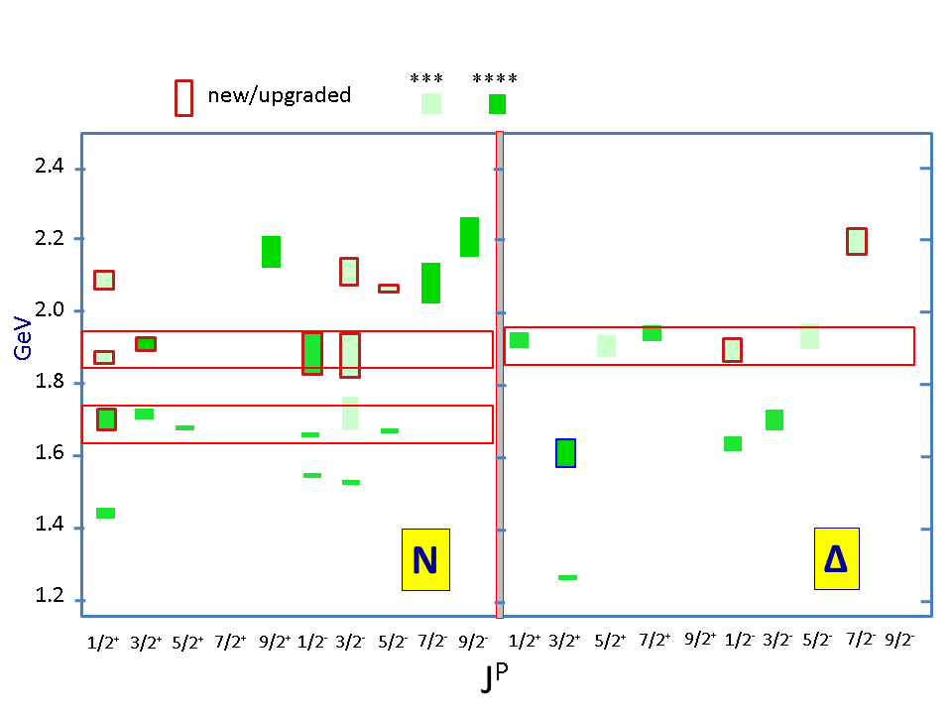
Advances in the Exploration of the N* Spectrum in Photoproduction
Several new nucleon resonances have been established through a global multi-channel analysis of exclusive photoproduction data
Nucleon resonances listed in Particle Data Group (PDG) tables
N*/Δ* Spectrum 2020
State N(mass)J^{P} | PDG pre 2012 | PDG 2020*
N(1710)1/2⁺ | *** | ****
N(1880)1/2⁺ |  | ***
N(1895)1/2⁻ |  | ****
N(1900)3/2⁺ | ** | ****
N(1875)3/2⁻ |  | ***
N(2100)1/2⁺ | * | ***
N(2120)3/2⁻ |  | ***
N(2000)5/2⁺ | * | **
N(2060)5/2⁻ |  | ***
Δ(1600)3/2⁺ | *** | ****
Δ(1900)1/2⁻ | ** | ***
Δ(2200)7/2⁻ | * | ***
Description of the exclusive electroproduction data off the proton with the same masses and hadronic decay widths as in photoproduction will validate the existence of new baryon states.
Combined studies of the CLAS π⁺π⁻p photo-/electroproduction off proton data allow us
to observe a new N’(1720)3/2⁺ baryon state in addition to those listed above.

Slide 32
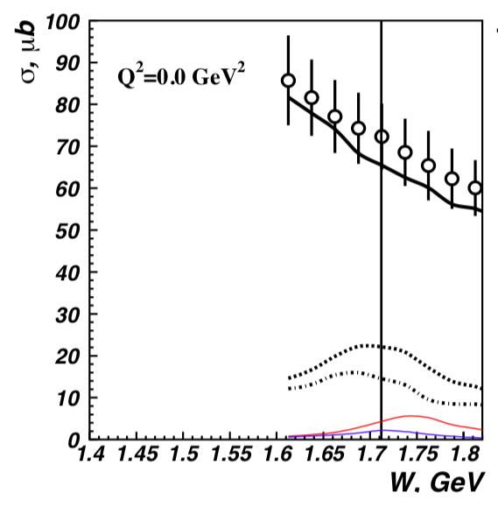
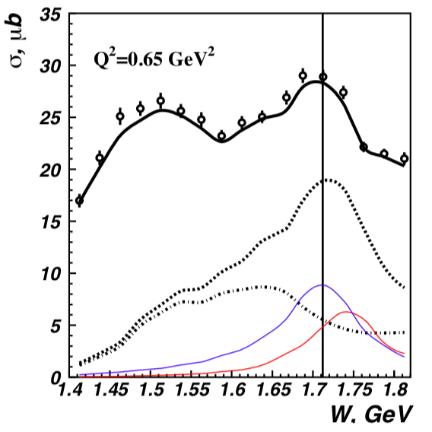
Newly Discovered N’(1720) 3/2⁺
π⁺π⁻p photoproduction
π⁺π⁻p electroproduction
V.I. Mokeev et al., Phys. Lett. B 805, 135457 (2020)
N(1720)3/2⁺
N’(1720)3/2⁺
Resonant part
N’(1720)3/2⁺
Resonant part w/o
N’(1720)3/2⁺,
& N(1720)3/2⁺
N(1720)3/2⁺
Evidence of a new N’(1720) 3/2⁺ resonance in the
photo- and electroproduction of the π⁺p channel

Slide 33
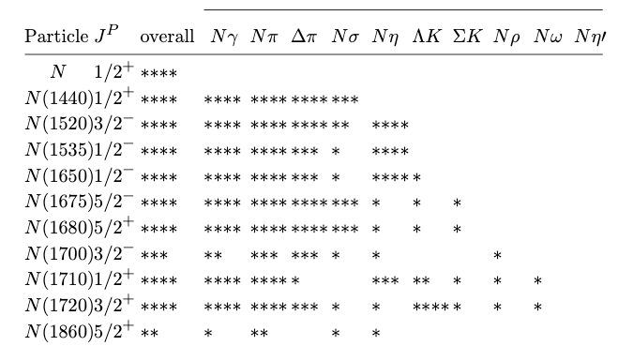
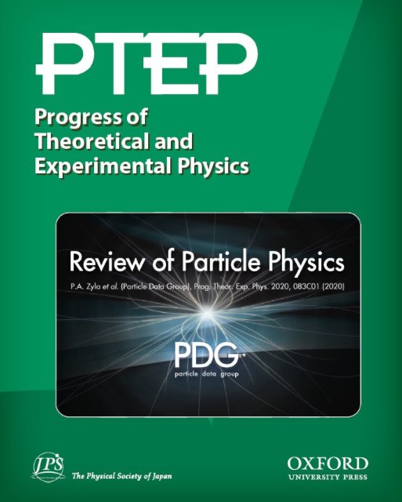
No
Data?

Slide 34


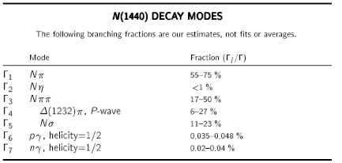
Decay Modes

Slide 35

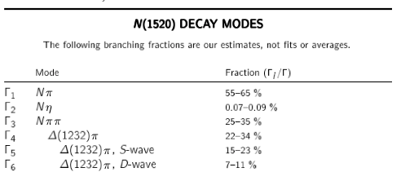
Decay Modes

Slide 36

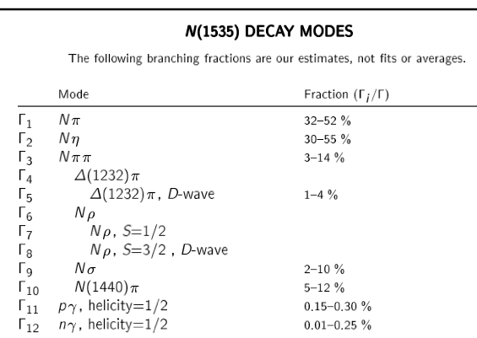
Decay Modes

Slide 37
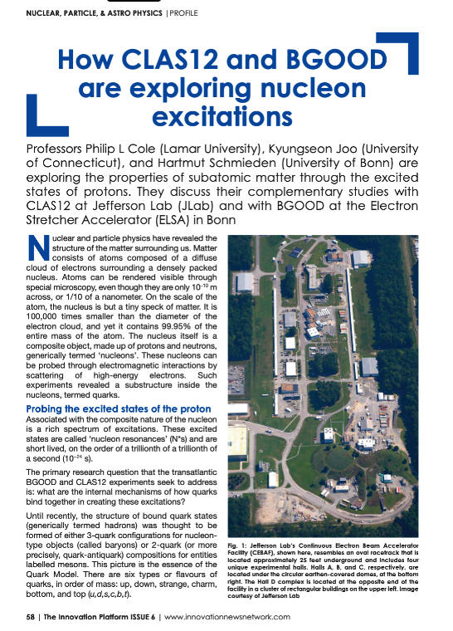
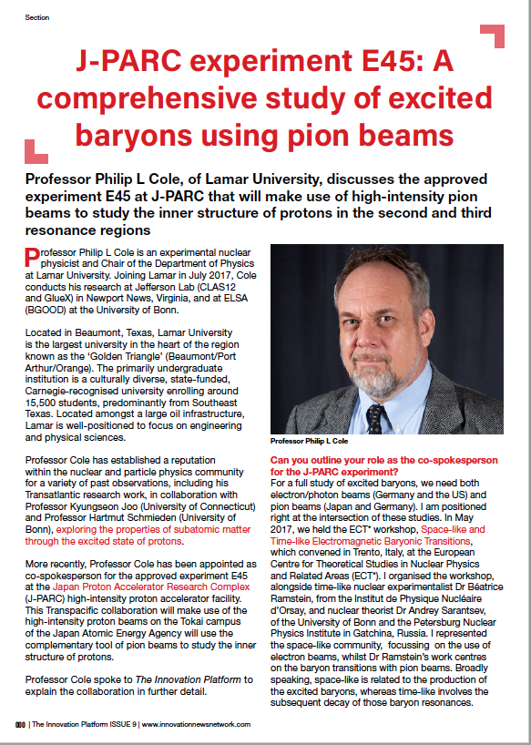
Getting the word out on electron and pion beams through The Innovation News Network
Issue 6 (June 2021) pages 58 to 62
Issue 9 (March 2022) pages 278 to 282

Slide 38
Getting the word out for why N*s to Policy Makers
The purpose of the articles was guided by the statement below:
The publication will be distributed digitally to over 200 000 people to include policy makers in nuclear physics in Europe, the US, Canada, Asia and the rest of the world. This will include local authorities, regional governments, government agencies, ministries and research councils as well as the scientific community, industry and academic institutions. It is also distributed to EU institutions like European Parliament, European Commission and the European Research Council and international agencies.
We seek to get the word out on the timeliness and importance of N* research.

Slide 39
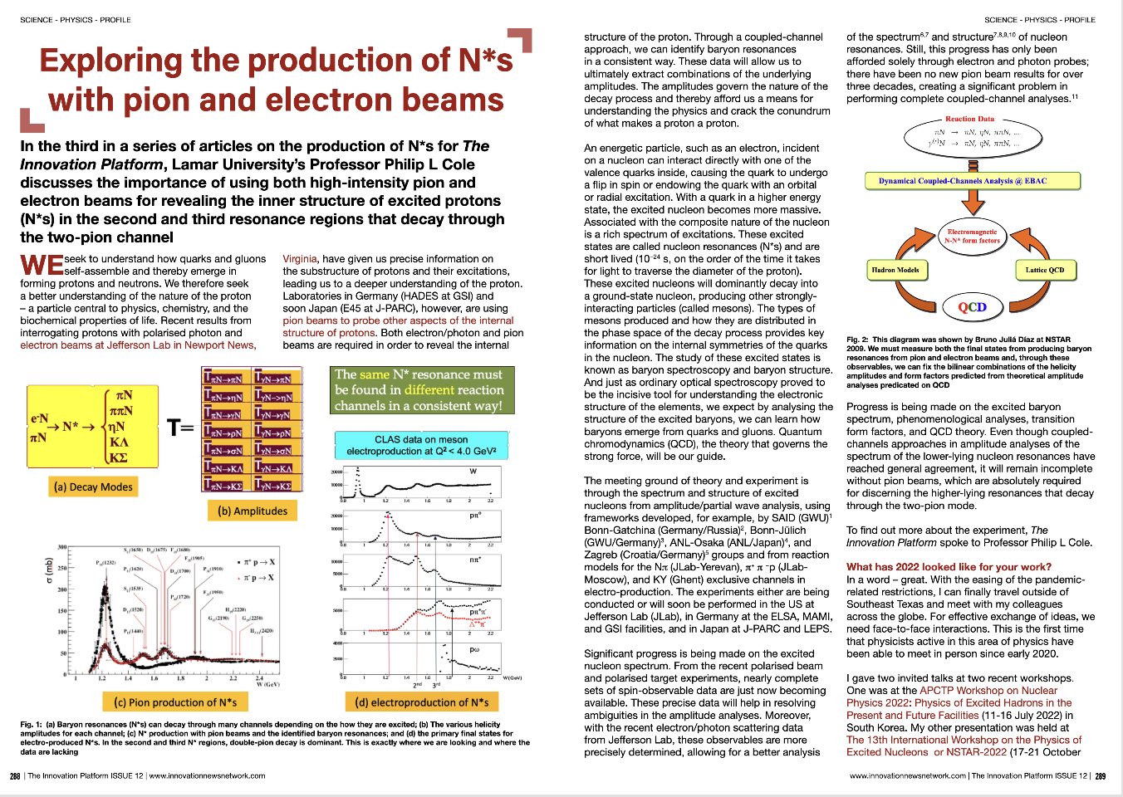
Exploring the production of N*s with pion and electron beams
This article stresses the need for Coupled–Channel Analysis
Issue 12 (December 2022) pages 288 to 292

Slide 40
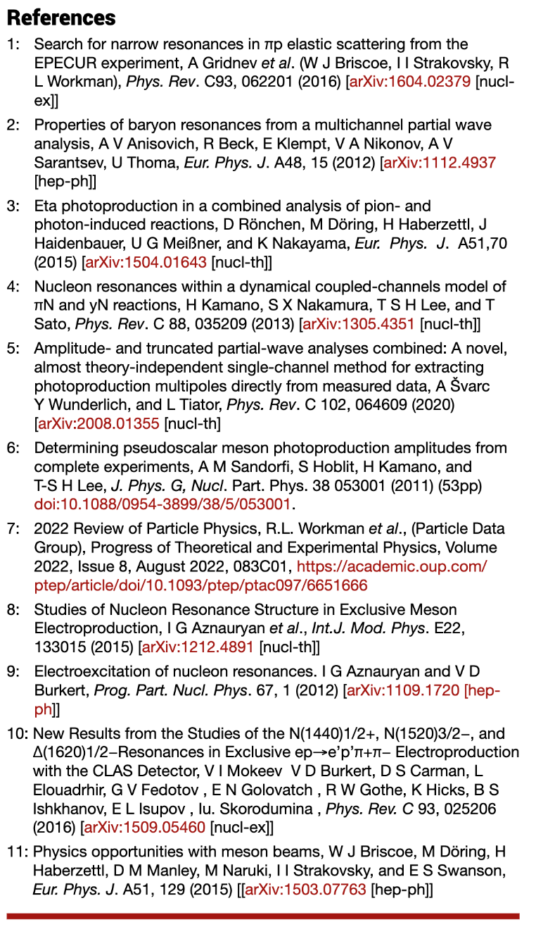
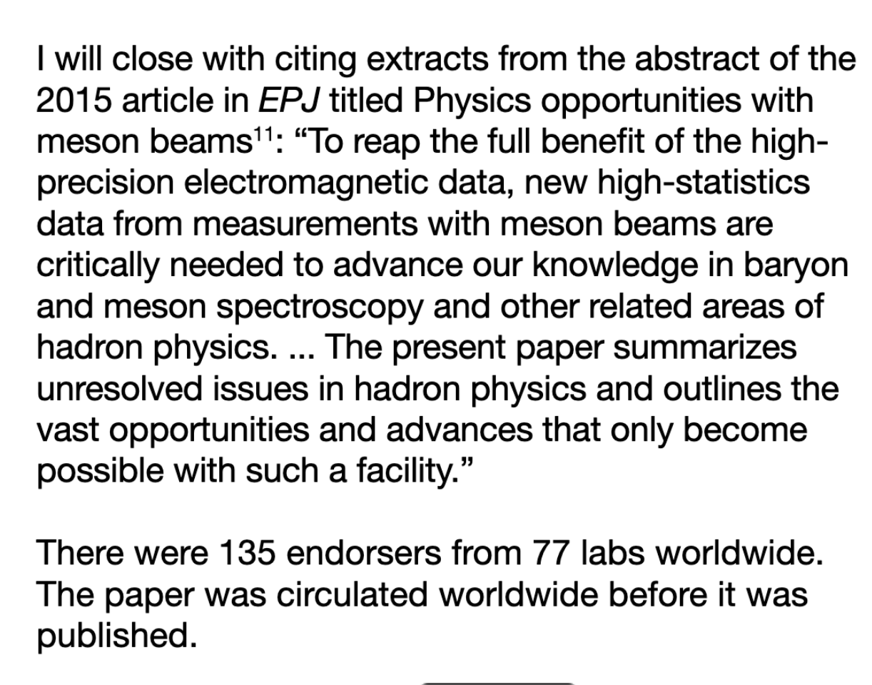
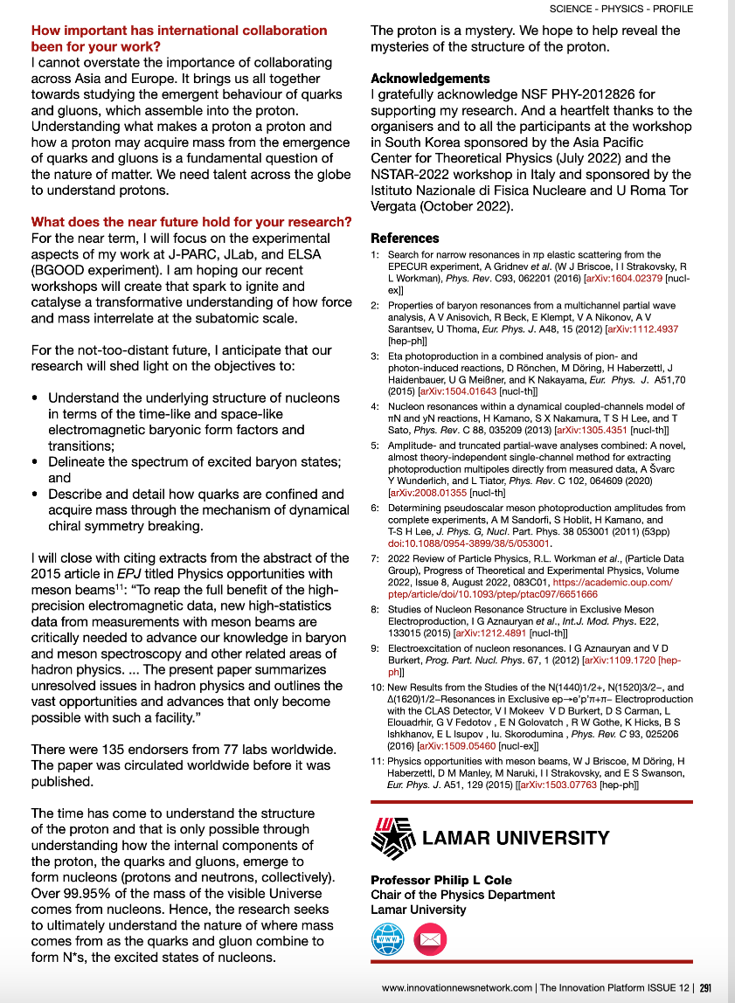
Exploring the production of N*s with pion and electron beams
This article stresses the need for Coupled–Channel Analysis
Issue 12 (December 2022) pages 288 to 292

Slide 41
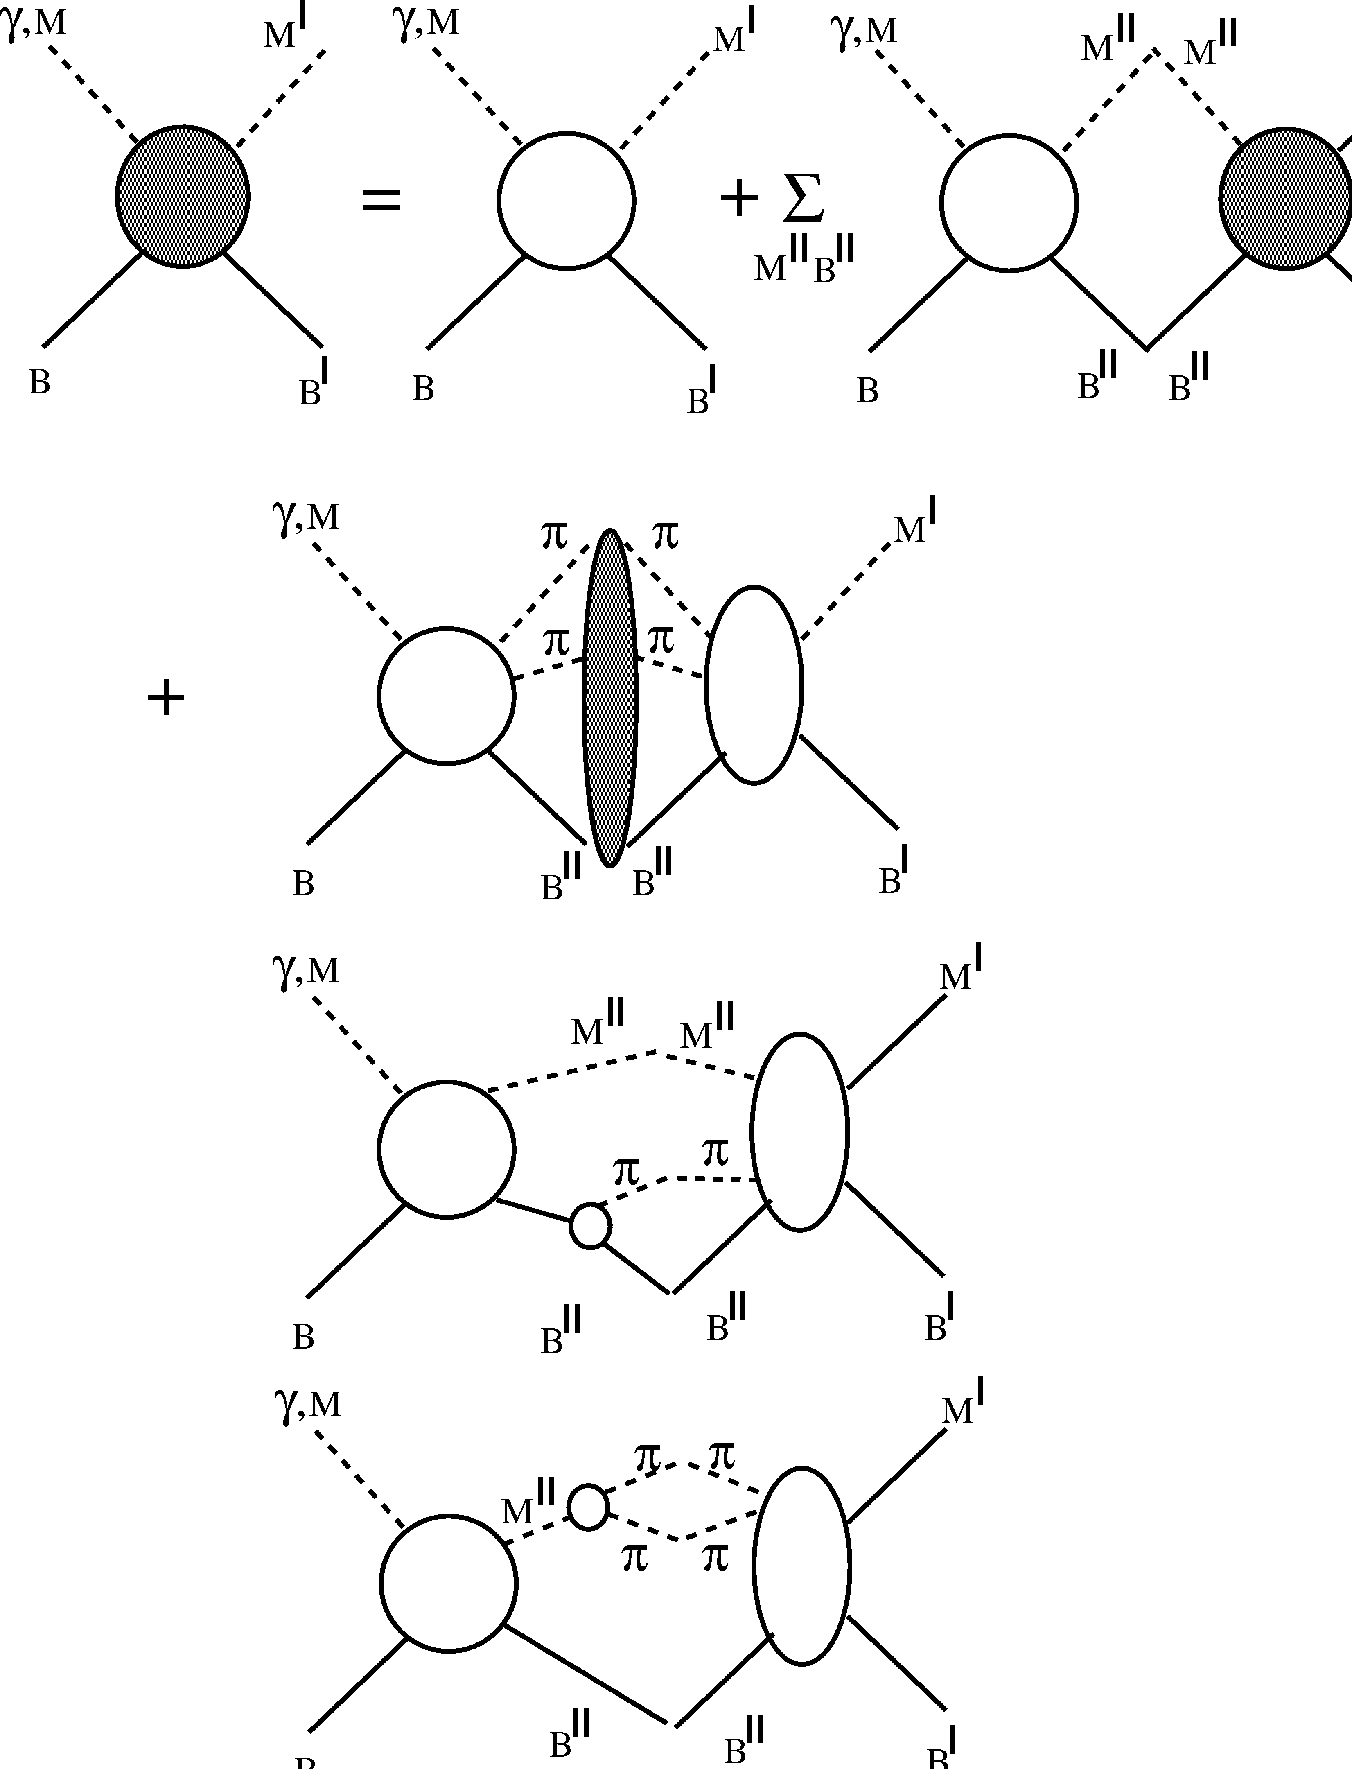

Coupled Channel Analysis (EBAC)
From Cole’s Summary
Talk of the Workshop
Pion-nucleon and 2-pion-nucleon contributions to the non-resonant T matrix.
International Organizing Committee:
V. Burkert
B. Juliá Díaz
R. Gothe
T.-S. H. Lee
V. Mokeev
October 13-15, 2008
T.-S. Harry Lee

Slide 42
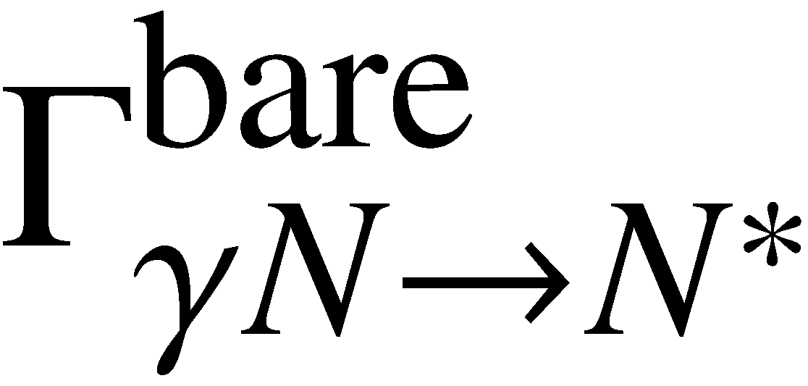
Current status of the analysis @ EBAC
Hadronic part
From Cole’s Summary Talk of the Workshop
π N → π N : fitted to the SAID PWA up to 2 GeV.
Julia-Diaz, Lee, Matsuyama, Sato, PRC76 065201 (2007)
π N → π π N : cross sections calculated; not fitted yet.
    Kamano, Julia-Diaz, Lee, Matsuyama, Sato, submitted to PRC
π N → η N : fitted to the data up to 2 GeV ( varied only bare N* → ηN )
    Durand, Julia-Diaz, Lee, Saghai, Sato, PRC78 025204 (2008)
γ N → π N : fitted to the data up to 1.6 GeV ( varied only )
Julia-Diaz, Lee, Matsuyama, Sato, Smith, PRC77 045205 (2008)
γ* N → π N : in progress Julia-Diaz, Kamano, Lee, Matsuyama, Sato
γ N → π π N : in progress Julia-Diaz, Kamano, Lee, Matsuyama, Sato
γ N → η N : in progress Durand, Julia-Diaz, Lee, Saghai
Electromagnetic part
October 13-15, 2008
Bruno Juliá Díaz

Slide 43
E45 data and the PWA EBAC Model
We are developing this!
Experimental data
or model data
Model inputs
Resonances
(m_{i}, g_{i}, λ_{i})
Xsection or PWA Fit code
to extract resonance parameters
Total and differential
Xsections
Fit
Compare
PWA (T)
Total and Differential Xsections
Resonances
(m_{i}, g_{i}, λ_{i})
πN or ππN event generator
GEANT4
Compare
Analyzer
Reconstructed πN or ππN tracks
Total and differential Xsections
(slides provided by Hiroyuki Sako)

Slide 44
PWA for E45 (Today)
Strategy proposed by T.-S. Harry-Lee
[ See: ]
T.-S. Harry Lee – December 8, 2022
Approximate PWA to average intermediate resonance momentum k to reduce variable (k, W) → (W)
  π(k₀)N(-k₀)→Δ(k)π(-k) →π (k₁)N(k₂)π(-k)
  (J: total angular momentum, LπN, LπΔ: spin-angular momenta)
  Validity confirmed with ANL-Osaka model
Parameterize averaged ANL-Osaka PWA with polynomials as a function of W
(slides provided by Hiroyuki Sako)

Slide 45
PWA for E45 (cont.)
Fit E45 differential cross sections with the averaged parameterized PWA, using the initial parameters from ANL-Osaka PWA
  Development of a code to calculate differential cross sections from PWA was started in Kyungson Joo’s group
Use separable model based on CMB approach to fit E45 averaged PWA and extract new PWA and resonance poles
  Development of separable model in JAEA and KNU started. So far only a simple isobar model with 2-body reaction (pN→pN or pΔ)
Use a sophisticated coupled-channel model to fit to the E45 data to obtain the resonance information
  Only theorists can do this, and we need your support!

Slide 46
Strategy for PWA code development proposed by T.S. Harry-Lee
Study validity of averaged PWA with comparison of cross sections of ANL-Osaka model
  →Already confirmed by T. S. Harry-Lee
(1) Parameterize the averaged PWA of ANL-Osaka with the polynomials as functions of W
(2) Calculate the differential cross sections from the averaged PWA
→Being developed by Kyungseon Joo’s group but only 2-body reactions so far)
(3) Fit the differential cross sections of E45 with the initial parameters of (14) and obtain new averaged PWA
Go over if time
(slides provided by Hiroyuki Sako)

Slide 47
Procedures of PWA code development (Cont.)
Develop CMB model which is on-shell approximation and separable model (each pole can be resolved) of ANL-Osaka model to repeat Procedure 2. Then extract resonance poles from CMB model.
  We started this development with an isobar model.
Extract resonance poles from ANL-Osaka with the fit results of 2. (only by ANL-Osaka experts). Solving Coupled-Channel equations required.
Go over if time
(slides provided by Hiroyuki Sako)

Slide 48
Averaged partial wave amplitudes
Approximation to reduce the number of kinematic variables for 3-body reactions
Consider reaction
π(k₀)N(-k₀)→Δ(k)π(-k) →π (k₁)N(k₂)π(-k)
  k₀ : Initial π momentum
  k : Intermediate Δ momentum
  k₁ k₂ : π and N momenta decayed from Δ
  k = k₁ + k₂
Go over if time
(slides provided by Hiroyuki Sako)

Slide 49
Cross sections
Total cross section
J: Total angular momentum
LπΔ: angular momentum of πΔ
LπN: angular momentum of πN
Partial wave cross section of (J, LπΔ , LπN ) with the Partial Wave Amplitude T
M: invariant mass of final πN
W: invariant mass of initial πN
(3)
Go over if time
(slides provided by Hiroyuki Sako)

Slide 50
(4)
(5)
Go over if time
(slides provided by Hiroyuki Sako)

Slide 51
Averaged PWA
(10)
Averaged over intermediate Δ momentum k
(8)
(9)
Go over if time
(slides provided by Hiroyuki Sako)

Slide 52
PWA code Status
Goal: Develop an analysis code to fit to measured cross sections and extract resonance information in πN→ππN reactions
First step: Fit to πN→MB 2-body reactions with a simple isobar model
The code was created in C++ and ROOT by Shinhyung Kim based on T.S.H. Lee’s Fortran code.
1 resonance (Δ) and 1 channel (πN): done by Shinhyung
2 resonances and 1 channel (πN): done
2 resonances and 2 channels (πN and πΔ):done
M resonances and N channels→ Implemented (2/12)
with C++ complex matrix library Eigen
to be checked with M≧3, N≧3
Next step
Optimization of fitting algorithms
Fit is very difficult with even for 2 resonances and 1 channel
Implement Generator for GEANT4
  2-body decays
  3-body decays
Go over if time
(slides provided by Hiroyuki Sako)

Slide 53
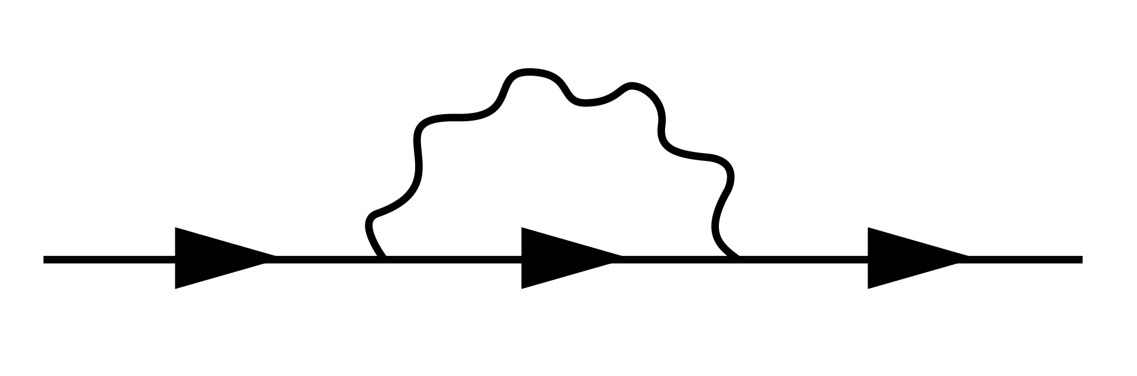
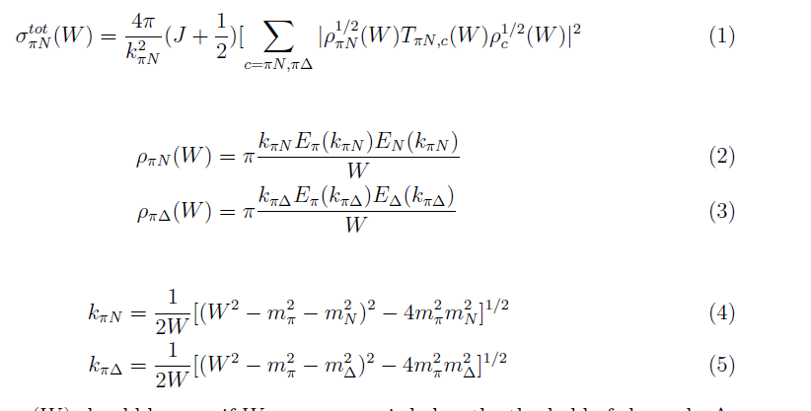
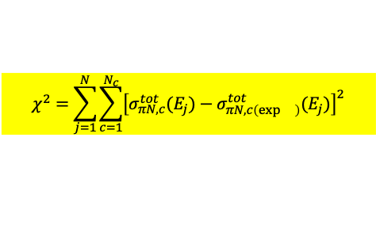
1 resonance + 1 channel
2 resonances + 1 channel
continuum
resonance
(17)
α,β : channels, i, j:resonance
g
g
g
π
NxN matrix
Σ=
Δ
Δ
Self energy
Self-energy
g
Ν
g
(18)
g
g
(19)
Fit with total cross section
$$χ^{2}=\sum_{j=1}^{N}{\sum_{c=1}^{N_{c}}{{\left[σ_{πN,c}^{tot}(E_{j})−σ_{πN,c\left(\exp{}\right)}^{tot}(E_{j})\right]}^{2}}}$$
(20)
Go over if time
(slides provided by Hiroyuki Sako)

Slide 54
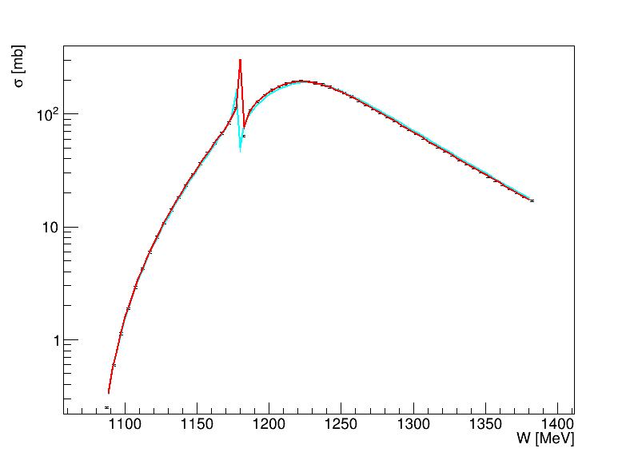
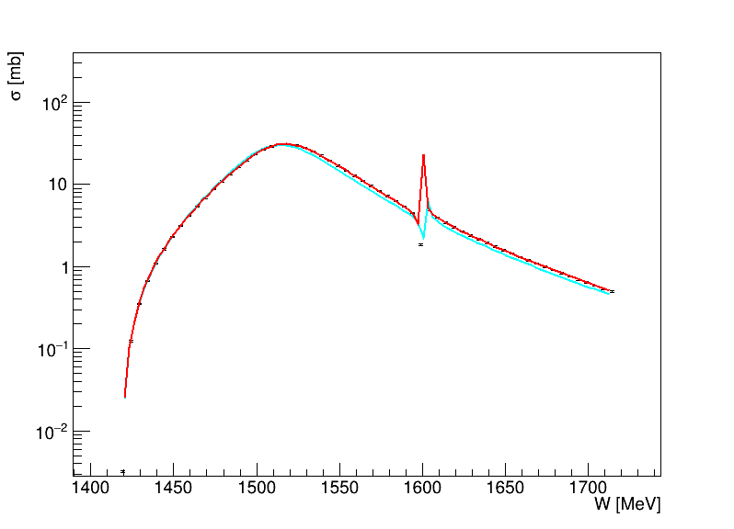
Fit result example (2 channels, w/ 2 hypothetical resonances)
πN→πN
πN→πΔ
Fit
Fit
Initial parameters
Points: cross section data
Initial parameters
Resonance 1
Resonance 2
Resonance 1
Resonance 2
Go over if time
(slides provided by Hiroyuki Sako)

Slide 55
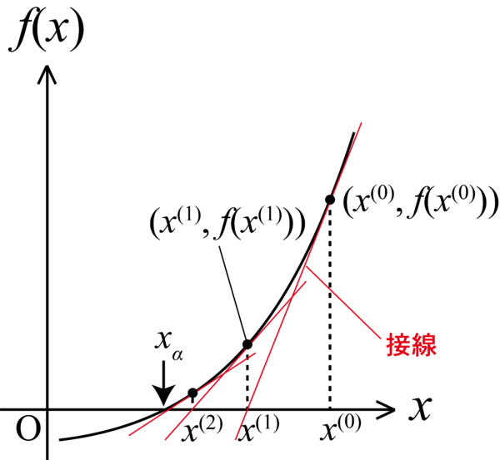
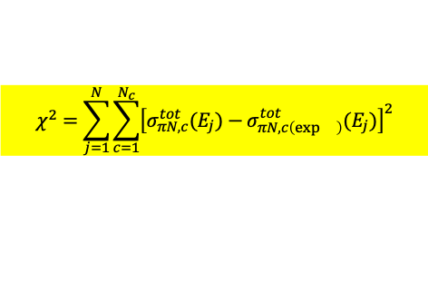
Development of Newton-Raphson method
$$χ^{2}=\sum_{j=1}^{N}{\sum_{c=1}^{N_{c}}{{\left[σ_{πN,c}^{tot}(E_{j})−σ_{πN,c\left(\exp{}\right)}^{tot}(E_{j})\right]}^{2}}}$$
Usually χ² (1-dimension) is minimized in many algorithms. χ² of the total cross section residuals of all data points
Simplex, gradient descent, … (implemented in Minuit library)
Instead of using χ², use residual vector of data-model at each data point!
S_{i}=f(x₁,x₂,…x_{n}, E_{i})-y(E_{i}): x₁,…x_{n}, model parameters, E_{i}: energy of i-th data point
  f: modeled cross section, y : measured cross section data
  χ² = ΣS_{i}² (i=1,…n, data points)
Require S=0, instead of minimizing χ²
And solve it with Newton-Raphson method (iterative)
x_{n+1} = x_{n} – (∂S(x_{n})/∂x)⁻¹S(x_{n})
∂S(x_{n})/∂x: Jacobian: J_{ij}= ∂S_{j}/∂x_{i}
Nonlinear equation is approximated to a linear solver problem!
Newton-Raphson method is very fast if the initial parameters are close to the true values.
Test with 2 resonances and 1 channel
χ² minimization (Minuit): 340 iterations
Newton-Raphson: 20 iterations
But, Newton-Raphson method can converge only if the initial parameters are close enough to the true values.
Tangent
line
Go over if time
(slides provided by Hiroyuki Sako)

Slide 56
Wherefore & Whither EBAC?
We need theoretical HELP to resuscitate and resurrect
This is not a job for Experimentalists
We need Theoretical Guidance
China has a strong history of Hadronic Physics – Let’s talk.
Who will pick up the mantle for Coupled Channel Analysis?
Employing pion and electron beams for insight into the
spectrum/structure of N*s
through their two-pion decays

Slide 57



Slide 58

Baryon spectrum through meson photoproduction
Baryon resonances in experiments with hadron beams and in the e⁺e⁻ collisions
Baryon resonances in ion collisions and their role in cosmology
Baryon structure through meson electroproduction, transition form factors, and time-like form factors
Amplitude analyses and baryon parameter extraction
Effective field theory, Phenomenological models, and Functional methods
Baryon spectrum and structure from first principles of QCD
Exotic Hadrons
Advances in modeling of baryon spectrum & structure
Facilities and future projects

Slide 59


Slide 60
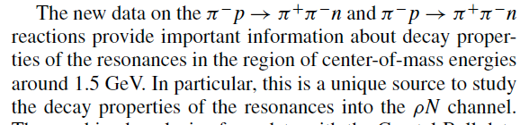
ρ decay mode for the
N(1520) and N(1535)

