Slide 1


Development of aerogel based
RICH detectors
Alexander Barnyakov
on behalf of BINP Aerogel group
Budker Institute of Nuclear Physics & Novosibirsk State Technical University , Novosibirsk, Russia
Aerogel RICH in the HEP
Aerogel R&Ds at the BINP
  FARICH technique progress
  FARICH with dual aerogel radiator concept
  Aerogel RICH with Fresnel lens
Summary
23 August 2023
Institute of High Energy Physics, Chinese Academy of Sciences, Beijing, China

Slide 2
Aerogel RICH in the HEP

Slide 3
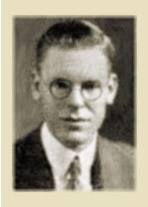
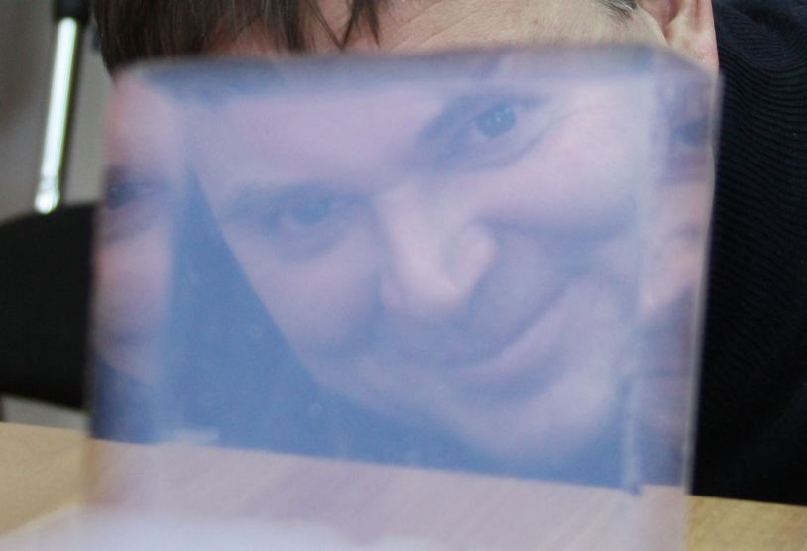
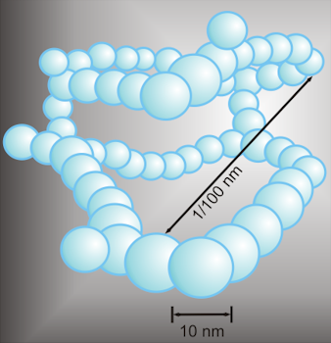
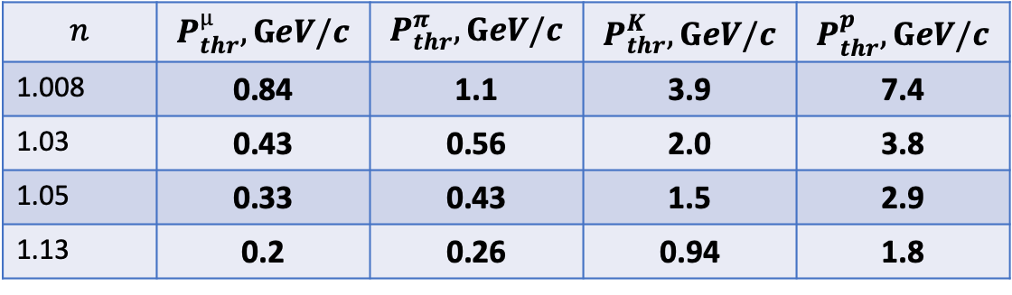
Aerogel is a classical nanomaterial
Aerogel was first synthesized by Samuel Stephens Kistler in 1931
S.S.Kistler, "Coherent Expanded Aerogels and Jellies“, Nature, 1931,vol. 127, p. 741
Aerogel – is a porous material with pore dimension less than visible light wavelength.
It is a classical nanomaterial. The most interesting for physics experiments are silicon dioxide (SiO₂) based aerogels:
$$n$$ | $$P_{thr}^{µ}, GeV/c$$ | $$P_{thr}^{π},GeV/c$$ | $$P_{thr}^{K},GeV/c$$ | $$P_{thr}^{p},GeV/c$$
1.008 | 0.84 | 1.1 | 3.9 | 7.4
1.03 | 0.43 | 0.56 | 2.0 | 3.8
1.05 | 0.33 | 0.43 | 1.5 | 2.9
1.13 | 0.2 | 0.26 | 0.94 | 1.8

Slide 4
How it all began?
1973
n=1.01—1.06 (1.2 using sintering)
L_{sc}(400) = 6 mm
There is a Cherenkov light from aerogel!
‘The are no evident signs of scintillations in aerogel’!

Slide 5
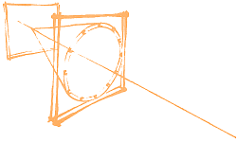
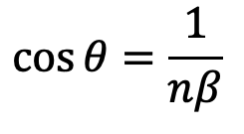
Ring Imaging Cherenkov detectors with aerogel radiators
If the Cherenkov radiation angle is measured, the precision in the determination (identification) of particle masses will be higher than in threshold counters.
In the 1980s and 1990s, a whole series of RICH detectors were constructed:
  CRID, SLD detector, SLAC(C₆F₁₄ n=1.277, C₅F₁₂/N₂ n=1.0017)
  RICH, Delphi detector, CERN, (C₅F₁₂|C₆F₁₄, C₄F₁₀)
  RICH, CLEOIII detector, Cornell, (LiF, n=1.50)
  DIRC, детектор BaBar, SLAC, USA (SiO₂, n=1.47)
Main problem – they do not provide π-K identification in the momenta range 4÷10 GeV/c
Material with n=1.03-1.05 is needed. Aerogel!
$$\cos{θ=\frac{1}{nβ}}$$
A.Roberts, NIM 9(1960)55
J.Seguinot and T.Ypsilantis, NIM 142(1977)377

Slide 6
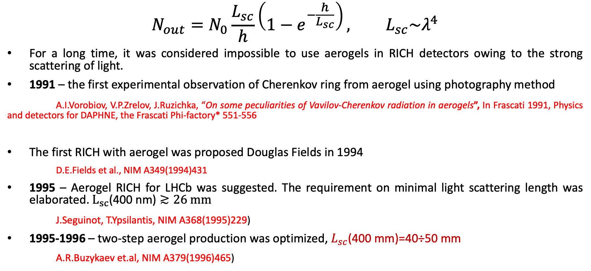
Peculiarities of aerogel use in RICH detectors
$$N_{out}=N_{0}\frac{L_{sc}}{h}\left(1−e^{−\frac{h}{L_{sc}}}\right), L_{sc}\sim λ^{4}$$
For a long time, it was considered impossible to use aerogels in RICH detectors owing to the strong scattering of light.
1991 – the first experimental observation of Cherenkov ring from aerogel using photography method
A.I.Vorobiov, V.P.Zrelov, J.Ruzichka, “On some peculiarities of Vavilov-Cherenkov radiation in aerogels”, In Frascati 1991, Physics and detectors for DAPHNE, the Frascati Phi-factory* 551-556
The first RICH with aerogel was proposed Douglas Fields in 1994
D.E.Fields et al., NIM A349(1994)431
1995 – Aerogel RICH for LHCb was suggested. The requirement on minimal light scattering length was elaborated. $L_{sc}\text{(400 }\text{nm}\text{)}≳26 mm$
J.Seguinot, T.Ypsilantis, NIM A368(1995)229)
1995-1996 – two-step aerogel production was optimized, $L_{sc}$(400 mm)=40÷50 mm
A.R.Buzykaev et.al, NIM A379(1996)465)

Slide 7
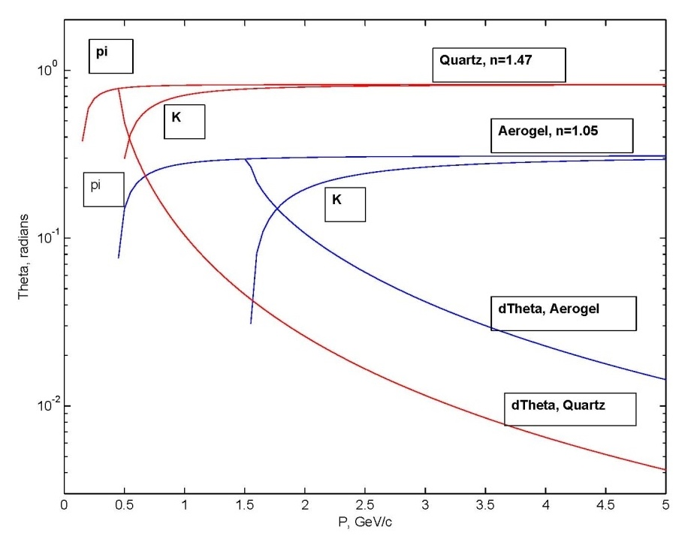
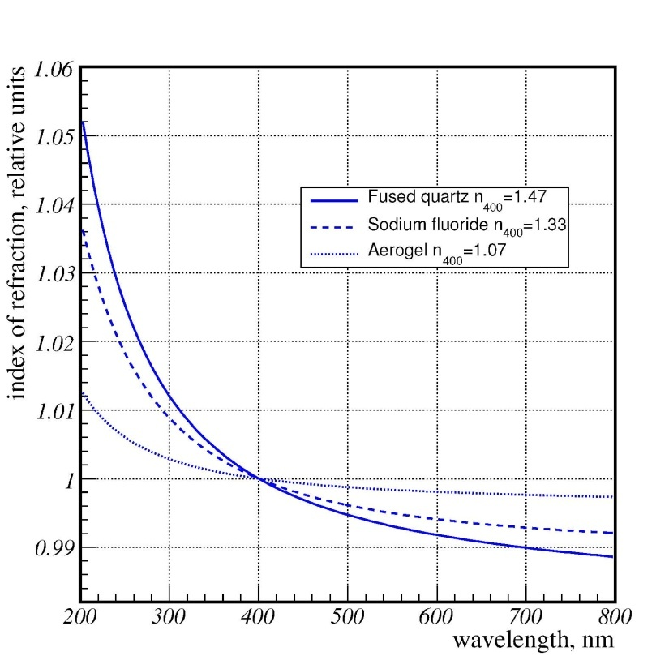
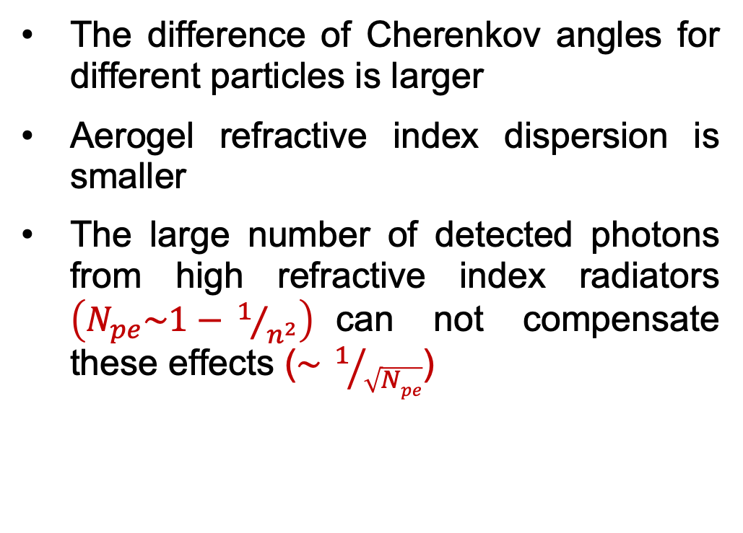
Why Aerogel RICH?
The difference of Cherenkov angles for different particles is larger
Aerogel refractive index dispersion is smaller
The large number of detected photons from high refractive index radiators $\left(N_{pe}\sim 1−{ 1}/{n^{2}}\right)$can not compensate these effects ($\sim { 1}/{\sqrt{Npe}}$)

Slide 8
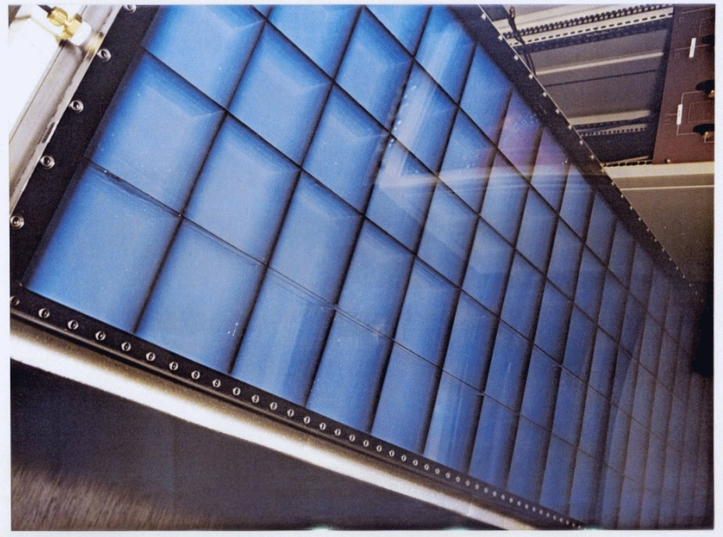
The first aerogel RICH
Hermes RICH (DESY, Gamburg)
Investigate spin structure of nuclons
π/K/p – separation at 2÷15 GeV/c
aerogel, n=1.03 -> π/K – separation 2÷7 GeV/c
C₄F₁₀, n=1.0014 -> π/K – separation 7÷15 GeV/c
Start of the design – 1996
1020 aerogel tiles 114x114x11mm³
Start of the operation -- 1998
Y.Miyachi, NIM A502(2003)202

Slide 9
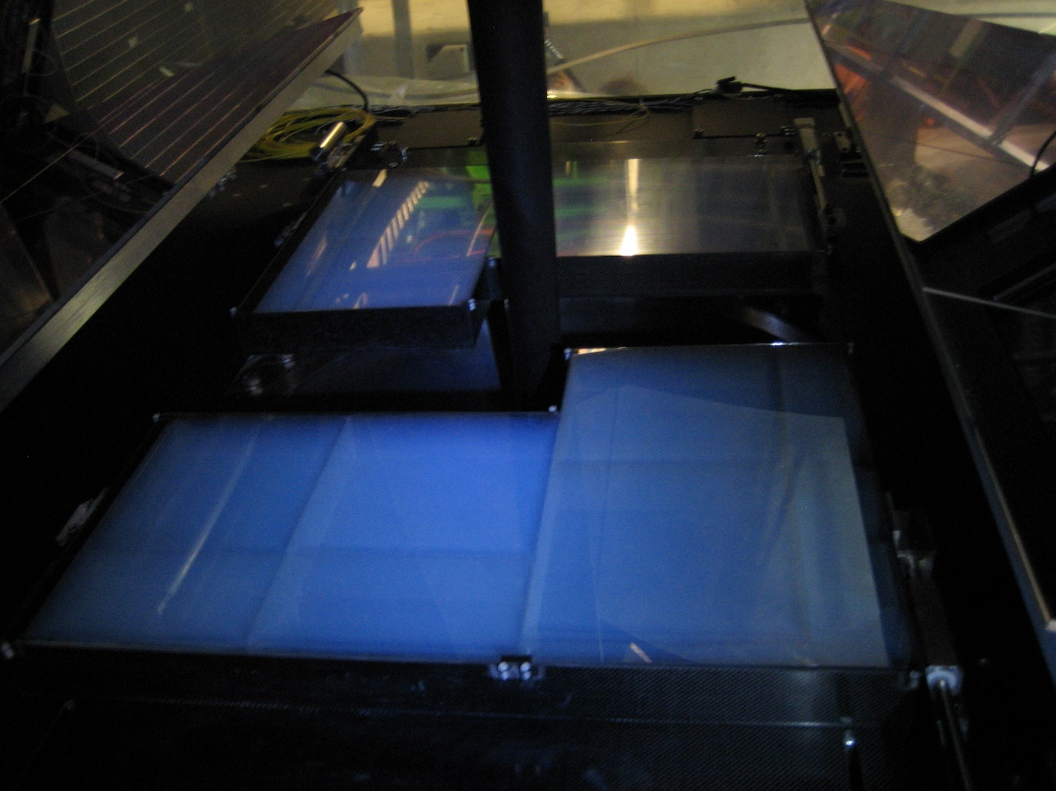
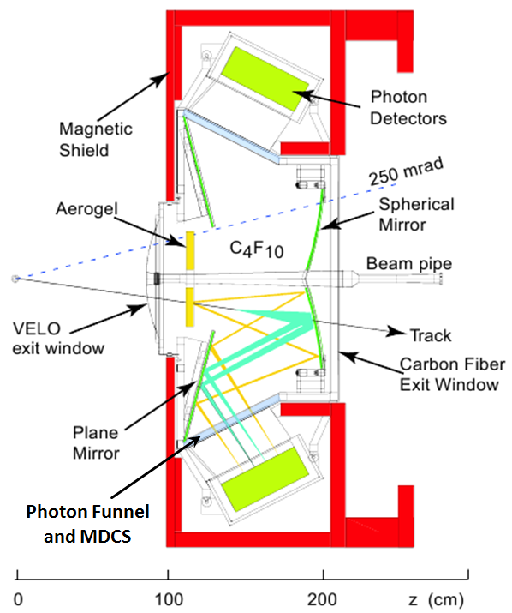
Aerogel in LHCb (LHC-CERN)
measure the parameters of CPV in the interactions of b-hadrons
BIC/BINP production, n=1.03, 20x20x5 cm tiles
Aerogel did not work – small number of photoelectrons in the ring + strong pile-up noise

Slide 10
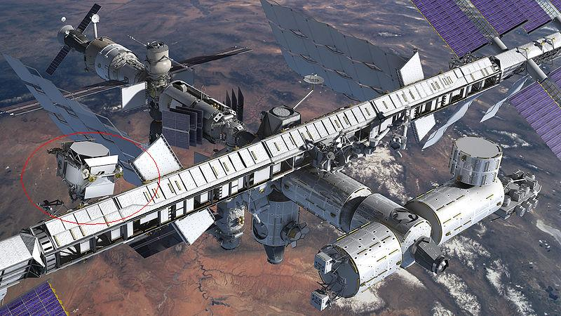
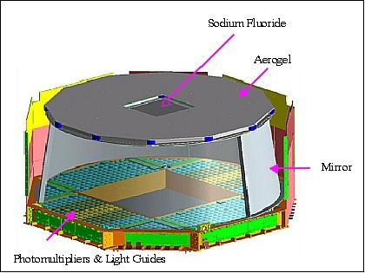
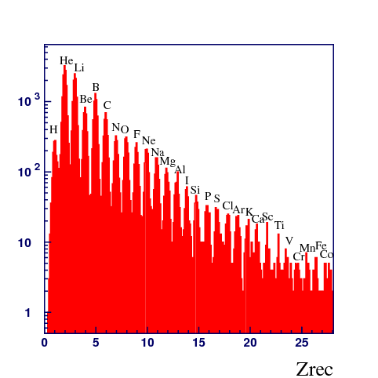
Aerogel RICH at AMS-02 at ISS
Measurement of Z of the nucleon, N_{pe}~Z²
BIC/BINP production, n=1.05
More than 10 years in operation since 2010
Very well agreement experimental measured parameters with expected (required) in the project
F.Giovacchini et al., NIM A970 (2020) 163657

Slide 11
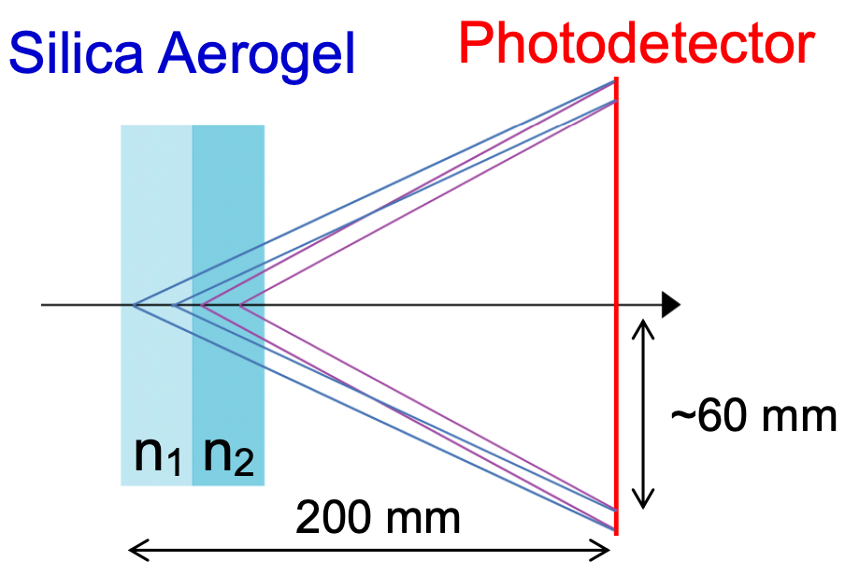
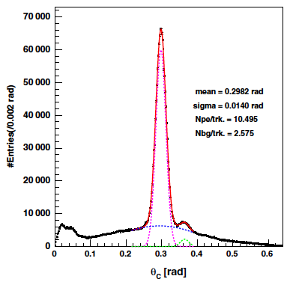
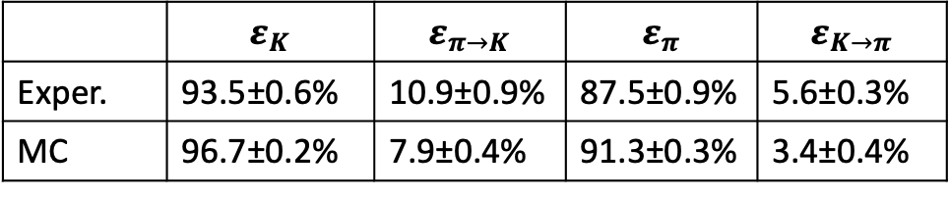
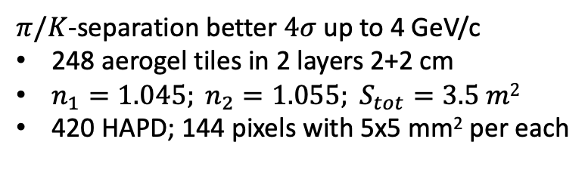
Belle II: ARICH
TBeam results
The first application of technique in Belle2 ARICH
Belle II
Proximity focusing aerogel RICH
Stack of two blocks with different n:
  n₁=1.045 / 20 mm
  n₂=1.055 / 20 mm
Focal distance 200 mm
Increase N_{pe} due thickness increase without σ_{Θc} degradation
$π/K$-separation better $4σ$ up to 4 GeV/c
248 aerogel tiles in 2 layers 2+2 cm
$n_{1}=1.045; n_{2}=1.055; S_{tot}=3.5 m2$
420 HAPD; 144 pixels with 5х5 mm² per each
PTEP 2016, 033H01
 | $$ε_{K}$$ | $$ε_{π→K}$$ | $$ε_{π}$$ | $$ε_{K→π}$$
Exper. | 93.5±0.6% | 10.9±0.9% | 87.5±0.9% | 5.6±0.3%
MC | 96.7±0.2% | 7.9±0.4% | 91.3±0.3% | 3.4±0.4%
T.Iijima et al., NIM A548 (2005) 383
Y.-T. Lai et al 2020 JINST 15 C07039
Notes:
Идея ФАРИЧ появилась в 2004 г.
Точность измерения черенковского угла связана с точностью измерения скорости, а значит с качеством разделения частиц.

Slide 12
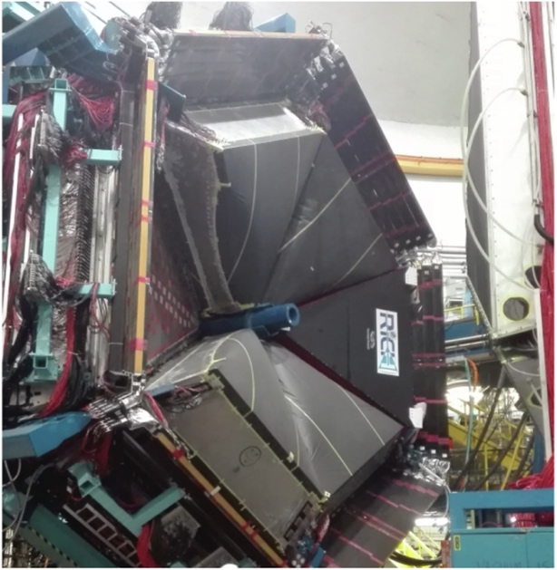
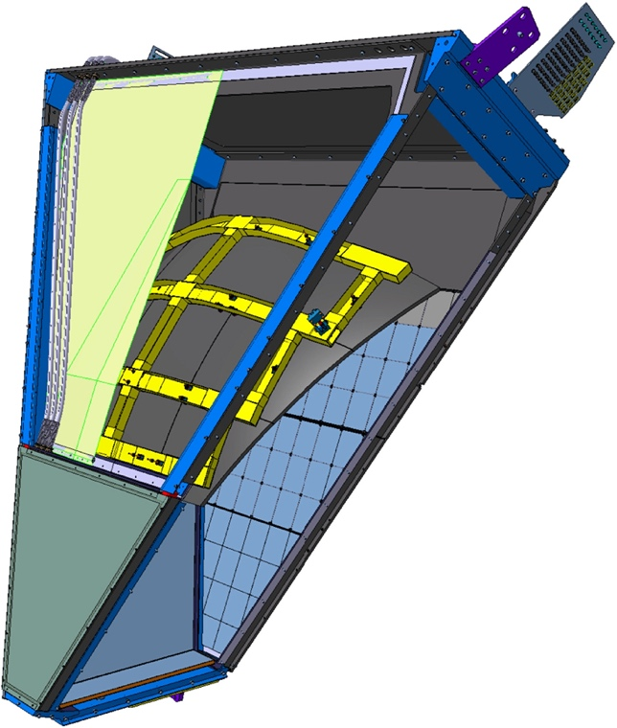
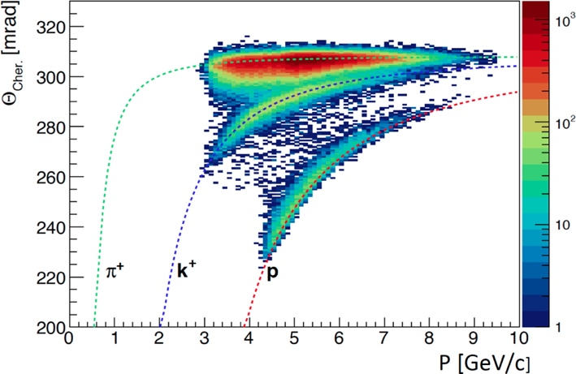
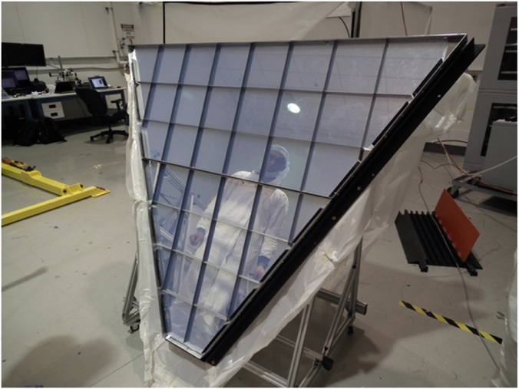
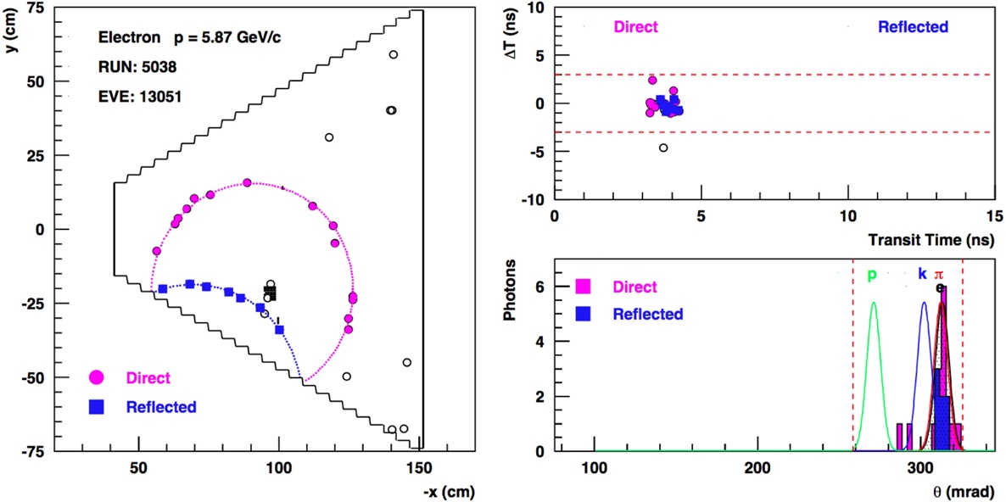
CLAS-12 RICH (J-Lab, Newport)
Investigate spin structure of nuclons
π/K/p-separation at 3÷8GeV/c
Aerogel n=1.05
2 sectors with 102 tiles 20x20x3(2)cm³/each
M. Contalbrigo et al., NIM A964 (2020) 163791

Slide 13
Aerogel R&Ds at the BINP

Slide 14

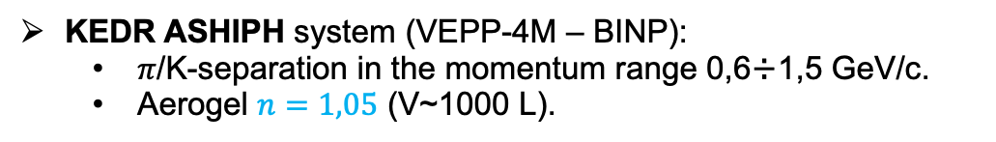
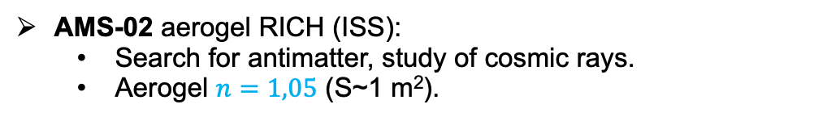

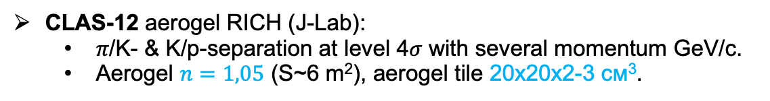
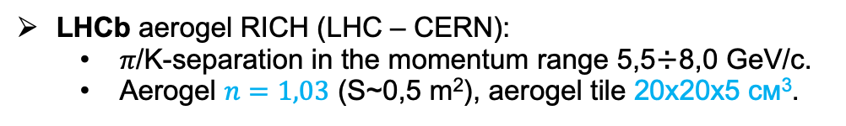
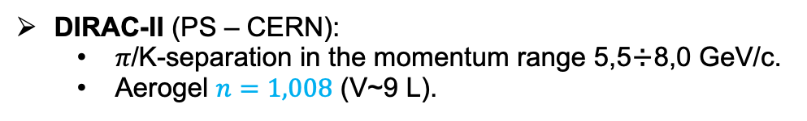
History of aerogel radiators in Novosibirsk
KEDR ASHIPH system (VEPP-4М – BINP):
  𝜋/K-separation in the momentum range 0,6÷1,5 GeV/с.
  Aerogel $n=1,05$ (V~1000 L).
SND ASHIPH system (VEPP-2000 – BINP):
  𝜋/K-separation in the momentum range 300÷870 MeV/с.
  Aerogel $n=1,13$ (V~9 L).
DIRAC-II (PS – CERN):
  𝜋/K-separation in the momentum range 5,5÷8,0 GeV/с.
  Aerogel $n=1,008$ (V~9 L).
AMS-02 aerogel RICH (ISS):
  Search for antimatter, study of cosmic rays.
  Aerogel $n=1,05$ (S~1 m²).
LHCb aerogel RICH (LHC – CERN):
  𝜋/K-separation in the momentum range 5,5÷8,0 GeV/с.
  Aerogel $n=1,03$ (S~0,5 m²), aerogel tile 20х20х5 см³.
CLAS-12 aerogel RICH (J-Lab):
  𝜋/K- & K/p-separation at level 4𝜎 with several momentum GeV/с.
  Aerogel $n=1,05$ (S~6 m²), aerogel tile 20х20х2-3 см³.
Aerogel RICH for CLAS12

Slide 15
Novosibirsk aerogels is hydrophilic!
Aerogel with bulk density 0.24 g/cm³ has internal surface area by 10⁶ times larger than external.
There are a lot of OH−groups at the aerogel SiO₂ surface. These groups are primary adsorption centres which are able to attract hundreds of the H₂O molecules per each.
In the hydrophobic aerogels OH−groups are exchanged by hydrophobic radicals such like Si(CH₃)₃
Influence of adsorbed water on optical parameters of hydrophilic aerogels produced in Novosibirsk are very well studied already.
Heating of hydrophobic aerogel up to above 175℃ makes it hydrophilic. Also more active radicals are able to replace Si(CH₃)₃ – groups and change aerogel optical parameters.
Before the finalization of any aerogel based counters design it is necessary to investigate influence of materials (such like WLS, hermetics or second gas/liquid Cherenkov radiators) which are going to be used in the construction on aerogel transparency.

Slide 16
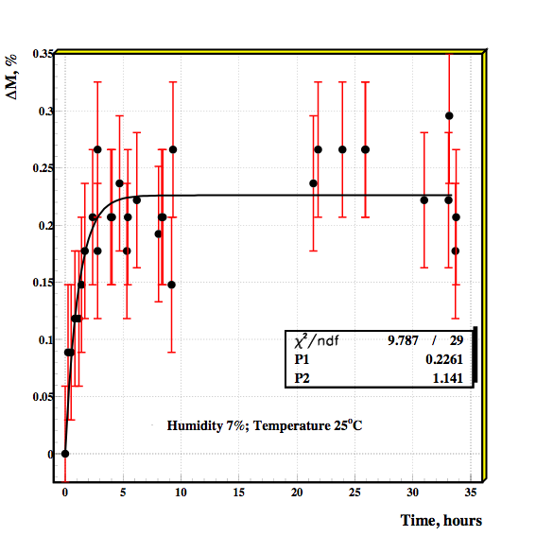
Water adsorption by aerogel
Adsorption
Desorption
Water adsorption and desorption are the fast processes with time constant about 1 hour.
Amount of adsorbed water depends on relative humidity of invironment.

Slide 17
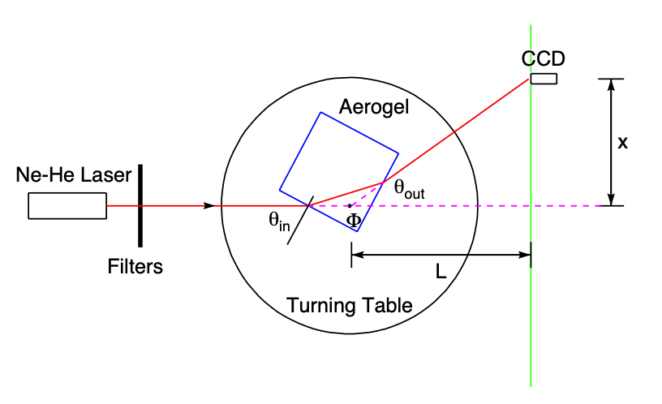
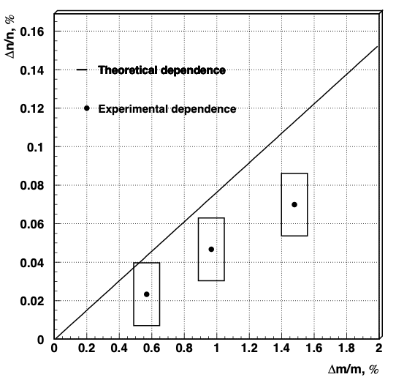
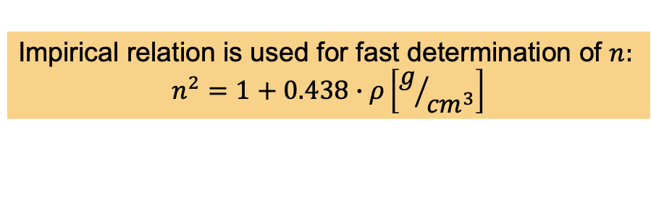

Refractive index
Impirical relation is used for fast determination of $n:$
$$n^{2}=1+0.438∙ρ\left[g/{{cm}^{3}}\right]$$
For theoretical dependence Lorentz-Lorentz formula
was used, which was expressed to calculate refractive
index of gases mixtures but it very often works for other
mixtures.
$n$ dependence on water adsorption

Slide 18
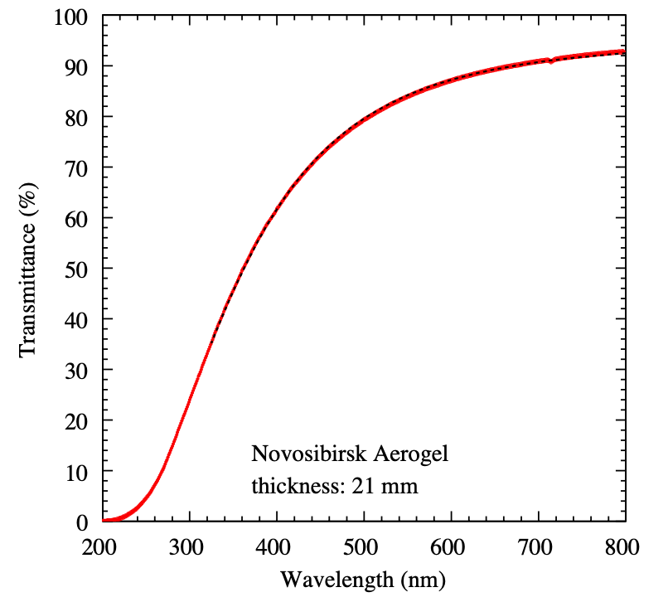
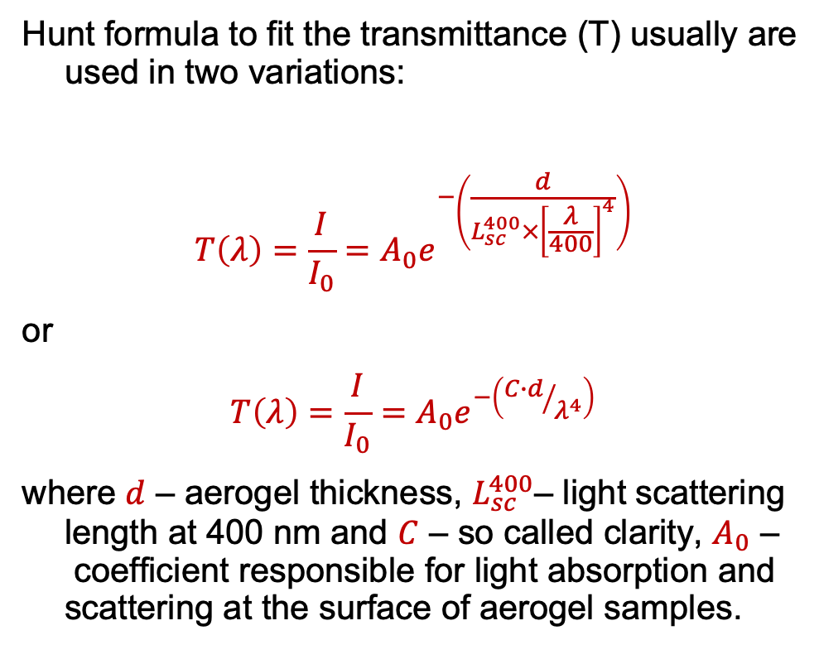
Aerogel transmittance and parameters of Rayleigh light scattering
Hunt formula to fit the transmittance (T) usually are used in two variations:
$T\left(λ\right)=\frac{I}{I_{0}}=A_{0}e^{−\left(\frac{d}{L_{sc}^{400}×{\left[\frac{λ}{400}\right]}^{4}}\right)}$
or
$T\left(λ\right)=\frac{I}{I_{0}}=A_{0}e^{−\left({C∙d}/{λ^{4}}\right)}$
where $d$ – aerogel thickness, $L_{sc}^{400}$– light scattering length at 400 nm and $C$ – so called clarity, $A_{0}$ – coefficient responsible for light absorption and scattering at the surface of aerogel samples.

Slide 19
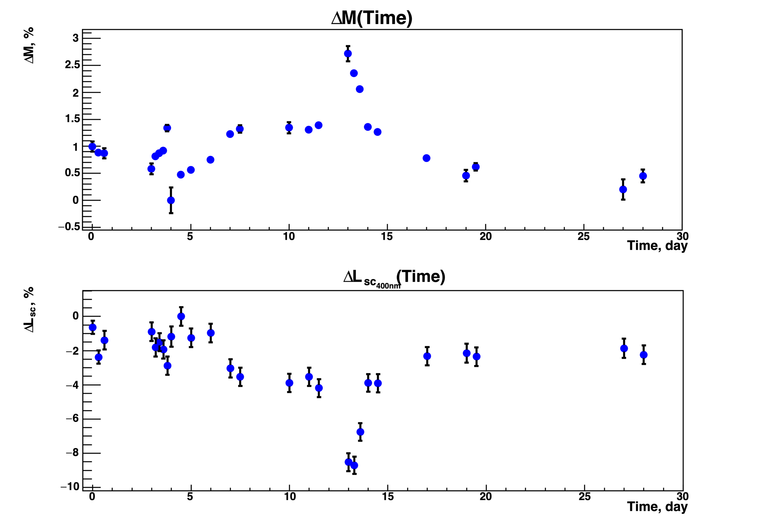
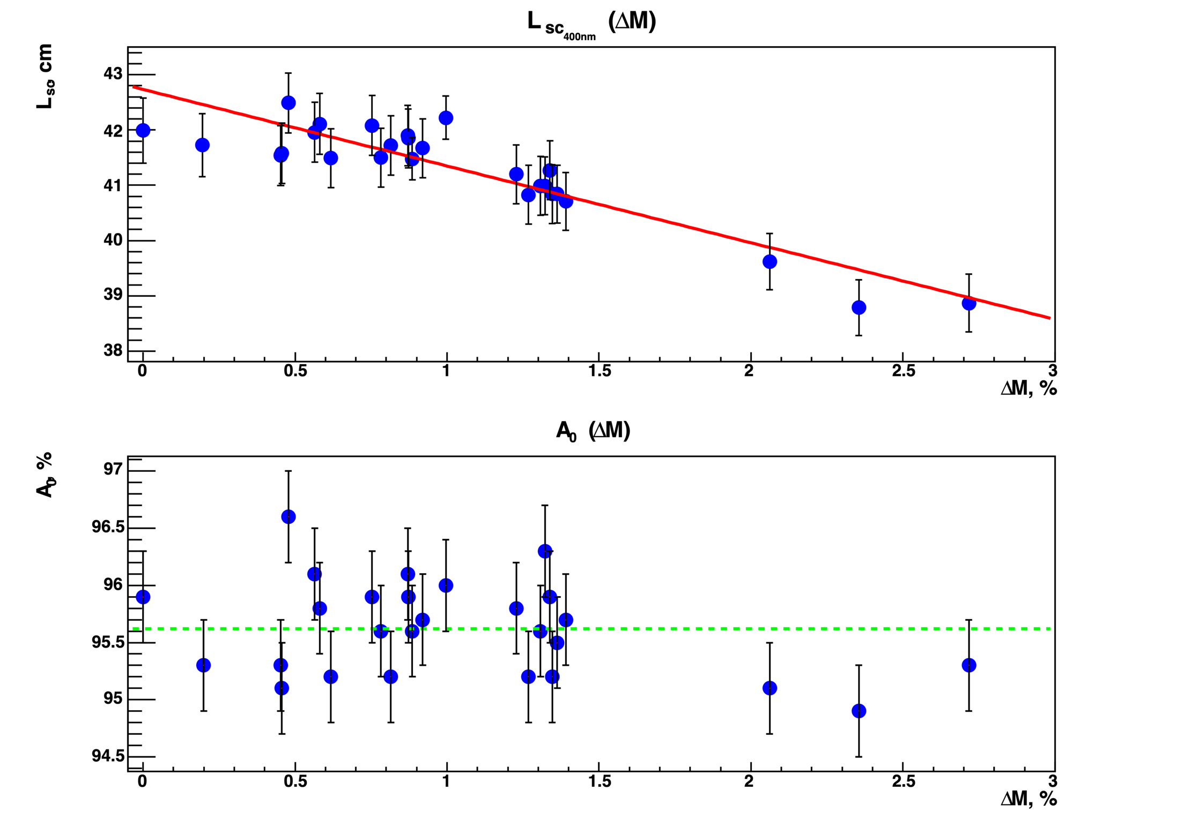
Influence of adsorbed water on Raleigh light scattering
Raleigh light scattering in aerogel strongly dependce on amount of adsorbed water the effects of light scattering length decrease in normal conditions doesn’t exceed 10% (L_{sc}(400 nm) drops from 43 to 38 mm).
T. Bellunato, et al., NIM A 527(3) (2004) 319

Slide 20
FARICH – 19 years of R&Ds (since 2004)

Slide 21
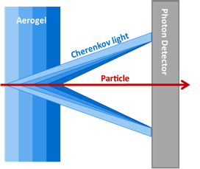
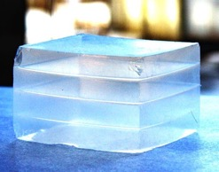
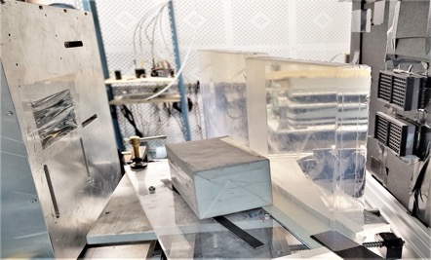
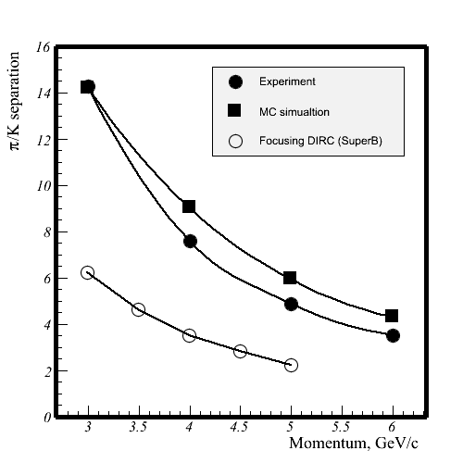
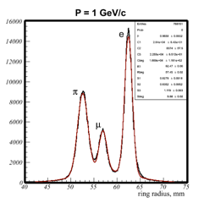
FARICH technique
2004÷2005
The first 4-layer monolithic sample
The Belle II (ARICH) is the first application of the method
n=1.030 6.0mm
n=1.027 6.3mm
n=1.024 6.7mm
n=1.022 7.0mm
Increase N_{pe} due thickness increase without σ_{Θc} degradation
T.Iijima et al., NIM A548 (2005) 383 and A.Yu.Barnyakov et al., NIM A553 (2005) 70
2017
Excellent PID capability were shown at CERN beam test in 2012
Two 4-layer focusing aerogel blocks
230x230x35 mm
A.Yu. Barnyakov, et al., NIM A 732 (2013) 352
2022÷2023
Notes:
Идея ФАРИЧ появилась в 2004 г.
Точность измерения черенковского угла связана с точностью измерения скорости, а значит с качеством разделения частиц.

Slide 22

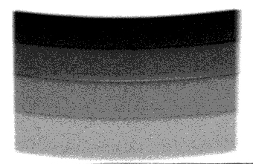
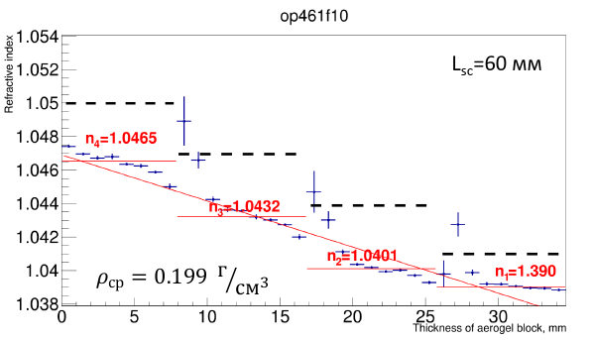

The largest 4-layers focusing aerogel samples
MaPMT H12700 (Hamamatsu)
with mask 3х3 mm²
2 aerogel pcs
230x230x35 mm
GEM
$$e^{−}$$
Refractive index profile is measured with help of didgital X-ray setup at the BINP.
Single photon Cherenkov angle resolution is investigated with relativistic electrons at BINP beam test facilities ”Extracted beams of VEPP-4M complex”.

Slide 23
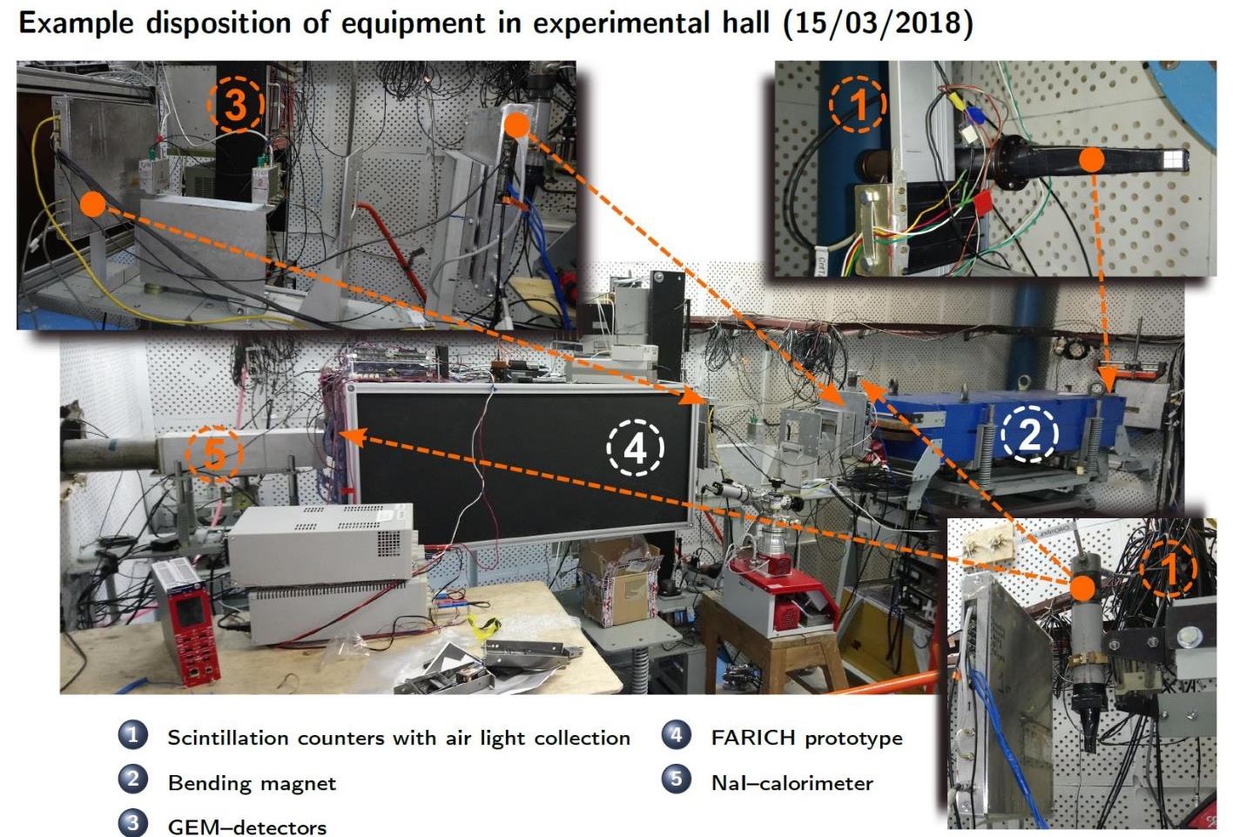
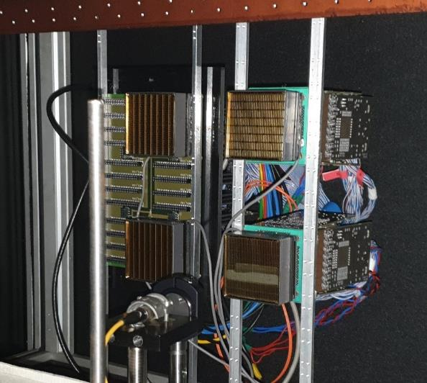
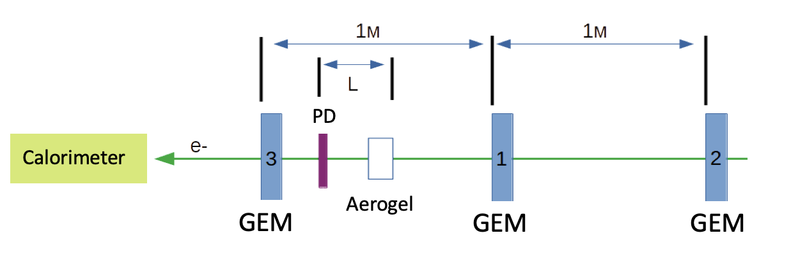
BINP beam test facility
4 MaPMT H12700
G N Abramov et al 2014 JINST 9 C08022

Slide 24
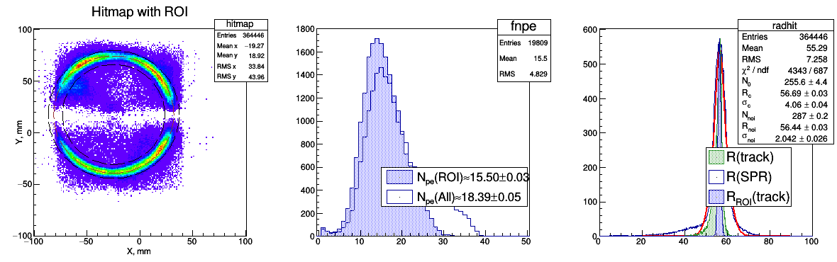
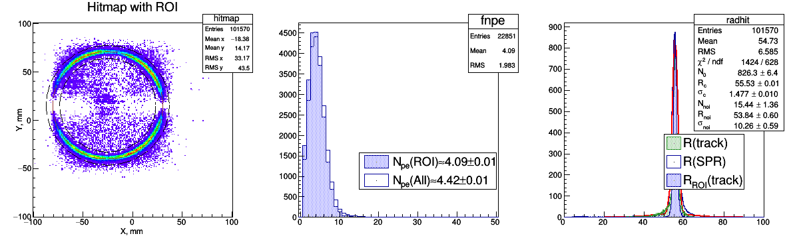
Beam test results
Pixel 6x6 mm
Geom.Eff. ~ 80%
Pixel 3x3 mm
Geom.Eff. ~ 20%

Slide 25



Cherenkov angle Single Photo-Electron (SPE) resolution
Belle II
PTEP 2016, 033H01
TBeam
Simulation
Aerogel: 20+20 mm (Chiba Univ.)
n(400nm): 1.045 +1.055
Pixel: 5x5 mm
4-layers (Novosibirsk) –>
1.039 ÷ 1.046
6x6 mm
–
–
3x3 mm
4-layers (ideal profile)
1.041 ÷ 1.050
3x3 mm
Geom.Eff. ~ 90%
$$N_{pe}≈10.5$$
Geom.Eff. ~ 80%
$$N_{pe}≈16$$
Geom.Eff. ~ 20%
$$N_{pe}≈4$$
The excellent single photon Cherenkov angle resolution ~7÷8 𝑚𝑟𝑎𝑑 was achieved with the 4-layer focusing aerogel tiles
with dimensions 23x23x3.5 cm for the first time in 2022!!!
This circumstance allows us to consider the FARICH detector design based on 4-layer focusing aerogel tiles with large dimensions (23x23x3.5 cm).

Slide 26







FARICH system for the SCTF
GEANT4 simulation
of edge effects
Aerogel layout
275 tiles 200x202x35 in barrel part
2x55 trapezoidal tiles in end caps:
2x12 – inner radius
2x18 – medium radius
2x25 – outer radius
Proximity focusing RICH
4-layer focusing aerogel
  n_{max} = 1.05 (1.07?), total thickness 35 mm
  $S_{aer}=15 m^{2}$
21 m² – total area of photon detectors
  • SiPMs – barrel part (16 m²)
  • MCP-PMT – endcap parts (4 m²)
~10⁶ pixels 3х3 mm² with pitch 4 mm
SHAPE | $$∆, mm$$ | Aerogel size, mm
 |  | 200 | 100 | 75 | 50
Parallelepiped | 6 | 0.86 | 0.74 | 0.62 | 0.5
Trapezoidal | 1 | 0.96 | 0.94 | 0.92 | 0.9
Notes:
Идея ФАРИЧ появилась в 2004 г.
Точность измерения черенковского угла связана с точностью измерения скорости, а значит с качеством разделения частиц.

Slide 27




FARICH edge effects: simulation & experiment
Parallelepiped shape aerogel G4sim
Tracks are in a midle of aerogel tile
Beam test & sim. results
Black paper between aerogel blocks
Tracks are in 6±4 mm from aerogel tile edge

Slide 28
FARICH proposal for SPD-NICA experiment

Slide 29

NICA: Nucleon Ion Colliding fAcility
https://nica.jinr.ru/complex.php

Slide 30


SPD: Spin Physics Detector
• Polarized $p$ (or $d$)
• 2E = 27 GeV (or 13.5 GeV/nucl)
• L = 10³² cm⁻²s⁻¹ (or 10³¹ cm⁻²s⁻¹)
PID:
• π/K/p - separation
• ToF (60ps) + Aerogel
http://spd.jinr.ru

Slide 31



FARICH option for SPD
π/K – separation in wide momenta range
Improve momentum resolution
A.Yu. Barnyakov, et al., NIM A 732 (2013) 352
A.Yu. Barnyakov, et al., NIM A 639 (2011) 290
Recent TBeam results:
$σ_{SPE}=7.5 mrad$
$N_{PE}=16$
π/K @ 8 GeV/c : $\frac{θ_{C}^{π}−θ_{C}^{K}}{{σ_{SPE}}/{\sqrt{N_{pe}}}}=\frac{309−303}{1.875}>3σ$
Precise mesurement of velocity with FARICH
improves momentum resolution: ${σ_{p}\left(K\right)}/p=1\%$@1 GeV/c
DC (Straw tubes): ${σ_{p}}/p=2\%$@1 GeV/c

Slide 32




Aerogel layout
For two endcap FARICH detectors it is required:
– 136 ”good” aerogel tiles 23x23x3.5 cm (5.44 m²);
– Produce, select and characterise $\sim 2×136$aerogel tiles with help of digital X-ray setup and other laboratory satnds including electron beam test facilities* at BINP;
– Cutt off 136 tiles in 4 different trapziodal shapes;
– 106 ”good” aerogel tiles 23x23x3.5 cm (4.24 m²);
– Produce, select and characterise $\sim 2×106$aerogel tiles with help of digital X-ray setup and other laboratory satnds including electron beam test facilities* at BINP;
– Cutt off 106 tiles in 2 rectangular and 2 trapziodal shapes;
2.5÷3 years for production
2÷2.5 years for production

Slide 33
FARICH with dual aerogel radiator

Slide 34




PID options for $π/K$ – separation
A.Yu. Barnyakov et al 2020 JINST 15 C04032
${dE}/{dx}$
  $\frac{σ_{{dE}/{dx}}}{\left\langle {dE}/{dx}\right\rangle }≤7\%→ ≥3σ$ up to 0.6 GeV/c
  $\frac{σ_{{N_{cl}}/{dx}}}{\left\langle {N_{cl}}/{dx}\right\rangle }≤4\%$ $→ ≥3σ$ up to 0.9 GeV/c
Focusing Aerogel RICH (FARICH)
(4 layer @ $n_{max}$=1.05) $→ ≥3σ$ from 0.5 to 6 GeV/c
ASHIPH@SiPM (n₁=1.03 and n₂=1.015) $→ ≥3σ$ from 0.6 to 3.5 GeV/c
Parametric simulation
EPJ Web of Conferences 212, 01012 (2019),
A.Yu. Barnyakov et al 2020 JINST 15 C04032
A.Yu. Barnyakov, et al., NIM A 732 (2013) 35

Slide 35






PID options for µ$/π$ – separation
${dE}/{dx}$
  $\frac{σ_{{dE}/{dx}}}{\left\langle {dE}/{dx}\right\rangle }≈7\%→ ≥3σ$ up to 0.15 GeV/c
  $\frac{σ_{{N_{cl}}/{dx}}}{\left\langle {N_{cl}}/{dx}\right\rangle }≈4\%$ $→ ≥3σ$ up to 0.25 GeV/c
TOF with $σ_{t}≈$100 ps $→ ≥3σ$ up to 0.2 GeV/c, e.g. Chernkov light from entrance window of MCP-PMT
FARICH (4-layer, $n_{max}$=1.05) $→ ≥3σ$ from 0.5 to 1.5 GeV/c
$∆T, ns$
$P, GeV/c$
Results of parametric simulation tuned with results of beam test campaign in 2021:
– SPR$\left(β=1,∎3 \text{mm}\right)$= 1.63 mm
– SPR$\left(β=1, \text{ø1 }\text{mm}\right)$= 1.36 mm
FARICH with dual aerogel radiator is proposed
to provide µ$/π$ – separation for 0.2≤P≤0.5 GeV/c
A.Yu.Barnyakov et al., NIMA 1039 (2022) 167044

Slide 36


RICH with dual radiators is not very new idea!
P=2 GeV/c
Liquid + Gas:
  RICH – DELPHI
  CRID – SLD
    C₆F₁₂(n=1.278@190nm) + C₅F₁₀(n=1.00174@190nm)
Aerogel + Gas:
  HERMES
  RICH1 – LHCb
    Aer.(n=1.03@400nm) + C₄F₁₀(n=1.00137@400nm)
Aerogel + Crystal:
  RICH+ToF – SuperB:
    Aer.(n=1.05@400nm) + Quartz (n=1.47@400nm)
  FARICH – SuperB:
    3-layer aer. n_{max}=1.07@400nm + NaF (n=1.33@400nm)
Aerogel + Aerogel:
  FARICH – SCTF:
    4-layer aer. n_{max}=1.05@400nm + aer (n=1.12@400nm)
Aerogel is material with easy tunnable refractive index!

Slide 37




Aerogels with high optical density
Sintering approach
ZrO₂ addition approach
230 мм
n=1.05
n=1.12
230 мм
n=1.2
n=1.25
L_{sc}(400nm)
The first sample of
SiO₂–ZrO₂ aerogel
n=1.13
Refractive index
The addition of small amount (0.03÷0.06 mol) of ZrO₂ in SiO₂ based aerogel alow us to produce highly transperant aerogels with high optical density:
Refractive index up to n=1.12
Rayleigh light scattering length L_{sc}(400nm) up to 30 mm
The main flaw
of this approach

Slide 38



Beam tests results of FARICH with dual radiator
ZrO₂–SiO₂ aerogel:
Thickness 12 mm & ø20 mm;
L_{sc}(400nm)=21±0.5 mm;
ZrO₂ aerogel
Photon detector
4-layer SiO₂ aerogel:
100x100x35 mm;
L_{sc}(400nm)=37±0.3 mm;
GEM3
GEM2
Photon detector
4 MaPMT H12700 (Hamamatsu);
256 pixels with 3x3 mm size;
GEM1–GEM2
GEM1
GEM1–GEM2–GEM3

Slide 39


G4 simulation vs beam test results
TBeam results
Optical parameters for G4 simultion
G4 simulation results
PDE for H12700 from data-sheet
Pixel 3x3 mm with pitch 6mm
Focal distance L=172 mm
The main difference between G4sim and TBeam is a photon small angle scattering effect on aerogel surfaces and inside. These effects have not implemented in G4sim yet.

Slide 40









µ/π-separation via G4 simulation
FARICH: "ideal” $n$ profile
FARICH (“ideal”)+ZrO₂–aer. ($n$=1.12/12 mm)
$$N_{σ}=\frac{{\overline{R}}_{C}^{µ}−{\overline{R}}_{C}^{π}}{{\left(σ_{R}^{π}+σ_{R}^{µ}\right)}/2}$$
$${\left(L_{f}−t_{Zr}−t_{Fa}\right)∙\frac{\sqrt{\left({n_{Fa}^{min}}^{2}−1\right)−\frac{m^{2}}{p^{2}}}}{\sqrt{\frac{m^{2}}{p^{2}}+1}}≤R}_{Fa}≤\left(L_{f}−t_{Zr}\right)∙\frac{\sqrt{\left({n_{Fa}^{max}}^{2}−1\right)−\frac{m^{2}}{p^{2}}}}{\sqrt{\left({n_{Fa}^{max}}^{2}−2\right)+\frac{m^{2}}{p^{2}}}}$$
$${\left(L_{f}−t_{Zr}\right)∙\frac{\sqrt{\left({n_{Zr}}^{2}−1\right)−\frac{m^{2}}{p^{2}}}}{\sqrt{\frac{m^{2}}{p^{2}}+1}}≤R}_{Zr}≤L_{f}∙\frac{\sqrt{\left({n_{Zr}}^{2}−1\right)−\frac{m^{2}}{p^{2}}}}{\sqrt{\left({n_{Zr}}^{2}−2\right)+\frac{m^{2}}{p^{2}}}}$$

Slide 41
RICH with Fresnel lens

Slide 42

EIC project
Key EIC Characteristics (parameters)
– High particle collision rate $L = {10}^{34}{cm}^{−2}s^{−1}$ $\left(\int{L}dt=100{fb}^{−1}/year\right)$
– Large center-of-mass energy range $ECM = 20÷140 GeV$
– electrons $2.5÷18 GeV$
– protons $40÷275 GeV (ions: Z/A×Ep)$
– Polarized beams of electrons and ions $(up to 70\%)$
– Large range of ion species $(p→U)$
– At least one large-acceptance detector
– Projected budget: $≈\$2.4 billion$ – Start date: $≈2031$
Almost approved concept since begin of 2022

Slide 43



ECCE-PID & mRICH system concepts
ECCE = EIC Comprehensive Chromodynamics Experiment
Physics requirements
  pion, kaon and proton ID
  over a wide range |η| ≤ 3.5
  with better than 3σ separation
  significant pion/electron suppression
Momentum-rapidity coverage
  forward: up to 50 GeV/c
  central: up to 6 GeV/c
  backward: up to 10 GeV/c
Demands different technologies
Cherenkov detectors:
  dRICH = dual RICH (aerogel + gas)
  hpDIRC = high-performance DIRC (synthetic fused silica)
  mRICH = modular RICH (aerogel + Fresnel lens)
68 modular counters oriented to IP:
– aerogel n=1.03 100x100x40 mm³
– acrylic Fresnel lens with focal distance 6”
– position sensitive photon detector HRRPD (MCP-PMT) or SiPM arrays

Slide 44

Aerogel RICH with Fresnel lens
Such approach allows us to improve Cherenkov angle resolution and optimize photo detectors area!

Slide 45


The thick aerogel for mRICH – EIC project
op460f11
BINP 2022:
single block 23x23x4 cm
with n=1.027
from BIC
230
230
40
n=1.027
FermiLAB 2021: stack of three 1 cm thickness
blocks with n=1.03 from Chiba University
In both cases there is no reason to make the aerogel thickness more than $\left(1÷2\right)∙Lsc:$
$$N_{out}=N_{0}\frac{L_{sc}}{h}\left(1−e^{−\frac{h}{L_{sc}}}\right), L_{sc}\sim λ^{4}$$
In case of approach “stack” the additional Cherenkov photons loss is occurred due to reflectance and scattering on the additional surfaces
There are two not cut off surfaces in aerogel
  “Optical surface” – it contacts only with air during the production
  “Bottom” – it contacts with metallic frame during the production processes
Several configuration of the aerogel Cherenkov radiators were tested with relativistic electron beams at BINP beam test facilities in 2022.

Slide 46






Cherenkov angle single photon resolution (SPR)
17.6 mm
457f4
19.0 mm
457f3
30.0 mm
460f4_3
19.0+17.6 mm
457f3+457f4
40. mm
460f11_22
50. mm
460f15_3
 | 457f4 | 457f3 | 460f4_3 | 457f3_f4 | 460f11_22 | 460f15_3
t/L, mm | 17.6/185 | 19.0/175 | 30.0/185 | 36.6/185 | 40.0/185 | 50.0/185
$σ_{θ_{C}}^{SPR}$, mrad | 14.46±0.06 | 15.92±0.06 | 16.96±0.05 | 20.8±0.1 | 24.0±0.1 | 26.7±0.1
N_{pe}^{* – 60% of the ring} | 4.01±0.01 | 4.16±0.01 | 7.69±0.02 | 5.51±0.02 | 8.22±0.03 | 8.05±0.02
$σ_{θ_{C}}^{trk}=\frac{σ_{θ_{C}}^{SPR}}{\sqrt{N_{pe}}}$,mrad | 7.2 | 7.8 | 6.1 | 8.9 | 8.4 | 9.4
$σ_{R_{C}}^{ROI}$, mm | 1.11±0.03 | 1.08±0.04 | 1.20±0.02 | 1.33±0.06 | 1.35±0.04 | 1.37±0.07
$$σ_{θ_{C}}^{R}≈\frac{1}{n^{2}}\frac{σ_{R_{C}}}{L−t/2}$$ | 5.9 | 6.15 | 6.65 | 7.5 | 7.7 | 8.1
Photon detector
t
$$R_{C}$$
Cherenkov light
L=175 mm
$θ_{C}^{R}=\arctan\left(\frac{R_{C}}{L−t/2}\right)$,
$σ_{θ_{C}}^{R}=\cos^{2}{θ_{C}}\left(\frac{1}{L−t/2}\right)∙\sqrt{{σ_{R_{C}}}^{2}+\tan^{2}{θ_{C}∙\left(σ_{L}^{2}+σ_{t}^{2}\right)}}≈\frac{1}{n^{2}}\frac{σ_{R_{C}}}{L−t/2}$,
How much effect from Fresnel lens is expected?!

Slide 47
Position-sensitive photon detectors

Slide 48





Photon detector options
Due to axial magnetic field the SiPM is only one possible candidate for the cylindrical part of the FARICH system!!!
For the endacp regions there are three options of photon detectors.
SiPM arrays
MCP-PMT
HAPD
There are several manufacturer in the world including China.
There is no comercially available SiPM arrays produced in Russia for the moment, but some R&Ds are going now.
Estimated cost of such detector option is about 100$/cm²
It is required to develop and produce special R/O electronics and cooling system to operate with SiPMs in SPD detector conditions
There are several manufacturer in the world including China.
There is no comercially available position-sensitive MCP-PMTs produced in Russia for the moment, but R&Ds are going now in (Baspik&Ekran FEP).
There is a very large spread of prices for rectangular position-sensitive MCP-PMT. The best price is about 200$/cm²
PDE is not so high, it is limited by photoelectron collection efficiency (~60%) and geometrical efficiency is worse than for SiPM option.
Specialised R/O elctronics is already developed for other experiments and could be adopted for the SPD experiment requirements
There is no such a big problem with intrinsic noise rejecion in comparison with SiPM option
Only Hamamtsu produced such devices for the Belle II experiment and now it doesn’t produced anymore!
There is no comercially available HAPDs in Russia for the moment, but R&Ds are going now in ISP SB RAS.
Price – ???
Expected PDE of such devices will less than for SiPM option but signficantly (1.5 times) higher than for MCP-PMT option.
Expected gain is about $1÷2∙{10}^{5}$
Development of specialised R/O elctronics is needed. It is possible to adopt some Belle II ARICH system expirience.
The S/N-ratio is about 1000, it means that only thermostabilization system to operate at the room temperature will enough for this option.
26.8 mm
73 mm
59 mm
Planacon XP85112
8x8 pixels with 6x6 mm
Cost: 15 $k\$$
KETEK PA3325-WB-0808
(BroadCom, USA)

Slide 49




SiPM array option
Joinbon Tech., China
KETEK-BroadCom, USA
– Endcaps: 2x2490 SiPM arrays 2.7x2.7 cm²
– Barrel: 18 000 SiPM arrays 2.7x2.7 cm²
– 1 470.7k pixels with 3x3 mm²
– Geometrical Efficiency $\frac{S_{detect}}{S_{total}}≈76÷80\%$
– Highly effective cooling sysytem is required!

Slide 50




Position-sensitive MCP-PMT
Hamamtsu R10754-016-M16(N)
59 mm
4x4 pixels with 5x5 mm
Planacon XP85112
8x8 pixels with 6x6 mm
HRPPD (Income)
10x10 cm; pixel 2.5x2.5 mm
NNVT (China)
Collector plane of MCP-PMT
Concept of Ekran FEP
(Summer 2022)
Availabilty: until end of 2023?!
Price: until end of 2023?!

Slide 51






Round vs Square MCP-PMT for the RICH
548 PMTs $∎$58х58 mm (PC $∎$50x50 мм) –>
$$Eff=\frac{548∙5×5}{S_{endcap}}=\frac{13700 {cm}^{2}}{19792{ cm}^{2}}≈0.69$$
16х16=256 pixels 2.9х2.9 mm
$$Eff=\frac{548∙256∙0.29×0.29}{S_{endcap}}=\frac{11798 {cm}^{2}}{19792{ cm}^{2}}≈0.596$$
630 PMTs Ø58 mm (PC Ø50 mm) –>
$$Eff=\frac{630∙π∙{2.5}^{2}}{S_{endcap}}=\frac{12370 {cm}^{2}}{19792{ cm}^{2}}≈0.625$$
216 pixels 2.9х2.9 мм
$$Eff=\frac{630∙216∙0.29×0.29}{S_{endcap}}=\frac{11444 {cm}^{2}}{19792{ cm}^{2}}≈0.58$$

Slide 52




Round vs Square MCP-PMT for the RICH (2) expected FARICH performance
To evaluate expected performance we can use recent FARICH beam test data:
$N_{pe}^{H12700}≈16$
${CE}^{H12700}≈0.8$ – photoelectron collection efficiency (${CE}^{MCP}≈0.6$)
${GE}^{TB}≈0.8$ – Geometrical Efficiency of Test Beam setup (${GE}^{exp}$is determined by fill factor of photon detectors for the experimental setup)
$$N_{pe}^{expect}=\frac{N_{pe}^{H12700}{∙CE}^{MCP}{∙GE}^{exp}}{{CE}^{H12700}{∙GE}^{TB}}$$
Square shape MCP-PMT
${GE}^{exp}≈0.59$
$N_{pe}^{expect}=\frac{16∙0.6∙0.59}{0.8∙0.8}≈8.8pe$ (for $β=1$)
$σ_{tr}^{θ}=\frac{σ_{SPE}^{θ}}{\sqrt{N_{pe}}}=\frac{7÷8 mrad}{\sqrt{8.8}}=2.3÷2.7 mrad$
Round shape MCP-PMT
${GE}^{exp}≈0.57$
$N_{pe}^{expect}=\frac{16∙0.6∙0.57}{0.8∙0.8}≈8.5pe$ (for $β=1$)
$σ_{tr}^{θ}=\frac{σ_{SPE}^{θ}}{\sqrt{N_{pe}}}=\frac{7÷8 mrad}{\sqrt{8.5}}=2.4÷2.7 mrad$
µ/π @ 1 GeV/c: $\frac{θ_{C}^{μ}−θ_{C}^{π}}{σ_{tr}^{θ}}=\frac{292−278}{2.5}=5.6σ$
π/K @ 6 GeV/c: $\frac{θ_{C}^{π}−θ_{C}^{K}}{σ_{tr}^{θ}}=\frac{309−299}{2.5}=3.9σ$

Slide 53








R/O electronics cost estimation
There are two modern approaches in development of specialised R/O electronics:
– ASIC (Application Specialised Integrated Circuits)
– FPGA (Field Programable Gate Arrays)
The differences in performance, power consumption and costs are not sufficient today!!!
FPG-TDC (GSI)
TOFPET-II (PetSys)
$\frac{9 834€}{2×384}≈13€/chan$ if N_{ch}<1000 (2019)
A system with 30kChannel (HADES):
$170k€/30k≈6€/chan$ (2017)
$\frac{31 008€}{8×128}≈30€/chan$ if N_{ch}≤1000
Power consumption: ~55mW/chan
A system with 100kChannel:
$5€/chan$ (2020)
Power consumption:
15mW/chan (ASIC) + DAQ (FPGA)~60mW/chan
Both options are not available for us, we are looking for new solution!

Slide 54
Summary
The PID systems based on aerogel Chernkov counters hve been developeing at the BINP since 1986 and huge experience is already accumulated
Aerogel based RICH detectors are very demand technique for some future colliding beam experiments
In 2020-2023 the essential progress in aerogel RICH development was achieved in Novosibirsk (BINP/BIC):
  Large (23x23x4 or 5 cm with n=1.03 or 1.05) and higly transperant aerogel blocks were produced and tested
  The 4-layer focusing aerogel sample with 20x20x3.5 cm size were produced for the first time in the world –> the possibility to create full-scale systems based on 4-layer focusing aerogel Cherenkov radiators was demonstrated
  The measured SPR (~7 mrad) of FARICH based on 4-layer focusing aerogel is in good agreement with simulation and expectation
  Recent progress in high opticaly dense aerogel production with help of ZrO₂ dope allows us to consider new design of FARICH detector with dual aerogel radiator which able to provide exccelent µ/π – separation from 0.2 up to 1.5 GeV/c
For further progress of the aerogel RICH detectors development of photon detectors and compatible R/O electronics are highly required

Slide 55
Back up slides

Slide 56


TBeam simulation with G4: input data.
To perform quntitively comparison TBeam results with G4 simulation it is necessary to implement in simulation very correct data on aerogel parameters (n, L_{sc}, thick) and also about photon detector parameters such like Geometry and PDE.
As a QE($λ$) we will use data for MaPMT H12700 from manufacturier (Hamamatsu) data-sheet (DS) normalized on our own direct measurement QE($λ$=409nm) performed with laser light sourse(see the pictures below: left).
Also it is necessary to take into account that flat-pannel MaPMTs have non 100% photoelectron collection efficiency (CE). According to invetigations (Ref. arXiv:1506.04302v2 [physics.ins-det] 5 Oct 2015) about 20% of photoelectrons are able to give by 5 times smaller amplitude than a single photoelectron peak due to skip of the first dynode stage (see the pictures below: right). It means that if the read out electronics discriminator threshold is set ~0.1-0.2pe we will lose about 20% of photoelectrons.
In the G4 simulation is implemented recalculated photon detection efficiency (PDE):
$$PDE\left(λ\right)=\frac{QE\left(λ\right)DS}{QE\left(409nm\right)DS}QE\left(409nm\right)Meas∙CE=\frac{QE\left(λ\right)DS}{32\%}20\%∙0.8$$

Slide 57


Expected e/$μ$/$π$ – separation with FARICH up to 1.5 GeV/с
700 MeV/c
1100 MeV/c
3 $σ$ level
1500 MeV/c
To estimate $μ$/$π$-separation capability in wide momentum range results of parametric simulation were used:
Refractive index profile approximation for aerogel sample 453f4 and its focusing distance L=160 mm
Simulation was performed for track angles 0^{о} and 45^{о}.
Number of photoelectrons for relativistic particles (beta=1) is equal to 39 (was taken from G4 simulation).
Single Photon Resolution (SPR) for relativistic particles SPR($∎3 \text{mm}\text{)}$=1.63 mm and SPR(ø1 mm)=1.36 mm
(was taken from beam test results).
Quality of particles separation is determined as:
$$Nσ=\frac{\overline{θ1}−\overline{θ2}}{(σ1+σ2)/2}.$$

Slide 58



Dependence of N_{pe} and $σ_{R}$ on aerogel thickness
N_{pe} dependes on the aerogel thickness as expected and limitted by the Releigh light scattering law.
Some ssytematical increase of N_{pe} (~13÷15%) are observed in new thick aerogels after increase of backing temperature (470˚C –> 600˚C). This effect could not be quantatively explained by increase of refractive indexes (1.027 –> 1.029) and it is contra to N_{pe} decrease (~5÷6%) expected due to Releigh light scattering decrease $(Lsc\left(400nm,1.027\right)≈47mm →Lsc\left(400nm,1.029\right)≈41mm)$
$σ_{R}\sim \sqrt{thickness}$ (as expected), while for several aerogel samples some deviations $σ_{R}$ from the dependence are observed. The reason of this effect could be in some impurites inside the aerogel which are able to give additional small angle forward scattering.

Slide 59






FEE based on FPGA-TDC
Amplifier board
27×27 mm² size
14-layer PCB
30x gain, 64 channels
couples to KETEK 8×8 SiPM array
TDC board
64 channels
2 TDC + 4 threshold FPGAs
10ps precision
• Each module readouts 6 arrays 8x8 pixels and equipped with optical transceiver.
• Thickness of 5-layer design is less than 5 cm.
Simulated single photon pulse shapes from amplifier for different input resistance. ~ 22mV amplitude can be achieved.
DC-DC convertor board
goes behind the backplane
51×84 mm² size
provides power to SiPMs, amplifiers, FPGA
uses air inductive coils to operate in the detector magnetic field
power, trigger & clock connectors

Slide 60
The first tests of FaRICH-Auslese-System
FPGA-TDC (FaRICH-Auslese-System) to readout 2304 SiPMs developed and produced in GSI.
ToT
Time, ns
Time, ns
The tests performed bu Mechael Traxler, Matthias Hoek and Merlin Böhm at HIM-Institute in Mainz.
Everything works as expected: ToT(Time) is as expected for single photon distribution.
Single photon detection time resolution without any corrections and proper TDC calibration is about 380ps (it is good enough value for FARICH), while intrinsic resolution of TDC is about 8÷12 ps.
A lot of dark counts are in the data (every 3rd hit is noise). Thermostabilization or cooling is needed for future tests.

