Slide 1
Update on Constituent-Based W-boson Tagging
Shudong Wang
Institute of High Energy Physics
Chinese Academy of Sciences

Slide 2
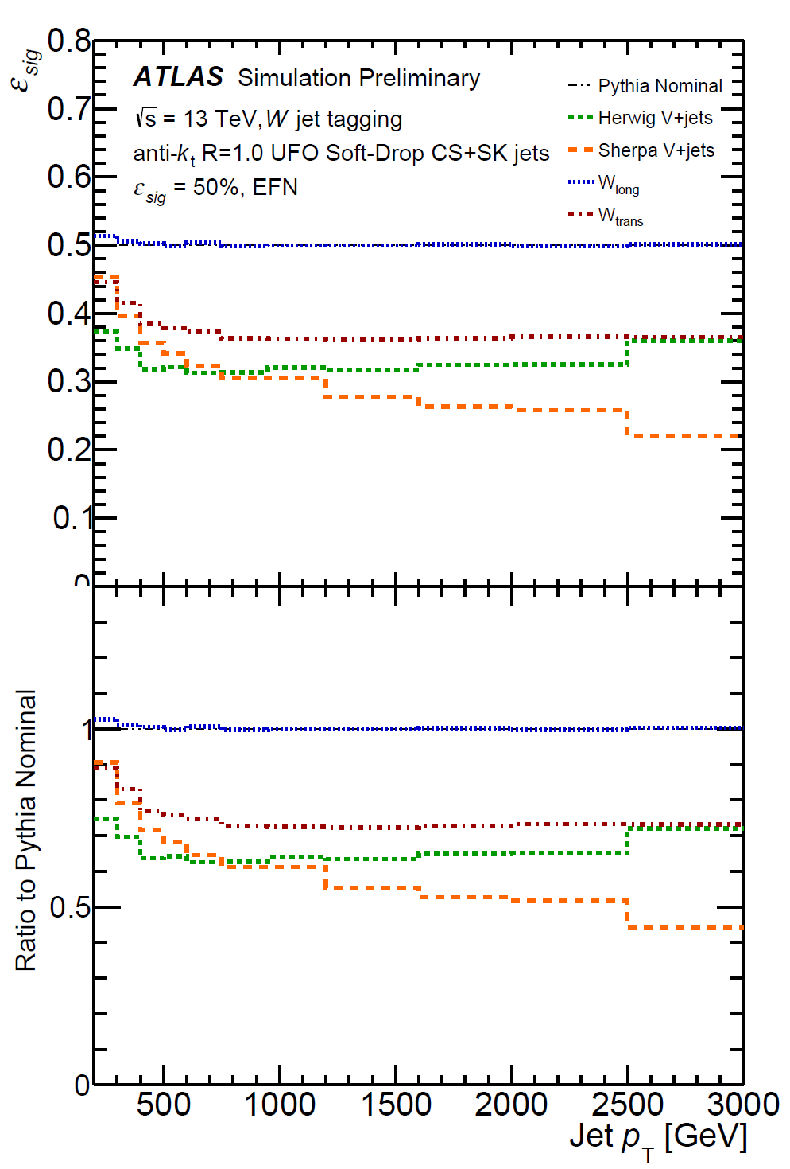
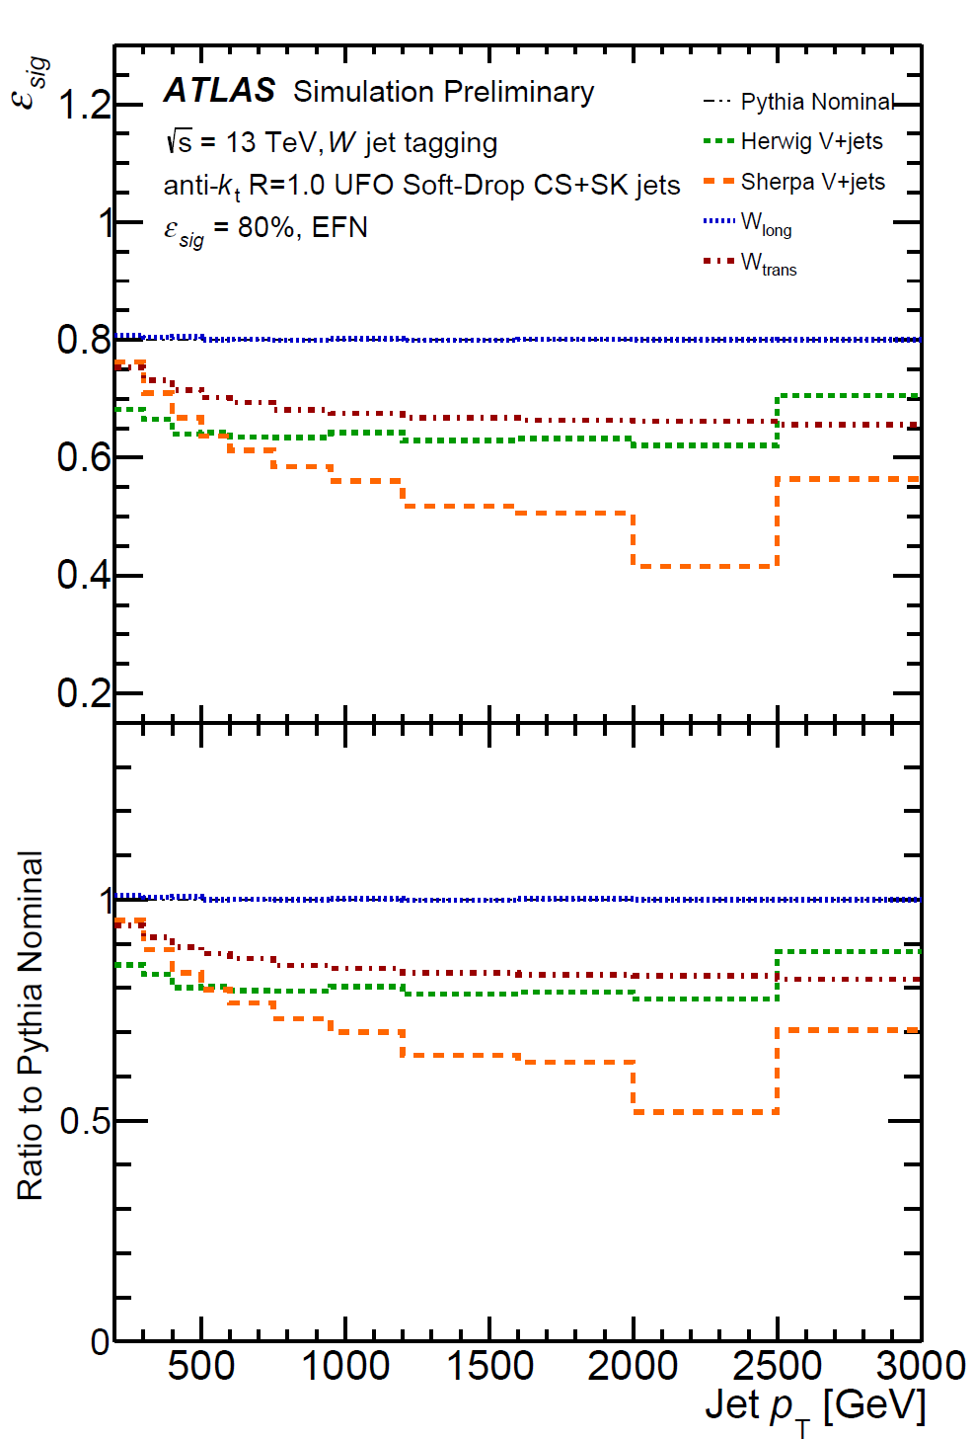
Tagger Performance
Dependence on signal modeling
EFN, eff=50%:
EFN, eff=80%:
Comparison of the signal efficiency of 𝑊 taggers in different samples of simulated 𝑊-jet, as a measure of model dependence. Shown is the signal efficiency using the threshold which results in an signal efficiency of 50% (left) or 80% (right) in each 𝑝_{T} bin for nominal Pythia 𝑊’->𝑊𝑍 sample.

Slide 3
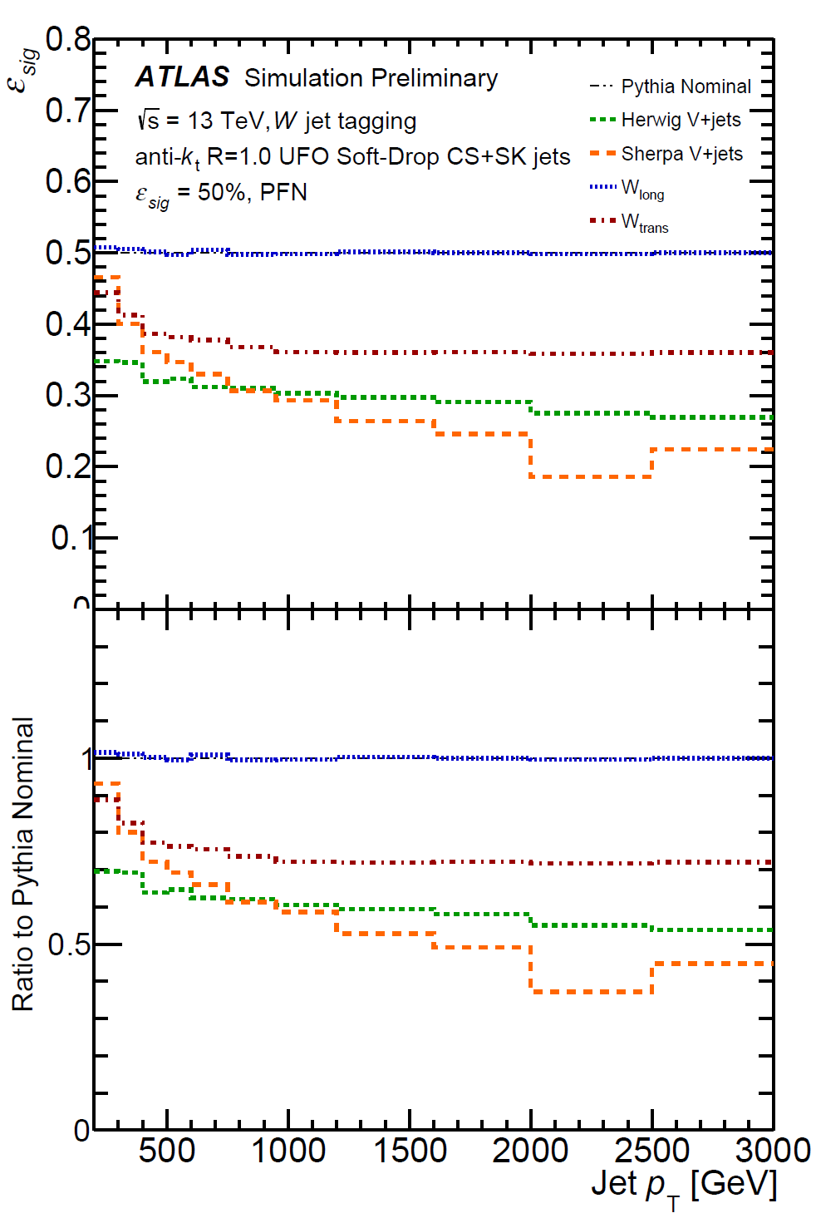
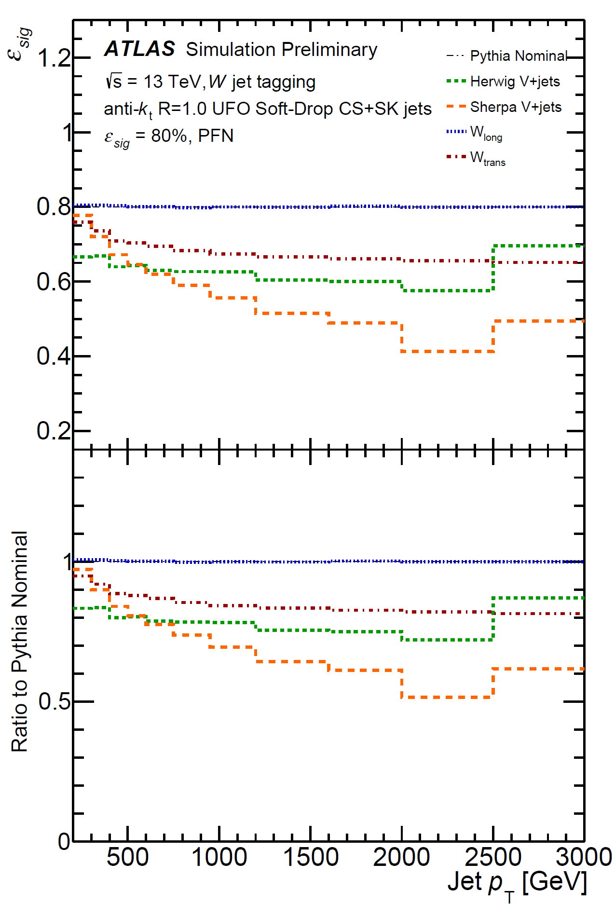
Tagger Performance
Dependence on signal modeling
PFN, eff=50%:
PFN, eff=80%:
Comparison of the signal efficiency of 𝑊 taggers in different samples of simulated 𝑊-jet, as a measure of model dependence. Shown is the signal efficiency using the threshold which results in an signal efficiency of 50% (left) or 80% (right) in each 𝑝_{T} bin for nominal Pythia 𝑊’->𝑊𝑍 sample.

Slide 4
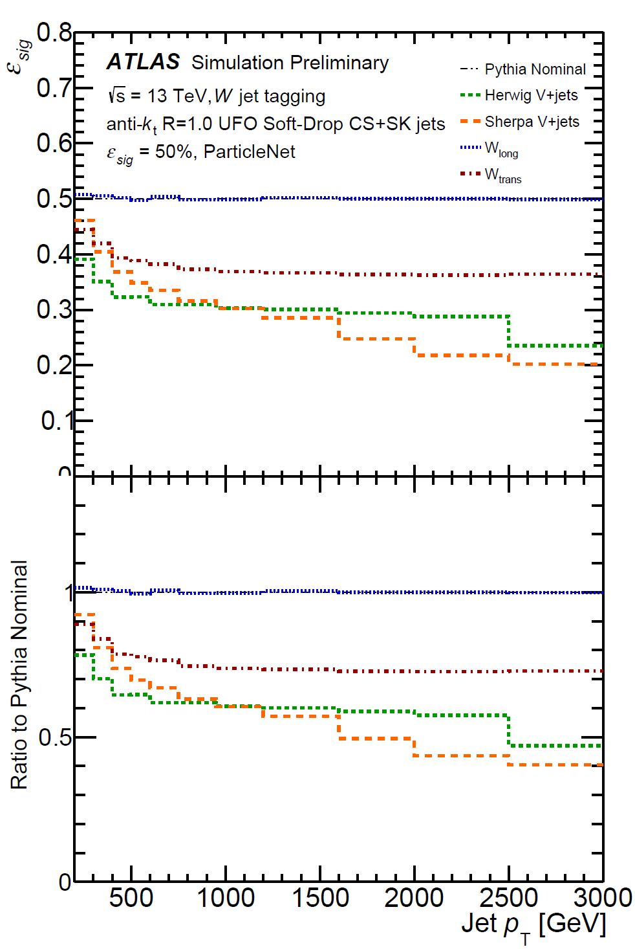
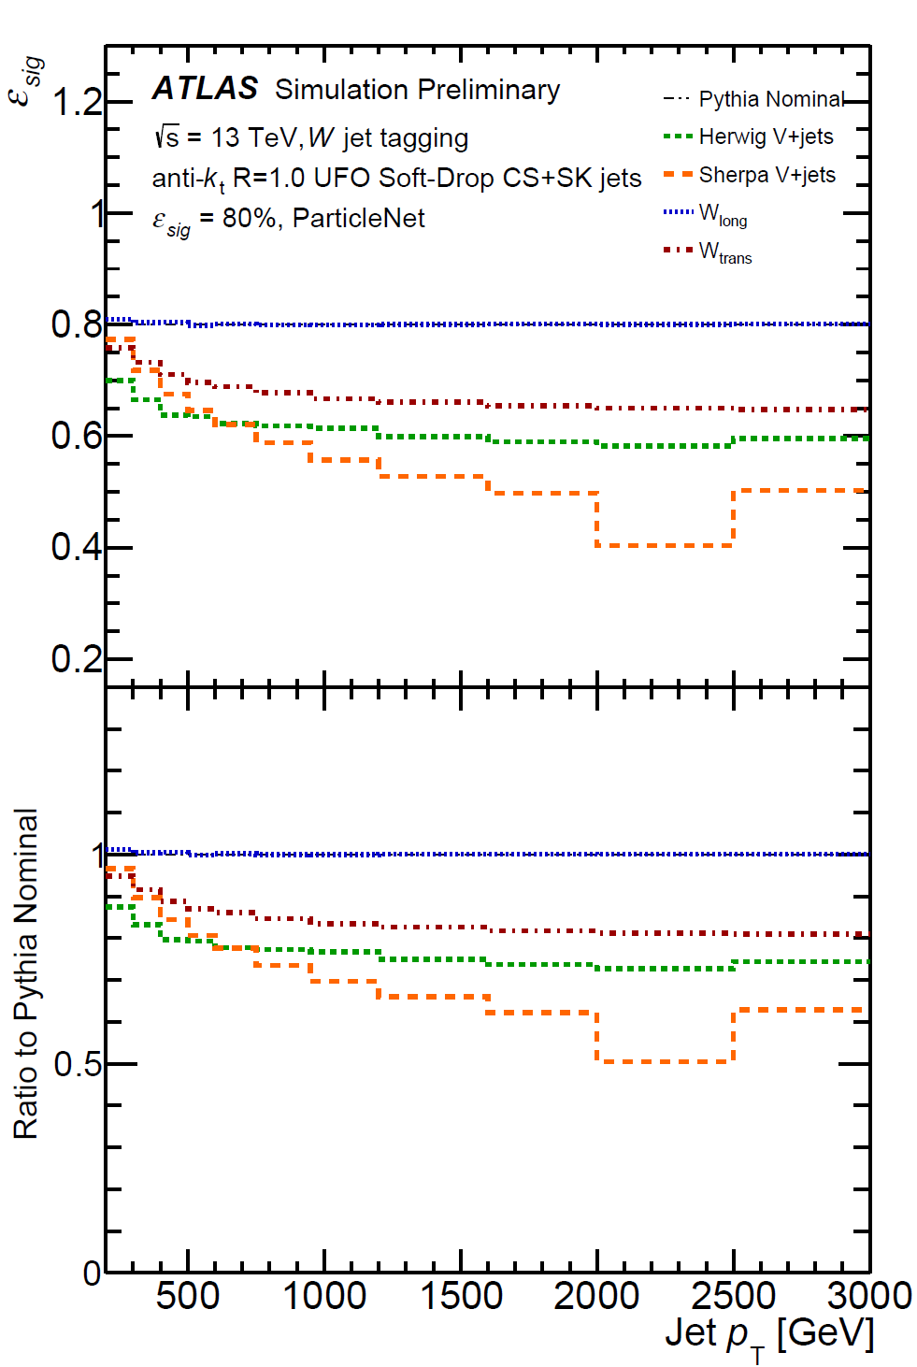
Tagger Performance
Dependence on signal modeling
ParticleNet, eff=50%:
ParticleNet, eff=80%:
Comparison of the signal efficiency of 𝑊 taggers in different samples of simulated 𝑊-jet, as a measure of model dependence. Shown is the signal efficiency using the threshold which results in an signal efficiency of 50% (left) or 80% (right) in each 𝑝_{T} bin for nominal Pythia 𝑊’->𝑊𝑍 sample.

Slide 5
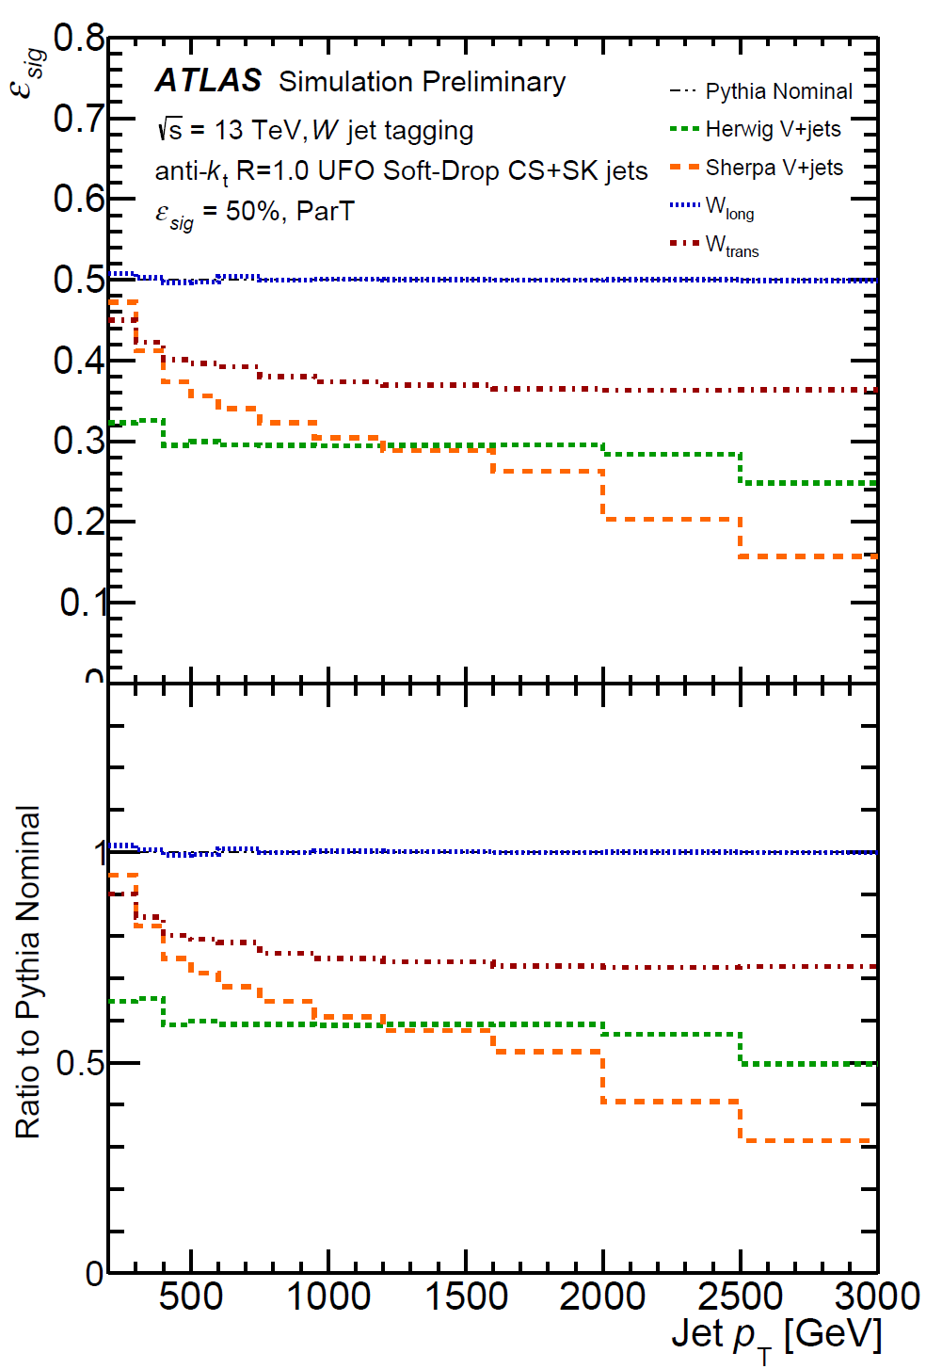
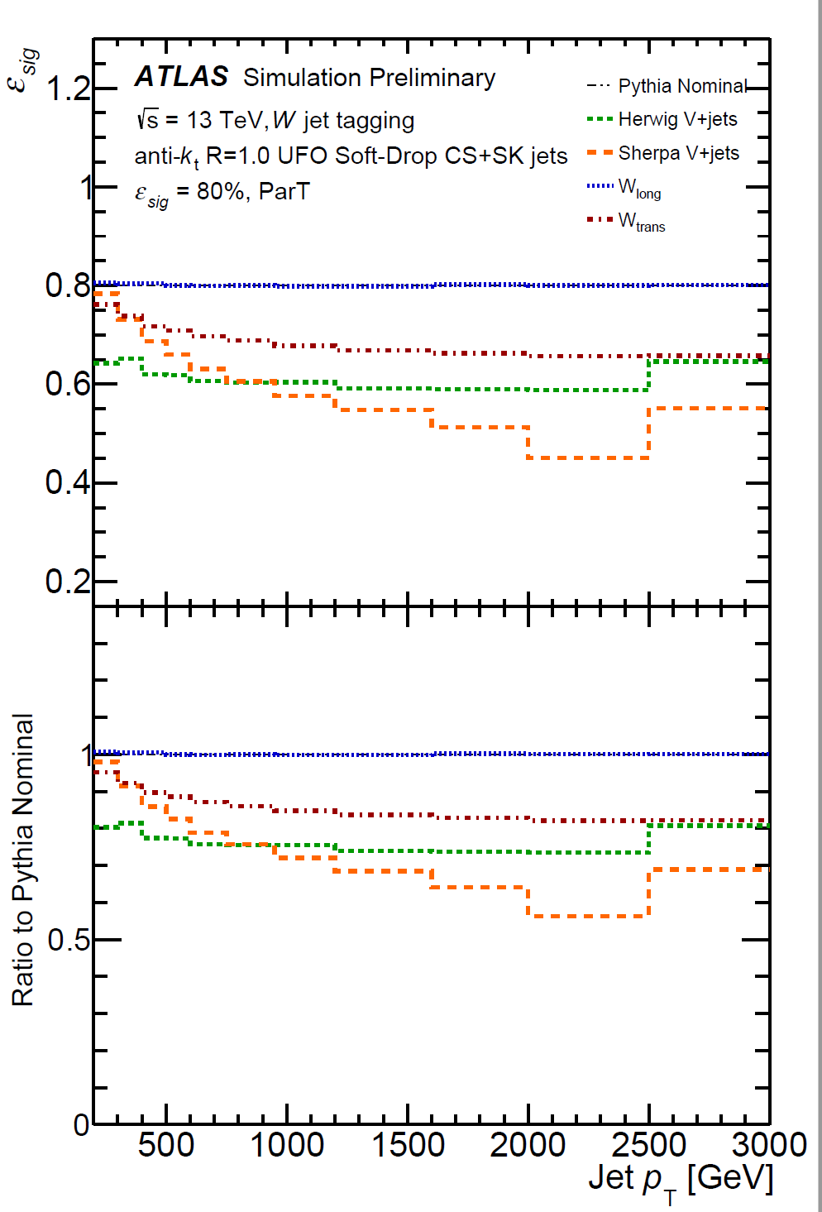
Tagger Performance
Dependence on signal modeling
ParticleTransformer, eff=50%:
ParticleTransformer, eff=80%:
Comparison of the signal efficiency of 𝑊 taggers in different samples of simulated 𝑊-jet, as a measure of model dependence. Shown is the signal efficiency using the threshold which results in an signal efficiency of 50% (left) or 80% (right) in each 𝑝_{T} bin for nominal Pythia 𝑊’->𝑊𝑍 sample.
Notes:
For all the studied taggers, significant decrease in signal efficiency of around 5%-40% is observed on alternative V+jets samples for the 50% working point. Similar behavior is observed for the 80% working point, but the decrease is smaller. The peformance on the W longitudianlly polarized sample is quite similar to the nominal performance. When taggers are applied to the W transversely polarized sample, the signal efficiency drops by about 15% for 50% wp and similarly for 80% wp.
The fact that the nominal $W' -> WZ$ sample has predominantly longitudinally polarized W bosons in the final state, while the transversely polarized W bosons are preferentially produced in SM V+jets events could be a potential explanations of such decrease.

