Slide 1
Search for$J/ψ→eμ+invisible$
Pan Huang
Nanjing University

Slide 2
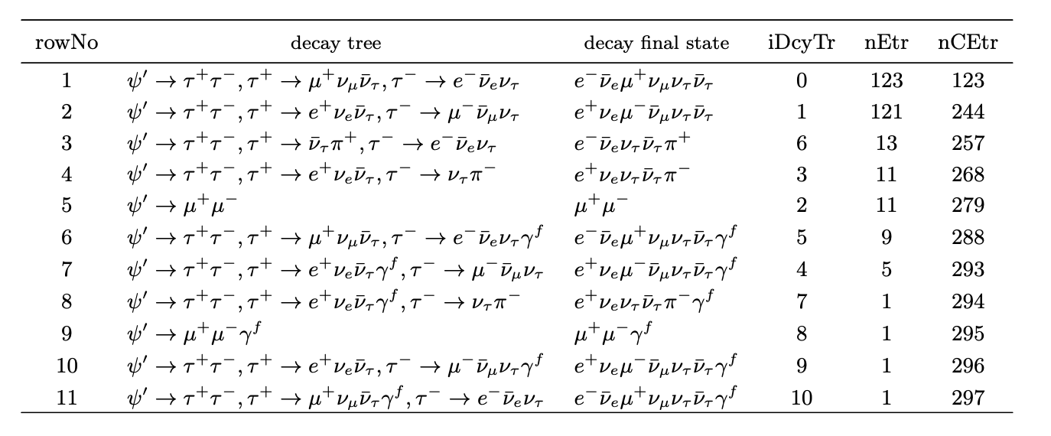
Background analysis of 𝝍(𝟐𝑺)→𝒆𝝁+𝒊𝒏𝒗𝒊𝒔𝒊𝒃𝒍𝒆
5

Slide 3
Search for$J/ψ→eμ+invisible$
 | Mass ($GeV/c^{2}$)
$$J/ψ$$ | 3.0969
$$ψ(2S)$$ | 3.6861
$τ$ | 1.7769
5

Slide 4
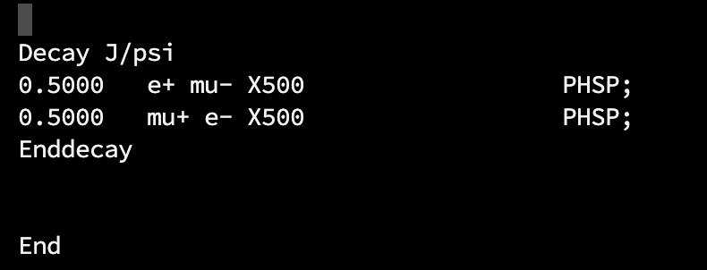
Single MC
decayDIY.dec
We define a stable particle with a mass of 500MeV/c² in pdt.table ,named X500. X500 stands for the invisible particle, which is boson.
We use phase space to generate the single MC.
pdt.table
5

Slide 5
Primary selection
Boss:708 Data set:2009 2.24x10⁸ ψ(2S) data samples
Good charged track selection
$\left|cosθ\right|<0.93$, $\left|\text{V}\text{z}\right|<1$0cm,$\left|\text{V}\text{r}\right|<1$cm
nGood = 2,PID
Particle identification
e E_{EMC}/P_{MDC} >0.8
$μ$ E_{EMC}/P_{MDC} <0.8
$N_{e}=N_{μ}=1$
Good photons
$E_{γ} >25MeV \text{for} \text{barrel}\text{ (}\left|cosθ\right| <0.\text{80}\text{)}$
$E_{γ} >50MeV for gap$ ($0.80<\left|cosθ\right| <0.86$)
$E_{γ}>50MeV$ for endcap ($0.86<\left|cosθ\right| <0.92$)
TDC time window: [0, 700] ns
$θ_{cγ}> {10}^{°} ,$Nγ>=0
6

Slide 6
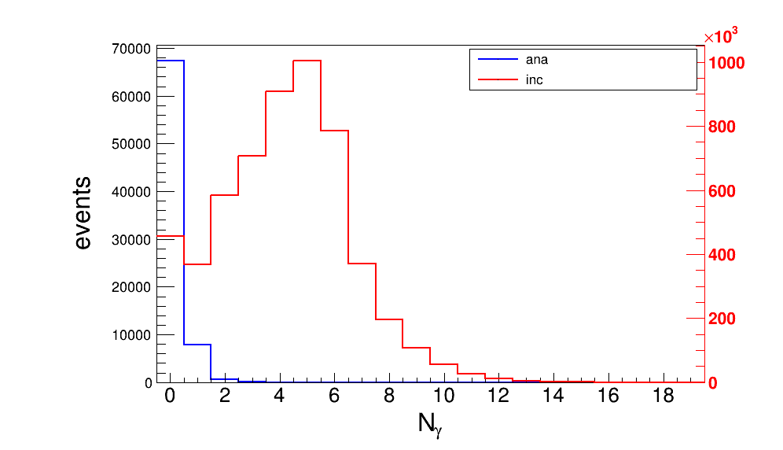
Further selection
$$N_{γ}=0$$
5

Slide 7
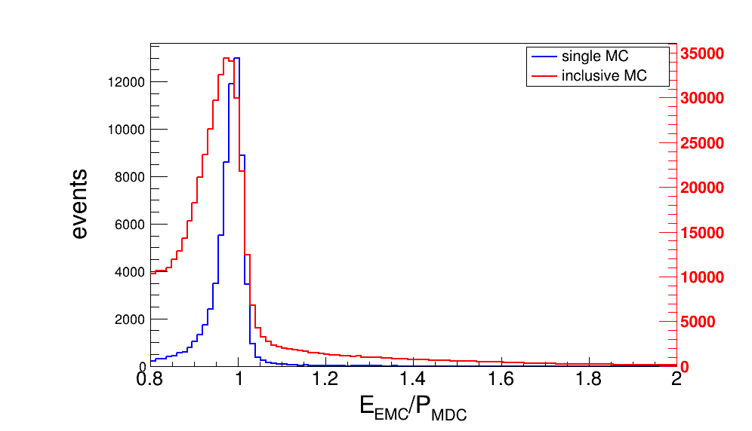
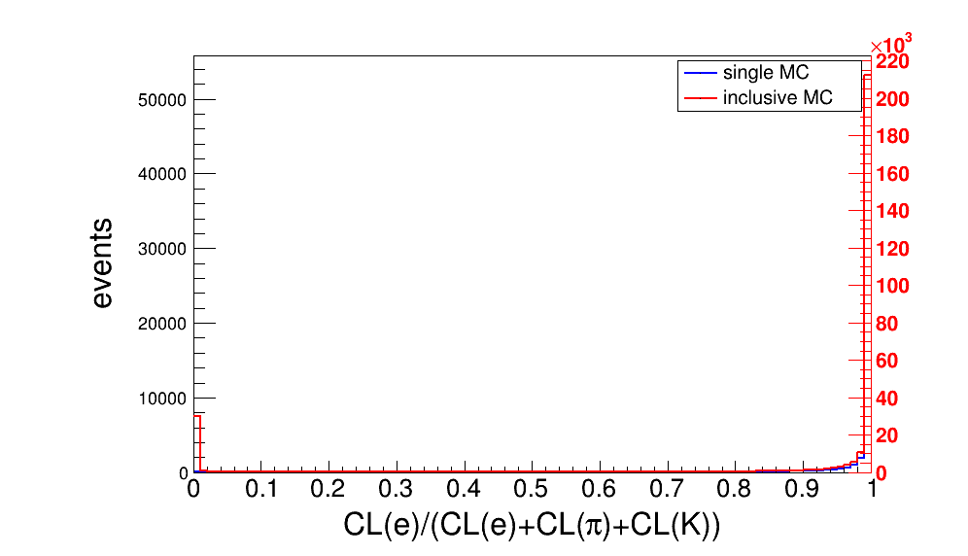
Further selection
Electron identification
0.9 < E_{EMC}/P_{MDC} < 1.1
Prob(e)/(Prob(e)+prob(π)+prob(k)) > 0.8
5

Slide 8
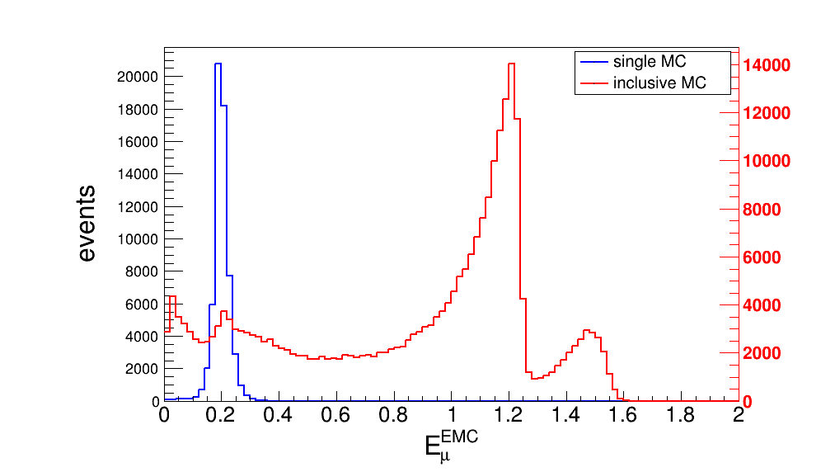
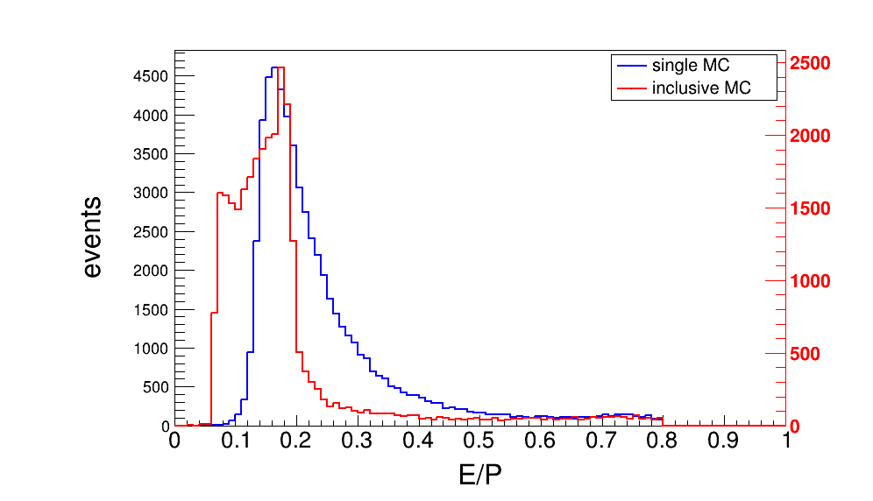
Further selection
Muon identification
0.1 < E(EMC) <0.3
Prob(μ) > Prob(e),Prob(μ) > Prob (K)
MUC depth >40 cm
5

Slide 9
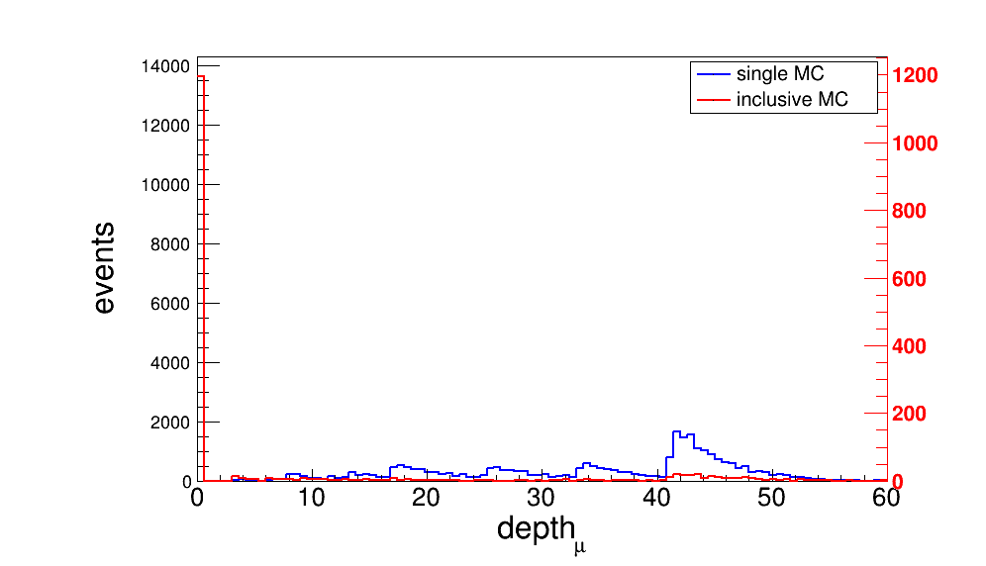
Further selection
MUC depth > 40 cm
5

Slide 10
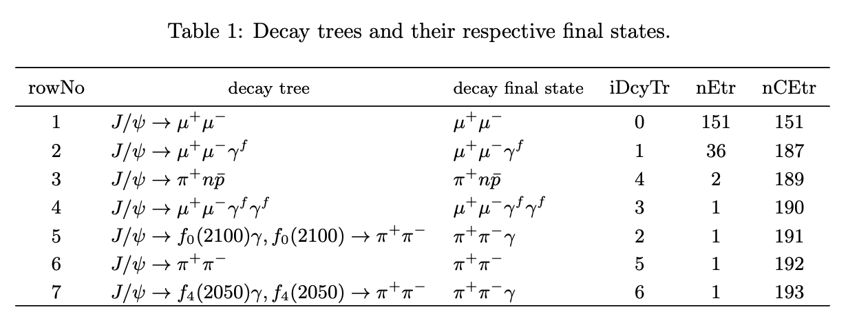
Background analysis
5

Slide 11
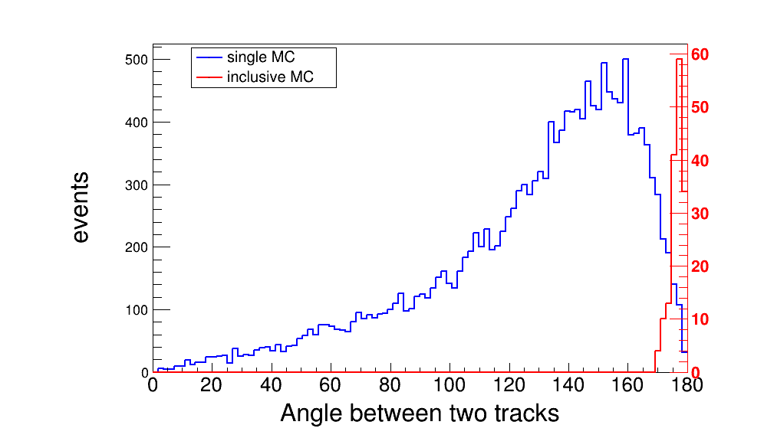
Background analysis
5

Slide 12
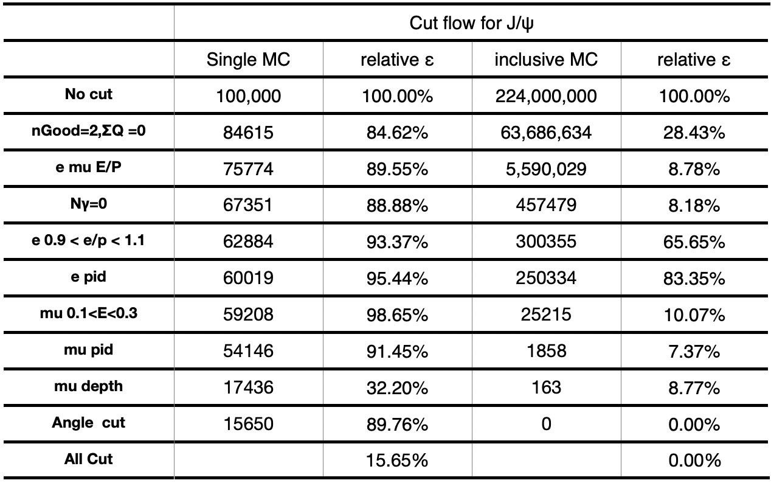
Background analysis
5

