Slide 1
Search for $J/ψ→eμ+invisible$
Pan Huang
Nanjing University

Slide 2
Primary selection
Boss:708 Data set:2018 4.6x10⁹ J/ψ data samples
Good charged track selection
$\left|cosθ\right|<0.93$, $\left|\text{V}\text{z}\right|<1$0cm,$\left|\text{V}\text{r}\right|<1$cm
nGood = 2,PID
Particle identification
e E_{EMC}/P_{MDC} >0.8
$μ$ E_{EMC}/P_{MDC} <0.8
$N_{e}=N_{μ}=1$
Good photons
$E_{γ} >25MeV \text{for} \text{barrel}\text{ (}\left|cosθ\right| <0.\text{80}\text{)}$
$E_{γ} >50MeV for gap$ ($0.80<\left|cosθ\right| <0.86$)
$E_{γ}>50MeV$ for endcap ($0.86<\left|cosθ\right| <0.92$)
TDC time window: [0, 700] ns
$θ_{cγ}> {10}^{°} ,$Nγ>=0
2

Slide 3
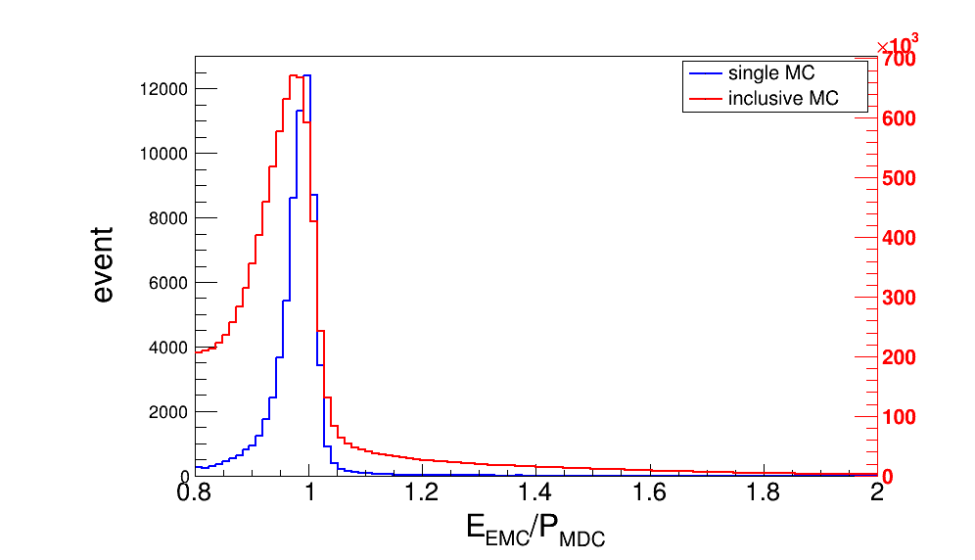
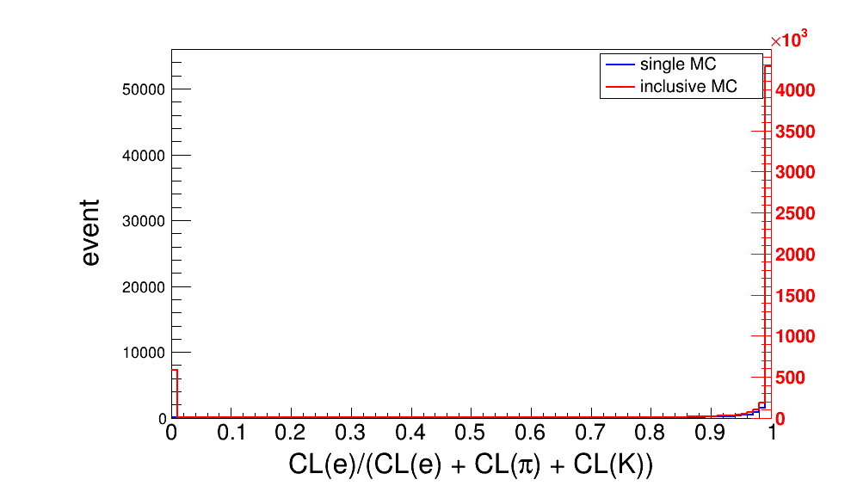
Further selection
Electron identification
0.9 < E_{EMC}/P_{MDC} < 1.1
Prob(e)/(Prob(e)+prob(π)+prob(k)) > 0.8
Prob(e) > Prob(μ),Prob(e)>Prob(p)
3

Slide 4
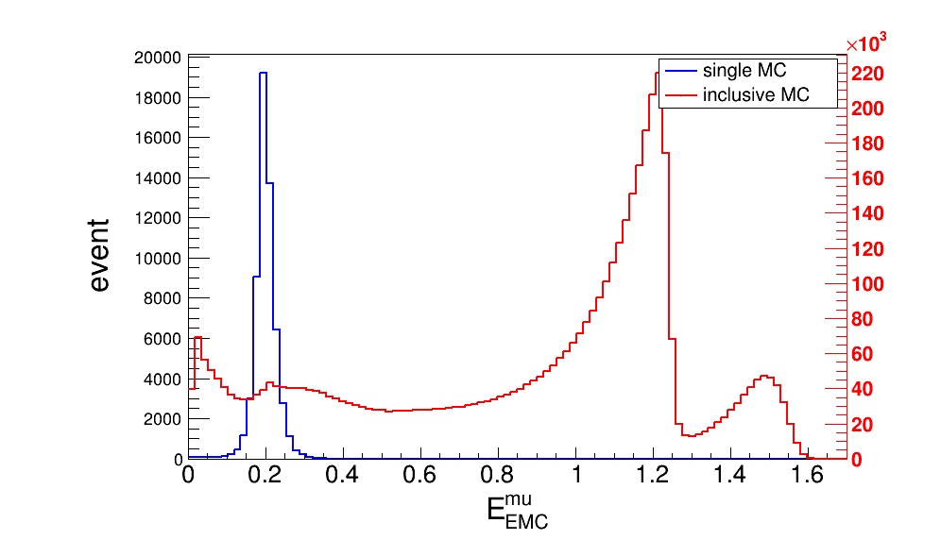
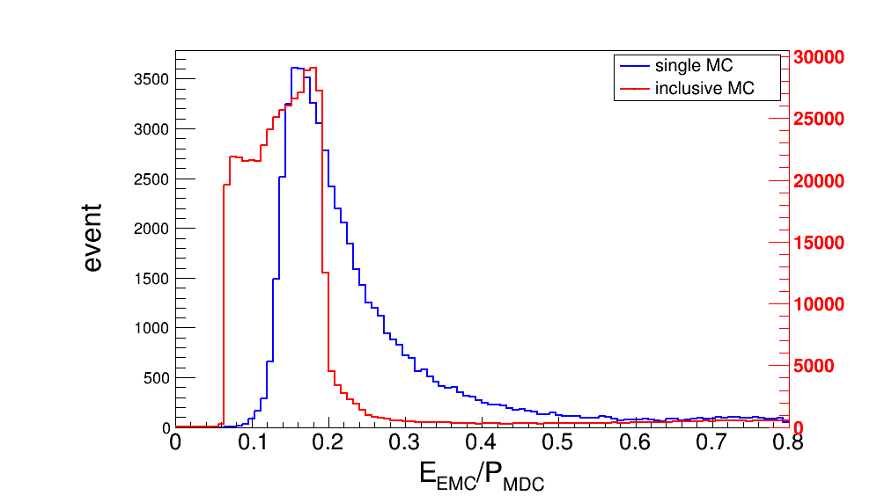
Further selection
Muon identification
0.1 < E(EMC) <0.3
0.1 < E_{EMC}/P_{MDC} < 0.3
Prob(μ) > Prob(e),Prob(μ) > Prob (K)
4

Slide 5
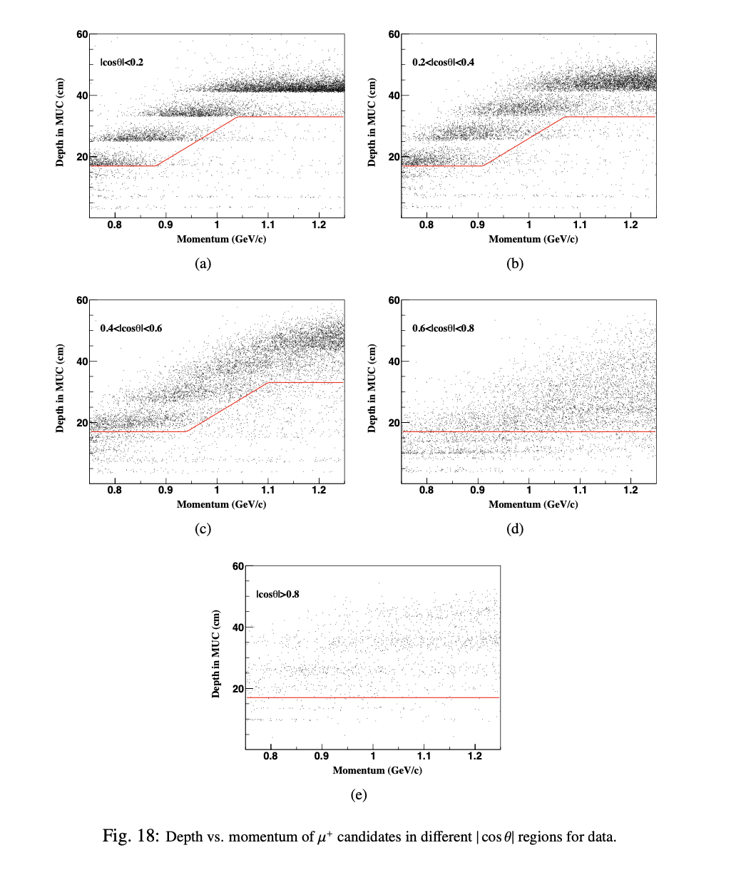
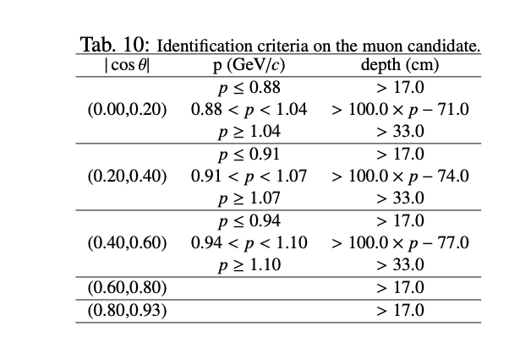
Further selection
MUC cut
5

Slide 6
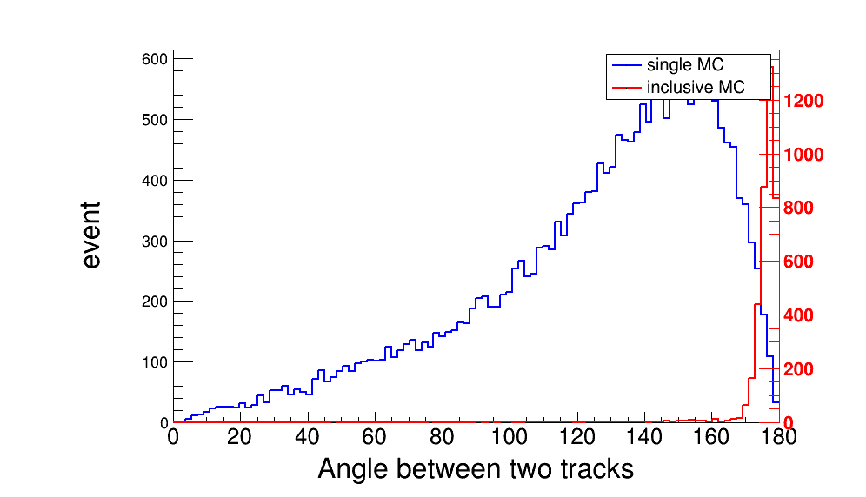
Background analysis
Angle cut : θ > 165
6

Slide 7
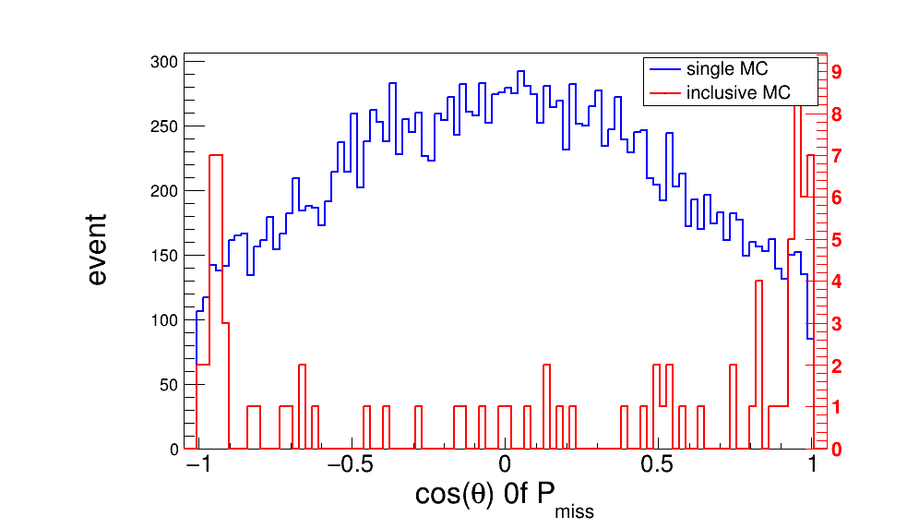
Background analysis
Angle cut : |cosθ| < 0.92
6

Slide 8
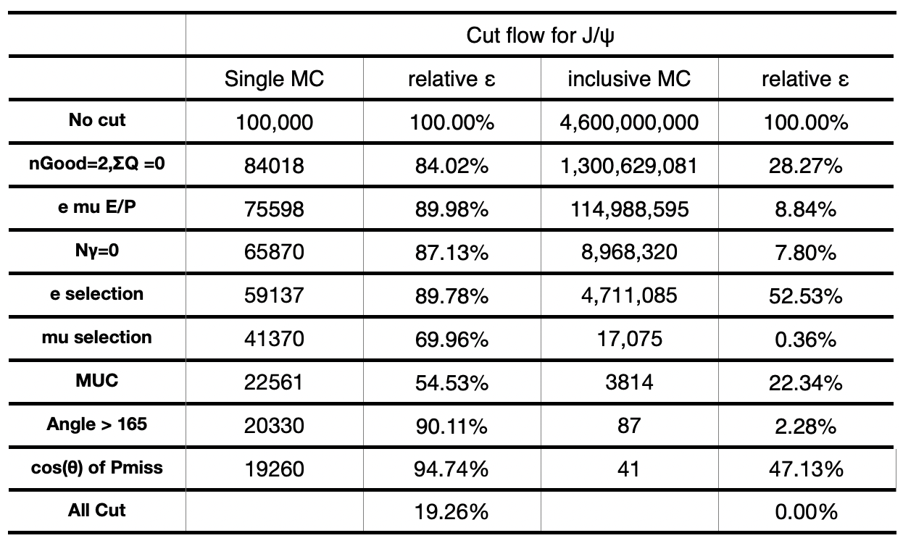
Background analysis
7

Slide 9
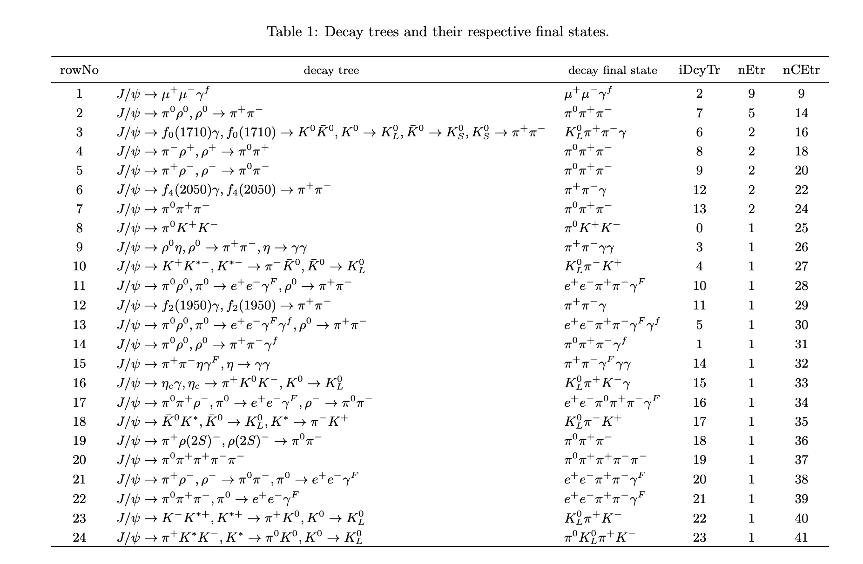
Background analysis
8

