Slide 1

Preliminary Conceptual Design of Fast Luminosity Monitor at the CEPC
Li Meng

Slide 2
CONTENTS
Evaluation of IP Beam Orbit Feedback System for CEPC
Preliminary Conceptual Design of Fast Luminosity Monitor for CEPC

Slide 3
CONTENTS
Evaluation of IP Beam Orbit Feedback System for CEPC
Preliminary Conceptual Design of Fast Luminosity Monitor for CEPC

Slide 4
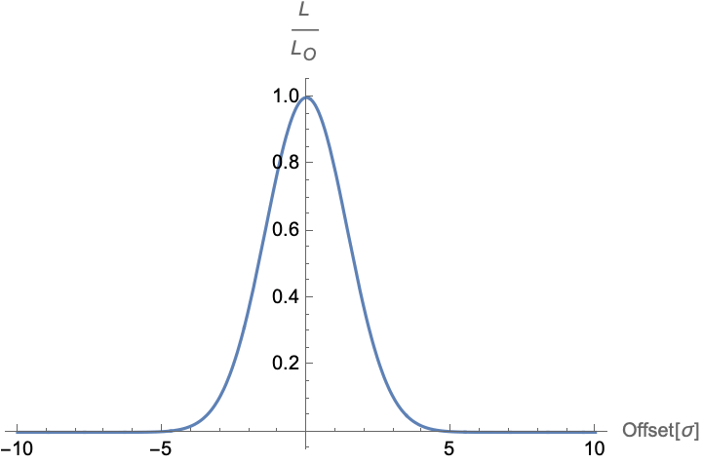

Beam orbit feedback system at IP
$$L/{L_{0}}$$
CEPC will use the nano-beam scheme to achieve a very high luminosity which implies very strong focusing at the IP resulting in very small vertical beam sizes. Because the beam sizes are tiny, the luminosity is very sensitive to the stability of the final focusing elements, whose vibrations cause an offset between the two beams at the IP, lead to a luminosity degradation.
It is essential to have an orbit feedback system at the IP to maintain an optimum collision condition and maximize the luminosity in the presence of mechanical vibrations.
The design of the beam orbit feedback systems for a machine depends on:
Machine parameters
BPM
Site selection and ground motion

Slide 5
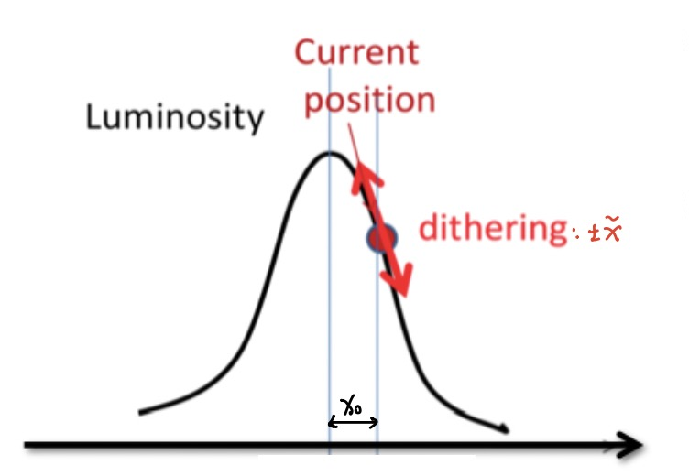
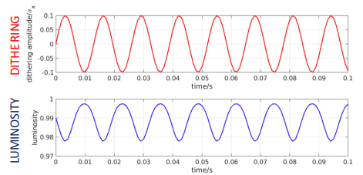
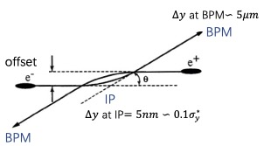
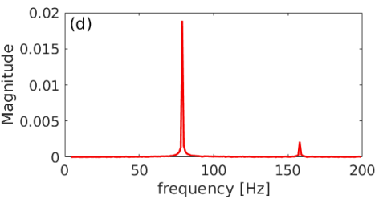




In principle, there are two possible methods used for the IP orbit feedback system.
Beam-beam deflection driven method
Luminosity driven system
The offset at the IP is too small to be accurately measured, but due to the beam-beam effect, which can introduce an deflect angle, and then transfer to a larger offset, by measuring this beam orbit with BPMs upstream and downstream of the IP , we can estimate the offset at the IP and the sign. If accuracy of BPM is precise enough, we may maintain the optimum collision with almost no luminosity loss. We usually prioritize this method for this reason.
Based on the measurement of the luminosity, we can know the offset between two beams, but cannot easily know its sign. And many other effects may also cause luminosity changes at relatively low frequency. To solve this problem, we should introduce a dithering with certain frequency, and then luminosity will change with same frequency, we can extract orbit shifts and correct them.
$$∆x=x_{o}+\tilde{x}sin⁡(2πft)$$
$${∆y}_{±}^{′}=−\frac{r_{e}N_{∓}}{γ_{±}σ_{y∓}^{∗}\left({\tilde{σ}}_{x∓}^{∗}+σ_{y∓}^{∗}\right)}{∆y}_{IP}$$
$${∆y}_{BPM}=\sqrt{β^{∗}β_{BPM}}∆y^{′}$$

Slide 6
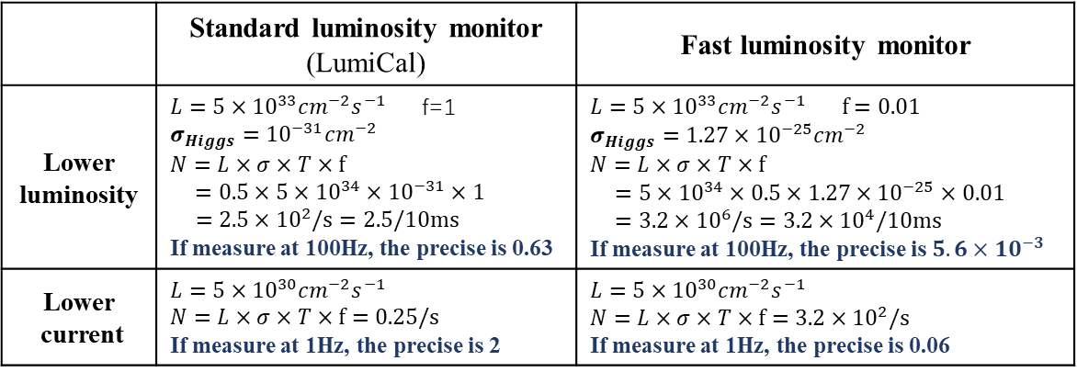
Necessity of the Fast Luminosity Monitor for CEPC
Used for IP orbit feedback as a back up
The expected resolution of BPMs at current design location is not good enough for both vertical and horizontal beam-beam deflection feedback. If we can add a few more BPMs near position of the maximum beta function, and all machine parameters can reach the design values, it probably okay for both horizontal and vertical feedback. But if the BPM in one direction is not so precise and at the beginning of the operation, the parameters can’t reach the design value, the feedback based on the BPM is not good enough.
Standard luminosity monitor also doesn’t work used for fast feedback.
Used for beam tuning
Beam size, beam intensity, etc
 | Standard luminosity monitor (LumiCal) | Fast luminosity monitor
Lower luminosity | $L=5×{10}^{33}{cm}^{−2}s^{−1}$ f=1 $σ_{Higgs}={10}^{−31}{cm}^{−2}$ $$N=L×σ×T×f$$ $=0.5×5×{10}^{34}×{10}^{−31}×1$ $$=2.5×{10}^{2}/s=2.5/10ms$$ If measure at 100Hz, the precise is 0.63 | $$L=5×{10}^{33}{cm}^{−2}s^{−1} f=0.01$$ $σ_{Higgs}={1.27×10}^{−25}{cm}^{−2}$ $$N=L×σ×T×f$$ $=5×{10}^{34}×0.5×1.27×{10}^{−25}×0.01$ $=3.2×{10}^{6}/s=3.2×{10}^{4}/10ms$ If measure at 100Hz, the precise is $5.6×{10}^{−3}$
Lower current | $$L=5×{10}^{30}{cm}^{−2}s^{−1}$$ $$N=L×σ×T×f=0.25/s$$ If measure at 1Hz, the precise is 2 | $$L=5×{10}^{30}{cm}^{−2}s^{−1}$$ $$N=L×σ×T×f=3.2×{10}^{2}/s$$ If measure at 1Hz, the precise is 0.06

Slide 7
CONTENTS
Evaluation of IP Beam Orbit Feedback System for CEPC
Preliminary Conceptual Design of Fast Luminosity Monitor for CEPC

Slide 8
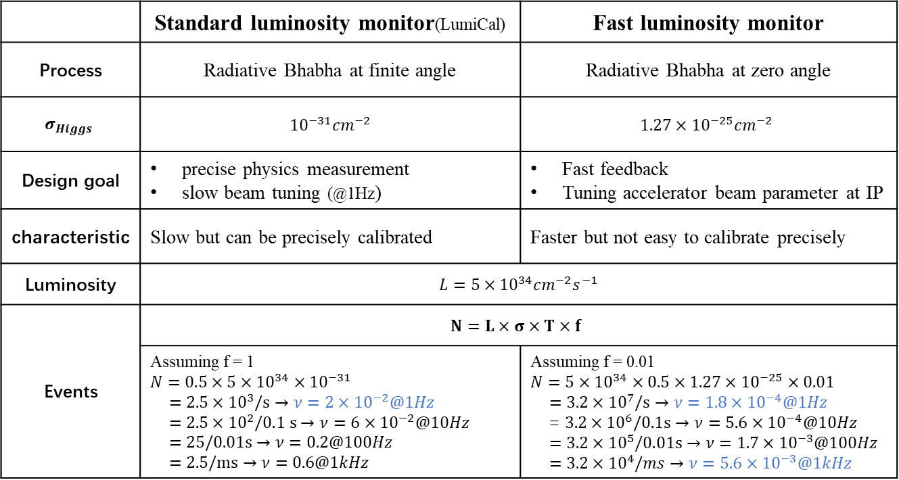
Comparison between standard and fast luminosity monitor
 | Standard luminosity monitor(LumiCal) | Fast luminosity monitor
Process | Radiative Bhabha at finite angle | Radiative Bhabha at zero angle
$$σ_{Higgs}$$ | $${10}^{−31}{cm}^{−2}$$ | $${1.27×10}^{−25}{cm}^{−2}$$
Design goal | precise physics measurement slow beam tuning (@1Hz) | Fast feedback Tuning accelerator beam parameter at IP
characteristic | Slow but can be precisely calibrated | Faster but not easy to calibrate precisely
Luminosity | $$L=5×{10}^{34}{cm}^{−2}s^{−1}$$
Events | $$N=L×σ×T×f$$
 | Assuming f = 1 $$N=0.5×5×{10}^{34}×{10}^{−31}$$ $$=2.5×{10}^{3}/s→ν=2×{10}^{−2}@1Hz$$ $$=2.5×{10}^{2}/0.1 s→ν=6×{10}^{−2}@10Hz$$ $$=25/0.01s→ν=0.2@100Hz$$ $$=2.5/ms→ν=0.6@1kHz$$ | Assuming f = 0.01 $$N=5×{10}^{34}×0.5×1.27×{10}^{−25}×0.01$$ $$=3.2×{10}^{7}/s→ν=1.8×{10}^{−4}@1Hz$$ = $3.2×{10}^{6}/0.1s→ν=5.6×{10}^{−4}@10Hz$ $$=3.2×{10}^{5}/0.01s→ν=1.7×{10}^{−3}@100Hz$$ $$=3.2×{10}^{4}/ms→ν=5.6×{10}^{−3}@1kHz$$
Any Collider must have a luminosity monitor, but not necessarily a fast luminosity monitor. If want to do fast IP luminosity tuning and feedback, maybe should have a fast and precise luminosity monitor.

Slide 9
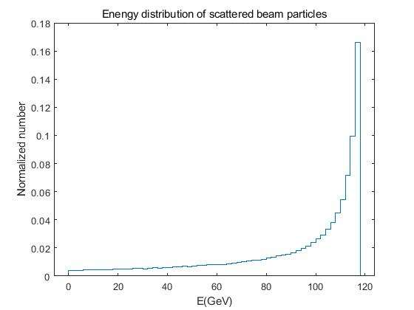
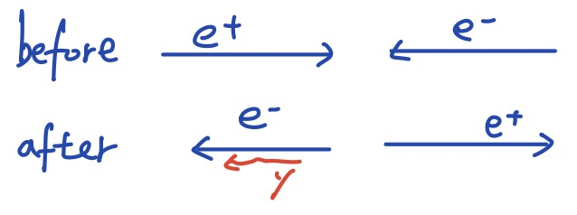
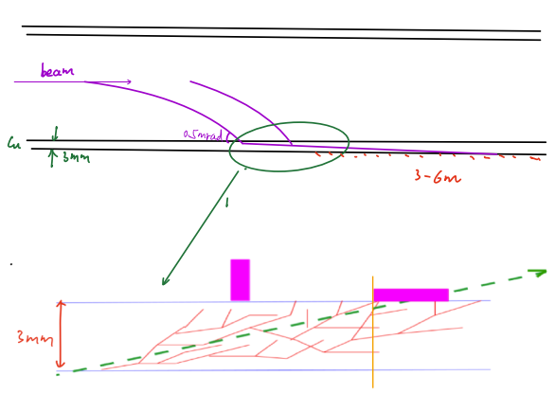
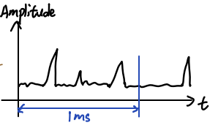
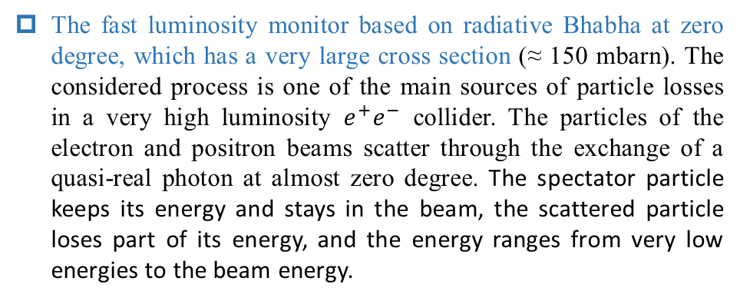
Preliminary Conceptual Design of Fast Luminosity Monitor for CEPC
Working principle
The fast luminosity monitor based on radiative Bhabha at zero degree, which has a very large cross section (≈ 150 mbarn). The considered process is one of the main sources of particle losses in a very high luminosity $e^{+}e^{−}$ collider. The particles of the electron and positron beams scatter through the exchange of a quasi-real photon at almost zero degree. The spectator particle keeps its energy and stays in the beam, the scattered particle loses part of its energy, and the energy ranges from very low energies to the beam energy.
The very low energy Bhabha particles will be deflected downstream of the IP at different locations and hit the vacuum chamber. And then these lost Bhabha scattering particles will interact with the material of the vacuum. The sensors placed just outside the vacuum pipe measure the charged particles in the secondary showers to provide the luminosity information.
$$∆N=L×σ×T×f⇒L∝∆N$$

Slide 10
Search a position for fast luminosity monitor
STEP1: Generating the Bhabha particles through the program( BBBREM or GUINEA-PIG)
STEP2: Tracking Bhabha particles and calculate the lossmap with SAD, trying to find a possible position where the loss rate is sufficiently large.
STEP3: Evaluate the level of background from beamstrahlung, beam-gas, beam thermal photons process, and then to check if the radiative Bhabha at zero angle process dominates over the sum of all the other processes at this possible position. Because we expect only the radiative Bhabha at zero angle, which is proportional to luminosity.
STEP4: After finding the best candidate of the monitor, should do a detailed simulation in Geant4 to estimate the signal in the detector and based on it to determine the specific location and geometry of detector and material of beam pipe.
STEP5: considering /selecting the detector technology (e.g., Cerenkov, array of pin diodes,etc...), The final precision will depend a lot on the efficiency for collecting the secondaries produced in the beam pipe. It could be that some extra material outside of the beam pipe and just in front of the detector will be needed to enhance the EM shower.

Slide 11
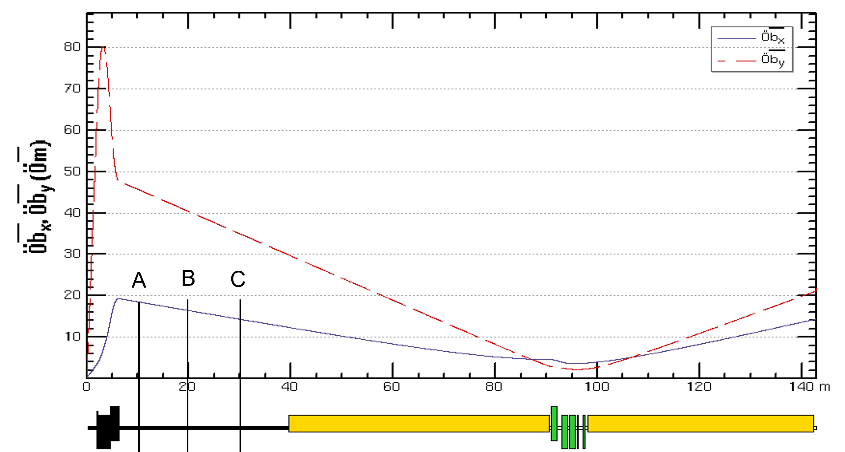
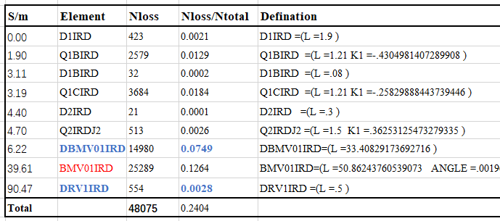
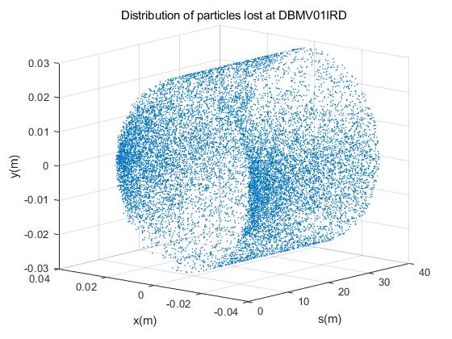
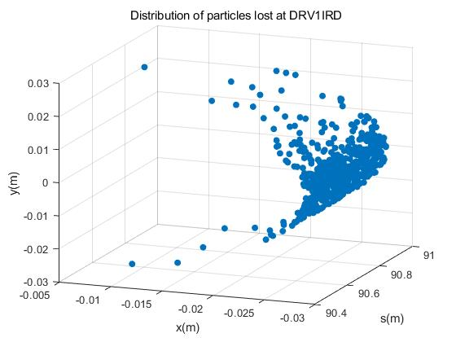
Tracking Bhabha particles and calculate the lossmap with SAD
We actually hope to place the detector behind the bend because the particles are deflected in one direction and have a more concentrated distribution.
But the first Bend BMV01IRD downstream of IP is too long, if the detector is placed behind the Bend, the number of particles that can be detected is too small. We consider placing the detector in the drift tube DBMV01IRD before this first Bend.

Slide 12
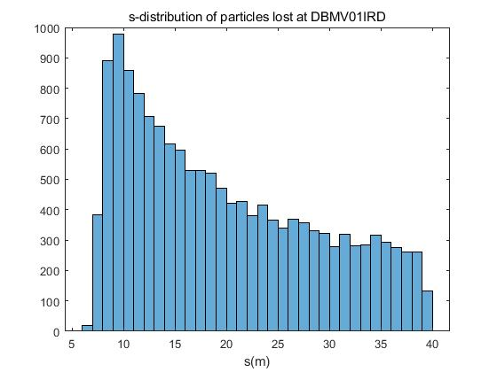
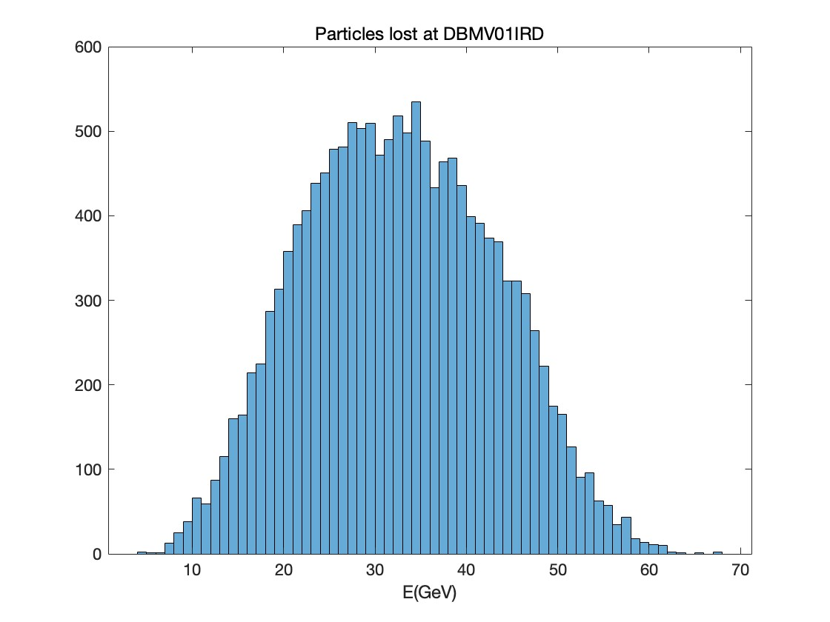
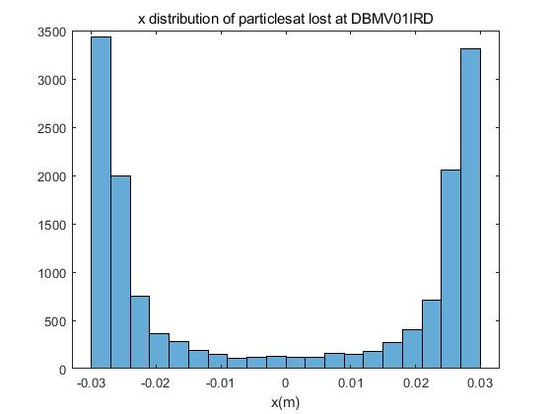
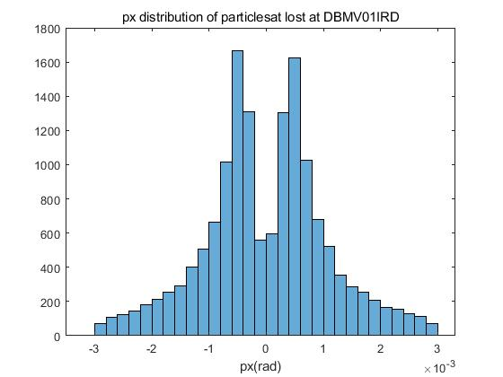
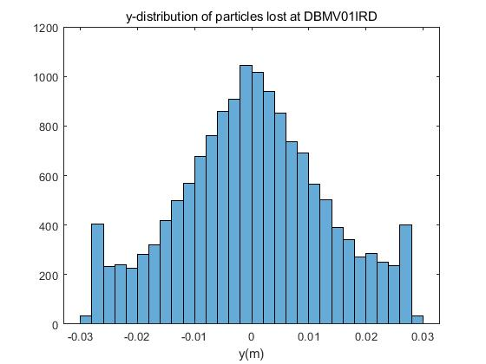
Distribution of particles lost on DBMV01IRD (L=33.4m)
Mean: 32.68GeV
Of course, we won't let the detector be as long as 30m, it will definitely be placed in the position with a high counting rate in the first 10m of drift tube. But need to determine the specific geometric size and position of the detector.
Also need to check if the beam-beam deflection will affect the distribution of lost particles to determine the number of detectors.

Slide 13
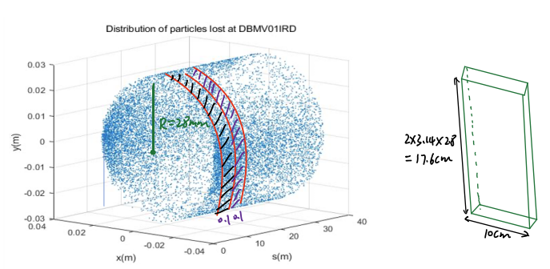
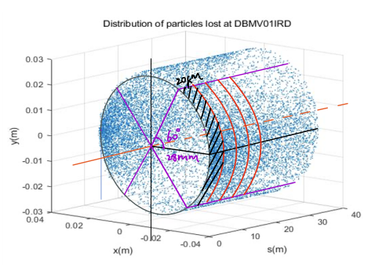
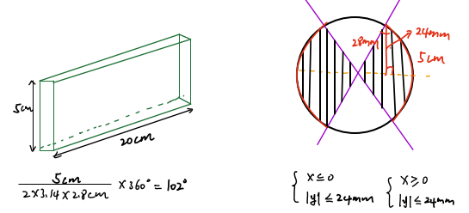
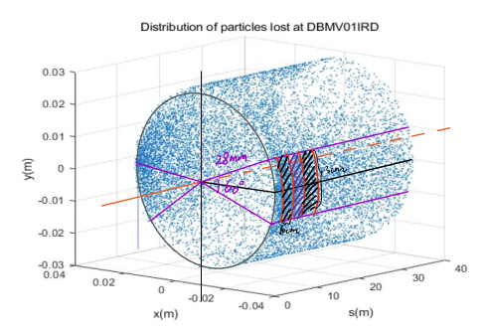
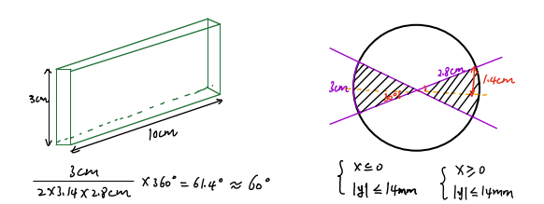


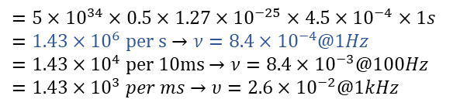
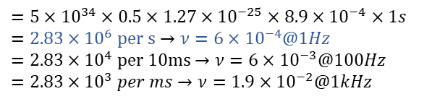




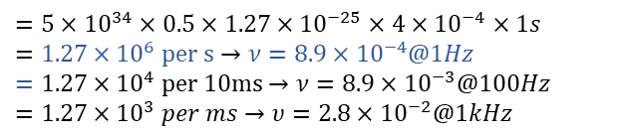
Select a best position to place the detector
$$f=\frac{N_{loss}}{N_{total}}=\frac{78}{2×{10}^{5}}=4×{10}^{−4}$$
$$f=\frac{N_{loss}}{N_{total}}=\frac{90}{2×{10}^{5}}=4.5×{10}^{−4}$$
$$f=\frac{N_{loss}}{N_{total}}=\frac{177}{2×{10}^{5}}=8.9×{10}^{−4}$$
$$N=L×σ×T×f$$
$$N=L×σ×T×f$$
$$N=L×σ×T×f$$
$$=5×{10}^{34}×0.5×1.27×{10}^{−25}×4×{10}^{−4}×1s$$
$$=1.27×{10}^{6} per s→ν=8.9×{10}^{−4}@1Hz$$
$$=1.27×{10}^{4} per 10ms→ν=8.9×{10}^{−3}@100Hz$$
$$=1.27×{10}^{3} per ms→υ=2.8×{10}^{−2}@1kHz$$
$$=5×{10}^{34}×0.5×1.27×{10}^{−25}×4.5×{10}^{−4}×1s$$
$$=1.43×{10}^{6} per s→ν=8.4×{10}^{−4}@1Hz$$
$$=1.43×{10}^{4} per 10ms→ν=8.4×{10}^{−3}@100Hz$$
$$=1.43×{10}^{3} per ms→υ=2.6×{10}^{−2}@1kHz$$
$$=5×{10}^{34}×0.5×1.27×{10}^{−25}×8.9×{10}^{−4}×1s$$
$$=2.83×{10}^{6} per s→ν=6×{10}^{−4}@1Hz$$
$$=2.83×{10}^{4} per 10ms→ν=6×{10}^{−3}@100Hz$$
$$=2.83×{10}^{3} per ms→ν=1.9×{10}^{−2}@1kHz$$
We assumed several different detector sizes and try to find a position with the high counting rate of lost scattered particles.
If the detector is 20cm long and 5cm high, the loss rate in a certain area becomes two times larger compared to other types. So only based on the counting rate, this size is better.

Slide 14
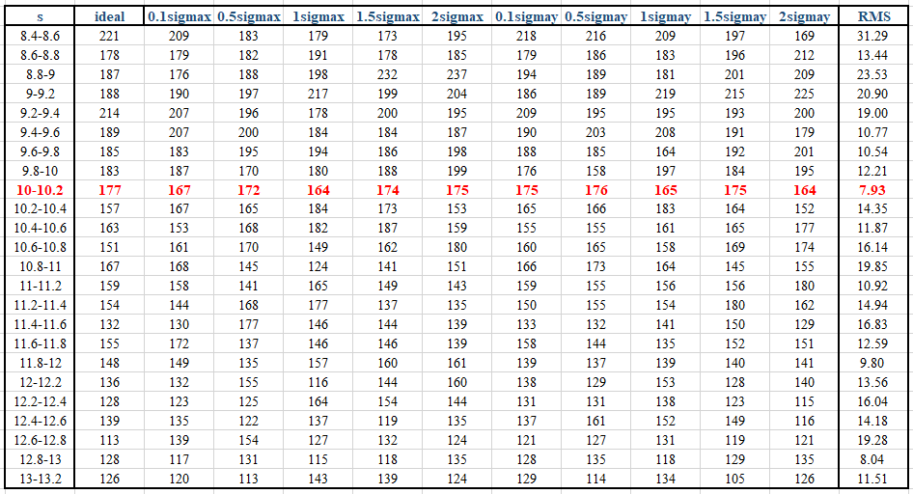
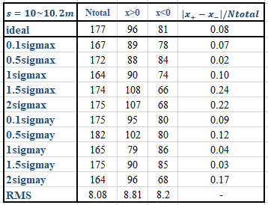

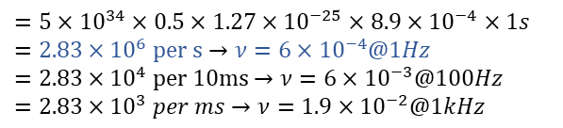
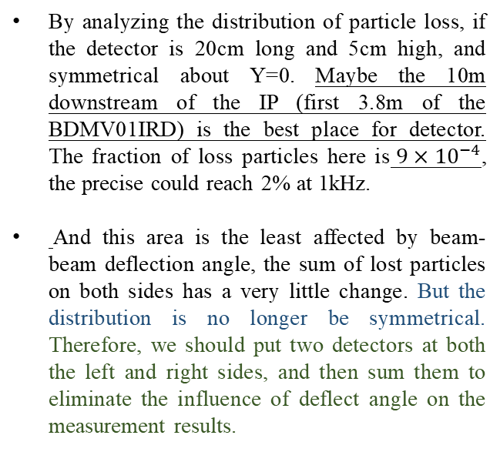
Select a best position to place the detector
$$f=\frac{N_{loss}}{N_{total}}=\frac{177}{2×{10}^{5}}=8.9×{10}^{−4}$$
$$N=L×σ×T×f$$
$$=5×{10}^{34}×0.5×1.27×{10}^{−25}×8.9×{10}^{−4}×1s$$
$$=2.83×{10}^{6} per s→ν=6×{10}^{−4}@1Hz$$
$$=2.83×{10}^{4} per 10ms→ν=6×{10}^{−3}@100Hz$$
$$=2.83×{10}^{3} per ms→ν=1.9×{10}^{−2}@1kHz$$
By analyzing the distribution of particle loss, if the detector is 20cm long and 5cm high, and symmetrical about Y=0. Maybe the 10m downstream of the IP (first 3.8m of the BDMV01IRD) is the best place for detector. The fraction of loss particles here is$9×{10}^{−4}$, the precise could reach 2% at 1kHz.
And this area is the least affected by beam-beam deflection angle, the sum of lost particles on both sides has a very little change. But the distribution is no longer be symmetrical. Therefore, we should put two detectors at both the left and right sides, and then sum them to eliminate the influence of deflect angle on the measurement results.

Slide 15
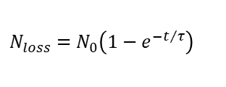
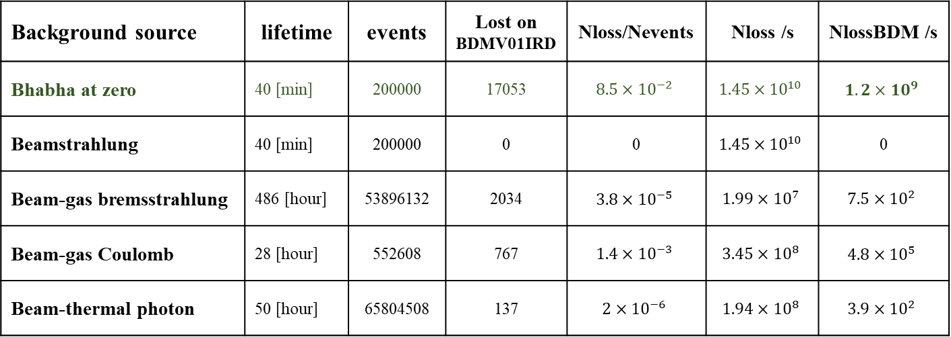
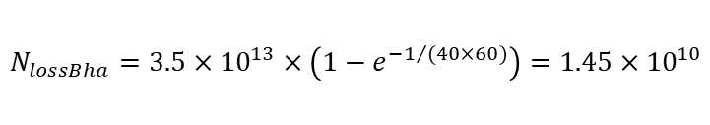

Evaluate the level of background
Haoyu Shi, Sha Bai
Background source | lifetime | events | Lost on BDMV01IRD | Nloss/Nevents | Nloss /s | NlossBDM /s
Bhabha at zero | 40 [min] | 200000 | 17053 | $$8.5×{10}^{−2}$$ | $$1.45×{10}^{10}$$ | $$1.2×{10}^{9}$$
Beamstrahlung | 40 [min] | 200000 | 0 | 0 | $$1.45×{10}^{10}$$ | 0
Beam-gas bremsstrahlung | 486 [hour] | 53896132 | 2034 | $$3.8×{10}^{−5}$$ | $$1.99×{10}^{7}$$ | $$7.5×{10}^{2}$$
Beam-gas Coulomb | 28 [hour] | 552608 | 767 | $$1.4×{10}^{−3}$$ | $$3.45×{10}^{8}$$ | $$4.8×{10}^{5}$$
Beam-thermal photon | 50 [hour] | 65804508 | 137 | $$2×{10}^{−6}$$ | $$1.94×{10}^{8}$$ | $$3.9×{10}^{2}$$
Assuming linear loss, i.e., the number of particles lost each turn is the same
$$N_{0}=N_{p}×N_{b}=1.3×{10}^{11}×268=3.5×{10}^{13}$$
$$T=\frac{C}{v}=\frac{100}{3×{10}^{5}}=3.3×{10}^{ −4}s$$
$$N_{loss}=N_{0}\left(1−e^{−t/τ}\right)$$
The number of lost particles due to Bhabha at zero degree in 1s :
$$N_{lossBha}=3.5×{10}^{13}×\left(1−e^{−1/{(40×60)}}\right)=1.45×{10}^{10}$$
The number lost on BDMV01IRD in which：
$$N_{lossBDM}=1.45×{10}^{10}×0.085=1.2×{10}^{9}$$
At BDMV01IRD, the radiative Bhabha at zero angle process dominates over the sum of all the other processes, can be ignored.

Slide 16

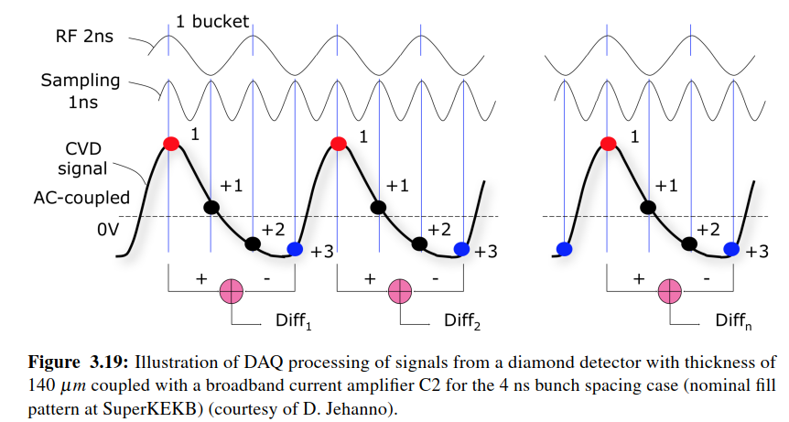
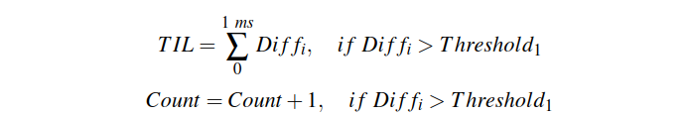
The requirements for detector
Energy Range: 10-60GeV, average energy is 33GeV
Time requirement: each bunch crossing generates a corresponding signal
the bunch spacing at Higgs energy is 600ns, so the time interval between signals is about 600ns
the bunch spacing at Z energy is 23ns, so the time interval between signals is about 23ns
Measurement items:
Integrate over 1ms the sum of all the differences
Gives the total number of pulse
Calculate the sum of all samples
The differences between the first and fourth sample provides the real signal amplitude for the first bunch
From Pang’s thesis

Slide 17
Summary
We only used SAD simulation to find the optimal location for placing the fast luminosity monitor, which is 10m downstream of the IP. This position not only has sufficient counting rate, but also the total number of lost particles is not very sensitive to the beam-beam deflection angle, and other background effects are very small compared with the radiative Bhabha at zero angle, can be ignored.
However, we still need to conduct more detailed simulation through Geent4, taking into account the material and size of the beam pipe and detector, to check the signal. generation.

Slide 18
Back up

Slide 19
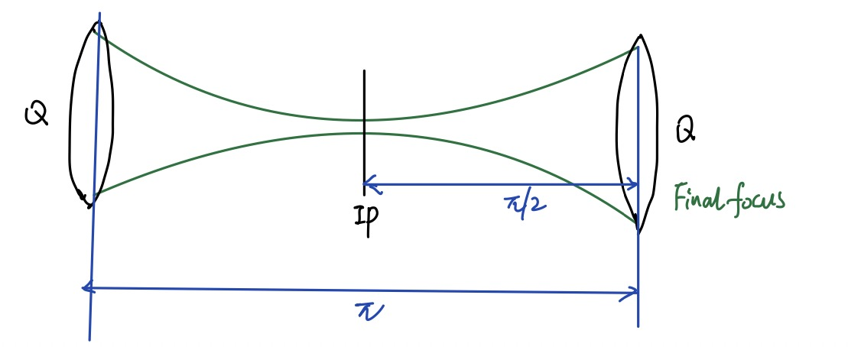
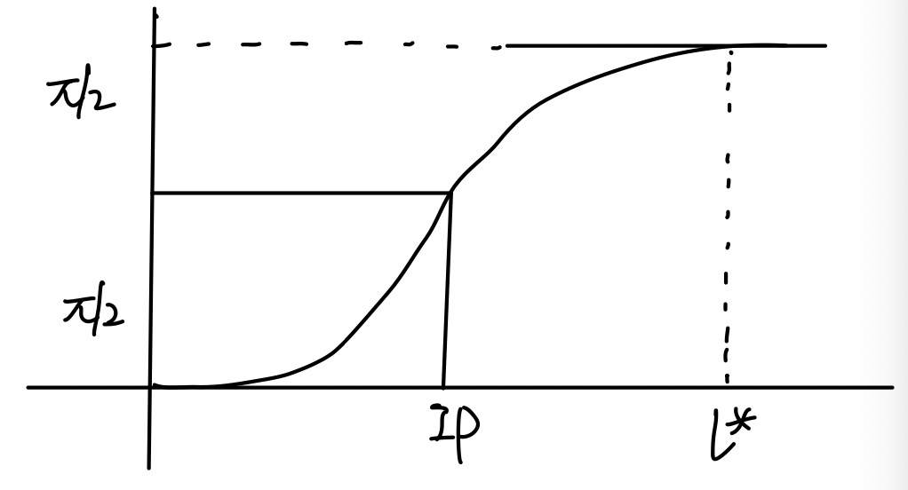
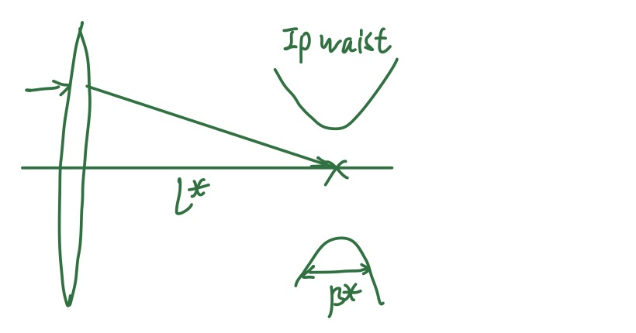
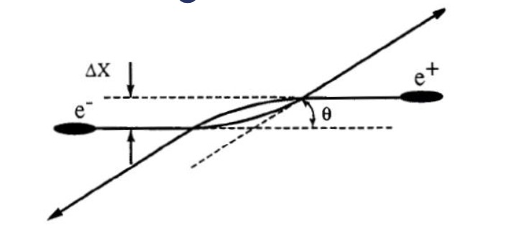
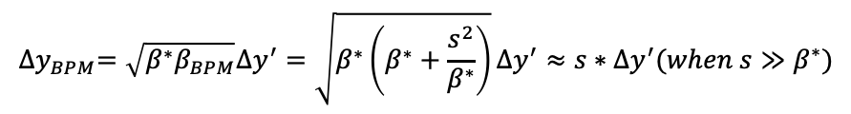
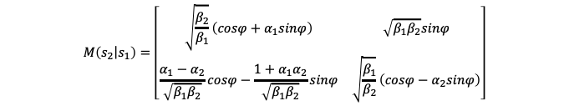
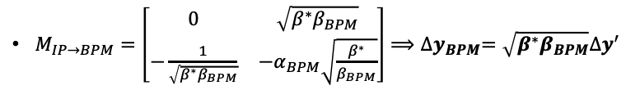


Sensitivity of deflection of beam-beam kick
$$M\left(\left.s_{2}\right|s_{1}\right)=\left[\begin{matrix}\sqrt{\frac{β_{2}}{β_{1}}}\left(cosφ+α_{1}sinφ\right) & \sqrt{β_{1}β_{2}}sinφ \\ \frac{α_{1}−α_{2}}{\sqrt{β_{1}β_{2}}}cosφ−\frac{1+α_{1}α_{2}}{\sqrt{β_{1}β_{2}}}sinφ & \sqrt{\frac{β_{1}}{β_{2}}}\left(cosφ−α_{2}sinφ\right)\end{matrix}\right]$$
$∆y$ at BPM$∽5μm$
BPM
offset
IP
$∆y$ at IP$=5nm∽0.1σ_{y}^{∗}$
BPM
If there is no Quadrupoles between IP and BPM
${∆x}_{±}^{′}=\frac{dx}{ds}=−\frac{2π}{β_{x±}^{∗}}ξ_{x±}{∆x}_{IP}=−\frac{r_{e}N_{∓}}{γ_{±}{\tilde{σ}}_{x∓}^{∗}\left({\tilde{σ}}_{x∓}^{∗}+σ_{y∓}^{∗}\right)}{∆x}_{IP}$
$${∆y}_{BPM}=\sqrt{β^{∗}β_{BPM}}∆y^{′}=\sqrt{β^{∗}\left(β^{∗}+\frac{s^{2}}{β^{∗}}\right)}∆y^{′}≈s∗∆y^{′}(when s≫β^{∗})$$
${∆y}_{±}^{′}=\frac{dy}{ds}=−\frac{2π}{β_{y±}^{∗}}ξ_{y±}{∆y}_{IP}=−\frac{r_{e}N_{∓}}{γ_{±}σ_{y∓}^{∗}\left({\tilde{σ}}_{x∓}^{∗}+σ_{y∓}^{∗}\right)}{∆y}_{IP}$
If there are Quadrupoles between IP and BPM
$M_{IP→BPM}=\left[\begin{matrix}0 & \sqrt{β^{∗}β_{BPM}} \\ −\frac{1}{\sqrt{β^{∗}β_{BPM}}} & −α_{BPM}\sqrt{\frac{β^{∗}}{β_{BPM}}}\end{matrix}\right]⟹{∆y}_{BPM}=\sqrt{β^{∗}β_{BPM}}∆y^{′}$
Need to plot a curve of the beta function to determine the beta value at BPM

Slide 20
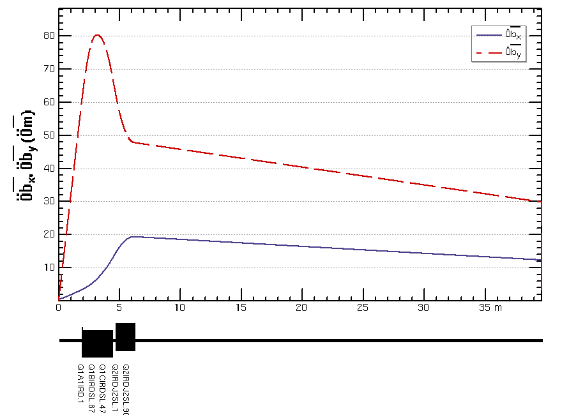
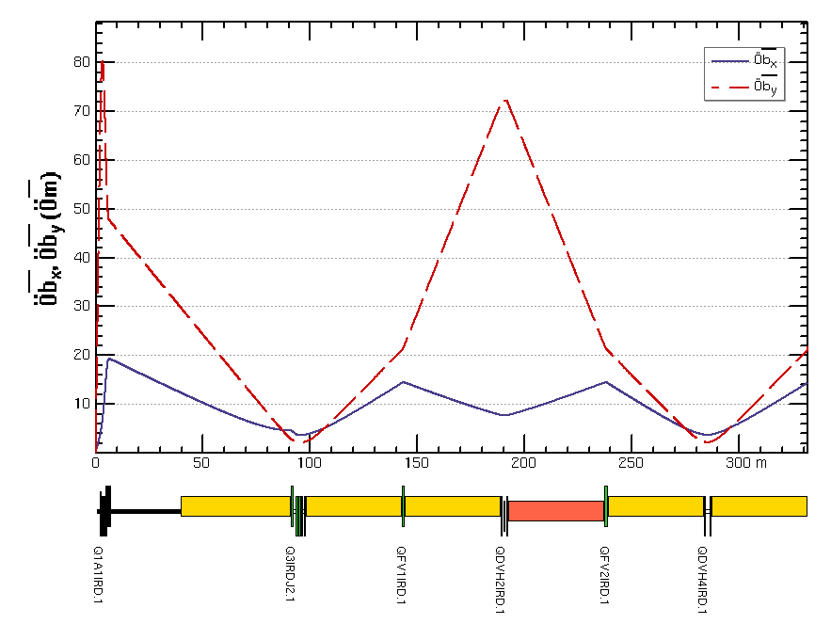
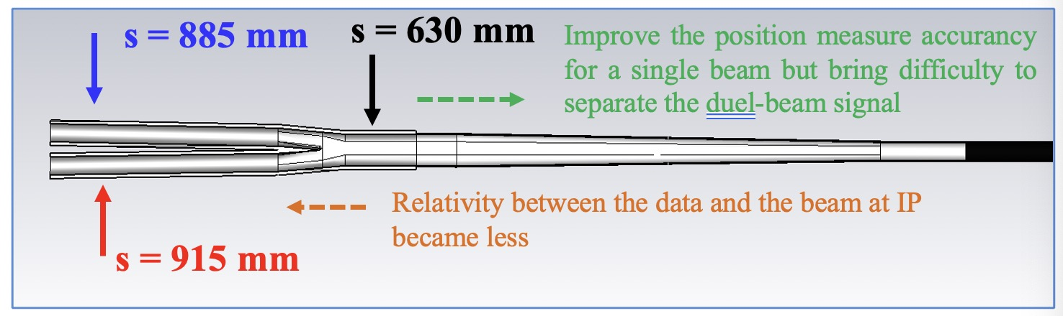
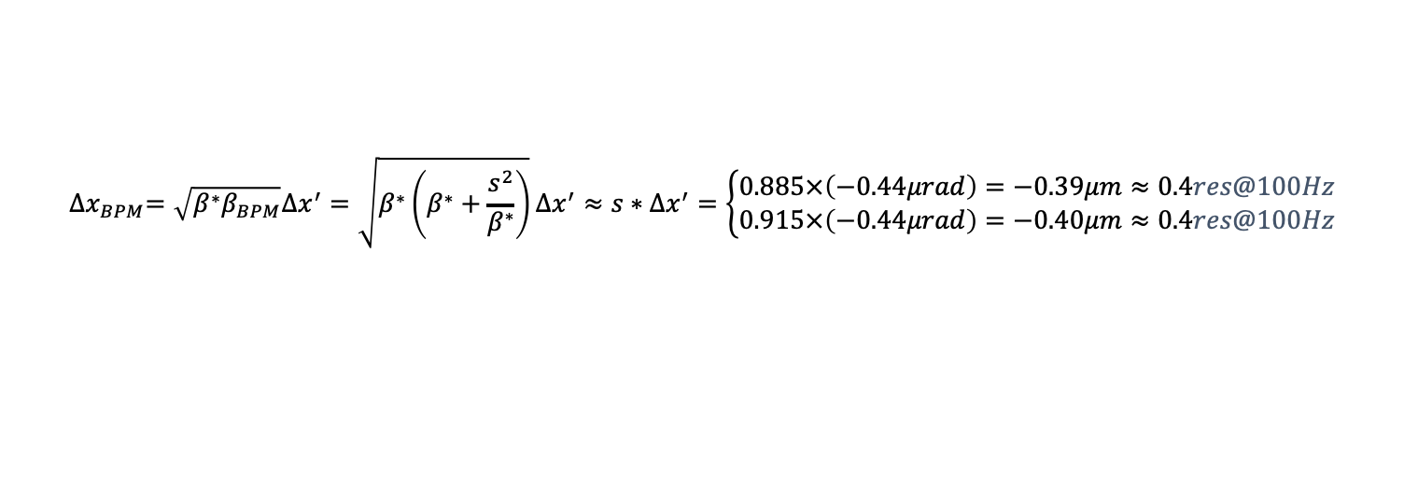
Select a position for BPM(x)
The BPM closest to the IP for measuring the electron orbit is at 0.885m and for positron is at 0.915m.
$${∆x}_{BPM}=\sqrt{β^{∗}β_{BPM}}∆x^{′}=\sqrt{β^{∗}\left(β^{∗}+\frac{s^{2}}{β^{∗}}\right)}∆x^{′}≈s∗∆x^{′}=\left\{\begin{matrix}0.885×\left(−0.44μrad\right)=−0.39μm≈0.4res@100Hz \\ 0.915×\left(−0.44μrad\right)=−0.40μm≈0.4res@100Hz\end{matrix}\right.$$
${∆x}_{BPM}=\sqrt{β^{∗}β_{BPM}}∆x^{′}⇒$If we place BPM at the maximum beta position, we can obtain a large offset at BPM
The first $β_{xmax}$ appears at 6m $⇒$ ${∆x}_{BPM}=\sqrt{0.3}×20×\left(−0.44μrad\right)=−4.8μm≈5res@100Hz$
The second${ β}_{xmax}$ appears at 144m $⇒$ ${∆x}_{BPM}=\sqrt{0.3}×14×\left(−0.44μrad\right)=−3.4μm≈3.5res@100Hz$

Slide 21
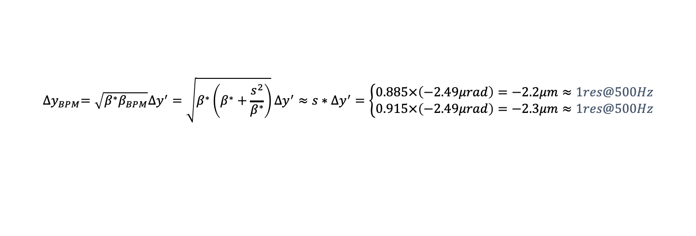
Select a position for BPM(y)
The BPM closest to the IP for measuring the electron orbit is at 0.885m and for positron is at 0.915m.
$${∆y}_{BPM}=\sqrt{β^{∗}β_{BPM}}∆y^{′}=\sqrt{β^{∗}\left(β^{∗}+\frac{s^{2}}{β^{∗}}\right)}∆y^{′}≈s∗∆y^{′}=\left\{\begin{matrix}0.885×\left(−2.49μrad\right)=−2.2μm≈1res@500Hz \\ 0.915×\left(−2.49μrad\right)=−2.3μm≈1res@500Hz\end{matrix}\right.$$
${∆y}_{BPM}=\sqrt{β^{∗}β_{BPM}}∆y^{′}⇒$If we place BPM at the maximum beta position, we can obtain a large offset at BPM
The first $β_{ymax}$ appears at 3m $⇒$ ${∆y}_{BPM}=\sqrt{1×{10}^{−3}}×80×\left(−2.49μrad\right)=−6.3μm≈3res@500Hz$
The second${ β}_{ymax}$ appears at 190m $⇒$ ${∆y}_{BPM}=\sqrt{1×{10}^{−3}}×72×\left(−2.49μrad\right)=−5.7μm≈3res@500Hz$

Slide 22



Orbit feedback system of SuperKEKB
Consideration of performance of the IP beam-beam deflection feedback both in the vertical and horizontal planes.
If want to keep the luminosity loss within 1%, the maximum offset at the IP is about $0.1σ^{∗}$.
SuperKEKB |  | $$N_{bunch}$$ $${[10}^{10}]$$ | $$β_{x}^{∗}/β_{y}^{∗}$$ $$[mm]$$ | $$σ_{x}^{∗}/σ_{y}^{∗}$$ $$[μm]$$ | $ξ_{x}^{∗}$/$ξ_{y}^{∗}$ | ${∆x}_{IP}$/${∆y}_{IP}$ $$0.1σ$$ $$[μm/nm]$$ | $∆x^{′}$/$∆y^{′}$ $$[μrad]$$ | $$l_{IP→BPM}$$ $$[m]$$ | ${∆x}_{BPM}$/${∆y}_{BPM}$ $$[μm]$$ | BPM resolution
Nominal | HER | 6.53 | 25/0.3 | 10.7/0.06 | 0.0012/0.081 | 1.07/6 | -0.32/-10.1 | 0.5 | 0.16/5.05 | 1um@5kHz
 | LER | 9.04 | 32/0.27 | 10.0/0.05 | 0.0028/0.088 | 1.0/5 | -0.56/-9.84 |  | 0.28/4.92
Current | HER | 3.05 | 60/1 | 16.6/0.22 | 0.0017/0.028 | 1.66/22 | -0.29/-3.76 | 0.5 | 0.15/1.88
 | LER | 3.67 | 80/1 | 17.9/0.22 | 0.0030/0.041 | 1.79/22 | -0.42/-5.66 |  | 0.21/2.83
f[Hz] |  | GM | Correct | Measure | BPM resolution | ${offset}_{BPM}$[um]
Nominal | H | 0.1 | 1 | 10 | 0.044um@10Hz | 0.16
 | V | 50 | 500 | 5000 | 1um@5kHz | 5.0
Current | H | 0.1 | 1 | 10 | 0.044um@10Hz | 0.15
 | V | 25 | 250 | 2500 | 0.71um@2.5kHz | 1.88
For nominal, have a factor of 5 in vertical and 3 in horizontal. To be safe, beam-beam deflection used for vertical and luminosity used for horizontal. For current, the BPM is not good enough, so they are not operating the vertical feedback so fast (100Hz).

Slide 23



Orbit feedback system of CEPC
Consider the case where the offset at IP is 0.1 sigma caused by ground motion, with about 1% luminosity loss and analyze the performance of the IP beam-beam deflection feedback both in the vertical and horizontal planes.
CEPC | $$N_{bunch}$$ $${[10}^{11}]$$ | $$β_{x}^{∗}/β_{y}^{∗}$$ $$[m/mm]$$ | $$σ_{x}^{∗}/σ_{y}^{∗}$$ $$[μm]$$ | $$ξ_{x}^{∗}/ξ_{y}^{∗}$$ | ${∆x}_{IP}$/${∆y}_{IP}$ $$0.1σ$$ $$[μm/nm]$$ | $$∆x^{′}/∆y^{′}$$ $$[μrad]$$ | $$l_{IP→BPM}$$ $$[m]$$ | ${∆x}_{BPM}$/${∆y}_{BPM}$ $$[μm]$$ | BPM resolution
Higgs | 1.3 | 0.3/1 | 14/0.036 | 0.015/0.11 | 1.4/3.6 | -0.44/-2.49 | 0.85 | -0.38/-2.12 | 0.3um@10Hz
Z | 1.4 | 0.13/0.9 | 6/0.035 | 0.004/0.127 | 0.6/3.5 | -0.12/-3.1 | 0.85 | -0.10/-2.64
W | 1.35 | 0.21/1 | 13/0.042 | 0.012/0.113 | 1.3/4.2 | -0.47/-2.98 | 0.85 | -0.40/-2.54
tt | 2.0 | 1.04/2.7 | 39/0.113 | 0.071/0.1 | 3.9/11.3 | -4.85/-2.63 | 0.85 | -4.12/-2.24
f[Hz] |  | GM | Correct | Measure | BPM resolution | ${offset}_{BPM}$[um]
HEPS (good) | H | <1 | 10 | 100 | 0.95um@100Hz | 0.38$→0.4times$
 | V | 5 | 50 | 500 | 2.1um@500Hz | 2.12$→1times$
BEPC (bad) | H | 0.02 | 0.2 | 2 | 0.13um@2Hz | 0.38$→3times$
 | V | 50 | 500 | 5000 | 6.7um@5kHz | 2.12$→0.3times$
KEK (bad) | H | 0.1 | 1 | 10 | 0.3um@10Hz | 0.38$→1times$
 | V | 50 | 500 | 5000 | 6.7um@5kHz | 2.12$→0.3times$
Ground motion of HEPS
The resolution of BPMs is not good enough for both vertical and horizontal beam-beam deflection feedback. We need to do luminosity feedback or also work on improving the BPMs.
5

Slide 24


[um]
Ground motion of BEPC
1.4um
0.1um
Ground motion of HEPS
Blue-vertical
Red-horizontal
3.6nm
3.6nm
50
1
5
0.02
f[Hz] |  | offset | GM | Correct | Measure | BPM resolution | ${offset}_{BPM}$[um]
HEPS (good) | H | 1.4um | <1 | 10 | 100 | 0.95um@2Hz | 0.38$→0.4times$
 | V | 3.6nm | 5 | 50 | 500 | 2.1um@500Hz | 2.12$→1times$
BEPC (bad) | H | 1.4um | <0.02 | 0.2 | 2 | 0.13um@2Hz | 0.38$→3times$
 | V | 3.6nm | 50 | 500 | 5000 | 6.7um@5kHz | 2.12$→0.3times$
KEK (bad) | H | 1.4um | 0.1 | 1 | 10 | 0.3um@10Hz | 0.38$→1times$
 | V | 3.6nm | 50 | 500 | 5000 | 6.7um@5kHz | 2.12$→0.3times$
$σ_{f_{measure}}=\frac{σ_{10Hz}}{\sqrt{{10}/{f_{measure}}}}$
The RMS displacement of HEPS integral over 1Hz up to 100Hz are 6nm, 16nm and 17nm on vertical (z), east to west (e) and north to south (n) direction respectively--The specific GM frequency cannot be found for the offset of 1.4um, and can only be said to be less than 1Hz, so the estimated value should have an error

Slide 25
Summary
It is important to pay attention to the stability of luminosity respect to offset and orbit feedback systems at IP are needed.
It is not easy to do beam-beam deflection feedback in both planes, but not impossible, as long as the two feedbacks operate with in different frequency ranges. On the other hand, it would be harder to do the luminosity based dithering feedback in both planes simultaneously, since it would imply probably two different dithering frequencies for each plane, and there is also some possibility of coupling between the orbit bumps used for the dithering. Also, contrary to the IP BPM method, the observable is the same for both planes, while BPMs can measure each plane separately. Recommended for both, beam-beam deflection for one direction and luminosity for another direction.
To have a good IP beam orbit feedback system, should
Have a very good BPM, which is good enough for one direction at least.
Choose a good site with good ground motion, which can reduce the demand for BPM.
also do luminosity feedback
$→$ Next I will do the same analyze for FCC-ee and compare it with SuperKEKB and CEPC.
$→$ If CEPC is sure to use luminosity feedback, I will do a preliminary conceptual design of a fast luminosity
monitor for CEPC, based on counting a fraction of single Bremsstrahlung events in at least one of the
rings at a location where other beam loss sources are sufficiently small.

Slide 26


guinea pig
The guinea pig program can run now, and I try to generate the distribution of beamstrahlung. The initial macro particle setting is 50000, only 531 particles were generated in the Pairs file, including a few low energy particles, 56, 70, and 78GeV and no particles lost in BDMV01IRD. The distribution of bremsstrahlung is also being generated, and I have tried it once, but the code has not finished running yet.

Slide 27


Distribution of particles lost on DBMV01IRD (L=33.4m)
$$σ_{x}=\sqrt{β_{x}^{∗}ε_{x}}=14μm,σ_{px}=\sqrt{{ε_{x}}/{β_{x}^{∗}}}=44μrad$$
The lost particles are mainly concentrated on the left and right sides of the first 10m drift tube, near y=0, and the distribution of particles on the both sides is almost symmetrical due to the current simulation does not add offset between two beams at IP.
However, when two beams have offset at the IP, the beam will be deflected with a certain angle due to the beam-beam effect. At this time, the distribution of lost particles may be asymmetric, and the total number of lost particles may also be different. So should added this angle to the simulation to check if has a major impact on measurement results.

Slide 28











your plots are showing the distribution of scattered electrons from the bremsstrahlung process as generated by BBBREM and with the position and angle distribution of the initial beam added
$$Nparticles=2×{10}^{5}$$
$$β_{x}^{∗}=0.33m,ε_{x}=0.65nm$$
$$sigmaxrandom=σ_{x}∗GaussRandom[]$$
$$β_{y}^{∗}=1mm,ε_{y}=ε_{x}∗0.002=1.3pm$$
$$sigmapxrandom=σ_{px}∗GaussRandom[]$$
$$σ_{x}=\sqrt{β_{x}^{∗}ε_{x}}=14μm,σ_{px}=\sqrt{{ε_{x}}/{β_{x}^{∗}}}=44μrad$$
$$sigmayrandom=σ_{y}∗GaussRandom[]$$
$$σ_{y}=\sqrt{β_{y}^{∗}ε_{y}}=36nm,σ_{py}=\sqrt{{ε_{y}}/{β_{y}^{∗}}}=36μrad$$
$$sigmapyrandom=σ_{py}∗GaussRandom[]$$
$$sigmazrandom=σ_{z}∗GaussRandom[]$$
$$σ_{z}=2.3mm,{ σ}_{e}=0.001$$
$$sigmaerandom=σ_{e}∗GaussRandom[]$$
$$xDist=sigmaxrandom$$
y$Dist=sigmayrandom$
z$Dist=sigmazrandom$
$$xpDist=xpDist0+sigmapxrandom$$
y$pDist=ypDist0+sigmapyrandom$
ee$Dist=dpDist0$
$$beam=\{xDist,xpDist,yDist,ypDist,zDist,eeDist\}$$

Slide 29

Effect of deflect angle on distribution of lost particles in BDMV01IRD
The maximum deflection angle caused by the beam-beam effect is estimated to occur when the offset is 1-2sigma, so the maximum angle added in the simulation is the deflection angle corresponding to 2sigma.
When there is an angle in the x direction, the number of particles lost on the whole drift tube is almost same, but the distribution on the left and right sides is asymmetric.
If put two detectors on both sides and then summed, can eliminate the influence of the angle in the x direction.
When there is a large angle in the y direction, the number of particles lost on the whole drift tube is little different, but the distribution on the left and right sides is almost symmetrical.
Even though put two detectors cannot eliminate the influence of the angle in the y direction.
It should be noted that we cannot make a 30m long detector, but a very small detector, approximately 10cm long and 3cm high. Therefore, we need to find the best local area to place the detector in the first 10m of BDMV01IRD, which should have sufficient counting rate and be almost unaffected by the deflect angle.

Slide 30

Select a best position to place the detector
$$f=\frac{N_{loss}}{N_{total}}=\frac{177}{2×{10}^{5}}=8.9×{10}^{−4}$$
$$N=L×σ×T×f$$
$$=5×{10}^{34}×0.5×1.27×{10}^{−25}×8.9×{10}^{−4}×1s$$
$$=2.83×{10}^{6} per s→ν=6×{10}^{−4}@1Hz$$
$$=2.83×{10}^{4} per 10ms→ν=6×{10}^{−3}@100Hz$$
$$=2.83×{10}^{3} per ms→ν=1.9×{10}^{−2}@1kHz$$
Assuming the detector is 20cm long and 5cm high, and symmetrical about Y=0. Maybe the 10m downstream of the IP (first 3.8m of the BDMV01IRD) is the best place for detector, the loss rate here is $9×{10}^{−4}$, the precise could reach 2% at 1kHz.
And this area is the least affected by beam-beam deflection angle, the sum of lost particles on both sides has a very little change. Therefore, we can put two detectors at both the left and right sides, and then sum them to eliminate the influence of deflect angle on the measurement results.

Slide 31



Firstly, evaluate the performance of IP beam-beam deflection feedback to see if the BPMs are good enough for fast luminosity feedback. Consider the case where the offset at IP is 0.1 sigma caused by ground motion, with about 1% luminosity loss
CEPC | $$N_{bunch}$$ $${[10}^{11}]$$ | $$β_{x}^{∗}/β_{y}^{∗}$$ $$[m/mm]$$ | $$σ_{x}^{∗}/σ_{y}^{∗}$$ $$[μm]$$ | $$ξ_{x}^{∗}/ξ_{y}^{∗}$$ | ${∆x}_{IP}$/${∆y}_{IP}$ $$0.1σ$$ $$[μm/nm]$$ | $$∆x^{′}/∆y^{′}$$ $$[μrad]$$ | $$l_{IP→BPM}$$ $$[m]$$ | ${∆x}_{BPM}$/${∆y}_{BPM}$ $$[μm]$$ | BPM resolution
Higgs | 1.3 | 0.3/1 | 14/0.036 | 0.015/0.11 | 1.4/3.6 | -0.44/-2.49 | 0.85 | -0.38/-2.12 | 0.3um @10Hz
Z | 1.4 | 0.13/0.9 | 6/0.035 | 0.004/0.127 | 0.6/3.5 | -0.12/-3.1 | 0.85 | -0.10/-2.64
W | 1.35 | 0.21/1 | 13/0.042 | 0.012/0.113 | 1.3/4.2 | -0.47/-2.98 | 0.85 | -0.40/-2.54
tt | 2.0 | 1.04/2.7 | 39/0.113 | 0.071/0.1 | 3.9/11.3 | -4.85/-2.63 | 0.85 | -4.12/-2.24
f[Hz] |  | GM | Correct | Measure | BPM resolution | ${offset}_{BPM}$[um]
HEPS | H | <1 | 10 | 100 | 0.95um@100Hz | 0.38$→0.4times$
 | V | 5 | 50 | 500 | 2.1um@500Hz | 2.12$→1times$
BEPC | H | 0.02 | 0.2 | 2 | 0.13um@2Hz | 0.38$→3times$
 | V | 50 | 500 | 5000 | 6.7um@5kHz | 2.12$→0.3times$
KEK | H | 0.1 | 1 | 10 | 0.3um@10Hz | 0.38$→1times$
 | V | 50 | 500 | 5000 | 6.7um@5kHz | 2.12$→0.3times$
The resolution of BPMs at current location used for measuring the beam orbit(no Quadrupoles between the IP and BPM) is not good enough for both vertical and horizontal beam-beam deflection feedback.

Slide 32

Need to improve the accuracy of BPM or also can consider adding BPM near the maximum beta position, with an offset expected to increase by 2-3 times and place multiple BPMs at both sides of IP maybe also increase the accuracy by 2 times.
${∆x}_{BPM}=\sqrt{β^{∗}β_{BPM}}∆x^{′}⇒$If we place BPM at the maximum beta position, we can obtain a large offset at BPM
$β_{xmax}$ appears at 6m $⇒⇒$ ${∆x}_{BPM}=\sqrt{0.3}×20×\left(−0.44μrad\right)=−4.8μm≈5res@100Hz$
$β_{ymax}$ appears at 3m $⇒{∆y}_{BPM}=\sqrt{1×{10}^{−3}}×80×\left(−2.49μrad\right)=−6.3μm≈3res@500Hz$
The current analysis is based on one single BPM, the feedback based on BPM in x direction maybe okay, y direction maybe up limit. And the measuring precision nearly proportional to the $\sqrt{N_{BPM}}$. That is to say plane if have enough BPMs and place the near the maximum beta function position, the feedback based on BPM probably okay for both horizontal and vertical.

Slide 33

Necessity of the Fast Luminosity Monitor for CEPC
Used for IP orbit feedback as a back up
All previous calculations assume that BPM can achieve design precise, and all machine parameters can reach the design values, we can put many BPMs near maximum beta position. But if the BPM in one direction is not so precise and at the beginning of the operation, the nominal parameters will not be achieved, the offset generated at BPM is not big enough to accurately measured with these BPMs.
And the luminosity is at least 10 times lower than the nominal value, and the cross-section of standard luminosity monitor is not large enough, so standard luminosity monitor also doesn’t work for fast feedback, then maybe the luminosity monitor can be alternative.
Used for beam size tuning
Whether you do beam size tuning with beam-beam deflection or luminosity, will introduce beam-beam blow up. We should minimize beam-beam blow-up by reducing strongly beam current, maybe factor of 100, then luminosity drops to ${10}^{30}$. And in that case, standard luminosity monitor doesn’t work, you need to wait ${10}^{4}s$.
 | Standard luminosity monitor (LumiCal) | Fast luminosity monitor
Lower luminosity | $L=5×{10}^{33}{cm}^{−2}s^{−1}$ f=1 $σ_{Higgs}={10}^{−31}{cm}^{−2}$ $$N=L×σ×T×f$$ $=0.5×5×{10}^{34}×{10}^{−31}×1$ $$=2.5×{10}^{2}/s=2.5/10ms$$ If measure at 100Hz, the precise is 0.63 | $$L=5×{10}^{33}{cm}^{−2}s^{−1} f=0.01$$ $σ_{Higgs}={1.27×10}^{−25}{cm}^{−2}$ $$N=L×σ×T×f$$ $=5×{10}^{34}×0.5×1.27×{10}^{−25}×0.01$ $=3.2×{10}^{6}/s=3.2×{10}^{4}/10ms$ If measure at 100Hz, the precise is $5.6×{10}^{−3}$
Lower current | $$L=5×{10}^{30}{cm}^{−2}s^{−1}$$ $$N=L×σ×T×f=0.25/s$$ If measure at 1Hz, the precise is 2 | $$L=5×{10}^{30}{cm}^{−2}s^{−1}$$ $$N=L×σ×T×f=3.2×{10}^{2}/s$$ If measure at 1Hz, the precise is 0.06

Slide 34




Select a best position to place the detector
$$f=\frac{N_{loss}}{N_{total}}=\frac{78}{2×{10}^{5}}=4×{10}^{−4}$$
$$N=L×σ×T×f$$
$$=5×{10}^{34}×0.5×1.27×{10}^{−25}×4×{10}^{−4}×1s$$
$$=1.27×{10}^{6} per s→ν=8.9×{10}^{−4}@1Hz$$
$$=1.27×{10}^{4} per 10ms→ν=8.9×{10}^{−3}@100Hz$$
$$=1.27×{10}^{3} per ms→υ=2.8×{10}^{−2}@1kHz$$
Assuming the detector is 10cm long and 3cm high and place it in the horizontal symmetrical about Y=0. In this case, the 8.6m downstream of the IP (at the first 2.4m of BDMV01IRD) is the good position for detector.
The total particles number lost on this area is almost unaffected by beam-beam deflection. But the distribution is no longer be symmetrical. So should put a detector on both sides. The fraction of loss particles here is $4×{10}^{−4}$, the precise could reach 3% at 1kHz.
It is not guaranteed that every lost particle can generate a signal in the detector, the fraction is about 60-70%, so it is necessary to consider a slightly larger detector.

