Slide 1
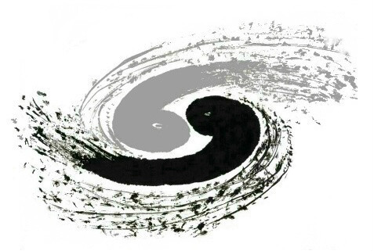
Cluster Simulation
via Neural Network
YiZhou Zhang, Tao Lin, WeiDong Li
zhangyz@ihep.ac.cn
30th Aug 2023

Slide 2
2
1
Background
Cluster Reconstruction via Neural Network
Outline
2
Design
Cluster Reconstruction via Neural Network
3
Working progress
Cluster Reconstruction via Neural Network

Slide 3
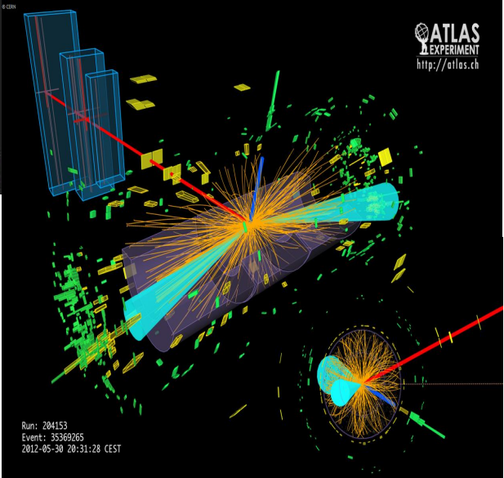
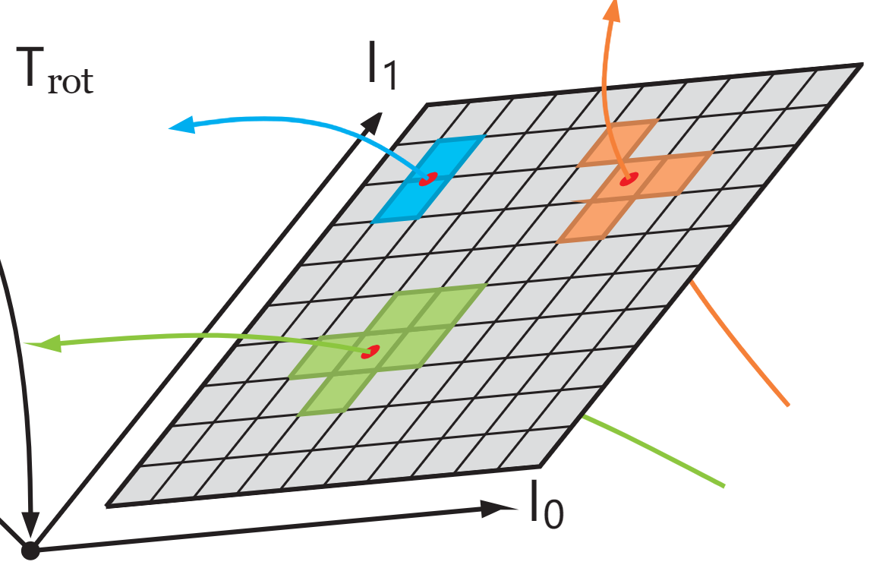
1
Background
3
Cluster Reconstruction via Neural Network
Requirements:
现有的模拟算法并不能模拟出粒子穿过感应器产生的感应簇。
Geant4模拟出的结果，只有模拟粒子穿过感应器的一个感应点。
Geant4模拟
Purpose：
根据粒子穿过感应器的真实响应感应簇，通过机器学习方法，训练出能够模拟产生感应簇的模型。
使用TestBeam的数据训练模型。
使用生成对抗网络。
感应簇
Reference: Acts Common Tracking Software https://acts.readthedocs.io/
Reference: R.M. Bianchi, “Event display of a 2-tau candidate in the ATLAS detector”

Slide 4
4
1
Background
Cluster Reconstruction via Neural Network
Outline
2
Design
Cluster Reconstruction via Neural Network
3
Working progress
Cluster Reconstruction via Neural Network

Slide 5
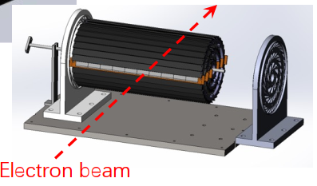
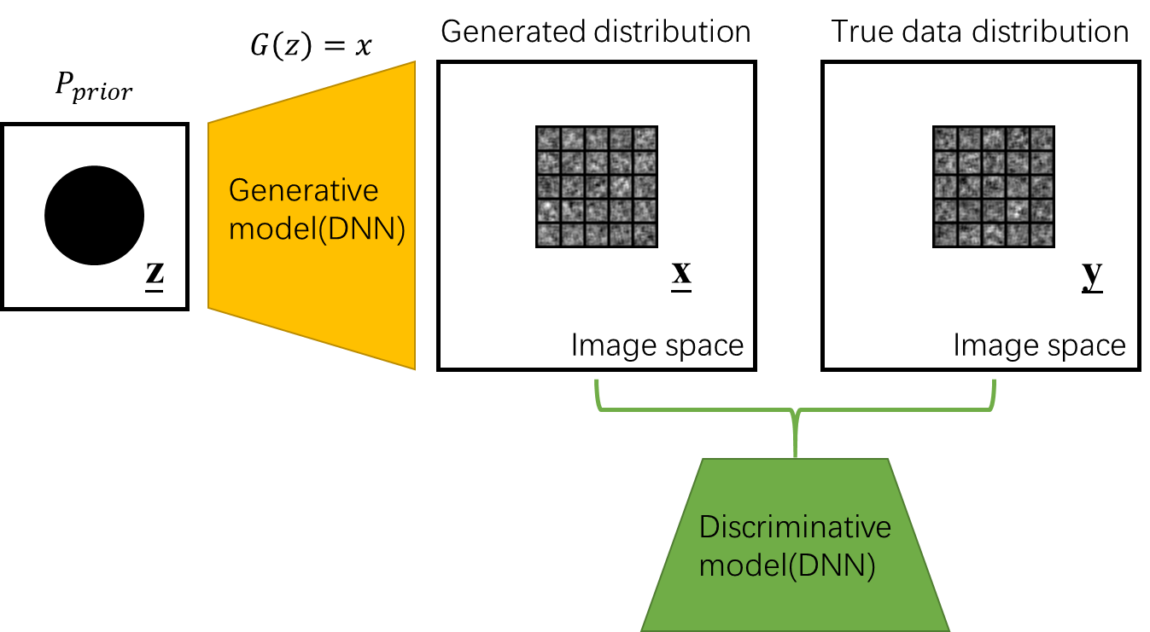
2
Design
Overview
5
Cluster Reconstruction via Neural Network
CEPCSW
EDM4hep::
TrackerHit
EDM4hep::
RawTimeSeries
Network Model
.pt
.so
Wrapped Functions
Wrapper
C++
libtorch
TestBeam Data
Neural Network
Load_model()
predict()

Slide 6
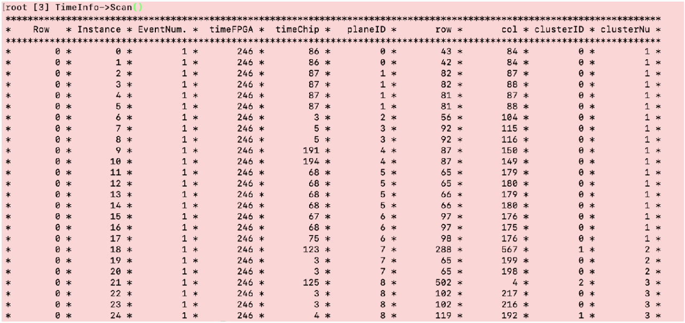
2
Design
Data Prepocessing
6
Cluster Reconstruction via Neural Network
TestBeam Data
Neural Network
Test Beam Data
Train the NN
using the data
.npy
1024 pixel
(42,84)
(43,84)
16 pixel
localize
(-0.5,0)
round
(8,8)
512 pixel
(0.5,0)
(9,8)
16 pixel
Relative Coordinates of Geometric Centers
Put it at a 16*16 pic as the train data
The cluster of one hit at the plane.

Slide 7
2
Design
GAN
7
Cluster Reconstruction via Neural Network
.npy
$$G\left(z\right)=x$$
Generated distribution
True data distribution
Train data
after preprocessing
$$P_{prior}$$
16*16 pixel
16*16 pixel
Generative model(DCNN)
(8,8)
z
x
(9,8)
y
Image space
Image space
.pt
Discriminative model(DCNN)
Save and Put
Generative Model into CEPCSW
We use a standard DCGAN model

Slide 8
2
Design
GAN
8
Cluster Reconstruction via Neural Network
16*16 pixel * 25
$$G\left(z\right)=x$$
$$P_{prior}$$
Generative model(DCNN)
Downsample
With a threshold
z
.pt
(-0.5,0)
(0.5,0)
Local Coordinates
(42,84)
(43,84)
(42.5,84)
round
The cluster of one hit at the plane.
One hit at the plane

Slide 9
9
1
Background
Cluster Reconstruction via Neural Network
Outline
2
Design
Cluster Reconstruction via Neural Network
3
Working progress
Cluster Reconstruction via Neural Network

Slide 10
3
Working progress
10
Overview
Cluster Reconstruction via Neural Network
TBD
CEPCSW
✔
EDM4hep::
TrackerHit
EDM4hep::
RawTimeSeries
✔
✔
Network Model
.pt
.so
Wrapped Functions
Wrapper
C++
libtorch
TestBeam Data
Neural Network
Load_model()
predict()
Need to be improved!

Slide 11
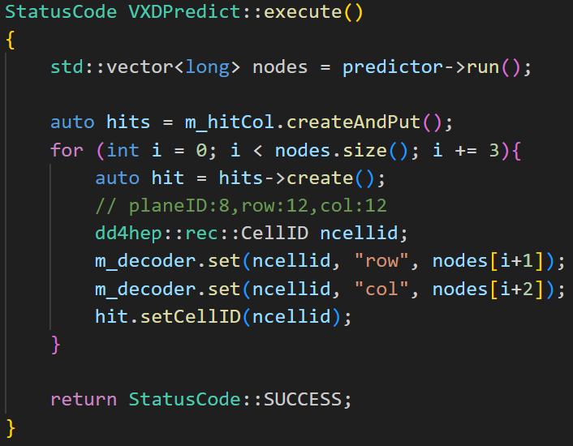
3
Working progress
Predict in CEPCSW
11
Cluster Reconstruction via Neural Network
CEPCSW
✔
Run prediction
EDM4hep::
RawTimeSeries
Save in a
RawTimeSeriesCollection
✔
.so
Wrapped Functions
Wrapper
C++
Load_model()
predict()
Encode in cellID

Slide 12
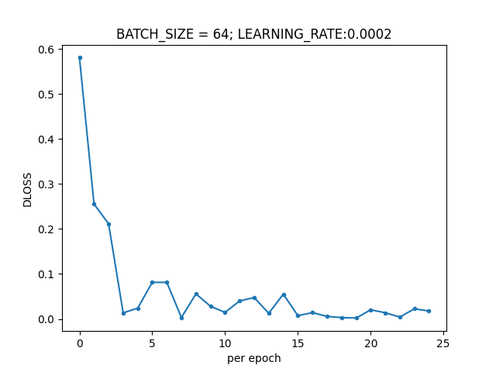
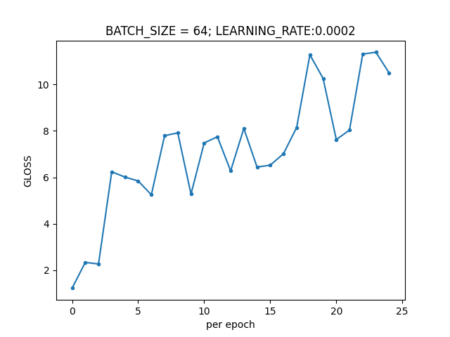
3
Working progress
DCGAN Train
12
Cluster Reconstruction via Neural Network
Discriminator Loss
Generator Loss
基本符合预期。
Discriminator下降过快，考虑降低辨别器训练频率。

Slide 13
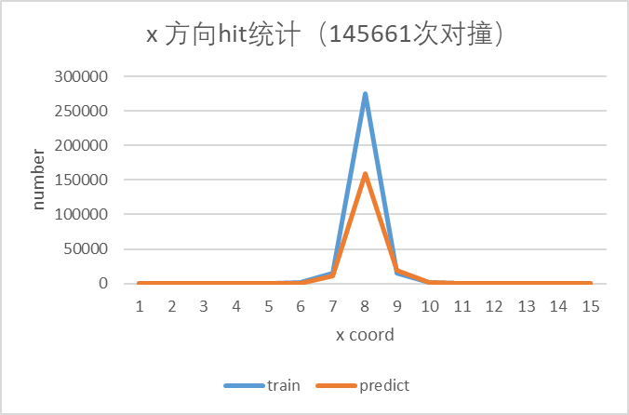
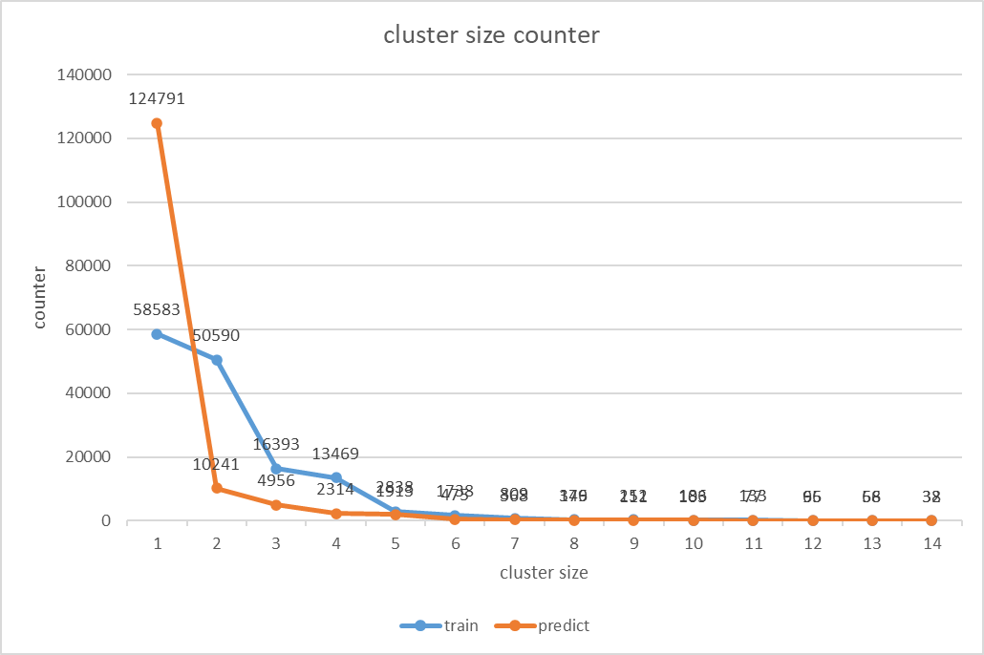
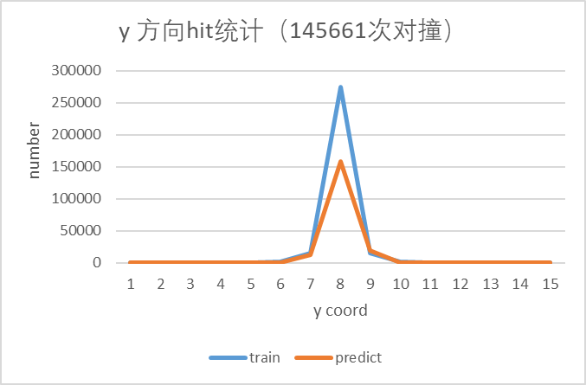
3
Working progress
DCGAN Predict
13
Cluster Reconstruction via Neural Network
Predictor分布分析：
训练出来的预测分布，cluster偏小，大部分预测都是只有一个点。
DCGAN没能很好的学习到训练集分布。

Slide 14
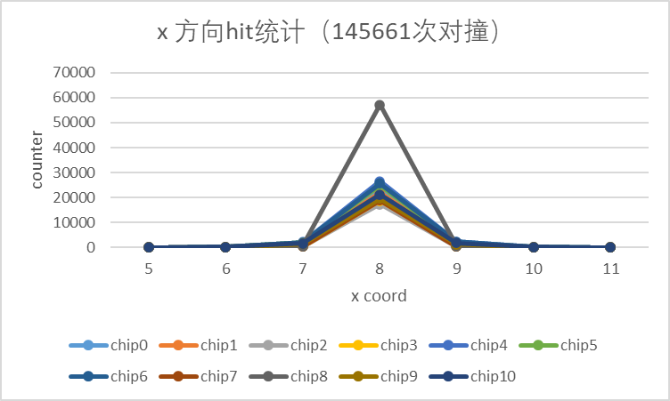
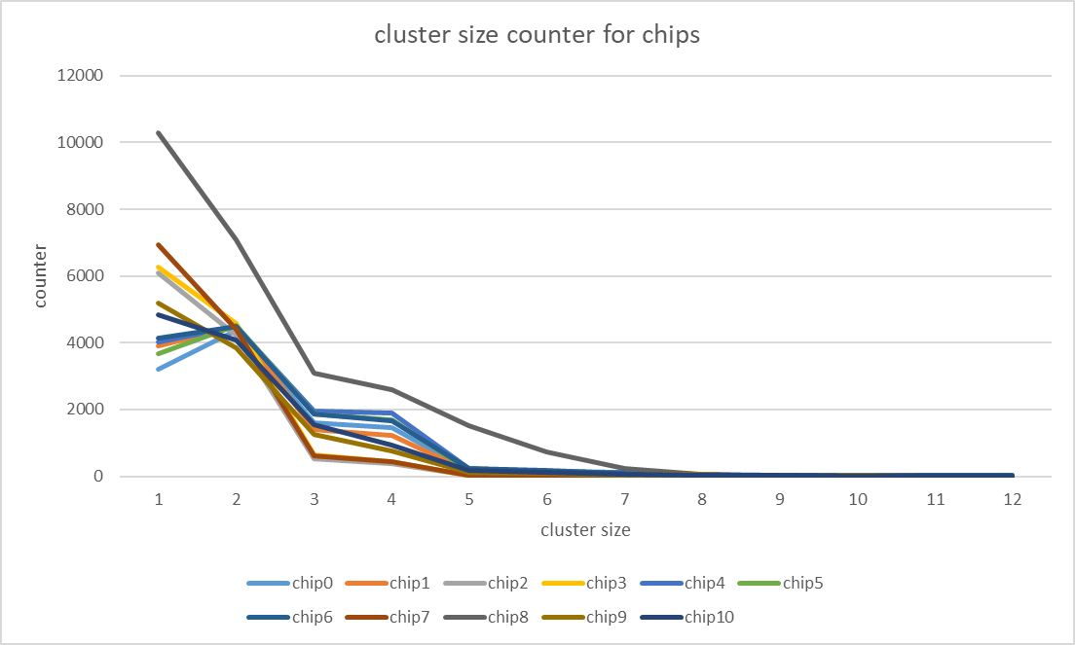
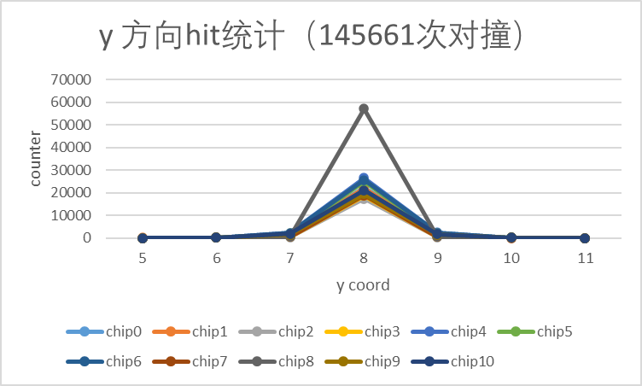
3
Working progress
DCGAN Predict
14
Cluster Reconstruction via Neural Network
训练数据分布统计：
从chip0-10，越靠后的plane，cluster越小

Slide 15
3
Working progress
Summary & future work
15
Cluster Reconstruction via Neural Network
Summary
目标：根据粒子穿过感应器的真实响应感应簇，通过机器学习方法，训练出能够模拟产生感应簇的模型。
使用标准的DCGAN模型，以TestBeam Data为训练集，训练了能初步预测簇形状的模型。
将模型加入CEPCSW，能够成功运行预测算法，并生成储存相应的RawTimeSeries Collection的root文件。
Future Work
目前网络模型结果不甚理想，需要进一步优化模型（如使用FLOW模型）
目前模型的输入为隐空间的噪音，后续需要考虑加入其他输入（如：粒子入射角，能量，类型等）
CEPCSW部分需要加入geant4模拟（需要TB的几何信息），使整一个预测工作流程跑通。

Slide 16
Thank You
YiZhou Zhang, Tao Lin, WeiDong Li
zhangyz@ihep.ac.cn
30th Aug 2023

Slide 17
Backup

