Slide 1
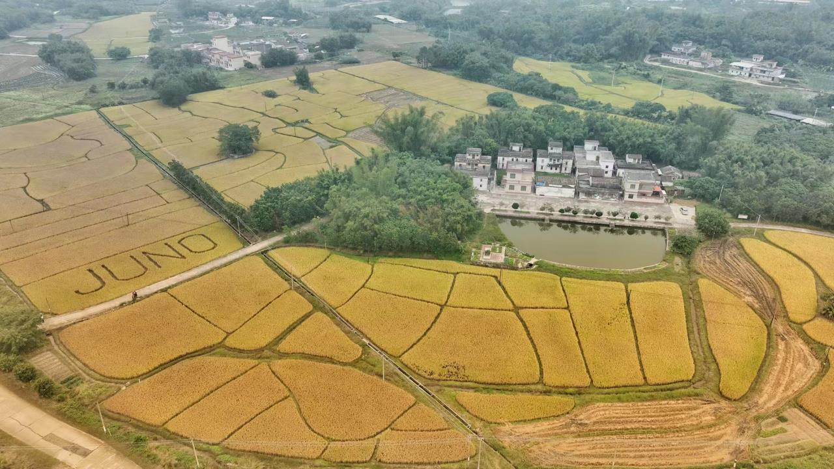
Status and prospects of JUNO
Zeyuan Yu (IHEP)
On behalf of the JUNO collaboration
Feb. 19th, 2024
International Symposium on Neutrino Physics and Beyond, 2024

Slide 2

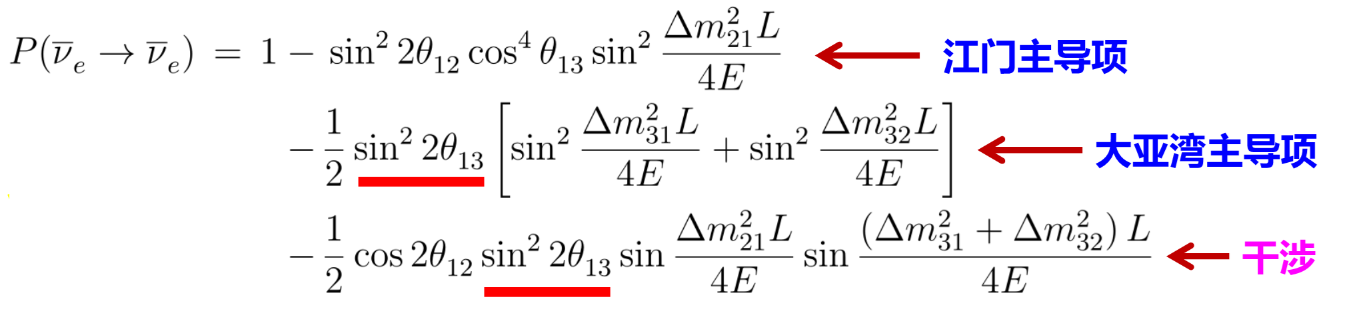
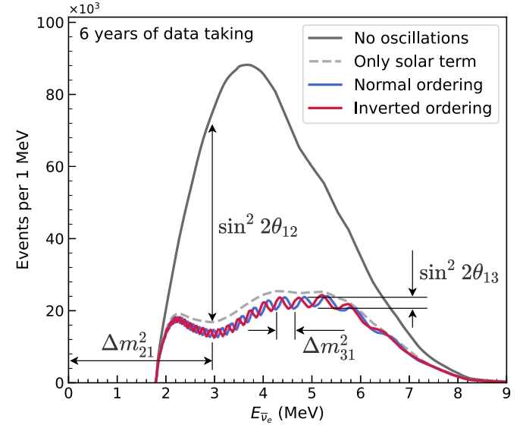
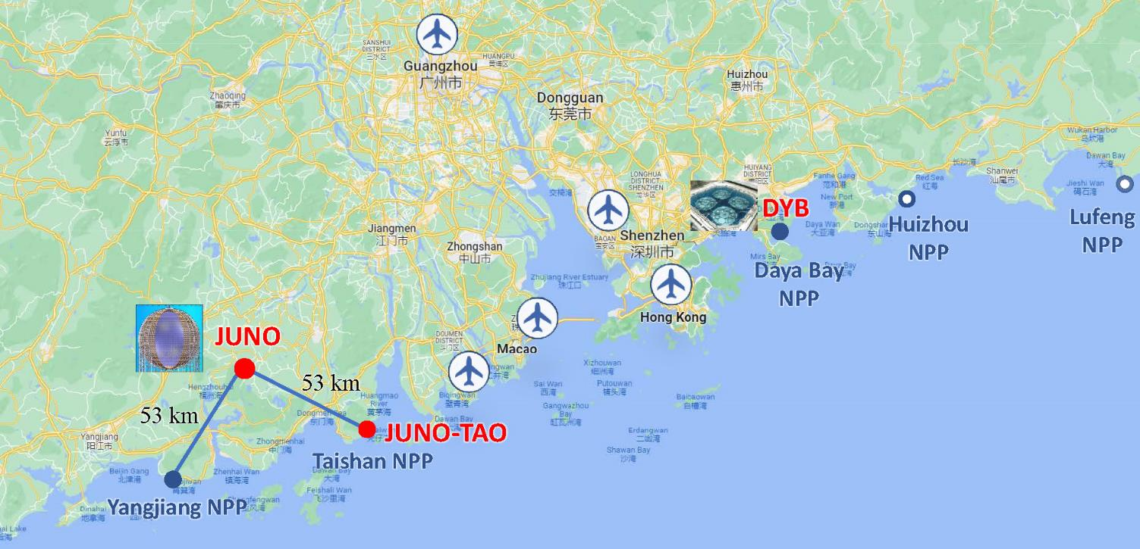
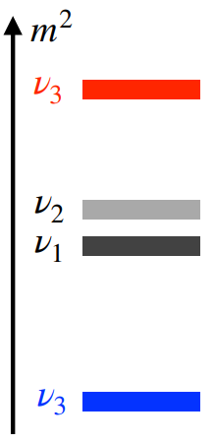

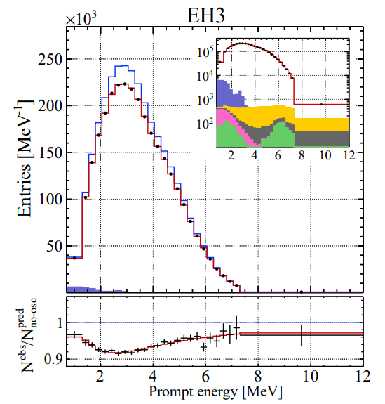
Jiangmen Underground Neutrino Observatory
Leading term at JUNO
Leading term at Daya Bay
Sensitive to mass ordering
Key for NMO:
1、20 kton liquid scintillator detector
2、3% energy resolution at 1 MeV energy deposit
3、low background
Daya Bay Far Hall

Slide 3
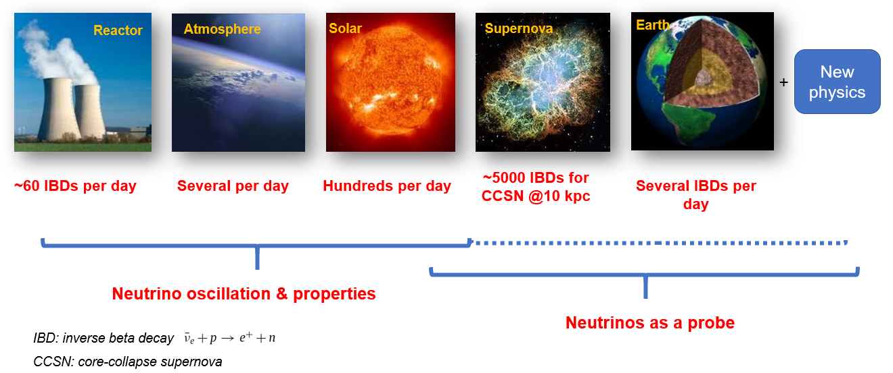
A multiple-purpose neutrino experiment
Neutrino oscillations, mass ordering (3-4 σ), precision measurement (<0.5%)
Astro-particle physics, supernovae neutrinos, geo and solar neutrinos

Slide 4
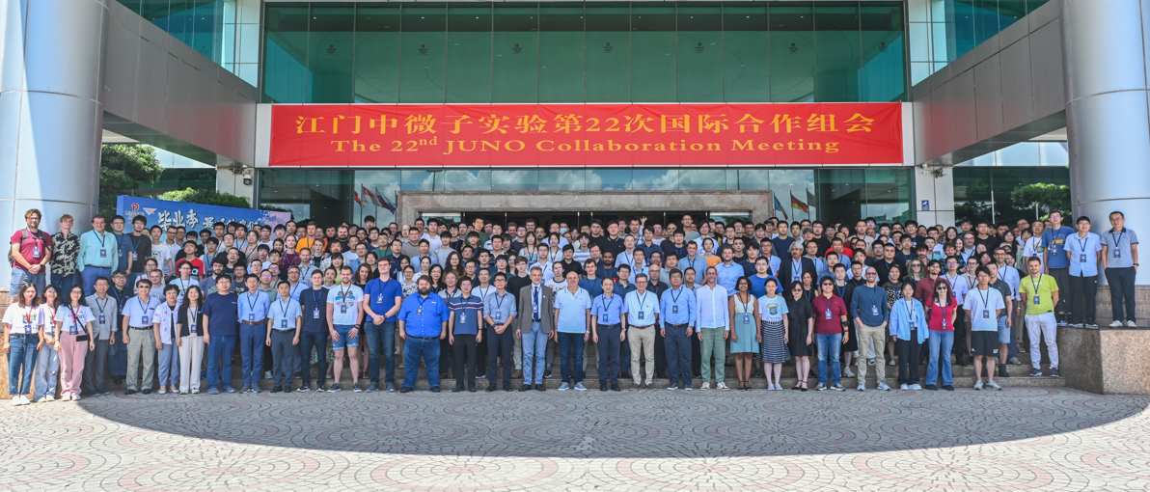
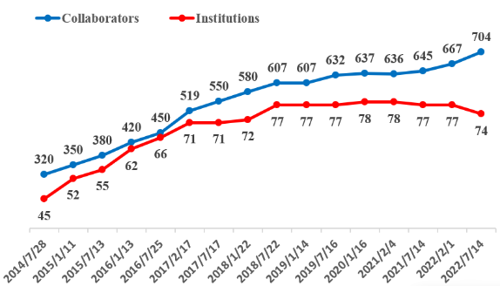
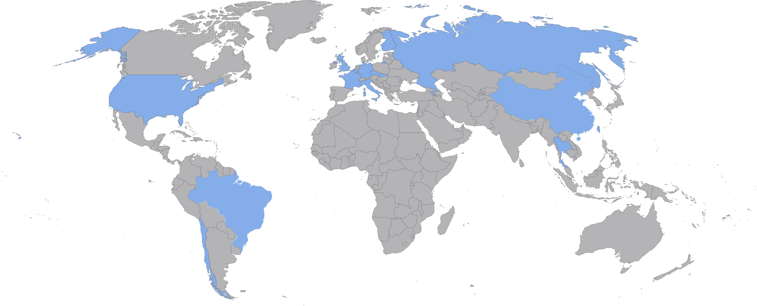
JUNO collaboration
74 institutes and more than 700 collaborators
Country | Institute | Country | Institute | Country | Institute
Armenia | Yerevan Physics Institute | China | SYSU | Germany | U. Mainz
Belgium | Universite libre de Bruxelles | China | Tsinghua U. | Germany | U. Tuebingen
Brazil | PUC | China | UCAS | Italy | INFN Catania
Brazil | UEL | China | USTC | Italy | INFN di Frascati
Chile | PCUC | China | U. of South China | Italy | INFN-Ferrara
Chile | SAPHIR | China | Wu Yi U. | Italy | INFN-Milano
Chile | UNAB | China | Wuhan U. | Italy | INFN-Milano Bicocca
China | BISEE | China | Xi'an JT U. | Italy | INFN-Padova
China | Beijing Normal U. | China | Xiamen University | Italy | INFN-Perugia
China | CAGS | China | Zhengzhou U. | Italy | INFN-Roma 3
China | ChongQing University | China | NUDT | Pakistan | PINSTECH (PAEC)
China | CIAE | China | CUG-Beijing | Russia | INR Moscow
China | DGUT | China | ECUT-Nanchang City | Russia | JINR
China | Guangxi U. | China | CDUT-Chengdu | Russia | MSU
China | Harbin Institute of Technology | Czech | Charles U. | Slovakia | FMPICU
China | IHEP | Finland | University of Jyvaskyla | Taiwan-China | National Chiao-Tung U.
China | Jilin U. | France | IJCLab Orsay | Taiwan-China | National Taiwan U.
China | Jinan U. | France | LP2i Bordeaux | Taiwan-China | National United U.
China | Nanjing U. | France | CPPM Marseille | Thailand | NARIT
China | Nankai U. | France | IPHC Strasbourg | Thailand | PPRLCU
China | NCEPU | France | Subatech Nantes | Thailand | SUT
China | Pekin U. | Germany | RWTH Aachen U. | U.K. | U. Warwick
China | Shandong U. | Germany | TUM | USA | UMD-G
China | Shanghai JT U. | Germany | U. Hamburg | USA | UC Irvine
China | IGG-Beijing | Germany | FZJ-IKP

Slide 5
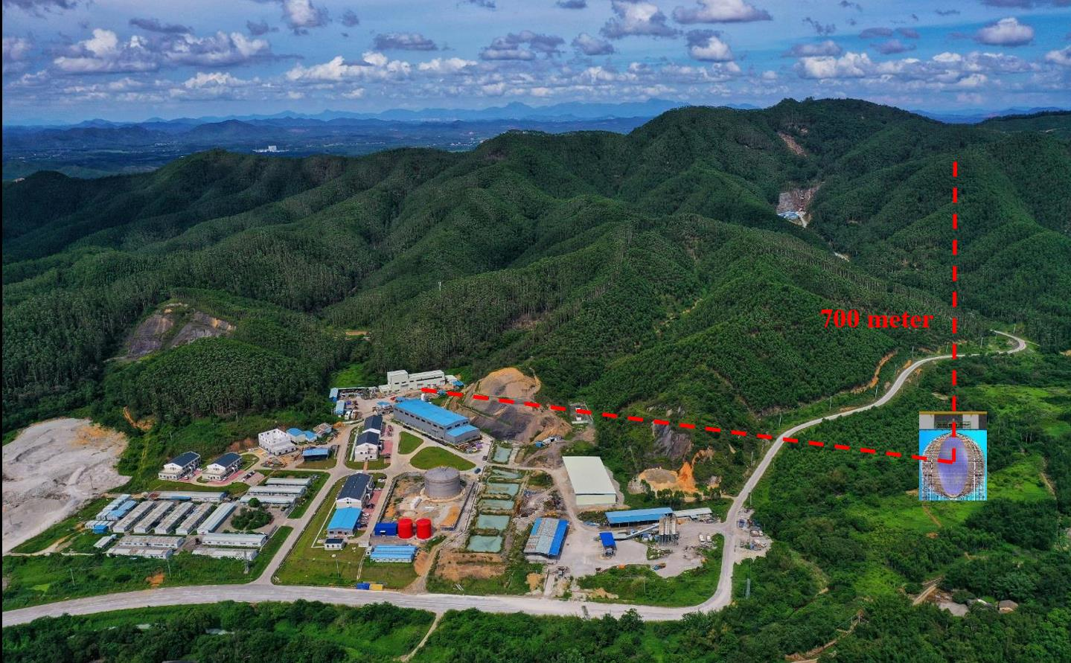
JUNO site
Surface buildings/campus finished
Surface Assembly Building
LAB storage (5k ton)
Water purification
Computing
Power station
Cable train
Office/Dorm
Vertical and slope tunnels
Vertical tunnel: 563 m
1265 m w/ slope of 42%
Muon flux 0.004 Hz/m²
5

Slide 6
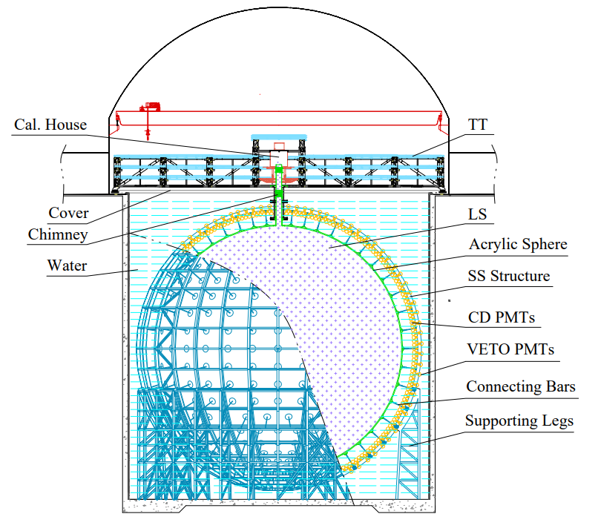
JUNO detector and progresses
Stainless Steel structure
  Finished in June 2022
Acrylic panels
  All the panels are ready for shipping to onsite
  Starting from the top, 14/23 layers finished
20,012 20’’ PMTs + 25,600 3’’ PMTs
  Production and performance test done
  7,225 LPMTs and 9,293 SPMTs installed
Liquid scintillator
  Purification plants finished onsite construction
  Successfully joint commissioning in Nov. 2023
6

Slide 7
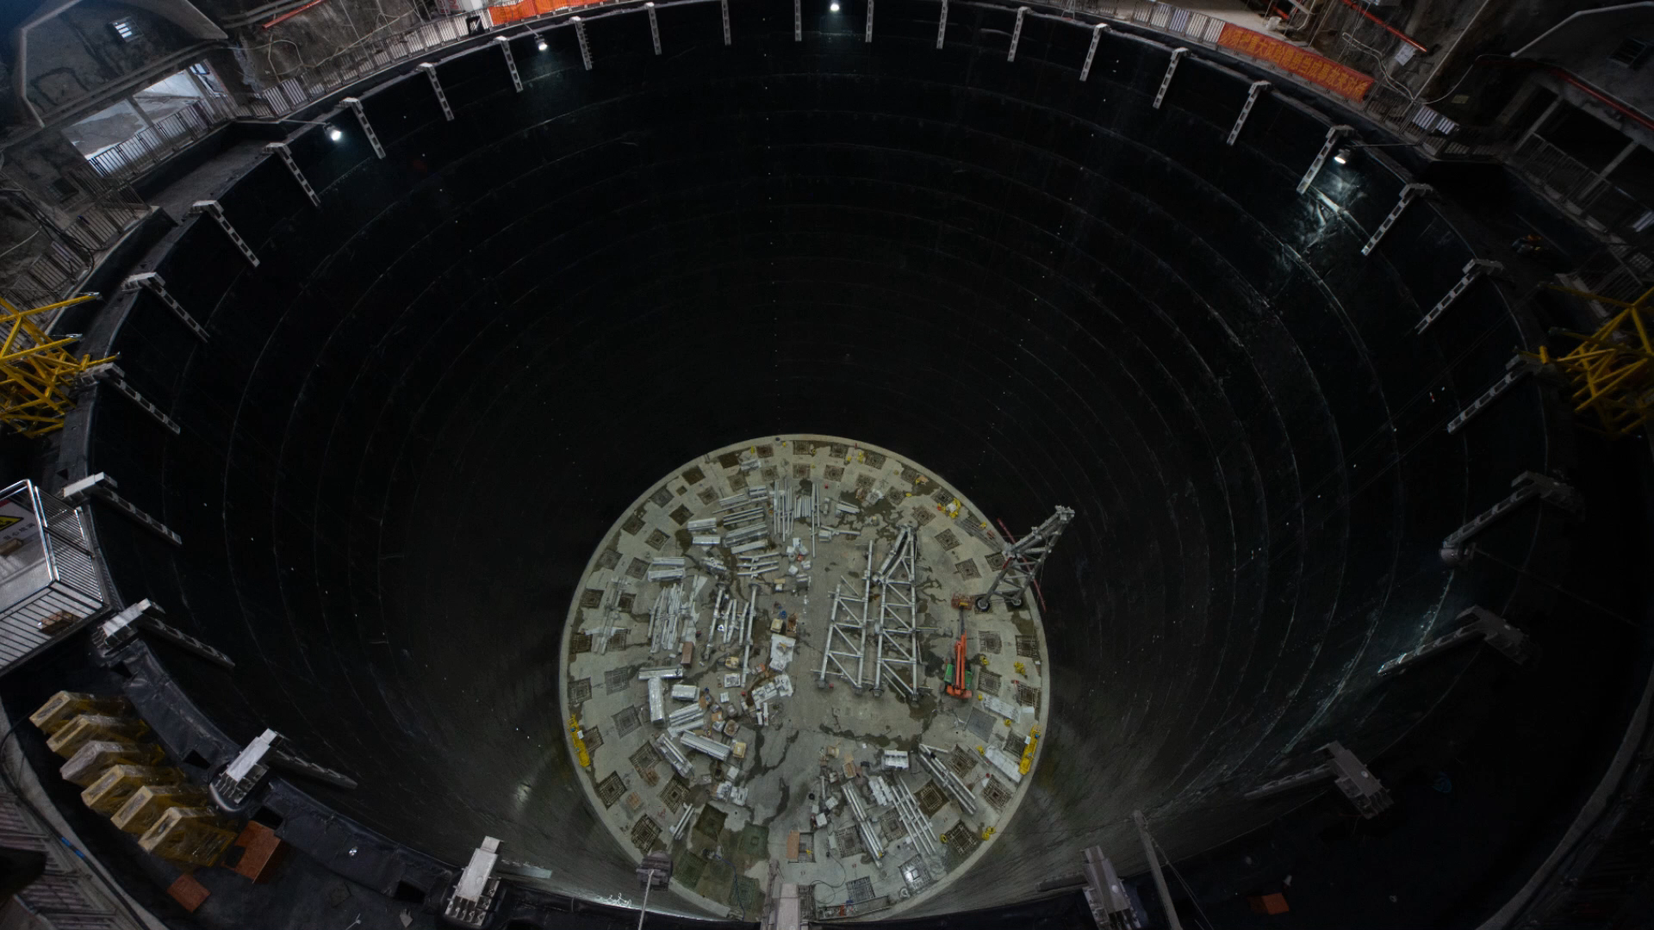
JUNO detector progresses

Slide 8
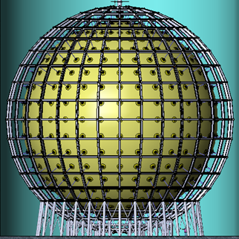
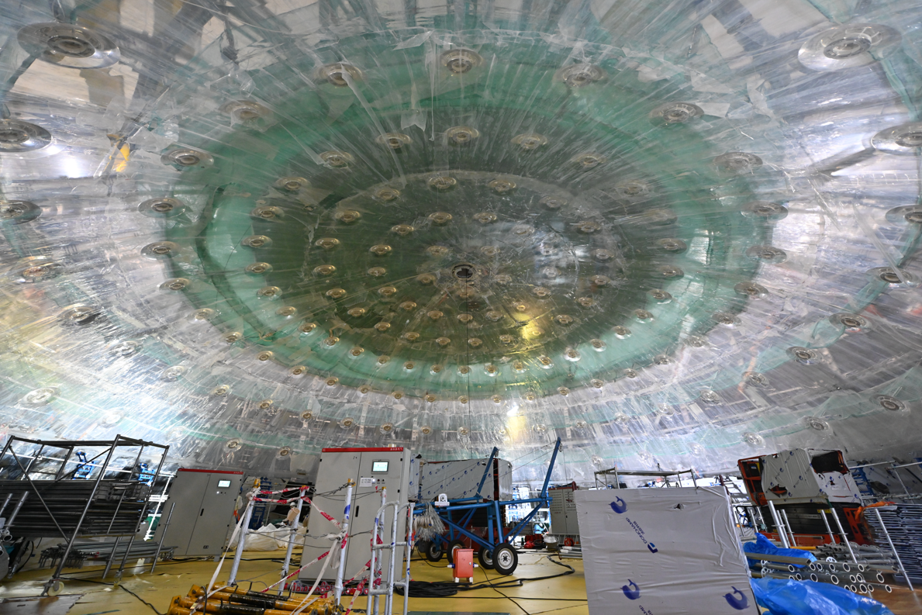
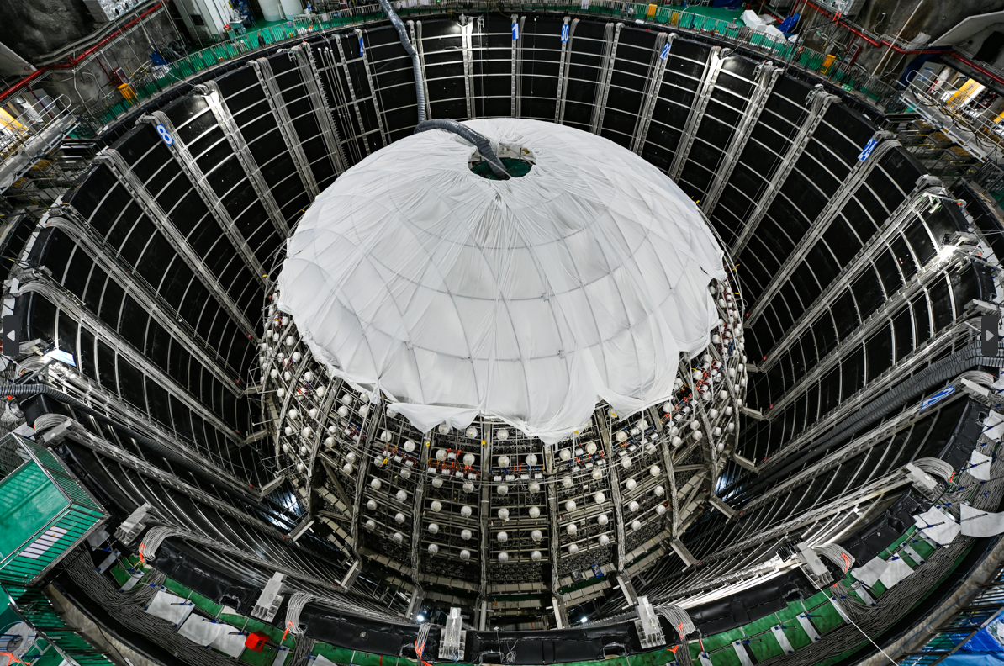
Central detector
Main difficulties overcome
  Acrylic transparency >96%, U/Th/K <1 ppt
  Fast bonding of 265 acrylic panels
  Mechanical precision for 3 mm PMT clearance
  Thermal expansion matching: 21ºC ± 1ºC
  Earthquake and liquid-solid coupling
arXiv: 2311.17314
8

Slide 9
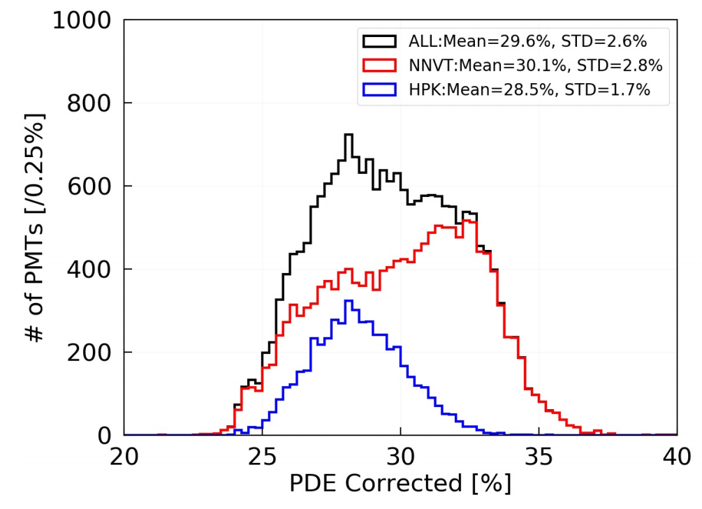
Photomultiplier Tubes
All PMTs produced, tested, and instrumented with waterproof potting
 | LPMT (20-inch) |  | SPMT (3-inch)
 | Hamamatsu | NNVT | HZC
Quantity | 5000 | 15012 | 25600
Charge Collection | Dynode | MCP | Dynode
Photon Detection Efficiency | 28.5% | 30.1% | 25%
Dynamic range for [0-10] MeV | [0, 100] PEs |  | [0, 2] PEs
Coverage | 75% |  | 3%
Reference | Eur.Phys.J.C 82 (2022) 12, 1168 |  | NIM.A 1005 (2021) 165347
PDE larger than required value 27% → expected energy resolution 2.9% @ 1MeV
Synergetic 20-inch and 3-inch PMT systems to ensure energy resolution and charge
9

Slide 10
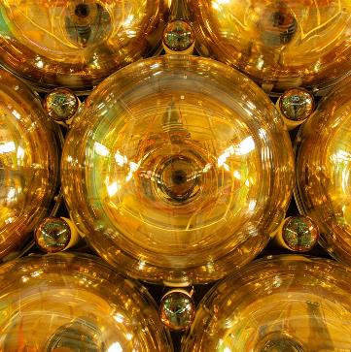
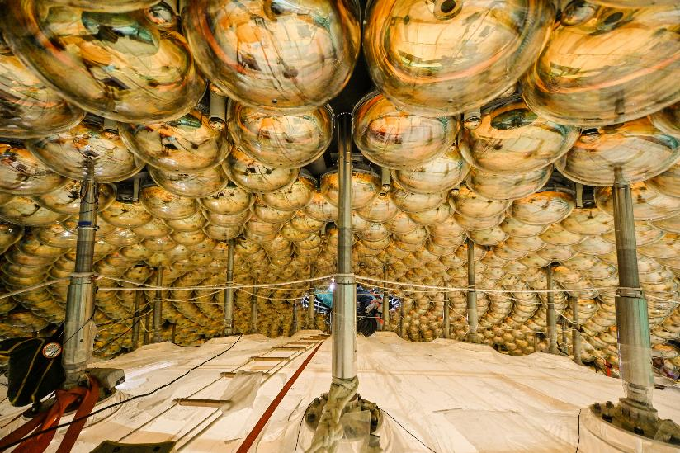
Photomultiplier Tubes
Clearance between PMTs: 3 mm → Assembly precision: < 1 mm
w/ protection cover (JINST 18 (2023) 02, P02013)
7,225 LPMTs and 9,293 SPMTs installed
10

Slide 11
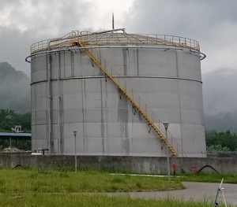
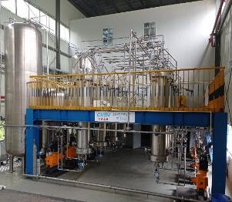
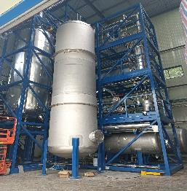
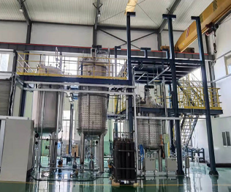
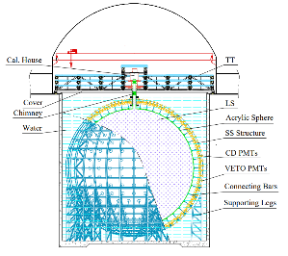
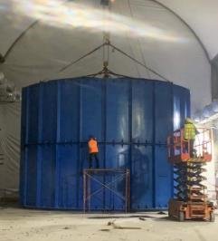
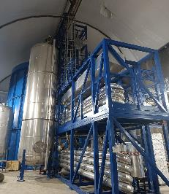
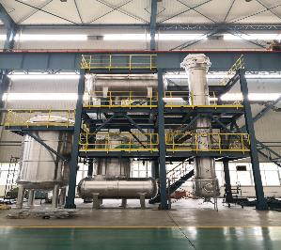
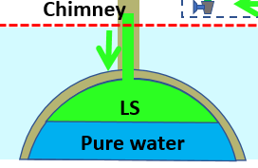
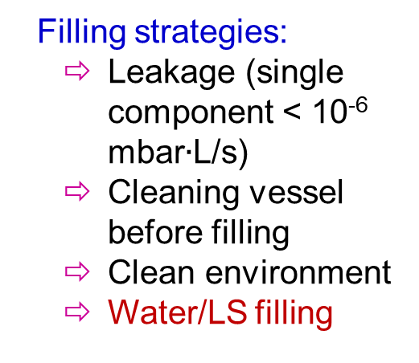
Liquid scintillator
Four purification plants to achieve target radio-purity 10⁻¹⁷ g/g U/Th and 20 m attenuation length
Filling strategies:
  Leakage (single component < 10⁻⁶ mbar$∙$L/s)
  Cleaning vessel before filling
  Clean environment
  Water/LS filling
5000 m³ LAB tank
1) Al₂O₃ for optical
2) Distillation for radiopurity
Mixing PPO and bis-MSB
SS pipes to underground
15%
85%
4) Gas stripping to remove Rn and O₂
3) Water extraction to remove radioactive impurities
OSIRIS to monitor the LS quality
Water filling of OSIRIS finished a half month ago, LS run starts soon.
11

Slide 12
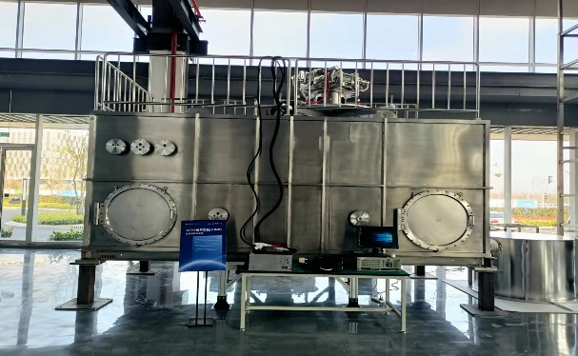
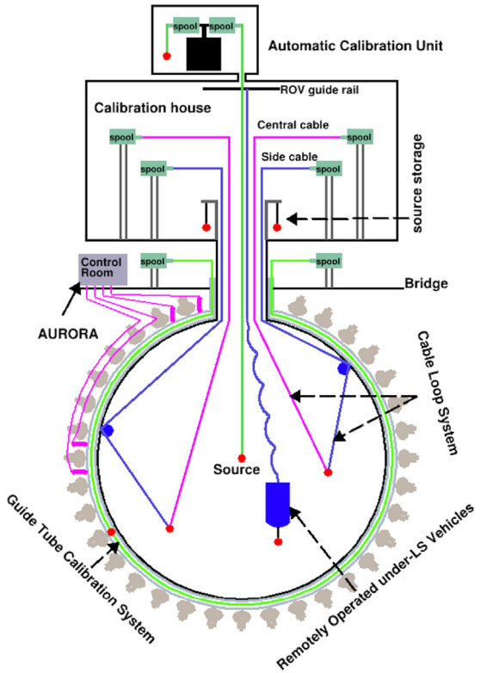
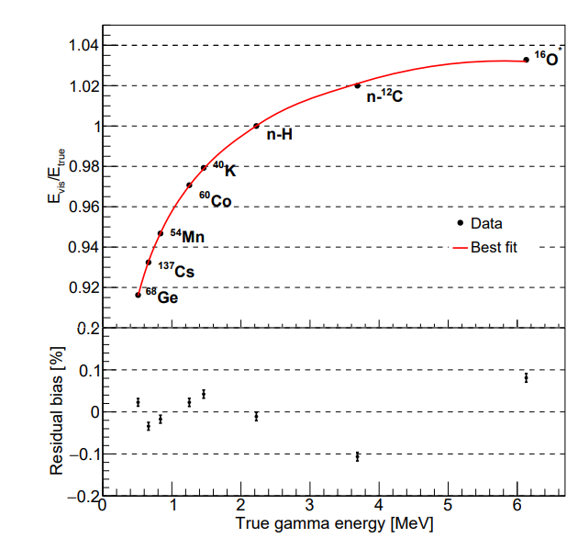
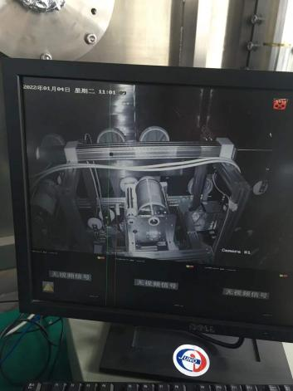
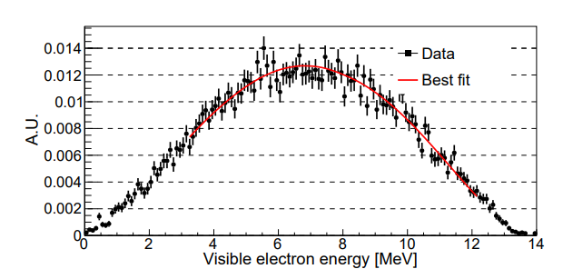
Calibration
1D, 2D, 3D scan systems with multiple calibration sources
Calibrate energy scale to better than 1% using gamma peaks and cosmogenic ¹²B beta spectrum
Cable system finished prototype test
12
JHEP 03 (2021) 004

Slide 13
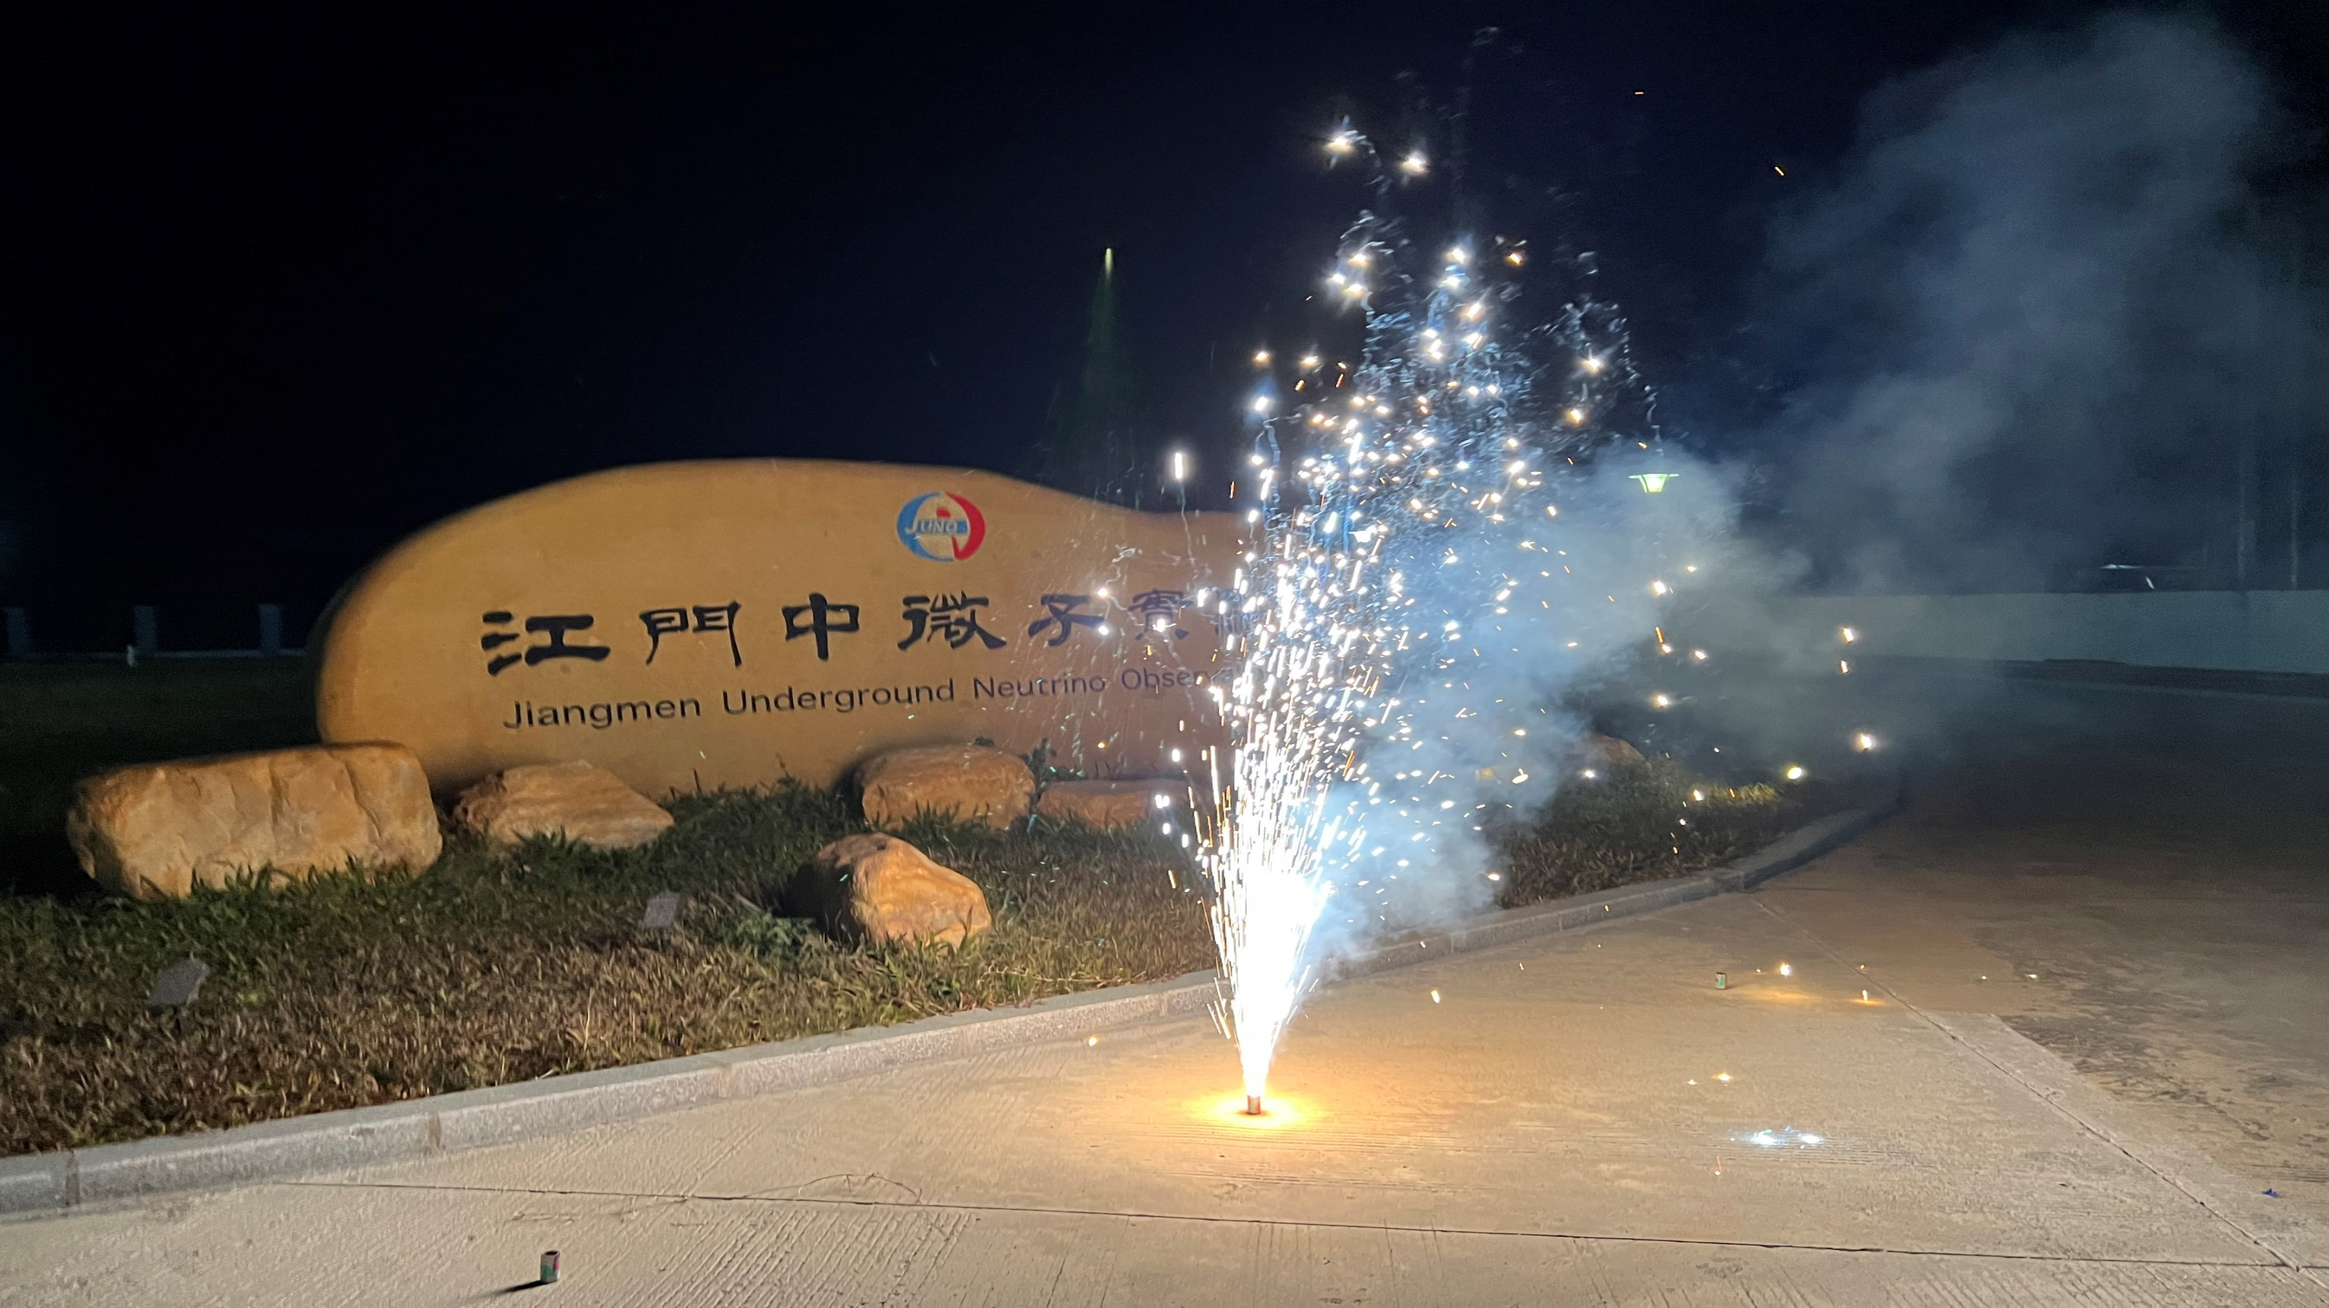
Observing nuclear reactors, the Solar System, and the Milky Way at Jiangmen

Slide 14
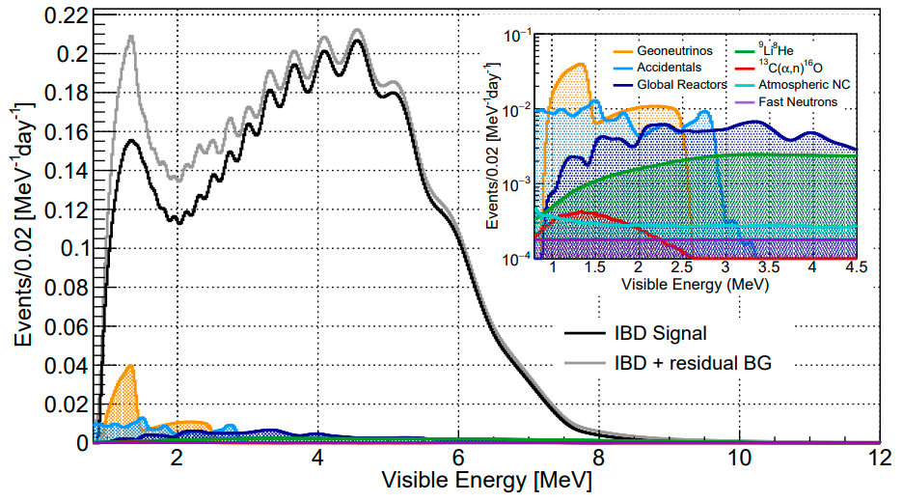

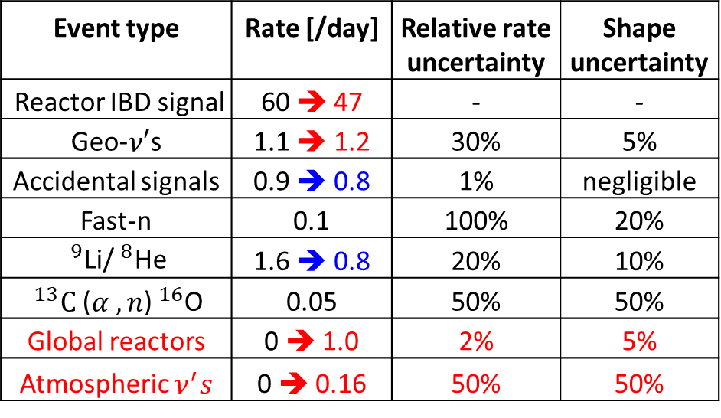


Reactor Antineutrino Oscillations
CPC 46 (2022) 12, 123001
Event type | Rate [/day] | Relative rate uncertainty | Shape uncertainty
Reactor IBD signal | 60 ➔ 47 | - | -
Geo-$ν′$s | 1.1 ➔ 1.2 | 30% | 5%
Accidental signals | 0.9 ➔ 0.8 | 1% | negligible
Fast-n | 0.1 | 100% | 20%
$^{9}$Li/$^{8}$He | 1.6 ➔ 0.8 | 20% | 10%
$^{13}C$($α ,n$)$^{16}$O | 0.05 | 50% | 50%
Global reactors | 0 ➔ 1.0 | 2% | 5%
Atmospheric $ν^{′}s$ | 0 ➔ 0.16 | 50% | 50%
JUNO physics book (J. Phys. G43:030401(2016)) → updated analysis
Updates for the spectra and rates since JUNO (2016)
2 fewer reactor cores in Taishan
Better muon veto strategy
Improved energy resolution:
3.0% $@$1MeV ➔ 2.9% $@$1MeV
More realistic estimate on signals and backgrounds
Slight less overburden
Lower radioactivity background based on latest measurements on material radiopurities

Slide 15
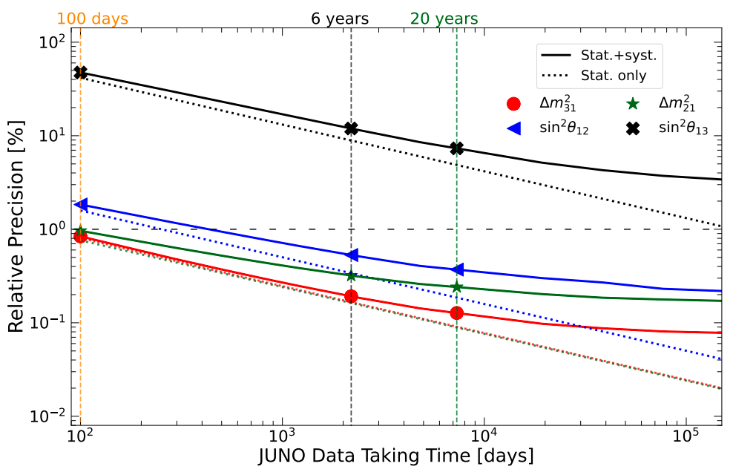
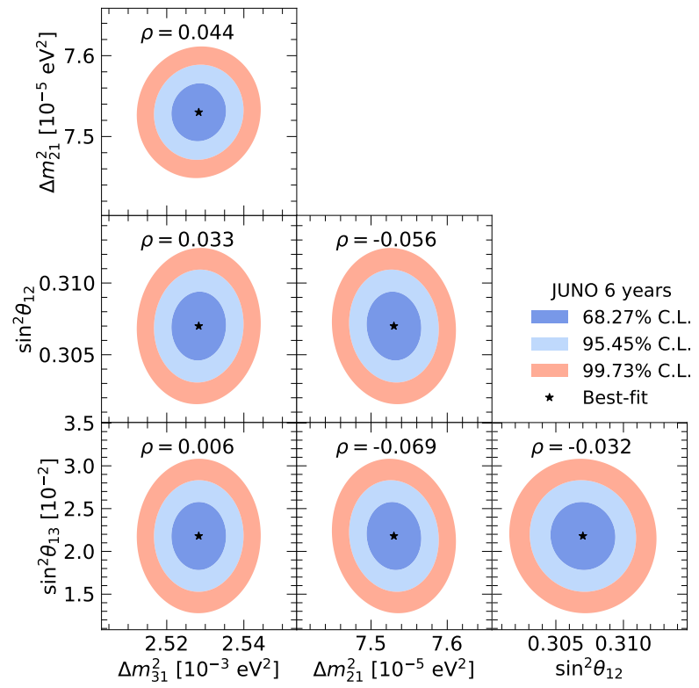
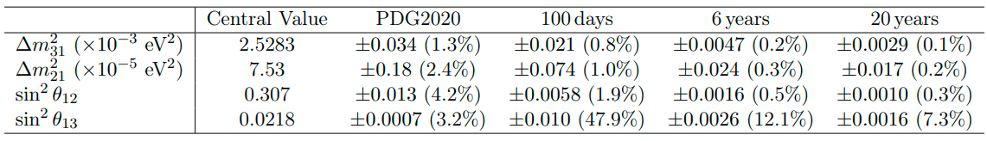
Precision Oscillation Measurement
About one order of magnitude improvements in precision over existing constraints
Precision of sin²$2θ_{12}$, $∆m_{21}^{2}$, |$∆m_{32}^{2}$| < 0.5% in 6 years

Slide 16
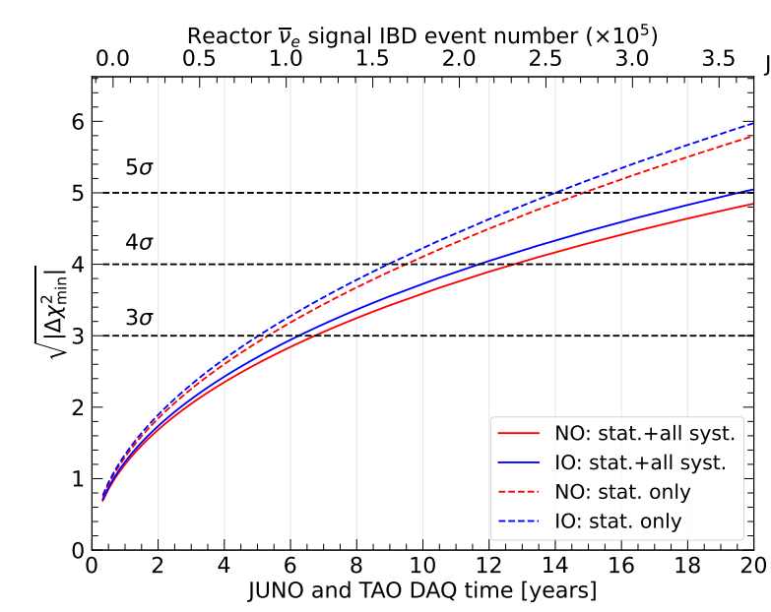
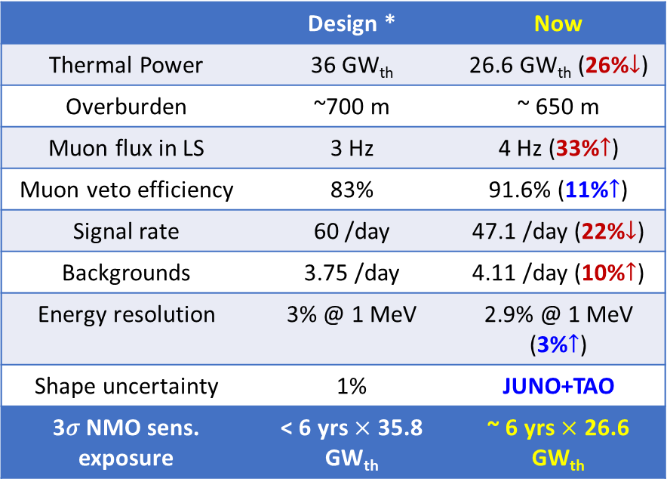
Neutrino Mass Ordering
 | Design * | Now
Thermal Power | 36 GW_{th} | 26.6 GW_{th} (26%$↓$)
Overburden | ~700 m | ~ 650 m
Muon flux in LS | 3 Hz | 4 Hz (33%$↑$)
Muon veto efficiency | 83% | 91.6% (11%$↑$)
Signal rate | 60 /day | 47.1 /day (22%$↓$)
Backgrounds | 3.75 /day | 4.11 /day (10%$↑$)
Energy resolution | 3% @ 1 MeV | 2.9% @ 1 MeV (3%$↑$)
Shape uncertainty | 1% | JUNO+TAO
3𝜎 NMO sens. exposure | < 6 yrs $×$ 35.8 GW_{th} | ~ 6 yrs $×$ 26.6 GW_{th}
Preliminary
* J. Phys. G 43:030401 (2016)
JUNO NMO median sensitivity: 3σ (reactors only) @ ~6 yrs * 26.6 GW_{th} exposure
Combined reactor+atmospheric neutrino analysis in progress: further improve the NMO sensitivity

Slide 17
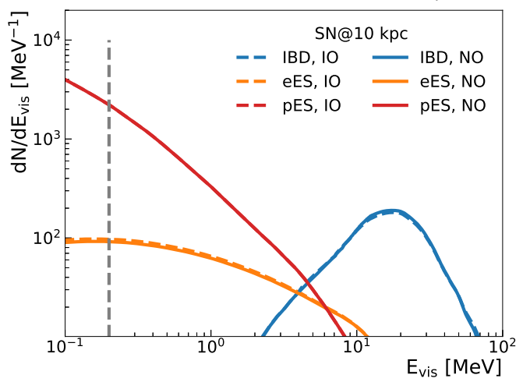
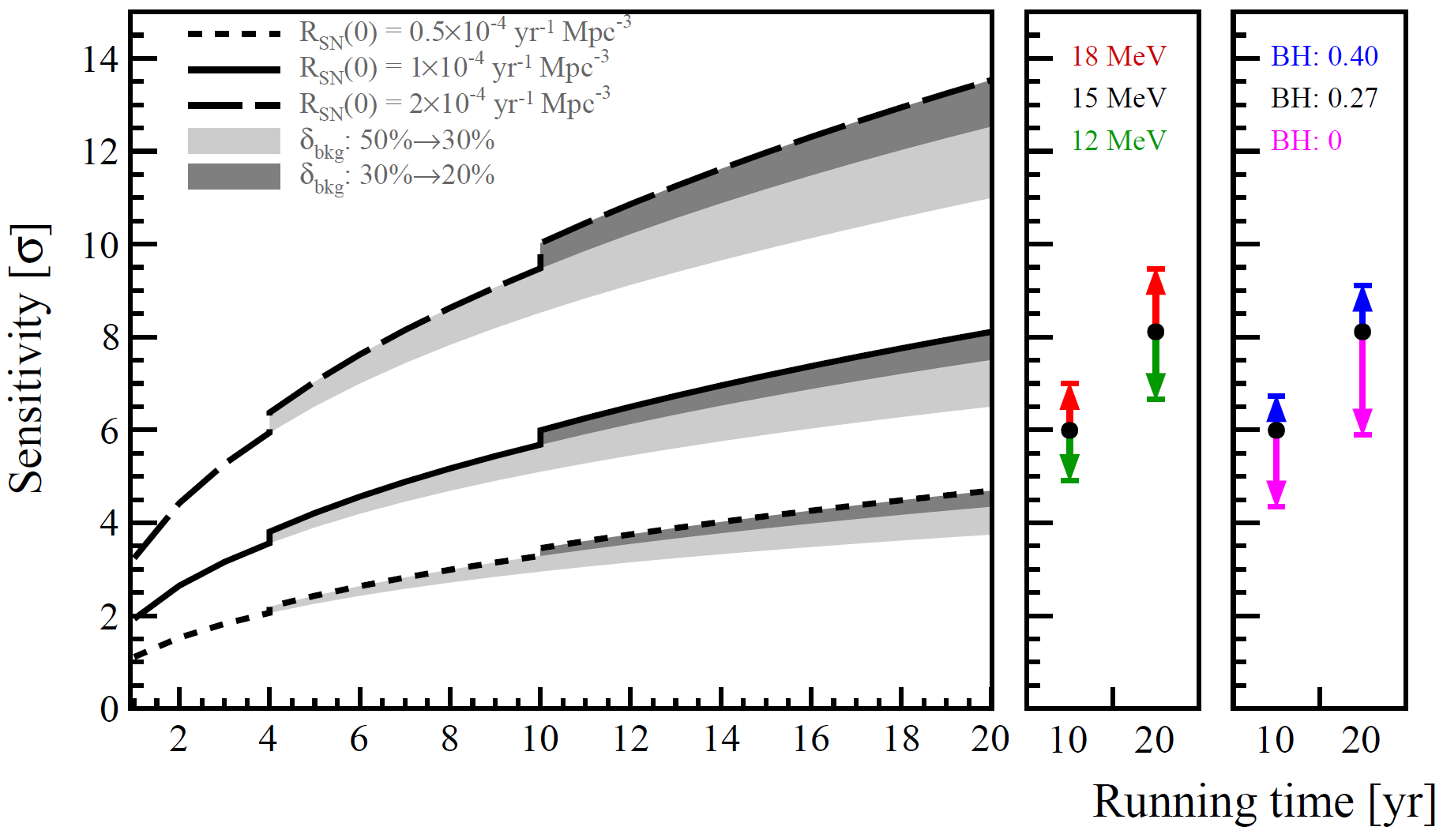
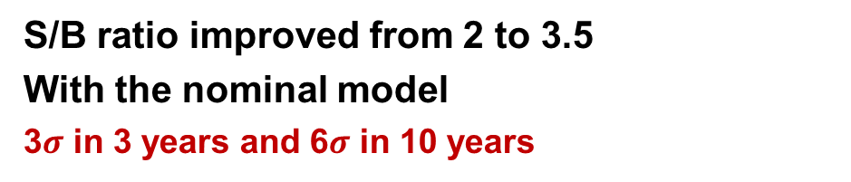
Supernovae neutrinos
SN neutrinos of 30 M⊙ Nakazato mode
Diffuse supernova neutrino background
Nominal model
JCAP 01 (2024) 057
JCAP 10 (2022) 033
3 detection channels sensitive to all flavors
Excellent capability for early warning
220~400 kpc with 50% probability
10 ~ 30 ms for typical 10 kpc
S/B ratio improved from 2 to 3.5
With the nominal model
3$σ$ in 3 years and 6$σ$ in 10 years

Slide 18
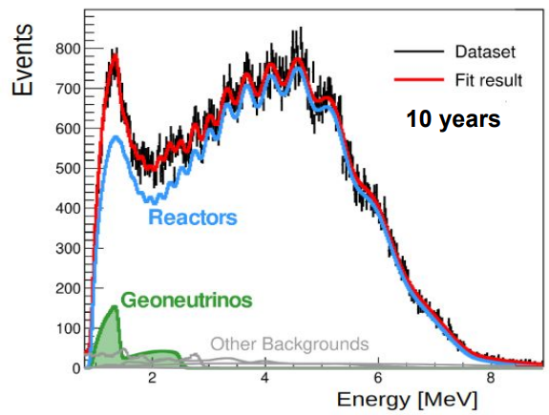
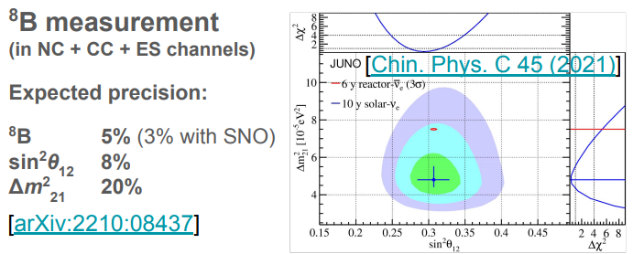
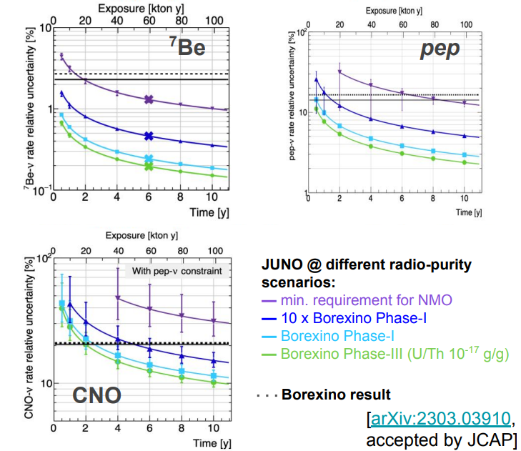
Solar and terrestrial neutrinos
JUNO could improve the measurement of solar ν’s
JUNO will collect the largest dataset of geoneutrinos in about 1 year
Precision of total geoneutrino signal with Th/U ratio fixed: ~8% in 10 years
KamLAND ~15%, Borexino ~17%

Slide 19
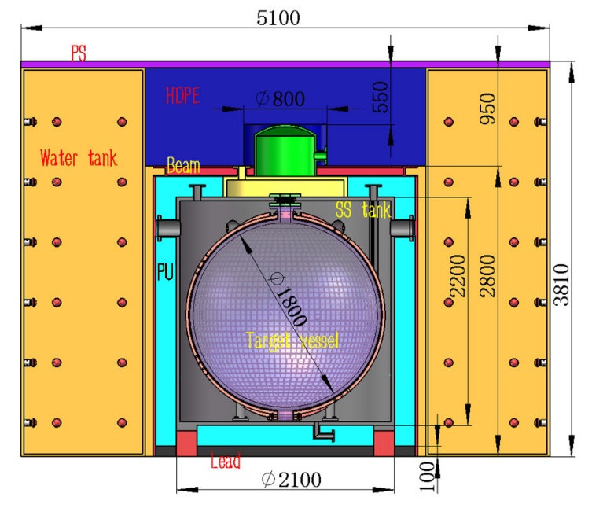
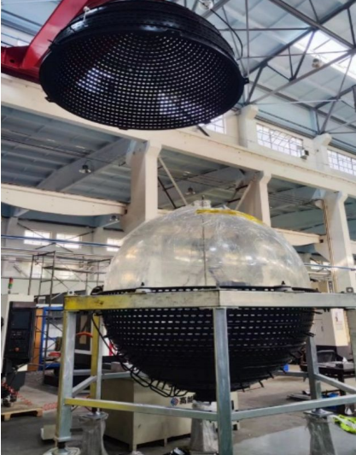

JUNO-TAO
Measurement of reactor anti-nu spectrum with no oscillations (within Taishan NPP building)
An innovative apparatus
● ~94% coverage with SiPM (~50% PDE)
● Cooling to -50°C
● 1 ton fiducial volume / 2.8 tons of Gd-LS
● 44 m to the reactor core
Rich Physics
●Sensitive to fine structure
● Model-independent reference spectrum for JUNO
● Improvement of nuclear databases
● Sensitive to sterile neutrino
Successful 1:1 prototype at IHEP, to be transported and assembled at Taishan NPP in 2024
TAO CDR arXiv:2005.08745
19

Slide 20


Future JUNO-0νββ upgrade
Concept of the experiment
JUNO offers an unique opportunity to search for 0νββ after completion of NMO measurements
Large target mass → 100-ton scale isotope loading
Excellent clean LS shielding → low background
Energy resolution < 3% @ 1 MeV
→ Potential to explore normal mass ordering parameter space of Majorana neutrino mass (SNOWMASS 2021)
Te-LS
or
Xe-LS
Critical R&D in progress
1、Te-loaded LS with high transparency, light yield and stability
2、Cosmogenic and ⁸B solar ν bkg rejection
3、Xenon enrichment w/ a company

Slide 21

Summary
JUNO is designed to measure the Neutrino Mass Ordering
Rich physics program, future JUNO-0νββ
Construction close to completion, data taking with water starts in 2024
Short-baseline experiment TAO provides JUNO the reference spectrum and benchmark for nuclear database
Physics | Sensitivity
Neutrino Mass Ordering | 3σ in ~6 years by reactor neutrinos.
Precision Measurement | Precision of $\text{sin}2θ_{12}$, $∆m_{21}^{2}$, |$∆m_{31}^{2}$| < 0.5% in 6 yrs
Supernova Burst (10 kpc) | ∼7300 of all-flavor neutrinos
DSNB | 3σ in 3 years
Solar Neutrino | ⁷Be, pep, CNO, and ⁸B neutrino fluxes depending on the LS radio-purity level
Nucleon Decays ($p→\overline{ν}K^{+}$) | 9.6$×$10³³ years (90% C.L.) in 10 yrs
Geo-neutrino | ∼400 per year, 8% measurement in 10 yrs
21

Slide 22

Thanks!

Slide 23


Slide 24


Slide 25


Slide 26


Slide 27




Energy Resolution
Change | Light yield in detector center [PEs/MeV] | Energy resolution | Reference
Previous estimation | 1345 | 3.0% $@$1MeV | JHEP03(2021)004
Photon Detection Efficiency (27%→30%) | +11%$↑$ | 2.9% @ 1MeV | arXiv: 2205.08629
New Central Detector Geometries | +3%$↑$
New PMT Optical Model | +8%$↑$ |  | EPJC 82 329 (2022)
Positron energy resolution is understood:
$$\frac{σ}{E_{vis}}=\sqrt{{\left(\frac{a}{\sqrt{E_{vis}}}\right)}^{2}+b^{2}+{\left(\frac{c}{E_{vis}}\right)}^{2}}$$
Photon statistics
Annihilation-induced $γ$s
Dark noise
Scintillation quenching effect
  LS Birks constant from table-top measurements
Cherenkov radiation
  Cherenkov yield factor (refractive index & re-emission probability) is re-constrained with Daya Bay LS non-linearity
Detector uniformity and reconstruction

