Slide 1
The Standard Model Effective Field Theory (SMEFT)
Shun Zhou
(IHEP & UCAS, Beijing)
Lecture 1：Introduction to Effective Field Theories
The First Zhujiang Winter School on Theoretical Physics
Quantum Matter Institute, South China Normal University
Guangzhou，2023-12-04

Slide 2
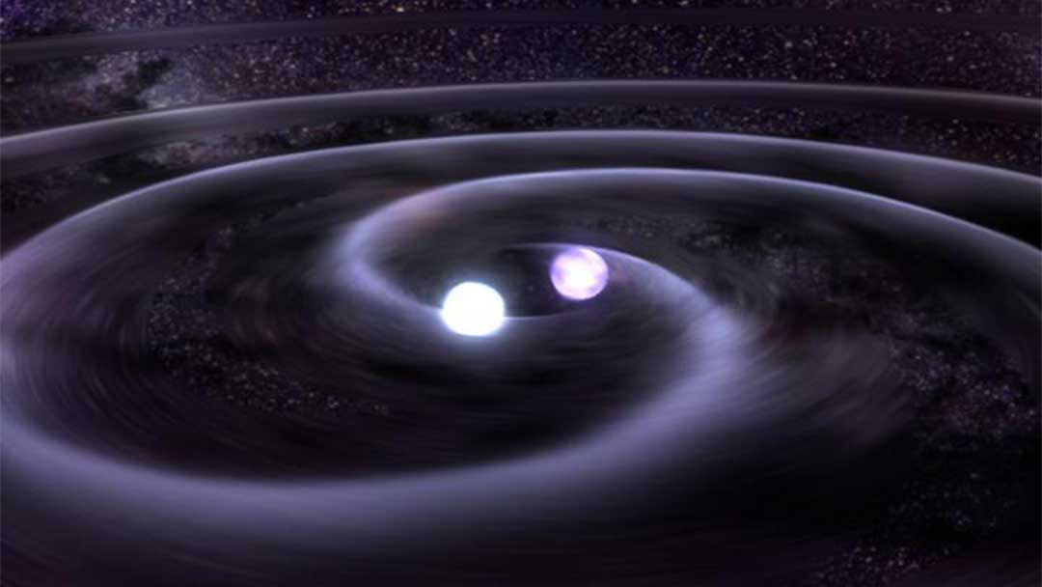
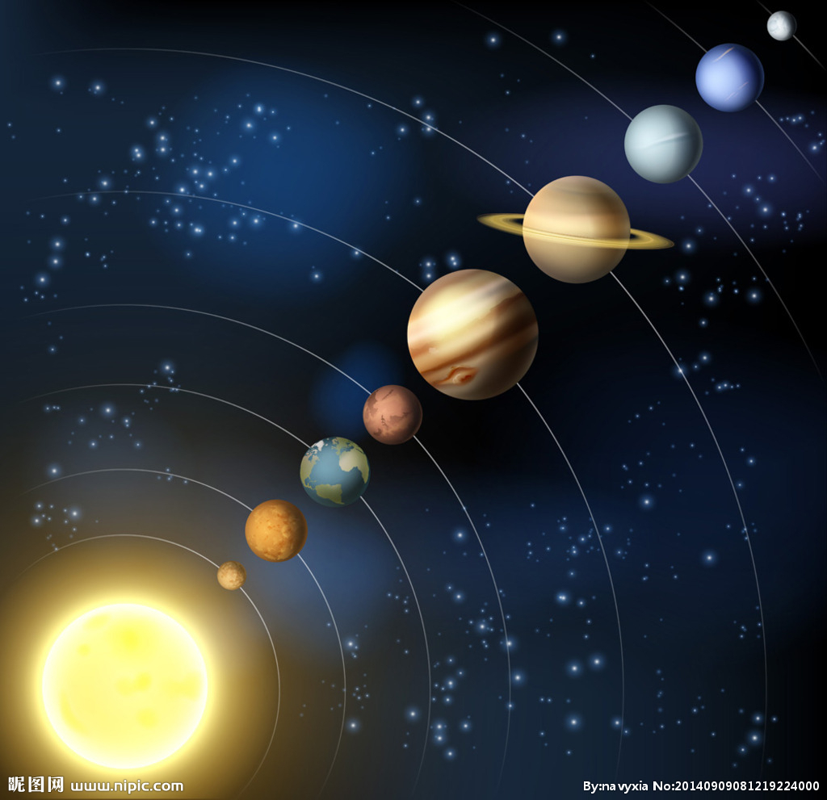
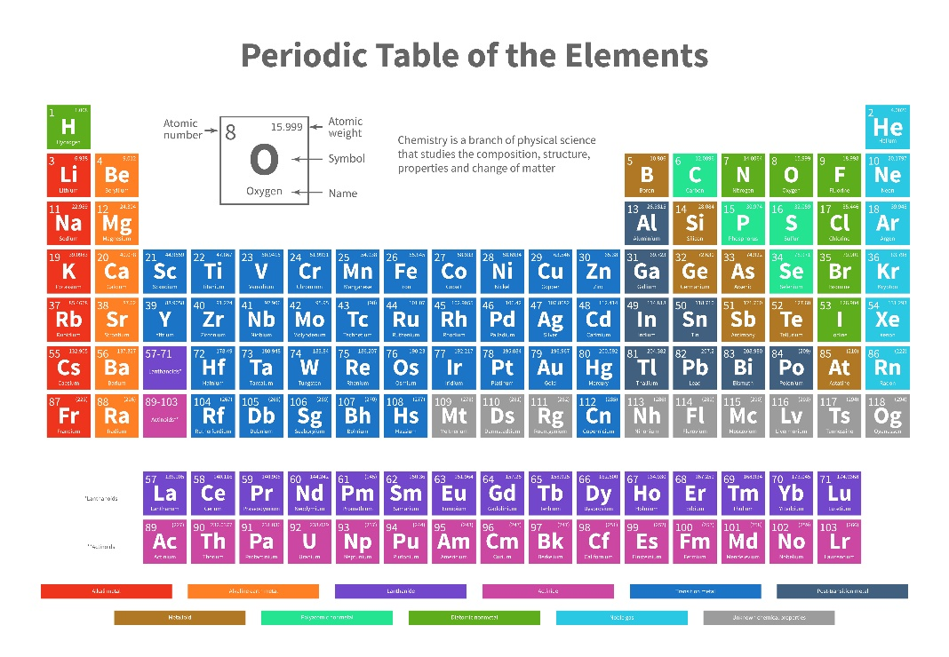
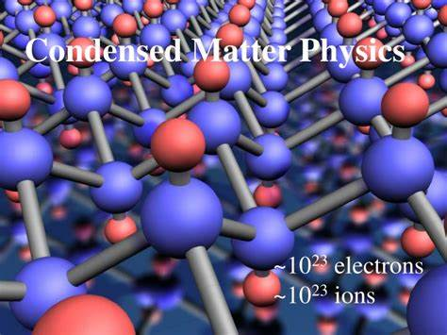

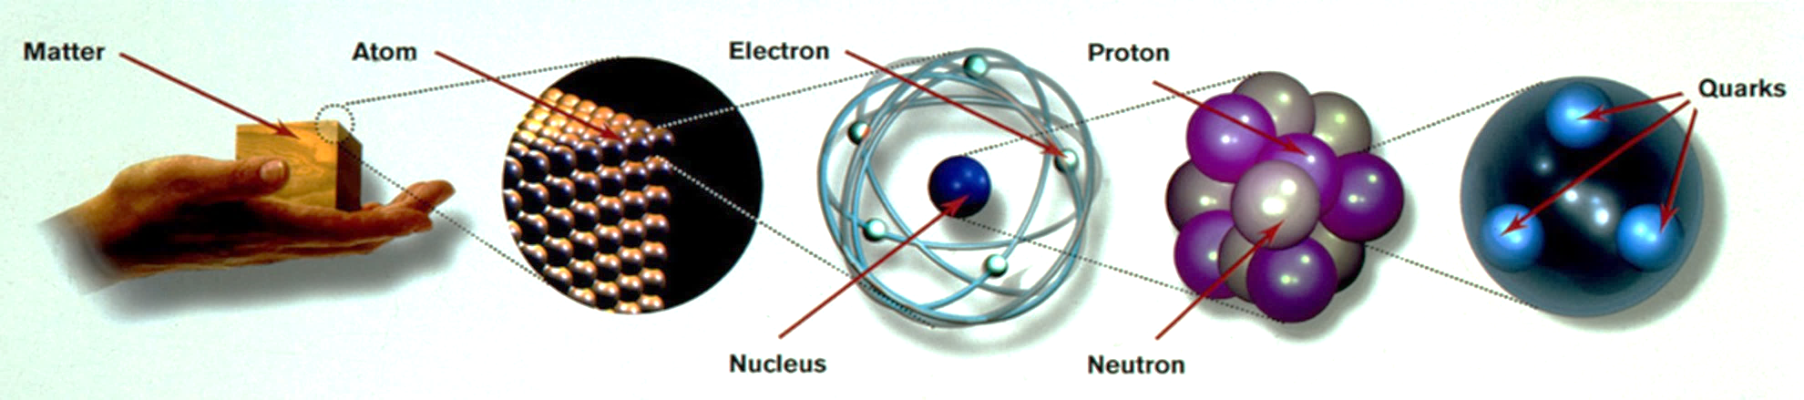
A. Motivation
Phenomena at various different scales
Focus on one scale leads to one discipline
Systematic methods for multi-scale problems

Slide 3
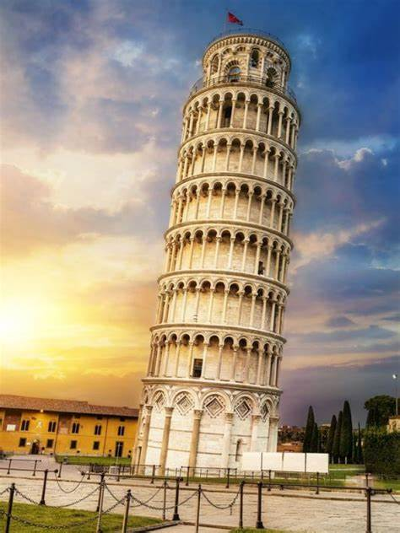
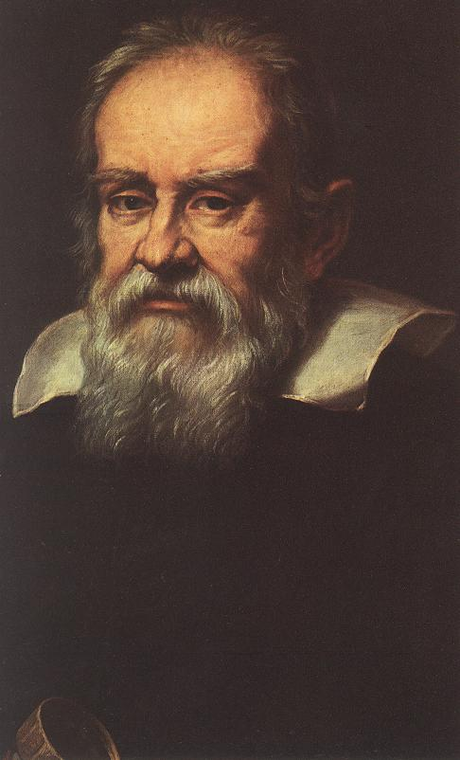

A. Motivation
Petrov & Blechman, Effective Field Theories, 2016
One example to explain all?
The Leaning Tower of Pisa
The Lagrangian for the freely-falling ball
acceleration
height
velocity
kinetic
potential
This is an effective Lagrangian!
The acceleration g assumed to be constant so that h → h + a is a symmetry of the Lagrangian (i.e., a constant is irrelevant)
The radius of the Earth R >> h
R
A better approximation to the potential with two unknown coefficients
A systematic approach to increasing the precision (power counting of h/R)
The accidental symmetry h → h + a is no longer assumed

Slide 4
A. Motivation
The Lagrangian of the“full”theory
Renormalization-group Equation (RGE)?
Newton's law of gravitation
R
determine the unknown coefficients by matching
The original potential reproduced as the leading-order term
experimental precision
Effective theory offers a systematic approach to probe underlying physics with precision measurements
Bottom-up: construct the most general form of the effective theory at the very scale of interest with a good rule of power counting, calculate the observables and compare the results with experimental data
Top-down: start with a“fundamental” theory valid for multiple scales, separate the degrees of freedom at different scales, expand the theory in terms of the small ratio of scales, match onto the effective theory

Slide 5
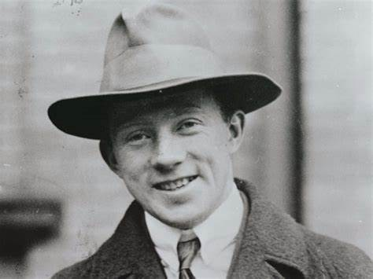
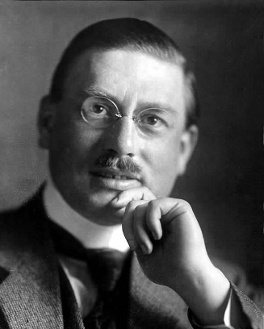
B. The Euler-Heisenberg Effective Lagrangian
A realistic example in Quantum Electrodynamics (QED)
Dittrich, IJMPA, 2014
Question raised to Heisenberg by Debye: @Leipzig U. in mid-1930s
Is there a light-by-light scattering in Dirac’s theory of electrons?
If so, there will definitely be a modification of Maxwell’s equations
Then Heisenberg assigned this task to his PhD student-Hans Euler
H. Euler, PhD thesis, Ann. Phys. 26, 398 (1936)
Hans Euler was killed in the World War II, already missed on June 21, 1941, one day before the Nazi Germany started the war against the Soviet Union
H. Euler & B. Kockel, Naturwissenschaften 23, 246 (1935)
W. Heisenberg & H. Euler, Z. Phys. 98, 714 (1936)
Low-energy light-by-light scattering induced by the electrons and positrons
The EH effective Lagrangian for constant background EM fields (cf. Euler-Kockel in weak-field limit)

Slide 6
B. The Euler-Heisenberg Effective Lagrangian: bottom-up approach
The EH effective Lagrangian in modern language
Grozin, Lectures on QED and QCD, 2007
Grozin, 0908.4392
In the world of only low-energy photons, we can write down the dimension-4 (dim-4) terms
light
light
Lorentz- and gauge-invariant terms in the Lagrangian
light
light
Retain further known symmetries (C- and P-parities)
Include all possible dim-6 and dim-8 invariant terms
No scattering
Scattering observed
How to construct the basis of high-dim. operators
First, specify the building blocks of high-dim. operators and their representations under symmetry groups
Gauge invariant Lorentz tensor
Mass dim.
Second, power counting of 1/Λ (inverse cutoff) to figure out all possible operators at a given mass dim.
Exercise 1: Find out all gauge & Lorentz invariant dim-4 operators and explain why only the usual term in L₀ is kept.
Dim-6:
①
②
③
④

Slide 7
B. The Euler-Heisenberg Effective Lagrangian: bottom-up approach
Third, implement integration by parts (IBP), the equation of motion (EoM) and the (Bianchi) identities to get rid of redundant operators
Example: Demonstrate that no dim-6 operators exist
①
reflecting the conservation of C-parity
②
Bianchi identity
②
③
②
③
Total derivative
④
Equation of motion
④
When the EoM is applied, one can immediately see that all the dim-6 operators vanish

Slide 8
B. The Euler-Heisenberg Effective Lagrangian: bottom-up approach
Dim-8:
Another form of the dim-8 operators via
[c₁] = [c₂] = -4
Transformation between two different bases of dim-8 operators
Rewrite the Lagrangian in terms of operators in the new basis
Exercise 2: Check this
c₁
c₂
Note: We have constructed the effective Lagrangian for low-energy photons based only on symmetry arguments (Lorentz, gauge, C and P), and thus the coefficients in front of the operators are arbitrary constants.

Slide 9
B. The Euler-Heisenberg Effective Lagrangian: bottom-up approach
The EFT as a quantum field theory with the following Lagrangian
Particle content: photon; Coupling constants: c₁ and c₂
Let’s go to the one-loop order
Phenomenological Lagrangians
Massless loop
Working at the order of 1/Λ⁴
No corrections to the photon self-energy
Couplings also need not be renormalized
Too simple to reveal more features
Weinberg, Physica 96A (1979) 327

Slide 10
B. The Euler-Heisenberg Effective Lagrangian: top-down approach
Feynman diagrams in QED for the light-by-light scattering
Grozin, 0908.4392
We do have a perfect theory of photons and electrons/positrons
Karplus & Neuman, Phys. Rev. 80 (1950) 380
Constantini et al., Nuovo Cim. A 2 (1971) 733
Left: 3 diagrams + fermion lines in the opposite direction
Consider γ (μ₁, p₁) + γ (μ₂, p₂) → γ (ν₁, p₁) + γ (ν₂, p₂) and |p₁|, |p₂| << M
Dimensional regularization
Amplitude in QED
Amplitude in the EFT
Finite in d = 4 –2ε → 4
The cutoff scale Λ = M
Matching between the full theory and the EFT

Slide 11
B. The Euler-Heisenberg Effective Lagrangian: phenomenology
The cross section of light-by-light scattering (unpolarized)
Dittrich, IJMPA, 2014
Numerical results
Dittrich & Gies, Probing the Quantum Vacuum, 2002
The upper bound given by the PVLAS experiment is larger by a factor of 10⁷
Compton scattering
The EH Lagrangian is useful for the low-energy EM processes
Dittrich & Reuter, Effective Lagrangians in QED, 1985
Delbrück scattering
Photon splitting

Slide 12
B. The Euler-Heisenberg Effective Lagrangian: top-down approach
Functional method: integrate out the electron field explicitly
Itzykson & Zuber, QFT, 1980
Meissner, Lecture Notes, 2012
Subtract the constant
Field independent
Charge conjugation
Fock-Schwinger proper time method
Dirac trace
Coordinate space
Dirac trace
in the constant background EM fields B & E

Slide 13
B. The Euler-Heisenberg Effective Lagrangian: top-down approach
constant background
Matrix exponential
Coordinate space
Baker-Campbell-Hausdorff (BCH) formula
cf. F^{μν} above

Slide 14
B. The Euler-Heisenberg Effective Lagrangian: top-down approach
The BCH formula
Similar for the H_{b} part

Slide 15
B. The Euler-Heisenberg Effective Lagrangian: top-down approach
Recall the harmonic oscillator
Wave-function normalization
Valid to all orders
Divergence to be removed by reormalization
Expansion in terms of a and b
Exactly the same as that derived in the diagrammatic methd
Finite: -1/m⁴

Slide 16
B. The Euler-Heisenberg Effective Lagrangian: top-down approach
Quantum Electrodynamics (QED)
Quantum Photon Dynamics (QPD)
+ high-dim.
Renormalization
No corrections to photon self-energy
MS
On-shell
MS
The relationship between QED and QPD at the matching scale needs to be clarified to define the EFT
Ward identity
Matching at
Choose a reasonable matching scale
Grozin, Lectures on QED and QCD, 2007

Slide 17
C. Generic Features of EFTs
Power Counting & Regularization Schemes
Manohar, 1804.05863
an infinite series of operators with increasing dimensions
The contributions from higher-dim. operators suppressed by powers of E/Λ, where E is the typical energy for physical processes and Λ is the cutoff scale, below which the EFT is valid
loop momentum cutoff
k < Λ_{c}
Violate the power-counting rule in the presence of Λ_{c}/Λ
Break the symmetries of the theory
In modern treatment of EFTs, dim. Regularization & mass-independent $\overline{MS}$ scheme are usually used
Decoupling theorem
Appelquist & Carrazone, 1975
insensitive to short-distance physics
Heavy fields of mass m decouple at low energy, generating operators suppressed by factors of m⁻¹, except for their contribution to renormalization effects.

Slide 18

C. Generic Features of EFTs
Another example from QED: photon self-energy
Mass-dependent subtraction scheme: p² = -M²
Decoupling limit
Mass-independent $\overline{MS}$ scheme
In the mass-independent scheme, one should integrate out heavy particles explicitly and construct the low-energy EFT correctly
insensitive to particle mass

Slide 19
C. Generic Features of EFTs
Renormalization-group Equations (RGEs) in the $\overline{MS}$ scheme
Wilson coefficient
β function
The operator mixing
The solution to the RGE of the Wilson coefficient
Manohar, 1804.05863
constant
The RGE-improved perturbation theory includes possible large log terms
The RGEs sums the logs
Integrating the RGEs terms by terms leads to
1-loop
Leading log
2-loop
Next-to-leading log

Slide 20
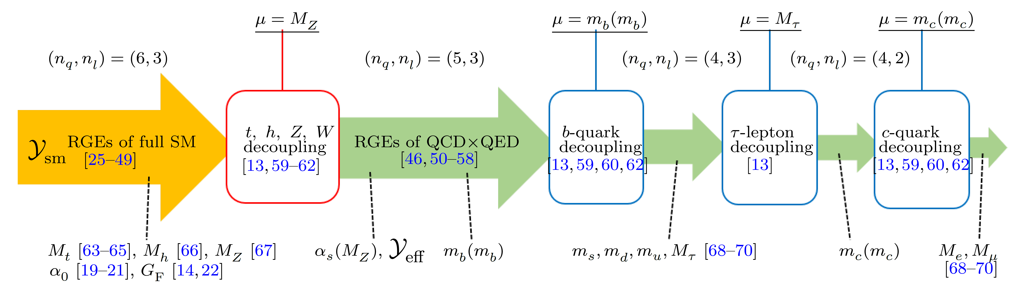
Summary
Effective theories widely applied in natural sciences to describe phenomena at various different length/energy scales
HEFT, SMEFT, LEFT, HQET, SCET, NRQED, NRQCD, HQET, LaMET, ……
Take most relevant degrees of freedom, symmetries and dynamics
With a power-counting rule to systematically improve the precision
Even if more fundamental theory of quantum fields exists, the EFTs are still very useful
Running-matching-running for fermion masses in the SM
Huang & Zhou, PRD, 2020

