Slide 1
The Standard Model Effective Field Theory (SMEFT)
Shun Zhou
(IHEP & UCAS, Beijing)
Lecture 2：Basic Structure of the SMEFT
The First Zhujiang Winter School on Theoretical Physics
Quantum Matter Institute, South China Normal University
Guangzhou，2023-12-04

Slide 2
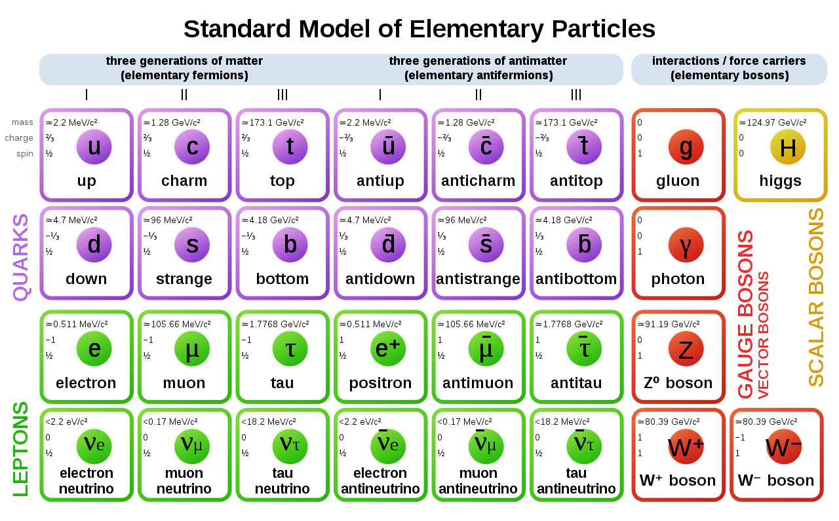

A. Basic Facts of the Standard Model
Features of the most successful theory of elementary particles
Three generations of quarks and leptons
Interactions mediated by gauge bosons
Exact and broken gauge symmetries
Renormalizable quantum field theory
Confinement and asymptotic freedom
Do you expect that the standard model (SM) can explain everything in nature? (e.g., gravity)
The SM should be an effective field theory (EFT) working well around the electroweak scale

Slide 3
A. Basic Facts of the Standard Model
The matter field content of the SM
The spacetime and gauge symmetries
Spontaneous gauge symmetry breaking
Quark flavor mixing
Lepton flavor mixing (massive neutrinos)
Brivio & Trott, Phys. Rep. 793 (2019) 1
The SM Lagrangian
Covariant derviative
So far the SM is consistent with all experimental observations, except for neutrino oscillations and DM

Slide 4
A. Basic Facts of the Standard Model
The discovery of the Higgs boson @ the LHC in 2012: the great success of the SM!
Bass, De Roeck, Kado, Nat. Rev., 21
The measured couplings of the Higgs boson to elementary particles vs. the SM predictions

Slide 5
A. Basic Facts of the Standard Model
The Higgs self-coupling is not yet measured, and the Higgs potential in general not verified
The running couplings in the SM, and given the top-quark & Higgs masses the electroweak vacuum is metastable
Buttazzo et al., JHEP, 13; Bednyakov et al., PRL, 15

Slide 6
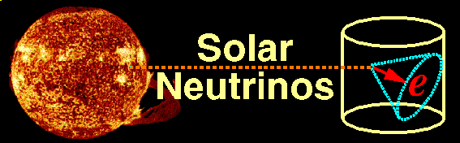
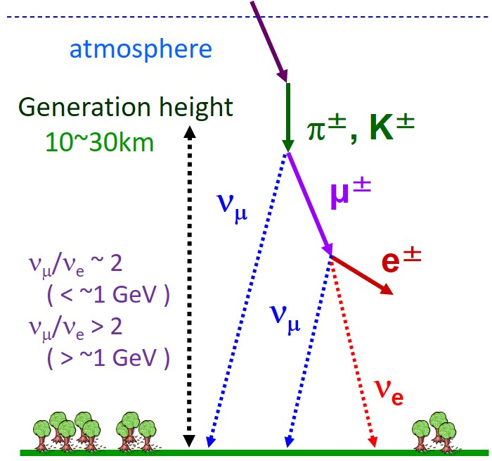
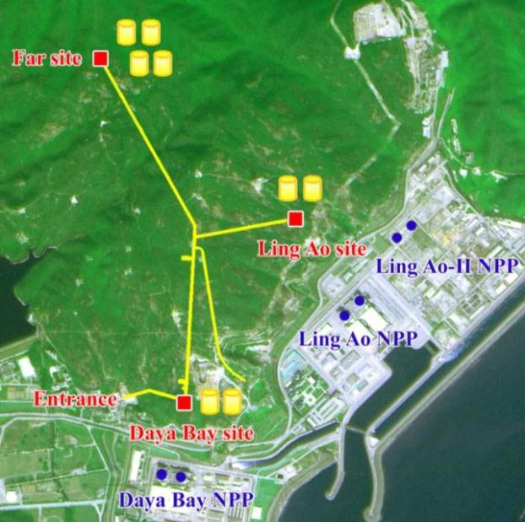
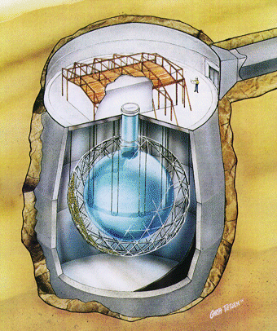
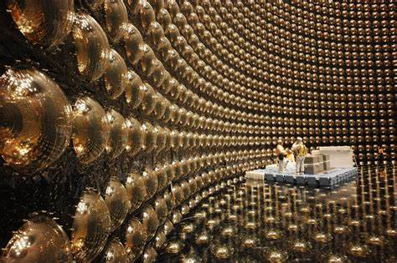
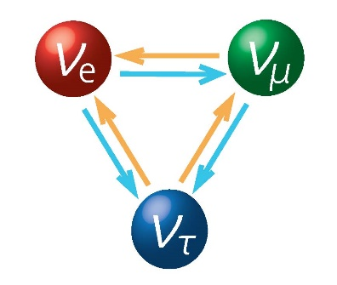


A. Basic Facts of the Standard Model
Daya Bay
SNO
Neutrinos are actually massive !!!
Large lepton flavor mixing exists
Nobel Prize in 2015
Super-K

Slide 7
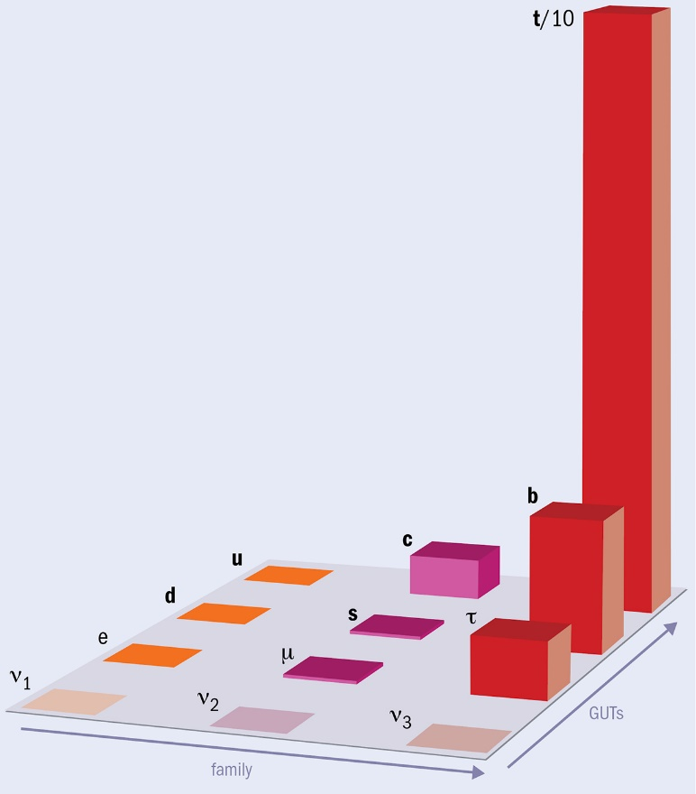



A. Basic Facts of the Standard Model
$$m_{t}≫m_{c}≫m_{u}$$
$$m_{b}≫m_{s}≫m_{d}$$
$$m_{τ}≫m_{μ}≫m_{e}$$
Xing, Phys. Rept, 2020
Flavor mixing pattern
CP violation
Credit: A. Tovey
Strong hierarchy among fermion masses

Slide 8
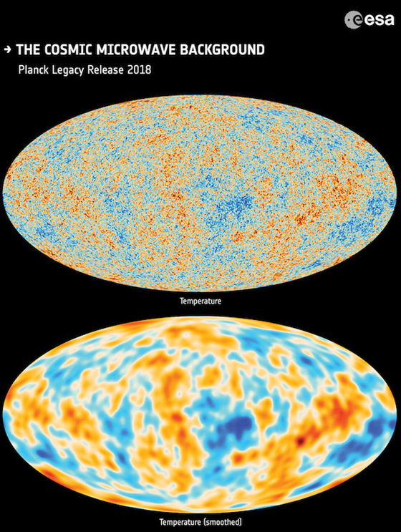
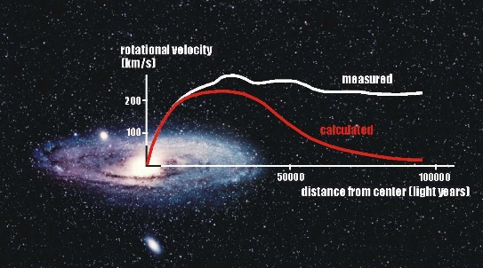
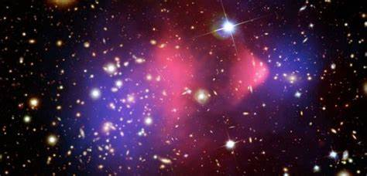
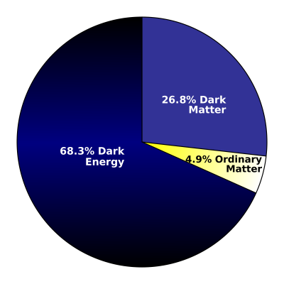

A. Basic Facts of the Standard Model
Rotation of galaxies
$$η_{\text{B}}≡\frac{n_{\text{b}}−n_{\overline{\text{b}}}}{n_{γ}}=(6.065±0.090)×{10}^{−10}$$
Bullet clusters
Strong evidence for the existence of dark matter, but we have no particle candidates in the SM
The mechanism for dynamical generation of baryon number asymmetry

Slide 9

B. Operator Basis of the SMEFT
Given those evidence for possible new physics, the SM should be just an effective field theory at the electroweak scale
Given the field content and symmetries of the SM, one may think it is straightforward to construct the basis of operators of mass dimensions higher than four. But not…
Exercise 3: prove that the dim-5 operator is unique
Mass dim. @d = 4
Lorentz-invariant combinations
Weinberg, 79
Balsiger et al., 2005.08573
Check gauge invariance
Unique dim-5 Weinberg operator for Majorana neutrino masses
Correctly estimate neutrino masses and predict that they are observable in neutrino oscillation experiments

Slide 10
B. Operator Basis of the SMEFT
Systematic analyses of dim-6 operators in the SMEFT
Buchmuller & Wyler, NPB, 1986
Gauge invariance
Total derivatives
Redundant via EoM
Balsiger et al., 2005.08573
Leung, Love & Rao, ZPC, 1986
within each class
Fermion Fierz identities
Lie group Fierz identities
Flavor identities
Aguilar-Saavedra, 1008.3562
Grzadkowski et al., 1008.4884
The Warsaw basis
Higgs field
For example
Fermion fields
Gauge fields
Choose less number of derivatives
Hermitian derivative

Slide 11
B. Operator Basis of the SMEFT
The Warsaw basis of dim-6 operators in the SMEFT: in total 59 operators conserving B and L
4
1
2
3
8
8
8
Four-fermion operators: 25
Grzadkowski et al., 1008.4884
Very rich phenomenology at the energy / intensity / cosmology frontiers, which are under active studies

Slide 12
B. Operator Basis of the SMEFT
Henning, Lu, Melia, Murayama, 1512.03433
Li et al., 2005.00008
Buchmuller & Wyler, 86
Murphy, 2005.00059
Grzadkowski et al., 1008.4884
Harlander, Kempkens & Schaaf，2305.06832
up to dim-12
Li et al., 2007.07899
Liao & Ma, 1607.07309
Liao & Ma, 2007.08125
Weinberg, 79
Lehman,1410.4193
Counting of independent operators up to dim-15

Slide 13
B. Operator Basis of the SMEFT
The basis of dim-7 operators in the SMEFT: 18 operators
Liao & Ma，1607.07309
12 operators
6 operators
Lehman,1410.4193
Exercise 4: show that the other operator is is indeed redundant
Gamma matrix identities
Lepton/Baryon number violation
Equation of motion

Slide 14
C. Renormalization Group Equations
The loop correction to dim-6 operators may need the conterterms not in the basis
Jenkins, Manohar, Trott, 1308.2627, 1310.4838
Alonso et al., 1312.2014, 1405.0486,
In general
the conterterm
vanish via EoM
Call E_{r} the EoM operators
EoM
The EoM operators renormalize among themselves, otherwise they contribute to the S matrix
The RGEs for dim-7 operators
Liao & Ma，1607.07309
for dim-8 operators
Chala & Li，2309.16611
Zeros in the anomalous dimensions of dim-8 operators from positivity

Slide 15
Summary
The SMEFT offers a model independent description of the impact of new physics on the SM particles at low energies and is useful in the precision era of particle physics
Phenomenological studies are far from complete, and a global fit analysis of experimental data in the SMEFT
The operator basis available up to dim-12, but the RGEs known for up to dim-7 operators, partly for dim-8
Liao, Ma, Wang, 1909.06272
Cirigliano et al., 1806.02780

