Slide 1
The Standard Model Effective Field Theory (SMEFT)
Shun Zhou
(IHEP & UCAS, Beijing)
Lecture 3：Functional Method for One-loop Matching
The First Zhujiang Winter School on Theoretical Physics
Quantum Matter Institute, South China Normal University
Guangzhou，2023-12-05

Slide 2
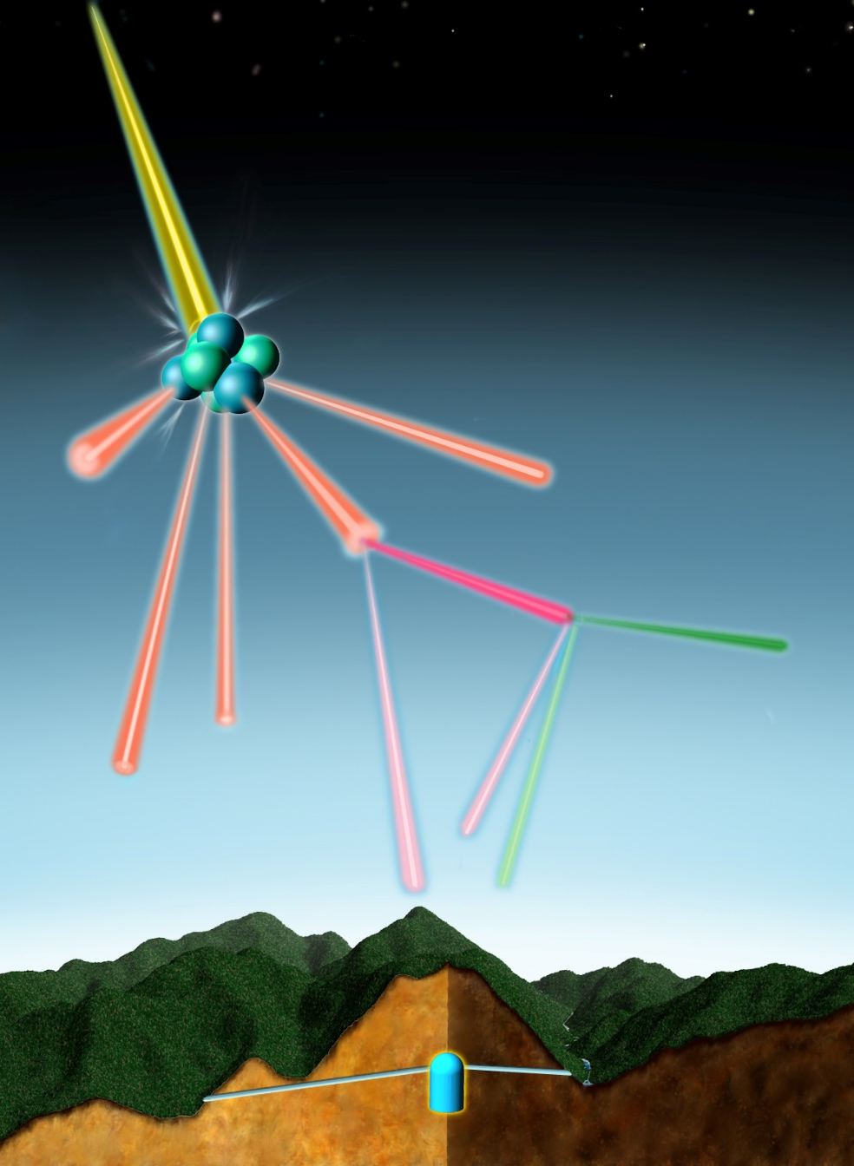
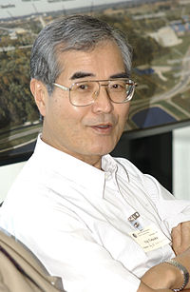
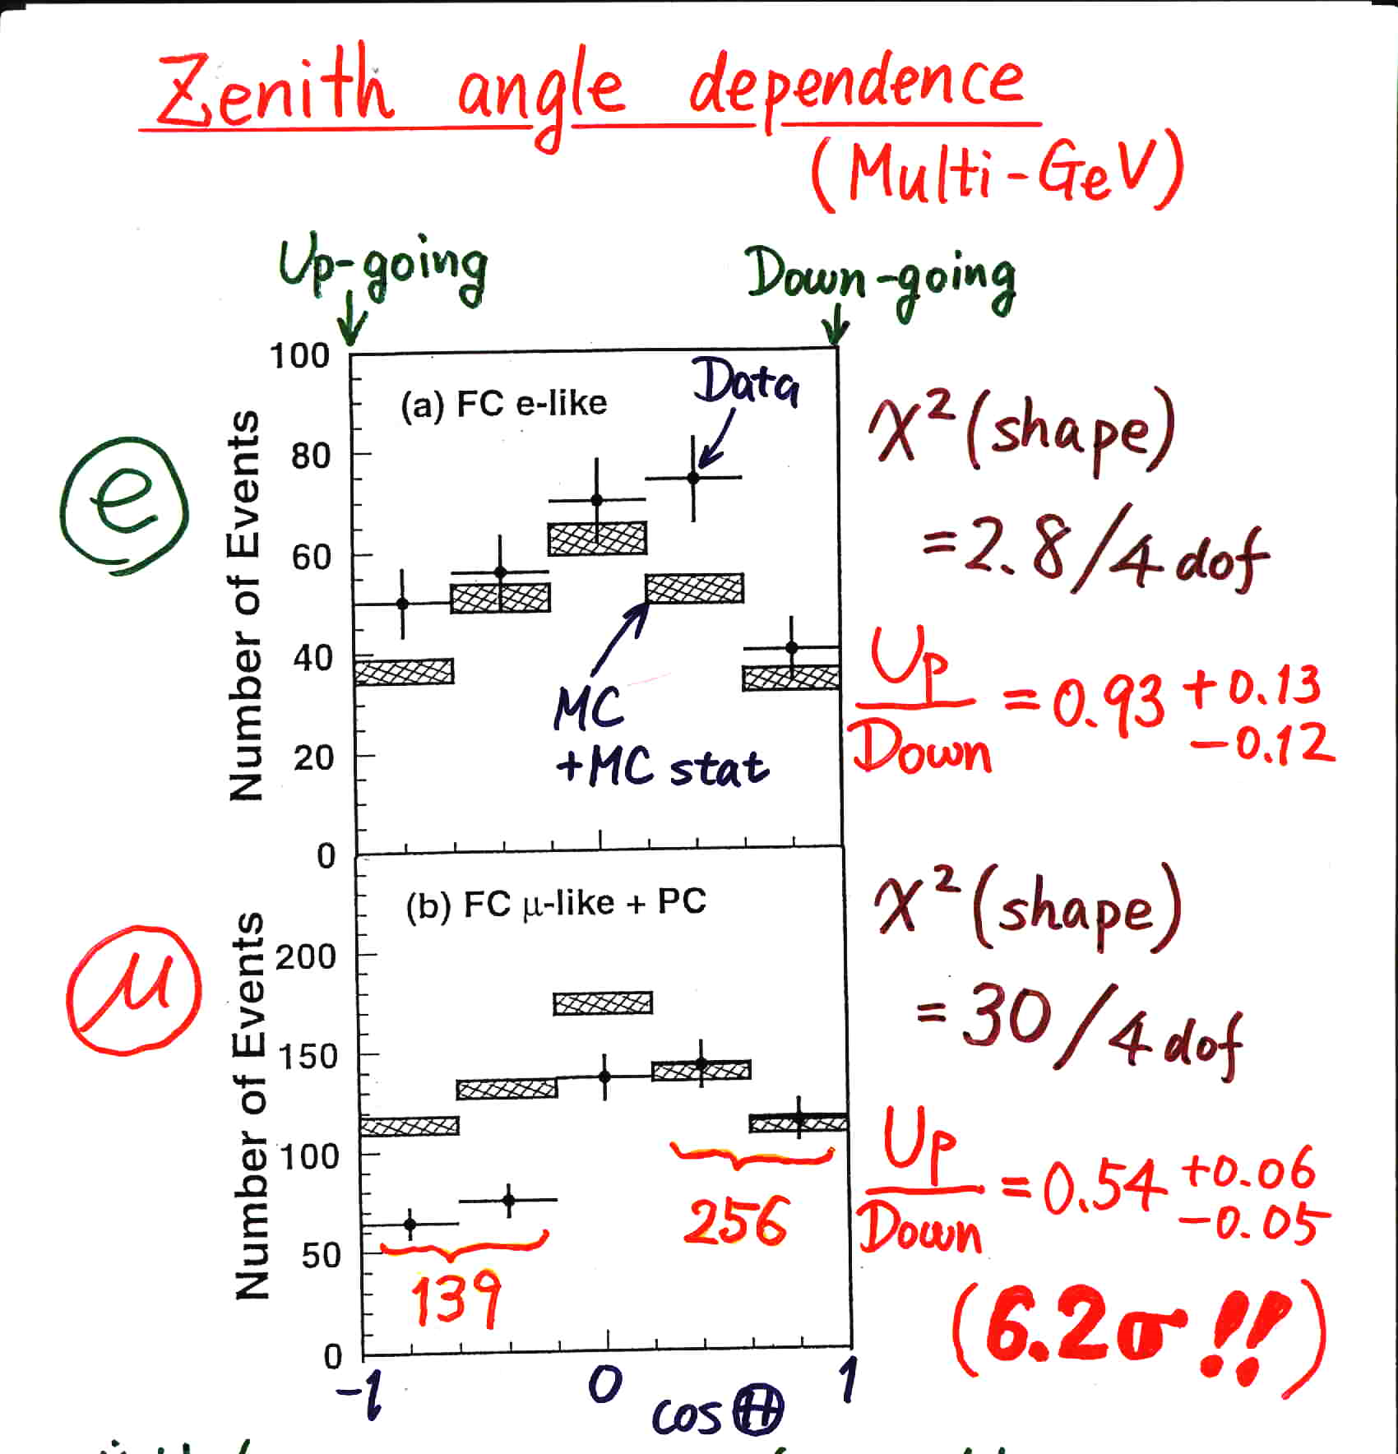
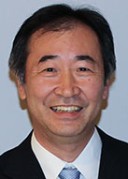
A. Motivation
COSMIC RAY
Super-Kamiokande @ Neutrino 98
AIR NUCLEUS
Yoji Totsuka
(1942-2008)
PION
MUON
ELECTRON
2 muon-neutrinos
1 electron-neutrino
T. Kajita
Discovery of atmospheric
neutrino oscillations
supported by
K2K, MINOS, T2K, NOνA
From Kajita, ICHEP 16

Slide 3
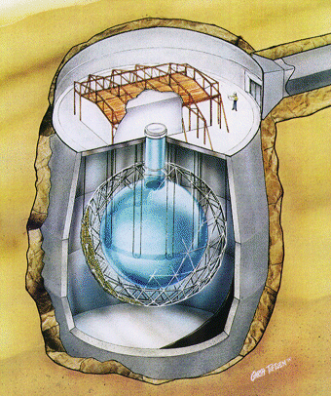
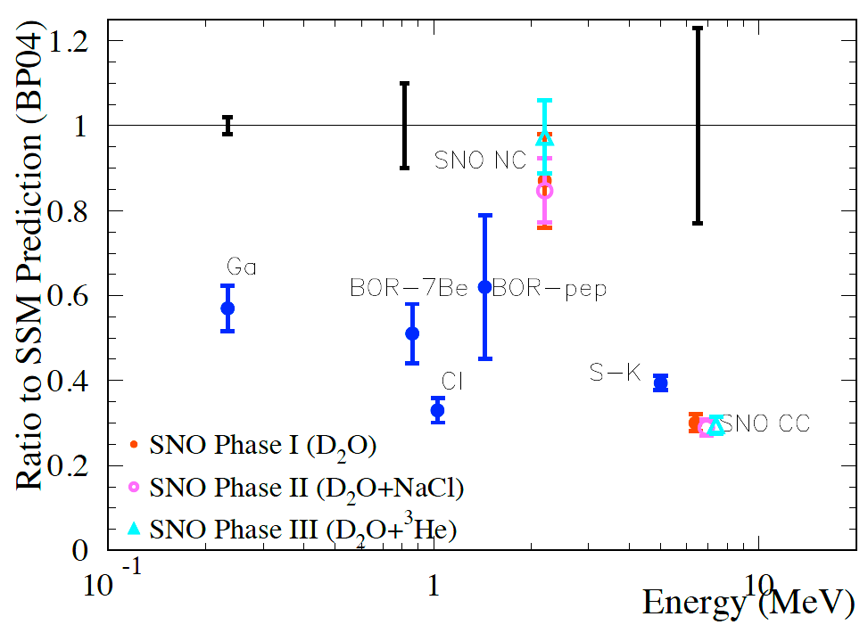

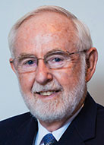
A. Motivation
all ν_{x}
ν_{e}only
SNO
Phys. Rev. Lett. 55 (1985) 1534
Discovery of solar
neutrino oscillations
supported by
KamLAND
Herbert H. Chen
陈华森
（1942-1987）
A.B. McDonald

Slide 4
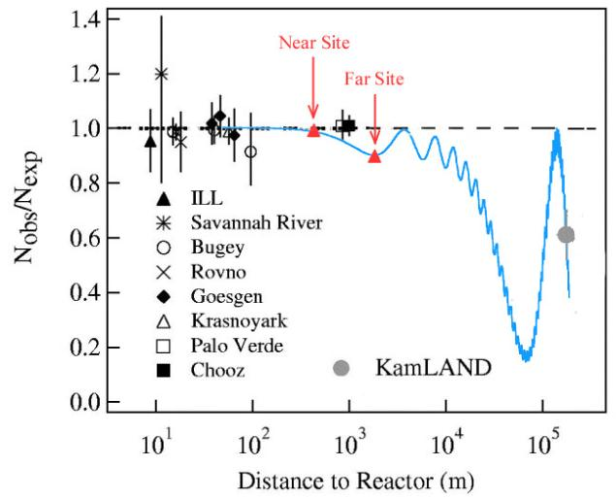
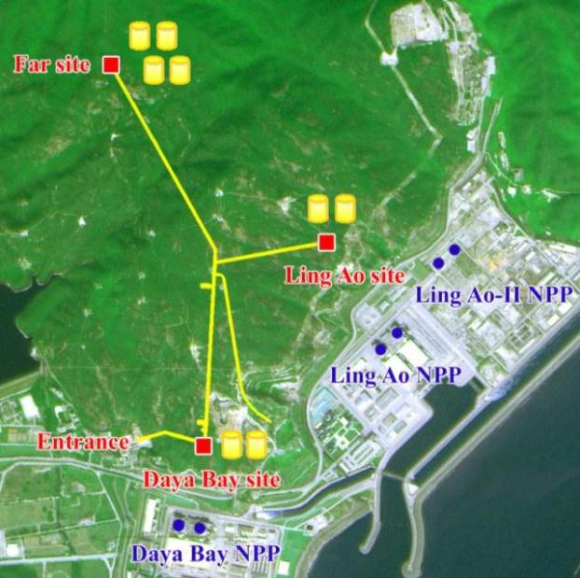
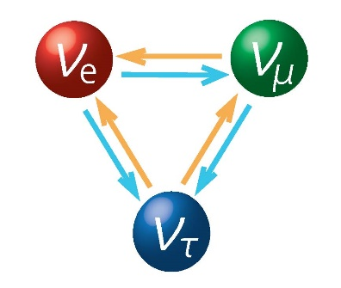
A. Motivation
Discovery of reactor
neutrino oscillations
A complete picture of three-flavor neutrino oscillations!
Double Chooz (far detector):
sin² θ₁₃ = 0.022 ± 0.013
Daya Bay (near + far detectors):
sin² θ₁₃ = 0.024 ± 0.004
RENO (near + far detectors):
sin² θ₁₃ = 0.029 ± 0.006
Dec. 2011
1.7σ
Neutrinos are actually massive particles !!!
Large lepton flavor mixing exists in nature
Mar. 2012
5.2σ
Apr. 2012
4.9σ
Origin of neutrino masses remains the big puzzle in particle physics: strong evidence for new physics

Slide 5
A. Motivation
Basic neutrino oscillation parameters
Esteban et al., 2007.14792, NuFIT 5.0 (2020)

Slide 6
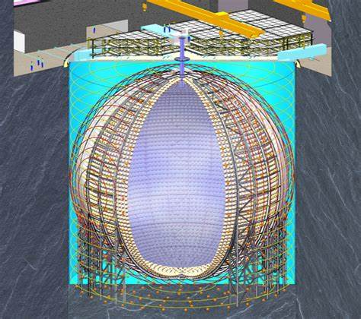

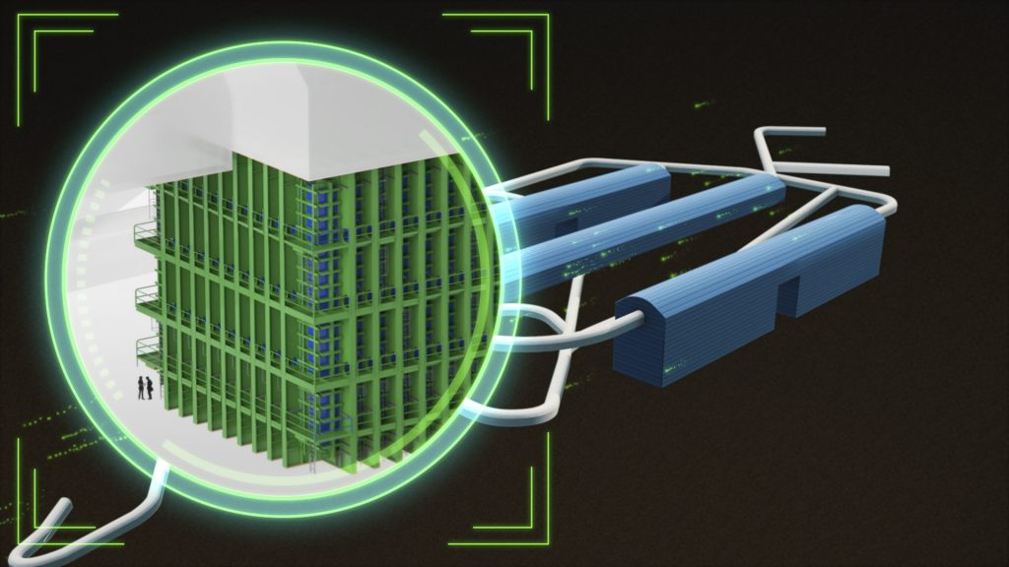

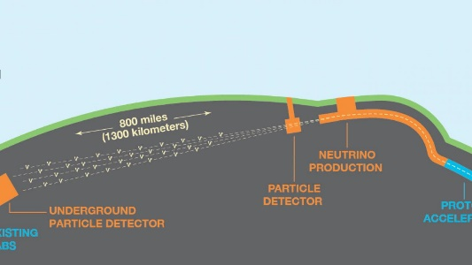

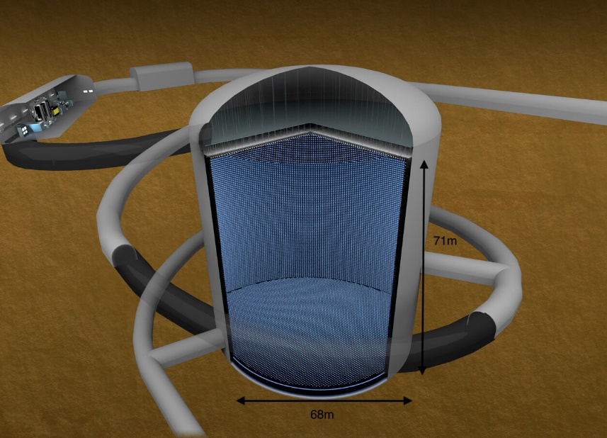
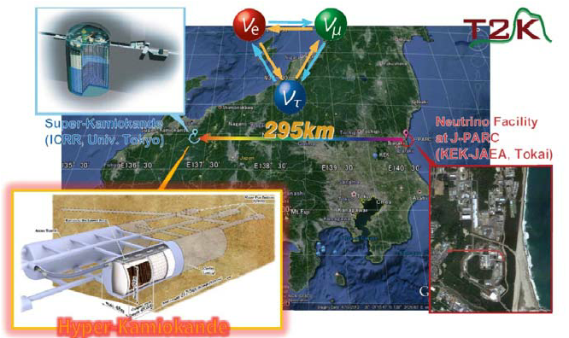

A. Motivation
JUNO: 2024, 20 kt liquid-scintillator
Neutrino mass ordering
Leptonic CP violation
DUNE: late 2020s, 34 kt liquid-Argon
Hyper-K: 2027
188 kiloton water = 8 x Super-K

Slide 7





B. Neutrino Mass Models
The simplest way to accommodate tiny neutrino masses
Dirac Neutrinos
Majorana Neutrinos
Generate Dirac ν masses in a similar way to that for quarks & charged leptons, after spontaneous gauge symmetry breaking
Generate tiny Majorana ν masses via the so-called seesaw mechanism
$$≈174 GeV$$
$$O(0.1 eV)$$
$$O({10}^{−12})$$
$$O(0.1 eV)$$
$$O({10}^{14} GeV)$$
Difficulties with Dirac neutrinos
Tiny Dirac masses worsen fermion mass hierarchy problem (i.e., m_{i}/m_{t} < 10⁻¹²)
Mandatory lepton number conservation, which is actually accidental in the SM
Retain SM gauge symmetries
Well motivated by the GUTs
Introduce all terms allowed by the SM gauge symmetries

Slide 8















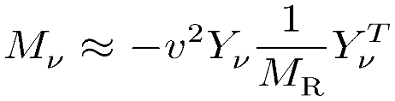
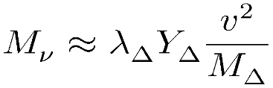

B. Neutrino Mass Models
Seesaw mechanism: the most natural way to understand tiny neutrino masses
Type-I: SM + 3 right-handed ν’s (Minkowski 77; Yanagida 79; Glashow 79; Gell-Mann, Ramond, Slansky 79; Mohapatra, Senjanovic 79)
Type-II: SM + 1 Higgs triplet (Konetschny, Kummer 77; Magg, Wetterich 80; Schechter, Valle 80; Lazarides et al., 80; Cheng, Li 80; …)
naturally be embedded into Grand Unified Theories, e.g., SO(10) GUT
Type-III: SM + 3 triplet fermions (Foot, Lew, He, Joshi 89)
Be able to explain both tiny neutrino masses and the matter-antimatter asymmetry in the Universe

Slide 9
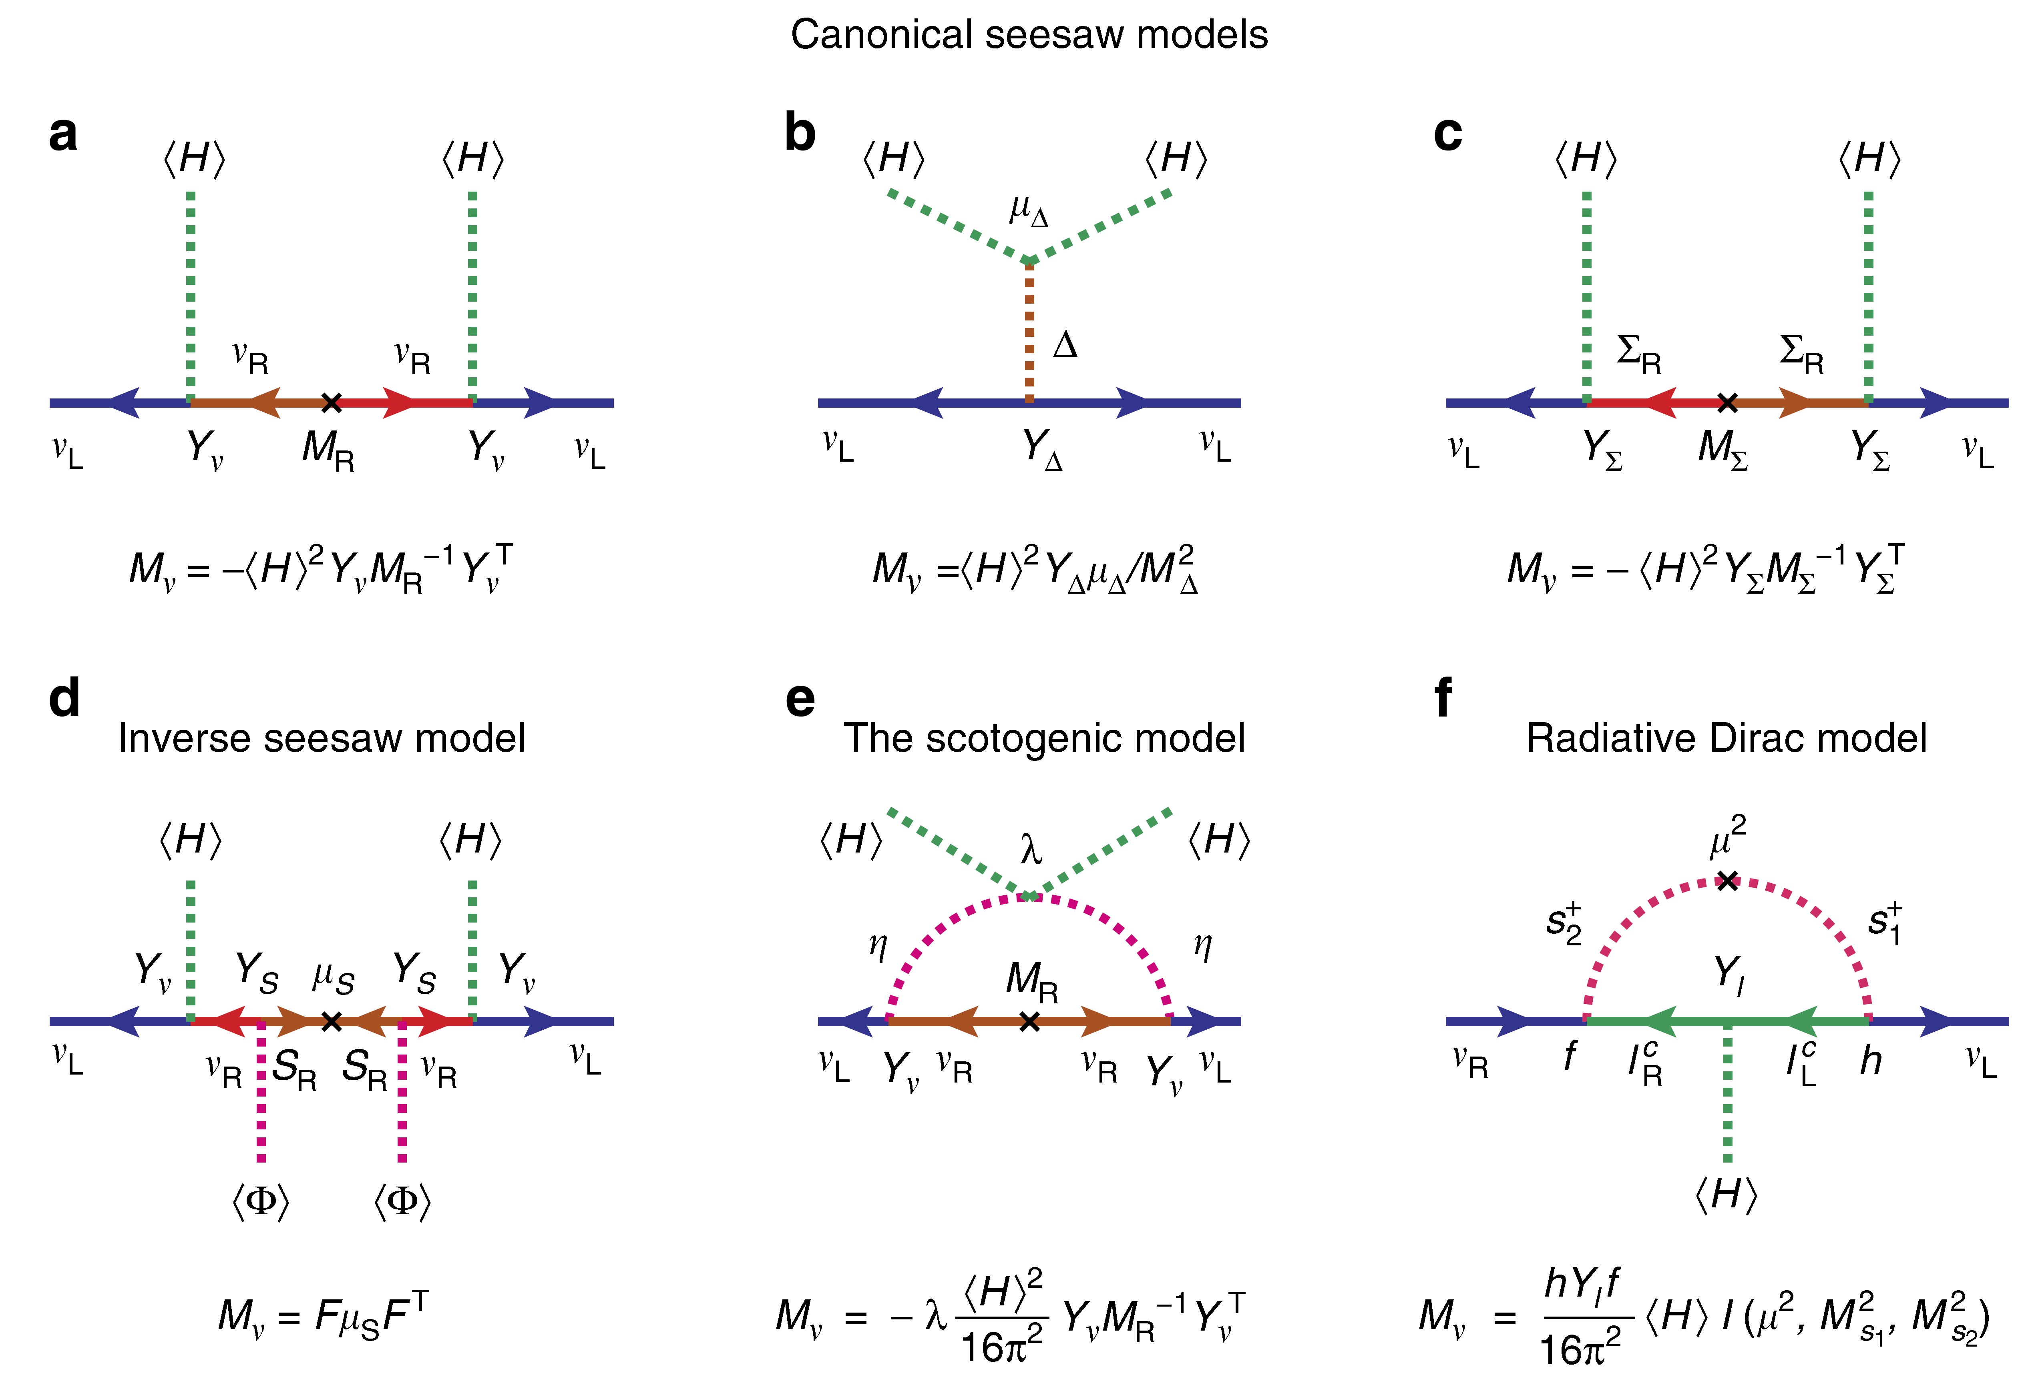
B. Neutrino Mass Models
Mohapatra, Valle, 87
E. Ma, 06
Kanemura et al, 11
Zee, 80, 86; Babu, 88

Slide 10
C. Functional Method for Matching
Henning, Lu, Murayama., 1412.1837, 1604.01019
Fuentes-Martin et al., 1607.02142
Zhang, 1610.00710
Cohen, Lu, Zhang, 2011.02484
Diagrammatic method: calculate the amplitudes twice, one in the UV theory and the other in EFT
Functional method: start with the UV theory, construct the operators and identify the coefficients

Slide 11
C. Functional Method for Matching
Point 1: What to be matched? Cf. matching of amplitudes in the diagrammatic case
Generating functional for Green functions in UV
sources for heavy & light fields
Background field method
One-light-particle-irreducible (1LPI) effective action
No external heavy particles
EoM for the background fields
Expansion up to quadratic terms
Quantum fields to be integrated

Slide 12
C. Functional Method for Matching
Point 1: What to be matched? Cf. matching of amplitudes in the diagrammatic case
Tree-level effective action
Gaussian integral
One-loop effective action
Similar in the EFT with the Lagrangian
Matching criterion
localized

Slide 13
C. Functional Method for Matching
Point 2: one needs to do calculations only in the UV theory without knowing the form of EFT
Diagonalization
Det = 1
Exercise 5: prove these two identities
from tree-level matching
Further simplification by using the method of regions
Beneke, Smirnov, NPB, 1998; Smirnov, book 2002

Slide 14
C. Functional Method for Matching
Point 3: The method of regions——expand the integrand in the hard region q, M >> p, m and in the soft region M >> q, p, m，and integrate them over the whole range of q
The UV- and IR-finite integral
hard part
soft part
Original integral = hard part + soft part

Slide 15
C. Functional Method for Matching
Point 3: The method of regions——expand the integrand in the hard region q, M >> p, m and in the soft region M >> q, p, m，and integrate them over the whole range of q
localized
Scaleless integral
zero
Only the hard part generates the operators at one loop

Slide 16
C. Functional Method for Matching
Point 4: functional trace and covariant derivative expansion (CDE)
Gaillard, NPB 1985; Chan, PRL 1986; Cheyette, NPB 1986
+ boson
Liao, Lectures at JNSS, 2023
- fermion
BCH formula

Slide 17
D. One-loop Matching of Seesaw Models
The type-I seesaw model as an UV-complete theory
Tree-level matching: simply applying the EOM
Expansion up to M⁻² (dim-6 operators)
Seesaw Effective Field Theory (SEFT) @ tree level
Two operators in the Warsaw basis
Neutrino masses &
flavor mixing
Unitarity violation of
flavor mixing matrix

Slide 18
D. One-loop Matching of Seesaw Models
At the one-loop level
Calculated to the given order of mass dimension
Log-type
Power-type
Field multiplet
Only three gauge singlets added into the SM

Slide 19
D. One-loop Matching of Seesaw Models
Interaction matrix
Fuentes-Martin et al., 2012.08506
2212.04510
Integration by parts
Fierz identities
Field redefinitions
Equations of motion
Further reduction to the Warsaw basis

Slide 20
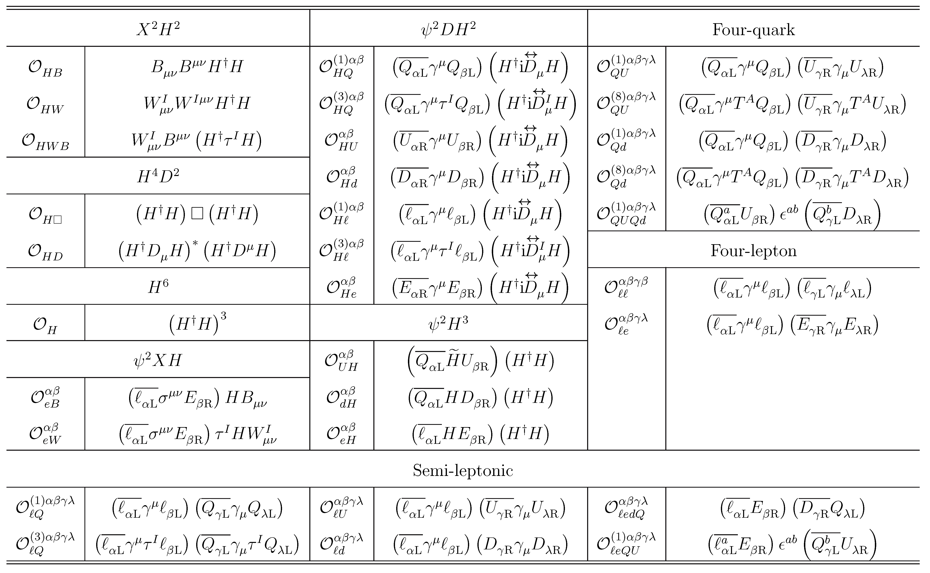
D. One-loop Matching of Seesaw Models
Zhang & Zhou, 2107.12133
Out of 59 operators in the Warsaw basis, 31 dim-6 operators in Seesaw EFT (SEFT)-I

Slide 21
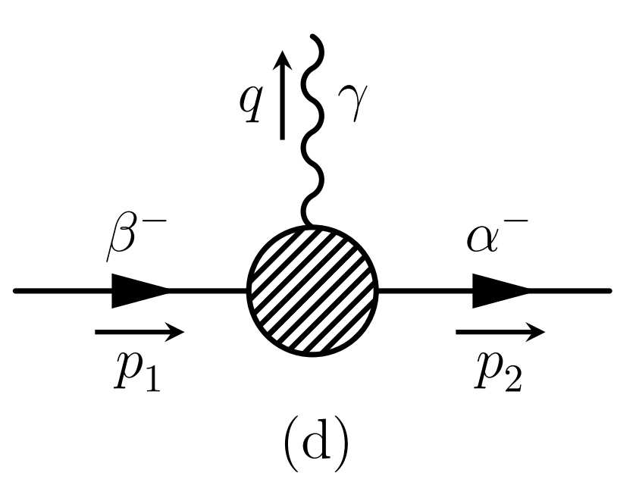
D. One-loop Matching of Seesaw Models
Lepton-flavor-violating decays of charged leptons
EFT with tree-level matching
The decay width
However, the calculation in the full theory for M_{i} >> M_{W} gives
EFT with one-loop matching: two more relevant dim-6 operators

Slide 22
Summary
The one-loop matching of seesaw models onto the SMEFT has been accomplished
Together with the RGEs we can make more precise predictions at low energies
Henning, Lu & Murayama, 1412.1837
Li, Zhou, 2309.14702
41 in SEFT-II
31 in SEFT-I
33 in SEFT-III

