Slide 1
The Standard Model Effective Field Theory (SMEFT)
Shun Zhou
(IHEP & UCAS, Beijing)
Lecture 4：Invariant Theory for CP Violation
The First Zhujiang Winter School on Theoretical Physics
Quantum Matter Institute, South China Normal University
Guangzhou，2023-12-05

Slide 2
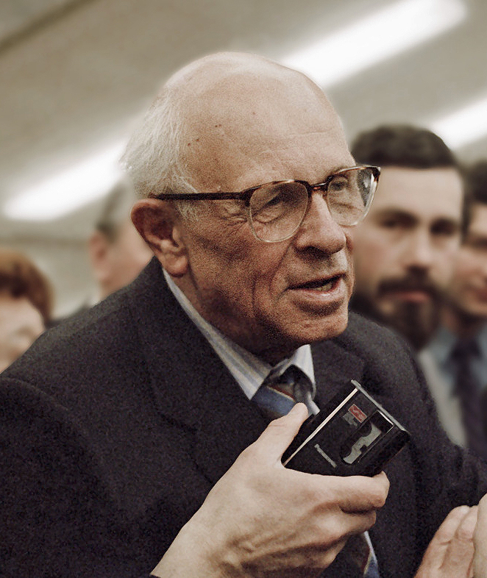
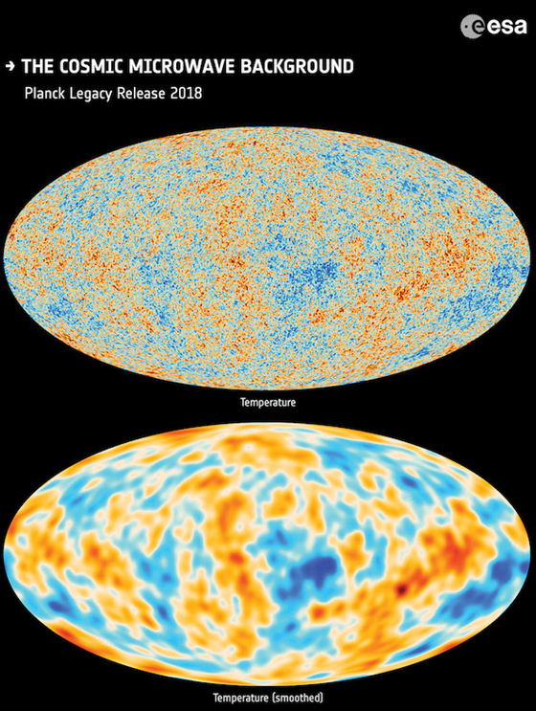

A. Introduction
Soviet nuclear theorist
(1921 – 1989)
Sakharov Conditions
Baryon number (B) violation
Breaking of CP and C symmetries
Out of thermal equilibrium
$$η_{\text{B}}≡\frac{n_{\text{b}}−n_{\overline{\text{b}}}}{n_{γ}}=(6.065±0.090)×{10}^{−10}$$
Dolgov, Phys. Rept., 1992
Boedeker & Buchmueller, Rev. Mod. Phys., 2021
The cosmological matter-antimatter asymmetry

Slide 3
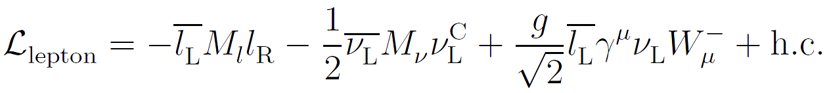


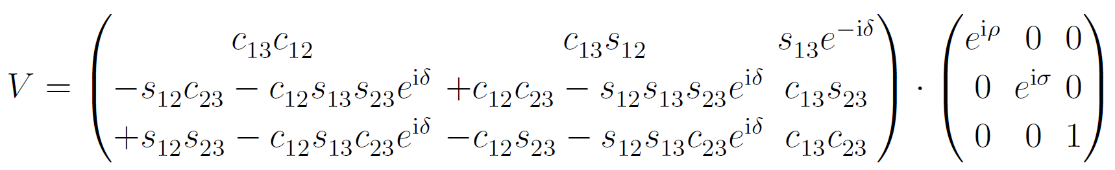
A. Introduction
Possible sources of CP violation: the SM with tiny Majorana neutrino masses
Lepton masses and flavor mixing
Pontecorvo-Maki-Nakagawa-Sakata (PMNS) matrix
in the standard parametrization (PDG)
Count the physical parameters (to be measured in experiments):
3 charged-lepton masses + 3 ν masses + 3 mixing angles + 3 CP phases = 12
In contrast, 18 (M_{l}) + 12 (M_{ν}) = 30 parameters in the lepton mass matrices

Slide 4
A. Introduction
Symmetries in the Lagrangian
invariant under unitary transformations in the flavor space
Lepton fields
Mass matrices
Lepton mass matrices do change under those transformations in the flavor space, but we know physical parameters (observables) should be invariant
Flavor invariants constructed from lepton mass matrices
Physical observables must be independent of the flavor basis
What do we mean by flavor invariants? How many invariants?
How to explicitly construct the flavor invariants in the theory?

Slide 5
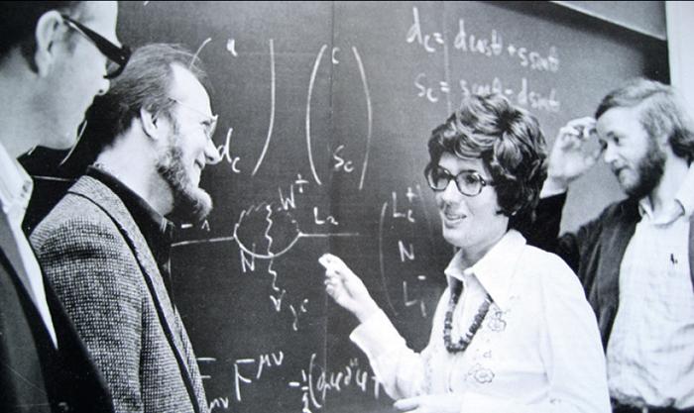
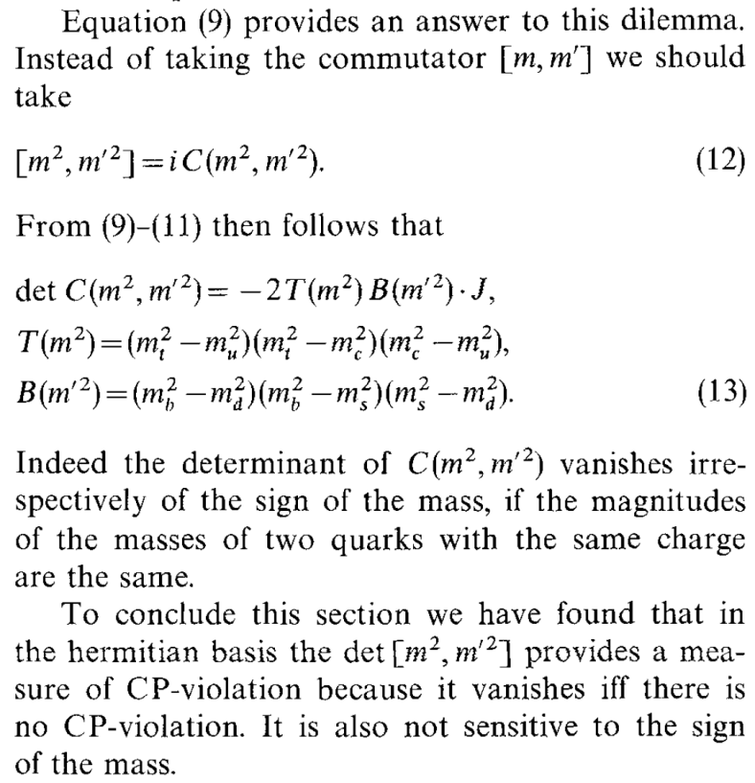


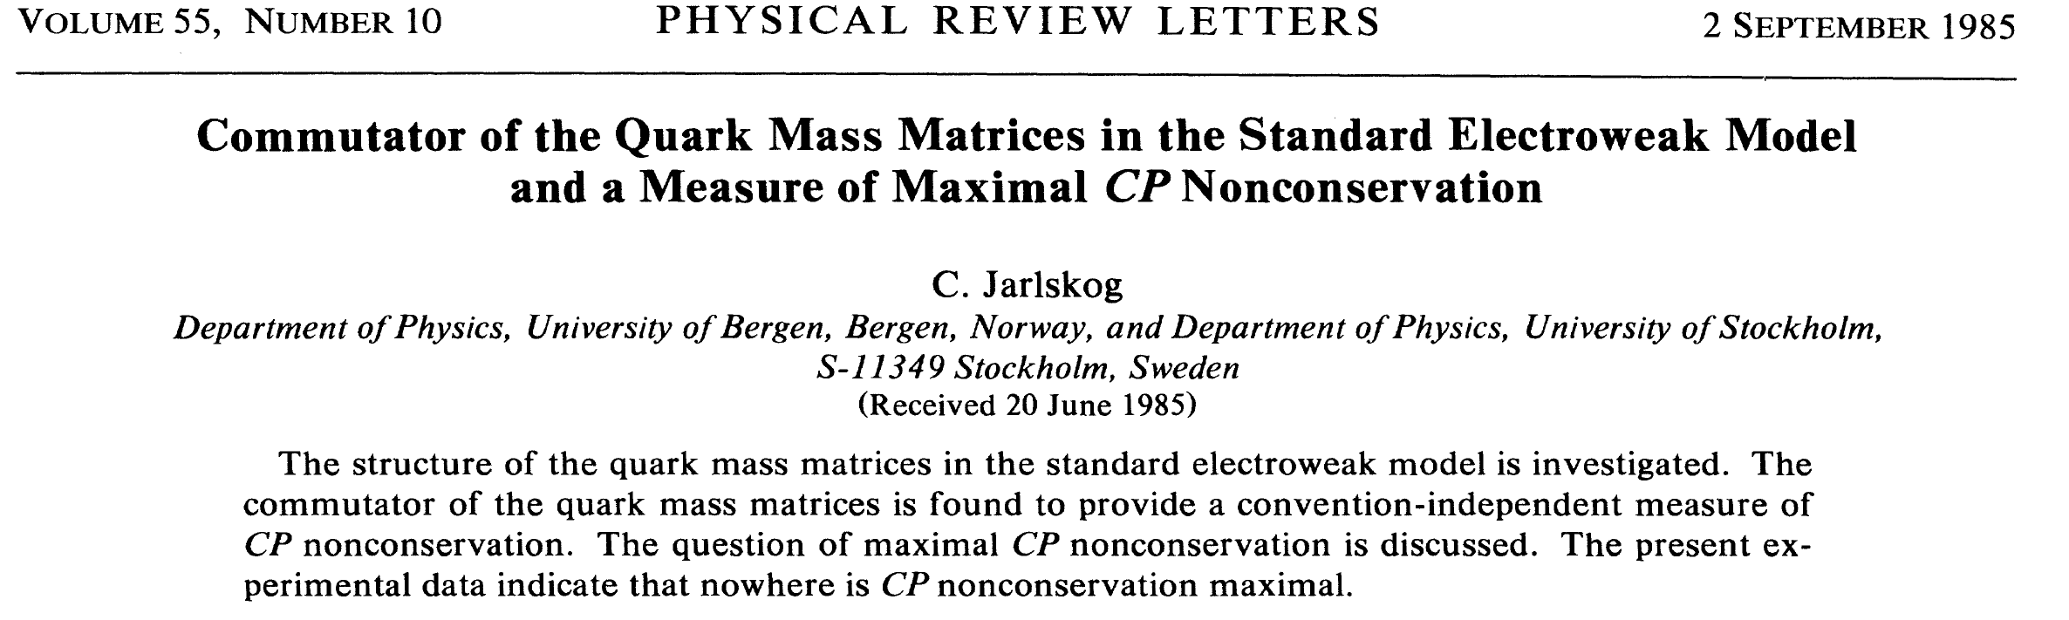
A. Introduction
© CERN Courier
Jarlskog, Z. Phys. C, 1985
Jarlskog invariant
Sufficient and
necessary condition for CP violation
Det C = 0
Cecilia Jarlskog @ NORDITA in 1980s

Slide 6
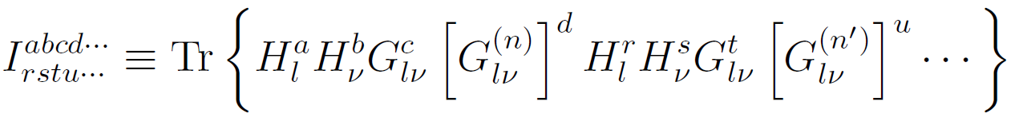
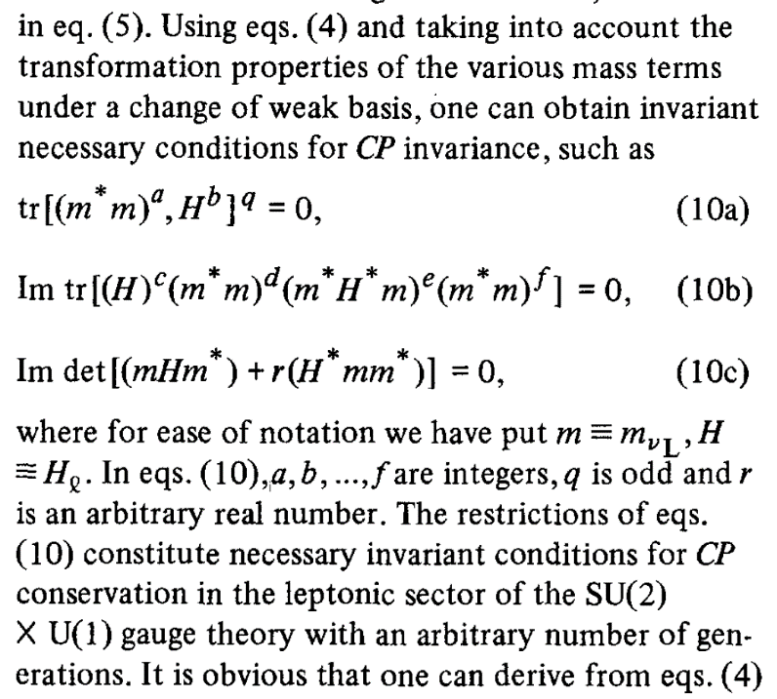
A. Introduction
Building blocks for constructing flavor invariants
which are 3x3 Hermitian matrices and transform as
Construction of flavor invariants
Branco, Lavoura, Rebelo, PLB, 1986; Yu, Zhou, PLB, 2020
Necessary conditions for CP conservation with massive Majorana neutrinos
It seems that the construction is quite arbitrary
It seems that there are infinitely many invariants
It seems that invariants can be very complicated

Slide 7
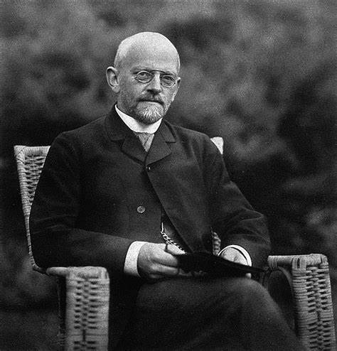
B. Flavor Invariants
David Hilbert’s 23 Fundamental Problems in Math
Lectures on the Fourteenth Problem of Hilbert by M. Nagata, 1965
The invariant ring of polynomials C[x₁, x₂, …, x_{n}] in the field C of complex numbers under the symmetric group S_{n} is finitely generated, and the generators are just the elementary symmetric polynomials
David Hilbert
(1862-1943)

Slide 8
B. Flavor Invariants
Hilbert Series (HS): two generations of leptons
Building Blocks
Representations
Character functions
Plethystic Exponential (PE)
Multi-graded HS
Plethystic Program
Benvenuti, Feng, Hanany, He, JHEP, 2007;
Hanany, Jenkins, Manohar, Torri, JHEP, 2011

Slide 9
B. Flavor Invariants
Plethystic Logarithm (PL)
Ungraded HS
Jenkins, Manohar, JHEP, 2009
Information from the ungraded HS
Denominator (primary)
2+3+1 = 6 algebraically-independent generators:
2 @ degree 2 (J₁, J₂)
3 @ degree 4 (J₃, J₄, J₅)
1 @ degree 6 (J₆)

Slide 10
B. Flavor Invariants
Ungraded Hilbert Series
Information from the ungraded HS
Numerator
NOT freely generated, and there are other generators in the generating set
Information from the PL function
Leading positive terms (for the invariants in the generating set)
7 basic generators, but one syzygy at degree (8, 8) among them

Slide 11
B. Flavor Invariants
How to reduce one flavor invariant to polynomials of basic ones
Cayley-Hamilton theorem
Numerically identify the coefficients from the linear equation array satisfied by the invariants of the same degree and CP parity
Wang, Yu, Zhou, JHEP, 2021
Counting the Physical Parameters (two-generation leptons)
2 charged-lepton masses + 2 ν masses + 1 mixing angle + 1 CP phase = 6
Number of physical parameters
=
Number of primary invariants
Jenkins, Manohar, JHEP, 2009

Slide 12
B. Flavor Invariants
Renormalization-group running (e.g., Antusch et al., PLB, 2001)
RGEs for flavor invariants
RGEs are closed for the invariants in the generating set, as expected
Only one CP-odd flavor invariant, whose RGE is proport. to itself; so if it is vanishing, CP is conserved
One can extend all these studies to the three-flavor case, but the calculations are definitely much more complicated

Slide 13
B. Flavor Invariants
Flavor Invariants: three generations of leptons
Building Blocks
Representations
Character functions
PL function
Ungraded HS
12 primary invariants, 33 basic invariants (?)

Slide 14
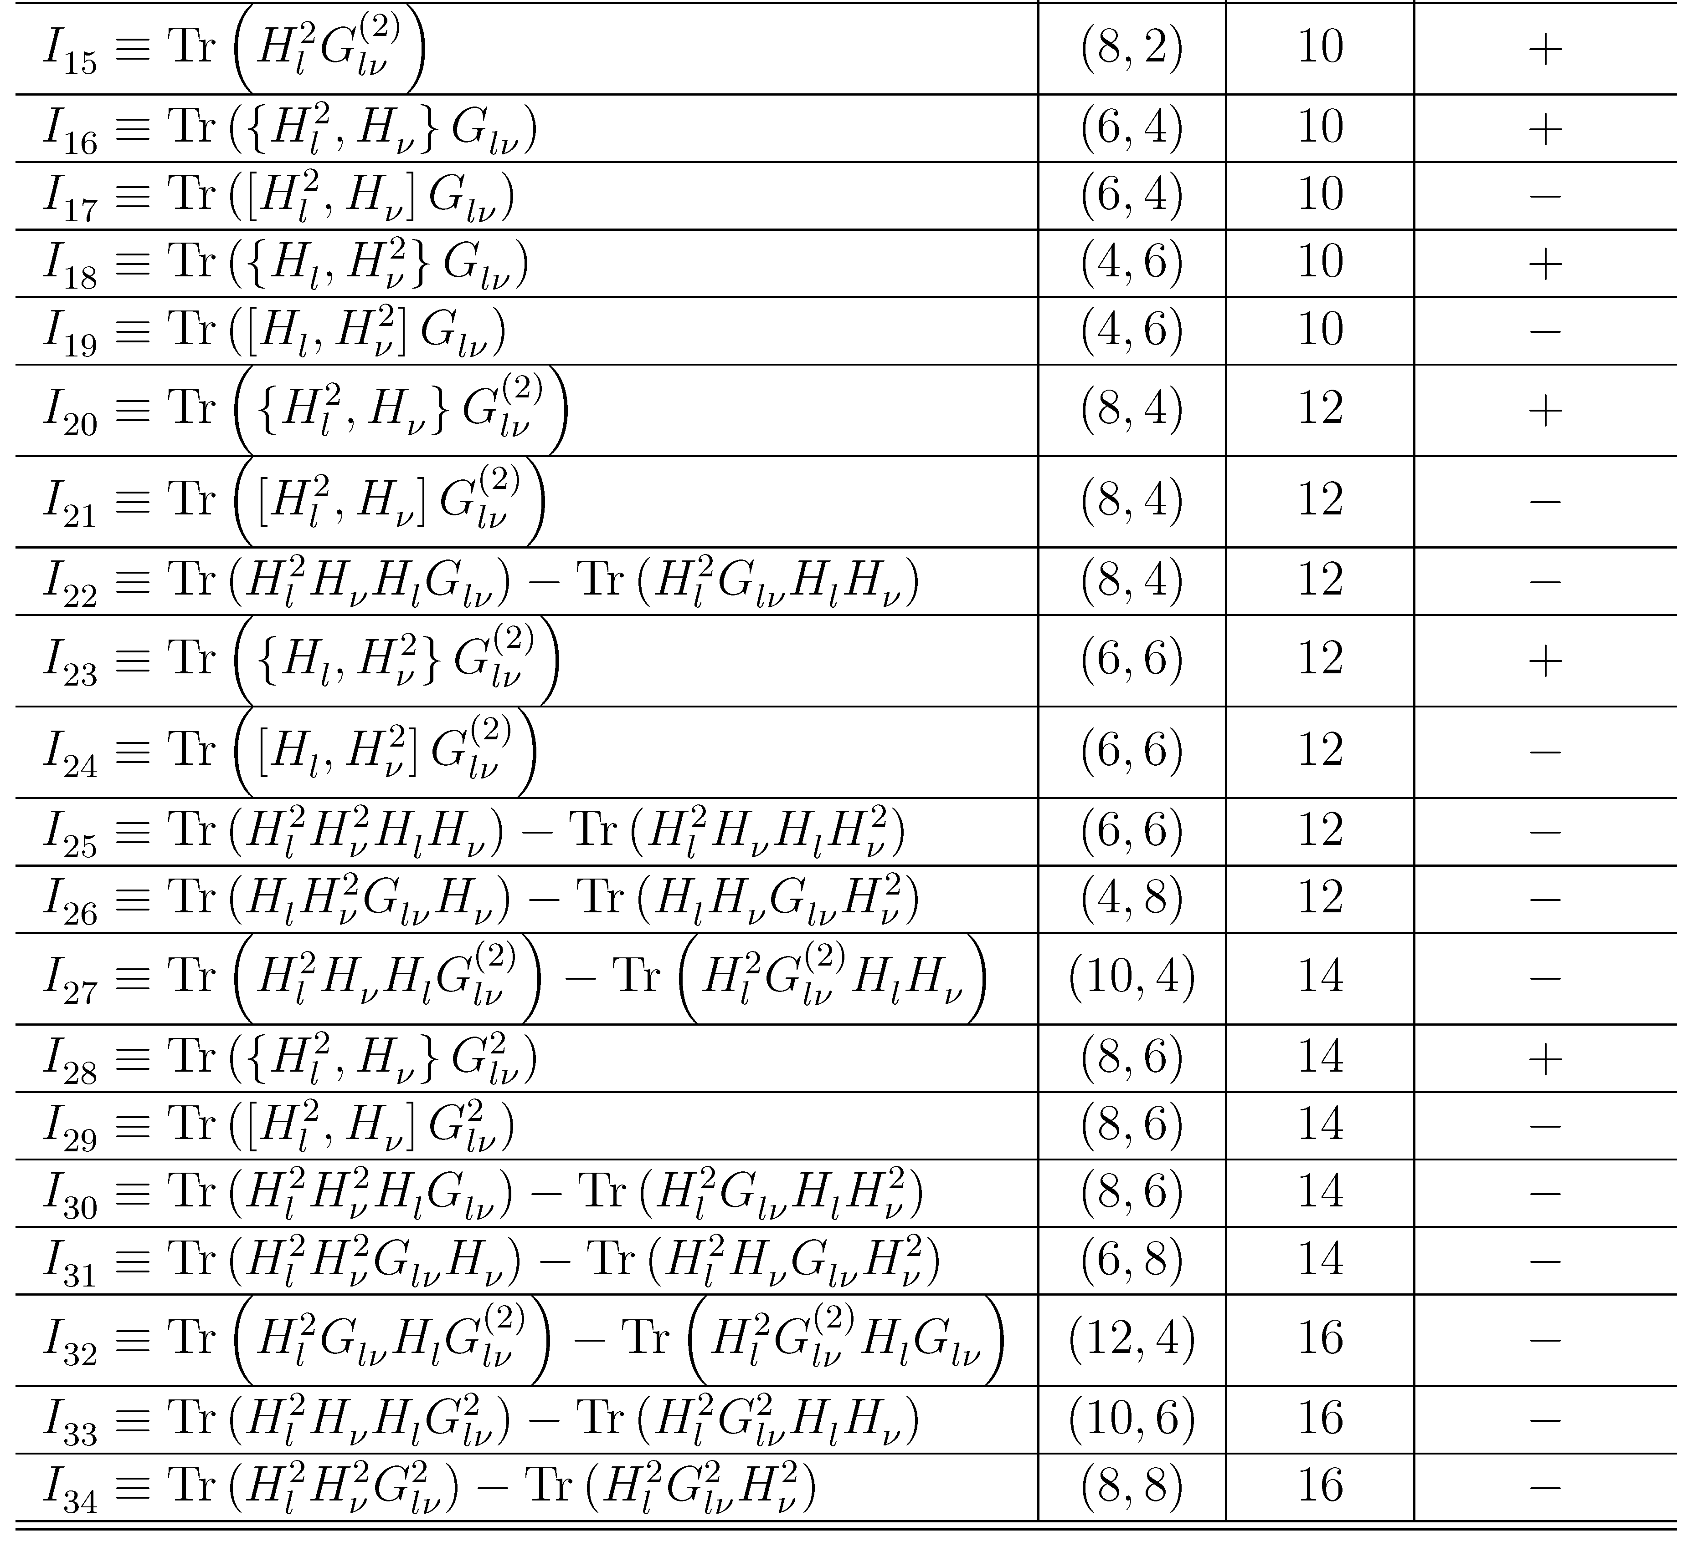
B. Flavor Invariants
Explicit construction of 34 basic invariants (19 CP-even vs. 15 CP-odd)
The RGEs of flavor invariants
Closed only if the 34th invariant is added!
Conjecture on the PL function
Possible cancellation in the PL function
We explicitly verify that there is indeed only one syzygy at degree (8, 8), which is independent of the 34th invariant I₃₄
But a rigorous proof is still lacking…

Slide 15
C. CP Violation in SMEFT
Sources of CP violation beyond the SM
arXiv:2112.03889
Standard Model Effective Field Theory (SMEFT): dim-6 operators (without dim-5!)
How about SEFT-I?

Slide 16
C. CP Violation in SMEFT
Flavor-basis transformations in the seesaw model
Translated into those on coupling matrices
To be consistent, flavor-basis transformations in the SEFT turn out to be
Building blocks for flavor invariants in the full theory
Building blocks for flavor invariants in the SEFT

Slide 17
C. CP Violation in SMEFT
Ungraded HS in the two-generation SEFT
2+4+2+2 = 10 primary invariants
The PL function in the two-generation SEFT
2+4+2+5+2+3 = 18 basic invariants
10 primary invariants with (*)
18 basic invariants:
(12 CP-even + 6 CP-odd)
4 syzygies at degree 8 for CP-odd invariants
6 – 4=2

Slide 18
Summary
New sources of CPV for cosmological matter-antimatter asymmetry
Flavor symmetries required by fermion flavor mixing
Possible extensions to other EFTs
SMEFT
Renormalization-group equations
Positivity bounds
Geometric description
Global-fit analysis

