Slide 1
From chiral EFT to nuclear Monte Carlo simulations
吕炳楠
中国工程物理研究院研究生院
Graduate School of China Academy of Engineering Physics
珠江理论物理冬季学校
华南师范大学 广州 2023/12

Slide 2
Table of contents
Introduction to the nuclear force problem
Chiral effective field theory
Quantum Monte Carlo methods
Modern applications of the QMC methods

Slide 3
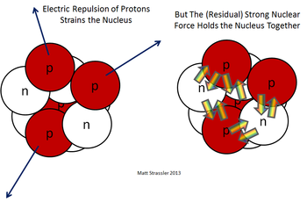
Part I: Introduction to the nuclear force problem

Slide 4
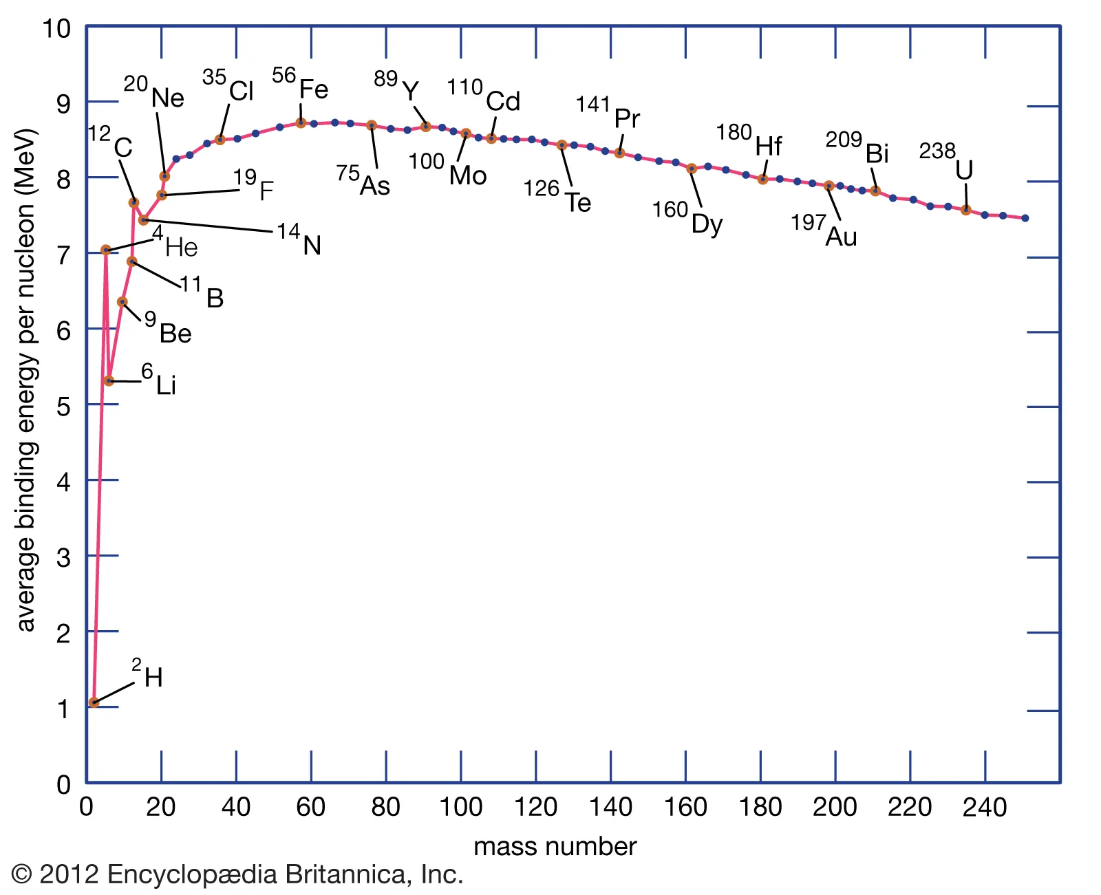
Basic facts about nuclear physics
Important length scales in nuclear physics
Proton/neutron radius: 0.84 fm
⁴He charge radius: 1.68 fm
¹⁶O charge radius: 2.70 fm
²⁰⁸Pb charge radius: 5.50 fm
Important energy scales in nuclear physics:
Proton/neutron mass: 939 MeV
Pion mass: 135 MeV
⁴He binding energy: 28.3 MeV; E/A=7.08 MeV
¹⁶O binding energy: 127.6 MeV; E/A=7.98 MeV
²⁰⁸Pb binding energy: 1636.4 MeV; E/A=7.88 MeV
Features of nuclear force:
Short-ranged, Saturated

Slide 5
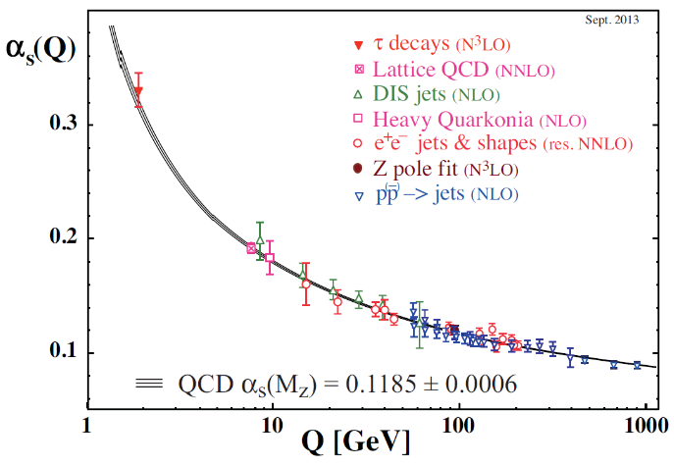
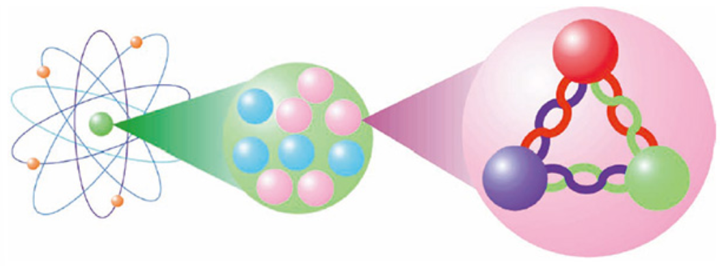
Why nuclear many-body problem is so hard?
Nuclear force originates from the QCD.
Features of strong interaction:
Asymptotic freedom of QCD Non-perturbative at low energy
Bound nuclei with A=2~300. Quantum many-body problem
Goals for nuclear theorists (Both are formidably difficult!):
Design an effective N-N interaction
Solve the many-body Schrodinger equations

Slide 6
Modern nuclear theories

Slide 7
Nuclear Force Problem
Nuclear Force Problem: Can the nuclear force calibrated with the N-N scattering and
few-body data uniquely and correctly predict the structures of finite nuclei?
Ab initio (Weak form)
Ab initio (Strong form)
N-N Scattering & few-body data
N-N Scattering & few-body data
Effective nuclear forces
(Skyrme, RMF, shell model, etc.)
Parametrize
Parametrize
Nuclear force
Nuclear force
Nuclear force
Parametrize
Parametrize
Predict
Predict
Predict
Structures of finite nuclei
Structures of finite nuclei
Structures of finite nuclei

Slide 8
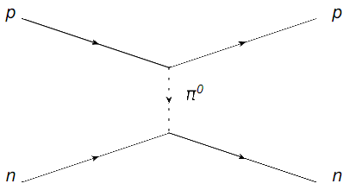
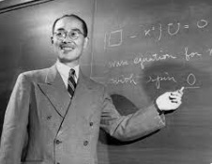
Yukawa potential
In 1935 Yukawa proposed the nuclear force model
$V\left(r\right)=−g^{2}\frac{e^{−mr}}{r}$
by considering two nucleons exchanging a heavy meson.
The potential is given by a Fourier transform of the pion-propagator
$V\left(p\right)=\frac{−g^{2}}{p^{2}+m^{2}}$
The pion mass $m≈135$MeV $≪M ≈939$ MeV
Uncertainty principle: $Δx Δp \sim ℏ$ → Force range $r\sim ℏ/ m ≈1.4$fm

Slide 9
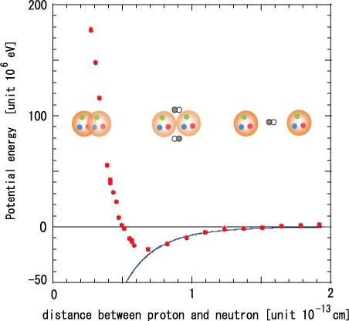
Bare nuclear force
Today we know only pion-exchange is insufficient
Long-range pion-exchange attraction
Short-range repulsion due to Pauli exclusion and
heavier meson exchange
Effective d.o.f.: Neutron, proton, pion (perhaps with several heavy mesons). How they interact?

Slide 10
Nuclear forces on the market
Phenomenological nuclear forces:
AV18 R. B. Wiringa, et al., Phys. Rev. C 51, 38 (1995), cited 4545 times
CD-Bonn R. Machledit, Phys. Rev. C 63, 024001 (2001), cited 2643 times
Chiral nuclear forces:
EM DR Entem et al., Phys. Rev. C 68, 041001 (2003), cited 1813 times
EGM E. Epelbaum et al., Nucl. Phys. A 747, 362 (2005), cited 858 times
Variants of chiral nuclear forces:
MAGIC K. Hebeler, et al., Phys. Rev. C 83, 031301 (2011)
GO A. Ekstrom et al., Phys. Rev. C 97, 024332 (2018)
HOPPE C. Drischler et al., Phys. Rev. Lett. 122, 042501 (2019)
HUTHER K. Vobig et al., Phys. Lett. B 808, 135651 (2020)
(Names are taken from R. Machleidt, Few-Body Systems 64, 77 (2023), arXiv:2307.06416)
The list continues growing.
Why we need so many different choices?
Different forces choose:
Different parametrization
Different momentum regulators
Different values of the cutoffs
Different few-body observables to fit

Slide 11
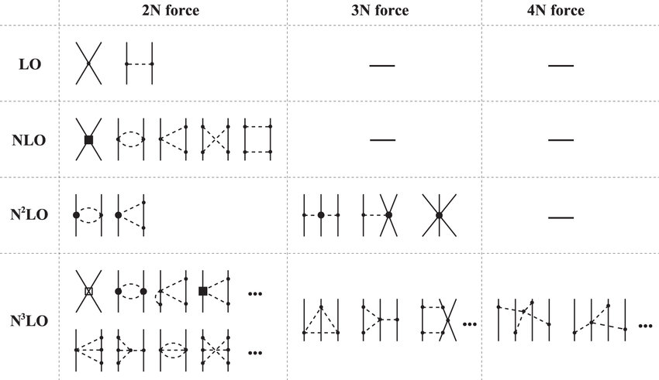
Typical nuclear forces
Nuclear force has strong spin-isospin dependence
→ Reflected by complicated operator structures
Nuclear chiral EFT

Slide 12
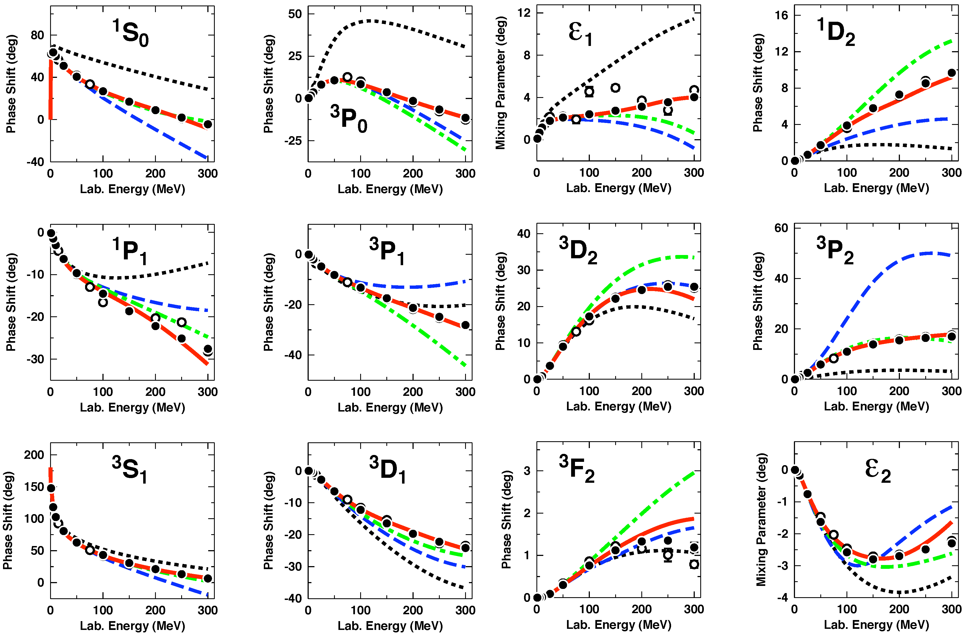
Parametrization of the nuclear force
It is conventional to parametrize
the nuclear force by matching
to the low-energy
nucleon-nucleon scattering data
Spin-1/2 + Spin-1/2 + Orbital
We first couple the spins
1/2 + 1/2 = 0 + 1
Then couple the total spin S=s1+s2
With the angular momentum L
Partial wave channels ^{2S+1}L_{J}
_{S = 0, 1}
L = 0, 1, 2, 3, … (S, P, D, F, …)
J = |L – S|, |L – S| + 1, …, L + S

Slide 13
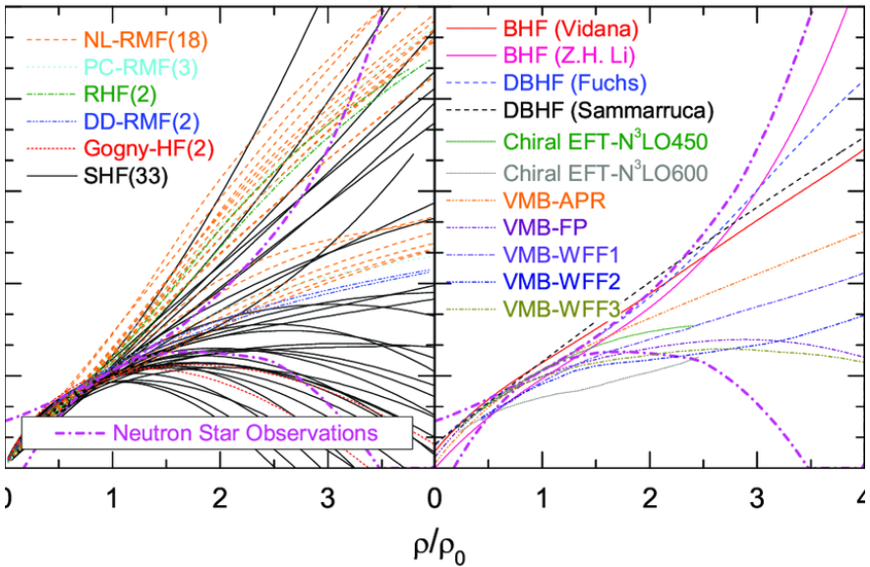
Model dependence of the nuclear forces
High-precision nuclear forces are constrained by the Low-energy
Nucleon-Nucleon scattering data
Quite different predictions for nuclear matter and medium-mass nuclei
Fails to reproduce the binding energies & charge radii globally
Nuclear matter equation of state
Symmetry energy

Slide 14
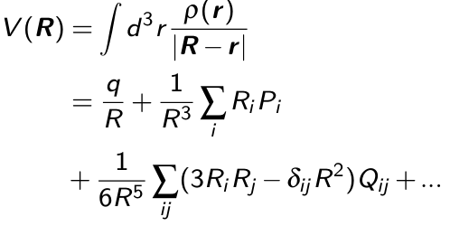
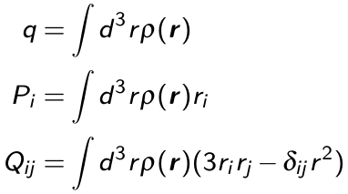
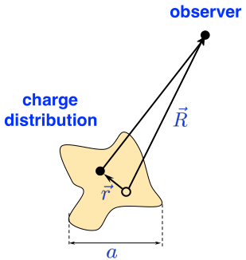
What is the essential degrees of freedom?
Upper: Specific heat of solids. At low temperature, most degrees
of freedom are frozen.
Lower: At long distances, only the total charge q, dipole moment,
quadrupole moment, …, are important.
Insight: Only parametrize relevant d.o.f.
This leads to the concept of EFT

Slide 15
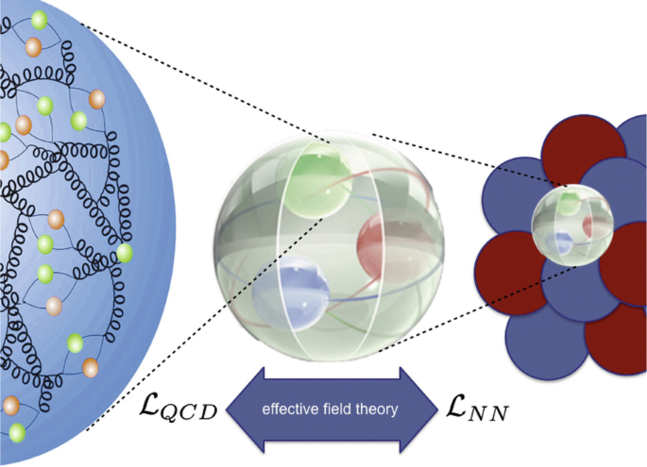
Part II: Chiral Effective Field Theory

Slide 16
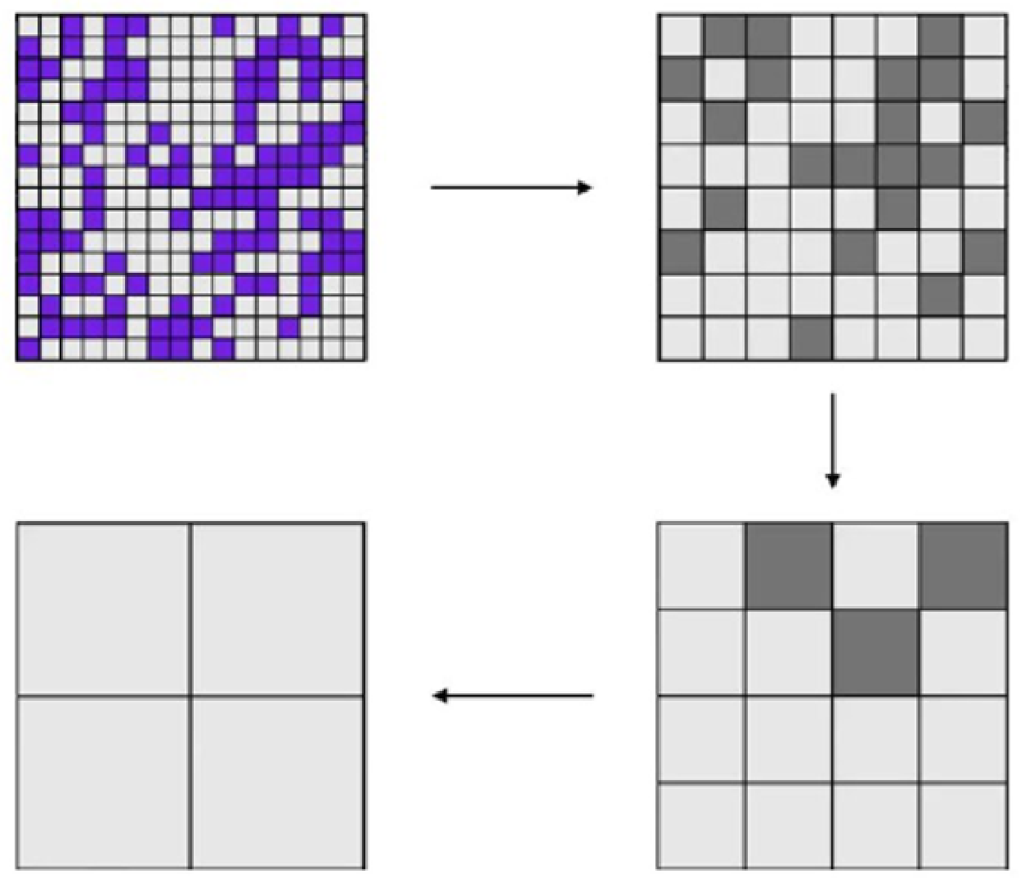
What is a nuclear EFT?
Modern nuclear force constructions are based on the Effective Field Theory
Theoretical foundation of EFT is the Wilsonian renormalization group:
High-momentum details can be integrated out & hidden in LECs
Low-momentum physics kept invariant under ren. group transformations

Slide 17
Art of building an EFT
Integrating out the QCD down to
$Λ≈500$ MeV gives a nuclear force
strictly equivalent to the QCD.
However, this is as difficult as solving
the non-perturbative QCD directly.
Fortunately, we know how this nuclear
force looks like:
It must respect symmetries Inherited
from the QCD (Lorentz, chiral, etc.).
Any term consistent with the symmetries
can appear in the expansion.
Terms with higher mass dimensions
are suppressed (power counting)
Unknown parameters (LECs) can be fixed
by matching to QCD or experiments
Degree of freedom
Essential elements of an EFT
Symmetry
Power counting

Slide 18
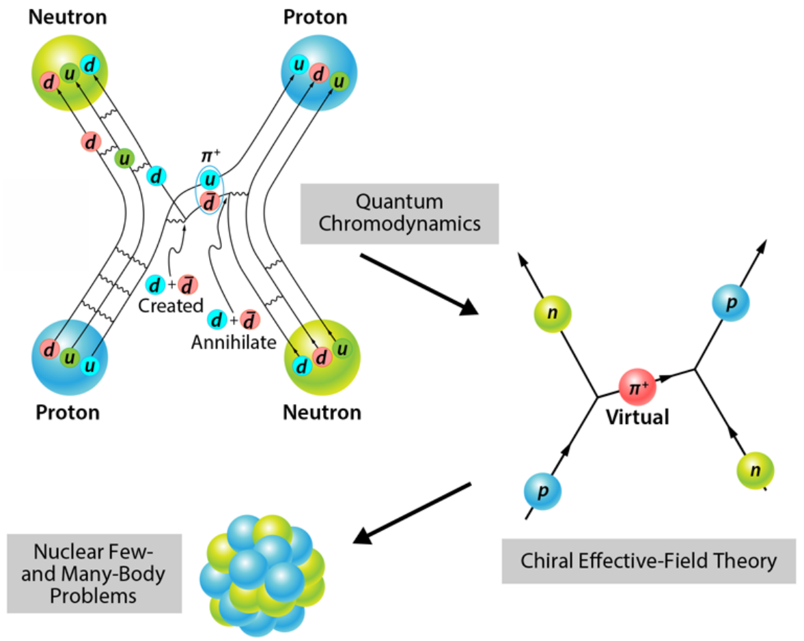
Scales in nuclear physics
Chiral EFT: Perturbative expansion of the N-N and $π$-N
potentials in powers of pion mass $m_{π}$ and nucleon momenta Q
QCD has an approximate chiral symmetry
Explicitly broken by non-zero quark mass ($m_{q}≈3$MeV)
Spontaneously broken SU(2)$×$SU(2)$→$SU(2)
Sp. broken exact symmetry → massless Goldstone boson
Sp. Broken approximate symmetry → very light bosons ($m_{π}≈140$MeV)
→ Long-range part of the nuclear force
In nucleus, Fermi momentum $p_{F}$~200 MeV
→ Short-range part of the nuclear force
Hard scale: $Λ_{χ}$~ 1 GeV: Chiral EFT works for Q $≪Λ_{χ}$

Slide 19
N-N interaction in nuclear chiral EFT
Long-range part: pion-exchange
Feymann diagrams
Short-range part: $δ$ functions
and their derivatives
Both interactions need regularization
Pion-exchange:
Dimensional regularization
Spectral function regulator
Local momentum regulator
Contact terms:
Local regulator
Non-local regulator
Single-particle regulator
All chiral EFTs are defined with certain
cutoffs $Λ,Λ_{π}$ etc. Are they equivalent?

Slide 20
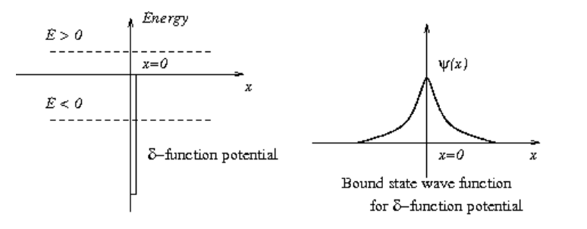
Why need a momentum cutoff?
A particle bound in a 1-d delta potential can be solved without any singularity
The Schrodinger equation (C > 0)
$[−\frac{1}{2M}\frac{d^{2}}{dx^{2}}−Cδ\left(x\right)]ψ\left(x\right)=Eψ\left(x\right)$
Integrate in the interval $x∈\left[−ε, ε\right]$ we get the boundary condition
$$ψ^{′}\left(0^{+}\right)−ψ^{′}\left(0^{−}\right)=−2MCψ\left(0\right)$$
Set $κ=\sqrt{\left(−2ME\right)}$, the wave function is
$$ψ\left(x\right)=\exp\left(−κ\left|x\right|\right)⟹−2κ=−2MC$$
Finally we get the binding energy
$$E=−κ^{2}/\left(2M\right)=−MC^{2}/2$$
N-N interaction is short-range
and has a shallow bound state
(deuteron) with E(²H)=-2.22 MeV
We consider a delta-potential with
strength C that support a shallow
bound state
In 1-d we can adjust C to reproduce
any experimental binding energy

Slide 21
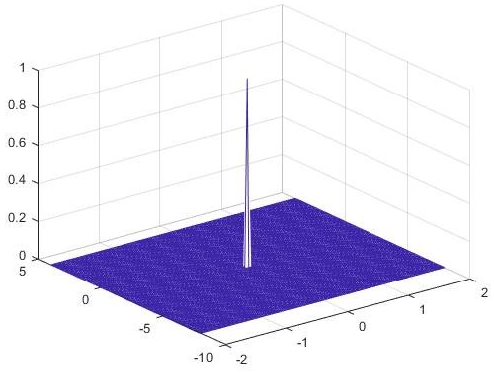
Why need a momentum cutoff?
However, a 3-d delta potential indeed produces singularities
The Schrodinger equation (C > 0)
$[−\frac{1}{2M}∇^{2}−Cδ^{3}\left(r\right)]ψ\left(r\right)=Eψ\left(r\right)$
On a sphere $r=ε$ we apply the Gauss’s law and get
$$4π\frac{∂ψ}{∂r}{\left.​\right|}_{r=ε}=−2MCψ(0)$$
Set $κ=\sqrt{\left(−2ME\right)}$, the wave function is
$$ψ\left(r\right)=\frac{e^{−κr}}{r}⟹\frac{∂ψ}{∂r}=−\frac{κr+1}{r^{2}}e^{−κr}→−\frac{1}{ε^{2}}$$
We instead match the boundary condition on the sphere
$$−\frac{κε+1}{ε^{2}}e^{−κε}=−\frac{MC}{2πε}e^{−κε}⟹κ=\frac{MC}{2π}−\frac{1}{ε}$$
The energy is unbounded from below for $ε→0$:
$$E=−\frac{κ^{2}}{2M}→−∞$$
Conclusion: Bare 3-d delta potential is unphysical
To reproduce a shallow bound state, a non-zero
$ε$ is needed to regulate the potential

Slide 22
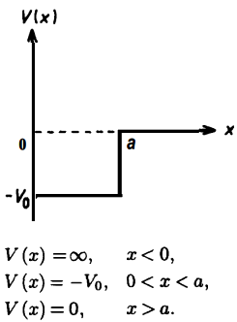
Dimensional analysis
Delta-potential can be seen as a limit of a square well
with width $a$ and depth $V_{0}$
In 1-d, the delta-potential is given by $a →0$, $V_{0}∝1/a$
Suppose the average distance between the particles is ~$a$,
the kinetic energy from uncertainty principle $K\sim 1/a^{2}$
the potential energy $V\sim V_{0}∝1/a$
In the limit $a →0$, $K$ increases faster than $V$, prevent the collapse
In 3-d, the delta-potential is given by $a →0$, $V_{0}∝1/a^{3}$
Suppose the average distance between the particles is ~$a$,
the kinetic energy from uncertainty principle $K\sim 1/a^{2}$
the potential energy $V\sim V_{0}∝1/a^{3}$
In the limit $a →0$, $K$ increases slower than $V$. The potential
energy dominate and the system collapse
Similar to the Oppenheimer limit,
where the gravitational potential energy
overwhelm the degeneracy pressure and
a neutron star collapses to a black hole

Slide 23
Contact term regulators
In momentum space, contact terms
become polynomials of in & out momenta
Incoming momenta: $p_{1},p_{2}$
Outgoing momenta: $p_{1}^{′},p_{2}^{′}$
Galilean invariance: $V$ only depends on
$p=\left(p_{1}−p_{2}\right)/2$, $p^{′}=\left(p_{1}^{′}−p_{2}^{′}\right)/2$
Equivalently, $V$ can also be expressed using $q=p^{′}−p,k=\left(p^{′}+p\right)/2$
Local regulator:
$V\left(p^{′},p\right)→V\left(p^{′},p\right)f_{Λ}\left(q\right)$
Non-local regulator:
$V\left(p^{′},p\right)→V\left(p^{′},p\right)f_{Λ}\left(p^{′}\right)f_{Λ}(p)$
Single-particle regulator:
$$V\left(p^{′},p\right)→V\left(p^{′},p\right)f_{Λ}\left(p_{1}^{′}\right)f_{Λ}\left(p_{1}\right)f_{Λ}\left(p_{2}^{′}\right)f_{Λ}\left(p_{2}\right)$$
$$f_{Λ}\left(p\right)=\exp\left[−{\left(p/Λ\right)}^{2n}\right]$$
Contact terms originate from heavy-meson exchanges
Mesons with mass $m_{H}≫Λ$ can be absorbed in $δ$-functions
Choose an appropriate $Λ$ satisfying $Q≪Λ≪m_{H}$
$Λ$ is an arbitrarily introduced parameter corresponding to no physical reality.

Slide 24
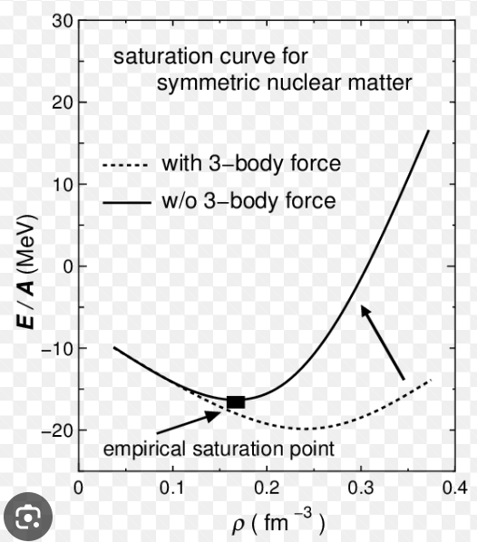
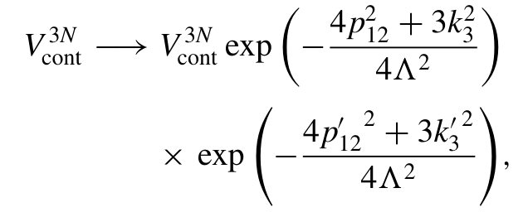
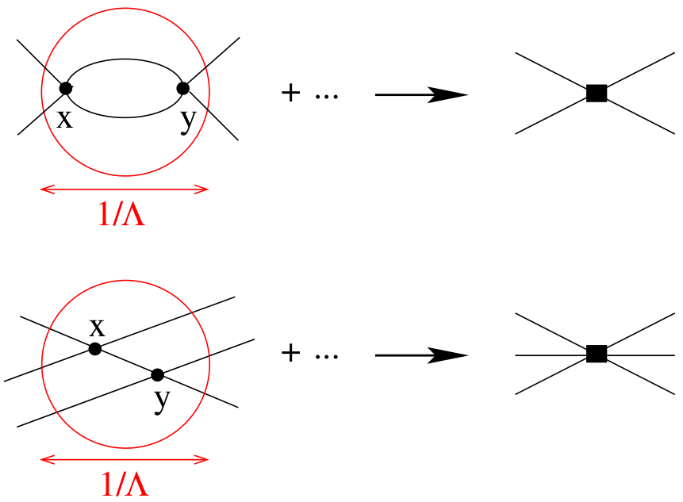
Three-body forces
3NF also need regularization, e.g.
where $p_{12},p_{12}^{′}$ and $p_{3}^{′}$ are relative
Jacobi momenta
Other regulators & $Λ$ are possible
Reasons for introducing the three-body forces:
Empirically, three-body forces are unavoidable in reproducing
triton binding energies & nuclear matter saturation point
Theoretically, in effective field theory three-body forces naturally
emerge when integrating out high-momentum modes
Empirically, four-body and higher-body forces are negligible
(could be understood via EFT power counting)

Slide 25
Mysterious three-body force
Thomas collapse:
A system constituted of three bosons interacting
via two-body separable potentials with fixed
two-boson binding is known to lead to bound-state
collapse in the case where the potential
parameters allow two-boson S-matrix poles close
to (resonance) and on (continuum bound state)
the real momentum axis.
Efimov physics:
Three identical bosons interact, with the prediction
of an infinite series of excited three-body energy
levels when a two-body state is exactly at the
dissociation threshold.
Borromean state:
In physics, a quantum-mechanical analog of
Borromean rings is called a halo state or an
Efimov state, and consists of three bound particles
that are not pairwise bound. The existence of such
states was predicted by physicist Vitaly Efimov,
in 1970, and confirmed by multiple experiments
beginning in 2006.

Slide 26
Symmetries of realistic nuclear forces
A N-N two-body interaction can be uniquely fixed by its matrix elements in a complete basis
In momentum basis $\left|p_{1}s_{1}t_{1}p_{2}s_{2}t_{2}\right\rangle$ with $s_{1},s_{2}=±1/2$ the spins, $t_{1},t_{2}=±1/2$ the isospins,
we have the two-by-two matrix elements
These matrix elements are strictly constrained by symmetries
Hermicity
Exchange symmetry
Translational invariance
Galilean invariance
Parity
Time reversal
Spatial rotation
Isospin symmetry
The QCD respects
Discrete symmetries of PCT (exact)
Symmetries of Poincaré group (exact)
Spatial translation
Temporal translation → Energy conservation
Spatial rotation
Boosts → Galilean invariance
Isospin symmetry (approx.)
Spirit of EFT: Use symmetries to write down the most general interactions

Slide 27
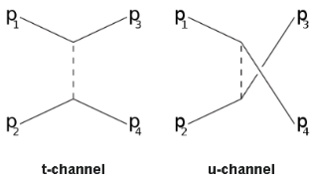
General form of the N-N interaction
For a general N-N interaction
Translational invariance implies total momentum conservation
Galilean invariance means the matrix element only depend on differences of the momenta
Only two of the four momenta p₁, p₂, p’₁, p’₂ are independent
we can choose them as $p=\left(p_{1}−p_{2}\right)/2,p^{′}=\left(p_{1}^{′}−p_{2}^{′}\right)/2$
or their linear combinations $q=p^{′}−p,k=\left(p^{′}+p\right)/2$
Note that q and k are momentum transfers in t- and u-channels
Theorem: Any 4 ×4 Hermite matrix can be written as a linear combination
of 16 matrices with real coefficients ($σ_{i,j}$ are Pauli matrices)
Proof: The trace of the product of any two basis is zero, while the trace
of the square of any basis is 4. Thus these 16 matrices are linearly
independent and span the space of 4 ×4 Hermite matrix.
The most general matrix elements are

Slide 28
General form of the N-N interaction
Drop the delta function and consider the isospin symmetry, the matrix elements become
The functions V and V_{T} are both rotational invariant → Couple vectors to scalars
This expression can not be further simplified without knowing the details of the interaction.
However, we can still apply the discrete symmetries to V and V_{T}
Parity: Under spatial reflection all momenta are reversed,
Time reversal: Both momenta and spins are reversed,
In deriving the T-transformation, we note that the T-transformation also exchanges
initial and final states
Particle exchange symmetry: Interchanging indices 1 and 2,
Together with the Parity we have
Hermicity: Hermite conjugate exchanges the initial and final state,
where the complex conjugate only applies to the coefficients (not to Pauli matrices)

Slide 29
General form of the N-N interaction
In terms of the momentum transfers q and k, the discrete symmetries give:
Symmetry | With p and p’ | With q and k
Parity
Time reversal
Particle exchange
Hermicity
Note that these conditions are satisfied for all N-N interactions, e.g., the one-pion-exchange-potential:
or spin-orbit coupling potential:

Slide 30
Contact terms
For contact terms we expand the potential V or V_{T} against q and k, then count the number of momenta
At Q⁰ order there is no momentum insertion, we have 2 independent operators
At Q² order there are 7 independent operators
At Q⁴ we have 15 independent operators
We can easily check that all these terms satisfies the symmetry constraints
V and V_{T} both contain such terms, thus we have 4 at Q⁰ and 14 at Q²
Symmetry | With p and p’ | With q and k
Parity
Time reversal
Particle exchange
Hermicity

Slide 31
Fermi-Dirac statistics
Nucleons are Fermions that gain a minus sign when two particles are exchanged in initial/final state
Define a particle exchange operator $P_{12}$ that
It is easy to verify that
with $P_{12}^{r}$ exchange the coordinates, which means $p →−p$
For any operator $V$, $V$ and $−VP_{12}$ have the same matrix elements in the subspace spanned by
anti-symmetrized wave functions (Note that $VP_{12}$ is Hermitian as $V$ commutes with $P_{12}$)
For example, $1$ and $−\left(1+σ_{1}⋅σ_{2}\right)\left(1+τ_{1}⋅τ_{2}\right)/4$ are exactly the same for Fermions,
$σ_{1}⋅σ_{2}$ and $−\left(σ_{1}⋅σ_{2}\right)\left(1+σ_{1}⋅σ_{2}\right)\left(1+τ_{1}⋅τ_{2}\right)/4=\left(σ_{1}⋅σ_{2}−3\right)\left(1+τ_{1}⋅τ_{2}\right)/4$ are exactly the same for Fermions
Thus among the four operators
Only two of them are linearly independent in the Fermionic subspace
For higher order operators, we also need the transformations
$q=p^{′}−p→p^{′}+p=2k$, $k=\left(p^{′}+p\right)/2→\left(p^{′}−p\right)/2=q/2$
E.g., the operator $k^{2}$ can be expressed as a linear combination of

Slide 32
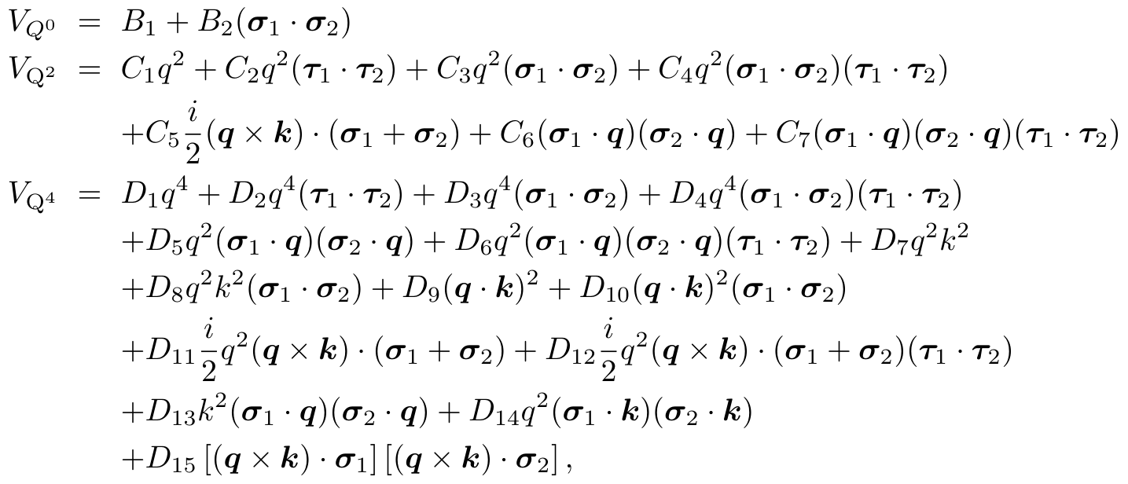
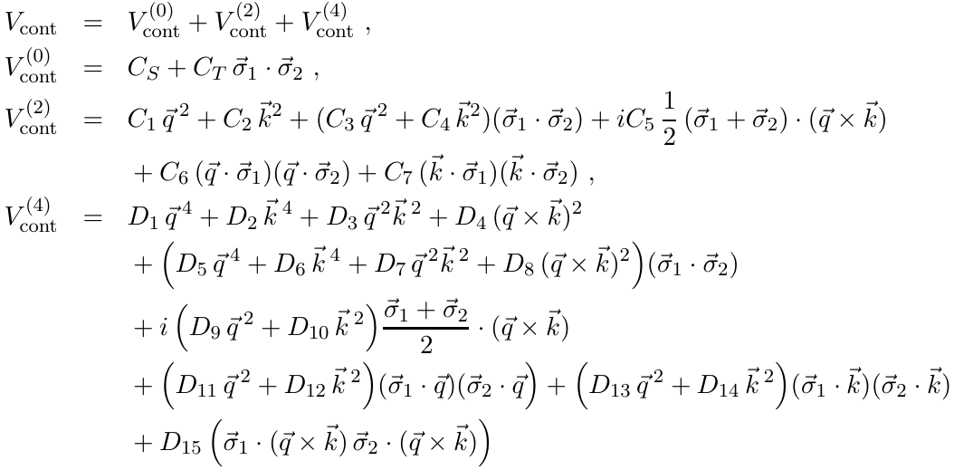
Choice of basis for contact terms
Due to the Fermi-Dirac statistics, the contact terms can be expressed using many different basis.
Most commonly used are two choices:
Local or semi-local basis, where most dependence on k are eliminated, replaced by isospin
dependent terms with $τ_{1}⋅τ_{2}$, convenient for Monte Carlo simulations
Isospin scalar basis, where all dependence on $τ_{1}⋅τ_{2}$ are eliminated
Both basis are equivalent and can be connected by a linear transformation. The detailed form and
Transformations can be found in literatures.
Local basis
Isospin scalar basis

Slide 33
Chiral EFT: Summary
Most important pieces of the nuclear chiral EFT:
Degrees of freedom (nucleons, pions)
Symmetries (Lorentz, chiral, discrete, …)
Power counting (expansion over momenta)
Further necessities:
Momentum regulators
Three-body forces
To be established:
Renormalization group invariance
Integrating the QCD down to ~500 MeV gives an EFT
of nucleons and pions.
This EFT exists but is unknown to us. However, we can write
down the most general form by considering the symmetries
The power counting scheme identify the most important pieces.
The remaining undetermined Low-Energy-Constants
can be fixed by matching to the experiments

Slide 34
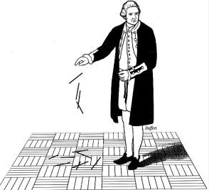
Part III: Quantum Monte Carlo methods

Slide 35
Introduction to Monte Carlo techniques
Consider approximating a one-dimensional integral by a simple Riemann sum
The x_{i}’s are at regularly spaced intervals.
Generalization to d dimensions is more challenging. If we keep the same number of grid points, N, then only N^{1/d} points per dimension and relative error can be quite large.
35

Slide 36
Suppose instead we choose the points at random positions in the d-dimensional space. Then relative error is purely statistical and can be as small as N ^{-1/2}
Example: Volume of 3D sphere using random darts
36

Slide 37
Select N uniformly distributed random points inside the cube. Determine the fraction of points inside the sphere. This gives an estimate for the ratio of the sphere volume to cube volume.
37

Slide 38
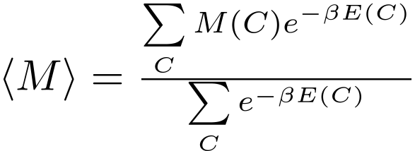
When calculating thermal averages in statistical mechanics or path integrals in Euclidean-time field theory, one computes sums or integrals over many degrees of freedom weighted by an exponential Boltzmann factor
Due to the exponential weight, nearly all of the configurations make only a very small contribution. So a simple dartboard random sampling is very inefficient.
Importance sampling
A more efficient method to calculate the average is to select configurations with probability equal to
38

Slide 39
This technique is called importance sampling. The thermal average is simply an average over representative configurations selected with this sampling probability.
The next step is to devise a way to select configurations with this sampling probability.
39

Slide 40
Markov process
We outline the ingredients of a Markov process. Consider a chain of configurations labeled by order of selection. We call this integer-valued label the computation step, τ.
Let us denote the probability of selecting configuration A at computation step τ as
Suppose we have selected configuration A at computation step τ. The probability that we select configuration B at computation step τ + 1 is denoted
40

Slide 41
This transition probability is independent of τ and independent of the history of configurations selected prior to selecting A at computation step τ. This defines a Markov process.
We note that
If the Markov process is ergodic, then after many computation steps, an equilibrium probability distribution is reached
41

Slide 42
Detailed balance
We want the equilibrium probability distribution to be
One way to do this is to require
for every pair of configurations A and B. This condition is called detailed balance.
After many computation steps we reach the equilibrium distribution, which satisfies
42

Slide 43
Comparing with the detailed balance condition, we conclude that
for all configurations A.
Metropolis algorithm
One popular method for generating the desired detailed balance condition is the Metropolis algorithm
Metropolis, Teller, Rosenbluth, J. Chem. Phys. 21 (1953) 1087
{
43
43

Slide 44
Worldline methods
One strategy for calculating the Euclidean-time path integral is to view the exponential of the free-particle Hamiltonian as a diffusion process
The particles trace out worldlines in space as a function of Euclidean time.
44

Slide 45
Interactions modify the worldline contributions to the path integral
45

Slide 46
Interchange of two identical fermions produces a minus sign in the path integral
46

Slide 47
This results in the fermion sign problem. The final result for the path integral is very small due to sign cancellations. The level of cancellations is given by
This can be extremely severe. Analogous to calculating the number 1 by evaluating each term in the binomial expansion
Usually some additional constraint such as the fixed-node approximation or constraint on worldlines is needed.
47

Slide 48
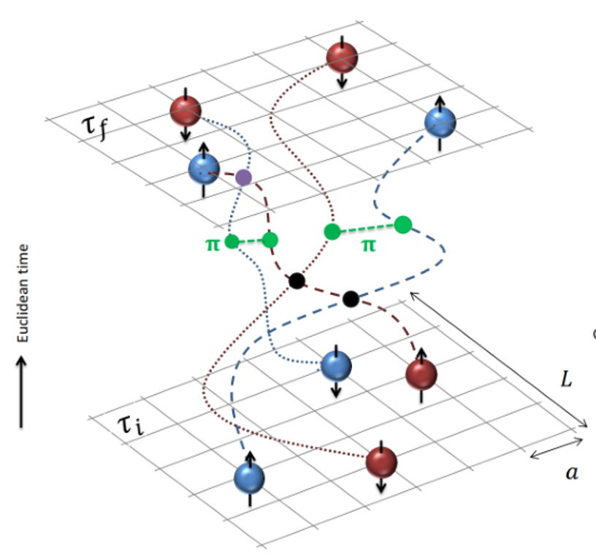
Auxiliary field methods
We can write exponentials of the interaction using a Gaussian integral identity
We remove the interaction between nucleons and replace it with the interactions of each nucleon with a background field.
48

Slide 49
Projection Monte Carlo with auxiliary fields
For simplicity we discuss the structure of the LO₁ and LO₂ calculations
For A nucleons, the matrix is A by A. If there is no pion coupling and the quantum state has total isospin equal to zero then
49

Slide 50
This shows the determinant is real. Actually we can show that the determinant is positive semi-definite. Consider an eigenvector
Let us define a new vector
Note that
Note also that the two vectors are orthogonal
So the complex eigenvalues come in conjugate pairs, and the real spectrum is doubly-degenerate.
50

Slide 51
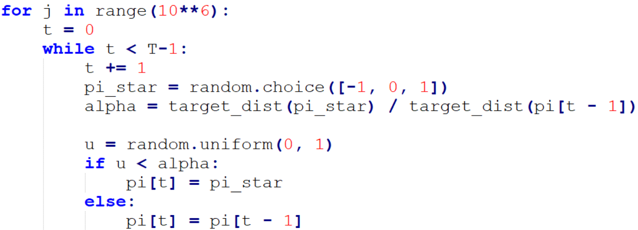

Slide 52
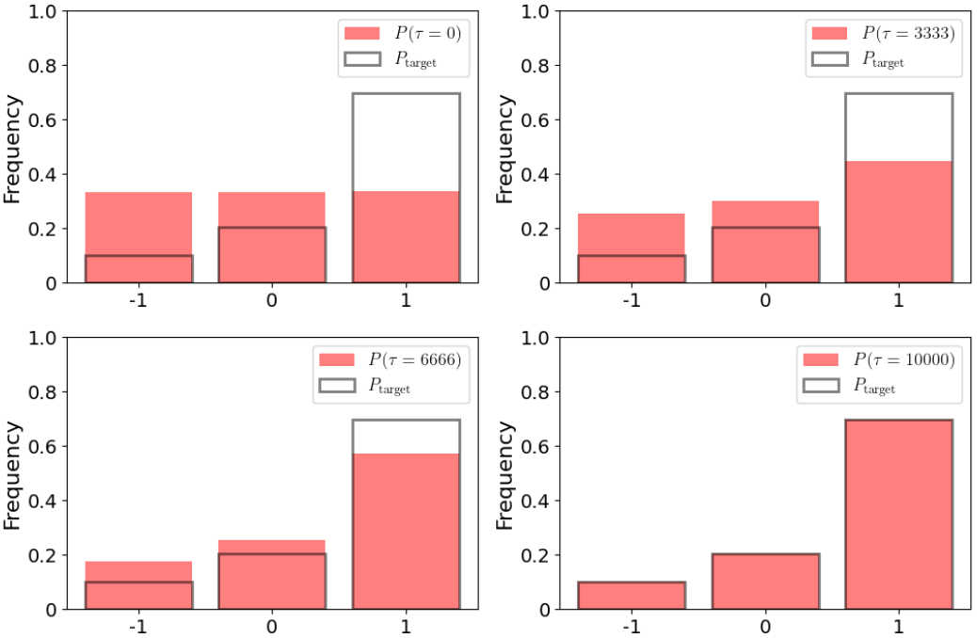

Slide 53
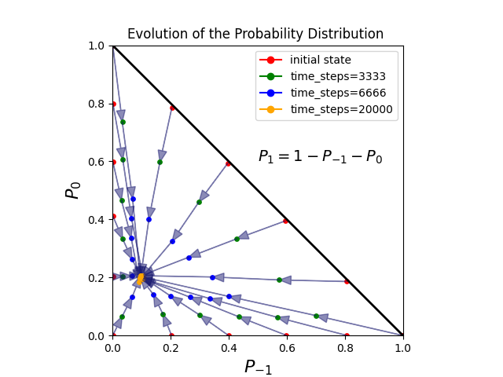

Slide 54
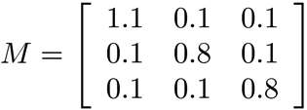
Homework problem
Let
Construct a Markov process with the Metropolis algorithm to compute
by sampling over all terms in the matrix product
If you can, write a computer code to do this Monte Carlo calculation and compare with the exact result.
54

Slide 55
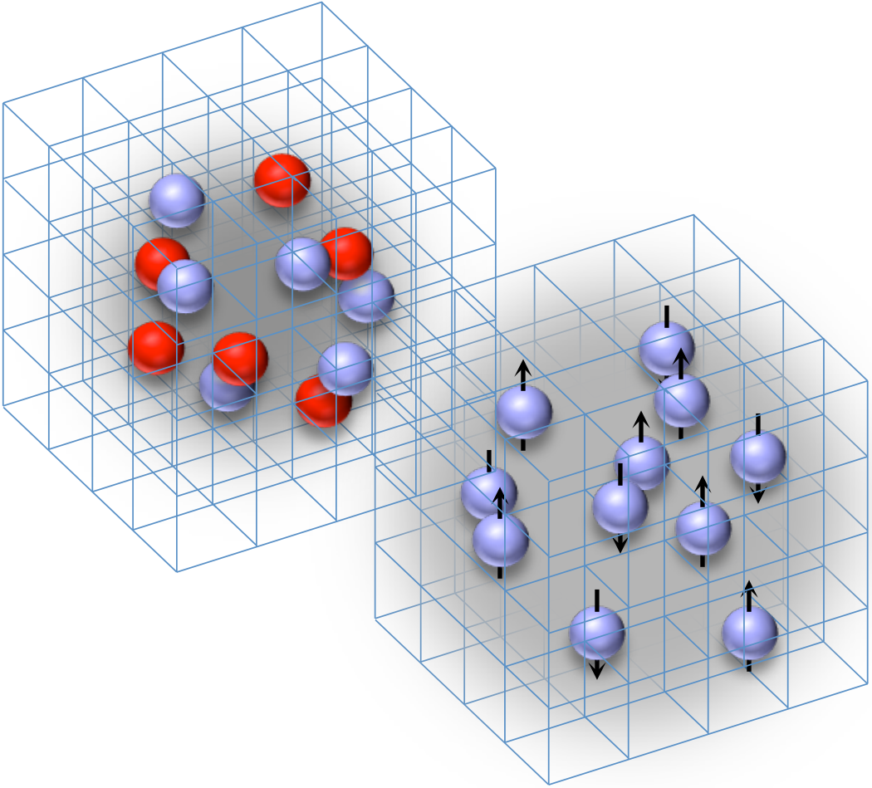
Part IV: Modern applications of QMC methods

Slide 56
Why need ab initio methods

Slide 57
维度诅咒：量子多体问题的本质困难
单粒子Hilbert空间维度：L
两粒子Hilbert空间维度：L^2
…
16粒子Hilbert空间维度：L^16

Slide 58
蒙特卡洛方法
引入随机数来辅助量子多体计算
多参数优化问题
高维积分问题
量子蒙特卡洛（QMC）应用与凝聚态、核物理、原子分子物理等
QMC算法核心为用蒙特卡洛方法计算积分
产生概率分布为p(x)的样本集，则被估计积分为f(x)/p(x)在样本集上的期望
若p(x)形式简单（如高斯分布、均匀分布等），可直接生成
若p(x)形式复杂，可用Metropolis算法等

Slide 59
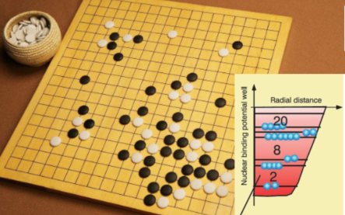
Lattice EFT: A many-body EFT solver
非微扰量子多体问题是计算物理
的核心挑战
核物理：2~300粒子系统，可能
找到严格解！
算法+硬件：新世纪的新机遇
能理解才能计算->
能计算才能理解

Slide 60
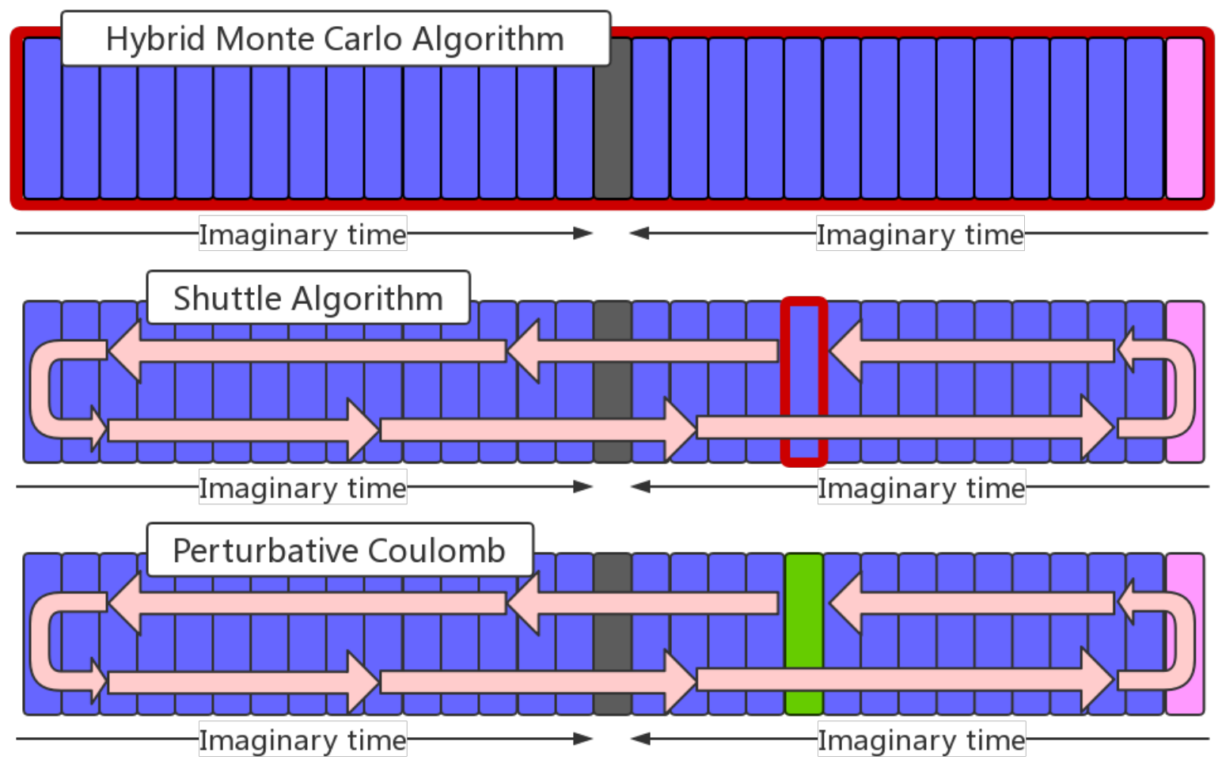
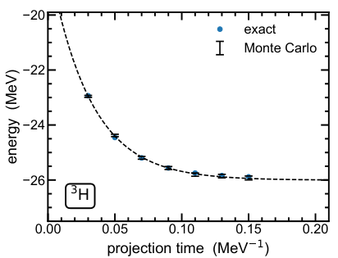
Lattice EFT: A many-body EFT solver

Slide 61
Alpha clustering in nucleus
两中子+两质子构成的alpha-结团，看起来
似乎在很多过程中充当基本单元
例：Hoyle state是C12中第二个0+态，其位
置决定了宇宙中碳丰度。迹象表明其为alpha
结团态。
若基本相互作用强度微调，是否还有足够多
碳元素支持生命出现？
换言之，碳基生命的出现是巧合，还是必然？
第一性原理计算帮助回答这些重要问题
PRL 119, 222505 (2017): 碳同位素中alpha
集团结构的层析

Slide 62
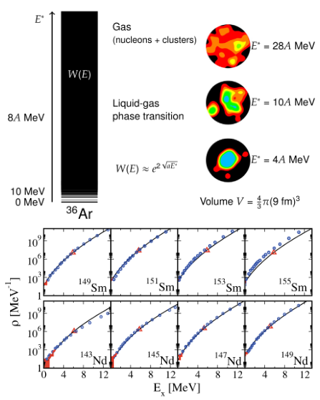
Nuclear thermodynamics

Slide 63
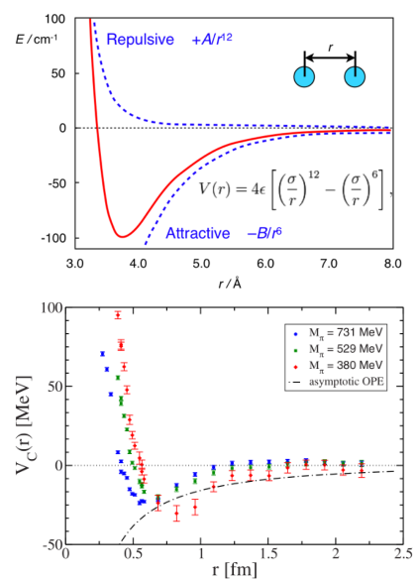
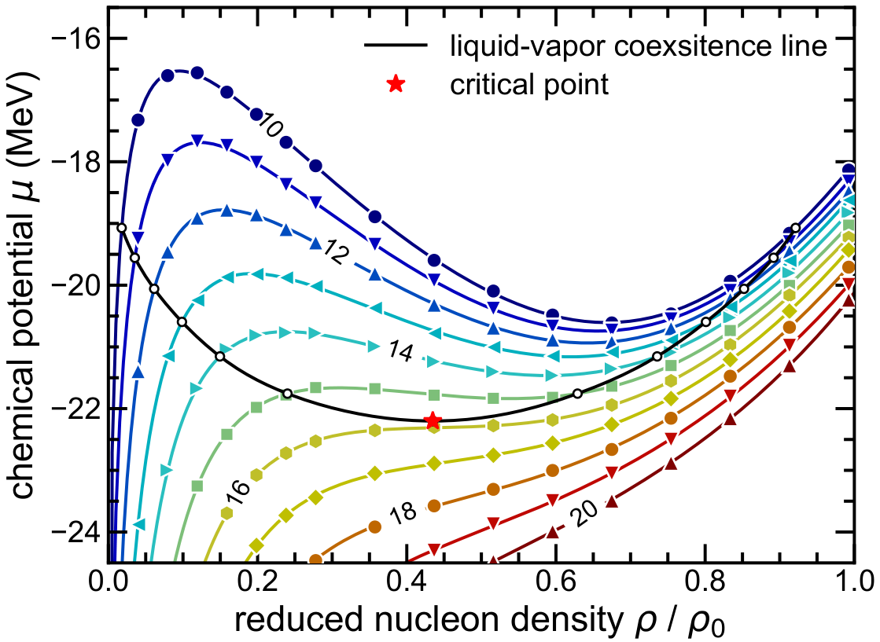
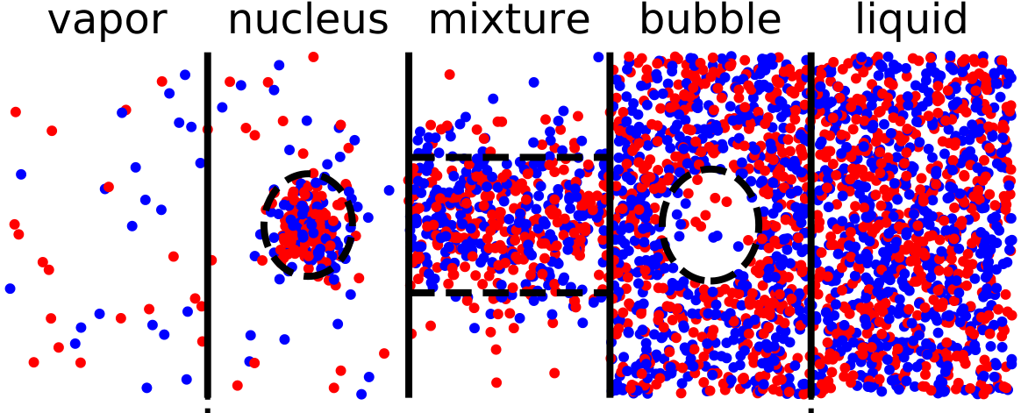
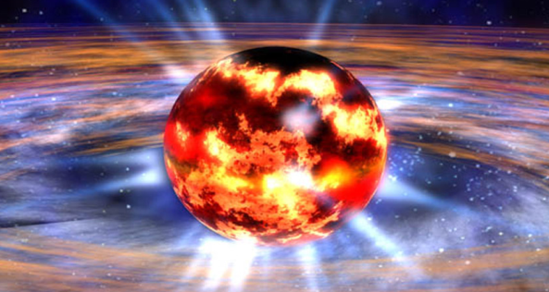
Nuclear thermodynamics
核力与范德尔瓦斯力相似：
短程排斥+长程吸引
水的液气相变->核物质的液气相变
与中子星冷却过程相关
PRL 125, 192502 (2020): 核物质液气相变
的第一性原理计算
传统算法基于巨正则系综
我们的新算法基于正则系综
->10~1000倍加速，使计算可行
探索新的自由度：温度

Slide 64
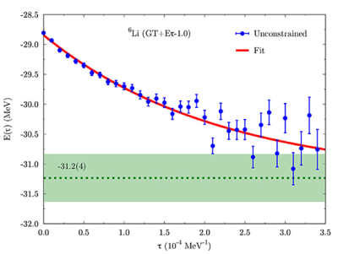
量子蒙特卡洛符号问题
符号问题：计算高度震荡函数的积分时，蒙卡方法失效
起因：费米子交换反对称性
解决方案：
采用有特殊对称性的哈密顿量
参数解析延拓、微扰法
改变积分流形 (thimble method)
复郎之万方程
对辅助场MC，若存在时间反演算符T，T^2=-1，
且初始态在T下不变，辅助场变换后的H在T下不变，
则可避免符号问题
对一般H的计算，可用微扰法

Slide 65
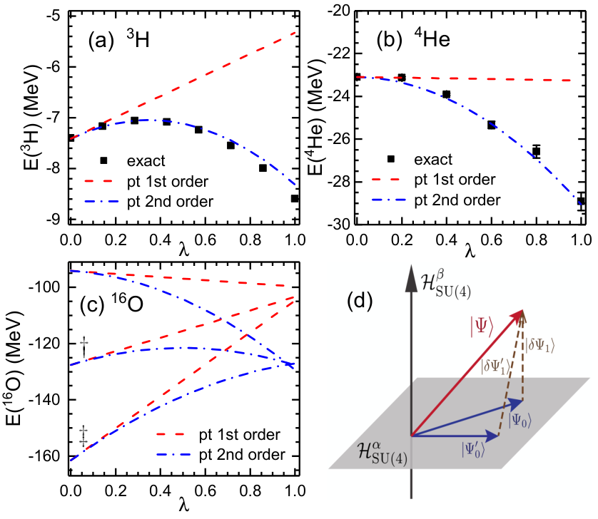
Perturbative quantum Monte Carlo
量子蒙卡计算可用来求解基态，
解激发态非常昂贵
传统微扰论中，二阶微扰需要
激发态信息，无法用在蒙卡计算中
PRL 128, 242501 (2022) 提出一种新的
微扰算法，在原子核基态能量计算中
精确计算了二阶微扰，结果与实验
符合的很好
与之前的预期不同，二阶微扰相当大。
仅保留一阶微扰的计算需要慎重考虑！
高阶微扰得到更精确的结果，使得某
些长期的困难问题，如EFT的重整化，
有望得到解答

Slide 66
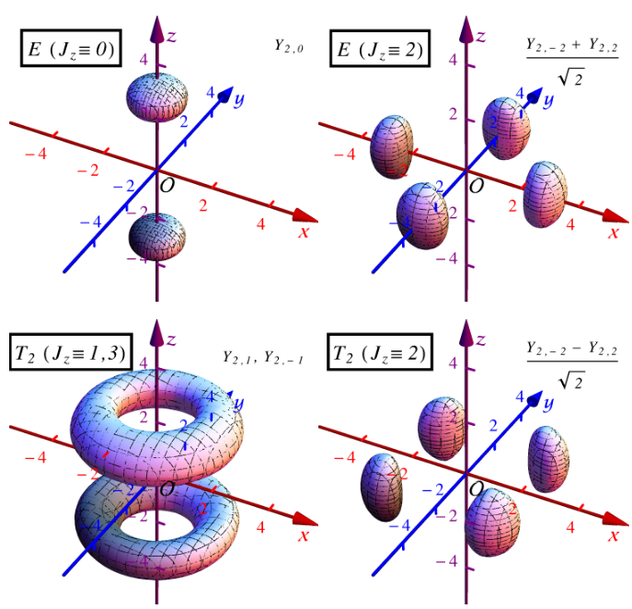
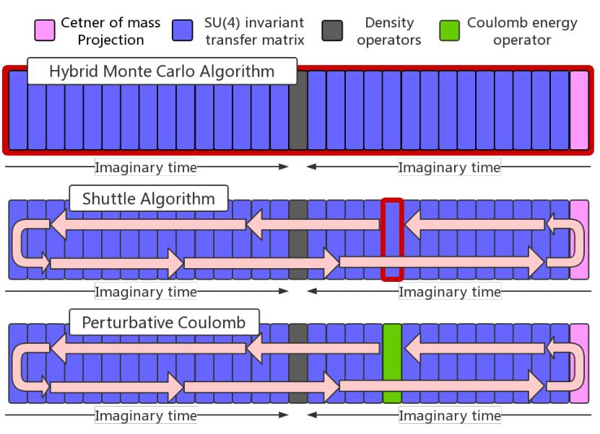
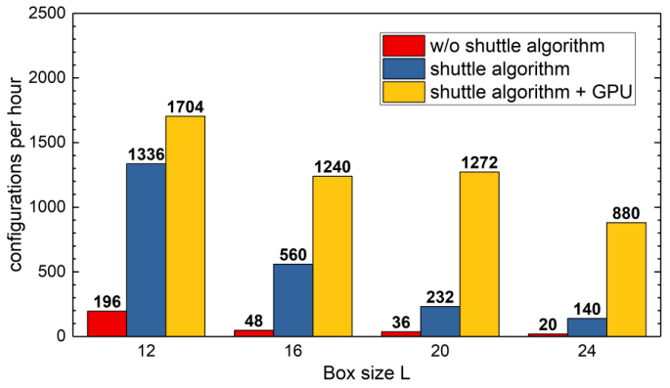
EFT on the lattice and novel algorithms
格点相当于动量截断正规化
破坏的转动对称性、伽利略
不变性等必须恢复
PLB 760, 309 (2016):
转动对称性的恢复
EPJA 53, 83 (2017):
Next^2 to leading order
PRC 98, 044002 (2018):
Next^3 to leading order
新算法(Shuttle Algorithm)对
格点计算有5-10倍加速
联合GPU，对较大规模计算有
40-50倍加速
PLB 797, 134863 (2019)

Slide 67
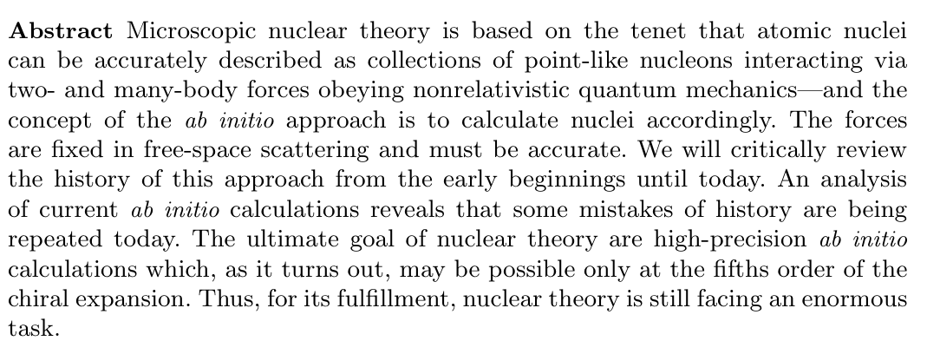
Objective of microscopic nuclear theory
Few-Body Systems 64, 77 (2023), arXiv:2307.06416

Slide 68
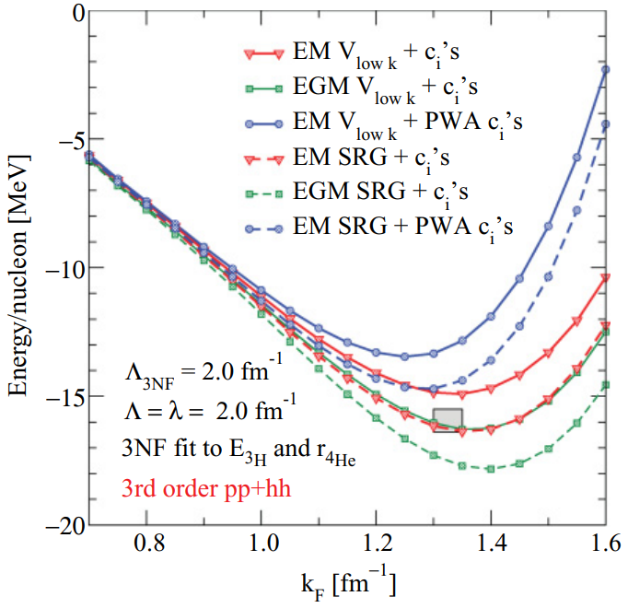
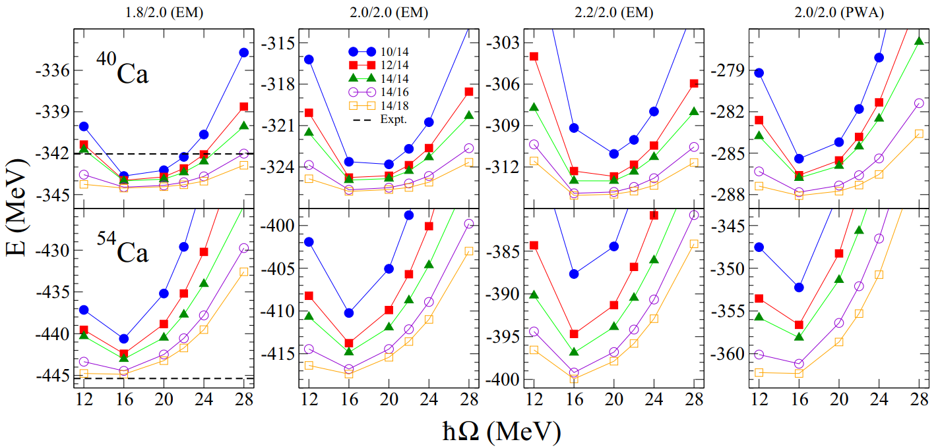
RG-(in)variance of the chiral forces
Similarity Renormalization Group (SRG) method can be used
to generate phase-shift-equivalent nuclear forces
Starting from a bare chiral force, new interactions can be
obtained by applying unitary transformations $U_{λ}$ or $U_{Λ}$
$λ$ and $Λ$ are effective cutoffs that can be varied continuously
While 2N and 3N physics are mostly independent of $λ/Λ$,
heavy nuclei & nuclear matter apparently depend on $λ/Λ$
K. Hebeler et al., Phys. Rev. C 83, 031301 (2011)
Renormalization group invariance of the chiral EFT is a
consequence of its construction.
However, this has never been proved and severely
violated in numerical calculations.
J. Simonis et al., Phys. Rev. C 96, 014303 (2017)

Slide 69
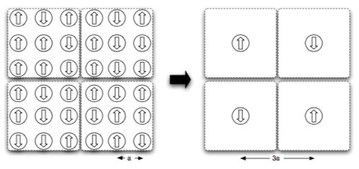
Kadanoff’s blocking & Wilson’s RG
Kadanoff’s solution to the Ising model: Substitute spin blocks by single spins.
The free energy $F=F\left(J,T,a\right)=F\left(J^{′},T^{′},3a\right)=F\left(J^{′′},T^{′′},9a\right)$
Change of the resolution scale $a$ amounts to a change of the coupling constants
Wilsonian RG: a continuous version of the blocking procedure
In momentum space, the details within $Λ^{′}<p<Λ$ are integrated out
The partition function $Z\left(c,Λ\right)=Z\left(c^{′},Λ^{′}\right)$ implies a implicit function $c=c\left(Λ\right)⟹$running coupling constants
The coupling constants $c$ can be multi-dimensional. In the space of all possible couplings, $c\left(Λ\right)$ generates the
Wilsonian RG flow. At low momentum limit $Λ→0$ the flows converge to a low-dimensional invariant surface

Slide 70
重整化群
有效场论在动量标度Lambda以下成立
降低Lambda时，高于Lambda的高能标物理被积分掉，被吸收到低能常数中，保证低于Lambda的物理不变
在Lambda变化时，得到一系列跑动耦合常数。这跑动用Wilsonian重整化群方程描述
系统的低能行为完全由重整化群流决定（不动点分析）

Slide 71
Ren. Group vs. Similarity Ren. Group
To answer the question on the self-consistency, we begin by building an inherently RG-invariant ($Λ$-independent) EFT
We may use Wilsonian RG approach. However, integrating out the high-momentum modes result in time-dependent interactions that are difficult to handle in Hamiltonian formalism
A more suitable choice is the Similarity Renormalization Group (SRG) method which involves unitary transformations of the Hamiltonian
Wisonian RG: Integrating out a momentum shell
$Z=\int{Dφ\exp\left[−S_{0}\left(φ\right)\right]=\int{\prod_{p<Λ}{dφ_{<}\prod_{Λ<p<Λ_{0}}{dφ_{>}exp⁡[−S_{0}(φ_{<}+φ_{>})]}}}}=\int{\prod_{p<Λ}{dφ_{<}exp⁡[−S_{eff}\left(φ_{<}\right)]}}$
Similarity RG: Decoupling the low- and high-momentum subspaces via unitary transformations
In Wilsonian RG the high-momentum modes are integrated into running coupling constants
Question: how to apply the SRG to generate the Wilsonian flow for a non-rel. Hamiltonian?
Lu & Deng, arXiv:2308.14559

Slide 72
An EFT of Spinless Bosons
To illustrate the idea, we start with an EFT of spinless bosons:
where $Φ\left(Φ^{+}\right)$ is the annilation (creation) operator, $m,C_{2,3}$ are particle mass and coupling constants, respectively. The colons denote the normal ordering.
The ellipsis stand for higher-body forces and interactions containing spatial derivatives
All terms allowed by the symmetries are included
The interactions only act on particles with momentum lower than $Λ$,
The operator $Φ_{Λ}^{+}$ creates a particle with a finite extension $\sim Λ^{−1}$
This regulator is imposed on single particle momenta, not on relative momenta, thus breaks the Galilean invariance

Slide 73
Decomposition of the Fock space
In the Fock space spanned by the momentum eigenstates , we can partition the Hamiltonian
We define space-0 as consisting all states with all $\left|p_{i}\right|≤Λ$,
Its complement space-1 containing all states with at least one $\left|p_{i}\right|>Λ$
$H$ does not couple space-0 and space-1, we can safely drop space-1
For a slightly lower $Λ^{′}$, we make a similar decomposition:
We define space-0’ as consisting all states with all $\left|p_{i}\right|≤Λ^{′}$,
Its complement space-1’ containing all states with at least one $Λ^{′}<\left|p_{i}\right|≤Λ$
Now the Fock space is decomposed into four pieces, $H$ has non-zero
matrix elements in all regions

Slide 74
Expansion of the Hamiltonian
By splitting the single-particle creation (annilation) operators, we can expand $H=H_{0}+H_{1}$
H0 is composed of all diagonal terms defined as containing no δΦ† and δΦ or containing both δΦ† and δΦ (non-zero in H00 and H11)
H1 consists of all residual terms containing δΦ or δΦ† but not both of them
(non-zero in H01, H10 and H11)

Slide 75
Decoupling the low- and high-momenta
We search for a unitary transformation that decouples the two subspaces space-0’ and space-1’
This can be achieved by applying a SRG transformation
For sufficiently large t, the non-diagonal blocks contained in H1 are suppressed → H1 vanishes
Remember that H0 is block-diagonal in the Fock space, we can safely drop all terms containing $δΦ$
Now we have a transformed Hamiltonian, $Λ→Λ^{′}$ and all coupling constants
updated to new values
As we used unitary transformations, new Hamiltonian has the same spectrum

Slide 76
Nuclear scattering and reaction
The transformation is unitary and localized:
with $φ_{1,2}$ single- or many-particle wave packets separated by a distance $≫Λ^{−1}$
For a typical reaction, the incoming (outgoing) state long before (after) the collision consists of
well seperated clusters, each of which corresponds to a bound state of the Hamiltonian.
Applying the transformation U to both the Hamiltonian and the incoming (outgoing) state, we transform H to H′ and the cluster wave functions from eigenvectors of H to that of H′ with the same binding energies
the unitarity of U ensures the invariance of the S-matrix element
All low-momentum physics are invariant under $Λ→Λ^{′}$ and calculating
with new coupling constants (Renormalization Group Invariance)

Slide 77
Numerical demonstration: realistic chiral force
We take a simplified nuclear chiral force to demonstrate the results,
$H_{N2LO}=K+V_{2N}+V_{3N}+V_{C}+V_{OPEP}$
2N and 3N contact terms are
We use single-particle regulators
$f_{2N}=\prod_{i=1}^{2}{g_{Λ}\left(p_{i}\right)g_{Λ}\left(p_{i}^{′}\right)}$, $f_{3N}=\prod_{i=3}{g_{Λ}\left(p_{i}\right)g_{Λ}\left(p_{i}^{′}\right)}$, $g_{Λ}\left(p\right)=$ $\exp\left(−p^{6} / 2Λ^{6}\right)$
Long-range Coulomb force $V_{C}$ and one-pion-exchange-potential $V_{OPEP}$ do not depend on $Λ$
We solve the many-body problem using Lattice EFT techniques

Slide 78
Determination of the LECs
For each value of $Λ$, We determine the coupling constants (LECs) by fitting to the N-N scattering phase shifts up
to 200 MeV and ³H binding energy E3=-8.482 MeV
We extrapolate to infinite box size to eliminate the finite volume effects
All LECs are completely fixed in A<=3 systems

Slide 79
Predictions of the RG-invariant EFT
The coupling constants are
combined with $Λ$ to form
dimensionless parameters,
${\overline{B}}_{i}=mΛB_{i}$, ${\overline{C}}_{i}=mΛ^{3}C_{i}$,
${\overline{C}}_{3N}=mΛ^{4}C_{3N}$
${\overline{B}}_{1}$, ${\overline{C}}_{3N}$ and others are
marginal/relevant/irrelevant
A single 3NF fitted to ³H
binding energy cancels most
of the $Λ$-dependence in ⁴He
and ¹⁶O binding energies
The remaining $Λ$-dependence
comes from the regulator
artifacts and Galilean invariance
breaking effects

Slide 80
Higher order terms are irrelevant
We add 15 more contact terms at N³LO and refit the
N-N phase shifts with higher precision
With N³LO terms ³H, ⁴He and ¹⁶O energies are all
shifted. However, their effects can be compensated
by adjusting a single 3NF
Can be understood via the Wilsonian RG language.
Note that the RG we generated is independent of
the particle number.

