Slide 1
Progress of the HL-LHC collaboration on CCT superconducting magnet and the R&D status of high field SC magnets
Qingjin XU
for the Superconducting Magnet Group,
Accelerator Division, IHEP-CAS

Slide 2
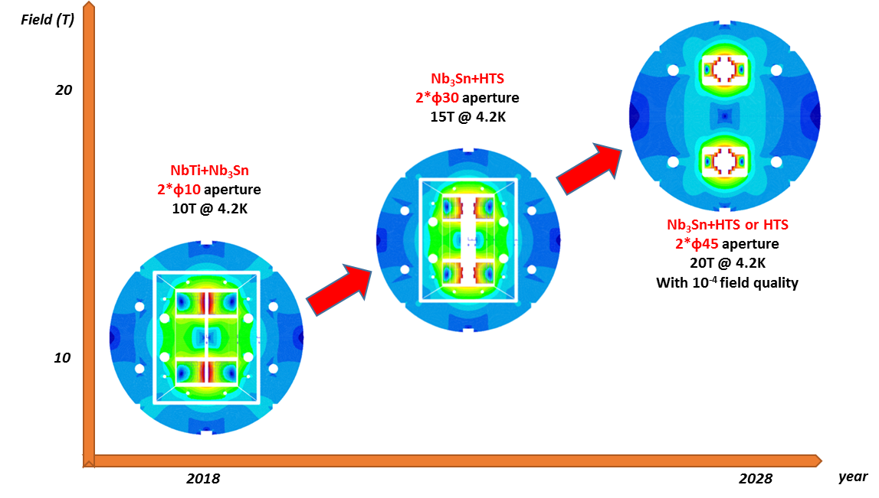
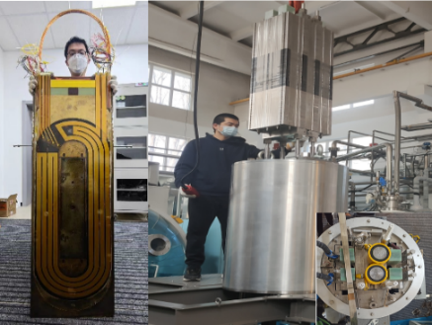
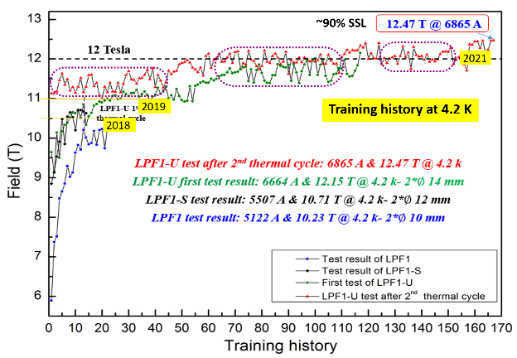
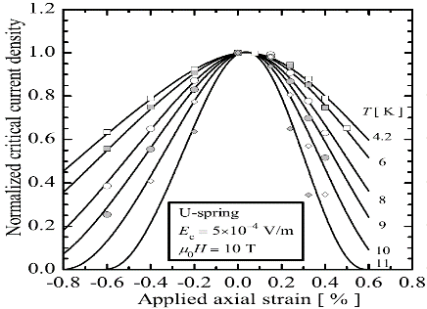
Roadmap of the High Field Magnet R&D at IHEP
2021-2023 16T @ 4.2K
Nb₃Sn + HTS
2018-2021, 12.47T @4.2K
NbTi + Nb₃Sn
Challenges: Stress control, quench protection, field quality control,……
Q. XU, MT-28, Aix-en-Provence, France, Sep 2023
2

Slide 3
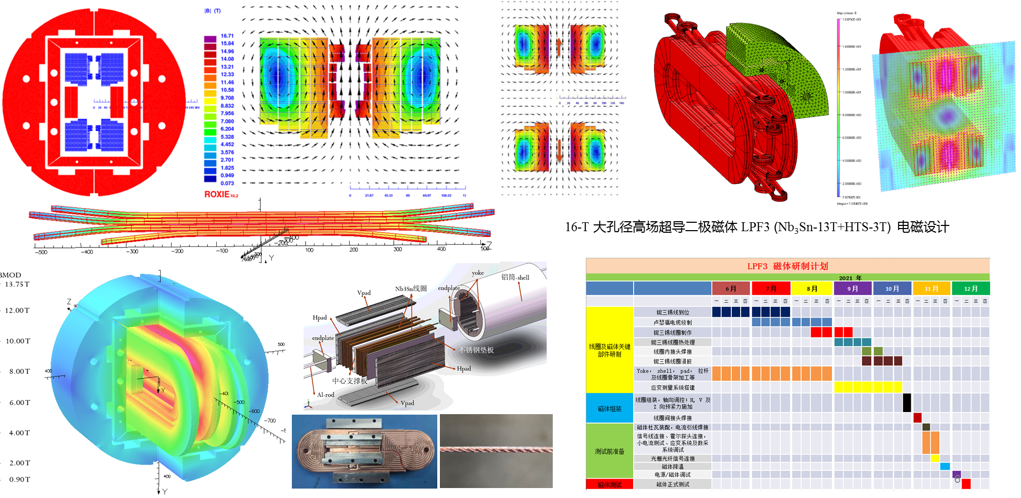
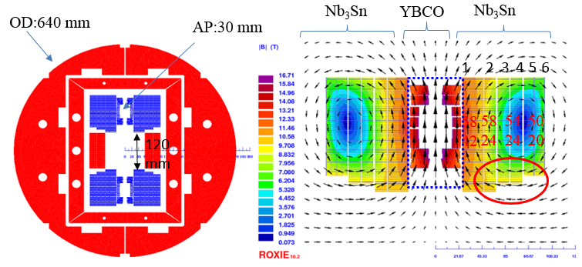
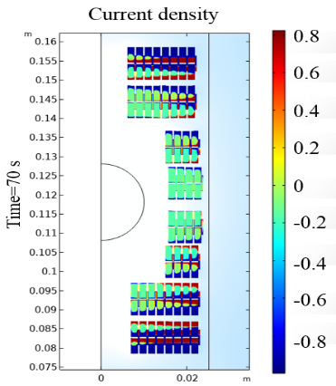
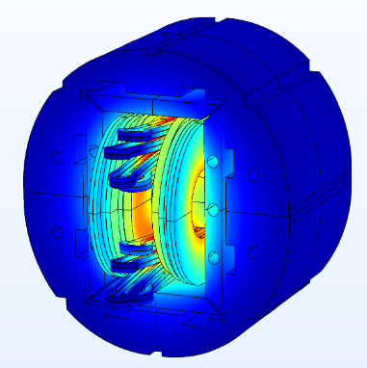
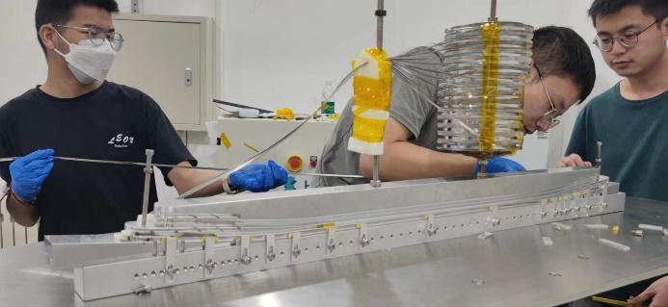
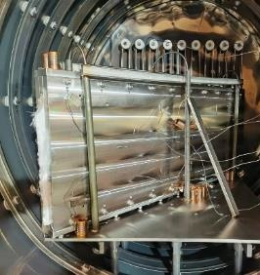
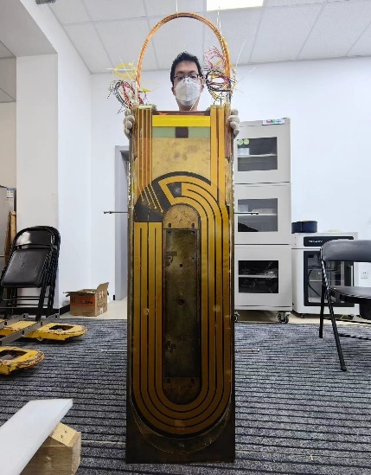
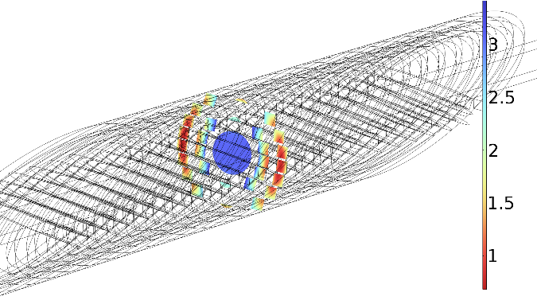
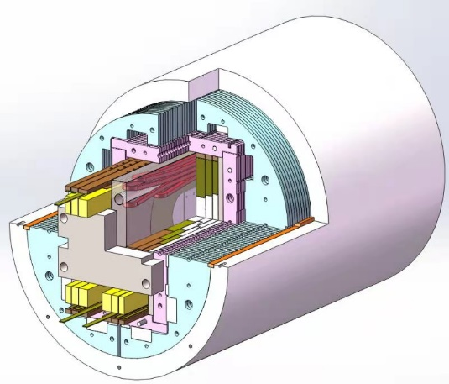
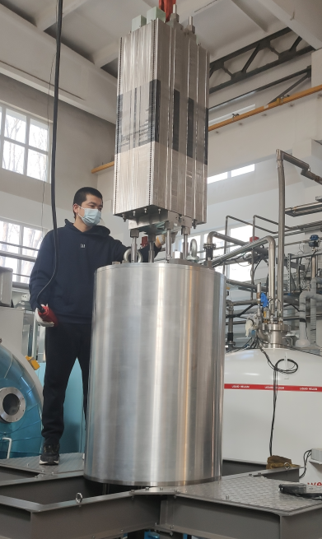
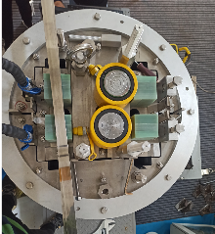
Development of the 16-T Model Dipole LPF3
16 T Model Dipole LPF3: Nb₃Sn 13 T (Common Coil with 55 mm gap) + HTS 3 T inserts (Block & CCT with ∅20 mm)
Q. XU, MT-28, Aix-en-Provence, France, Sep 2023
3

Slide 4
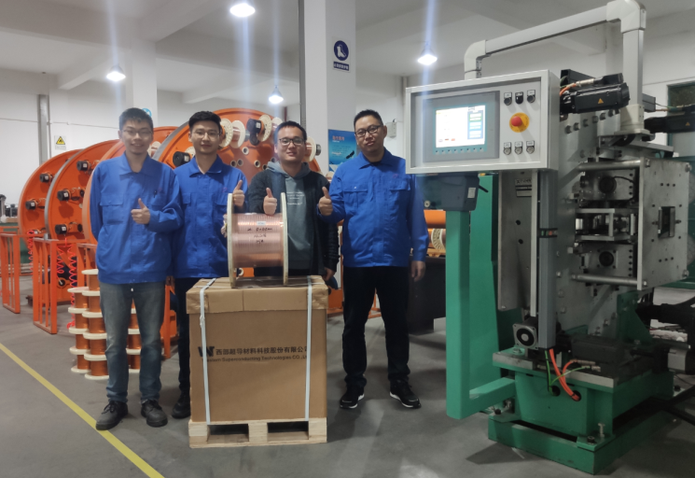
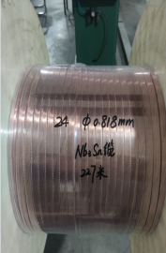
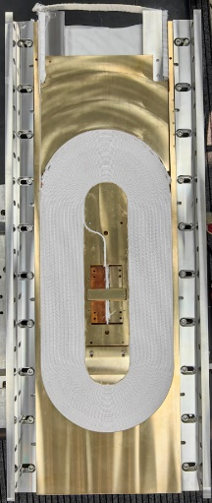
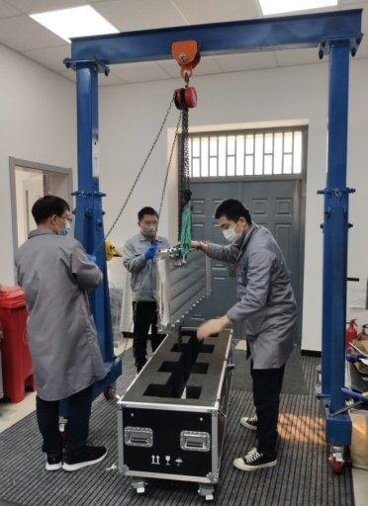
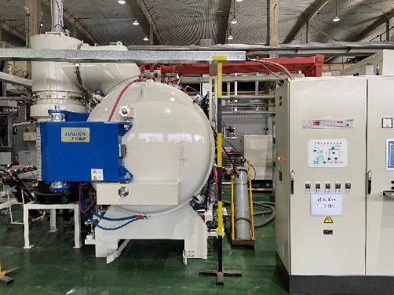
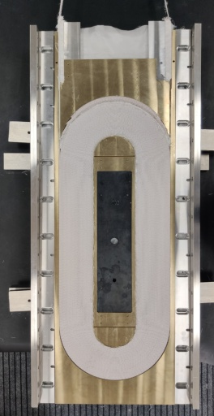
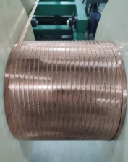
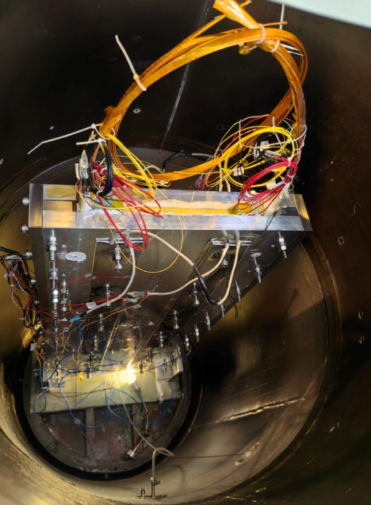
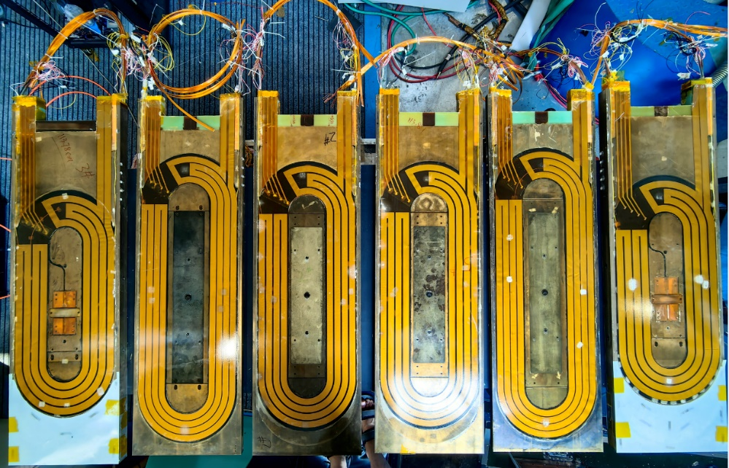
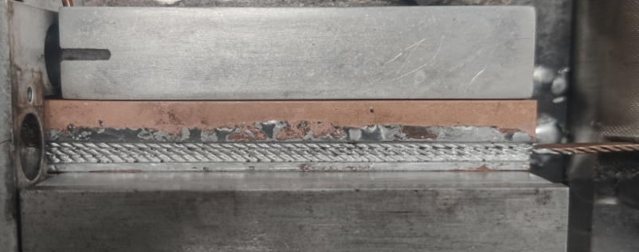
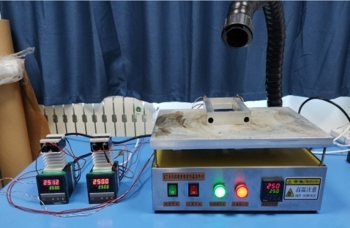
Development of the 16-T Model Dipole LPF3
The Nb₃Sn coils for LPF3
3OrM1-3, Chengtao Wang et al
Q. XU, MT-28, Aix-en-Provence, France, Sep 2023
4

Slide 5
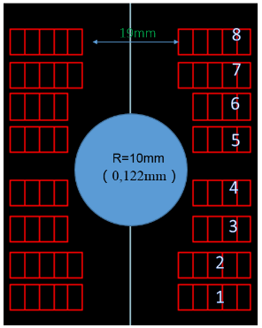
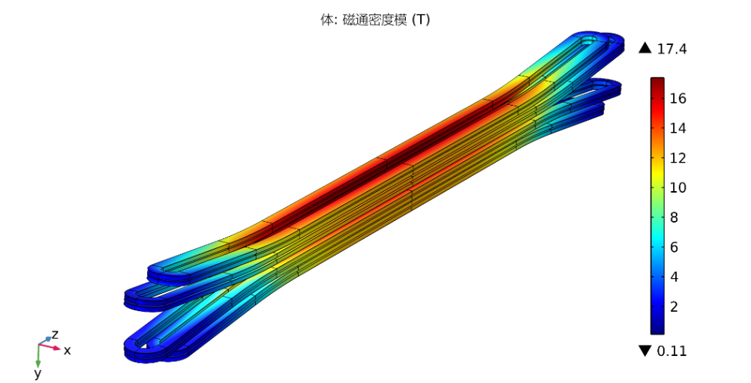
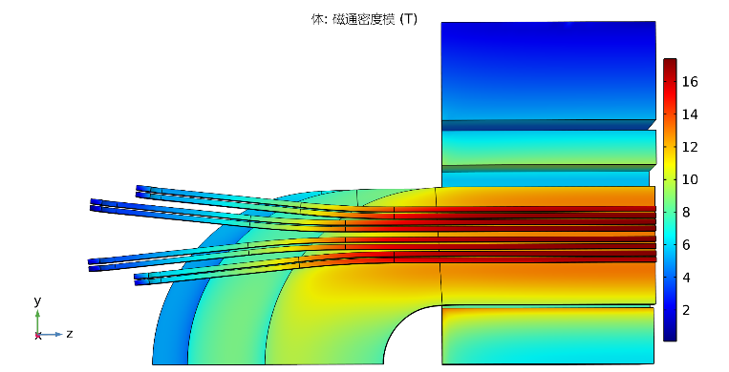
Development of the 16-T Model Dipole LPF3
The ReBCO block insert coils for LPF3
4PoM03-06, Ze Feng et al
Parameters | Values
L0 | 409.6 mm
L1 | 540.2 mm
Rhard | 800 mm
Aend | 6 °
R1 | 9.5 mm
Z1 | 120 mm
Q. XU, MT-28, Aix-en-Provence, France, Sep 2023
5

Slide 6
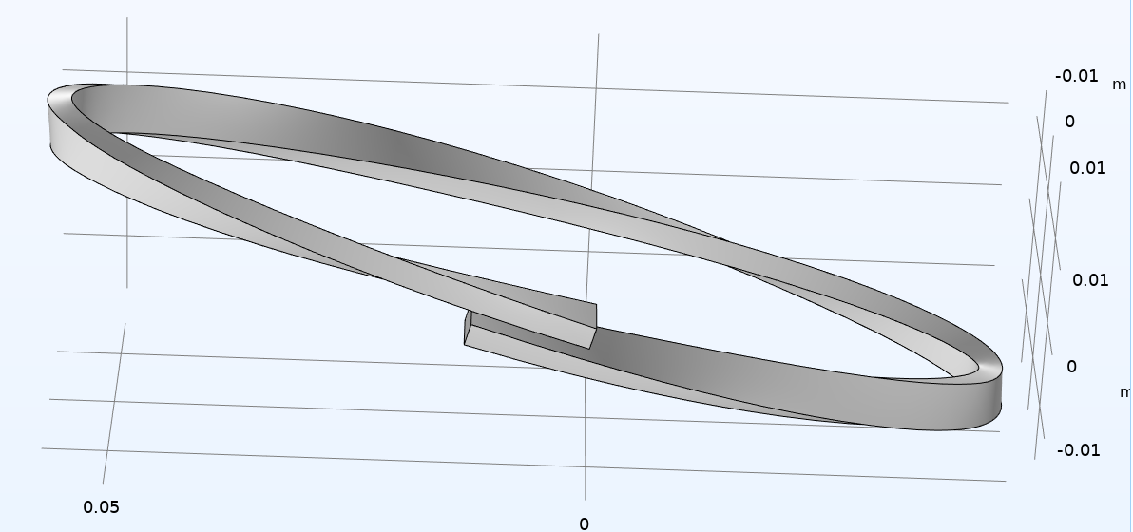
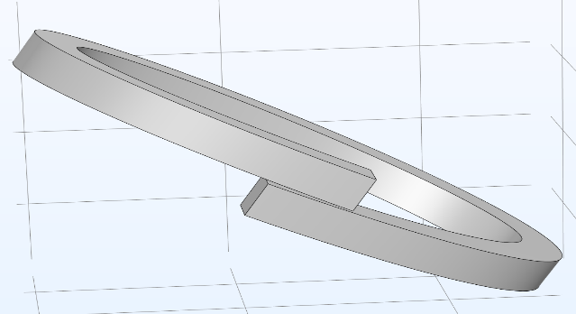
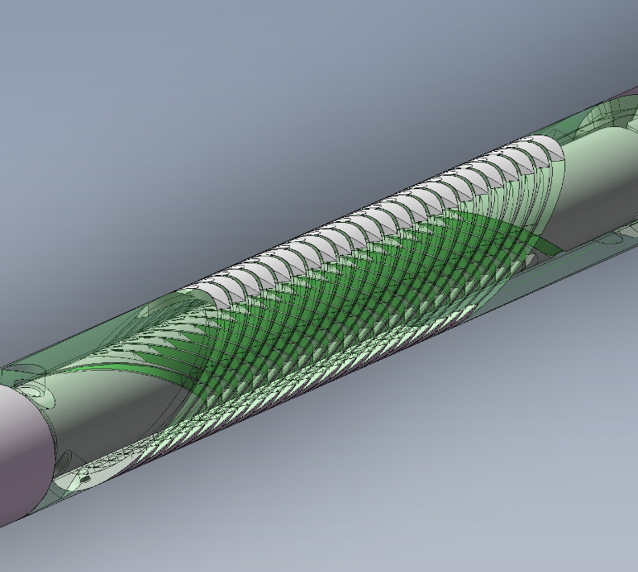
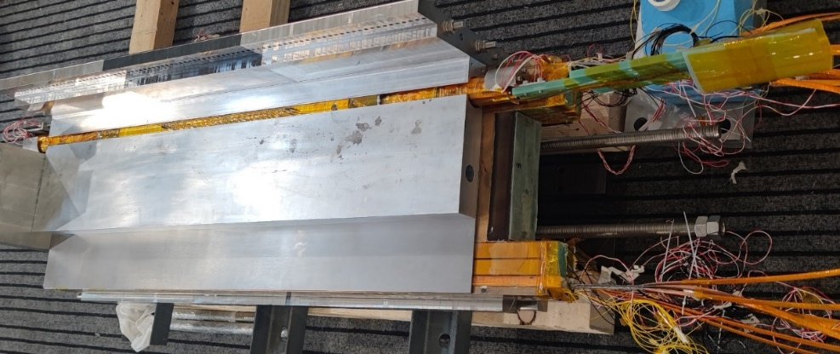
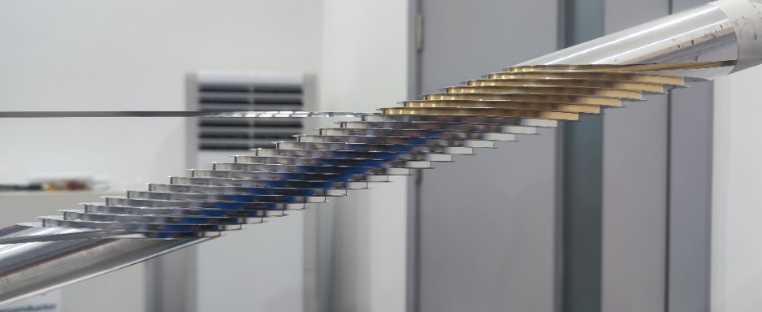
Development of the 16-T Model Dipole LPF3
The ReBCO CCT instert coils for LPF3
2OrM2-8, Rui Kang et al
典型CCT线圈结构示意
“斜螺线管”型CCT线圈结构示意
Q. XU, MT-28, Aix-en-Provence, France, Sep 2023
6

Slide 7
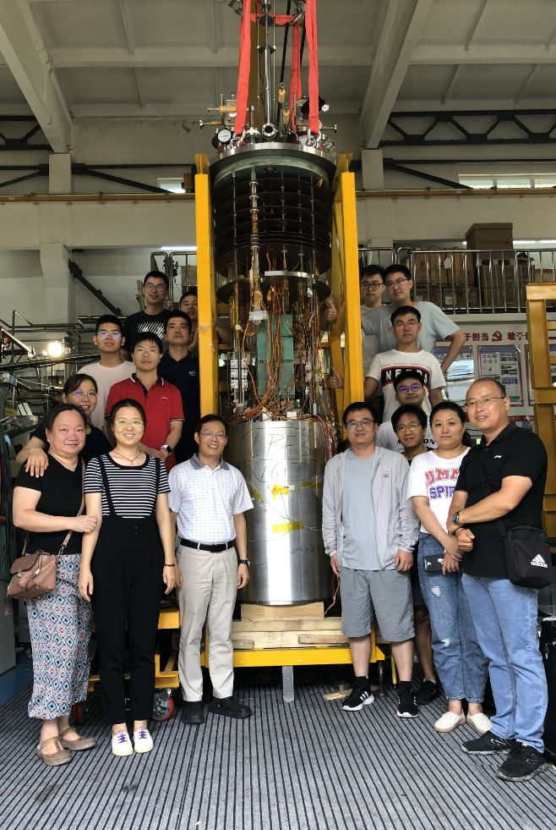
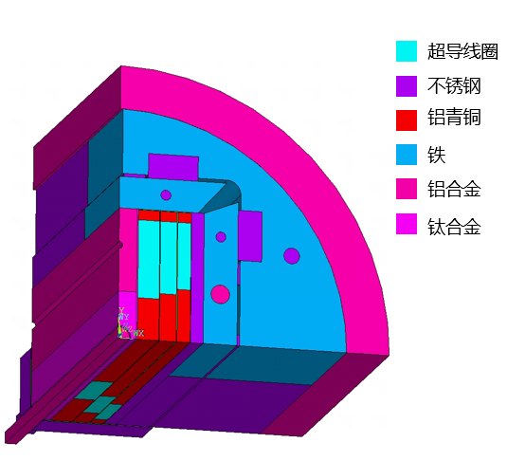
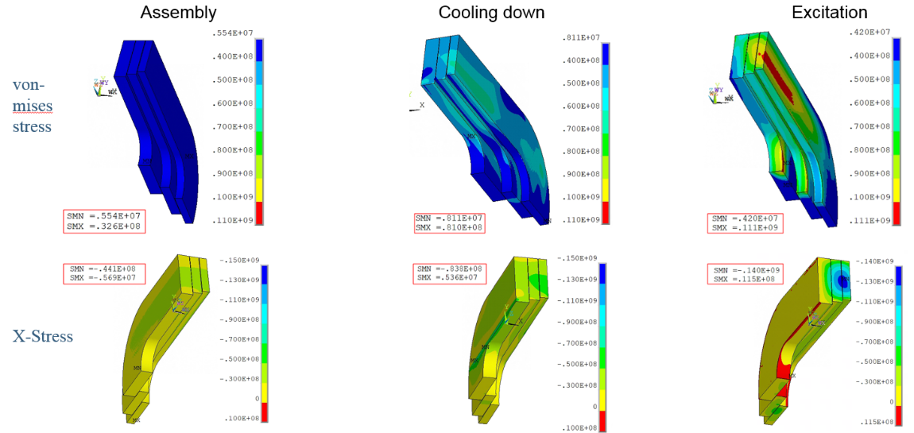
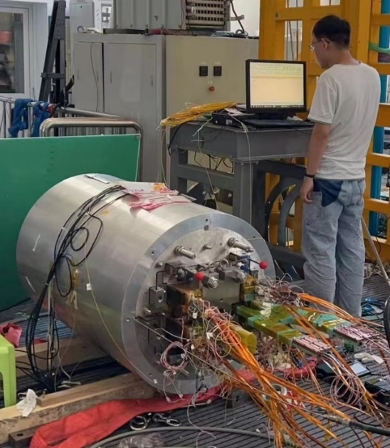
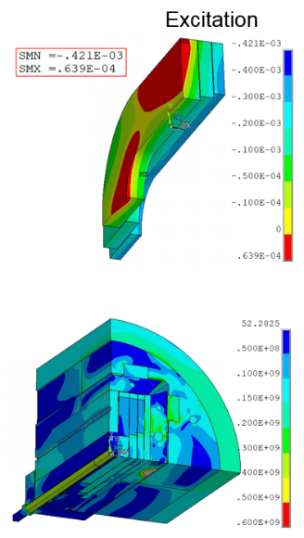
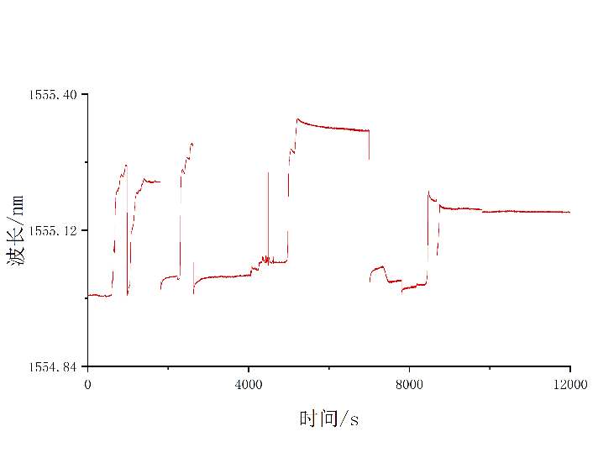
Development of the 16-T Model Dipole LPF3
Pre-stress and assembly of LPF3
1PoA02-03,Yingzhe Wang et al
Stress monitoring during
assembly with FBG
Pre-stress applied with commercial hydraulic jack
7
7
Q. XU, MT-28, Aix-en-Provence, France, Sep 2023
2023.8.29 Assembly completed

Slide 8
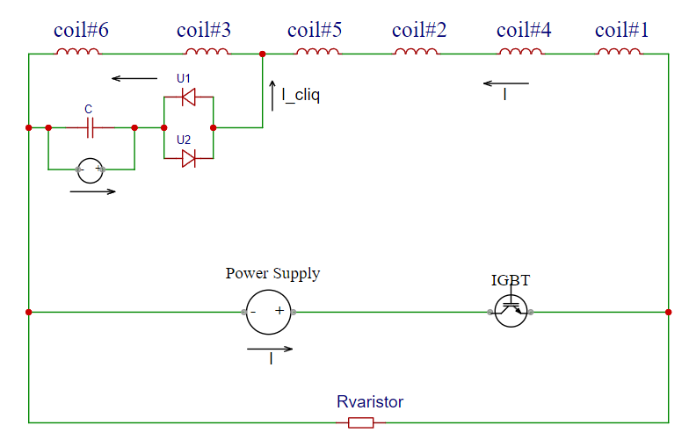
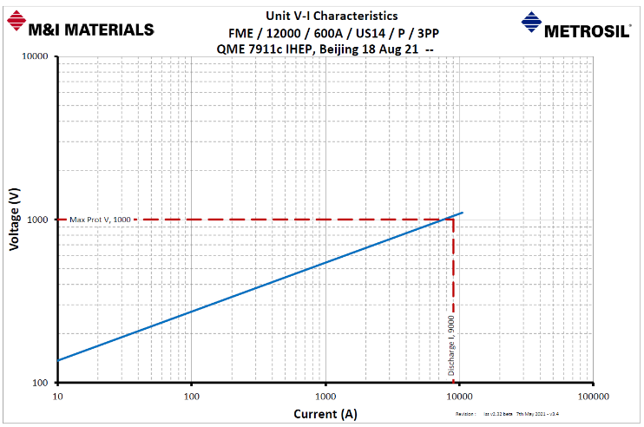
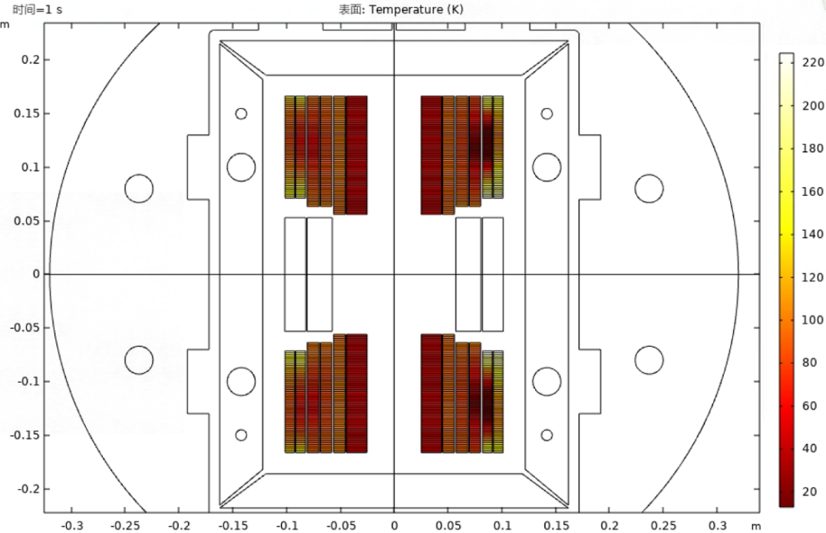
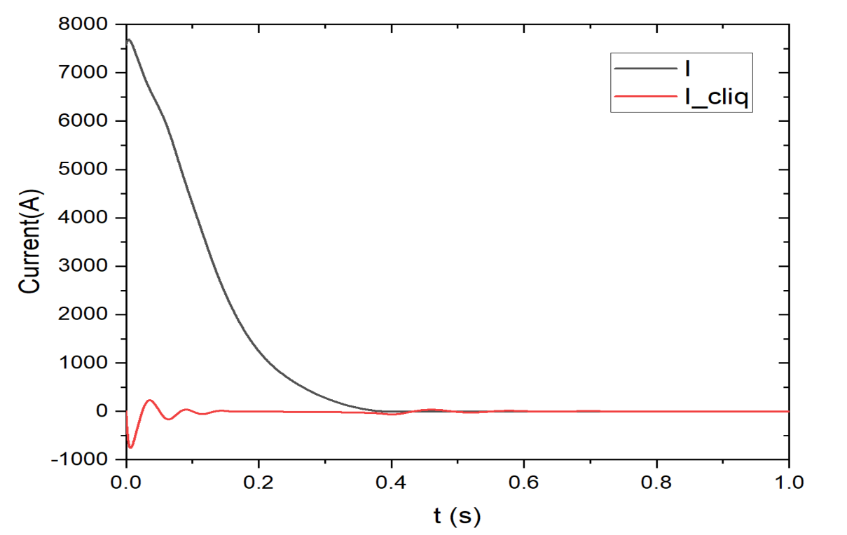
Development of the 16-T Model Dipole LPF3
Quench protection of LPF3
3PoA04-08, Jinrui Shi et al
Varistor plus CLIQ to protect the Nb₃Sn coils. The maximum hot spot is ~ 230 K
NI configuration plus dump resistor to protect the 2 HTS insert coils
Feasibility study of applying the no-insulation coil on accelerator magnets
Current decay curve at the operating current
2OrM2-8,
Rui Kang et al
5PoM04-09,
Hongjun Zhang et al
Q. XU, MT-28, Aix-en-Provence, France, Sep 2023
8

Slide 9
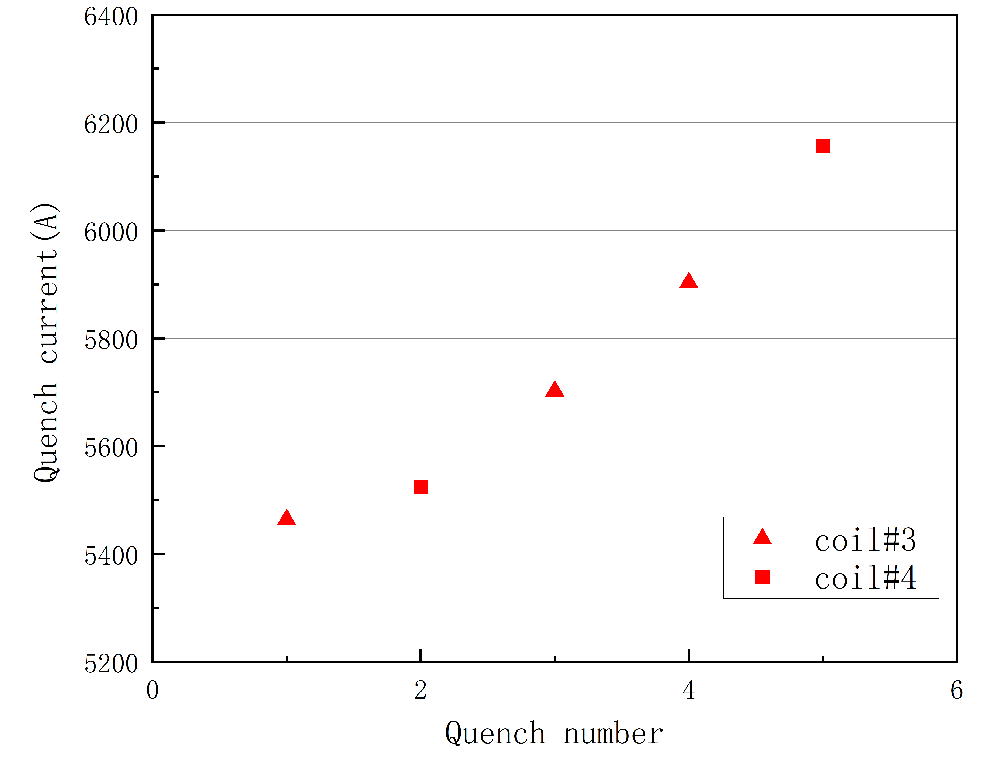
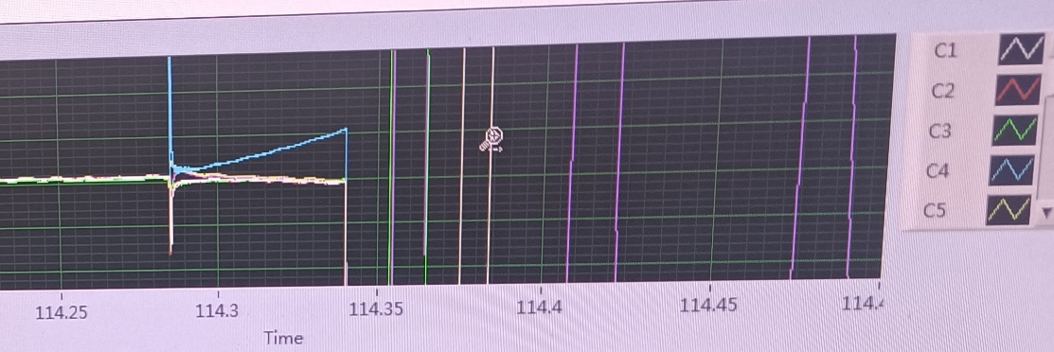
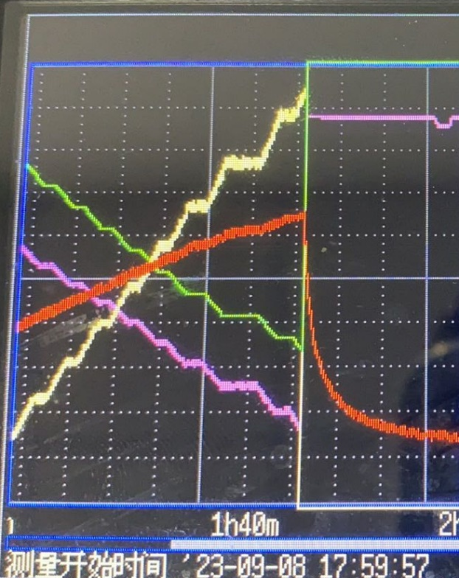
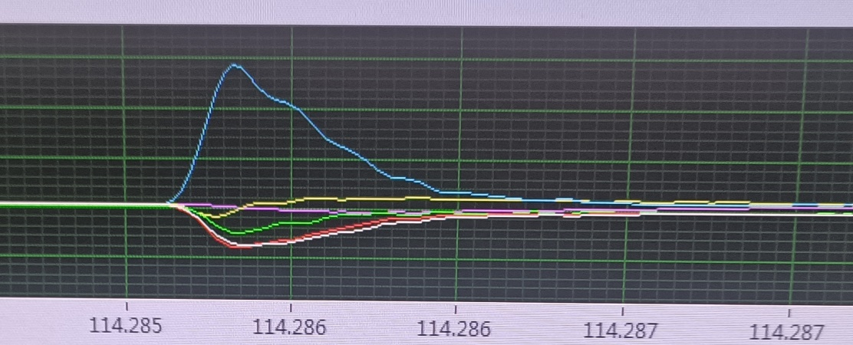
Development of the 16-T Model Dipole LPF3
Preliminary fresh test results just last week!
5OrM2-7, Wei Li et al
The 1st preliminary test carried out in the week Sep 3-8 2003. The 6 Nb₃Sn coils were firstly ramped
5 quenches occurred from 9 to 10 T, all caused by FLUX JUMP, but with an encouraging upward trend
Test stopped due to the limited size of He recovery gasbag, > 100 m³ He gas was evaporated during the 5th quench
HTS CCT insert was ramped independently, quenched at 90% of the I_{op} with a linearly increased voltage curve, probably indicating a damage of ReBCO conductor durting the coil fabrication process
~10 T
~9 T
9

Slide 10
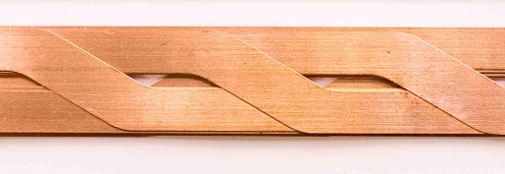
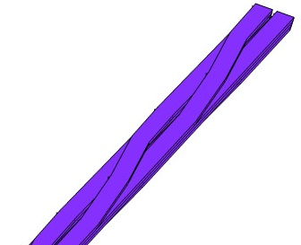
R&D of the HTS transposed cable: X-cable
Development of a Roebel-like Transposed Cable with the in-plane bending of HTS tapes
KIT proposed the Roebel cable concept by punching wide tapes to realize transposition in 2006
IHEP successfully fabricated the first in-plane transposed REBCO cable in 2020
Martin N. Wilson proposed the idea in1997
In-plane transposed HTS cable
In-plane transposed HTS cable
4PoA03-14
Juan Wang et al
Punch-assemble transposed HTS cable
4PoA03-13
Yaqiang Wang et al
IHEP successfully fabricated the first IBS transposed cable in 2021
Siemens developed a transposed cable with in-plane bending Bi-2223 tapes in 2004
IHEP proposed the transposed cable with in-plane bending of HTS tapes in 2017
Q. XU, MT-28, Aix-en-Provence, France, Sep 2023
10

Slide 11
R&D of the HTS transposed cable: X-cable
Development of a Roebel-like Transposed Cable with the in-plane bending of HTS tapes
Juan Wang et al
Q. XU, MT-28, Aix-en-Provence, France, Sep 2023
11

Slide 12
IBS Technology: Status and Outlook
90% Stainless-steel & 10% Sliver stabilized IBS tape achieved the highest J_{e} in 2022!
Significantly reduced the cost and raised the
mechanical properties.
IBS 2025
IBS 2022
IBS 2019
IBS 2016
Q. XU, MT-28, Aix-en-Provence, France, Sep 2023
12

Slide 13
IBS Technology: Status and Outlook
The First IBS Solenoid Coil at 32 T background field
2OrM2-7, Chunyan Li et al
I_{c} of Φ34mm-17 turns-DPC reached 60 A at 4.2 K and 32 T, world’s highest record up to now.
Q. XU, MT-28, Aix-en-Provence, France, Sep 2023
13

Slide 14
IBS Technology: Status and Outlook
Quench propagation study of the IBS coils
Chunyan Li et al
Experimental data shows significant quench propagation in the IBS coils! More testing will be carried out
Q. XU, MT-28, Aix-en-Provence, France, Sep 2023
14

Slide 15
IBS Technology: Status and Outlook
IBS solenoid at 32 T
Racetrack at 10 T
1.3 kA transposed cable
J_{e} > 450 A/mm²
@ 10 T, 4.2 K
100-m 7-core IBS tape fabricated
J_{e}= 100 A/mm²
@ 10 T, 4.2 K
Z. Zhao
IBS (T_{c} 55K)
2008.02
2008.04
2008.09
2016
2018
2020
2022
Discovery of IBS
Discovery of
122 phase IBS
IBS solenoid at 24 T
Racetrack at 8 T
J_{e}= 300 A/mm²
@ 10 T, 4.2 K
H. Hosono
IBS (T_{c} 26K)
J_{e} of IBS expected to be similar as ReBCO in 5 years with better mechanical properties and lower cost
Q. XU, MT-28, Aix-en-Provence, France, Sep 2023
15

Slide 16
Development of CCT Magnets for HL-LHC
China provides 13 units CCT twin-aperture dipole magnets for HL-LHC
To be installed in the ATLAS & CMS interaction regions, help to raise the luminosity by 5 times
The 1st time CCT type magnets applied to an operating accelerator.
Q. XU, MT-28, Aix-en-Provence, France, Sep 2023
16

Slide 17
Development of CCT Magnets for HL-LHC
Successful design upgrade to solve the “long training problem”, significantly reduced the times of quench during training, ensured the project progress “on track”.
HL-LHC Schedule for the Collaboration Board 2022
Q. XU, MT-28, Aix-en-Provence, France, Sep 2023
17

Slide 18
Training of MCBRD02 & MCBRD03
Development of CCT Magnets for HL-LHC
AP1(CB12，25 quenches 526A) reached ±422A after 11 quenches.
AP2(CB09, 33 quenches 530A; after thermal cycle ＞500A) reached ±422A without any quenches.
Q. XU, MT-28, Aix-en-Provence, France, Sep 2023
18

Slide 19
Development of CCT Magnets for HL-LHC
Milestone of the HL-LHC CCT Magnet Project
Agreement signed
btw IHEP and CERN
The CCT magnet from China under test at CERN
Installation to tunnel
The qualified prototype delivered to CERN
All the 12 series CCT magnets delivered to CERN
HL-LHC commissioning
Q. XU, MT-28, Aix-en-Provence, France, Sep 2023
19

Slide 20
Summary
Long-term advanced superconducting magnet R&D for future high-energy accelerators is ongoing at IHEP-CAS
10+ T model dipoles being developed at IHEP, reached 12.47 T at 4.2 K in mid 2021. 16 T (Nb₃Sn+HTS) model dipole under test in 2023. 20 T accelerator magnets expected to be realized in 2020s
Strong domestic collaboration for the advanced superconductor R&D (HTS & Nb₃Sn): Stainless-steel-Silver stabilized IBS tape achieved the highest J_{e} in 2022! Significantly reduced the cost and raised the mechanical properties
China & CERN Collaboration on accelerator technology: development of HL-LHC CCT magnets going well
Looking forward to a world wide synergy on the advanced accelerator magnet R&D in future
Q. XU, MT-28, Aix-en-Provence, France, Sep 2023
20

Slide 21
About MT-28: numbers (1/2)
The accelerator community is still a major contributor to the magnet technology:
1/5 plenary ( 2 for Fusion, 1 for MRI and 1 for electricity);
7/28 oral sessions:
(1) plan and progress, (2) quench and NI, (3) high field, (4) design and analysis, (5) Nb3Sn, (6) HL-LHC and (7) detector magnet.
15/86 poster sessions:
(1) design and analysis, (2) thermal design and cryogenics, (3) mechanical analysis, (4) mechanical design and fabrication, (5) Nb3Sn, (6) high field, (7) field quality, (8) tests, (9-10) quench and insulation×2, (11) (general) measurement techniques, (12) field measurement, (13) field analysis, (14) progress and systems status, (15) large device design.
Q. XU, MT-28, Aix-en-Provence, France, Sep 2023
21

Slide 22
About MT-28: numbers (2/2)
REBCO attracts the most interests among all superconductors:
>200 about REBCO or HTS, 56 about Nb3Sn, 12 about NbTi, 2 about IBS (more in EUCAS about IBS wires), 15 about MgB2, 16 about Bi-2212, 5 about Bi-2223.
11 about CCT (canted-cosine-theta) magnet:
CERN, HUST, USTC, CIEMAT for gantry, IHEP, PSI, IMP, LBNL for HEP.
NbTi, Nb3Sn, Bi-2212 and REBCO are all considered.
>50 about No-insulation technology.
5 orals and 16 posters are contributed by IHEP.
The Superconducting Magnet Group @ MT-28
Q. XU, MT-28, Aix-en-Provence, France, Sep 2023
22

Slide 23
About MT-28: impressive works
Paraffin-Wax impregnation is found very efficient to eliminate training quenches in CCT coils for both Nb3Sn and NbTi. (by PSI, CERN, University of Twente)
Q. XU, MT-28, Aix-en-Provence, France, Sep 2023
23

Slide 24
About MT-28: impressive works
Novel quench protection system based on CLIQ: S-CLIQ and E-CLIQ (by CERN).
Replacements of quench heaters.
Secondary-CLIQ
External-CLIQ
Q. XU, MT-28, Aix-en-Provence, France, Sep 2023
24

Slide 25
About MT-28: impressive works
A comprehensive research framework for NI technique
(by Seoul National University)
Q. XU, MT-28, Aix-en-Provence, France, Sep 2023
25

Slide 26
Many thanks to the colleagues at ACC for providing helps for magnet manufacturing and testing, and
thanks for your attention
Aug 29 2023
@ Beijing China

