Slide 1
Preliminary Introduction to the EMT Form Factors
Chen Ruixiang
Reference：
1. H. Pagels, Phys. Rev. 144, 1250 (1966).
2. arxiv: 1805.06596

Slide 2
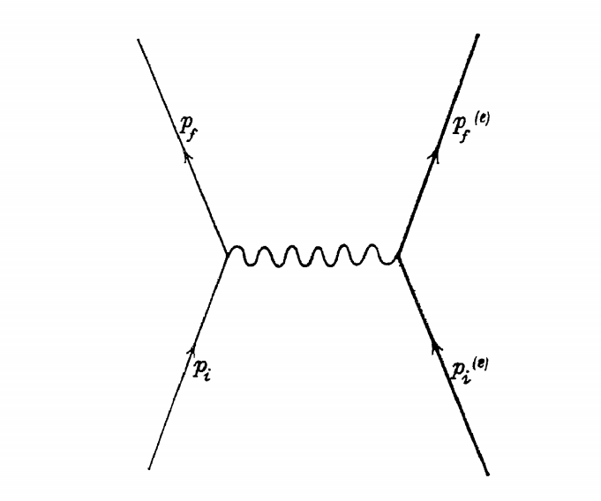
Introduction
Consider the scattering process of electron and positron pairs
The scattering amplitude is
Transition matrix elements describes the response of a single-particle state |p> of momentum p to the probing electromagnetic potential.

Slide 3
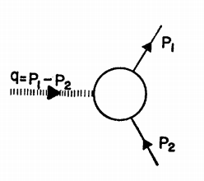
Introduction
The matrix element can be further written in the following form
F₁(q²) and F₂(q²)are called (EM)form factors and have the following constraints：

Slide 4
Introduction
q=0 represents a 0 momentum transfer
“ Physically, q²→0 means that the electron’s momentum changes very little during the scattering. Measuring a slight deflection in the trajectory of one charged particle (due to the presence of another) is how we measure the coefficient in Coulomb’s law. Thus, eq. (63.1) corresponds to this traditional definition of the charge of the electron.”
—Srednicki,P386
Form factor gives information about electronic charge and magnetic moment.

Slide 5
Introduction
As is coupled to the electromagnetic field, it is the energy-momentum tensor(EMT) of the system that is coupled to the gravitational field, due to the following relationship:
Mass plays a role as the “charge” of gravitation make us expect reveals the information about mass of particles at least

Slide 6
EMT Form Factors
The EMT obtained from the following equation is called Belinfanté energy-momentum tensor，which is symmetric and conservative
For QCD

Slide 7
EMT Form Factors
The matrix element can also be written directly
spin 1/2
Using Gordon identity

Slide 8
EMT Form Factors
spin 0
A、B、D、G ect. are called EMT form factors

Slide 9
Constraints on The Form Factors
In QED, is proportional to the totally renormalized charge of the system, So, a is proportional to the totally renormalized mass m.
Using zero momentum transfer and rest frame，From the physical meaning of the EMT, only the 00 component is non-zero, which means energy density
It leads to

Slide 10
Constraints on The Form Factors
The constraints on the form factor in the 1/2 spin case can be obtained
Also considering the trace of EMT
Only the 00 component contributes to it under q=0, p=0.

Slide 11
Constraints on The Form Factors
Using the same procedure one can calculate the constraint in 0 spin system

Slide 12
Constraints on The Form Factors
When q²≠0，there are also some constraints
If spin≤1，Lorentz invariance imposes the fundamental equal-time commutation rule
Hence one obtains a sum rule for the matrix elements

Slide 13
Calculating Form Factors: Example
The direct calculation of the form factor in the presence of interactions is very difficult.
The following perturbative calculations will be performed for electron using the dispersion relation.
Begin by assuming that：
1. are analytic functions of q² in the cut q² plane with a branch cut extending from q²=0 to q²=∞.
2. → 0.

Slide 14
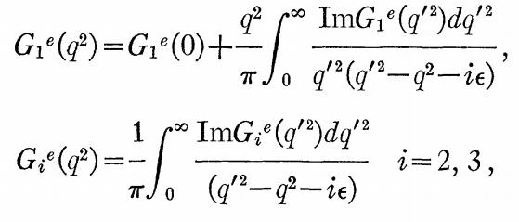
Calculating Form Factors: Example
Applying the following dispersion relations
The first formular is called subtracted dispersion relation

Slide 15
Calculating Form Factors: Example
The imaginary part of the form factors can be calculated by the production of electron-positron pairs

Slide 16
Calculating Form Factors: Example
Then
We need to truncate the sum, to lowest order in α we may approximate the sum
by keeping only two intermediate states ，
scattering amplitude part× production vertex part

Slide 17
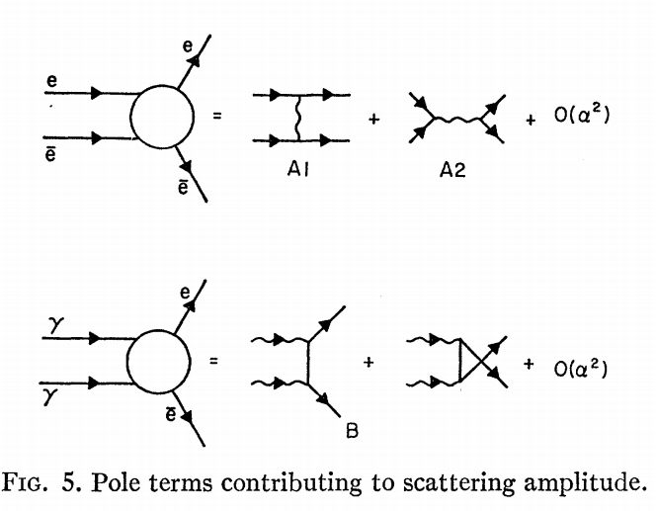
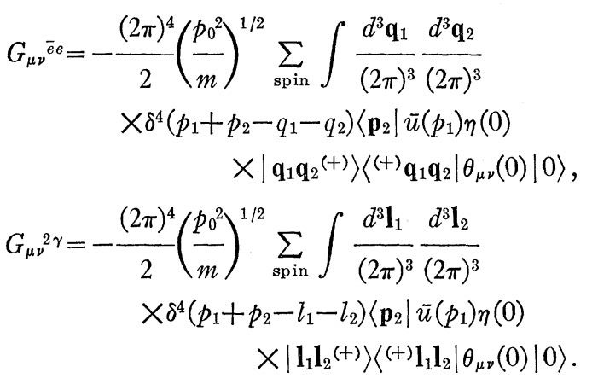
Calculating Form Factors: Example
The scattering amplitude parts are just the amplitude of ,

Slide 18
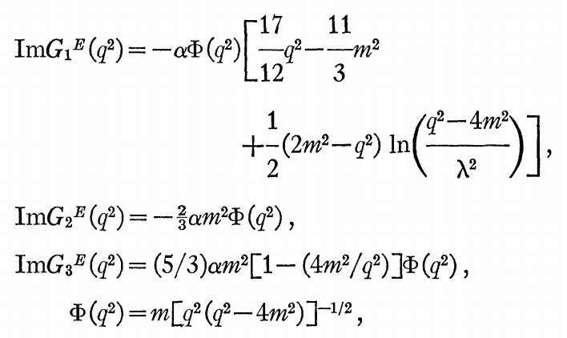
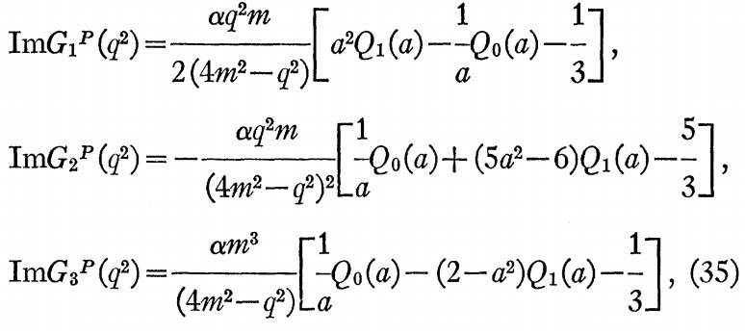
Calculating Form Factors: Example
Combined above calculation, one finally obtained
The contribution of and to separately conserve
are Legendre functions of the second kind.

Slide 19
Calculating Form Factors: Example
Considerable simplification is achieved if instead of considering the matrix elements of the trace
The dispersion relation has 3 possible forms if:
1.
2. The integral in (38)has the property that as q²→∞ it vanish.
3.

Slide 20
Calculating Form Factors: Example
1. Subtracted relation and has no more information to calculate the mass.
2. Subtracted relation but as q→∞，G(q²)→m₀.
we could calculate the mass shift due to interactions.
3. Implying all the mass arises as a consequence of interactions.

Slide 21
Relation to Physics Meaning
The articles on which the above calculations are based only talks about the total EMT form factors and limited physical meaning.
Now, using methods developed in recent years, such as GPDs(Generalized Parton Distributions), one can discuss the form factors by parts and reveal more physical meaning.

Slide 22
Relation to Physics Meaning
The values of A^{Q} and A^{g} can be obtained from parameterizations of the parton distribution functions extracted from deep-inelastic scattering experiments
describes the probability density to find a quark or gluon carrying the fraction x of the hadron’s momentum in infinite-momentum frame.
For instance, in the nucleon quarks carry about 54 % and gluons about 46 % of the nucleon momentum at a scale of µ² = 4 GeV²

Slide 23
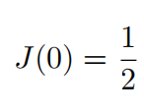
Relation to Physics Meaning
Likewise,
The form factor D(t) at zero-momentum transfer is unconstrained.
This value is often referred to as the D-term D ≡ D(0)

Slide 24
Relation to Physics Meaning
The D-term is sometimes referred to as the “last unknown global property.”

Slide 25
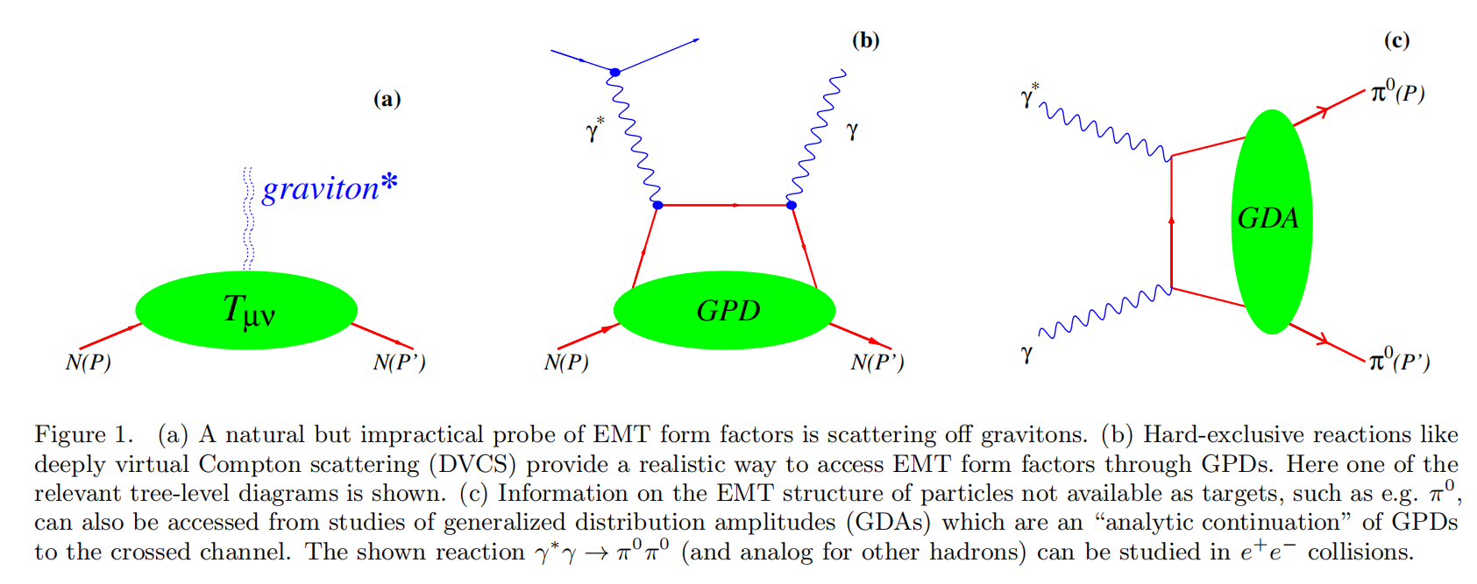
Relation to Physics Meaning
A practical opportunity to access EMT form factors emerged with the advent of GPDs.

Slide 26
Relation to Physics Meaning
In the case of the nucleon, the second Mellin moments of unpolarized GPDs yield the EMT form factors.

Slide 27
Relation to Physics Meaning
The physical content of the information encoded in the EMT form factors is revealed in the Breit frame.
According to the physical meaning of each component of EMT, the form factor can be endowed with physical meaning.

Slide 28
Relation to Physics Meaning
We can now define the static EMT T^{µν}(r, s) of a hadron by Fourier transform
00 component
The spatial distribution of the energy inside a hadron.

Slide 29
Relation to Physics Meaning
ij component
The ij-components of static EMT define the stress tensor.
The total stress tensor can be decomposed in a traceless part associated with shear forces s(r) and a trace associated with the pressure p(r).

Slide 30
Relation to Physics Meaning
The 0k-components of the EMT are related to the spatial distribution of the nucleon spin.
The individual contributions of quarks and gluons as follows:

Slide 31
Brief Conclusion
Such fundamental properties of a particle as mass and spin can be viewed as the response of a particle to external gravitational field.
As the gravity couples to matter via the energy-momentum tensor (EMT), the mass and the spin of a particle can be obtained from the matrix elements of EMT.
A(t) relates to mass/energy, J(t) relates to spins, D(t) relates to spatial deformations and therefore is expressed in terms of the stress-tensor which characterizes the distribution of forces inside the system.

Slide 32
Thanks

