Slide 1
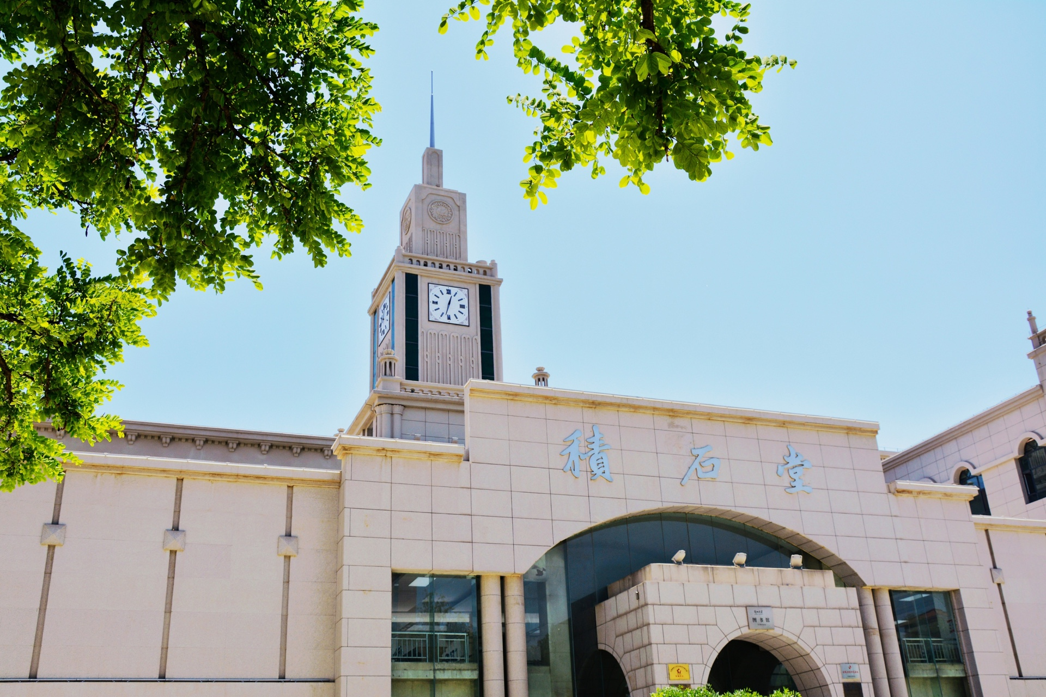

2023PQCD研讨会
暨第⼀届重味物理讲习班
Charmed baryon decays with
re-scattering mechanism
Cai-Ping Jia(贾彩萍)
Lanzhou University
In collaboration with Hua-Yu Jiang and Fu-Sheng Yu
2023.11.04

Slide 2
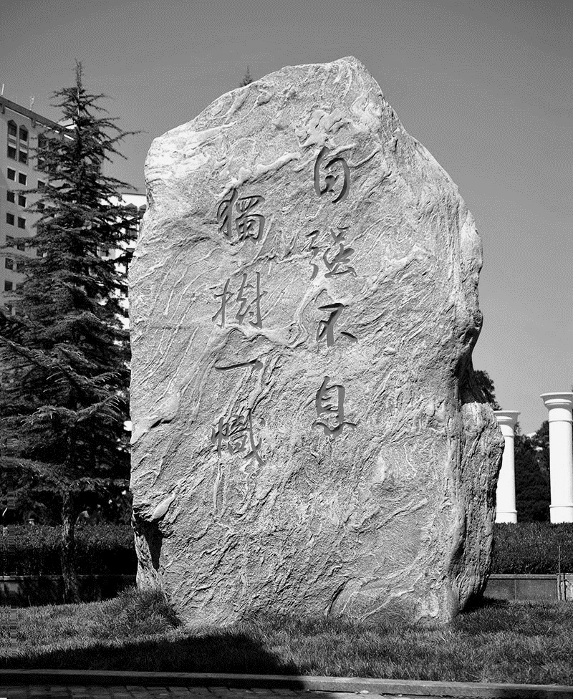

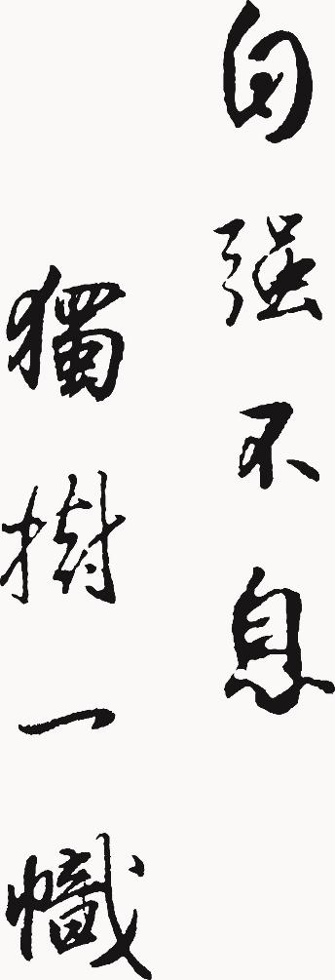
Introduction
Framework
Results and discussion
Summary
Content

Slide 3
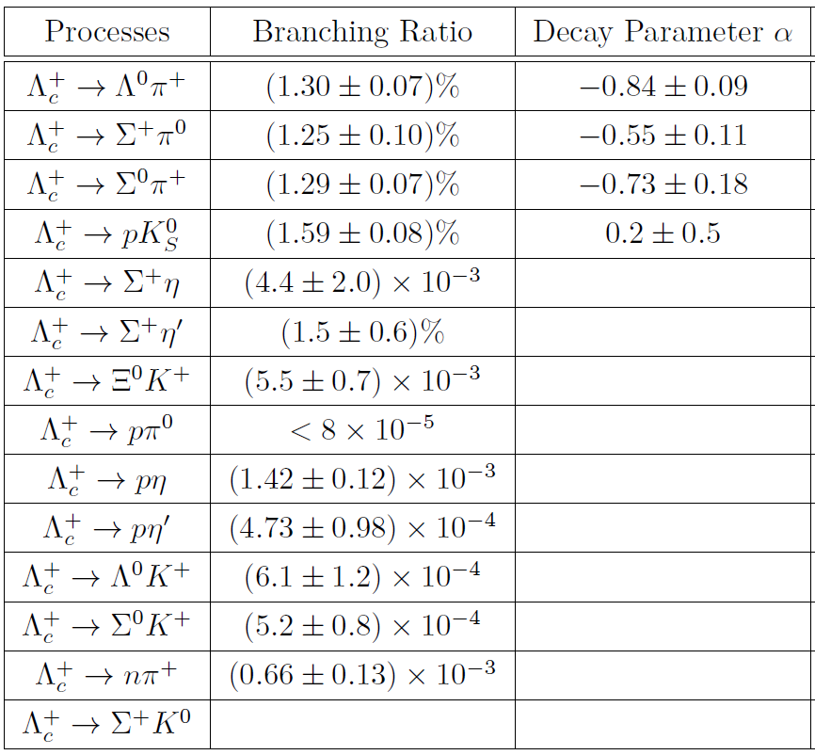
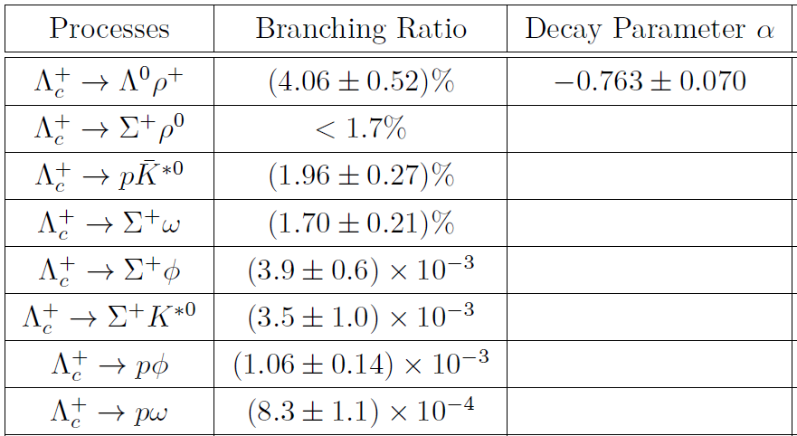

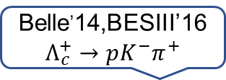
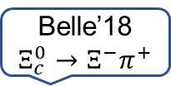
Introduction
Experiment：
Belle,PRL(2014);BESIII,PRL(2016)
Belle,PRL(2019)
Belle’14,BESIII’16
$$Λ_{c}^{+}→pK^{−}π^{+}$$
Belle’18
$$Ξ_{c}^{0}→Ξ^{−}π^{+}$$
1976
No absolute BRs
Upgrade
BESIII Collaboration……
Belle II Collaboration……

Slide 4
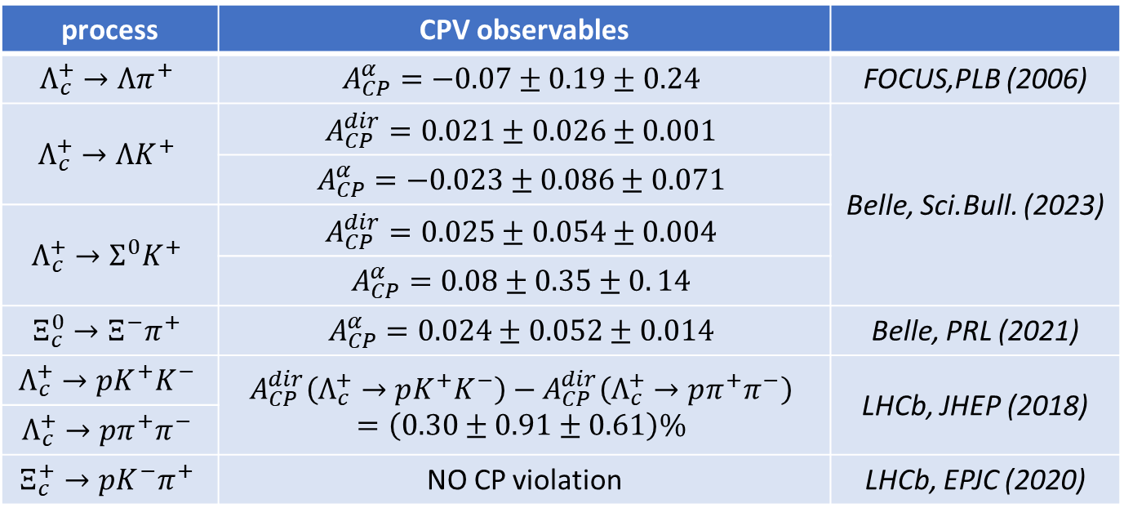
Introduction
Experiment：
  CP violation is required for the matter-antimatter asymmetry in the Universe [Sakharov, 1967]
  CPV in strange, charm and bottom mesons have been well established.
  No CPV has been yet observed in charmed baryon decays.
process | CPV observables
$$Λ_{c}^{+}→Λπ^{+}$$ | $$A_{CP}^{α}=−0.07±0.19±0.24$$ | FOCUS,PLB (2006)
$$Λ_{c}^{+}→ΛK^{+}$$ | $$A_{CP}^{dir}=0.021±0.026±0.001$$ | Belle, Sci.Bull. (2023)
 | $$A_{CP}^{α}=−0.023±0.086±0.071$$
$$Λ_{c}^{+}→Σ^{0}K^{+}$$ | $$A_{CP}^{dir}=0.025±0.054±0.004$$
 | $$A_{CP}^{α}=0.08±0.35±0. 14$$
$$Ξ_{c}^{0}→Ξ^{−}π^{+}$$ | $$A_{CP}^{α}=0.024±0.052±0.014$$ | Belle, PRL (2021)
$$Λ_{c}^{+}→pK^{+}K^{−}$$ | $$A_{CP}^{dir}\left(Λ_{c}^{+}→pK^{+}K^{−}\right)−A_{CP}^{dir}\left(Λ_{c}^{+}→pπ^{+}π^{−}\right)$$ $$=\left(0.30±0.91±0.61\right)\%$$ | LHCb, JHEP (2018)
$$Λ_{c}^{+}→pπ^{+}π^{−}$$
$$Ξ_{c}^{+}→pK^{−}π^{+}$$ | NO CP violation | LHCb, EPJC (2020)

Slide 5
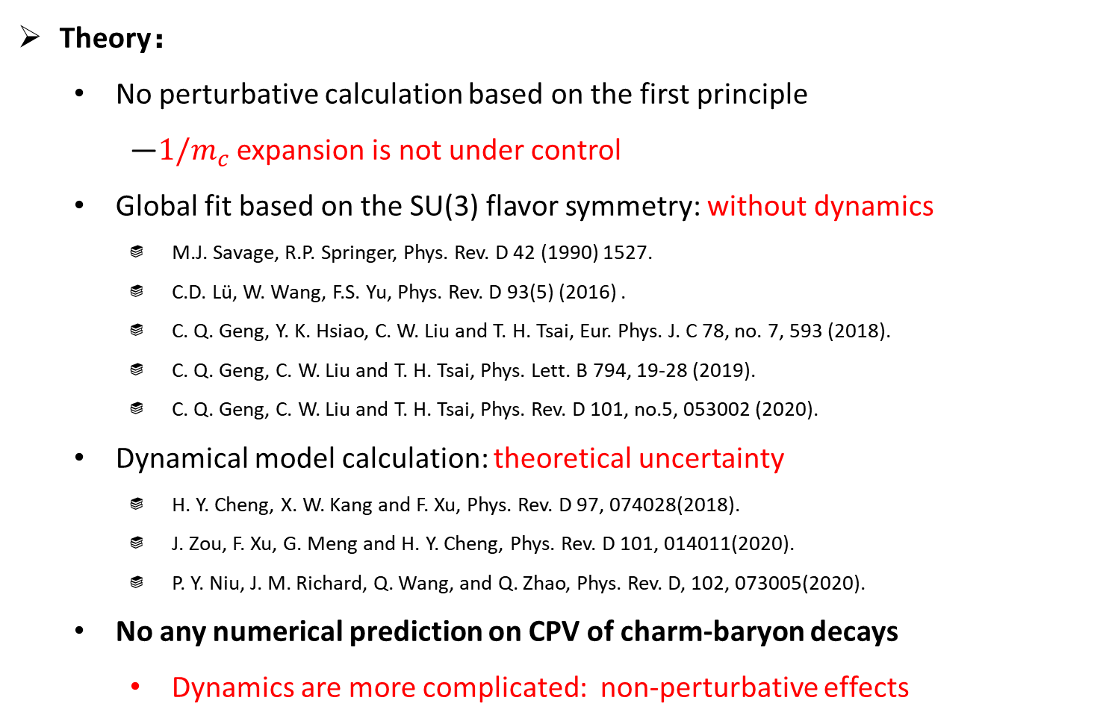
Introduction
Theory：
  No perturbative calculation based on the first principle
    —${1/m}_{c}$ expansion is not under control
  Global fit based on the SU(3) flavor symmetry: without dynamics
    M.J. Savage, R.P. Springer, Phys. Rev. D 42 (1990) 1527.
    C.D. Lü, W. Wang, F.S. Yu, Phys. Rev. D 93(5) (2016) .
    C. Q. Geng, Y. K. Hsiao, C. W. Liu and T. H. Tsai, Eur. Phys. J. C 78, no. 7, 593 (2018).
    C. Q. Geng, C. W. Liu and T. H. Tsai, Phys. Lett. B 794, 19-28 (2019).
    C. Q. Geng, C. W. Liu and T. H. Tsai, Phys. Rev. D 101, no.5, 053002 (2020).
  Dynamical model calculation: theoretical uncertainty
    H. Y. Cheng, X. W. Kang and F. Xu, Phys. Rev. D 97, 074028(2018).
    J. Zou, F. Xu, G. Meng and H. Y. Cheng, Phys. Rev. D 101, 014011(2020).
    P. Y. Niu, J. M. Richard, Q. Wang, and Q. Zhao, Phys. Rev. D, 102, 073005(2020).
  No any numerical prediction on CPV of charm-baryon decays
    Dynamics are more complicated: non-perturbative effects
①
②
③

Slide 6
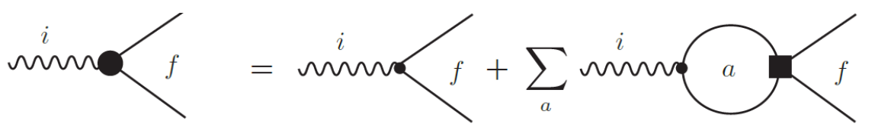
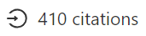
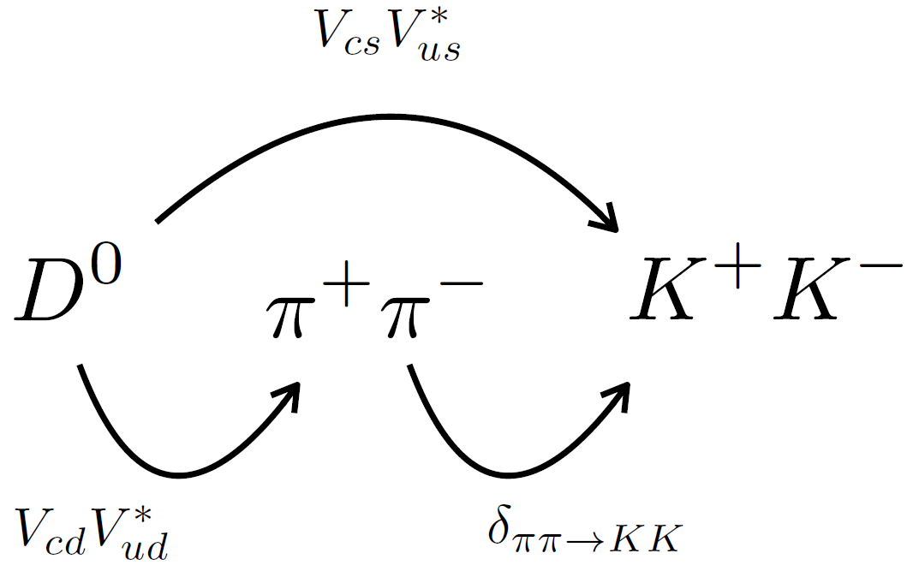
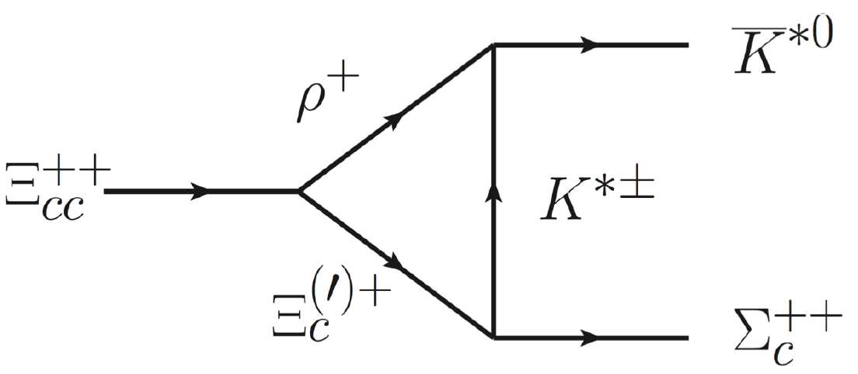
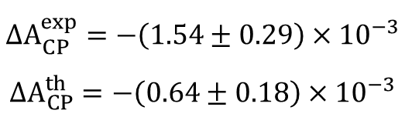
Framework
Final-state interactions：
  The natural physical image of the long-distance nonperturbative contribution
    H. Y. Cheng, C. K. Chua and A. Soni, Phys. Rev. D 71, 014030 (2005).
    H. Y. Cheng and C. W. Chiang, Phys. Rev. D 81, 074021 (2010).
    Bediaga, Frederico, Magalhaes, PRL2023;Pich, Solomonidi, Silva, PRD2023. data-driven
    F.-S. Yu, H.-Y. Jiang, R.-H. Li, C.-D. Lv, W. Wang, Z.-X. Zhao, Chin. Phys. C 42 (5) (2018) 051001.
$$ΔA_{CP}^{exp}=−\left(1.54±0.29\right)×{10}^{−3}$$
$$ΔA_{CP}^{th}=−\left(0.64±0.18\right)×{10}^{−3}$$
“Discovery Potentials of Doubly Charmed Baryons”
Successfully !

Slide 7
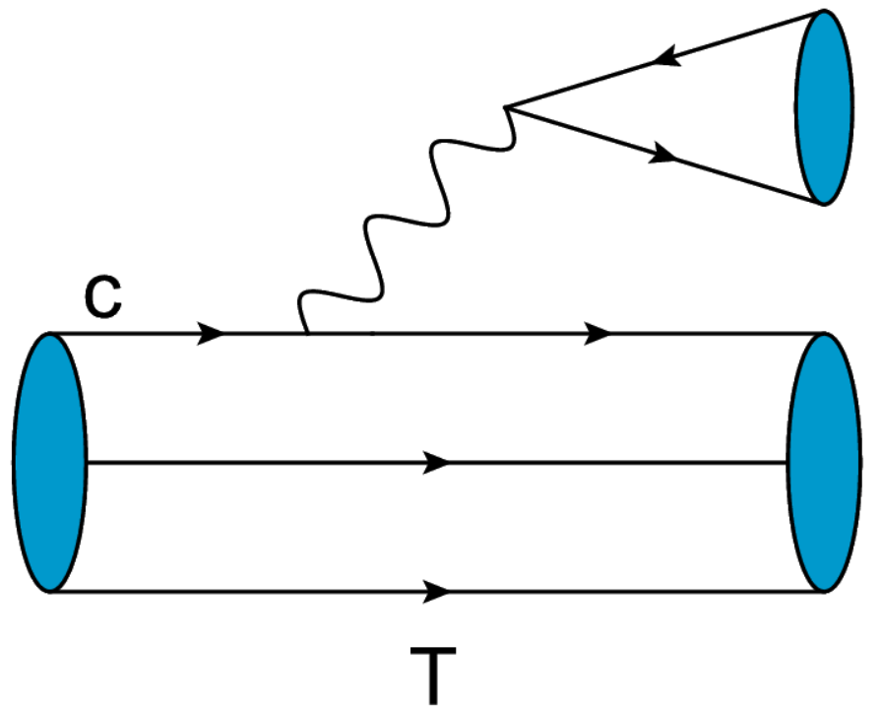
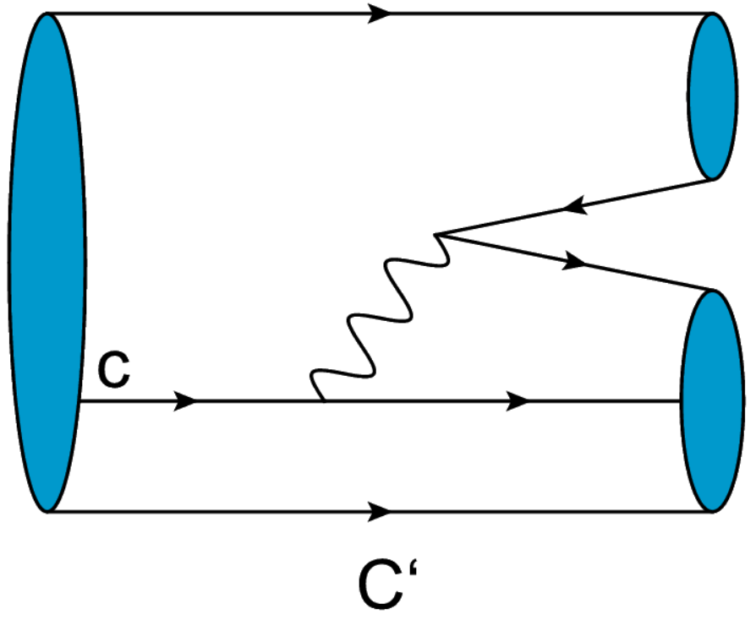
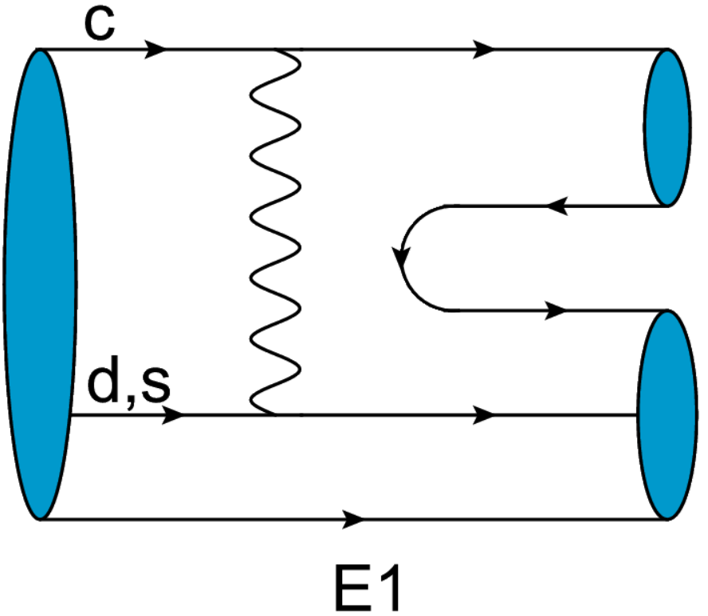
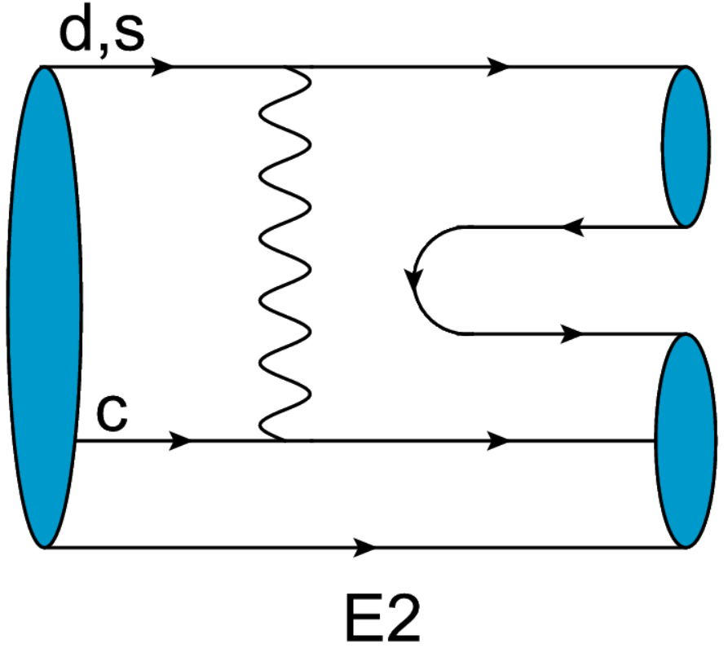
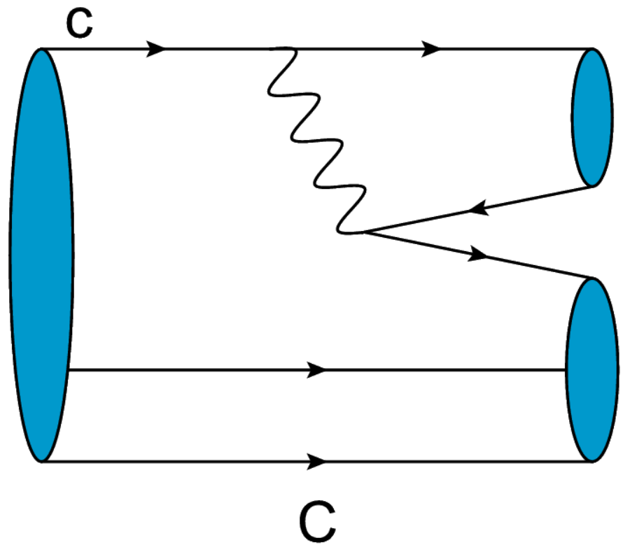
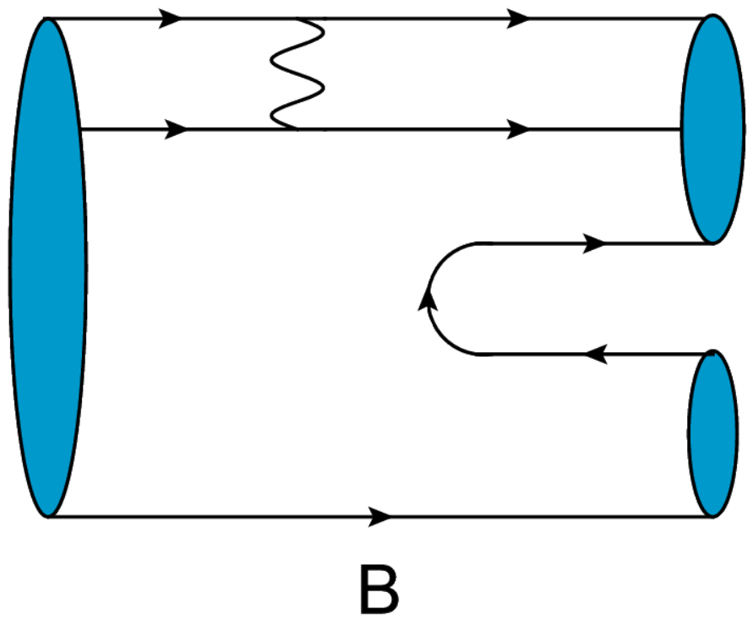


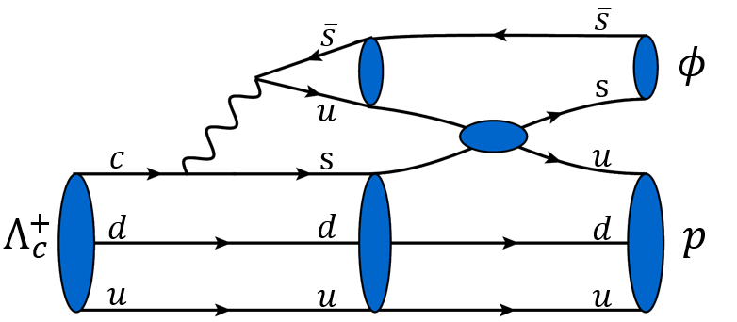
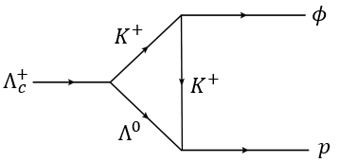
Framework
Natural physical image of long-distance nonperturbative contribution
Short-distance
Long-distance
① dynamics
quark exchange hadronic triangle

Slide 8
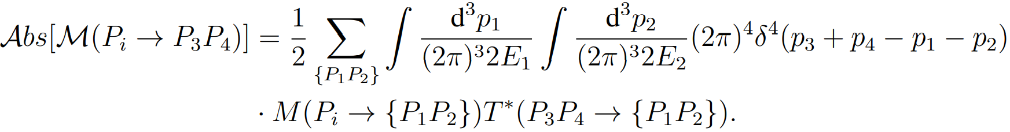
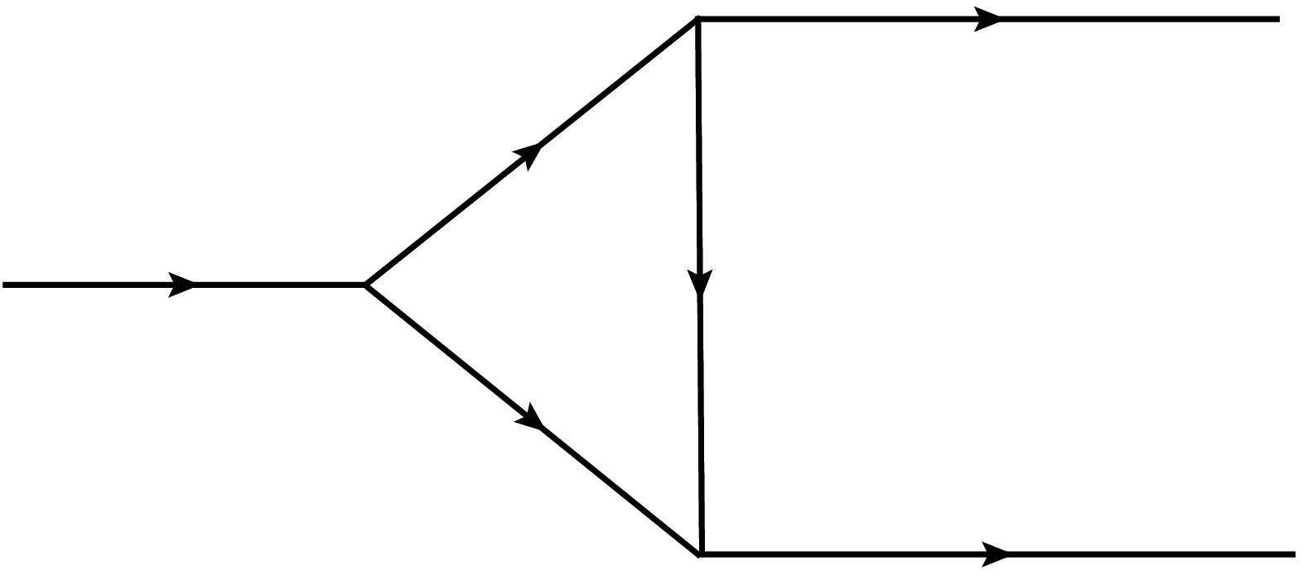

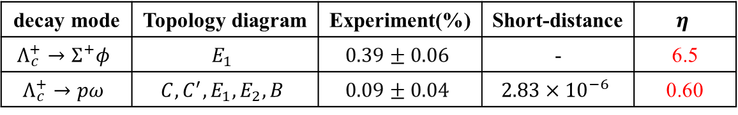

Framework
Conventional method：optical theorem + Cutkosky cutting rule
  H. Y. Cheng, C. K. Chua and A. Soni, Phys. Rev. D 71, 014030 (2005)……..
  Strong model-dependent in charmed baryon decay：
  Only a part of the imaginary contribution is included……
$$Λ=m_{k}+ηΛ_{QCD}$$
$$\frac{m^{2}−Λ^{2}}{p^{2}−Λ^{2}}$$
decay mode | Topology diagram | Experiment(%) | Short-distance | $$η$$
$$Λ_{c}^{+}→Σ^{+}φ$$ | $$E_{1}$$ | $$0.39±0.06$$ | - | 6.5
$$Λ_{c}^{+}→pω$$ | $$C,C^{′}, E_{1},E_{2}, B$$ | $$0.09±0.04$$ | $$2.83×{10}^{−6}$$ | 0.60
Off-shell effects
Lost contribution
$$\frac{m^{2}−Λ^{2}}{p^{2}−Λ^{2}}$$
J.J. Han, H.Y. Jiang, W. Liu, Z.J. Xiao, and F.S. Yu, ” Chin. Phys. C 45, 053105 (2021).

Slide 9
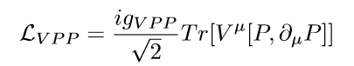
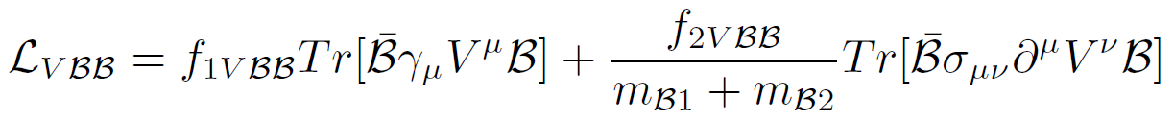


Framework
Improving method：Loop integral
  Weak vertex
  Strong scattering
    S. Meinel, Phys. Rev. Lett. 118, no.8, 082001 (2017).
    T.M.Aliev, A. Ozpineci, M. Savci and V. S. Zamiralov, Phys. Rev. D80 016010 (2009) .
$$\frac{m^{2}−Λ^{2}}{p^{2}−Λ^{2}}$$
$$Λ=m_{k}+ηΛ_{QCD}$$
decay constant heavy-to-light form factor
Error sources

Slide 10

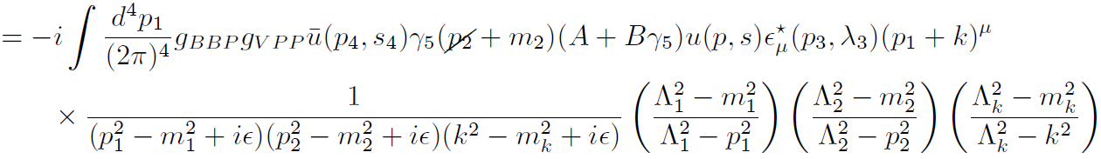

Framework
Improving method：Loop integral
  The complete amplitudes with strong phase
  The contribution of the real part is on the same order as the contribution of the imaginary part!
  The process dependence of the parameters is greatly reduced.
② model dependence
$$Λ=m_{k}+ηΛ_{QCD}$$

Slide 11
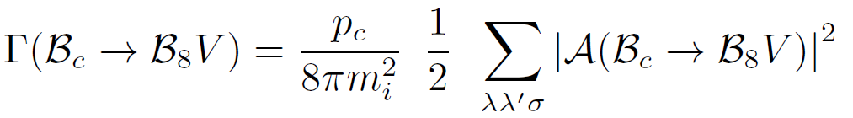
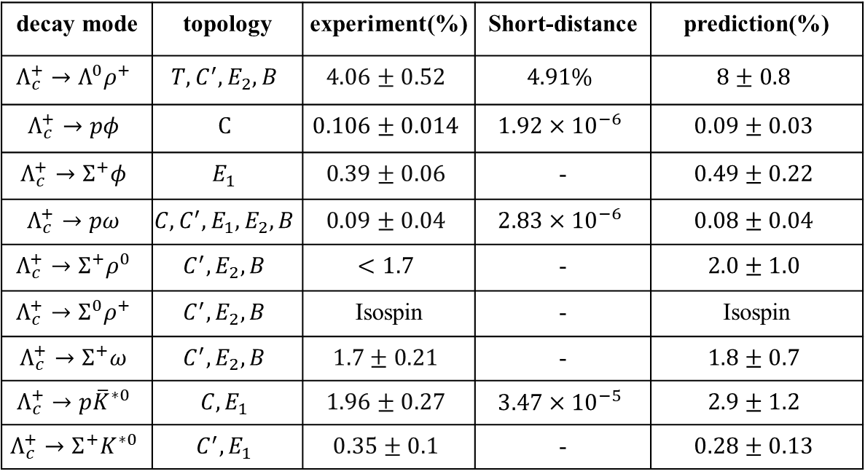

Results and discussion
Branching ratio:
  Only one parameter explains all the 8 experimental data!
$$η=0.6±0.1$$
1
2
decay mode | topology | experiment(%) | Short-distance | prediction(%)
$$Λ_{c}^{+}→Λ^{0}ρ^{+}$$ | $$T,C^{′}, E_{2}, B$$ | $$4.06±0.52$$ | $$4.91\%$$ | $$8±0.8$$
$$Λ_{c}^{+}→pφ$$ | $$C$$ | $$0.106±0.014$$ | $$1.92×{10}^{−6}$$ | $$0.09±0.03$$
$$Λ_{c}^{+}→Σ^{+}φ$$ | $$E_{1}$$ | $$0.39±0.06$$ | - | $$0.49±0.22$$
$$Λ_{c}^{+}→pω$$ | $$C,C^{′}, E_{1},E_{2}, B$$ | $$0.09±0.04$$ | $$2.83×{10}^{−6}$$ | $$0.08±0.04$$
$$Λ_{c}^{+}→Σ^{+}ρ^{0}$$ | $$C^{′}, E_{2}, B$$ | $$<1.7$$ | - | $$2.0±1.0$$
$$Λ_{c}^{+}→Σ^{0}ρ^{+}$$ | $$C^{′}, E_{2}, B$$ | Isospin | - | Isospin
$$Λ_{c}^{+}→Σ^{+}ω$$ | $$C^{′}, E_{2}, B$$ | $$1.7±0.21$$ | - | $$1.8±0.7$$
$$Λ_{c}^{+}→p{\overline{K}}^{∗0}$$ | $$C, E_{1}$$ | $$1.96±0.27$$ | $$3.47×{10}^{−5}$$ | $$2.9±1.2$$
$$Λ_{c}^{+}→Σ^{+}K^{∗0}$$ | $$C^{′}, E_{1}$$ | $$0.35±0.1$$ | - | $$0.28±0.13$$

Slide 12
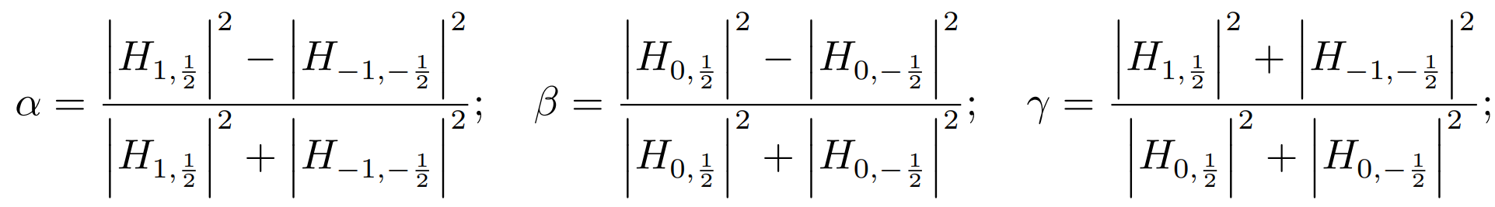
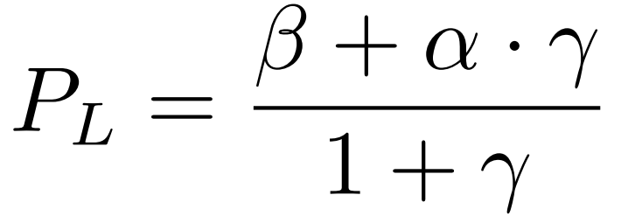
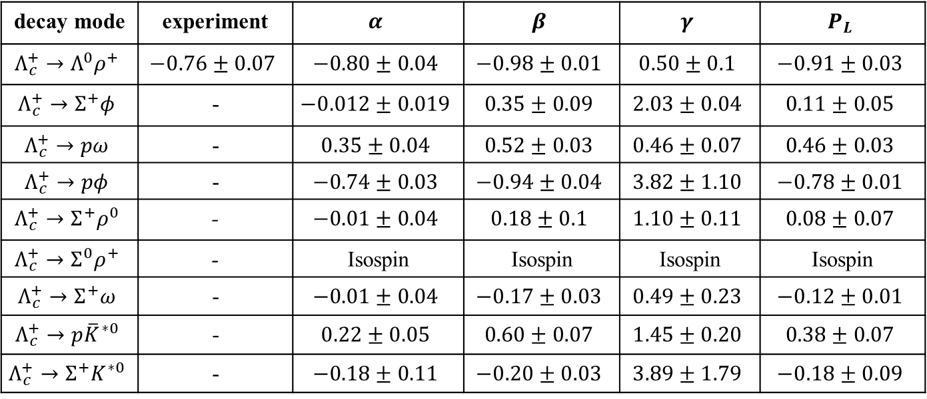
Results and discussion
Decay parameters:
decay mode | experiment | $$α$$ | $$β$$ | $$γ$$ | $$P_{L}$$
$$Λ_{c}^{+}→Λ^{0}ρ^{+}$$ | $$−0.76±0.07$$ | $$−0.80±0.04$$ | $$−0.98±0.01$$ | $$0.50±0.1$$ | $$−0.91±0.03$$
$$Λ_{c}^{+}→Σ^{+}φ$$ | - | $$−0.012±0.019$$ | $$0.35±0.09$$ | $$2.03±0.04$$ | $$0.11±0.05$$
$$Λ_{c}^{+}→pω$$ | - | $$0.35±0.04$$ | $$0.52±0.03$$ | $$0.46±0.07$$ | $$0.46±0.03$$
$$Λ_{c}^{+}→pφ$$ | - | $$−0.74±0.03$$ | $$−0.94±0.04$$ | $$3.82±1.10$$ | $$−0.78±0.01$$
$$Λ_{c}^{+}→Σ^{+}ρ^{0}$$ | - | $$−0.01±0.04$$ | $$0.18±0.1$$ | $$1.10±0.11$$ | $$0.08±0.07$$
$$Λ_{c}^{+}→Σ^{0}ρ^{+}$$ | - | Isospin | Isospin | Isospin | Isospin
$$Λ_{c}^{+}→Σ^{+}ω$$ | - | $$−0.01±0.04$$ | $$−0.17±0.03$$ | $$0.49±0.23$$ | $$−0.12±0.01$$
$$Λ_{c}^{+}→p{\overline{K}}^{∗0}$$ | - | $$0.22±0.05$$ | $$0.60±0.07$$ | $$1.45±0.20$$ | $$0.38±0.07$$
$$Λ_{c}^{+}→Σ^{+}K^{∗0}$$ | - | $$−0.18±0.11$$ | $$−0.20±0.03$$ | $$3.89±1.79$$ | $$−0.18±0.09$$
M. Ablikim et al., Phys. Rev. Lett., vol. 129, no. 23, p. 231803, 2022.

Slide 13
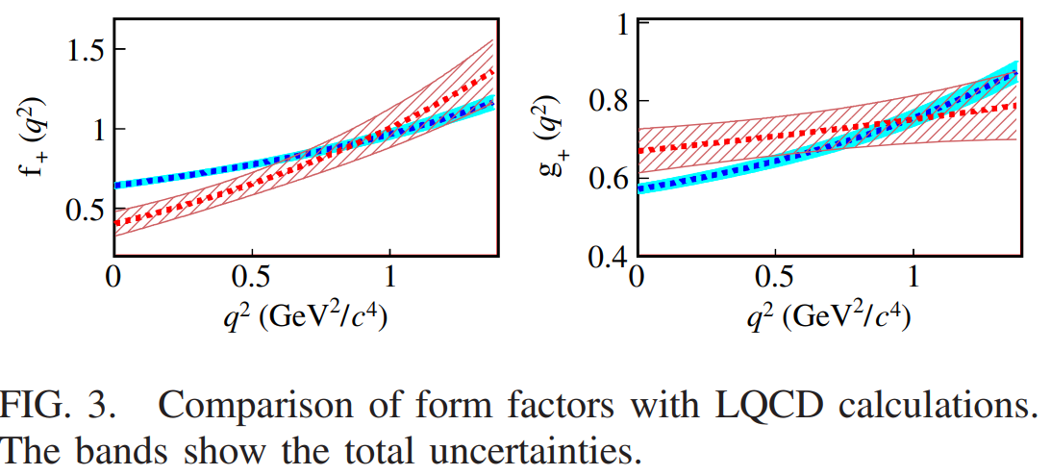
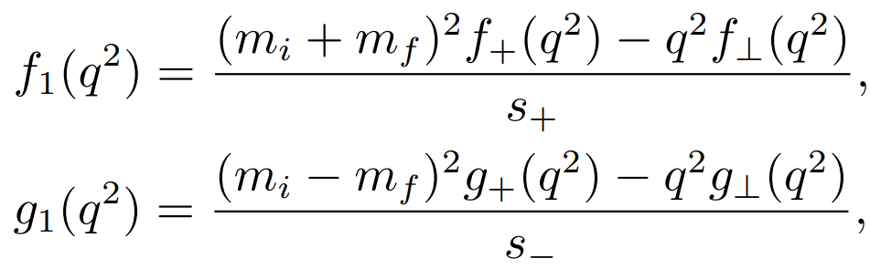
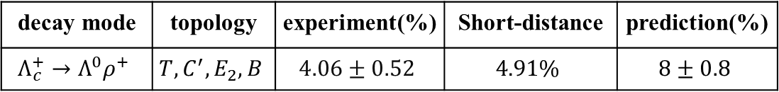
Results and discussion
short-distance dominated:
  M. Ablikim et al., Phys. Rev. Lett., vol. 129, no. 23, p. 231803, 2022.
It is essential to input the much more precise form factors!
decay mode | topology | experiment(%) | Short-distance | prediction(%)
$$Λ_{c}^{+}→Λ^{0}ρ^{+}$$ | $$T,C^{′}, E_{2}, B$$ | $$4.06±0.52$$ | $$4.91\%$$ | $$8±0.8$$

Slide 14
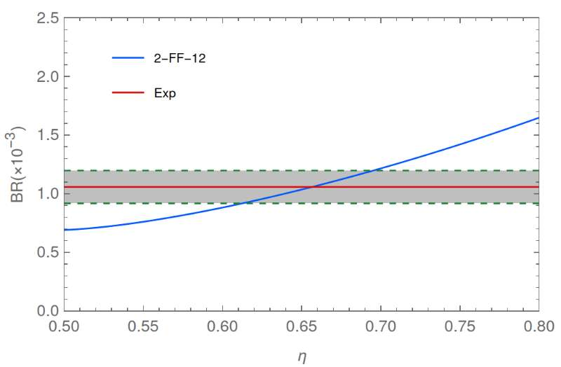
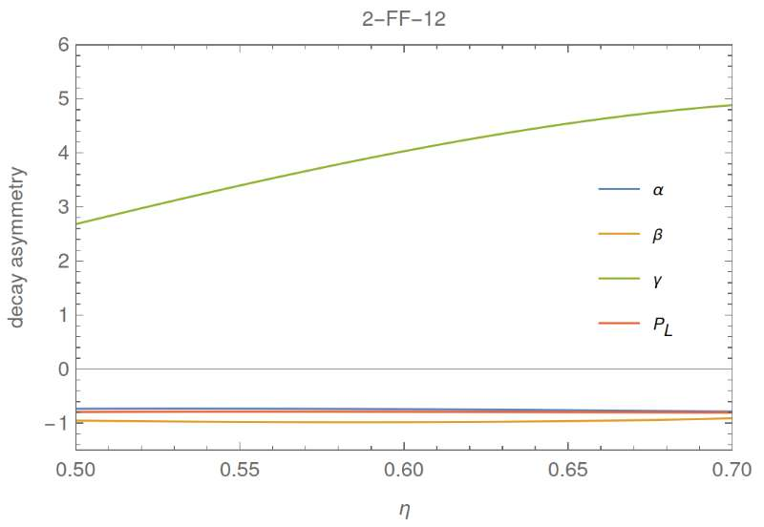

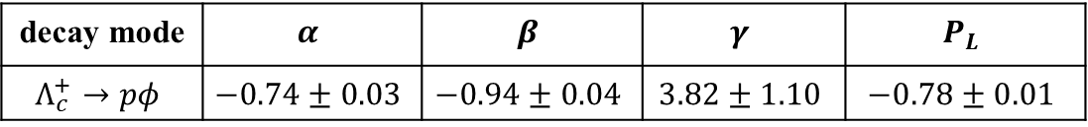
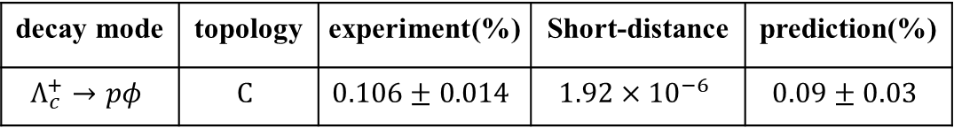
Results and discussion
long-distance dominated:
  The branching ratio is dependent on the parameter $η$;
  The decay parameters are almost independent of the parameter $η$;
decay mode | topology | experiment(%) | Short-distance | prediction(%)
$$Λ_{c}^{+}→pφ$$ | $$C$$ | $$0.106±0.014$$ | $$1.92×{10}^{−6}$$ | $$0.09±0.03$$
decay mode | $$α$$ | $$β$$ | $$γ$$ | $$P_{L}$$
$$Λ_{c}^{+}→pφ$$ | $$−0.74±0.03$$ | $$−0.94±0.04$$ | $$3.82±1.10$$ | $$−0.78±0.01$$

Slide 15
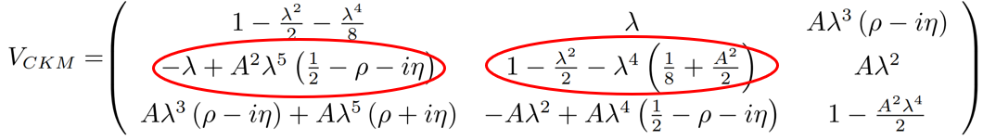
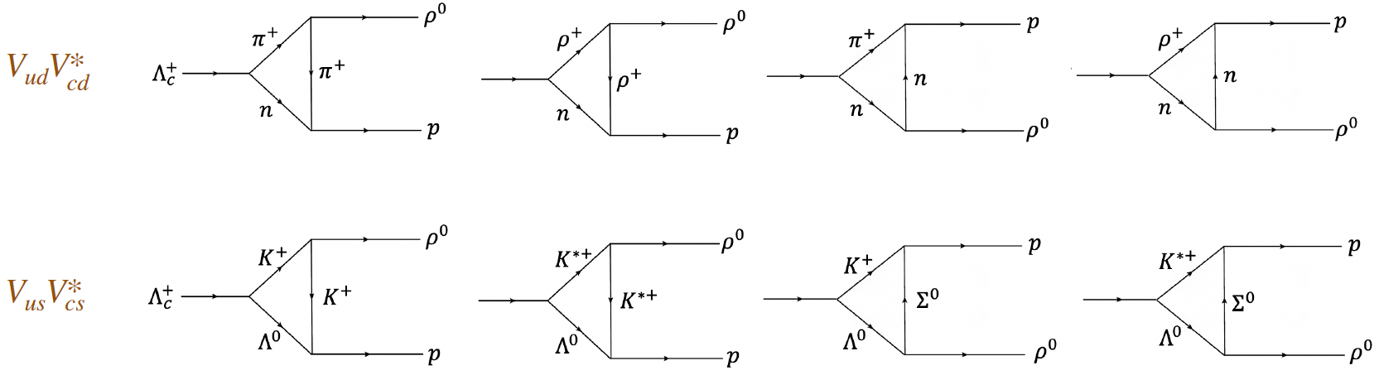
Results and discussion
CP violation:
  key points: phase difference—strong and weak
  CPV can be easily obtained within the re-scattering mechanism !

Slide 16
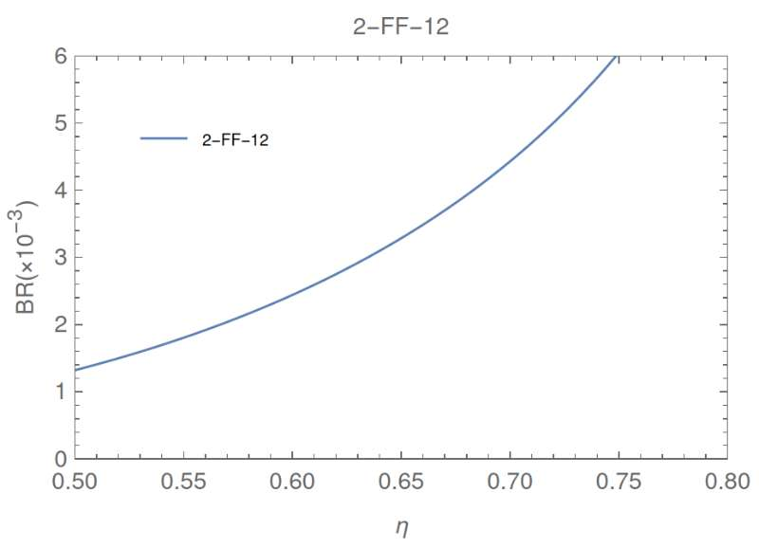
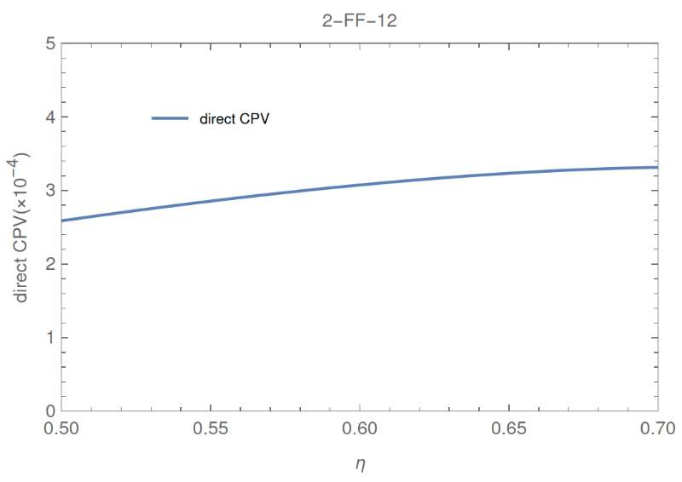
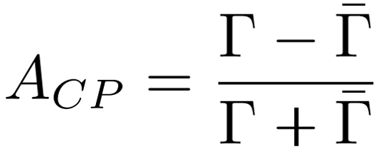
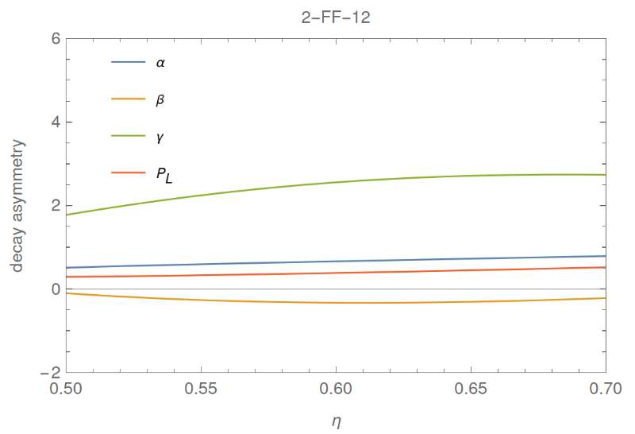
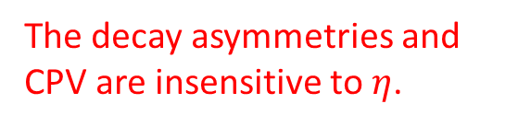

Results and discussion
CP violation:
$$Λ_{c}→pρ^{0}$$
The decay asymmetries and CPV are insensitive to $η$.
③ CPV calculation

Slide 17
Summary
Summary
  Re-scattering mechanism is the natural physical image of the long-distance nonperturbative effects.
  Using only one parameter to explain a class of channels with the re-scattering mechanism, avoids introducing too many parameters and reducing the predictive power of theory.
  Predicting the decay parameters and CP violation of charmed baryon decay naturally.
  Generalizing……
Thank you very much!

Slide 18
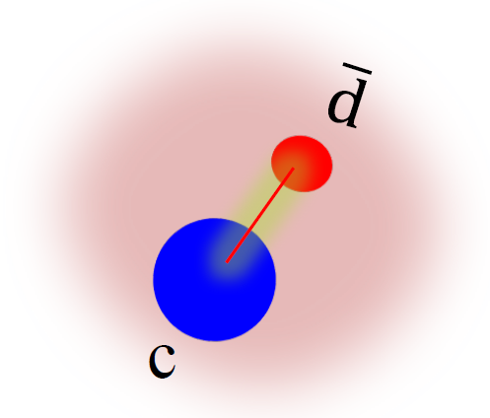



Introduction
Charmed Hadron：
$m_{b}=4.18GeV$ perturbation
$m_{c}=1.27GeV$
粲重子
粲介子
difficult to calculate
ideal platform to understand its dynamics
non-perturbative effects

Slide 19
Introduction
Sakharov conditions for Baryogenesis[Sakharov, 1967]:
  baryon number violation
  C and CP violation
  out of thermal equilibrium
CPV in strange and bottom mesons have been well established.
CPV of charm meson:
  Factorization-assisted topology (FAT)[Li, Lu, Yu, 2012 ]
  topological approach + QCDF[Cheng, Chiang, 2012]
  Re-scattering mechanism with data-driven[Bediaga, Frederico, Magalhaes, PRL2023;Pich, Solomonidi, Silva, PRD2023]
CPV of Charm baryon: the next opportunity and challenge of charm physics

Slide 20





Results and discussion
CP violation:
  key points: phase difference—strong and weak
  Direct CP violation and decay parameter induced CP violation
  CP violation of charmed baryon can be calculated with re-scattering mechanism!
Long-distance contribution CKM matrix
$$A=λ_{d}\left(T_{d}+{QL}_{d}\right)+λ_{s}\left(T_{s}+QL_{s}\right)=a_{d}e^{iφ_{d}}e^{iδ_{d}}+a_{s}e^{iφ_{s}}e^{iδ_{s}}$$
$$\overline{A}=a_{d}e^{−iφ_{d}}e^{iδ_{d}}+a_{s}e^{−iφ_{s}}e^{iδ_{s}}$$
$${\sim 10}^{−4}$$

