Slide 1
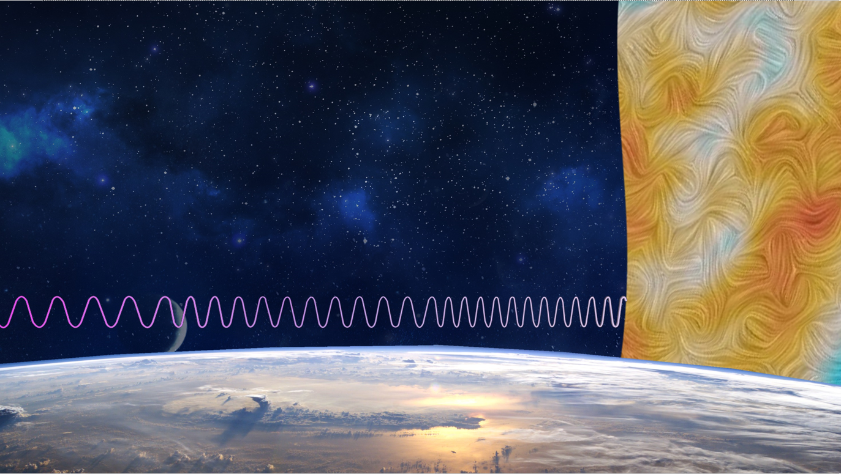
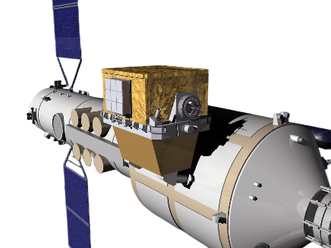
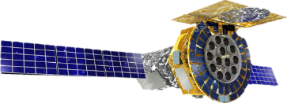
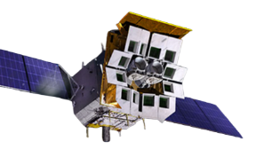
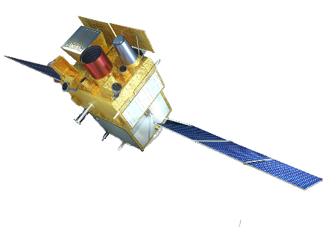
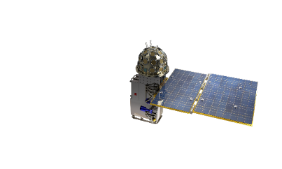
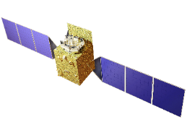
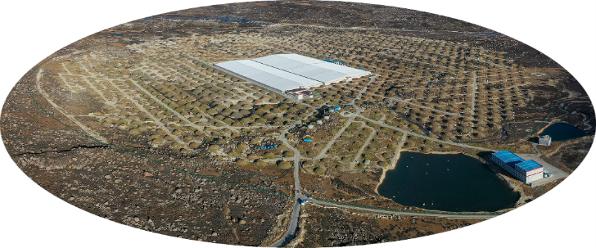
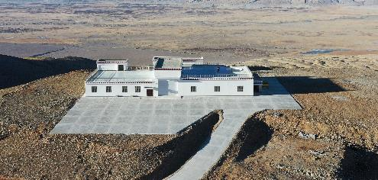
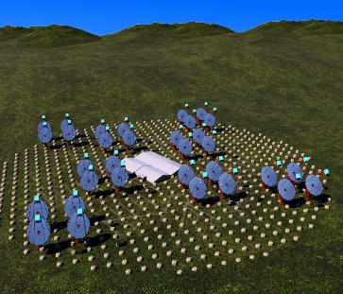
Report of Particle Astrophysics Division (PAD)
Shuang-Nan Zhang
Institute of High Energy Physics
Sept. 20, 2023

Slide 2
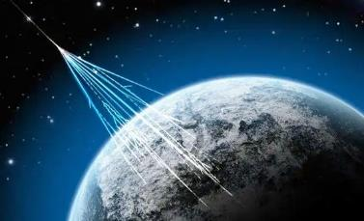
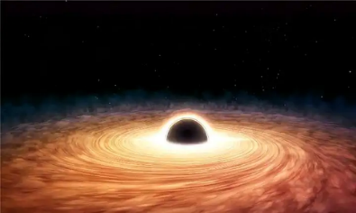
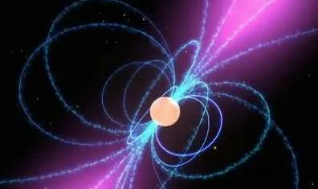
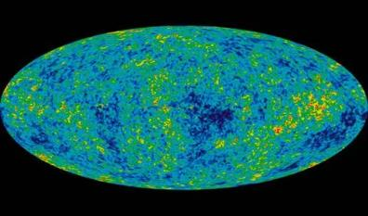
About PAD: mission
Particle Astrophysics
  formed by the close integration of particle physics, astrophysics, and cosmology
  use high-energy particles and radiation as probes to study the fundamental astronomical and physical problems related to
    extreme energy, strong gravity, strong magnetic field, and large scale
Extreme energy
Extreme gravity
Extreme
magnetic field
Large scale
Ultra-high-energy (UHE)
cosmic rays
10¹⁶ times higher in energy than visible light photons
Near the event horizon of a black hole
10⁹ times stronger than the gravitational force on the surface of the Earth
On the surface of a neutron star
10¹³⁻¹⁵ times stronger than the magnetic field on the surface of the Earth
Primordial gravitational waves
its wavelength reaches the cosmic scale of about
10¹⁰⁻¹¹ light-years

Slide 3
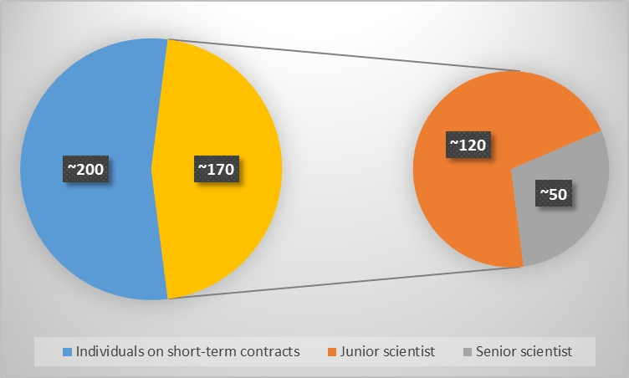
About PAD: general status
PAD
  is the main base for China's observation and research on particle astrophysics
  has developed a range of internationally leading scientific instruments, including space-based, ground-based, multi-messenger, and multi-wavelength technologies
  is establishing itself as a world-class research institution for particle astrophysics
A high-level research team consisting of ~170 permanent employees, including ~50 senior scientists
~200 individuals on short-term contracts: postdoctoral researchers, graduate students, adjunct researchers between IHEP and other institutions

Slide 4
About PAD: scientific questions
PAD focuses on three major scientific questions:
  the origin of cosmic rays, extreme gravity and magnetic fields of black holes and neutron stars, and primordial gravitational waves and cosmic expansion
Subjects
Goals
The century-old mystery of the origin and acceleration mechanism of high-energy cosmic rays
The origin of cosmic rays
What happens around black holes, the mystery of the magnetic field structure and composition of neutron stars
Extreme gravity and magnetic fields of black holes and neutron stars
The mystery of the origin and accelerated expansion of the universe, the Hubble tension
Primordial gravitational waves and cosmic expansion

Slide 5
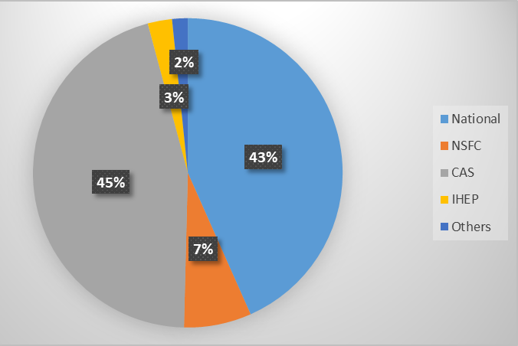
Funds and Publications
Funds in 2018 ~ 2022: 1310 millions RMB
Funds in 2013 ~ 2017: 608 millions RMB
  Percentage increase: ~115%
Publications in 2018 ~ 2022: 1250
Publications in 2013 ~ 2017: 1225
  Neutrino & CMS groups moved to EPD in 2019;
  Publications based on PAD’s missions & experiments have increased significantly recently.
Highly cited papers based on our projects:
Project | Title | Journal | ESI
HXMT: China’s 1st X-ray & hard X-ray observatory | Discovery of oscillations above 200 keV in a black hole X-ray binary with Insight-HXMT | NATURE ASTRONOMY | SPACE SCIENCE/1%
 | HXMT identification of a non-thermal X-ray burst from SGR J1935+2154 and with FRB 200428 | NATURE ASTRONOMY | SPACE SCIENCE/0.1%
LHAASO: the most sensitive UHE γ-ray observatory | Ultrahigh-energy photons up to 1.4 petaelectronvolts from 12 gamma-ray Galactic sources | NATURE | Multidisciplinary/1%
 | Observation of the Crab Nebula with LHAASO-KM2A-a performance study | CHINESE PHYSICS C | PHYSICS/1%

Slide 6
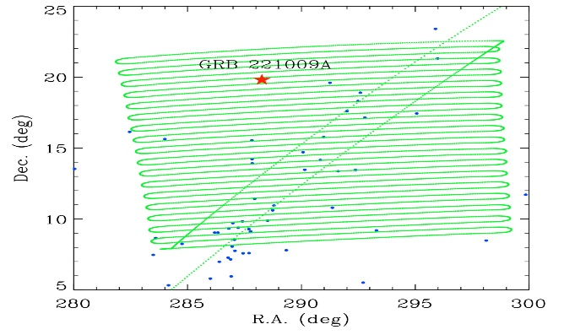
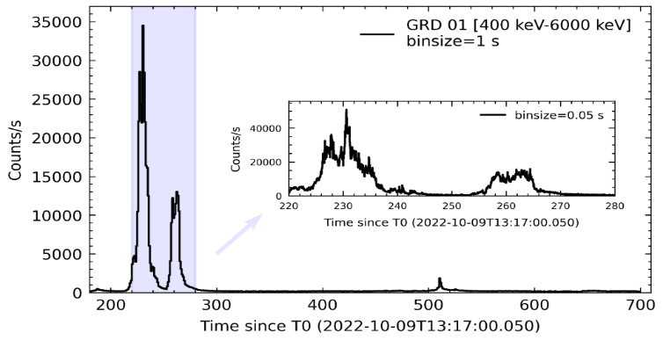
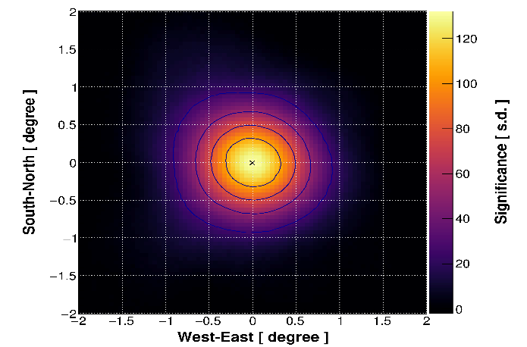
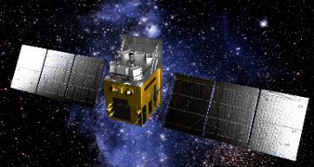
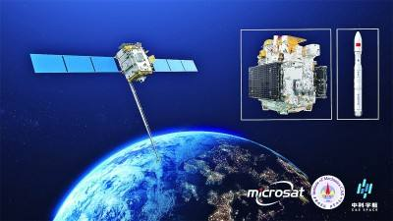
The advantage of our joint observations
X-ray
Soft gamma-ray
High-energy gamma-ray
HXMT
GECAM-C
LHAASO
LHAASO, Insight-HXMT, and GECAM-C observations of the brightest-of-all-time GRB 221009A
Widest energy range coverage -- internationally unique capability.
Please refer to the reports of Profs. Shaolin Xiong and Zhen Cao for further details on highlights of PAD’s scientific achievements.

Slide 7
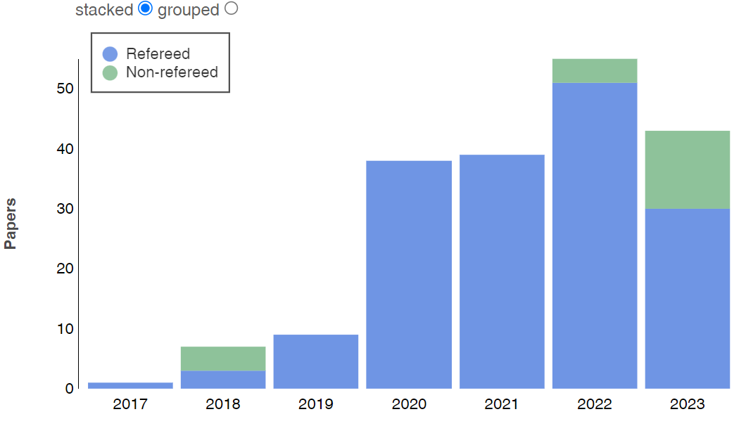
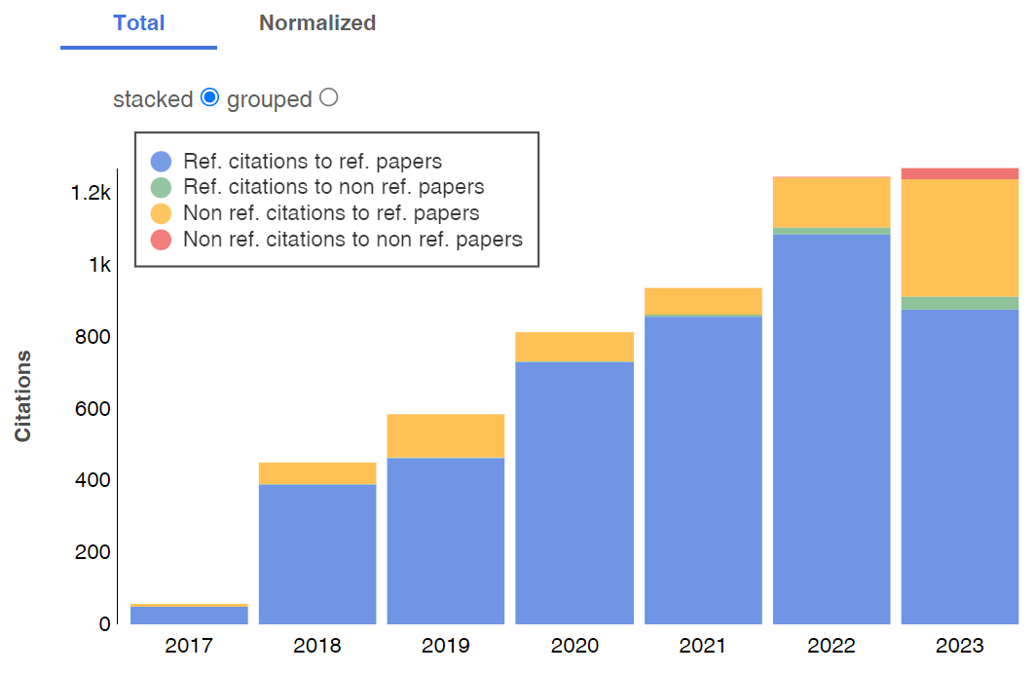
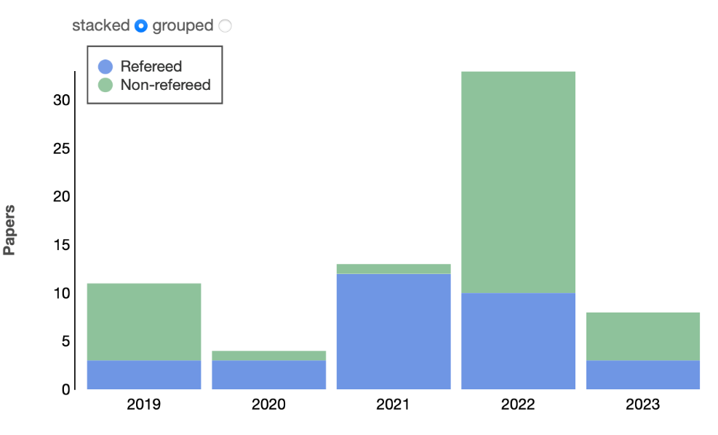
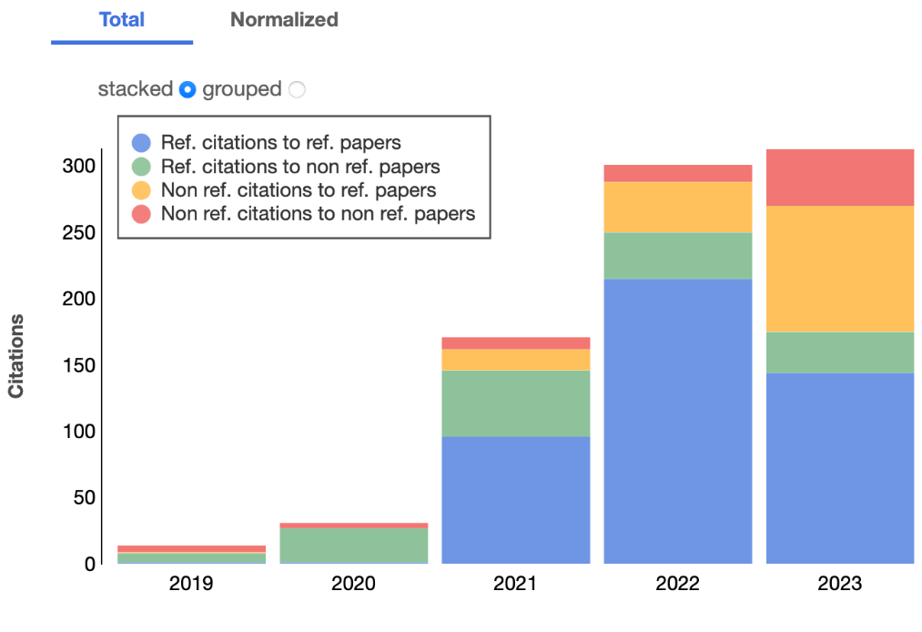
Publications of HXMT & LHAASO
Insight-HXMT publications and citations: ADS, updated on Aug. 27
LHAASO collaboration publications and citations: ADS, updated on Aug. 27

Slide 8
Improvement since 2018: space program
Comments in Assessment of 2018:
  The space program was ranked A+
  PAD had a very concise and very full roster of Space missions for the next 5 years, and the leadership has to coordinate international collaborations very closely to assure timely deliveries of instrumentation.
  Necessary measures should be taken to ensure the quality and progress of GECAM.
  Implementation & Achievements:
  Projects like EP, SVOM, eXTP and HERD have extensive international collaborations, and special measures have been taken to ensure smooth international cooperation. In particular, the delivery of the focusing mirror and detector for the EP/FXT has been successfully completed, ensuring that the EP can be launched as planned by the end of 2023.
  The GECAM project has faced severe challenges during its development due to the pandemic. However, a series of measures have been taken to ensure the progress of the project, and GECAM was successfully launched in December 2020 as scheduled.

Slide 9
Improvement since 2018: cosmic rays
Comments in Assessment of 2018:
  The ranking of this direction was A (LHAASO was still under construction at that time).
  LHAASO is an exciting and ambitious project that has the potential to attract leading international scientists and position China to be one of the world-leaders in cosmic ray research.
  Implementation & Achievements:
  LHAASO’s full array started operation in July 2021, becoming the world's leading UHE gamma-ray detection facility with the highest detection sensitivity and all-sky monitoring capability in the world. The facility operates very stably, and its performance meets all designed requirements. LHAASO passed the national acceptance in May 2022.
  With the world’s UHE gamma-ray highest detection sensitivity and high-quality data sets, LHAASO has found over 40 UHE cosmic accelerators within the Milky Way and the highest energy photon reaching 1.4x10¹⁵ (quadrillion) electron-volts, the highest energy photon ever observed, thus launching the UHE Gamma Astronomy Era, etc.

Slide 10
PAD roadmap of experiments
Roadmap for the development of PAD experiments:
Subjects | Projects in operation | Projects in construction | In R&D and for mission adoption
Origin of cosmic rays | LHAASO | HERD | LACT
Extreme gravity and magnetic fields of black holes and neutron stars | HXMT GECAM | EP/FXT SVOM/GRM | eXTP POLAR-2
Primordial gravitational waves and cosmic expansion | SARM | AliCPT-1 | AliCPT-2

Slide 11
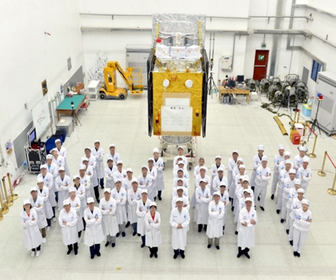
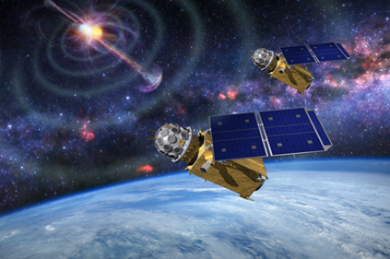
Space-based projects: in operation
Hard X-ray modulated telescope (Insight-HXMT)
  China's first X-ray astronomy satellite;
  has broad X-ray energy bands, large areas, and high timing and energy resolution when observing fast X-ray variability in a broad energy band;
  has been operating in orbit for over six years, functioning smoothly and successfully observing various objects.
  Gravitational wave high-energy Electromagnetic Counterpart All-sky Monitor (GECAM)
  dedicated γ-ray all-sky monitor composed of two microsatellites
  The 1st Chinese space telescope that can downlink data in near real-time (time latency < ~1 minute)
  has detected many X-ray and gamma-ray transients
Please refer to the report of Prof. Shaolin Xiong for details: Space-based programs

Slide 12
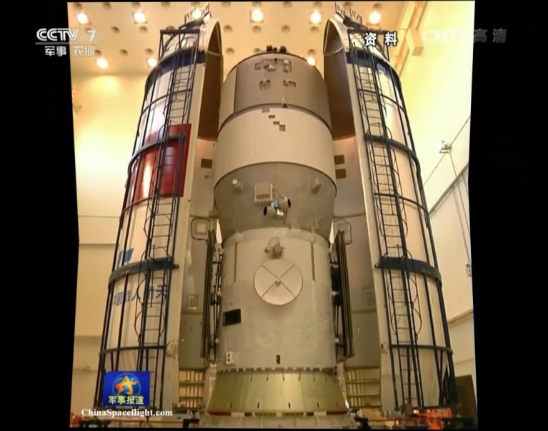
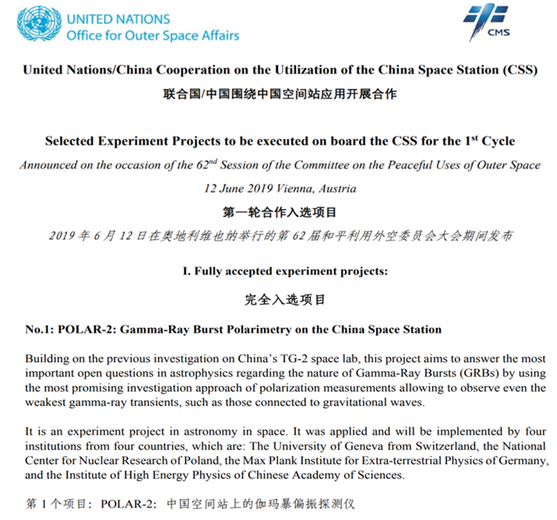
Space-based projects: POLAR to POLAR-2
The Gamma-Ray Burst polarimeter POLAR
  was launched onboard China’s space lab “Tiangong-2” on September 2016;
  is a space mission dedicated to the polarization measurements of GRBs prompt emissions in the 50-500 keV energy range;
  under the collaboration between Chinese and European scientists.
  POLAR-2
  Successor of POLAR, enhanced Gamma-Ray Burst polarimetry experiment onboard China Space Station: 2-1000 keV polarization and spectroscopy
Please refer to the report of Prof. Shaolin Xiong for details: Space-based programs

Slide 13
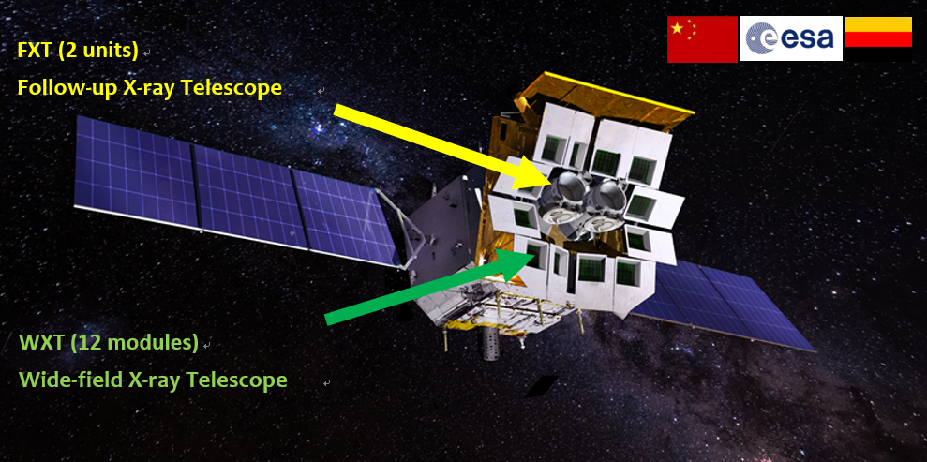
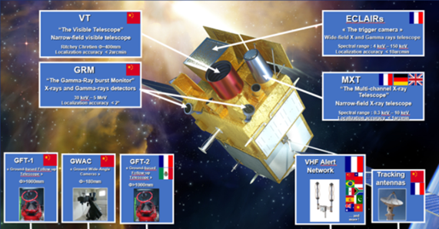
Space-based projects: EP & SVOM
PAD is a crucial research and development institution for the two high-energy astronomical satellites
  Einstein Probe (EP) : 2023.12.31
  Chinese-French astronomical satellite SVOM (Space-based multi-band astronomical Variable Objects Monitor): 2024
Please refer to the report of Prof. Shaolin Xiong for details: Space-based programs
EP
SVOM

Slide 14
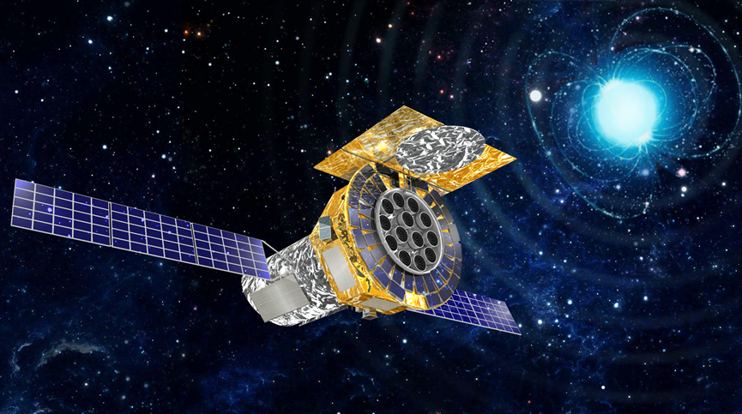
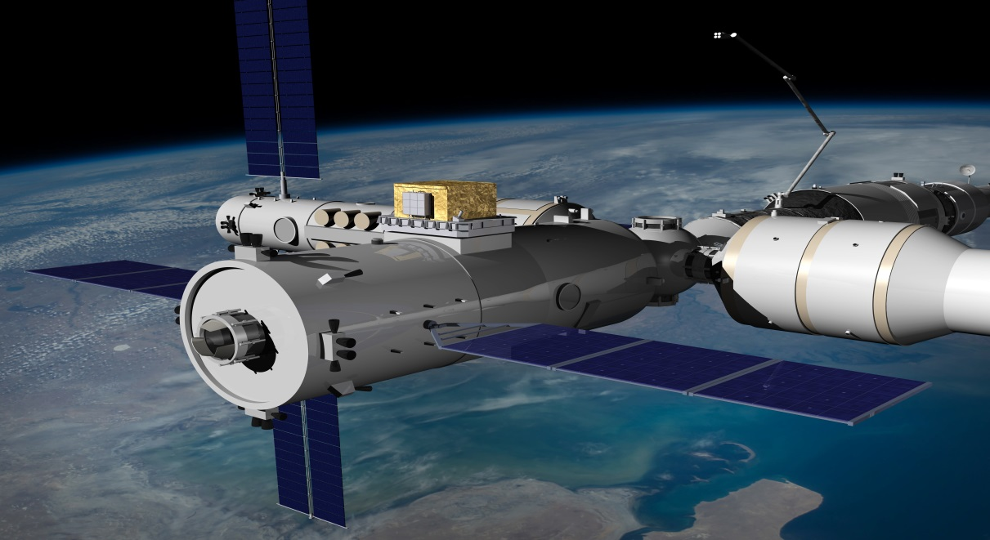
Space-based projects: future eXTP & HERD
PAD has also spearheaded the development of the next-generation flagship space missions, including
  enhanced X-ray Timing and Polarimetry mission (eXTP)
  High Energy cosmic-Radiation Detection (HERD) facility
Please refer to the report of Prof. Shaolin Xiong for details: Space-based programs
eXTP (2029?)
HERD (2027?)

Slide 15
Ground-based projects: LHAASO
Large High Altitude Air Shower Observatory (LHAASO)
  located 4,410 meters above sea level in Daocheng County, Sichuan Province, China
  world's leading ultra-high energy (UHE) gamma-ray detection facility with the highest sensitivity and all-sky monitoring capability
  It consists of three interconnected detectors:
    5,195 electromagnetic particle detectors and 1,188 muon detectors located in the square-kilometer complex array (KM2A)
    a 78,000 m² water Cherenkov detector array (WCDA)
    18 wide-field-of-view Cherenkov telescopes (WFCTA)
  Using these four detection techniques, LHAASO has the ability to measure cosmic rays omnidirectionally with multiple variables simultaneously
Please refer to the report of Prof. Zhen Cao for details: Ground-based Cosmic Ray and Gamma Ray Programs

Slide 16
Ground-based projects: LACT & HUNT
Large Array of imaging atmospheric Cherenkov Telescopes (LACT)
  is a next generation Image Atmosphere Cherenkov Telescope
  consists 32 telescopes and its angular resolution is better than 0.05° above 10 TeV;
  At around 100TeV, its 500-hour gamma ray detection sensitivity is almost the same as the sensitivity of LHAASO for one year;
  allows us to identify the PeVatron gamma ray sources and measure their morphology in detail, which can help us to reveal the mechanism of the PeVatron gamma ray emission and then deeply explore the origin of the high energy cosmic rays.
  High-energy neutrino telescope (HUNT)
  is our long-term plan for future Cosmic ray research, to devote to the research of high-energy neutrino detection, such as the proposed high-energy neutrino telescope project with a scale of 30 cubic kilometers underwater in the South China Sea;
  has completed the test of the detector with a water depth of 1,800 meters in the South China Sea, and is planning to deploy a string of OMs in Lake Baikal.
Please refer to the report of Prof. Zhen Cao for details: Ground-based Cosmic Ray and Gamma Ray Programs

Slide 17
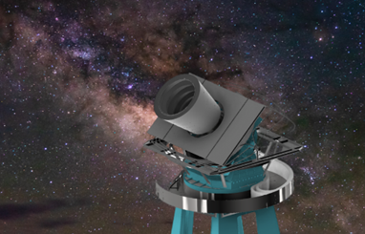
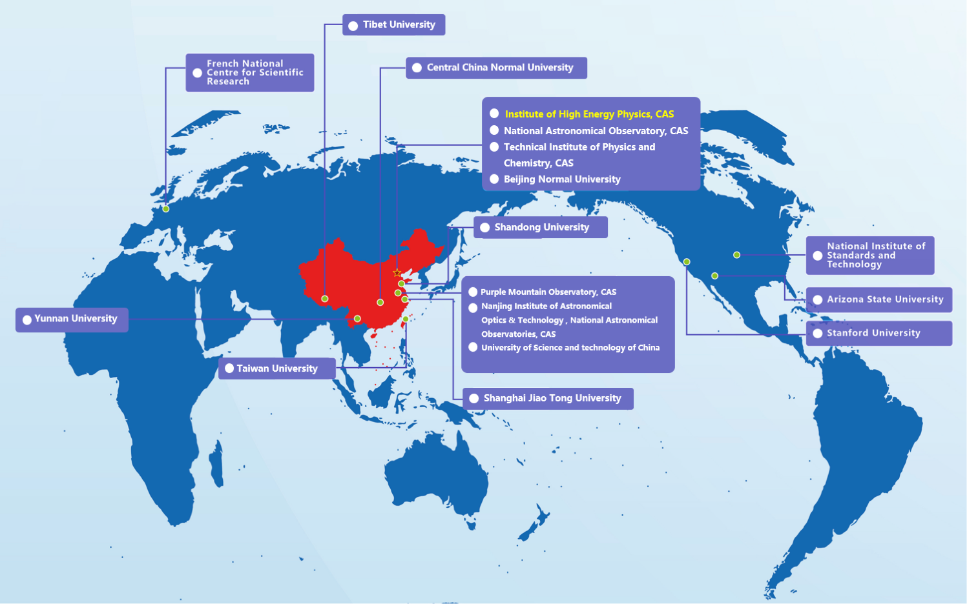
Ground-based projects: Ali-CPT
Ali CMB Polarization Telescope (Ali-CPT)
  led by IHEP/PAD and consists of over 100 scientists from 17 institutions
  will scan the CMB polarization in the northern sky with high precision
  The scientific goals include :
    study CMB E and B mode physics
    detect the primordial gravitational waves
    test inflation and bouncing theories
    measure cosmic birefringence
    study foreground emission
    search for compact sources and transients

Slide 18
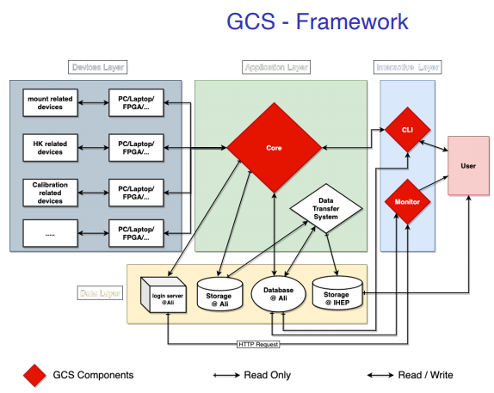
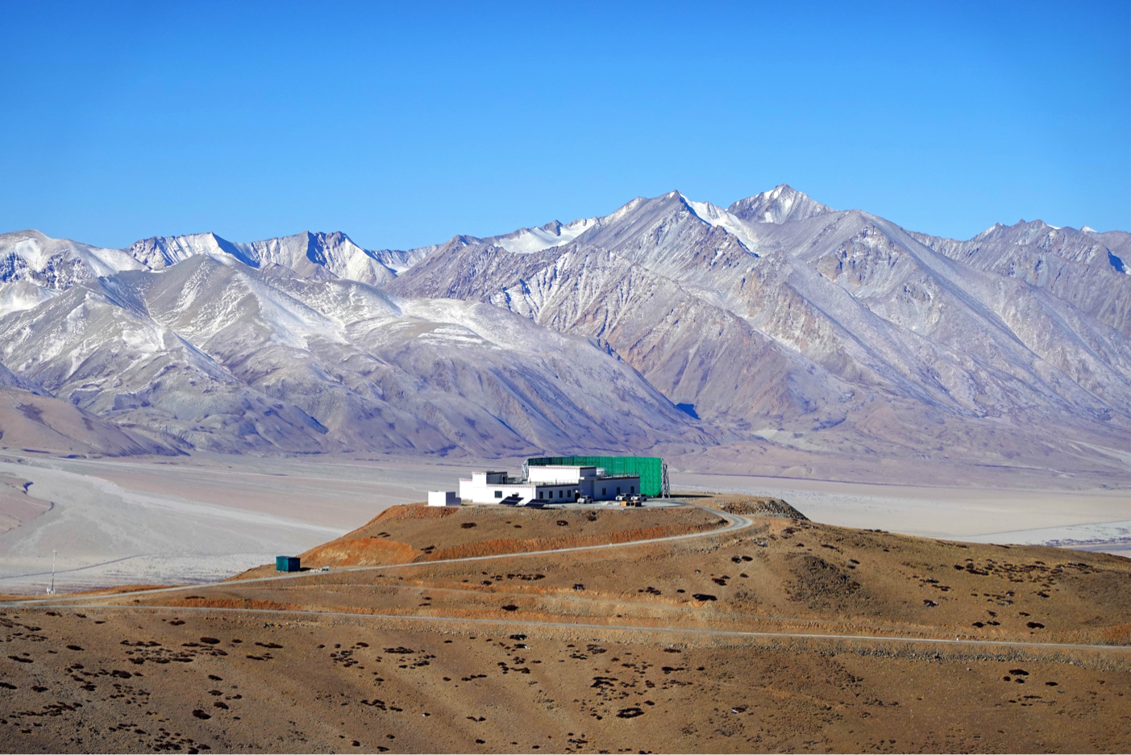
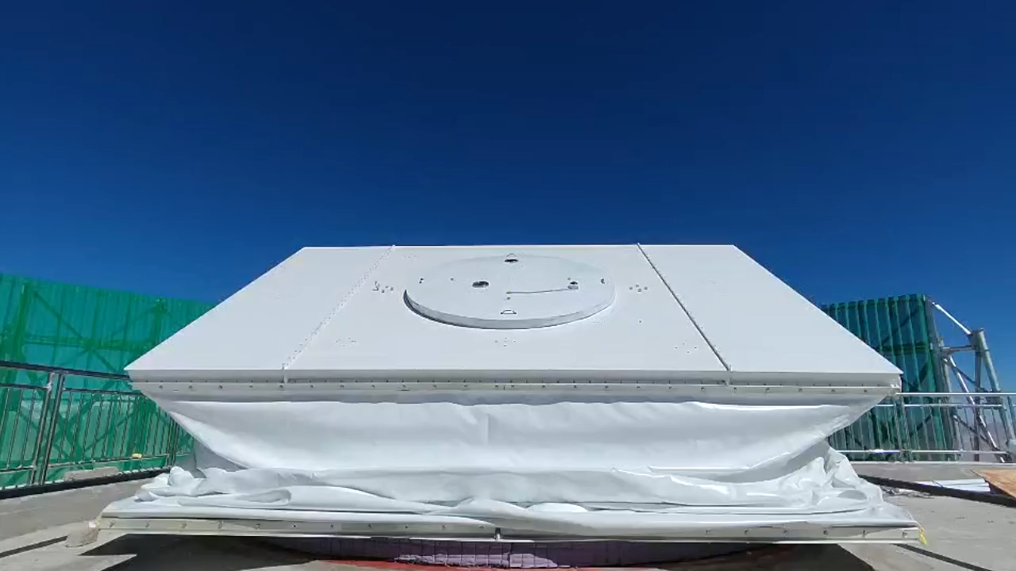
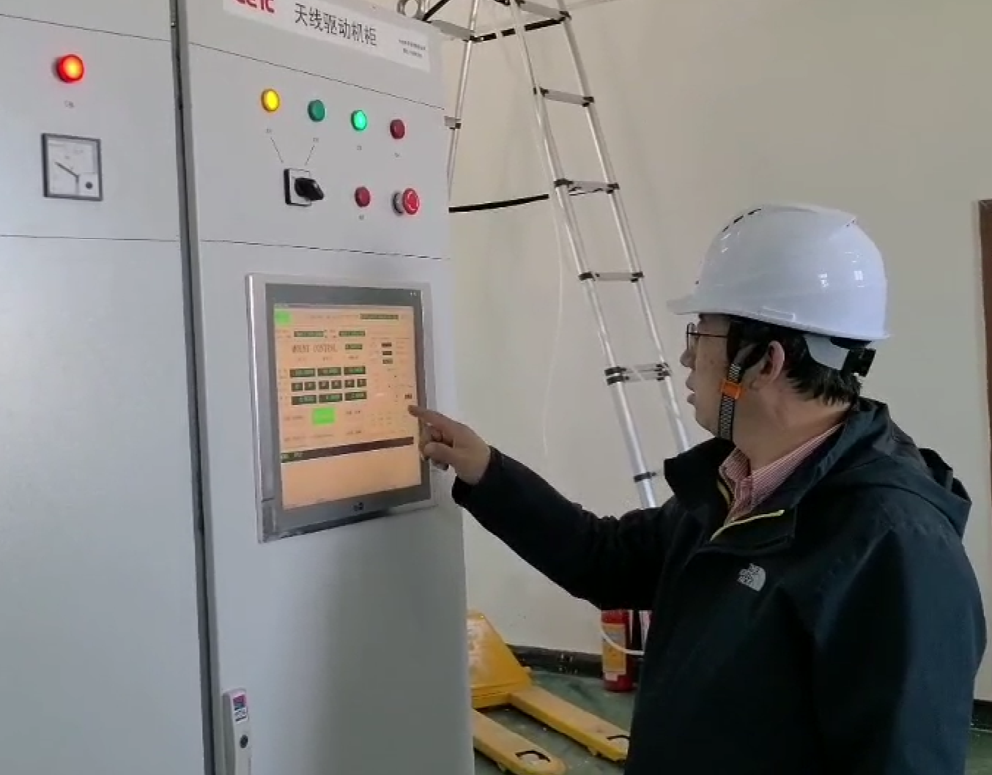
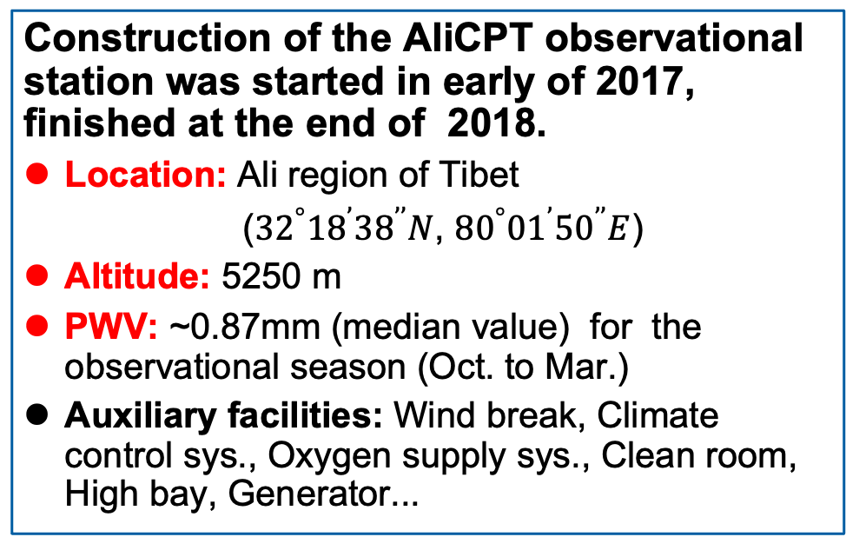
AliCPT observatory: Unique in the Northern Hemisphere
Construction of the AliCPT observational station was started in early of 2017, finished at the end of 2018.
Location: Ali region of Tibet
(${32}^{°}{18}^{’}{38}^{’’}N$, ${80}^{°}{01}^{’}{50}^{’’}E$)
Altitude: 5250 m
PWV: ~0.87mm (median value) for the observational season (Oct. to Mar.)
Auxiliary facilities: Wind break, Climate control sys., Oxygen supply sys., Clean room, High bay, Generator...
The design and manufacture of AliCPT Mount was started in 2017, deployed at site in 2020.
Large scan range: -270° to 270°
High scan speed: 5 deg/s
Pointing accuracy: 10 arcsec
Control system and network deployed in the site in 2020.
High sample rate: 200Hz
Dedicated network line from station to IHEP: 100Mbps

Slide 19
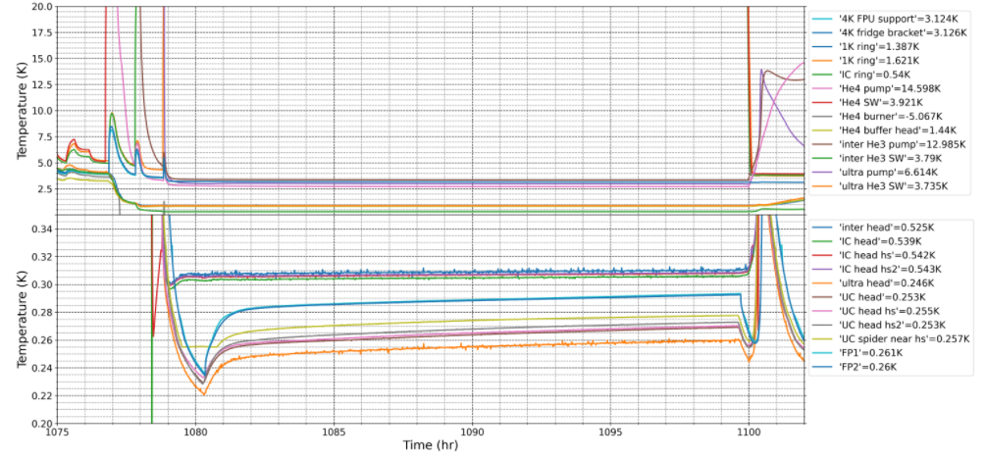
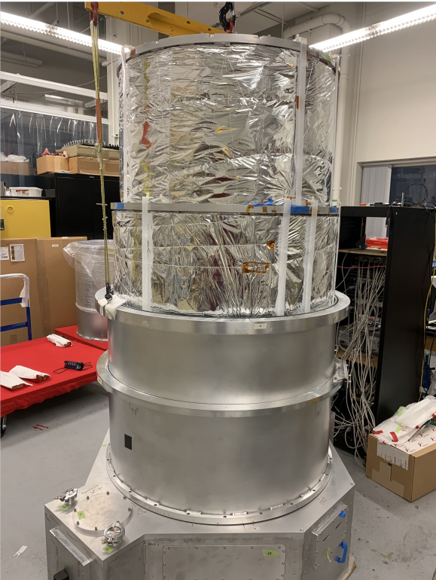
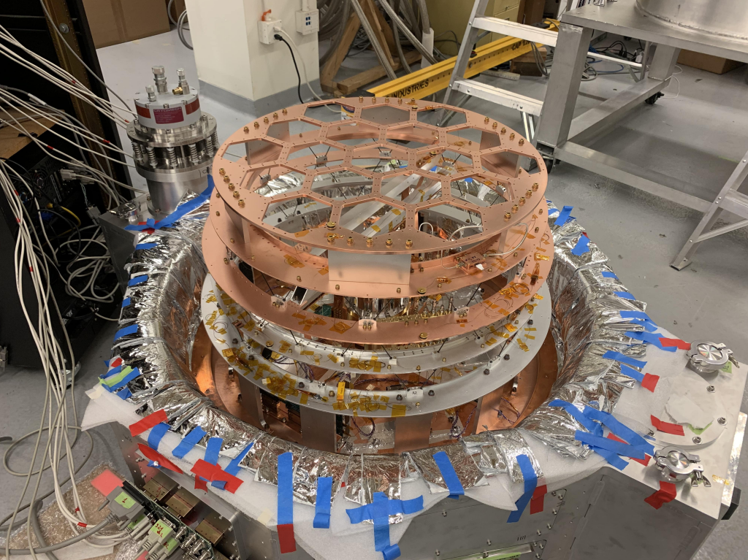
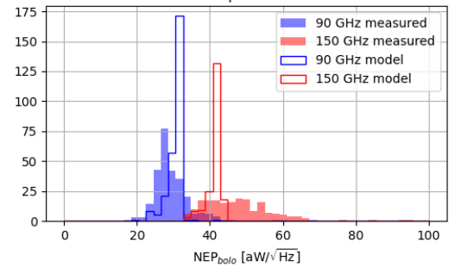
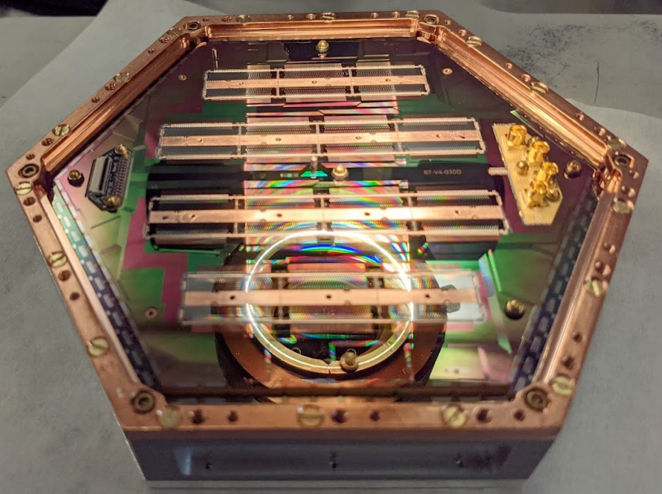
AliCPT-1 (1st phase of AliCPT) Receiver
Design and manufacture of receiver was started in 2018. All components of receiver have been finished in 2021; to be deployed before the end of 2023.
Double refractive optics: aperture size (720mm)
Focal plane: diameter (635mm) with 19 modules about 30000 TES detectors, dual bands: 90&150GHz
Detector module: 1704 optical TES detectors with uMUX readout multiplexer (multiplexing factor 896:1)
Cryostat: PT420-RM + Sorption refrigerator, temperature of focal plane (260mK)
The receiver has been integrated and tested in Stanford Lab for the first and second cooling down, currently preparing for the third run.
Cooling capacity: 20uW@260mK
Measured NEP: 33aW/sqrt(Hz) for 90GHz and 46aW/sqrt(Hz) for 150GHz

Slide 20
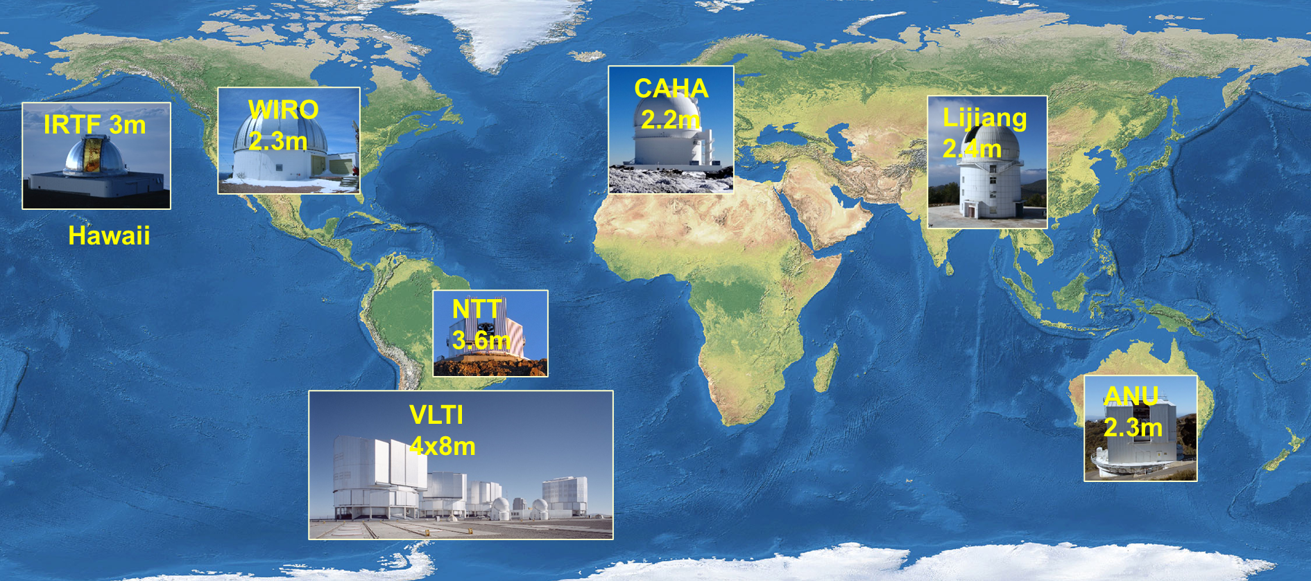
Ground-based projects: SARM on Quasars and Cosmology
  SARM uses a series of 2 m class telescopes to do spectral monitoring of quasars and VLTI (Very Large Telescope Interferometer) to do spectro-astrometric observations of quasars.
  Provides a new, timely method to measure masses of supermassive black holes as well as geometric distances of quasars
  SARM aims to resolve the so-called “Hubble tension” between early and late universe measurements of the Hubble constant

Slide 21
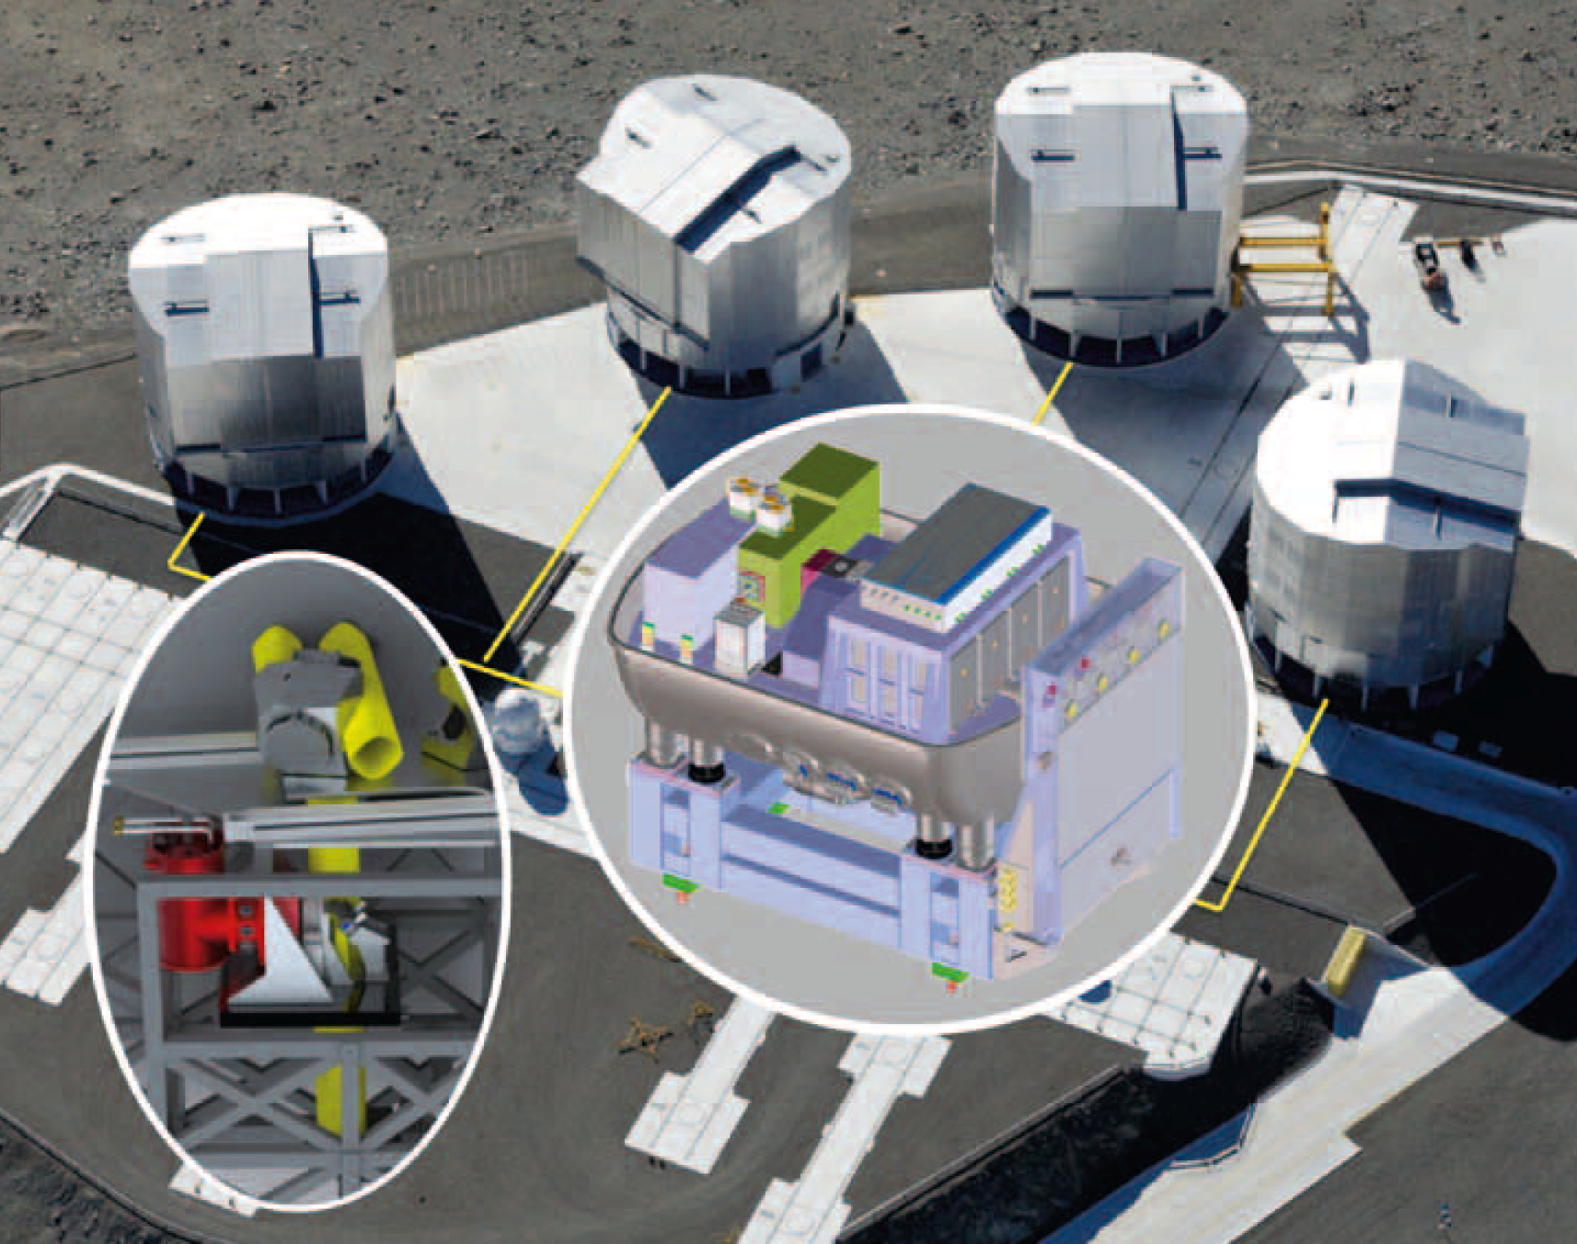
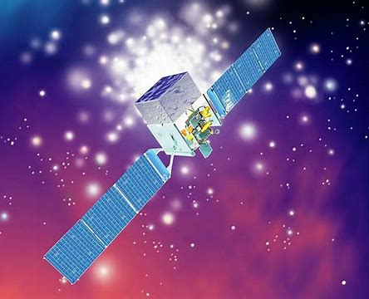
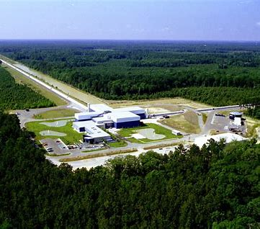
Stellar-mass black holes in AGN disk: a new hot topic
Sgr A*
+ EHT BH picture
Tagawa+(2021)
Gravity collaboration (2023)
Sgr A* : J.-M. Wang et al. (2023)
AGN disk: EMRI (extremely mass ratio inspiral)
Electromagnetic counterparts
J.-M. Wang+2021, ApJ, 916, L17
J.-M. Wang+2021, ApJ, 911, L14
J.-M. Wang+2023, ApJL (submitted)
Periodicity of variations in Sgr A*
VLTI
Fermi
LIGO
LISA
Genzel+(2003), von Fellenberg+(2023)

Slide 22
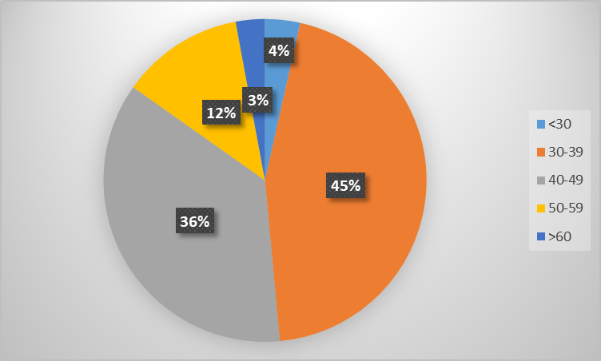
Manpower
Number of Staff: Keeping Stable!
Neutrino & CMS moved to EPD!
Age distribution
2017:
PhD/71%; MSc/21%
Avg. age: 38
2023:
PhD/74%; MSc/22%
Avg. age: 41
~81% are in the “golden age” (30-49) group.

Slide 23
Many talents recruited recently (2021-)
Direction | No. | Name | Age | Where from
Origin of cosmic rays | 1 | Felix Aharonian*# | 68 | Max Planck Institute, Professor Emeritus
Extreme gravity, density and magnetic fields: black holes and neutron stars | 2 | 易疏序Shuxu Yi* | 33 | Radboud Univ., Postdoc
黑洞与中子星的极端引力和磁场 | 3 | 王夕露Xilu Wang* | 32 | UC Berkeley, Postdoc
黑洞与中子星的极端引力和磁场 | 4 | 张亮Liang Zhang | 33 | Southampton Univ., UK, Postdoc
黑洞与中子星的极端引力和磁场 | 5 | 徐妍珺Yanjun Xu | 29 | Caltech, Postdoc
黑洞与中子星的极端引力和磁场 | 6 | Rahim Moradi* | 36 | ICRA & INAF, Italy, Associate Researcher
Primordial gravitational waves and cosmic expansion | 7 | 舒诗博Shibo Shu | 31 | Caltech, Postdoc
原初引力波和宇宙膨胀 | 8 | 闫代康Daikang Yan | 31 | NIST, Postdoc
*About half are theorists! In response to many recommendations to PAD.
# Part-time only

Slide 24
International Cooperation
Research area | Projects | Number of Countries (incl. China) | Number of Institutions (domestic + overseas) | Number of Researchers (domestic + overseas)
Space Astronomy | POLAR | 3 | 1+3 | 23+13
 | POLAR-2 | 4 | 3+3 | 33+21
 | eXTP | 26 | 41+125 | ~100+~200
 | HERD | 5 | 41+31 | 216+108
High Altitude Cosmic Ray | LHAASO | 5 | 22+4 | 265+14
 | ASγ | 2 | 14+16 | 77+42
 | ARGO | 2 | 8+17 | 49+23
Telescopes | AliCPT | 3 | 13+4 | ~70+~30
 | SARM | 6 | 3+6 | 15+10
Mandate from IHEP director: not a good project without major international cooperation!

Slide 25






Leading scientists
Tipei Li
CAS Academician
Shuang-Nan Zhang
PI of POLAR, HXMT, eXTP and HERD
Zhen Cao
PI of LHAASO
Jianmin Wang
PI of SARM
Fangjun Lu
eXTP manager
Hongbo Hu
Formal ASγ PI

Slide 26











Outstanding young scientists
Congzhan Liu
AliCPT technical director
Shaolin Xiong
PI of GECAM
Shoushan Zhang
Head of WFCTA
Leader of LACT
Hong Li
AliCPT manager
Yanrong Li
Core member of SARM
Songzhan Chen
Physics of LHAASO
Yongwei Dong
Payload chief designer of HERD
Lian Tao
PI of CATCH
Zhengwei Li
Deputy chief engineer of AliCPT
Wenxi Peng
PI of MeVGRO
Mingjun Chen
Head of WCDA
Leader of HUNT

Slide 27
Strategic Planning of PAD
will finalize the construction and scientific observation of the Ali CMB Polarization Telescope observation station, while also extending the scope of the SARM collaboration and its outcomes;
with complete and operate the two flagship space missions eXTP and HERD;
will persist in enhancing theoretical research on particle astrophysics and take the initiative in proposing and leading the international large-scale science project, Explore the eXtreme Universe (EXU), which includes eXTP, HERD, etc;
will focus on advancing cutting-edge technologies for detecting cosmic rays, including the development of LACT, which complements LHAASO, as well as the exploration of high-energy neutrino observation in the deep sea;
will achieve notable advancements in enabling detection technologies, such as high-energy radiation and particle detectors in space, X-ray optics, superconducting detectors, and gas X-ray polarization detectors.

Slide 28
PAD Fleet of multi-messenger & multi-wavelength instruments
Under development
HERD (2027?)
eXTP (2029?)
About to launch
Primordial gravitational waves
（ultra-high energy scale）
EP/FXT (2023)
SVOM/GRM (2024)
In operation
Insight-HXMT (2017-)
GECAM(2020-
X-ray
Gamma-ray
UHE gamma-ray
Under development
LACT
LHAASO
Ali-CPT
(microwave)

Slide 29
Summary and Challenges
China’s leading research center in particle astrophysics:
  Cosmic ray/space high energy astronomy/cosmology; in house detector/electronics/ mechanics/observation/interpretation/simulation/theory
Internationally unique:
  With facilities from sea level, high altitude mountain, satellite and space station.
Many challenges ahead:
  Scientific productivity and impacts from on-going projects;
  Adoption of eXTP and HERD, and intern. collaboration;
  Many large projects, but still very young teams, though well staffed
Many thanks for you evaluation!

Slide 30
Backup slides

Slide 31





Insight-HXMT: X-ray Binaries
Extreme Magnetism near Neutron Stars:
~150 keV CRSF from Swift J0243.6+6124
Evidence for multipole magnetic field
Extremely Complex Interactions in NSXBs:
1st Galactic ULX Swift J0243.6+6124, GPD to RPD transition;
Corona cooling by NS burst
Extreme Gravity Near Black Holes
MAXI J1820+070:
> 200 keV QPO; precession jet
Fast flowing-out jet

Slide 32



Insight-HXMT & GECAM: FRBs and GRBs
Main burst
flare
Early afterglow
CHIME: FRB 200428
An+, arXiv:2303.01203
GRB 221009A
Precursor
Fast radio bursts: Identification and accurate measurement of an X-ray burst of the magnetar SGR1935 with FRB 200428.
Gamma-ray bursts: ~150 GRBs/year, the brightest GRB 221009A with early jet break
Insight-HXMT: SGR J1935+2154
Li+, 2021, Nature Astronomy

Slide 33





Highlights of GECAM
Discovered the second X-ray bust coincident with a FRB from SGR J1935+2154, firmly established the association between FRB and XRB
Discovered the brightest long duration merger-origin GRB 230307A, first measured the jet geometry in gamma-ray
Discovered a new type of energetic electron beams originated from the Earth, challenging the current theory
[Wang et al., Atel #15682]
[Xiong et al., GCN 33406,
Sun et al., Nature, under review]
[Zhao et al., GRL, 2023]

Slide 34


LHAASO: opened a new window in UHE γ astronomy
Crab, Science 373, 425 (2021)
1st LHAASO source catalog
  Including 90 VHE/UHE gamma ray sources;
  Discovered more than 40 UHE
  (E > 100 TeV);
  Revealing a large number of PeVatrons cosmic accelerator candidate celestial bodies in our galaxy.
The highest energy gamma photon ever observed: up to 1.4 PeV;
Accurately measured the gamma ray energy spectrum of Crab, with the highest energy up to 1.1 PeV, which challenges the standard model of electron acceleration in high-energy astrophysics.
Crab
Nature, 594, 33-36, 2021
Science, 373,
425-430, 2021
LHAASO J0534+2202
LHAASO
开启了“超高能伽马天文学”新领域！
PeVatrons
Nature 594:33-36 (2021)
1.4 PeV
1st LHAASO UHE gamma ray source catalog
arXiv:2305.17030v1 and
submitted to APJ (2023)
34

Slide 35


LHAASO: revealed the mystery of the brightest GRB
On October 9, 2022, LHAASO observed the brightest gamma ray burst (GRB221009A), the bright of all time.
>64 k very high energy photons detected from the GRB, LHAASO made several important discoveries
  Unprecedently accurate measurement of the entire light curve of high-energy photons in the afterglow;
  First time observing the onset of a TeV afterglow;
  Discovered a jet break in the TeV light curve in its decay phase, revealing the mystery of the brightness of the brightest-of-all-time GRB;
  The highest energy GRB photon ever observed: up to 13 TeV.
LHAASO Collaboration, Science 380, 1390–1396 (2023)

Slide 36




SARM first measured the geometric distance of the quasar 3C 273
This provides a geometric approach for resolving the so-called “Hublle constant tension”, which is a big challenge to the current standard cosmology models.
The basic concept is: reverberation mapping measure the physical size of the broad-line region of the quasar, while spectroastrometry measures the angular size. A combination of these two yields the geometric distance.
$$∆R$$
Reverberation mapping：∆𝑅
Spectro-astrometry： ∆𝜃
Geometric distance： D_{A} = ∆𝑅/∆𝜃
quasar
∆𝜃
Earth
(This figure credit to Riess 2019)
Wang et al., nature astronomy, vol 4 517-525 (2020)

Slide 37


Ground Based Programs Team
~60 IHEP scientists involved in LHAASO
  Chief Scientist and Spokesperson: Zhen Cao
  Gamma Ray Physics Coordinator: Songzhan Chen
  Charged Cosmic Ray Physics Coordinator: Shoushan Zhang
~20 IHEP scientists involved in AliCPT
  Chief scientist and spokesperson: Xinmin Zhang
  Deputy Project Managing Director/Chinese Coordinator of the Scientific Section : Hong Li
  Deputy Project Manager/Chinese Coordinator of the Hardware Section: Congzhan Liu
~5 IHEP scientists involved in SARM
  Chief scientist: Jianmin Wang
IHEP has built a strong team for Particle Astrophysics Ground Based Programs.
37

Slide 38



AliCPT Science and Data Analysis Platform
CMB B mode Sciences
  Measuring BB spectrum, searching for primordial gravitational waves, testing models of inflation and other early Universe;
  Measuring TB/EB spectra, searching for cosmic birefringence, testing Chern-Simons theory, Axion-like interaction and CPT symmetry;
  Reconstructing CMB lensing effect;
Millimeter-wave Northern Sky Survey
  Galactic foreground, magnetic fields science;
  Axion dark matter detection;
  Time-domain astronomy.
AliCPT Data Analysis Platform has been developed and ready for end-to-end simulation and scientific analysis.
Scan strategy of AliCPT :
  Deep Survey: 10%, Noise level ~ 14uk.arcmin
  Low foreground sky patch for PGWs and B mode physics.
  Wide Survey: 55%, Noise level ~ 40uk.arcmin
  Scanning half sky at millimeter dual bands, for the studies on foreground, point sources, etc.
  Daily cadence enables time-domain astronomy.
AliCPT (90/150GHz) + Planck + WMAP
AliCPT (90/150GHz/40GHz) + Planck + WMAP
Map depth
Survey weight
Forecast on r sensitivity

