Slide 1
Status Report of
Multi-Disciplinary Research Division
DONG Yuhui
Multi-Disciplinary Research Division, IHEP
Sep. 20, 2023

Slide 2
Outline
1
Introduction
2
Performance and Future Plans
3
Improvements since 2018
4
Summary
Notes:
报告分成5个部分。介绍部门情况；2018年评估的结果和改进措施；各部分的目前工作情况和未来计划；争取的资源和面临的挑战；最后的总结。

Slide 3
Vision & Mission
Part 1
IHEP: one of the world’s leading high-energy physics research centers, and a world-class, large-scale, comprehensive, multidisciplinary research base.
Building and operating synchrotron radiation beamlines and end-stations;
BSRF & HEPS (in construction)
Developing cutting-edge experimental methods and X-ray optical techniques;
PAPS/HEPS/BSRF
Performing in-house research based on SR facilities.
Biomedical Effects of Nanomaterials and Nanosafety, Environment and Health, Protein Structures and Functions, Nuclear Chemistry
Notes:
Vision（上半部分）当然要和整个IHEP的定位契合，mission（下半部分）：建设和运行装置、实验方法和技术研究、基于大装置的前沿研究。

Slide 4
Structure
Part 1
♣ Manpower: 198 scientists and engineers, 25 support and administrative staffs, 289 students and post-doctoral researchers.
Beijing Synchrotron Radiation Facility
LI Xiaodong
High Energy Photo Source
DONG Yuhui, TAO Ye, LI Ming
Platform of Advanced Photo Source
LIU Peng
Positron Annihilation
CAO Xingzhong
Nanomaterials & Nanosafety
GU Zhanjun
Environmental Health & Safety
ZHANG Zhiyong
Protein Structure
DONG Yuhui
Very young team: 85% of staffs < 45 yrs.
During the projects of HEPS-TF & PAPS, many young staffs have been recruited. Now they are the main teams of HEPS.
Nuclear Energy Radiochemistry
CHAI Zhifang & SHI Weiqun
Nuclear Archeology
FENG Xiangqian
Notes:
介绍多学科的概况，多少人员，年龄分布，分成几个部分。蓝色的是工程项目，绿色是在大装置上开展in-house研究的团队。

Slide 5
Manpower
Part 1
Project | Prof. | AP& SE | AR& Eng | TE | Total | Students& Postdocs
BSRF | 6.7 | 16.41 | 7.33 | 0.1 | 30.54 | 73.33
HEPS (PAPS) | 15.5 | 38.99 | 47.57 | 23.9 | 125.96 | 23.87
In-house Research | 22.8 | 35.6 | 3.1 | 0 | 61.5 | 191.8
Support | 0 | 2 | 2 | 1 | 5 | 0
Total | 45 | 93 | 60 | 25 | 223 | 289
Most manpower is allocated to the facility projects (BSRF, HEPS, PAPS)
In-house research teams are carefully selected
Notes:
不同项目上的人员分布。大部分的人员集中在光源项目上。

Slide 6
Research Funding: 2018-2022 (MCNY)
Part 1
 | 2018 | 2019 | 2020 | 2021 | 2022
MOST | 11.24 | 7.45 | 4.42 | 47.94 | 13.14
NSFC | 10.28 | 18.26 | 13.27 | 18.50 | 14.19
CAS | 24.23 | 29.01 | 59.71 | 4.12 | 47.47
IHEP | 3.33 | 2.80 | 2.43 | 7.17 | 1.58
others | 1.75 | 5.20 | 5.81 | 41.20 | 23.96
Competitive | 50.83 | 62.72 | 85.64 | 118.93 | 100.33
HEPS | 49.99 | 3.27 | 5.45 | 61.54 | 277.33
PAPS | 36.10 | 26.06 | 0 | 0 | 0
Total | 136.92 | 92.05 | 91.10 | 180.47 | 377.66
The PAPS project was completed and HEPS started in 2019.
The competitive funding is mainly from MOST, NSFC and CAS, part from Beijing Municipal.
Blue: competitive
Red: construction & development
Notes:
年度经费，竞争性经费在7千万左右，其余的是工程经费

Slide 7
Papers Published
Part 1
Papers by MRD members
Year | 2018 | 2019 | 2020 | 2021 | 2022 | Total
MRD | 536 | 520 | 535 | 572 | 573 | 2736
IHEP | 1560 | 1632 | 1566 | 1867 | 1893 | 8518
% | 34.4 | 31.9 | 34.2 | 30.6 | 30.3 | 32.1
Including the papers of SR methodological research and technology developments, as well as in-house research.
Many papers collaborated with other institutions and universities due to methodological and technological developments.
Notes:
多学科发表的文章。有一部分是合作论文，2015年以后人员转移到光源（HEPS-TF是2016发改委经费到位，但是2015年已经开始），文章数目少了一些。

Slide 8
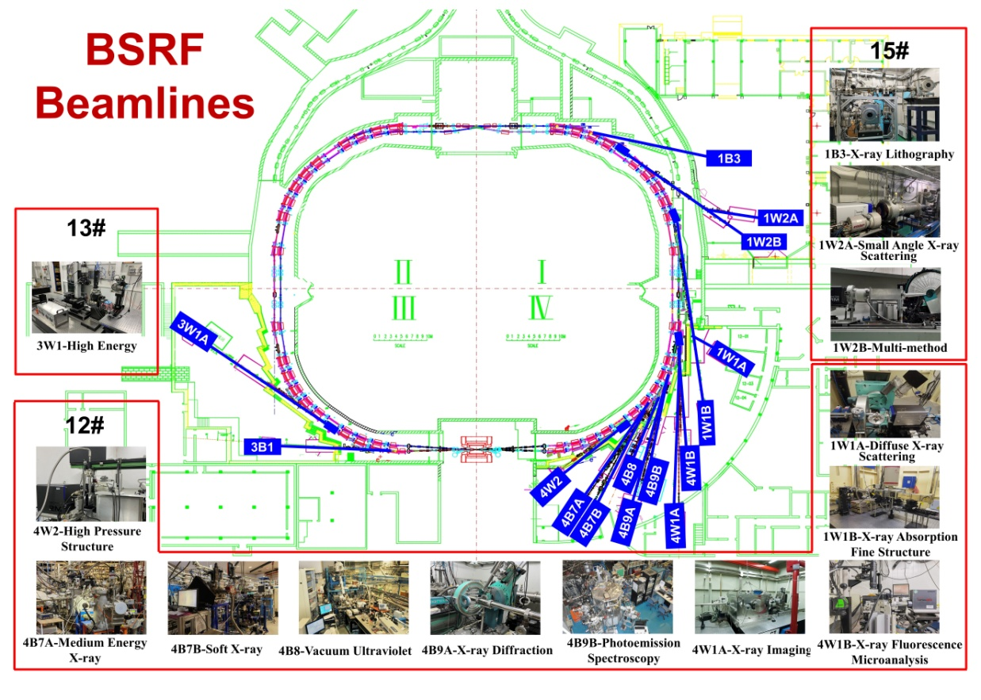
Performance: BSRF
Part 2
5 wigglers, 4 bending magnets
14 beamlines
14 end-stations
Dedicated mode: 2.5 GeV/200 mA
Parasitic mode: depending on HEP
Beamtime: ~1400 hrs/year
Proposals: ~650(dedicated)+220(parasitic)/year
Users: ~1800/year
Papers: ~1000/year
An important experimental platform in northern China.
Typical 1GSR
User support + methodological development + beamline R&D
The machine will be upgraded to BII-U. No dedicated mode in future.
Notes:
进入第三部分（似乎需要一个过渡？），讲述各部分的具体情况。首先是BSRF，目前是中国北方重要，也是唯一的同步辐射实验平台。

Slide 9
Papers by BSRF users, 2012-2022
Part 2
Year | 2012 | 2013 | 2014 | 2015 | 2016 | 2017 | 2018 | 2019 | 2020 | 2021 | 2022
JCR-An1 | 23 | 42 | 38 | 84 | 113 | 150 | 184 | 279 | 408 | 526 | 647
Total | 194 | 249 | 340 | 381 | 390 | 450 | 491 | 627 | 735 | 924 | 1080
% | 11.9 | 16.9 | 11.2 | 21.0 | 29.0 | 33.33 | 37.47 | 44.5 | 55.5 | 56.9 | 59.9
Only 2 months of dedicated operating time per year.
JCR-AN1: Top 5% impact factors by JCR (Journal Citation Report)
Notes:
BSRF历年用户发表文章的统计，突出BSRF运行的效率。

Slide 10
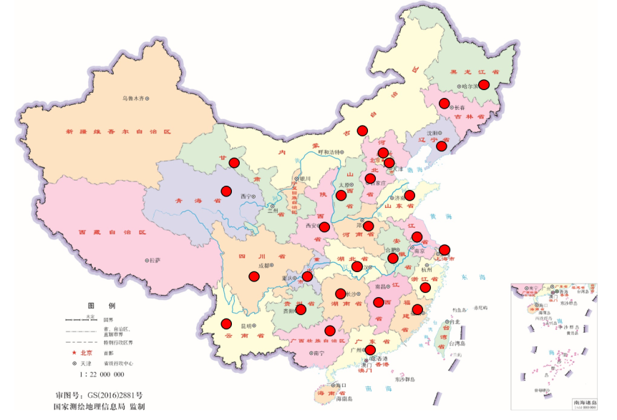
The users and proposals @BSRF
Distribution of proposals
Location of users
1080 papers published in 2022
（JCR-AN1: 647, Science: 2; Cell: 1; Nature series: 61;
Science series: 9; Cell series: 19）
Most users and publication at materials and chemistry.
Fundamental researches focus on physics.

Slide 11
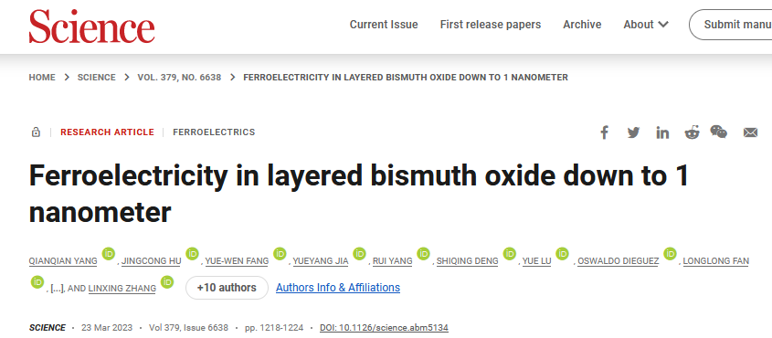
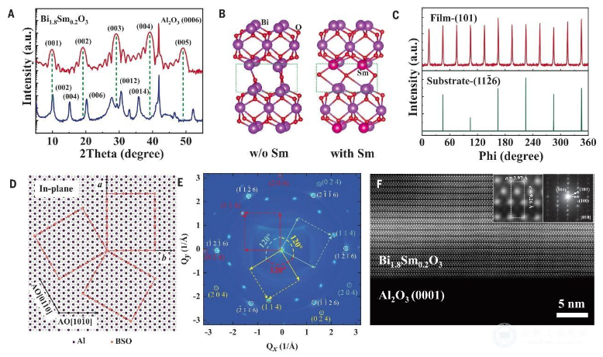
BSRF Research Highlight: Materials
Part 2
The materials research mainly focus on metals, energy storage, electronic materials.
The teams of BSRF strongly involved in the experiments and analysis.
Not simply “measurement”, but “research”
A very simple method to grow the very thin (<1nm) bismuth oxide film.
Stable and high ferroelectricity
Potential for high quality and mass production of devices
The structures of the thin films were systematically studied at BSRF-1W1A
The structure of bismuth oxide thin film growth on single crystal matrix
Science, 379, 1218-1224 (2023)
Notes:
2013年来用户的高水平工作5

Slide 12
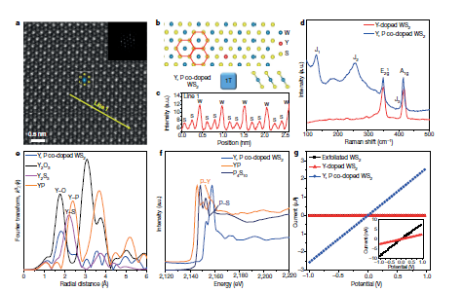
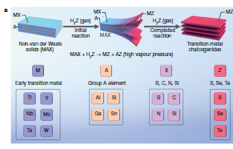
BSRF Research Highlights: Electronic
BSRF-1W1B，4B7B
Detector
Two-dimensional thin films used in electronic
Doping is critical for modifying the properties of thin film and improving the performance of devices.
The XAS techniques of BSRF revealed the mechanism of how doping atoms stabilized the structures of thin films.
Nature 577, 492-496 (2020)

Slide 13
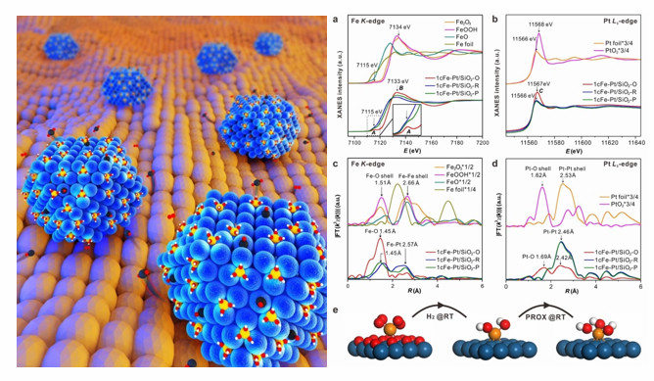
BSRF Research Highlight: Chemistry
Catalysis mechanism in energy storage, petrochemical industry, coal conversion.
The teams of BSRF strongly involved in the experiments and analysis.
Not simply “measurement”, but “research”
Two teams from USTC (Prof. LU Junling and WEI Shiqiang) developed a new type of catalysis Fe(OH)₃@Pt, which can solve the problem of CO in fuel cell.
The in-situ XAFS of BSRF identified the structures and the machamism of catalysis.
Nature, 565, 631–635 (2019)

Slide 14
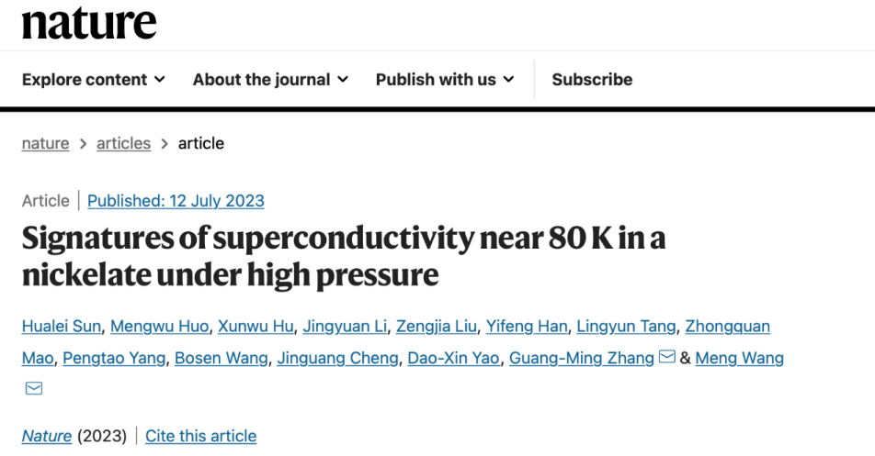
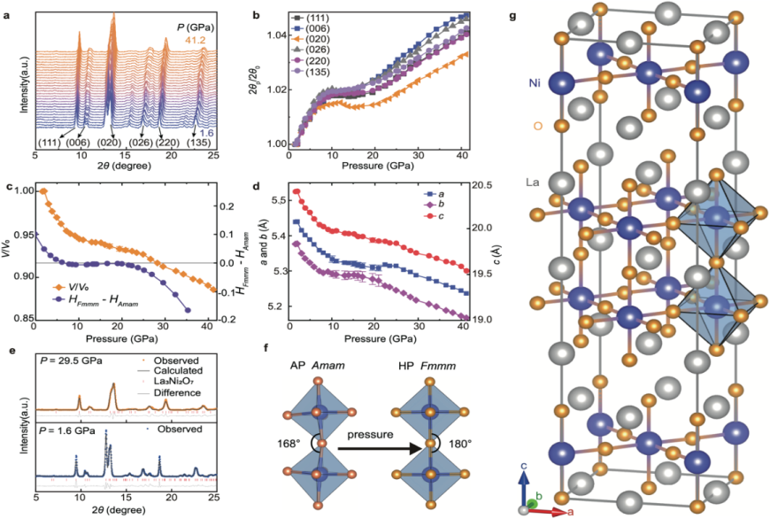
BSRF Research Highlights: Condensed matter physics
Part 2
The researches of superconductivity and high pressure are very active.
Very strong teams in China, especially around Beijing area (IOP, HP-STAR, Jilin Univ. etc.).
Long history of methodological research and cooperation @BSRF
High-temperature superconductivity found in Ni-based material.
The structures of nickelate at high pressure were studied at BSRF-4W2.
Providing important clues for explanation the mechanism of superconductivity.
The structures of La₃Ni₂O₇ at high pressure. A phase transition from Amam to Fmmm was found.
Nature (2023) https://doi.org/10.1038/s41586-023-06408-7
Notes:
2013年来用户的高水平工作1（似乎需要一句口号式的话，否则说太多了听众反而不知道该记住哪个）

Slide 15
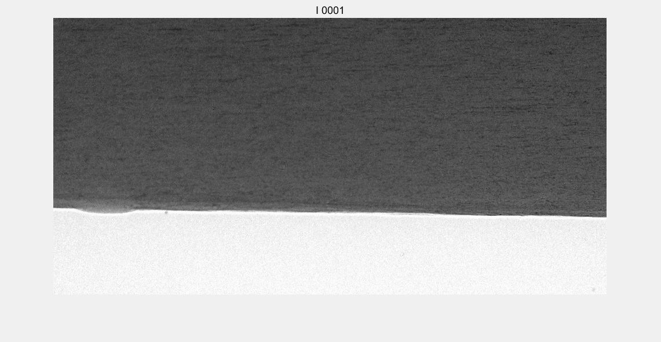
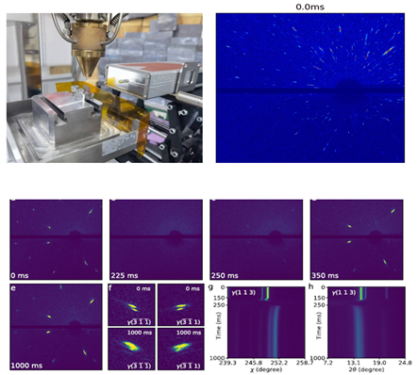
BSRF Research Highlights: Methodology
Part 2
TR X-ray imaging
Methodological research related to HEPS
Mainly on time-resolved methods
X-ray optical metrology
The pores and cracks observed in the melting of Al-alloy
The dynamic properties of alloys in additive manufacturing is one of the important scientific cases of HEPS.
A series of methodological researches were carried on BSRF-3W1 beamline.
TR-Laue diffraction found the torsion of crystals in Ni-alloys
Nature Communications (2023) 14:2961
Notes:
2013年来用户的高水平工作3

Slide 16
Future plan of BSRF (BII-U)
July 2024: Most of beamlines keep operation. Some BL, such as 4B8-VUV, 4W2-HP will close due to the interference to collider.
July, 2024 – Dec. 2024, upgrading to BII-U.
Jan. 2025, commissioning. Parasitic mode.
Before 2030, BEPC operation. BSRF parasitic mode.
The situation of BSRF beamlines depend on the user requirements and HEPS beamlines.
After 2030, need discussion…

Slide 17
BEPC II-U beamlines
Criteria of reserved BIIU BL
User requirements
Complementary with HEPS
Manpower
Schedule
2022.8 Reserved BLs decision
2022.8—2024.6 Design and manufacturing
2024.7 Installation
2025.1 Commissioning, parasitic mode (year round)
BL | Reasons
1B3/LIGA | The only LIGA beamline in China. Manufacturing the device for space projects of IHEP, and Ni/SU8 based CRL for HEPS.
4B7A/4B7B | The energy range complementary with HEPS
4B9B/PES | The energy range complementary with HEPS
1W1B/XAFS | Hugh user number. HEPS can not satisfy the user requirement in short time.
1W1A/Diffusion scattering | Hugh user number. HEPS can not satisfy the user requirement in short time.
1W2B/Testing | Testing of HEPS instruments.

Slide 18
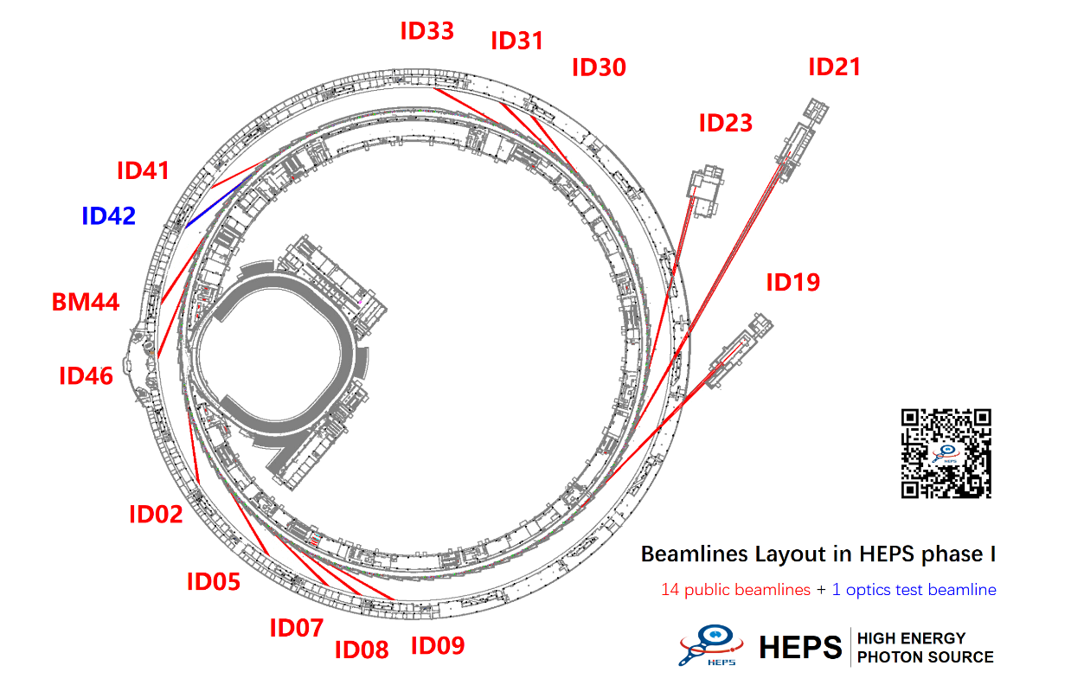
Layout of HEPS Phase I Beamlines

Slide 19
HEPS Phase I Beamlines list
 | Beamlines | Features
High Energy | Engineering Materials | 50-170keV, XRD, 3DXRD, SAXS, PDF
 | Hard X-Ray Imaging | 10-300keV, Phase and Diffraction contrast imaging, 200mm large spot, 350m long
High Brightness | NanoProbe | Small probe, <10nm; In-situ nanoprobe, <50nm; 180m long
 | Structural Dynamics | 15-60keV, single-shot diffraction and imaging; < 50nm projection imaging
 | High Pressure | 110nm focusing, diffraction and imaging
 | Nano-ARPES | 100-2000eV, 100nm focusing, 5meV@200eV, APPLE-KNOT undulator
High Coherence | Hard X-ray Coherent Scattering | CDI(<5nm resolution), sub-μs XPCS
 | Low-Dimension Probe | Surface and interface scattering, surface XPCS

Slide 20
Phase I Beamlines list (cont.)
 | Beamlines | Features
General beamlines | NRS&Raman | Nuclear Resonant Scattering and X-ray Raman spectroscopy
 | XAFS | Routine XAFS, plus 350nm spot and quick XAFS
 | Tender spectroscopy | Bending magnet, 2-10keV spectroscopy
 | μ-Macromolecule | 1μm spot, standard and serial crystallography
 | Pink SAXS | Pink beam, lest optics
 | Transmission X-ray Microscope (TXM) | Full field nano imaging and spectroscopy
Test beamlines | Optics Test | With undulator and wiggler source for optics measurement and R&D

Slide 21
Status of HEPS Beamline
Designs
Key technologies
Procurement and Delivery
Test and Installation
Schedule

Slide 22
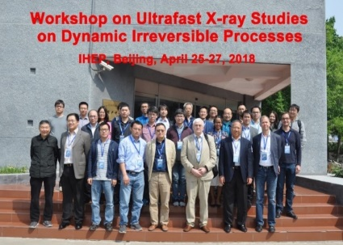
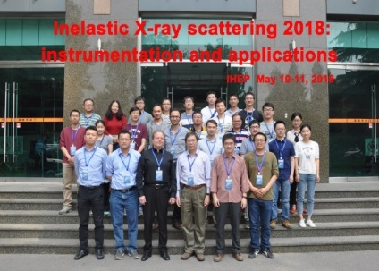
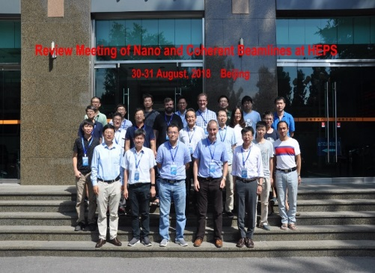
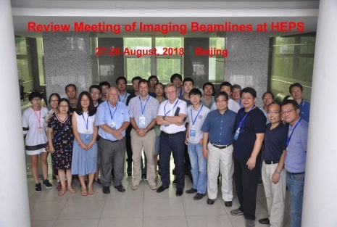
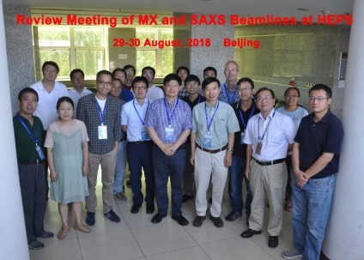
Design - Refining the design of beamline and endstation
HEPS IAC meeting: 2018, 2019
International conferences on HEPS research: Apr./May 2018
Two groups of BLs: IAU/IAW/BM, IVU/CPMU
Group 1 BLs international review: Aug. 2018
Group 2 BLs international review: Jan. 2019
Committees from PETRAIII, SPring-8, KEK-PF, SLS, Diamond, Sirius, MAX IV, APS, CHESS
Scientific scope, optical layout, technical details, …

Slide 23
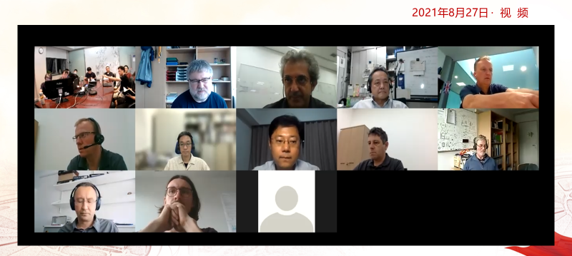
Refining the design of beamline and endstation
During the pandemic period, a series of online reviews organized, including two international reviews of the optical design of the nanoprobe beamline and the coherent scattering beamline in 2021.
In 2023, the international reviews of the endstation design of the coherent scattering beamline and the nanoprobe beamline are conducted
international online review of the optical design of the the coherent scattering beamline in 2021/08/27

Slide 24
IAC suggestions
IAC-2018: the present list of beamlines does not contain the sciences which unavoidably request such ultra-low emittance. Serious development of science cases is highly needed.
IAC-2019: Many of the beamline designs have been developed significantly following the recommendations of the 2018 IAC, and many of them have improved considerably. In general, more of them are designed to exploit the high-performance of the HEPS machine, and more of them are designed to specialise and be excellent in one or two techniques rather than cover a greater number of techniques less well. The science goals of most of the beamlines have improved, where improvement was recommended by the 2018 IAC.
Define a staffing matrix for a typical beamline – including both the people assigned to the beamline itself (physicists, engineers, technicians) and those provided through support services (optics, FEA...)

Slide 25
Key technologies
X-ray optics
Thermal management
Optics metrology
Wavefront preservation and crystal/device fabrication
X-ray detector
Data acquisition and analysis
Supported by both HEPS and Platform for Advanced Photon Source Technology R&D (PAPS)

Slide 26
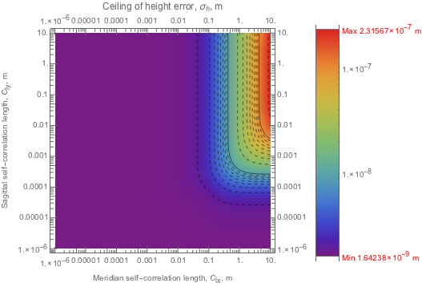
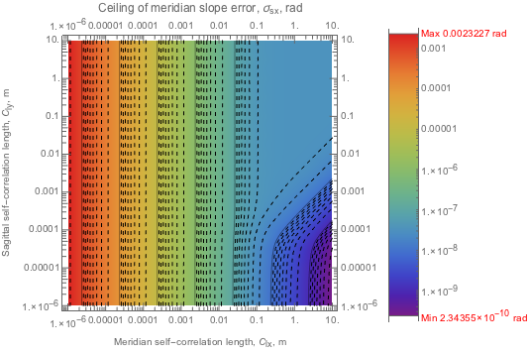
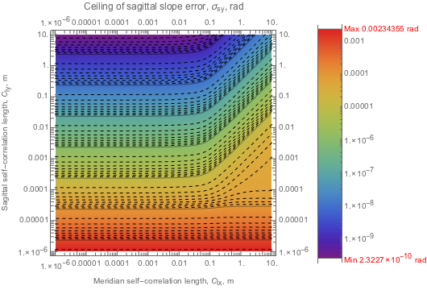
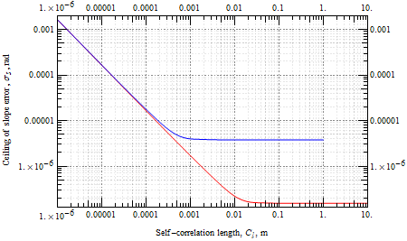
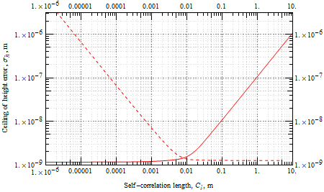
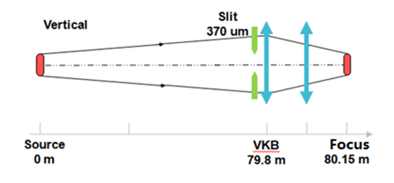
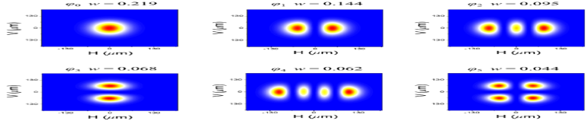
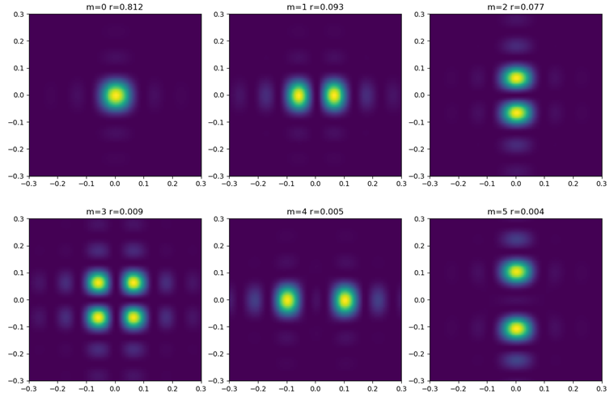
X-ray optics
A wave-optics simulation based on a coherent modes decomposition and a wavefront propagation model.
The simulation software, Coherence Analysis Toolbox (CAT)
Used in BL design
HEPS B4 coherent scsttering
Intensity distribution at focusing point
Source (IVU) coherent modes distribution
Coherent mode at focusing point
Xu etal. Optical Express 2022, 30, 7625

Slide 27
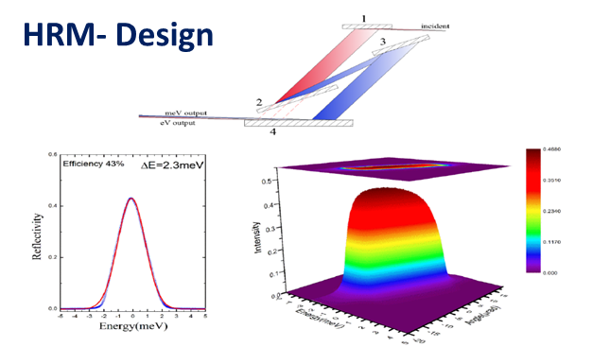
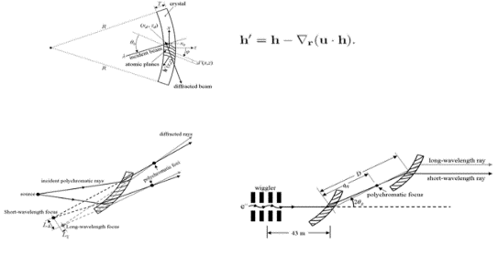
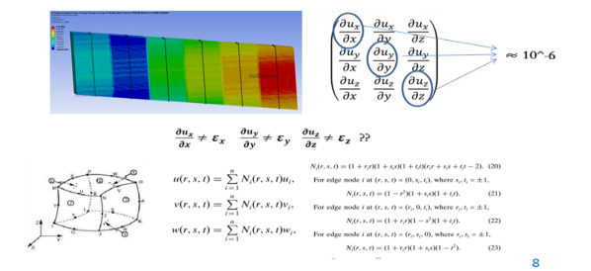
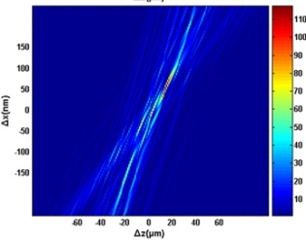
Dynamical diffraction theory
Developing a general numerical framework for X-ray diffractive optics based on the Takagi–Taupin (TT) dynamical theory with a general integral system of the TT equations formed for the FEA
Used in HEPS-TF and HEPS
For high-energy-resolution/high-energy monochromators designs
Yuhang Wang, Optics Express 28 (2020)
Also used in HEPS-TF and HEPS
For multilayer devices in B2 nano-probe/B3 dynamic structure/B6 high pressure

Slide 28

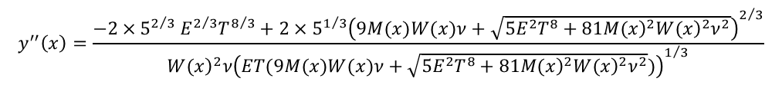
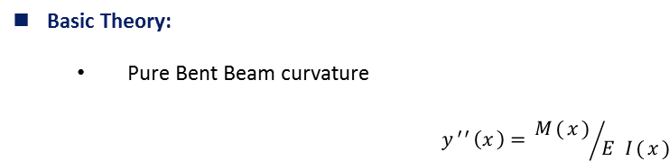

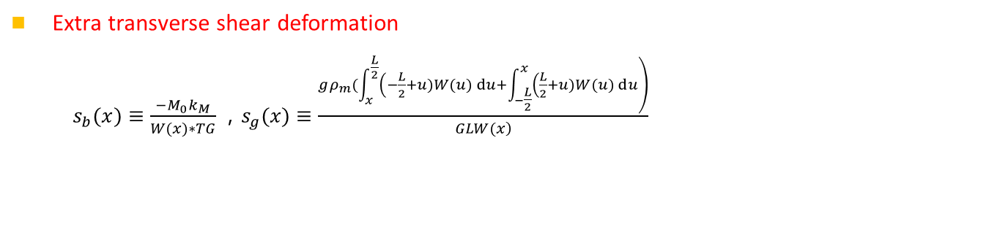
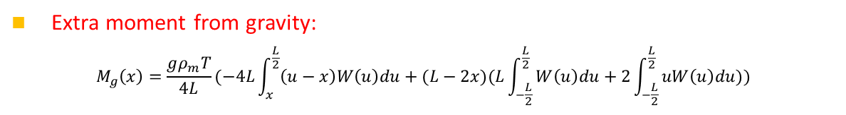
Developing the theories of bending mirrors
y
x
Basic Theory:
  Pure Bent Beam curvature
    $$y^{′′}\left(x\right)={M(x)}/{E I(x)}$$
M
Extra moment from gravity:
$M_{g}\left(x\right)=\frac{gρ_{m}T}{4L}(−4L\int_{x}^{\frac{L}{2}}{\left(u−x\right)W\left(u\right)du}+(L−2x)(L\int_{−\frac{L}{2}}^{\frac{L}{2}}{W\left(u\right)du}+2\int_{−\frac{L}{2}}^{\frac{L}{2}}{uW\left(u\right)du}))$
M
  Extra transverse shear deformation
  $s_{b}(x)≡\frac{−M_{0}k_{M}}{W(x)∗TG}，s_{g}(x)≡\frac{\left.gρ_{m}(\int_{x}^{\frac{L}{2}}{\left(−\frac{L}{2}+u)W(u)ⅆu\right.}+\int_{−\frac{L}{2}}^{x}{\left(\frac{L}{2}+u)W(u)ⅆu\right.}\right)}{\left.GLW(x\right)}$
  Extra transverse deformation:
    $$h_{c}(x)≡\frac{T^{2} ν}{12}\frac{M(x)}{E I(x)}$$
  Curvature (including Influence of saddle deformation)
$$y^{′′}\left(x\right)=\frac{−2{×5}^{2/3}E^{2/3}T^{8/3}+2×5^{1/3}{\left(9M(x)W(x)ν+\sqrt{5E^{2}T^{8}+81{\left.M(x\right)}^{2}{\left.W(x\right)}^{2}ν^{2}}\right)}^{2/3}}{{\left.W(x\right)}^{2}ν{\left(ET(9M(x)W(x)ν+\sqrt{5E^{2}T^{8}+81{\left.M(x\right)}^{2}{\left.W(x\right)}^{2}ν^{2}})\right)}^{1/3}}$$
Notes:
As we all known
The basic theory of mirror bending is pure bent beam theory
The curvature from bending is equal to M divided by E I.
。。。。

Slide 29
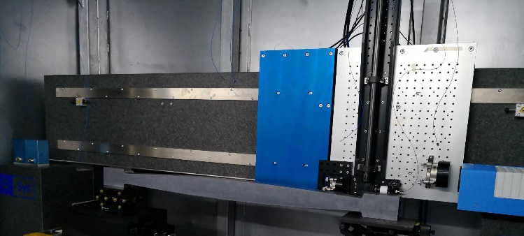
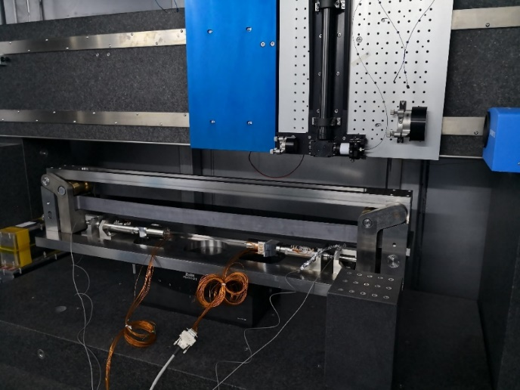
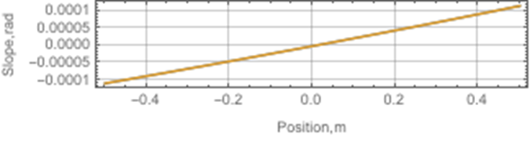

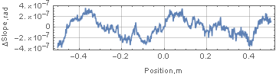

1m ellipitical bending mirror
 | Measuring Results
Effective length | 1000mm
Elliptical Bending shape accuracy | 0.17μrad (elliptical)
Bending shape accuracy RMS 0.17μrad
Stability: 72h, deformation 66nrad RMS

Slide 30
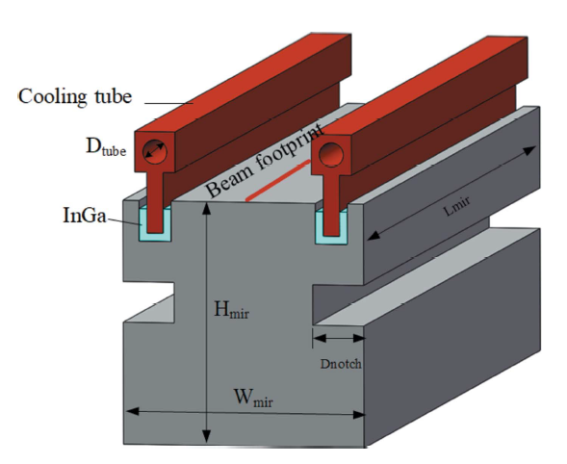
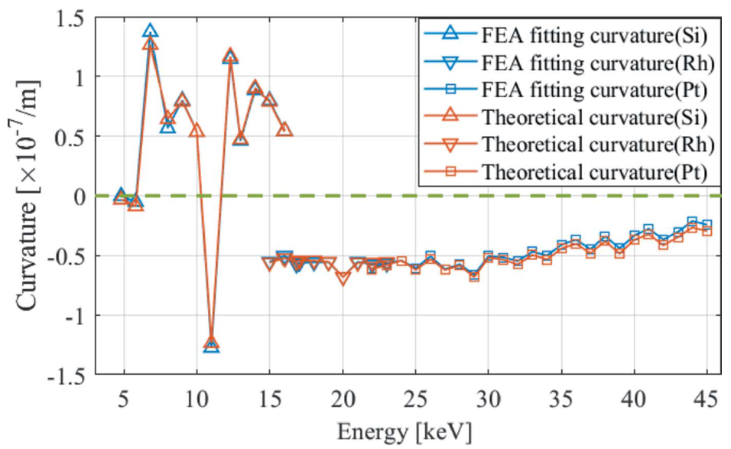
Thermal management
Highly efficient thermal deformation optimization method
Smart-cut mirrors over the entire photon energy range
By optimizing the notches of water-cooled white-beam mirrors, the RMS of the curvatures of the thermal deformation of the white-beam mirror over the entire photon energy range is minimized. Considerably simplifies design of all of the water-cooled white-beam mirrors

Slide 31
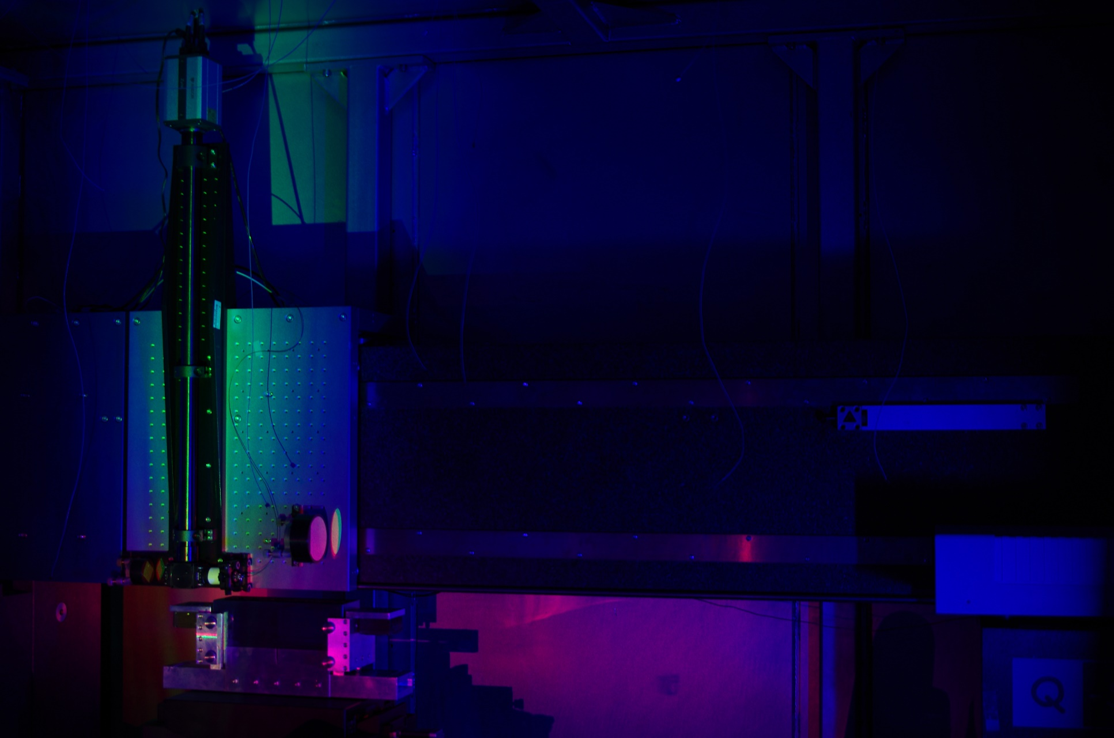
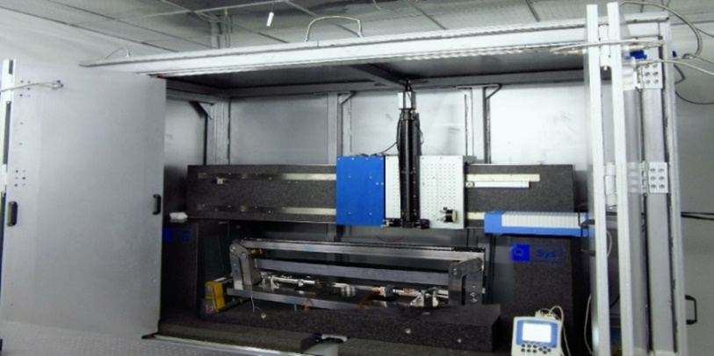
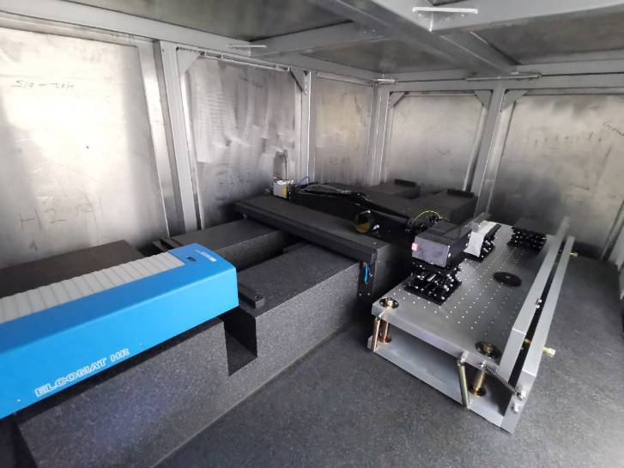
Optical metrology (Flag LTP)

Slide 32

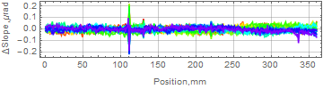
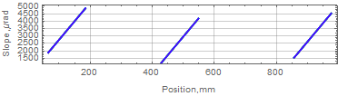
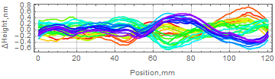
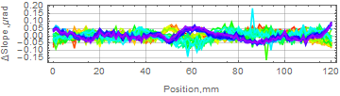
Precision of measurement for flat/curve mirror
360mm flat mirror measurement, Tilt 1.6mrad and translation 400mm, 8+8 times scan
Spatial resolution 1mm
(Slope error sensitive to spatial resolution)
Precision (including systematic error)
RMS 24.5 nrad
3mrad range 120mm curved mirror measurement, Tilt 0.35mrad / 0.7mrad and translation
10+10+10 times scan
Curve mirror slope/height
RMS 29.0 nrad / RMS 0.23nm

Slide 33
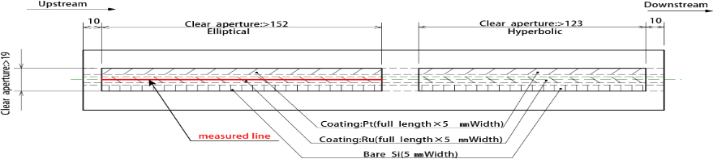
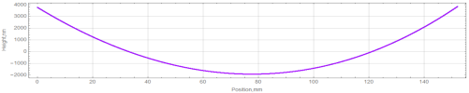
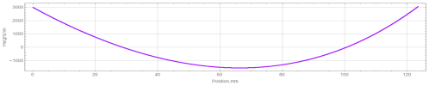







Measurement of the mirror of B4 beamline (Curve, 0.1nm RMS)
Length 415mm
Mirror | Shape | Parameter | Specification | Measurement
B4-Wolter | Elliptical | Slope error RMS | 50nrad | 35nrad
 | Hyperbola |  |  | 41nrad
 | Elliptical | Height error RMS/PV | 0.4nm / 6nm | 0.11nm/0.59nm
 | Hyperbola |  |  | 0.12nm/0.7nm
1mm resolution
1mm resolution
Slope error RMS 0.035μrad
Slope error RMS 0.041μrad
Slope error RMS 0.11nm，PV 0.59nm
Slope error RMS 0.12nm，PV 0.70nm
MP-NSP : 50nrad and 0.5nm @2.5mm resolution
【1】Lei Huang, etc. Optics and Lasers in Engineering, Volume 162, 2023
NSP : 0.133μrad @2.5mm resolution
【2】Shinan Qian, etc. Proc. of SPIE Vol. 9687 96870D-1

Slide 34



Aspheric Stitching Interferometer
Surface metrology during fabrication
Surface metrology for serve curvature of crystal
Proposed ASI based on angular measurement, has been applied in BNL, ALBA.
The proposed θ-R method is used in metrology of serve curvature

Slide 35


Online wavefront measurement
Double-edge wavefront measurement
Innovative method
Solving the problems of coherence, stability, distortion of wavefront in 1GSR
Successful application in BSRF: ~1pm precision
Moving Edge
Fixed Edge
Measurement precision 14 nrad and 1 pm RMS
Notes:
F:\科研工作\双刃法波前检测\experiment data\20221020\fine-polish\ref-after\round1\cry001.dat
F:\科研工作\双刃法波前检测\experiment data\20230722\japan\2\result20230815\analysis

Slide 36



Fabrication of wavefron-preservating crystals
Crystal | Wavefront
BSRF | 86.3±16.1nrad
From Japan | 91.6±11.8nrad
From France | 189.2±23.5nrad
The quality of crystals (170nrad) is satisfied the requirements of 4GSR.
Notes:
F:\科研工作\双刃法波前检测\experiment data\20220710\result_0719_50um

Slide 37



Channel-Cut crystal
Rocking curve measurement layout
Old methos
New method
Rocking curve
Morphology
Reflectivity: 85.1%VS.88.3%(theory)
Homogenous morphology
Wavefront error: 130nrad RMS
The qualities are better than commercial products
美国晶体
Double-edge wavefront measurement

Slide 38







Analysis crystals
Spherically bent Si(660)
~1eV @9.7keV
Bent striped Si(660)
~0.53 eV@9.7keV
diced Si(553)
~0.037 eV@8.9keV
glued
Vacuum mounted
● Spherically bent analyzers for XRS: excellent focusing & energy resolution
● Bent-striped analyzers for XRS: energy resolution improved
● Flat-diced analyzers for RIXS: highly improved energy resolution

Slide 39



Multilayer Laue Lens (MLL)
Para. | Req.
Material | WSi₂/Si
N. Layer | 13030/ 8030
Thickness | 64μm/ 44μm
Focus | 8×8nm²
Magnetron sputtering
Growth rate drift 0.3%
Position error (PV) ±5nm, simulated focus spot 8nm. Fulfilled the demand of nano-probe

Slide 40




Multilayer devices
Coating on mirrors
Multilayer mono.
Gradient multilayer mirror
Linear
BD
High order
BB
Energy resolution: 4.1%
Reflectivity: 75%
Thickness error ±0.35%(pv)
Precision: 6.5pm(rms)
Coating: Pt, Ni, B4C

Slide 41



Reflective lens
Ni-based kinoform
Tested in PETRA III, focus spot 4μm@87keV
1D SU8-based CRL
Used in HEPS B1
Ni-based kinoform
CRL profile
Design
CRL profile μm
FWHM=3.95μm
Position μm
CRL profile error
CRL profile error μm
Position μm
Ni-based kinoform
Focusing
Shape profile error 0.75μm RMS

Slide 42





Monochromator for high stability and less deformation
VDCM
HDCM
Fast-scan DCM
HR-DCM
Stability of VDCM
<10nrad RMS
Under cooling
Stability of HDCM
<20nrad
Fast-scan DCM
100 XAFS spectra /s @0.6°
Deformation of crystals during clamping
＜0.1μrad RMS

Slide 43



Detector
Parameters | 1st generation | 2nd generation –new
Sensor | 320um silicon PIN | 320-500μm
Pixel size | 150umX150um | 140umX140um
Pixel array | 1248X1728 (single module 208X288, 4X6 modules) | Single module 256×576 pixels (3.6cm×8cm)
Counting rate | 1Mcps | >1Mcps
Dynamic range | 20bit | 20bit
Flame rate | 1KHz (design), continuous read-out 100Hz | 1KHz continuous read-out
Energy range | 8-20keV | >6keV
Threshold | single | Double
Death point | <1‰ | <1‰
Gap | 1.6mmX2.5mm | 1.2mm×2.8mm
Single module of the PAD used in HEPS
Mass production

Slide 44



Data management and analysis
Data acquisition and beamline/end-station control: MAMBA
Data management: DOMAS
Data analysis: DAISY

Slide 45
Procurement and Delivery
> 2/3 contracts signed
Front ends for 15 beamlines delivered by October 2023.
Enclosures, utilities and safety interlock system delivered 50%
Optics
75% mirrors delivered by July 2023.
First batch of the diamond CRL delivered.
Opto-mechanics
All mirror vessel systems for group #1 beamline (Beamlines from BM and in-air insertion devices) delivered.
4 monochromators delivered.
Detectors：Advanced pixel array detectors package ordered

Slide 46


Test and installation- Front ends
14 of 17 front-ends delivered
Factory acceptance
Installation start

Slide 47


Test and installation - X-ray Mirror systems
Focusing, collimating mirrors
38/40 are designed by HEPS teams
Factory acceptance
Test measurement after delivery

Slide 48

Test and installation-Monochromators
VDCM
HDCM
Fast-scan DCM
HR-DCM
First Double Crystal Monochromator installed at 2023/7

Slide 49




Test and installation- Enclosures
B8 XAS
BE TXM
BA PX
B7 Imaging

Slide 50



Test and installation- endstation instrumentation
X-ray Raman spectrometer prototype module tested at BSRF
Prototype module
15 analyzer crystals/module
X-ray Raman signals

Slide 51
Schedule
Group 1 beamline,
Test finish in the first half of 2024
Commissioning in the second half of 2024
Group 2 beamline
Test finish in the first half of 2025
Commissioning in the first half of 2025

Slide 52
Performance: In-house Research
Part 2
Positron annihilation (+SR, material research)
Biomedical Effects of Nanomaterials and Nanosafety (Reported by Prof. GU Zhanjun)
Environment and Health
Protein Structures and Functions
Nuclear Chemistry (Reported by Prof. SHI Weiqqun)
Development of techniques, SR-based research
Funding: NSFC, MOST, CAS, Beijing Municipal
~100M CNY per year
“Institutionalization Research”: Facility + in-house research teams + other institutes of CAS. Focusing on basic scientific issues in one field. Developing new experimental method, innovative analysis and knowledge-finding tools, directing to the industrial production
Notes:
In-house研究要基于大科学装置，为大科学装置的技术发展提供指引，连接用户和装置，不是为了和别的研究所和大学竞争。经费来自竞争性的经费申请。

Slide 53





Institutionalization Research Project: Nano-medicine for breast cancer
  In-situ and dynamic analysis of protein corona on the surfaces of nano-particles
  Poly-peptide lead compound finding
  Standardization protocals in production
  Clinical trials
  The National Center for Nanoscience and Technology (Prof. ZHAO Yuliang)
  IHEP (Prof. DONG Yuhui)

Slide 54
Future Plans: HEPS follow-up beamlines
Part 2
Criteria for HEPS beamline selection: Scientific and Industrial questions as well as cutting-edge experimental methods motivated in 4GSR.
Upon schedule of insertion installation, without impeding the operation of existing BLs, 4-5 ID installed per year
32 bls has been planned
Fields | Material | Physics | Chemistry | Envir. | Energy | Industry | Bio. | Meth.
BL | 3 ID, 3 BM | 5 ID, 1BM | 1 ID, 5 BM | 2 ID | 2 ID, 1 BM | 1 ID, 4 BM | 2 BM | 2 ID
Organizing institutionalization research teams/projects based on HEPS
Materials
Chemistry (Dynamic properties of catalysis)
Notes:
HEPS线站选择的标准

Slide 55
Assessment Result in 2018
Part 3
“The future HEPS will strengthen the multi-disciplinary activities of IHEP.”
“limited resources”, “A lack of technical manpower – engineers, technicians, software experts, detector development experts.”
A clear strategy, as for the BSRF should be defined.
Young staffs recruitments: 84 new members in HEPS
28 Post-docs
Big X-ray optics and mechanical teams: All devices in the BLs and end-stations are developed by the whole team. Every device is in charge by a member.
BSRF provides the testing platform for HEPS devices, and complementary in experimental method, energy range with HEPS.
Recruiting new member for in-house research, very closely connecting with HEPS.
Institutionalization Research
Notes:
2013年的评估结果：有很大发展，但是各部分水平不一。

Slide 56
The present list of beamlines does not contain the sciences which unavoidably request such ultra-low emittance. Serious development of science cases is highly needed.
HEPS has 44 straight sections available for the insertion devices, and more than 40 beamlines from bending magnets. However, too many bending beamlines make the space of each beamline smaller.
Therefore, there will be unavoidable overlaps for the beamline list of HEPS with those of other facilities.
The phase I BLs have been re-designed (almost) in 2018-2019, following the instruction of IAC and discussing within international panels. Follow-up BLs are organized by scientific cases and research fields. The new design of BM BLs can solve the problem of space.
The installation of BLs has started. The designs and the techniques have been verified.
Should thinking about the possibilities and managements of user beamlines, as well as industrial beamlines.

Slide 57
Improvements
Part 3
Engaging and cultivating external scientific leaders in the broad communities
Beamline Advisory Committee (BAC) for every beamline, Beamline Technique Advisory Committee (BTAC).
Recruit future research staff and leaders (ongoing)
Young staff: ZHANG Xingxing, DONG Kang, JIA Xun, REN Zhe, ZHOU Tiankun from APS, SPring-8, DESY, BNL, Diamond.
~ 50 engineers in X-ray optics and machinery. Most of the BL and end-station devices are home-designed and verified.
Organization of engineer teams
X-ray optics, precision machinery, general machinery
All components and devices are design and manufacturing by whole team
In-house research
Carefully selected fields, SR-based research
Cooperation with user team on scientific issues: Institutionalization Research Project.
Notes:
为了实现mission，重要的是人员队伍的建设：取得国外同类装置上专家的指导，招收年轻的领军人物，聘请国外有经验的客座教授。

Slide 58
Summary
Part 4
Multi-Disciplinary Research Division builds and operates light source (BSRF/HEPS), develops innovative techniques and methods (PAPS), carries on frontier research (Institutionalization Research Project), to provides a world-class, large-scale, comprehensive, multidisciplinary research base.
BSRF is an important experimental platform for much scientific research, especially in the north of China.
The new HEPS facility will bring world-class synchrotron science and applications to China.
Technical research is essential for the development of the facilities.
In-house research connects the user and facility teams, and is also very important for operation and development.
Notes:
总结，把mission再说一遍。

Slide 59

Thank you for your attention!
UCAS
SECUF
(IOP-CAS)
HEPS
Dynamic structure
PAPS
Hard X-ray imaging
Nano-probe
Medicine Imaging facility
(PKU & IBP-CAS)
Earthlab
(IAP-CAS)

