Slide 1
Division of Nuclear Technology and Applications & Jinan Branch
Lei Shuai
September 21, 2023
Notes:
Good afternoon everybody，I will report Division of Nuclear Technology and Applications and Jinan Branch.

Slide 2
Contents
1
Overview
2
R&D Achievements
3
Jinan Branch and Spinoff
4
Future plan
4
5
Summary
Notes:
My report include five parts: first, overview of our group.

Slide 3
Division of Nuclear Technology and Applications
Division of Nuclear Technology and Applications (DNTA) was founded in 2002, and reformed in 2012
Mission of DNTA
Based on the technology developed with large facilities in IHEP, carry out application-oriented research, key technology, key component research and development
Focus on instrumentation, engineering and system development
Contribute to public safety, human health and national economy
Research areas
Nuclear medical imaging
Non-destructive testing (NDT)
Radiation safety monitoring
Notes:
DNTA is restructured in 2012, Our mission is Carry out key technology and key component research and Focus on advanced technology integration, advanced application instruments, equipment and systems development. The research areas include Nuclear medical imaging, Precision detection, Radiation safety monitoring

Slide 4
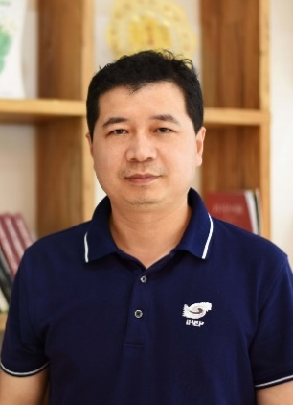
Manpower
Total number: 127
58 staff
50 graduate students and 11 visiting graduate students
6 post doctors and 2 assistants
79% of them are with doctor’s degree
Long Wei
(Nuclear imaging)
Cunfeng Wei
(X-ray imaging)
Zhiming Zhang
(Nuclear detecting)
Lei Shuai
(Nuclear imaging)
Beiping Cai
(Management)
Notes:
127 people works in DNTA in total, for 58 staffs, 79% of them are doctors, and 80% of them are with senior professional titles

Slide 5
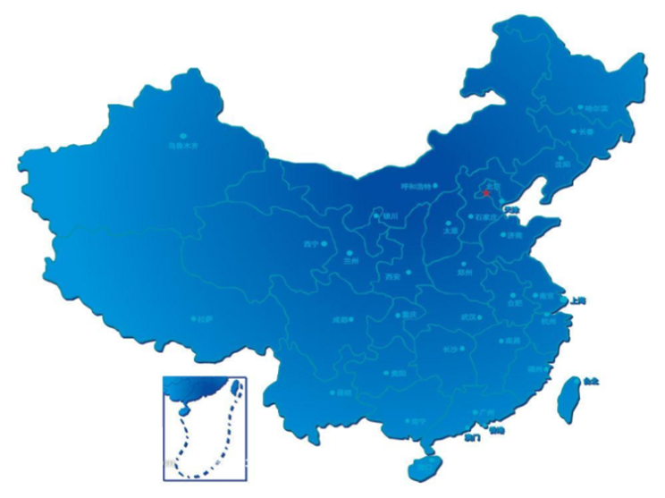
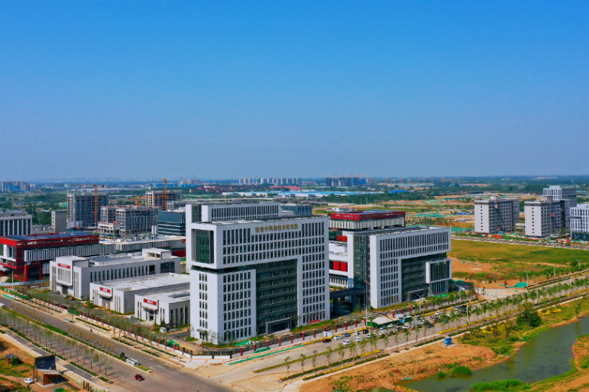
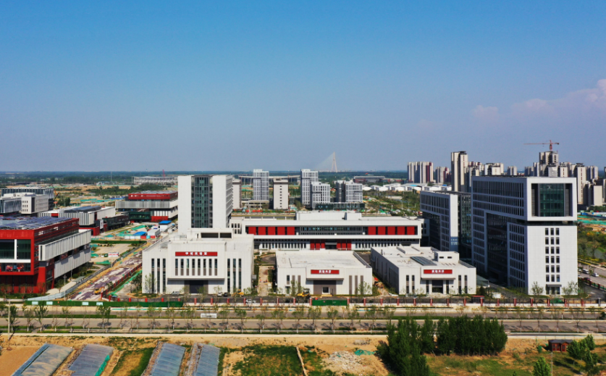
Jinan Branch
New engineering and incubation platform supported by local government in 2020
IHEP provides technology and IP supports, meanwhile local government offers grant-in-aid support and sites.
Operated by DNTA (two organizations, one leadership team)
Scientists and leader team from DNTA & local employees
Manpower (local employees)
54 staff
About 70% are engineers and about 30% are marketers
Beijing
90 min. by China Railway Express
Jinan
Notes:
Jinan branch is established in 2020 as a new spin-off platform in order to research on cutting-edge technology, core technology and engineering development.

Slide 6
Laboratory
Over 30,000 square meters area & equipment with a total value of more than ¥100 million
22,500 square meters in Jinan & 7500 square meters in Beijing
Qualification/certification and the infrastructure meets the needs for R&D activities and radiation protection(with the permissions of using isotopes, X-ray tubes, neutron source and other radiation devices)
Notes:
We have over 30000 square meters area laboratory and equipment with a total value of more than 100 million.

Slide 7
Laboratory in Jinan branch
Nuclear Medicine Laboratory:
Class B radiochemical laboratory
One 16.5Mev cyclotron
GMP standard clean room
X-ray Laboratory:
Precision testing equipment research and development laboratory
Precision non-destructive testing service center
Main building：
Meeting room & exhibition hall
Executive office
Software Lab
Detector Lab
Electronics Lab
Pilot laboratory:
1st floor: Precision non-destructive testing
2nd floor: Radiation Instrument pilot testing
Notes:
In Jinan branch, we constructed Pilot labortatory, X-ray Laboratory, and Nuclear Medicine Laboratory

Slide 8
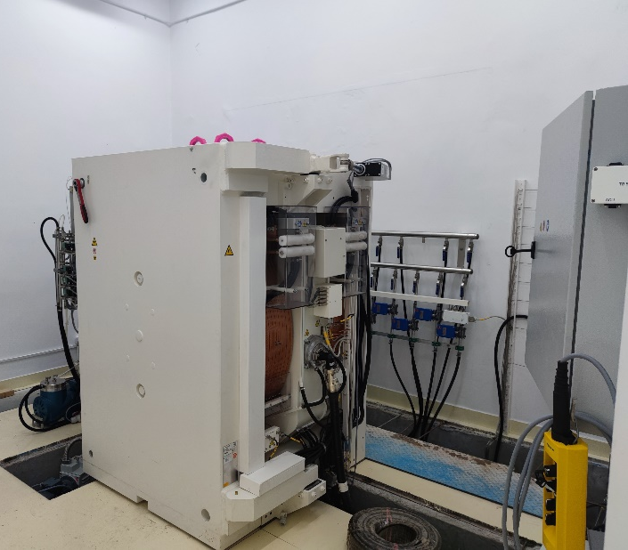
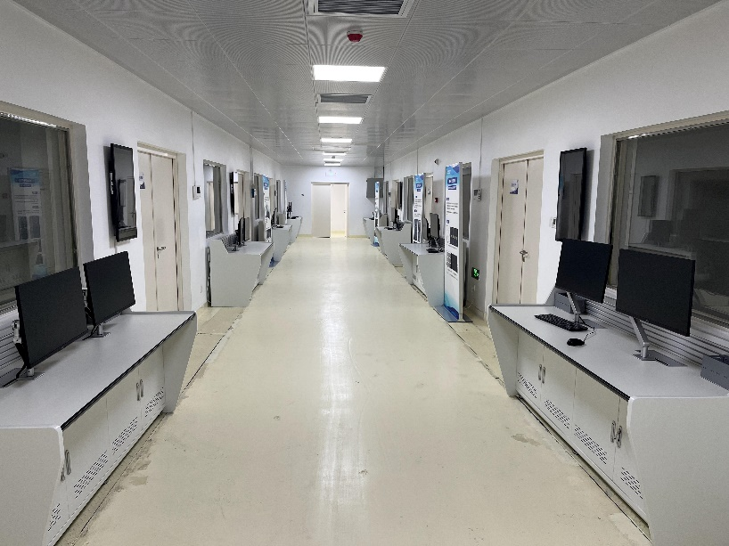
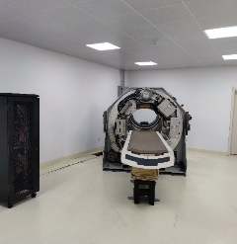
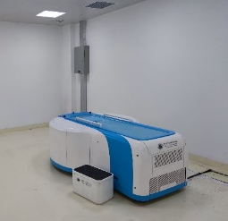
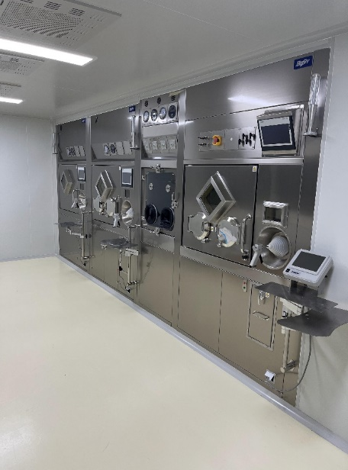
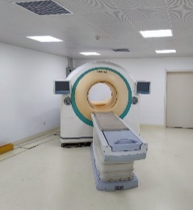
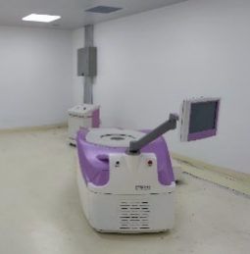
eg. Nuclear medicine laboratory
16.5MeV Cyclotron production of nuclides
Radiopharmaceutical synthesis
injection
Scanning experiment
Accelerator
Hot cell
PET/CT rooms
Molecular imaging experiment（Grade B radiochemical laboratory）
Notes:
As a example, in Nuclear medicine laboratory, we assembled Accelerator and hot cell for production of Radiopharmaceutical. And Medical imaging equipments developed in our team are applied in image room.

Slide 9
Contents
1
Overview
2
R&D Achievements
3
Jinan Branch and Spinoff
4
Future plan
4
5
Summary
Notes:
Second, research of DNTA.

Slide 10
Contents
2
R&D Achievements
Nuclear medical imaging
Non-destructive testing
Radiation safety monitoring
Notes:
For nuclear medical imaging.

Slide 11
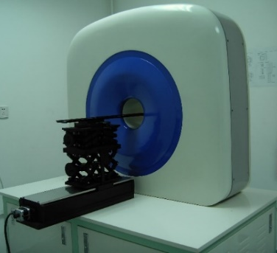
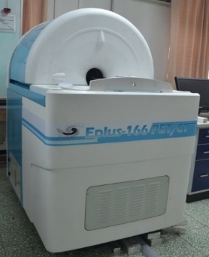
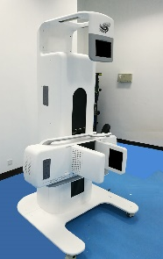
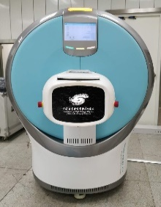
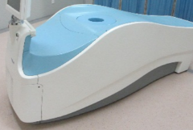
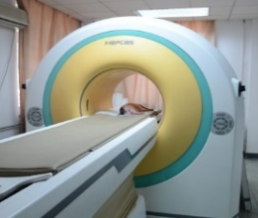
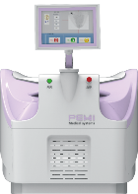
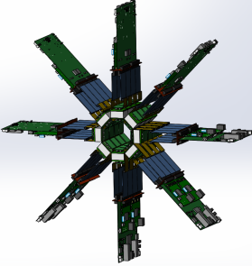
R&D of Nuclear Medical Imaging Systems
Focusing on the R&D of high-performance animal PET imaging systems
Developed a number of advanced preclinical PET, CT and PET/CT systems
~2018
2018~2023
China's first small animal PET
small animal PET/CT
Primates animal
PET
Flat PET
Spectral Micro-CT
Total body animal
PET/CT
2008
2012
2015
2021
2023
2005
2011
2018
2020
2022
China's first breast specific PET(PEM)
Clinical PET
CFDA registration of PEM
Delivery of a small animal PET
Ongoing—Higher sensitivity
small animal PET
Notes:
IHEP is the earliest institution engaged in PET imaging technology research in China. In recent years, We Focused on the R&D of high-performance animal PET imaging systems and developed a number of advanced preclinical PET, CT and PET/CT systems.

Slide 12
1. R&D of total body animal PET/CT
Total body animal PET/CT（2022）
System characteristics：the longest(200mm axial FOV) small animal PET so far as we know, the whole body dynamic imaging of rats can be completed with single bed scan
System performances：the spatial resolution reaches 0.8mm, the sensitivity reaches 12.1%@150~750keV
Type | Year | Axial FOV(mm) | Radial FOV(mm) | Spatial resolution(mm) | Sensitivity
Inviscan IRIS （France） | 2016 | 95 | 80 | 1.1 | 8% @250-750keV
Mediso NanoScan （Hungary） | 2017 | 100 | 80 | 0.9 | 7% @250-750keV
Molecubes β-CUBE （Belgium） | 2018 | 130 | 76 | 0.97 | 12%@255-765keV
Bruker Albira （Germany） | 2020 | 148 | 80 | 0.7 | 9%@255-767 keV
Total body animal PET/CT（IHEP） | 2022 | 200 | 100 | 0.8 | 10%@250-750keV 12%@150-750keV
Total body animal PET/CT
Performance comparison of similar systems
One of the most sensitive PET systems for small animals in the world！
Notes:
In 2022, we developed a total body animal PET/CT system. The PET subsystem have the longest axial field of view so far as we know. Benefit from this, it will be one of the most sensitive commercial PET systems for small animals in the world. In addition it also obtains a large radial FOV and high spatial resolution better than 1mm.

Slide 13
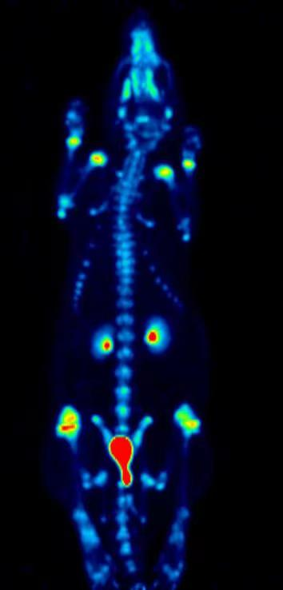
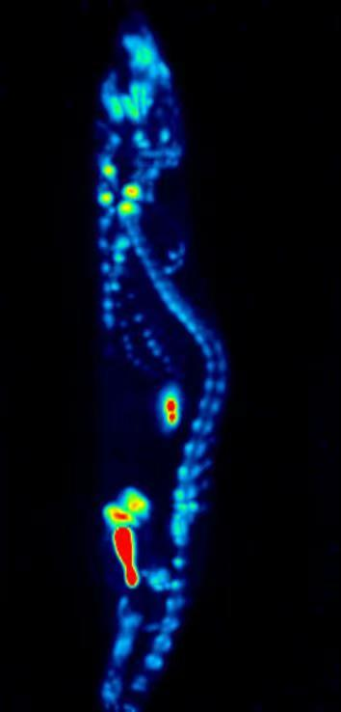
1. R&D of total body animal PET/CT
PET imaging applications
dynamic imaging of rat with 0.2s/frame（fused with CT image)
bone imaging with high spatial resolution
Benefit from characteristics as full field, high sensitivity and fusion with Spectral CT,
the system can observe the initial process of nuclide metabolism!
Notes:
These are some imaging applications on our system.
Benefit from characteristics as full field, high sensitivity and fusion with Spectral CT, the system can realize total body dynamic imaging with 0.2s/frame so that we can observe the initial process of nuclide metabolism after injection!
Besides this, we can also achieve PET images with high spatial resolution in conventional static imaging mode.

Slide 14
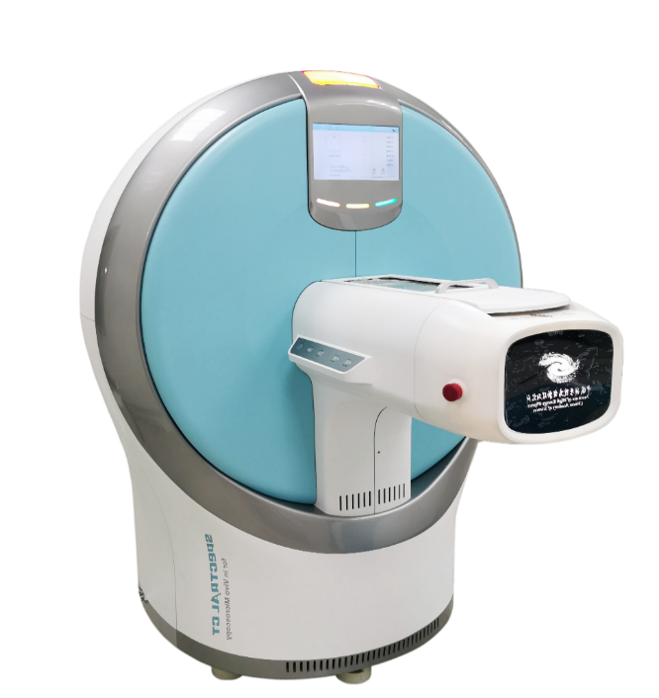
2. R&D of animal spectral μCT
Animal Spectral Micro-CT（2021）
System characteristics：New Generation of Photon Counting Spectral CT Technology,
High Spatial Resolution and SNR，Muti-Material Decomposition, High sensitivity K-edge Imaging.
System performances：the spatial resolution reaches 15um, the contrast resolution reaches 5‰
System | MARS-CT （New Zealand, 2020） | Animal Spectral Micro-CT ( IHEP, 2021 )
X-ray source | 120kVp | 90kVp
Detector | Photon Counting Detector | Photon Counting Detector
Energy thresholds | 2-8 | 2-8
DR spatial resolution | —— | better than 8 um
CT spatial resolution | ~ 100 um | better than15 um
Animal Spectral Micro-CT
Performance comparison of similar systems
The First Prize for Science and Technology Progress Award of the Chinese Society for Stereology (Feb. 2021)
The first product in its category in China！
Notes:
In 2021, we developed a Animal Spectral Micro-CT system. Which is the first product in its category in China and the highest spatial resolution of animal Spectral CT in the world. This system is a New Generation of Photon Counting Spectral CT Technology, Benefit from this, it will be High Spatial Resolution and SNR, and new imaging capabilities of Muti-Material Decomposition, High sensitivity K-edge Imaging

Slide 15
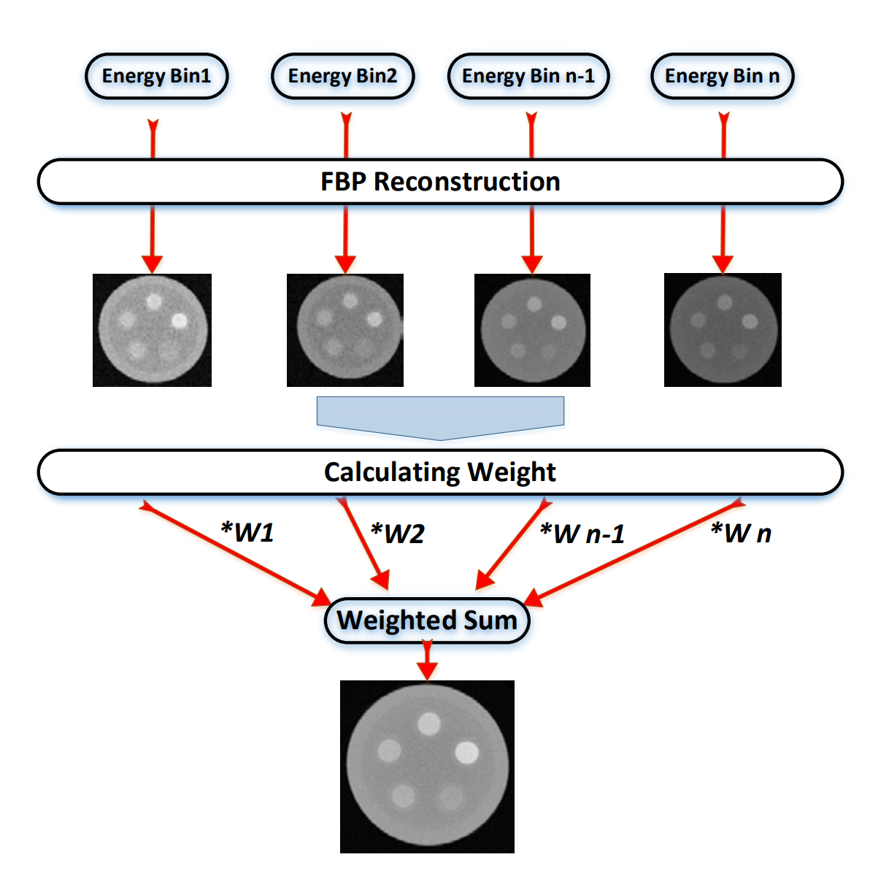
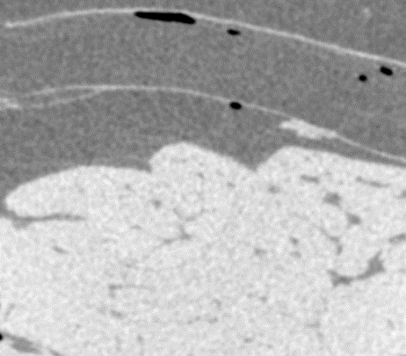
2. R&D of animal spectral μCT
Multi-Energy Weight Imaging Technique
Animal adipose tissue
Conventional CT
Our system
The multi-energy weight imaging method was used to improve the contrast of CT imaging and find the microscopic features in animal tissues
Multi-Energy Weight Imaging Technique Method
Notes:
Conventional CT 对比度分辨能力不足，影响了对于动物体内微小特征的识别。利用本系统的Multi-Energy Weight Imaging Technique，可以将融合多能谱的数据加权成像，能够有效提升密度接近组的的成像区分能力，更有利于发现不同器官中的微小特征

Slide 16
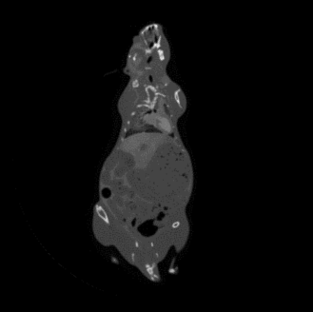
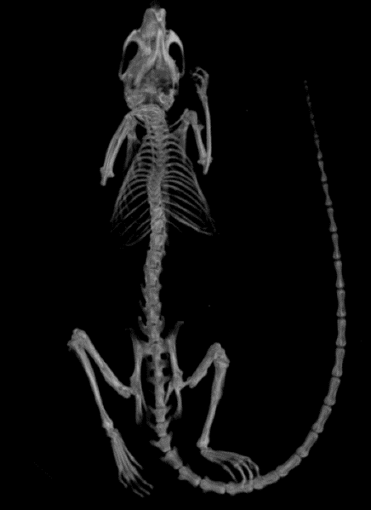
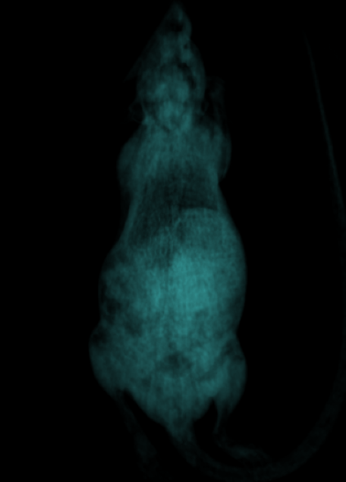
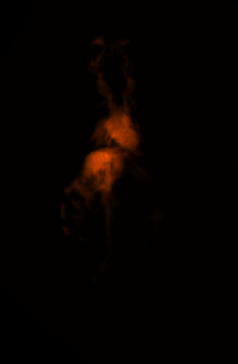
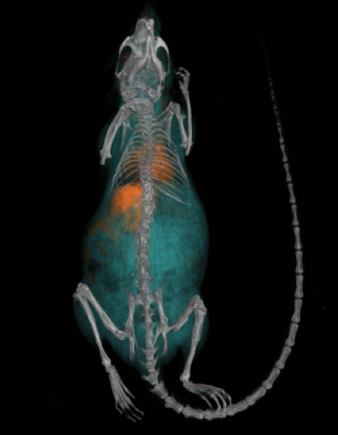
2. R&D of animal spectral μCT
High Sensitivity K-edge Imaging Technique
Bone image
Soft tissue image
Gadolinium image
Conventional CT
Images of soft tissue, bone and gadolinium of animals can be obtained respectively to realize the separation of various substances, then the density and spatial distribution of different substances can be obtained
Color
Fusion
Material decomposition imaging (gadolinium agent)
Notes:
Conventional CT技术仅能获得动物体内的三维结构信息,缺乏元素的识别能力。利用本系统的High Sensitivity K-edge Imaging Technique，对小鼠钆造影剂成像，可以分别对小鼠体内的骨组织、软组织、钆元素识别及单独成像，获得不同物质及元素在体内的分布和定量信息，为发展CT探针提供有效工具。
.

Slide 17
Contents
2
R&D Achievements
Nuclear medical imaging
Non-destructive testing
Radiation safety monitoring
Notes:
For Precision detection

Slide 18
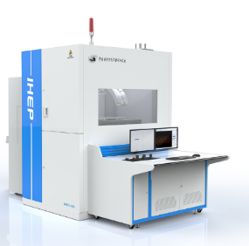
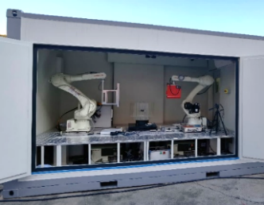
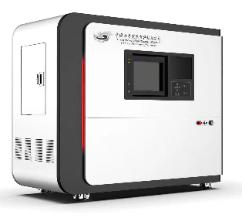
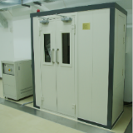
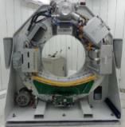
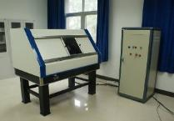
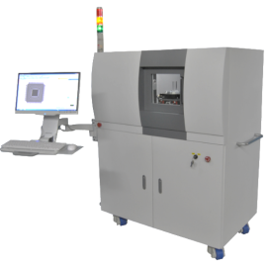
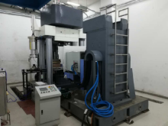
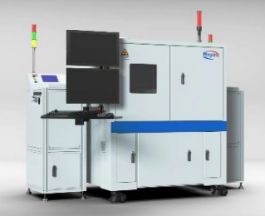
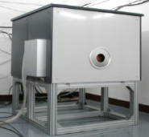
Non-destructive testing
Focusing on the R&D of the high-end of the scientific equipment
Developed a number of serialized, various field of view, high resolution CT equipment for NDT
~2018
2018~2023
450keV & 6MeV CT
fossil CT
Spiral CT
Micro-CL
CL for IC test
Robotic CT
Spectral Micro-CT for NDT
2006
2010
2014
2016
2019
2021
2023
2008
2012
2015
2017
2020
2022
130 keV Micro-CT
Mobile micro-CT
9 MeV CT
Rock mechanics CT
Spectral Micro-CT
CL for IGBT test
Notes:
在精密检测技术方面，我们致力于研发了一系列通用型CT无损检测设备，在此基础上，近5年来，针对生物医学成像、植物原位成像、半导体检测等领域的最新应用需求，发展了多能谱CT成像技术、机械臂多自由度成、IGBT在线检测CL技术像技术等，形成了一批新型的、特色化的高端CT科学仪器，性能表现突出，具有国际竞争力。

Slide 19
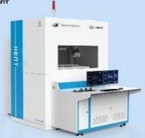
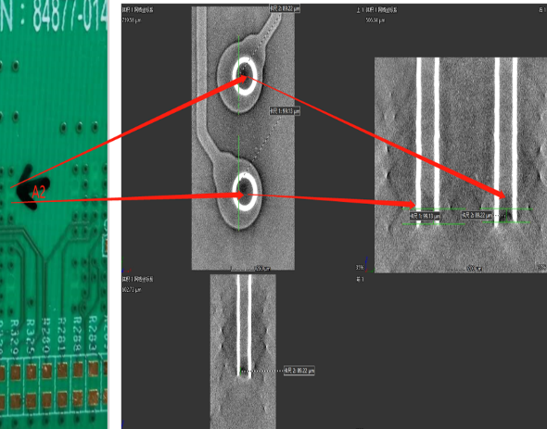
1. Micro-CL (Computed Laminography)
Our CL was originally developed for planar fossil scanning
Being able to acquire high quality image for the microscopic structure of planar fossils, CL is almost the only reliable way to make this achievement
The device is the only planar fossil dedicated CT in the world
Applications in electronic device and battery examinations
CL imaging is now becoming an important quality evaluation method for large-size planar electronic devices and has been widely used in the semiconductor field
Blade battery image
(pixel size 21μm, scanning time72s)
PCB Stub measurement
Notes:
This is Micro-Computed Laminography. Our system was originally developed for planar fossil scanning. Now it finds new applications in electronic device and battery examinations.

Slide 20
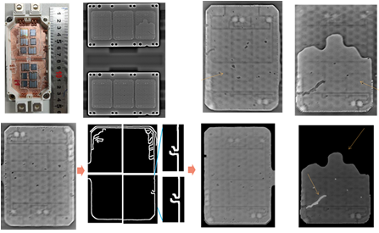
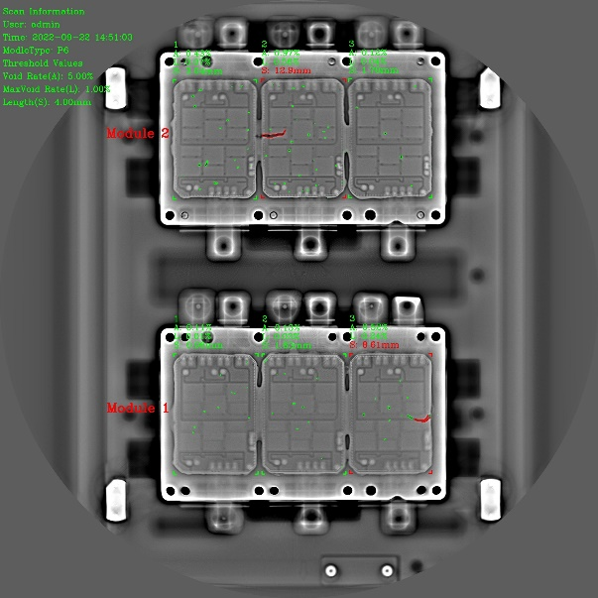
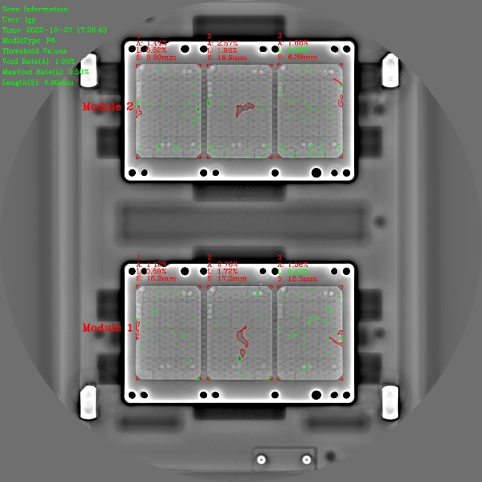
1. Micro-CL (Computed Laminography)
IGBT is a widely used electronic and electrical component and its performance can be largely influenced by the weld quality of the DBC base board. The X-ray laminography examination for IGBT welding defect plays an essential role in the industry and is carried out automatically, digitally and intelligently.
DBC layer locating and segmentation：by applying image segmentation and object tracking network, the DBC area can be recognized and a warning will be raised if the absence of weld is detected
Void defect recognition and quantization: the void defects in the weld layer are outlined by semantic segmentation network and then quantified. Segmentation accuracy is 98.85% and mIoU is 98.81% on the test set. The system has been used in Starpower in Jiaxing for over 1 year.
Notes:
IGBT is a widely used electronic and electrical component. The X-ray laminography examination for IGBT welding defect plays an essential role in the industry and is carried out automatically, digitally and intelligently.

Slide 21
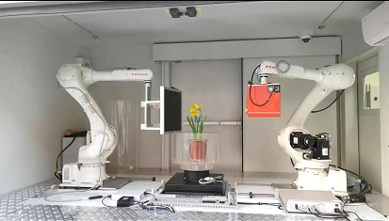
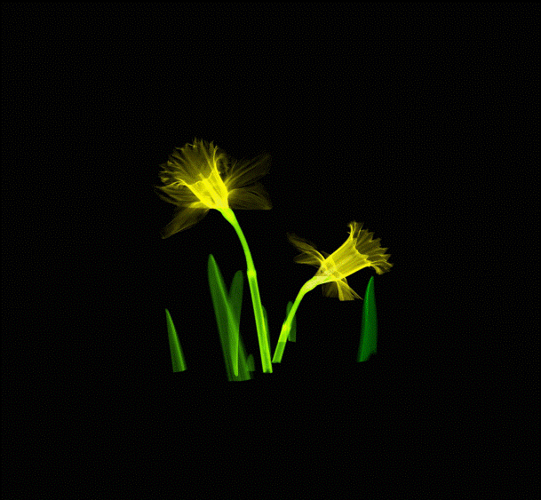
2. Robotic CT
High accuracy robotic detection system
Our robotic CT is an intelligent, automatic and customized X-ray imaging system, which can be used in medical examination, scientific study and industrial NDT. Its high degree of freedom, flexibility and diversity make it an efficient solution in different areas.
High degree of freedom: the robot is capable to deal with sophisticated object scanning
Flexibility: used in medical examination, vehicle in-situ scanning, large component local scanning
Diversity：global DR, multi-view 3D scanning, local high resolution CT, global large FOV CT
Eg: Plant in-situ scanning
Notes:
This is a Flexible X-ray imaging system. Our robotic CT is an intelligent, automatic and customized X-ray imaging system, which can be used in medical examination, scientific study and industrial NDT. Its high degree of freedom, flexibility and diversity make it an efficient solution in different areas.

Slide 22
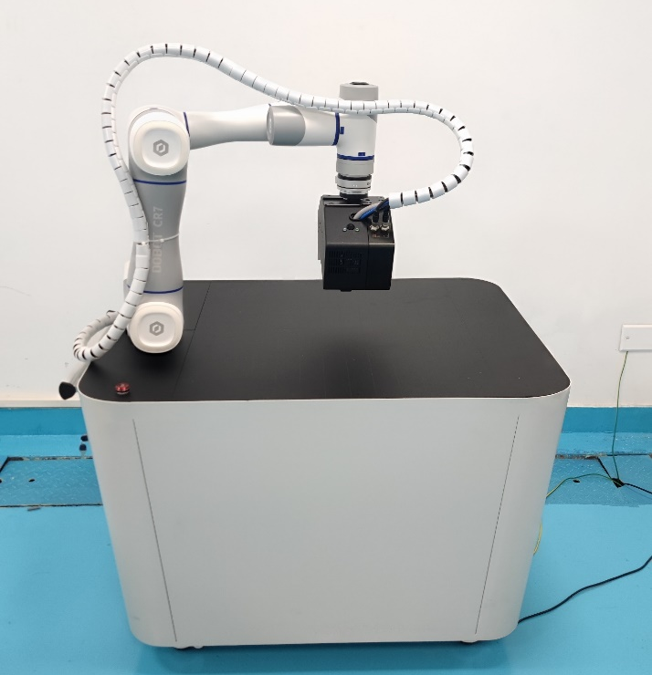
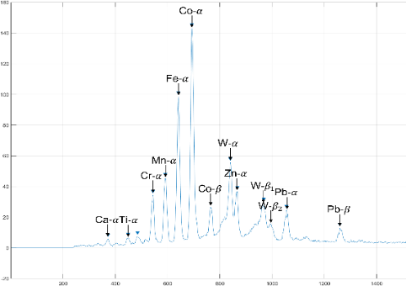
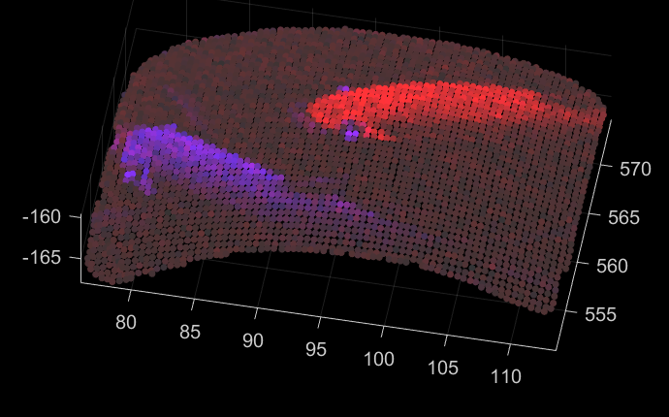
3. Flexible μXRF imaging system
The currently available micro X-ray florescence (XRF) spectrometers in the market are only capable to scan planar samples, with no ability to acquire element distribution on complicated-shaped object
Co （Mn，Cr）
Fe
Planar surface scanning
Teapot made in Jingdezhen
(China’s porcelain capital)
By incorporating a 3D camera, the sample outline can be detected and used to guide the robot in the element scanning
The device solves the problem of accurate element detection and imaging on curved or uneven surface
Curved surface scanning
Notes:
This is a flexible micro x-ray florescence imaging system. By incorporating a 3D camera, the sample outline can be detected and used to guide the robot in the element scanning. This device solves the problem of accurate element detection and imaging on curved or uneven surface.

Slide 23
Contents
2
Research of DNTA
Nuclear medical imaging
Non-destructive testing
Radiation safety monitoring
Notes:
For Radiation safety monitoring

Slide 24
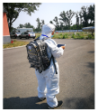
Imagers & other monitors developed
~2018
2018~2023
Neutron Imager
Imagers
portable gamma imager
Gamma Compton Imager
Radiation Emergency Monitoring System
key methods of coding
gamma imager prototypes
Time Coded Imager
Vehicle-mounted
gamma imager
Orbital-robot mounted gamma Imager
Portable Neutron Imager
2006
2010
2014
2016
2018
2020
2022
2013
2015
2017
2019
2021
2023
Other radiation monitors
RAMO Dosimeter
Various
Radiaiton Monitors
Gamma Direction finder
Personal Dosimeter Distribution System
²³⁵U Enrichment detection system for nuclear fuel rods
Environmental and on-Site Radiation Monitors
Notes:
We have developed a serials of radiation monitor and radiation imager for environmental use.

Slide 25
1. ²³⁵U enrichment inspection for nuclear fuel
The nuclear power industry in China has entered a rapid development phase
54 units (operational）and 23 units (under construction）
Need more than 1 million fuel rods (AFA3G) per year
Every fuel rods include hundreds of pellets
Need 100% inspection of ²³⁵U enrichment
Two main online methods for ²³⁵U enrichment inspection
Active neutron assay (ANA) using ²⁵²Cf
The ²⁵²Cf is very expensive with a short half-life
The fission product of ²³⁵U is highly radioactive
It need strict shielding protection
Passive gamma-ray assay (PGA) without ²⁵²Cf
Directly detect the spontaneous γ-rays of pellets
It is more economical and safer than ANA method
However it need lots of detection units work together
Method | ANA | PGA
Manufacturers | Domestic | Domestic (IHEP)
Detector | BGO + PMT | CsI(Tl) + SiPM
Testing Speed | ~ 4.2 m/min | ≥ 6 m/min
R of the mean enrichments | 0.9910 | 0.9997
R of the abnormal enrichments | 0.9985 | 0.9989
Notes:
有源法²⁵²Cf卡脖子²⁵²Cf 源半衰期短（2.6年），检测成本高，废源处置难
装置复杂，体积大，场所剂量率高，人员存在剂量照射风险
经中子活化后的燃料棒放射性强，需要一定时间冷却

Slide 26
1. ²³⁵U enrichment inspection for nuclear fuel
Compact detection & data acquisition system (DAS)
Modular design：128 independent detection units integrated in 4 modules
Small volume：Using small SiPMs instead of big PMTs to subdivide the detection intervals
Good cost performance：Using CsI(Tl) coupled with SiPM to balance cost and performances
High integration：All 128 signals could be processed in parallel by the DAS based on FPGA
Excellent data processing and correction algorithms
Dynamic collection and time-delay superposition
Reduce statistical fluctuation and improve detection accuracy
Pellet age correction based on two energy windows
Suitable for pellets in non-radioactive equilibrium
Reduce the waiting time (>2 months) from production to test
It could avoid misjudgments of ²³⁵U enrichment due to different production times of pellets
Pellets of different production times
Notes:
有源法²⁵²Cf卡脖子²⁵²Cf 源半衰期短（2.6年），检测成本高，废源处置难
装置复杂，体积大，场所剂量率高，人员存在剂量照射风险
经中子活化后的燃料棒放射性强，需要一定时间冷却

Slide 27
1. ²³⁵U enrichment inspection for nuclear fuel
In 2020, we have developed a set of compact high-speed PGA equipment and then applied in the China North Nuclear Fuel Co. (CNNFC) for 3 years
The fastest (up to 7.2 m/min) online ²³⁵U enrichment inspection equipment by now
The Scientific and Technological Progress Award of The China Nuclear Energy Association, Second Prize
Achieved 3 patents and S&T achievements transformation more than 16 million CNY
The Second Prize of the Scientific & Technological Progress Award of The China Nuclear Energy Association
Patented passive enrichment detection won the 24th China Patent Award

Slide 28
2. Dynamic Imaging of Radioactive Source
Dynamic imaging of radioactive source is a critical technique in radiation monitoring
Our team proposes a deep learning based Optical-Radiation dual-modality image sequence fusing algorithm to improve accuracy and veracity of moving radioactive sources location and tracking
Our products have been deployed in several border ports for public nuclear safety monitoring
CLSTM-KF
γ-ray camera
reconstruction
Radiation image
CLSTM network
Hot-spot location
Kalman filtering
（KF）
Single frame matching
γ-ray
Temporal sequence matching
matching
results
Optical information
Optical video
YOLOv3
Pedestrian location
DeepSort
Matching for hot-spot and pedestrian
Optical tracking
Notes:
Real-time locating is a critical technique in radiation monitoring. We proposes a multi-mode image sequence merging strategy to solve dynamic imaging problem.

Slide 29
2. Dynamic Imaging of Radioactive Source
The algorithm integrated in a high sensitivity γ camera in Vehicle platform.
Dynamic Radiation Monitoring in Shandong Tumor Hospital.
Nuclear Radiation Monitoring Vehicle
One patient injected with I-131 was dynamically tracked in Shandong Tumor Hospital
Notes:
We integrated the algorithm in a high sensitivity γ camera in Vehicle platform. And applied dynamic Radiation Monitoring in Shandong Tumor Hospital. The hot spot can tracking the volunteer in real time.

Slide 30
2. Dynamic Imaging of Radioactive Source
The algorithm is also suitable for Motion Platform.
22 miles/hr @14mCi Cs-137 @ 25m（0.06μSv/h）
Roughly equivalent to:
~87 miles/hr @1Ci Ir-192 @ 200m（0.05μSv/h）
(Ir-192 source with activity of 1Ci is typically used in NDT testing)
Notes:
The algorithm also Suitable for Motion Platform. When the equipment was moving at a speed of 36km/h, it can locate hotspot on the ground dynamically.
If we put this sensitivity in another way. There was one radioactive source Ir-192 (iridium) for industrial uses with an activity of 1 Ci(curie), it could be dynamically imaged at a distance of 200 m with a speed up to 140 km/h

Slide 31
Contents
1
Overview
2
Research of DNTA
3
Jinan Branch and Spinoff
4
Future plan
4
5
Summary
Notes:
For spin off

Slide 32
Ray Image Testing Technology (Jinan) Co.
Ray Image Testing Technology (Jinan) Co., Ltd. was founded in 2021, the company originated from IHEP, the team has been supported by the national key R&D program for many times.
The company focuses on the research and development, manufacturing, sales and leasing of X-ray precision nondestructive testing equipments, and provides testing services, strives to provide customers with the best customized solutions.
Shandong Province science and technology small and medium-sized enterprise
Spin-off Company
CEO: Pro. Baodong Liu
Notes:
For NDT, we established Ray Image Testing Technology Co., focuses on the research and development, manufacturing, sales and leasing of X-ray precision nondestructive testing equipment.

Slide 33
Ray Image Testing Technology (Jinan) Co.
Integrated circuits testing
Scientific instrument
IGBT Testing
Industrial CT
Notes:
For NDT, we established Ray Image Testing Technology Co., focuses on the research and development, manufacturing, sales and leasing of X-ray precision nondestructive testing equipment.

Slide 34
Radiation safety monitoring instrumentation
Mass-production of advanced, high-quality radiation instruments and meters
Notes:
In radiation safety monitoring instrumentation. We dedicated in Mass-production of advanced, high-quality radiation instruments and meters.

Slide 35
Radiation safety monitoring instrumentation
Mass-production of advanced, high-quality radiation instruments and meters
Notes:
In radiation safety monitoring instrumentation. We dedicated in Mass-production of advanced, high-quality radiation instruments and meters.

Slide 36
Digitizer – NDA812
Digitizer - NDA812
8 channels、14-bit@250Msps
2 Vpp input full scale voltage
Waveform sampling mode/energy spectrum mode，including n/γ determination、digital filtering、multichannel coincidence、pile-up rejection, etc.
Wave sampling mode
Energy spectrum mode
Mass product
Test Scene
Notes:
Also we developed Digitizer as products, which as 8 channels、14-bit and 250Msps.it can works in mutipl modes.

Slide 37
Customs and Application
Customs include environmental protection department, scientific research institutes, nuclear power plant, customs, medical treatment, industrial testing, etc.
Over 100 sets of products of various models have been delivered
Participated in many important emergency missions and guarantee missions
Shandong Nuclear and Radiation
Safety Monitoring Center
Zhangjiagang Municipal CNNC Huakang Radiation Co., Ltd.
Notes:
Our customs include environmental protection department, scientific research institutes, nuclear industry, customs, medical treatment, industrial testing, and so on.

Slide 38
Contents
1
Overview
2
R&D Achievements
3
Spin off of Jinan Branch
4
Future plan
4
5
Summary

Slide 39
Future Plan
Technology research
3D-PET detector and sub-100ps TOF-PET detector
X-ray photon counting detector
Components and instrumentation
Small animal PET system with higher sensitivity based on 3D&TOF detector
Digital radiation monitoring system for nuclear power plant
High energy CT for new energy vehicle
Technology transfer
Total body animal PET/CT
Radiopharmaceuticals development
Commercial precision testing & radiation safety testing services

Slide 40
Contents
1
Overview
2
R&D Achievements
3
Jinan Branch and Spinoff
4
Future plan
4
5
Summary

Slide 41
Summary
Our team’s work is based on the technology developed with large facilities in IHEP.
We were dedicated in Nuclear medical imaging, Non-destructive testing and Radiation safety monitoring, implementing instrumentation and applications.
We should perform further R&D in response to demands of application, market, and establish more R&D platforms with industry to carry out the technical transformation and industrialization.

Slide 42
Thank you for your attention!

