Slide 1
Space Programs of IHEP
XIONG Shaolin
Particle Astrophysics Division
Institute of High Energy Physics
Sep. 20, 2023
International assessment 2023

Slide 2
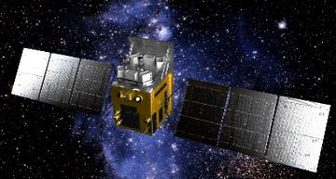
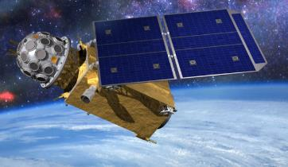
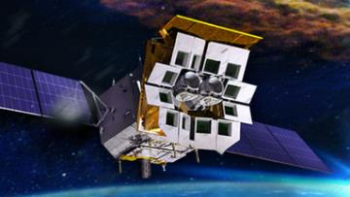
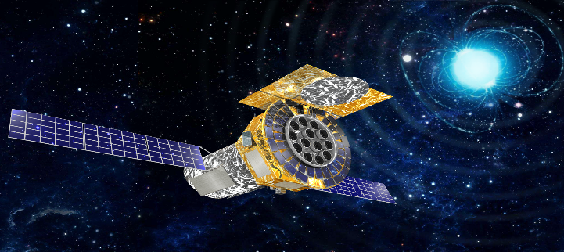
Outline
Vision and Scientific Objectives
Roadmap and Timeline
Leaders, Manpower & Funding
Missions and Highlights
Supporting facilities
Summary
Insight-HXMT
GECAM
Einstein Probe
eXTP

Slide 3
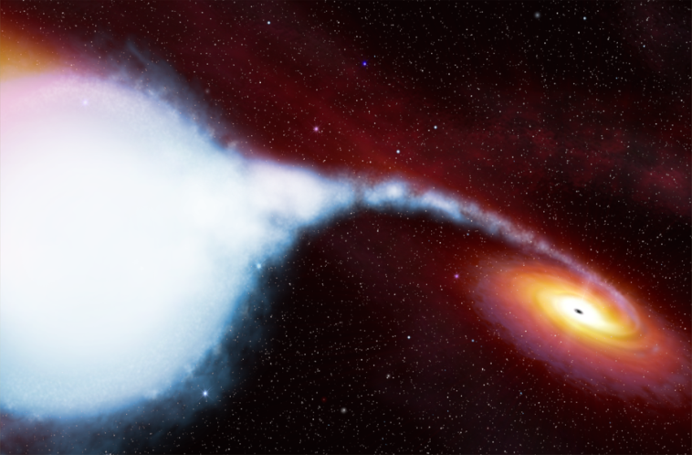
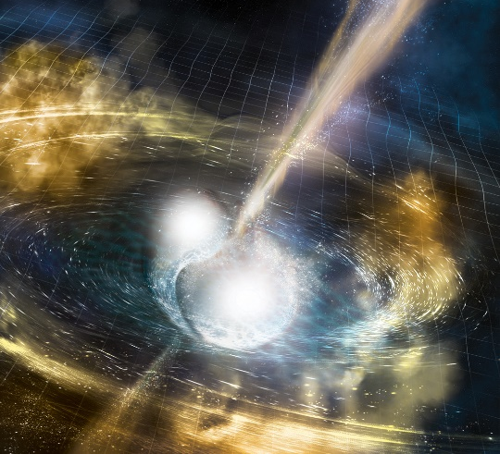
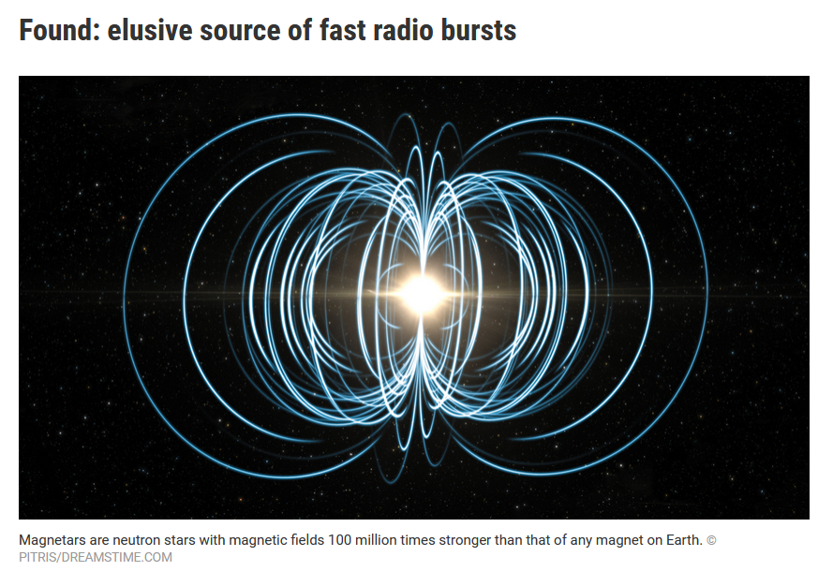
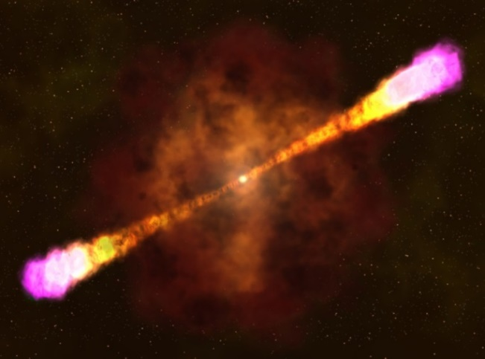
Vision & Scientific Objectives
To explore the forefront
Origin, property and evolution of Universe
Cosmology, galaxies and star endpoint (BH/NS)
Heavy elements
Fundamental laws in extreme conditions
Extreme Gravity, Density, Magnetic field
Accretion, jet, outflow
Multi-messenger multi-wavelength radiation mechanism and source
Compact Objects
Black Holes (BH), Neutron Stars (NS)
GRB, XRB, Pulsars
GW EM counterpart from merger
Galaxy and Universe
Active Galactic Nuclei (AGN)
Galaxy Clusters, IGM
Cosmic Rays, Dark Matter
BH/NS X-ray binary
Binary NS merger
Magnetar
Gamma-ray burst

Slide 4
Roadmap for Space Programs
Missions
In the Past
Missions
In-Operation
Missions
Under Construction
Missions
Applying for Adoption
SZ-2/XD
POLAR
Insight-HXMT
GECAM
SVOM/GRM
EP/FXT
Enhanced X-ray Timing and Polarimetry mission (eXTP*)
POLAR-2
X-ray Astronomy
CE-1/2/3-XRS
SJ-10/SRD
AMS02
DAMPE
CSES
AMS02 upgrade
High Energy cosmic-Radiation Detection (HERD*)
Space Particle Detection
*IHEP-led International Flagship

Slide 5
Mission Timeline
Past 5 years
HXMT
DAMPE/STK
POLAR
GECAM-A/B
GECAM-C
GECAM-D
SVOM/GRM
EP/FXT
POLAR-2/BSD
Pre-adoption
Construction
eXTP*
Operation
HERD*
*
Flagship
present
1990
2000
2010
2020
2030
Year

Slide 6
Mission manpower & funding (2018-2022)
Mission | Stage | Leaders (Generation/Age) | Manpower (FTE) | 5-year Funding (Million CNY)
Insight-HXMT | In-Operation | LI Tipei (83) ZHANG Shuang-Nan (60) LU Fangjun (53) SONG Liming (59) LIU Congzhan (42) LI Xiaobo (41) | 14.7 | 70
GECAM |  | XIONG Shaolin (40) LI Xinqiao (43) ZHENG Shijie (43) | 9.5 | 110
EP/FXT | To launch | CHEN Yong (53) JIA Shumei (45) | 19.7 | 133
SVOM/GRM |  | WU Bobing (55) DONG Yongwei (42) | 6.3 | 15
POLAR-2 | Waiting for the final approval | ZHANG Shuang-Nan (60) SUN Jianchao (39) | 3.2 | 3
eXTP* |  | ZHANG Shuang-Nan (60) LU Fangjun (53) XU Yupeng (52) TAO Lian (37) GE Mingyu (39) | 18.3 | 90
HERD* |  | ZHANG Shuang-Nan (60) DONG Yongwei (42) LI Zuhao (50) PENG Wenxi (41) | 18.1 | 35
*IHEP-led Large International Flagship

Slide 7
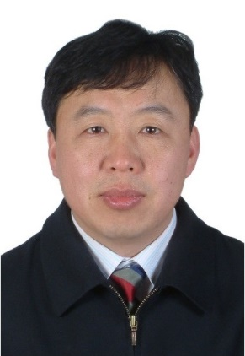
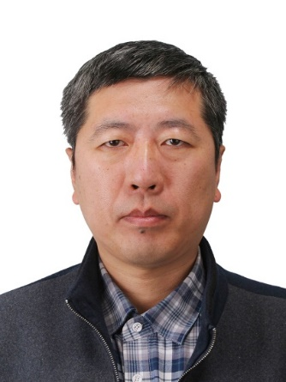
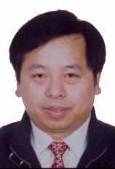
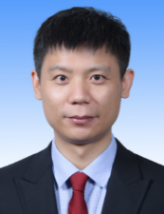
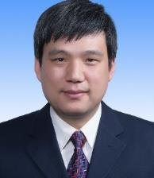
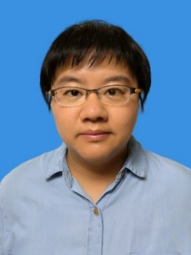
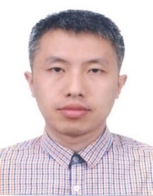
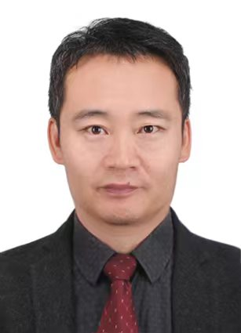
Leaders of space missions
LI Tipei
CAS Academician
HXMT
ZHANG Shuang-Nan
PI of POLAR, HXMT
eXTP and HERD
LU Fangjun
HXMT payload
eXTP manager
SONG Liming
HXMT, GECAM
Science Operation
XU Yupeng
eXTP payload
CHEN Yong
EP/FXT
WU Bobing
SVOM/GRM
XIONGShaolin
PI of GECAM
LIU Congzhan
HXMT Payload
DONG Yongwei
HERD Payload
TAO Lian
HXMT, eXTP
LI Xiaobo
Science Operation
PENG Wenxi
HERD Payload
LI Zuhao
HERD, AMS02
SUN Jianchao
POLAR, POLAR-2

Slide 8
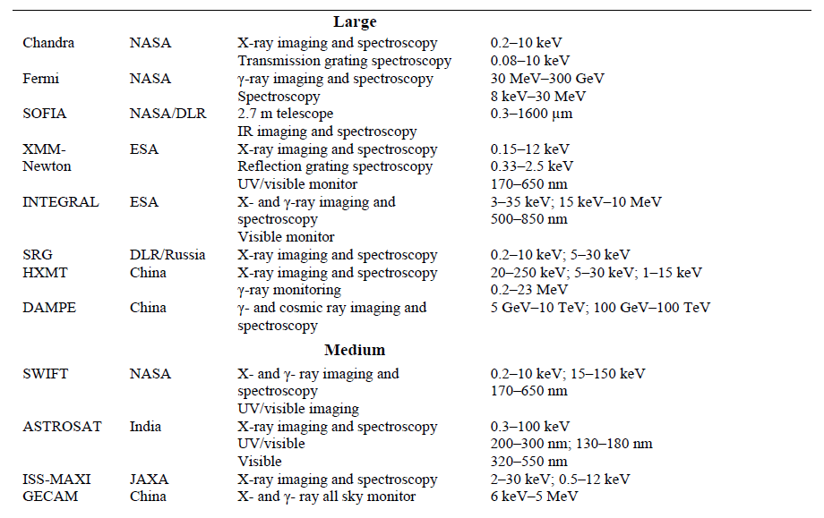
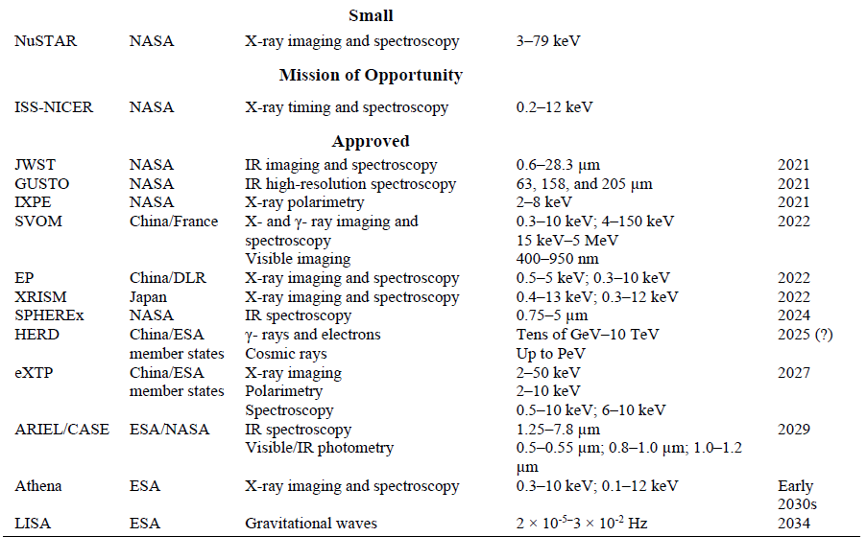
IHEP played an important role
IHEP led/involved in key high-energy astrophysics space missions in China
IHEP-led: HXMT, GECAM, HERD, eXTP IHEP-involved: DAMPE, SVOM, EP
From “Astro 2020: Pathways to Discovery in Astronomy and Astrophysics for the 2020s”

Slide 9
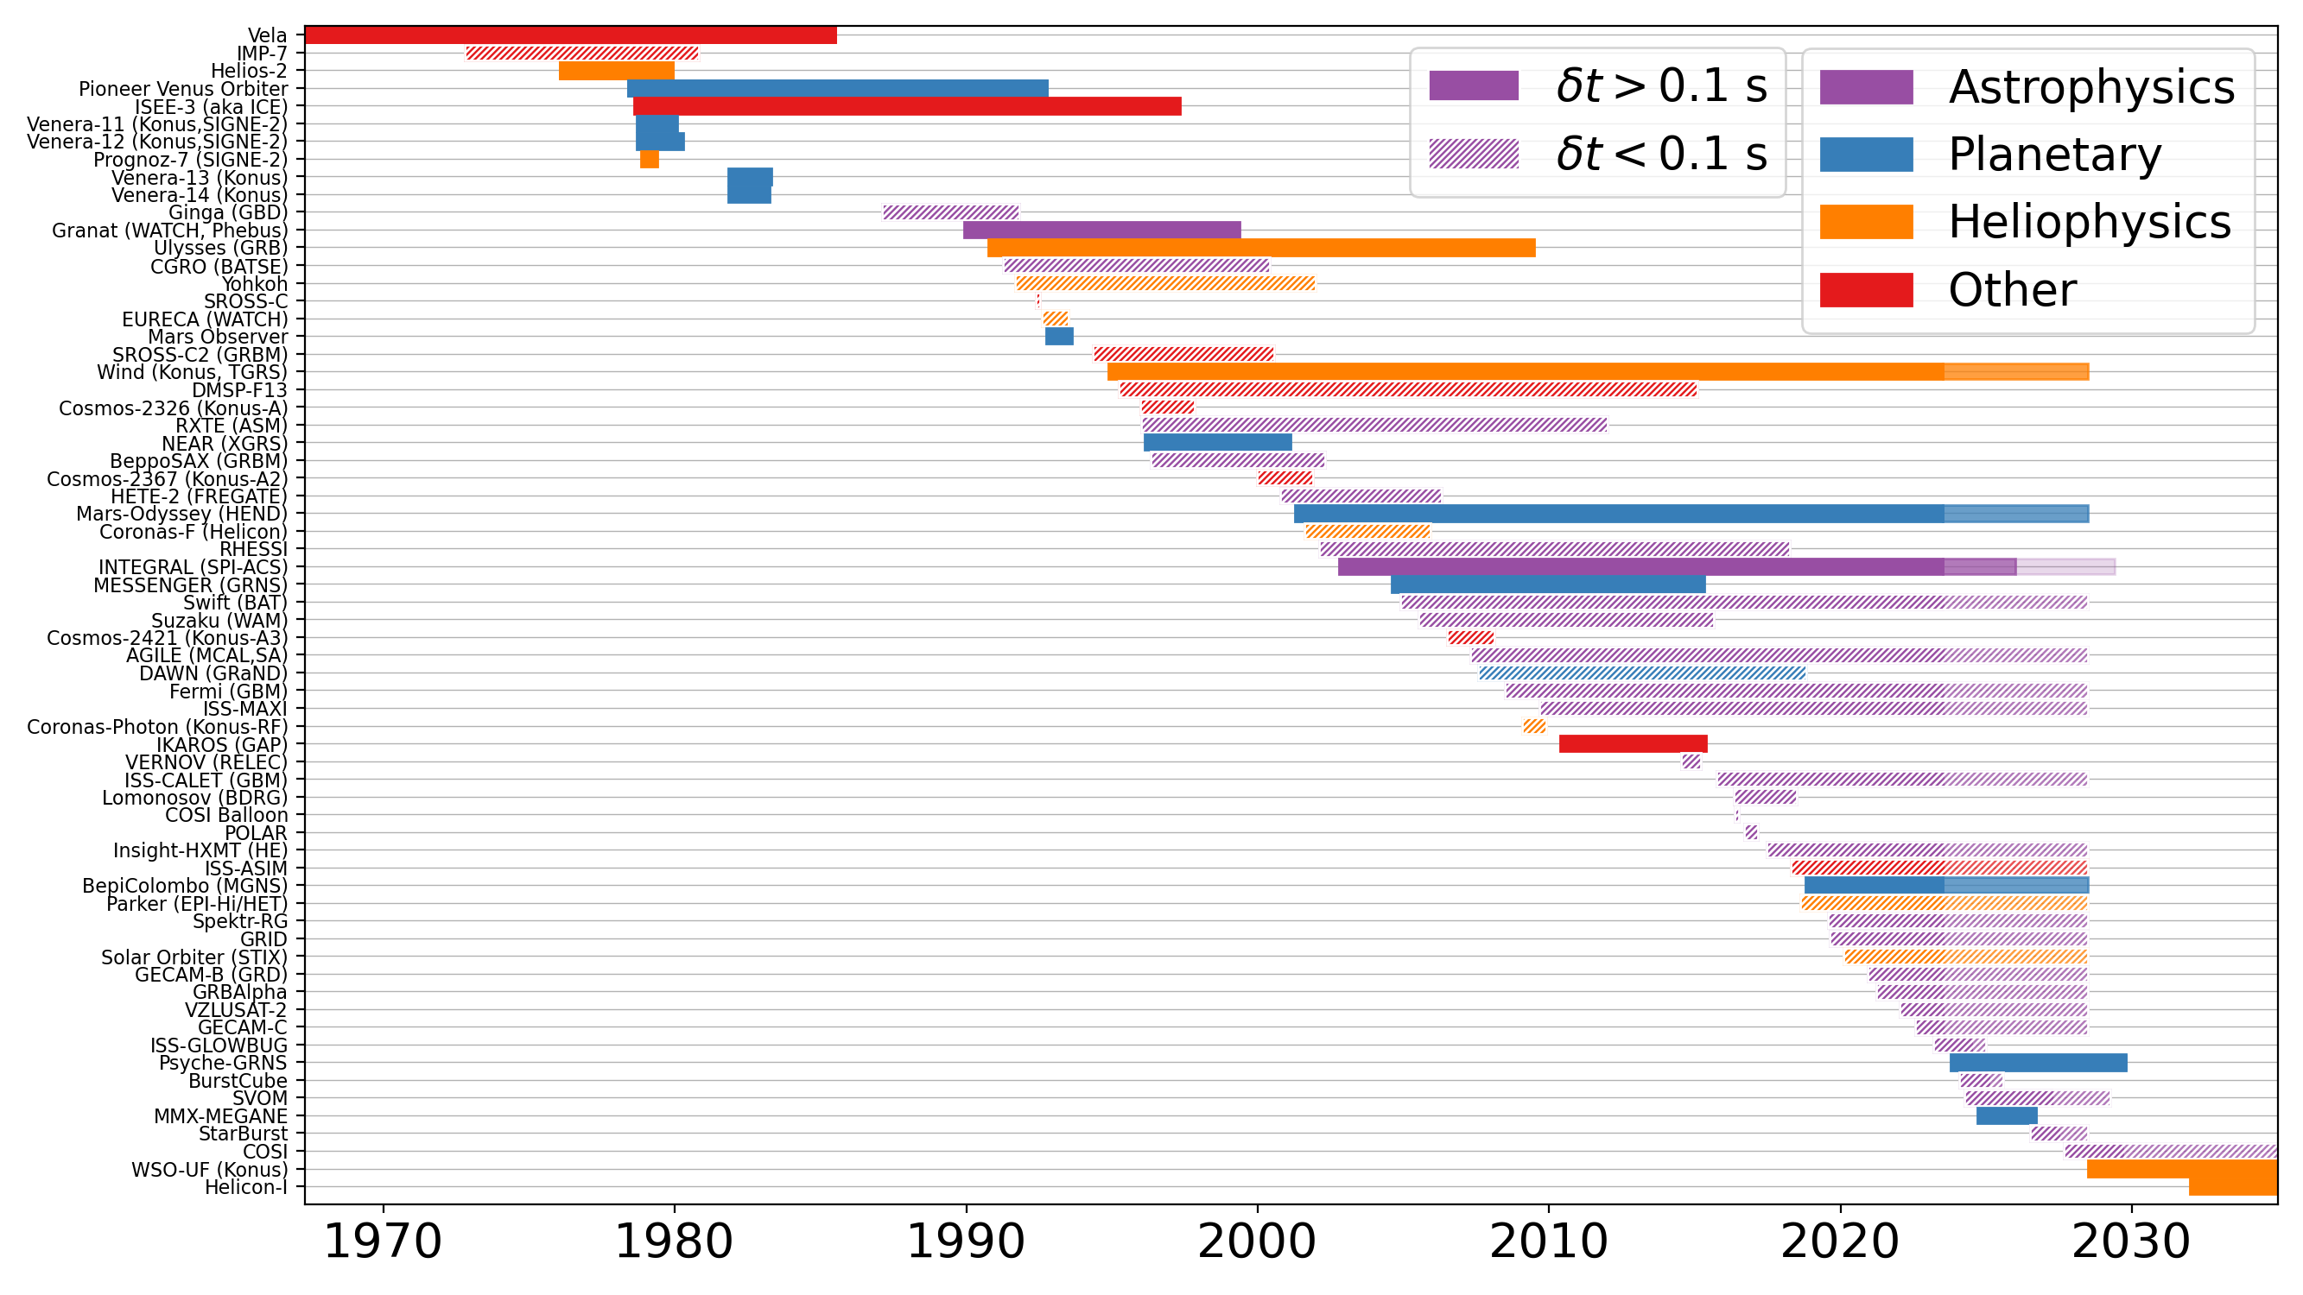
IHEP GRB missions in IPN (Interplanetary GRB Network)
Gamma-ray burst
IHEP GRB missions:
POLAR
Insight-HXMT
GECAM-B
GECAM-C
SVOM
Figure constructed based on information in https://github.com/dsvinkin/IPN_history
Credit: Eric Burns

Slide 10
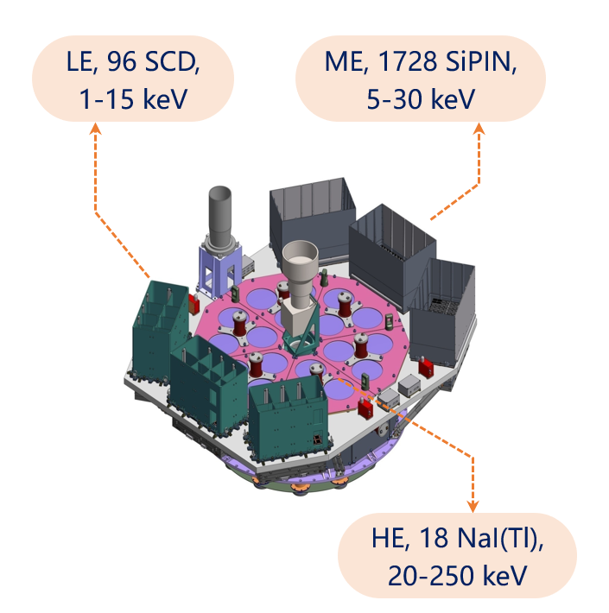
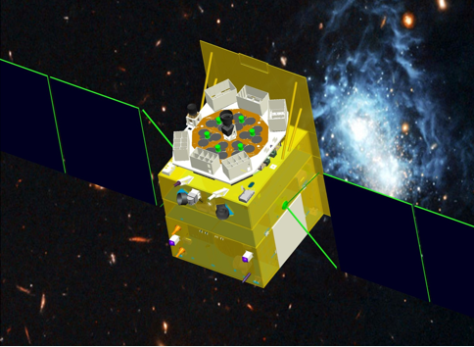
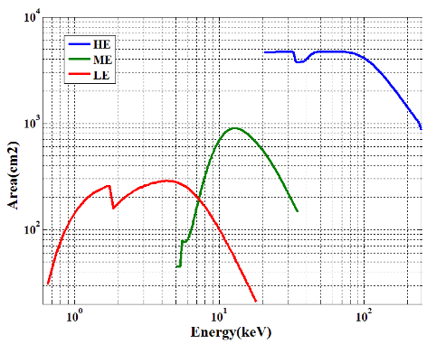
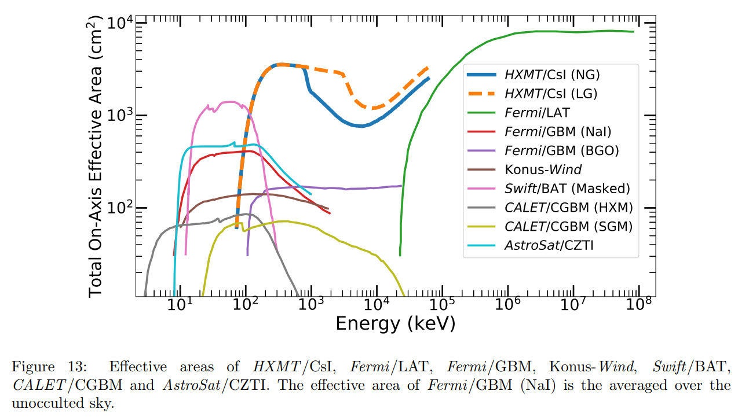
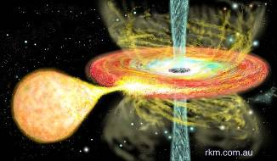
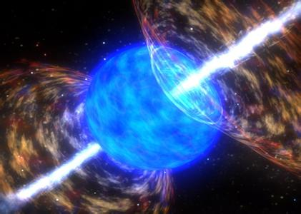
Hard X-ray Modulation Telescope (Insight-HXMT)
China’s 1st X-ray astronomy satellite
Proposed 1993, selected in 2011
Launched on June 15th 2017
Working in-orbit：6+ years
Designed lifetime: 4 yrs
Orbit: Attitude 550 km Inclination: 43°
Obs. Modes: Pointed, Scanning and γ all-sky monitoring
Science objectives
Galactic plane scan to monitor/discover transient sources
High statistics study of black holes and neutron stars
Gamma-ray transients: GRB/XRB with GW, FRB etc.
HXMT satellite
HXMT telescopes
Insight-HXMT features:
Broad energy bands
Large detection area
High time resolution
Capable to bright source
Notes:
增加性能指标对比

Slide 11
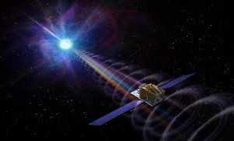
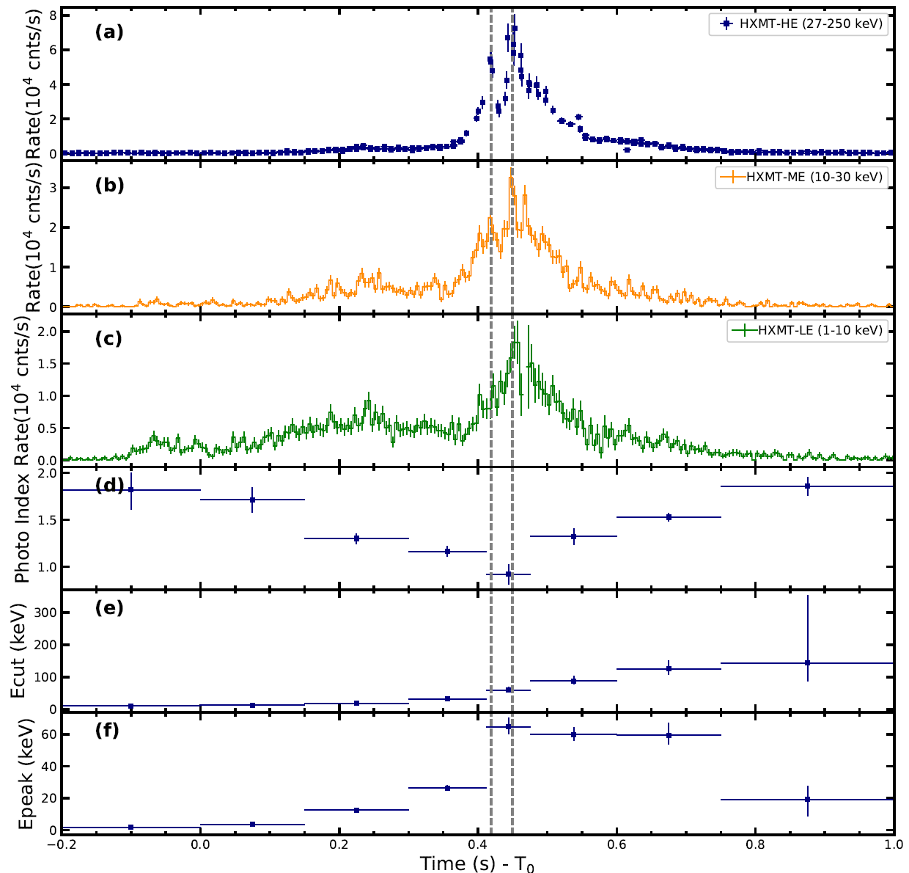
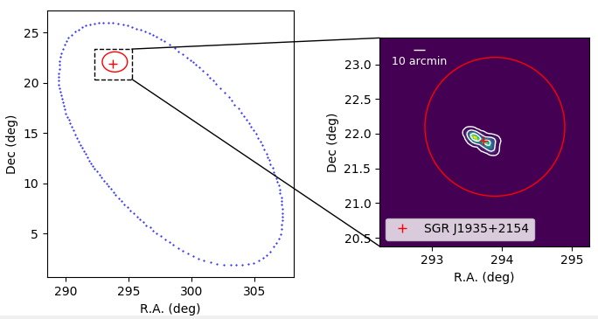
Insight-HXMT Highlights: FRB origin
Identify an X-ray burst associated with FRB 200428 from SGR J1935+2154, help to determine the origin of Fast Radio Burst (FRB)
Most detailed measurements of this XRB in very wide energy band (1-200 keV)
Localize the XRB, first time ever to determine the origin source of a FRB
Firstly identify the high energy counterpart (narrow x-ray peak) of the radio pulses of FRB
Breakthrough of the Year 2020
(by both the Science and Nature)
Li et al., 2021, Nature Astronomy
CHIME: FRB 200428

Slide 12
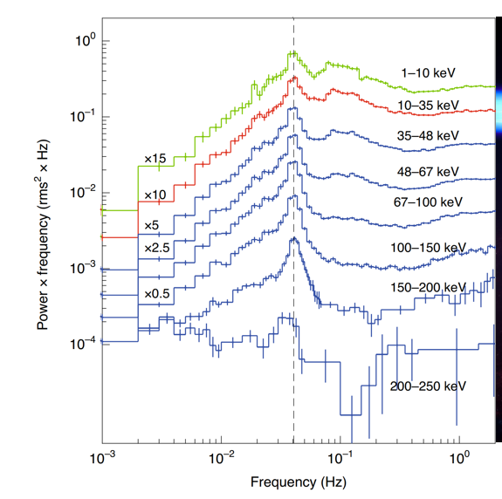
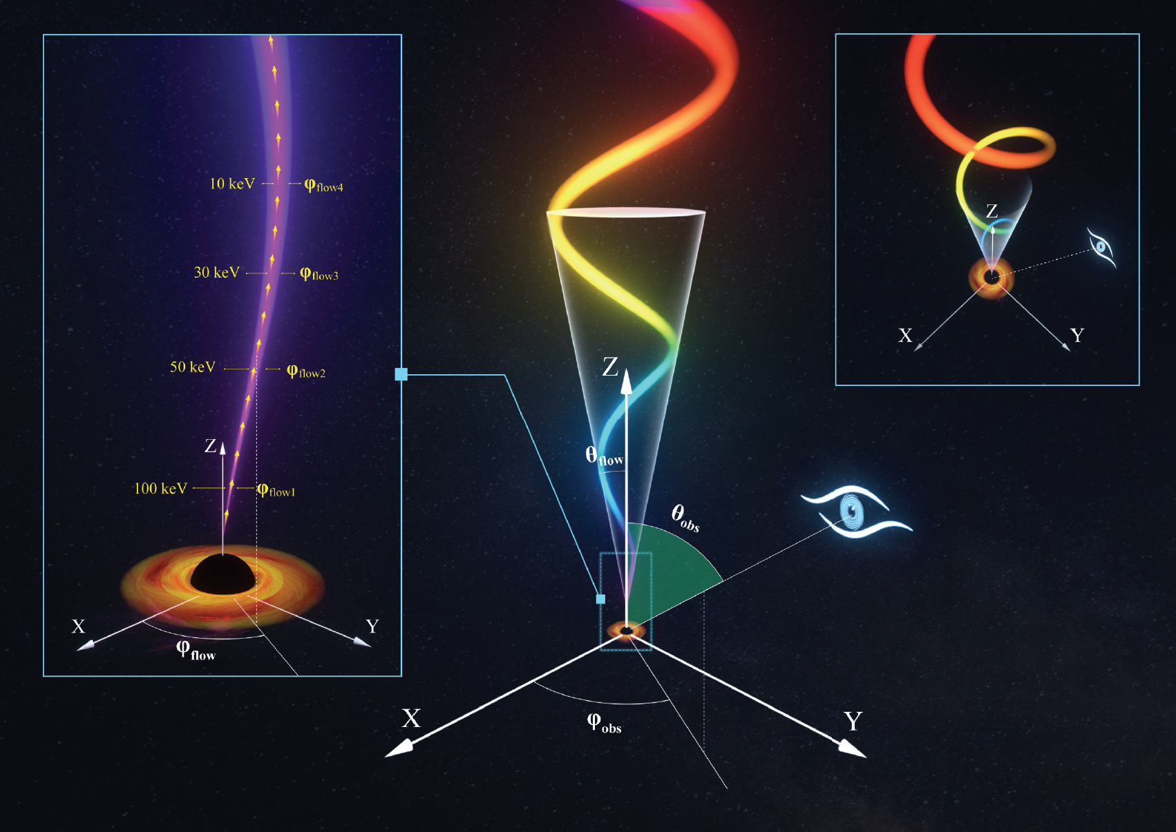
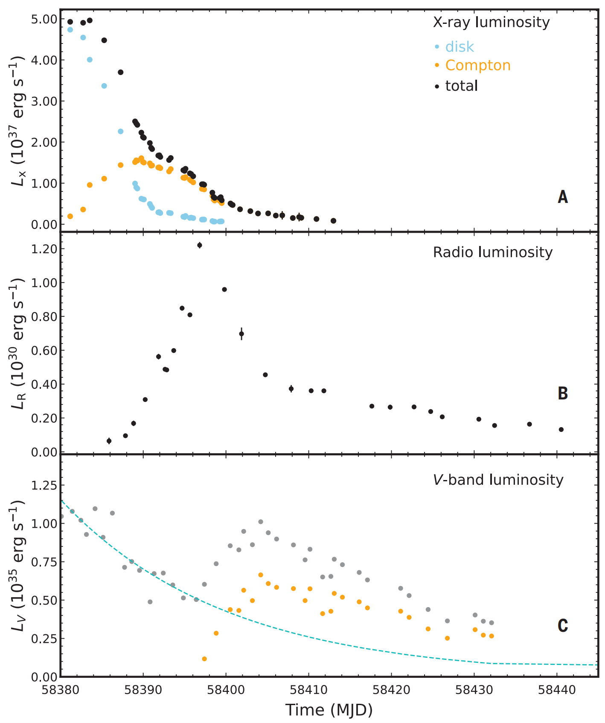
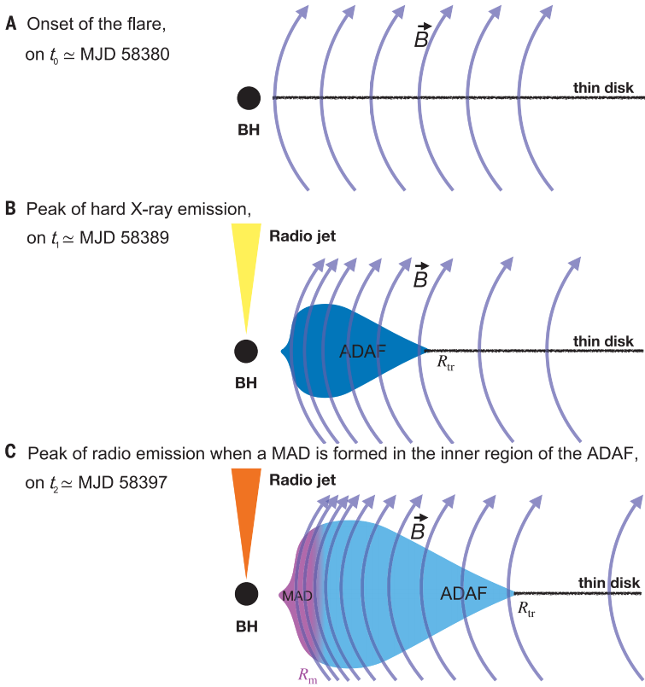
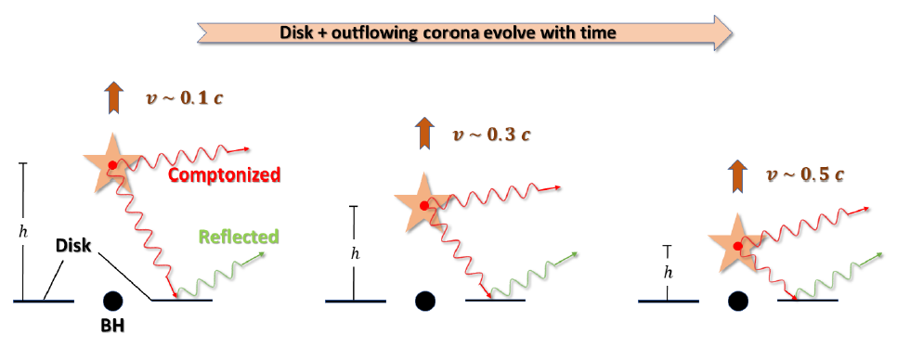
Insight-HXMT Highlights: BH X-ray Binaries
Discoveries of jet and accretion physics by most comprehensive observations of a new black hole (BH) XRB MAXI J1820+070
Discovery of low frequency oscillations above 200 keV, nearest jet around BH (Ma et al., 2021, NA)
A jet-like corona is escaping outward at relativistic speed (You et al., 2021, NC)
Indicate formation of a magnetically arrested disk (You et al., 2023, Science)
Ma et al., 2021, Nature Astronomy
You et al., 2021
Nature Communication
HXMT observation with optical and radio telescopes
You et al., 2023, Science

Slide 13
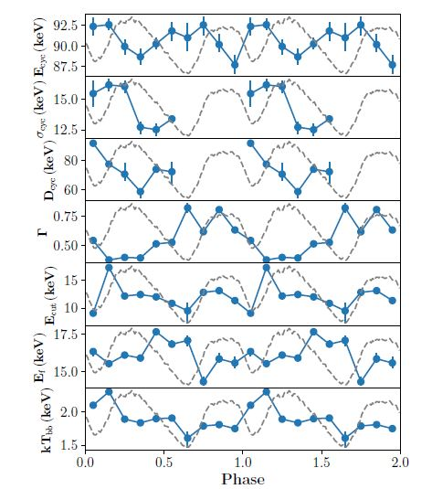
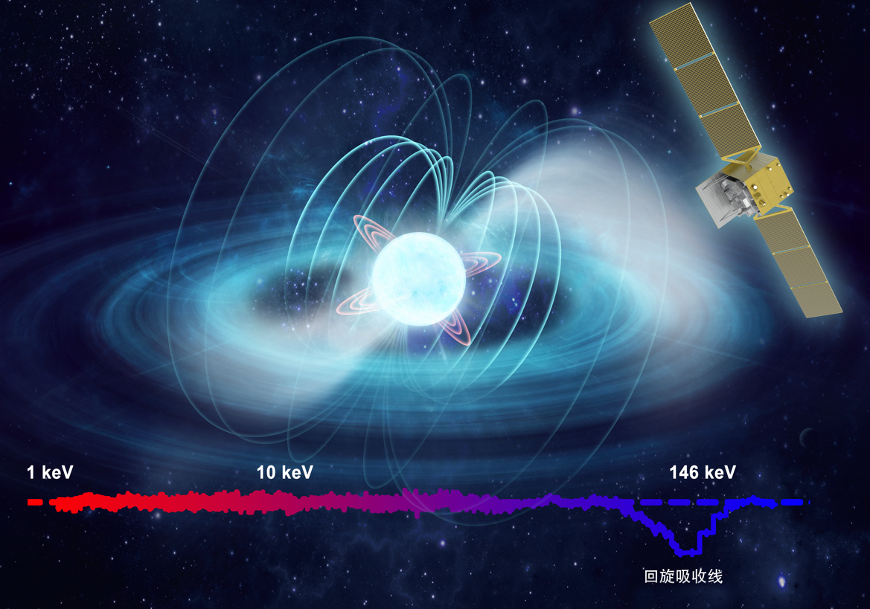
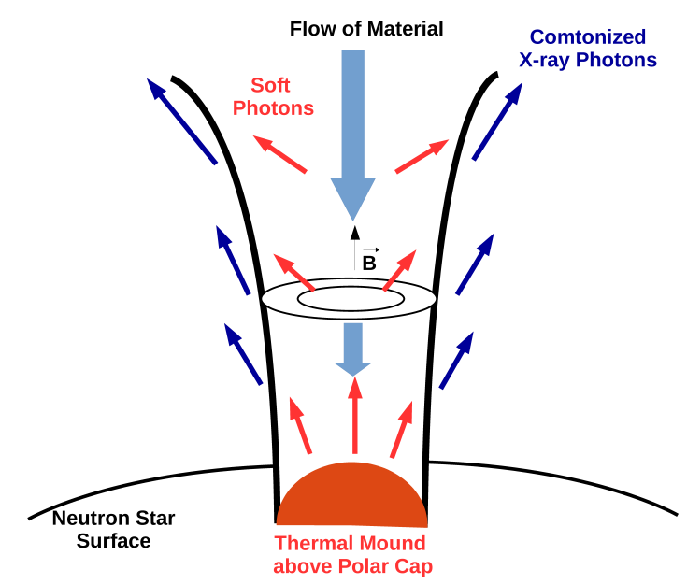
Insight-HXMT Highlights: NS X-ray Binaries
Directly measure and discover the strongest magnetic field on neutron star surface by Cyclotron Resonance Scattering Feature (CRSF)
First record：CRSF~90 keV in GRO J1008-57 → 8 billion Tesla
New record：CRSF~150 keV in Swift J0243.6+6124 → 16 billion Tesla
CRSF
Swift J0243.6+6124 ：CRSF ~ 146 keV
GRO J1008-57：CRSF ~ 90 keV
Kong et al. 2022, ApJL
Neutron star X-ray Binaries
Ge et al. 2020, ApJL

Slide 14
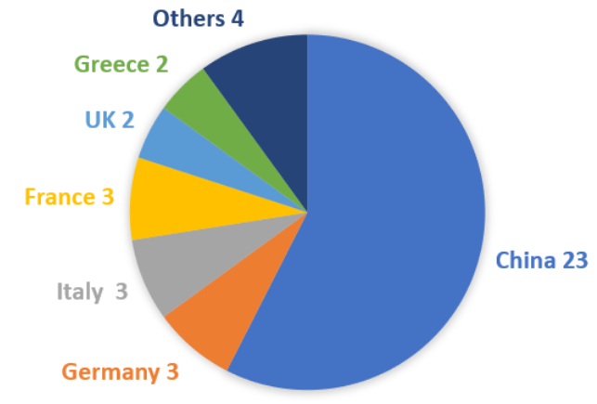
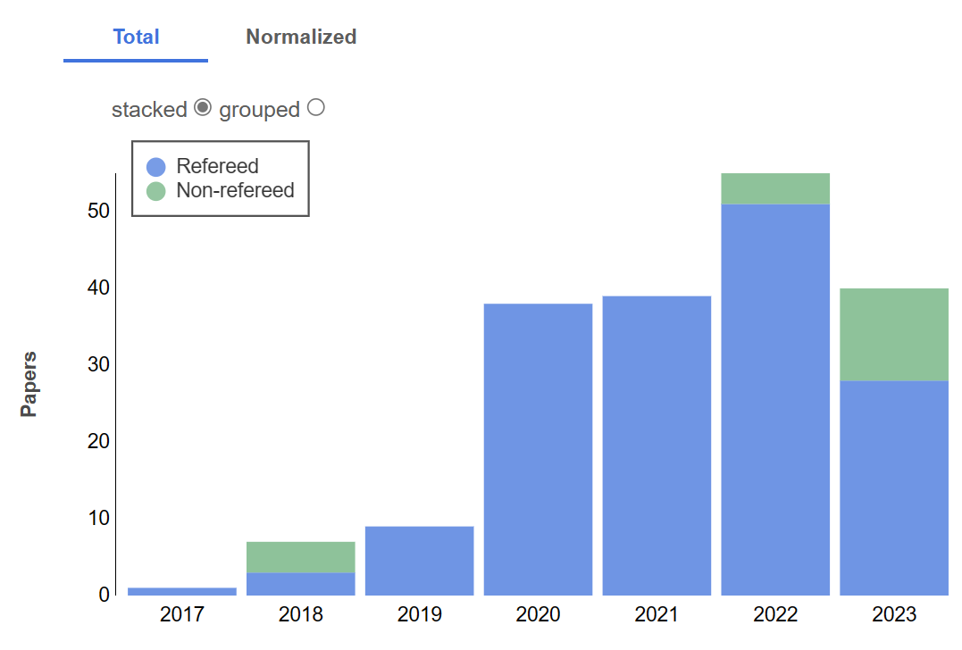
Insight-HXMT collaboration and influence
Six cycles of announcement of opportunities (AO) have been issued for Insight-HXMT mission. ~20TB data have been released, with a data public release rate of 92%.
As of August 2023, ~190 papers have been published by 300+ researchers from 15 foreign and 36 domestic research institutions, with a total of 5300+ citations.
Cycle | Submission Period | Proposals Amount | Observation Amount | Observation Period | ToO
AO01 | 2016.8-9 | 90 | 517 | 2017.11-2019.06 | 39
AO02 | 2019.1-2 | 35 | 349 | 2019.07-2020.07 | 26
AO03 | 2020.4-5 | 34 | 329 | 2020.08-2021.07 | 16
AO04 | 2021.4-5 | 33 | 333 | 2021.08-2022.08 | 30
AO05 | 2022.4-5 | 43 | 339 | 2022.09-2023.08 | 30
AO06 | 2023.4-6 | 50 | 337 | 2023.09-2024.08 | /
Number of papers from
NASA ADS: increasing
AO proposals from 40 institutions
Data release rate: 92%

Slide 15
Insight-HXMT collaboration teams
15 research institutes/universities

Slide 16
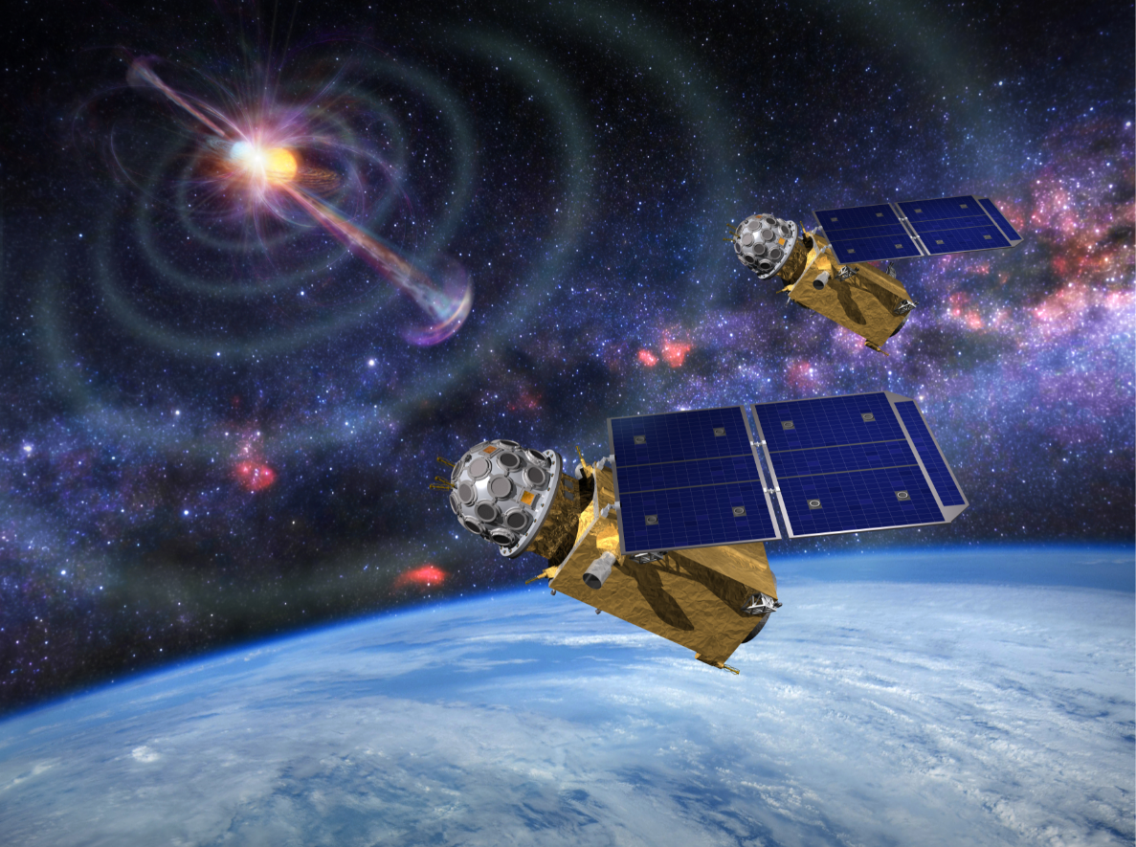
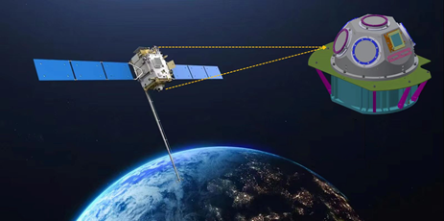
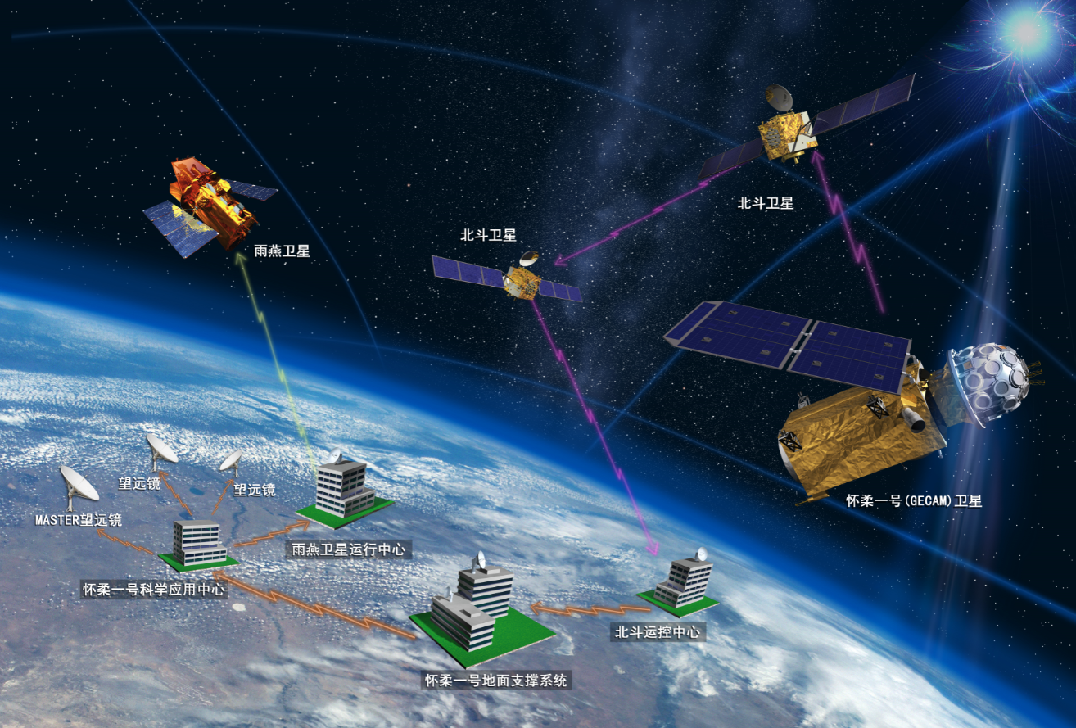
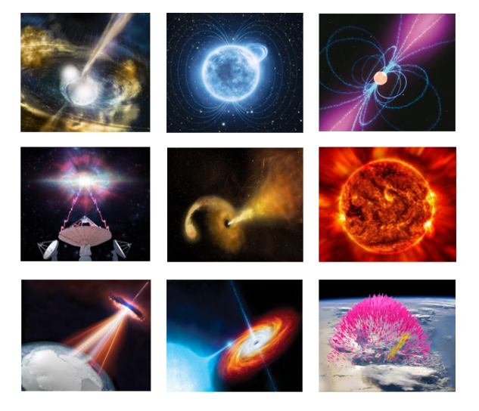
GECAM
Gravitational wave high-energy Electromagnetic Counterpart All-sky Monitor
(The first “Mission of Opportunity” for gravitational wave astronomy)
GECAM constellation
Gamma-ray All-sky monitor
GECAM-A/B/C are in the Low Earth Orbit
GECAM-D to deep-space orbit in Mar. 2024
Key Features
Full-sky coverage in 6 keV to 6 MeV
First real-time alert to guide follow-ups with novel application of Beidou navigation system
GECAM-A/B
GECAM-C
Swift/BAT
BDS
Science objectives
Gravitational Wave EM (GWEM)
Gamma-ray Burst (GRB)
Soft Gamma-ray Repeater (SGR)
Solar-Earth transients
MASTER
GECAM
GECAM alerts lead to follow-up observations, first in China

Slide 17
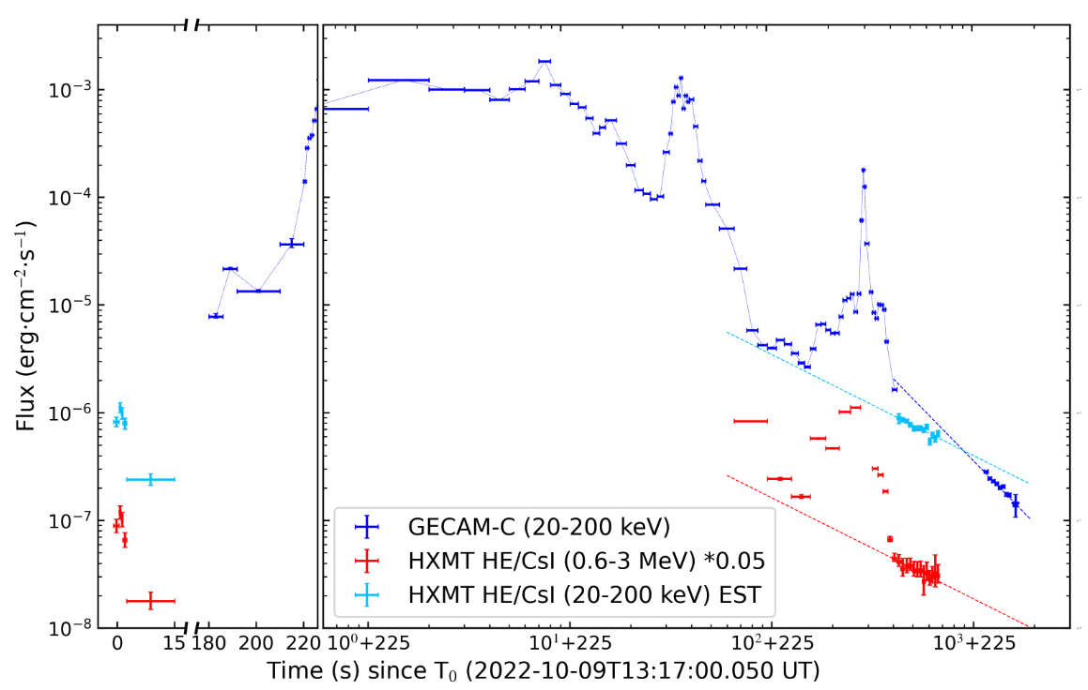
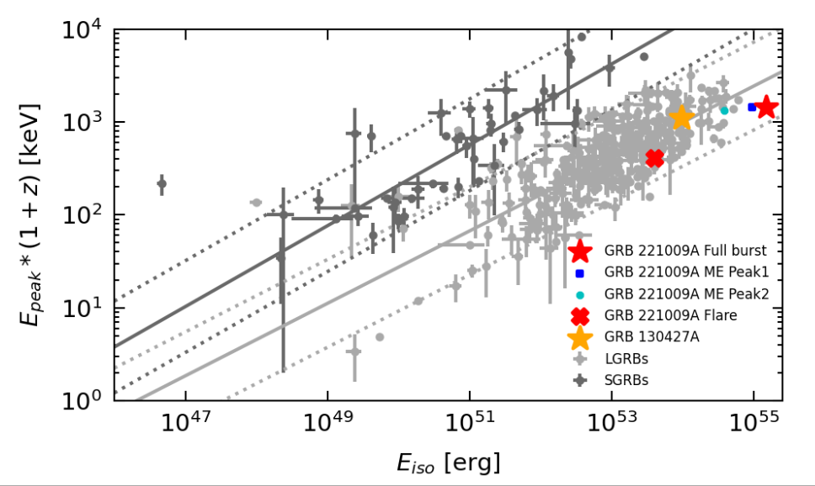
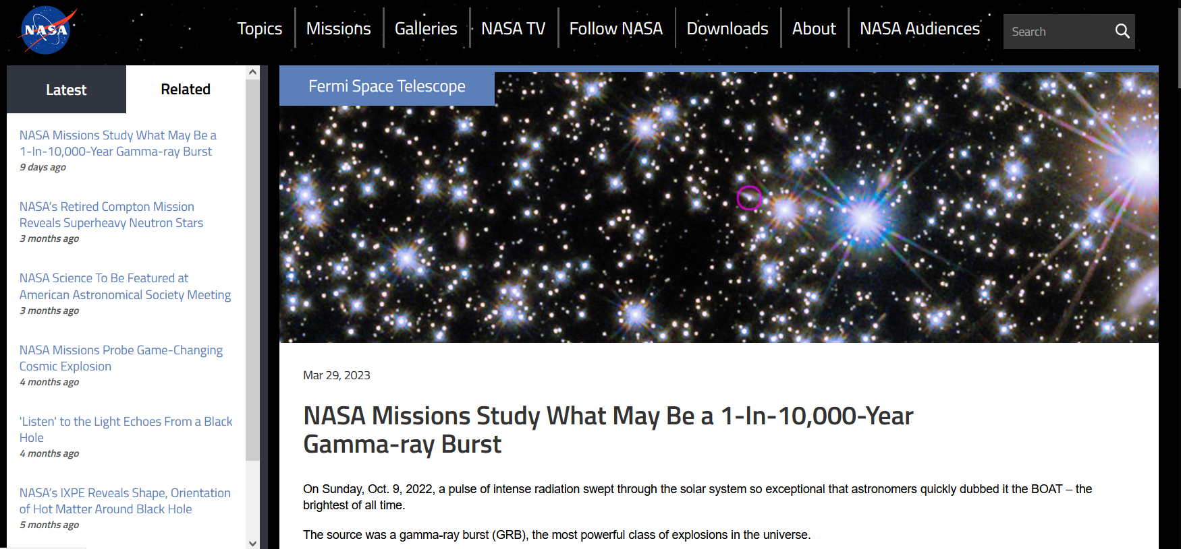
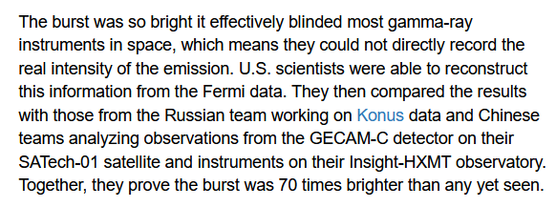
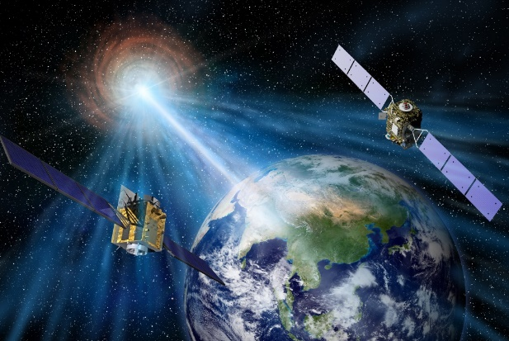
GECAM Highlights: GRB
GECAM-C accurately measure the Brightest-of-all-time GRB (GRB 221009A)
[An+, arXiv:2303.01203]
GECAM-C uniquely provided the accurate measurement of the extreme main burst
GECAM-C found this burst has the largest isotropic energy (Eiso = 1.5E55 erg)
GECAM-C and HXMT together found it launched the narrowest jet (~0.7 deg), challenging most GRB theories
Joined the global press release on March 28, 2023
Set new records in the GRB history!

Slide 18
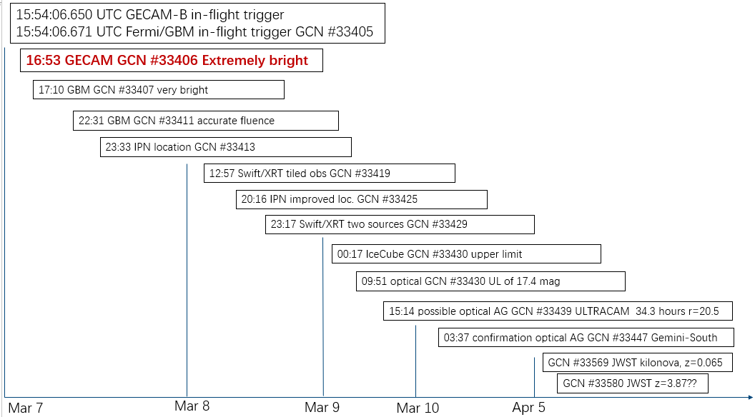
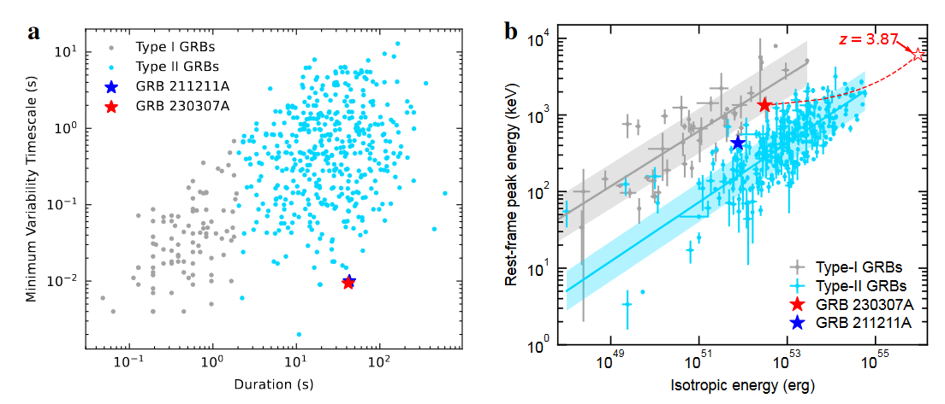
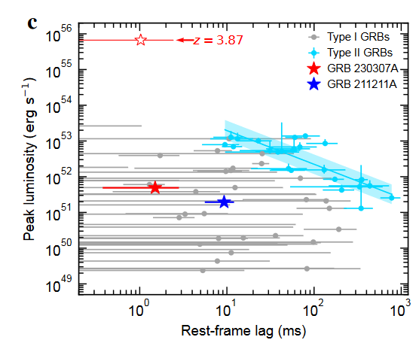
GECAM Highlights: GRB
Discovered the brightest long duration merger-origin GRB 230307A
Firstly report this extremely bright burst with Beidou, which triggered global observation campaign
Most accurate measurement of prompt emission while others got saturated due to extreme brightness
Spectral and temporal measurements support the merger origin, rather than collapsar
First time to determine jet geometry in gamma-rays in prompt emission phase: jet angle ~3.4 deg
[Xiong et al., GCN 33406]
[Sun et al., Nature, under review]

Slide 19
GECAM Highlights: FRB-XRB relation
Both GECAM-B and GECAM-C discovered an X-ray bust associated with a FRB from the Galactic magnetar SGR J1935+2154
the second event of this kind, firmly established the association between FRB and XRB
GECAM discovered an X-ray burst associated with a much weaker radio burst
Confirm the high energy narrow peaks associated with radio pulses
Critical to understand the mechanism of both the FRB and other radio burst as well as x-ray bust from magnetar
XRB by GECAM
FRB by CHIME
[Wang et al., Atel #15682]
[Li et al., In prep.]
Magnetar emits x-ray and radio burst

Slide 20
EP/FXT (Follow-up X-ray Telescope)
Einstein Probe (EP) is a mission dedicated to time-domain astronomy
Instruments: WXT (Wide-field X-ray Telescope) + FXT (Follow-up X-ray Telescope)
FXT is one of the two payloads onboard EP
IHEP-led Collaboration with MPE, ESA, and Technical Institute of Physics and Chemistry, CAS
FXT has the largest effective area and strongest grasp capability
Compared to such kind of follow-up telescope internationally in-operation
Timeline
Approval at the end of 2017
At present, AIT of the satellite
Plan to launch by the end of 2023
FXT

Slide 21
EP/FXT performance
Characteristics of FXT and comparison
 | EP/FXT | Swift/XRT
FoV | 1°×1° | 23.6’×23.6’
Effective area | 660 cm² @ 1.5 keV | 125 cm² @ 1.5 keV
Focal length | 1.6 m | 3.5 m
Angular resolution | 21” @ 1.5 keV; HPD | 18” @ 1.5 keV; HPD
Time resolution | 23.7 μs; Timing; 1D | 1.8 ms; WT; 1D 140 μs; PD; entire CCD
 | 50 ms; Full frame 2 ms; Partial-window | 2.5 s; IM
sensitivity | 1×10⁻¹⁴ erg/s/cm²; in 10⁴ s | 2×10⁻¹⁴ erg/s/cm²; in 10⁴ s
Filter wheel | 6 (positions and filters) | 1 thin filter
EP satellite integration
Mirror assembly

Slide 22
SVOM/GRM (Gamma-Ray Monitor)
Collaboration between China (CAS, CNSA) and France (CNES)
Plan to launch in Mar. 2024, with lifetime of 3+2 years
GRM: gamma-ray monitor with wide field of view
Location, Spectrum, Temporal characteristics of bursts
NaI(Tl): X-ray detector (15~5000 keV)
3 GRDs with different orientations
Acoustic and vibration tests on SVOM carried out in August of 2023 in Shanghai
SVOM/GRM is developed by IHEP

Slide 23
POLAR-2
Enhanced GRB polarimeter, as successor of POLAR with ×4 effective area
Officially selected by CSS through UNOOSA in 2019, aims to launch around 2025
Instruments of POLAR-2:
HPD (Europe + IHEP): launch ~2025
BSD (IHEP) and LPD: launch ~2026
Ceremony of MOU signing
Nov./2019
HPD modules
ESRF beam test
BSD module
ESRF beam test

Slide 24
HERD (High Energy cosmic-Radiation Detection facility)
Flagship
HERD, as a space particle experiment and gamma ray observatory, is a China-led large international collaboration with key European contributions led by Italy
One of the two flagship scientific experiments onboard China Space Station (CSS)
Core Sciences
Precise measurement of the cosmic ray electron spectrum and high-sensitivity search for dark matter signals
Cosmic ray origin and cosmic ray physics
High-sensitivity high-energy gamma-ray sky survey observation and all-sky monitoring
G.F. (e) | >3 m²sr@200 GeV
G.F. (p) | >2 m²sr@100 TeV
Energy range (e/γ) | 10 GeV - 100 TeV (e); 0.5 GeV - 100 TeV (γ)
Energy range (p) | 30 GeV - 5 PeV
Charge meas. | Z=1-28; <0.15 c.u.@Z=1
Energy resolution (e) | 1%@200 GeV
Energy resolution (p) | <25%@100 GeV – PeV
e/p separation | >3*10⁵(90% eff.@100GeV)
Angular resolution | 0.1 deg.@10 GeV

Slide 25
HERD international consortium
The HERD consortium includes ~200 scientists from China and Europe
Most of the members have been collaborating on previous high energy experiments in science and hardware development.
8 international workshops (in person) have been organized in China and Europe since 2012
5 CERN beam tests on HERD prototypes have been successfully implemented
Management structure established:
Institution Leaders Board; Technical Executive Board; Publication Board
 | Participating institutions
Payload Module | IHEP
CALO | IHEP, XIOPM, NNVT, CMBA; INFN Florence; CIEMAT
SCD | INFN Perugia, INFN Torino, etc.; IHEP, PMO
FIT | Univ. of Geneva, EPFL; ICCUB
PSD | INFN Bari, INFN Pavia, INFN Lecce, GSSI, etc.; ICCUB, IFAE; IHEP
TRD | GXU, CCNU, IMP
Trigger | IHEP, CIEMAT, IFAE, etc.
Ground calibration | IHEP, GXU, INFN sections, Univ. of Geneva, CERN
Science center | IHEP, SDU, ASDC & INFN-CNAF (Italy)
Sciences | IHEP, PMO, USTC, YNO, NAOC, SDU, GXU, TSU, PKU, NJU, YNU, SWJTU, HKU, Academia Sinica, and institutions from Italy, Switzerland, Spain, etc.

Slide 26
HERD performance, status and plan
Experiment （Launch year) | Energy range(e/γ) | Energy range(p) | Energy res.(e/γ) | Energy res.(p) | e/p sepa. | Acceptance(e) m²sr | Acceptance(p) m²sr
FERMI (2008) | 1GeV-300GeV | 30GeV-10TeV | 10% | 40% | 10³ | 0.9 | <0.28
ISS-AMS02 (2011) | 1GeV-1TeV | 1GeV-1.8TeV | 2% | - | 10⁶ | 0.12 | 0.12
ISS-CALET (2015) | 1GeV-10TeV | 50GeV-10TeV | 2% | 35% | 10⁵ | 0.12 | --
DAMPE(2015) | 5GeV-10TeV | 40GeV-100TeV | ≤1.5% | 25-35% | 3*10⁴ | 0.3 | 0.04
HERD(~2027) | 10GeV-100TeV 0.5GeV-100TeV(γ) | 30GeV-PeV | 1% | 20% | 10⁶ | >3 (10X DAMPE) | >2 (50X DAMPE)
HERD is a next generation experiment with much better performance on direct measurement of high energy e, p, γ
Payload-level design is completed
Plan to launch to CSS in 2027

Slide 27
eXTP: enhanced X-ray Timing and Polarimetry
Flagship
Important Sciences
Extreme gravity, magnetism, density
Neutron stars, black holes, etc
Cutting-edge technology
Spectral, polarization, timing, imaging
Large eff. Area (~3.4 m²@6 keV)
High spec. resol.(<180 eV@6 keV)
High throughput: 15 Crab up to 8 hours
Payload | Configuration | Eff. area (m²) | Timing res. (μs)
Spectroscopy Focusing Array (SFA) | 9 telescopes | 0.6 m² @ 1.5 keV | 10
Large Area Detector (LAD) | 40 modules | 3.0 m² @ 8 keV | 10
Polarimetry Focusing Array (PFA) | 4 telescopes | 300 cm² @ 3 keV | 10
Wide Field Monitor (WFM) | 6 cameras | 3.1 Sr (FOV) | 10
PI: Shuang-Nan Zhang (IHEP) Europe: Marco Feroci (INAF, Rome)

Slide 28
eXTP International Consortium
Five refereed papers have been published in a special issue of SCIENCE CHINA Physics, Mechanics & Astronomy, Feb. 2019
S.-N. Zhang, A. Santangelo, M. Feroci, Y.P. Xu, et al., The enhanced X-ray Timing and Polarimetry mission - eXTP
A. L. Watts, W.F. Yu, J. Poutanen, S. Zhang, et al., Dense matter with eXTP
A. De Rosa, P. Uttley, L.J. Gou, Y. Liu, et al., Accretion in Strong Field Gravity with eXTP
A. Santangelo, S. Zane, H. Feng, R.X. Xu, et al., Physics and Astrophysics of Strong Magnetic Field systems with eXTP
J. J. M. in 't Zand, B. Enrico, J.L. Qu, X.D. Li, et al., Observatory science with eXTP
PI Institute: IHEP
Total number of citing papers: 240, citations: 293 (ADS, 26 Aug 2023)

Slide 29
eXTP performance, status and plan
The mirror module developed by IHEP and collaborators
Phases C+D+E1 to be funded in 14th 5-yr plan of China
(now highly recommended by CAS)
Aim to adoption in 2023 and launch in 2029
PFA engineering mode end to end test @ IHEP

Slide 30
Supporting facilities
100-m calibration facility
One of the longest in the world
Calibration and test for detectors and Focusing mirrors in X-ray
Strong support for future missions
Integration & Test Center
(Exp. Hall #4, tour later)
Technology R&D
Test, Integration, etc.
Clean rooms
Science Operation Center
(3rd Floor of New building, tour later)
Science operation
Data processing and release
Hardware and Software infrastructure
Support all space missions
100-m X-ray calibration facility
PSF calibration of x-ray telescope
Science Operation Center
for Space Missions
Integration & Test Center

Slide 31
Summary
IHEP Fleet of space missions
Vision & Science goals
Extreme universe, compact objects, fundamental laws
Roadmap
Past, current operation & develop, future missions
Science achievements
FRB origin, Magnetar bursts
X-ray binaries: BH jet, accretion disk, magnetic field of NS
GRB, binary compact merger, multi-messenger sources
International collaboration and influence
Insight-HXMT, GECAM, EP, SVOM, POLAR-2, eXTP, HERD…
Astro2020, IPN, publication, data release, observation call…
Manpower and funding
Leading scientists in different generations, especially young talents
Healthy funding in recent years. Two flagship mission to be funded
Supporting facilities
Technology R&D, Test & calibration facilities, Operation center
Thank You!

Slide 32
Backup slides

Slide 33
Roadmap for Space Programs
Missions
In-Operation
Under construction
Missions
ready for adoption
Conceptual Missions
Past Missions
SZ-2/XD
POLAR
Insight-HXMT
GECAM
SVOM/GRM
EP/FXT
Enhanced X-ray Timing and Polarimetry mission (eXTP*)
POLAR-2
CATCH
(Chasing All Transients Constellation Hunters)
WXPT
(Wide band X-ray Polarization and Imaging Telescope)
X-ray Astronomy
CE-1/2/3-XRS
SJ-10/SRD
AMS02
DAMPE
CSES
High Energy cosmic-Radiation Detection (HERD*)
MeVGRO
(Wide-field MeV Gamma-Ray Observatory)
Space Particle Detection
*IHEP-led Large International Flagship

Slide 34
Co-founder of the AMS International Collaboration
The Alpha Magnetic Spectrometer (AMS) experiment is the most powerful and sensitive physics detector ever deployed in space and is exploring a new exciting frontier in physics research.
AMS Magnet is the “core” of the detector and was built by IEE, IHEP of CAS and CALT under the leadership of Professor Hesheng Chen from IHEP.
The Electromagnetic Calorimeter (ECAL) was built by a collaboration of researchers from IHEP, INFN Pisa in Italy and LAPP in2p3 in France.
AMS is performing detector upgrade (launch~2026) by adding 8m² silicon strip detector (L0) on top of the existence detector which will increase the acceptance to 300%. IHEP is taking responsibility of the designing and production of the detector module, as well as the integration and testing.
AMS Magnet on Space Qualification test
AMS ECAL on Space Qualification test
Prof. Samuel Ting Visit AMS L0 LAB

Slide 35
Co-founder of the AMS International Collaboration
IHEP has made major contribution to the data analysis including the measurement of the fluxes of cosmic ray positron, electron, antiproton and nuclei.
AMS will continue operate till the end of the International Space Station which is no earlier than 2030. With the upgrade, AMS will greatly improve it’s physics potential. IHEP AMS group will continue analyzing the continually increased data, search for the origin of dark matter by measuring light anti-matter (positrons, antiprotons and anti deuterons), mysteries of the missing of antimatter by measuring heavy antimatter ( anti-helium, anti-carbon and anti-oxygen) and search for the origin of cosmic rays by measuring heavy nuclei.
Requires more data
for accurate measurement
Positrons from
Cosmic Ray Collisions
By 2030，AMS will greatly improve the accuracy of the antiproton spectra
By 2030, AMS will provide complete and accurate spectra for the 29 elements and provide the foundation for a comprehensive theory of cosmic rays
By 2030, AMS will ensure that the measured high energy positron spectrum indeed drops off quickly as predicted by dark matter models

Slide 36
Future missions under concept study
CATCH (Chasing All Transients Constellation Hunters)
Intelligent X-ray constellation with 126 microsatellites of 3 types
Spectrum, timing, polarization with high sensitivity
Game changer in soft x-ray (follow-up) observations!
MeVGRO (MeV Gamma-Ray Observatory)
Filling the MeV gap!
0.3~300 MeV with wide field of view
Spectrum: nuclear lines and continuum
Imaging, Timing, Polarization
WXPT (Wide band X-ray Polarization and Imaging Telescope)
Wide band polarization with unpreceded high accuracy
Focusing in 3-60 keV
Wide FOV in 50-500 keV

Slide 37
POLAR collaborations
Signature of Sci. MOU 2012, UNIGE
Meeting 2016, IHEP
1st POLAR meeting, Mid./Sep./2007, IHEP
Meeting 2017, Sierre
2nd POLAR meeting, Mid./Sep./2009, UNIGE
Meeting 2013, IHEP
Meeting 2018, IHEP
Meeting 2011, IHEP
Meeting 2019, IHEP
Meeting 2014, IHEP

Slide 38
POLAR-2 collaborations
2019
2021

Slide 39
IHEP-led POLAR-2/BSD progress and plan
HPD payload aims to launch ~2025, BSD and LPD aim to launch ~2026
Prototype detector modules have been produced for the three payloads, preliminary calibration results show good performance
More promising scientific results can be expected by the whole POLAR-2 mission
40 keV
LPD CubeSat experiment
High gain channel
40 keV
HPD modules
ESRF beam test
Low gain channel
BSD module
ESRF beam test
Preliminary in-orbit results

Slide 40
eXTP Mission Development & Plan
Phase B: Jan 2019-Dec 2022
Funded in China by the Major Background Study Project by CAS
LAD & WFM Phase B study supported by European member states
Adoption in China: ~ by end 2023?
PDR (early 2024)
Phase C: Jan 2024 – Dec 2026
CDR ( ~ Oct 2026)
Phase D (FM): Jan 2027 – Mar 2029
Phase E1: Apr 2029 – Aug 2029
Launch
The mirror module developed by IHEP and collaborators in China
Phases C+D+E1 to be funded in 14th 5-yr plan of China
(now highly recommended by CAS)
EEF@2.98keV
PFA engineering mode end to end test @ IHEP

Slide 41
POLAR
Collaborations: China (IHEP), Switzerland (UNIGE, PSI, ISDC), Poland (NCBJ)
Main goal: Polarization measurement of GRB prompt emissions with high precision
Extended detection abilities in-orbit: Pulsars, Solar flares, etc.
Main phases for development
2005~2010, concept and prototype
2011~2013, qualification model
2013~2016, flight model
15th Sep. 2016, launch
Main compositions: OBOX & IBOX
Instrument Characteristics
OBOX size: 462×462×262.5 mm³ IBOX size: 247×160×85 mm³ Plastic scintillator bar size: 5.9×5.9×176 mm³
Mass: OBOX: 28 kg, IBOX: 3.5 kg
Energy range: 50 – 500 keV
FOV: ~50% of the sky
Orbit data
Orbit: ~400 km
Orbital inclination: ~42.79°, Period: ~ 92 mins
OBOX
IBOX

Slide 42
POLAR-2 instruments design
High-energy Polarization Detector: HPD
E-range for polarimetry: ~30-800 keV
100 modules, 6400 plastic scintillator bars
Effective area: > 2000 cm², > 1000 cm² for Pol.
FOV: ~50% sky
Collaborations: UNIGE/IHEP/MPE/NCBJ
Has been approved through United Nations
HPD payload
Low-energy Polarization Detector: LPD, GXU, China
~2-10 keV X-ray polarimetry
Broad energy-band Spectrum Detector: BSD, IHEP/CAS, China
~10-2000 keV for spectroscopy
Accurate GRB localization: < 1°
Status: under review for approval
LPD payload
BSD payload

Slide 43
CATCH
Chasing All Transients Constellation Hunters (CATCH)
Intelligent X-ray constellation that consists of 126 microsatellites of 3 types
Type A satellites (timing observations), Type B (imaging, spectroscopy, timing), Type C (polarization)
CATCH observation mode
Uninterrupted monitoring
All-sky follow-up observations
Scanning observations
Capacities:
Flexible field of view (FOV)
Multi-dimensional observations:
Imaging, spectroscopy, timing, polarization
CATCH will be a powerful mission to study the dynamic universe!
arXiv:2210.06109 for more info

Slide 44
Rational of CATCH mission
The catalog of transients is growing rapidly
Challenge: How to perform follow-up observations for so many sources?
follow-up mission (scarce)
Survey telescopes: find transients
CATCH: performs follow-up observations
Large observatories: do fine measurements
large amounts of transients
CATCH could bridge the survey telescopes and large observatories

Slide 45
Timeline and international cooperation
International cooperation
Current partners
France (CEA Paris-Saclay):
In the process of signing the MOU on joint scientific research between SVOM and CATCH-1
Plan to collaborate on research and development of detector ASIC chips and seek funding support through both Chinese and French channels.
Potential collaborators
Germany (Tubingen):
Expressed interest in scientific and detector cooperative research.
Italy (INAF-IAPS):
Expressed interest in providing PixDD detectors for CATCH.
Spain:
We plan to organize a special issue about small satellites in the Journal of High Energy Astrophysics (JHEAP) to promote international astronomical cooperation based on small satellites.
Timeline and roadmap of CATCH

Slide 46
MeVGRO (“NüWa”)
(MeV Gamma-Ray Observatory)
Aim to observe 0.3~300MeV (GeV) gamma-rays in wide-field
-Energy spectrum: nuclear lines and continuum
-Imaging
-Timing
-Polarization
MeV Gap
Proposed by IHEP to Chinese Academy of Sciences (CAS) in 2017.
Concept research funded by CAS (~2020)
Prototype development funded by NFSC and CNSA (~2024)
Proposed to CAS as a candidate mission for Intensive Study in 2022
女娲
Collaboration: PMO, Microsat, CAST
THU, NPU, BUAA, … in China
INFN, DESY, ICCUB
Sensitivity is expected to be improved by 1~2 orders of magnitude
Notes:
NuWa——a Chinese mythological character, Chinese mythology, a goddess who create human, also the goddess of Sky-patching, repairing/mending the Pillar of Heaven
Our team has a lot successful experience in high-energy astronomical mission, like DAMPE, HXMT. We are now developing HERD and eXTP.
We have a science team ….. We have capabilities to make silicon and CZT detectors, design ASIC.
NuWa/NvWa——a Chinese mythological character, a goddess who create human, also the goddess of Sky-patching(补天女神)
Scan: 5yrs ~1yr有效曝光
CNSA:航天局预研项目
背景型号
CAST： 航天五院
NPU：西北工业大学
INFN：

Slide 47
MeVGRO design
Gamma-ray converter tracker (GCK)
Energy Calorimeter (ECAL)
3D CZT (2 layers, total 6cm )
Anti-concident Detector (ACD)
PSD, Veto for charge particles
50 layers silicon tracker (DSSD)
Converter and tracker
Energy measure, Compton camera
Cosmic burst monitor(CBM)
LaBr3+SiPM

Slide 48
MeVGRO Science and performance
Key Science Goals
Main Science Goal
Supernova Explosion Mechanisms
Heavy-element Formation and Evolution
Cosmic-ray Origin
MeV Radiation and Compact Objects
Diffusive MeV Background Emission
Opportunity Observations
MeVGRO sensitivity

Slide 49
Timeline of X-ray Polarimetry
首次测量到Blazar喷流的X-ray偏振
Ioannis Liodakis. et al., accepted by Nature
Aerobee 350
Crab Nebula
15.4%±5.2%
Novick, R. et al., ApJ, 174, L1 (1972)
Feng, H. et al., NatAs, 4, 511 (2020)
Credit: NASA
Credit: NASA
1976
2022
1971
2019
IXPE
OSO-8
Crab Nebula
19.2%±1.0%
Crab
15.7%±1.5%
Feng, H. & Bellazzini, R., NatAs, 4, 547 (2020)
Weisskopf, M. C. et al, ApJ, 208, L125 (1976)
Weisskopf, M. C. et al., ApJ, 220, L117(1978)
Bucciantini, N. et al, 2022, arXiv:2207.05573

Slide 50
Timetable of WXPT
Phase D: Qualification and production of WXPT
WXPT was proposed by IHEP
Preliminary design of multi-layer reflection coatings for hard X-ray optics
Credit: NASA
Credit: NASA
2019
2027
2032
2017
2023
2029
Launched into orbit
Prototype of Compton Polarimetry was developed by 1024 pixel CZT array
Phase C: Detailed definiation of the payload of WXPT and Qualified the performance of the Hard X-ray optics

Slide 51
Telescope | Energy Range (keV) | Effective Area (cm²)
WXPT | 3~60 keV | >2000@10 keV >300@60 keV
IXPE | 2~8 keV | 502@ 2.3 keV 590@4.5 keV
eXTP/PFA | 2~8 keV | >3200@2 keV

Slide 52
Timeline
2001 SZ-2/XD: the first x/gamma-ray space detector
2016 POLAR: dedicated GRB polarimeter
2017 Insight-HXMT: 1st Chinese X-ray telescope
2020 GECAM: monitor energetic transients all-sly
2023 EP/FXT: most sensitive wide FOV X-ray monitor
2024 SVOM/GRM: multi-wavelength observatory
2025 POLAR-2: wide X/gamma polarimeter
2027 HERD: 1st 3-D calorimeter with 5-side acceptance, flagship mission in China’s Space Station
2029 eXTP: 1st X-ray timing-spectroscopy-polarimetry flagship observatory
2030s CATCH, MeVGRO, WXPT…
IHEP Fleet of space missions

