Slide 1
Nuclear Energy Chemistry
Shi Weiqun
Institute of High Energy Physics
Sep. 20, 2023

Slide 2
Outline
1
Background and Mission Statement
2
Team Introduction, Publications and Funding
3
Research Directions and Highlights
4
Others

Slide 3
Background: Rapid Development of Nuclear Power Industry in China
In operation
55 Units, 56.99 GWe
Under construction
23 Units, 23.40 GWe
4.98% of all electricity
in 2022
(Data from Jan, 2023)
SNF inventory
>23,500t in 2030
“China Nuclear Energy Development Report -2022” > --China Nuclear Energy Industry Association

Slide 4
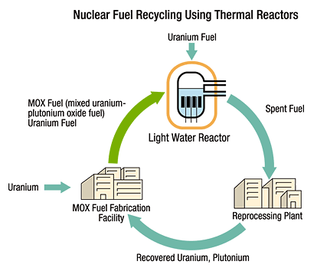
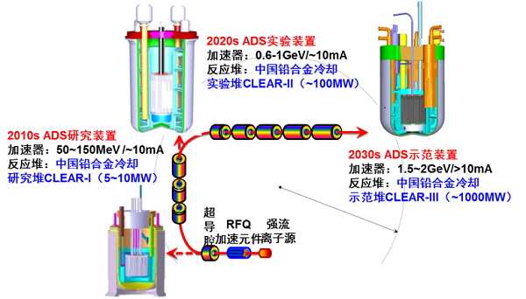
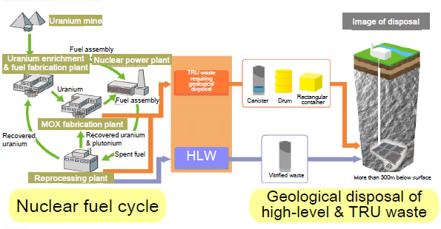
Mission: Solve Key Radiochemical Challenges in Nuclear Fuel Cycle
First strata
Uranium and plutonium
Reprocessing is the Key Stage of nuclear fuel cycle.
U
Uranium
Fuel fabrication
LWR/FBR for electricity
Reprocessing
Minor actinides: americium and curium
Radiochemistry!!
FPs
Fuel fabrication
Reprocessing
ADS Partition & Transmutation
Second strata
Plutonium, americium, and curium
Disposal
Future advanced nuclear fuel cycle (double strata)

Slide 5
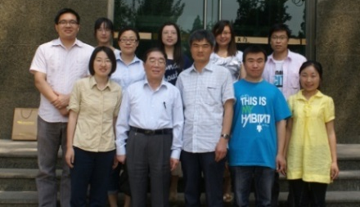
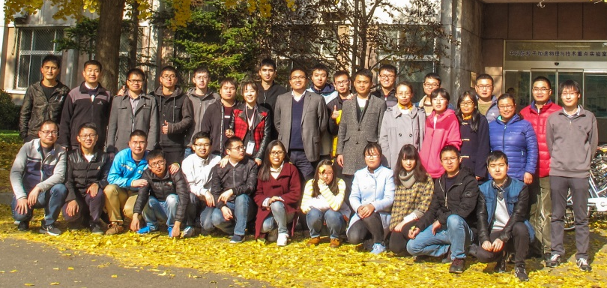
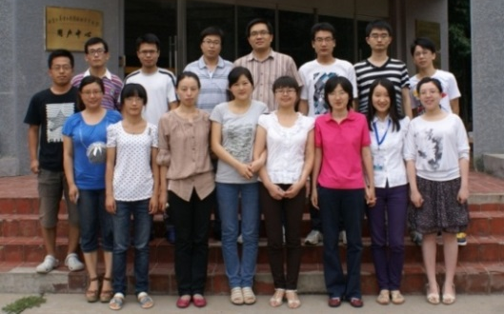

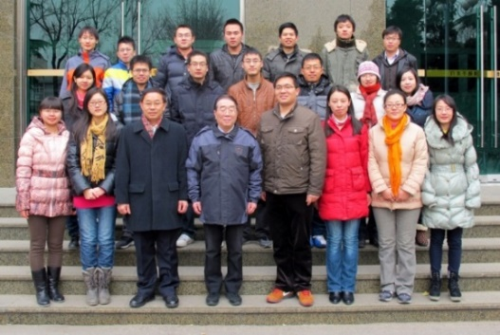

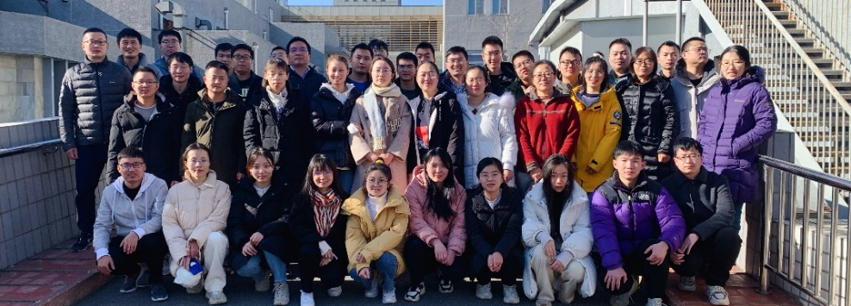
Team Introduction: history
2010
2012
2013
2018
2022
A keen-witted and capable team！

Slide 6
Team Introduction: Staff and Students
4 Professors
8%
8 Associate Professors
10%
17%
5 Postdocs
65%
32 Graduate students
Age | numbers
>35 | 10 (20%)
30-35 | 4 ( 8% )
20-30 | 35 (72%)
Basic and applied fundamental research on spent fuel reprocessing
Preparation and characterization of actinide complexes
Computational chemistry of actinides
22
10
17

Slide 7
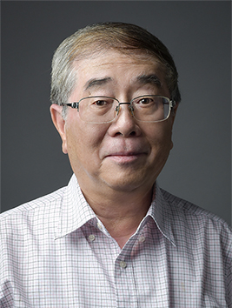
Team members
Prof. Zhifang Chai, Member of CAS
  Developed nuclear technology and nuclear analysis methodology and applied
  them in several interdisciplinary fields.
  Published more than 600 papers , 8 Chinese books and 5 English books, and
  given more than 60 plenary or keynote presentations at important international
  conferences.
  The George von Hevesy Award (2005), and 9 national and ministerial level awards.
  The Outstanding Scientific and Technological Achievement Award of the CAS (2019).
  Editorial board of 4 international journals (e.g. Radiochimica Acta, Metallomics) and 10 domestic
  journals.

Slide 8
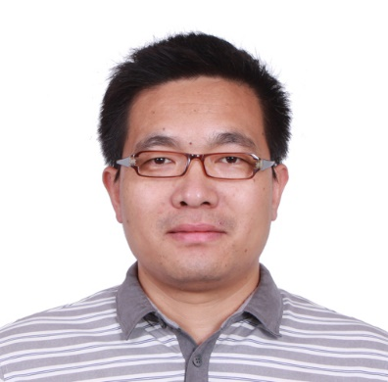
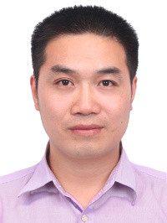
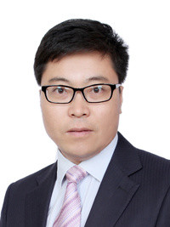
Team members（Full Professors)
The National Science Fund for Distinguished Young Scholars (2019)
The National Science Fund for Outstanding Young Scholars (2021)
Youth Innovation Promotion Association CAS
Prof.Dr. Wei-qun Shi
Ph.D: Tsinghua University
Born: 1976
Research Interest:
Actinide Separation
Prof.Dr. Dr. Lei Mei
Ph.D: Peking University
Born: 1986
Research Interest:
Actinide Coordination Polymers
Prof.Dr. Dr. Liyong Yuan
Ph.D: Peking University
Born: 1981
Research Interest:
Actinide Separation Materials

Slide 9
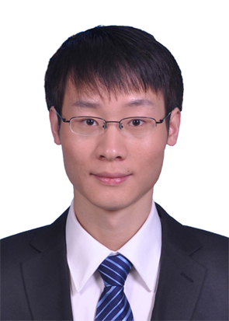
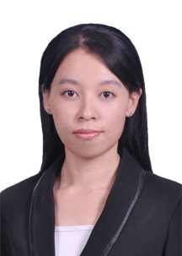
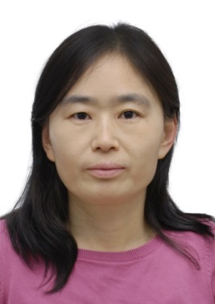

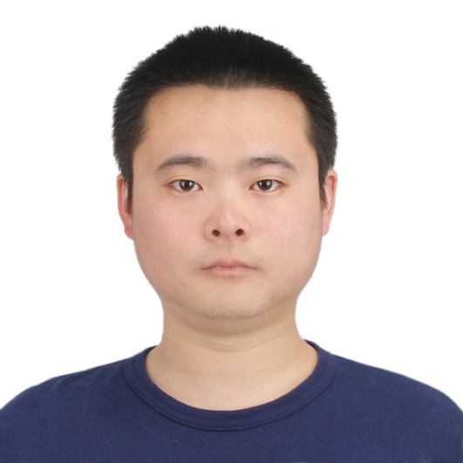
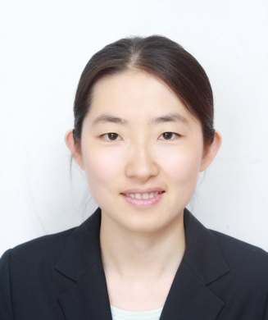
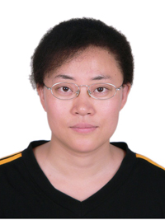
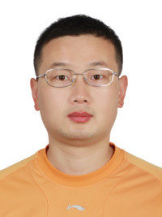
Team Introduction: Associate Professors
Lin Wang Assoc. Prof.
PhD. 2012
Peking University
Actinide separation chemistry
Congzhi Wang Assoc. Prof.
PhD. 2012
Beijing Institute of Technology
Actinide computational chemistry
Qunyan Wu Assoc. Prof.
PhD. 2010
Beijing Institute of Technology
Actinide computational chemistry
Yalan Liu Assoc. Prof.
PhD. 2015
China Institute of Atomic Energy
Actinide molten salt chemistry
Kongqiu Hu Assoc. Prof.
PhD. 2015
Tsinghua University
Actinide coordination chemistry
Jianhui Lan Assoc. Prof.
PhD. 2010
Beijing University of Chemical Technology
Actinide computational chemistry
Zijie Li Assoc. Prof.
PhD. 2007
Chinese Academy of Sciences
Actinide separation chemistry
Jipan Yu Assoc. Prof.
PhD. 2014
Tsinghua University
Actinide chemistry

Slide 10
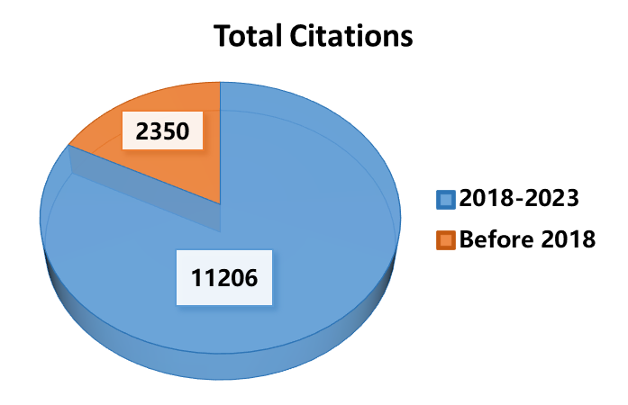
Published Papers and Citations
Dr. Shi Weiqun: 2020-2022 Elsevier “Highly Cited Chinese Researchers” in Nuclear Science and Technology.

Slide 11
Publications and Patents
J. Am. Chem. Soc. | 2 | Angew. Chem. Int. Ed. | 3 | CCS Chem. | 2
Nat. Commun. | 2 | Chem | 1 | Adv. Funct. Mater. | 5
Appl. Catal. B: Environ. | 1 | Chem. Sci. | 1 | Environ. Sci &Technol. | 4
J. Electrochem. Soc. | 13 | Electrochim. Acta. | 6 | Electrochem. Commun. | 1
Chem. Eur. J. | 9 | Inorg. Chem. | 39 | Chem. Commun. | 3
Phys. Chem. Chem. Phys. | 6 | J. Phys. Chem. | 6 | Organometallics | 5
ACS Cent. Sci. | 1 | Dalton Trans. | 12 | Sci. Chin. Chem. | 2
Patents | 9
Representative publications:
ZW Huang#, KQ Hu#, L Mei*, WQ Shi*, et al. J. Am. Chem. Soc. 2023, 145, 18148.
L Mei#*, P Ren#, WQ Shi*, et al. J. Am. Chem. Soc. 2020, 142, 16538.
KQ Hu#, PX Qiu#, LW Zeng#, SX Hu#, Wei-Qun Shi*, et al. Angew. Chem. Int. Ed. 2020, 59, 20666. (hot paper)
L Mei#, SW An#, WQ Shi*, et al. Angew. Chem. Int. Ed. 2020, 59, 16061.
Y Wang, LY Yuan*, ML Zhai*, WQ Shi*, et al. Chem 2020, 6, 2796-2809.
XH Kong,# QY Wu,# KQ Hu*, WQ Shi*. CCS Chem. 2023, 5, 1144.
JP Yu#, LY Yuan#, S Wang#, WQ Shi*. CCS Chem. 2019, 1, 286.

Slide 12
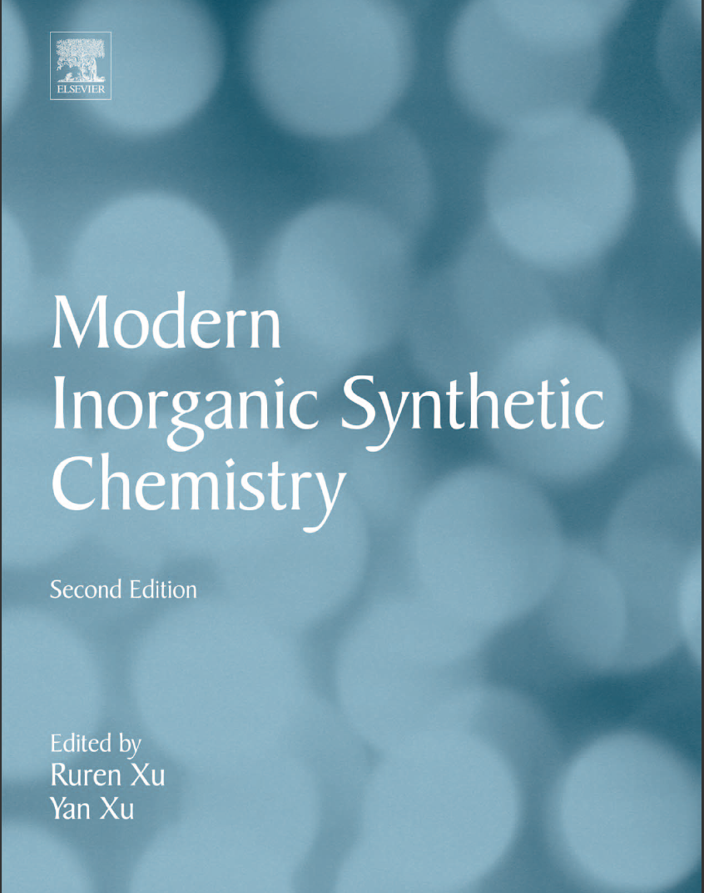
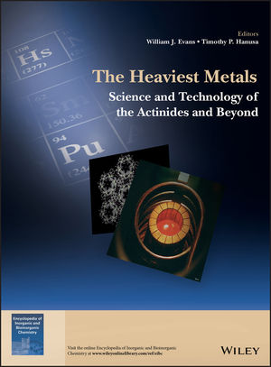
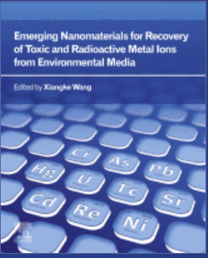
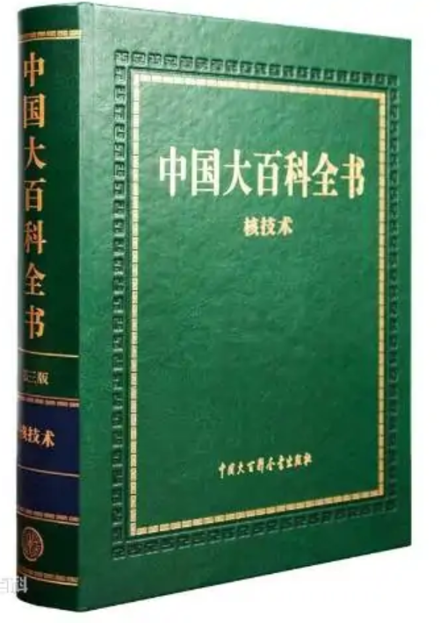
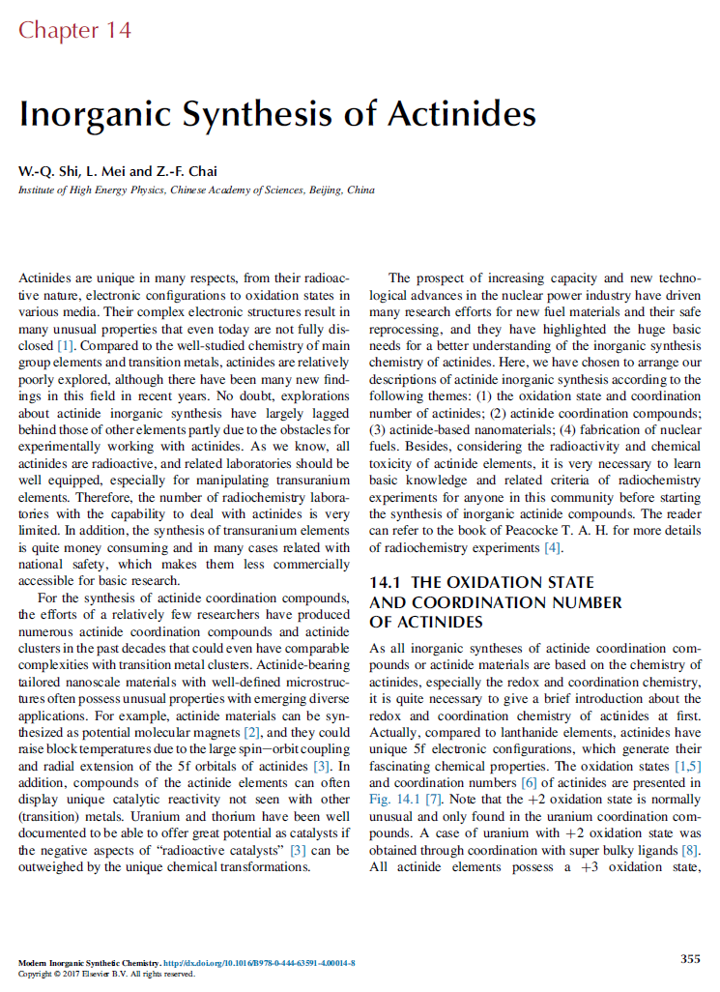
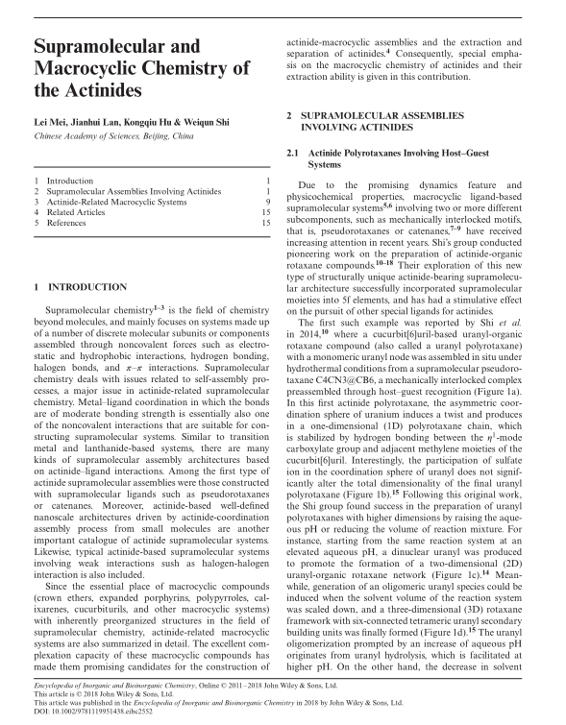
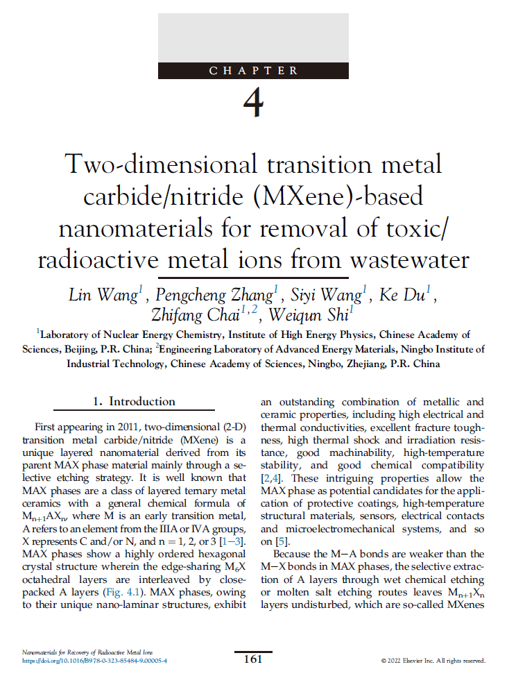
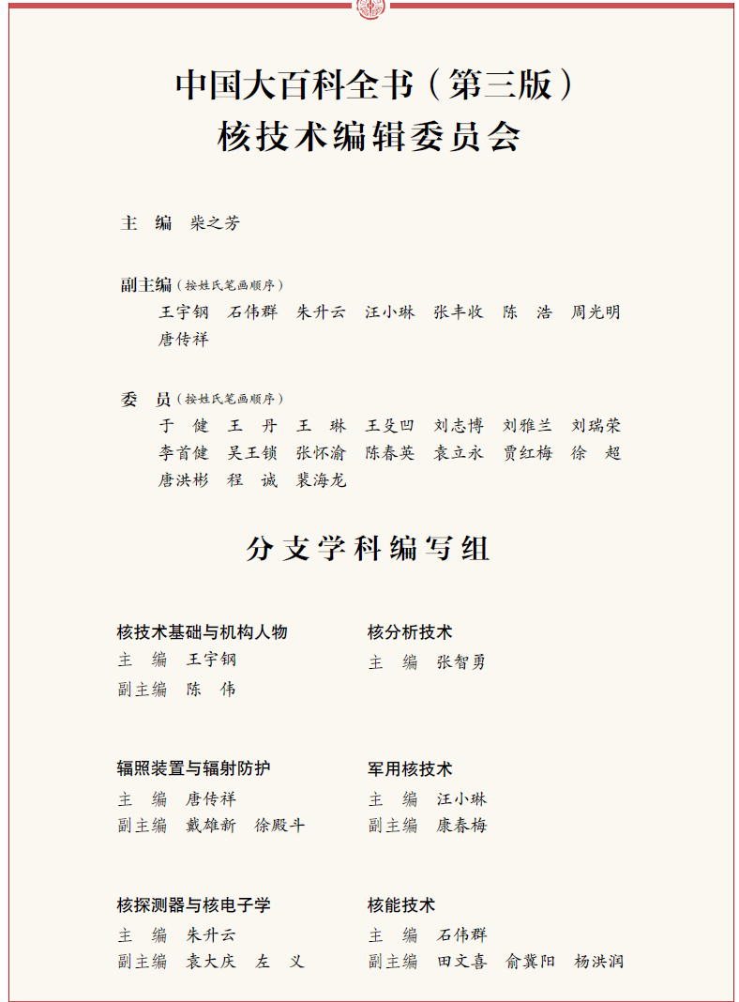
Published Books
Encyclopedia of China
Vol of Nuclear Techniques
The first book chapter about actinide supramolecular chemistry

Slide 13
Funding
Sources:
National Natural Science Foundation of China (NSFC)
State Administration of Science, Technology and Industry for National Defence
Chinese Academy of Sciences
Enterprises
Year | Number of projects | Budget (million RMB) | Notes
2018 | 7 | 5.44
2019 | 8 | 5.62 | Including NSFC for Distinguished Young Scholars (4 million)
2020 | 10 | 10.88 | Including the Key Program of NSFC
2021 | 7 | 5.32 | Including NSFC for Outstanding Young Scholars (2 million)
2022 | 6 | 35.57 | Including Special Research Foundation for SFR
2023 | 7 | 10.62 | Including Special Research Foundation for R&D of NE
Total | 45 | 73.45

Slide 14
  Main Research Directions
Fundamental Principle：Science-based, Goal-oriented
Nuclear Energy Radiochemistry
Synthesis of composite materials for actinide sequestration and their property investigation
Molten Salt Chemistry associated with pyrochemical reprocessing of spent nuclear fuels.
Nuclear fuel cycle
Actinide Chemistry
Notes:
14

Slide 15
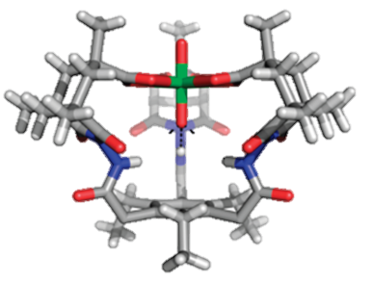
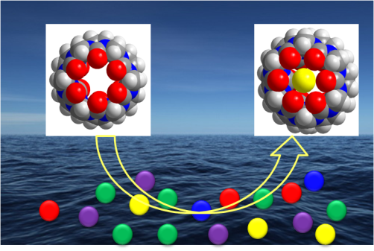

Research Topic 1: Actinide coordination chemistry
Metal-ligand interactions
Metal-ligand interactions are fundamental to the study of actinide chemistry and materials
Related studies can provide important basis for radionuclide separation
Our research focuses on the construction and application of actinide supramolecular systems
J. Am. Chem. Soc. 2023, 145, 18148; Adv. Funct. Mater. 2023, 33, 2213039; CCS Chem. 2023, 5, 1144; Adv. Funct. Mater. 2023, 33, 2303530;
Chem. Sci. 2023,14, 6330; Angew. Chem. Int. Ed. 2023, 62, e202216690.
Nat. Commun. 2022, 13, 2030; J. Am. Chem. Soc. 2020, 142, 16538;
Angew. Chem. Int. Ed. 2020, 59, 16061; Angew. Chem. Int. Ed. 2020, 59, 20666; Nat. Commun. 2019, 10, 1532; Chem. Commun. 2018, 54, 2248.
Radionuclide separation and disposal
Functional complexes and materials

Slide 16
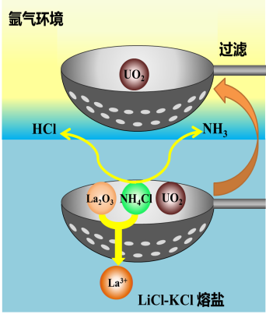
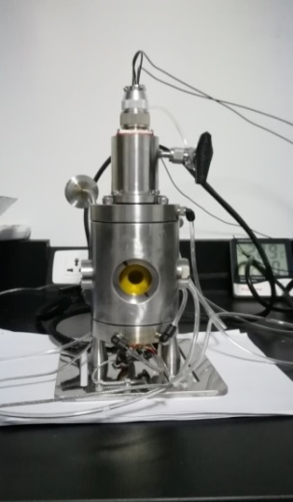
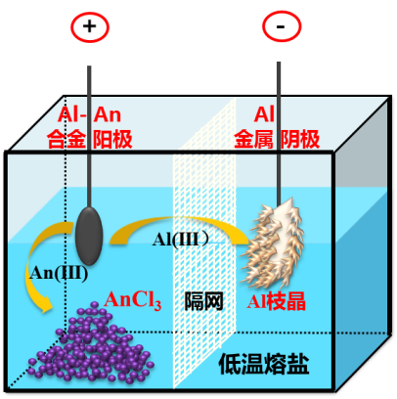
Research Topic 2: Molten Salt Chemistry for Pyrochemical Processing of SNF
Investigating the An/Ln separation mechanism and exploring new separation strategies by combining electrochemistry, in-situ spectroscopy, and computational simulation
An/Ln Separation via Al cathode
Actinide Oxide dissolution
In-situ measurements
Separation in mild medium
Nat. Commun. 2021, 12, 5777.; ACS Sustain. Chem. Eng. 2023, 11, 8161-8172.; Inorg. Chem. 2022, 61, 6519–6529.;
Sep. Purif. Technol. 2022, 292, 121025.; Sep. Purif. Technol. 2022, 281, 119853.; Sep. Purif. Technol. 2021, 265, 118524; Chem. Eur. J. 2022, 28, e202200443.; Chem. Eur. J. 2021, 27, 11721-11729.; Electrochem. Commun. 2019, 103, 55-60.;
Electrochim. Acta 2023, 439, 141733.; Electrochim. Acta 2022, 404, 139573.; Electrochim. Acta 2020, 353, 136449.; Electrochim. Acta 2019, 326, 134971.; Electrochim. Acta 2019, 319, 869-877.; Electrochim. Acta 2018, 275, 100-109.; J. Electrochem. Soc. 2023, 170, 032501.; J. Electrochem. Soc. 2021, 168, 062511.; J. Electrochem. Soc. 2021, 168, 032507.; J. Nucl. Mater. 2020, 542, 152475.; J. Nucl. Mater. 2020, 532, 152049.; J. Nucl. Mater. 2019, 523, 16-25.;

Slide 17
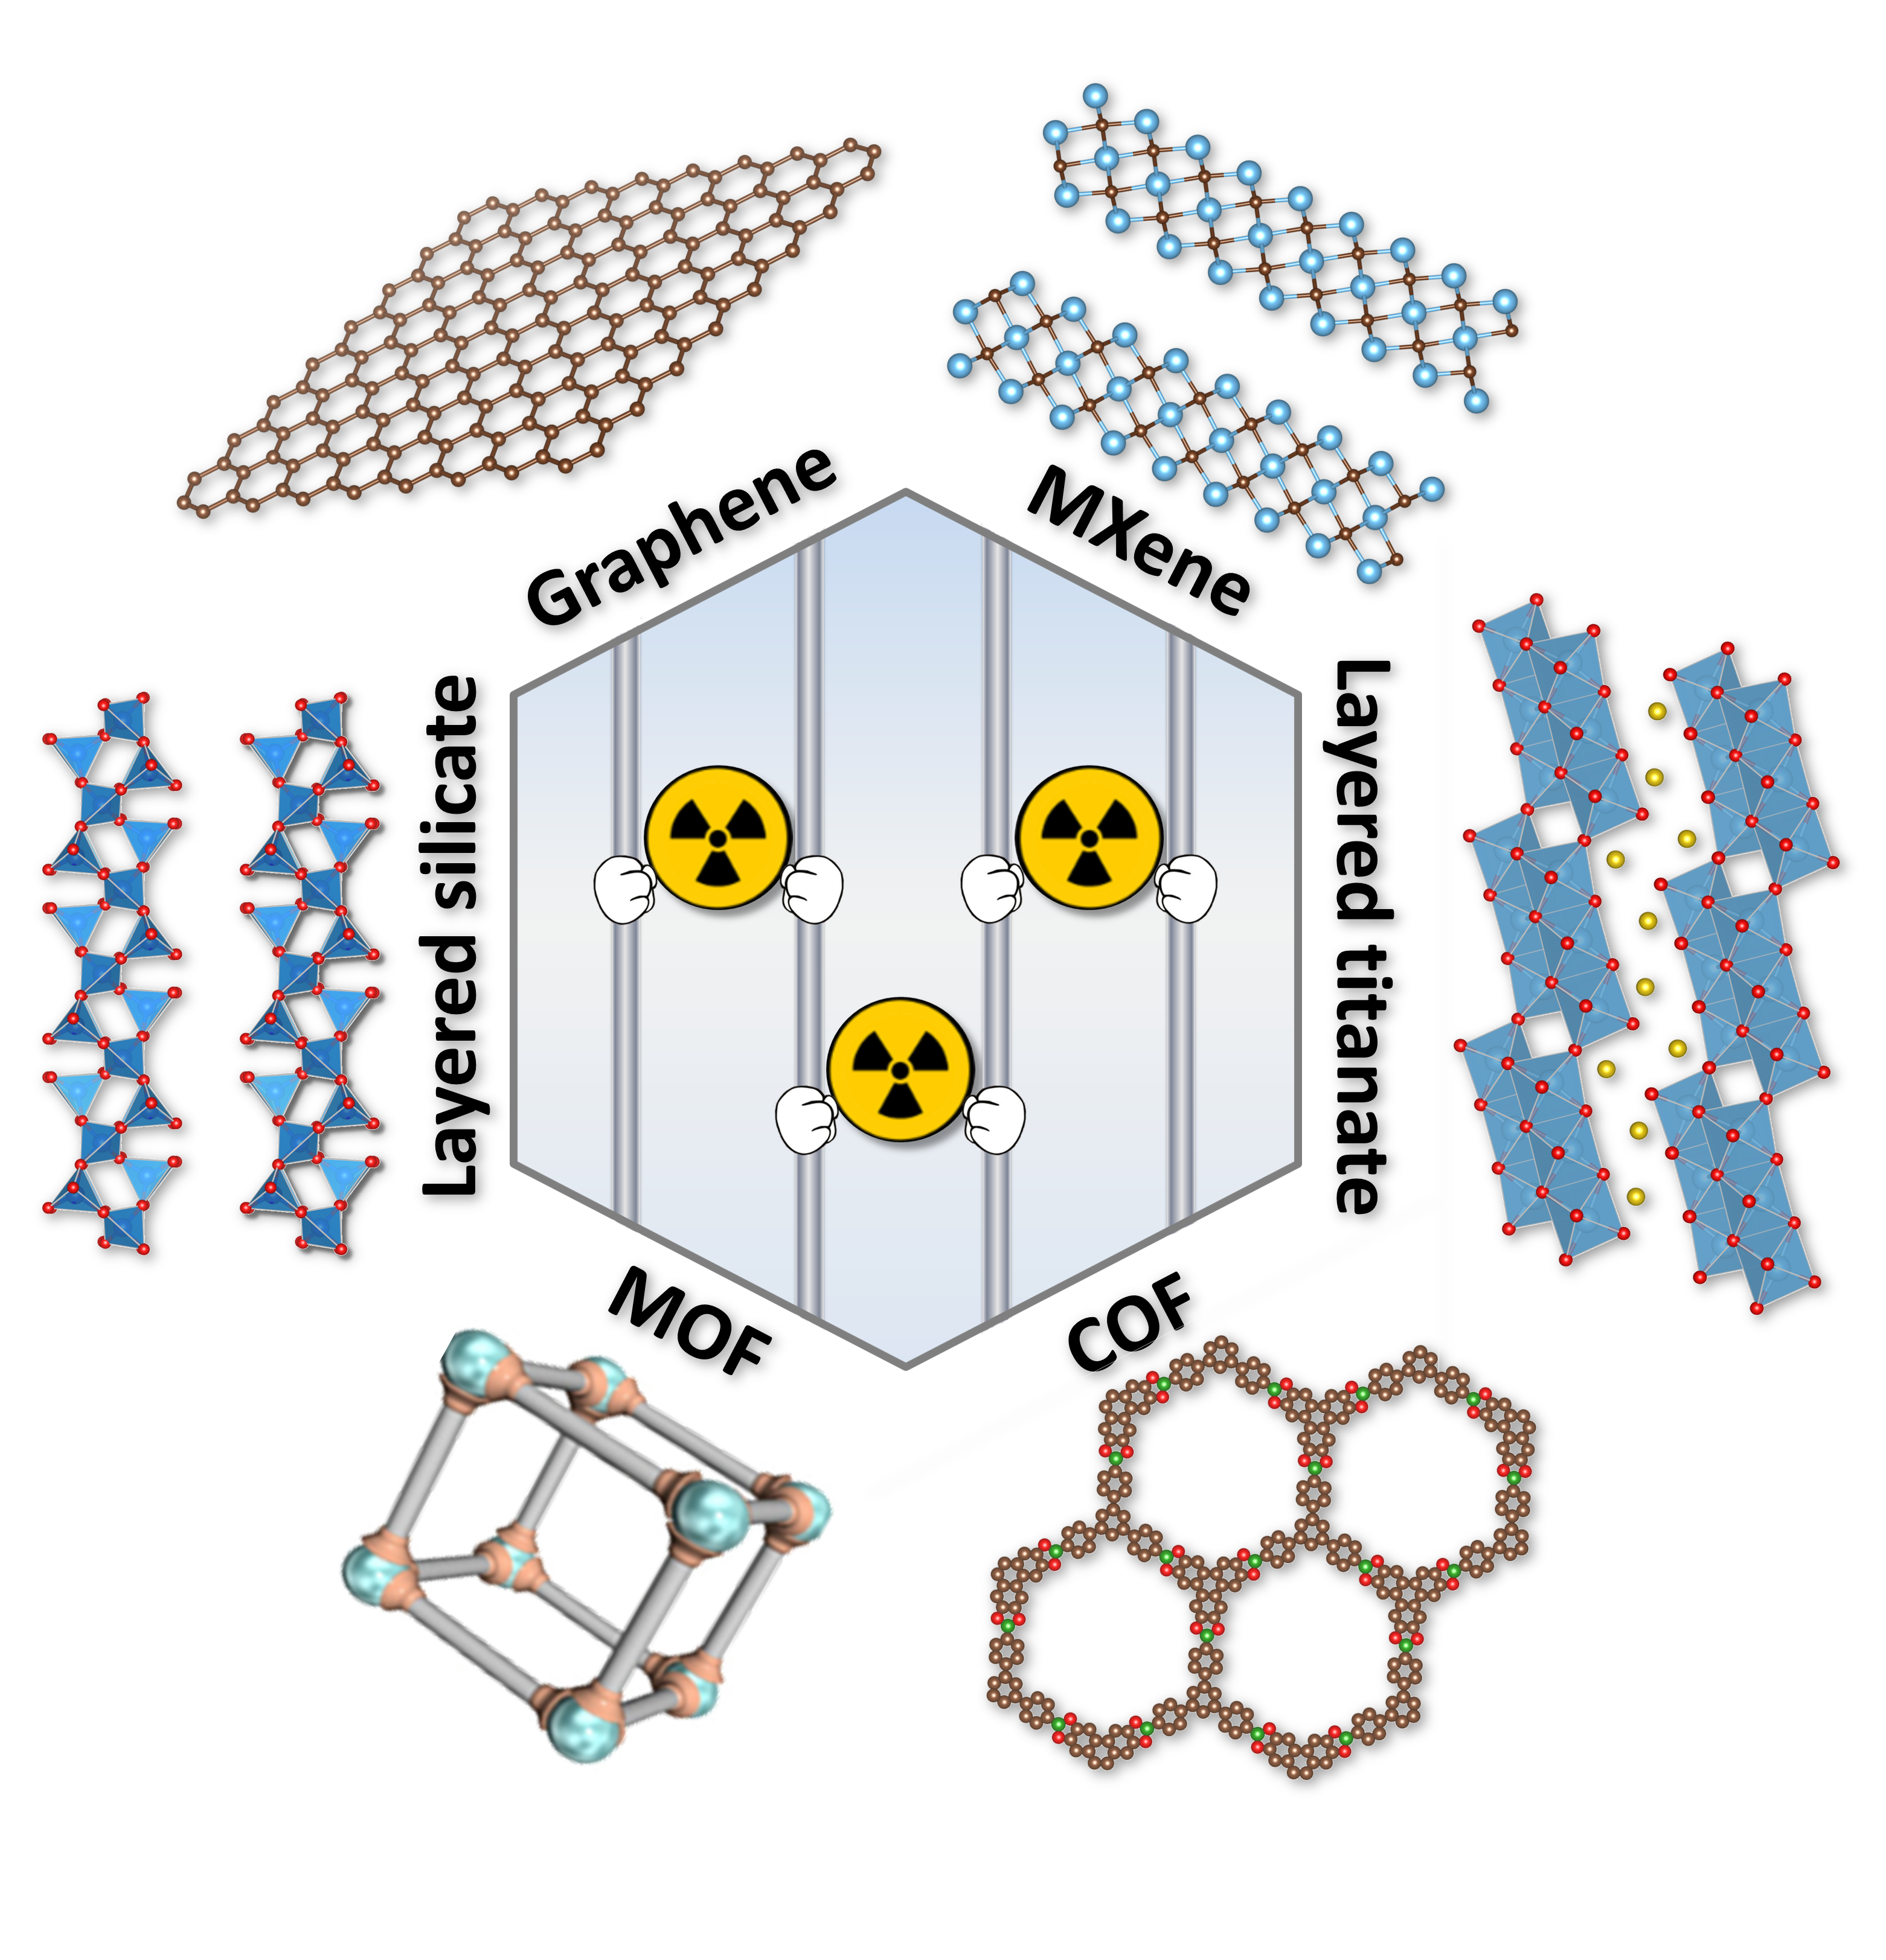
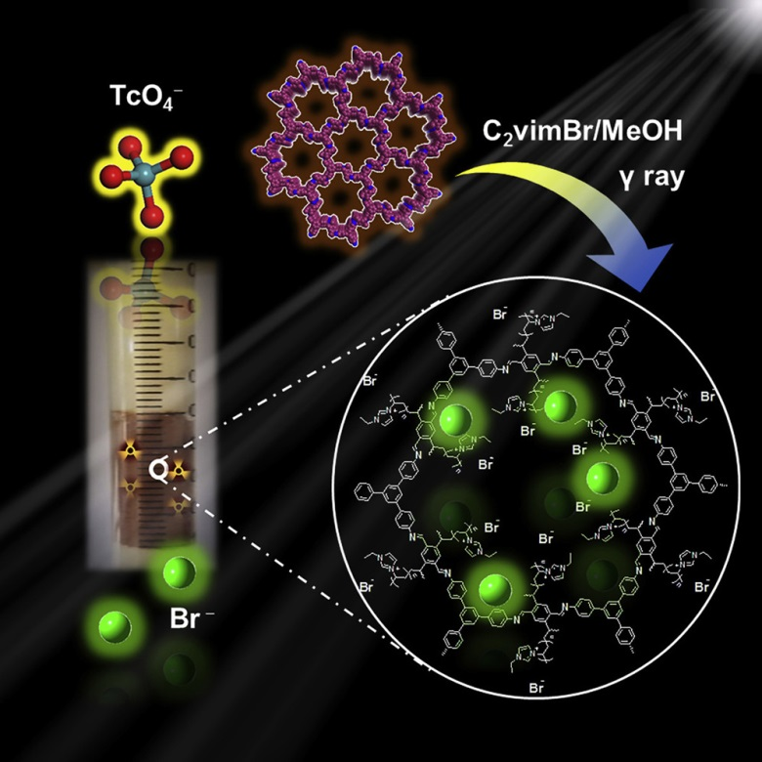
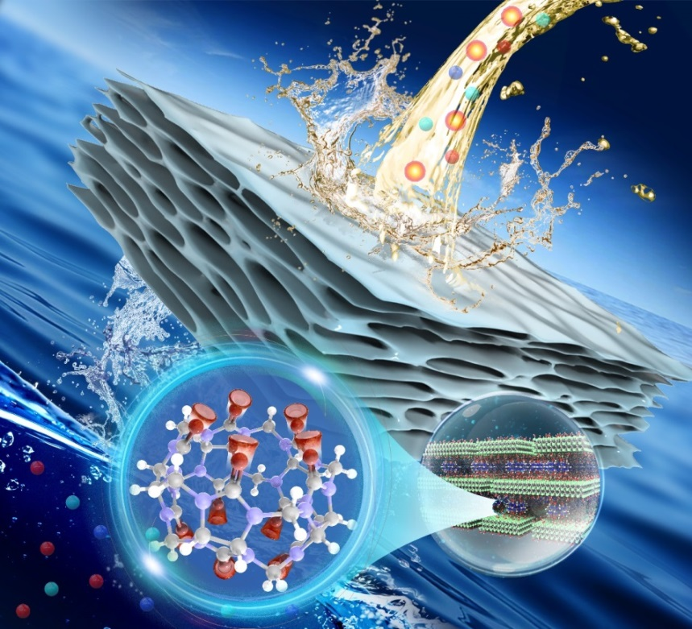

Research Topic 3: Radionuclide Separation by Functional materials
Functional porous materials
Functional layered materials
U(VI)
Pu
Am
Np
U
Tc
I
Sr
Cs
Th
Bio-inspired 2D membrane
CCS Chem. 2019, 1, 286.
Chem 2020, 6, 2796.
Adv. Funct. Mater. 2022, 32, 2205222.
Adv. Sci. 2023, 10, 2206516.
Environ. Sci. & Technol. 2018, 52, 10748.
Environ. Sci. & Technol. 2019, 53, 3739.
Environ. Sci. & Technol. 2019, 53, 10917.
Appl. Catal. B: Environ. 2020, 267, 118688.
Environ. Sci.: Nano 2020, 7, 724.
J. Hazard. Mater. 2020, 396, 122731.
J. Hazard. Mater. 2021, 408, 124949.
Chem. Eng. J. 2022, 444, 136397.
Chem. Eng. J. 2023, 463, 142408.
Chem. Eng. J. 2023, 455, 140523.

Slide 18
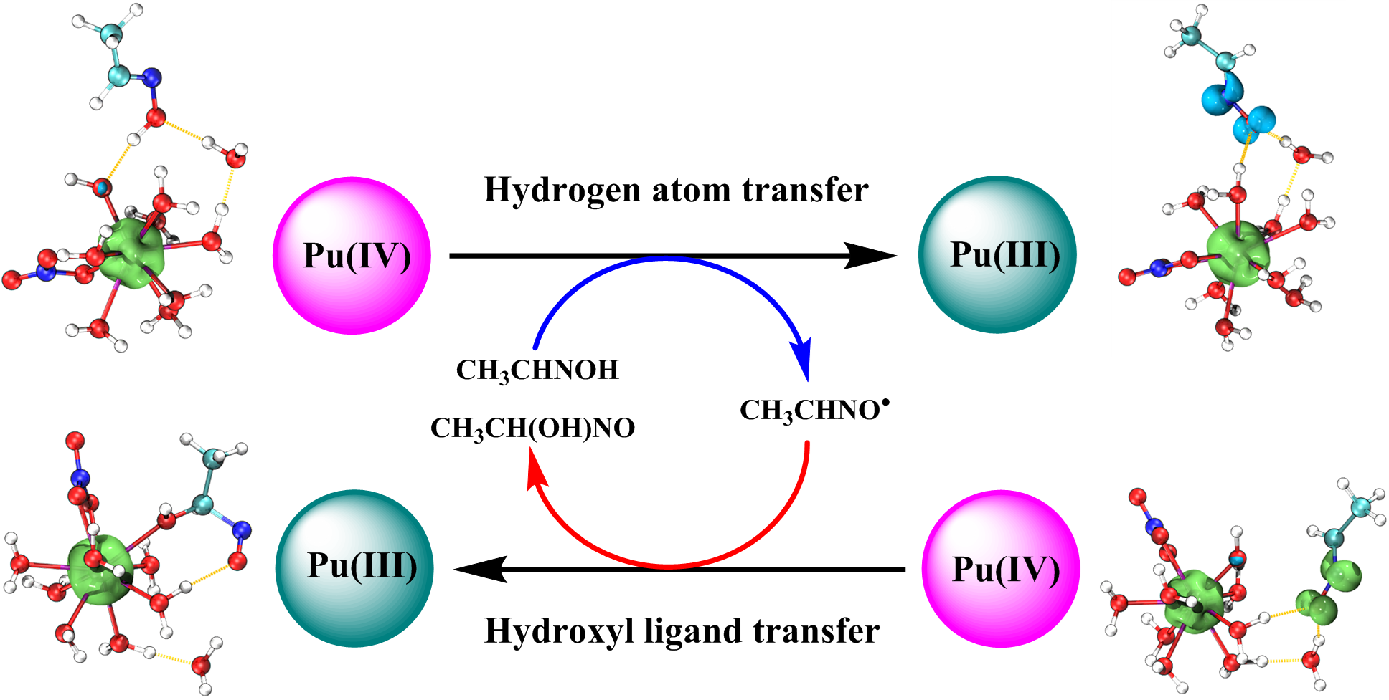
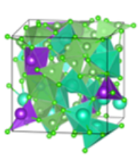
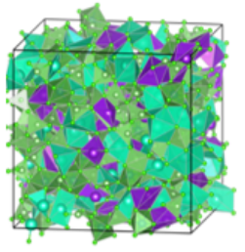
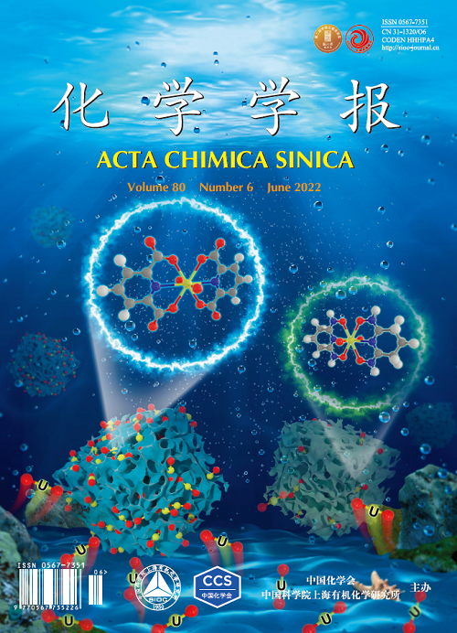
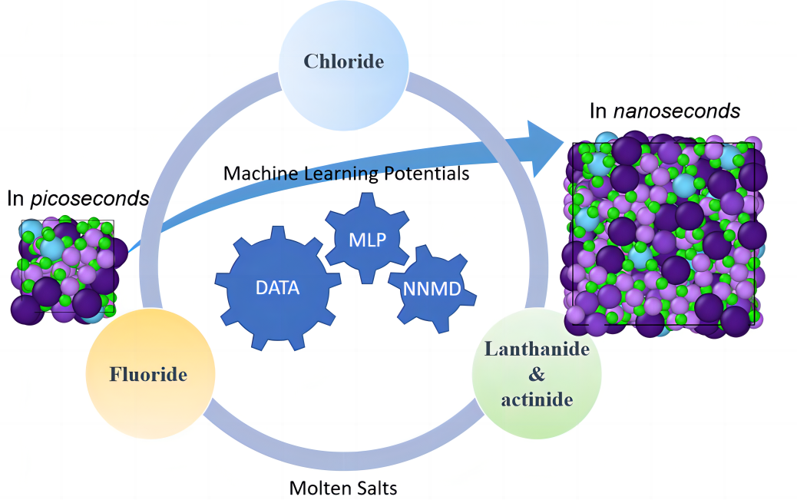
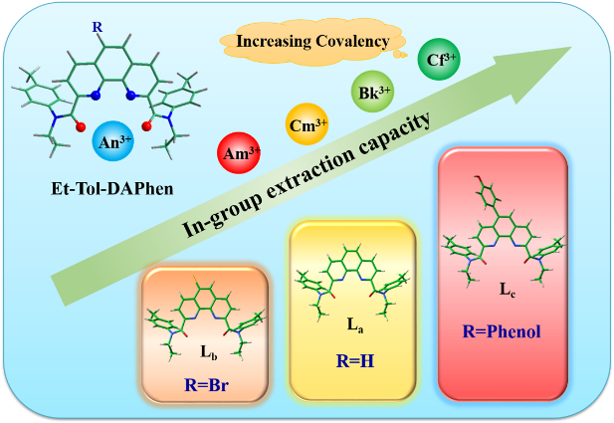
Research Topic 4: Actinide Computational Chemistry
DP-GEN
AIMD
DPMD
Actinide Reduction mechanism
Ligand design for solvent extraction
Molten salt coordination structure
Uranium extraction from seawater
Inorg. Chem. 2023, 62, 8179-8187; 2023, 62, 4581-4589; 2023, 62, 2705-2714; 2022, 61, 15423-15431; 2022, 61, 6110-6119; 2022, 61, 4404-4413; 2021, 60, 16409-16419; 2020, 59, 11469-11480. J. Phys. Chem. A 2023, 127, 4259-4268; 2022, 126, 406-415; 2021, 125, 6180-6188. Phys. Chem. Chem. Phys. 2022, 24, 17782-17791; Dalton Trans. 2022, 51, 11381-11389; 2021, 50, 3559-3567.

Slide 19
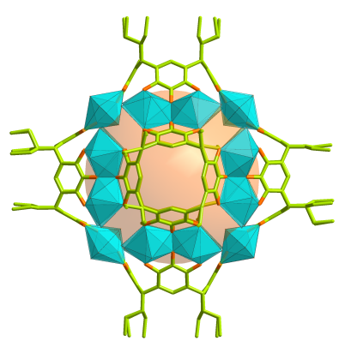
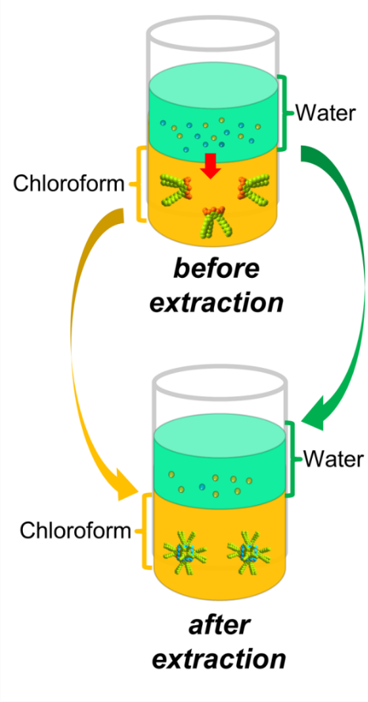
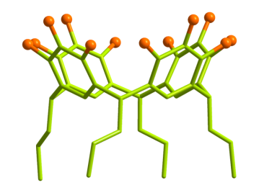
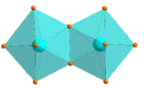

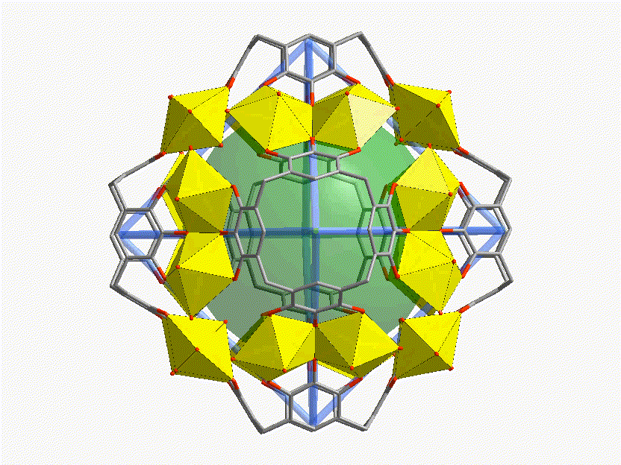
Highlight 1: A new paradigm for the extraction and separation of actinides by self-assembled nanocage species
Dear Colleague,
Congratulations!
Your article, Actinide Separation Inspired by Self-Assembled Metal-Polyphenolic Nanocages (10.1021/jacs.0c08048), is one of our most cited publications from 2020-2021.
Thank you for publishing with JACS - I look forward to receiving more of your first-class science in the future.
Sincerely,
Erick M. Carreira
Editor-in-Chief of JACS
PgC3 macrocycle
[U₂₄(PgC3)₆]
2 nm
Mei, L,#*; Ren, P.#; Wu, Q.-y.; Ke, Y.-b.; Geng, J.-s.; Liu, K.; Xing, X.-q.; Huang, Z.-w.; Hu, K.-q.; Liu, Y.-l.; Yuan, L.-y.; Mo, G.; Wu, Z.-h.; Gibson, J. K.; Chai, Z.-f.; Shi, W.-q.* J. Am. Chem. Soc. 2020, 142, 16538.

Slide 20
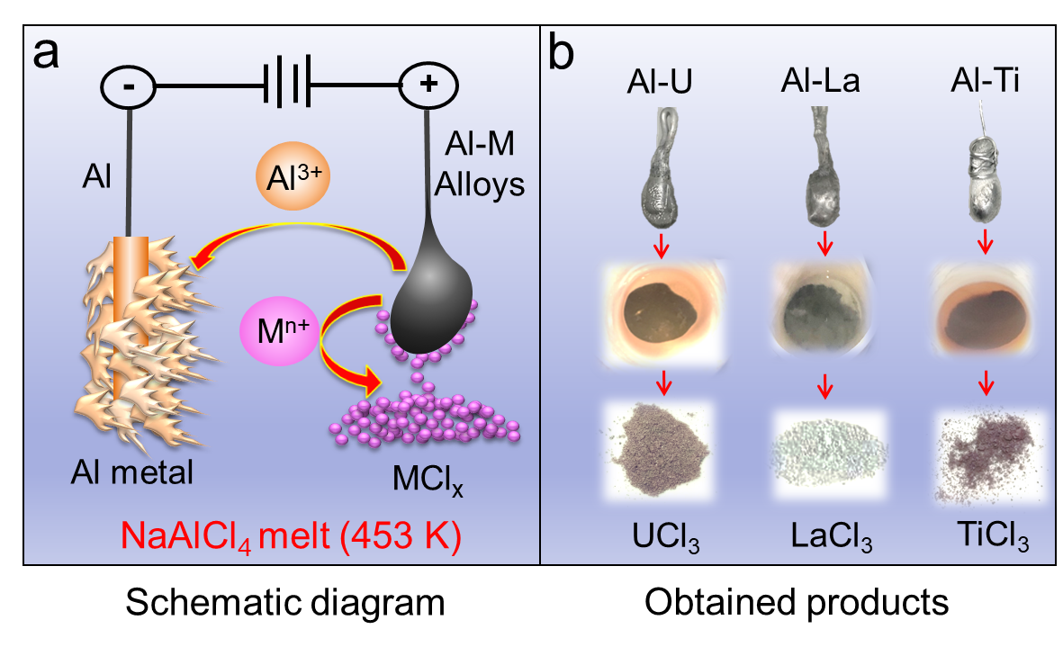
Highlight 2: Improved electrolytic refining technology : in-situ anodic precipitation process for efficient separation of Al alloys
Peer review：
Very clever and ranks high in the categories of originality and significance.
Novel and interesting
A modified
electrorefining process
High efficient separation
Based on
solubilities difference
Under mild
conditions
YK Zhong, YL Liu*, K Liu, L Wang, L Mei, JK Gibson, JZ Chen, SL Jiang, YC Liu, LY Yuan, ZF Chai, WQ Shi*. Nat. Commun. 2021, 12, 5777.

Slide 21

Highlight 3: Breakthrough in efficient and highly selective extraction of uranium/plutonium at high acidity using functional COFs materials
High irradiation stability
Good acid resistance
Nutral or negatively charged surface
Strong coordination capability
JP Yu#, LY Yuan#, S Wang#, JH Lan, LR Zheng, C Xu, J Chen, L Wang, ZW Huang, WQ Tao, ZR Liu, ZF Chai, JK Gibson, W Shi*. CCS Chem. 2019, 1, 286-295

Slide 22
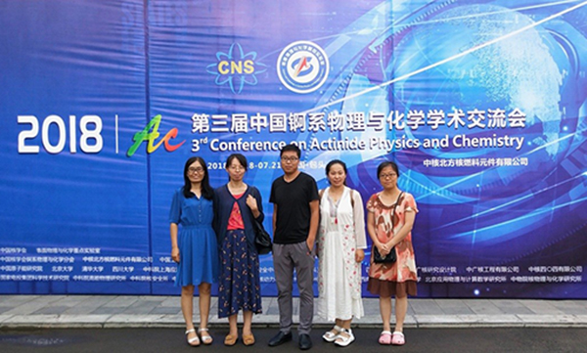
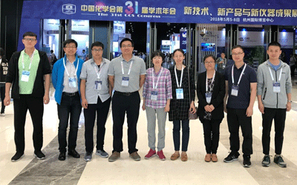


















Academic Exchanges
Since 2018, we have hosted 3 conferences and participated in more than 120 conferences, including over10 invited presentations at international conferences, over 50 invited presentations at domestic conferences, over 100 oral presentations, over 80 poster presentations, and over 20 awards for excellent presentations or poster presentations.

Slide 23






Science Communication
https://english.cas.cn/newsroom/research_news/chem/202110/t20211012_284622.shtml
Active in public science popularization for nuclear energy in various media such as CCTV and web media
Nuclear waste disposal
https://www.eurekalert.org/news-releases/936115
Nuclear Energy Utilization and Nuclear Radiation
Academic research is widely reported by media including EurekAlert (AAAS) and CAS news.

Slide 24









Young Talent Training
Lab Outstanding Alumni
Cheng-liang Xiao
Zhejiang University
Professor
Zhi-hui Zhang
Changzhou University
Professor
Fei-ze Li
Sichuan University
Associate Professor
Tao Bo
CAS
Associate Researcher
Kui Liu
Sun Yat-sen University
Associate Professor
Hao Deng，
Southwest University,
Associate Professor
Li-wen Zeng
CAS
Scientific Editor
Yu-ke Zhong
CAS
Postdoc
Tai-qi Yin
CAS
Postdoc

Slide 25
Lab Instrumentation
Molten salt based electrochemistry
Actinide organic ligand synthesis
Instrumentation
Porous material synthesis and characterization
Computational actinide chemistry
Actinide material synthesis and characterization

Slide 26
Future Orientation
Science-based, Goal-oriented
Basic research on actinide chemistry and materials；
Actinide frontiers deciphered by High Energy X-rays (XAFS,XRD,SAXS, in
situ and Operando measurements)
Meet the national needs in nuclear fuel cycle (nuclear fuel reprocessing and
nuclear waste disposal)；

Slide 27
Challenges
Nuclear energy chemistry research is money consuming! We need seek for
stable and large amount of financial support.
Public concerns and expectations.
Recruiting and training young talents.
Superb lab instrumentation for future radiochemical research (Dedicated
SR beamline).

Slide 28




Acknowledgment

