Slide 1
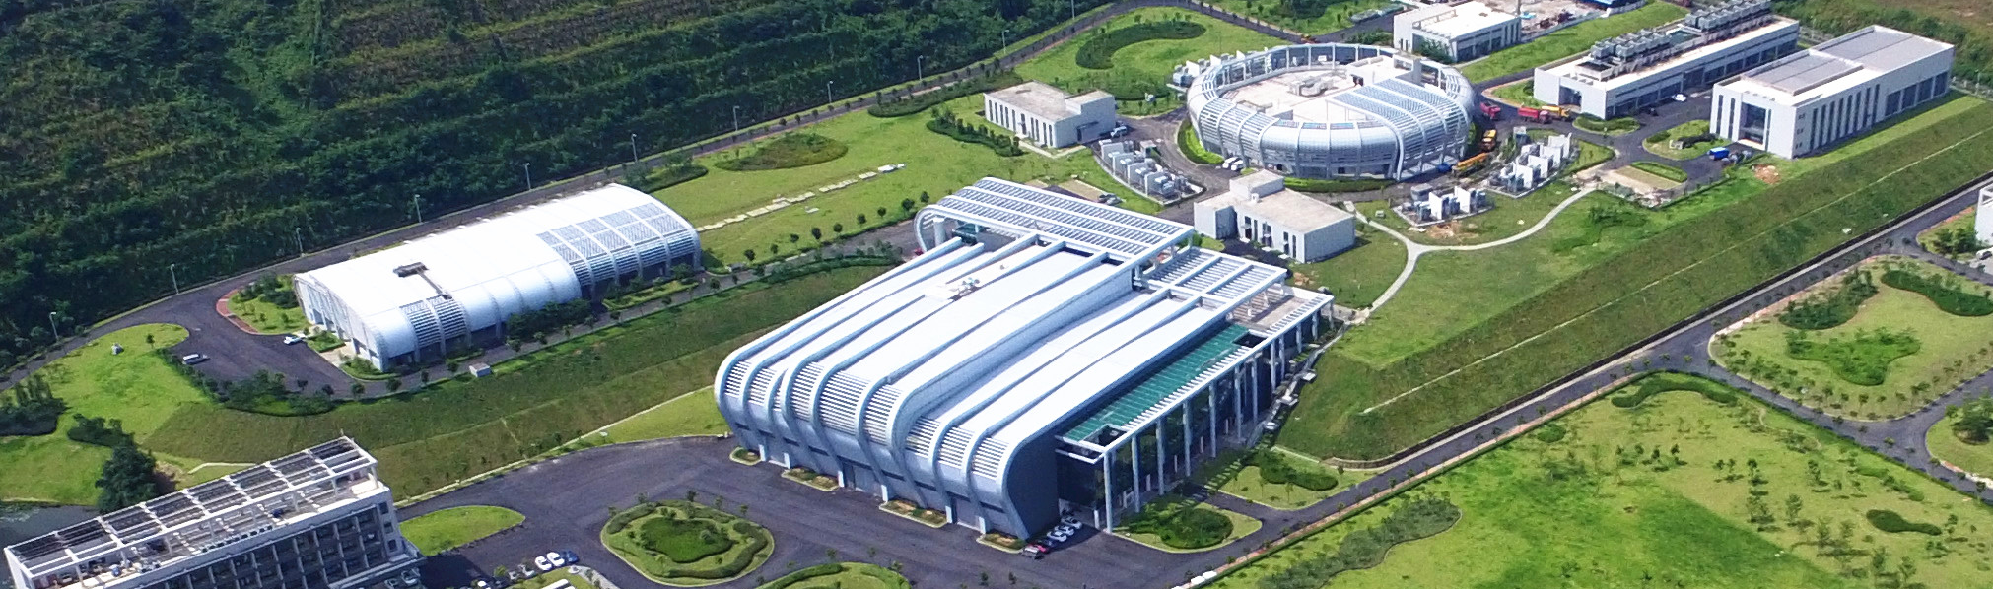
CSNS accelerator system and upgrade
Huachang Liu
Institute of High Energy Physics
Oct. 30, 2023

Slide 2
Contents
1
Introduction of CSNS accelerator
2
Operation and beam power upgrading
3
Design and pre-research on CSNS-II
4
Summary

Slide 3
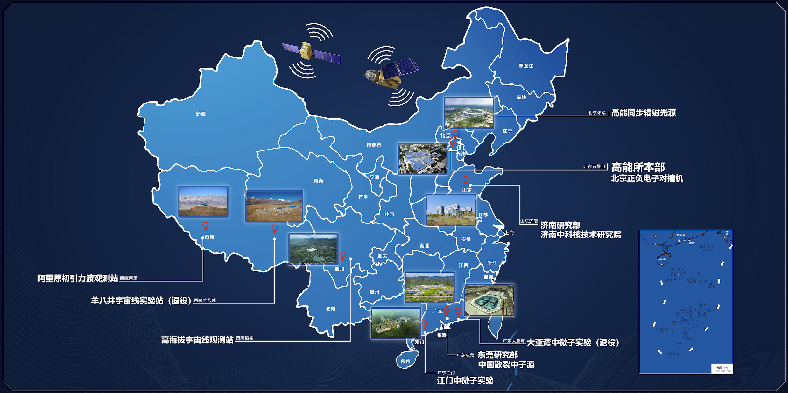
Dongguan Branch
Established on Feb. 19th 2013, to construct and manage the CSNS
Located in Dongguan, Guangdong Province
★
CSNS
•

Slide 4
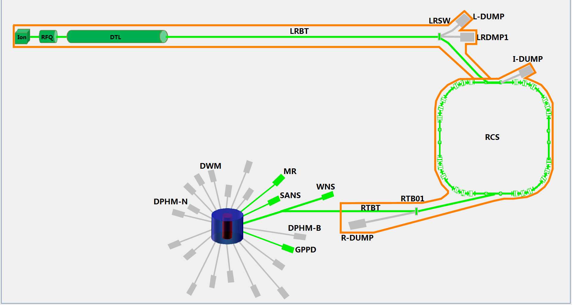
CSNS Overview
Project Budget: 2.3 BCNY
Funded by central government and Guangdong local government
Construction: 2011.9~2018.3
80 MeV H⁻ linac
1.6 GeV
25 Hz
100 kW
25Hz,1.6GeV
Tungsten target
3 instruments
Makes China one of four countries around the world with a major pulsed spallation neutron source

Slide 5
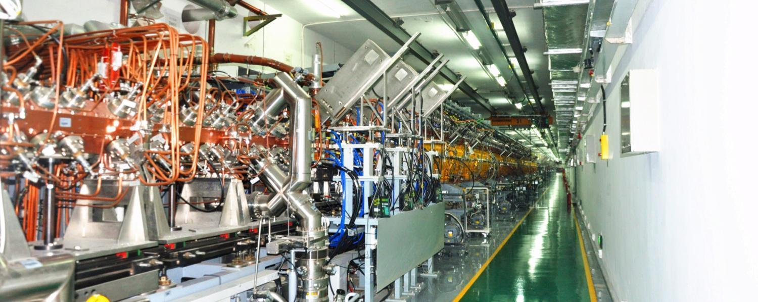
H- Linac Design
 | Ion Source | RFQ | DTL
Input Energy（MeV) |  | 0.05 | 3.0
Output Energy(MeV) | 0.05 | 3.0 | 80
Pulse Current (mA) | 20 | 15 | 15
RF frequency (MHz) |  | 324 | 324
Chop rate (%) |  | 50 | 50
Duty factor (%) | 1.3 | 1.05 | 1.05
Repetition rate (Hz) | 25 | 25 | 25

Slide 6
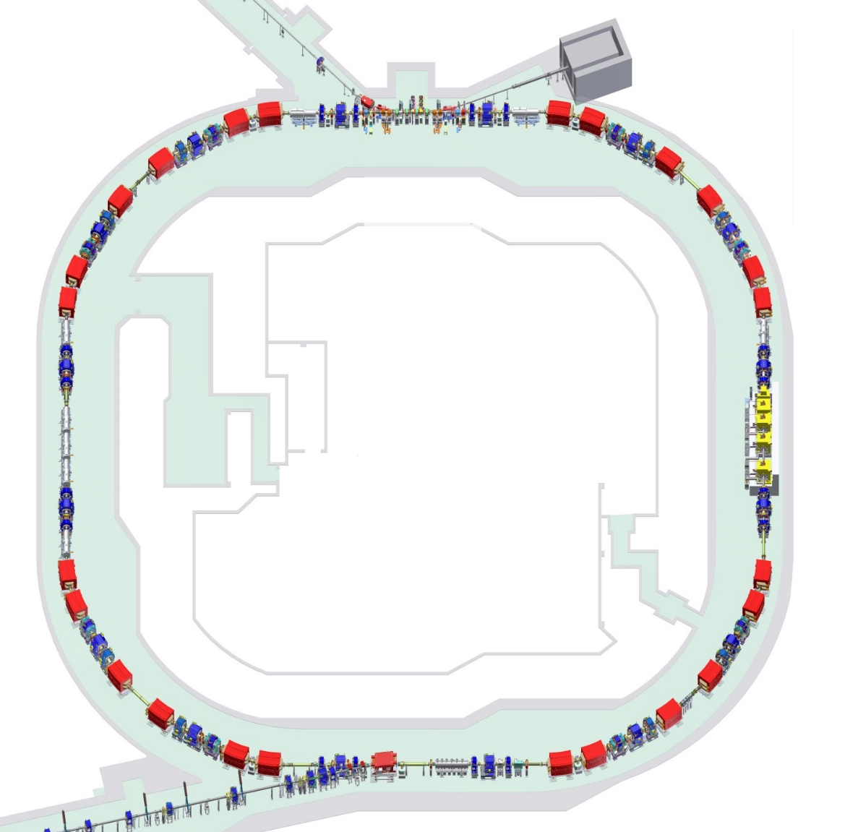
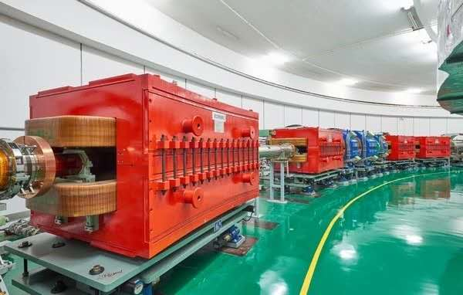
RCS Design
Lattice of 4-fold symmetry, triplet
227.92m circumference
Four long straight sections for injection, acceleration, collimation and extraction
24 main dipoles with one power supply
48 main quadrupoles with 5 power supplies
Ceramic vacuum chambers for the AC & pulsed magnets
8 RF ferrite loaded cavities to provide 165 kV

Slide 7
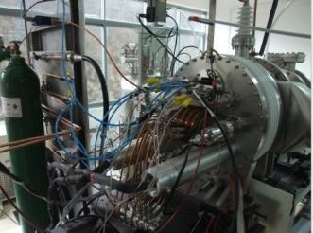
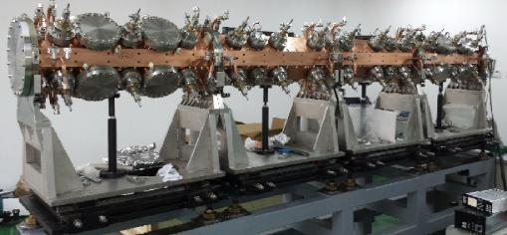
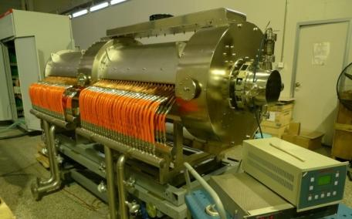
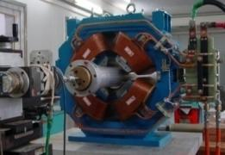
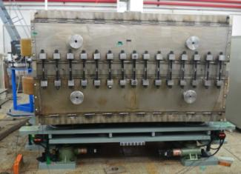
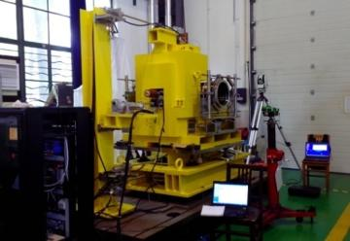
Key technologies of CSNS accelerator
H⁻ ion source – High current, high reliability, long-lifetime
Fast beam chopper- Fast beam rise/fall time
RFQ – Design, Processing technology
DTL(Drift tube linac)
Resonant magnets and Power supply
Ferrite-loaded RF cavity
collimator
High accuracy AC magnetic field of magnets
High accuracy field tracking in RCS
H⁻ ion source
RFQ
Ferrite-loaded RF cavity
Quadrupole
Collimator
Resonant dipole
Notes:
Through constructing CSNS accelerators, we have broken through a series of critical technologies in high-power proton accelerators

Slide 8
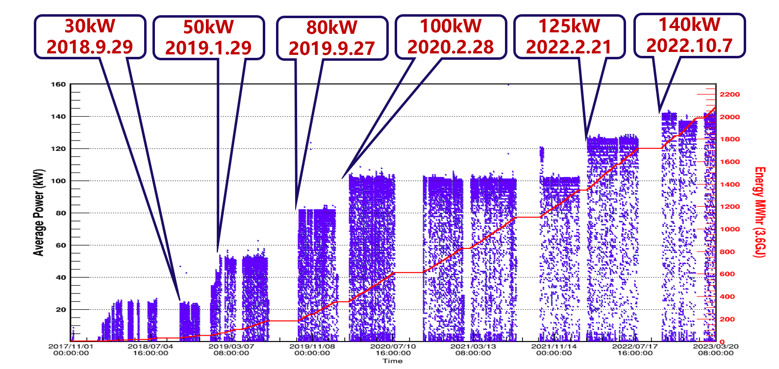
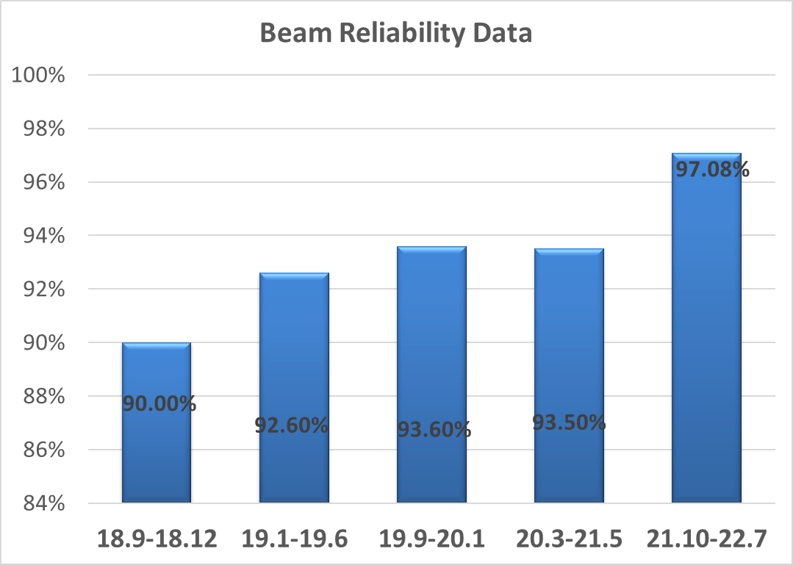
CSNS accelerator performance
Key milestones(On schedule)
Power and Energy on Target
2015 start beam commissioning
2017 first beam on target
2018 end of beam commissioning
start operation for user program(20kW)
2020 Reach full power(100kW)
The accelerator routinely operates with >90% availability in recent years
From October 2021 to July 2022, the beam availability
has been improved to more than 97%.

Slide 9
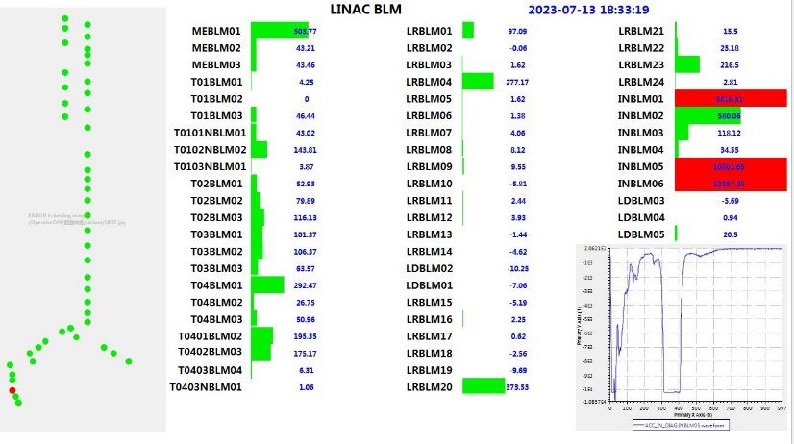
Challenges from Linac commissioning
Linac beam transmission~100%, activation level<3.5mrem/hr@30cm
Linac commissioning
1、Beam pulse: 100μs ->540 μs
2、Beam current: 10mA ->17mA
Challenges:
Beam loss <1W/m (~100mrem/hr@30cm)
Beam loss mechanism | Transmission improved | Beam loss mitigation
Beam halo/tails | 2~3% | Transverse matching: studying the effect of the fringe magnetic field, keeping beam equipartitioned, making phase advance smoothing, etc. Longitudinal matching: keeping the RFQ transmission>95%, optimizing buncher settings.
Ion source turn on/off transient | ~0.5% | About 20μs beam pulse is chopped with the LEBT chopper.

Slide 10
Challenges from RCS commissioning
Beam power on target | Challenges | Solutions
50kW→80kW | Too large beam size after painting, non-uniform beam distribution, large transverse coupling | By using the correlated painting instead of the anti-correlated painting
80kW→100kW | Serious beam instability | Optimization of the tune and chromaticity
100kW→125kW | Emittance increase caused by broken four-fold symmetry of the RCS; Large beam instability | Slight modification of injection system; installation of AC trim quadrupoles and AC sextupoles
125kW→140kW | Strong space charge effects | Installation of a dual harmonic RF cavity

Slide 11
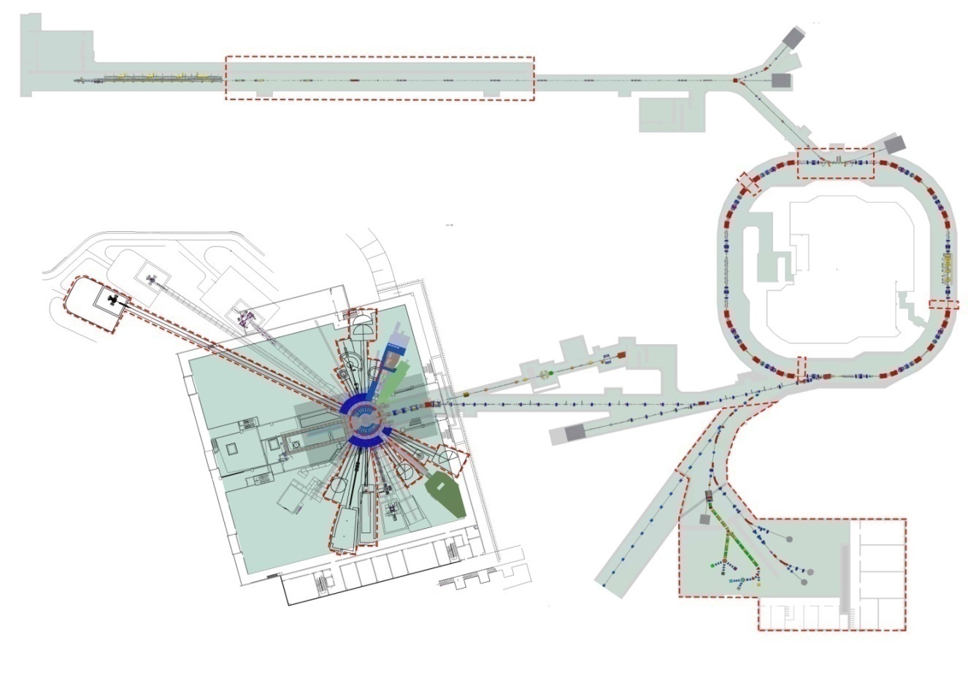
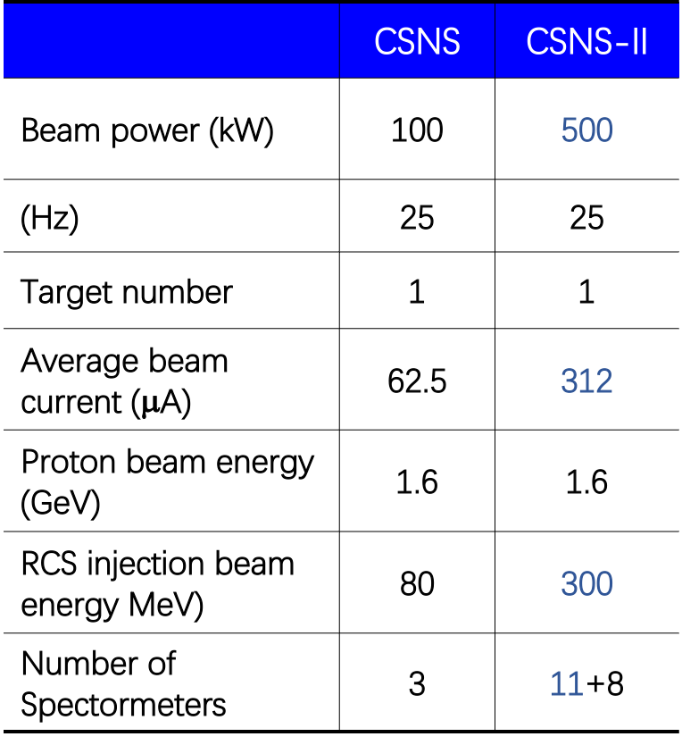
China Spallation Neutron Source II
Linac
Linac upgrade from 80MeV to 300MeV
Beam power upgrade to 500kW
Rapid Cycling
Synchrotron
靶站
Target to 500kW
谱仪
New 11 spectrometers
Proton & muon Experimental station
Construction duration: 69 months；Keep operation for user during upgrade

Slide 12
CSNS-II accelerator
The total budget of CSNS-II
3 Billions CNY (~400 M USD)
CSNS accelerator budget
1 Billion CNY (~137 M USD)
Linac RF
SRF cavities,
Cryogenic
。。。

Slide 13
R&D for CSNS-II accelerator
1. Linac R&D→ 300MeV, 40mA+
Newly developed RF-driven H− ion source
Superconducting linac
RF power source
2. RCS R&D→ 500kW
  Beam dynamics
  High power MA loaded cavity
  New injection painting

Slide 14
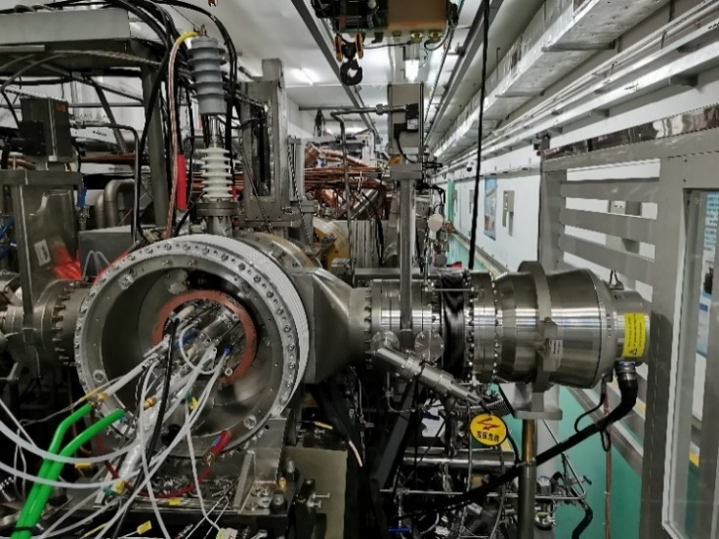
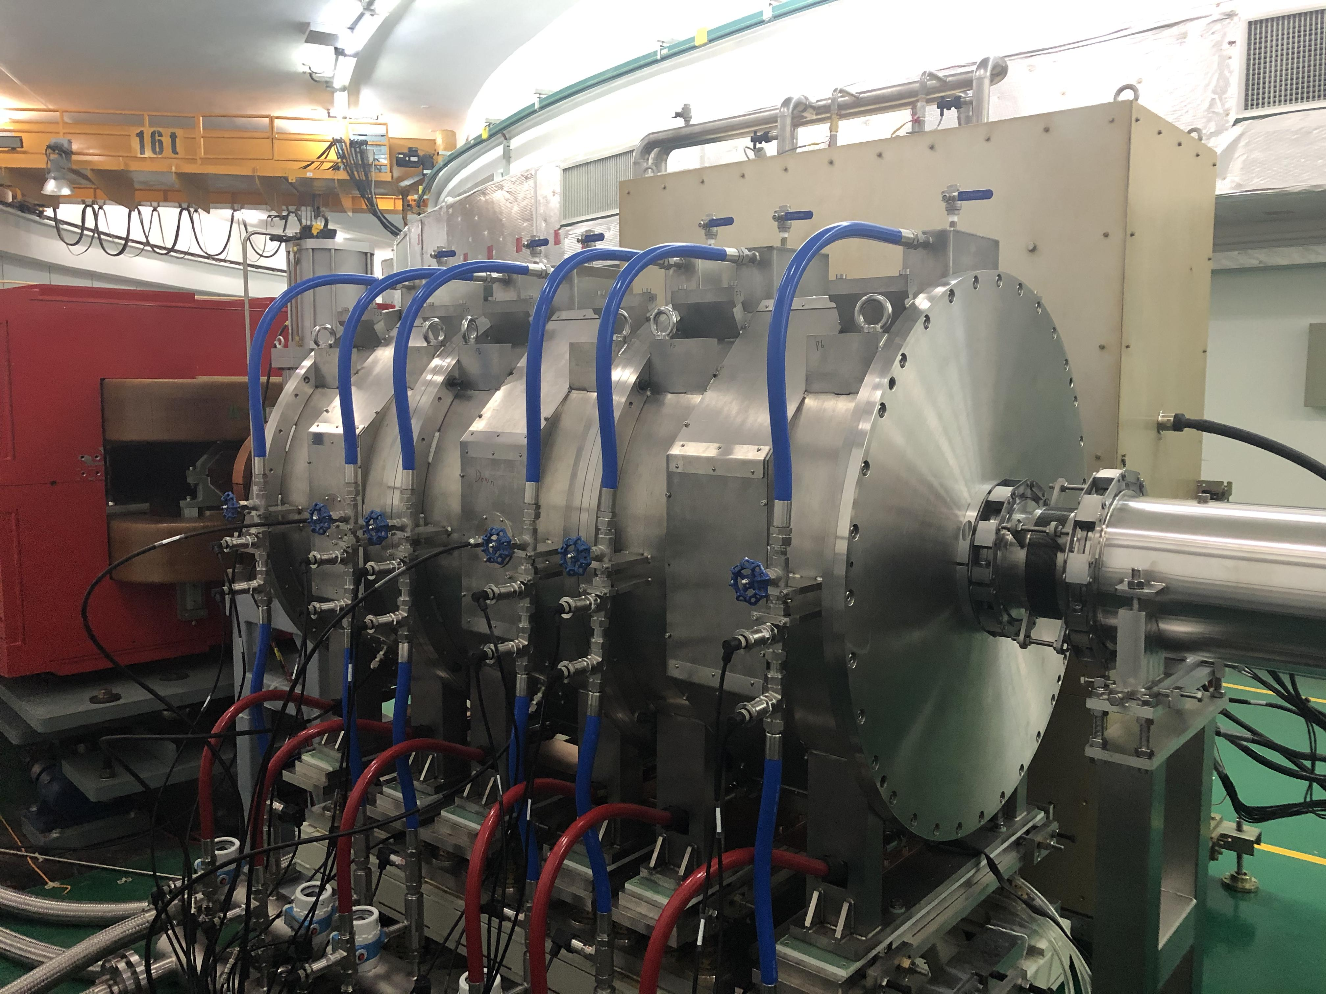
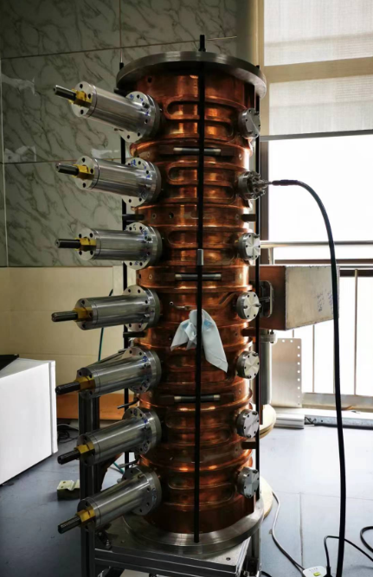
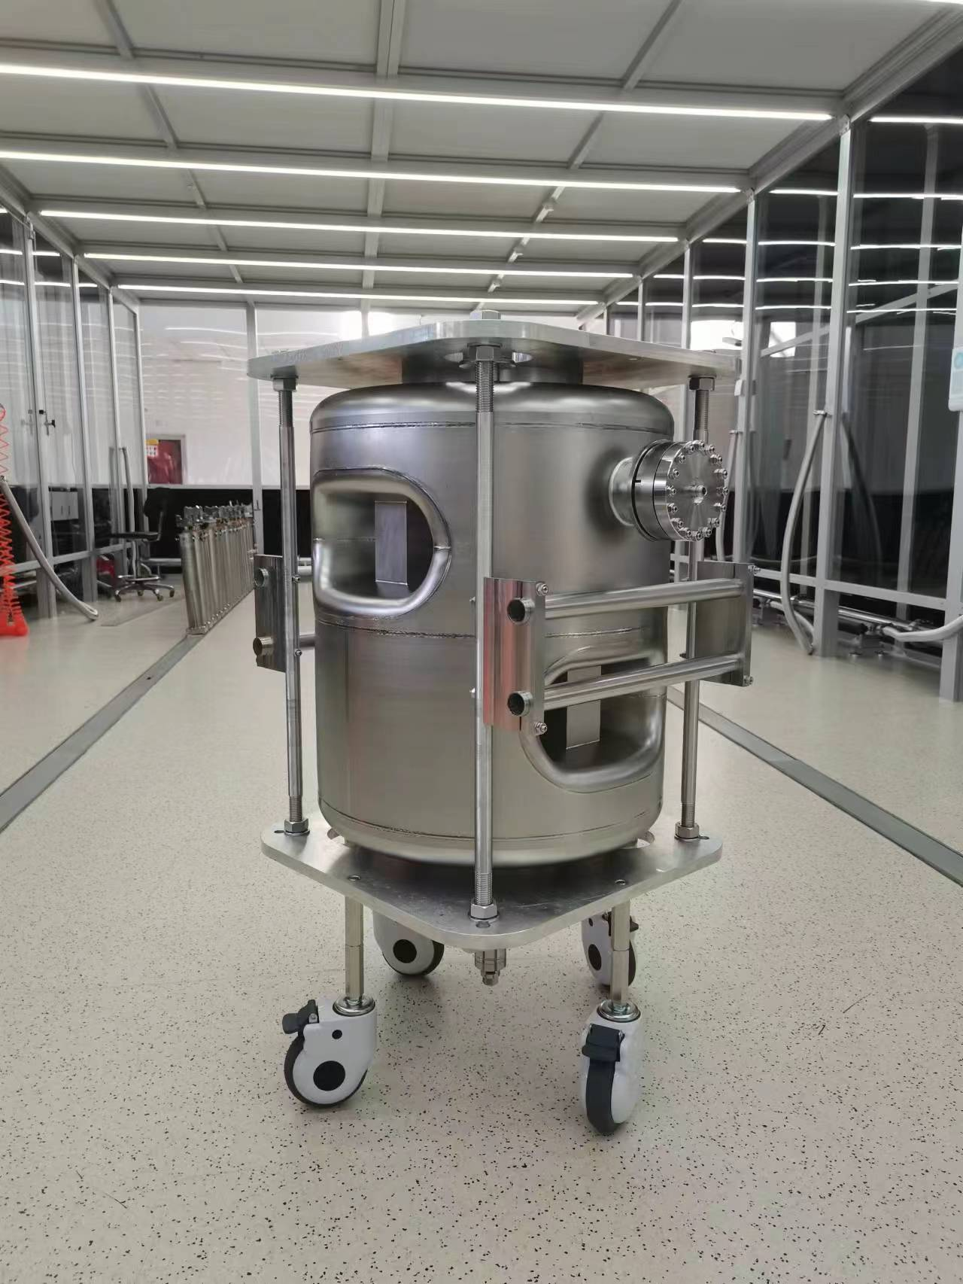
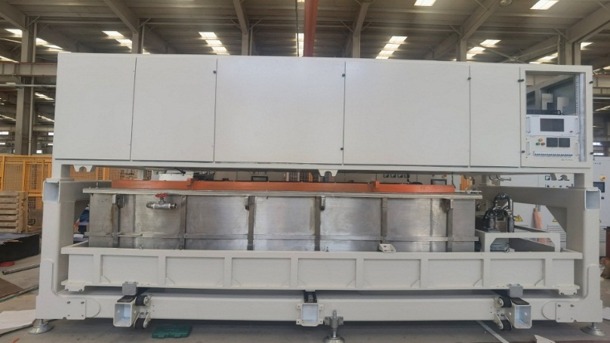
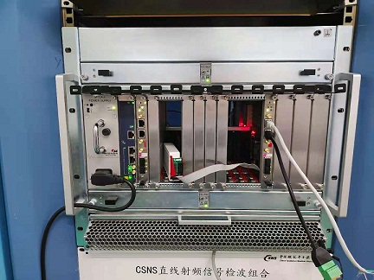
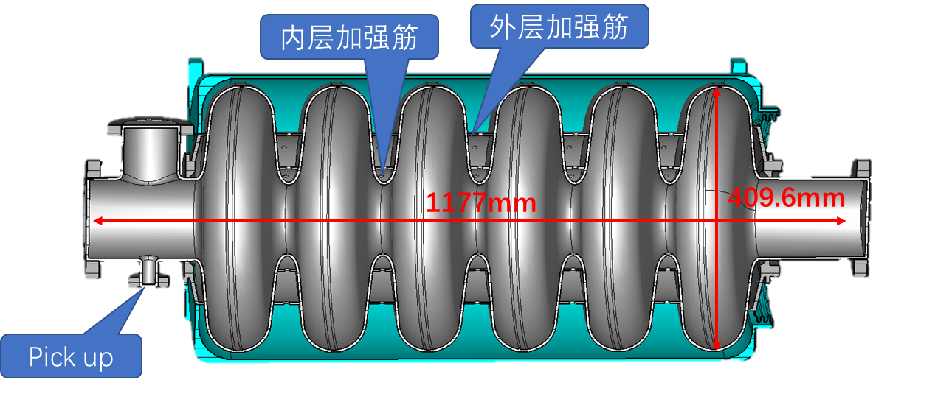
R&D for CSNS-II Accelerator
7-cell pi-mode debuncher
RF H⁻ ion source
MA second harmonic cavity
Prototype SC cavities: Double
spoke & Ellipsoidal cavity
Long-pulse solid-state modulator
Low-level RF prototype

Slide 15
R&D : RF-Driven H- ion source
Facility | Op. Current (mA) | Duty Factor | RMS Emitt. (π.mm.mrad) | Life Time（month） | Availability | Structure
ISIS | >50 | 1.1% | 0.35 | 5 | 99.3% | Penning
SNS | >50 | 6% | 0.25 | 19 | 99.9% | In Antenna RF
J-PARC | 47 | 1.25% | 0.26 | 22 | 99.8% | In. Antenna RF
CSNS | 42 | 1.35% | <0.31 | >45 | 99.999% | Ext Antenna RF
Innovations：
The H- ion source was put into commissioning since Sep. 2021
Excellent performance with nearly 100% availability
External-antenna structure.
Silicon-nitride plasma chamber.
Concise and reliable ignition system

Slide 16
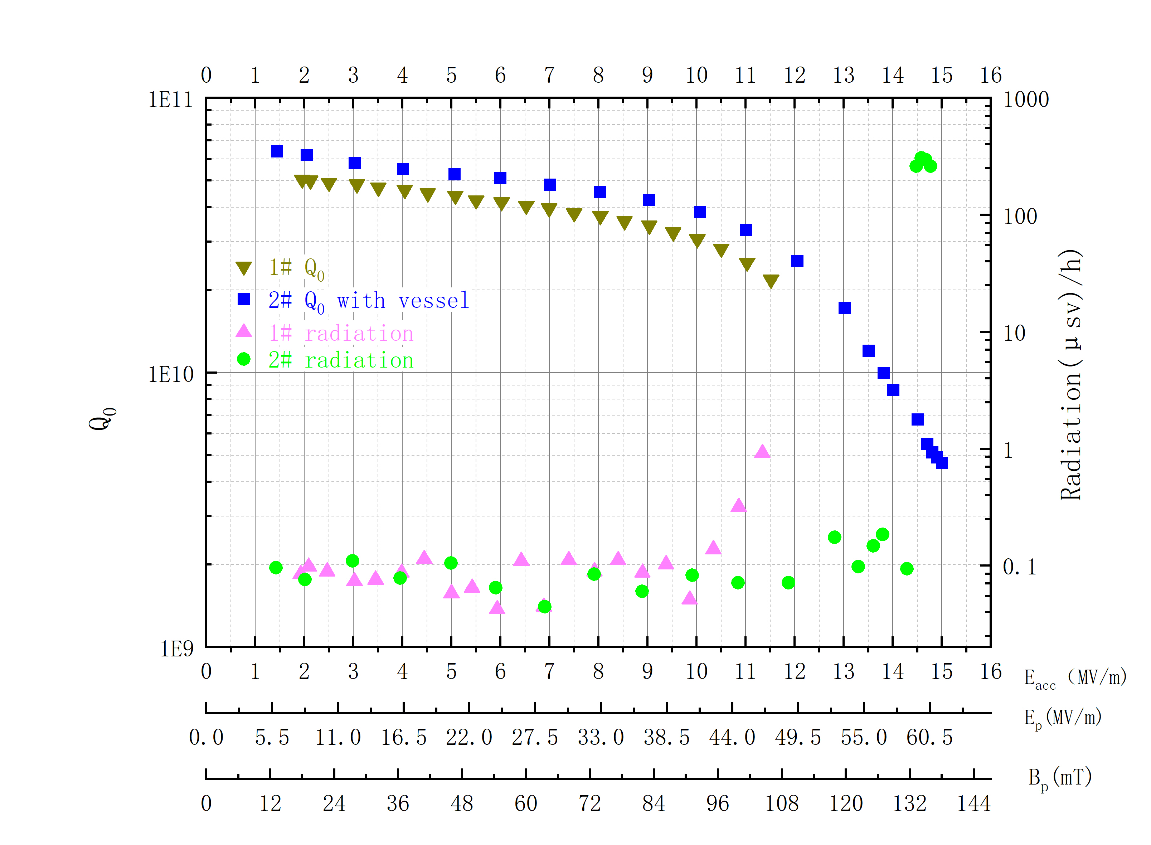
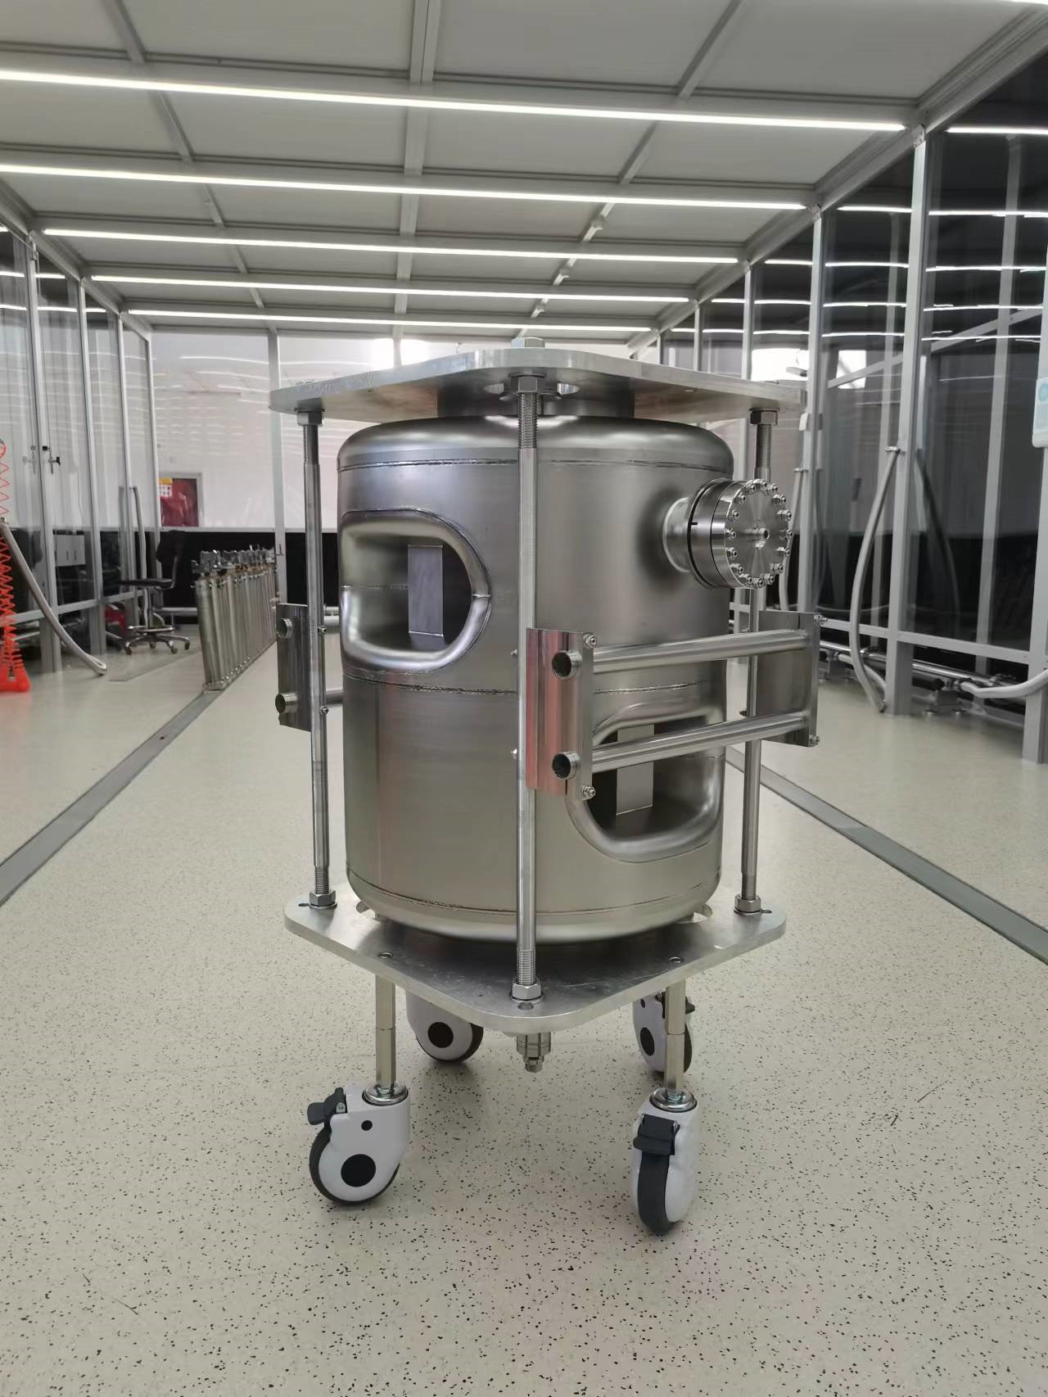
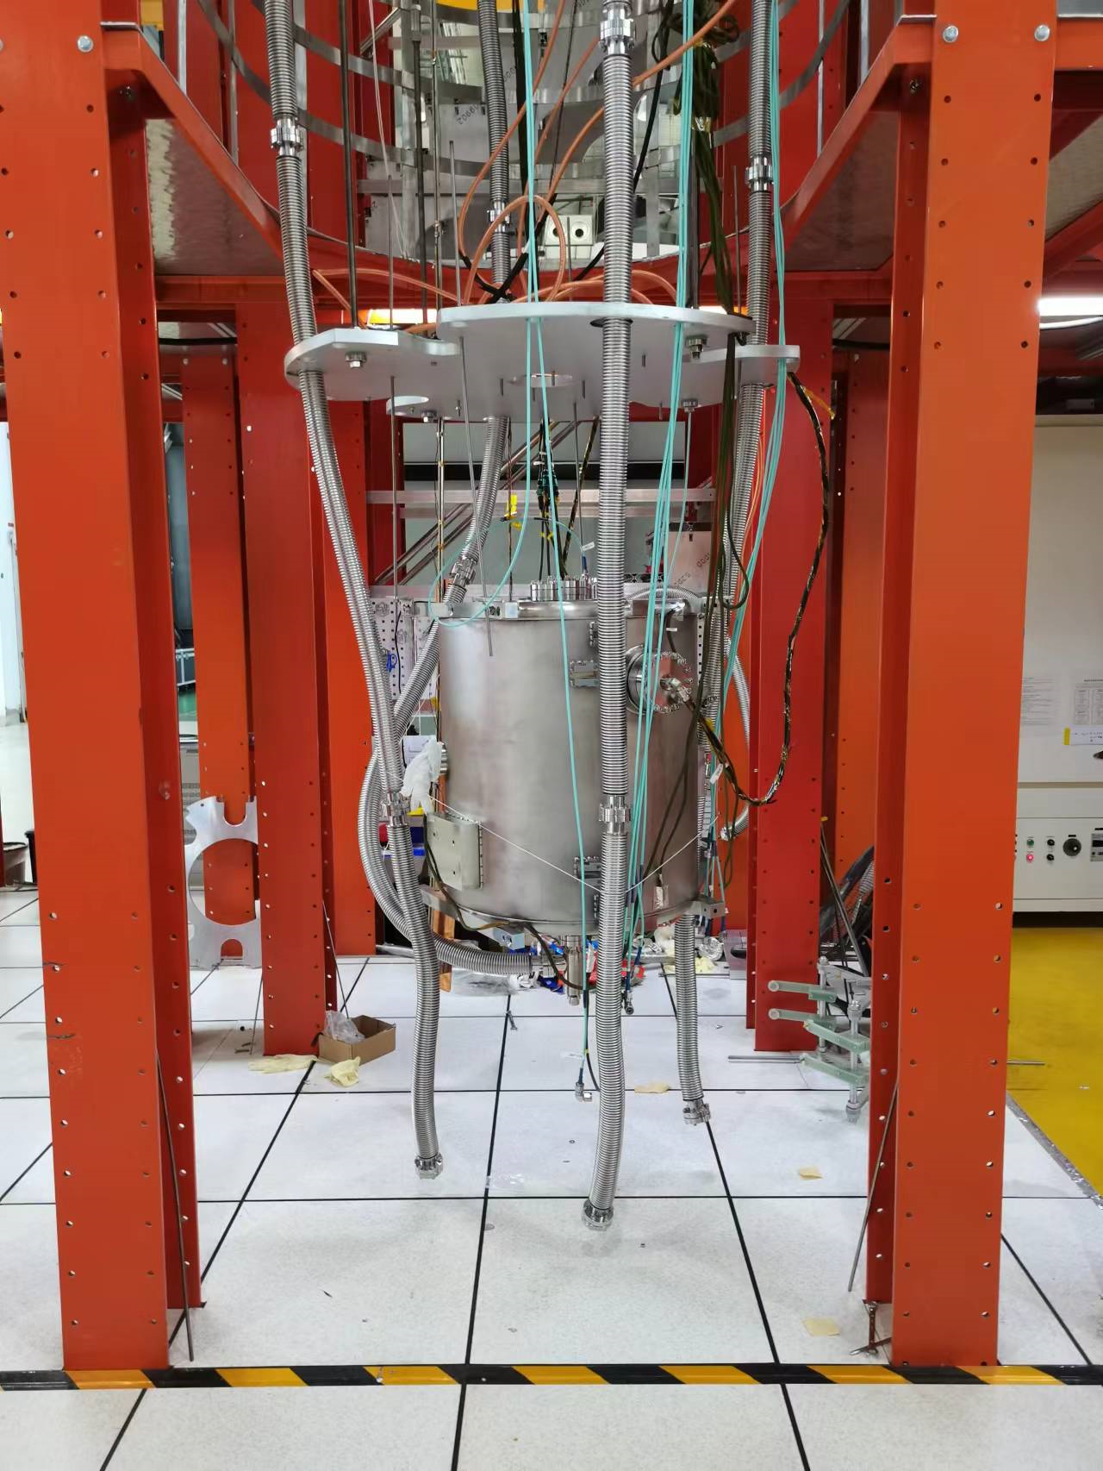
R&D: Spoke cavity
Spoke cavity prototype
parameter | prototype | improved
Frequency(MHz) | 324 | 324
β_{opt} | 0.5 | 0.5
E_{p}/E_{acc} | 4.1 | 3.44
B_{p}/E_{acc}(mT/(MV/m)^2) | 9.2 | 8.86
R/Q（Ω） | 410 | 401
G（Ω） | 120 | 118
Beam tube diameter（mm) | 50 | 50
E_{acc}(MV/m) | 7.3 | 9
The prototype of DSR
The prototype of cavity
with vessle
Vertical testing data of the prototype
The parameter of DSR
Two double spoke cavity prototypes have been fabricated and tested, the maximum Eacc reaches at 15 MV/m, and the Q is above 4E10 at 7.3MV/m.
Based on the experience gained in the prototyping，we improved the cavity design and process to enhance the performance further.

Slide 17
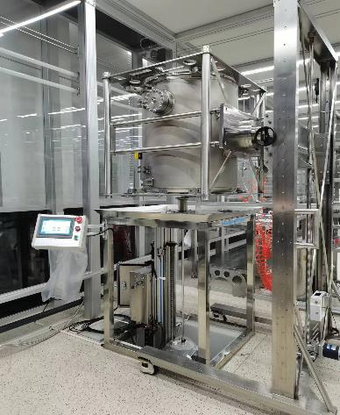
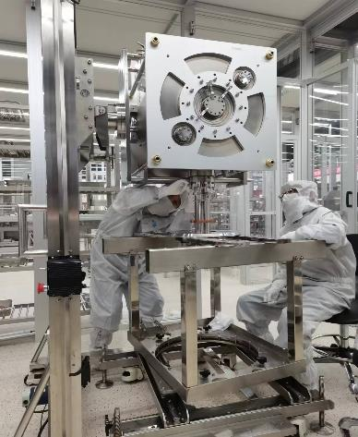
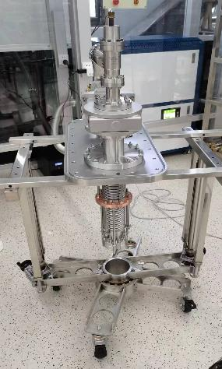
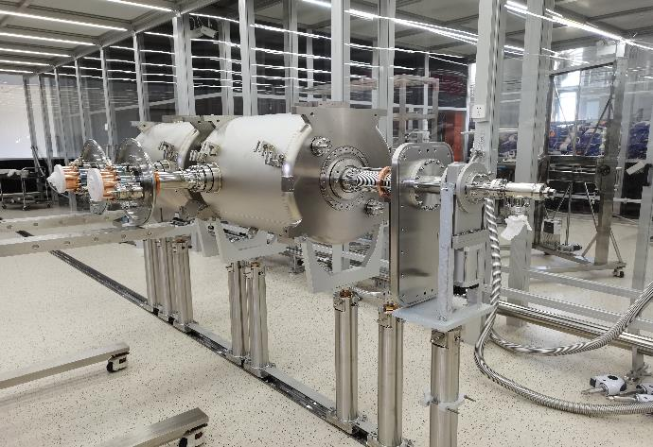
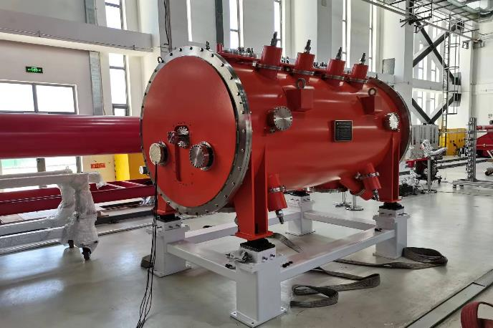
R&D: Spoke cavity
HPR
Coupler installation
Bellows installation
Cavity string assembly
The cavity string assembly in the clean room is
Completed
The cryomodule and valve box have been delivered to PAPS.
The installation of the cryomodule and valve box will be finished in the next five weeks……

Slide 18
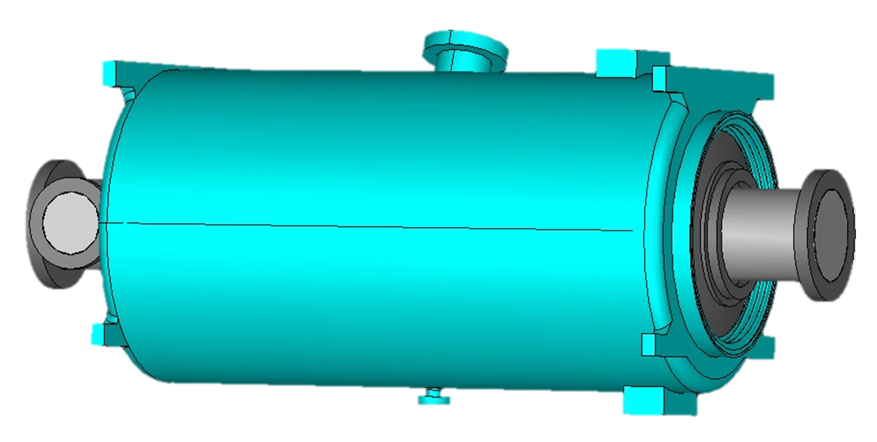
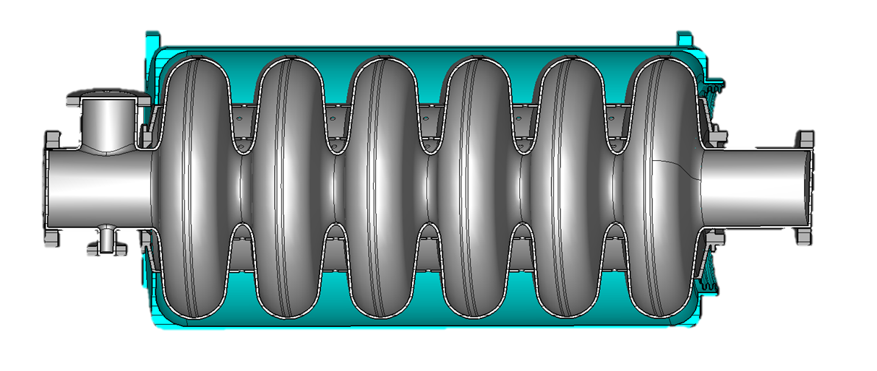
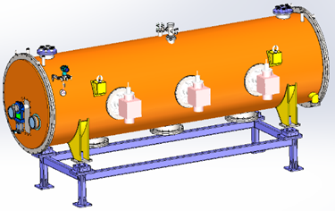
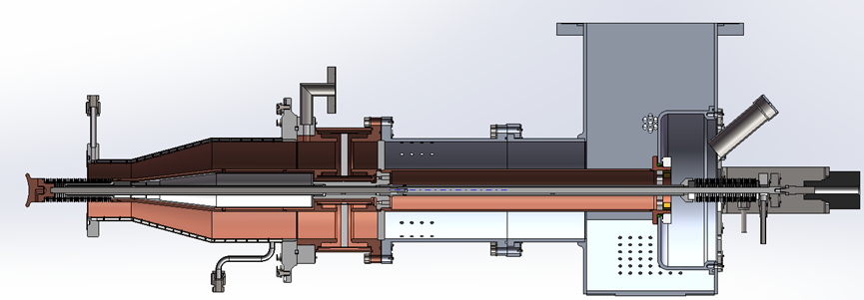
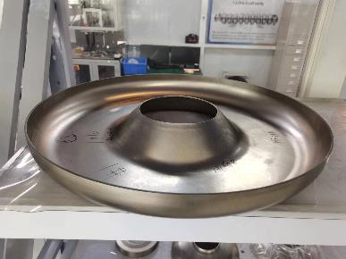
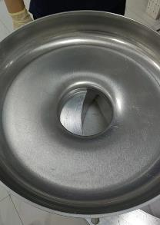
R&D: elliptical cavity
648 MHz 6-cell elliptical Cavity
parameter | design
Frequency(MHz) | 648
TTF@β_{g} | 0.7
β_{g} | 0.62
E_{p}/E_{acc} | 2.53
B_{p}/E_{acc}(mT/(MV/m)2 | 5.45
R/Q（Ω） | 309
G（Ω） | 177
Beam tube diameter（mm) | 105/120
Cell-cell coupling（%） | 1.35
E_{acc}(MV/m) | 14
mechanical structure of ellipsoidal cavity
The mechanical design of coupler
The cryomodule structure
The design of the superconducting cavity, coupler, magnetic shield, and tuner has been completed.
The cryomodule is currently under design.
The cavity is currently being fabricated.
End cover

Slide 19
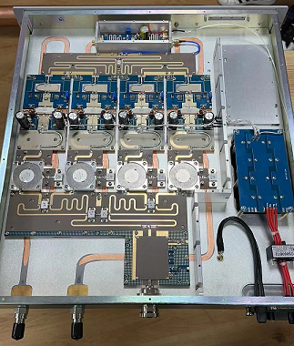
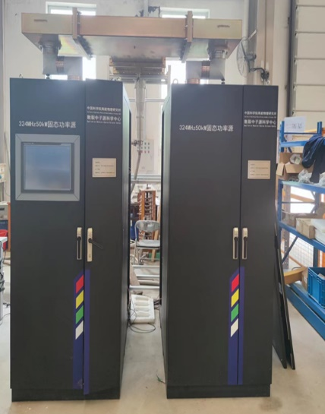
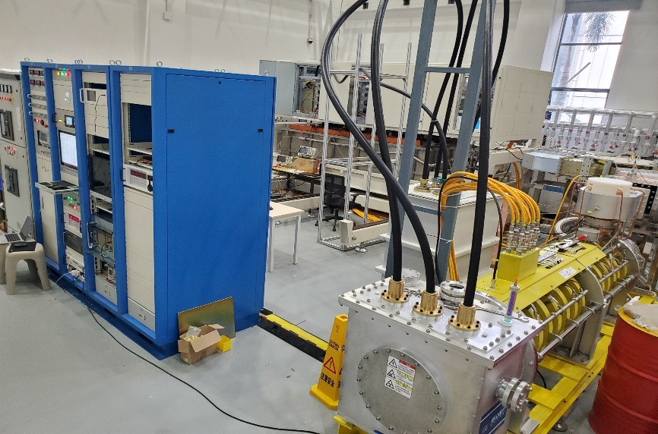
R&D: RF power source
A separate power source for each cavity, to adjust power and phase
  300kW @ 324MHz * 20
  >500kW @ 648MHz * 24
Spoke cavity
Solid state amplifier, with 30% safety margin
Elliptical cavity
Klystron + solid modulator + circulator and load

Slide 20
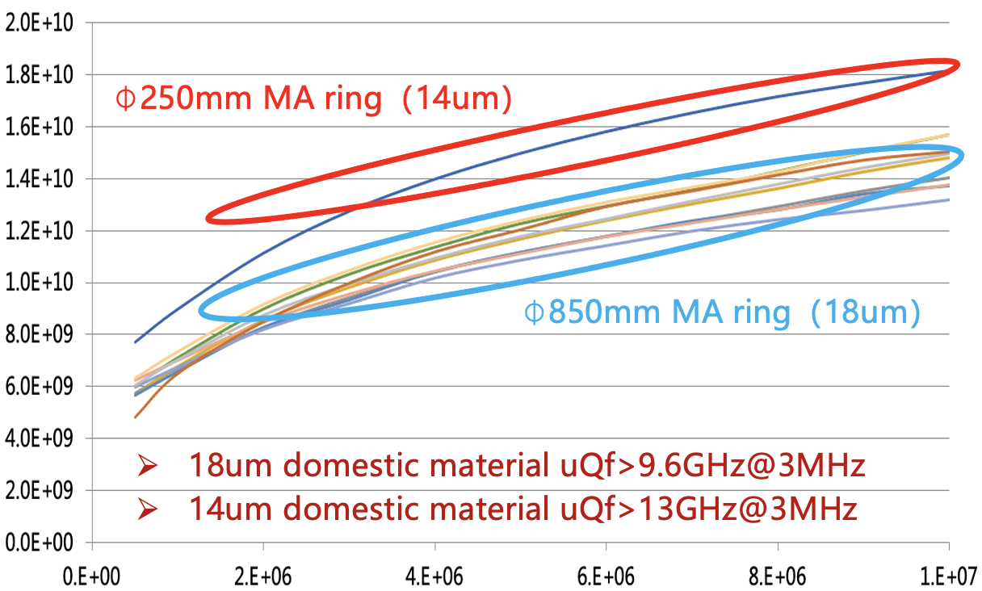
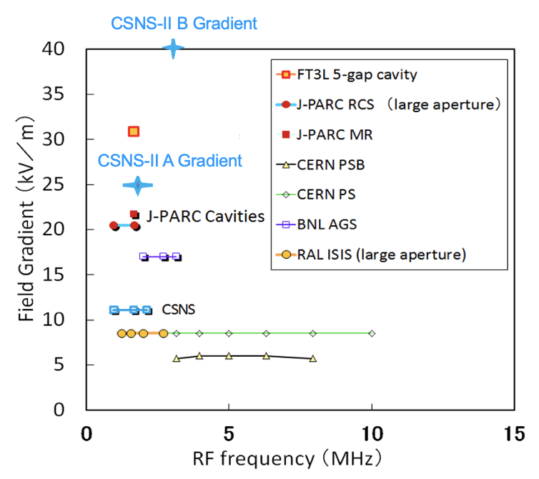
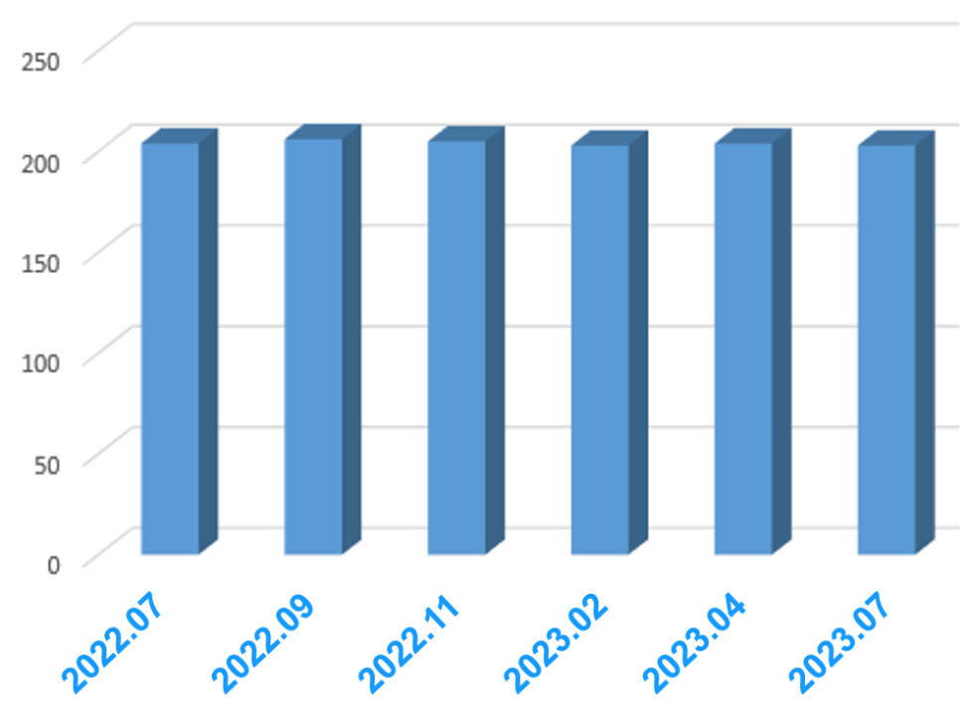
R&D：MA loaded cavity
Magnetic alloy loaded cavity
Test acceleration gradient > 50kV/m
Operation acceleration gradient > 40kV/m
Cavity impedance variation < 3%（>9600 hrs）
2022.09 officially put into operation
Frequency range 1-4MHz
A：25Hz/50% fundamental hormonic
B：25Hz/15% second hormonic
Cavity impedance variation <3%

Slide 21
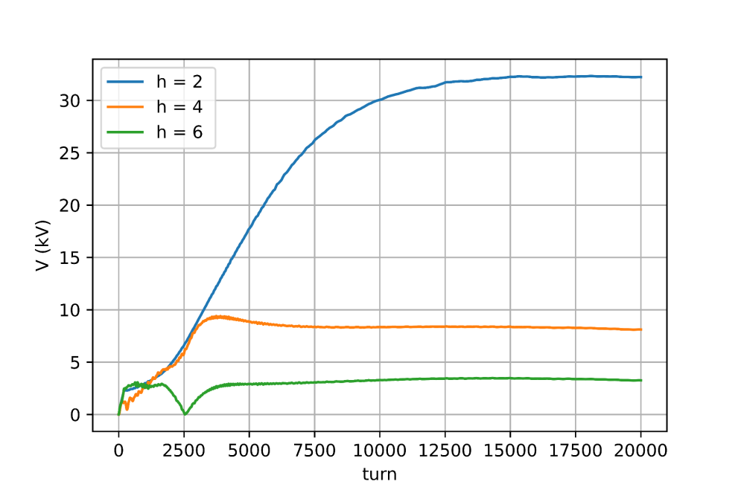
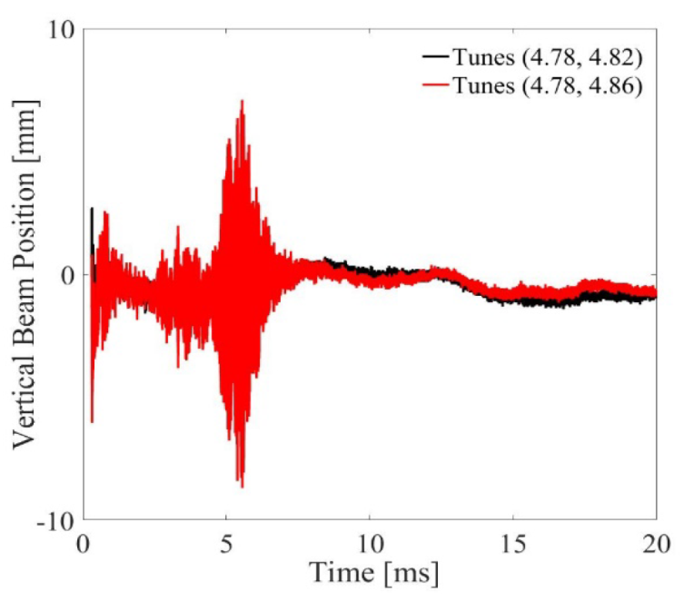
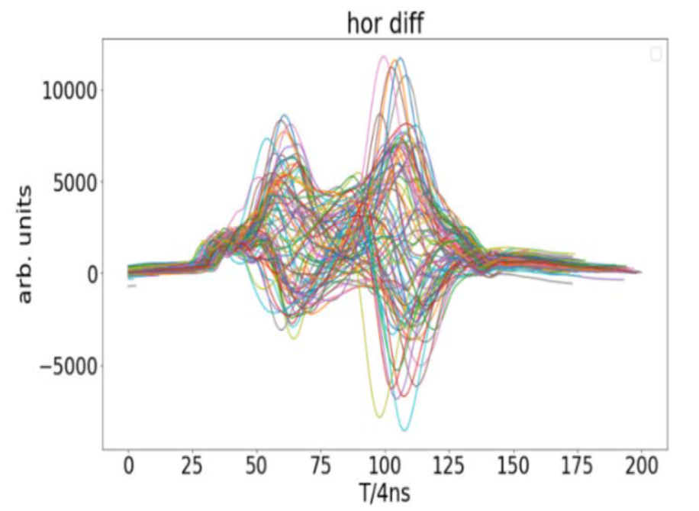
Beam dynamic challenges in the CSNS-II RCS
Challenges | Solutions
Emittance increases driven by space charge effects | Dual harmonic RF cavity system; Painting injection
Emittance increase caused by broken four-fold symmetry of the RCS | New injection system
Beam instability | Increasing chromaticity damping and octupole magnet damping; Installation of a beam feedback system; optimization of the tune
Large beam loss at the arc section | Installation of a momentum collimator system
Too small vertical acceptance of the circulating beam vacuum chamber at the Lambertson magnet inlet | New Lambertson magnet
The cryomodule structure
Three dual harmonic RF cavity
Notes:
We have corresponding strategies to address these challenges

Slide 22
Summary
IHEP has successfully built and operated a high-energy & high-current proton accelerator
Thanks to the hard work of the accelerator team, CSNS has achieved an excellent performance compared to the similar facilities
CSNS-II project is ready for implementation with all crucial technologies and physics in place, following the completion of CSNS plus initial R&D research.

Slide 23
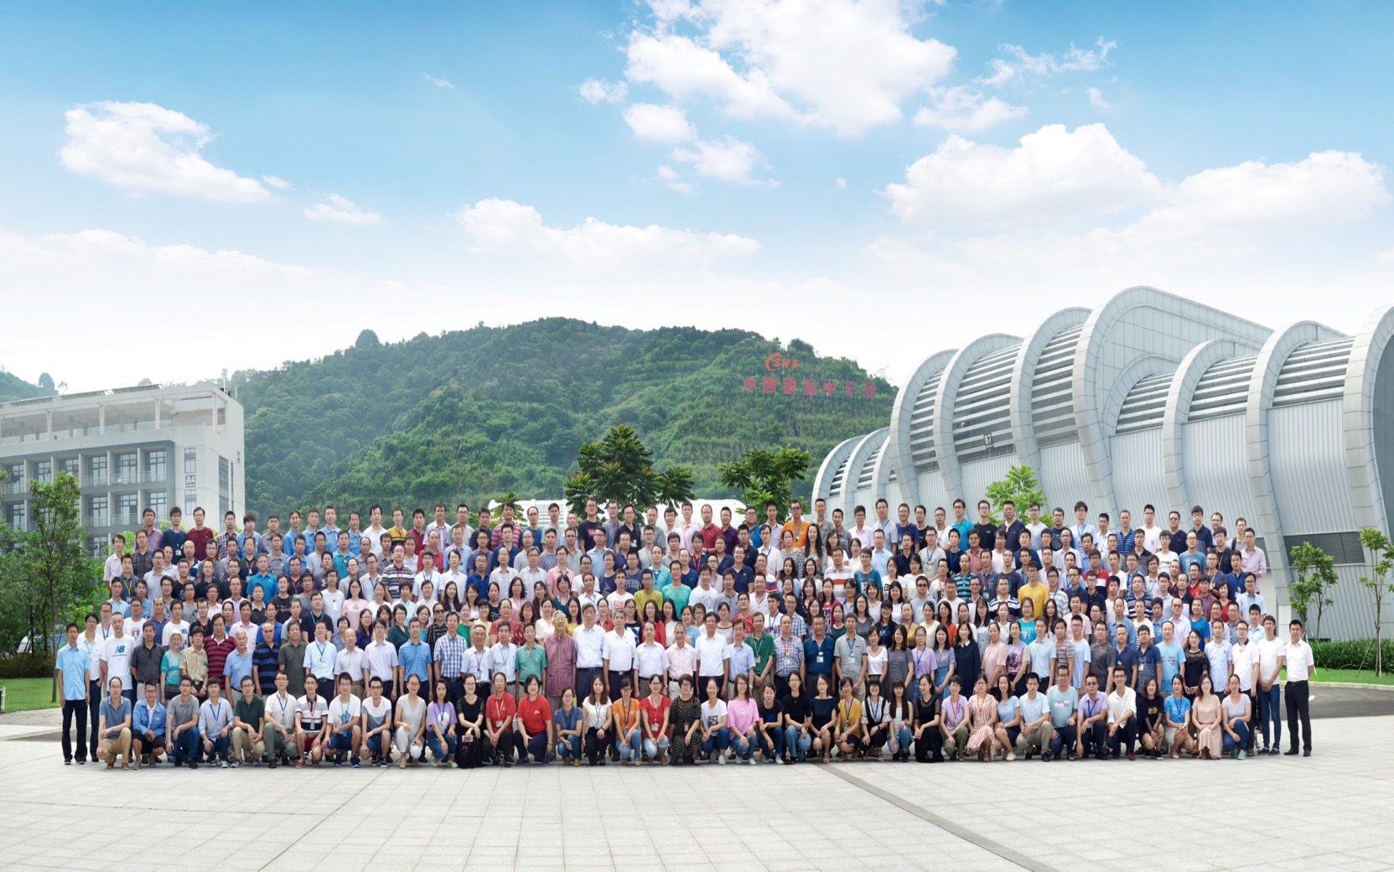
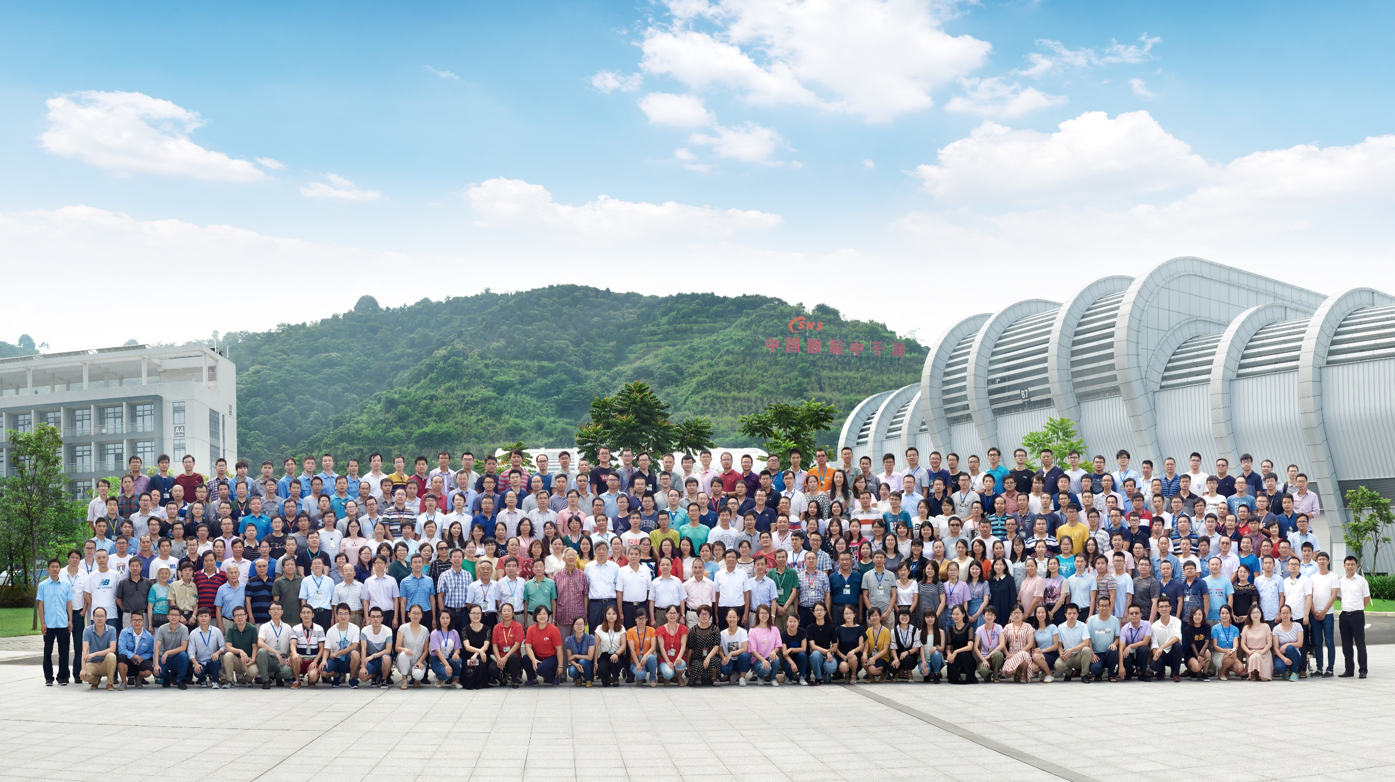
Thanks for your attention!

