Slide 1

WORKSHOP OF MELODY2023
An efficient high power proton accelerator and its possible muon applications
Tianjue Zhang for the Cyclotron Team at CIAE
China Institute of Atomic Energy
Nov 4th, 2023

Slide 2
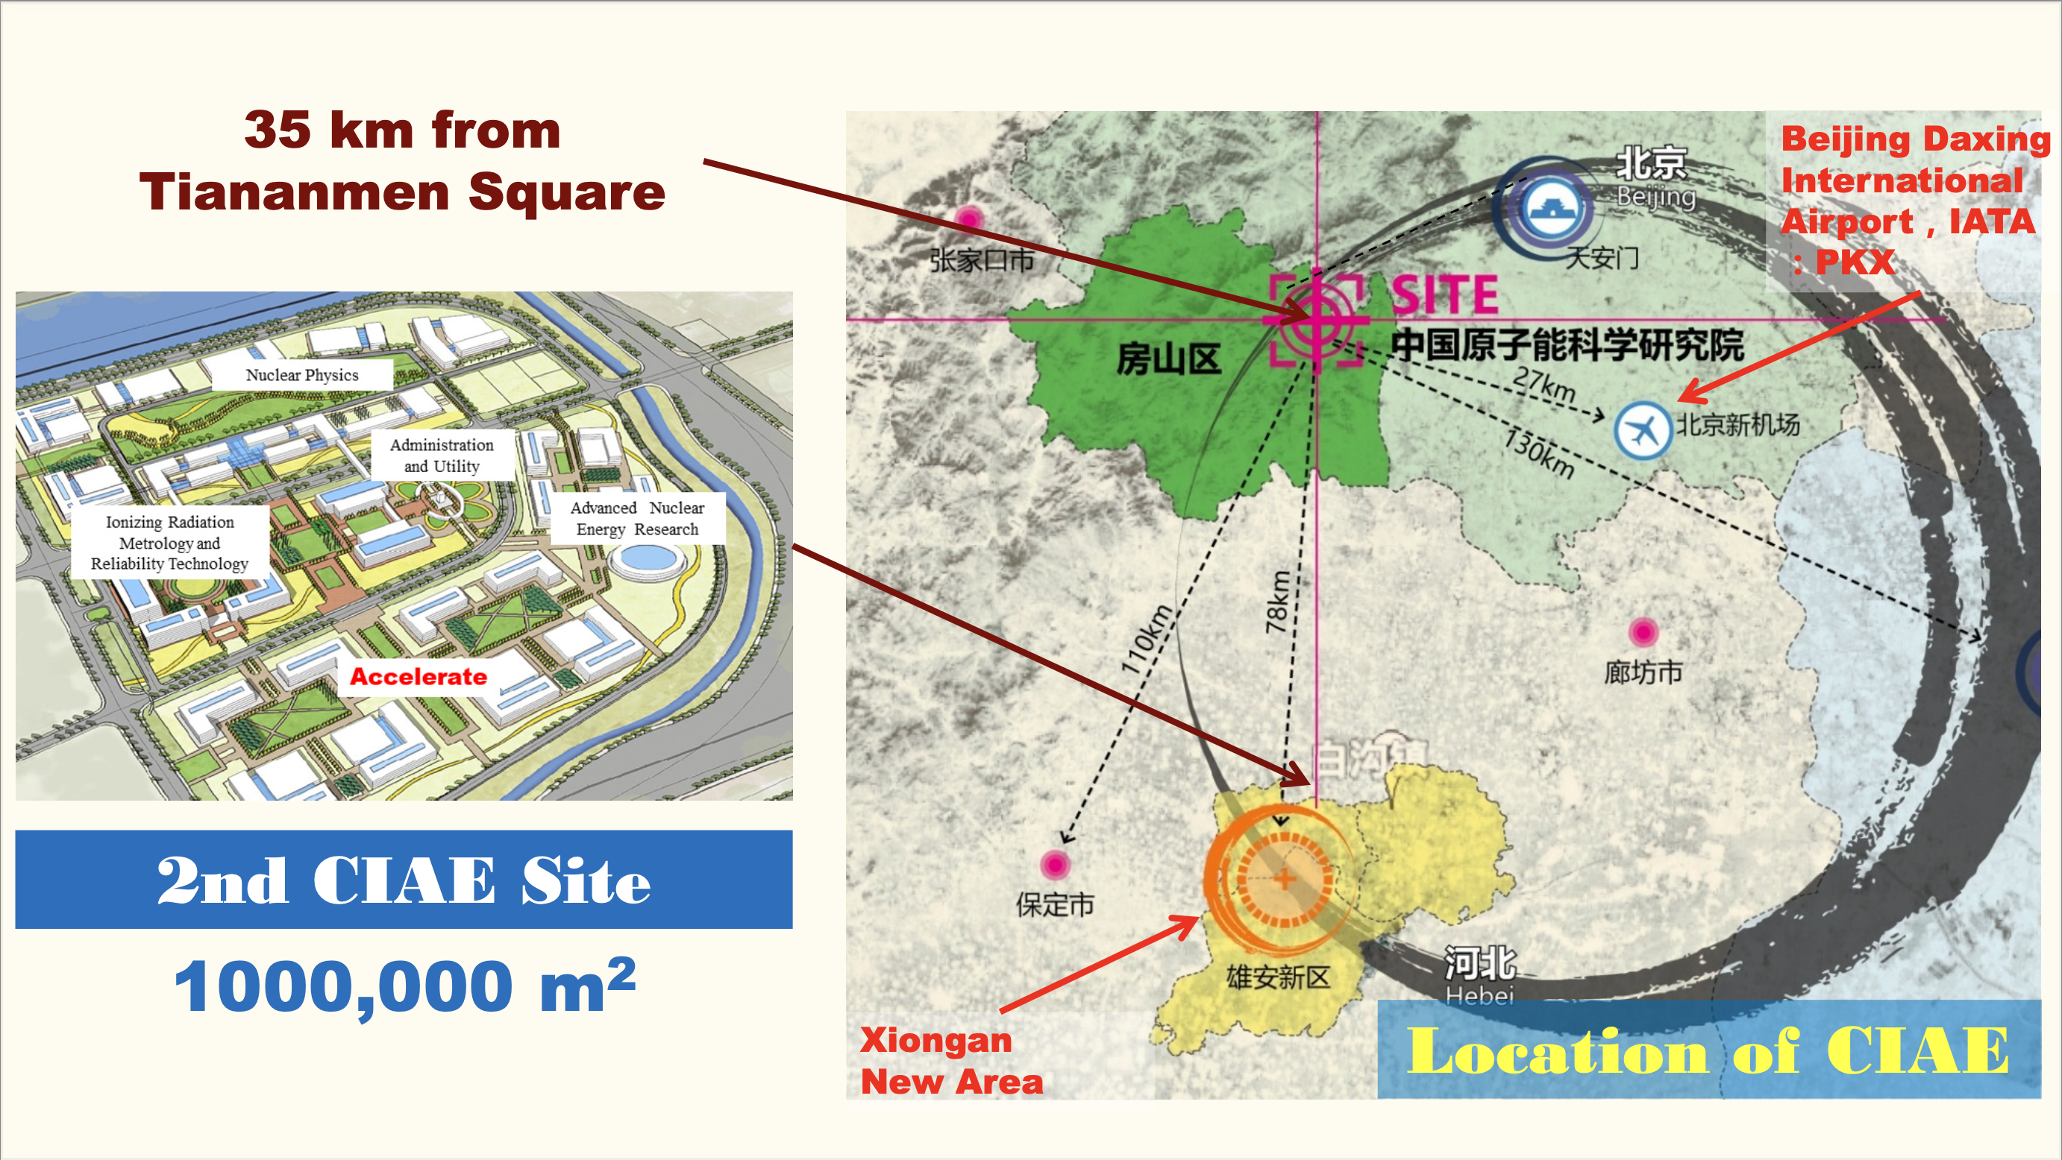

Slide 3
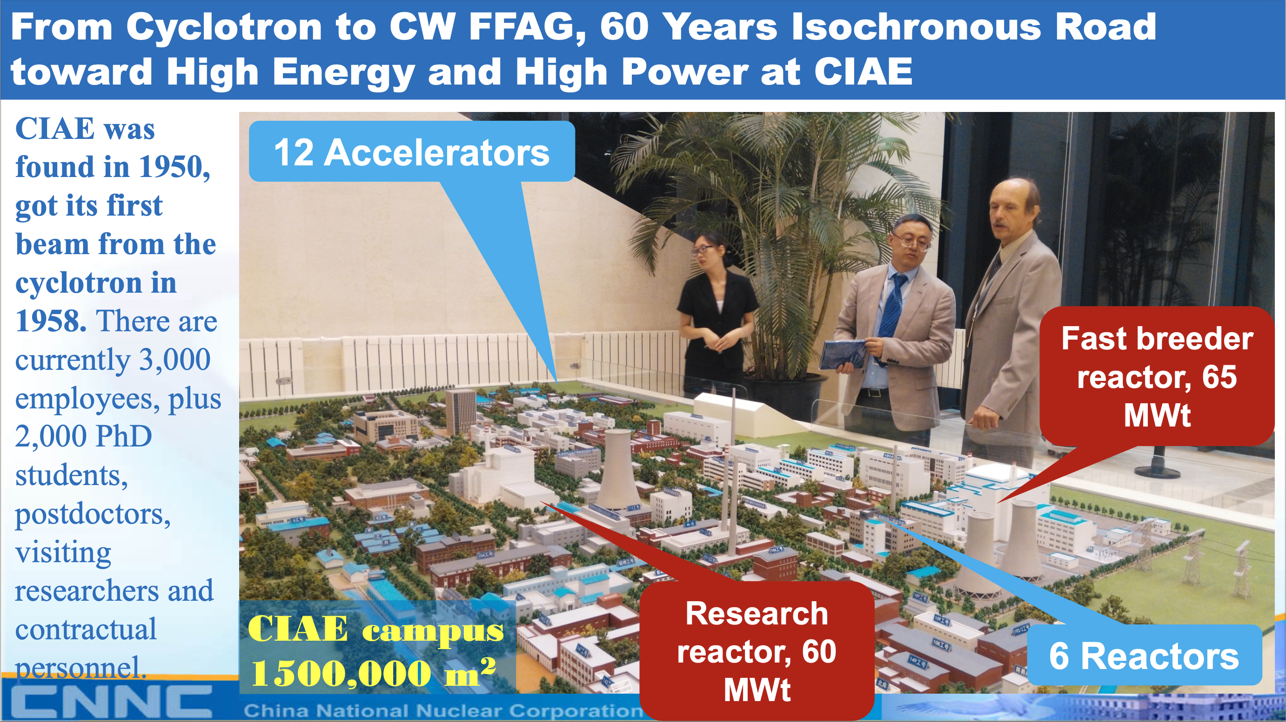

Slide 4
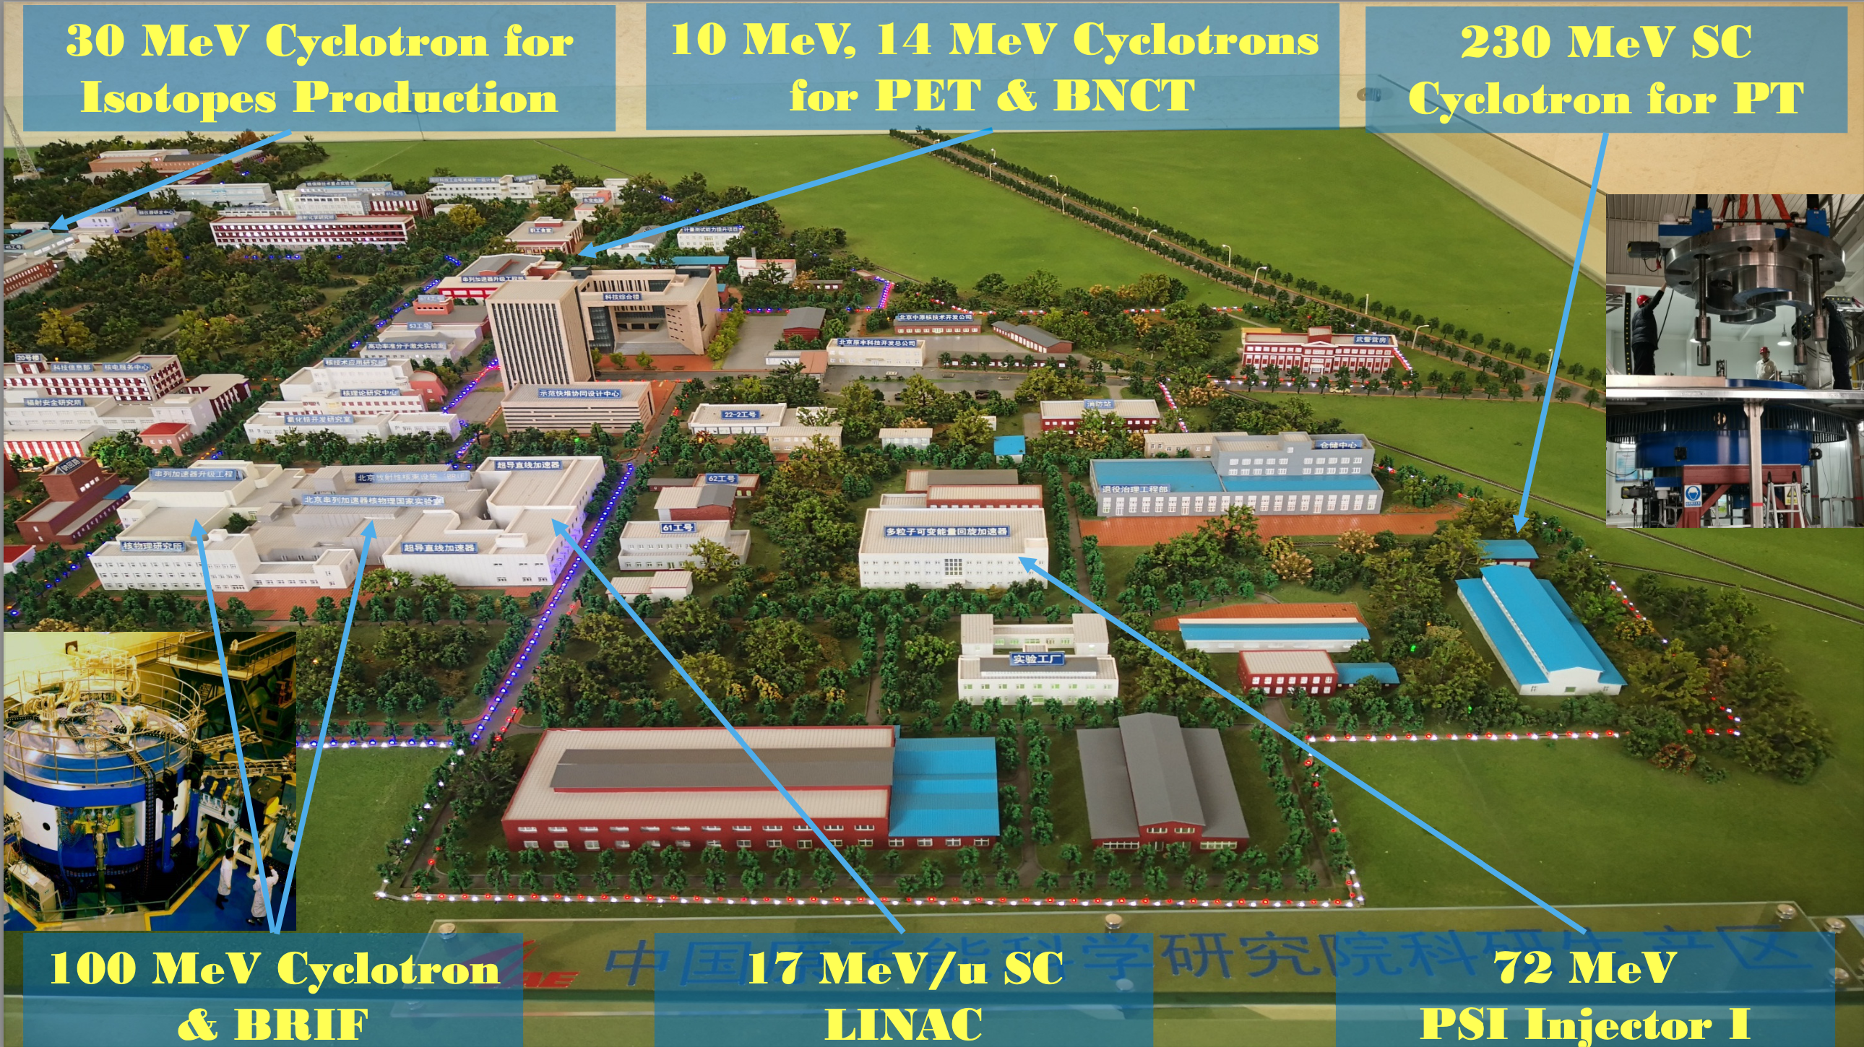

Slide 5


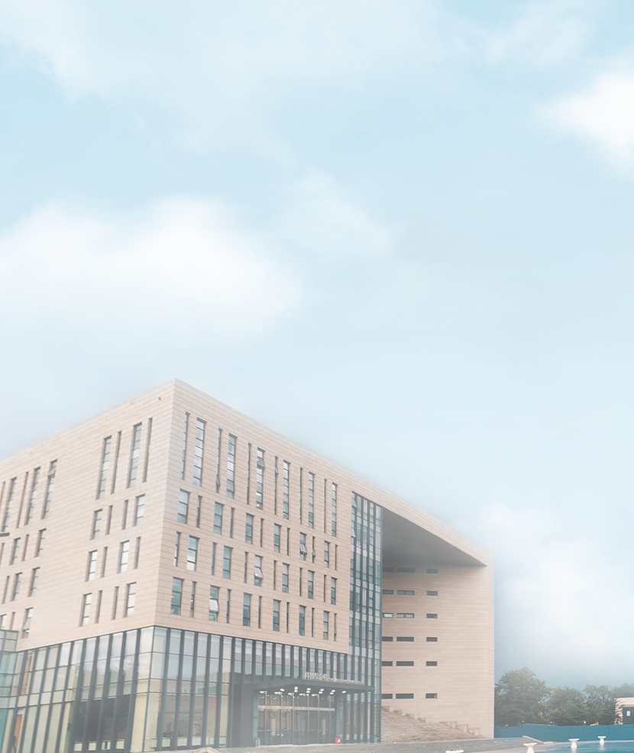
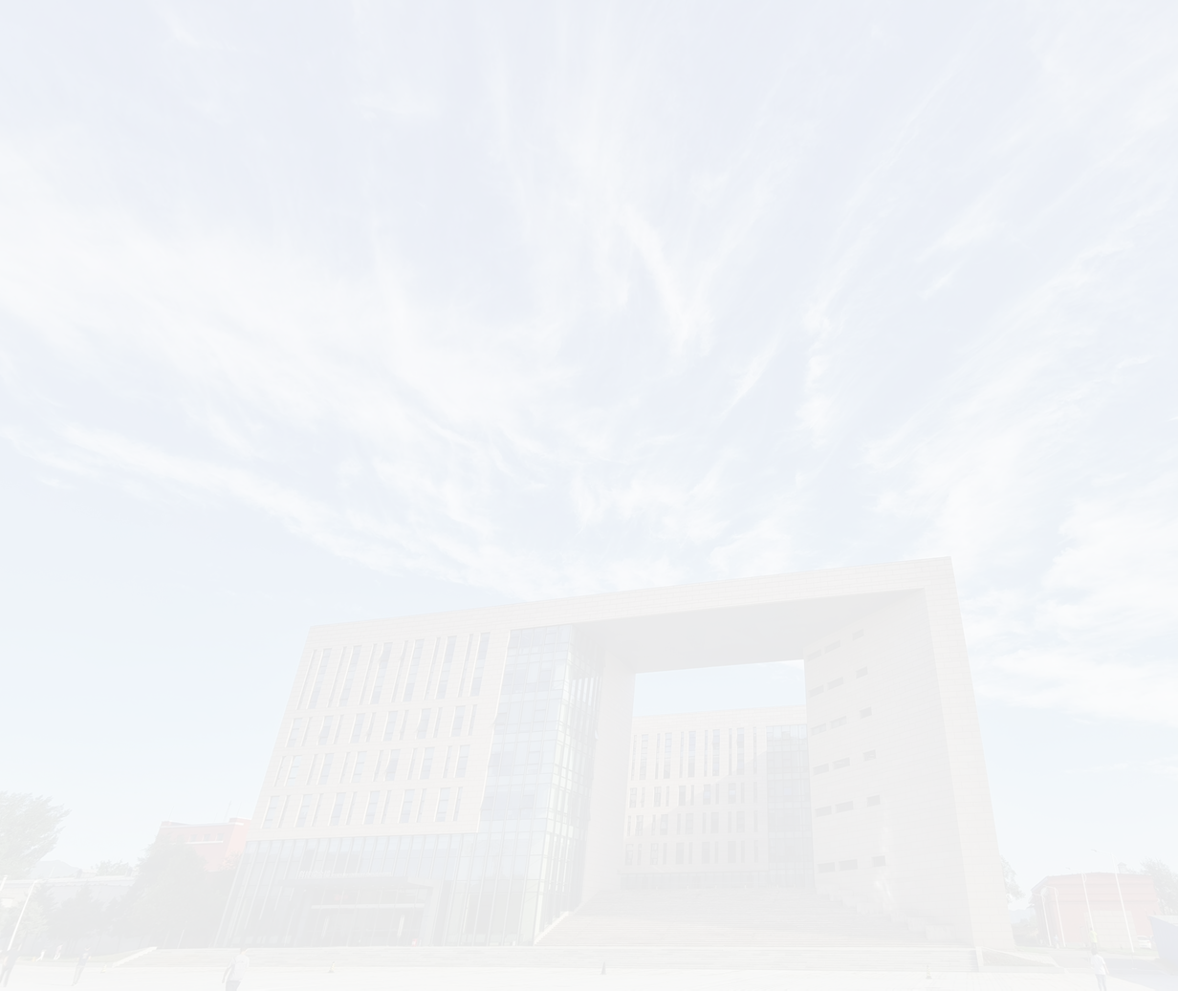
Plan of Talk
1
General consideration and overall design
2
Beam dynamics and parallel computing
3
RF system & HTS magnet
4
Possible muon application
5
Summary

Slide 6
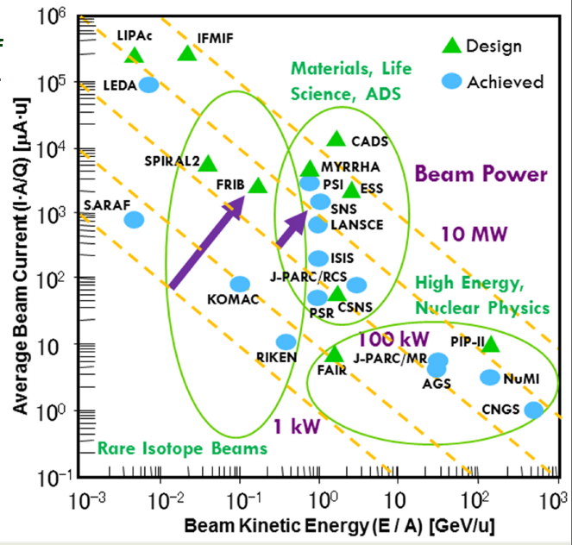
Project Motivation
High energy and high current proton accelerators are widely applied in frontier research fields such as nuclear physics and particle physics, national economic fields such as medical application and advanced energy, and even national defense industry and national security
High-power facilities in the world
★CIAE
The MW class proton accelerators attracting institutions to continue research and tackle key problems.
★CIAE
Proton accelerator with an average beam power of 5-10 MW is the world's dream machine for more than 30 years.

Slide 7
Current status for high power proton accelerator
High Power Proton Accelerator:
Cyclotron, LINAC and RC Synchrotron
The average power of the three different types of constructed accelerators currently is from 0.2MW to 1.4MW
RC Synchrotron
Institute | Facility | Energy (MeV) | Power (kW) | Current (uA) | Repetition rate (Hz) | Remark
RAL | ISIS | 800 | 200 | 250 | 30 | Short pulse
JAERI/KEK | J-PARC | 3000 | 1000 | 333 | 25 | Short pulse
ORNL | SNS | 1000 | 1400 | 1300 | 60 | Short pulse
LANL | LANSCE | 800 | 1000 | 1000 | 100 | Long pulse
PSI | SINQ | 590 | 1400 | 2400 | - | CW
TRIUMF | ISAC | 500 | 200 | 400 | - | CW
Europe | ESS | 2000 | 5000 | 2500 | 14 | Long pulse
LINAC
Cyclotron

Slide 8

Current status for high power proton accelerator
High Power Proton Accelerator:
Cyclotron, LINAC and RC Synchrotron
The average power of the three different types of constructed accelerators currently is from 0.2MW to 1.4MW
RC Synchrotron
Institute | Facility | Energy (MeV) | Power (kW) | Current (uA) | Repetition rate (Hz) | Remark
RAL | ISIS | 800 | 200 | 250 | 30 | Short pulse
JAERI/KEK | J-PARC | 3000 | 1000 | 333 | 25 | Short pulse
ORNL | SNS | 1000 | 1400 | 1300 | 60 | Short pulse
LANL | LANSCE | 800 | 1000 | 1000 | 100 | Long pulse
PSI | SINQ | 590 | 1400 | 2400 | - | CW
TRIUMF | ISAC | 500 | 200 | 400 | - | CW
Europe | ESS | 2000 | 5000 | 2500 | 14 | Long pulse
CIAE | CYCIAE-2000 | 2000 | 6000 | 3000 | - | CW FFAG
LINAC
Cyclotron

Slide 9
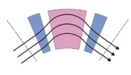
Current status for high power proton accelerator
 | Cyclotron (Isochronous) | Linac | RCS | FFAG (Isochronous)
CW beam
FF magnets
Fixed RF
>1 GeV
The road map of higher power machine
L. Calabretta and Y. Ishi, Overview of FFAG, FFAG-2018： Energy limit：1 GeV

Slide 10
Basic Description of 2 GeV CW FFA –Energy efficiency
Energy efficiency
CW FFA with HTS magnets and high-Q RF cavity ≈ 30%
The energy efficiency of the PSI isochronous cyclotron is about 3 times of the other types.
To develop high average beam power, high power efficiency, and high cost-effective proton machine, the isochronous accelerator is a good technical route.
HTS magnet is used to replace the normal temperature magnet , and an RF cavity with Q value of 90000 to replace the 45000 cavity at PSI. Energy efficiency can be increased from PSI’s ~20% to 30%,
LINAC+RCS
SC LINAC
～3 %
～8.6%
CYCLOTRON
Total power of PSI Cyclotron ~8 MW，1.4 MW proton beam, beam/grid efficiency: 18%, after upgrade: 24%

Slide 11
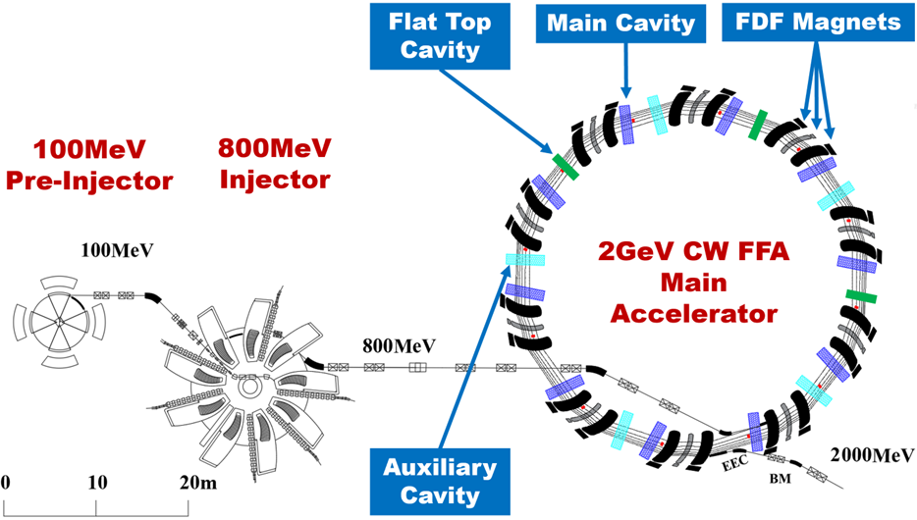
Basic Description of 2 GeV CW FFA
2011
800 MeV Ring Cyclotron Proposal
2014
2GeV FFA Conceptual Design
2018
2GeV Isochronous FFA Proposal
2019
Financial Support for Pre-research
Goal: 2GeV, 3mA, 6MW CW Proton Beam

Slide 12
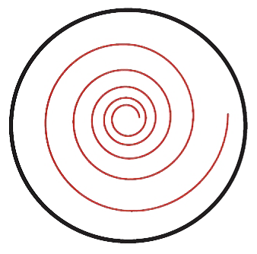
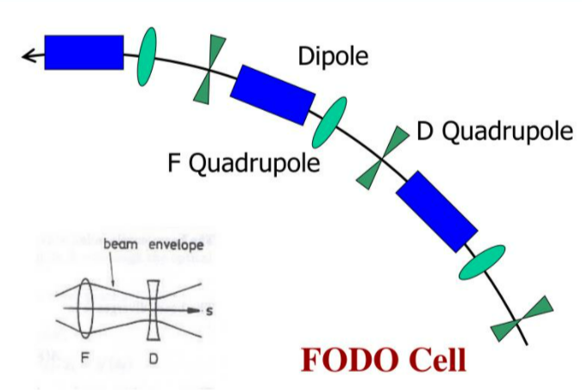
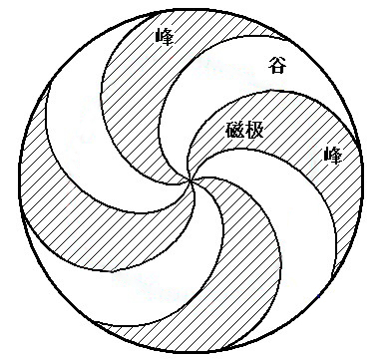
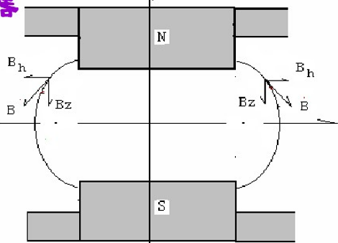
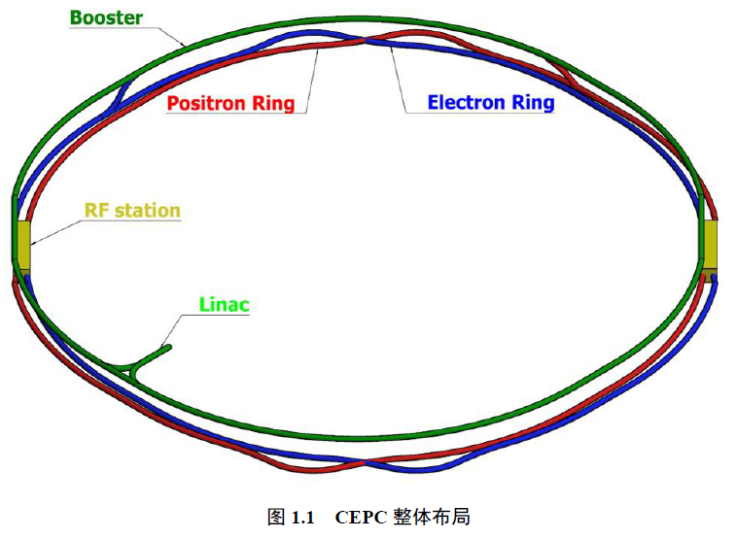
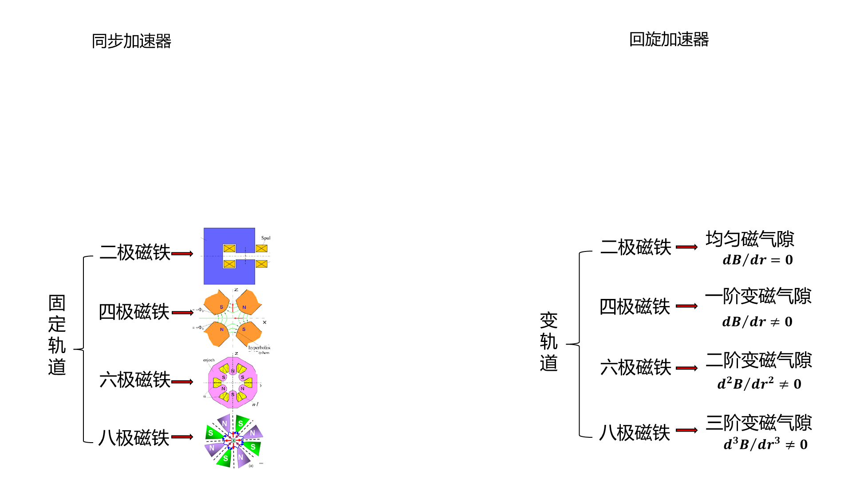




Realization of strong focusing in GeV-class FFA
Theory
Adjustment of peak field gradients in wide radial range.
Synchrotron
Cyclotron
In a synchrotron, particle orbits are fixed within a small radial range, and the tune is easily controlled, so the energy can reach higher levels than in a cyclotron.
Thomas focusing
Dipole
In a cyclotron, hundreds of orbits change with energy increasement, which makes it more difficult to control the tune within certain range or manipulate it.
Dipole
$$dB/dr=0$$
Quadrupole
uniform gap
Quadrupole
$$dB/dr≠0$$
Fixed orbits
variable orbits
1st order variable gap
Sextupole
Sextupole
$$d^{2}B/dr^{2}≠0$$
2nd order variable gap
Octupole
Octupole
$$d^{2}B/dr^{2}≠0$$
3rd order variable gap
E.D. Courant, M.S. Livingston, H.S. Snyder, "The Strong-Focusing Synchrotron—A New High Energy Accelerator", Phys. Rev. 88 (5): 1190–1196 (1952).

Slide 13
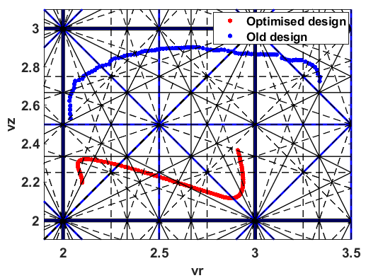
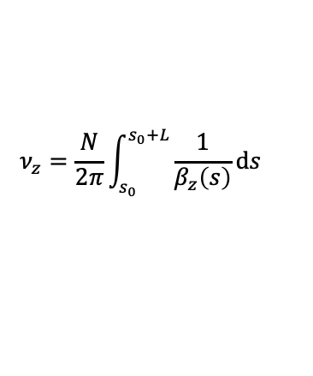
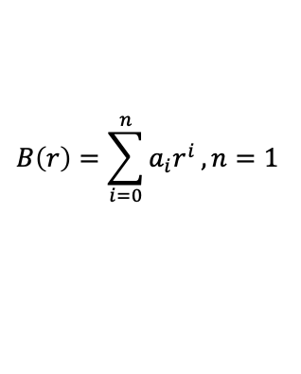
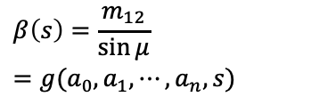
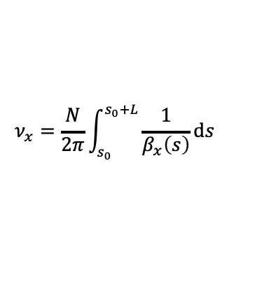
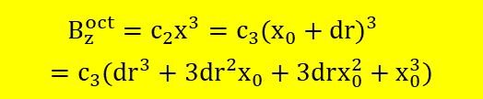

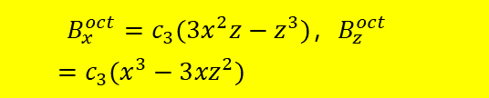


Realization of strong focusing in GeV-class FFA
Example
Adjustment of peak field gradients in wide radial range.
Simple 1st order magnet
Work path optimization
Effects of magnets such as quadrupole, hexapole, and octupole lenses to enhance vertical and radial focusing, compensate chromaticity, and handle resonance are realized by high order field equivalent.
$$B\left(r\right)=\sum_{i=0}^{n}{a_{i}r^{i}}, n=1$$
Octupole Component
Radial field
$$B_{x}^{oct}=c_{3}{(3x}^{2}z−z^{3})，B_{z}^{oct}=c_{3}(x^{3}−3{xz}^{2})$$
Transfer matrix
$$M=M_{0}M_{1}⋯M_{n}$$
$$m_{ij}=f(a_{0},a_{1},⋯,a_{n},s)$$
No vertical motion and delta momentum equals dp
Twiss parameter
$$β\left(s\right)=\frac{m_{12}}{\sin{μ}}=g(a_{0},a_{1},⋯,a_{n},s)$$
$$B_{z}^{oct}=c_{2}x^{3}=c_{3}{(x_{0}+dr)}^{3}=c_{3}({dr}^{3}+3{dr}^{2}x_{0}+3drx_{0}^{2}+x_{0}^{3})$$
Modulating the magnetic field gradient in a large radial range, provides additional focusing power and chromaticity matching effects, hit the energy limit of isochronous accelerators.
Oscillation frequency
$$ν_{x}=\frac{N}{2π}\int_{s_{0}}^{s_{0}+L}{\frac{1}{β_{x}\left(s\right)}ds}$$
Nolinear effect
quadrupole
Dipole, distort Isochronism
$$ν_{z}=\frac{N}{2π}\int_{s_{0}}^{s_{0}+L}{\frac{1}{β_{z}\left(s\right)}ds}$$
Solving $a_{0}$ and $a_{1}$

Slide 14
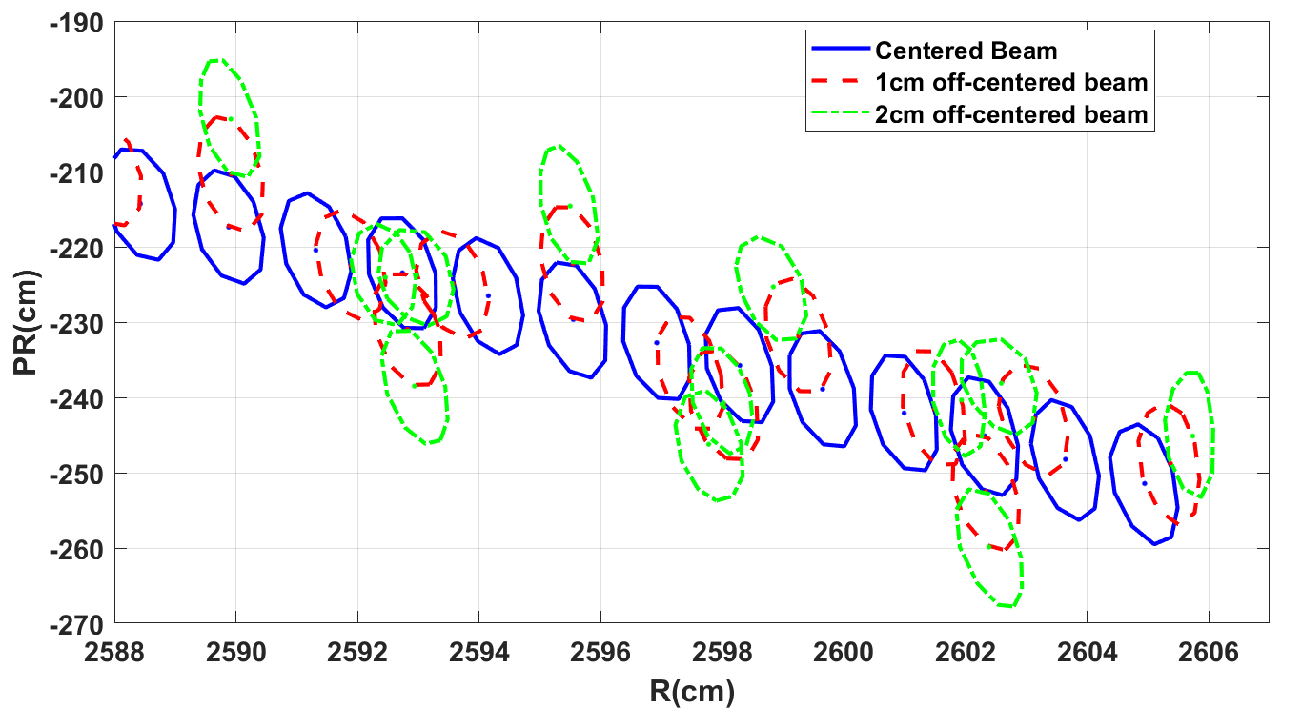
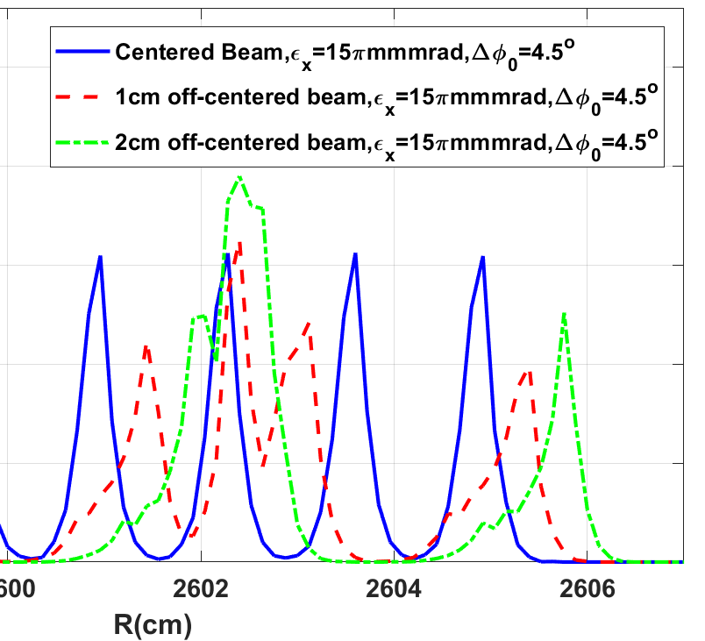
Injection, extraction, and RF consideration
Extraction
Two methods for increasing the turn separation
Five RF cavities are added in addition to the original design of 10 RF cavities so that the energy gain per turn is up to 15 MeV. Thereby, the turn separation is increased from 10 mm to 15 mm, and can be further increased to about 30 mm by precession.
Septum
Septum

Slide 15
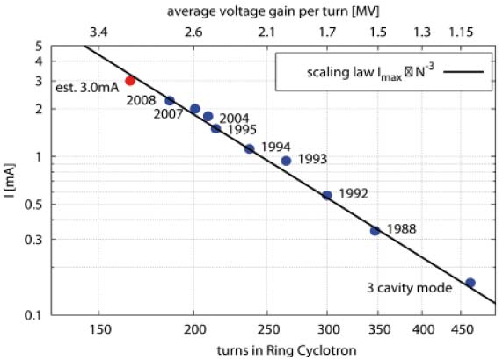
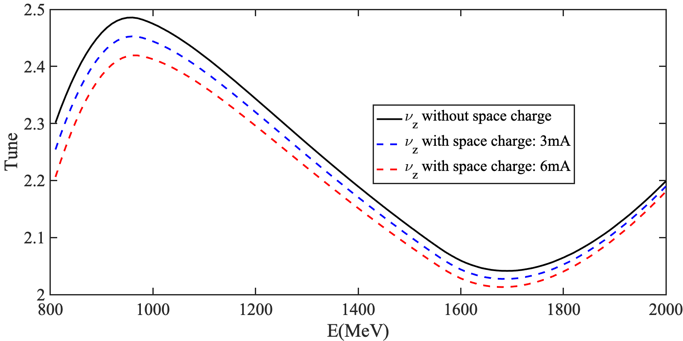
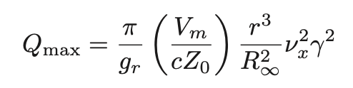

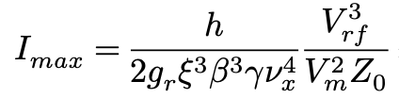


Injection, extraction, and RF consideration
Current limit
3 mA/6 MW beam could be expected very conservatively
Beam Intensity Estimation
Tune Shift Estimation
[1]
[2]
[1]
PSI scaling law
[2]
Dr. Richard Baartman, TRIUMF, Proc. of cyclotrons 2013
The beam intensity of ~5 mA for 10 MeV, and more than 10 mA for 15 MeV energy gain per turn. Such a high current limitation is also due to the big transverse acceptance of FFA.
Taking into account relativistic effects for the high energy beam, the tune shift is 0.025 ~ 0.1 in high energy and low energy regions.
The 2GeV FFA machine has a potential to hit the aim of 10MW average beam power.

Slide 16
Injection, extraction, and RF consideration
RF system
High-Q RF cavitiy is crucial for stable operation.
Layout of 2 GeV FFA
In the overall design, we still have five valleys with enough space, one for injection/extraction, and the rest for flattop cavities.
During the operation of this high power machine, in case of the worst case, two RF systems fail. Our solution is to improve the Q value of each main RF cavity in the design stage. Then we should be able to increase the voltage of each RF cavity by 20% to maintain the 15 MeV energy gain per turn.
We have completed the 1:4 scale RF cavity test, and the test result of Q value encourages this idea.

Slide 17
Plan of Talk
1
General consideration and overall design
2
Beam dynamics and parallel computing
3
RF system & HTS magnet
4
Possible muon application
5
Summary

Slide 18
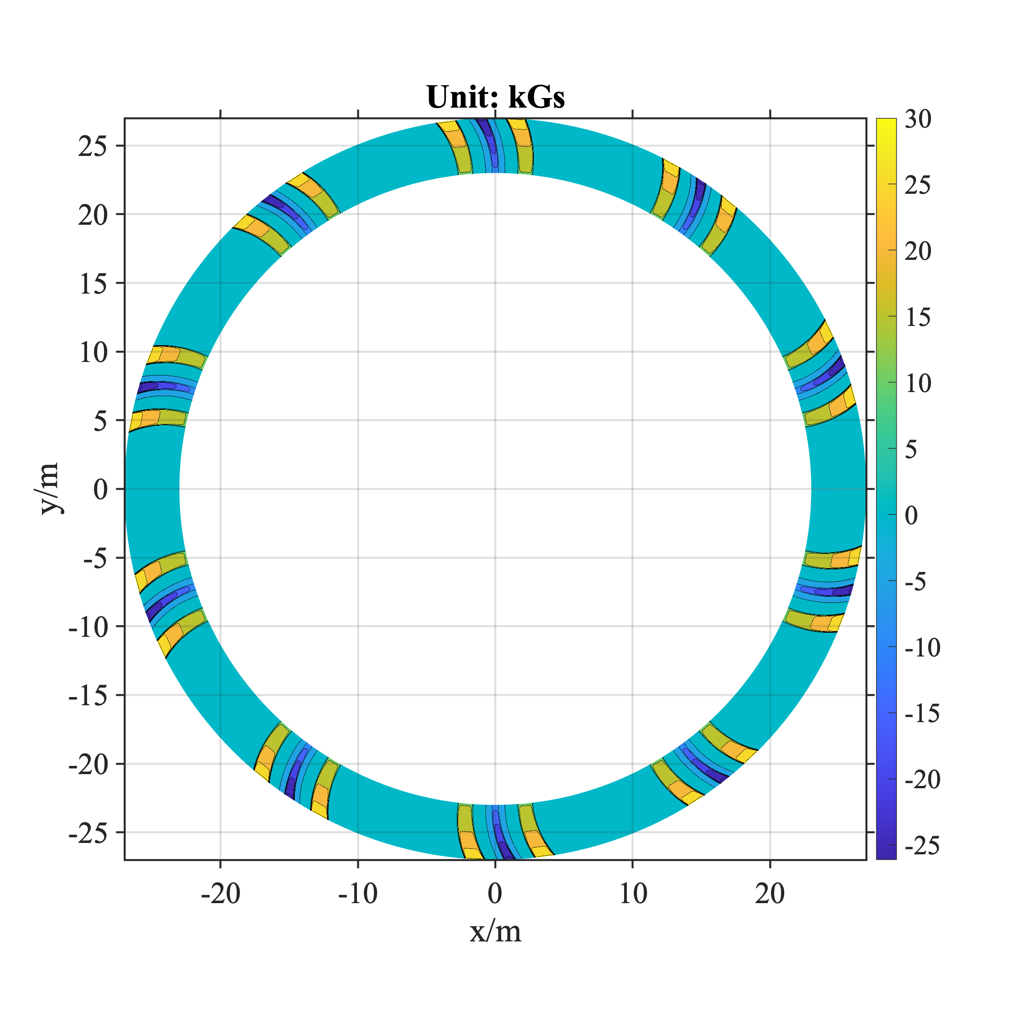
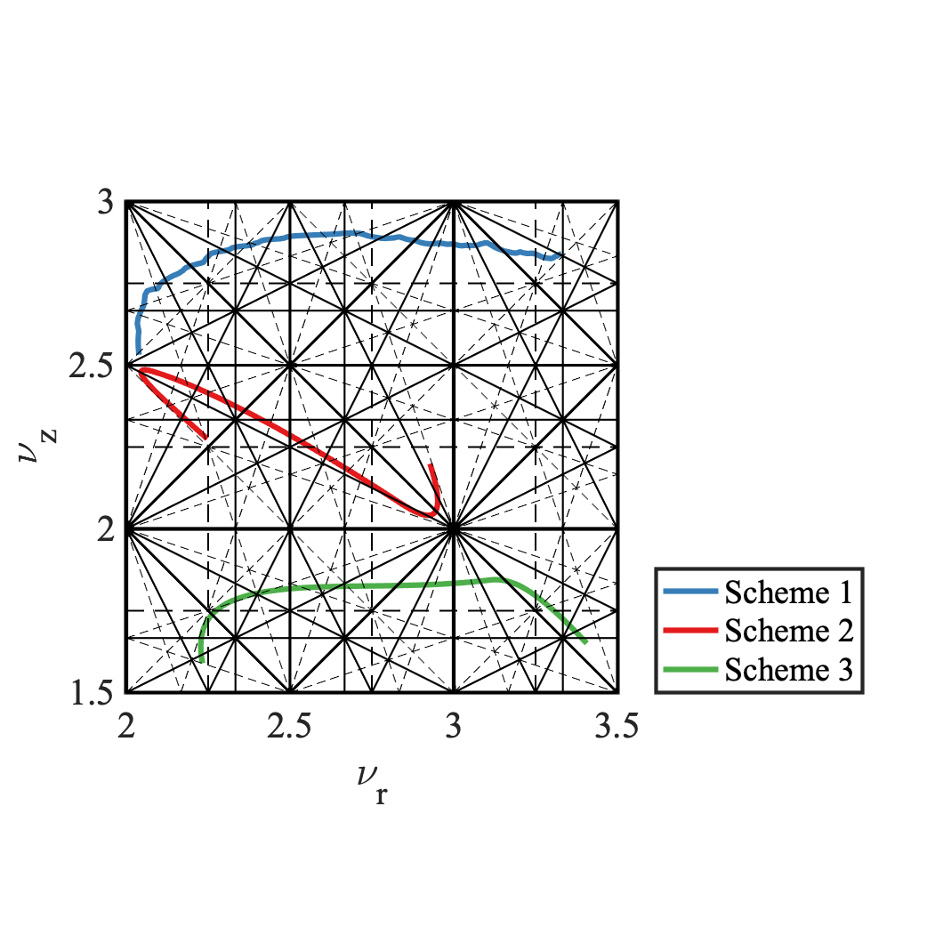
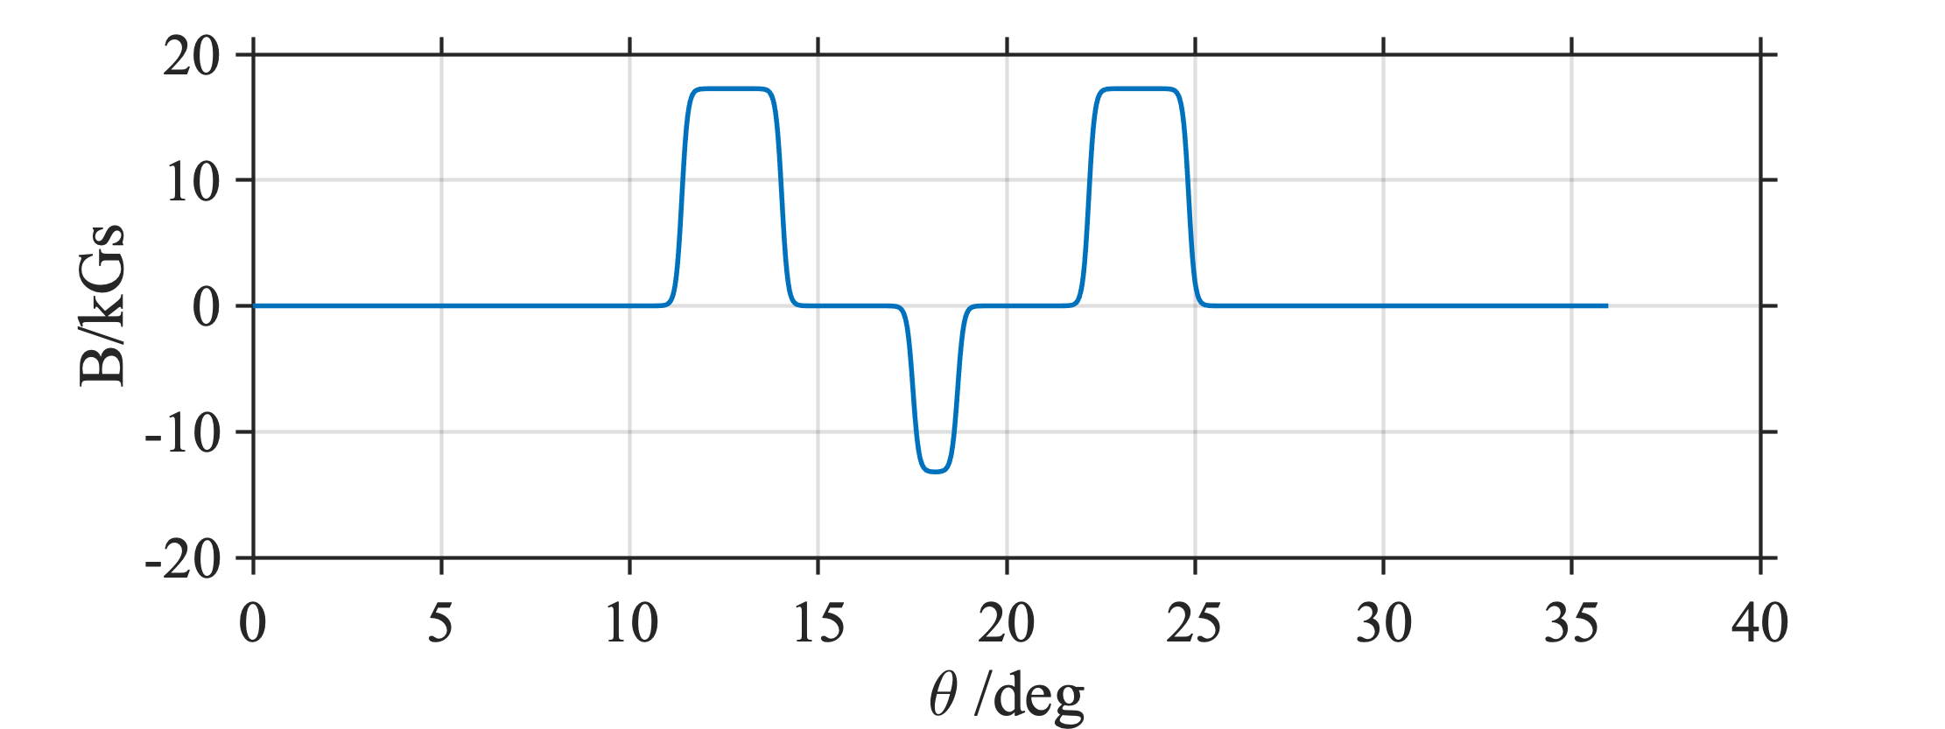

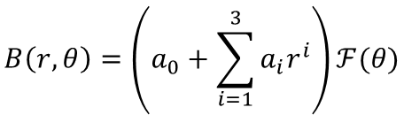
Basic beam dynamics and resonance study
Field distribution
2GeV FFA tune diagram
Parameters | Scheme 1 | Scheme 2 | Scheme 3
Extracted energy/GeV | 2 | 2 | 2
F magnet radius/m | 23.3~26.8 | 18.2 ~20.9 | 17.6~19.4
D magnet radius/m | 23.3~26.8 | 18.2 ~20.9 | 17.6~19.4
Focusing field/T | 1.5~2.7 | 1.56~2.62 | 1.57~2.66
Defocusing field/T | 1.0 ~2.4 | 1.77~2.51 | 1.15~2.31
Number of lattices | 10 | 10 | 10
RF frequency/MHz | 44.4 | 35.1 | 51.6
Cavity voltage/MeV | 1.2 | 1.5 | 1.5
Harmonic number | 26 | 16 | 22
Number of cavities | 10 | 15 | 15
Turn separation for the extraction/cm | 1.5 | 1.5 | 2
径向三阶调变磁场梯度
Scheme 1
Scheme 2
Scheme 3
边缘场
$$B\left(r,θ\right)=\left(a_{0}+\sum_{i=1}^{3}{a_{i}r^{i}}\right)ℱ(θ)$$
$$F=\frac{1}{1+\exp\left(C_{0}+C_{1}\left(s/λ\right)+…\right)}$$

Slide 19
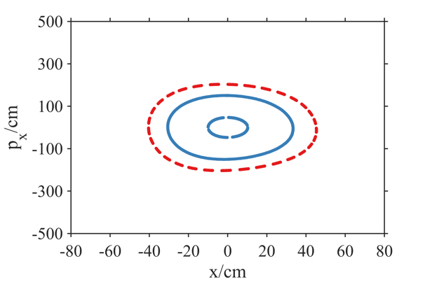
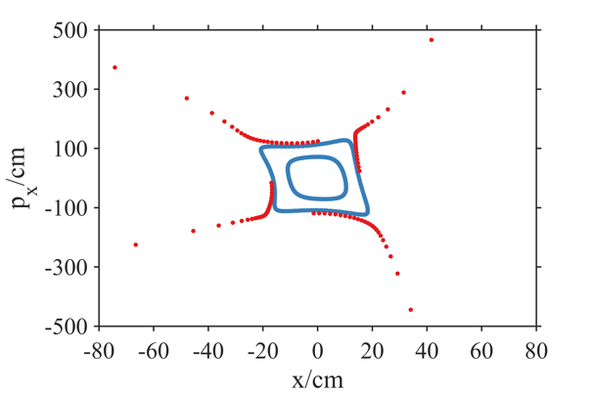
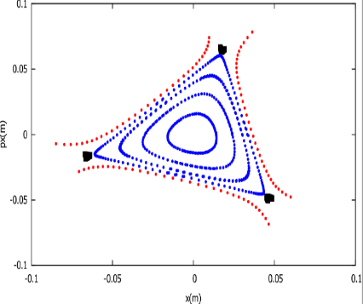
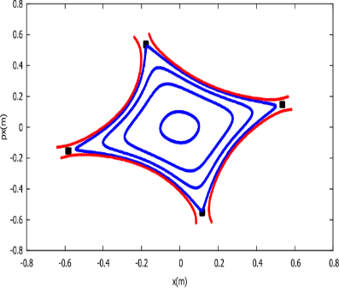
Basic beam dynamics and resonance study
Stable region
10 cell lattice scheme is suitable for 2 GeV isochronous FFA
The physical parameters of the lattice scheme have been determined for all schemes and are proven to be feasible in engineering.
Analyze the phase space of 3rd and 4th inherent resonance during the 2GeV acceleration, and the large transverse phase space acceptance of the accelerator lays the foundation for higher current beam acceleration.
Stable region for Scheme 2
Stable region for Scheme 3
Energy = 800 MeV
4V_{r}=10
3V_{r}=10
4V_{r}=10

Slide 20
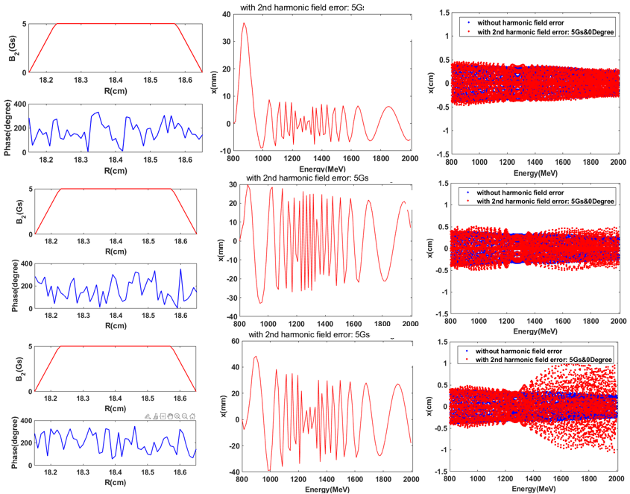
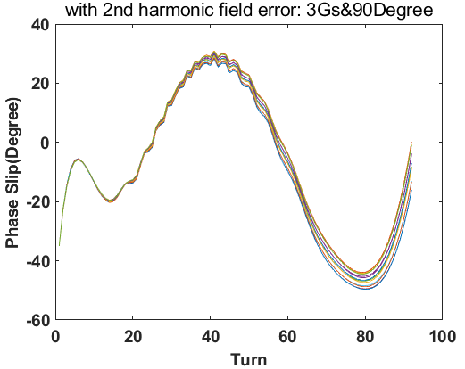
Basic beam dynamics and resonance study
Resonances
𝜈_{r}=2 would cause radial and longitudinal coupling effect.
The 𝜈_{r}=2 resonance line will excite the overall oscillation of bunches, and bunches will be stretched longitudinally, resulting in increased energy dispersion.
By adjusting the phase of B₂ properly, the beam can be centered.
Resonance Suppression Method

Slide 21
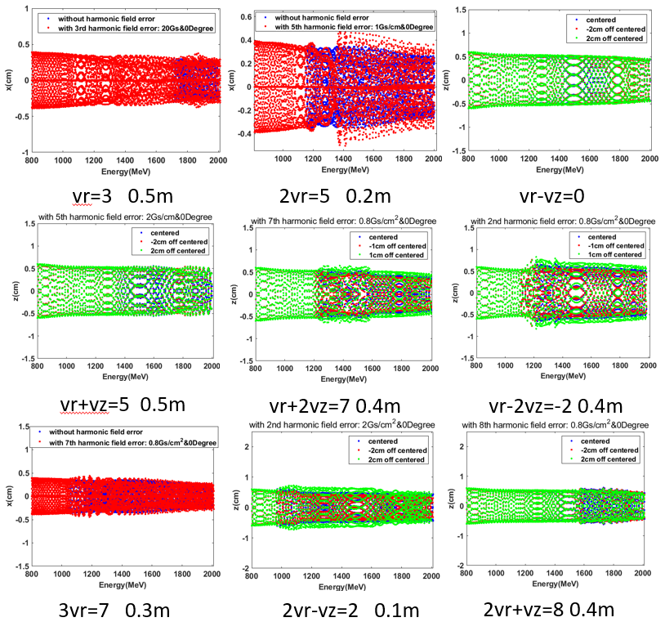
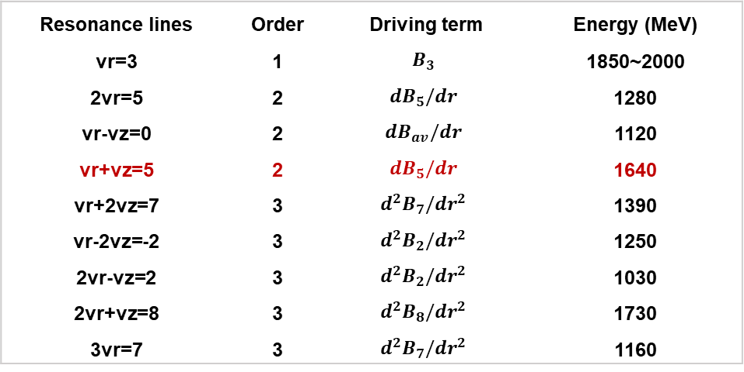
Basic beam dynamics and resonance study
Resonances
10 cell lattice scheme is suitable for 2 GeV isochronous FFA
Driving terms of the resonance excited by 3rd and lower order imperfection field are summarized, and the results ensures that the influence of the resonance excited by magnetic field is controllable.
Numerical simulation for resonance study
Resonance lines | Order | Driving term | Energy (MeV)
vr=3 | 1 | $$B_{3}$$ | 1850~2000
2vr=5 | 2 | $${dB}_{5}/dr$$ | 1280
vr-vz=0 | 2 | $${dB}_{av}/dr$$ | 1120
vr+vz=5 | 2 | $${dB}_{5}/dr$$ | 1640
vr+2vz=7 | 3 | $${d^{2}B}_{7}/{dr}^{2}$$ | 1390
vr-2vz=-2 | 3 | $${d^{2}B}_{2}/{dr}^{2}$$ | 1250
2vr-vz=2 | 3 | $${d^{2}B}_{2}/{dr}^{2}$$ | 1030
2vr+vz=8 | 3 | $${d^{2}B}_{8}/{dr}^{2}$$ | 1730
3vr=7 | 3 | $${d^{2}B}_{7}/{dr}^{2}$$ | 1160

Slide 22
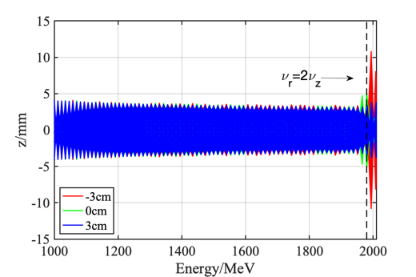
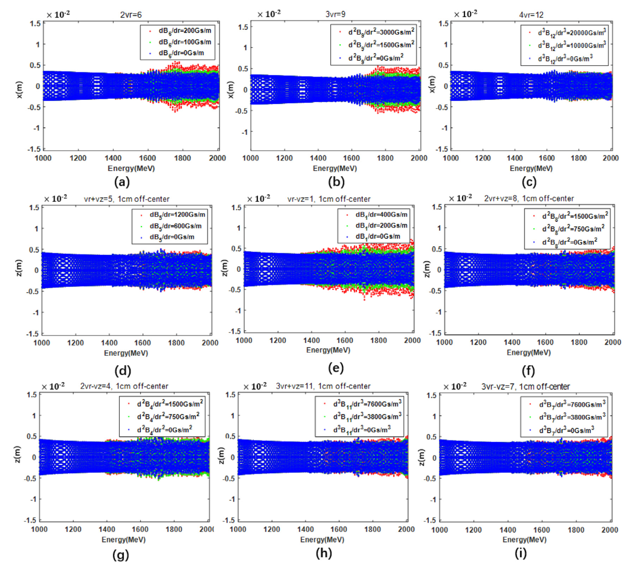
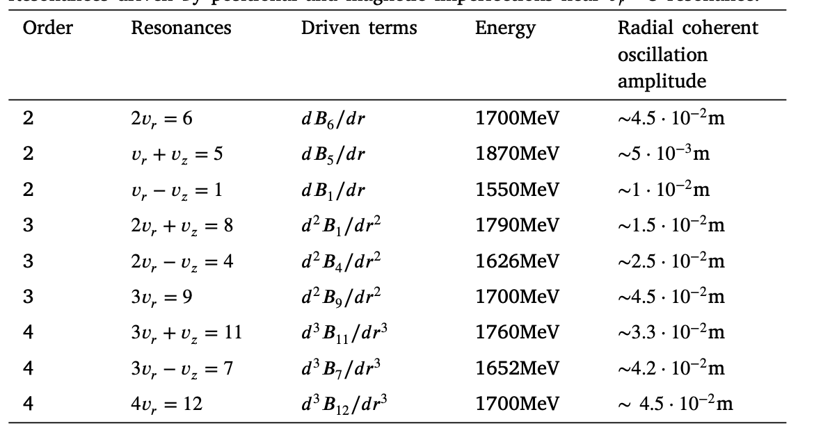
Resonance study – Scheme 3
Resonances
10 cell lattice scheme is suitable for 2 GeV isochronous FFA
Although we introduce large driving terms, the radial and axial beam size are not significantly blown up. Radial resonance lines which mainly destruct the radial beam envelope are shown from plot (a) to (c).
Simulation with imperfection
Vr-2Vz=0
Walkinshow resonance, off-center ~3 cm
2Vr+2Vz=10
But some of them are not mentioned, like Vr-Vz=1. Sextupole resonance of Vr-2Vz=0, and the octupole sum resonance of 2Vr+2Vz=10 should be very strong.

Slide 23
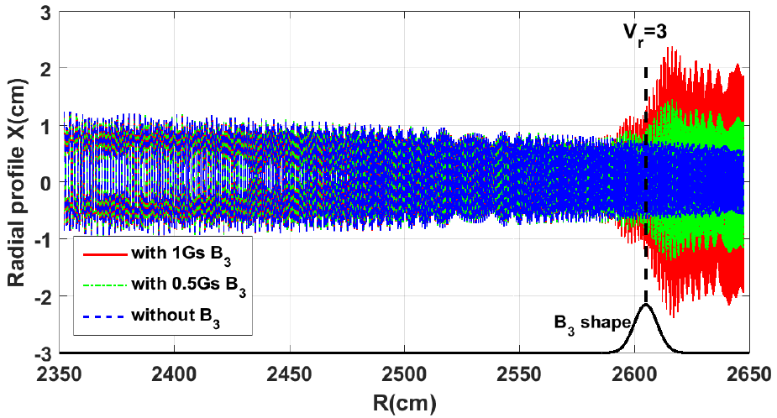
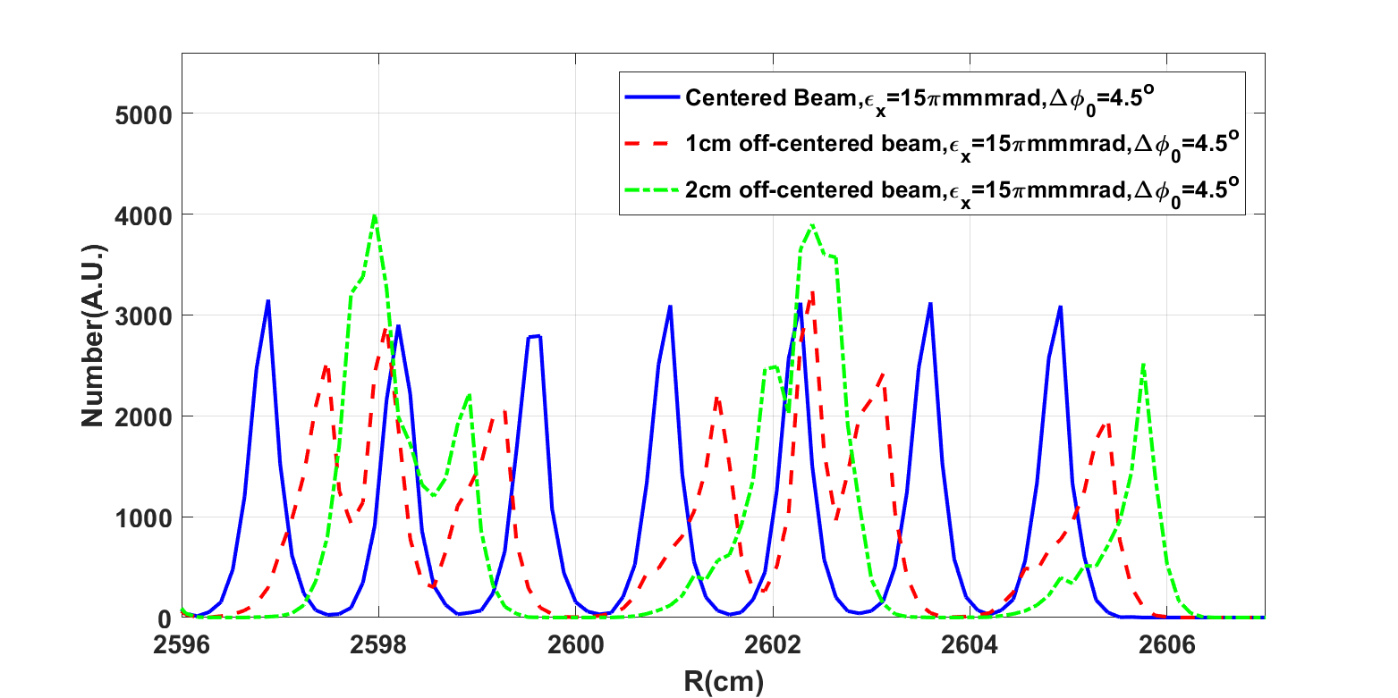
Possible solutions for extraction
Extraction
Three options for beam extraction (1)
Option 1: Crossing through the 𝜈_{r}=3 integer resonance, and utilizing one of half-integer resonances for extraction.
The Vr=3 resonance is the most serious resonance line affecting the beam current. The third harmonic of 1 Gs will cause the beam envelope to increase by 2~3 times
Half-integer resonance extraction is a relatively mature scheme in isochronous circular accelerators, and the turn separation is doubled. But the introduction of half-integer resonance in 2 GeV FFA needs to pass through 𝜈_{r}=3 integer resonance first.
(1) Half-integer resonance extraction
Scheme 1
Septum
Scheme 2
Scheme 3
Septum
The requirement for magnetic field error is too challenging in engineering.

Slide 24
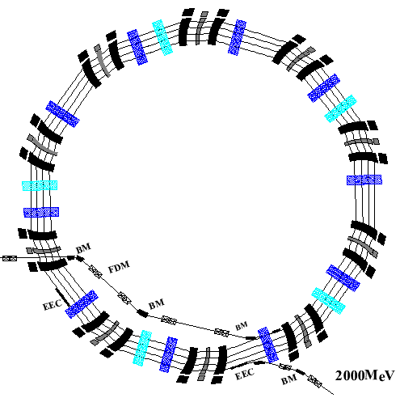
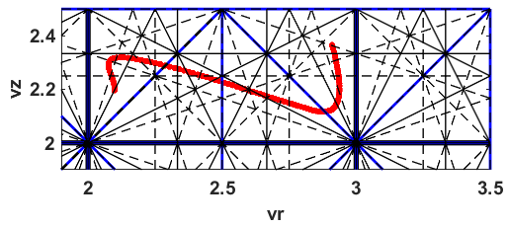
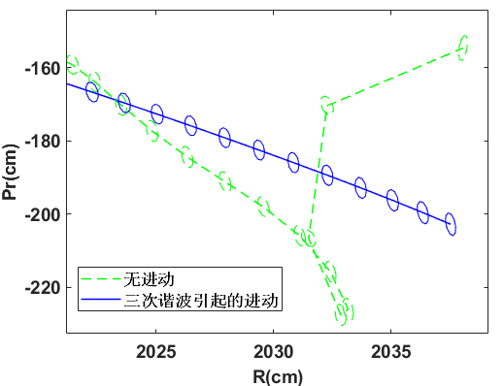
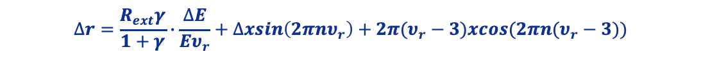
Possible solutions for extraction
Extraction
Three options for beam extraction (2)
Option 2: Avoiding and utilizing the 𝜈_{r} =3 integer resonance, introducing harmonic magnetic field for precession extraction.
It is beneficial to arrange injection and extraction components based long drifts. And the number of cavities is increased from 10 to 15, and turn separation is enlarged from 10 mm to 15 mm.
Adjusting the working path of the extraction area, and controlling 𝜈_{r}≈3 resonance to drive radial oscillation. Turn separation generated by precession can be increased to more than 30 mm.
Integer resonance and precession extraction
$$∆r=\frac{R_{ext}γ}{1+γ}∙\frac{∆E}{Eυ_{r}}+∆xsin\left(2πnυ_{r}\right)+2π(υ_{r}−3)xcos(2πn(υ_{r}−3))$$
Energy gain
nonlinear resonance
Precession due to integer resonance
Cavity
V_{z}
Long drift
Septum
V_{r}
Longitudinal defocusing phase and reasoance precession leads to beam envelope growth

Slide 25
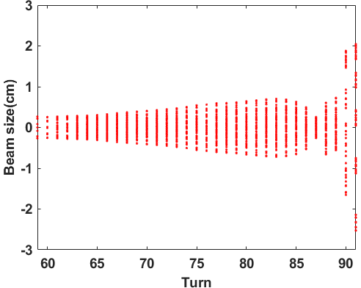
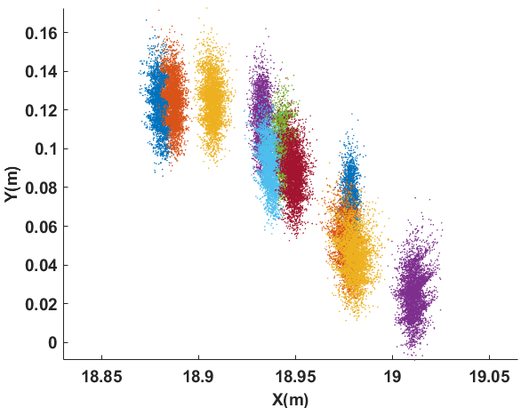

Possible solutions for extraction
Extraction
Three options for beam extraction (2)
In order to avoid crossing the resonance 𝜈_{𝑟}=𝟑, there is a certain phase shift with RF system near extraction region.
The phase width and energy dispersion of the beam increase during extraction, which causes the beam envelope increases to a certain amount during precession extraction.
Septum
Extraction
Three options for beam extraction (3)
The emittance of the injected beam is selected as 2.2 mm*mrad, the phase width is ±3°, the beam envelope is about 2.5 cm.
It can be seen that placing the ESD at a position with a radius of 1899.5 cm is conducive to a high-efficiency extraction
Partical distribution on radial probe
Septum

Slide 26



Parallel computing and code opimization
Parallel computing
Software development and algorithm optimization
Adaptive mesh refinement (AMR) is within OPAL code.
AMR in OPAL (Left) and the large domain size in radial and longitudinal direction for the case of FFA (Right).
AMR Flow chart after modification
Start
Yes
The modified algorithm deletes the domain mapping process and changes the grassroots area 𝛺0 according to the change of the boundary value of bunches.
Yes
end

Slide 27



Parallel computing and code opimization
Parallel computing
Software development and algorithm optimization
Simulation time comparison
Simulation result comparison
brings about an increase in the overall time spent
When the time other modules cost is not changed, time spent on solving the poisson equation accounts for the majority of numerical simulation.
The results of the newly developed algorithm AMR_NEW are more close to FFT.
Before modification
After modification
Emmitance
 | MX/Y/Z | Total/s | Regrid/s | Solve/s | Map/s
AMR | 32/32/4 | 228.6 | 0.84 | 220.2 | 0.035
AMR_NEW | 32/32/4 | 115.5 | 3.16 | 103.22 | 0.02
RMS size
Better performance for the case with large domain size in radial and longitudinal direction
Beam location

Slide 28




Parallel computing and code opimization
The followings are the compared results with and without the space charge effect, with and without flattop cavity in more detail.
The followings are the compared results with and without the space charge effect, with and without flattop cavity in more detail.
Initial conditions:
Emittance is 2 𝜋 mm⋅mrad
Phase width is 3°
Beam size ~2cm, turn separation up to 3cm.
The amplitude and phase of 3rd harmonic flat-top cavity need to be improved. And with neighbouring bubnches effect, cleaner extraction is expected.
0 mA, 16382 macro particles, without flat-top cavity
3 mA, 16382 macro particles, without flat-top cavity
6 mA, 16382 macro particles, without flat-top cavity
6 mA, 16382 macro particles, with flat-top cavity

Slide 29
Plan of Talk
1
General consideration and overall design
2
Beam dynamics and parallel computing
3
RF system & HTS magnet
4
Possible muon application
5
Summary

Slide 30
RF system Design
RF system
Specification and Key parameters
Main & Auxiliary Cavity: for acceleration
Layout of 2 GeV FFA
10 to 15 sets of accelerating Cavities are needed. Each cavity runs at a 1MW power level, providing ~1MV acc. Voltage, and is loaded with ~600kW beam.
Flat-top Cavity: essential for a better beam
Flat-top cavities are discovered to be essential in multi-bunch beam simulation. The basic idea is to absorb or dump power from the beam. The massive beam power is why 3 to 5 cavities are needed. The phase of each cavity should be aligned to the fundamental.

Slide 31

RF SubSystem Design
Amplifier
The 1.5MW Tetrode will be driven by a 100kW solid-state Amp.
A three-stage amplification chain is needed to drive the cavities. The first two are solid-state amplifiers up to 100kW. The last one is tetrode based, capable of providing 1.5MW RF Power.
The RF system will start with self-excitation mode. Later on, the cavities phase will be locked to an external reference for beam acceleration. A full digital Low-level RF controller will be used.
Heavy beam loading is a challenge to the stability
of the Main RF, and even more difficult for Flat-top system

Slide 32


RF Amplifier Preliminary Design
Amplifier
The 1.5MW Tetrode will be driven by a 100kW solid-state Amp.
For the IPA, the solid-state design is used, and the advanced technology of LDMOS with reflect power protection and adequate redundancy is applied.
Driven Stage
Final Stage
For the FPA, the tetrode-based design is used. To guarantee the stability of the FPA output, the ground grid configuration is adopted.
Solid-state for 100kW driven and 1.5MW Tetrode for the FPA

Slide 33

LLRF system Preliminary Design
LLRF
A direct RF sampling control is studied for Self-excited Loop
The single gap cavity may suffer from Lorentz Force Detuning. Therefore a self-excited compliable RF control is pursued.
Direct RF sampling digital control
Voltage Stability: 1X10⁻⁴
Phase Stability: ±0.1°
Hardware & technology for direct RF sampling is mature enough these years to make it possible.
For this purpose, the dedicated control module, as shown on the right side, was developed for this purpose using the FPGA and the SOC (System On Chip) technologies.
Full digital RF control operates in the self-excited loop using FPGA

Slide 34


1:1 Scale Acceleration Cavity Design
Four numerical cavity modules are investigated. 2 of them seem promising. The boat shape has a 20 Mega-ohm shunt impedance and the highest Q value. Various simulations and experiments were carried on to study the boat shape further.
Item | Rectangular | Omega | Racetrack | Boat
Frequency(MHz) | 35 | 35 | 35 | 35
Operating Mode | TM110 | TM110 | TM110 | TM110
Quality Factor | 65880 | 84100 | 96670 | 103700
Shunt Impedance(Max, MΩ) | 5.38 | 10.08 | 19.29 | 20.14
Shunt Impedance(Min, MΩ) | 2.43 | 2.15 | 10.41 | 10.95
Power Dissipation(kW@2MV) | 743 | 397 | 207 | 200
Acceleration Gap Length(m) | 2.8 | 2.8 | 2.8 | 2.85
Acceleration Gap Height(m) | 0.15 | 0.15 | 0.15 | 0.15
Acceleration Gap Width(m) | 0.8 | 0.8 | 0.8 | 0.8
Has it been built before? | Yes, multiple | Yes, PSI ring | Not known | Not known
Mechanical design challenge | Low | High | Medium | High
Tuning Difficulty | Low | Difficult | Medium | Difficult
Highest Energy
Gain per Turn
1,rectangular
2,omega
3,racetrack
4,boat shape
High Q Value，
High Energy Gain per Turn
35 MHz waveguide-type cavities

Slide 35



World-Class
PSI Ring Cyclotron’s
RF Cavity
1:1 Scale Acceleration Cavity Design
Preliminary design of
CIAE 2GeV FFA
boat-shaped cavity
The Q Value
almost doubled
Resonance frequency | Q-value
35.0 MHz | 103700
RF power@ 2MV W/O Beam loading
~200kW
L×W×H=6.91m×2.10m×3.14m
Bigger Cavity, Higher Q Value

Slide 36



1:4 RF Cavity Design and Manufacturing
1:4 scale Cavity: design phase
The RF → Thermal → Structural → RF fully self-consistent closed-loop multi-physics FEM simulation and analysis is done. According to scale law: Frequency is 4 times higher, and Q/R_{sh} is expected to be half.
Q~43500、R_{max}~10MΩ

Slide 37





1:4 RF Cavity Design and Manufacturing
Overall strategy for manufacturing
Sophisticated parts are machined;
EBW is applied in joining all parts;
Surface polishing is handcrafted;
Both the outer elliptical-shaped and inner circular-shaped parts are formed by mold pressing. Due to the existence of the spring back phenomena and the difficulty of finding an accurate reference for the wire-electrode cutting, additional Computer Numerical Control (CNC) machining is needed. Finally, all the dimension errors will be compensated by fine finishing the nosecone according to the measurement during the cavity pre-assembling process for frequency checking.

Slide 38


1:4 RF Cavity Design and Manufacturing
1:4 scale Cavity： Result is promising
Q and R_{sh} are good: reaches 97%; Manufacture is green light; Tuning of the cavity is verified; The vacuum seal is verified; High Power Coupler is verified; High power test is underway.
At 1 atmosphere pressure, two small loop probes with very small coupling coefficients were used to obtain the S21 frequency sweeping curve of the quarter scale cavity, then a loaded quality factor almost equal to the unloaded quality factor Qs can be obtained. It can be known that the unloaded Qs is higher than 42314.3, which is ~97.3% and 96.7% of the calculated values of 43500 and 43700.
Q=42314.3

Slide 39






High-temperature superconducting magnets
B_{f}=0.4221*(r-23.5)³-1.7247*(r-23.5)²+4.7565*(r-23.5)+14.8348
Magnetic field of the F magnet
Orbit range
Magnetic field
of the D magnet
Field distribution between FEM and soft edge model, at r=26.5m in a single cell
B_{d}=-0.6386*(r-23.5)³+2.9921*(r-23.5)²-9.0592*(r-23.5)-4.6466
After obtaining the analytical magnetic field and the basic geometry of the magnets, e.g. the spiral angle, then the magnet design is initiated, to match the field distribution between the FEM and the analytical model

Slide 40




High-temperature superconducting magnets
Magnet key tech: manufacture, mapping & shimming large range pole profile
B_{f}=0.4221*(r-23.5)³-1.7247*(r-23.5)²+4.7565*(r-23.5)+14.8348
B_{d}=-0.6386*(r-23.5)³+2.9921*(r-23.5)²-9.0592*(r-23.5)-4.6466
 | Length/Diam. (m) | Weight (ton) | Magnetic field (T)
F Bend | ~5.4 | ~386 | 1.5~2.7
D Bend | ~5.4 | ~266 | -1.0~-2.4
CYCIAE-100 | 6.2 | 435 | 0.3~1.36
100MeV: 435 ton
Elliptical pole profile of CYCIAE-100 magnet
The weight and dimension of each F / D magnet is equivalent to the main magnet of CYCIAE-100. Considering successful use of elliptical gap in 100 MeV cyclotron to generate radial varying gradient field, the iron magnet of 2GeV FFAG could benefit a lot from the design and construction experience of the room temperature 100 MeV H⁻ cyclotron CYCIAE-100.

Slide 41
High-temperature superconducting magnets
Why High Temperature Superconducting (HTS) coils?
 | Room temperature coil | HTS coil | LTS coil
Radius of FFAG ring | ~34m | ~27 m | ~18m
Radiation resistance | Yes | Yes | No
Power consumption | Very Large | Low, easier to remove heat@30K | Medium, need more cooling power to remove heat@4.2K
Smaller size than room temperature coil magnets, radiation resistant compared to LTS magnets and lower power consumption to get higher energy efficiency of the whole machine.

Slide 42




HTS magnet R&D
Basic idea
Superferric: high energy efficiency and radiation resistance
HTS magnet with large gradient
ReBCO HTS tape has high Bc, Tc and Ic, thus is more stable under the thermal impact from beam loss. And compared to LTS, HTS is a better radiation resistant material.
Iron pole HTS coil
Cryostat
60 K shielding
30 K cold mass
HTS coil：high magnetic field yield compact size；iron pole：magnetic field and gradient modulation in large range.

Slide 43




HTS magnet R&D
General issues
HTS magnet safety, design and shimming scheme
Heat load and the quench protection of large HTS magnet
Gradient modulation in large range in radial direction is achieved by varying the pole gap of HTS magnet.
Field shimming by change the height of the gap, width of the pole. Change the spiral angle and trim coil to adjust the local tune diagram
HTS tape is co-winding with stainless steel, thus the HTS coil can be self-protected during quench by bypassing the current.
Quench detection is based on voltage probes and is interlocked with the power supply.
Heigh of the gap
未见明显增长
Width and spiral angle of the pole
Field shimming by using the combination of degrees of freedom with less influence on the working diagram.

Slide 44









HTS magnet R&D
Multiphysics
EM, thermal, quench and mechanical simulation
Influence of support links and tolerance on beam dynamics
Manufacturing process flow of high temperature superconducting coil
Multiphysics simulation considering the thermal, electromagnetic, mechanical coupling effect; position adjustment method of coil.
Installation of support links and the upper shielding
Single pancake coil winding & test
HTS coil installation
Installation of upper shielding
Installation of upper OVC
Installation of 300K OVC
Installation of magnet

Slide 45






HTS magnet R&D
HTS Coils
Metel-insulation HTS double pancake was wound and tested
Ramping under liquid nitrogen immersion
Hall probe
bubble chamber
Terminal voltage measurement
HTS coil
Current source
B-I curve
Ramping history

Slide 46





HTS magnet R&D
1:4 Magnet
HTS coils are assembled with iron yoke
Variable gradient field of 1:4 scaled supperferric magnet is measured
I=243A，field>2T
Voltage<0.3mV
3rd order pole face
I/A | B/Gs | Voltage/mV |  |  |  |  |  | Temp
 |  | 1# | 2# | 3# | 4# | 5# | 6#
0 | 0.0 | 0 | 0 | 0 | 0 | 0 | 0 | 24.3K
10 | 2820 | 0 | 0.1 | 0.2 | 0.1 | 0.1 | 0 | 24.3K
20 | 5764 | 0 | 0 | 0 | 0 | 0 | 0 | 24.3K
30 | 8554 | 0.1 | 0.3 | 0.2 | 0.2 | 0.2 | 0.1 | 24.3K
40 | 10494 | 0 | 0 | 0 | 0 | 0 | 0 | 24.2K

Slide 47
Plan of Talk
1
General consideration and overall design
2
Beam dynamics and parallel computing
3
RF system & HTS magnet
4
Possible muon applications
5
Summary

Slide 48

High Power Proton FFA and Heavy Ion LINAC Accelerator Complex
Muon Experimental Terminal

Slide 49

Muon properties and decay
Better precisions
Looking for anormalies
Intrinsic Muon Properties
  Gyromatic ratio (g-2)
  Mass
  Lifetime
  EDM

Slide 50



Mu2e/COMET
Proton Beam：8GeV@8kW
Time Structure: 200ns pulse separated by 1695ns
Going to start…

Slide 51
Mu2e @ 2GeV/6MW
Construct the pulsed structure:
  200ns pulse separated by 2000ns
  2GeV/ 600kW
Use the same target and detector system
Need to investigate the background
Rough estimation：
Increase the sensitivity by 2 orders of magnitude！
Par. | Mu2e@Ferimilab | Mu2e@CIAE
Running time | 3y | 3y
POT/y | 1.2×10²⁰ | 4.4×10²²
Muon yield | 0.0019 | ~5×10⁻⁴
Capture rate | 0.609 | 0.609
Detector acceptance | 0.08 | 0.08
Sensitivity | 3×10^{–17} | 3.11×10^{–19}

Slide 52


Muon g-2
Fermilab:
  Muon Evergy: 3.094 GeV/c
  dp/p < 0.5%
  Muon rate: 10^4 muon/s
  Total >1.8*10^11 to 0.14ppm
J-PAC:
  300 MeV/c, starting from eV energy.
  Moderate surface muons at a rate of 1E8/s
    Expected muon rate 3E5/s, in case a powerful laser can be achieved.
    Total > 2E12 to 0.14 ppm
g-2 @ 2GeV/6MW, 1E9 μ⁺/s can be expected,
IMPROVE BY 1 ORDER OF MAGNITUDE

Slide 53
Plan of Talk
1
General consideration and overall design
2
Beam dynamics and parallel computing
3
RF system & HTS magnet
4
Possible muon applications
5
Summary

Slide 54
Summary
A CW FFA is proposed by CIAE to produce a 2GeV/6MW proton beam.
Beam dynamics results show good isochronism towards 2 GeV and have a very large phase space acceptance. The turn separation can be increased to ~3 cm with 5 additional cavities and off-centered injection, which seems to be enough for single turn extraction and for providing pulsed beam.
R&D Activities for key components, including the 1:4 HTS magnet and the high energy efficiency RF system, are finished for the 2 GeV high power CW FFA accelerator complex.
Some potential muon applications are exciting based on 6 MW proton beam. We are looking forward to more users and cooperation.

Slide 55
Thanks for your attention!

