Slide 1
Workshop on Muon Science Technology and Industry (MELODY 2023)
μSR study on the magnetic frustrated systems with triangular lattice and honeycomb lattice
Gaoting Lin
Jie Ma’s group
2023-11-05
Notes:
Good morning, everyone. Firstly, thank you very much to the conference team! As a user of uSR, I’m very glad to introduce my some works about the uSR study on the magnetic frustrated systems with triangular lattice and honeycomb lattice.

Slide 2
01
Introduction
章节
目录
1) Magnetic geometrical frustration and QSL
2) Kitaev QSL and Na₂Co₂TeO₆
References: The Innovation 4, 100484, (2023); Nat. Commn. 12, 5559, (2021); Nat. Phys. In review, (2022) DOI: https://doi.org/10.21203/rs.3.rs-2034295/v1.
CONTENTS
02
μSR study on QSL candidates
1) PRB 106, 085115 (2022): μSR on NaYbSe₂
2) Unpublished: μSR on Na₂Co₂TeO₆
03
Summary
Notes:
The main content of the report is divided into the following parts. When it comes to QSL, maybe we need to introduce the understanding of quantum magnetism and frustration. I also use this as a starting point to introduce the topic of today's report. Based on our uSR and neutron scattering experimental results, I will introduce the magnetic ground state of NCTO, a possible multi-domain zigzag antiferromagnetic order at zero field. Finally, summarize the research results.

Slide 3
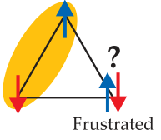
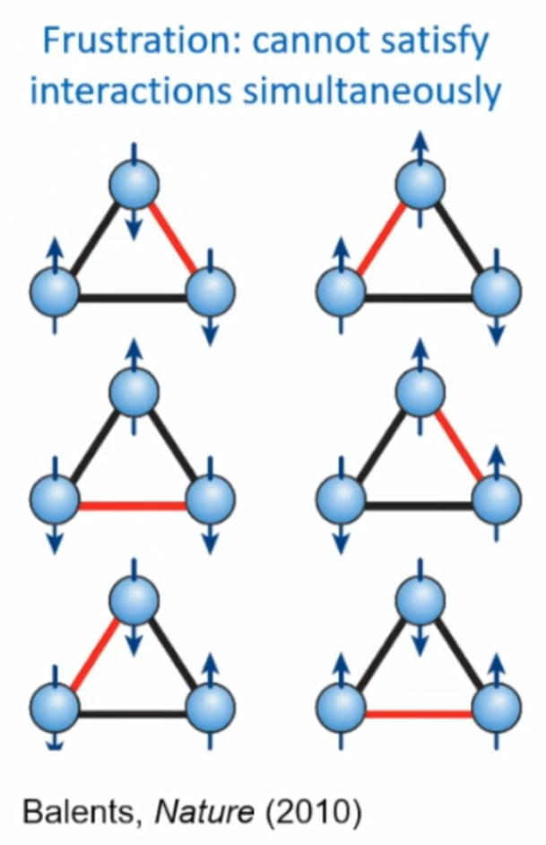
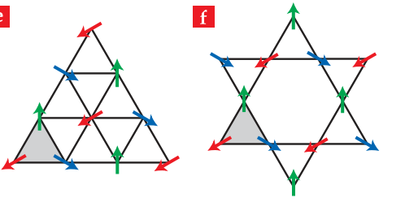
Quantum magnetism and magnetic geometrical frustration
Ising interaction in triangular lattice
J < 0
J > 0
120° AFM order
Takashi Imai and Young S. Lee, Physics Today 69, 30 (2016)
Notes:
We know, in a non-frustrated cubic lattice, when considering only the nearest neighbor interaction and hosting Ising type exchange, the material will exhibit magnetic order when the temperature is down to phase transition temperature, as shown in the two classical ferromagnetic and antiferromagnetic orders.
If the Ising type spin arrangement exhibits significant antiferromagnetic exchange interaction in triangular lattice, the three nearest neighbor spins will compete. when the spins of two lattice points is antiparallel arrangement, the spins on the third lattice point will show various forms of combinations, which may exhibit highly degenerated ground states. This will induce magnetic geometric frustration, thereby the ground state may present some novel quantum phenomena. Of course, it is also possible to have a 120 degree antiferromagnetic order similar to the one shown in the figure.

Slide 4
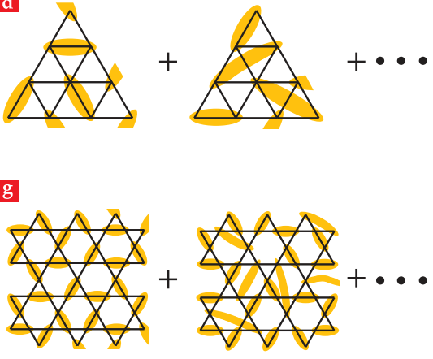
Quantum spin liquid (QSL)
Singlet
Ising interaction in triangular lattice
Three characters:
1) No long-range order;
2) Fractional excitations;
3) Long-range quantum entanglement;
4) Beyond the conventional Landau paradigm for phase transitions and spontaneous symmetry breaking.
Applications:
1) Understanding the mechanism of high-T superconductivity;
2) Fractional excitations for topological quantum computing.
Gaoting Lin and Jie Ma, The Innovation 4, 100484, (2023);
Takashi Imai and Young S. Lee, Physics Today 69, 30 (2016).
Notes:
Having strong geometric frustration and presenting strong quantum fluctuations will lead to the behavior of quantum spin liquid in the ground state. QSL was first proposed by Anderson as a resonant valence bond model. After half a century of development, the current understanding of QSL is still based on this pattern. QSL has the following characteristics: 1) No long-range order; 2) Fractional excitations; 3) Long-range entanglement; 4) Beyond the conventional Landau paradigm for phase transitions and spontaneous symmetry breaking. The potential applications will help to understand the mechanism of high-T superconductivity and promote the development of topological quantum computing.

Slide 5
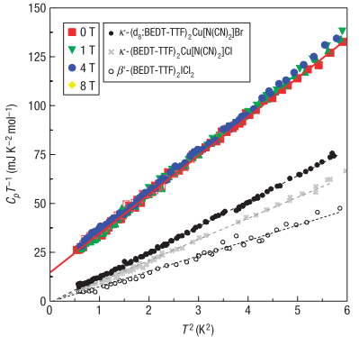
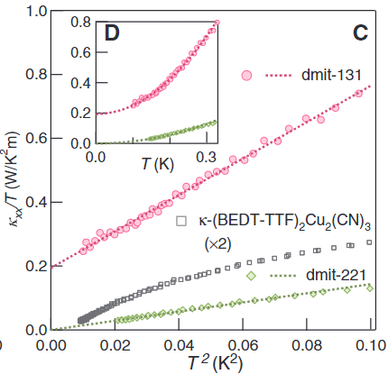
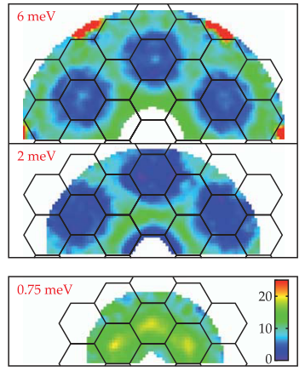
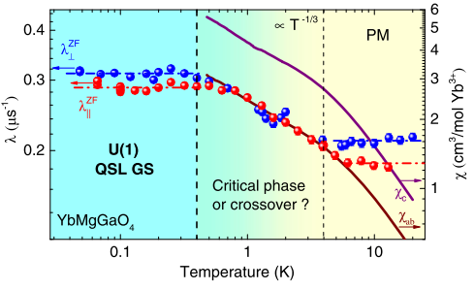
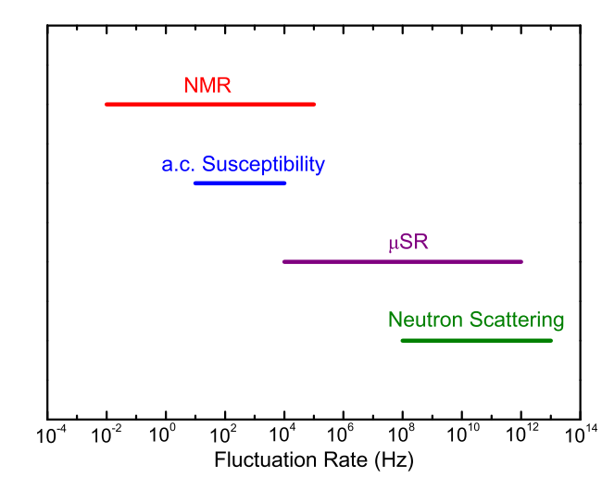
How to identify a QSL?
Step Ⅰ: Role out magnetic order, spin glass
Magnetic susceptibility, specific heat, μSR, NMR, neutron scattering, and so on.
Step Ⅱ: Detect the spinon excitations
Heat capacity
Thermal conductivity
Neutron scattering
μSR
κ-(BEDT-TTF)₂Cu₂(CN)₃
YbMgGaO₄
PRL 117, 097201 (2016)
Nat. Phys. 4, 459 (2008).
Science 328, 1246 (2010).
ZnCu₃(OD)₆Cl₂
Nature 492, 406 (2012).
Notes:
Usually, the macroscopic measurements of magnetic susceptibility, thermal conductivity, and specific heat are traditional techniques for distinguishing whether a QSL phase exists. Furthermore, the microscopic probes that are sensitive to the local magnetism, for example, muon spin relaxation (µSR) and nuclear magnetic resonance (NMR). As shown examples, the power-law linear dependent behavior from heat capacity and thermal conductivity, the continuum excitations from inelastic neutron scattering, and the temperature-independent plateaus from the uSR, all these observations indicate the QSL states. The different fluctuations rates indicate the mutual verification of various experimental observations will be more helpful to identify possible QSL ground state.

Slide 6
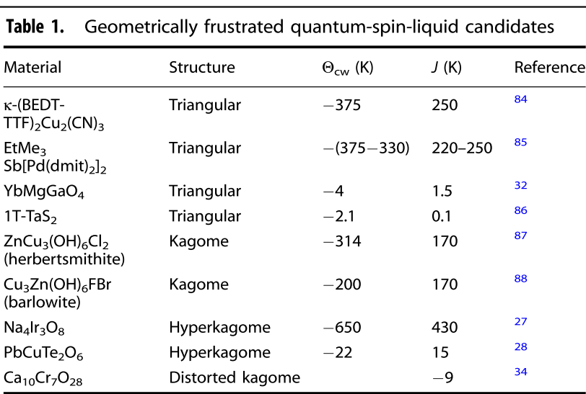
QSL candidates in two-dimension system
Jinsheng Wen et al., npj Quantum Materials 4, 12 (2019)
Note: NaYbO₂, two-dimensional triangular Dirac spin liquid, M. M. Bordelon et al., Nat. Phys. 15, 1058 (2019).
NaYbSe₂, two-dimensional triangular spinon fermi surface spin liquid, Peng-Ling Dai et al., PRX 11, 021044 (2021).
Notes:
In fact, in two-dimension QSL candidates, researchers have find many potential QSL candidates，as shown in the label. In addition, Recently, there has been extensive research on the family of ytterbium systems without magnesium/gallium site disorder.

Slide 7
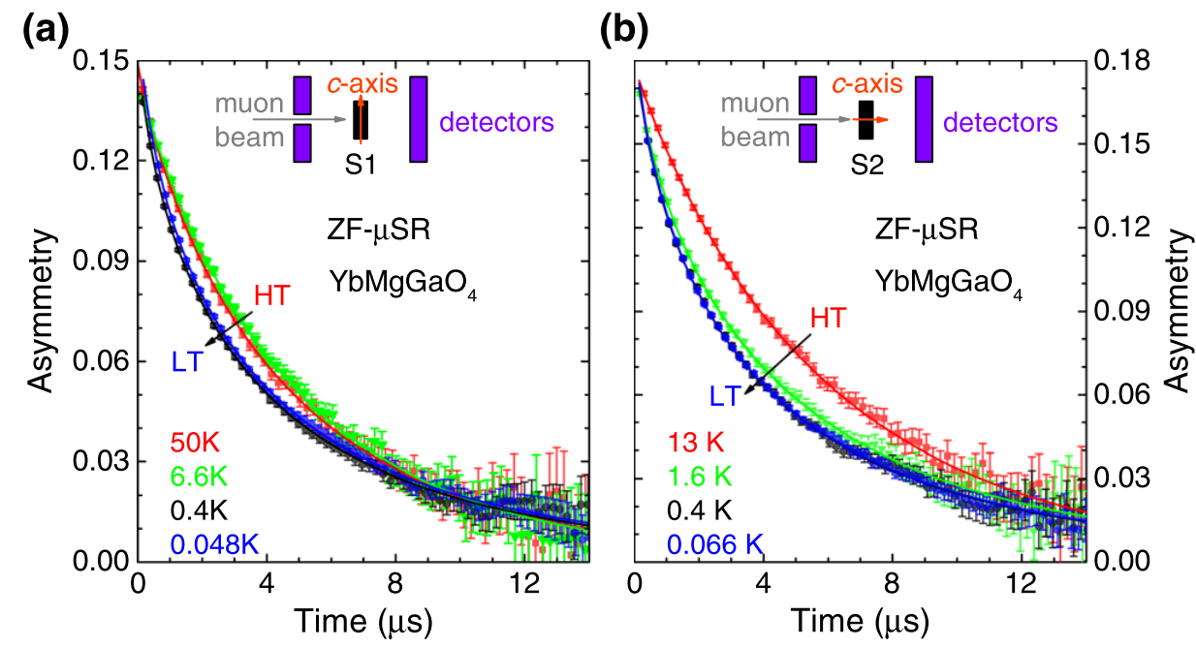
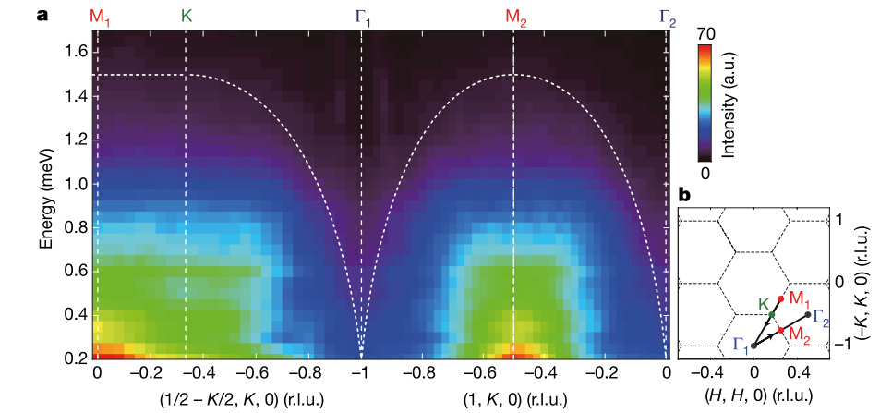
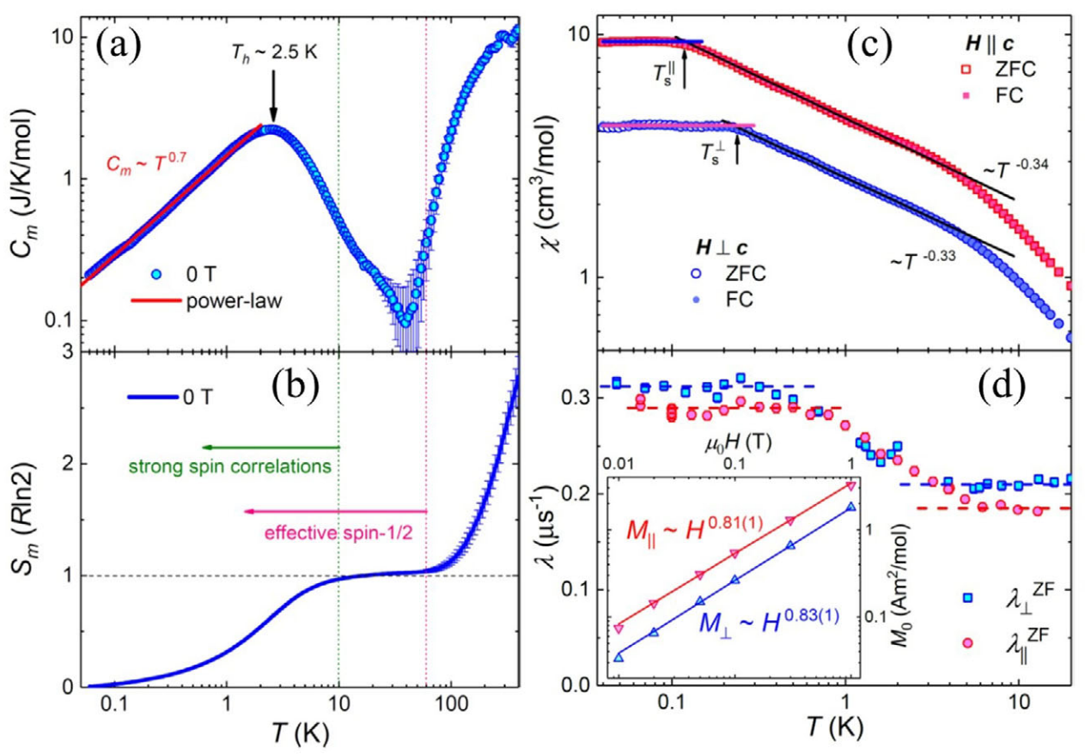
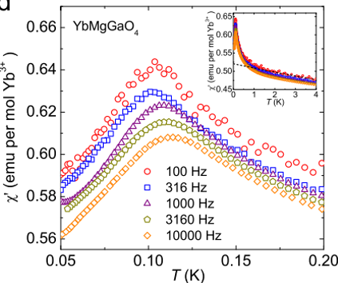
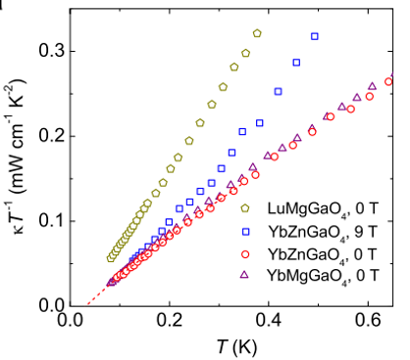
QSL candidates in two-dimension system: YbMgGaO₄ (YMGO)
(a) QSL’ evidences:
C_{m} ≈ T^{0.7},below ≈2K,suggesting gapless low-energy spin excitations;
the 𝜇SR spectra show no spin freezing down to 48 mK with robust dynamics and strong (zero-point) quantum fluctuations;
Continuous spin excitations.
(b) Evidences against QSL:
AC susceptibility measurements, which show strong frequency-dependent peaks around 0.1K, characteristic of a spin glass
Thermal conductivity indicates no contribution from magnetic excitations.
Yuesheng Li, PRL 117, 097201 (2016)
Yao Shen et al., Nature 540, 559 (2016);
Yuesheng Li, Adv. Quantum Technol., 1900089 (2019);
Jinsheng Wen et al., npj Quantum Materials 4, 12 (2019).
Notes:
As 2D promising QSL candidates, YMGO has the large-size single crystals, which meets the requirements of various experimental technologies. As shown in the picture, magnetic specific heat shows the linear-temperature-dependence behavior; the 𝜇SR spectra show no spin freezing down to 48 mK with robust dynamics and strong quantum fluctuations; Continuous spin excitations can be observed by INS. These experimental observations indicate the possible QSL ground state in YMGO. However, AC susceptibility measurements show strong frequency-dependent peaks around 0.1K, indicating feature of a spin glass; Thermal conductivity indicates no contribution from magnetic excitations. These experimental observations are against QSL. Why? These differences may be originated from the nonmagnetic magnesium/gallium site disorder of intrinsic issues.

Slide 8
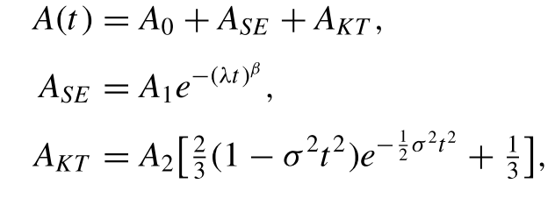
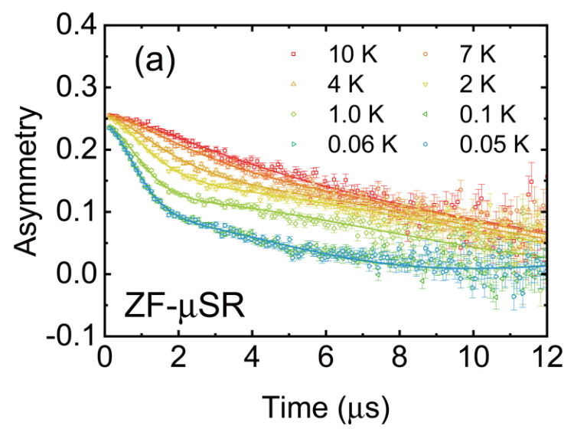
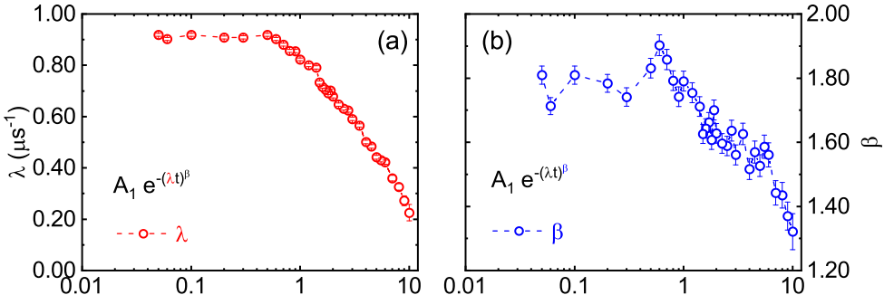
μSR study of NaYbSe₂ (NYS) using the MuSR spectrometer at ISIS
No oscillation is seen in the ZF-μSR spectra down to 50mK;
No spin-glass-like freezing
Both λ and β go up to a plateau below 0.3 K, indicating the emergence of a stable magnetically disordered QSL ground state.
Zheng Zhang, …, Jie Ma, PRB 106, 085115 (2022)
Notes:
Another 2D representative QSL candidates, NYS has a simpler structure and avoids the issue of magnesium/gallium site disorders. In NYS, Our group also observe some QSL evidences by the uSR, supporting the magnetic disordered state with strong quantum fluctuations.

Slide 9
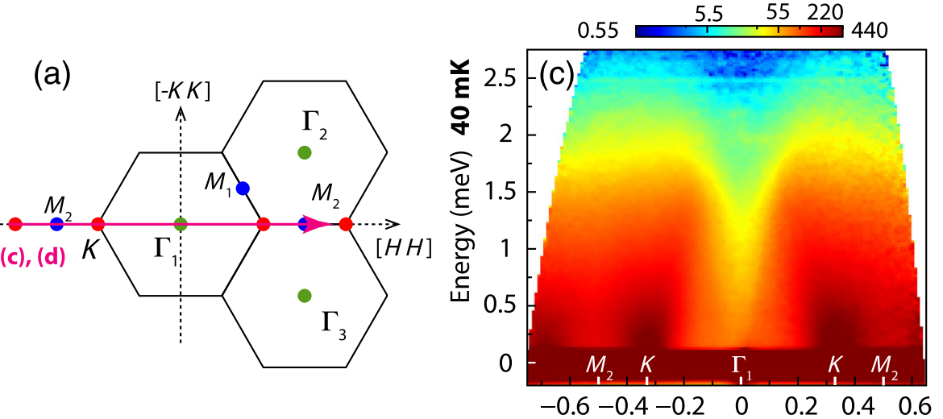
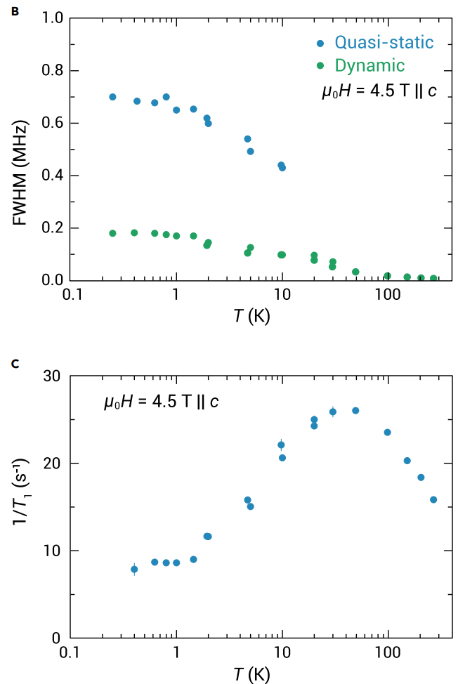
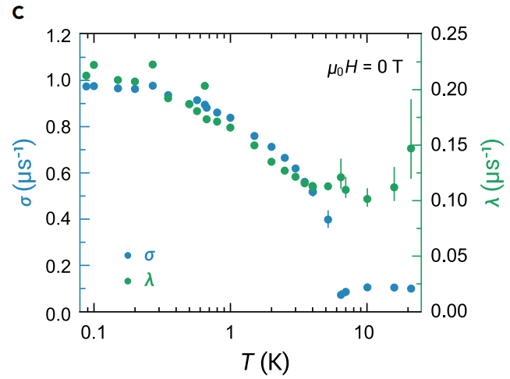
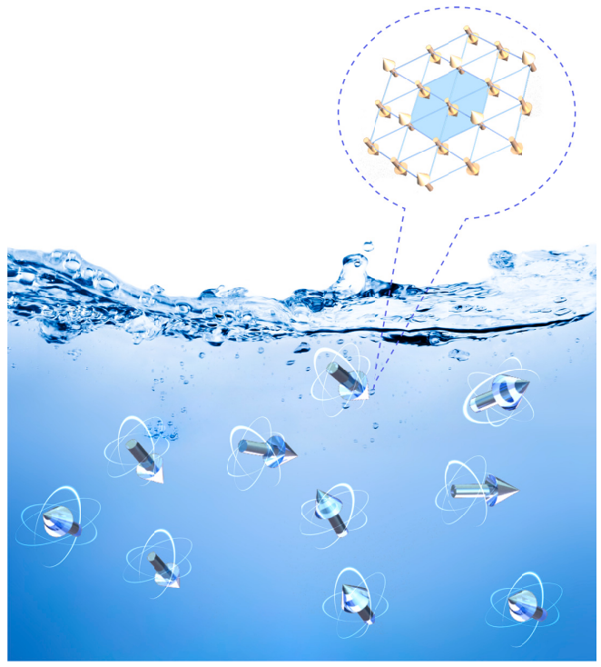
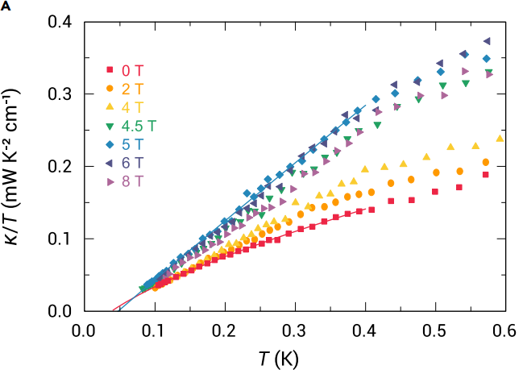
QSL candidates in two-dimension system: NaYbSe₂ (NYS)
(a) QSL’s evidences:
C_{m}/T (<0.5 K) is almost a constant, indicating the spinon Fermi surface spin liquid;
the 𝜇SR spectra show no spin freezing with robust dynamics and strong quantum fluctuations;
Continuous spin excitations by INS.
NMR indicates the coexistence of short-range magnetic order and QSL
(b) Evidences against QSL:
Thermal conductivity indicates no contribution from magnetic excitations.
Peng-Ling Dai et al., PRX 11, 021044 (2021);
Zihao Zhu et al., The Innovation 4, 100459 (2023).
Notes:
Different to YMGO, NYS shows the spinon Fermi surface spin liquid confirmed by the INS, uSR, and NMR. However, thermal conductivity indicates no contribution from magnetic excitations. Zihao Zhu etc think that the ground state of NaYbSe2 can be regarded as a mixed state with both QSL and fluctuating short-range ferrimagnetic droplets.

Slide 10
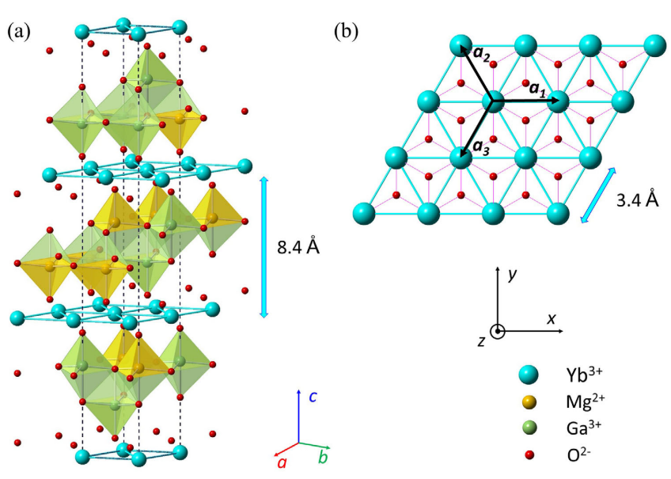
Is there a pure QSL?
In conclusion, the small spins, little structure disorder and defect, strong geometrical frustration, and so on are still necessary reference criteria for finding promising QSL candidate materials.
Yuesheng Li, Adv. Quantum Technol., 1900089 (2019);
Gaoting Lin and Jie Ma, The Innovation 4, 100484, (2023).
Notes:
Noted that such a proposal may be also attributed to the intrinsic ABC-stacking with the possibility of chirality that results in the stacking-induced magnetic frustration from the theory suggestions.
Indeed, the structural disorder is inevitable for a real QSL material, and the uncertainties due to the lattice defect make the extraction of the intrinsic ground state complicated and unpredictable. In material searching, the small spins, little structure disorder and defect, strong geometrical frustration, and so on are still necessary reference criteria for finding promising QSL candidate materials. Experimentally, the realization of QSLs still faces enormous challenges. If a real QSL compound is identified, it will greatly promote the development of quantum computer and high-temperature superconductors.

Slide 11
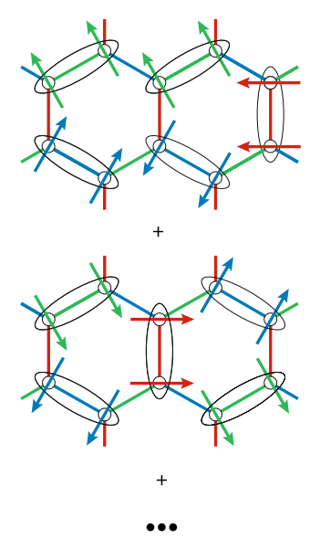
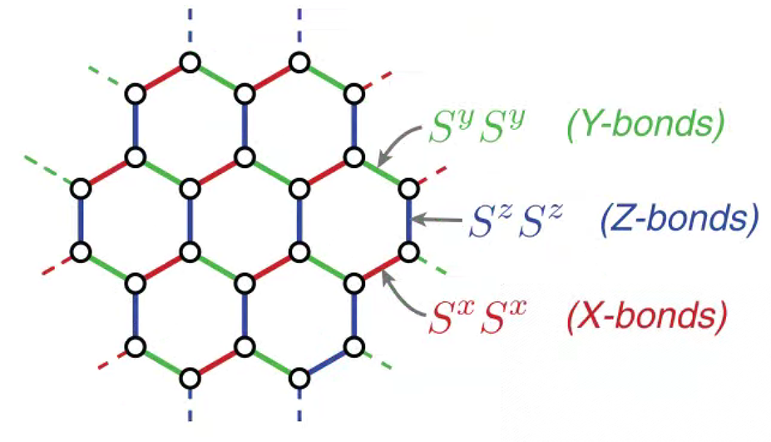
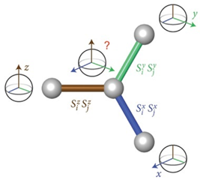
Kitaev model
Alexei Kitaev, Annals of Physics 321, 2 (2006)
Stephen M Winter et al., J. Phys.: Condens. Matter 29, 493002 (2017)
Simon Trebst and Ciarán HickeyPhysics Reports 950, 1 (2022)
Hidenori Takagi, et al., Nat. Rev. Phys. 1, 264 (2019)
Notes:
At present, although our vision of finding an ideal QSL candidate through such intensive and unremitting theoretical and experimental efforts has not yet been realized, this field has been substantially advanced. Such as the Kitaev model, an exactly solvable spin model that features a topological QSL ground state. Based on the Hamiltonian, in such a honeycomb lattice, a magnetic ion is surrounded by three nearest neighbors, and we name these three bonds as X-bond, Y-bond, and Z-bond. When there is the Ising anisotropic exchange interaction. The spin of the central ion will not know how to arrange, leading to frustration. In this case, the ground state is expected to be QSL ground state. A QSL ground state with ferromagnetic Kitaev interaction is shown in the figure.

Slide 12
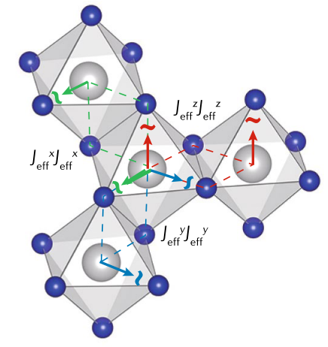
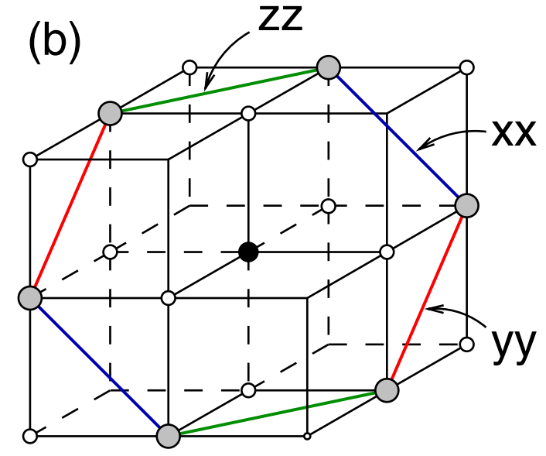
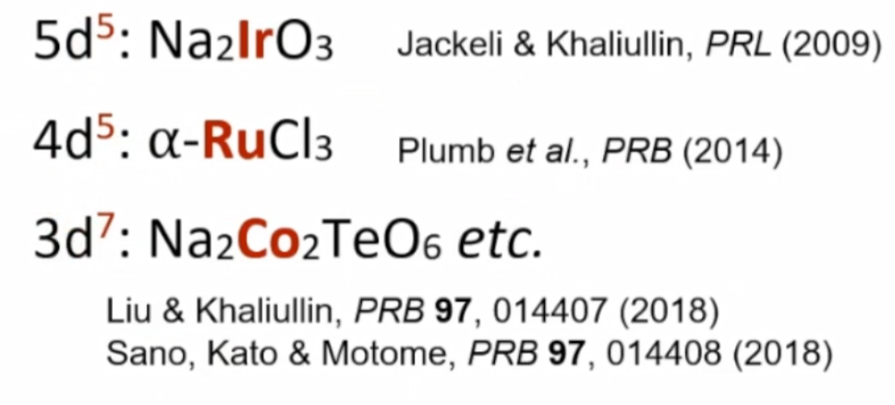
Realization of Kitaev model in real materials
The essential prerequisites:
The magnetic ions have spin–orbital entangled, Kramers degenerate ground states;
The magnetic ions arranged on a suitable lattice, with the two-dimensional (2D) honeycomb lattice being the simplest example;
Predominance of the Kitaev exchange interaction K over other terms like Heisenberg J or anisotropic exchange Γ
G. Jackeli1 and G. Khaliullin, PRL 102, 017205 (2009);
Gaoting Lin, et al., Nat. Commn. 12, 5559 (2021);
Kim, et al., J. Phys.: Condens. Matter 34, 023001 (2022)
Simon Trebst and Ciarán Hickey, Physics Reports 950, 1 (2022)
Hidenori Takagi, et al., Nat. Rev. Phys. 1, 264 (2019)
Notes:
After more than ten years of development, some possible candidate materials have been found in this system, and these materials can be found from 5d to 3d transition metal compounds. In fact, the essential prerequisites as follow: The magnetic ions have spin–orbital entangled, Kramers degenerate ground states; The magnetic ions arranged on a suitable lattice, with the two-dimensional (2D) honeycomb lattice being the simplest example; Predominance of the Kitaev exchange interaction K over other terms like Heisenberg J or anisotropic exchange Γ.

Slide 13
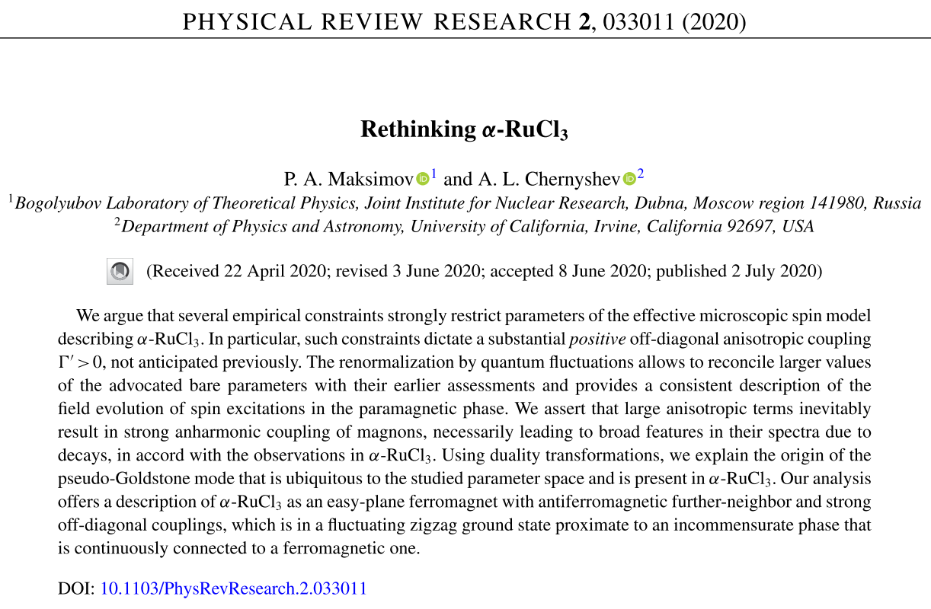
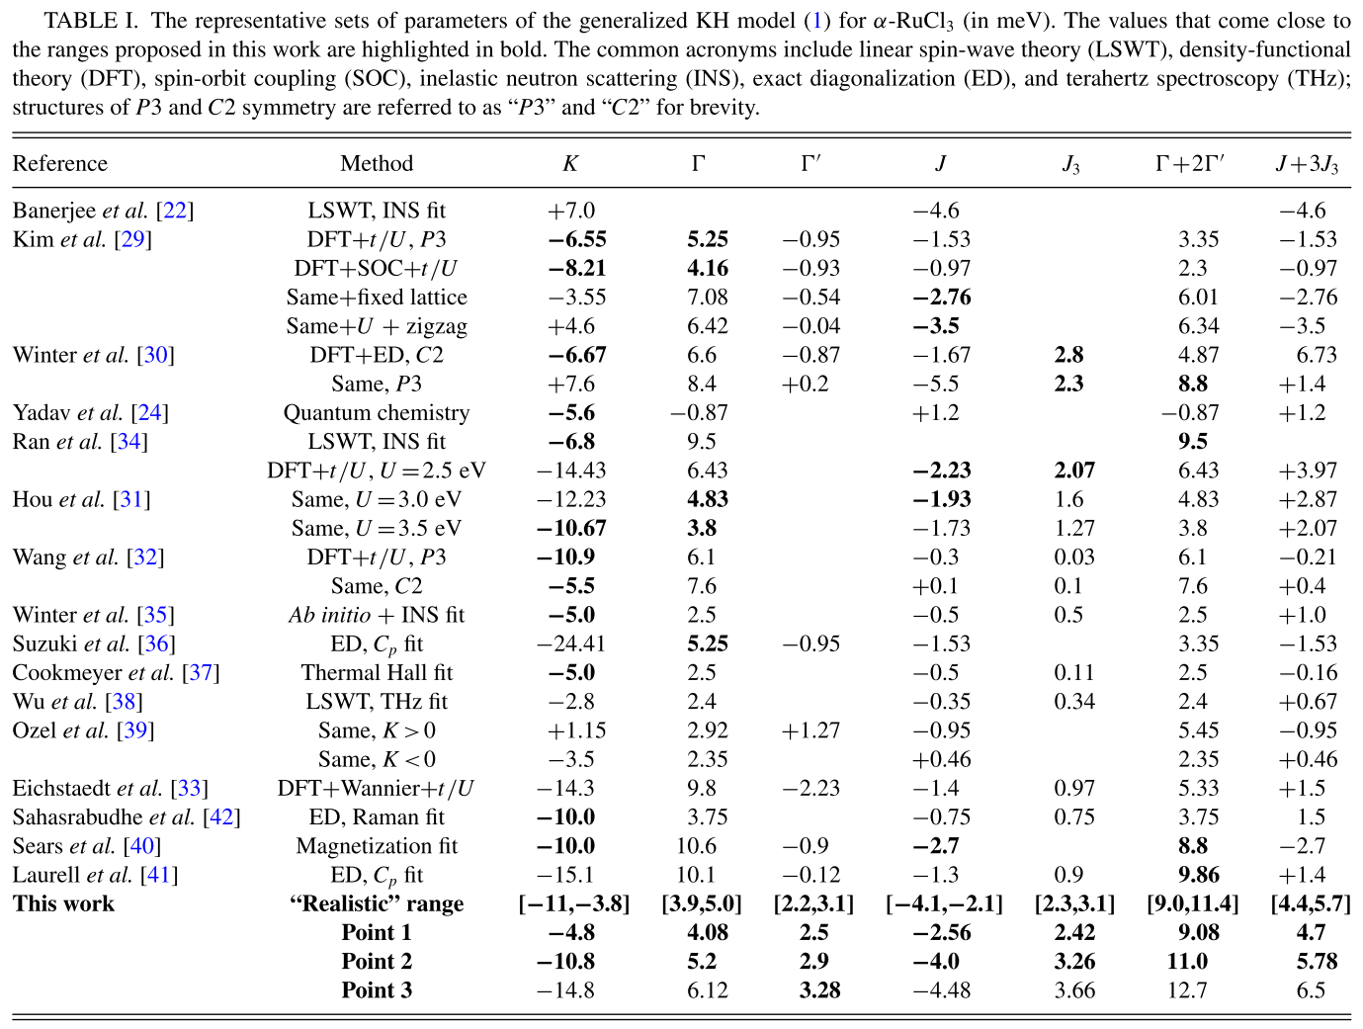
Generalized Heisenberg–Kitaev mode
Notes:
As a representative Kitaev QSL candidate RuCl3 has public a lot of papers. The spin Hamiltonian has been extended to a generalized Heisenberg–Kitaev (H–K) model with five symmetry-allowed terms. As shown that, there is all kinks of exchange interaction parameters.

Slide 14
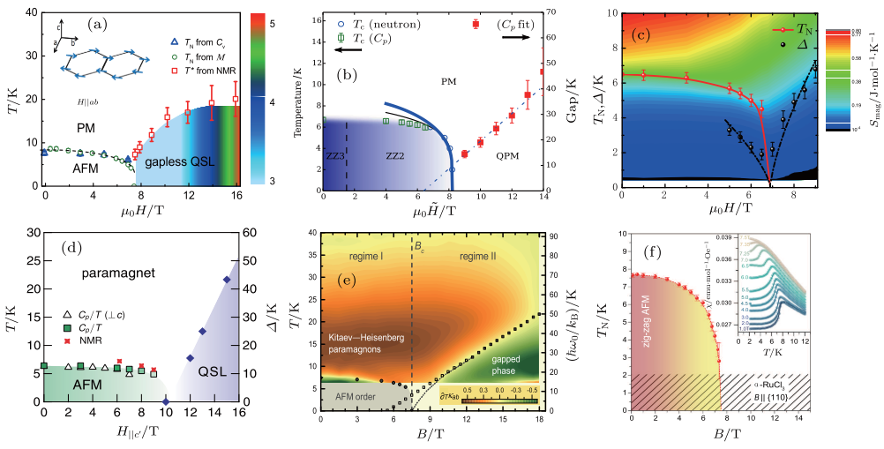
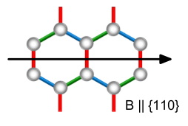
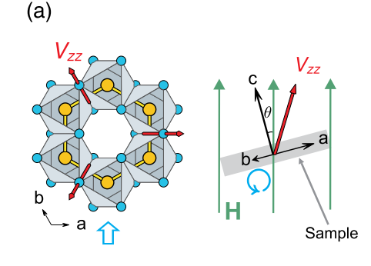
Magnetic phase diagram of α-RuCl₃ obtained from various measurements
PRL 119, 227208 (2017)
PRB 95, 180411(R) (2017)
PRB 96, 041405(R) (2017)
H // ab plane
H // ab plane
H // ab plane
H // ab plane
H∥c’
PRL 119, 037201 (2017)
PRL 120, 117204 (2018)
2018 npj Quantum Materials 3 8
Notes:
In addition, various experimental measurements give the similar magnetic phase diagram, indicating a Kitaev QSL can be observed between 7 and 10T.

Slide 15
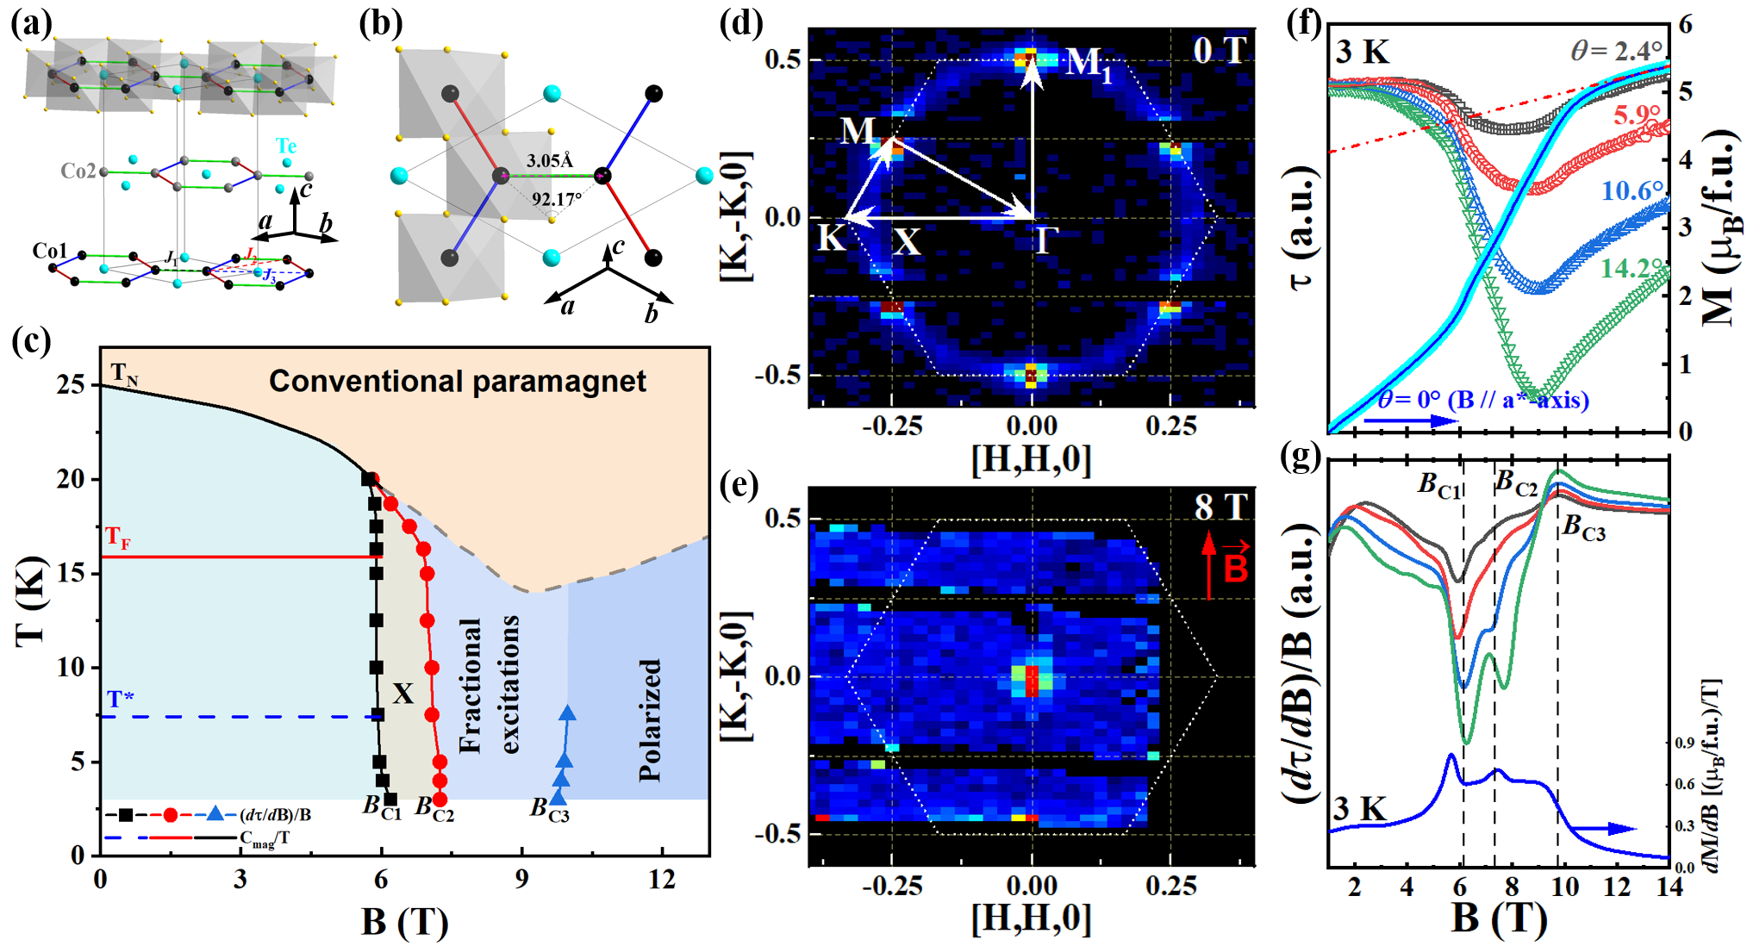
Structure and phase diagram of Na₂Co₂TeO₆ (NCTO)
Na₂Co₂TeO₆, P6₃22
Nat. Commn. 12, 5559, (2021);
Nat. Phys. In review, (2022) DOI: https://doi.org/10.21203/rs.3.rs-2034295/v1.
Notes:
In 3d-based compounds. Although there is a weaker spin-orbit coupling, the Kitaev interaction is very significant. As a promising candidate, NCTO have been discussed that there is a field-induced QSL state between 7.5T and 10T with applied magnetic field parallel to a*-axis.
Compared to RuCl3, there is a more perfect CoO6 octahedron and more compact. And the contributions from the spin-orbital exchange channels t2g-eg and eg-eg can weaken the Γ and Γ′ exchanges.

Slide 16
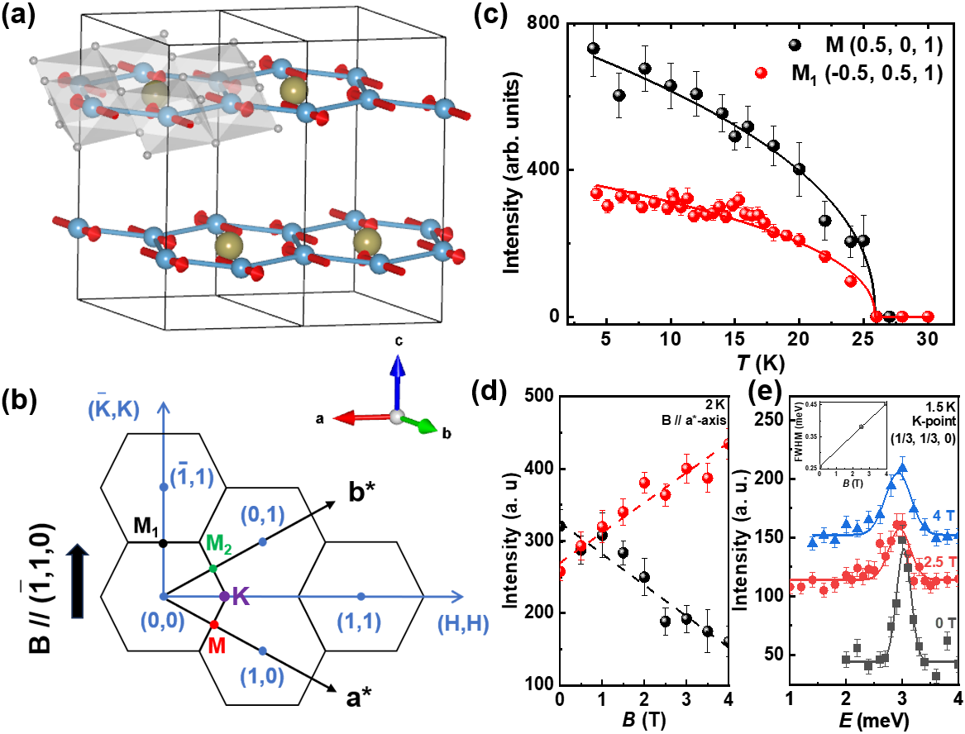
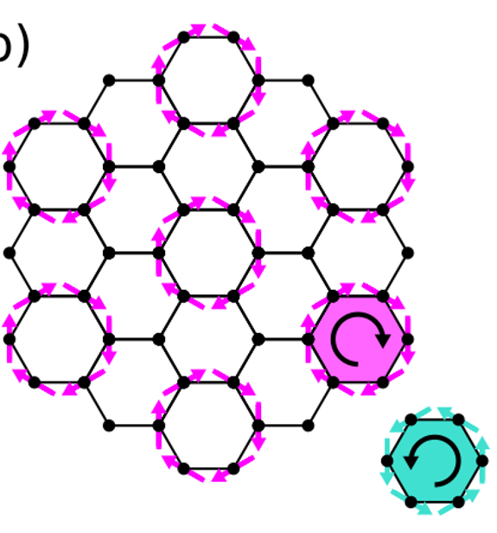
Magnetic structure of Na₂Co₂TeO₆
Unpublished
Multi-domain structure
triple-q order
or multi-k structure
Supporting the multi-domain structure
Weiliang Yao, …, Yuan Li, PRR 5, L022045 (2023)
Notes:
However, the two magnetic structures, multi-domain or multi-k structure, are still an urgent problem to be solved, which will be helpful to understand the competitive relationship between various magnetic interactions. Using the same parameters, the power-law function gives the similar I(T) curves at the M and M₁ points. The small bump at T_{F} only can be observed by the I(T) curves of M₁-point, which means that the magnetic anisotropic-exchange interactions induce the non-equivalent magnetic domains at M and M₁ points. The field-dependent intensities of magnetic reflections further confirm that the magnetic domains along the magnetic field direction are growing while other directions are suppressed.

Slide 17
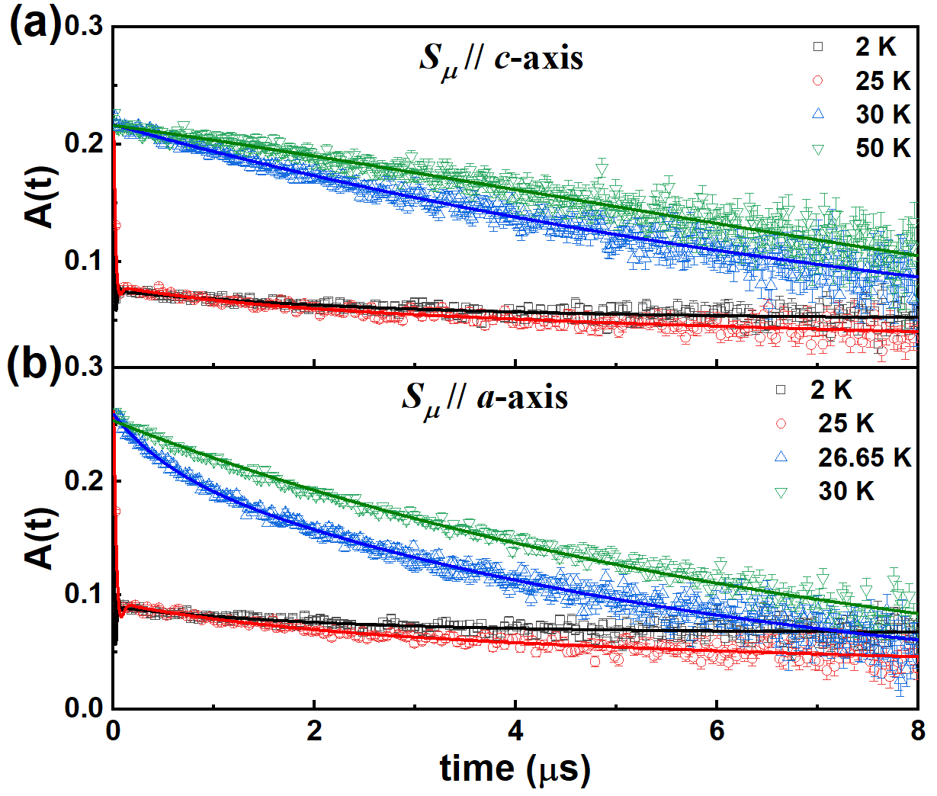
μSR study of Na₂Co₂TeO₆ using the M20D at TRIUMF
Unpublished
Notes:
As another important technique used to study complex quantum magnetism, μSR is an extremely sensitive magnetic probe at a microscopic level. The mutual collaboration between neutron diffraction and μSR will help us to further verify the multi-domain structure and the quantum fluctuations in NCTO. Using this function, we can well fit our uSR data.

Slide 18
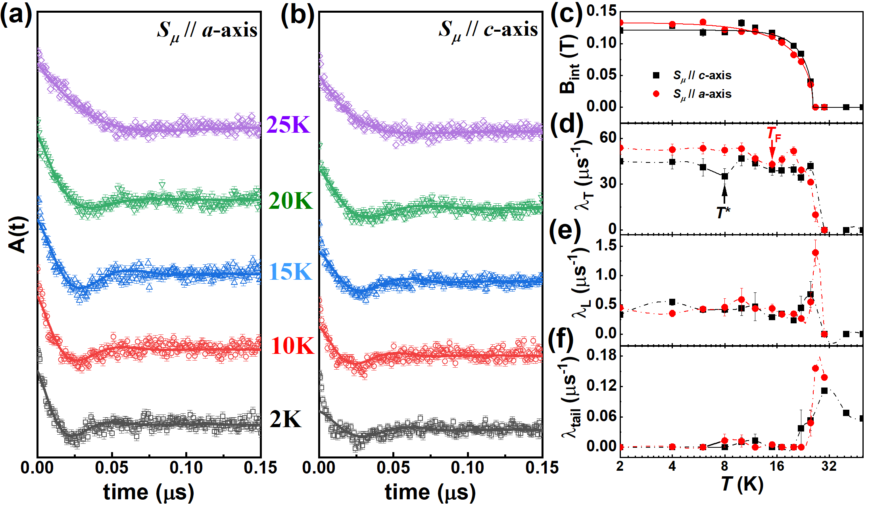
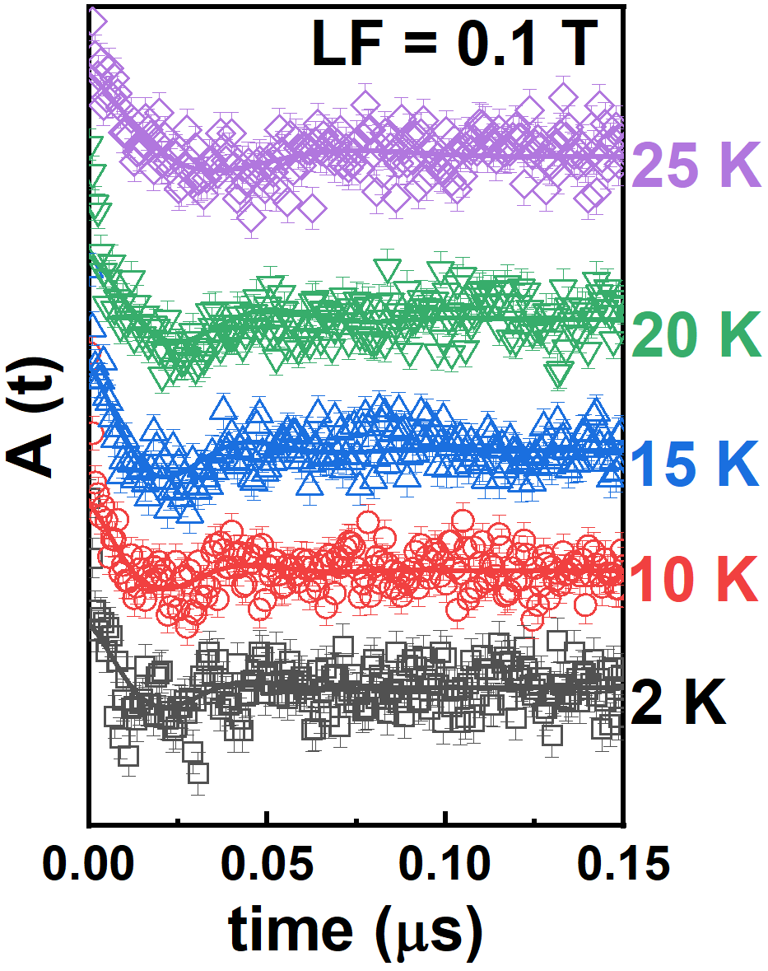
μSR study of Na₂Co₂TeO₆ using the M20D at TRIUMF
Unpublished
The ZF-μSR time spectra present the very fast depolarization and superimposed oscillations within 50 ns below T_{N}, suggesting the characteristic of strong quasistatic internal field.
λ_{T} represents the transverse muon-spin relaxation rates, reflecting the width of static magnetic field distribution. The anomalies observed at T_{F} and T* should be attributed to the redistribution of magnetic domains originated from three different k-vectors.
Notes:
The ZF-μSR time spectra present the very fast depolarization and superimposed oscillations within 50 ns below T_{N}, suggesting the characteristic of strong quasistatic internal field. And the superimposed oscillations are not disappeared at LF = 0.1T, which confirm the oscillations is from the AFM order. The temperature-dependent λ_{T} also give some anomalies at TF and T*, which suggest that the redistribution of magnetic domains originated from three different k-vectors.

Slide 19
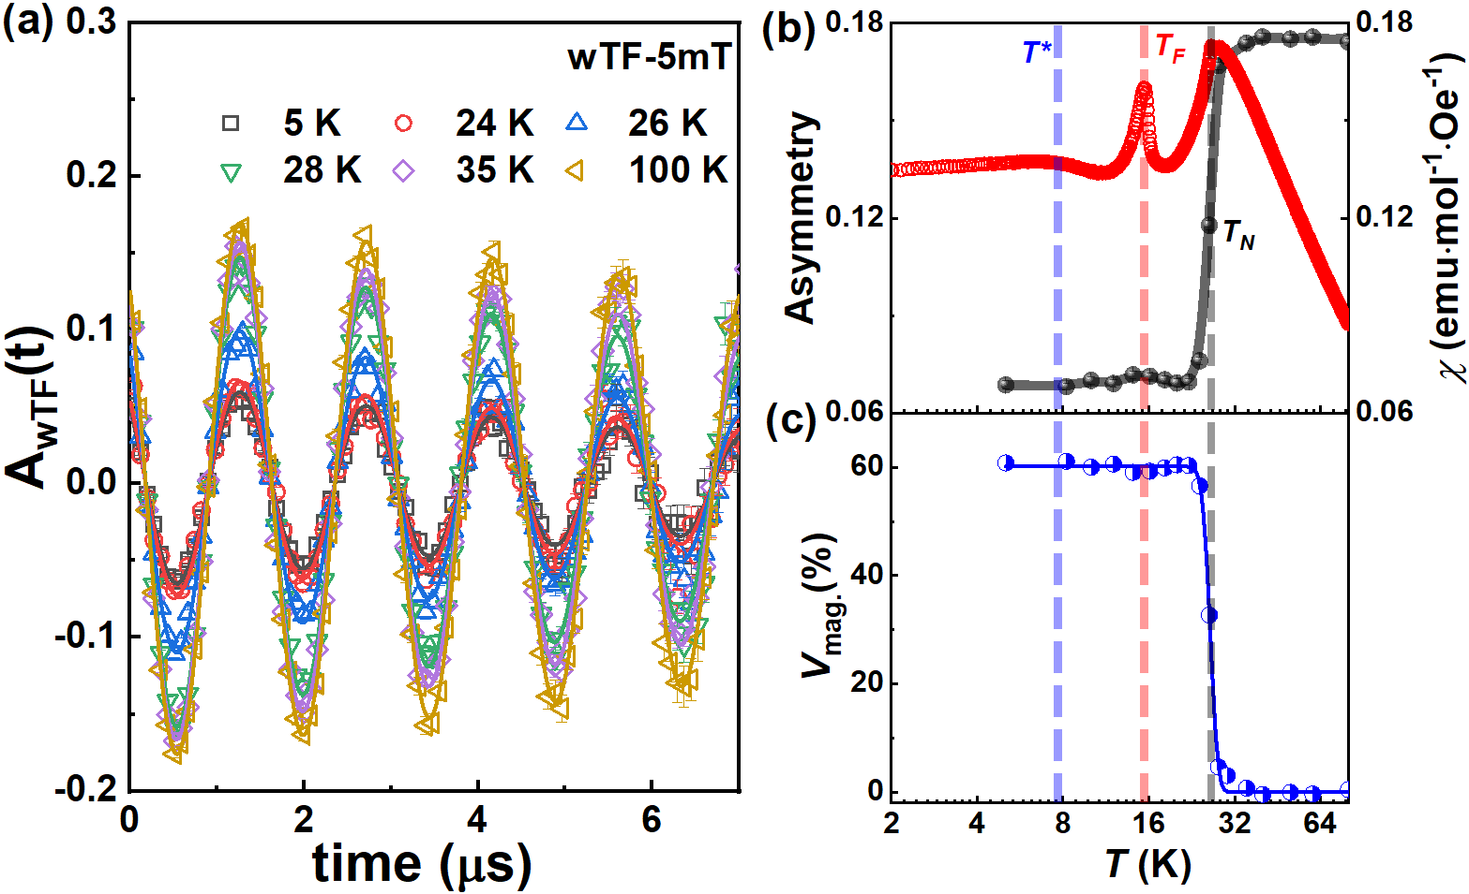
μSR study of Na₂Co₂TeO₆ using the GPS at PSI
Unpublished
Such a low V_{mag}(0K) = 60 % maybe suggest that the bond-dependent anisotropic frustrations (Kitaev interactions) and quantum fluctuations play important roles in understanding the rich magnetic phase diagram of NCTO.
The strong spin dynamics should be quantum at low temperatures and the opening of spin-wave-excitation gap below T_{F} (from INS results) further eliminates the contribution of thermal fluctuations to such large dynamic volume fraction.
Notes:
A quantitative analysis from weak transverse-field μSR spectra allows extracting the temperature evolution of the magnetic volume fraction. We obtain a low value of 60%. Such low magnetic volume fraction maybe suggest the magnetic ordered ground state of NCTO presents the distinct quantum spin fluctuations. Instead, another possible reason with the about 40% dynamic volume fraction may be from the magnetic domain wall.

Slide 20
Summary
1) NCTO hosts a multi-domain zigzag magnetic ground state along with strong quantum fluctuations ;
2) Our findings can well reflect the exposition of microscopic origin from HK model where the coexistence of static magnetic order from the non-Kitaev interactions and dynamic quantum fluctuations from the frustrated K term indicates the highly frustrated magnetic structure (Another possible reason with the about 40% dynamic volume fraction may be from the magnetic domain wall);
3) With the increasing magnetic fields, the broadening of the spin-wave-excitation gap at K-point further suggests that the quantum fluctuations can be enhanced by the applied magnetic field, which promotes further interests on the field-induced magnetically disordered state with strong quantum fluctuations.

Slide 21
Acknowledgments
ISIS
D. T. Adroja
Peter J. Baker
T. G. Perring
TRIUMF
Xiyang Li
Sarah Dunsiger
SJTU
Mingfang Shu,
Jinlong Jiao,
Jie Ma,
μSR
experiment
ECNU
Tian Shang
PSI
Tony Shiroka
RUC (Theory)
Qirong Zhao,
Guijing Duan,
Rong Yu,
Zhengxin Liu
ANSTO
Guochu Deng
SNS/ORNL
A. I. Kolesnikov
Neutron
experiment
HZB, Deutschland
Gerrit Günther
Margarita Russina
Zhilun Lu
J-Parc Facility
Takatsugu Masuda
Shinichiro Asai
Shinichi Itoh
UTK (Crystal growth)
Qing Huang
Haidong Zhou
Notes:
Finally, I would like to thank my collaborators for their support.

Slide 22
Thanks for your attention!

Slide 23
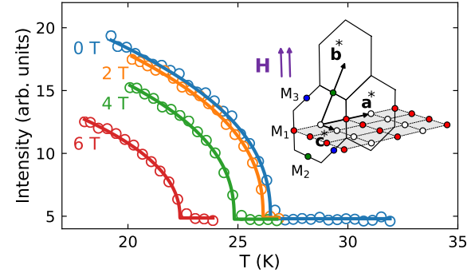
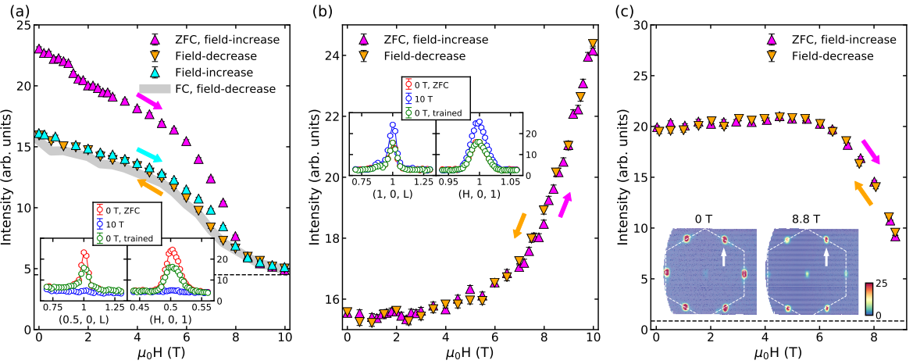
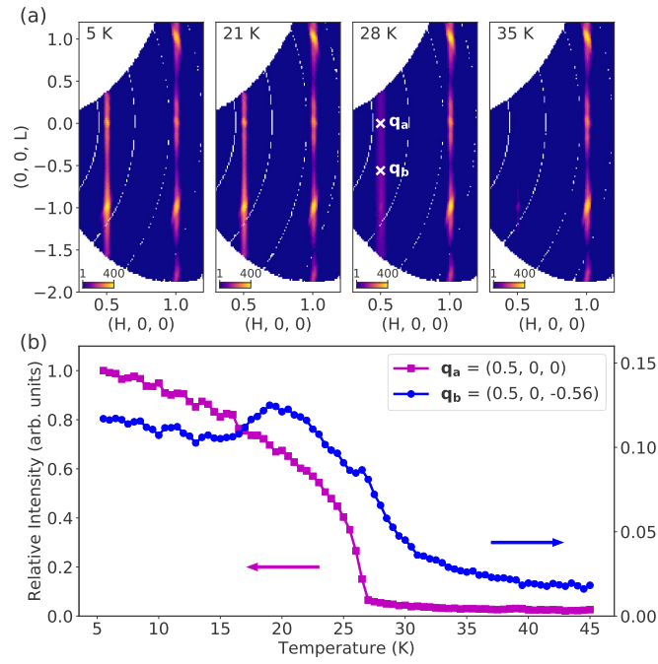
Single-crystal neutron diffraction in Na₂Co₂TeO₆ from Yuan Li’s papers
M-point (0.5, 0, 1)
BT-7
4SEASONS
PRL 129, 147202 (2022)
PRR 5, L022045 (2023)
BT-7
BT-7
(0, 0.5, 1)
LET
(0.5, 0, 1)
(1, 0, 1)
4SEASONS
PRB 103, L180404 (2021)

Slide 24
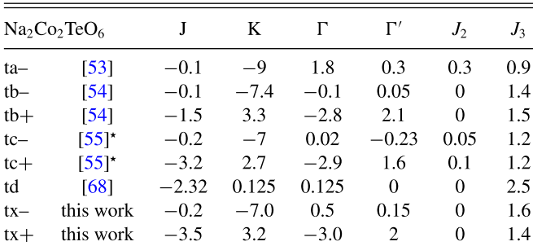
The representative sets of parameters of the generalized KH model for NCTO
Best fit model parameters from powder INS
Low-energy dynamics can be dictated by the J₃-Δ model, indicating the J₃ is important in NCTO.
Weiliang Yao, et al., PRL 129, 147202 (2022);
Alaric L. Sanders, et al., PRB 106, 014413 (2022)

Slide 25
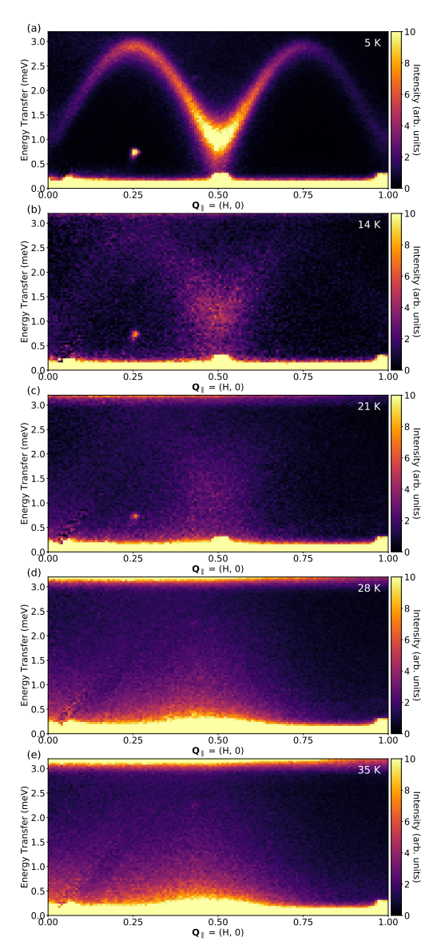
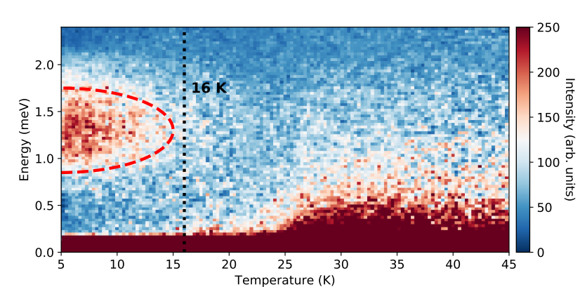
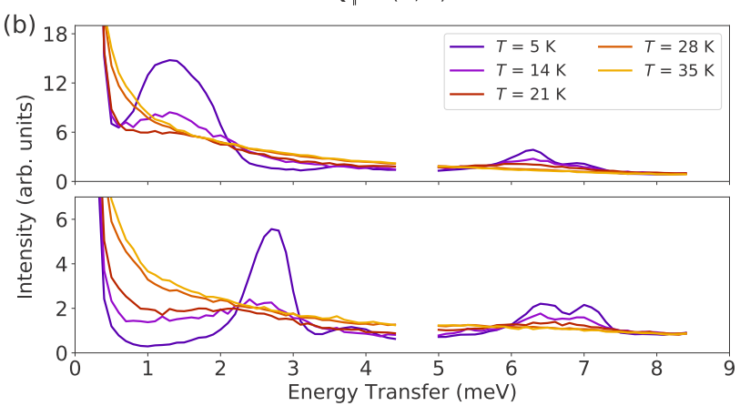
Gapped (∼ 1 meV) excitations are observed below about 16 K
PRB 103, L180404 (2021)

Slide 26
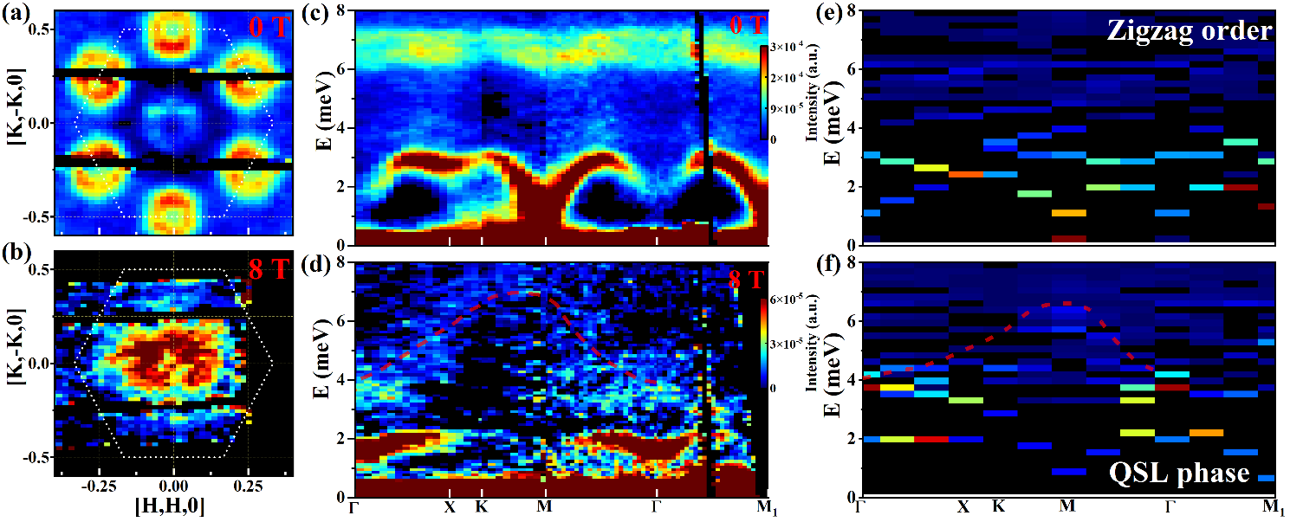
Spin-excitation spectra with E_{i} = 18 meV
J₁ = −1.54 meV, J₃ = 1.32 meV, K = 1.408 meV, Γ = −1.32 meV, and Γ′ = 0.88 meV, which are equivalent to J₁ = 0.066 meV, J₃ = 1.32 meV, K = −3.399 meV, Γ = 0.286 meV, and Γ′ = 0.077 meV via the dual transformation.
Based on the generalized KH model, we theoretically calculated the dynamic structure factor. The results contain both magnon excitations and spinon-continuum, which agree well with the inelastic neutron spectrum at B = 8 T. (point III)

Slide 27
μSR for NCTO using the ARTEMIS at J-Parc
Ping Miao, et al., arXiv:2307.16451v1 (2023)

