Slide 1
μSR as a primary tool to search for superconductors with broken time-reversal symmetry
Vadim Grinenko
Tsung-Dao Lee Institute, Shanghai Jiao Tong University, Shanghai
Workshop on Muon Science Technology and Industry MELODY2023
6 November 2023

Slide 2
μSR as the most sensitive bulk magnetic probe:
Discovery of BTRS superconductivity in iron-based superconductors with average spontaneous magnetic fields ~ 0.1 Oe.
Split superconducting and BTRS transition under uniaxial strain in Sr₂RuO₄.
Strain induced spin density wave (SDW) with magnetic moment ~ 0.1μ_{B.}
BTRS superconductivity under hydrostatic pressure.
V. Grinenko et al., Phys. Rev. B 95, 214511 (2017).
V. Grinenko et al., Nat. Phys. 16, 789 - 794 (2020).
V. Grinenko et al., Nat. Phys. 17, 1254–1259 (2021).
Y. Iguchi et al. Science 380,1244-1247(2023)
I. Shipulin et al., Nat Commun 14, 6734 (2023).
V. Grinenko et al., Nat. Phys. 17, 748–754 (2021).
V. Grinenko et al., Nat Commun 12, 3920 (2021).

Slide 3
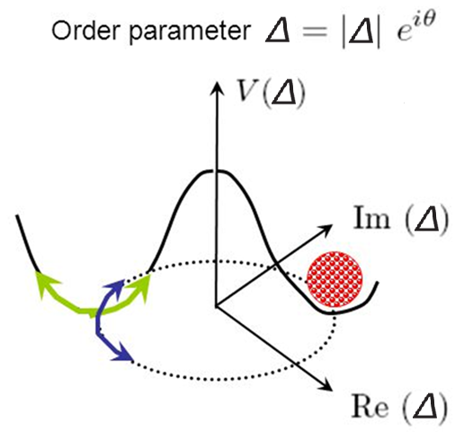
Superconductors that break time reversal symmetry (BTRS)
Superconducting state below T_{c} can be characterized by a complex order parameter Δ = |Δ|e^{iφα}, which has amplitude and phase.
The order parameter characterizes how strong the symmetry is broken below transition temperature.
T
At T_{c} broken U(1)
and
T(Z₂) – time reversal symmetry: Δ Δ* ≠ | Δ_{α}|e^{iθ}
V (Δ)
?
?
Δ*
0
Δ
https://slideplayer.com/slide/5363094/
The fundamental symmetry which spontaneously violates by any superconducting state.
Two energetically equivalent states with Δ ≠ Δ*
meaning spontaneously broken Z₂ symmetry.
BTRS state can be described by two component imaginary order parameter: $\text{Δ}\text{1}±\text{i} \text{Δ}\text{2}$.
Two different phase transitions → T_{c} ≠ T_{BTRS}.

Slide 4
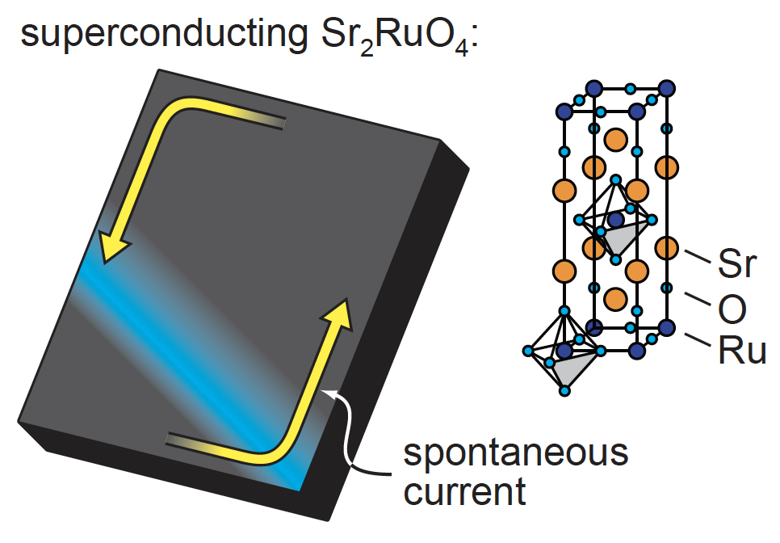
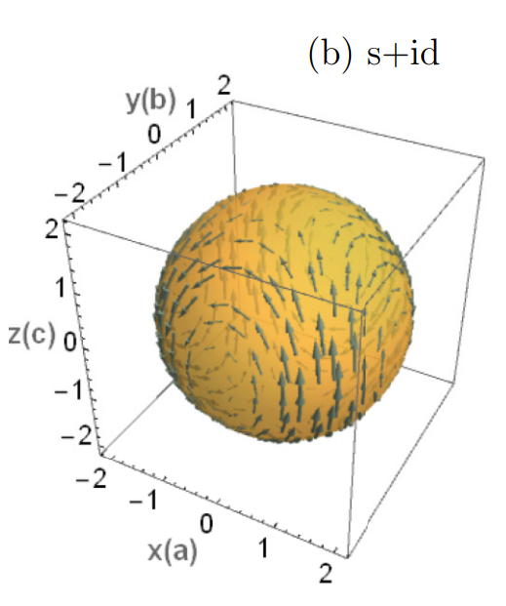
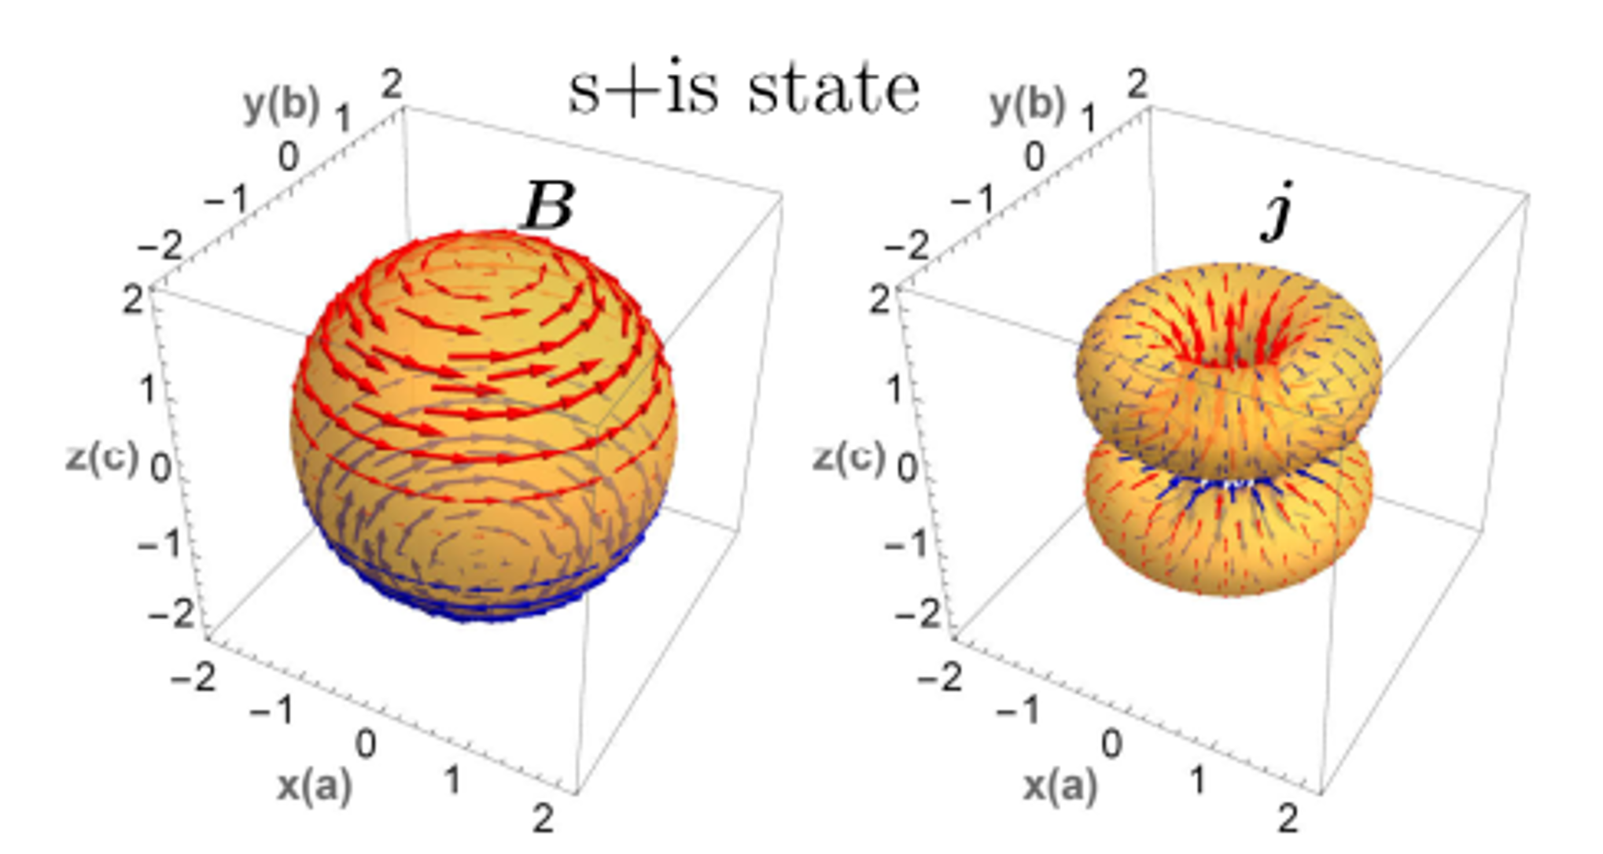
Phenomenologically, broken time reversal symmetry
Phenomenologically, broken time-reversal symmetry results in the appearance of a spontaneous magnetization (m) when a superconductor is cooled below T_{BTRS}.
m
C. Hicks, MPI Dresden
Spontaneous fields appear around inhomogeneities or at the domain walls (no spontaneous fields in infinite homogeneous superconductor).
The structure and value of the fields depend on the type of the order parameter, the anisotropy of the system and the structure of inhomogeneities.
V. Grinenko et al., Nat. Phys. 16, 789–794 (2020)
V. L. Vadimov and M.A. Silaev, PRB 98, 104504 (2018)

Slide 5
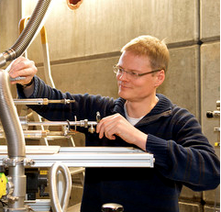
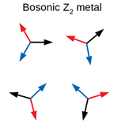
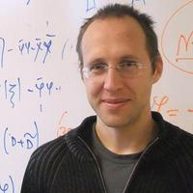
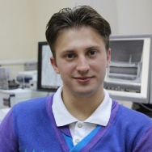
Discovery of BTRS superconductivity in Ba_{1-x}K_{x}Fe₂As₂
Experiment:
μSR/NQR
Rajib Sarkar, Hans-Henning Klauss,
TU Dresden, Germany
Hubertus Luetkens,
PSI Villigen, Switzerland
Ba_{1-x}K_{x}Fe₂As₂ single crystals
Kunihiro Kihou and Chul-Ho Lee
AIST, Tsukuba, Japan
AC specific heat and ultrasound
Tino Gottschall, Denis Gorbunov,
Sergei Zherlitsyn, Jochen Wosnitza HZDR, Dresden-Rossendorf, Germany
Calorimetry and magnetization
Ilya Shipulin, IFW Dresden, Germany
Thermoelectrical transport
Nadia Stegani, Federico Caglieris,
CNR-SPIN Genova
Christoph Wuttke, Christian Heß,
Bernd Büchner
IFW Dresden, Germany
Theory:
Daniel Weston, Ilaria Maccari
KTH, Stockholm, Sweden
Julien Garaud,
Institut Denis Poisson CNRS-UMR, France
Egor Babaev
KTH, Stockholm, Sweden
Scanning SQUID Microscopy
Yusuke Iguchi
Kathryn A. Moler

Slide 6
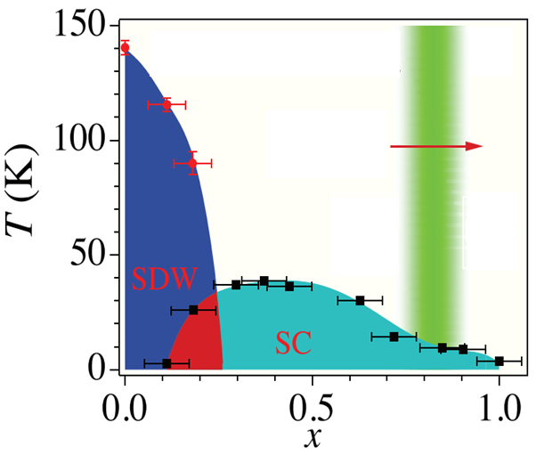
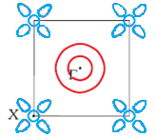
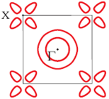
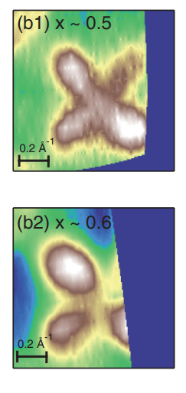
Effect of Lifshitz transition on Ba_{1-x}K_{x}Fe₂As₂ superconductivity
Lifshitz transition of
the electron pocket at X-point BZ
electron
hole
hole
Lifshitz
transition
D. Evtushinsky at al.,
ARPES (unpublished)
x ~ 0.7 - 0.9
N. Xu et al., PRB 88, 220508(R) (2013)
W. Malaeb et al., PRB 86, 165117 (2012)
Hole doping results in topological changes of the Fermi surface (Lifshitz transition) at x_{L} = 0.55 – 0.9.
The superconducting dome is continuous across the Lifshitz transition.
What is the effect of Lifshitz transition on the superconducting state?

Slide 7
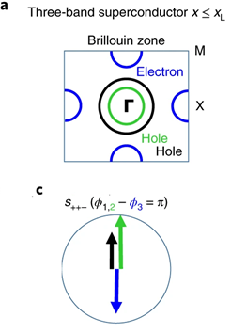
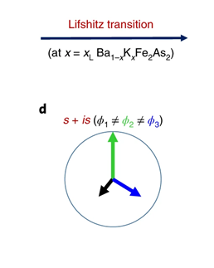
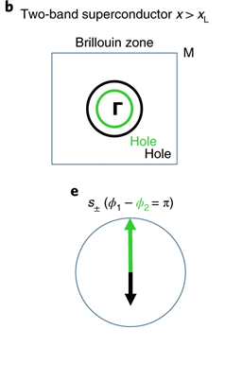
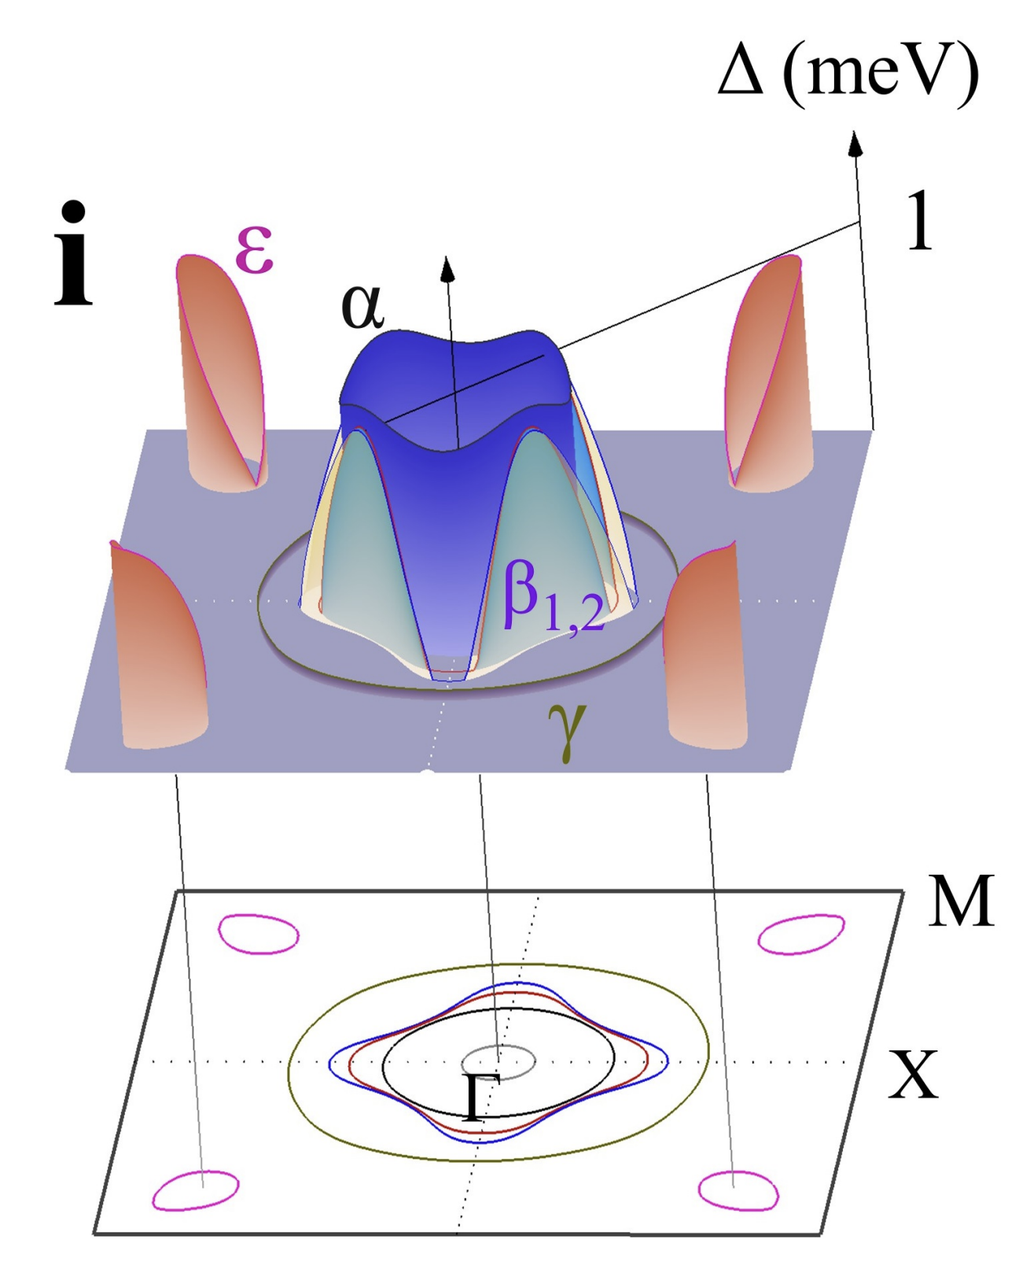
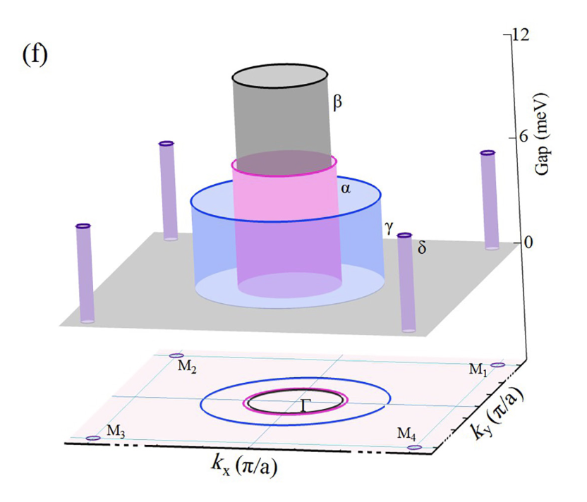
Possible s+is superconductivity at Lifshitz transition
Isotropic $s_{±}$ in optimally doped $Ba_{0.6}K_{0.4}Fe_{2}As_{2}$
Nodal $s_{±} in KFe_{2}As_{2}$
V. Grinenko et al., Nat. Phys. 16, 789–794 (2020).
see also J. Garaud, J. Carlström, and E. Babaev, Phys. Rev. Lett. 107, 197001 (2011), S. Maiti and A. V. Chubukov, Phys. Rev. B 87, 144511 (2013); A. Chubukov, Springer Series in Materials Science, 211, 255 (2015)
Cai et al., Science Bulletin 66 (2021)
D. Wu et al., arXiv:2212.03472v1
Competition between different s± pairing states → intermediate s-state with frustrated phases of the order parameter → Broken Time Reversal Symmetry (BTRS).
Lifshitz
transition
N. Xu et al., PRB 88, 220508(R) (2013)

Slide 8
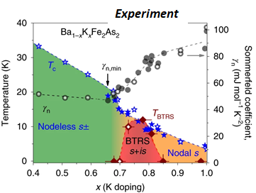
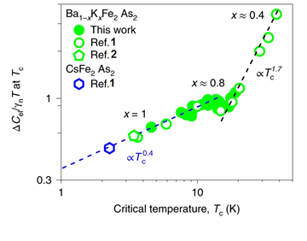
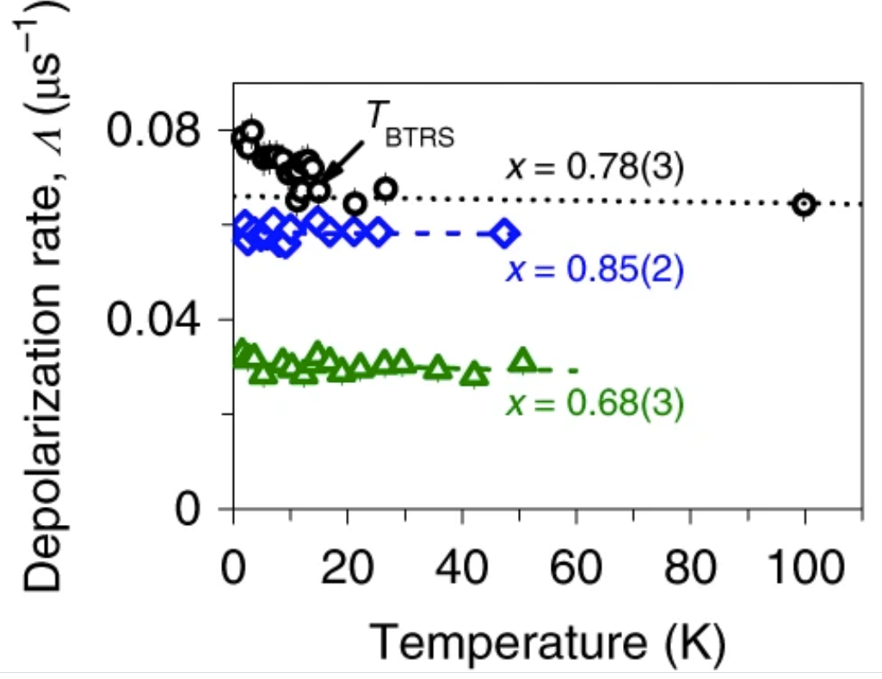
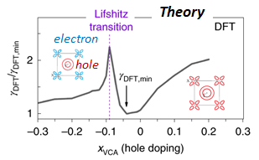
BTRS superconductivity in Ba_{1-x}K_{x}Fe₂As₂
Change of the scaling behavior → two superconducting (SC) phases!
Moun spin depolarization rate is enhanced for x ~ 0.8
SC2
SC1
SC1
SC2
Lifshitz
transition
Average spontaneous field <B_{int}> = ΔΛ/λ_{μ} ~ 0.1 G.
SC1
A narrow BTRS dome (0.7 > x > 0.85) close to the Lifshitz transition between two different superconducting states.
SC2
V. Grinenko et al., Phys. Rev. B 95, 214511 (2017).
V. Grinenko et al., Nat. Phys. 16, 789 - 794 (2020).
N. Xu et al., PRB 88, 220508(R) (2013)

Slide 9
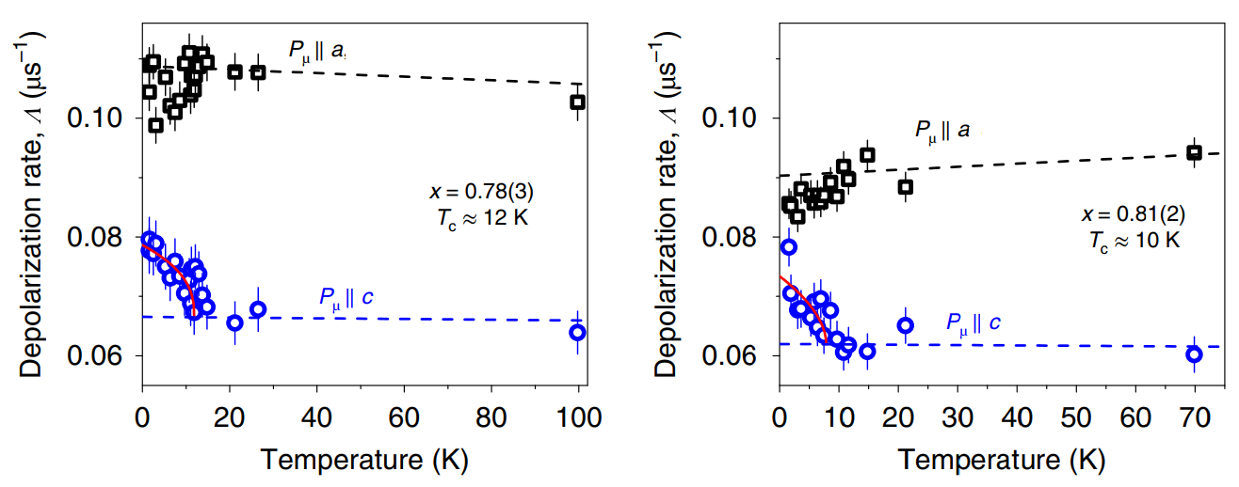
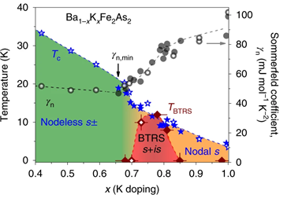
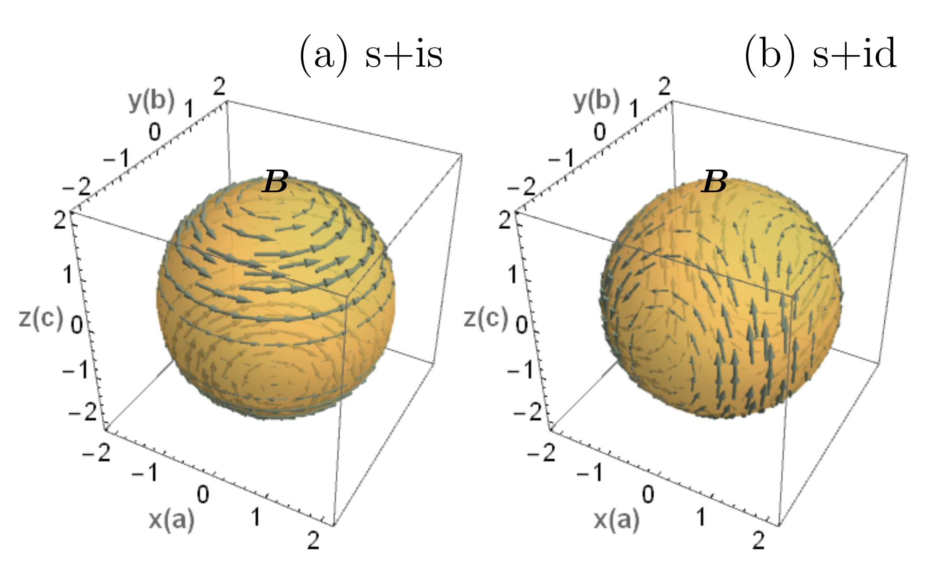
Anisotropy of the spontaneous magnetic fields in BTRS state
What is the BTRS order parameter ?
V. Grinenko et al., Nat. Phys. 16, 789–794 (2020)
Spontaneous fields are anisotropic → consistent with an s+is state!
V. L. Vadimov and M.A. Silaev, PRB 98, 104504 (2018)

Slide 10
What is further evidence for BTRS?
For long time a BTRS superconductivity was an extremely rare phenomenon. However, in a recent years “hundreds” of new BTRS superconductors were discovered.
If it is intrinsic:
Why this unusual phenomena is so common?
Do we need “new” theory of superconductivity to understand it?
Extrinsic reasons:
Is it a muon-induced effect?
Is it the interaction of local moments with superconductivity?
Is BTRS intrinsic or extrinsic to Ba_{1-x}K_{x}Fe₂As₂?

Slide 11
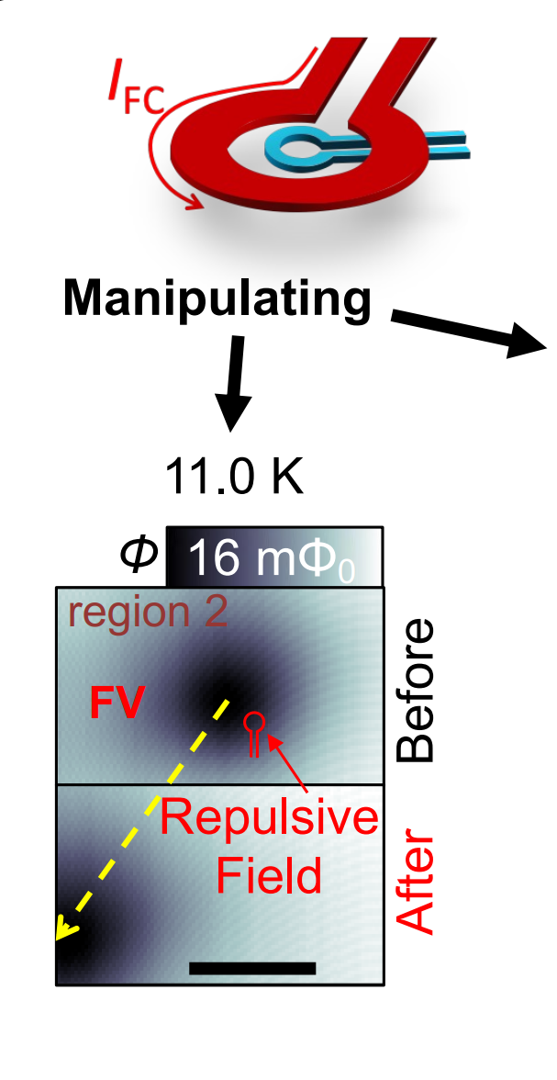
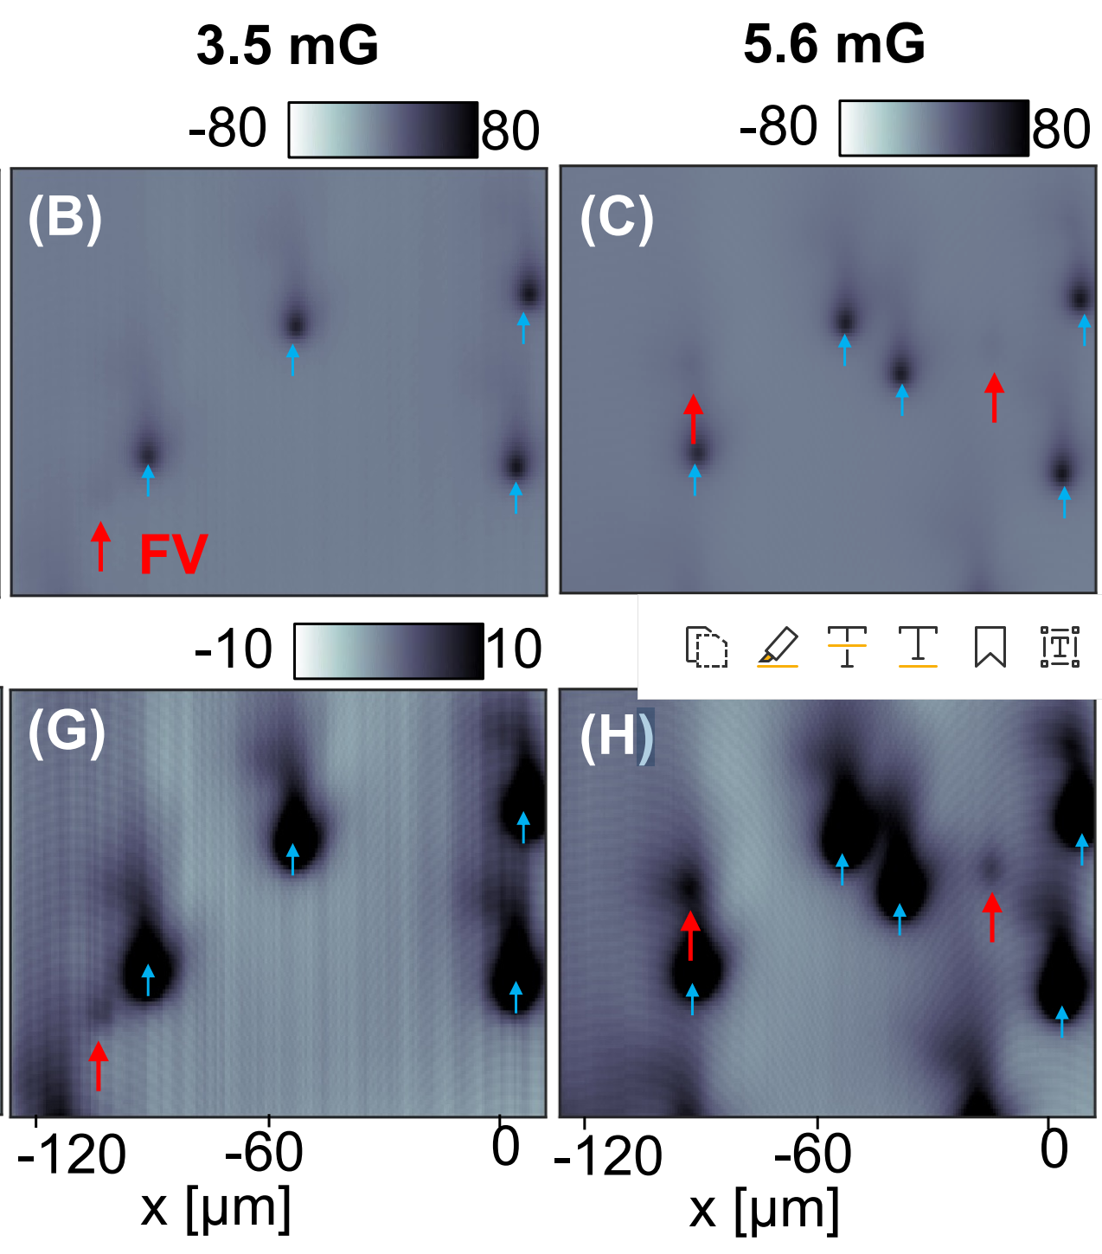
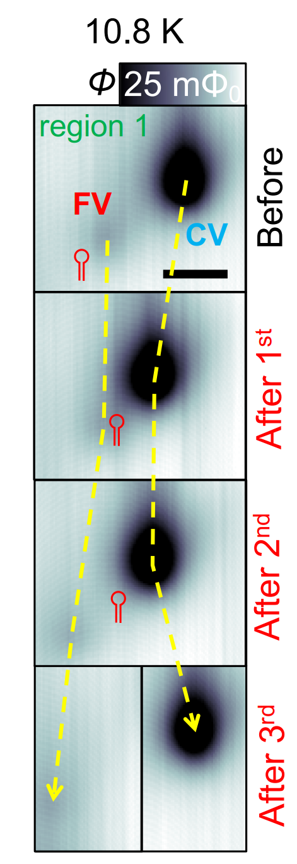
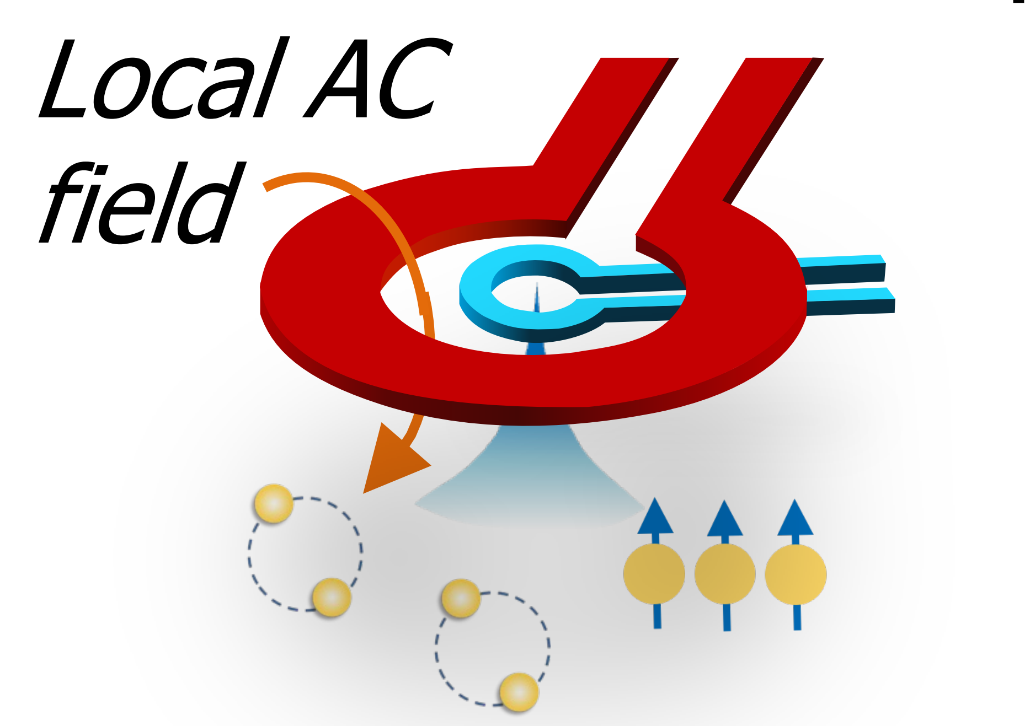
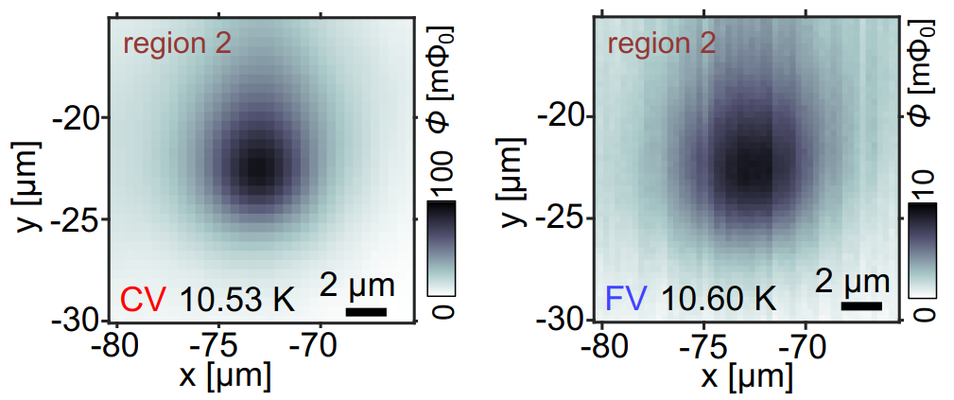
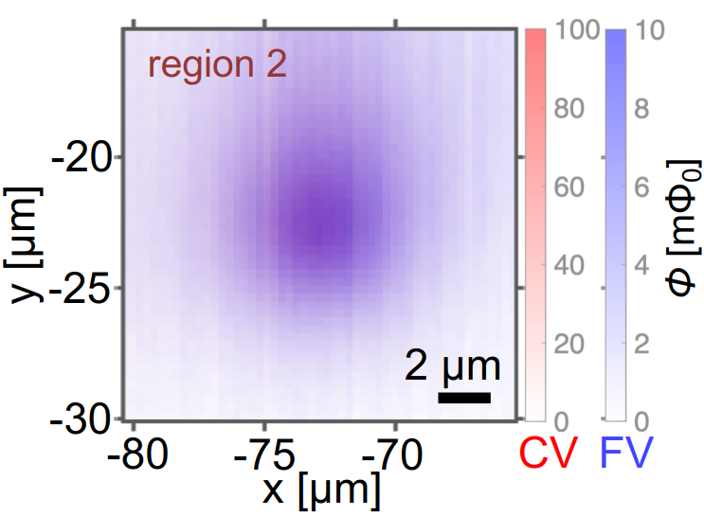
Discovery of fractional vortices (FV) in the BTRS state
Scanning SQUID Microscopy
V. Grinenko et al., Nat. Phys. 16, 789–794 (2020)
Support for multicomponent superconductivity!
FV are mobile un related to defects!
~ 10% of vortices are fractional vortices (FV)
Abrikosov vortices
Fractional vortices
Abrikosov and Fractional vortices pinned at the same location.
FV – quantum objects unrelated to specific defects in the sample.
Y. Iguchi et al. Science 380,1244-1247(2023)

Slide 12
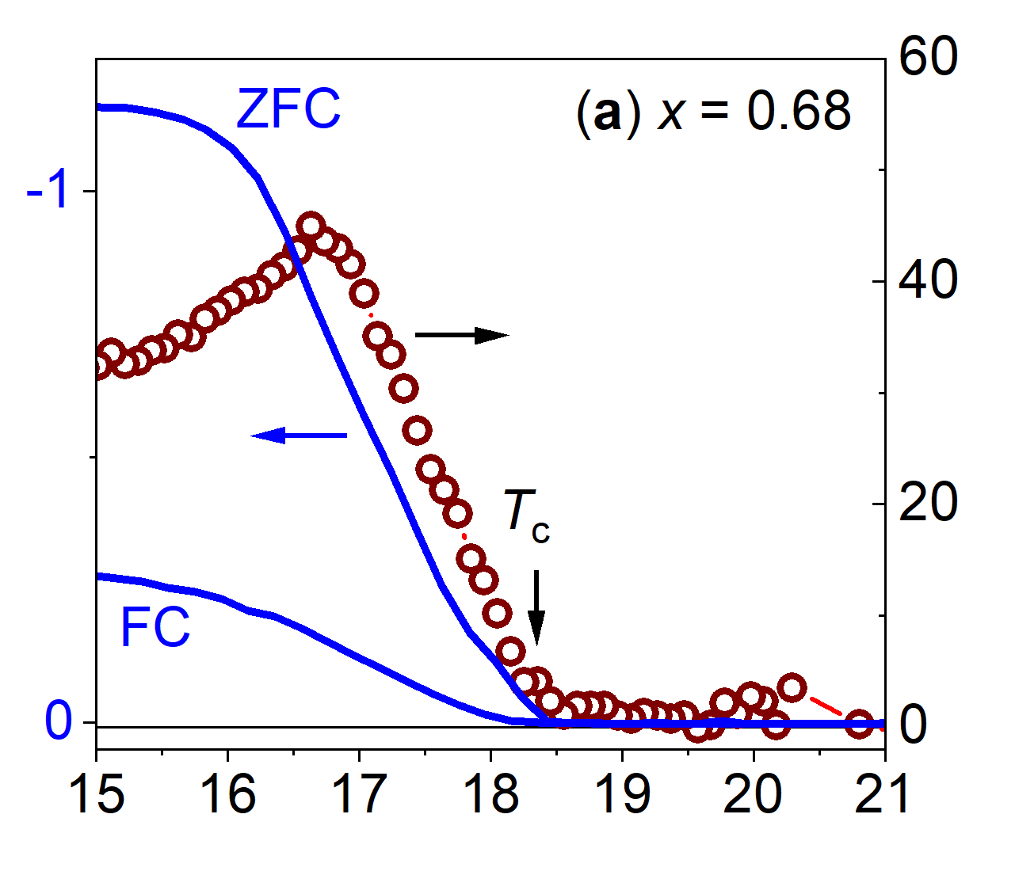
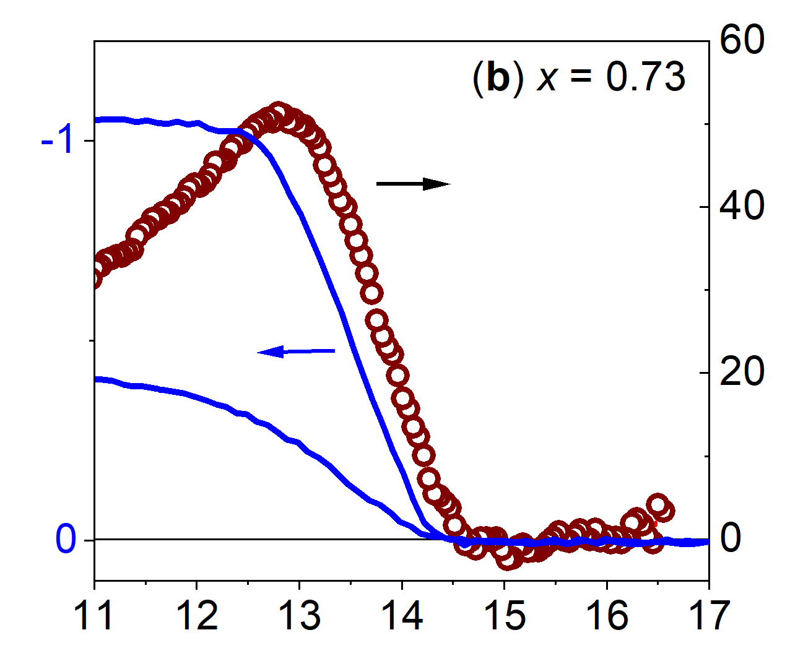
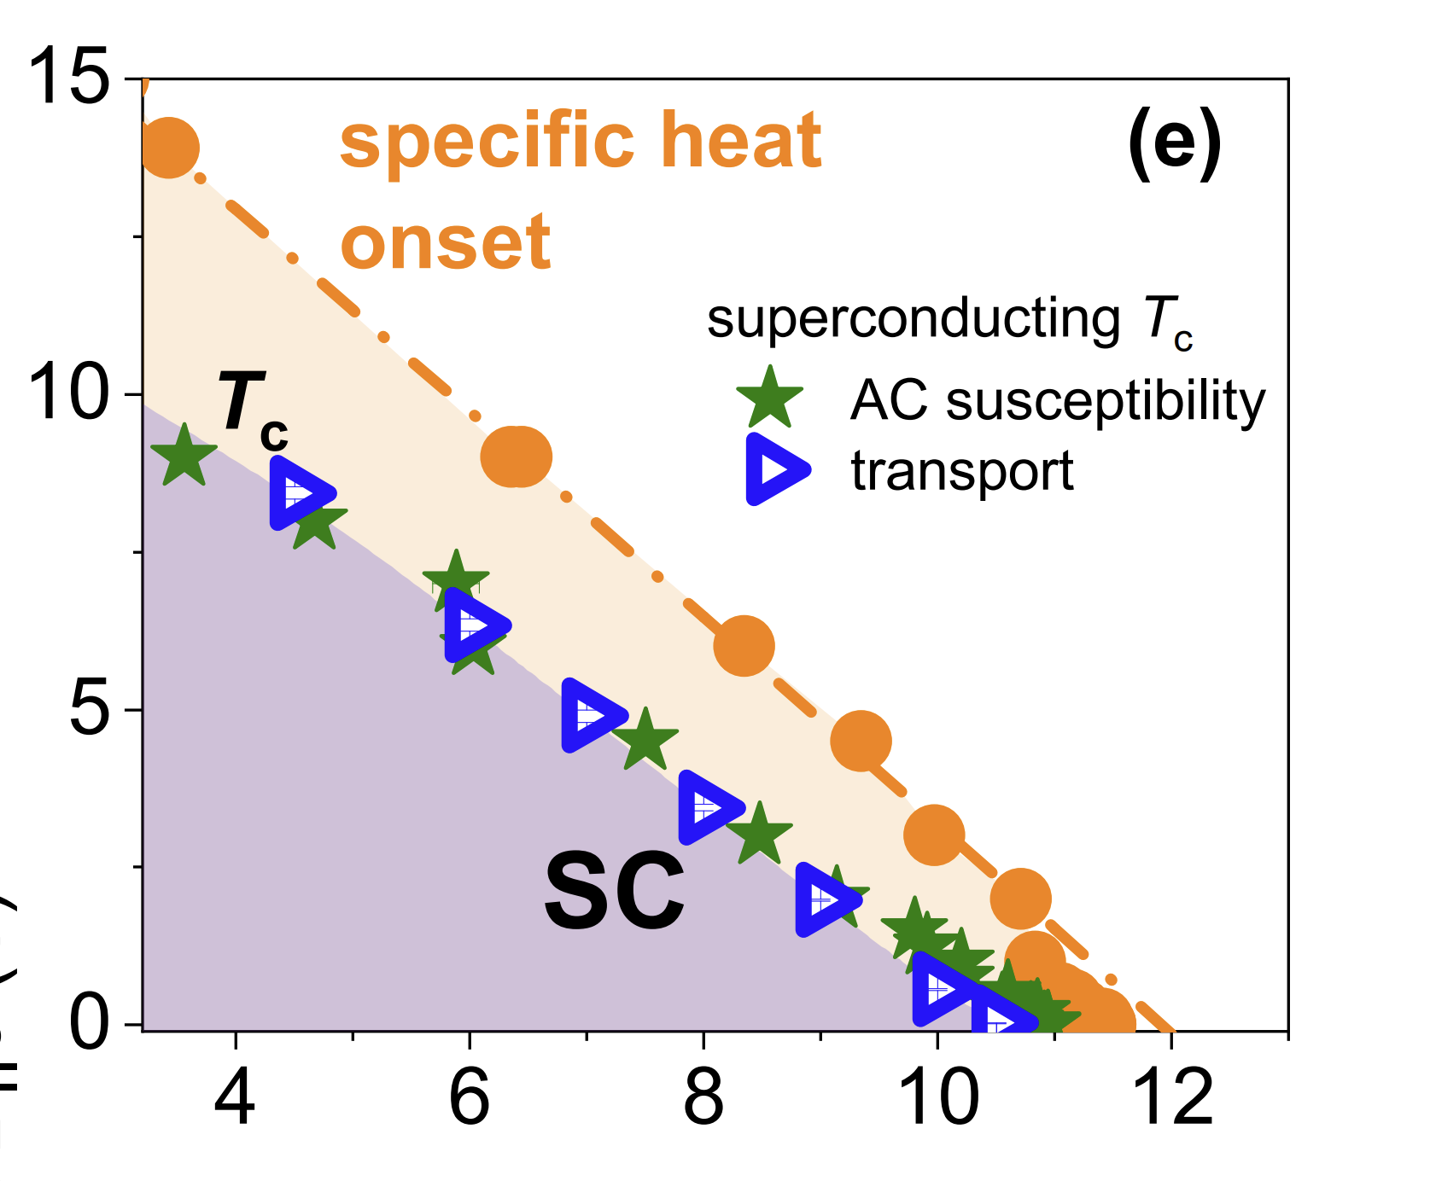
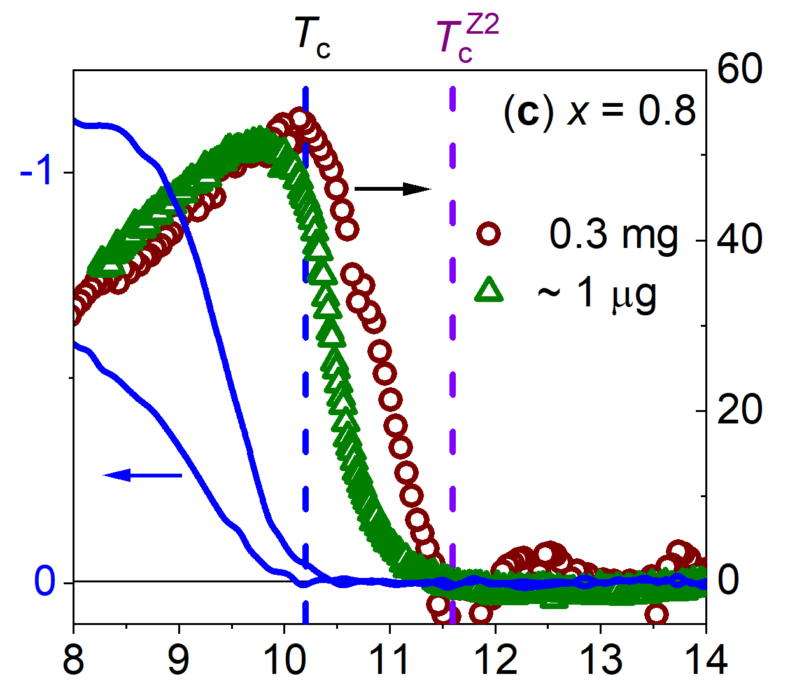
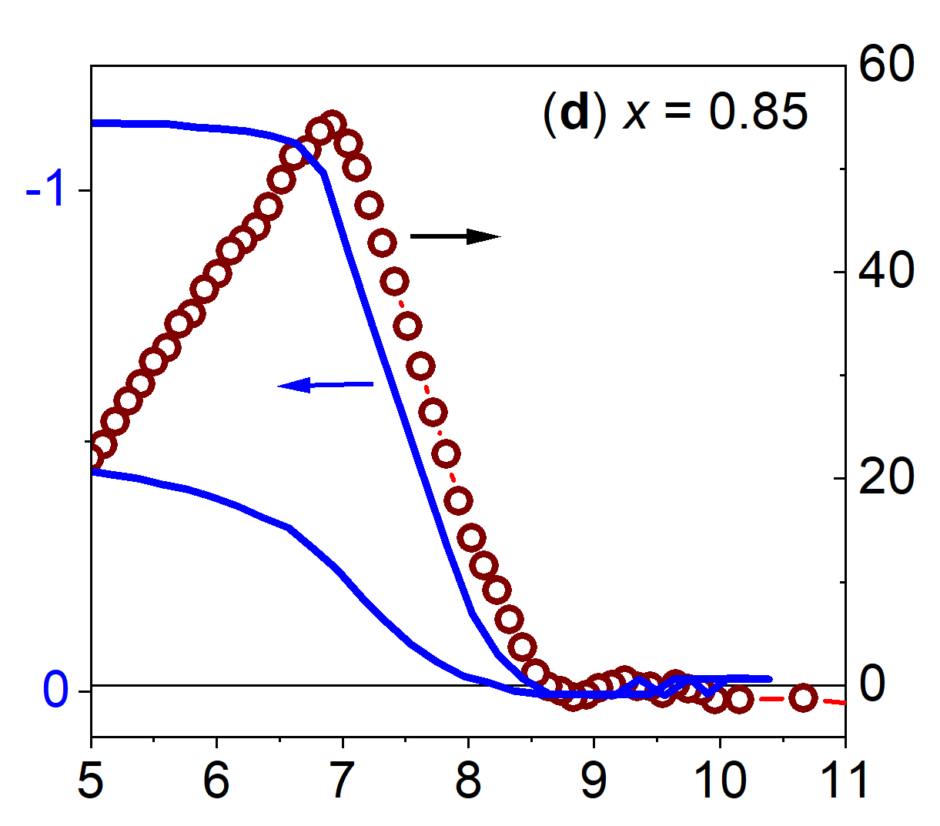
Is there a phase transition above T_{c}?
Critical fields (T)
Specific heat ΔC_{el}/T (mJ/mol•K²)
Temperature (K)
V. Grinenko et al., Nat. Phys. 16, 789–794 (2020).
The splitting increases in applied magnetic field.
Is there specific heat anomaly at T_{BTRS} ?
What is the nature of the transition above T_{c}?
V. Grinenko et al., Nat. Phys. 17, 1254–1259 (2021)
The splitting between transitions seen by the specific heat and susceptibility is observed for the samples with the “strongest” BTRS phase found in the µSR experiments.

Slide 13
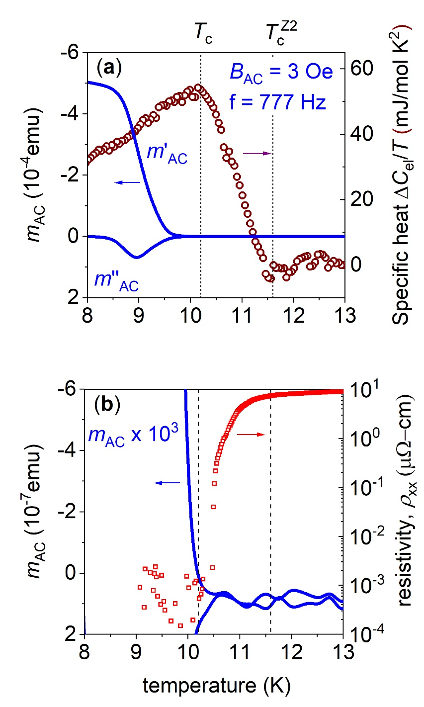
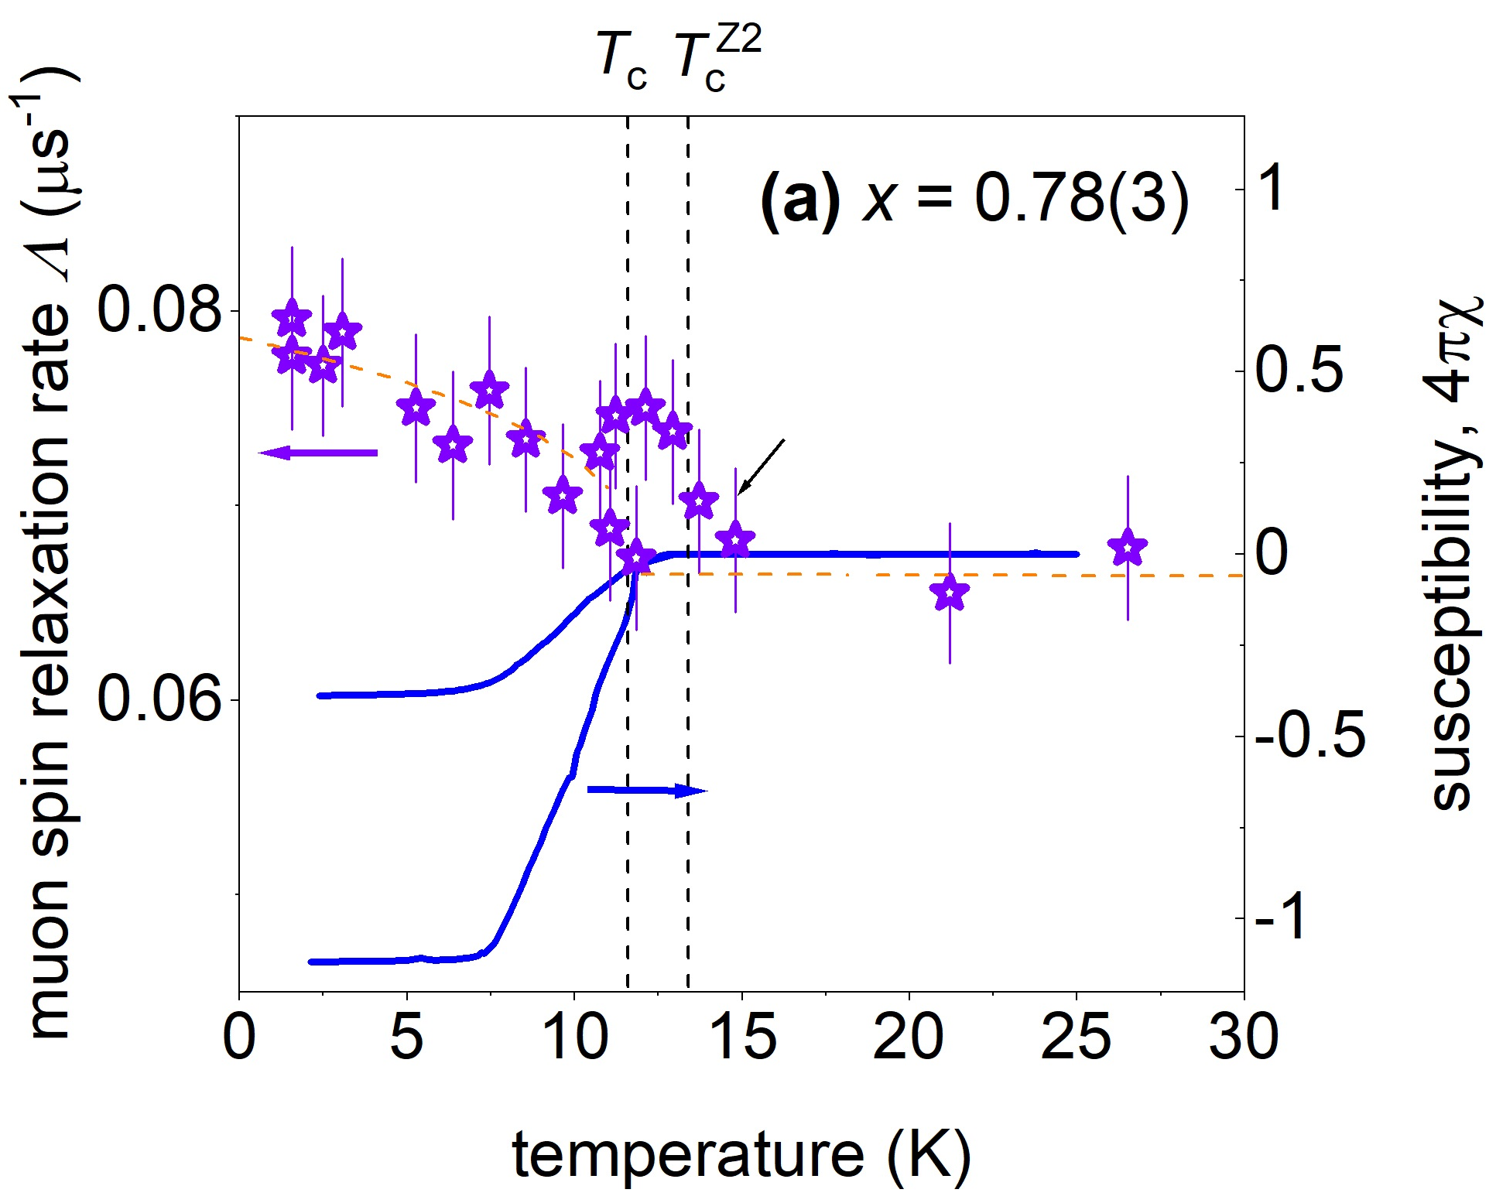
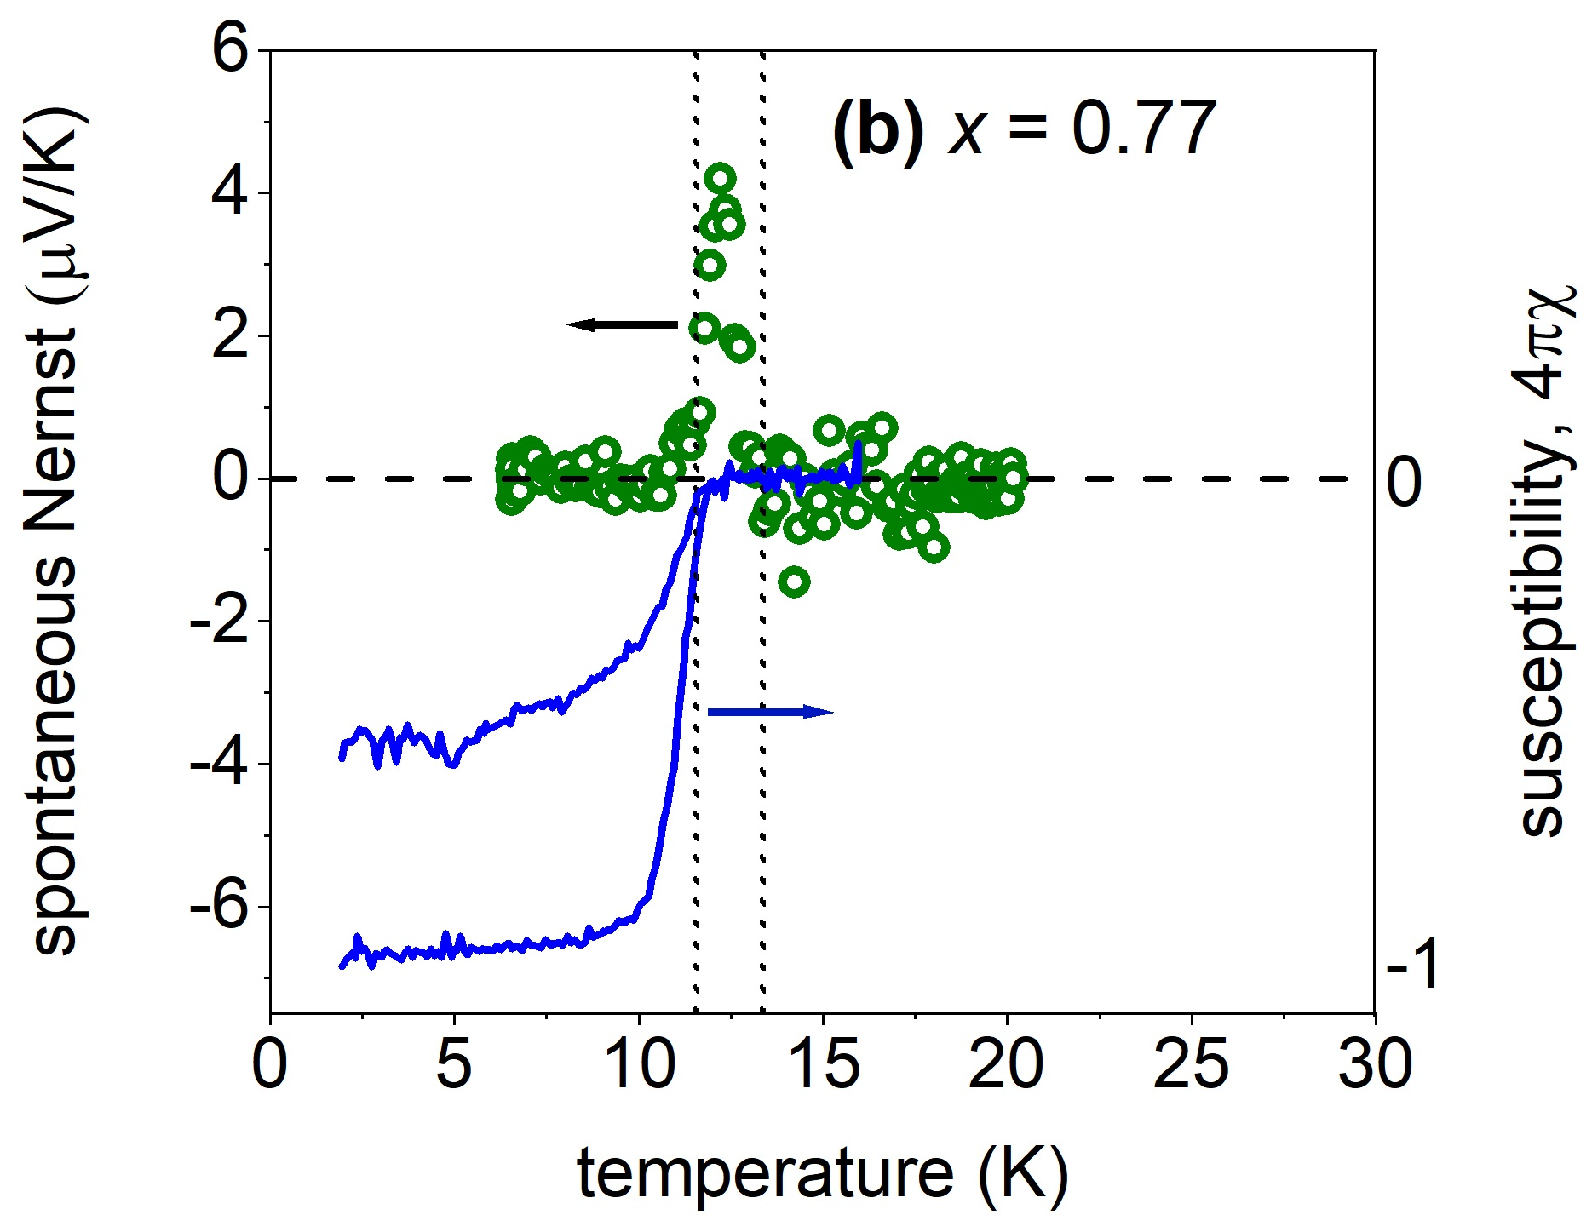
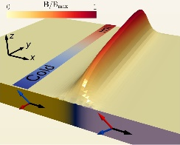
Criteria for T_{c} and Z₂ transition (T_{c}^{Z2})
T_{c} T*
V. Grinenko et al., Nat. Phys. 16, 789–794 (2020).
T_{c} is defined by zero resistance.
In the resistive state diamagnetic susceptibility is small.
The specific heat anomaly develops at T* > T_{c}, preformed Cooper pairs?
Evidence for the Z₂ transition above T_{c} from μSR and spontaneous Nernst effect!
V. Grinenko et al., Nat. Phys. 17, 1254–1259 (2021)

Slide 14
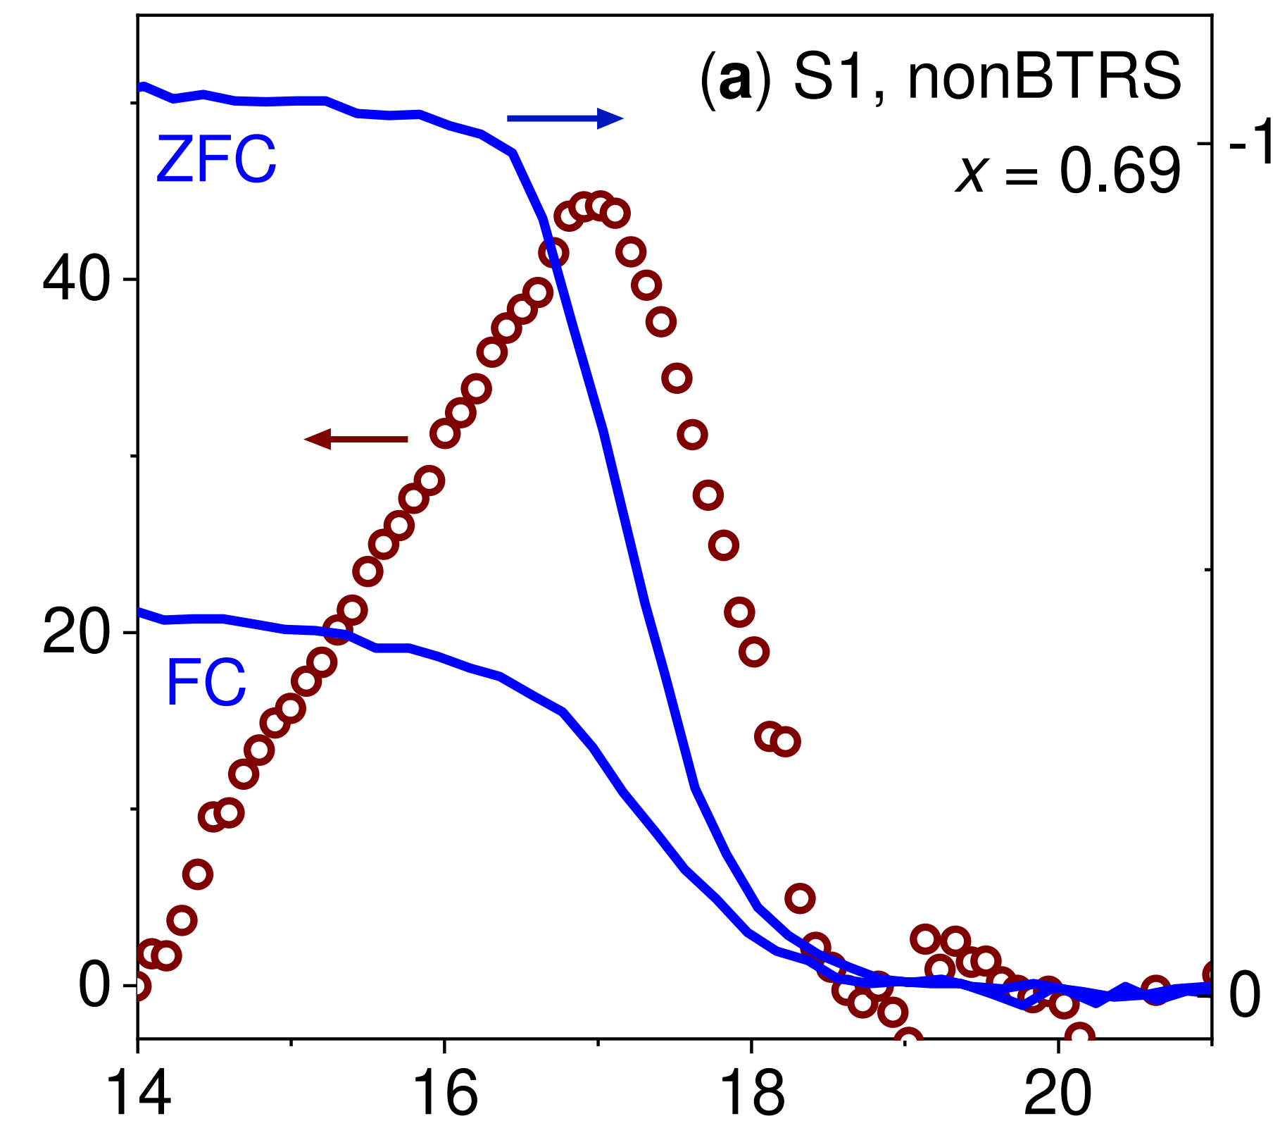
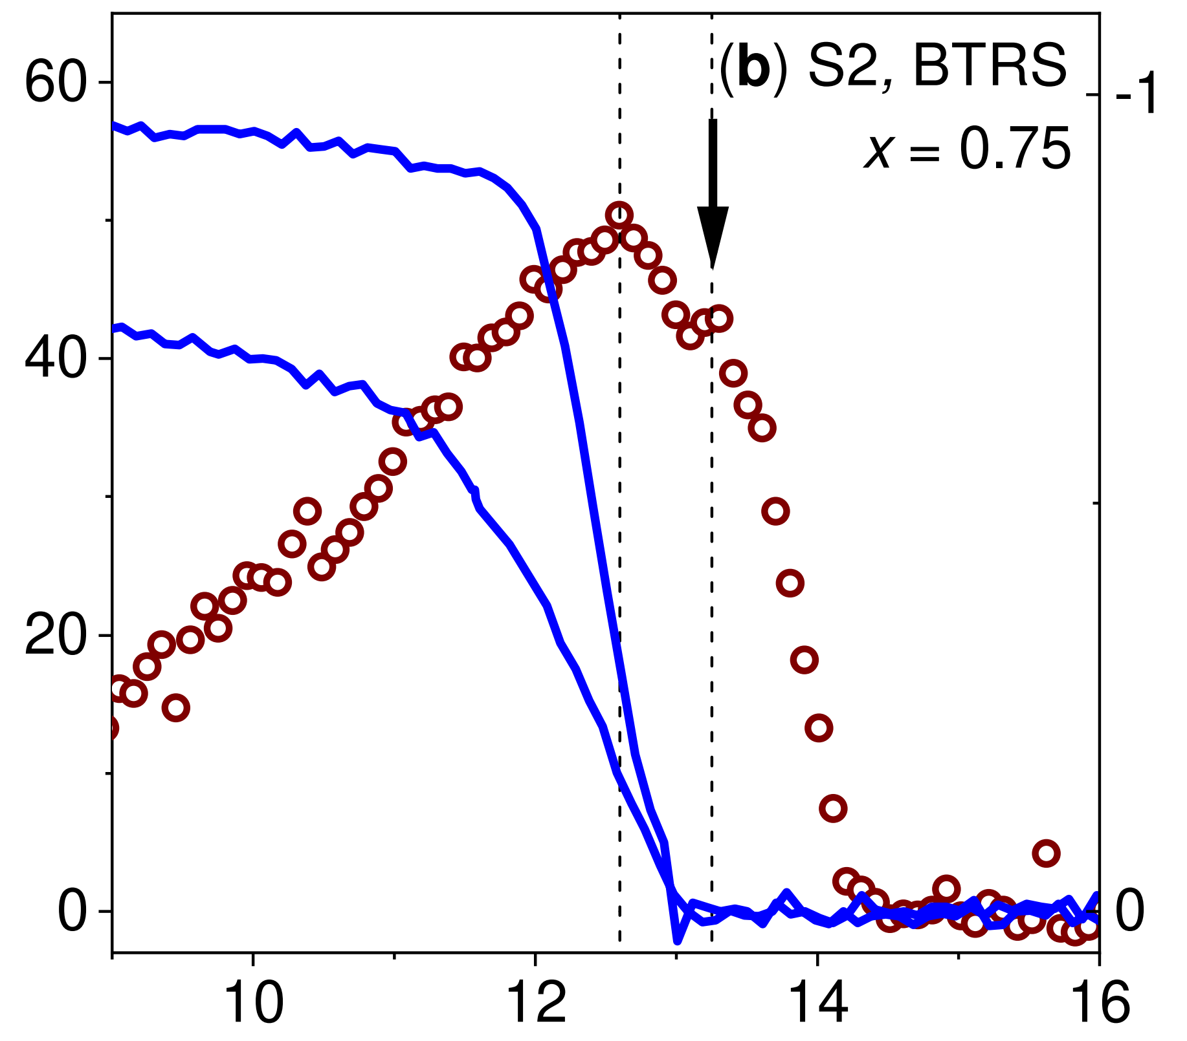
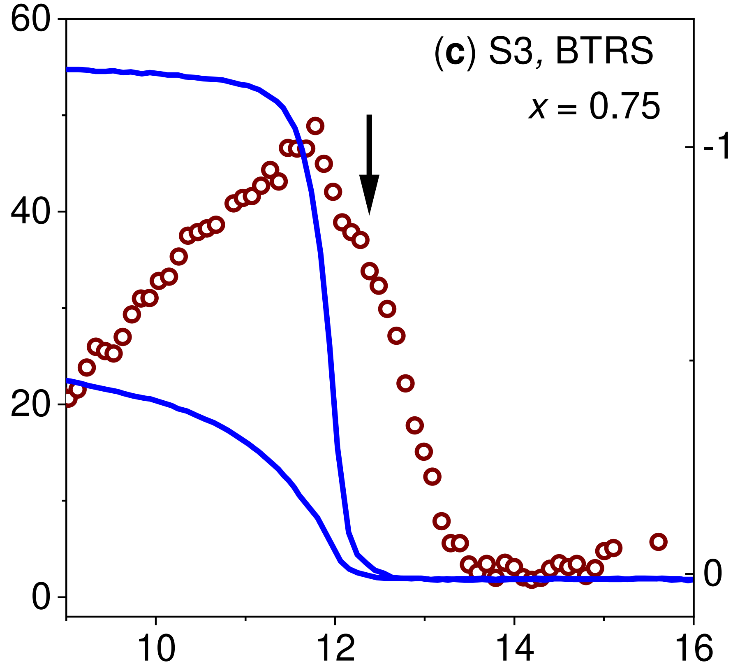
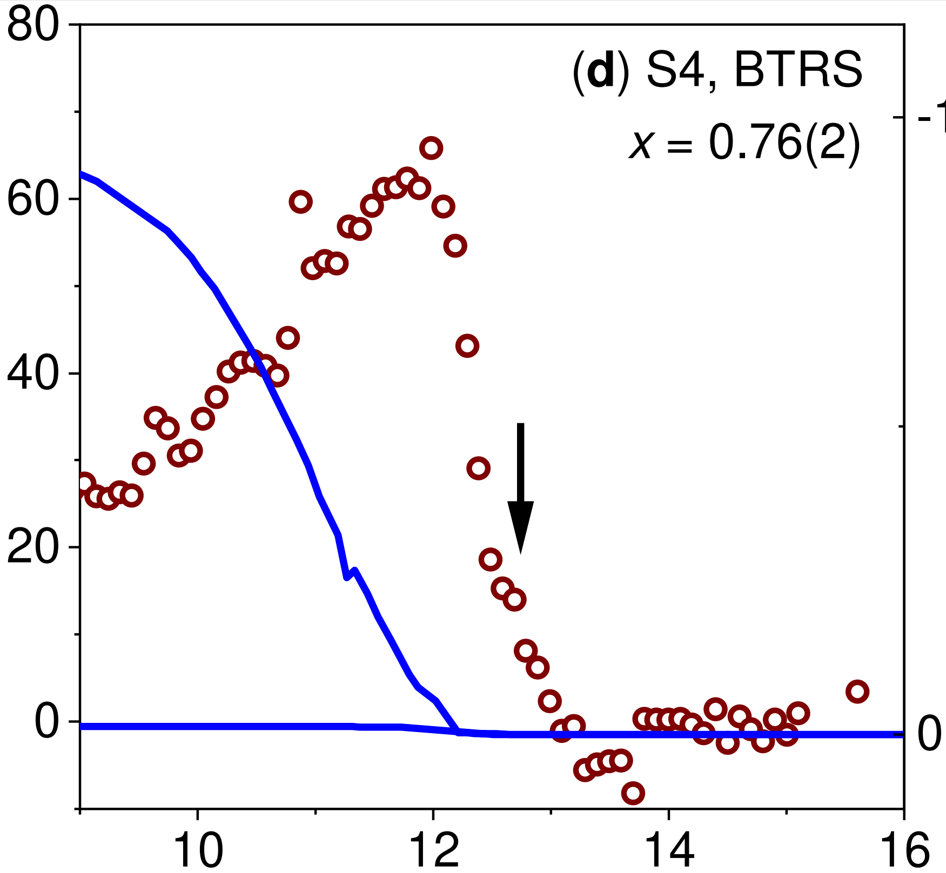
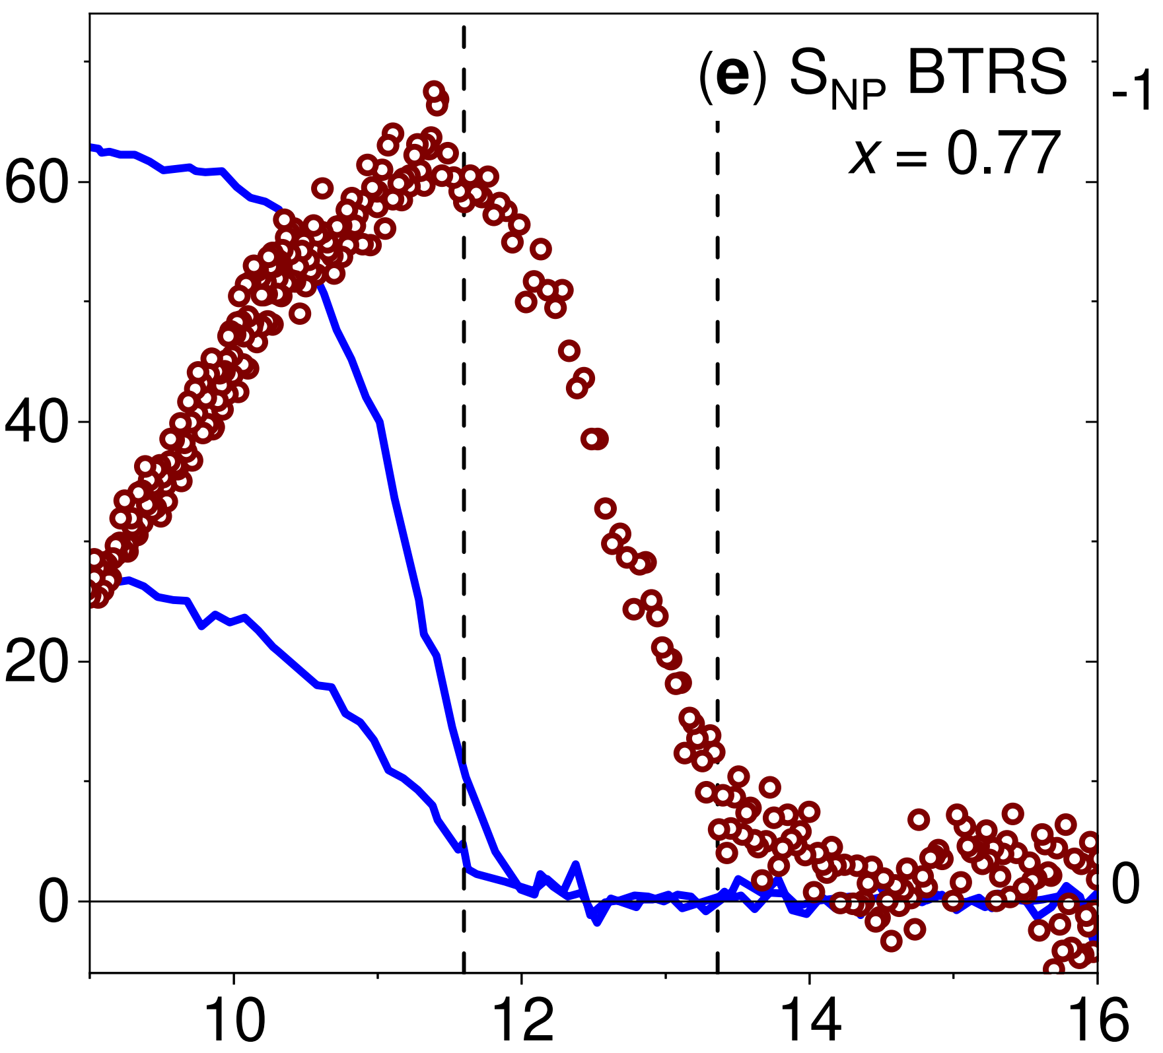
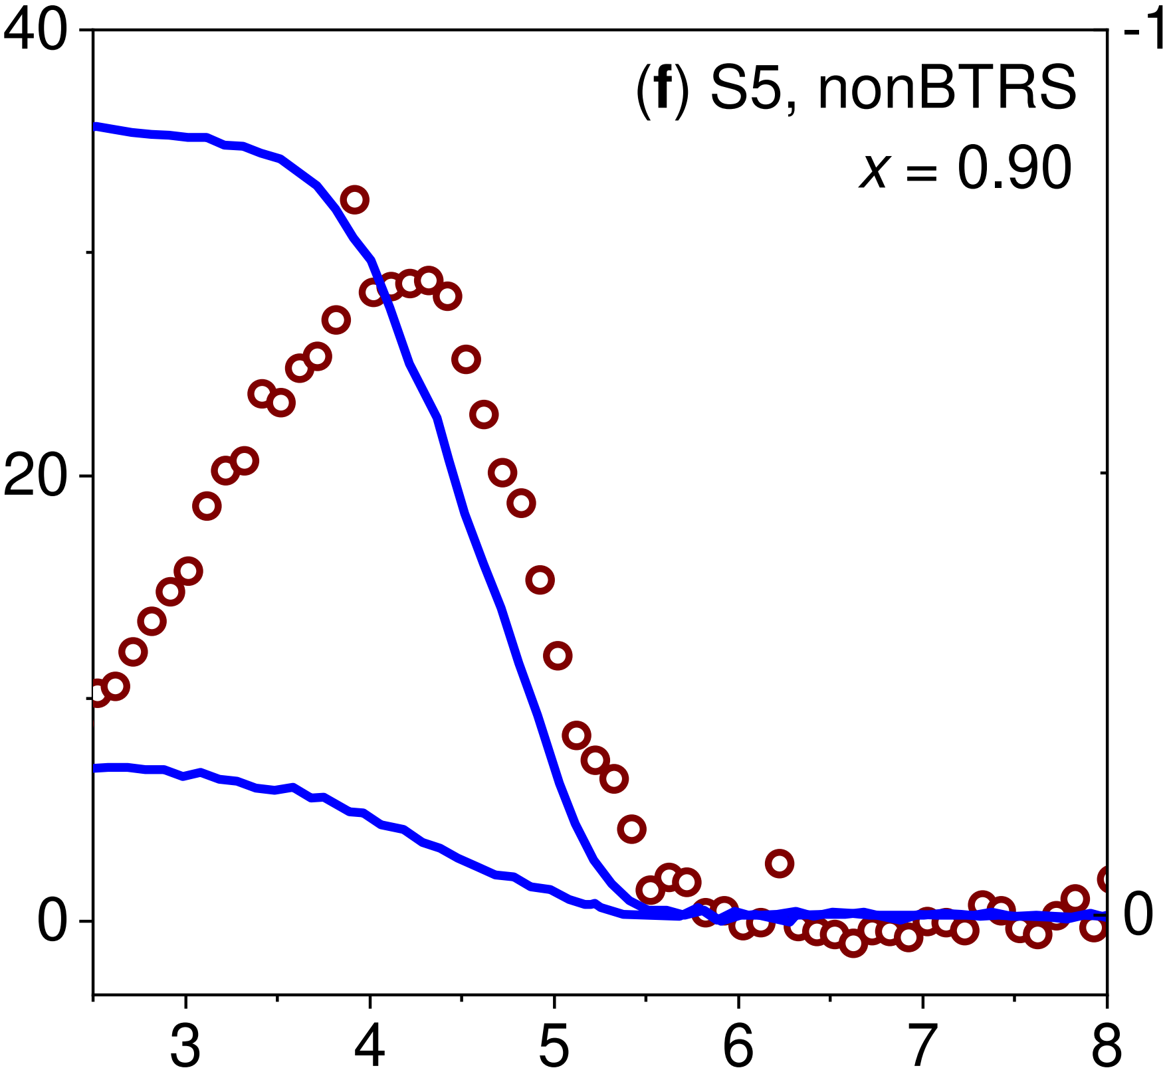
Calorimetric evidence for phase transition above T_{c} in zero magnetic field
The shoulder-like anomaly above T_{c} in a narrow doping range around x ~ 0.75.
Is there evidence for the BTRS phase?
I. Shipulin et al., I. Shipulin et al., Nat Commun 14, 6734 (2023).

Slide 15
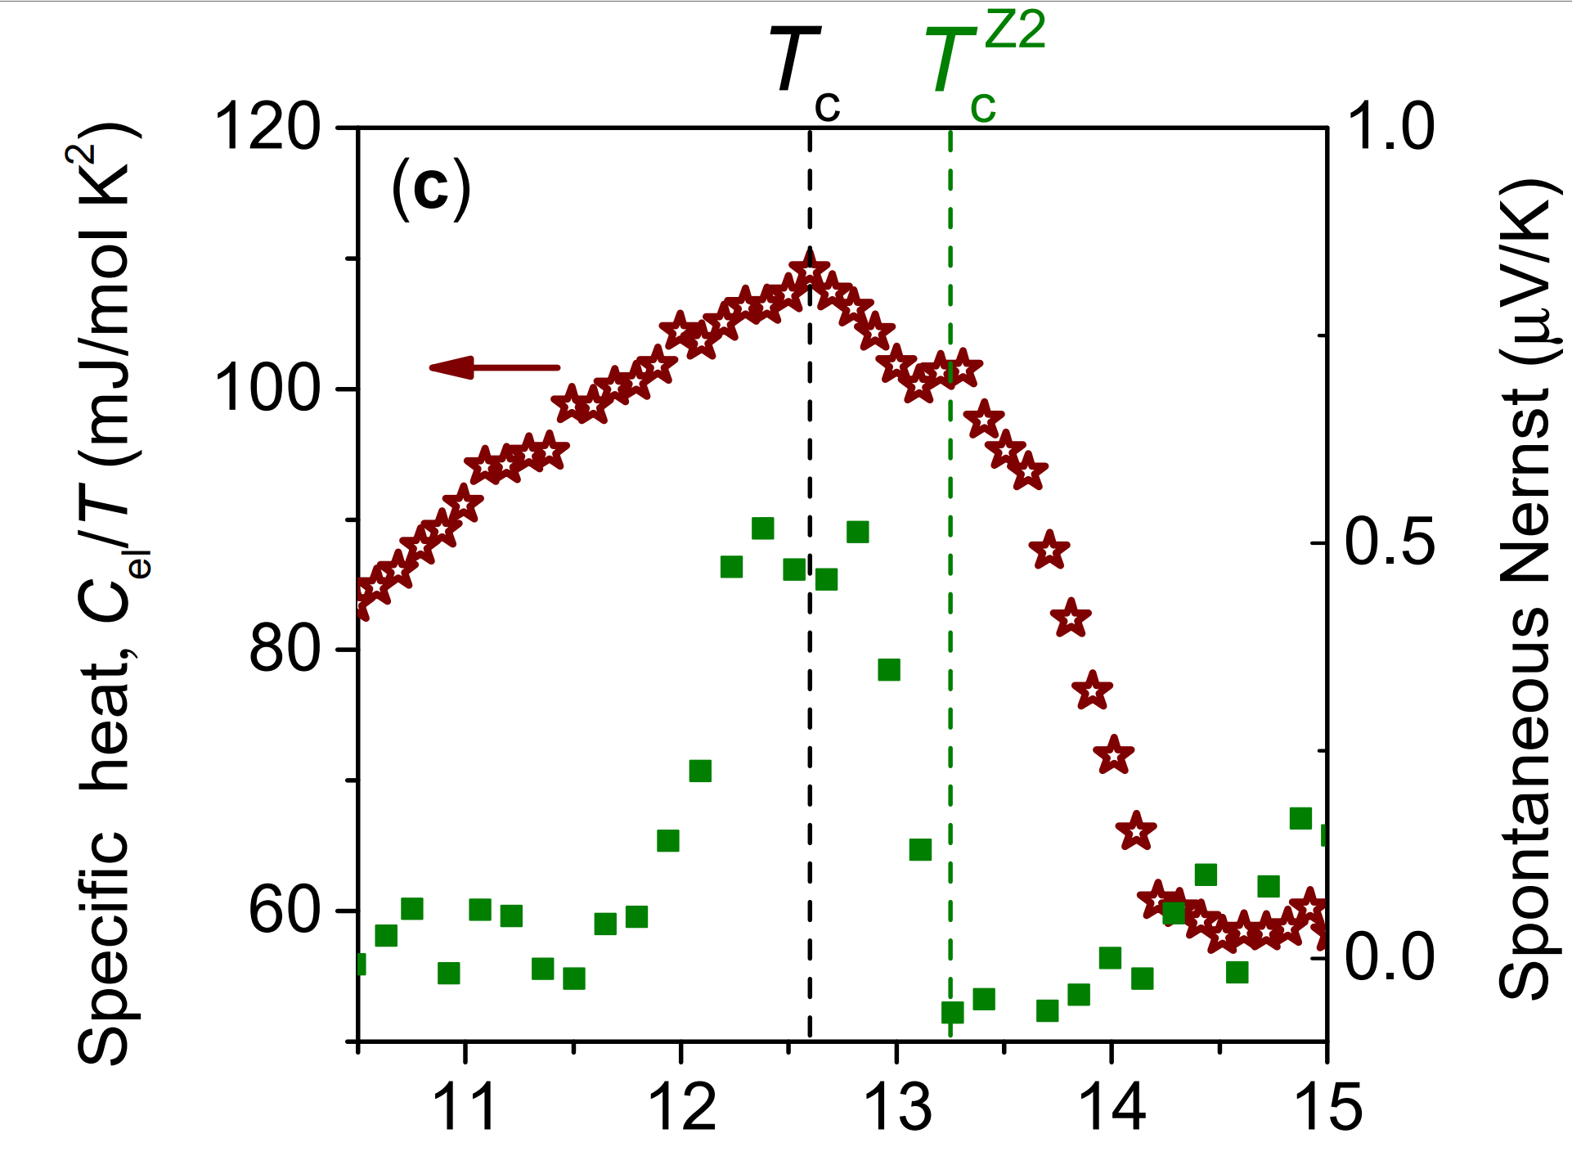
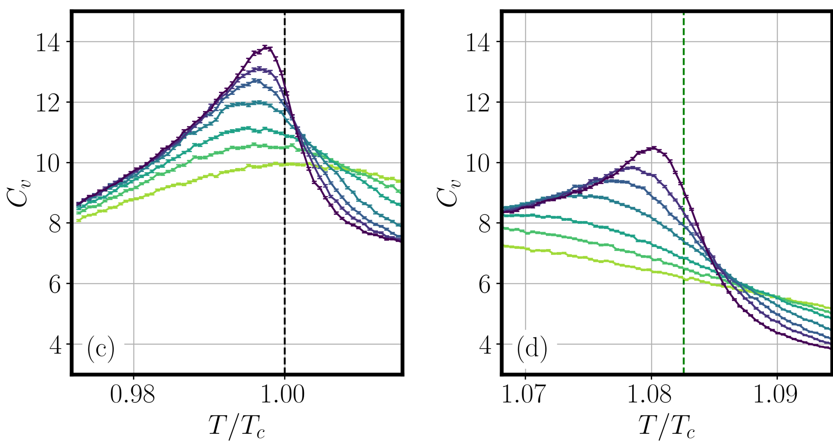
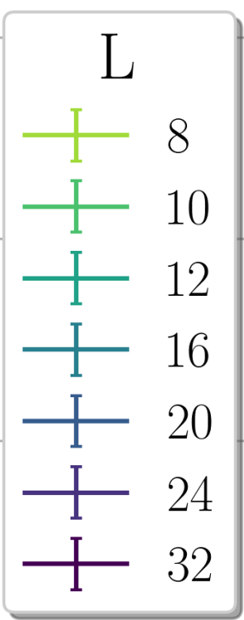
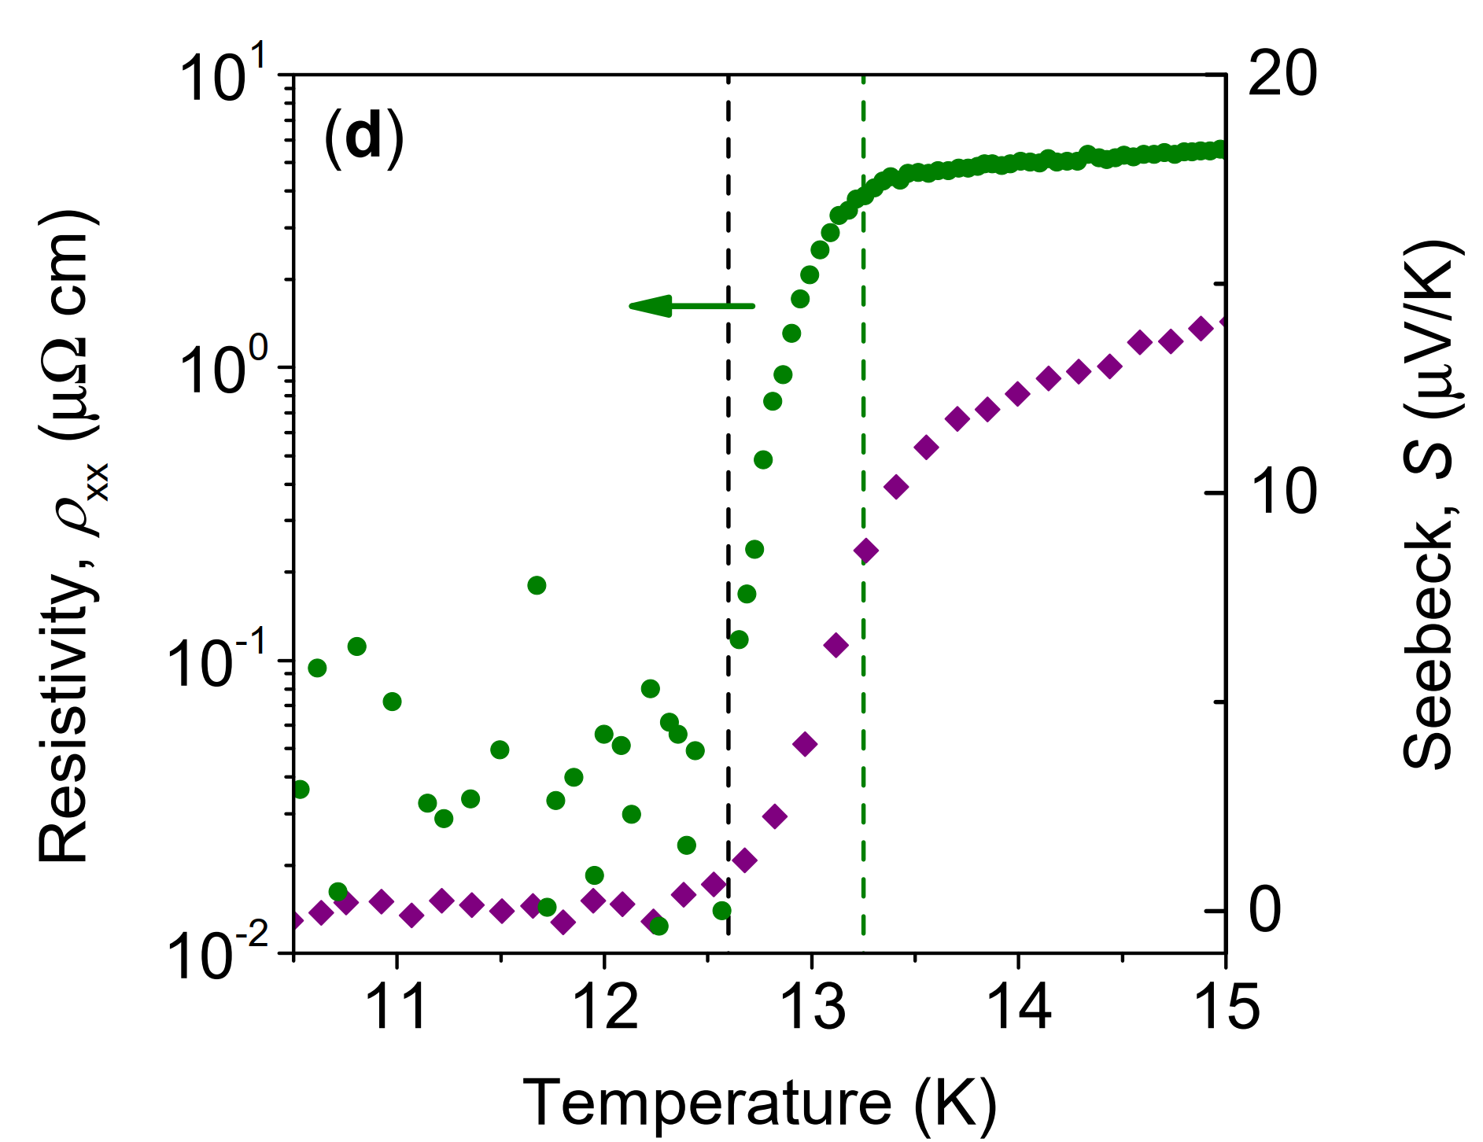
Calorimetric evidence for phase transition above T_{c} in zero magnetic field
The spontaneous Nernst signal confirms Z2;
Monte-Carlo (MC) simulations of two component model with phase fluctuations.
Zero resistivity the superconducting transition.
Theoretical simulations are qualitatively consistent with the experimental observations of two transitions.
In our model phase fluctuations suppress stronger superconductivity (U(1) transition) compared to Z₂ transition.
Is there evidence for superconducting fluctuations?
I. Shipulin et al., Nat Commun 14, 6734 (2023).

Slide 16
Spontaneous Nernst and fluctuations above T_{c}
In BKFA without BTRS state spontaneous Nernst signal is absent and superconducting fluctuations are weak.
Strong superconducting fluctuations in the samples with BTRS state!
V. Grinenko et al., Nat. Phys. 17, 1254–1259 (2021).

Slide 17
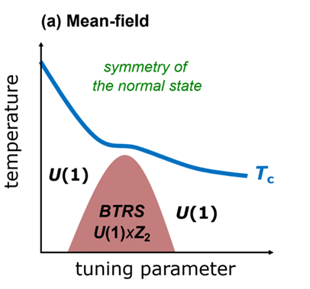
Conclusions: the phase diagram of the sample with a possible quartic metal phase
Conclusions:
T_{BTRS}≤ T_{c}
A new state appear from incoherent Cooper pairs at T_{c}^{Z2} > T_{c} which is a bound state of four fermions – correlated state of pairs of Cooper pairs.
At T_{c}^{Z2} we observe increased muon spin relaxation rate and spontaneous Nernst effect as well thermodynamic signatures.
A lack of the Meissner effect and finite resistance at T_{c}^{Z2} indicate absence of coherent Cooper pairs.
Preformed Cooper pair exist above T_{c}^{Z2} up to T ~ 2T_{c} as evidenced by the observation of the field-dependent Nernst effect and by deviation of the resistivity from the high-temperature behavior.
T_{BTRS} > T_{c}
V. Grinenko et al., Phys. Rev. B 95, 214511 (2017).
V. Grinenko et al., Nat. Phys. 16, 789 - 794 (2020).
V. Grinenko et al., Nat. Phys. 17, 1254–1259 (2021).
Y. Iguchi et al. Science 380,1244-1247(2023)
I. Shipulin et al., Nat Commun 14, 6734 (2023).
Fluctuations suppress faster a continuous U(1) than discreet Z2 symmetry.

Slide 18
μSR as the most sensitive bulk magnetic probe:
The main collaborators at PSI:
Discovery of BTRS superconductivity in iron-based superconductors with average spontaneous magnetic fields ~ 0.1 Oe.
Split superconducting and BTRS transition under uniaxial strain in Sr₂RuO₄.
Strain induced spin density wave (SDW) with magnetic moment ~ 0.1μ_{B.}
BTRS superconductivity under hydrostatic pressure.
V. Grinenko et al., Phys. Rev. B 95, 214511 (2017).
V. Grinenko et al., Nat. Phys. 16, 789 - 794 (2020).
Hubertus Luetkens
Rustem Khasanov
The main participants in the projects:
V. Grinenko et al., Nat. Phys. 17, 748–754 (2021).
Hans-Henning Klauss,
TU Dresden
Manfred Sigrist
ETH Zurich
V. Grinenko et al., Nat Commun 12, 3920 (2021).
Clifford W. Hicks
University of Birmingham
Shreenanda Ghosh
The Johns Hopkins University

Slide 19
Motivation
Is Sr₂RuO₄ a chiral (Δ_{x} ± iΔ_{y}) superconductor?

Slide 20
Sr₂RuO₄ is multiband superconductor
Crystal structure
Electronic orbitals relevant for conductivity
Fermi surface
C. Hicks, MPI Dresden
S. Raghu et al., Journal of Physics: Conference Series 449, 012031 (2013).
Sr₂RuO₄ has a complex electronic structure, makes it similar to Fe-based superconductors.

Slide 21
Sr₂RuO₄ is multiband superconductor
Variety of possible superconducting order parameters in Sr₂RuO₄
Multi-band nature of the Fermi surface results in a possibility of mixed pairing states with the pairing mediated by spin fluctuations, candidates: s+id, d+ig, s+ip
Mixed pairing or chiral
?
d_{xz}+id_{yz}
A. T. Rømer, et al., PRL 123, 247001 (2019); PRB 102, 054506 (2020); PRB 104, 064507 (2021);
S. A. Kivelson, et al., npj Quantum Mat. 5, 43 (2020).
Alternatively, the orbital degree of freedom can encode chiral order parameters with a pairing originated from local interactions, candidates: d+id.
A. Ramires, and M. Sigrist, Physical Review B (2019). H. G. Suh et al.,Phys. Rev. Research 2, 032023(R) 2020.
A. Ramires, arXiv:2110.10621.
A chiral p-wave is excluded according to the NMR Knight shift measurements:
A. Pustogow et al., Nature 574, 72 (2019).
K. Ishida, et al., J. Phys. Soc. Jpn. 89, 034712 (2020).
A. Chronister et al., PNAS 118 (25) e2025313118 (2021).
The reduction of the NMR Knight shift below T_{c}

Slide 22
How can we distinguish between chiral and non-chiral superconductivity using µSR?
(d_{xz} ± id_{yz})
Accidentally degenerated sates:
T_{c} and T_{BTRS} transitions must split under symmetry breaking uniaxial strain.
Do not split with the hydrostatic pressure and isotropic disorder.
T_{c} and T_{BTRS} transitions must split under uniaxial strain.
Uniaxial pressure
Do split with the hydrostatic pressure and disorder.
(100) direction
(110) direction
V. Grinenko et al., Nat Commun 12, 3920 (2021).
Tetragonal
y
Splitting of T_{c} and T_{BTRS} is expected for both: chiral and accidentally degenerated orders.
Important demonstration that T_{c} and T_{BTRS} are related to a different phase transitions.
x
Orthorhombic

Slide 23
Sr₂RuO₄ under the (100) strain
Tetragonal
What is the effect of van Hove on BTRS state?
Can van Hove induce magnetism?
Orthorhombic
Experimental setup for the μSR:
along (100)
S. Ghosh et al., Review of Scientific Instruments 91, 103902 (2020).
V. Grinenko et al., Nat. Phys. 17, 748–754 (2021).
T_{c} is measured by AC susceptibility.
T_{BTRS} by zero-field µSR.
A. Steppke, et al., Science 355, eaaf9398 (2017).

Slide 24
BTRS superconductivity of Sr₂RuO₄ under the (100) strain
Tetragonal
T_{BTRS}
T_{BTRS}
Orthorhombic
T_{c}
Relaxation rate, λ (µs⁻¹)
AC susceptibility
Relaxation rate, λ (µs⁻¹)
AC susceptibility
Temperature (K)
A. Steppke, et al., Science 355, eaaf9398 (2017).
Significant splitting of T_{BTRS} and T_{c}!
BTRS state exists above van Hove singularity!
Temperature (K)
V. Grinenko et al., Nat. Phys. 17, 748–754 (2021)

Slide 25
Strain induced SDW phase in Sr₂RuO₄
Tetragonal
Orthorhombic
van Hove
A. Steppke, et al., Science 355, eaaf9398 (2017).
An incommensurate SDW phase well above the van Hove singularity with T_{N} ~ 7 K;
V. Grinenko et al., Nat. Phys. 17, 748–754 (2021)
Small internal magnetic fields correspond roughly to 0.1 µ_{B} (similar to Sr₃Ru₂O₇);
The SDW internal field is 100 times stronger than spontaneous fields due to BTRS superconductivity.

Slide 26
μSR measurements of Sr₂RuO₄ under uniaxial strain
Lifshitz transition
Spontaneous superconducting diode effect
Elastocaloric effect
SDW state
T_{BTRS}
T_{c}
V. Grinenko et al., Nat. Phys. 17, 748–754 (2021).
YS. Li et al., Nature 607, 276–280 (2022).
M. S. Anwar et al., arXiv:2211.14626v1
Superconducting T_{c} and T_{BTRS} split by uniaxial strain → two distinct phases!
SDW phase detected by μSR is confirmed by elastocaloric effect measurements.
Split T_{c} and T_{BTRS} is confirmed by spontaneous superconducting diode effect measurements.
Tetragonal
y
x
What is the evidence from other probes in favor of the μSR phase diagram?
Orthorhombic
Uniaxial strain induces spin density wave order (SDW) above the Lifshitz transition in odd with early theoretical predictions.

Slide 27
How can we distinguish between chiral and non-chiral superconductivity using µSR?
(d_{xz} ± id_{yz})
Accidentally degenerated sates:
T_{c} and T_{BTRS} transitions must split under symmetry breaking uniaxial strain.
Do not split with the hydrostatic pressure and isotropic disorder.
Disorder effect on T_{c}
T_{c} and T_{BTRS} transitions must split under uniaxial strain.
Do split with the hydrostatic pressure and disorder.
At small concentrations the dominant effect of La on T_{c} is related to a pair breaking effect.
V. Grinenko et al., Nat Commun 12, 3920 (2021).
La-doping results in isotropic in-plane disorder without anisotropic internal strain.
La-doping is an ideal tool to study the effect of disorder on T_{c} and T_{BTRS}
N. Kikugawa et al., Phys. Rev. B 70, 060508(R) (2004)

Slide 28
Time reversal symmetry breaking in Sr_{2-y}La_{y}RuO₄
1% of La doping suppresses T_{c} by 50% as compared with a impurity free T_{c0}
T_{BTRS} ≈ T_{c}
The normal state electronic specific heat is nearly the same for all samples, γ_{n} ≈ 40 mJ/mol-K² -> the DOS and correlation effects are unchanged.
Sharp superconducting transition -> homogeneous suppression of superconductivity by a pair braking effect.
T_{BTRS} = T_{c} in the sample with a half of the disorder free T_{c0};
Together with the splitting between T_{BTRS} and T_{c} under uniaxial strain
→ evidence in favor of a chiral superconductivity in Sr₂RuO₄
V. Grinenko et al., Nat Commun 12, 3920 (2021).

Slide 29
Theory: Splitting of the T_{c} and T_{TRSB} under disorder for accidentally degenerated orders
Accidentally degenerated sates:
d+ig state
Manfred Sigrist
T_{c} and T_{BTRS} transitions must split under uniaxial strain.
Do split with the hydrostatic pressure and disorder.
V. Grinenko et al., Nat Commun 12, 3920 (2021).
B. Zinkl. & M. Sigrist, arXiv:2009.10089 (2020).
Fine-tuning is possible that transitions do not split with disorder.
Therefore, additional experiments are needed!

Slide 30
How can we distinguish between chiral and non-chiral superconductivity using µSR?
(d_{xz} ± id_{yz})
Accidentally degenerated sates:
T_{c} and T_{BTRS} transitions must split under symmetry breaking uniaxial strain.
Do not split with the hydrostatic pressure and isotropic disorder.
T_{c} and T_{BTRS} transitions must split under uniaxial strain.
Do split with the hydrostatic pressure and disorder.
Hydrostatic pressure preserves tetragonal symmetry a = b
V. Grinenko et al., Nat Commun 12, 3920 (2021).
Tetragonal
y
x
“Fine tuning” is impossible for both disorder and hydrostatic pressure!
D. Forsythe et al., Phys. Rev. Lett. 89, 166402 (2002)
N. Shirakawa et al., Phys. Rev. B 56, 7890 (1997)

Slide 31
The first μSR measurements of BTRS superconductivity under pressure
Rustem
Khasanov
Sample +cell
Sample
Tetragonal
BTRS transition temperature, T_{BTRS} (K)
T_{BTRS} = T_{c}
T_{c}
T_{BTRS}
Superconducting transition temperature, T_{c} (K)
T_{BTRS} ≈ T_{c} due disorder and under hydrostatic pressure
Temperature (K)
Evidence for two component chiral
superconductivity in Sr₂RuO₄.
Suppression of superconductivity and time-reversal symmetry breaking under pressure.
V. Grinenko et al., Nat Commun 12, 3920 (2021)

Slide 32
Is there any other method to detect the phase transition below T_{c}?
J Garaud et al., Phys. Rev. B 98, 014520 (2018)
We studied the vortex structure under uniaxial strain using muon spin rotation experiments.
The BTRS phase transition result in divergence of the coherence length.
This divergence should affect intervortex integration.

Slide 33
Summary: T_{BTRS} under pressure and disorder in Sr₂RuO₄
Taking in to account symmetry consideration the natural possibility is a chiral d_{xz}± id_{yz} superconducting state!
Problems for chiral d_{xz}± id_{yz} state:
Missing anomaly in the specific heat under uniaxial strain;
Missing cusp in T_{c} under the strain.
Problems for mixed pairing states:
Unusual fine tuning of T_{c} and T_{BTRS} under hydrostatic pressure and with disorder;
Reproducible observation of the Kerr effect.
BTRS transition temperature, T_{BTRS} (K)
T_{BTRS} = T_{c}
Superconducting transition temperature, T_{c} (K)
The related µSR publications:
V. Grinenko et al., Nat Commun 12, 3920 (2021).
V. Grinenko, S. Ghosh et al., Nat. Phys. 17, 748–754 (2021).

Slide 34
Some experimental evidences for multicomponent order parameter in Sr₂RuO₄
Polar Kerr effect
Enhanced muon spin relaxation rate below T_{c} → spontaneous magnetic fields
J. Xia, A. Kapitulnik et al., PRL (2006)
Altogether these experiments are consistent
with chiral state.
Decrease of the transverse sound viscosity at T_{c}, -> elastic constant C₆₆ -> indication for 2D order parameter.
C. Lupien, PhD thesis (2002)
Luke, G. M. et al. Nature 394, 558–561 (1998)
S .Ghosh et al., Nat. Physics (2020) , S. Benhabib et al., Nat. Physics (2020)

Slide 35
Evidences against chiral superconductivity in Sr₂RuO₄
Scanning SQUID microscopy
Missing cusp in T_{c} under strain
Theory
Experiment
Absence of edge currents?
J. R. Kirtley, et al., Phys. Rev. B 76, 014526 (2007)
C. W. Hicks et al., Phys. Rev. B 81, 214501 (2010)
Problems with interpretation Josephson effect: S. Kashiwaya et al., PRB 100, 094530, S.-I. Suzuki et al., PRB 101, 054505 (2020), ….
C. W. Hicks et al., Science 344, 283-285 (2014).
A. Steppke, et al., Science 355, eaaf9398 (2017).
Missing anomaly at T_{TRSB} in the specific heat under uniaxial strain
It can be explained by the suppression of superconductivity by surface reconstruction.
Y.-S. Li et al., PNAS 118 (10) e2020492118 (2021)
C. A. Marques et al., arXiv:2005.00071
A. Kreisel et al., arXiv:2103.06188
R. Fittipaldi et al., Nat Commun. 12, 5792 (2021).
Are T_{c} and T_{TRSB} transitions split under uniaxial strain?

Slide 36
Two critical temperatures in Ba_{0.23}K_{0.77}Fe₂As₂ with BTRS state
T_{c}^{Z2} - formation of bound state and appearance of spontaneous Nernst signal;
T_{c} - Meissner effect and zero resistance;
T_{SF}^{low} - freezing all vortices.
The anomaly in the specific heat at T_{c}^{Z2} is observed in applied magnetic field.
The anomaly is not resolved in zero field.
V. Grinenko et al., Nat. Phys. 17, 1254–1259 (2021).

