Slide 1
Target design of CSNS-II MELODY
Lei Liu, Yu Bao, Nikolaos Vassilopoulos, Zhiduo Li
Huayan He, Guangyuan Wang, Junsong Zhang, Yuanguang Xia…
2023.11.05

Slide 2
Content
1
1. Engineering Introduction
2. Design Progress of Target Station Equipment
3. Maintenance Design of Equipment
4. Future Work Plan

Slide 3
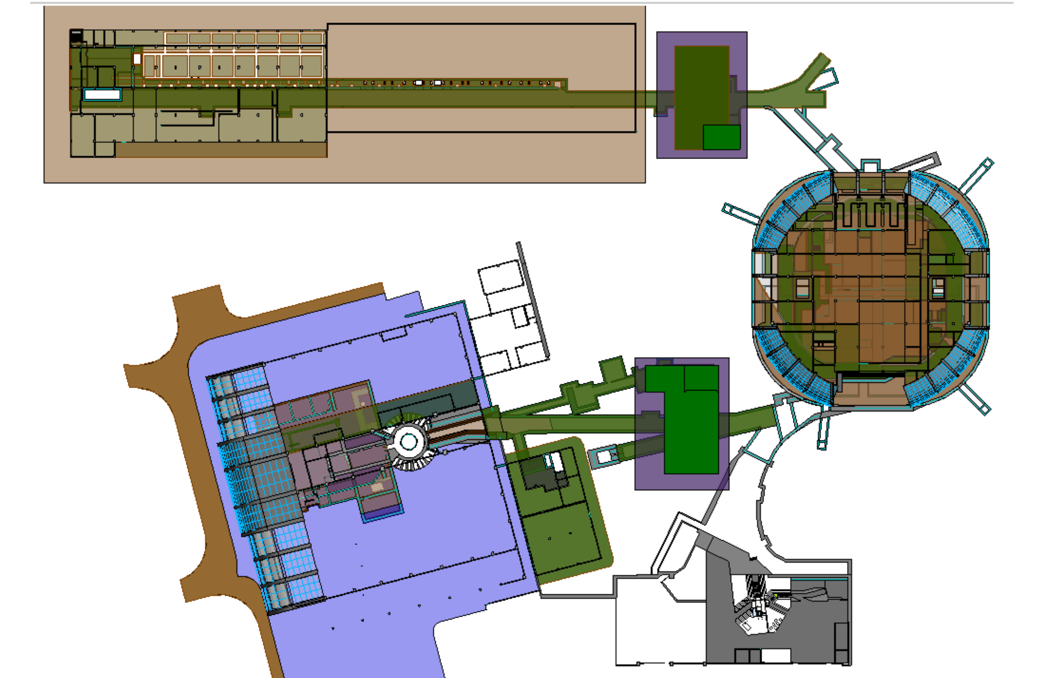
1. Engineering Introduction
2
1.1 Introduction to CSNS-II
After the CSNS-II project increases the beam power to 500kW, it will provide conditions for the construction of the muon source. The proton accelerator frequency is 25Hz, and the proton energy is 1.6GeV. In the extraction section, we extract a beam cluster every second, which is transported to the muon source target station through a transport line to produce muon. The power is 20kW(4% of 500kW).
LINAC
RCS
Neutron target station
20kW
Muon target station

Slide 4
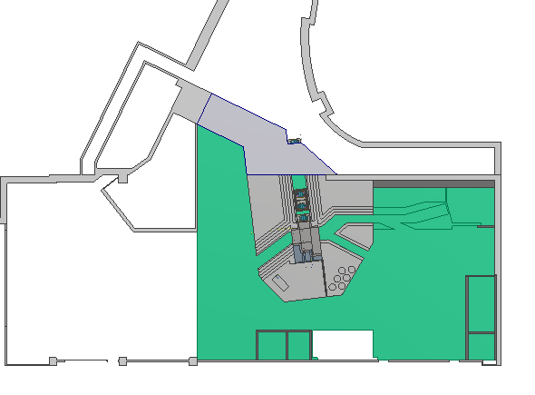
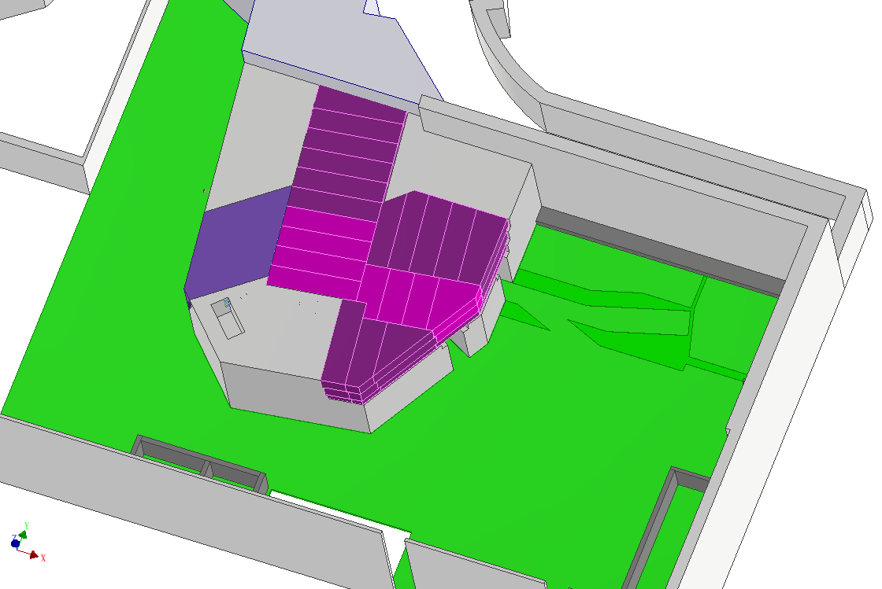
1. Engineering Introduction
3
1.2 Introduction to CSNS-II muon target station
The muon target station is a newly built independent target station, consisting of one proton beam line and three muon beam lines. In the CSNS-II project, only one surface muon beam line is constructed, and the remaining two beam lines will be constructed later.
All equipment is installed inside the shielding, with a fixed concrete shielding of about 1100 cubic meters, a movable concrete shielding of about 500 cubic meters, and a steel shielding of about 800 tons.
Proton beam
fixed concrete shielding
muon beam line 1
muon beam line 1
movable concrete shielding
muon beam line 3
muon beam line 2
steel shielding

Slide 5
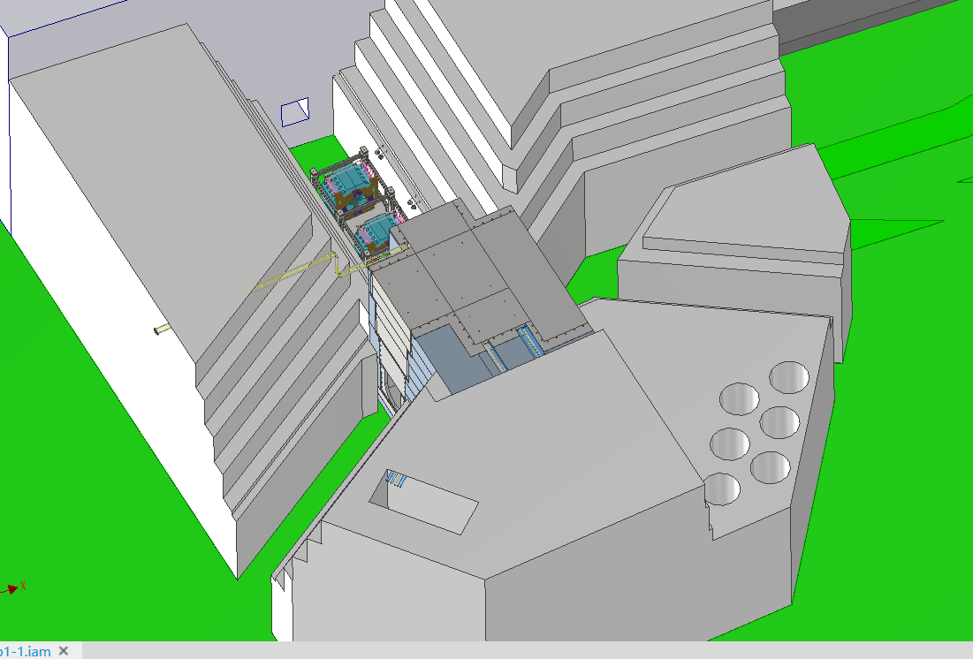
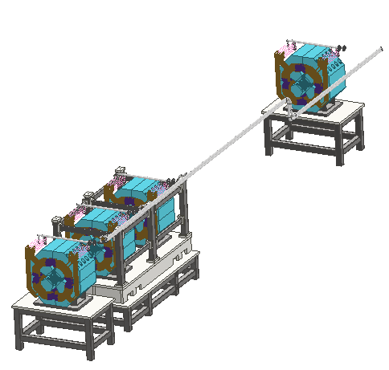
2. Design Progress of Target Station Equipment
4
At present, only one proton beam line and one muon beam line need to be constructed for the muon source target station. The muon target is located on the proton beam line, and the important equipment is introduced as follows:
2.1 Equipment located in low radiation areas of proton beam line
The proton beam lines in the target station include low radiation areas and high radiation areas. The equipment in the low radiation area mainly includes three quadrupole magnets, which can be maintained at close range.
For ease of installation and maintenance, the magnets adopt a common support design scheme. The magnet water and electricity are connected from the top along the tunnel back to the upper tunnel.
Proton beam
muon beam line 1
water and electricity
Magnet outside the target station
common support scheme
muon target

Slide 6
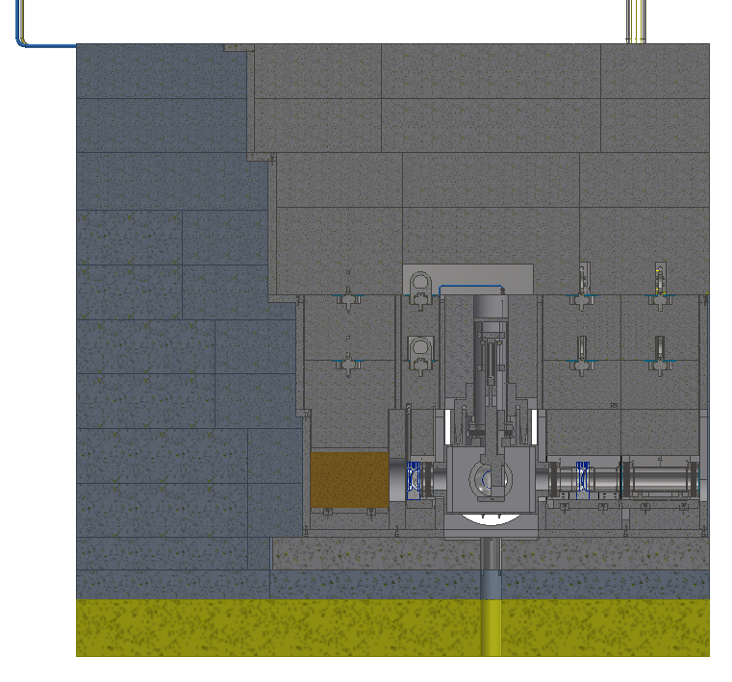
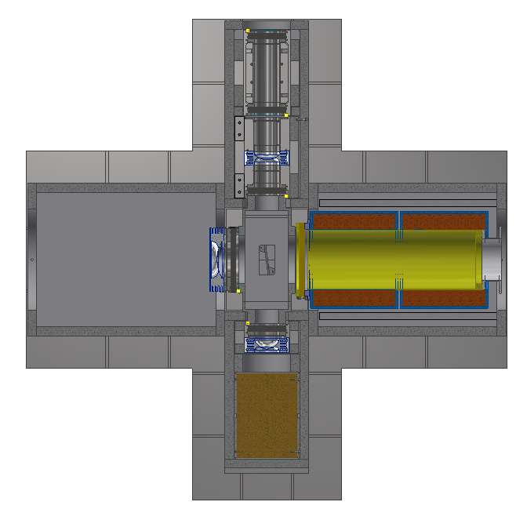
2. Design Progress of Target Station Equipment
5
2.2 Equipment located in high radiation areas of proton beam line
Due to the high radiation dose in this area, all equipment requires remote sealing and maintenance, and the structure is complex. This area includes muon target and vacuum chamber, proton beam windows, and beam absorber.
Proton beam
Section view
Inflatable bellows
PBW
Vertical view
beam absorber
PBW
target and vacuum chamber

Slide 7
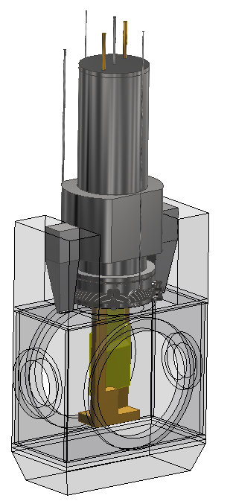
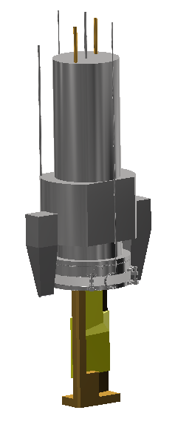
2. Design Progress of Target Station Equipment
6
2.2.1 Muon target and vacuum chamber
The muon source target includes a target body and a vacuum chamber. During maintenance, only the target body needs to be replaced without replacing the vacuum chamber.
The target body is inserted into the vacuum chamber from the top and sealed and connected through an inflatable bellows.
Target
Inflatable bellows
Vacuum chamber
vertical view
target and vacuum chamber

Slide 8
2. Design Progress of Target Station Equipment
7
(1) Selection of muon target parameters
Study semi-interaction vs rotation for 5000 π mm mrad for MELODY for surface muons, The best two target configurations for MELODY in terms of surface muon rates.
L = 12 cm
L = 24 cm
semi-interaction
rotated
H = 12 cm
H = 24 cm
W = 6σ
W = Effective Length of interaction · sin(θ)

Slide 9
2. Design Progress of Target Station Equipment
8
180 deg. backward
new
Proton beam
270 deg. for pions
R = 10 cm
90 deg. for surface muons
L = 20 cm
L = 20 cm
sideways
sideways
x
z
0 deg. forward

Slide 10
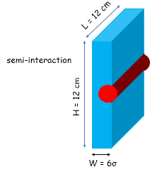
2. Design Progress of Target Station Equipment
9
Semi-interaction results for different material, 5000 π mm mrad.
μ+ / sec (10⁶ ), 20 kW - P ≤ 29.8 MeV/c | 5000 π mm mrad
dx in σx | Graphite | Copper | Tungsten
0 | 40 | 104 | 92
-1 | 48 | 146 | 140
-2 | 53 | 145 | 161
-3 | 38 | 90 | 114
+40%
+25%
+75%
Statistical errors 4% for Gr, 3% for W, and 2% for Cu
New emittance analysis optimized using MIGRAD minimization in CERN’s MINUIT program -> no change in physics but higher surface muon rates
Target displacement optimizes pion range in material for maximum surface muon production
Better optimized when the target is displaced horizontally between -1 σx and -2 σx, σx = 0.29 cm
Copper and Tungsten produce significantly more surface muons

Slide 11
2. Design Progress of Target Station Equipment
10
L = 24 cm
Selected option for MELODY for easier implementation
An extended target is rotated on the horizontal plane with respect to the center of the gaussian beam
Optimize the pion range in material for maximum surface muons production. The width of the target is function of the angle and the effective length of interaction
W = Effective length of interaction · sin(θ)
Extra surface muons from the extended sides for small lengths of effective interaction (eff. intL)
Lower rotation angles below 10 deg. have better results (from our studies and PSI’s ones)
H = 24 cm
W = Length of interaction · sin(θ)

Slide 12
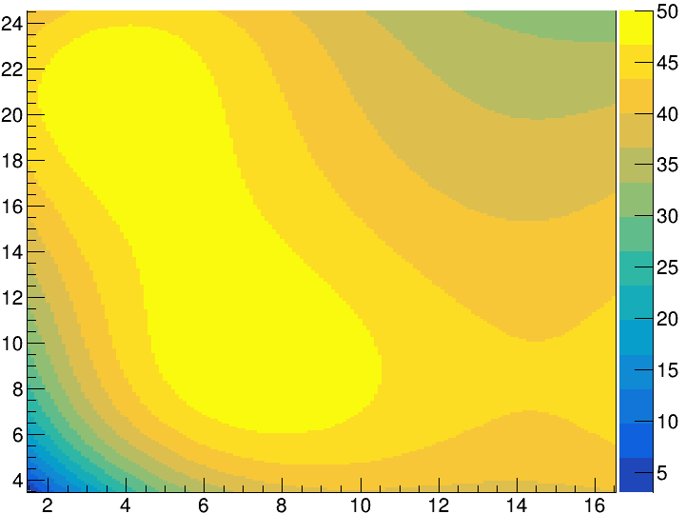
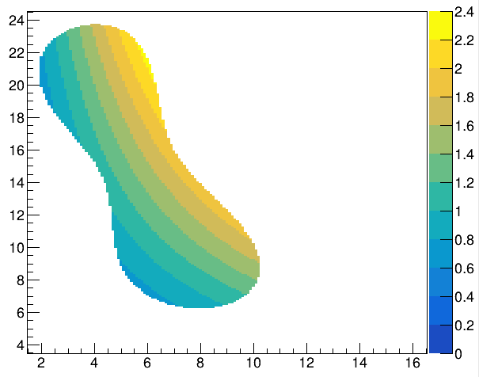
2. Design Progress of Target Station Equipment
11
Graphite: surface muon rates as function of the eff. intLs and the rotation angles of the target within the 6% stat. error of AI analysis @ 5000 π mm mrad
Each contour represents the surface muon rates within the 6% stat. error, from best rates to worse ones
Within the stat. error of the AI analysis, there are many parameters for the rotated target to be chosen
The best parameters are:
lengthier interactions, eff. intL > 6 cm
Smaller angles, rotation ≤ 10.5 deg.
Palette in 10⁶
surface muons/sec
Palette in
width, cm
AI result
Width = 1.4 cm
*
(4,20)
Slab widths within the best 6% of rates
Width = 1.46 cm
*
eff. intL, cm
(6, 14)
eff. intL, cm
Width = 1.17 cm
*
(7.1, 9.5)
rotation, deg.
rotation, deg.

Slide 13
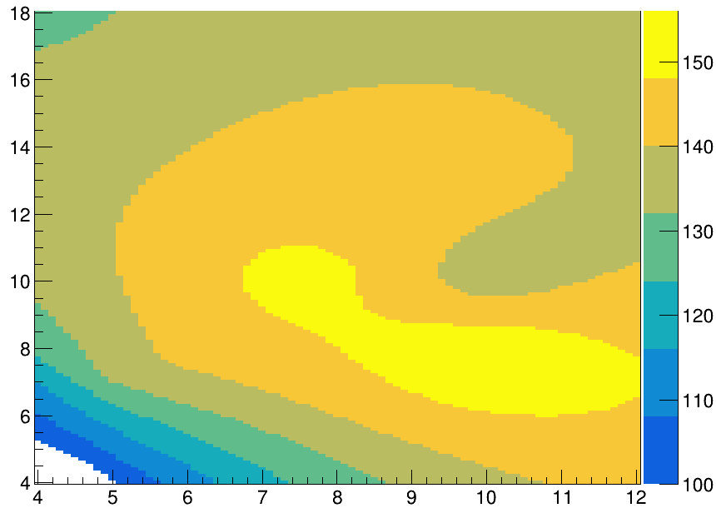
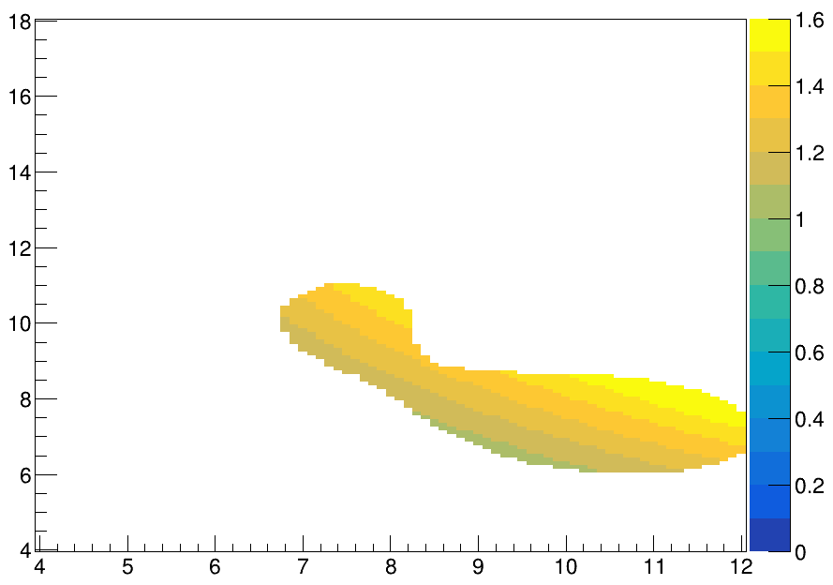
2. Design Progress of Target Station Equipment
12
Copper: rates as function of the best eff. intL and rotation angles of the target within the 5% stat. error of AI analysis (preliminary)
AI result
Palette in (10⁶)
surface muons/sec
Palette in
width, cm
Slab widths within the best 5% of rates
eff. intL, cm
eff. intL, cm
Width = 1.37 cm
*
(7.7, 10.2)
Width = 1.35 cm
*
(10.1, 7.7)
rotation, deg.
rotation, deg.

Slide 14
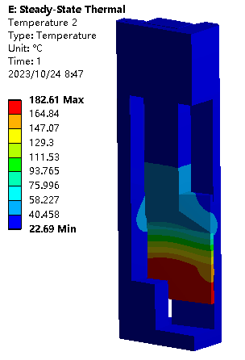
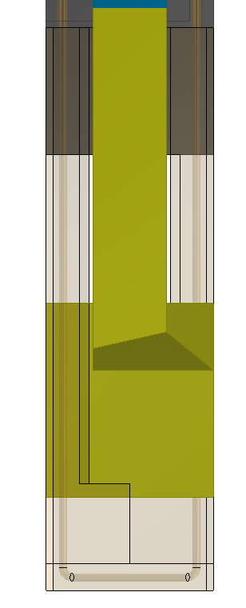
2. Design Progress of Target Station Equipment
13
(2) Structure Design
The target material is copper, with a target surface length of 250mm and a thickness of 13mm. Due to the use of a 3-target design, the target surface is 200mm high and has an expected lifespan of over 5 years.
By adjusting the input air pressure, the expansion of the corrugated pipe is achieved, pushing the target material down. A cooling water pipe is designed inside the target base to cool the target. The maximum temperature of the target core is 182 ℃, and the water temperature rises by 8 ℃.
air-pressure duct
compression spring
corrugated pipe
Copper target
Water-cooled base
Water-cooled pipeline

Slide 15
2. Design Progress of Target Station Equipment
14
2.2.2 PBW
There are three proton beam windows around the target:
PBW1: used to separate the vacuum between the proton beam line and the muon beam line, does not affect each other;
PBW2: Design a proton beam window at the end of the vacuum chamber to seal it;
PBW3: Due to the reservation of a muon beam line, in order to achieve remote installation of the beam line equipment in the future, it is necessary to design a proton beam window to temporarily achieve vacuum sealing and remove it later.
Due to the high radiation area, all proton beam windows are sealed with inflatable bellows. The material of the proton beam window has been preliminarily determined to be aluminum.
Now, we believe that the structure here is too complex, and simplifying it will be an important task.
PBW1
环形加速器
PBW3
PBW2

Slide 16
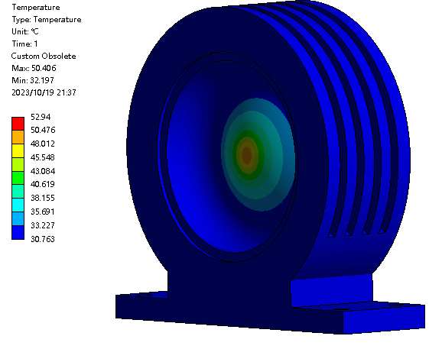
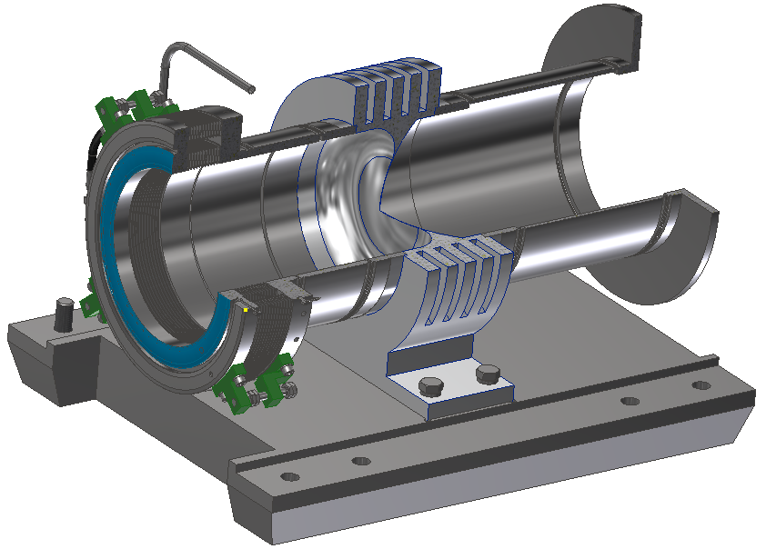
2. Design Progress of Target Station Equipment
15
2.2.2 PBW
Structure: The PBW adopts a single-layer membrane structure design, with a preliminary design film thickness of 1mm. Air cooling grooves are processed around the beam window to improve the cooling effect.
Thermal deposition power: The total beam power is 20kW, and the thermal deposition power on the PBW is about 7W.
Simulation analysis results: In a room temperature environment, the center temperature of the PBW is 53 degrees, so the PBWs at various positions do not need to be water-cooled.

Slide 17
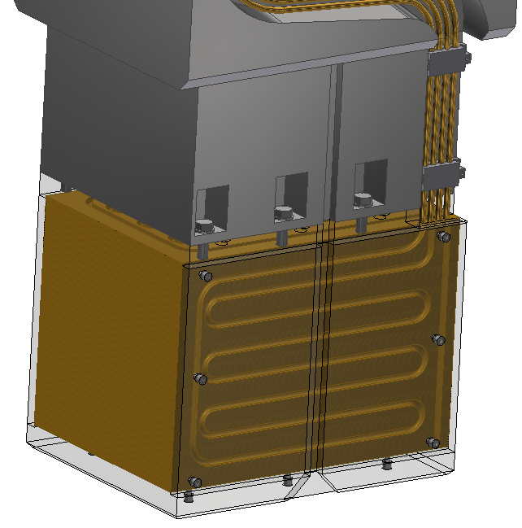
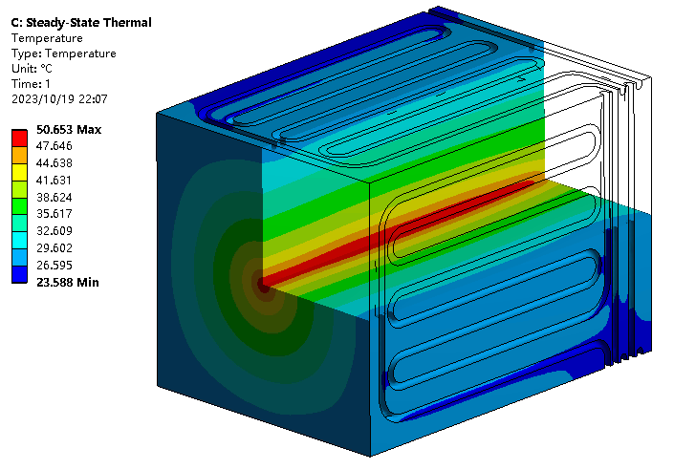
2. Design Progress of Target Station Equipment
16
2.2.3 Beam absorber
Structure: The beam absorber material is copper, with a square structure, and one water-cooled pipeline is arranged on each side for cooling, with an inner diameter of 12mm. To prevent water leakage in the pipeline, a whole water pipe is wound without any joints at the bottom.
Simulation analysis results: In a water-cooled environment, the water temperature rises by 8.6 ℃, and the maximum temperature at the center of the beam absorber is 50 degrees.
环形加速器
beam absorber

Slide 18
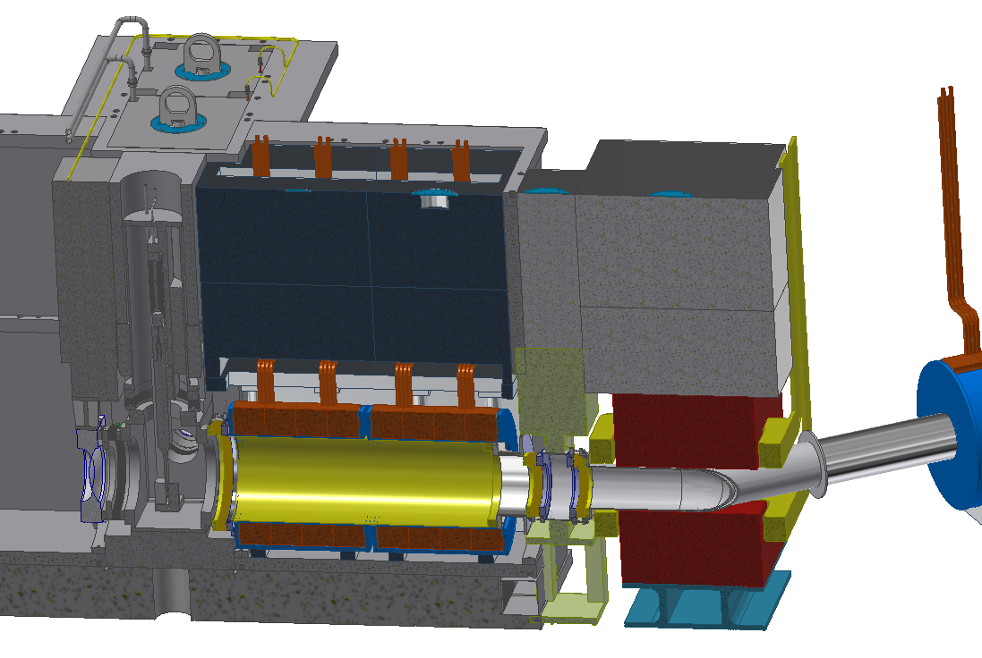
2. Design Progress of Target Station Equipment
17
2.3 Equipment located in the high radiation area of the muon beam line
The first device of the muon beam line is a solenoid with an inner diameter of 500mm and a distance of about 350mm from the target center. Due to its location in a high radiation area, the connection between the solenoid and the target vacuum chamber is made of inflatable bellows.
The total length of the solenoid is about 1.5 meters and it weighs about 3 tons. There is a bipolar magnet downstream of the solenoid, with a distance of about 0.8 meters between the two. Due to the lifting weight of the hall crane being 30 tons, it is not possible to lift both magnets and the shield at the same time. Therefore, it must be split into two units and sealed with inflatable bellows in the middle.
solenoid
bipolar magnet
Copper target
Inflatable bellows

Slide 19
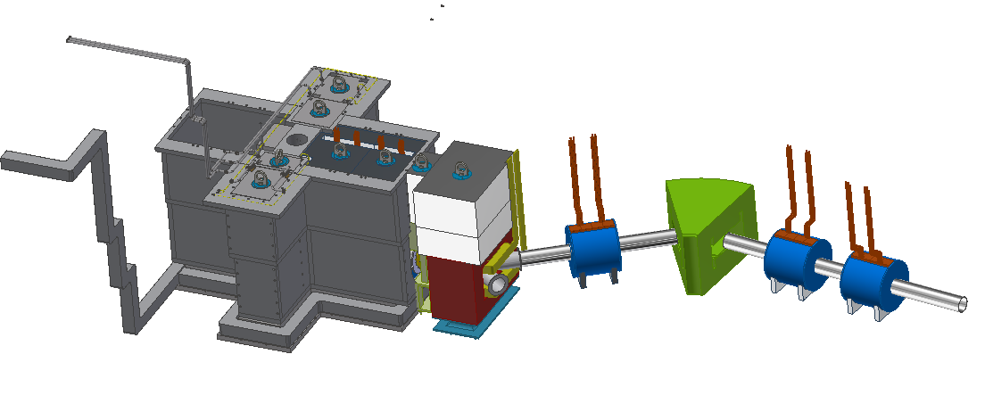
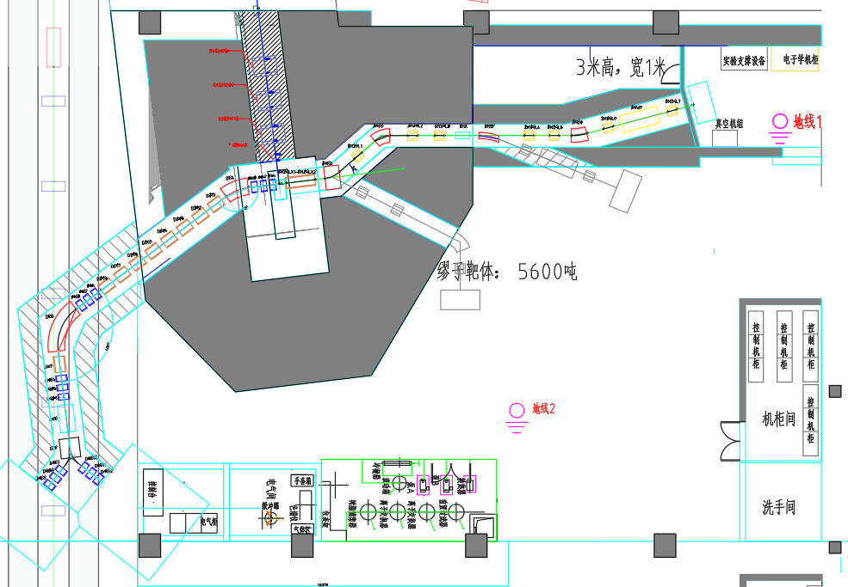
2. Design Progress of Target Station Equipment
18
2.4 Equipment located in the low radiation area of the muon beam line
From the first bipolar magnet to the rear, there is a low radiation area, and the equipment mainly consists of solenoids and bipolar magnets. Due to the low radiation, personnel can directly approach for maintenance, and simple tools can be designed for maintenance.

Slide 20
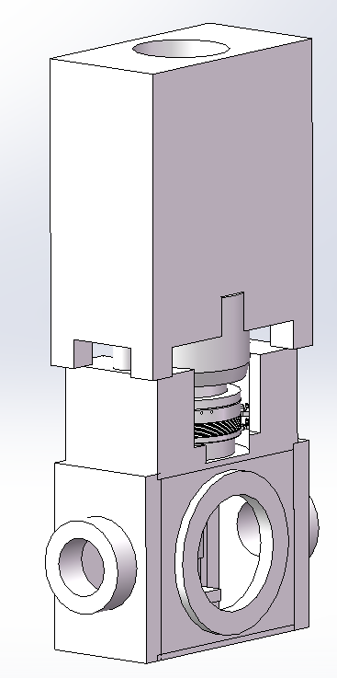
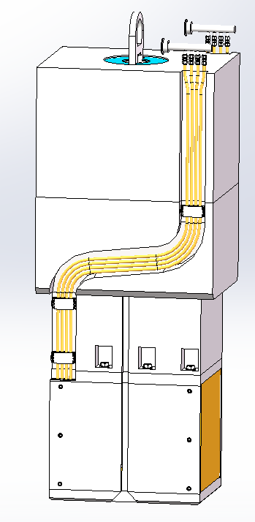
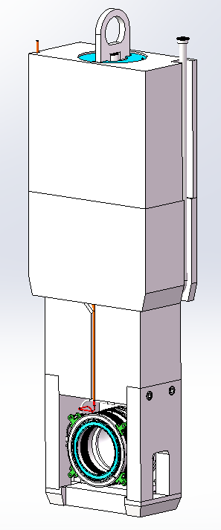
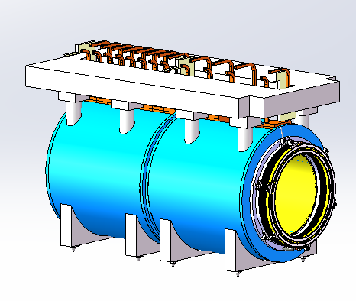
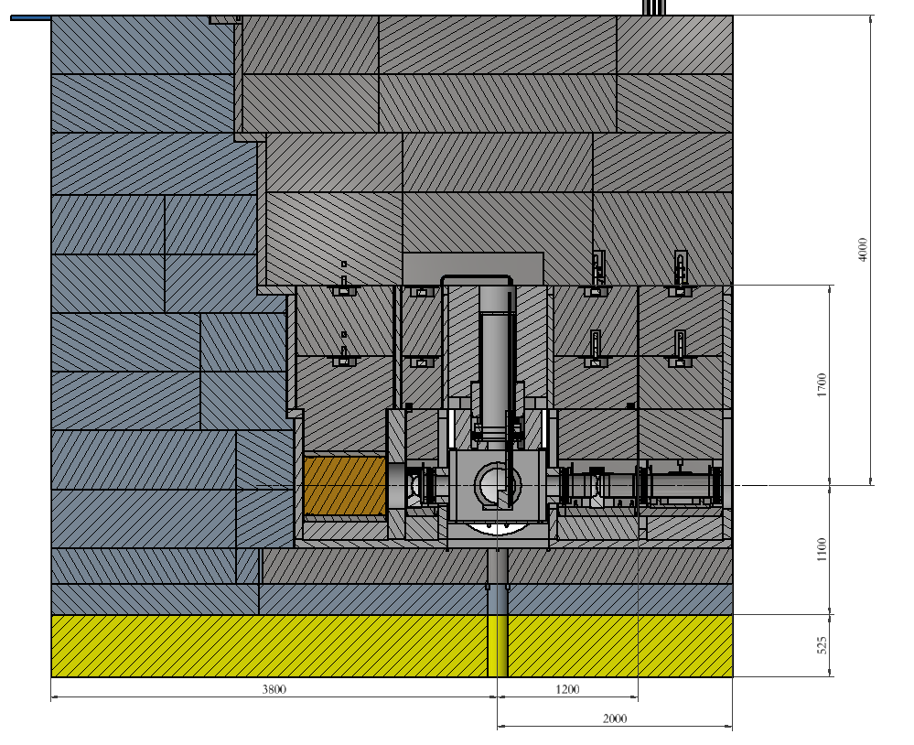
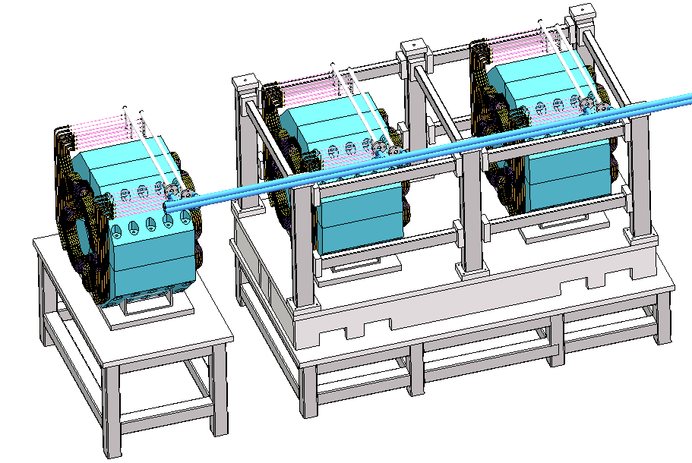
3. Maintenance Design of Equipment
19
The internal equipment of the target station is mainly distributed in the low radiation area of the proton beam line, high radiation area of the proton beam line, high radiation area of the muon beam line, and low radiation area of the muon beam line. For low radiation areas, personnel can operate and maintain them in close proximity in a short period of time, which is relatively simple. However, remote maintenance methods must be used for equipment in high radiation areas.

Slide 21
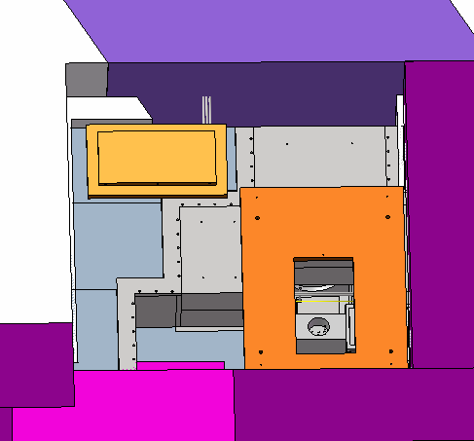
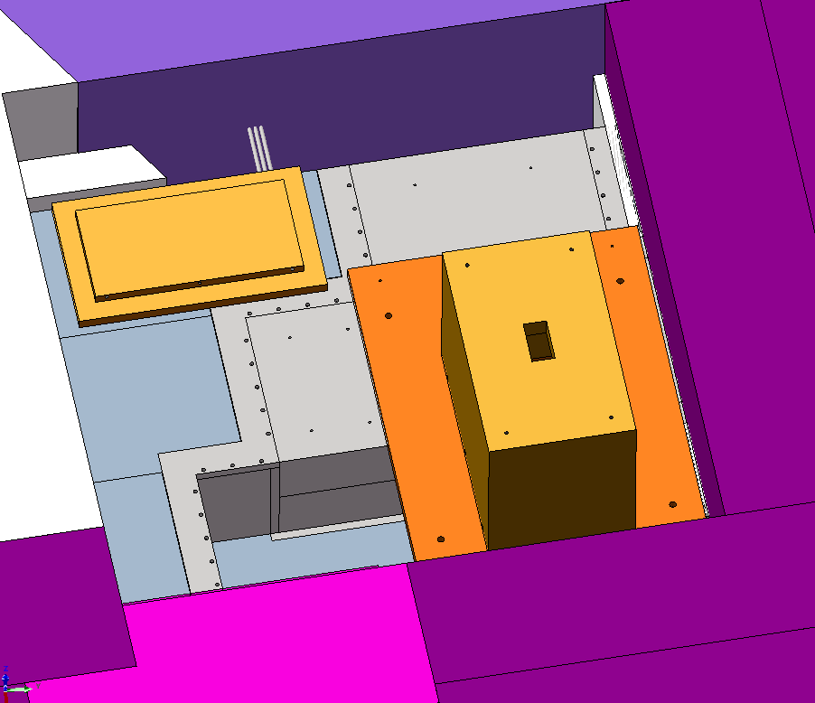
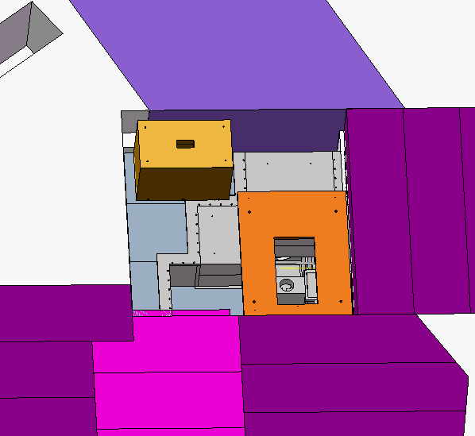
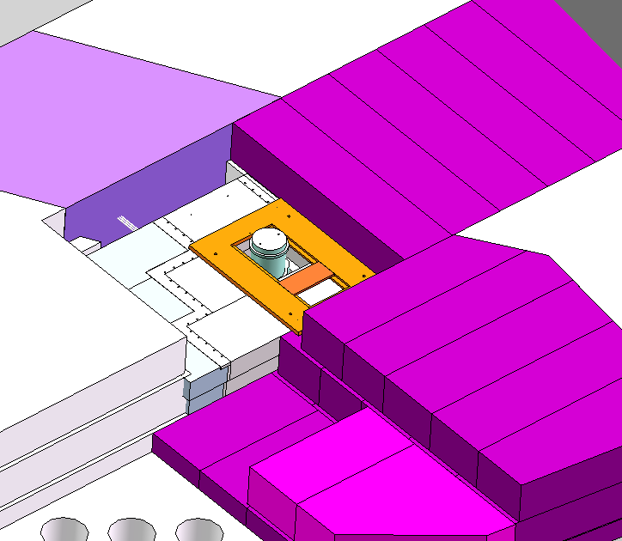
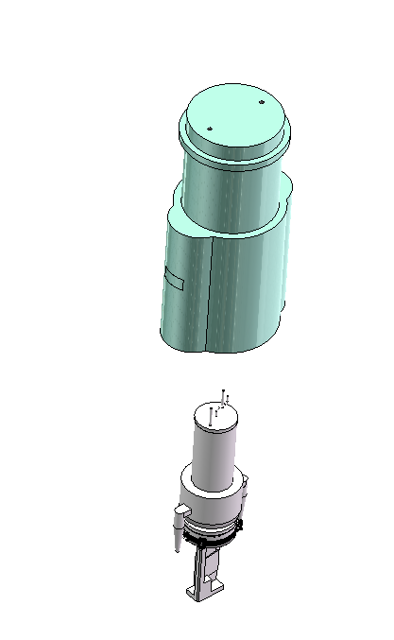
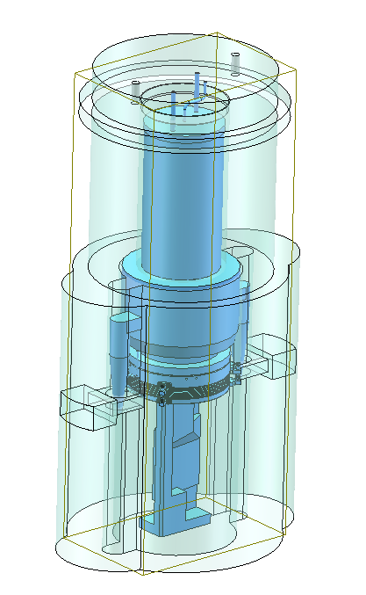
3. Maintenance Design of Equipment
20
Taking the muon target as an example, the upper shielding is now removed. At a distance of about 1.5 meters above the beam line, where personnel can approach, the equipment pipeline is disconnected. Then, the shielding container is covered above the equipment, and the equipment is lifted into the shielding container using special tools, and then removed as a whole.
There are two ways to handle abandoned equipment replaced in high radiation areas:
1. Target: Due to the need for regular replacement of the target, six target placement holes are designed on one side of the shielding of the target station. After the shielding container is used to remove the target, the target is directly inserted into the holes and permanently placed;
2. Other equipment: This type of equipment only needs to be replaced and maintained in case of failure. After being removed from the shielded container, it can be directly transported to the processing hall for storage.

Slide 22
4. Future Work Plan
21
Pipeline design
Shield design
Equipment design
Equipment manufacturing
Testing and Installation
2023.12
2024.03
2024.10
2025.12
2026.10

Slide 23
Thanks for your attention！

