Slide 1
Beam Intensity and Profile Measurement of MELODY
You Lv
On behalf of MELODY Collaboration
Workshop on Muon Science Technology and Industry
(MELODY 2023, Dong Guan, 2023-11-06)
Notes:
Good afternoon, everyone. My name is You, from CSNS. My presentation is the beam intensity and profile measurement of MELODY.

Slide 2
Outline
Beam specification of MELODY
Innovation of BIMD
Simulation study of BIMD
Method of BPMD
Summary
Notes:
This is the outline of my presentation. The first is a short introduction to the beam specification of MELODY. And then I will introduce the methods of BIMD and BPMD. And I will also talk about the progress of the two systems. Finally, it is a short summary and the future work in the next step.

Slide 3
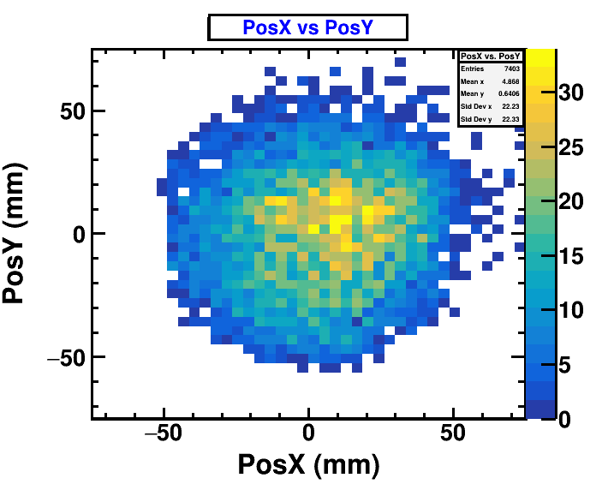
Beam specification
MELODY: The first muon source in China.
µSR
COL3
Wien Filter
MBB
MS2
Kicker
MS5
COL1
MS4
MS3
MBC
MSX
MS1
COL2
MBA
Surface muon beamline for µSR applications
Key Parameters:
Pulsed muon @1 Hz
Surface muon @28 MeV/c
Intensity @ 10⁵-10⁷ μ+/s
Profile @ Φ10-Φ100 mm
The major source of contamination is positrons with momentum around 28 MeV/c.
Beam spot @ Φ100
Notes:
The MELODY will be the first muon source in CHINA. The surface muon beamlibe for usR application will be built first. This graph shows the layout of surface muon beamline. It will be the first muon beamline on MELODY. It is a pulsed muon source with a frequency of 1Hz. The momentum of surface muons is about 30MeV/c. The G4beamline simulation gives an intensity of about 10⁵ to 10⁷ u+/s. The beam profile can be adjusted from Phi20 to Phi100 mm according to different applications. We will use a Wien Filter to remove the positrons in the beam, but the major source of contamination is still the positrons with momentum around 30 MeV/c.

Slide 4
Requirement of BIMD
BIMD: Beam Intensity Measurement Detector.
Measure muon beam intensity, and estimate the ratio of background positron.
Efficiently discriminate muons and background positrons.
Beam Intensity Measurement Detector
µSR Spectrometer
Valve
Flange A
Flange B
Flange C
Tube
The last magnet
820mm
Position of the BIMD on MELODY
BIMD Features
In general, muons in a pulsed beam exceed the temporal resolution of detector, it is unrealistic to use the counting method to measure the intensity.
Destructive technique based on energy deposition measurement.
Notes:
Muon beam intensity is the key parameter for the MELODY. The beam intensity measurement detector (BIMD) is proposed to measure the beam intensity and estimate the ratio of background positrons. So, the BIMD has to efficiently discriminate muons and background positrons. The BIMD is located at the outlet of the beam tube after the last magnet, as shown in this figure. In general, muons in a pulsed beam exceed the temporal resolution of BIMD, so it is unrealistic to use the counting method to measure the intensity. The common method is the destructive technique based on energy deposition measurement for a pulsed beam. By measuring the energy deposition of muons in the detector to reconstruct the intensity.

Slide 5
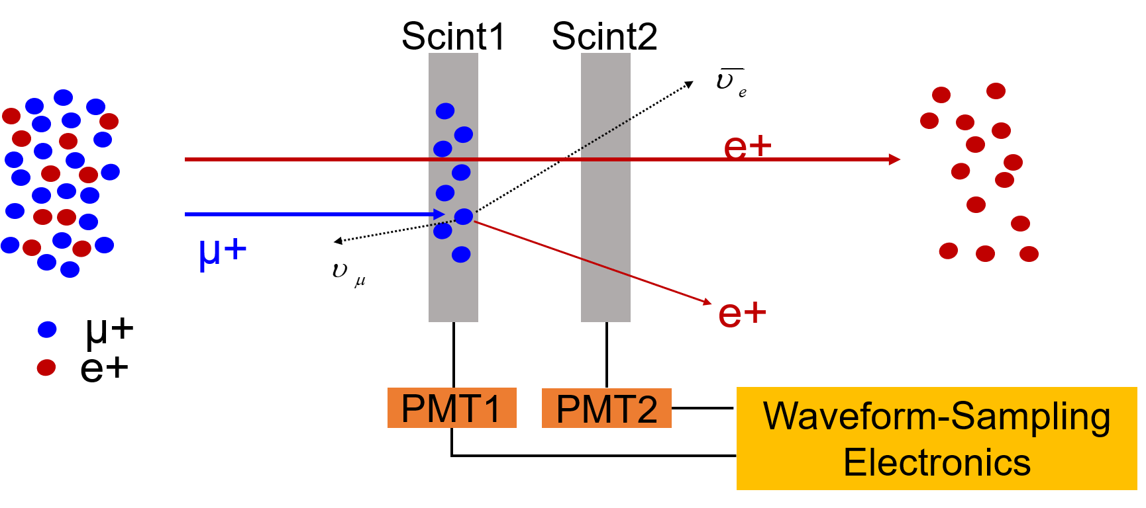
Innovation of BIMD
BIMD Solution: A double-stacked scintillator detector with PMT readout.
Schematic diagram of BIMD
Muons stop in the Scint1 then decay while positrons pass through Scint1 and Scint2.
Signal waveform is recorded with the waveform-sampling electronics.
The intensity of µ+ and e+ are reconstructed using the PSD method.
Notes:
According to the requirement of MELODY, we propose a double-stacked scintillator detector with PMT readout to measure the beam intensity. The schematic diagram of BIMD is shown in this graph. When the beam hits the detector system, the muons stop in Scint1 and then decay while positrons pass through Scint1 and Scint2. The Signal waveform of the detector system will be recorded with the waveform-sampling electronics. The first scintillator detector includes three different signal parts, the muons and background positrons from the beam particles, and the positrons from muon decay. The second scintillator detector includes two signal parts, the positrons in the beam particles and the positrons from muon decay. By using the pulse shape discrimination method, the different signal components can be discriminated, and the intensity of muons and background positrons can be reconstructed.

Slide 6
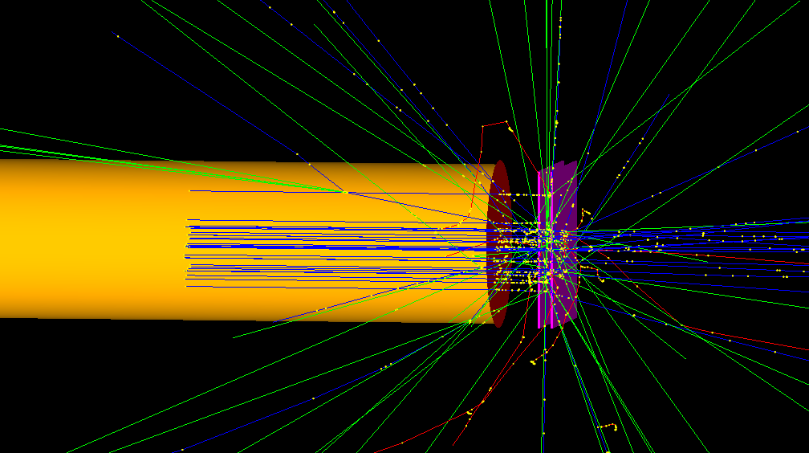
Simulation setup
BIMD Response: Studied with Geant4 simulation.
Pulse time structure: Parabolic distribution (130 ns width).
Muon energy and beam profile: calculated using G4beamline simulation.
Background positrons: 28 MeV/c
Window
Scint2
Beam Pipe
Scint1
Geant4 model
Time structure of beam pulse
Energy distribution
Notes:
The detector response of BIMD has been studied with Geant4 simulation. The geometry model built in Gean4 is shown in this graph. It includes the beam tube, beam window, and scintillators. The beam pulse time structure is shown in the left graph, it has a parabolic distribution with a 130 ns bottom width. The particle energy and beam profile are calculated using G4beamline simulation. The background positrons are added to the beam particle.

Slide 7
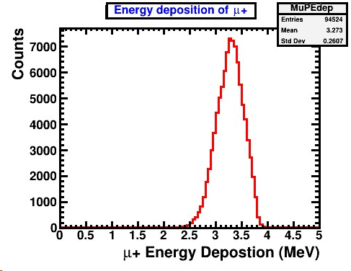
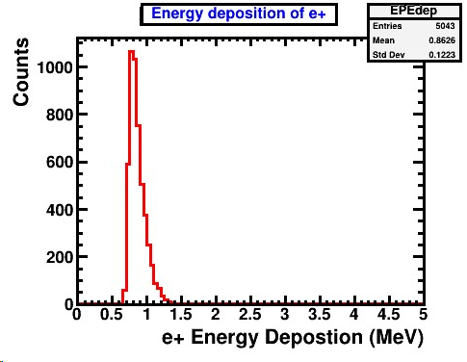
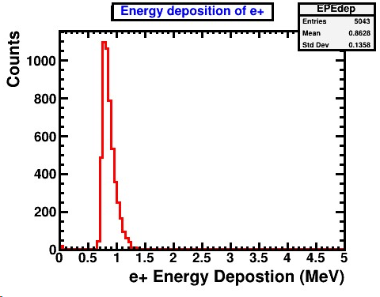
Total energy deposition
Muons deposit energy in the Scint1: 3.27 MeV/µ+
Background positrons deposit energy in Scint1 and Scint2 identically : 0.86 MeV/e+
µ+ in Scint1
e+ in Scint1
e+ in Scint2
Notes:
This slide shows the simulation result of the energy deposition of surface muons and positrons passing through the two scintillators. The thickness of the scintillator is set to 1cm. The surface muons stop in the Scint1 and deposit an average energy of 3.27MeV, as shown in the right graph. The background positrons can pass through both scintillators and deposit energy identically as shown in the bottom graph. The average energy deposition in each scintillator is about 0.86 MeV.

Slide 8
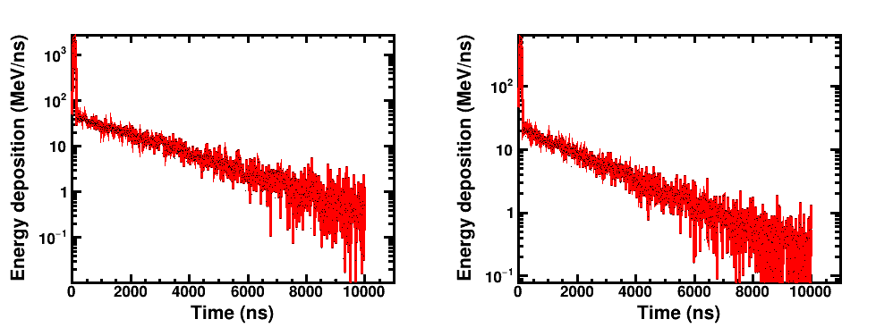
Energy deposition vs. time
Energy deposition dependent on time
Scint1
Scint2
µ+ and background e+
background e+
e+ of µ+ decay
e+ of µ+ decay
The peak structure is similar to the time structure of the beam pulse, which is mainly caused by the surface muons and background positrons.
The long tails are caused by the positrons from muon decay.
Notes:
The positrons from muon decay also deposit energy in the two scintillators, and it decreases exponentially with time. The key to the beam intensity measurement is to distinguish and reconstruct the energy deposited by different particles. The two graphs show the energy deposition dependent on time in Scint1 and Scint2, which have a very sharp peak followed by a long exponentially decaying tail. The peak structure is similar to the time structure of the beam pulse, which is mainly caused by the surface muons and background positrons. The long tails are caused by the positrons from muon decay.

Slide 9
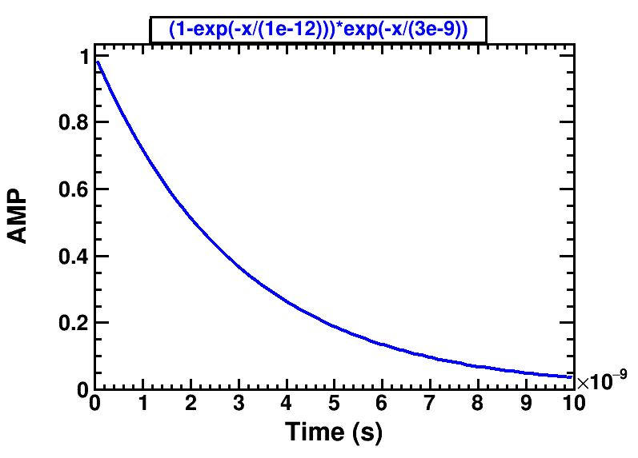
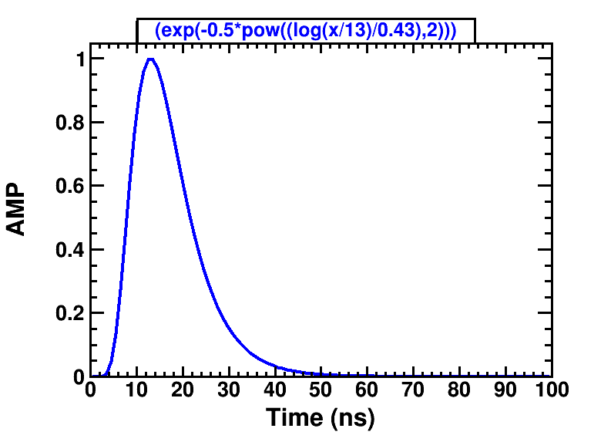
Signal processing
Signal processing flow diagram: parameterized modeling methods
Beam Particle
Energy deposition in scintillator
Photons
(PMT)
Electron
signal
Waveform
(Electronics)
The number of photons and electrons processed in each step are randomly sampled using Poisson distribution.
Photon emission and collection, electron emission, and amplification are included.
Waveforms are obtained by convoluting the energy deposition function and response function.
Response function of scintillator and PMT
Scintillator
PMT
Notes:
According to the energy deposition, the signal waveforms of scintillator detectors are obtained by using the parametric modeling method, as shown in this flow diagram. It includes the process of photon emission by scintillator, photon collection, electron emission, and electron amplification by the PMT. The number of photons and electrons processed in each step are randomly sampled using Poisson distribution. The response function of the scintillator and PMT are shown in the bottom graph. Finally, the waveforms are obtained by convoluting the energy deposition function and response function.

Slide 10
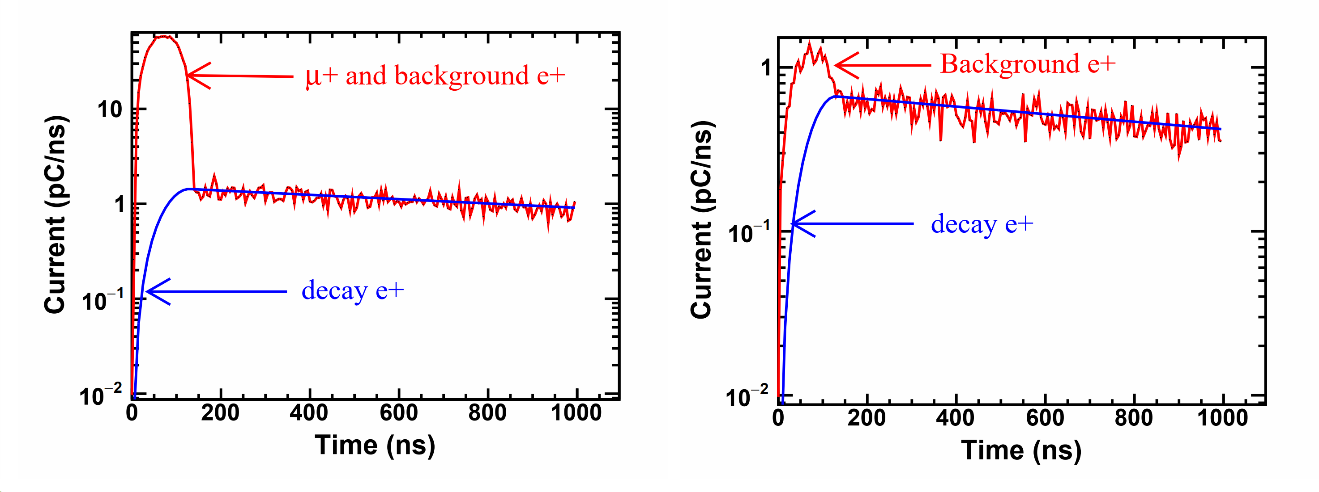
Intensity reconstruction
Simulated signal waveforms of scint1 and scint2 (5% positrons)
Scint1
Scint2
Positron signal from the muon decay can be fitted by the exponential function convoluted by a parabolic function.
When the ratio of muons to positrons is 95%, the reconstructed biases are 0.7% and 2.3% respectively.
Notes:
The simulated signal waveforms are shown as the red line in these two graphs when the ratio of background positron is 5%. The positron signal from the muon decay can be fitted by an exponential function convoluted by a parabolic function as shown in the blue line in the graph. In Scint2, the area between the red line and the blue line is contributed by the background positrons and the intensity can be calculated according to the formula below. While it is contributed by the surface muons and background positrons in Scint1. The intensity of the surface muons can be calculated by the last equation. The results show that the muon and positron intensity can be reconstructed correctly as can be seen in the table. When the ratio of positrons to muons is 95%, the reconstructed biases are 0.7% and 2.3% respectively.

Slide 11
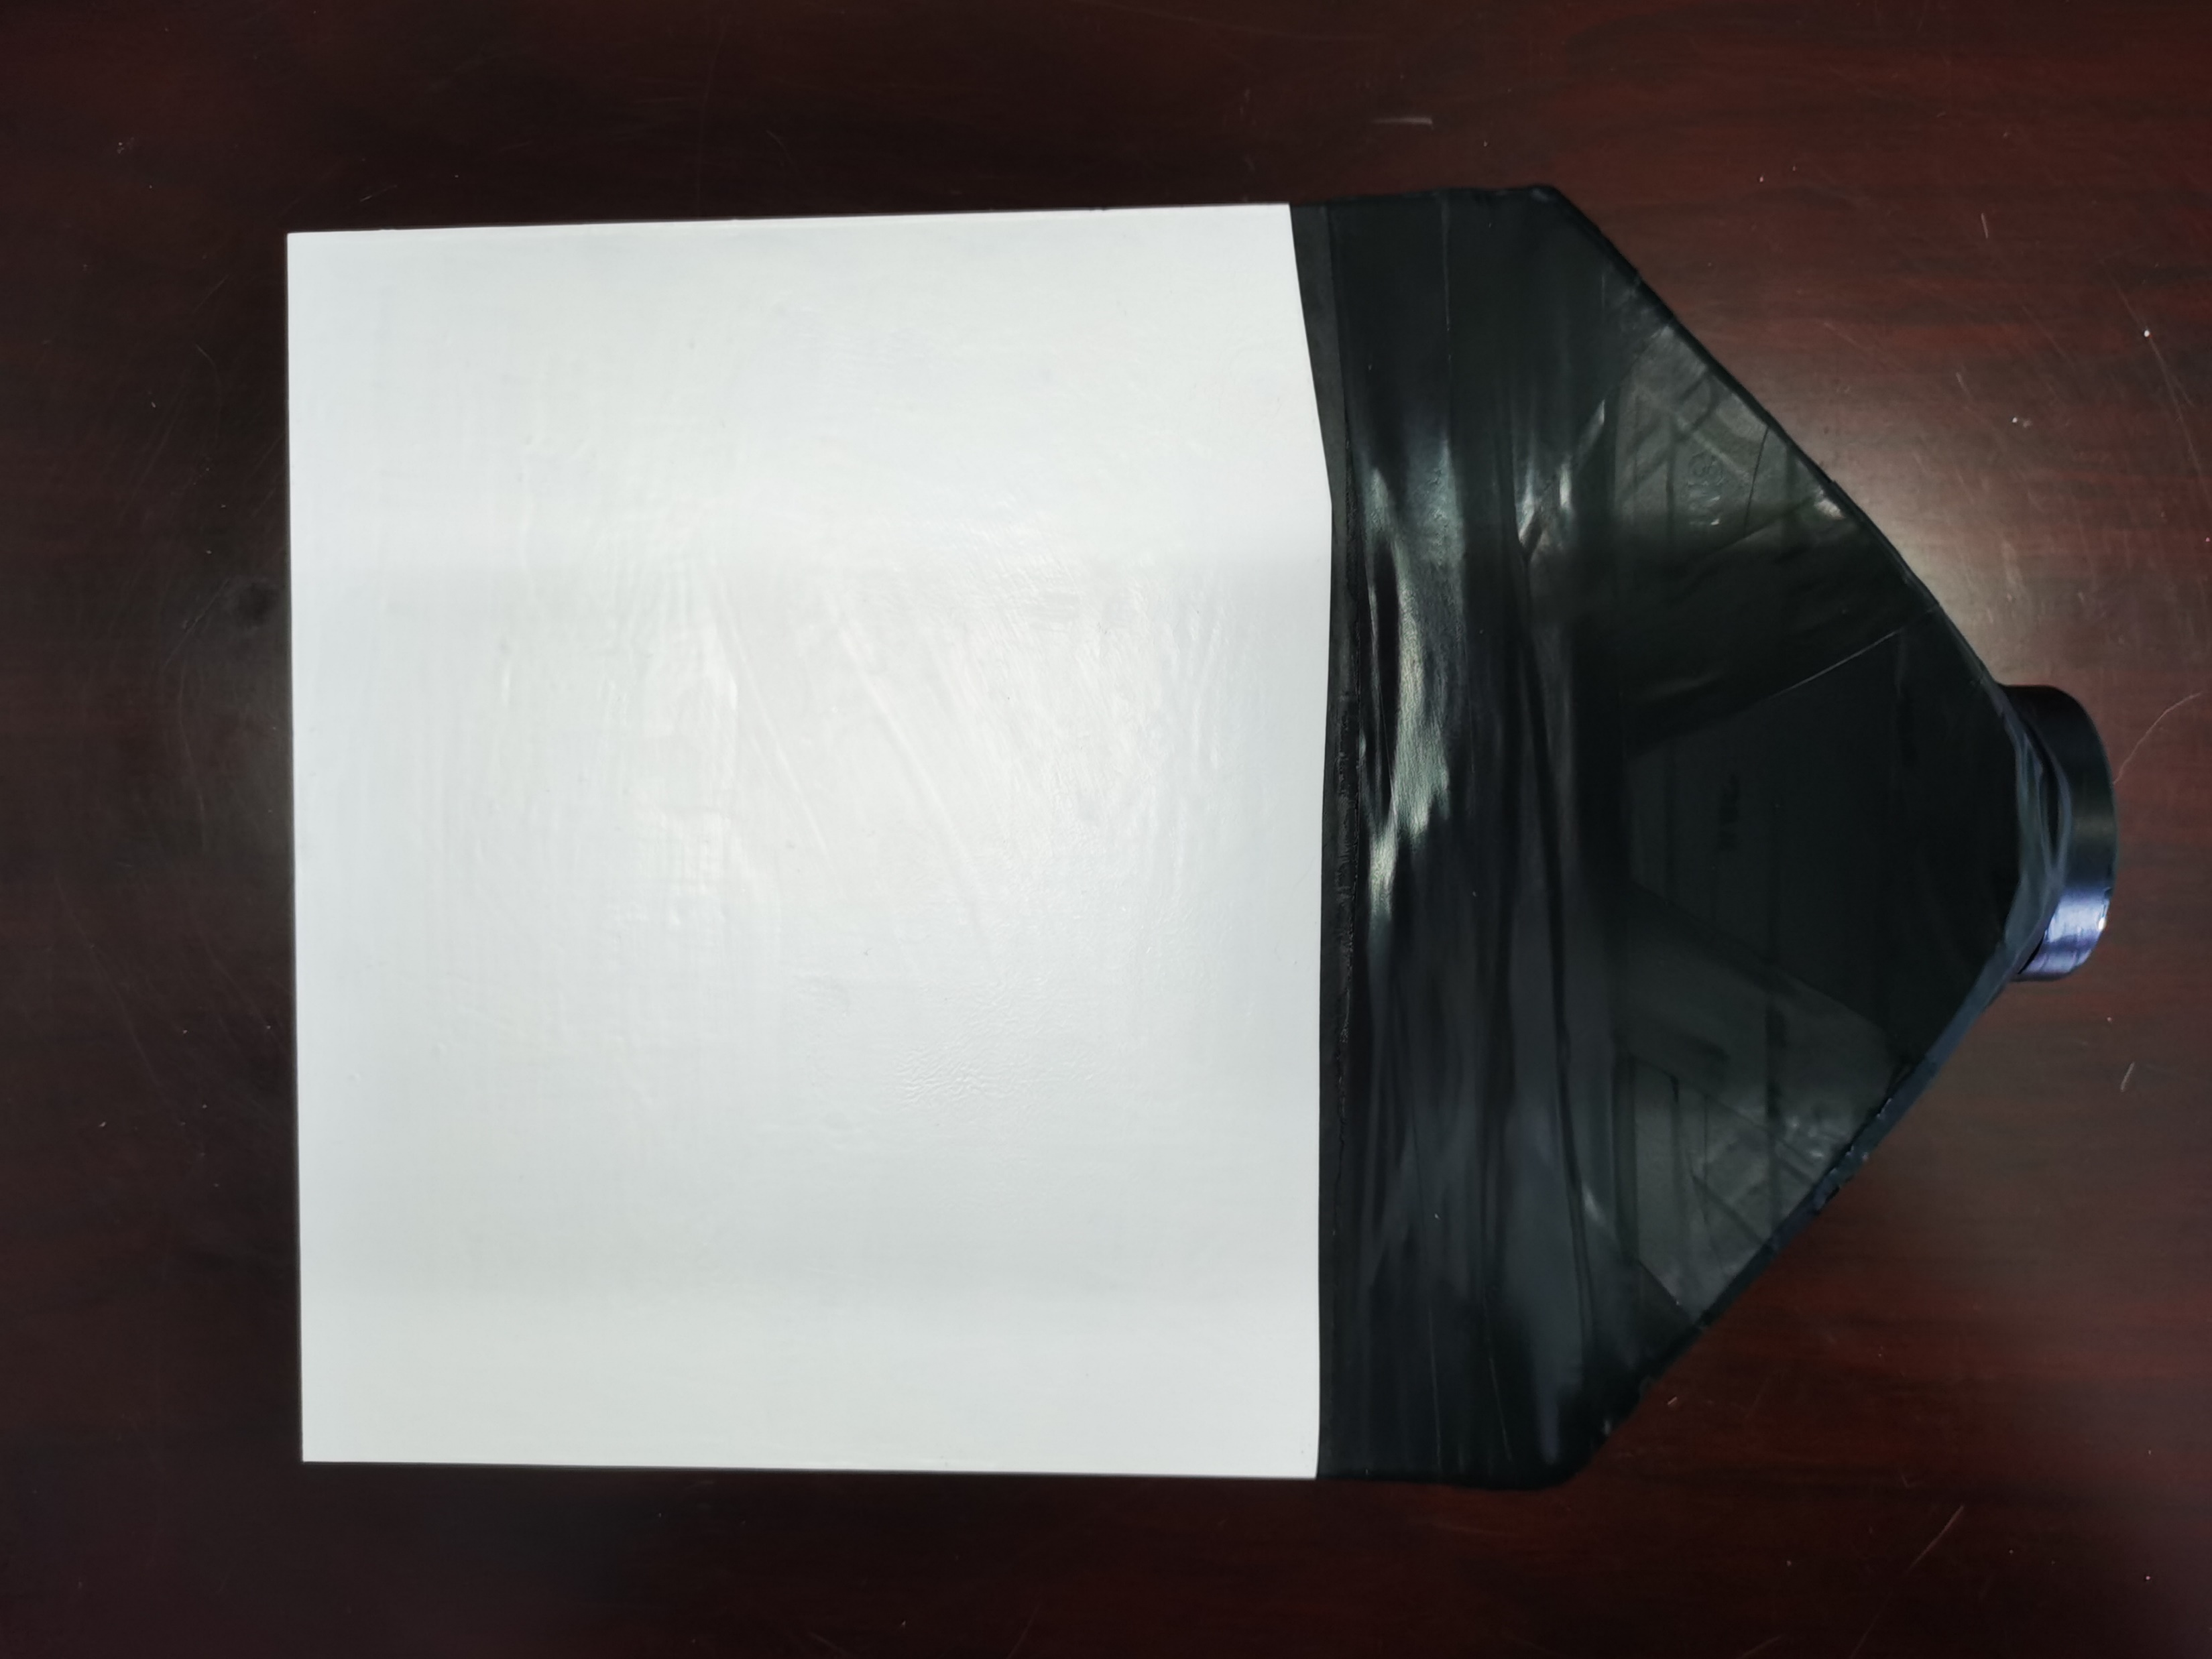
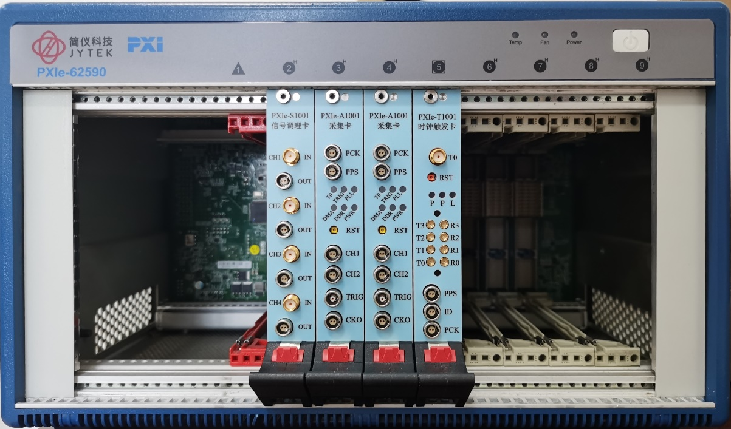
Next plan
Optimizing the simulation process (photon transportation, signal noise…).
Preparing the detector prototype.
Radioactive source and muon beam test.
Performing evaluation and optimization.
15cm ╳ 15cm Scintillator
Wave-sampling electronics
PMT
Notes:
The whole simulation process is still very preliminary, we will optimize it by considering the photon transportation and signal noise. We will prepare the detector prototype and test the performance with a radioactive source and muon beam. These three pictures show the scintillator, electronics and PMT respectively.

Slide 12
Layout of BPMD
BPMD: Beam profile measurement detector.
A scintillating screen and a camera readout.
Beam profile can be obtained by the camera directly.
Scintillator screen: ZnS (Zinc sulfide)
Camera: ACA1920-50GM
Scintillating screen
Camera
Beam
Schematic diagram of BPMD
Camera
Notes:
The BPMD is used to measure the beam profile. As shown in the schematic diagram, it includes a scintillator screen and a camera readout. The beam hit the screen and emit photons collected by the camera. The beam profile can be obtained by the camera directly. We have prepared a zinc sulfide screen and a camera. This system will be tested with ISIS muon beam in the next year.

Slide 13
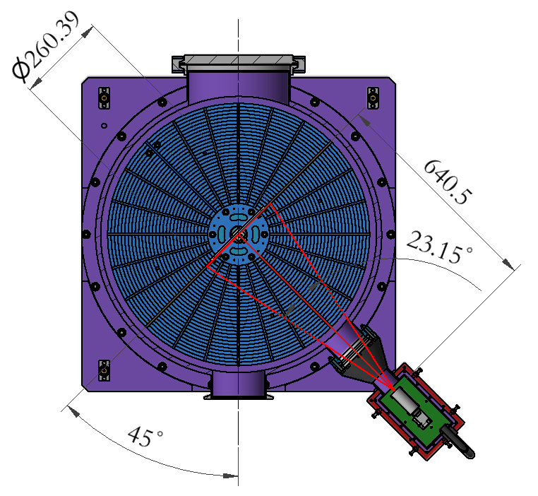
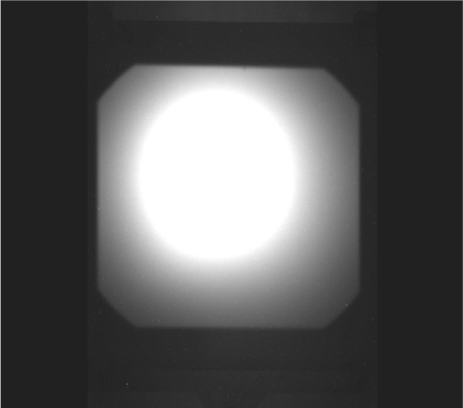
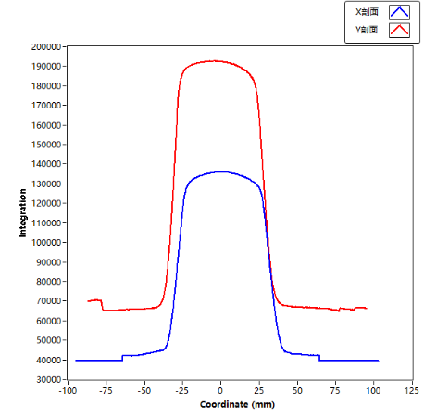
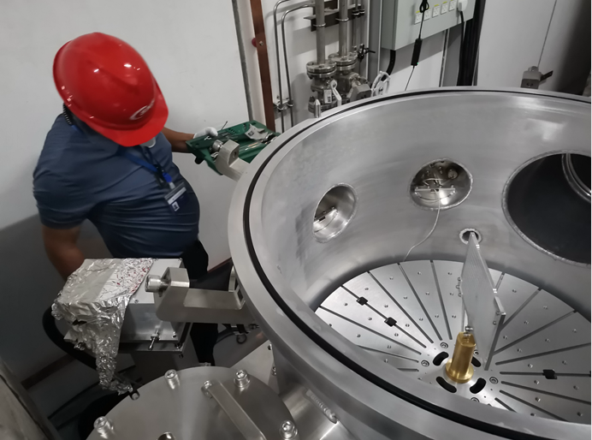
Proton beam profile test
The BPMD has been applied to the proton beamline at CSNS.
80 MeV protons @~10⁸ p/s
A reliable proton profile was obtained.
It can also be applied to the muon beam.
Proton beam profile
Test setup
Notes:
The BPMD system has already been applied to the proton beamline at CSNS. The right pictures show the experimental setup. And the test results are shown in the left graphs. A reliable proton profile was obtained and the system can also be applied to the muon beam.

Slide 14
Summary
Conclusion:
A double-stacked scintillator detector was proposed to measure the beam intensity.
Simulations showed that BIMD can reconstruct the muon intensity accurately and discriminate positrons effectively.
The BPMD including a scintillating screen and a camera was developed.
The proton beam test also showing promising results.
Future work:
Optimize the simulation by including photon transportation, and signal noise.
Prepare the BIMD prototype.
Performing a beam test at ISIS.
Thank you, questions?
Notes:
A double-stacked scintillator detector was proposed to measure the beam intensity. Simulations showed that BIMD can reconstruct the muon intensity accurately and discriminate positrons effectively. The BPMD including a scintillating screen and a camera was developed. The proton beam test also showed promising results. In the next, we will optimize the simulation by including photon transportation, and signal noise. We will prepare the BIMD prototype and perform a beam test at ISIS.

