Slide 1



The Simulation of the GSHCAL for CEPC
Peng Hu, Dejing Du, Yuexin Wang, Yong Liu, Manqi Ruan, Sen Qian
Institute of High Energy Physics, CAS
On behalf of the CEPC Calorimeter Working Group &
the Glass Scintillator Collaboration

Slide 2
Outline
Introduction and Motivation
Intrinsic performance of the GSHCAL
PFA performance of the GSHCAL
Summary

Slide 3
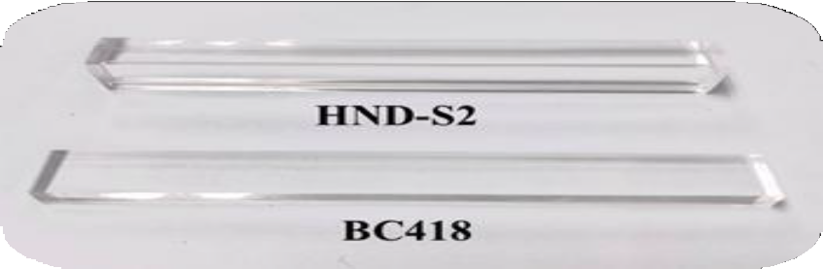
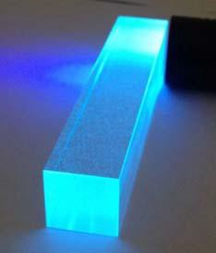
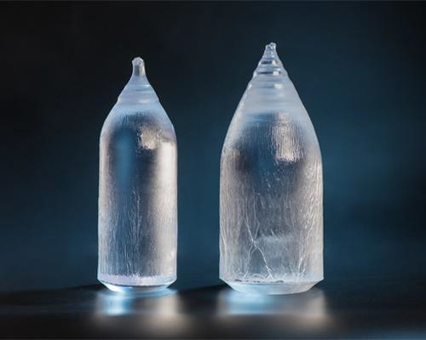

1.1 The Glass Scintillator
Plastic Scintillator
Glass Scintillator
Crystal Scintillator
High light yield Fast decay Low cost
Large Density Energy resolution Large size
High light yield Fast decay Low cost
Large Density Energy resolution Large size
High light yield Fast decay Low cost
Large Density Energy resolution Large size
4
Notes:
Here, I will just give a brief introduction, more details will be covered in the next talk by Hua Zhehao.
So, the glass scintillator is a relatively new material, which shows great potential in the high energy physics.
It has advantages of high density and low cost at the same time.
Its density could be up to 6 g/cm3, which is close to the density of bgo and lyso crystal.
Also, its cost can be lower than the plastic scintillator in mass production.
The light yield is a main shortage for glass scintillator and is one the R&D targets in GS Collaboration.

Slide 4
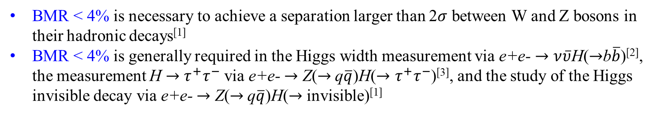
1.2 The Boson Mass Resolution
In order to avoid the complexity induced by the jet clustering algorithm in events with hadronic final states, the Boson Mass Resolution (BMR) defined as the mass resolution of these hadronic systems is introduced to quantify the detector performance
The BMR is a very important index for the achievement of the major scientific goals in the CEPC
BMR < 4% is necessary to achieve a separation larger than 2$σ$ between W and Z bosons in their hadronic decays^{[1]}
BMR < 4% is generally required in the Higgs width measurement via e+e- $→ν\overline{υ}$H($→$b$\overline{b}$)^{[2]}, the measurement H $→$ $τ^{+}τ^{−}$ via e+e- $→$ Z($→$q$\overline{q}$)H($→τ^{+}τ^{−}$)^{[3]}, and the study of the Higgs invisible decay via e+e- $→$ Z($→$q$\overline{q}$)H($→$ invisible)^{[1]}
[1] CEPC Conceptual Design Report: Volume 2, arXiv:1811.10545.
[2] H. Zhao, arXiv:299 1806.04992
[3] D. Yu, doi:10.1140/epjc/s10052-019-7557-y
Notes:
Then, I want to give an introduction to the Boson mass resolution, which will be used in our simulation.
In order to …
The BMR is a very important ..

Slide 5
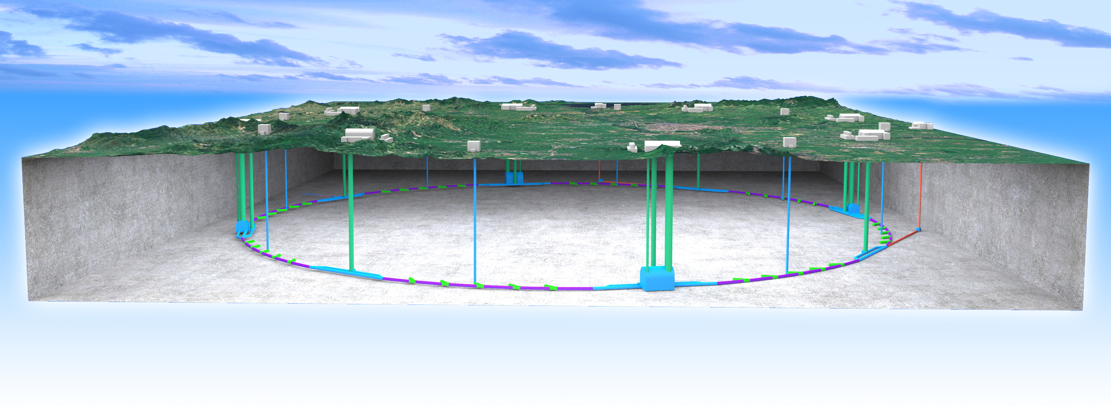
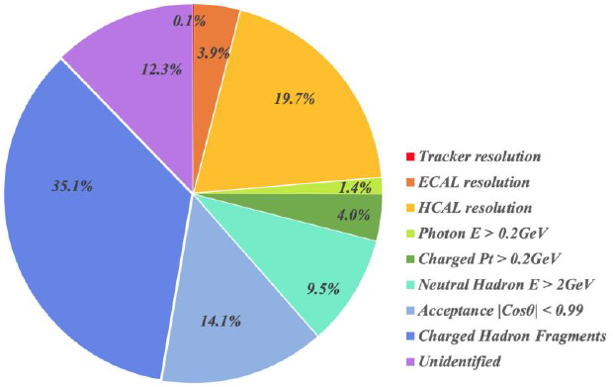
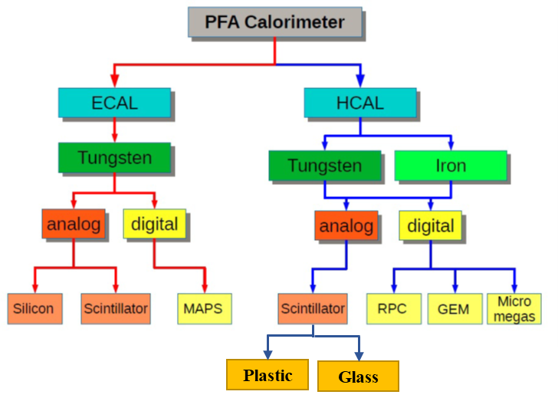
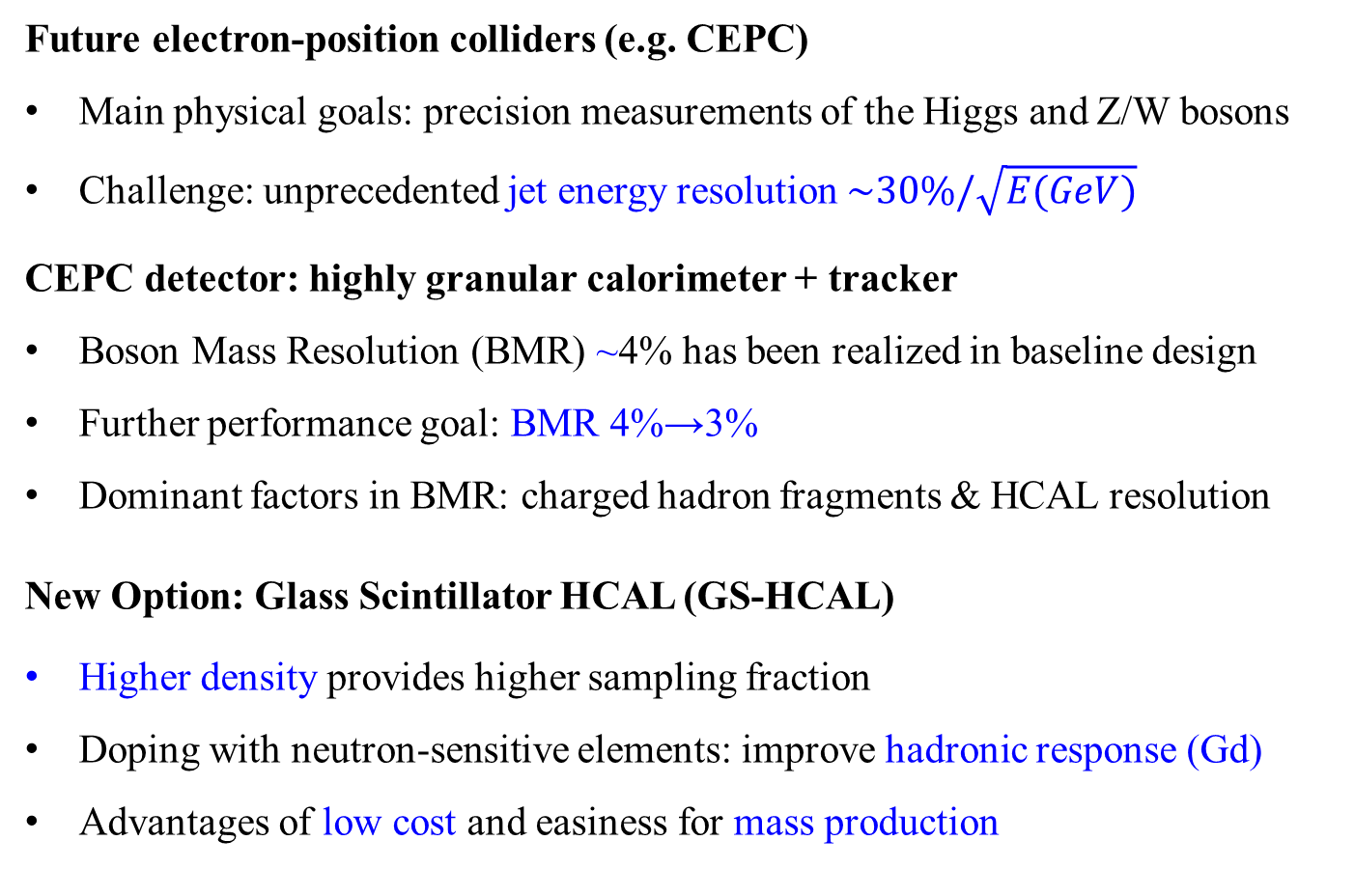
1.3 Motivation
Future electron-position colliders (e.g. CEPC)
Main physical goals: precision measurements of the Higgs and Z/W bosons
Challenge: unprecedented jet energy resolution $\sim 30\%/\sqrt{E(GeV)}$
CEPC detector: highly granular calorimeter + tracker
Boson Mass Resolution (BMR) ~4% has been realized in baseline design
Further performance goal: BMR 4%→3%
Dominant factors in BMR: charged hadron fragments & HCAL resolution
New Option: Glass Scintillator HCAL (GS-HCAL)
Higher density provides higher sampling fraction
Doping with neutron-sensitive elements: improve hadronic response (Gd)
Advantages of low cost and easiness for mass production
The Factors on BMR from Fast Simulation
By Yuexin Wang
Notes:
For CEPC, the PFA paradigm consisting of highly granular calorimeter and tracker, was applied to address the challenge from jet resolution and realize the main physical goals.
The BMR around 4% has been realized in the baseline design with the Si/W ECAL and GRPC HCAL and our further goal is to improve the BMR from 4% to 3%.
The analysis to fast simulation told us that the dominant factors in current BMR are charged hadron fragments & HCAL resolution. Based on this, we proposed a new option: glass scintillator HCAL, which can provide higher sampling fraction to improve hadronic response due to higher density and Doping with neutron-sensitive elements. Also the HCAL layer can be more compact since the NIL of glass scintillator is smaller.

Slide 6
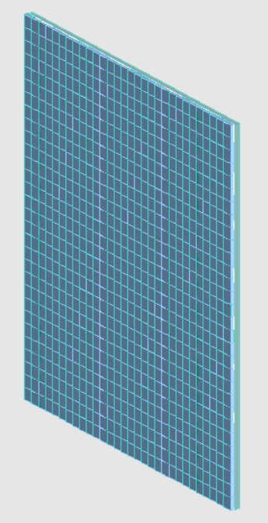
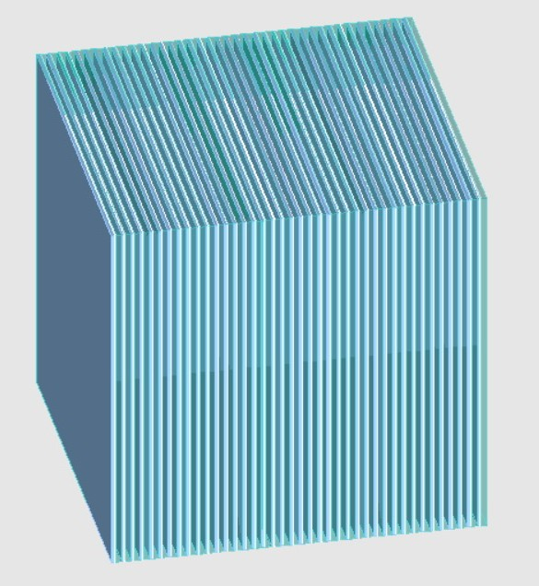
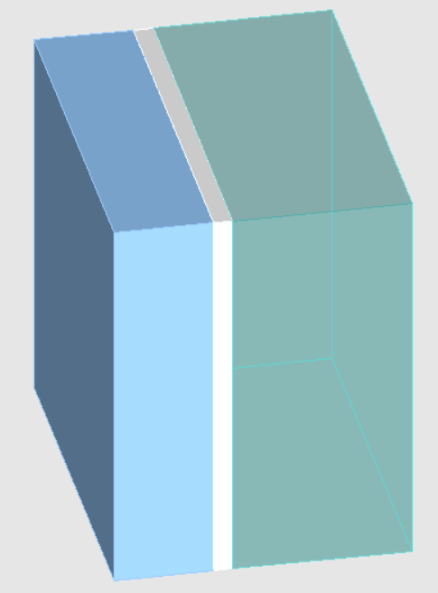
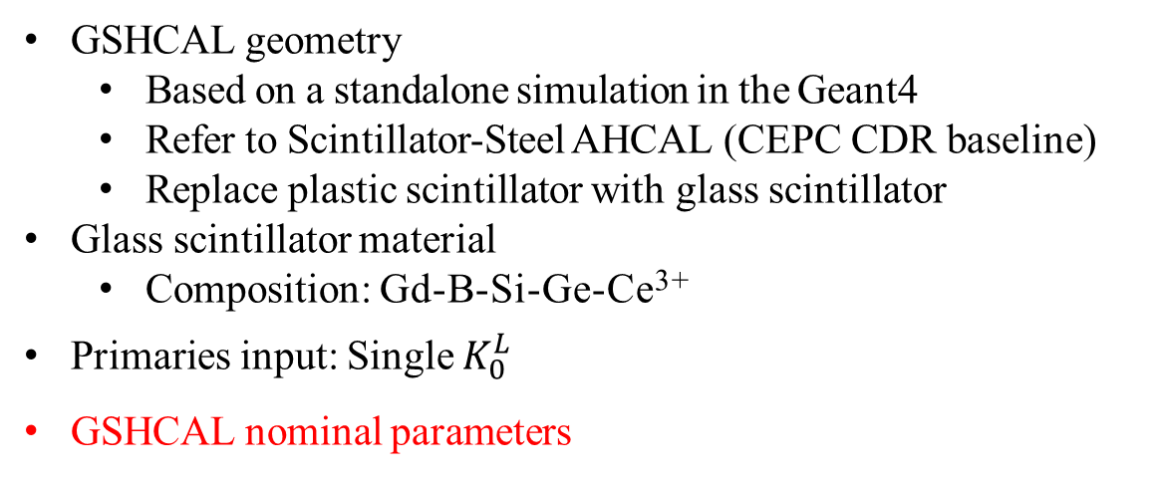
2.1 Intrinsic Performance Simulation of the GSHCAL
GSHCAL geometry
  Based on a standalone simulation in the Geant4
  Refer to Scintillator-Steel AHCAL (CEPC CDR baseline)
  Replace plastic scintillator with glass scintillator
Glass scintillator material
  Composition: Gd-B-Si-Ge-Ce³⁺
Primaries input: Single $K_{0}^{L}$
GSHCAL nominal parameters
Total number of layers | 40
Total nuclear interaction length | 6 𝝀
Glass tile size | 40×40×10 mm³
Glass density | 6 g/cm³
Readout threshold | 0.1 MIP
Glass 10mm
Steel
PCB 2mm
By Dejing Du

Slide 7
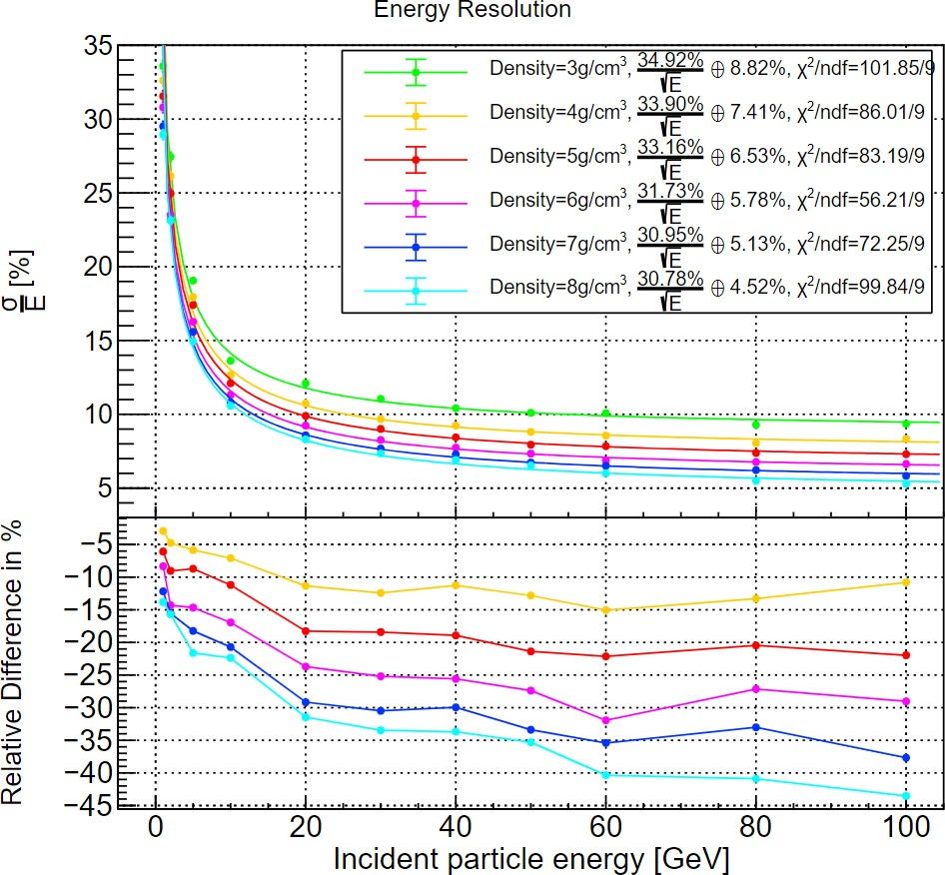
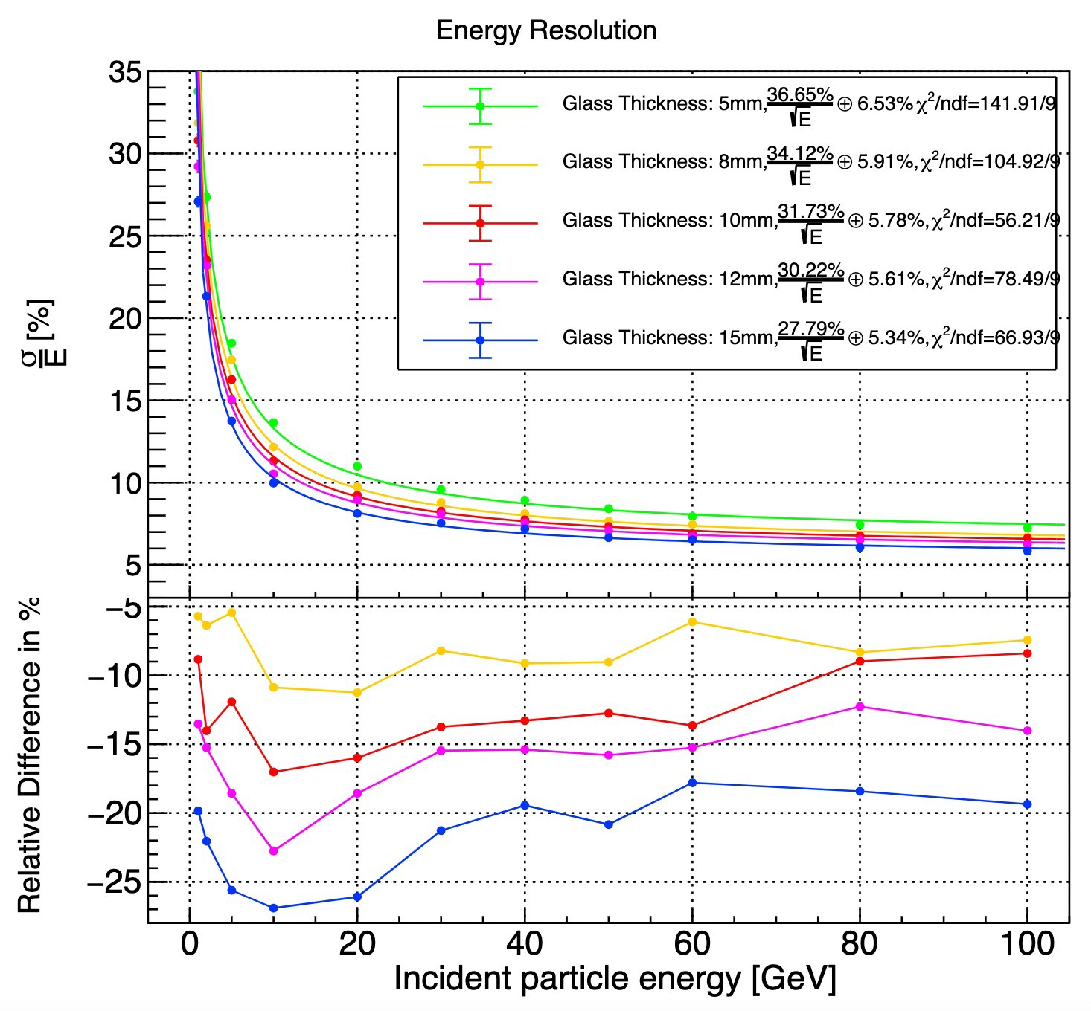
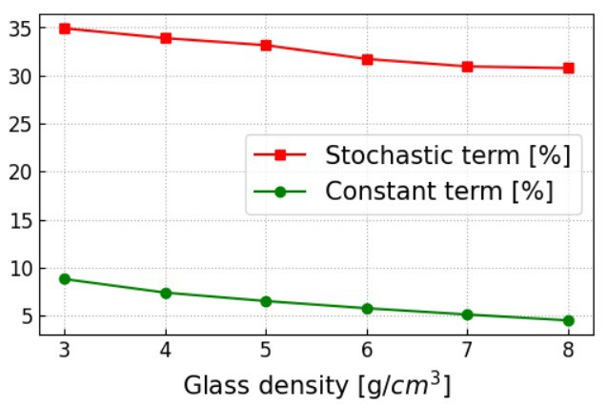
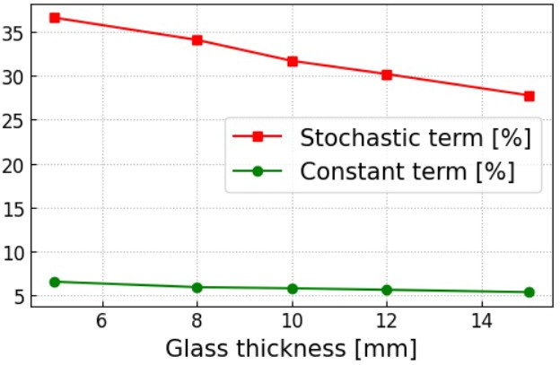
2.2 Impact of Density and Thickness
By Dejing Du
Increasing glass density is a very effective way to improve the hadronic energy resolution due to a higher sampling fraction, but the light yield will suffer from degradation
Increasing glass thickness is another effective way to improve the hadronic energy resolution due to a higher sampling fraction, but the transmittance will suffer from degradation

Slide 8
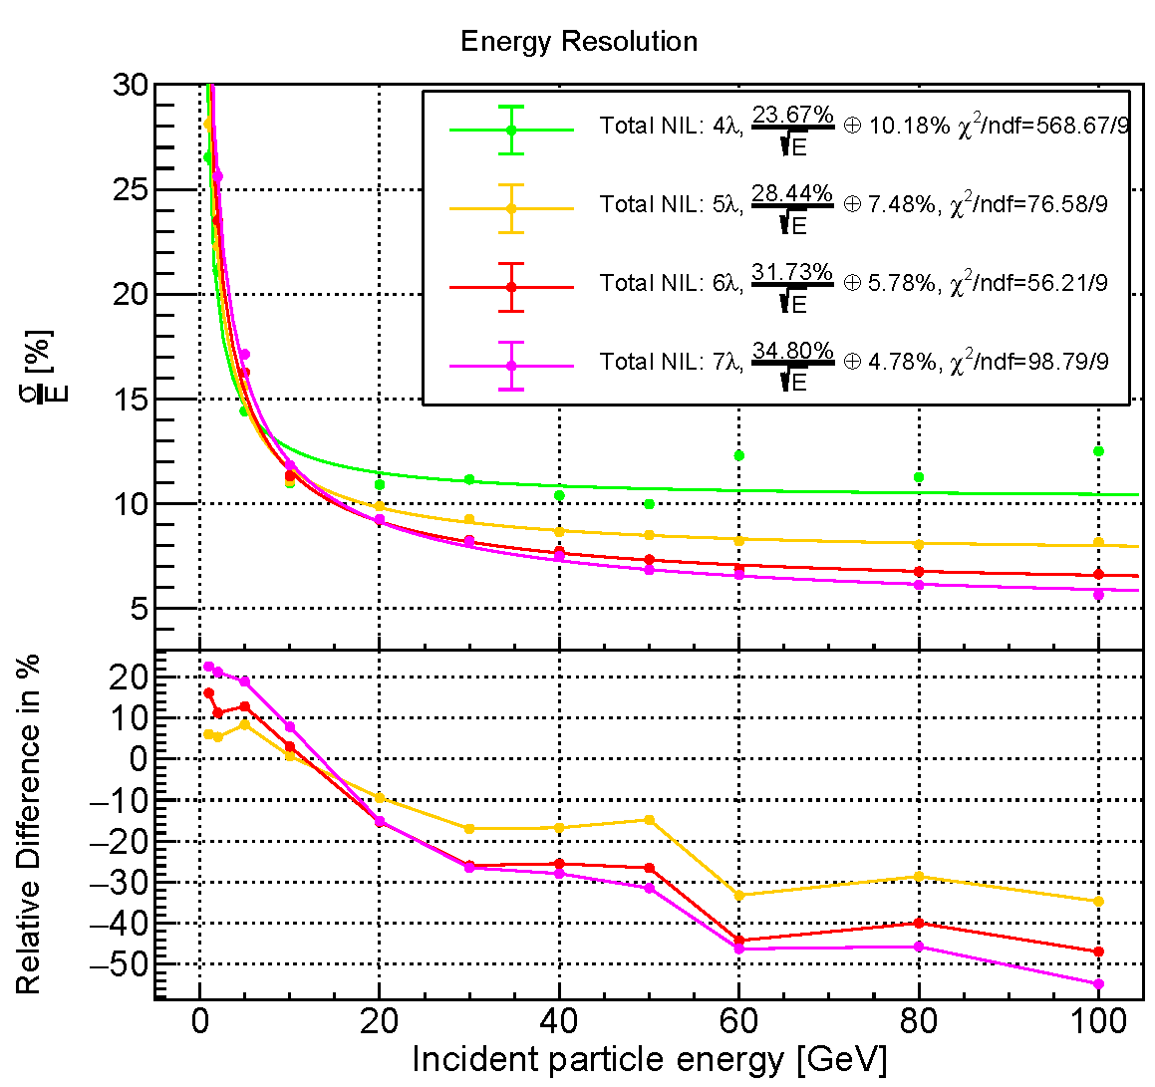
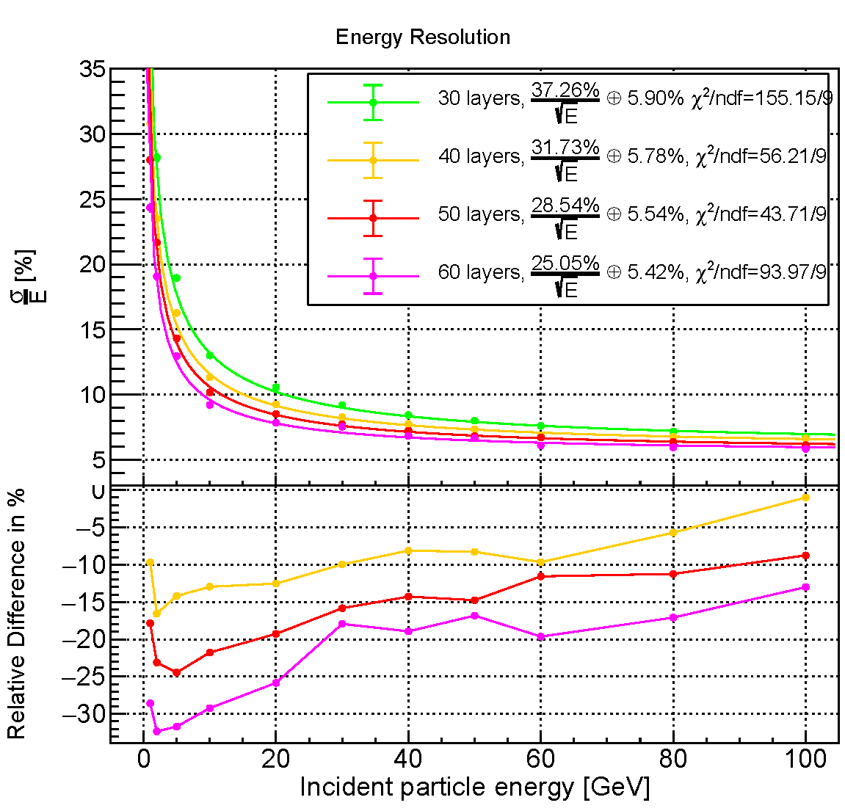
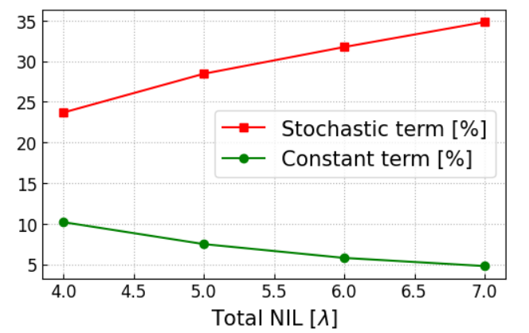
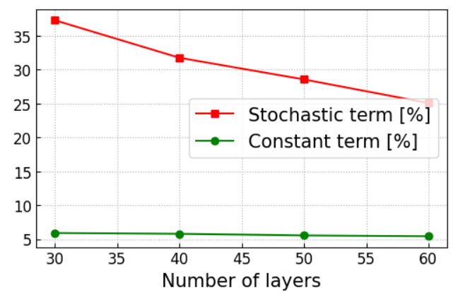
2.3 Impact of Total NIL and Number of Layers
By Dejing Du
Increasing the total nuclear interaction length can suppress the shower leakage, which gives a better constant term; the sampling fraction will decrease at the same time, thus a worse stochastic term is observed
Increasing the number of layers will improve both the sampling fraction and the sampling frequency of the GSHCAL, but the readout channel will also increase rapidly

Slide 9
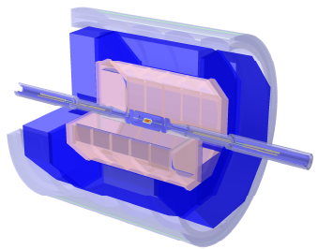
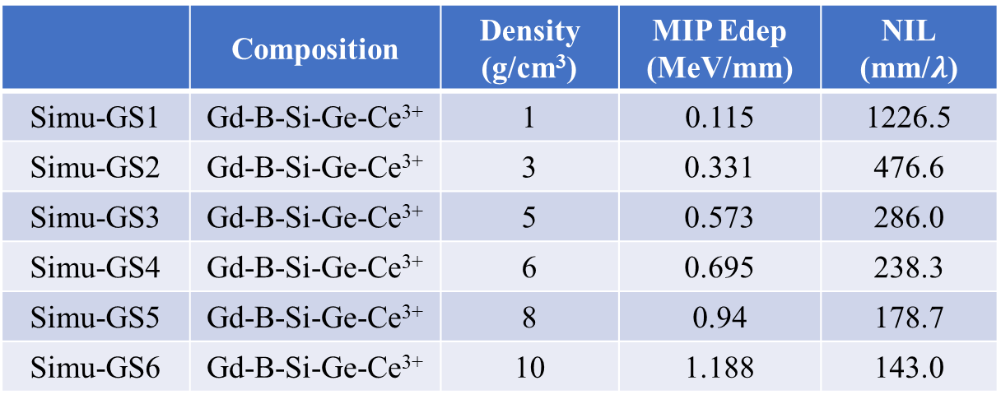
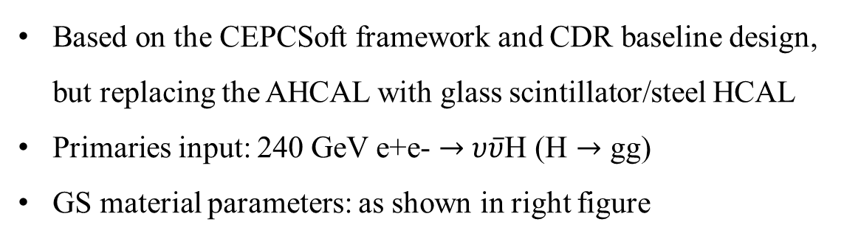
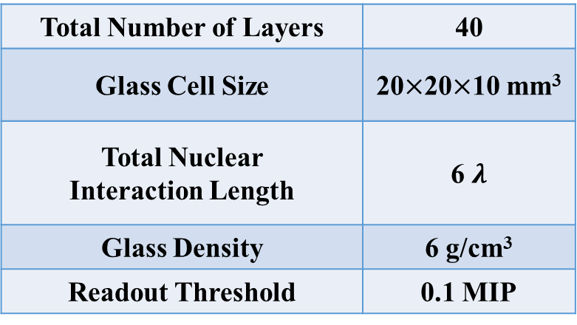
3.1 PFA Performance Simulation with the GSHCAL
Setup
Based on the CEPCSoft framework and CDR baseline design, but replacing the AHCAL with glass scintillator/steel HCAL
Primaries input: 240 GeV e+e- $→$ $υ\overline{υ}$H (H $→$ gg)
GS material parameters: as shown in right figure
GSHCAL
Si/W ECAL
GSHCAL Nominal Parameter
Total Number of Layers | 40
Glass Cell Size | 20$×$20$×$10 mm³
Total Nuclear Interaction Length | 6 $λ$
Glass Density | 6 g/cm³
Readout Threshold | 0.1 MIP
Notes:
The PFA performance is the focus of our simulation and directly related with the BMR.
This simulation was based on …

Slide 10
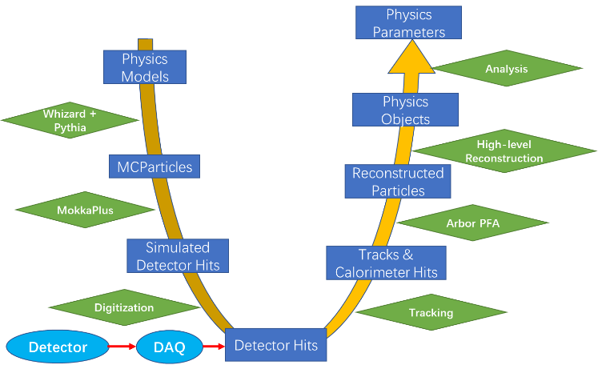
3.2 Event Reconstruction and BMR Analysis
Setup
Arbor PFA is applied
The readout threshold in each glass cell was set to 0.1 MIP
Event selection cut：Pt_ISR<1 GeV && Pt_neutrino<1 GeV && |Cos(Theta_Jet)|<0.8
Reconstruction Pipeline
The CaloHit digitization, including the scintillation process and readout time window were not considered in the following results

Slide 11
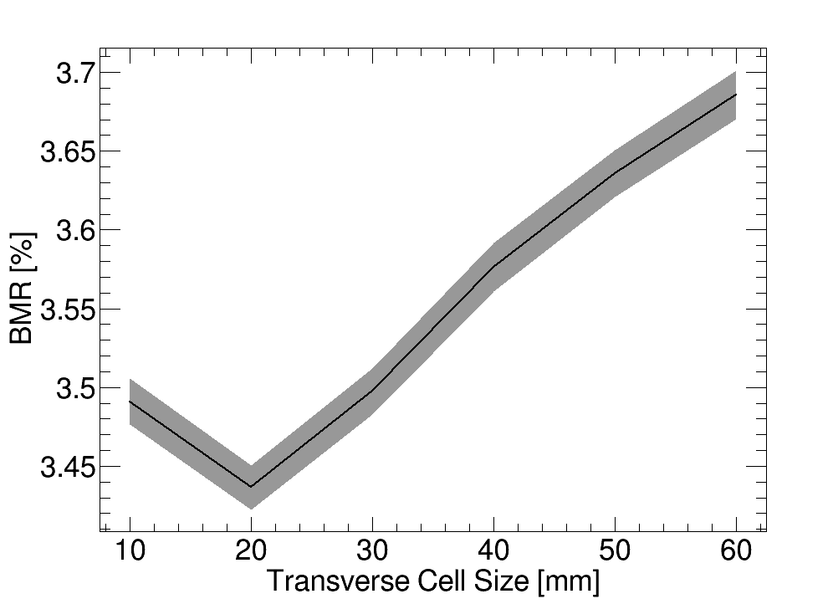
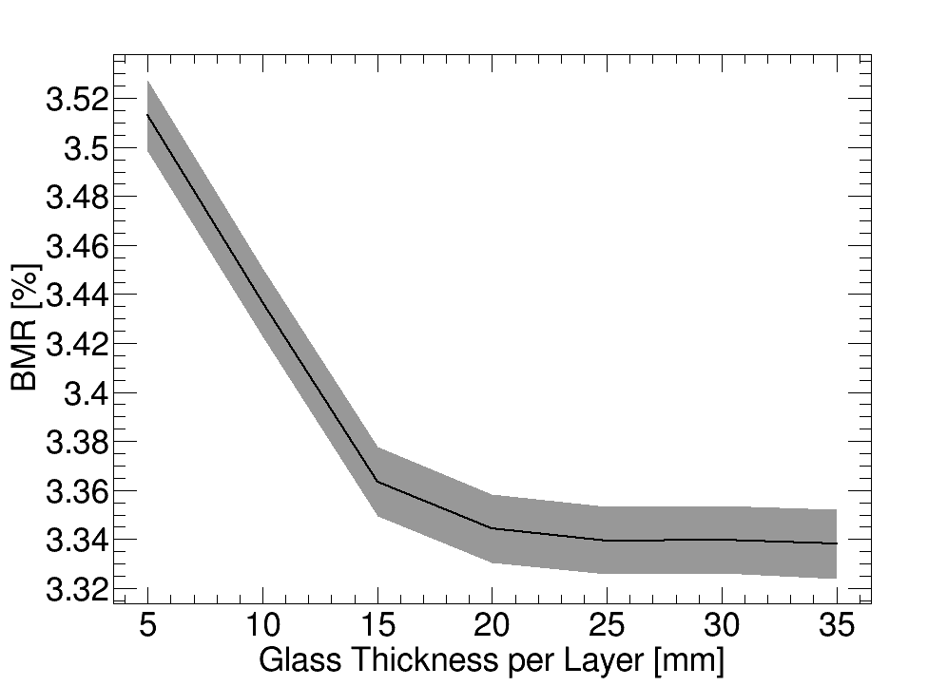
3.3 Impact of Transverse Size and Thickness
A thicker glass cell is conducive to a higher sampling fraction and a better BMR, though the transmittance and the position response non-uniformity will become worse; besides, the glass thickness will be also limited by the total thickness of the GSHCAL
A glass thickness of 10 mm will be chosen for current design, considering the BMR improvement provided by a thicker glass cell is not significant and meet the requirement from other aspects
The transverse size of the glass cell is a very important factor for the granularity and total number of readout channels of the GSHCAL
Considering the PFA performance and total number of readout channels, a transverse size of 20 mm will be chosen for current design (though the behavior with cell size lower than 20 mm needs a further study)

Slide 12
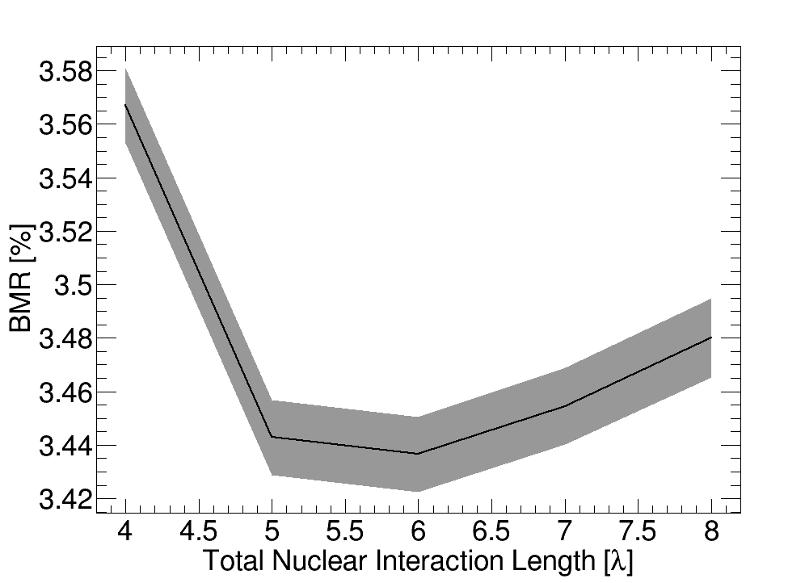
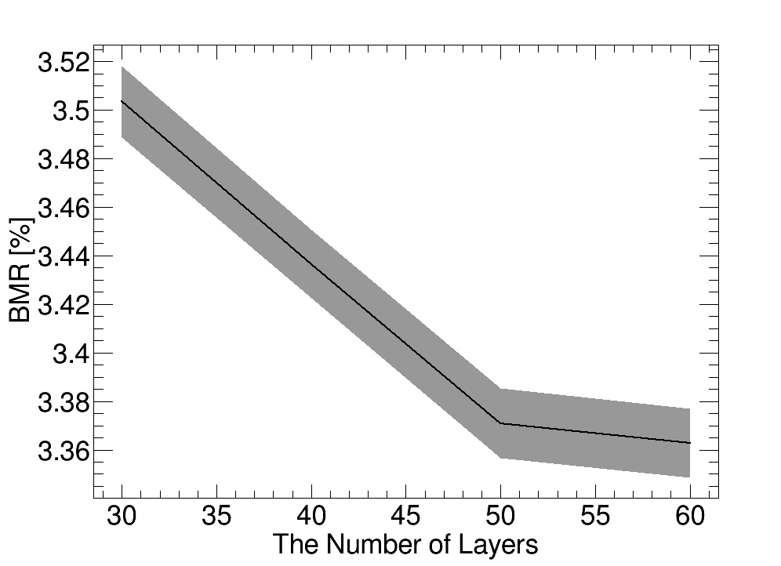
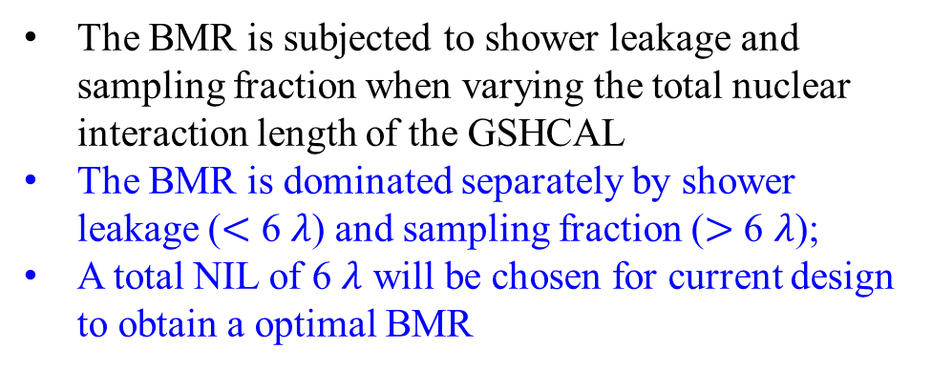
3.4 Impact of Total NIL and Number of Layers
The BMR is subjected to shower leakage and sampling fraction when varying the total nuclear interaction length of the GSHCAL
The BMR is dominated separately by shower leakage ($<$ 6 $λ$) and sampling fraction ($>$ 6 $λ$);
A total NIL of 6 $λ$ will be chosen for current design to obtain a optimal BMR
The increase of sampling layers will improve the sampling frequency and sampling fraction, which is beneficial to achieve a better BMR
40 sampling layers will be chosen for current design, considering the BMR improvement provided by more sampling layers is not significant and the number of readout channels is in a reasonable level

Slide 13
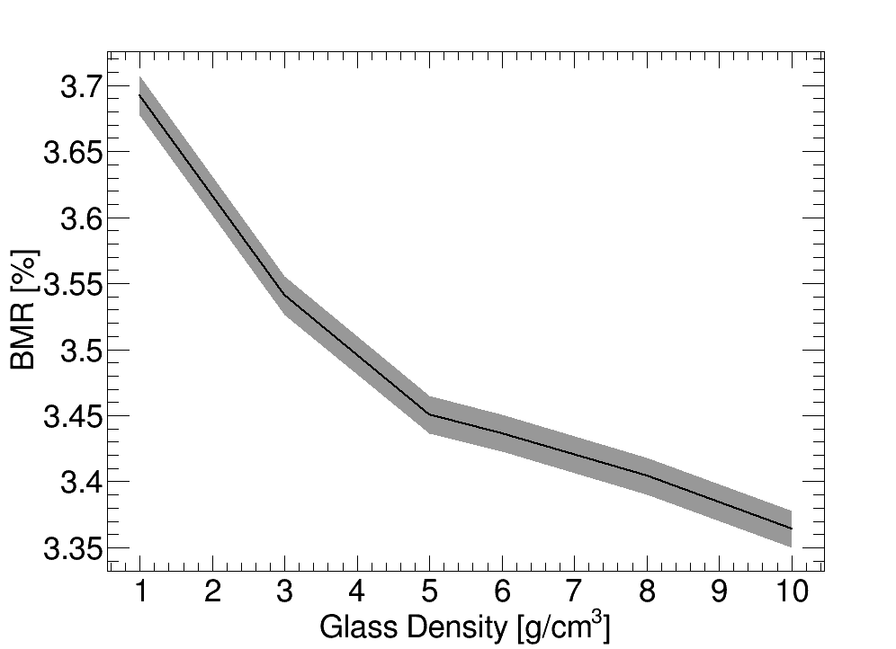
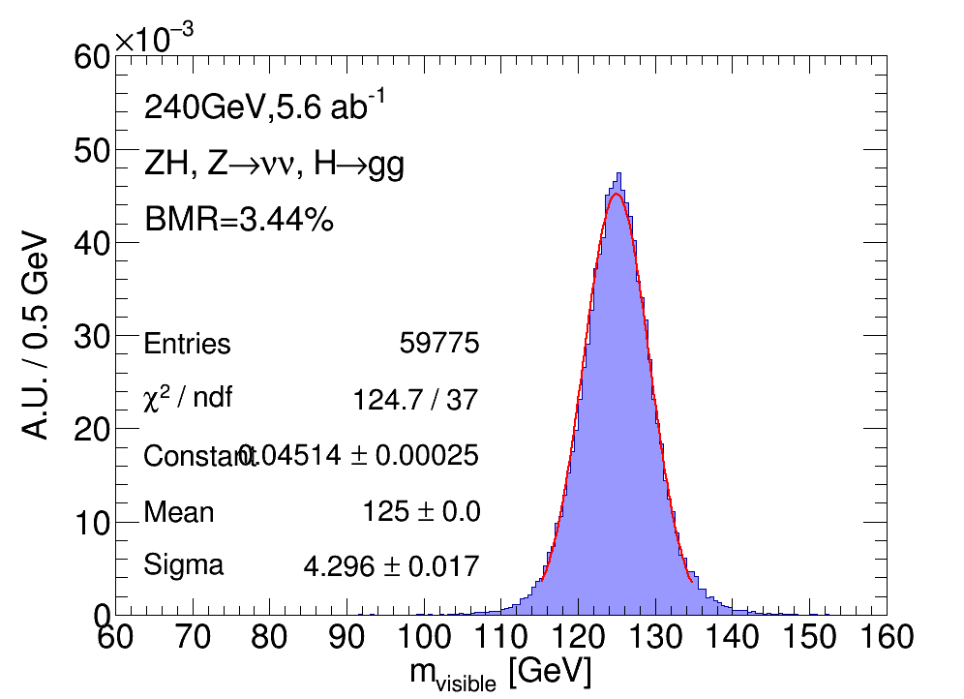
3.5 Impact of Density
The BMR in nominal setup
The high-density glass scintillator is beneficial to a better BMR and more compact design, but the scintillation performance (light output, transmittance and etc.) usually decrease with increasing glass density
A glass density of 6 g/cm³ will be chosen for current design, since the BMR improvement provided by a higher density is not significant and the degradation of scintillation performance is acceptable

Slide 14
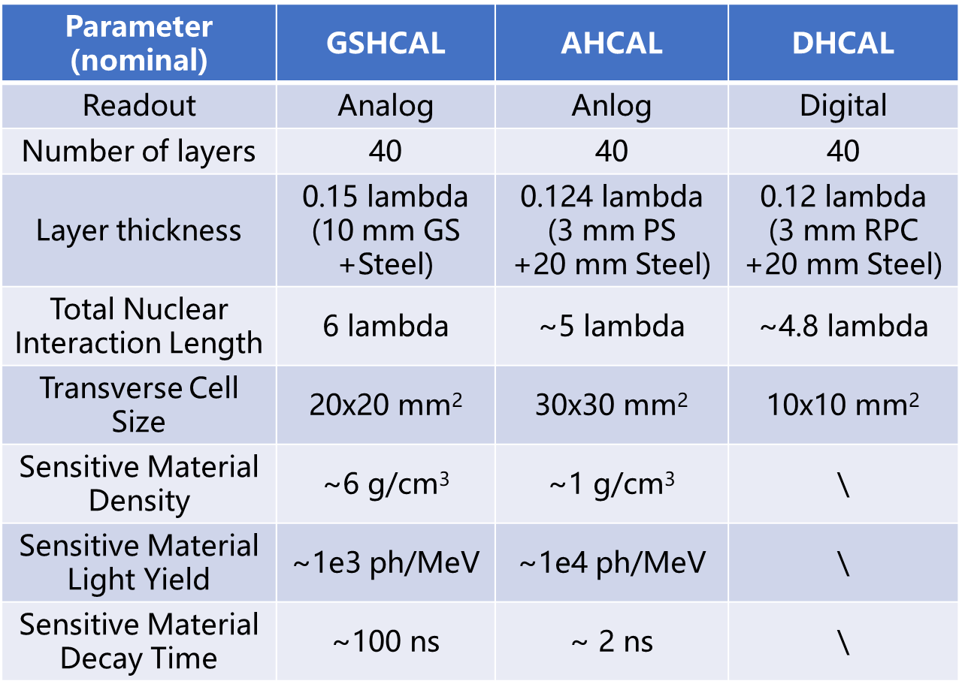
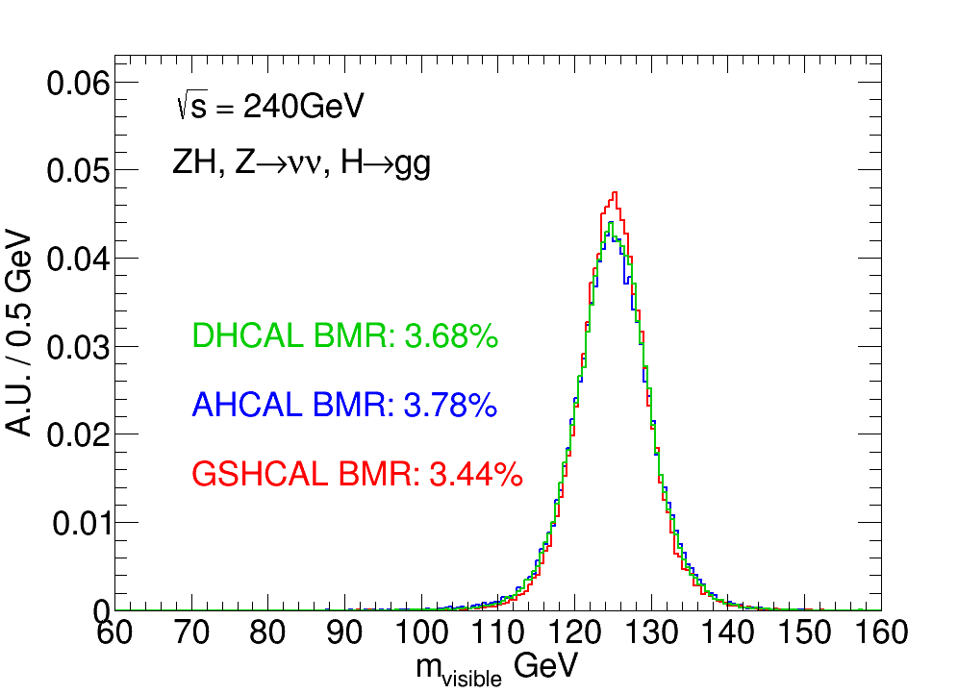
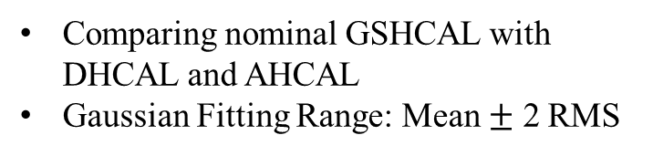
3.6 Baseline Design vs. GSHCAL
Comparing nominal GSHCAL with DHCAL and AHCAL
Gaussian Fitting Range: Mean $±$ 2 RMS
In the CDR baseline design, the BMR of DHCAL ~3.7%, and of AHCAL ~3.8%;
By replacing the CEPC_v4 baseline HCAL with the GSHCAL , the BMR can reach ~3.4% in the nominal setup and show ~10% improvement with. the AHCAL baseline design (~3.8%)

Slide 15
Summary
The performance of the GSHCAL in a nominal setup was studied both in a standalone simulation and in the CEPCSoft framework
In terms of the PFA performance, the BMR with GSHCAL of nominal setup can reach ~3.44% and show ~10% improvement with respect to the baseline AHCAL design (~3.8%), which is a very promising alternative design
Fine tuning of the PFA parameters is needed and will be further studied; the implementation of digitization process is still ongoing

Slide 16
Thank you!

Slide 17
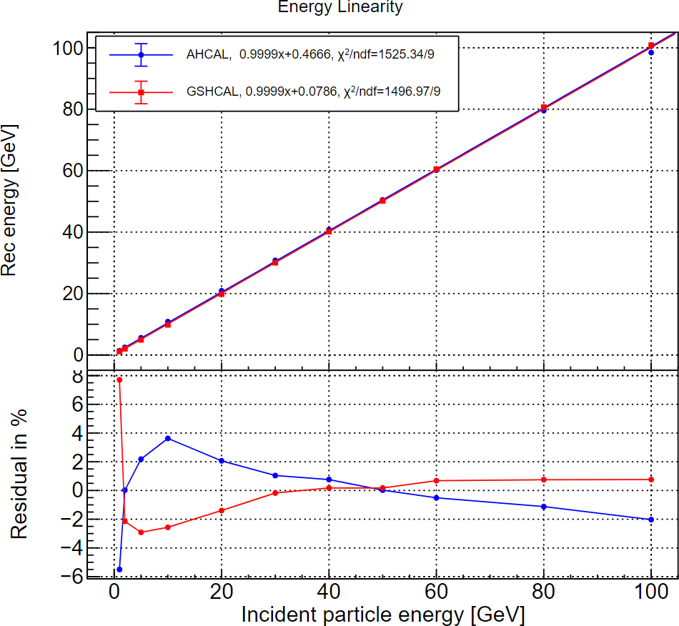
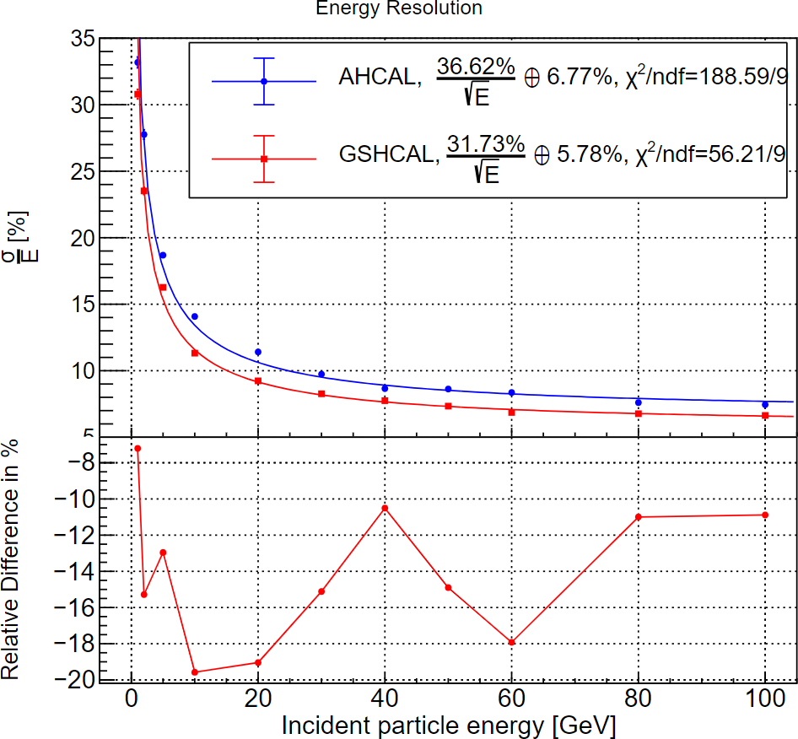
Intrinsic performance (GSHCAL vs. AHCAL)
Intrinsic performance comparison: CDR baseline AHCAL vs. nominal GSHCAL
Energy linearity: GSHCAL slightly worse than AHCAL
  Within ±3% range in 10-100 GeV, but with a relatively worse linearity in lower energy range
Energy resolution: GSHCAL has a better hadronic energy resolution and improves by around 15%

Slide 18
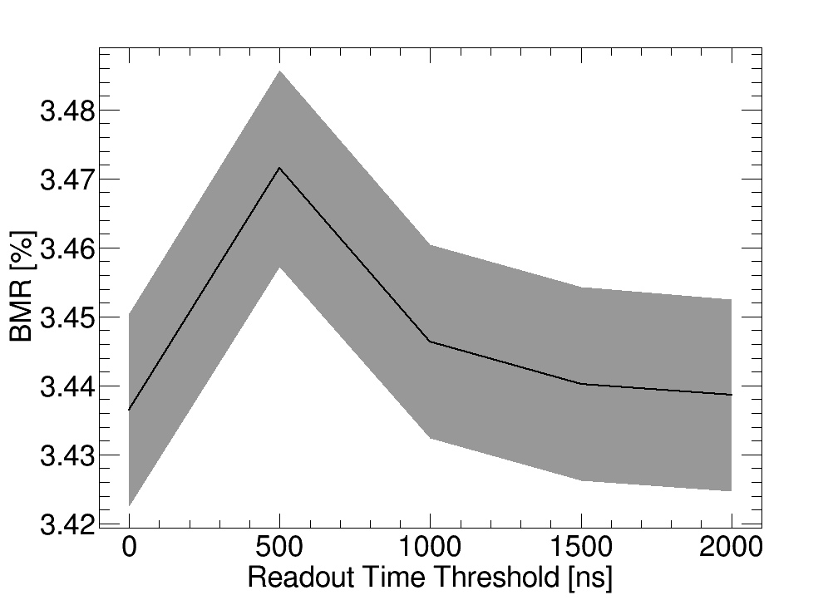
Digitization for Readout Time
Only the (G4)step whose time is within the time threshold will be considered
Threshold 0 means no time digitization (i.e. all steps will be used)
The readout time threshold has an important impact on the slow signal (mainly caused by neutrons); more slow signals will be rejected as the time threshold decreases, thus the energy resolution and the BMR also become worse
A higher readout time threshold is beneficial to obtain a better BMR but the improvement is not significant, thus 1 us is considered to be enough

Slide 19
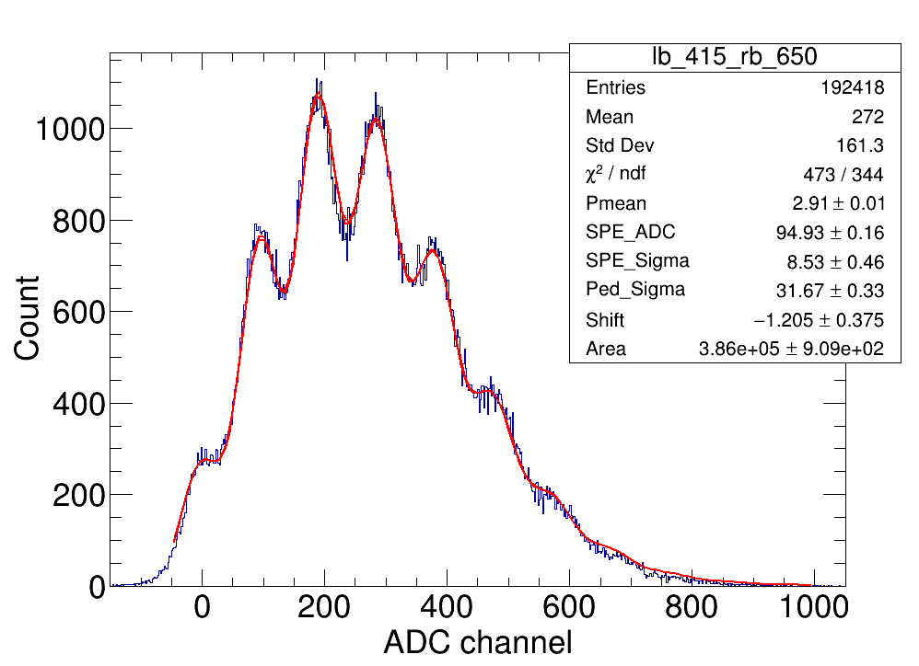
Digitization for Detected Photoelectrons
PE_{detected} = Gaus( Poisson(Mean_pe), Sigma)
Edep_{detected} = PE_{detected}/MIPLO
Simga = Sqrt(Poisson(Mean_pe)*SPE_Sigma²+Ped_Sigma²)
Poisson sampling with consideration of the scintillation process and the photon detection efficiency of the SiPM; the Mean_pe is the mean detected p.e. for MIP (p.e./MIP)
Gaussian sampling with consideration of the fluctuation of a given photoelectron signal, which is caused by the fluctuation of the pedestal (the electronics noise, denoted as Ped_Sigma) and the single photoelectron signal (from the gain and the amplifier, etc, denoted as SPE_Sigma)
Measured SPE spectrum of Hamamatsu S13360-6050CS, fitted with convoluted Poisson and Gaussian function mentioned above to obtain SPE_Sigma and Ped_Sigma

Slide 20
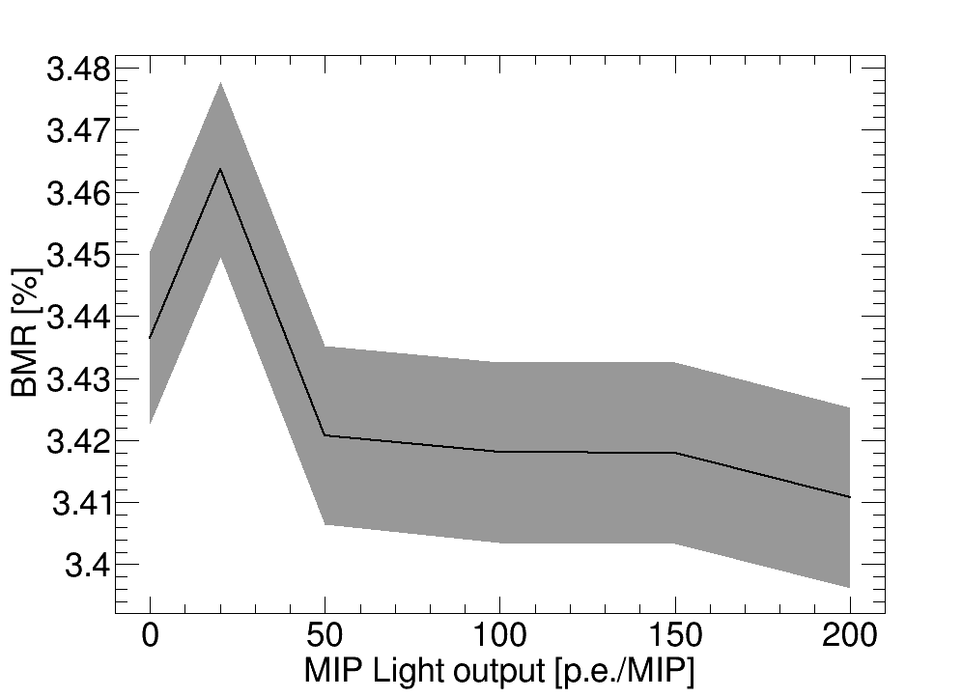
Digitization for Detected Photoelectrons
The energy deposition is sampled based on the method mentioned in last slide
Readout threshold was fixed to 5 p.e.
0 p.e./MIP means no digitization for detected photoelectrons (i.e. the energy threshold of 0.1 MIP is used)
The MIP Light output will have a significant impact on the fluctuation of electronics signal and thus a very important factor to the BMR
MIP response of 50 p.e./MIP is enough to obtain a optimized BMR based on this preliminary simulation

Slide 21
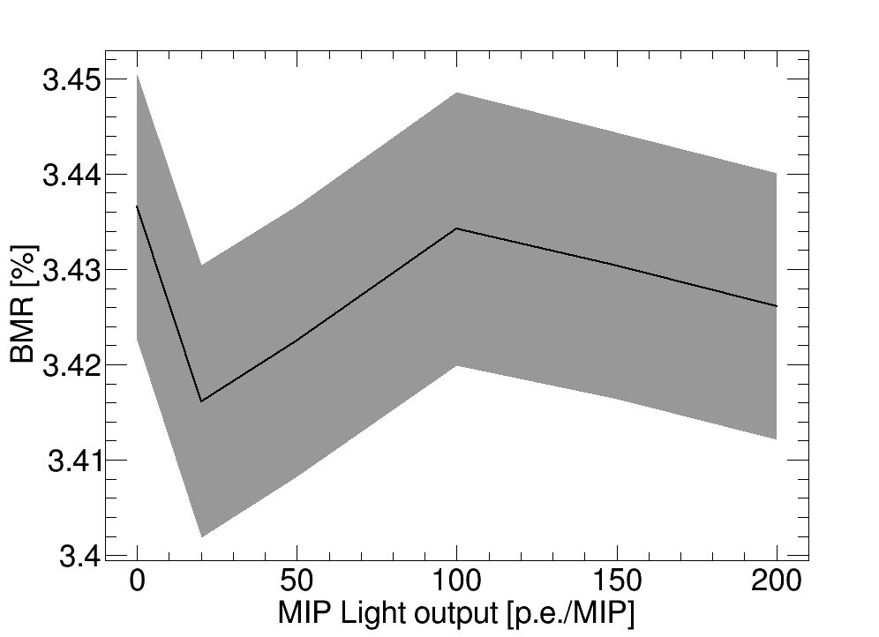
Digitization for Detected Photoelectrons
The energy deposition is sampled based on the method mentioned in last slide
The threshold was based on energy and fixed to 0.1 MIP
The MIP Light output is expected to have a significant impact on the fluctuation of electronics signal and thus a very important factor to the BMR
According to current simulation, the impact is insignificant, the abnormal trend shown in this plot should be further studied

