Slide 1
湖南大学
Hunan University
用手征微扰论研究
报告人：周家煜
时间：2023.11.12
第五届天问粒子物理论坛
湖南·长沙

Slide 2
湖南大学
Hunan University
目录
Background
The chiral Lagrangian of SU(3)
Feynman diagrams
Amplitude
Phase space integral
Data processing

Slide 3
湖南大学
Hunan University
手征微扰历史背景
The SU(3) Chiral Perturbation Theory (ChPT) is a theoretical framework in particle physics primarily used for describing and calculating low-energy processes under strong interactions. This theory was developed based on Quantum Chromodynamics (QCD), the fundamental theory that describes strong interactions.
The historical background and development overview are as follows:
QCD and Strong Interactions: Between the 1960s and 1970s, physicists gradually developed QCD as the theory for strong interactions. QCD is a gauge theory based on the SU(3) group, describing the interactions between quarks and gluons.
Breaking of Chiral Symmetry: At low energies, strong interactions exhibit spontaneous breaking of chiral symmetry. This means that although the fundamental equations of QCD are chiral symmetric, its ground state (i.e., the physical vacuum) does not obey this symmetry.
Development of Chiral Perturbation Theory: To address the computational challenges of low-energy QCD, physicists developed Chiral Perturbation Theory. This theory leverages the properties of chiral symmetry and its spontaneous breaking, allowing systematic calculations of strong interaction processes at low energies through effective field theory.
SU(3) Chiral Perturbation Theory: The theory was initially developed based on SU(2) symmetry (involving two light quarks) and later expanded to SU(3), including three light quarks (up, down, and strange). This expansion enabled the theory to more comprehensively describe the strong interaction phenomena at low energies.
Application and Development of the Theory: Since its introduction, SU(3) Chiral Perturbation Theory has been significantly successful in describing low-energy strong interaction processes, such as the interactions of π mesons, K mesons, and η mesons. It has also played an important role in understanding the structure of hadrons and the non-perturbative nature of strong interactions.

Slide 4
湖南大学
Hunan University
SU(3)拉氏量
The Lagrangian in SU(3) Chiral Perturbation Theory should satisfy the following key invariances or principles of symmetry:
Chiral Symmetry: In QCD, if quark masses are ignored, the theory exhibits chiral symmetry, meaning it does not differentiate between left-handedness and right-handedness. In practical applications, considering that actual quark masses are small, chiral symmetry is approximately valid. The Lagrangian in SU(3) Chiral Perturbation Theory should approximately maintain this symmetry.
Local Gauge Invariance: As an effective theory of QCD, the Lagrangian in SU(3) Chiral Perturbation Theory needs to maintain local SU(3) gauge symmetry, reflecting the strong interactions among quarks.
Lorentz Invariance: Physical laws are invariant under Lorentz transformations, meaning that the Lagrangian in SU(3) Chiral Perturbation Theory should also be invariant under these transformations.
CPT Invariance: According to the CPT theorem, all physical laws must remain invariant under the combined transformations of charge conjugation (C), parity transformation (P), and time reversal (T). This applies to SU(3) Chiral Perturbation Theory as well.
Spontaneous Symmetry Breaking: In the low-energy region, QCD exhibits spontaneous breaking of chiral symmetry. The Lagrangian in SU(3) Chiral Perturbation Theory should be able to describe the effects of this spontaneous symmetry breaking.

Slide 5
湖南大学
Hunan University
SU(3)拉氏量

Slide 6
湖南大学
Hunan University
费曼图
Tree diagrams：

Slide 7
湖南大学
Hunan University
费曼图
One-Loop diagrams：
The virtual photon is to be appended on all possible lines and vertices. Wave function renormalization diagrams are also shown.

Slide 8
湖南大学
Hunan University
振幅的对称性
The pionic matrix element of the electromagnetic current：

Slide 9
湖南大学
Hunan University
振幅的对称性
In the isospin limit that will be assumed throughout this paper, the current matrix
element for the $2π^{+}2π^{−}$ channel can be expressed in terms of the matrix element for the $2π^{0}π^{+}π^{−}$channel

Slide 10
湖南大学
Hunan University
树图的振幅
Tree diagrams of $O(p^{2}) :$
For the sake of simplicity in amplitude, the definition of Dalitz variables can be defined as:

Slide 11
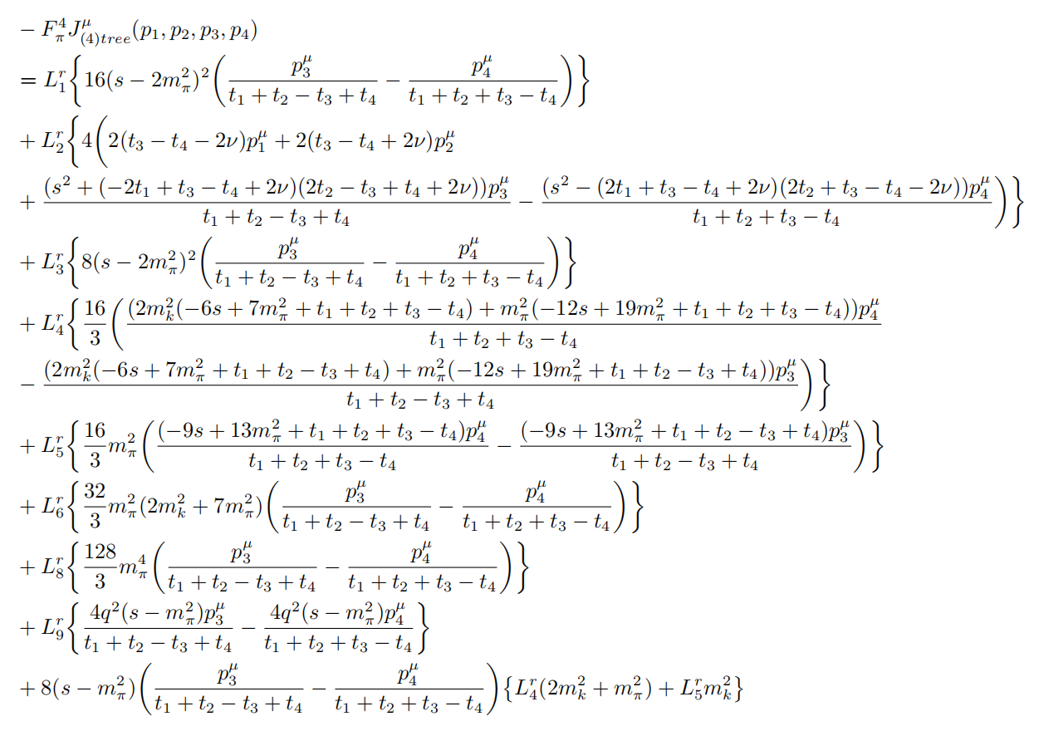
湖南大学
Hunan University
树图的振幅
Tree diagrams of $O(p^{4}) :$

Slide 12
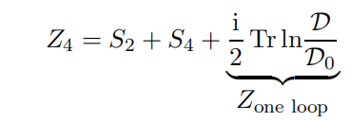
湖南大学
Hunan University
圈图的振幅
The calculation of loop diagrams can be performed using the method of generating functionals as described in the paper by R. Unterdorfer and G. Ecker from 2005.
dµ[ξ] is the functional measure for the matrix field ξ. Planck’s constant is set equal to 1.
Z is the connected Green functions :

Slide 13
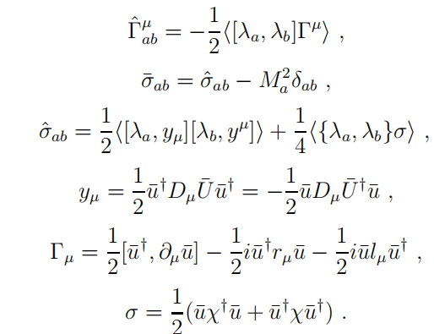
湖南大学
Hunan University
圈图的振幅

Slide 14
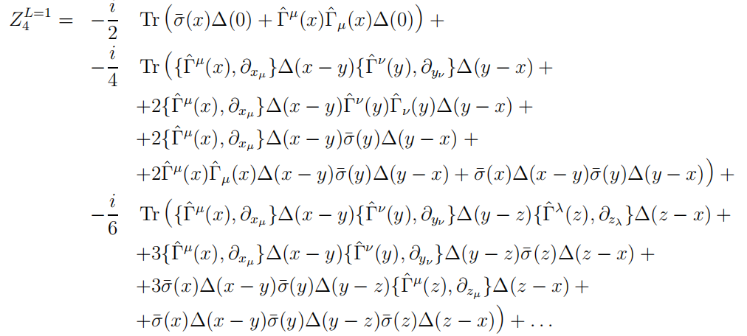
湖南大学
Hunan University
圈图的振幅
One-Loop：

Slide 15
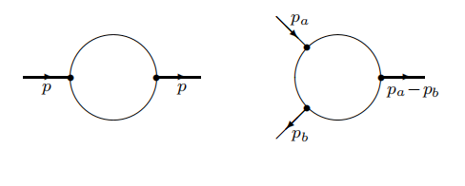
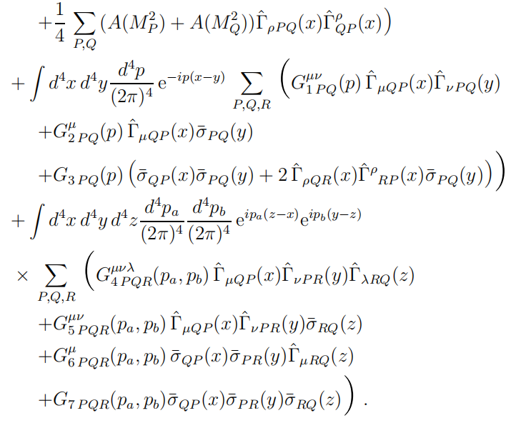
湖南大学
Hunan University
圈图的振幅
One-Loop：

Slide 16
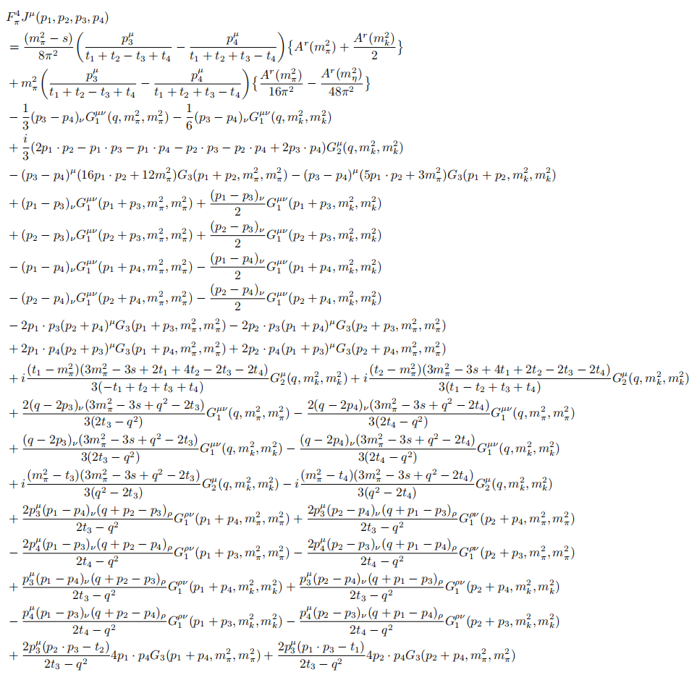
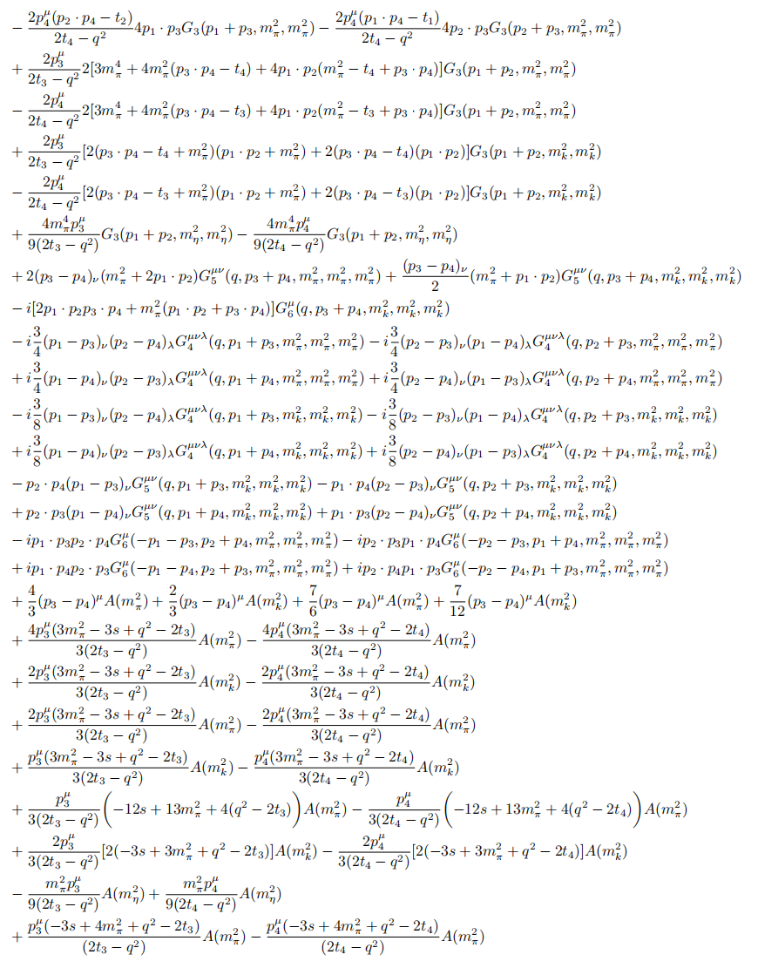
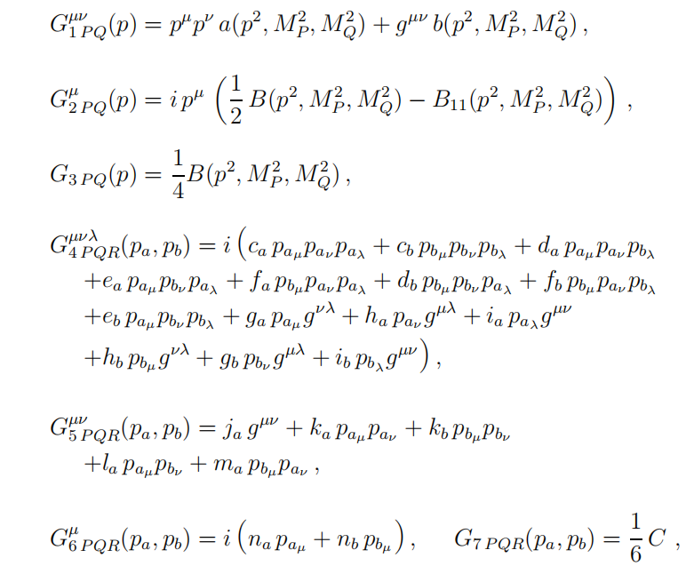
湖南大学
Hunan University
圈图的振幅
R. Unterdorfer and G. Ecker, JHEP 10 (2005), 017 .
The calculation of loop diagrams can be conducted using the method of generating functionals outlined by R. Unterdorfer and G. Ecker, with the definitions of loop integrals and constituent functions following: their definitions. This leads to the loop diagrams being:

Slide 17
湖南大学
Hunan University
四体相空间积分
The four-body phase space integral can be written as:

Slide 18
湖南大学
Hunan University
四体相空间积分
The limits of integration are :

Slide 19
湖南大学
Hunan University
四体相空间积分
The definition of the Gram determinant is as follows:
1
2
3
4

Slide 20
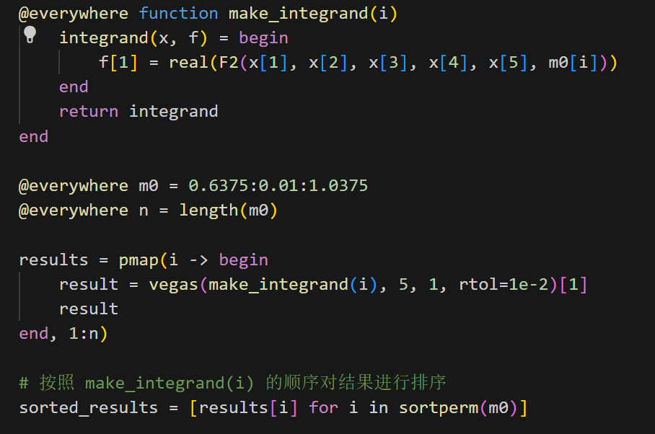
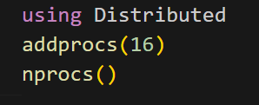
湖南大学
Hunan University
数据处理
In Julia, when using the LoopTools package to call A, B, and C functions in loop diagrams, multi-threading computation is not supported. However, parallel computation can be achieved using a multi-process approach.
It is necessary to add processes, with the specific number of processes adjusted according to the CPU core count and memory size. Subsequently, multi-process concurrent computation can be carried out. An example is as follows:
In Julia, when using the Cuba package for Monte Carlo sampling in five-dimensional phase space integration, if the integrand has poor convergence properties, the sampling can be excessive, leading to a significant waste of computation time.

Slide 21
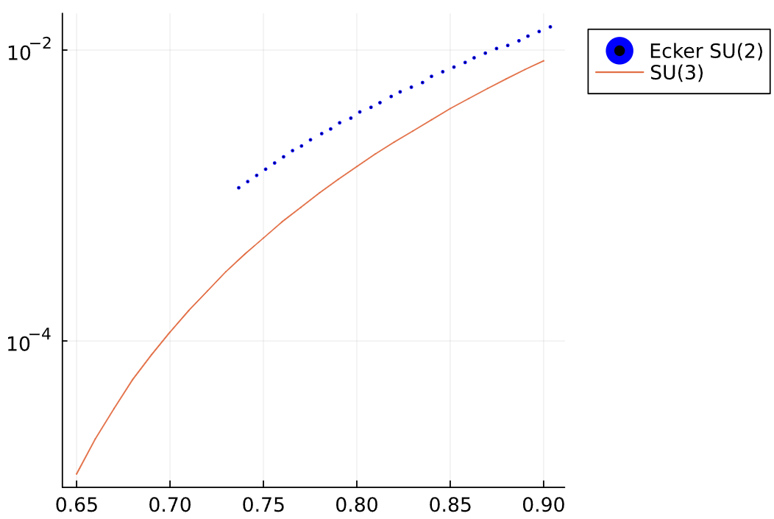
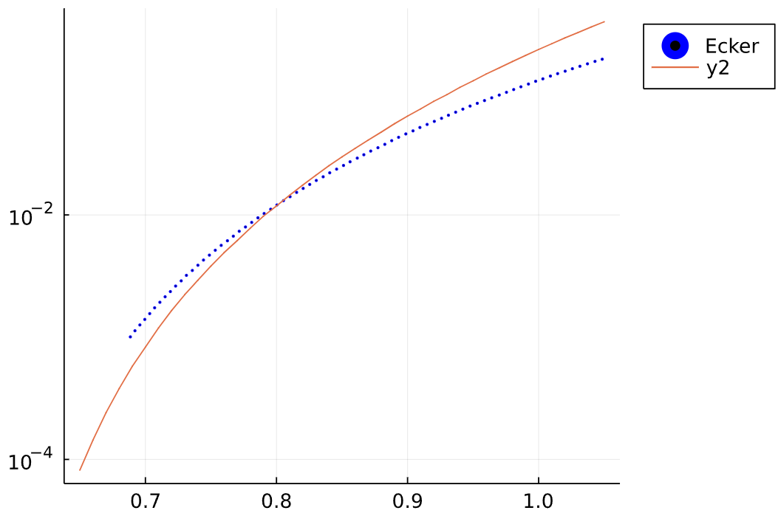
湖南大学
Hunan University
结果
Comparison of SU(3) results with SU(2) results in the low energy region.

Slide 22
湖南大学
Hunan University
Thank You!

