Slide 1
Accurate in-situ density measurement and anomaly detectability for rock petrophysics with cosmic-ray muon radiography
Jie PANG
North China Electric Power University
Ran HAN Zhiwei LI
Beijing Institute of Spacecraft Environment Engineering
In collaboration with Imad Laktineh: Institut de Physique des 2 Infinis de Lyon
14th Workshop of the FCPPL 2023.11.06
Notes:
Thank for committee give me this chance to report our work, our work is about

Slide 2
Outline
1
Introduction
2
Accurate density measurement
3
Anomaly classify
4
Summary
Notes:
I will introduce our work from this four part

Slide 3
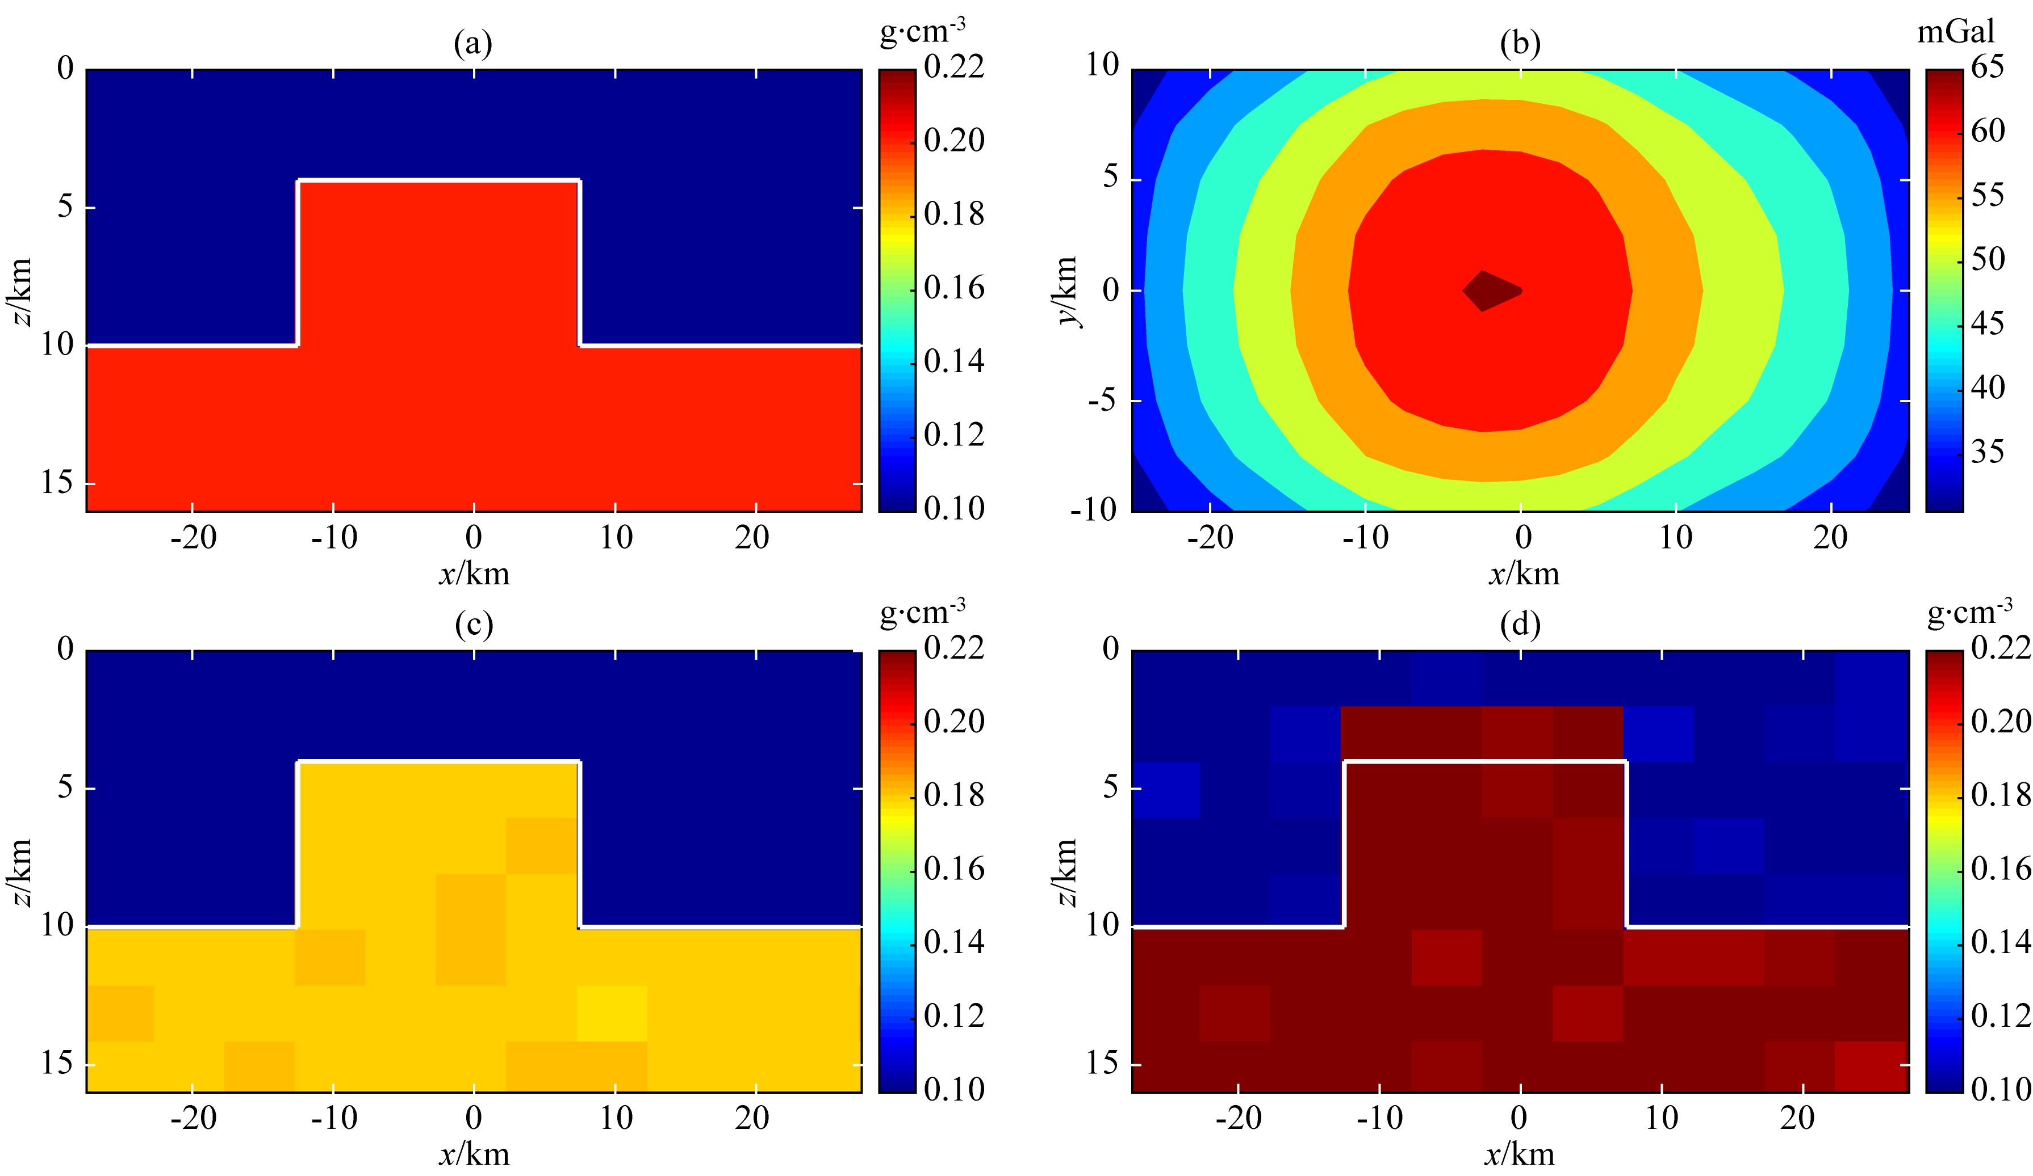
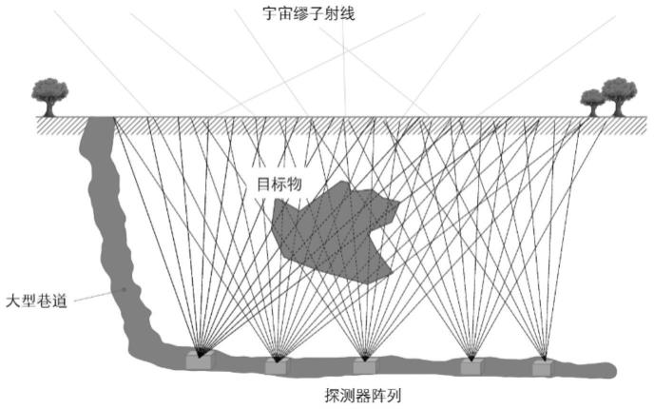
Introduction
Honglei Li et. al. 2021
Traditional density inversion use gravity data.
Gravity inversion suffer non-uniqueness of solution.
Density inversion is a complex calculation.
Cosmic-ray muon can penetrate thick rocks.
Matter density directly connect with number of muon detected in downstream.
Muon radiography can inversion the in-situ density, and with high spatial resolution.
This work try to measure accurate in-situ density by muon radiography.
Notes:
We make a accurate in-situ density measurement based on muon radiography
Traditional density inversion in rock petrophysics use gravity data, but …, and is complex in calculation
Muon radiography is a new technology in petrophysics can

Slide 4
Model
Need to detect the muon of opensky and the surviving muon which cross the matter.
Notes:
Muon radiography need to detect the attenuation of muon after interaction with the matter, therefore

Slide 5
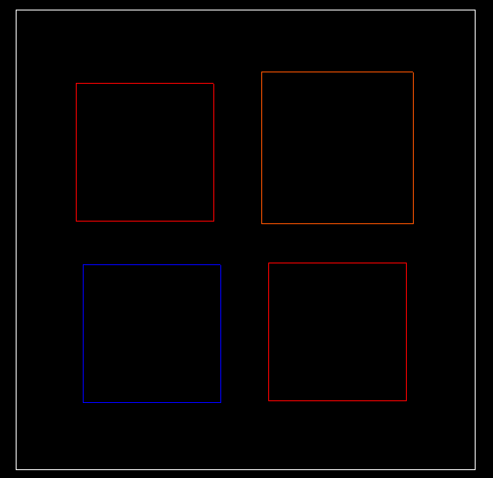
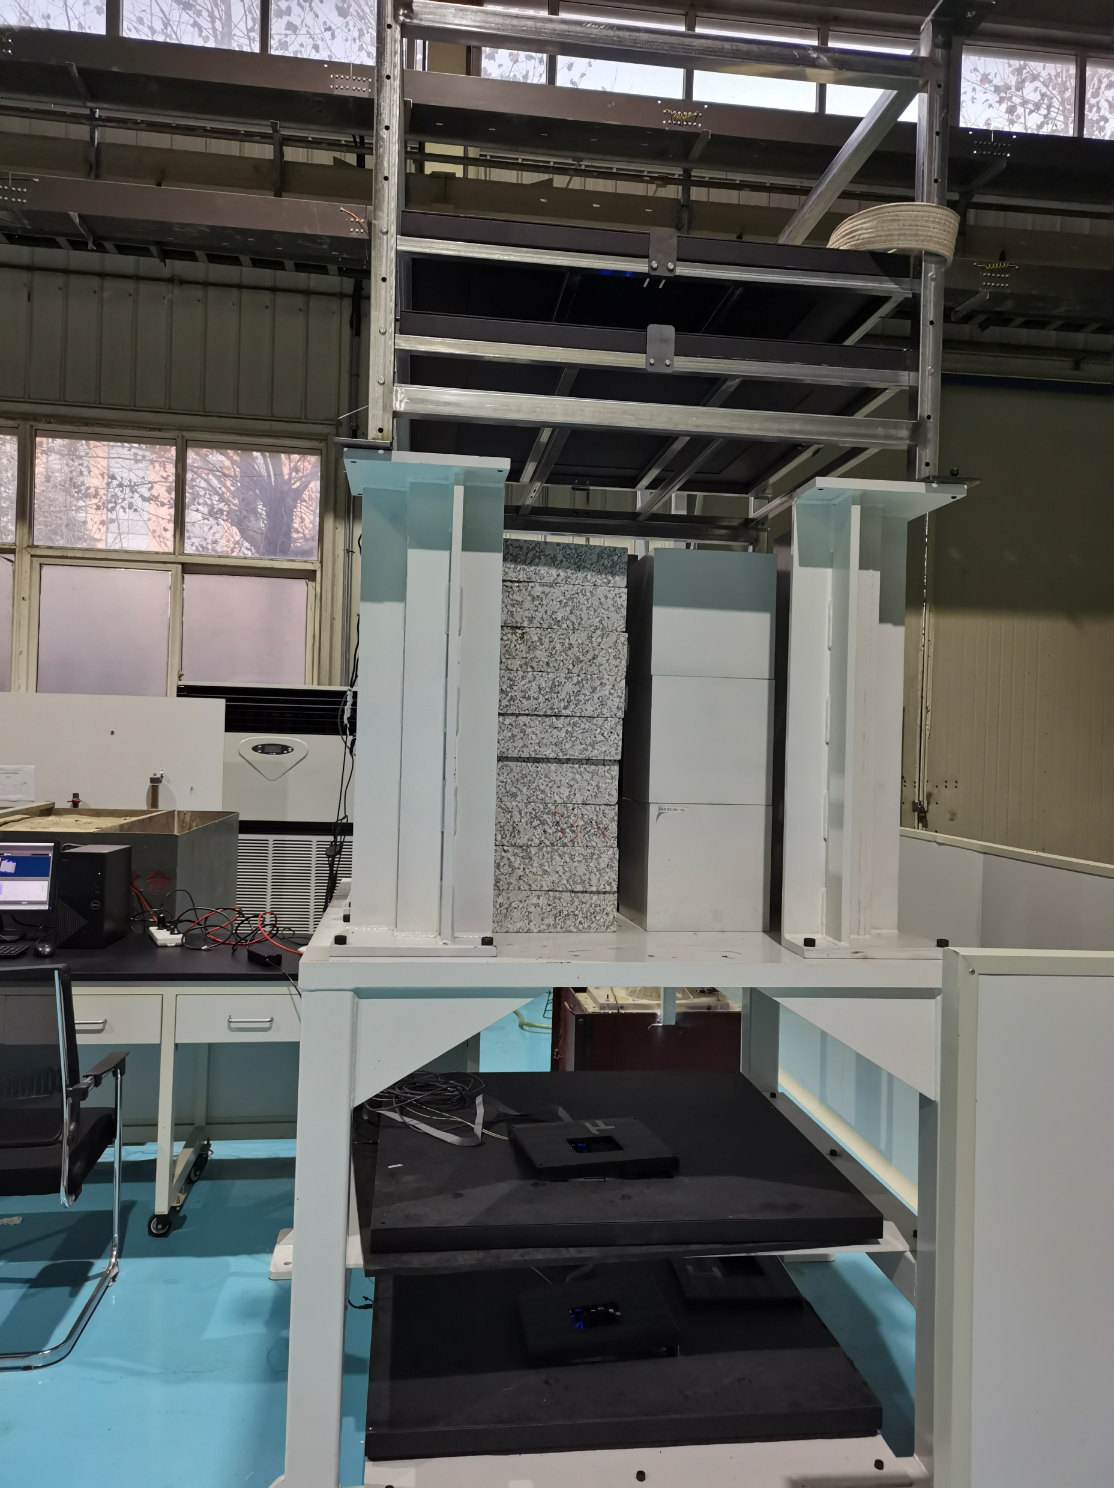
Experiment
Top view
Laboratory photo
30cm
30cm
Fe
(Thickness
90cm)
10cm
Rock
(Thickness
88.5cm)
10cm
10cm
Water
(Thickness
76cm)
Fe
(Thickness
90cm)
10cm
30cm
30cm
We try to invert three different type of matters in our experiment.
Each layer is 50$×$50 pixels.
Notes:
In our work we place three type of materials to try to measurement their density

Slide 6
Outline
1
Introduction
2
Accurate density measurement
3
Anomaly classify
4
Summary
Notes:
I will introduce my work from this four part, firstly, I will introduce density inversion method and machine learning method we use in this work

Slide 7
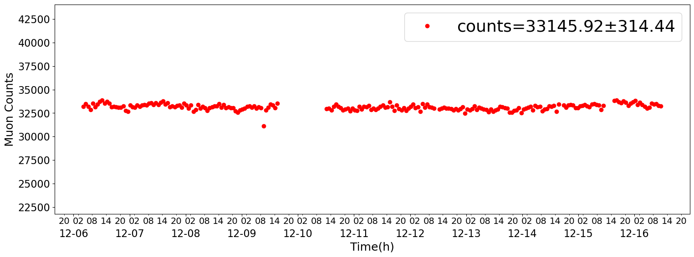
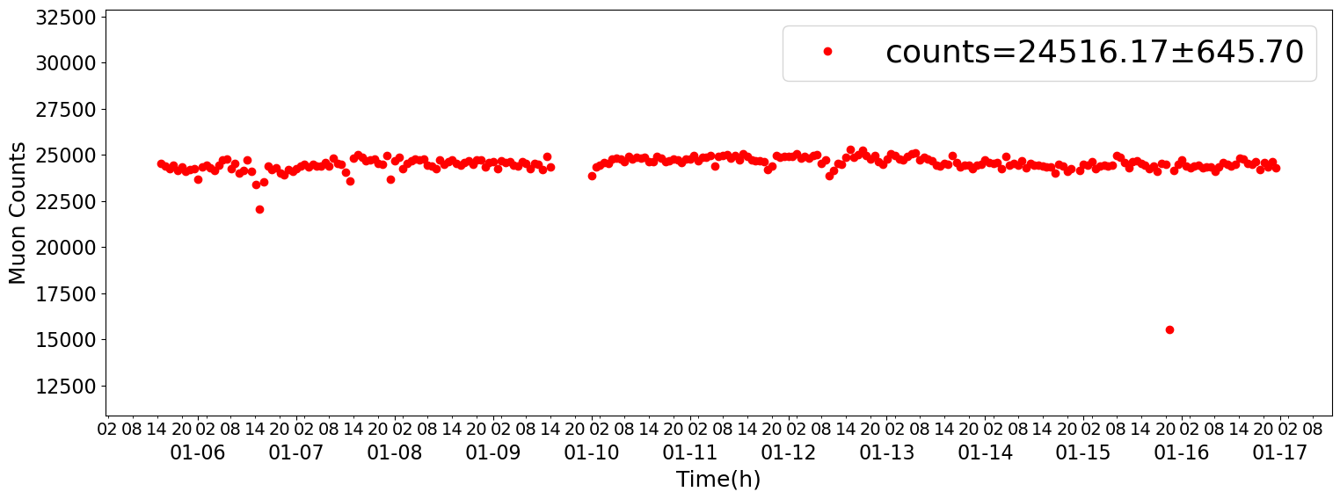
Raw data stability
Without models
Discard
Counts over 3$σ$ will be discarded
Detector efficiency is approximately 87%
Each phase with 220 hours of data
With models
Discard
Next step will select the muon events which be used in density inversion.
Notes:
Here shows the stability of our raw detected data, than we obtain 87% of useful counts that mean each phase with 220 hours of data

Slide 8
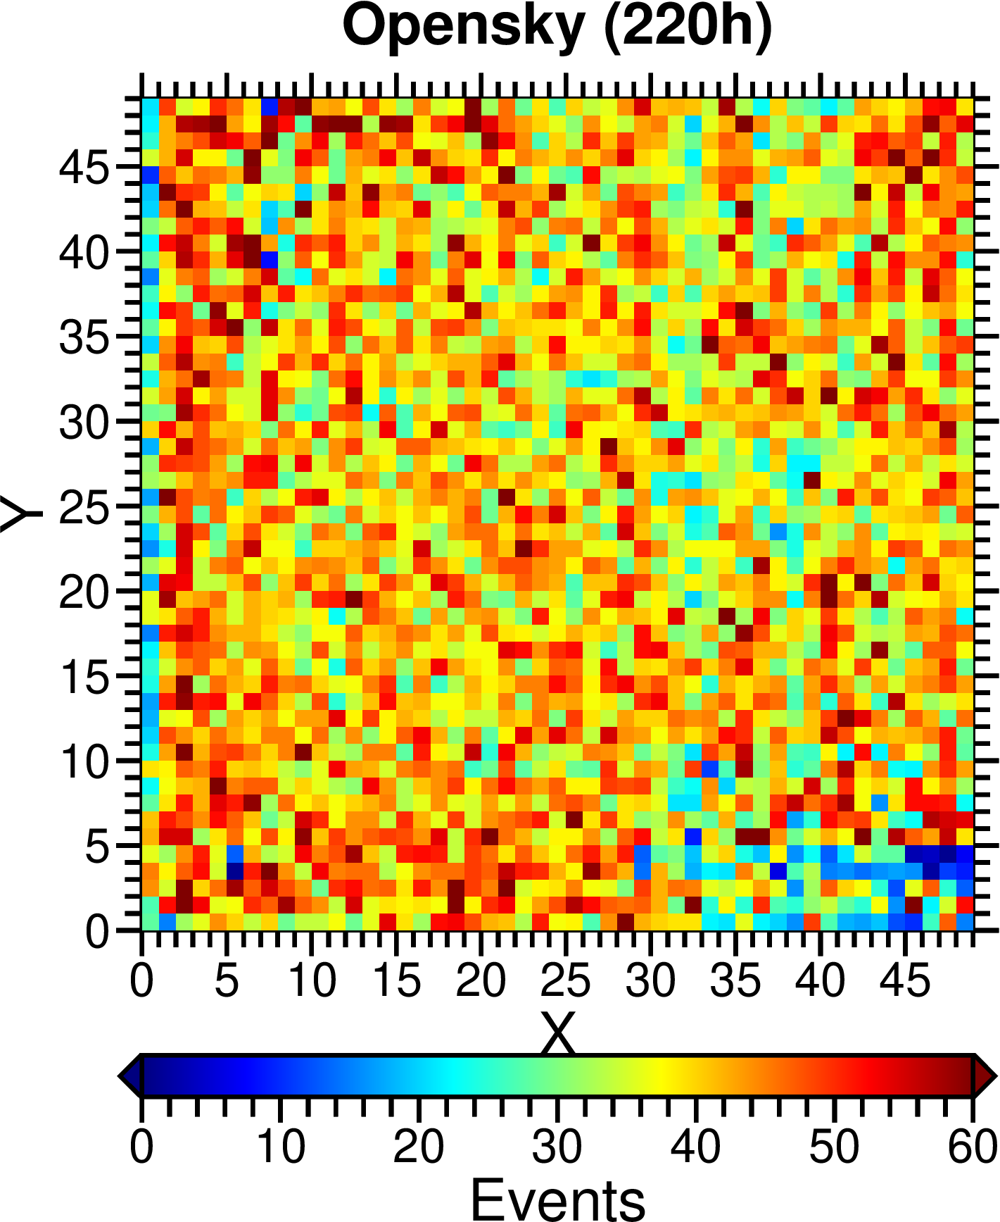
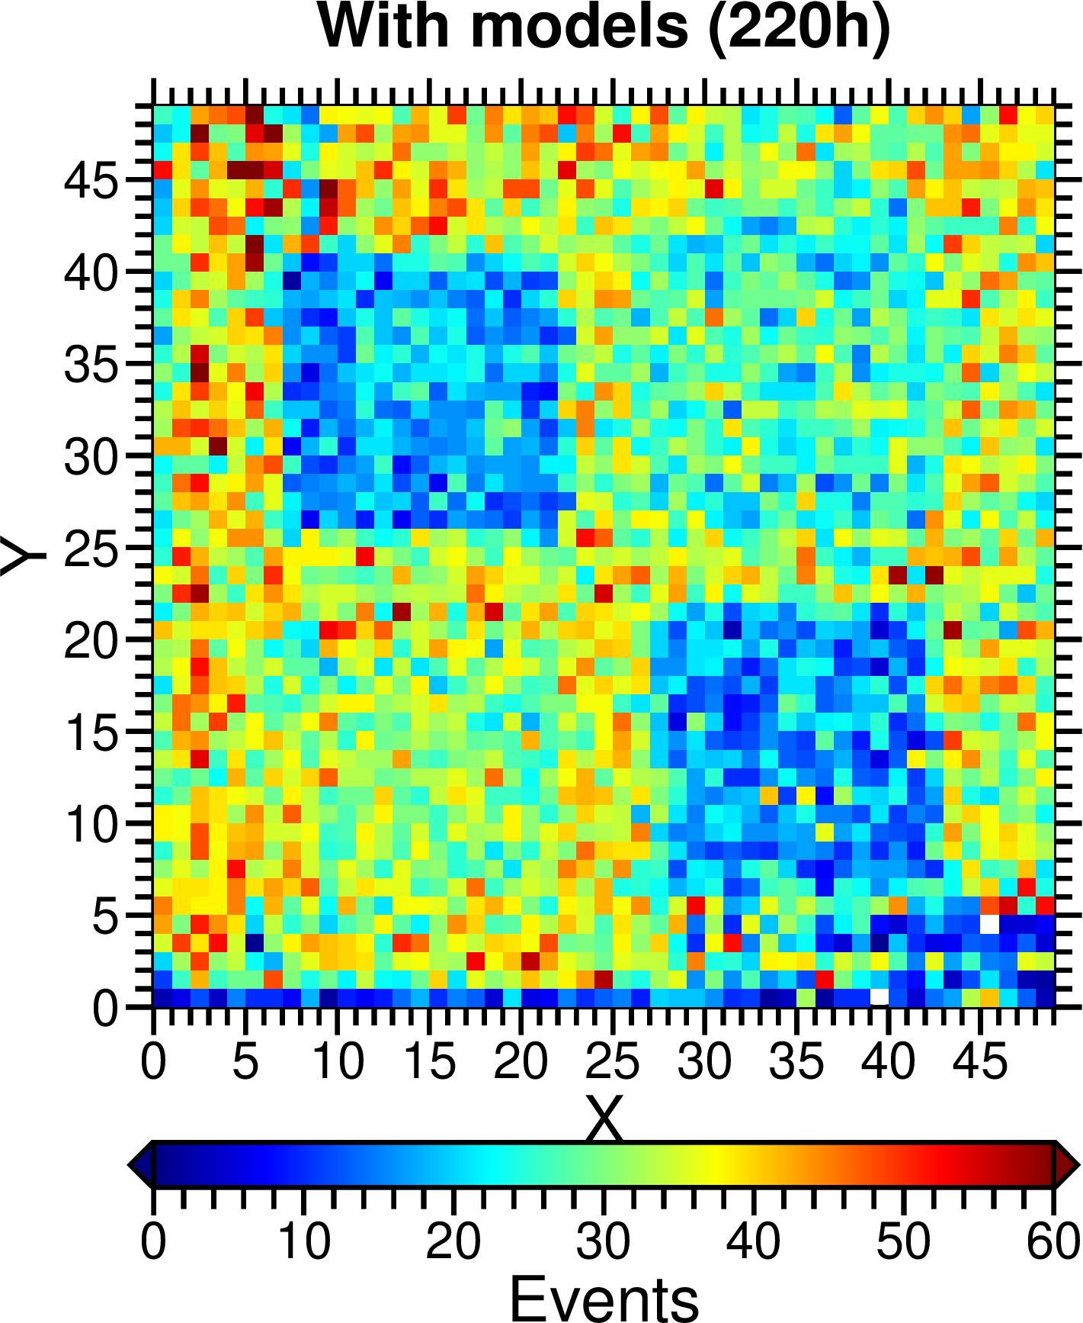
Events Reconstruction
$$±1pixels$$
2-D events distribution
$$±1pixels$$
$$±2pixels$$
Filtering criteria:
Events hit in four layers in the same time.
Events hit in each layer fit with a straight line.
Nearly vertical muon events.
Each pixels with few events, that will have an influence to the accuracy of inversion density.
Notes:
Here is the filtering criteria we select muon events
Events hits in four layers in the same time consider as a potential muon events
Then use the hits in layer 1 and layer 4 to fit a straight line, hits in layer 2 and layer 3 should with a distance in plus or minor 1pixels
And finally we select the nearly vertical muon events which layer 1 and layer 4 with maximum deviation of plus or minor 2 pixels the selected result are show in right

Slide 9
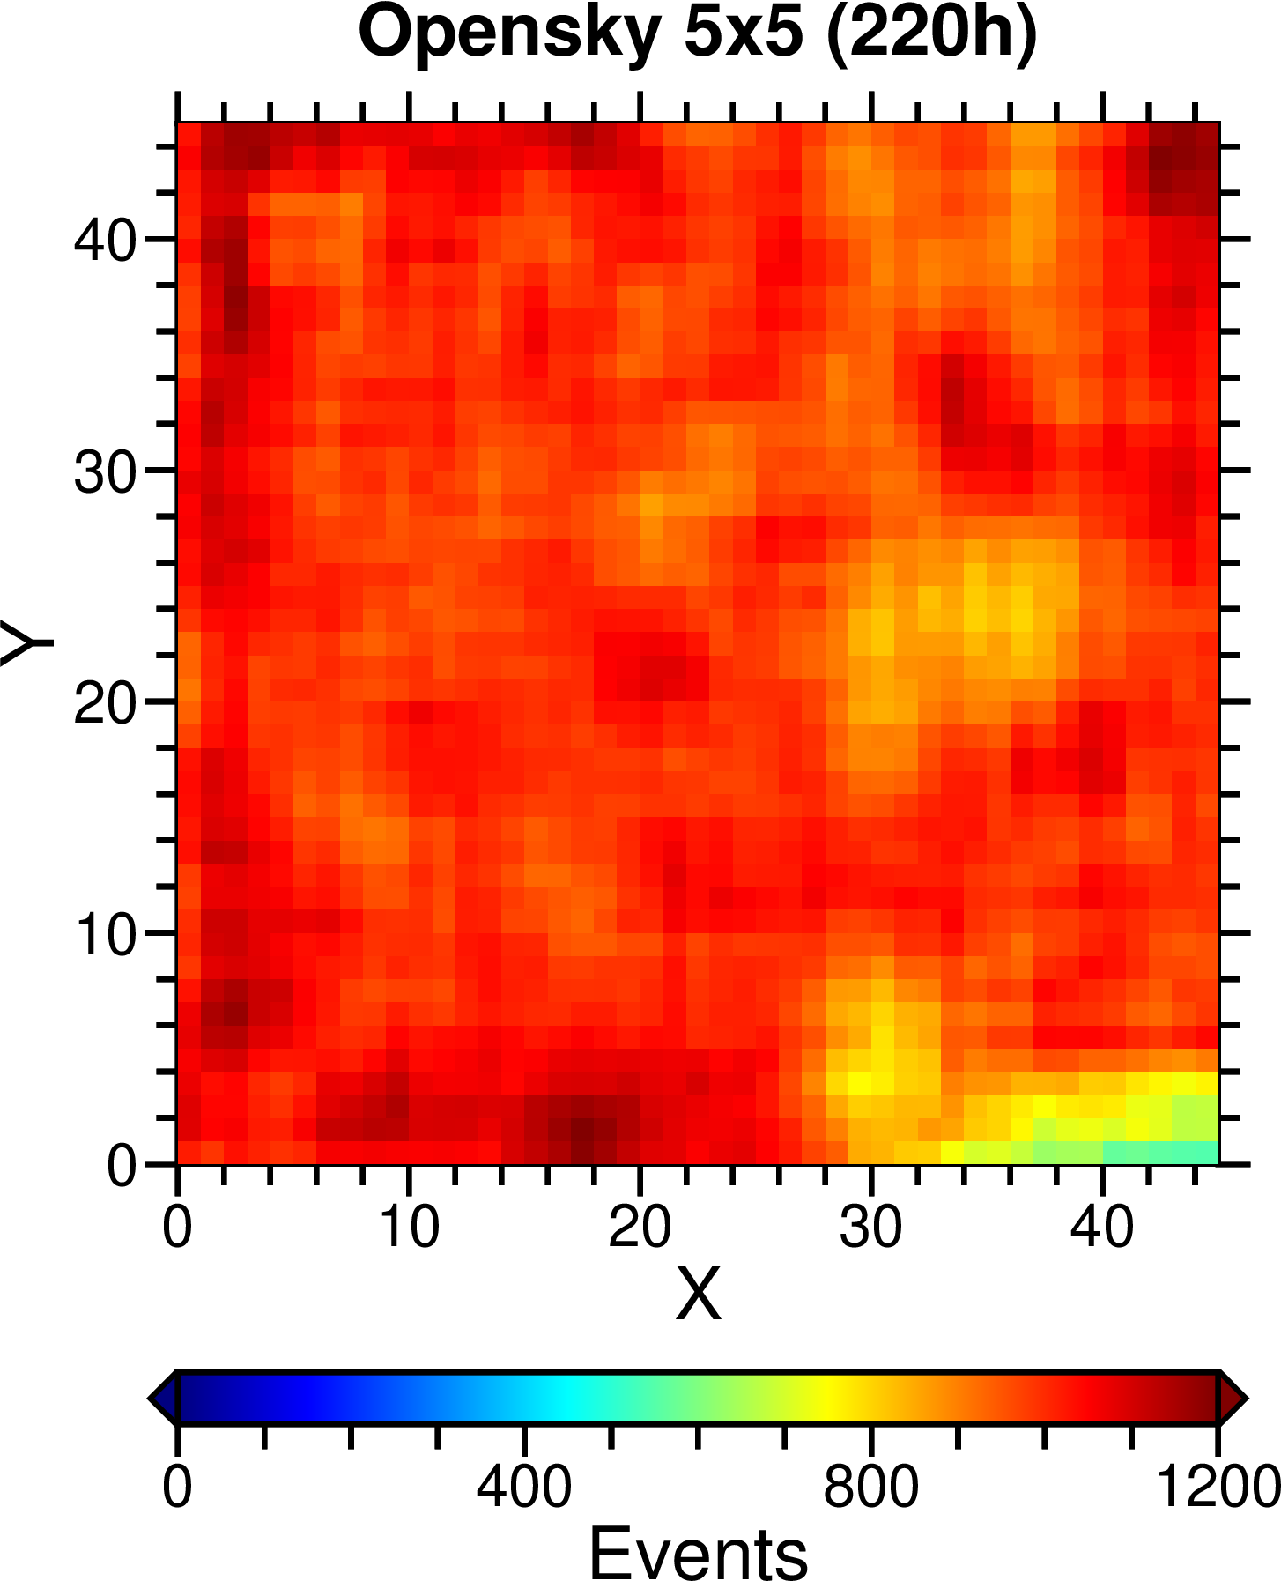
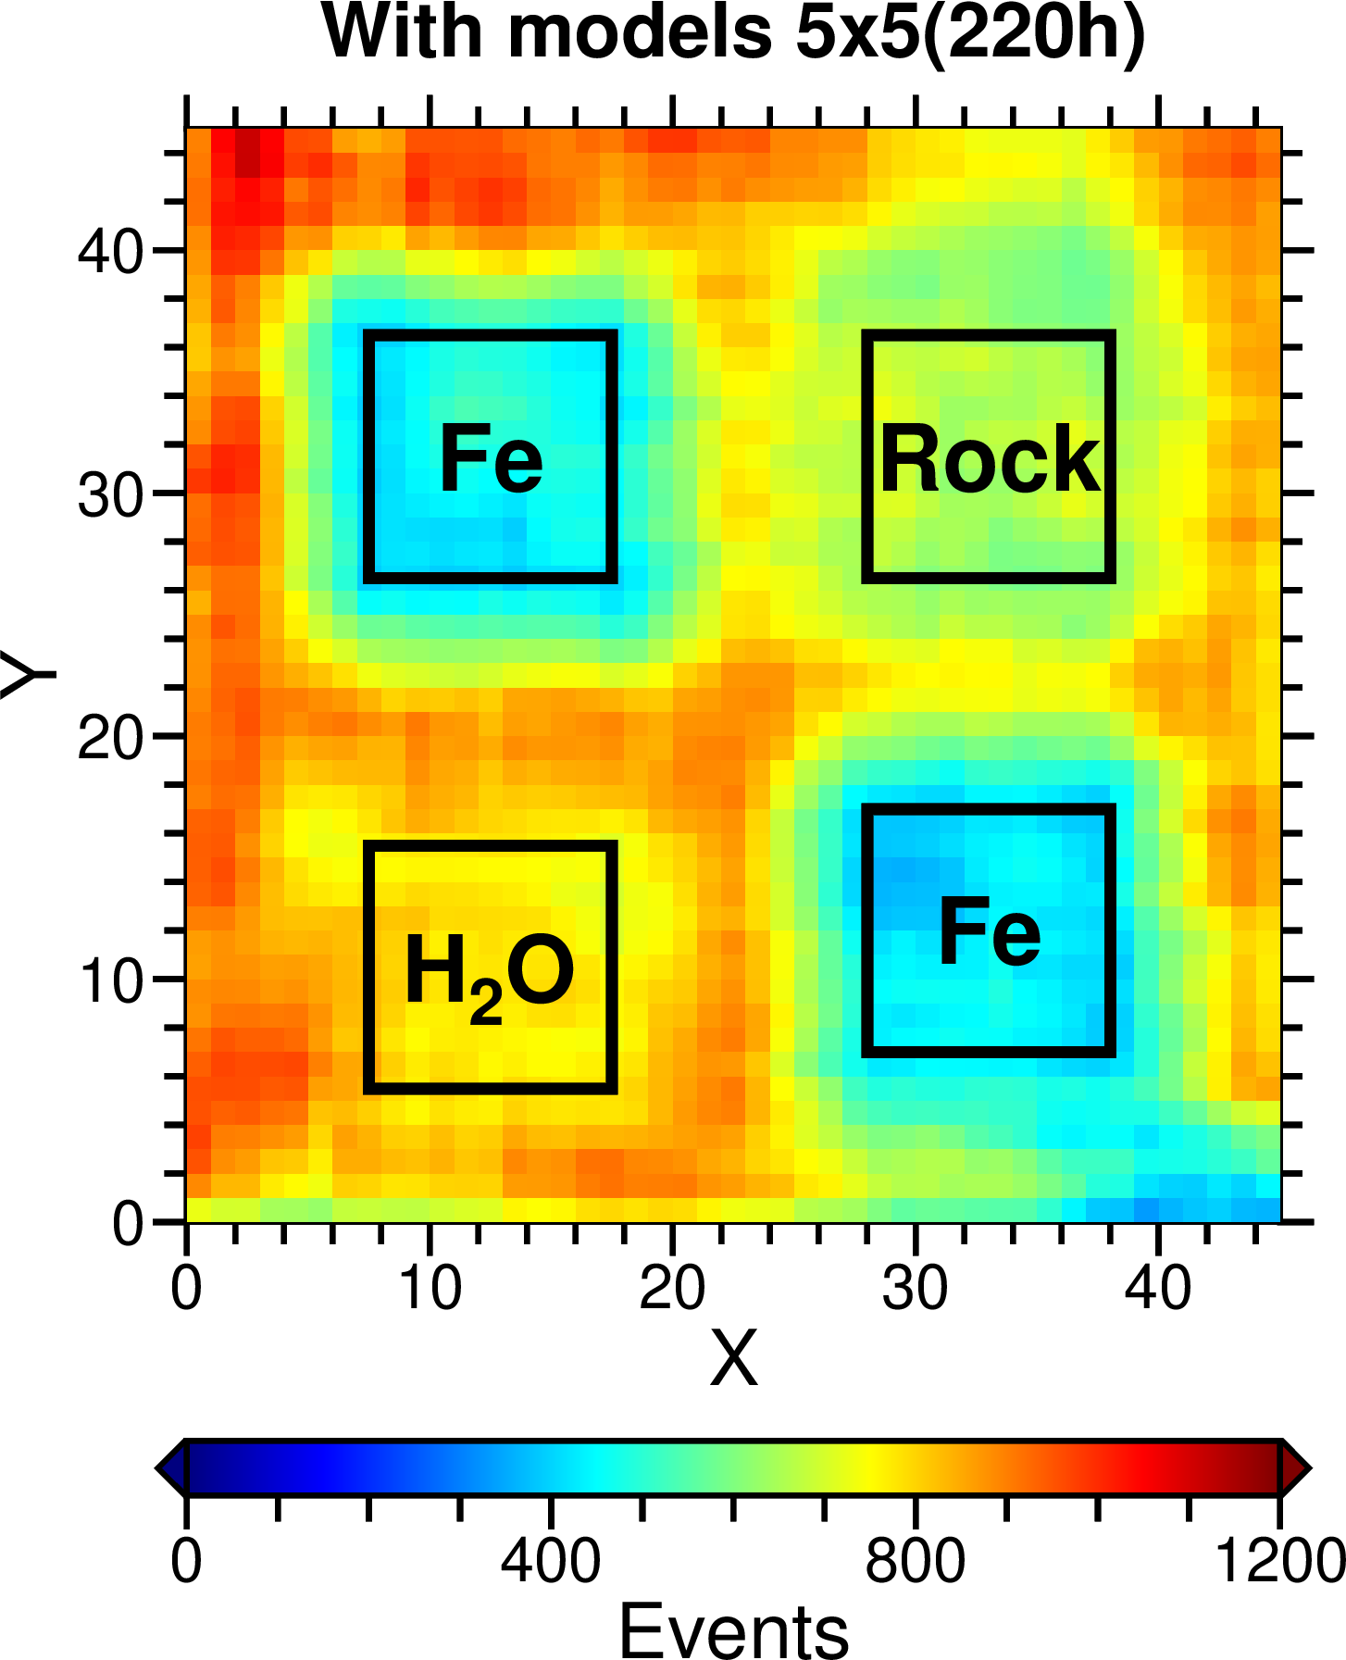
Box filtering Processing
2-D events distribution after box filtering
A $5×5$ kernel is used to merge the events in each pixels.
The error has been reduced by sacrificing spatial resolution.
Consider the coulomb scattering, only events in black frame are use in inversion.
Notes:
We use box filtering to increase the event we use in density inversion

Slide 10
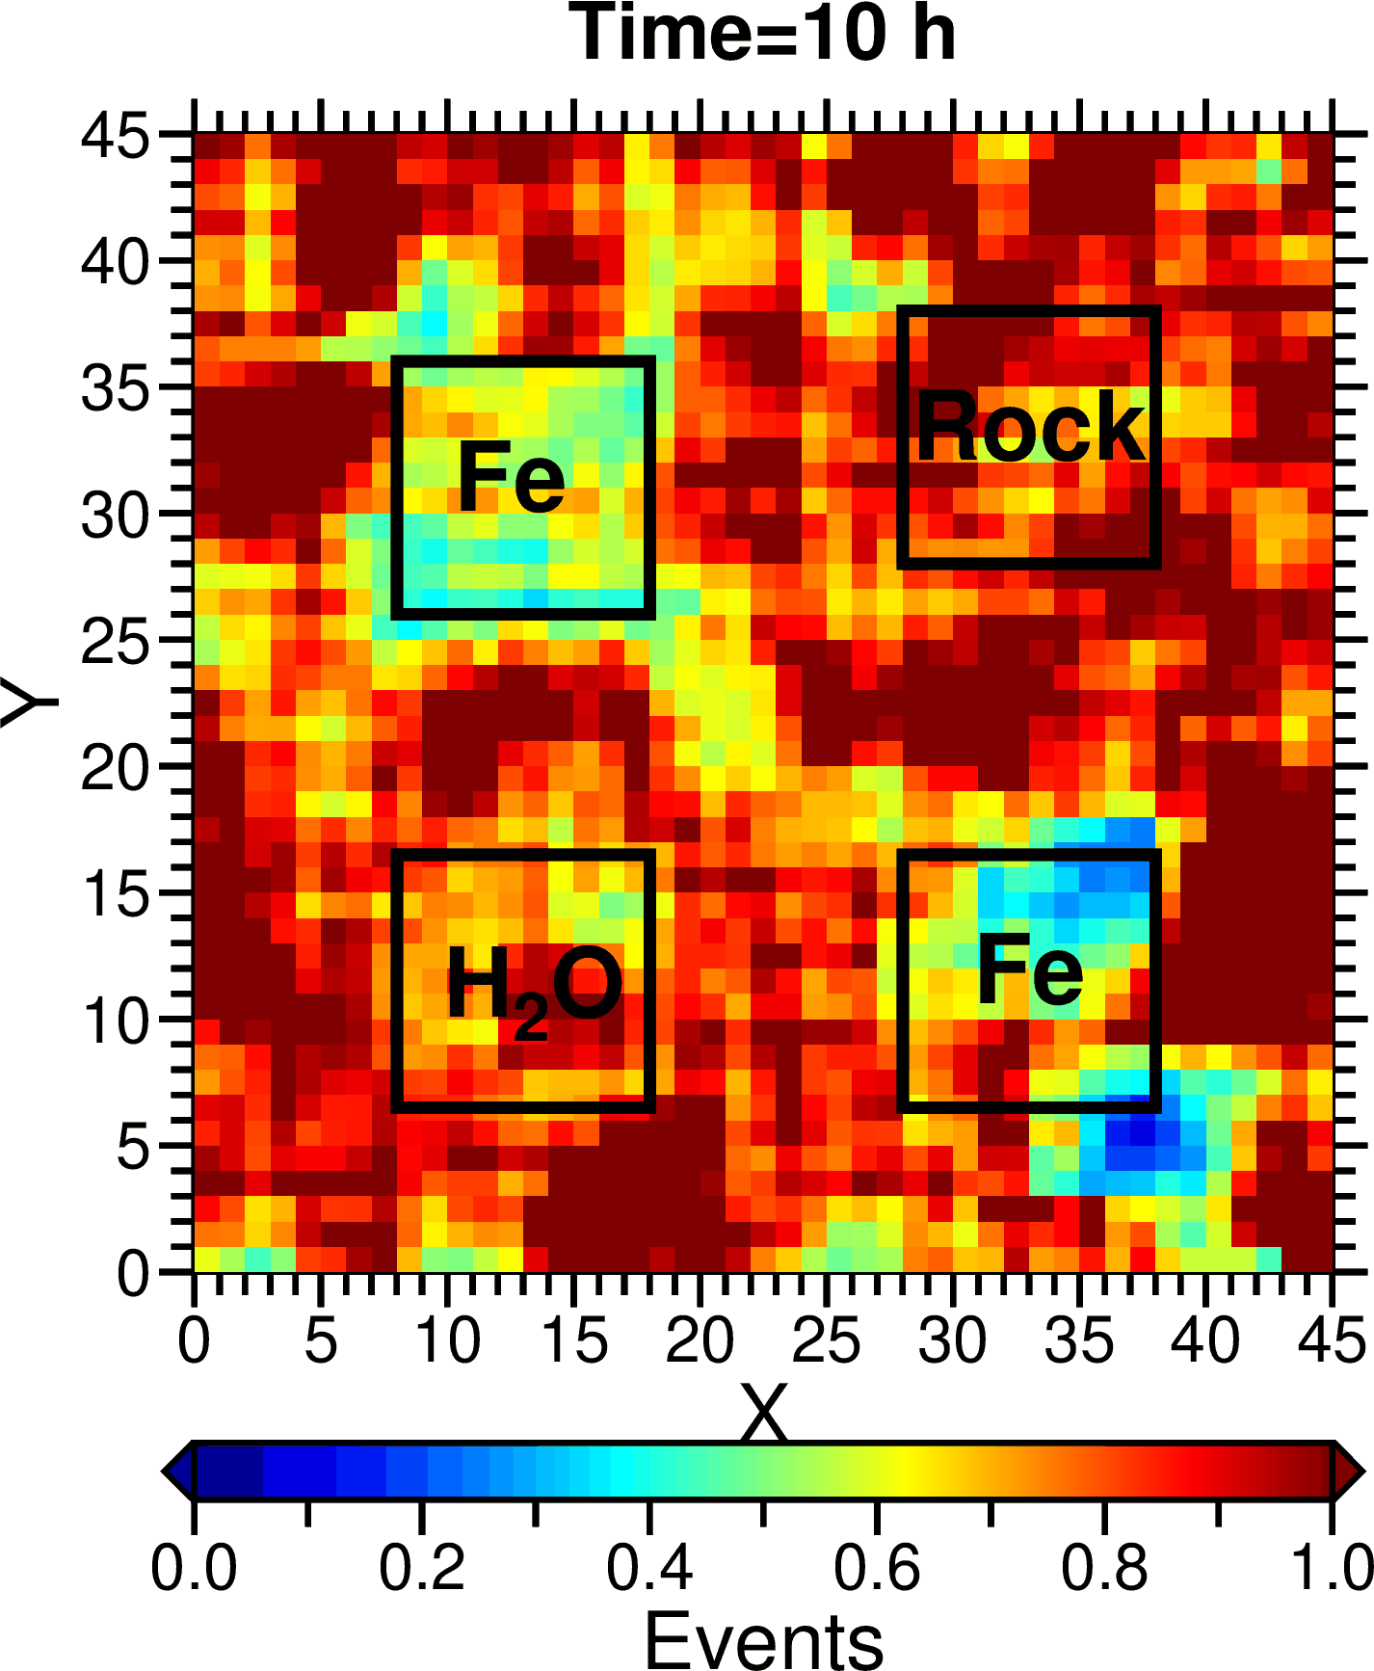
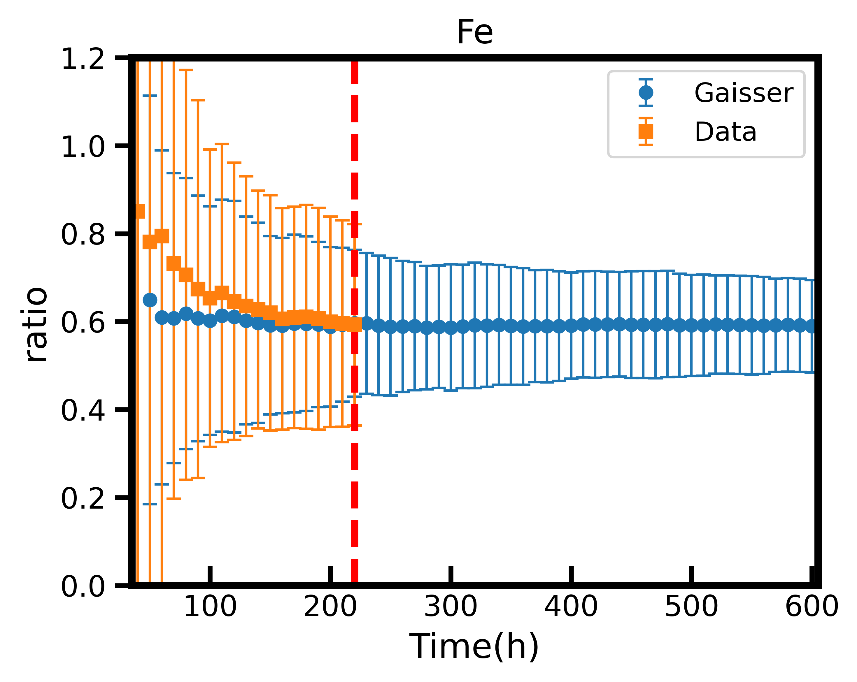
Effect of Recording Time
$$ratio=\frac{N_{with model}}{N_{Opensky}}$$
Ratio distribution over time
Ratio variation over time
Divide the events of opensky by the events of models placement can obtain the ratio.
With the recording time increases, the error decreases.
Simulation shows more recording time will have a better result.
With the ratio distribution, we can calculate the inversion density.
Notes:
Here we show the effect of recording

Slide 11
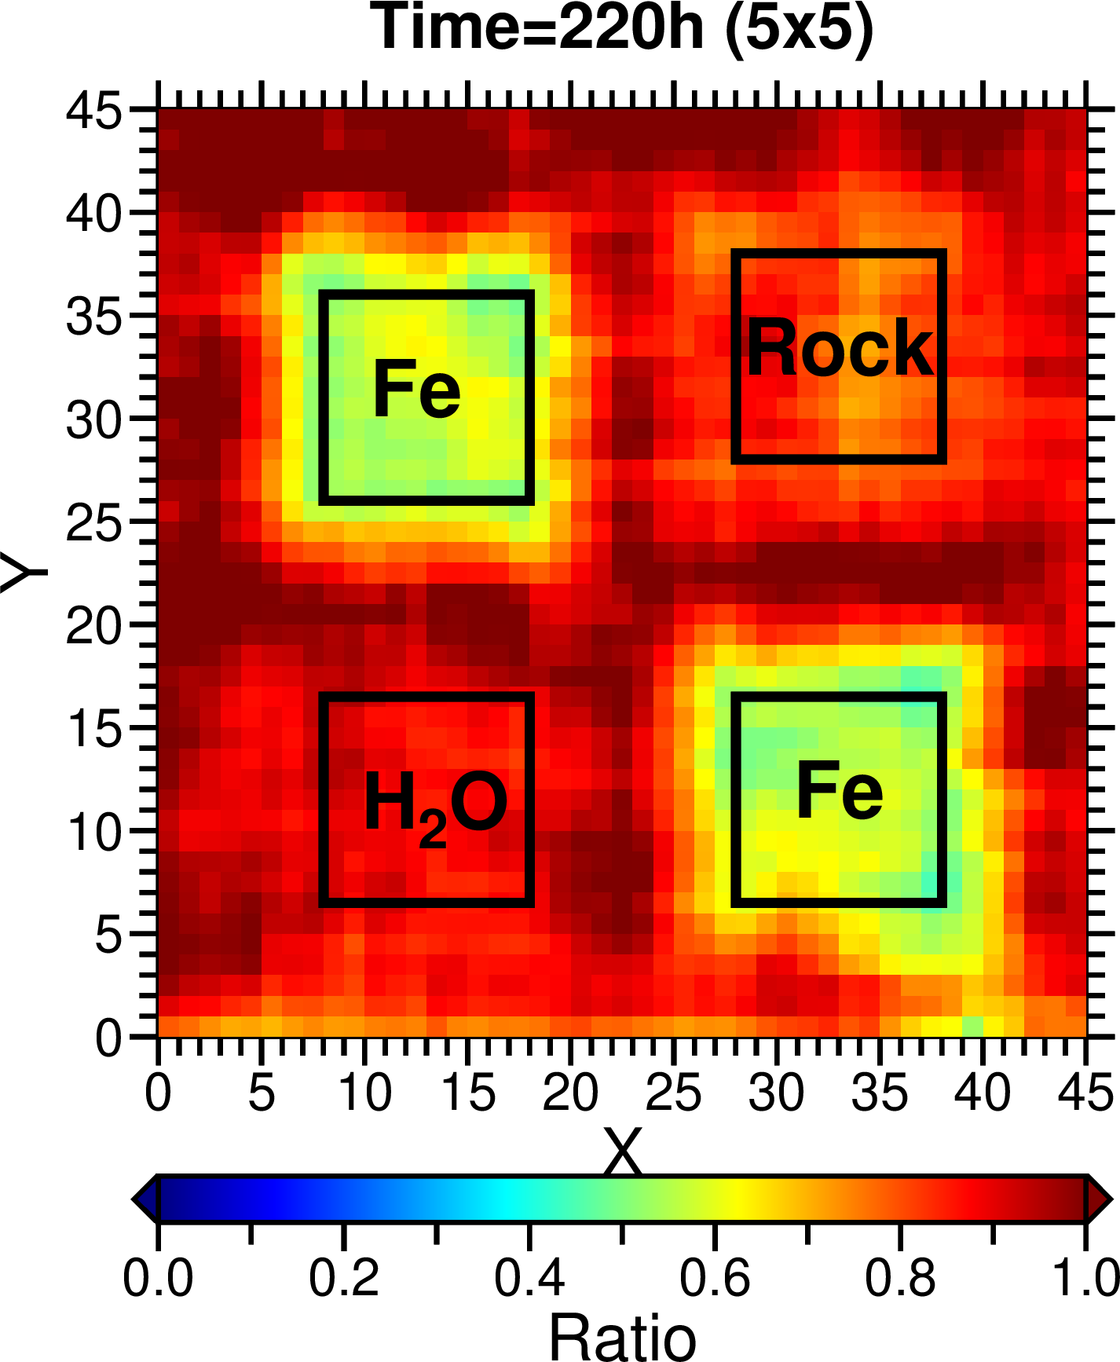
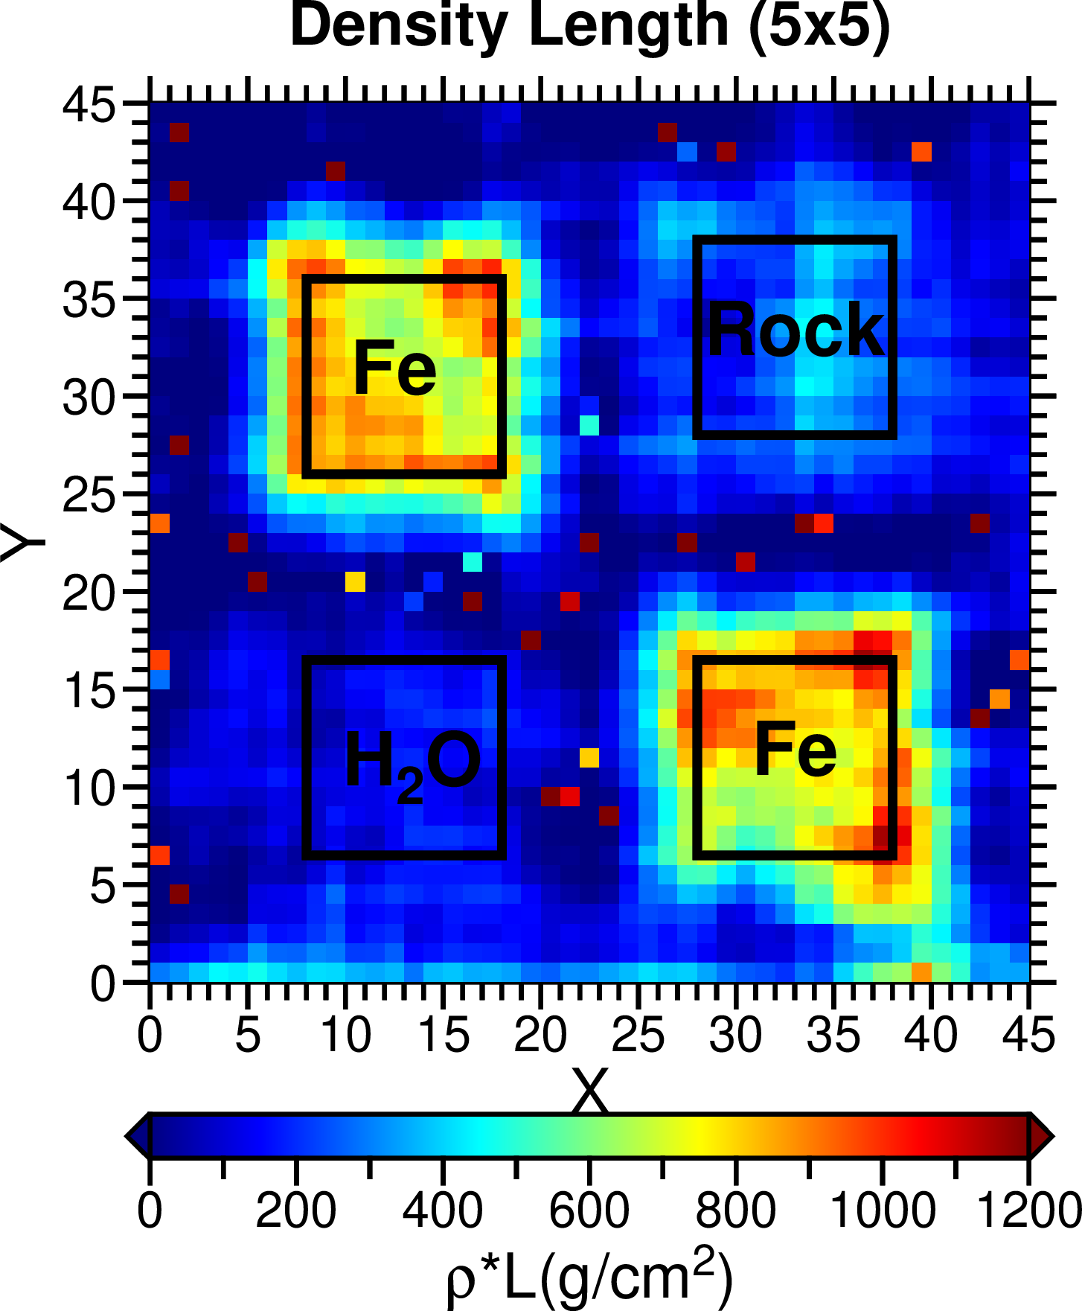
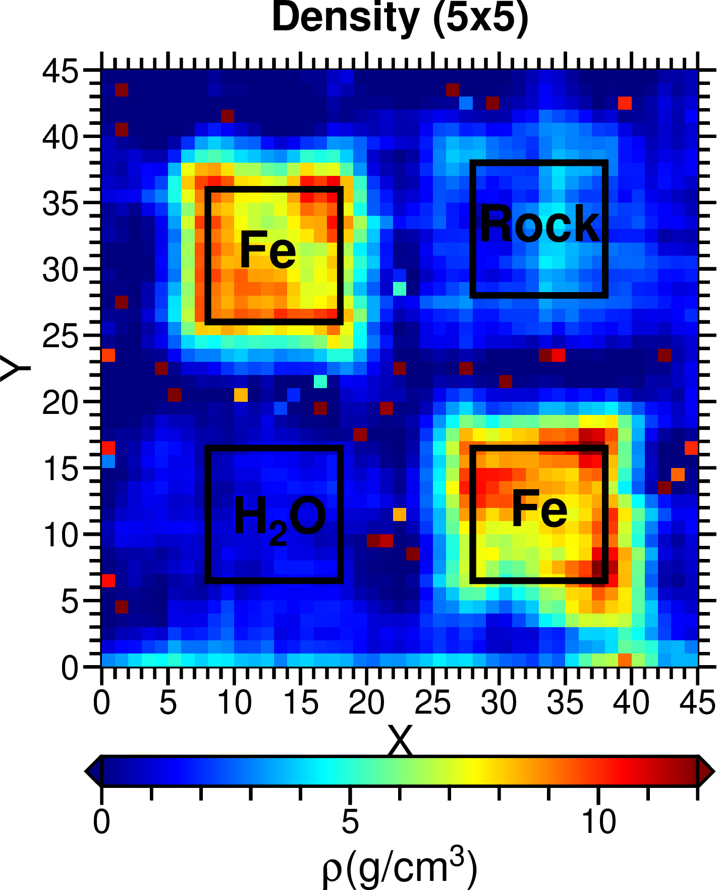
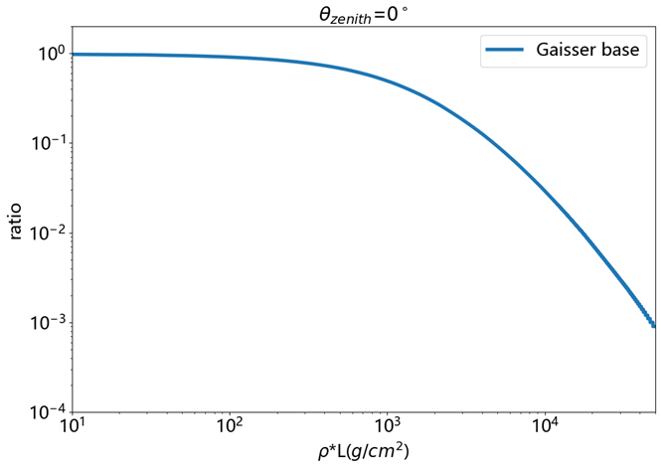
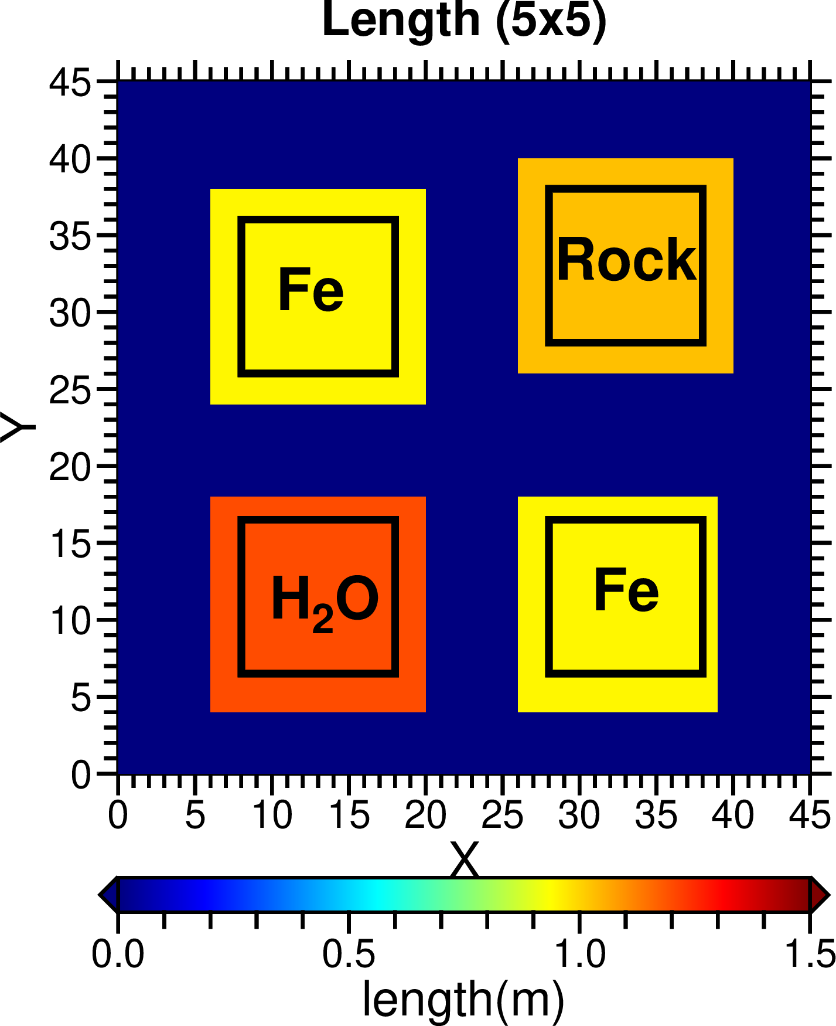
Density Inversion
2-D ratio distribution
2-D $ρ×L$ distribution
2-D density distribution
Correlation between ratio and $ρ×L$
Known thickness
Divide the density length distribution by known thickness can obtain the density distribution.
Notes:
The correlation between ratio and density length can be calculated.
The path length of muon cross matter can be considered as the thickness of matter since nearly vertical events filtering.
With ratio distribution, correlation between ratio and density length and matter thickness, one can inverse the distribution of density.

Slide 12
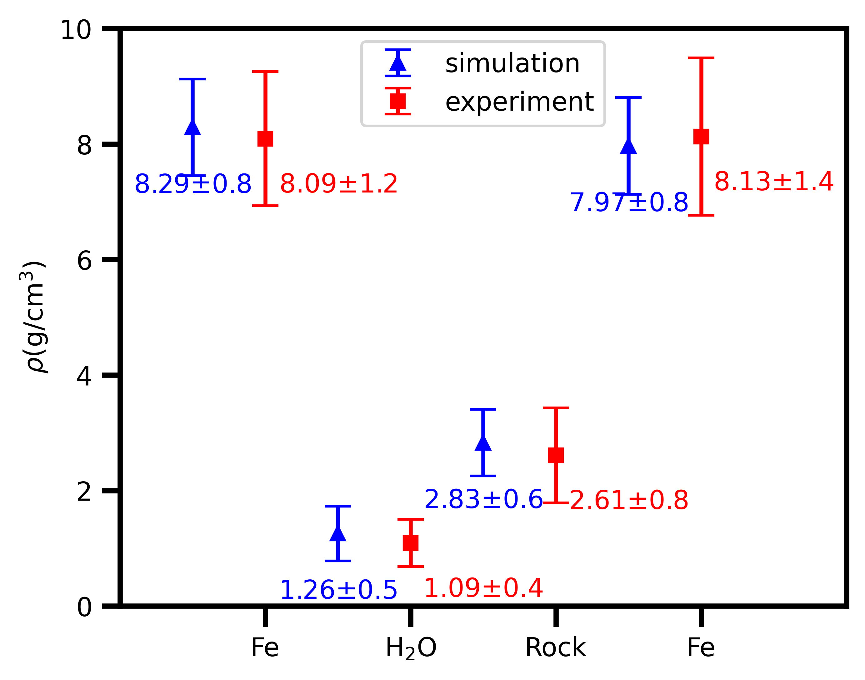
Density Inversion
Muon radiography used in density inversion with a accuracy about 2.5~9%.

Slide 13
Outline
1
Introduction
2
Accurate density measurement
3
Anomaly classify
4
Summary
Notes:
I will introduce my work from this four part, firstly, I will introduce density inversion method and machine learning method we use in this work

Slide 14
BP network Method
BP process
Cross
Entropy
Ratio
(1500h
simulation)
input
Relu(1,32)
Relu(32,16)
Relu(16,8)
Softmax(8,4)
output
Density
anomalous
Muon radiography needs a long recording time.
Matter with low density length shows a high sensitivity in ratio variation.
Neural network can quickly divide input features into different labels after training with enough data.
We build a backpropagation neural network to classify different density anomalies.
Notes:
We also try to use machine learning way to classify different density anomalous. Here is the backpropagation neural network we construct, it has three hidden layers and use relu as the activation function
And loss function is cross entropy, it can classify anomalous to four type based on the input ratio

Slide 15
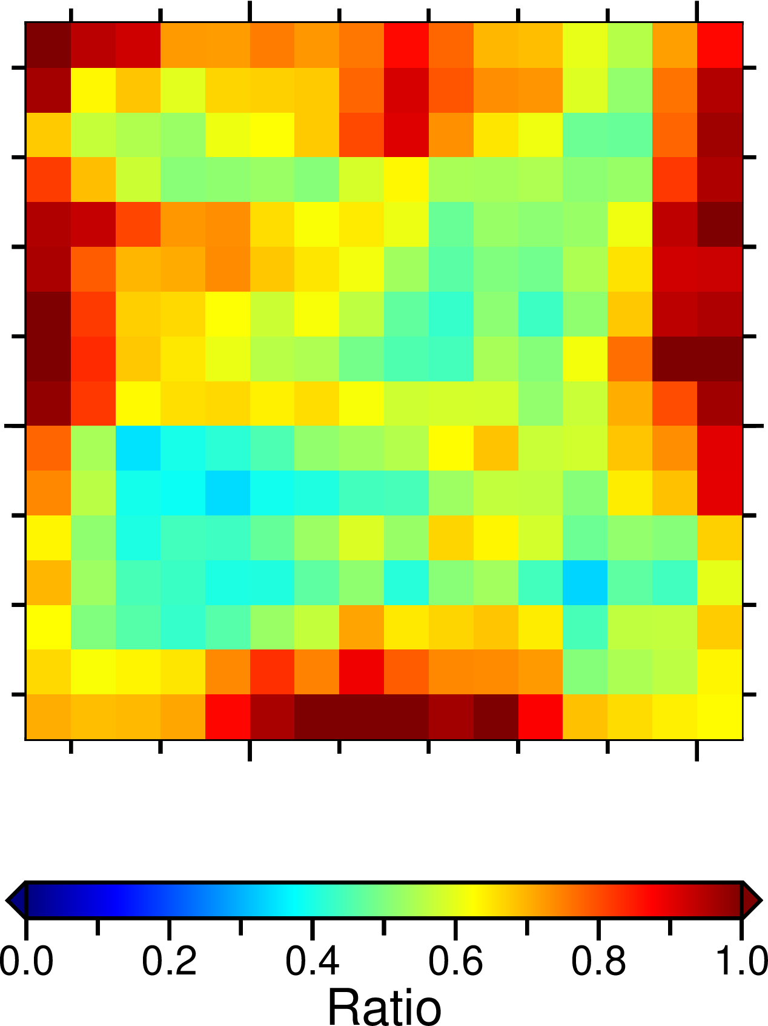
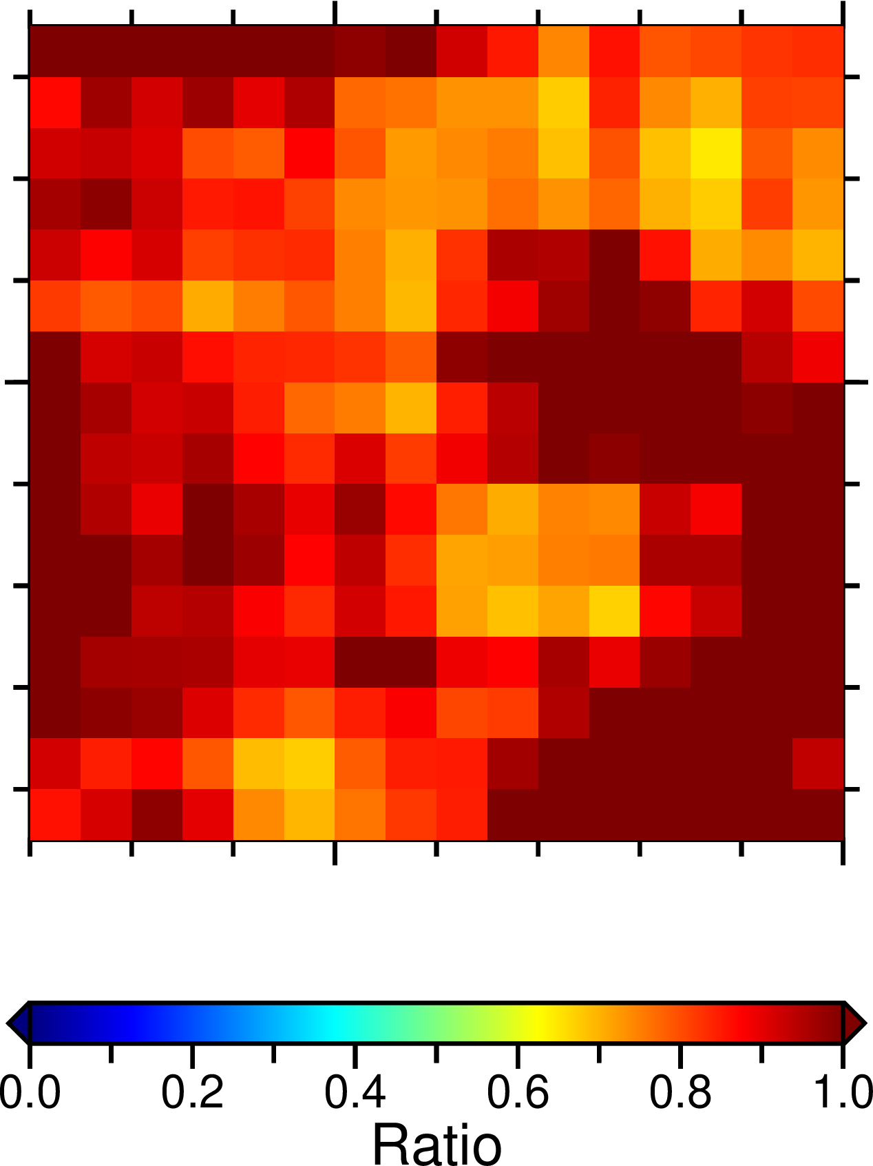
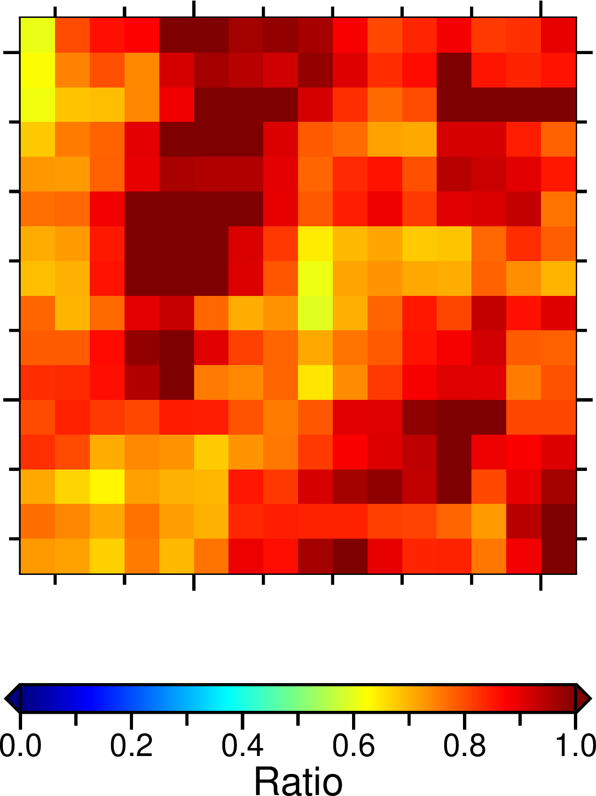
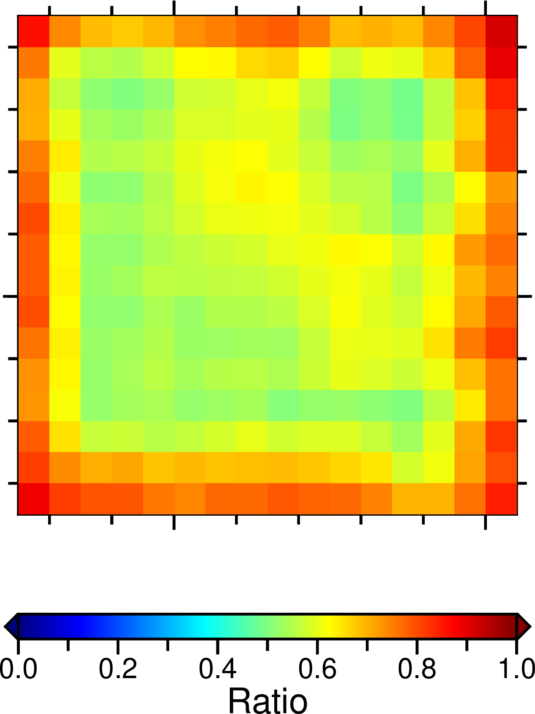
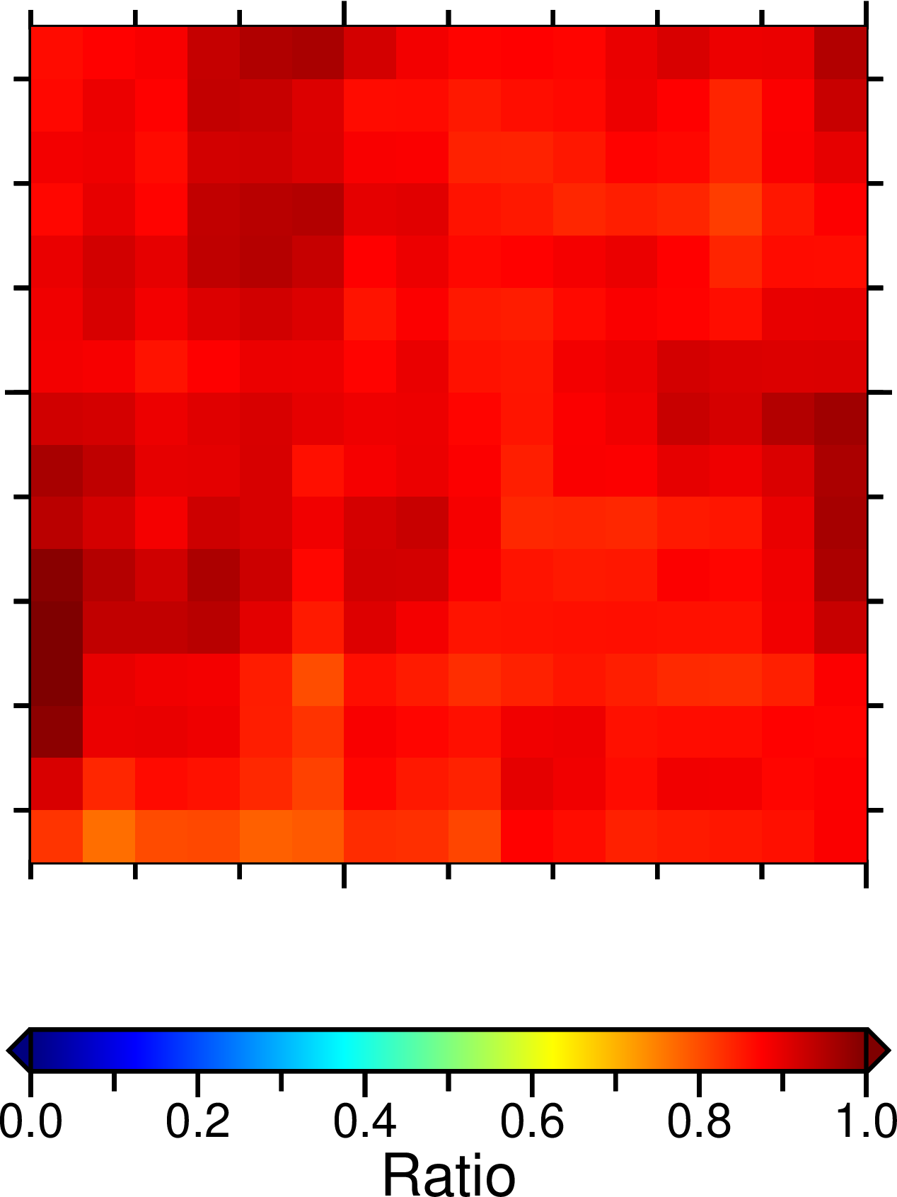
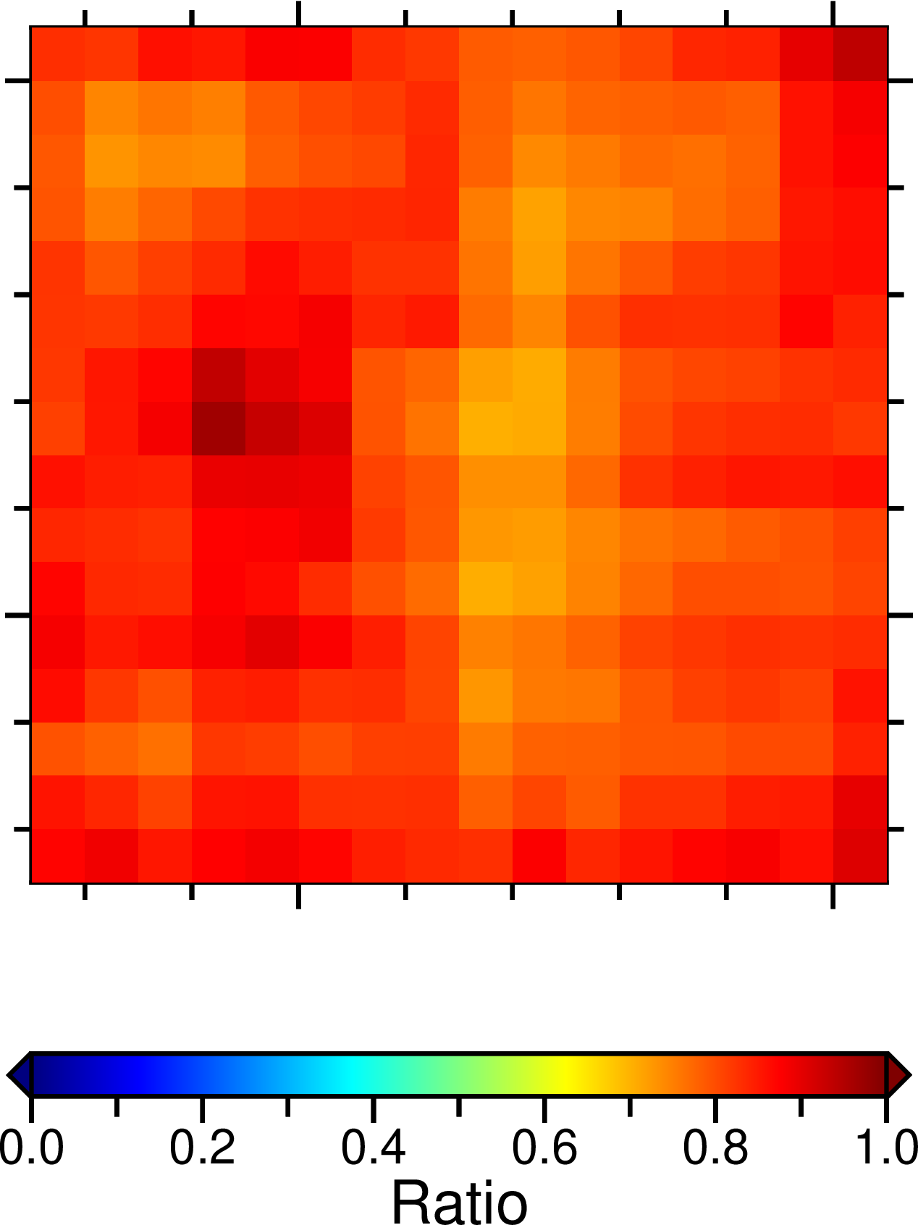
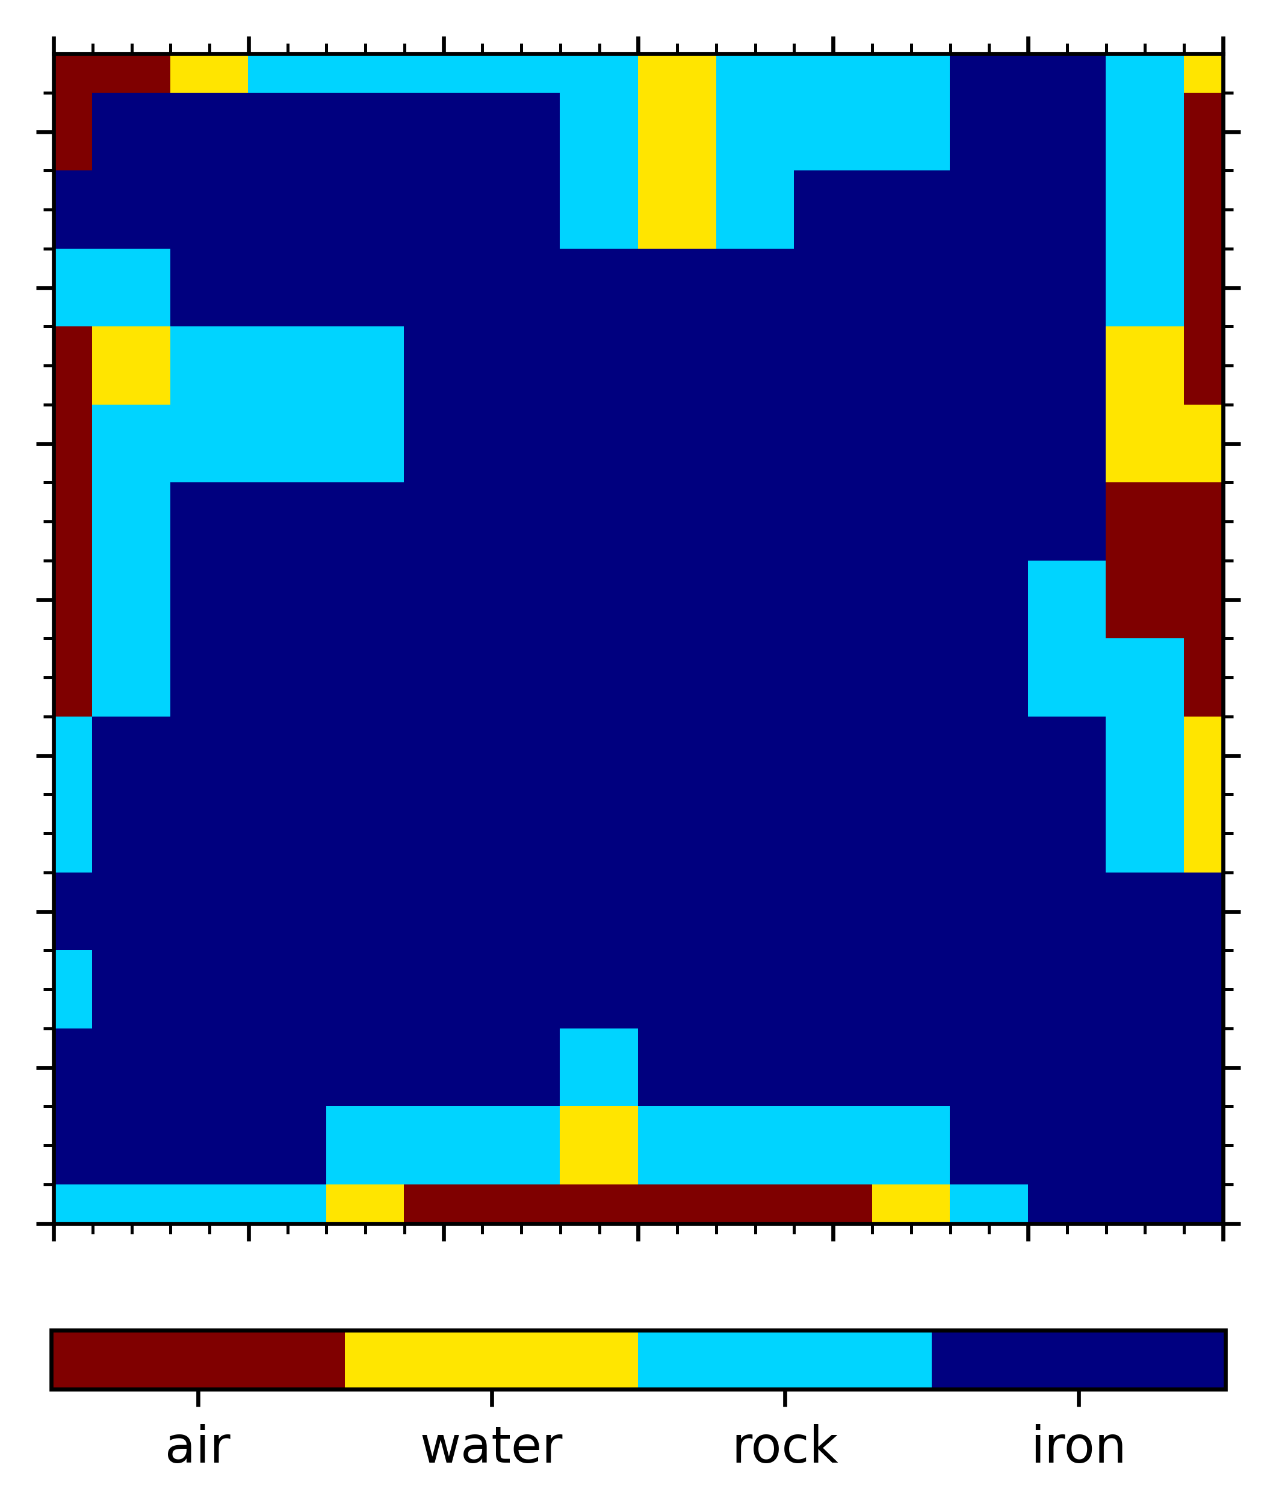
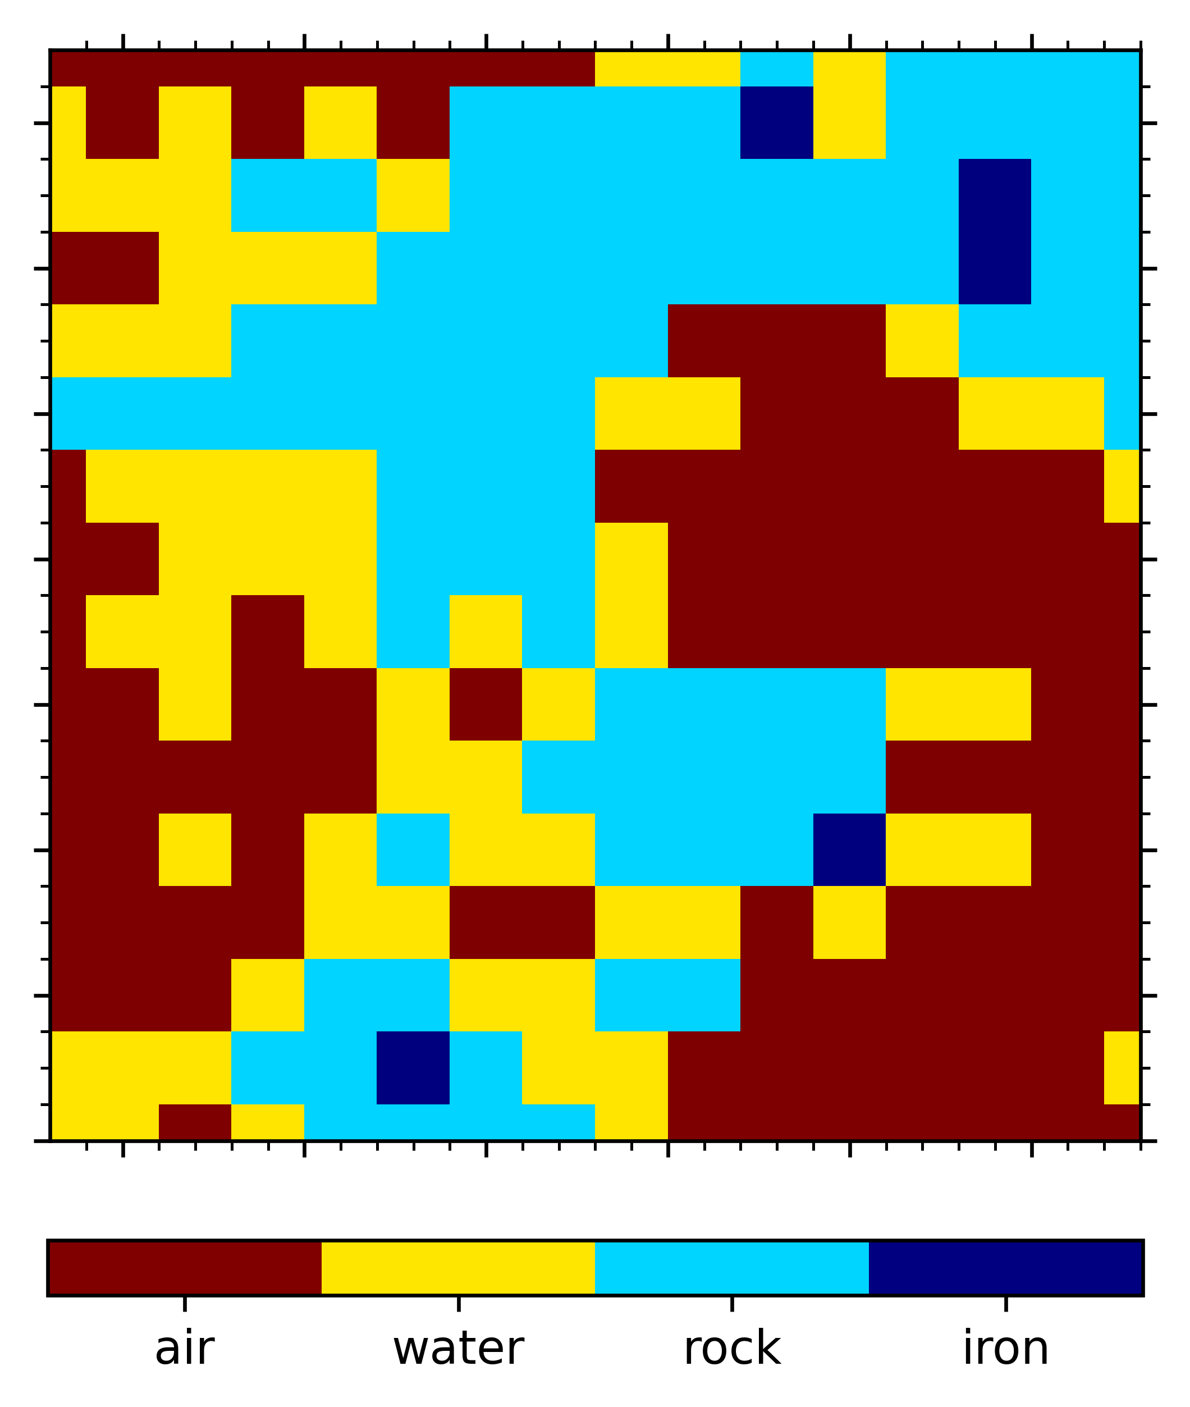
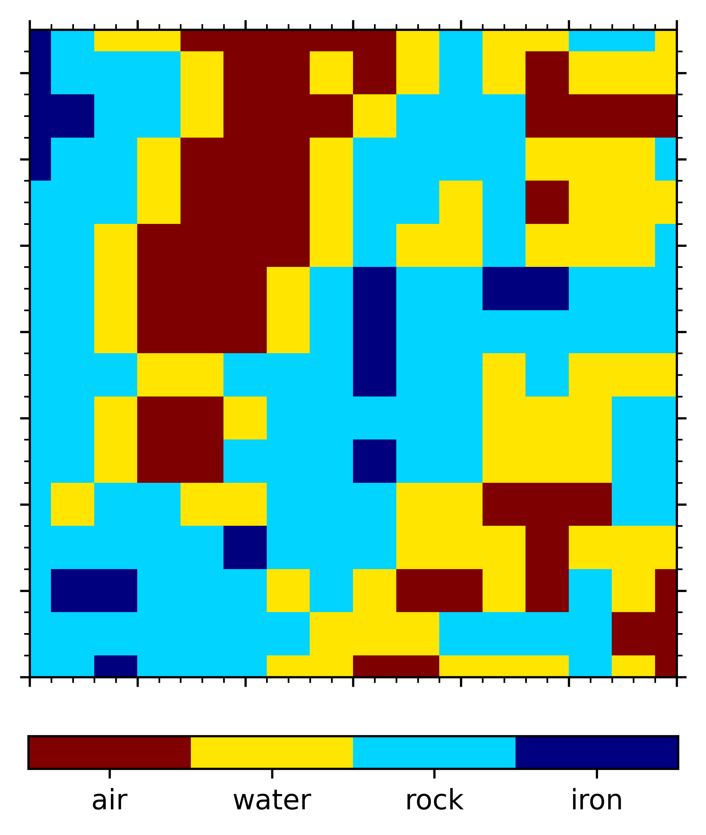
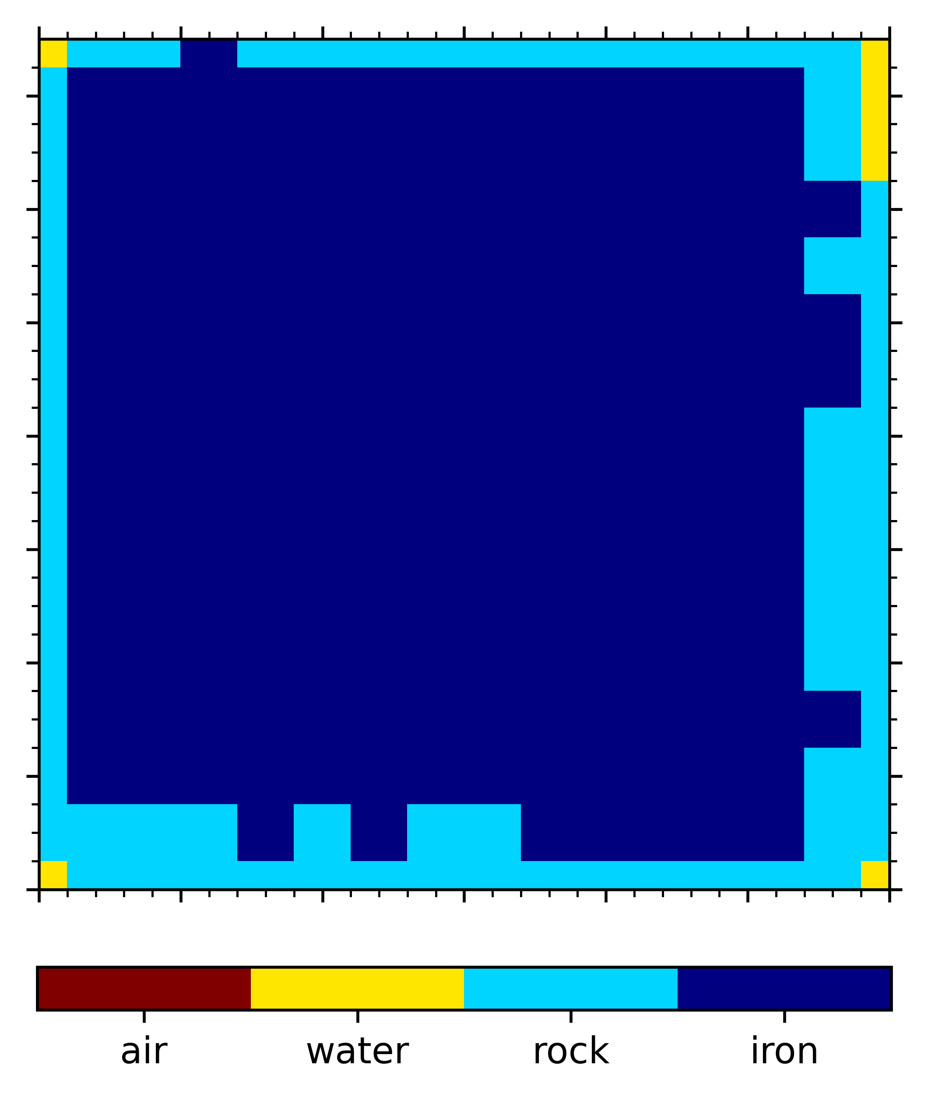
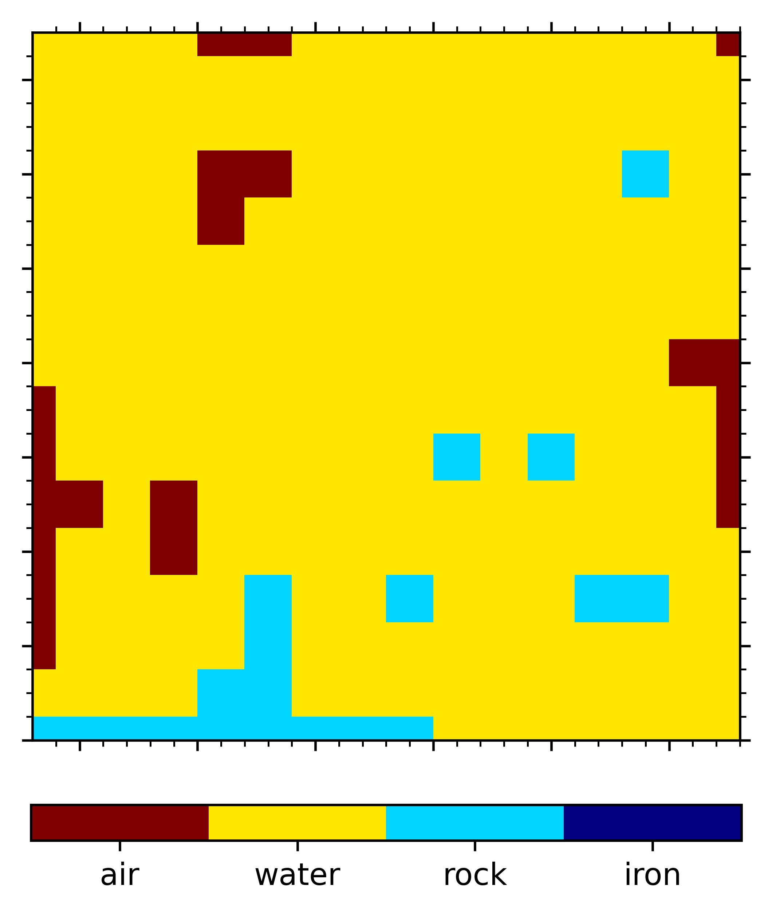
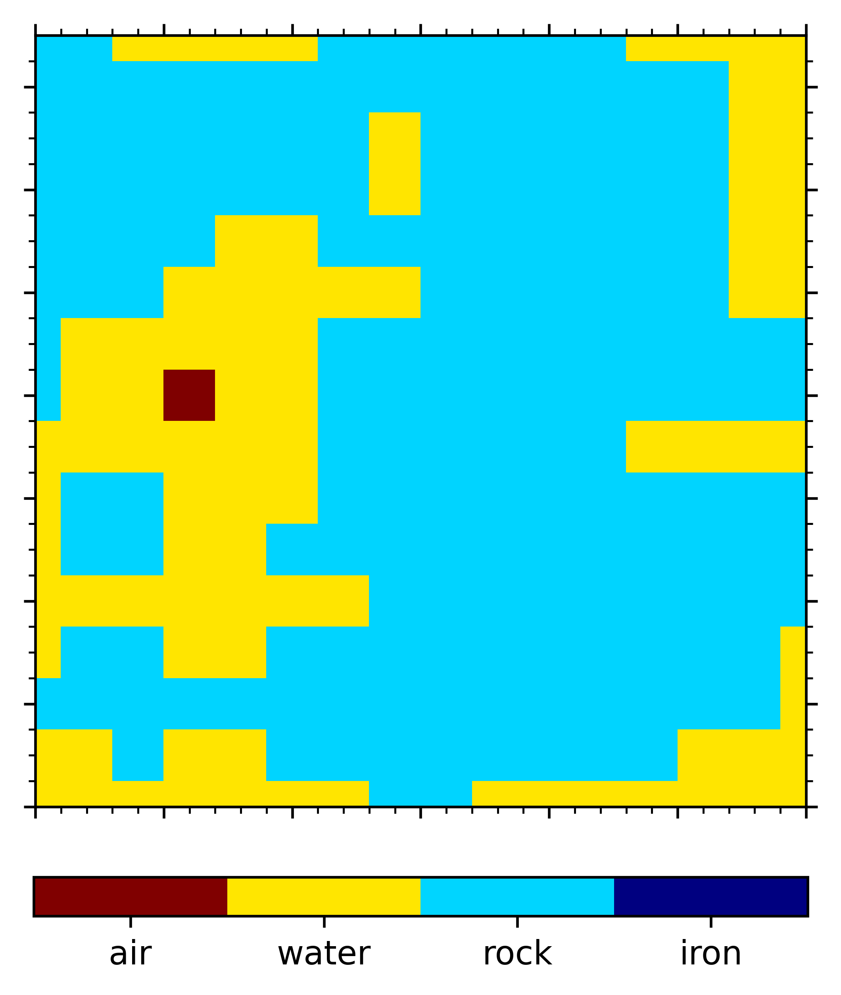
 | 20h Experiment |  |  | 220h Experiment
 | Fe | Water | Rock | Fe | Water | Rock
Features
Classify
result
High density matter can be classified quickly, but low density matter need more recording time.

Slide 16
Outline
1
Introduction
2
Accurate density measurement
3
Anomaly classify
4
Summary
Notes:
I will introduce my work from this four part, firstly, I will introduce density inversion method and machine learning method we use in this work

Slide 17
Summary
We use radiography for density inversion, after events filtering and data processing, our obtain accurate inversion results.
We study the detectability of three type of anomalous using machine learning method and the results shows that the anomalous can be well classify.
In next step, we try to classify density anomaly with close features.
Notes:
我们首先开展了实验对没有穿透物质和穿透不同物质情况下的缪子事例进行了探测得到了220个小时的有效数据

