Slide 1
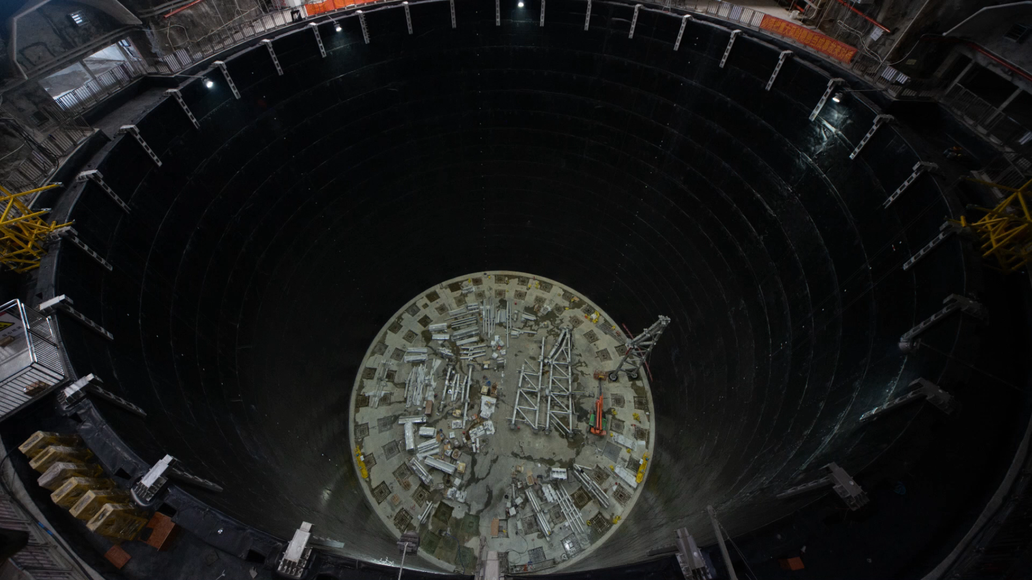
An installation video of the truss, acrylic, PMTs …

