Slide 1
The radon and radium measurement systems for JUNO
Cong Guo IHEP
On behalf of the JUNO-VETO group
2023-11-07

Slide 2
Outline
An introduction to JUNO
Radioactive background requirements on ultra-pure water
Radon measurement and radon removal
Radium measurement and radium removal
The status of the 100 t/h ultrapure water system for JUNO
Summary

Slide 3
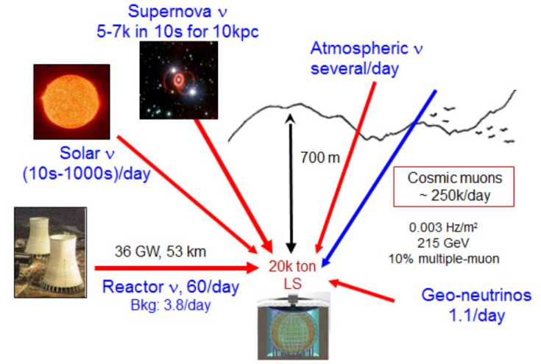
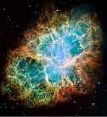
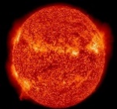
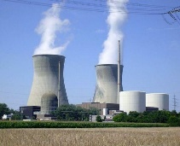
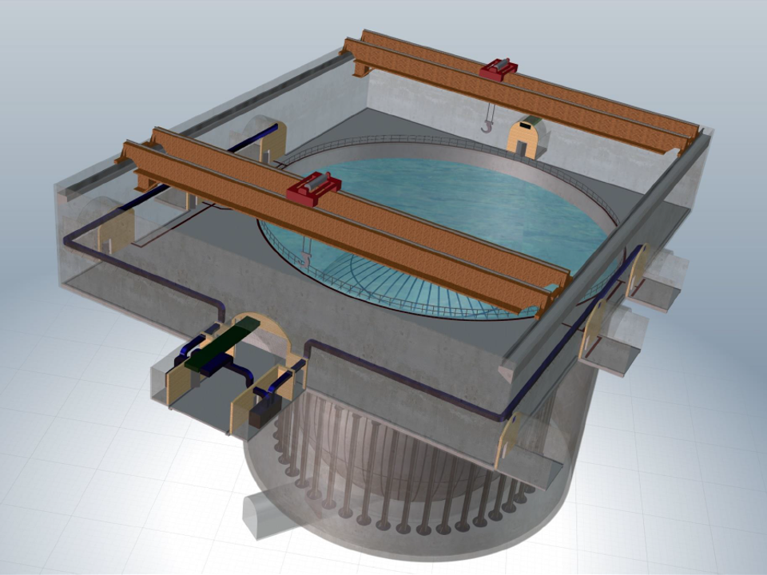
JUNO: A multipurpose neutrino experiment
Phyiscs:
Determine neutrino mass ordering
Precise measurements of three neutrino oscillation parameters
Supernova neutrinos
Solar neutrinos
Atmospheric neutrinos
Geo-neutrinos
Exotic searches, proton decay

Slide 4
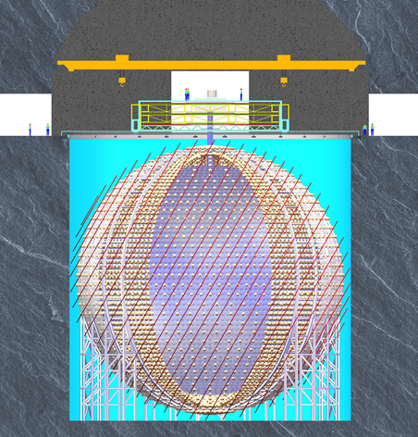
JUNO: A low-background experiment
Research | Expected Signal | Energy range
Reactor neutrino | 60 IBD/day | 0~12MeV
Solar neutrino | Hundreds per year for ⁸B | 0~16MeV
Geoneutrino | ~400 per year | 0~3MeV
Atmospheric neutrino | Hundreds per year | 0.1~100GeV
DSNB (w/s PSD) | 2-4 IBD/year | 10-40MeV
Supernova burst | 5000 IBDs at 10kpc 2300 elastic scattering | 0-80MeV
The expected signal event rate is low and the energy is small;
The background of the detector should be well-controlled;
The detector is located 700 m underground and submerged in a Water Cherenkov Detector (WCD).

Slide 5
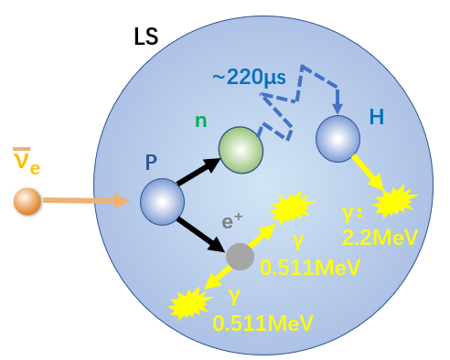
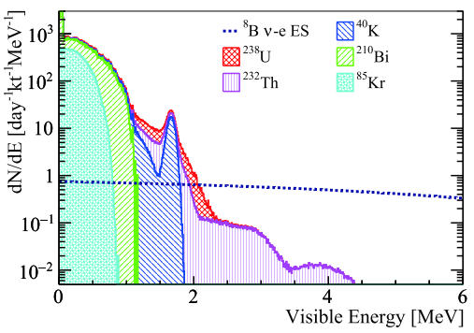
JUNO signal and background
Reactor neutrino detection (IBD):
Prompt signal: 0.7 MeV< E_{p} < 12 MeV;
Delayed signal: 1.9 MeV < E_{d} < 2.5 MeV;
Natural radioactive elements (²¹⁴Bi from ²³⁸U-²²⁶Ra-²²²Rn decay chain, ²⁰⁸Tl from ²³²Th decay chain ) and cosmic muons are the main background sources;
IBD
Solar neutrino detection (ν-e elastic scattering):
Signal as a single event;
Events in 2-3 MeV dominated by ²¹⁴Bi (²³⁸U-²²⁶Ra-²²²Rn decay chain) decays and ²¹²Bi (²³²Th decay chain) decays;
Events in 3-5 MeV dominated by ²⁰⁸Tl (²³²Th decay chain) decays;
Estimated base on ²³⁸U/²³²Th in LS is 10⁻¹⁷ g/g;
Internal radioactivity background after cuts for solar neutrino detection

Slide 6
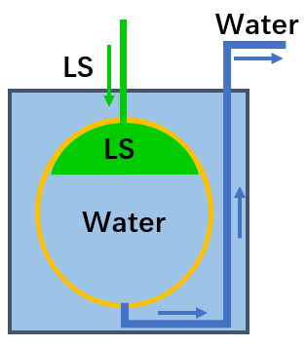
Background requirements on UPW
Ultra Pure Water (UPW) in the WCD:
Gamma rays from the radioactive elements in water will contribute to the accidental background;
UPW for LS filling:
LS contacts UPW directly;
Water may pollute LS;
 | Veto | Filling
Flow rate | 100 t/h | 50 t/h
²³⁸U/²³²Th | 10⁻¹⁴ g/g | 10⁻¹⁶ g/g
²²²Rn concentration | 10 mBq/m³ | 5 mBq/m³
²²⁶Ra concentration | 10 mBq/m³ | 50 μBq/m³
Rn detector sensitivity | 1 mBq/m³ | 1 mBq/m³
Ra detector sensitivity | 1 mBq/m³ | 10 μBq/m³
LS filling

Slide 7
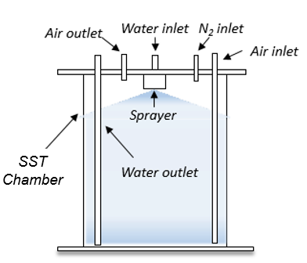
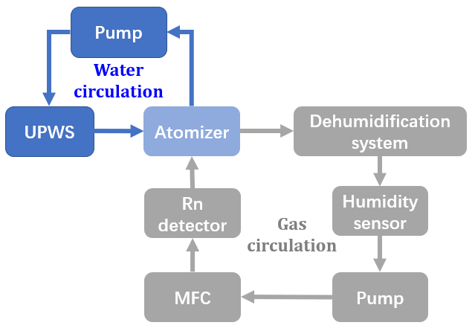
Rn concentration in water measurement
Atomizer
Schematic diagram of the measurement system
Radon in water can not be measured directly;
An atomizer is used to transfer radon from water into gas,
C_{Rn in water}/C_{Rn in gas} = $0.105+0.405e^{−0.0502T} \left(T is temperature in the unit of oC\right);$

Slide 8
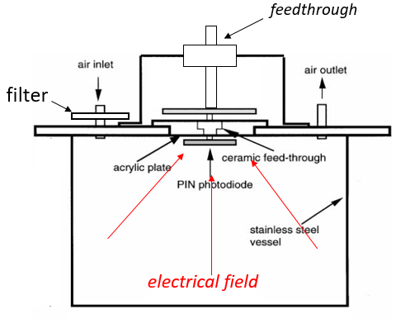
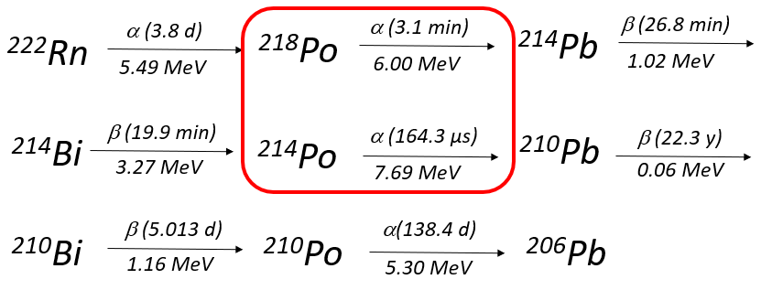
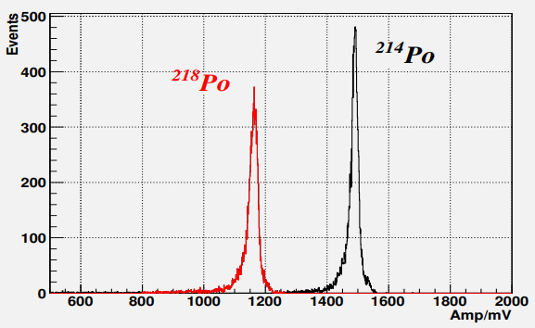
Rn concentration in water measurement
The radon concentration is determined by detecting the alphas from ²¹⁸Po and ²¹⁴Po decay using a Si-PIN detector;
The detecting efficiency is calibrated with a gas flow radon source;

Slide 9
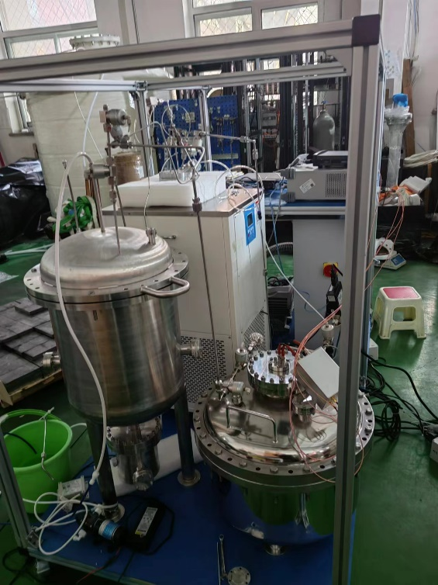
Rn concentration in water measurement
A semi-automatic radon concentration measurement system in water has been developed;
Electromagnetic valves are used in the system;
Software has been developed for remote operating;
Based on the background and the calibration results, the sensitivity of the system is ~1mBq/m³;
Atomizer
Rn detector
Radon concentration in water measurement system

Slide 10
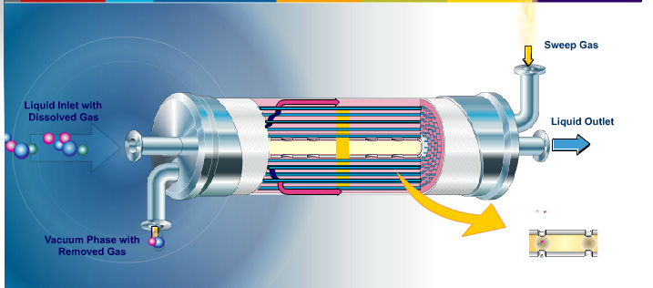
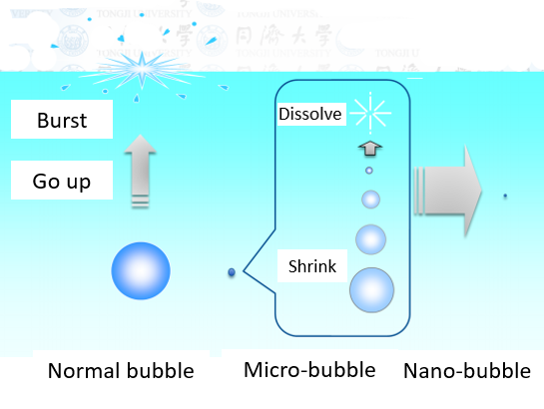
Rn removal from water
The main device for removing radon from water is the degassing membrane, which is made up of microporous hollow fibers;
The radon removal efficiency decreases as the gas in the water decreases;
Micro-bubble device is used to load gas into water, so as to increase the radon removal efficiency;
According to the prototype measurement results, the radon concentration in water has been reduced to 3.6 ± 2.3 mBq/m³ from ~1Bq/m³;
Schematic diagram of degassing membrane
Working principle of Micro-bubble device

Slide 11
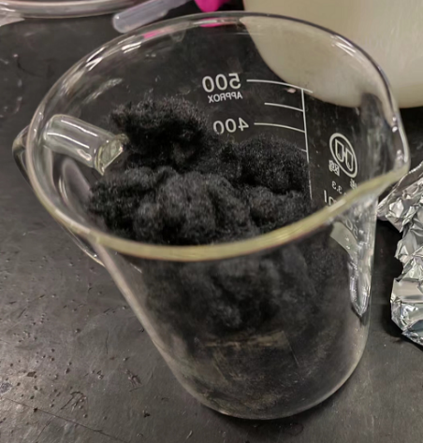
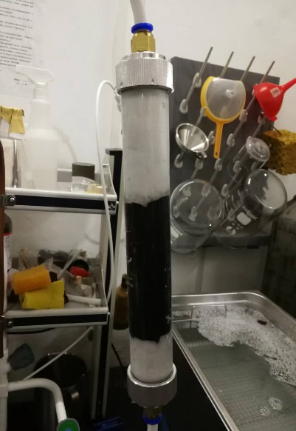
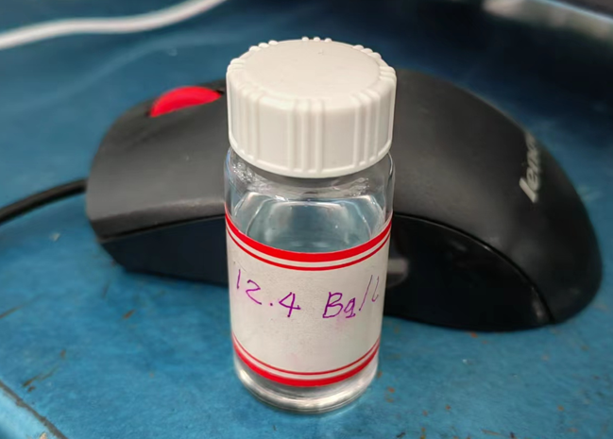
Ra concentration in water measurement
Mn-fiber
Extraction column
²²⁶Ra solution
²²⁶Ra, the progenitor of ²²²Rn, has a half-life of 1600y, 10 μBq/m³ ≈ 5* 10⁻²²g/g;
MnO₂ has strong adsorbability for radium;
Mn-fiber is used to extract radium from water, Mn-fiber is polyurethane fiber with MnO₂ attached;
The radium extraction efficiency is calibrated with ²²⁶Ra solution;

Slide 12
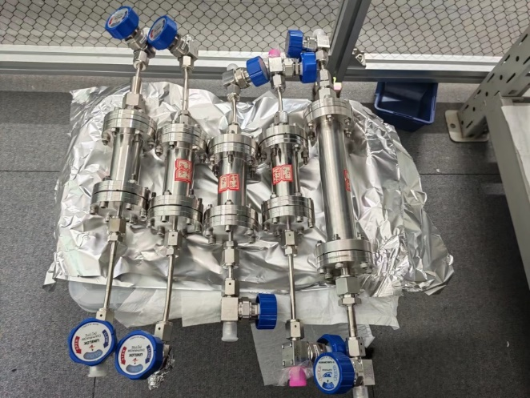
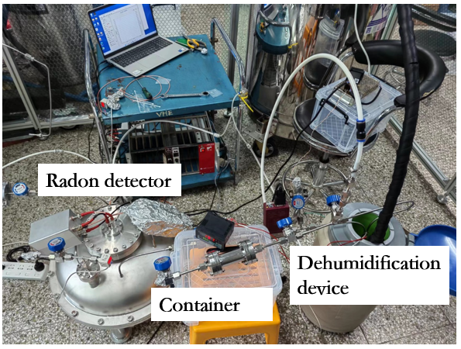
Ra concentration in water measurement
²²⁶Ra is detected by its gaseous daughter ²²²Rn;
After several days of sealing, the ²²²Rn is transferred to the radon detector to measure its activity;
The activity of ²²⁶Ra to ²²²Rn flows :
A_{Ra} = A_{Rn}/(1-e^{-λt})
t is the sealing duration, if t = 3.8 days, A_{Rn}= 0.5*A_{Ra};
According to the background and calibration measurement results, the sensitivity of this system is ~10 μBq/m³;
Emanation chamber

Slide 13
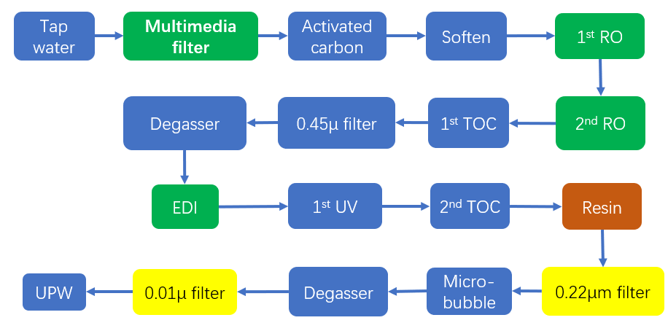
Ra removal from water
Radium exists in ultrapure water primarily in the ionic form;
The UPW production process is essentially a deionization process;
Multimedia filter, Revise Osmosis (RO), Electro-De-Ionization (EDI), and resin can be used to remove radium from water;
The prototype measurement results showed that the radium concentration can be reduced to 53 ± 40 μBq/m³ from ~500mBq/m³;
The flow chart of a UPWS

Slide 14
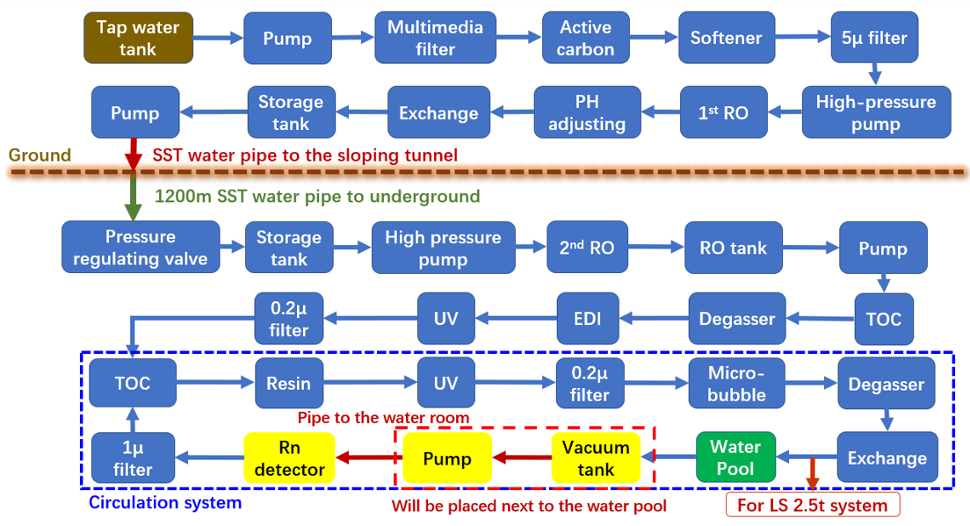
The UPWS of JUNO

Slide 15
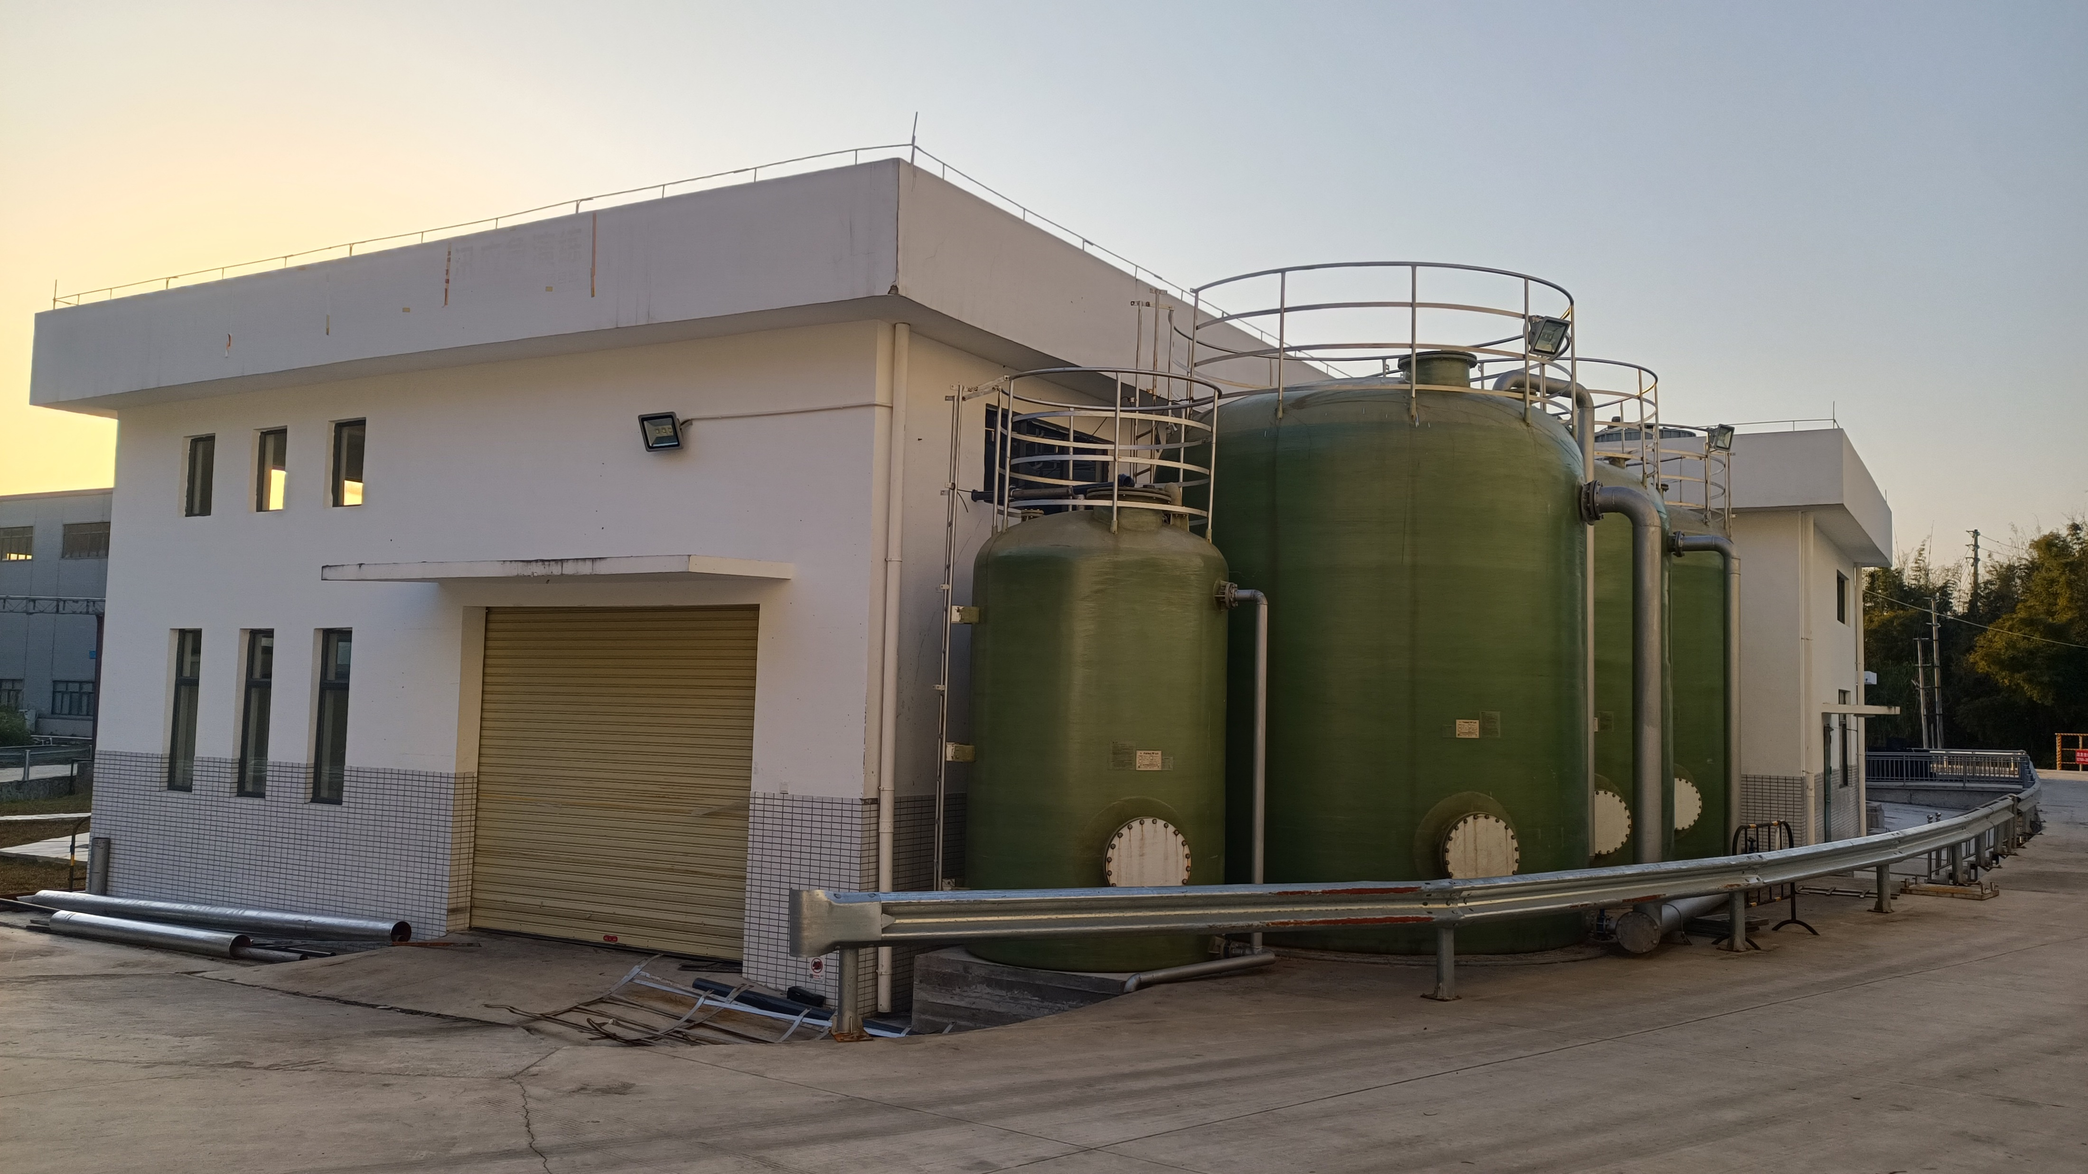
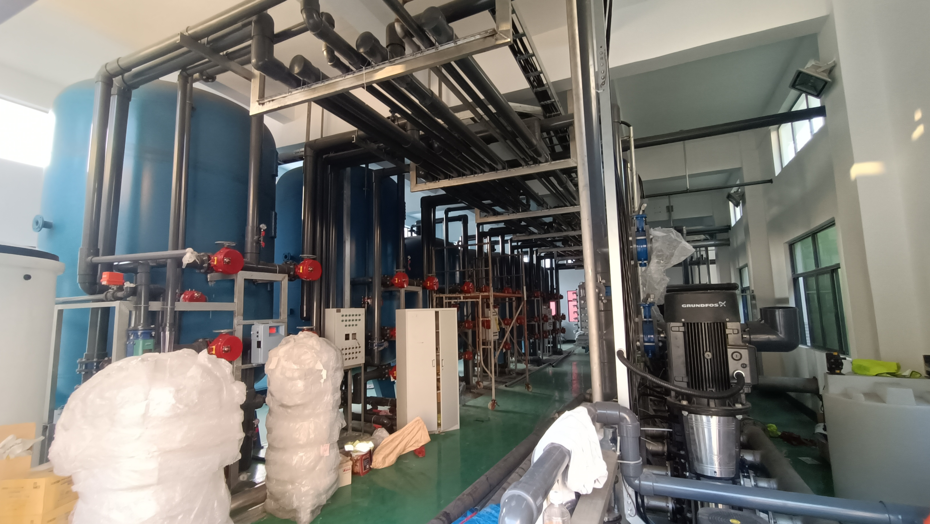
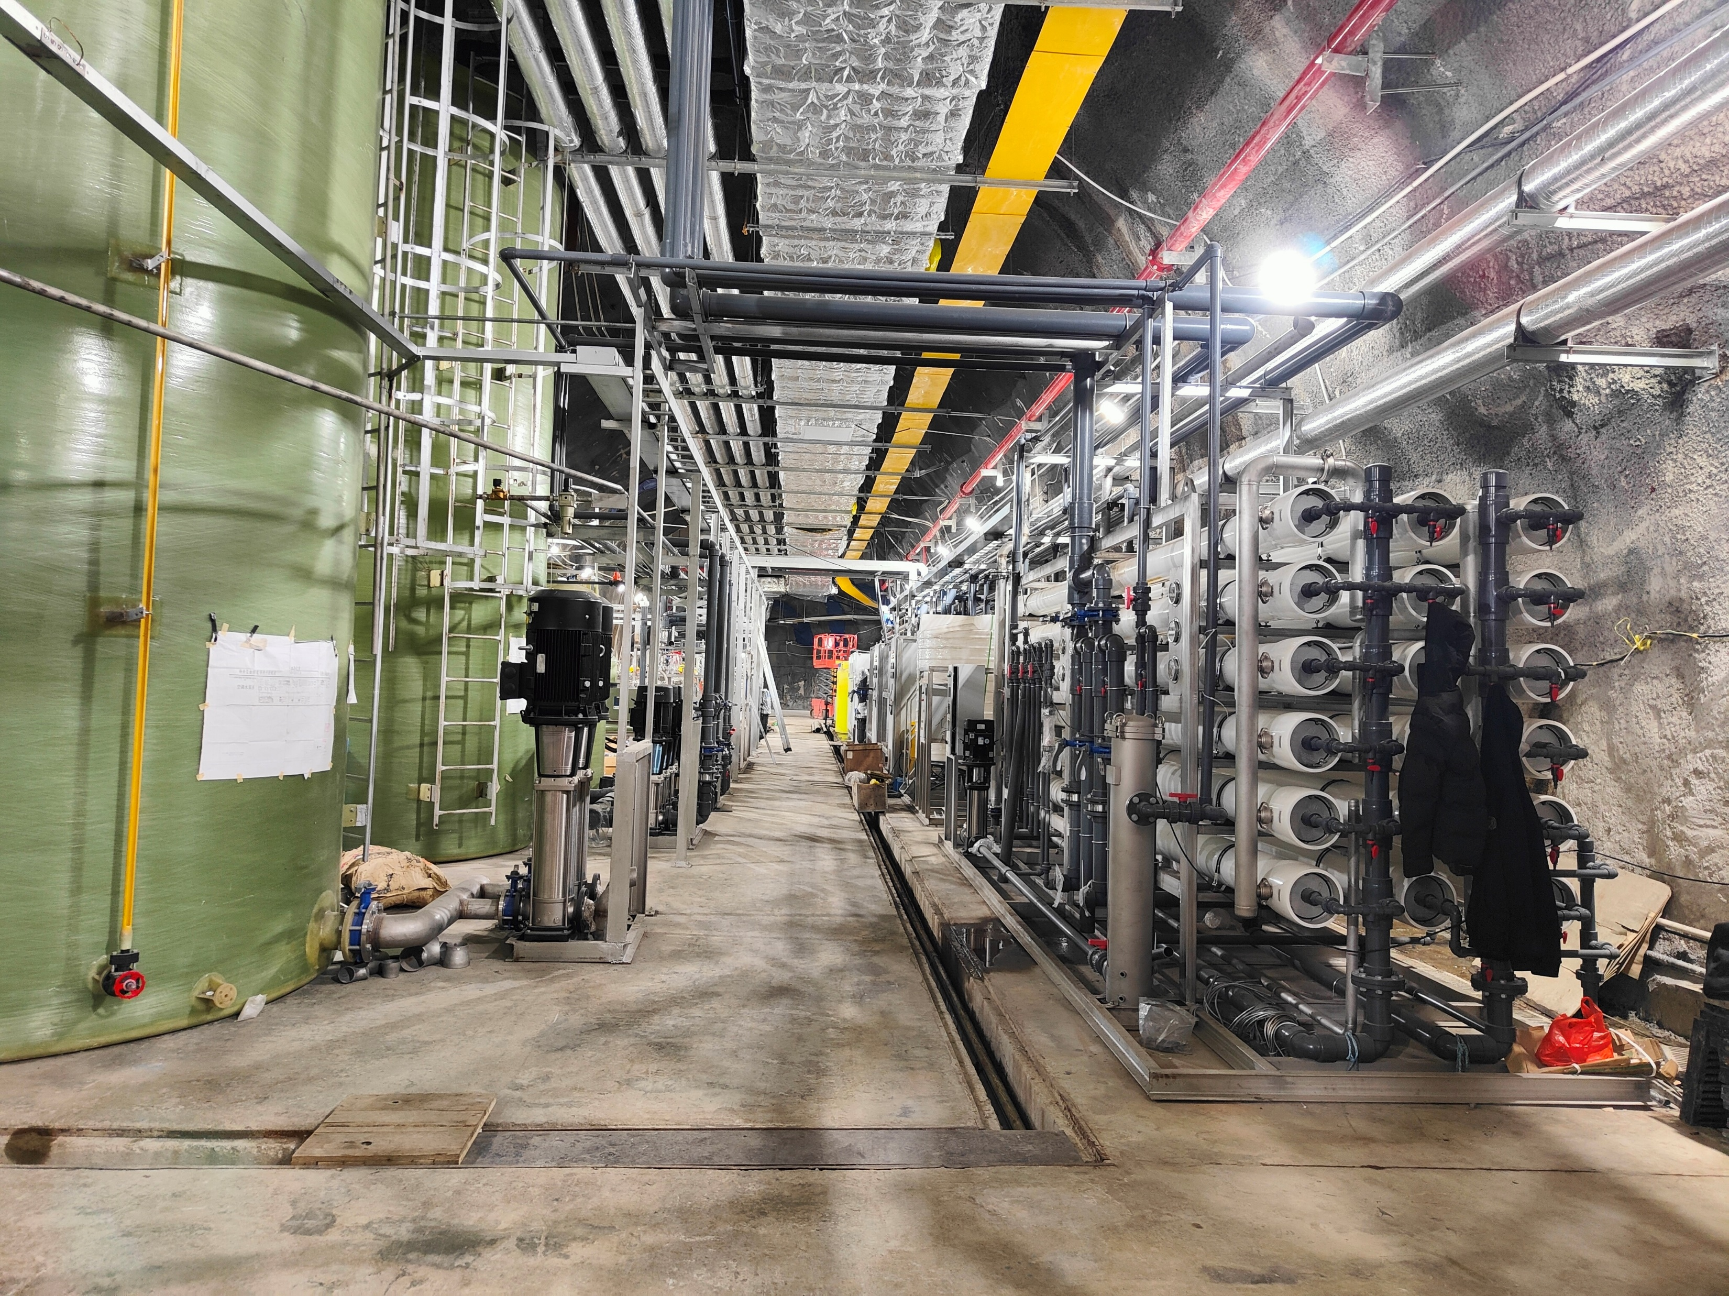
The UPWS of JUNO
Water room on the ground
Water system on the ground
Water system underground
The surface building was completed in 2022;
The installation of the water system is basically finished, only some pipes need to be connected;
The commissioning of the system is expected to start in Dec. 2023.

Slide 16
Summary
JUNO is a multi-purpose neutrino experiment
JUNO is also a low-background experiment under construction at 700m underground and submerged in a WCD
In addition to being used in the WCD, UPW will also be used for LS filling
An UPWS is developing to produce very low radioactive UPW (²²²Rn < 5mBq/m³, ²²⁶Ra <50 μBq/m³ ) with a flow rate of 100t/h;
Two setups for measuring ²²²Rn (²²⁶Ra) concentration in water with a sensitivity of ~1 mBq/m³ (~10 µBq/m³) have been developed
Based on the prototype measurement results, the radon concentration in water can be reduced to 3.6 ± 2.3 mBq/m³ and the radium concentration in water can be reduced to 53 ± 40 μBq/m³
The installation of the UPWS is ongoing and the commissioning is expected to start in Dec. 2023

