Slide 1
Large-Scale Structures
of the Universe
Cheng ZHAO
Department of Astronomy, Tsinghua University
Nov 6, 2023 @ FCPPL2023

Slide 2
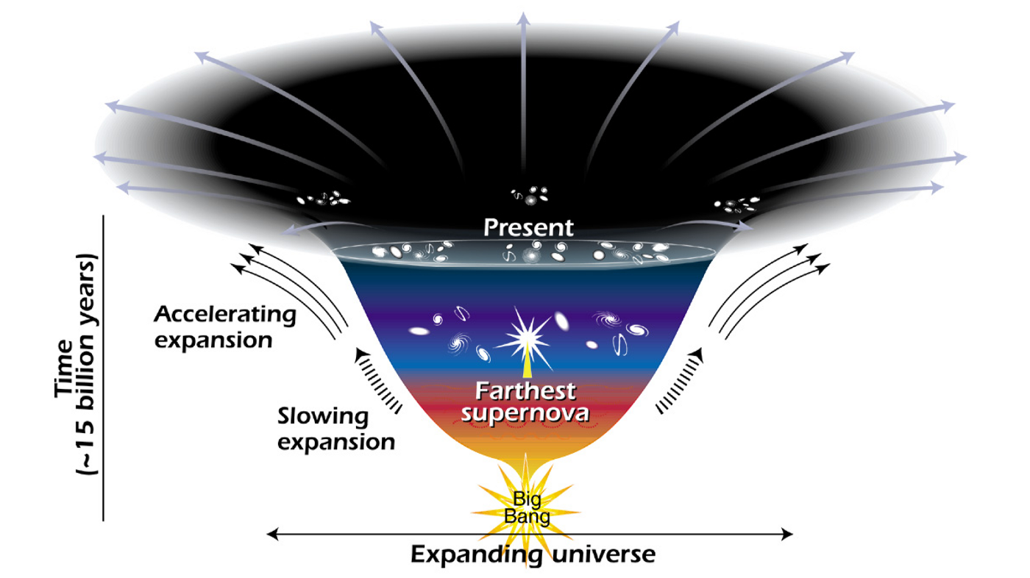
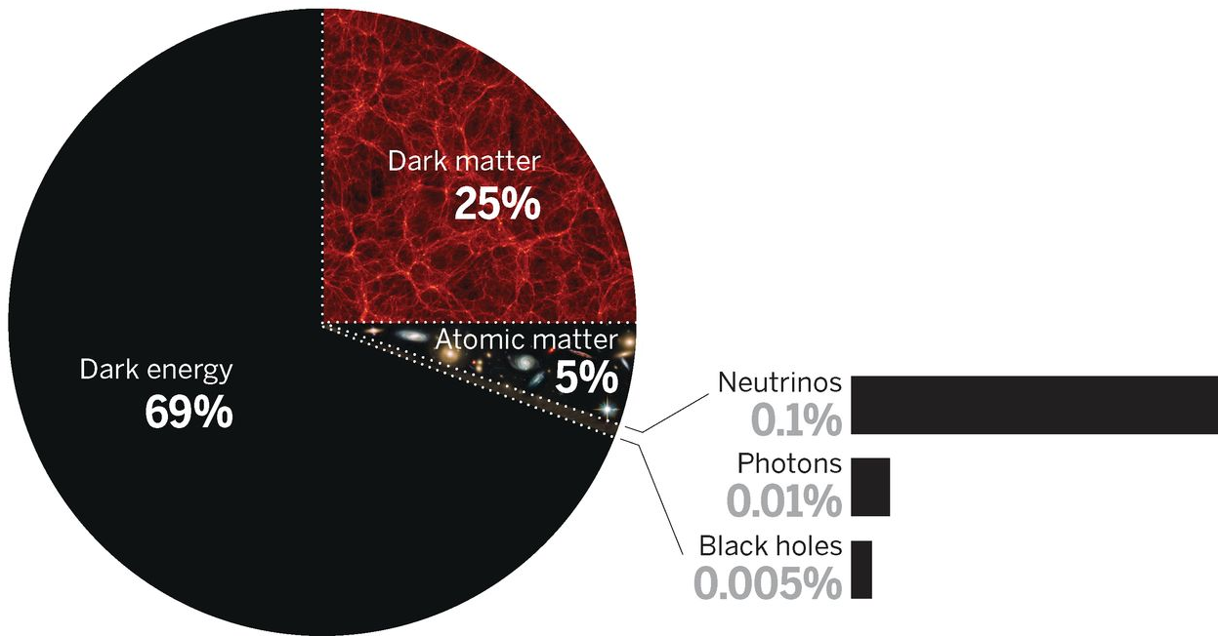
Mysteries of the Dark Universe
Credit: NASA/STSci/Ann Feild
Spergel 2015
Dark Energy (DE)
Dark Matter (DM)
Beyond…
Repulsion
Attraction
Fundamental physics
Smoothly distributed
Constant energy density
Accelerating expansion
Weakly interacting
Mostly cold
Dominates gravity
Inflation
Neutrino masses & mixing
…
Notes:
Here is the picture of our standard cosmology model at the moment.
The universe started with a hot big bang, and went through inflation, then the radiation and matter dominated era with slowing expansion, and recently the dark energy dominated phase with accelerating expansion.
The energy budget of the universe today consists of mostly dark components, including almost 70% DE and 25% dark matter.
We know little about these dark components, … say…
However, a key problem is, there is not yet convincing particle candidates or mechanisms in the standard model of particle physics for these dark components.
Apart from DE and DM, there are also a number of fundamental physical problems in cosmology.
It is interesting as these are sort of known unknowns.
This is basically because modern cosmology is an observational driven science.
We have seen lots of surprises and we rely on the unknowns to explain the observations.
In order to have a better understanding of the physical problems, we certainly need more observations or experiments, to define better the properties of the unknowns, or, probably, discover more unknowns.

Slide 3
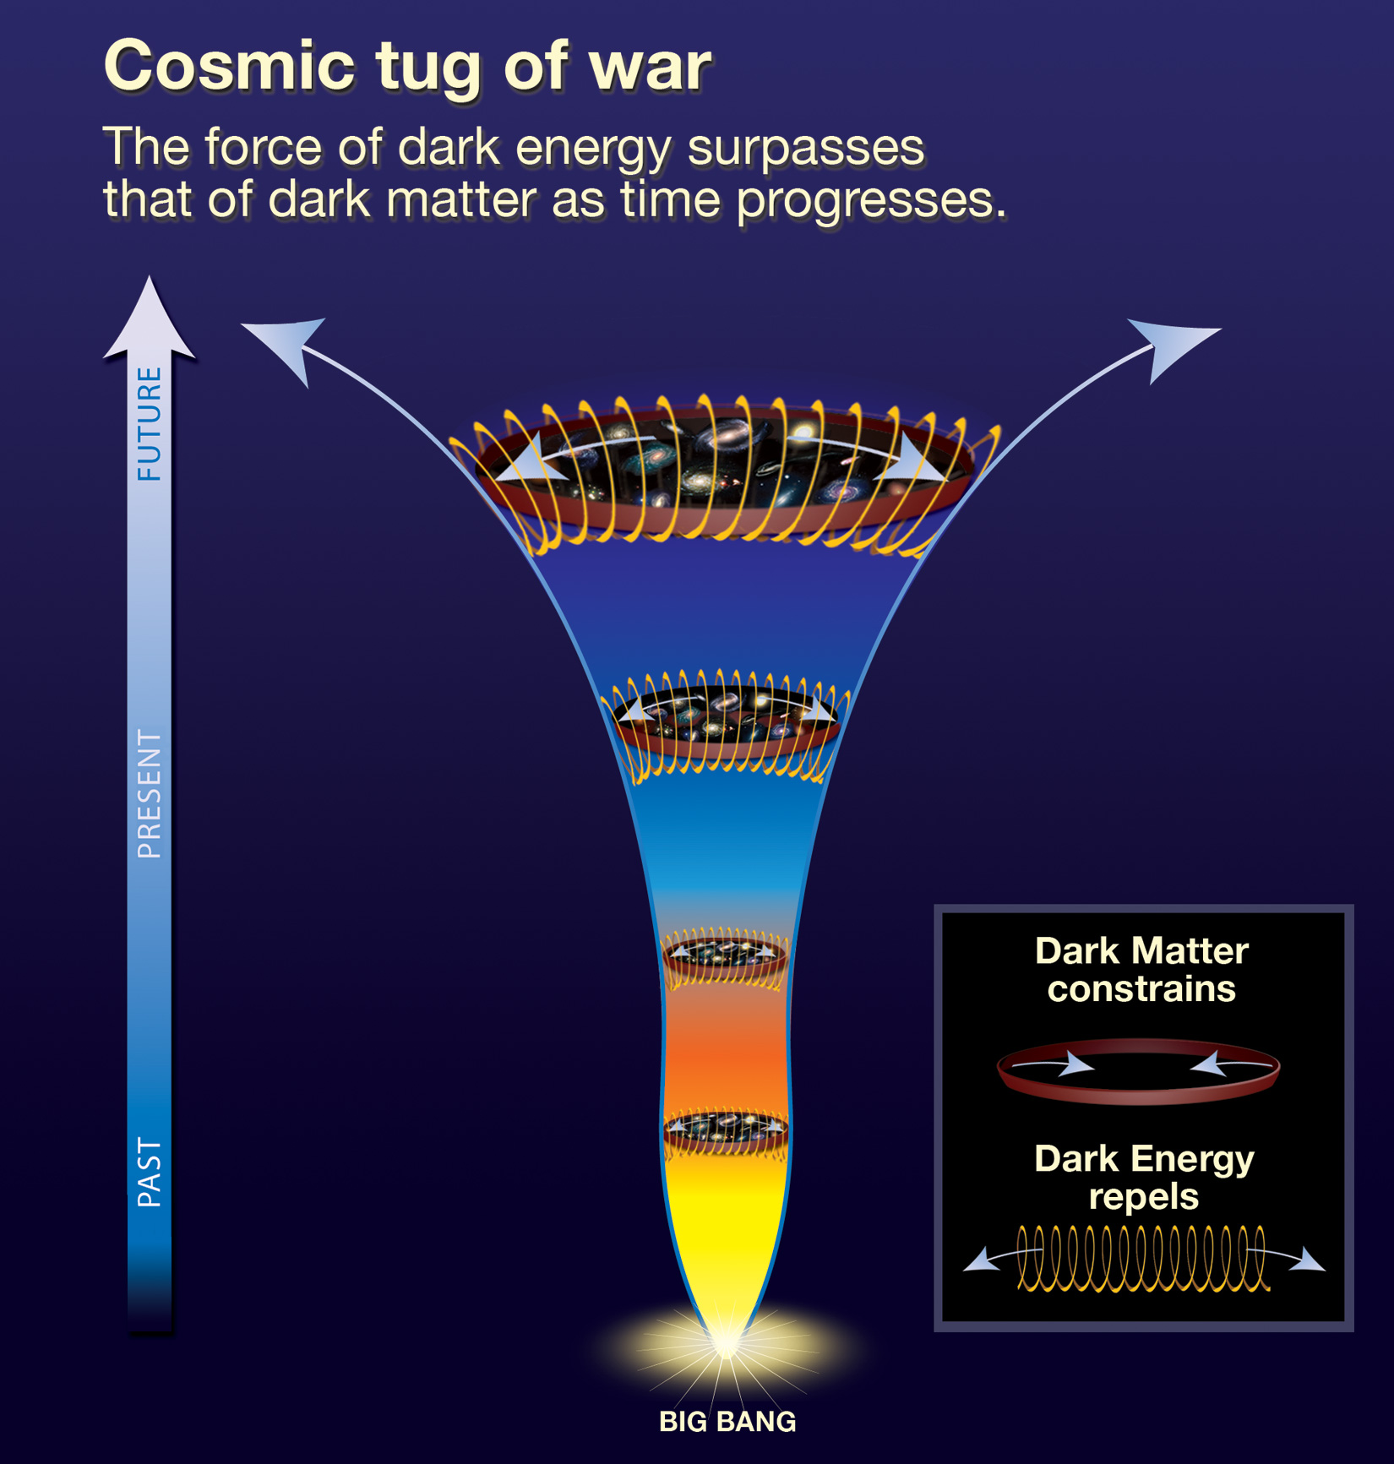
Large-scale structures
Inhomogeneity /
clustering
Credit: ESA/Planck, SDSS/BOSS
Structure growth
Cosmic expansion
Credit: NASA/ESA/
STSci/Ann Feild

Slide 4
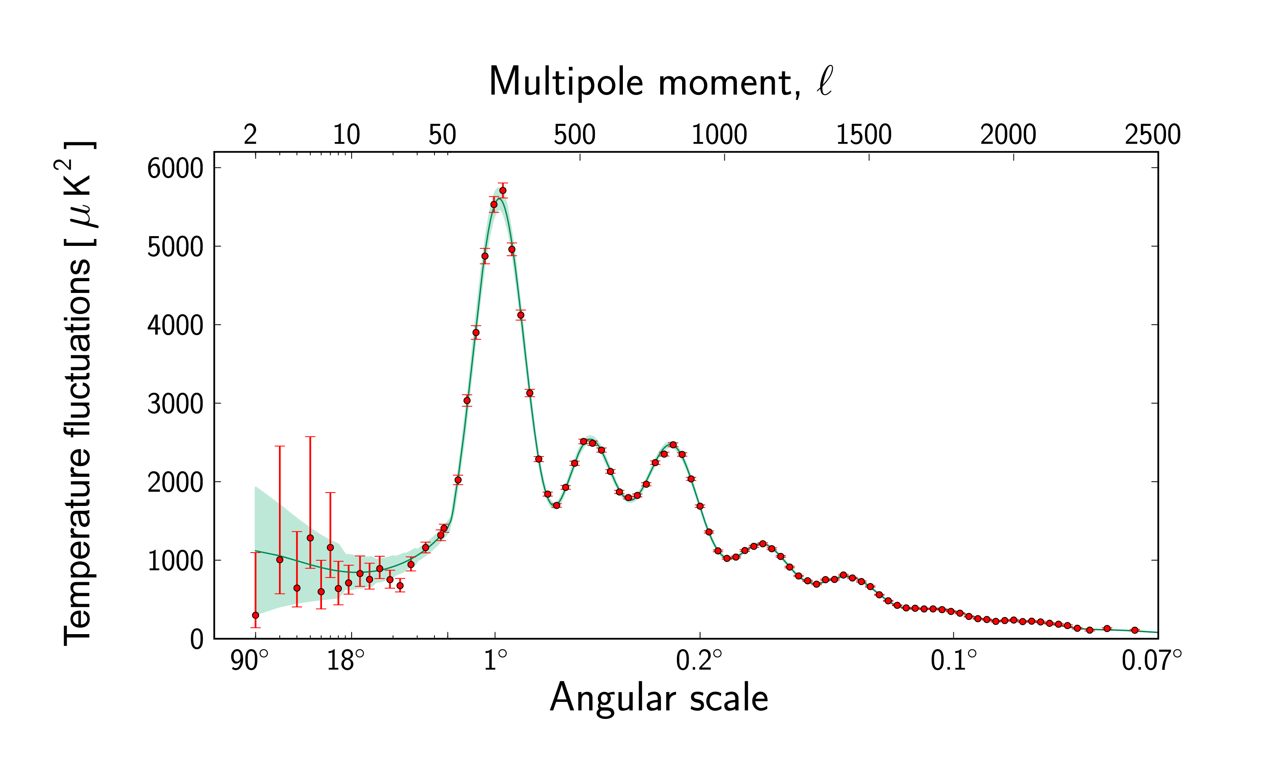
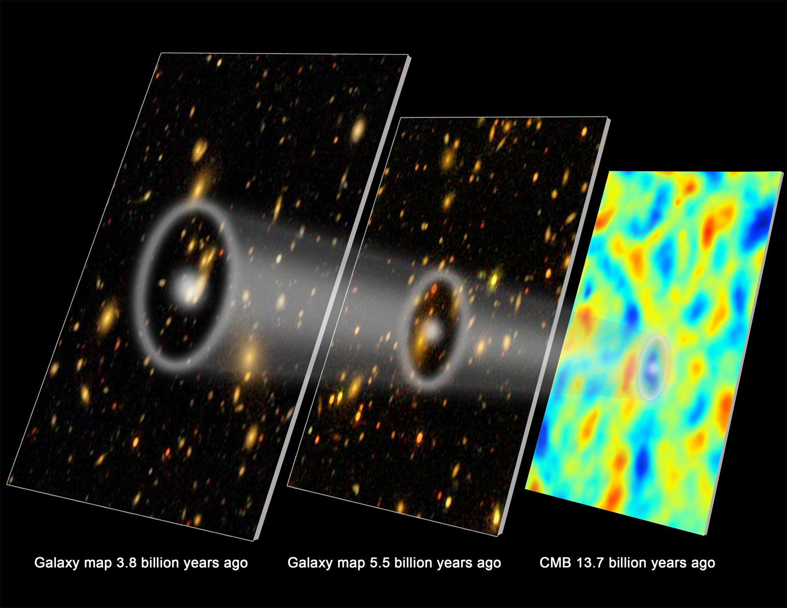
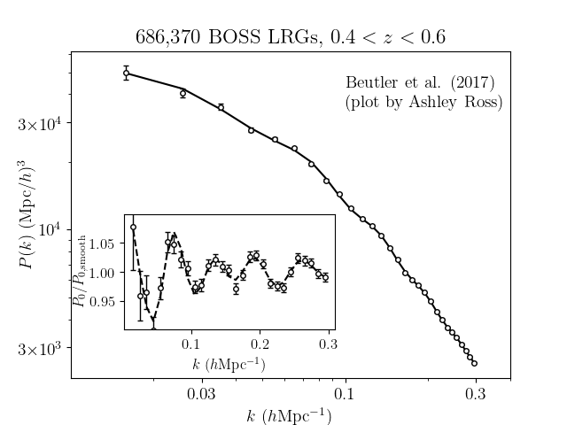
Baryon Acoustic Oscillation (BAO)
Standard ruler for expansion history
Credit: Zosia Rostomian
Planck 2013
$$D_{A}(z)θ$$
$$\frac{cdz}{H(z)}$$

Slide 5
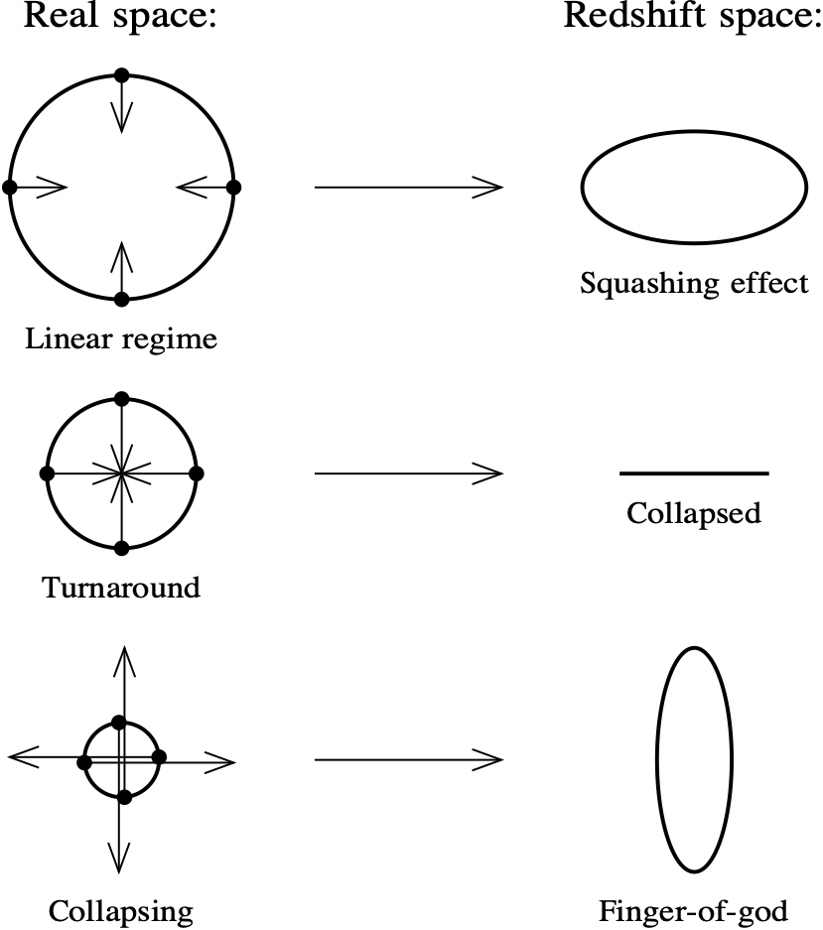
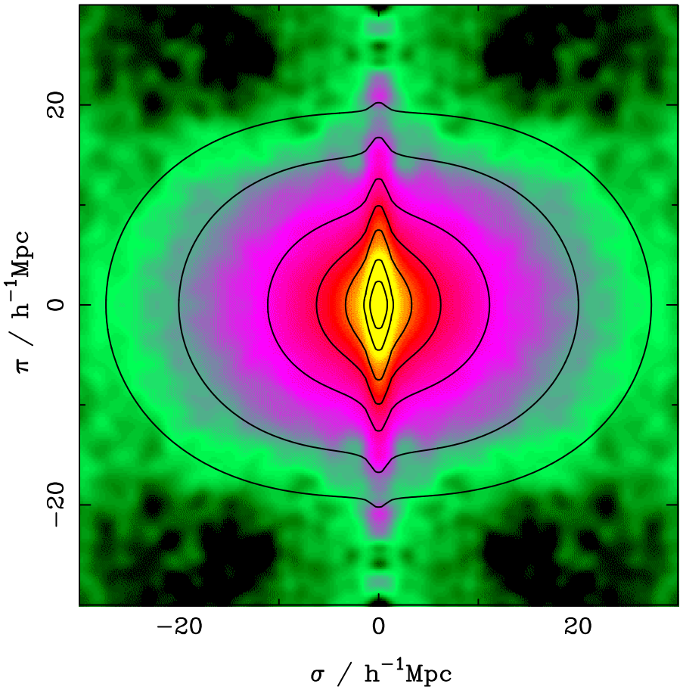
Redshift-space distortion (RSD)
Measurement of structure growth
Coherent flow
Virialized motion
Hamilton 1998
Peacock+ 2001

Slide 6
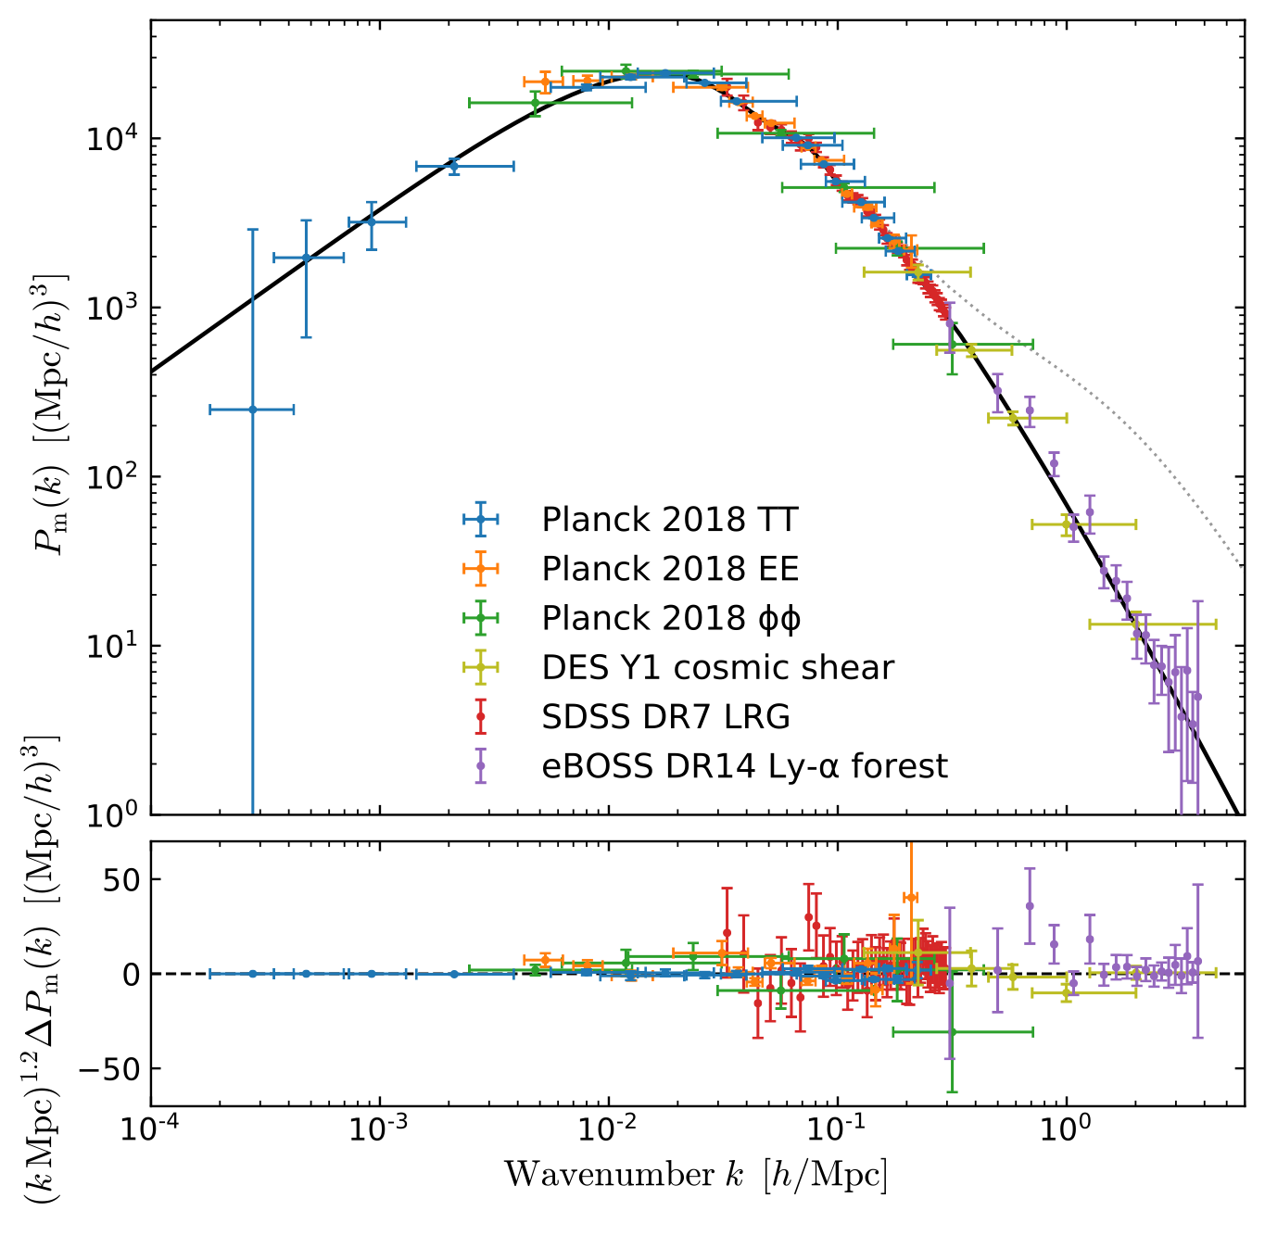
Matter Power Spectrum
Primordial
non-Gaussianity
Dark energy: Baryon Acoustic Oscillation
Structure growth:
Redshift-Space Distortion
Matter-radiation
equilibrium
“Coldness” of dark matter
Spectroscopic survey
small
scale
large
scale
Chabanier+ 2019

Slide 7
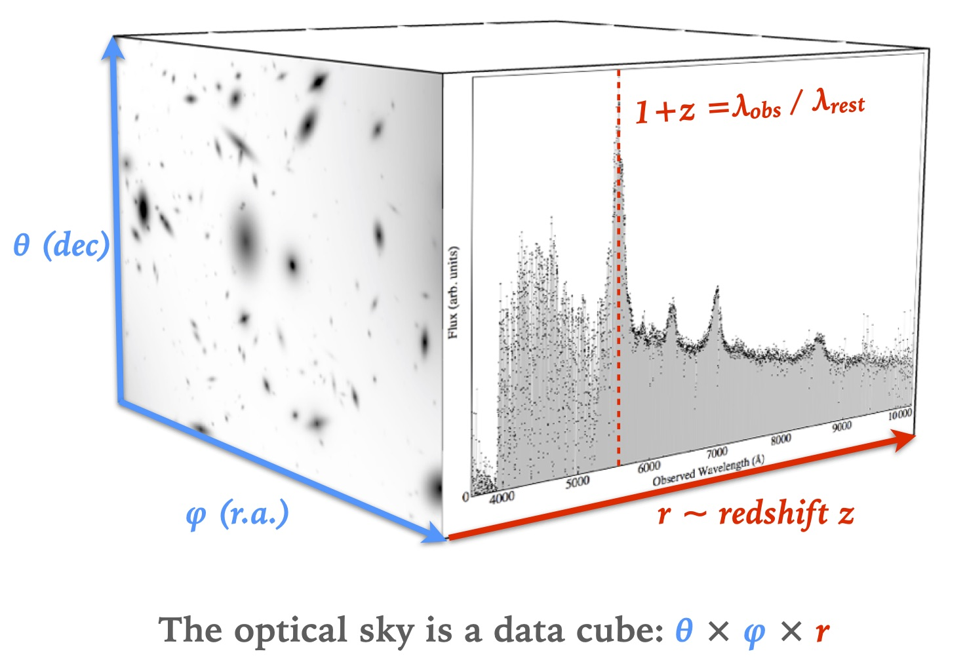
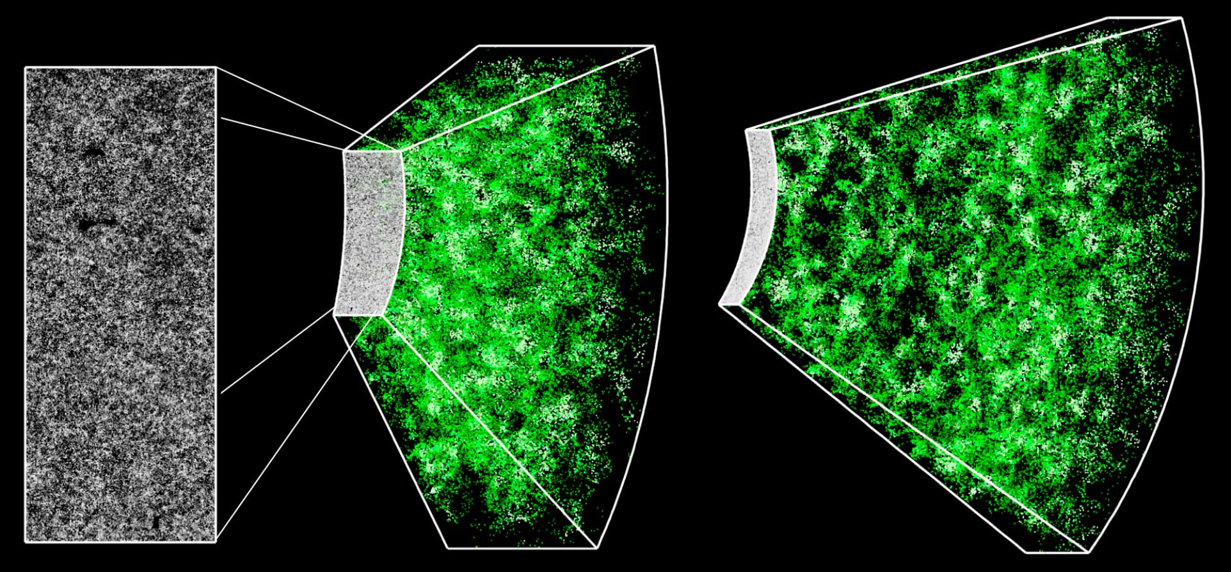
Spectroscopic Survey: data cube
Credit: David Kirkby
Credit: BOSS/Jeremy Tinker
Notes:
The basic principle of a spectroscopic survey is to measure the redshifts of targets from the spectra. Given the 2 angular coordinates and the depth as redshift, we can infer the 3D position and construct the 3D map of Universe.

Slide 8
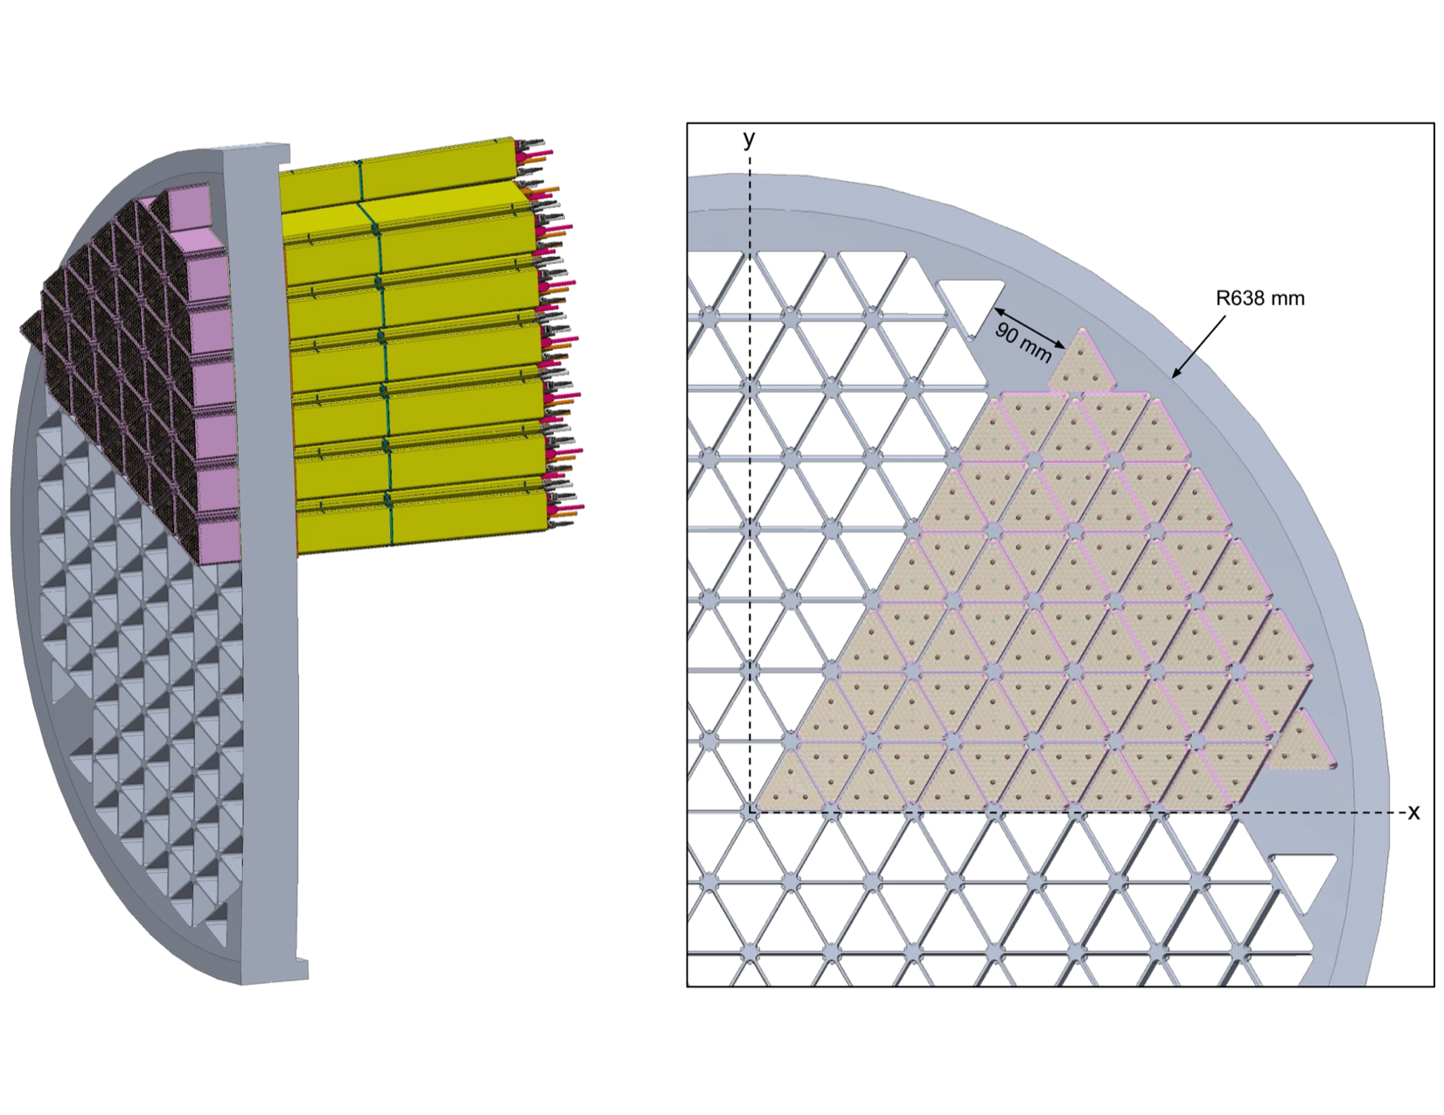
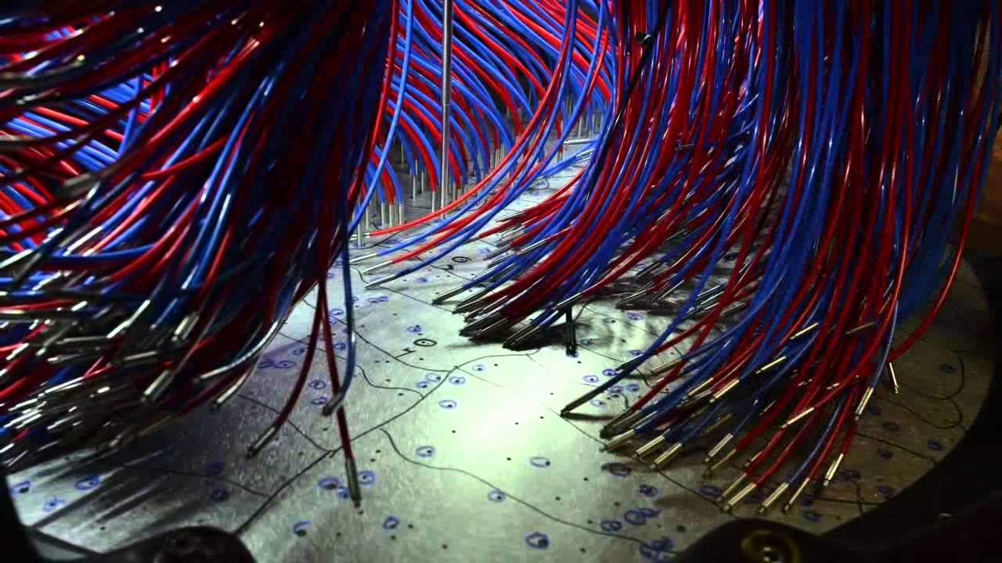
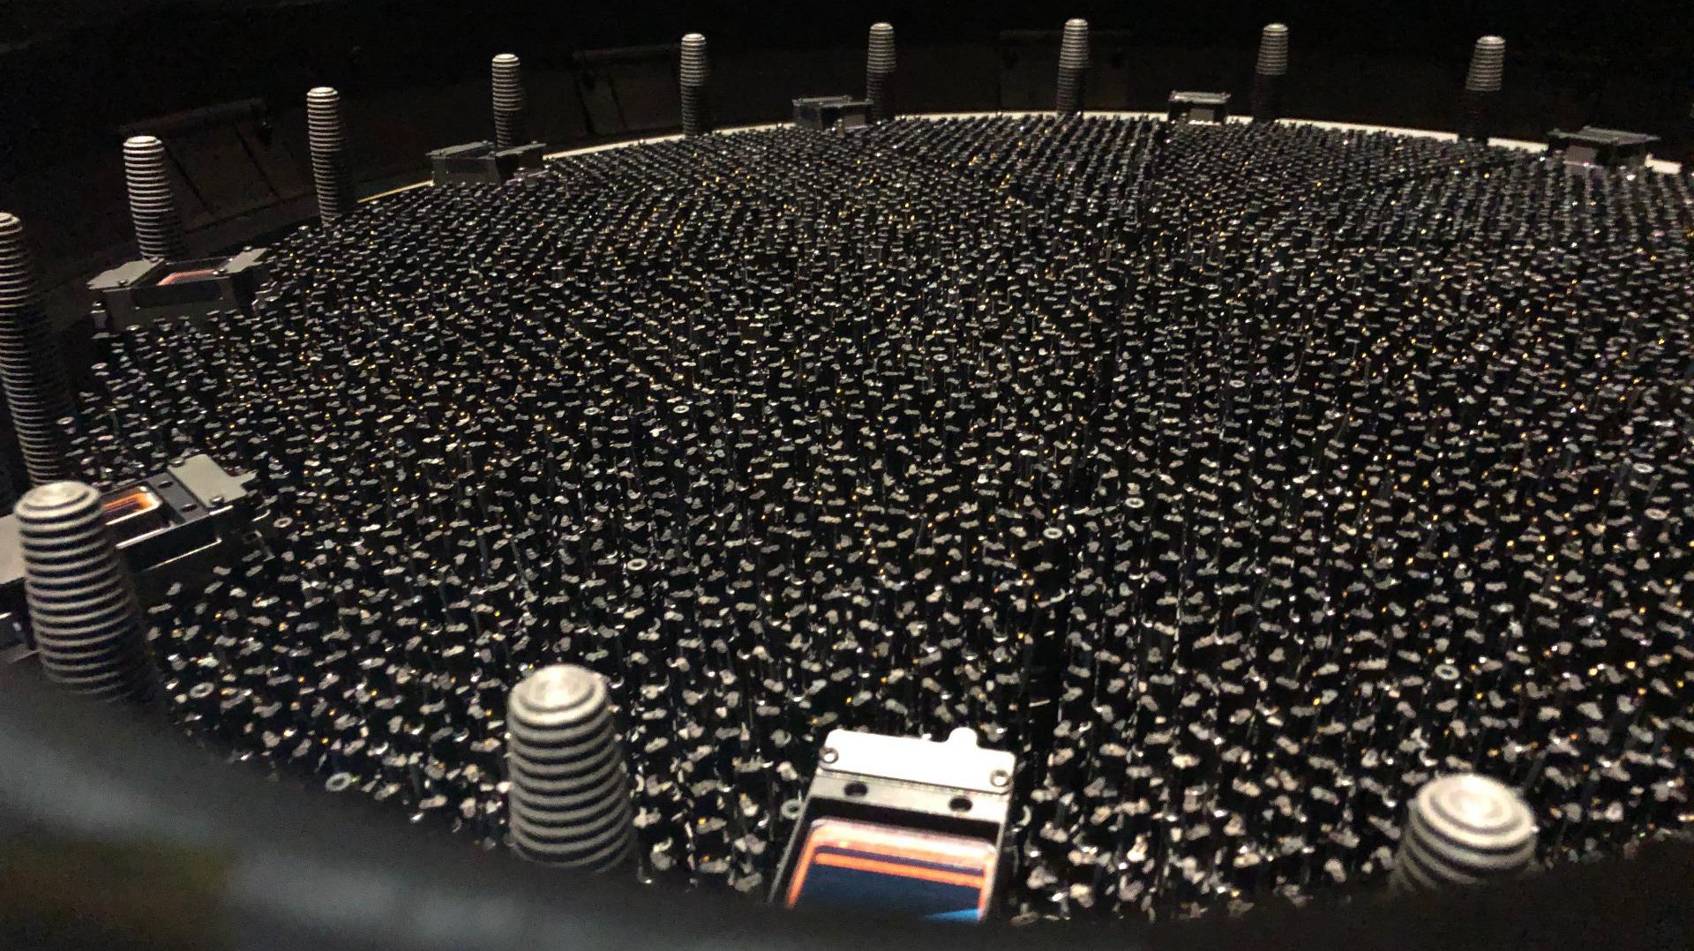
Massive Spectroscopic Surveys
Past
Present
Future
and more …
Credit: SDSS, DESI

Slide 9
Spectroscopic Survey: 3D maps
Credit: Anand Raichoor
Notes:
This video shows the latest 3D map made of galaxies and quasars, obtained from the SDSS project in the last 2 decades.
Each point shows the reconstructed 3D position of a galaxy or quasar in comoving space.
One can see that the data so far has occupied a significant fraction of the observable universe, indicated by the last scattering surface of CMB.

Slide 10
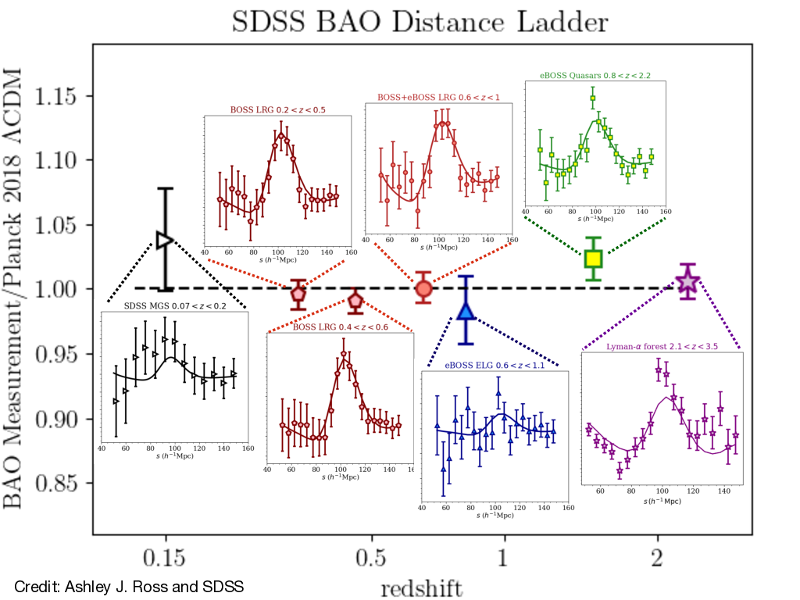
SDSS BAO

Slide 11
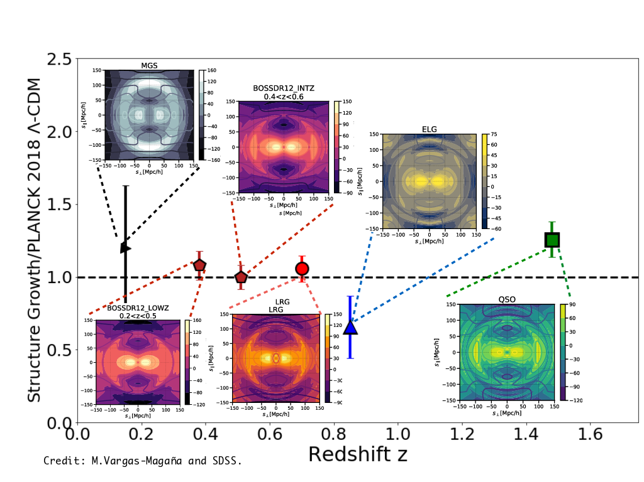
SDSS RSD

Slide 12
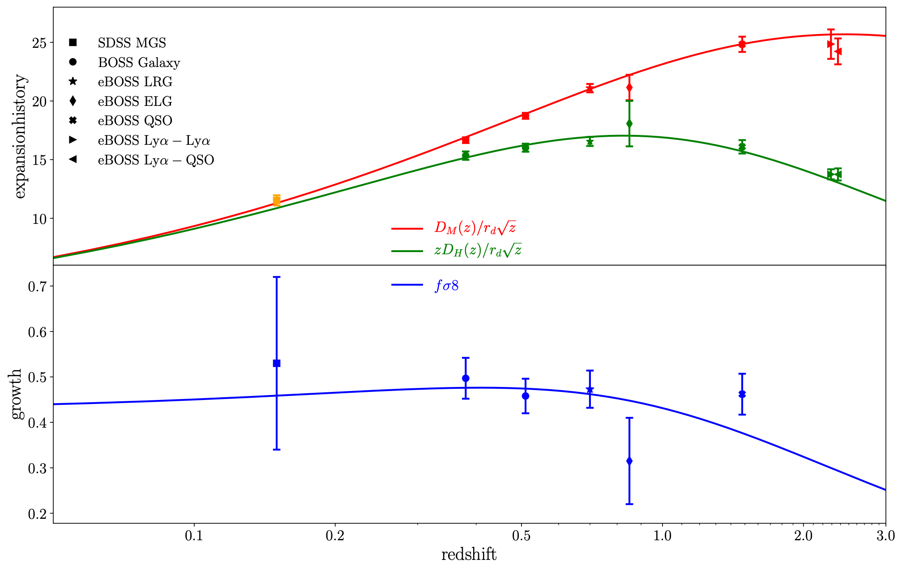
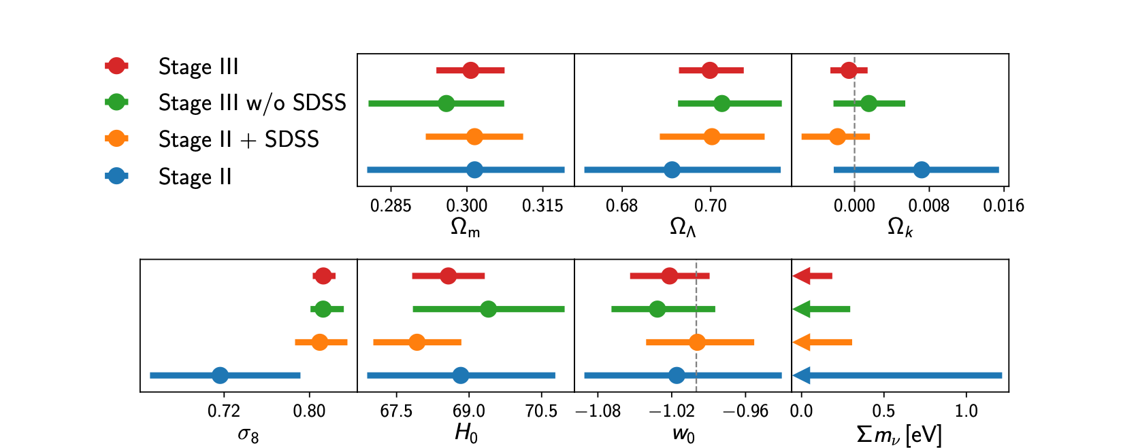
SDSS Cosmology Results
BAO
RSD
eBOSS 2021

Slide 13
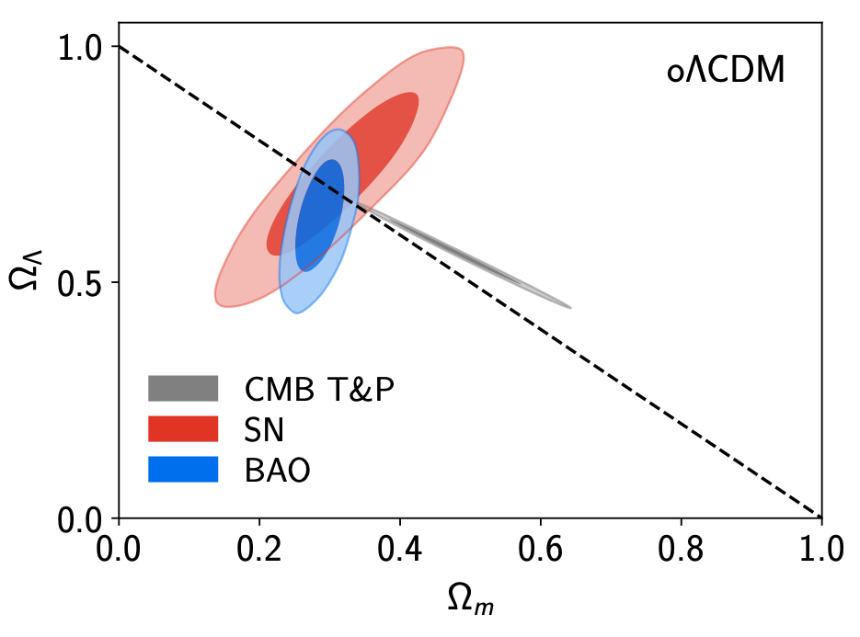
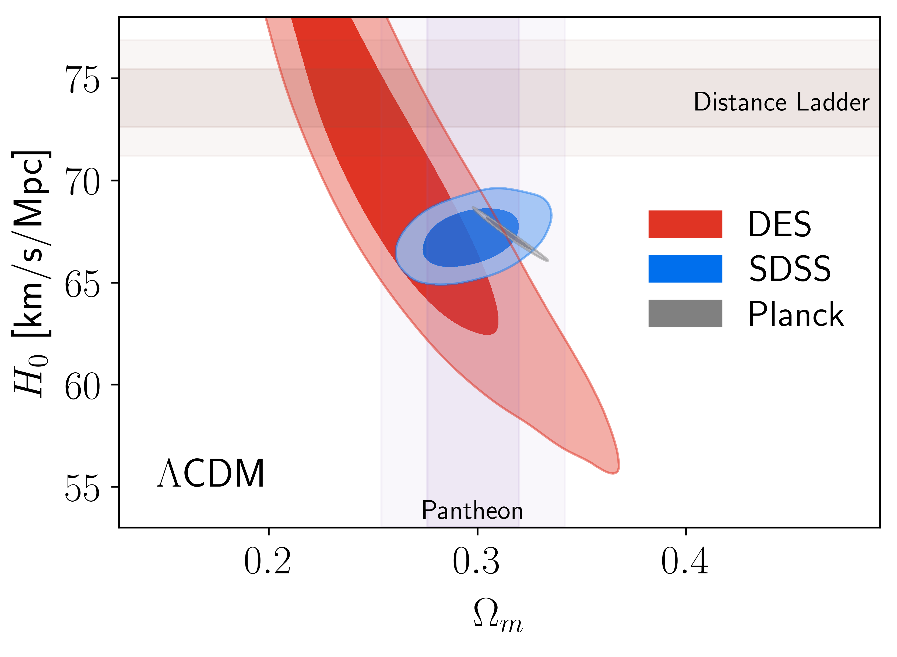
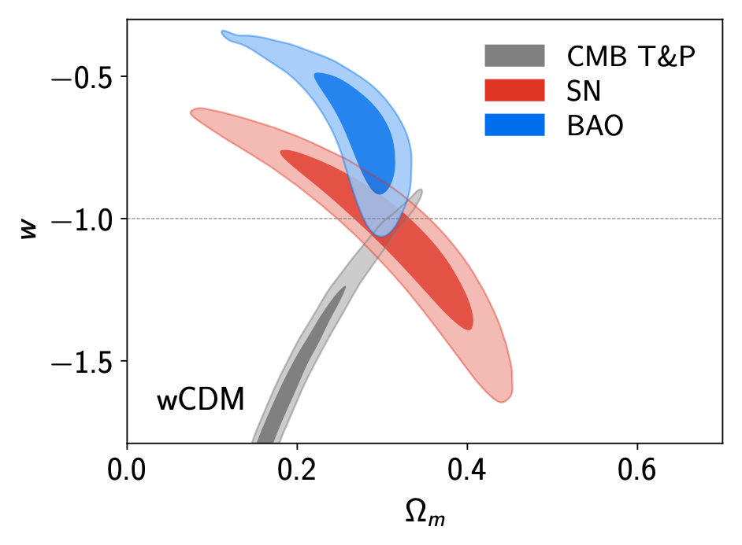
SDSS Cosmology Results

Slide 14
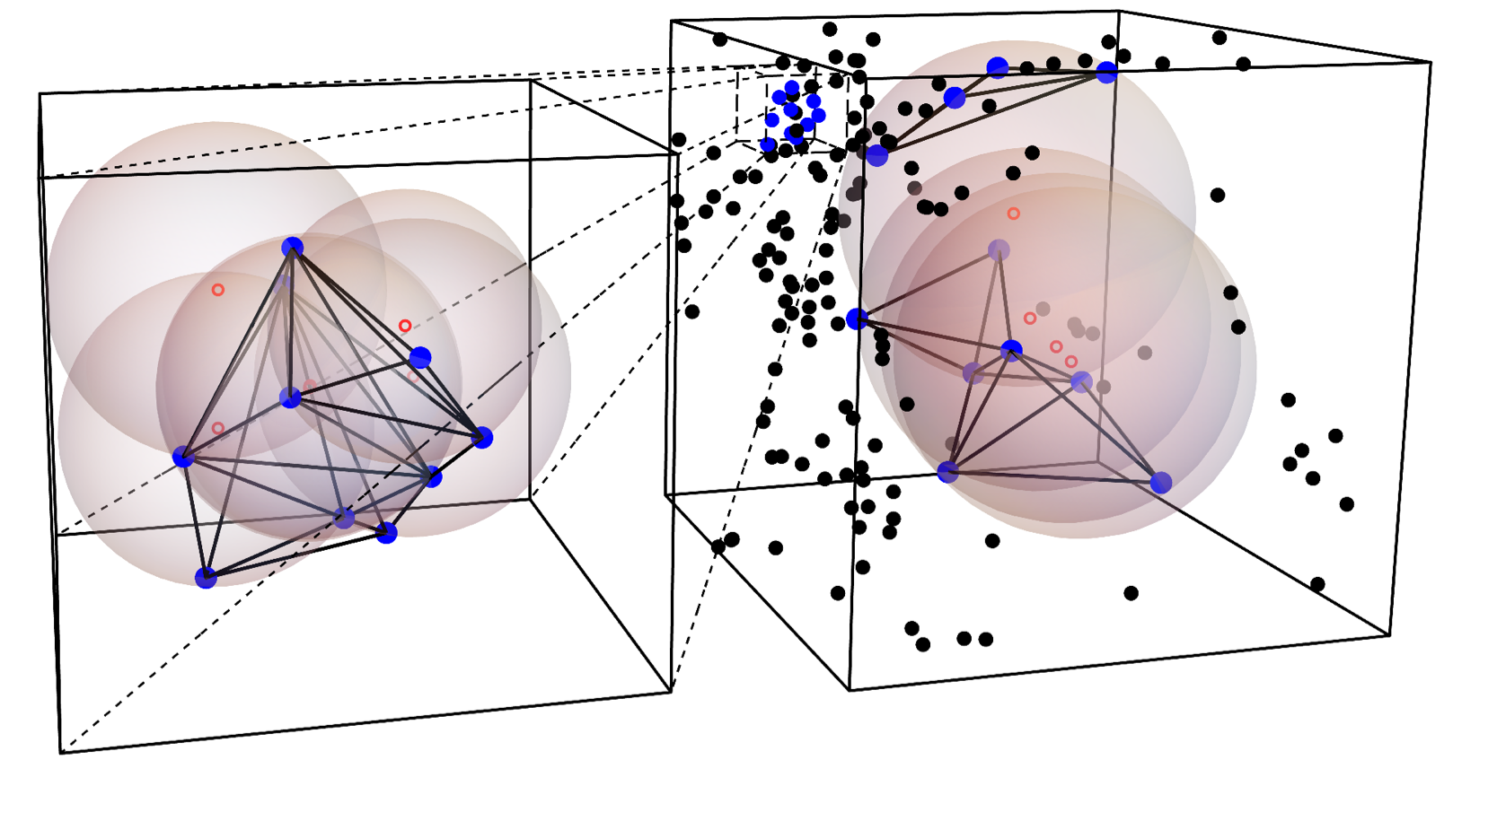
Delaunay Triangulation Voids (DT Voids)
Visualisation
80 Mpc/h
Black & blue: haloes
Red: centres of “voids”
12 Mpc/h
Cosmology independent
Complexity: N log(N)
CZ+ 2016

Slide 15
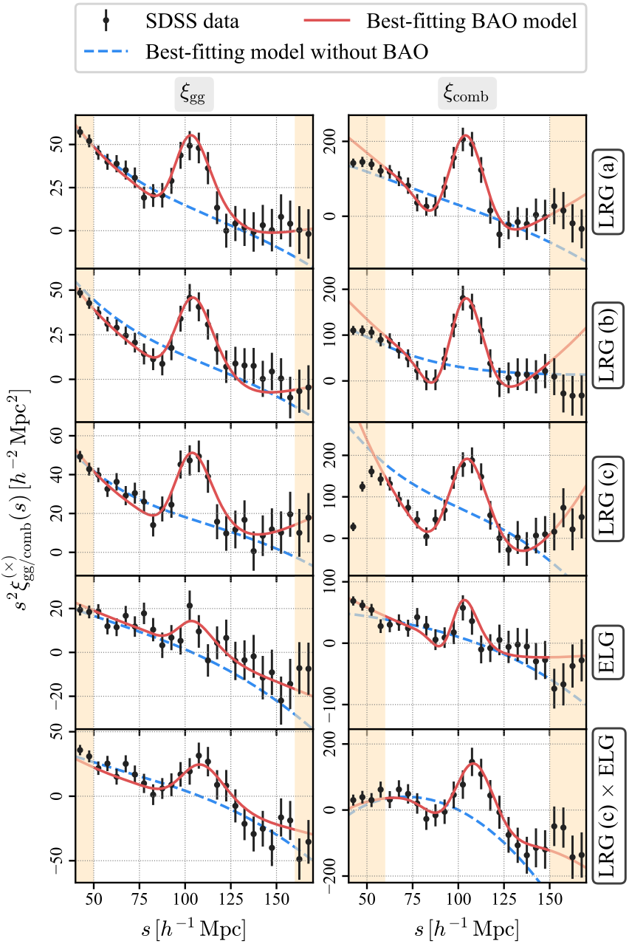
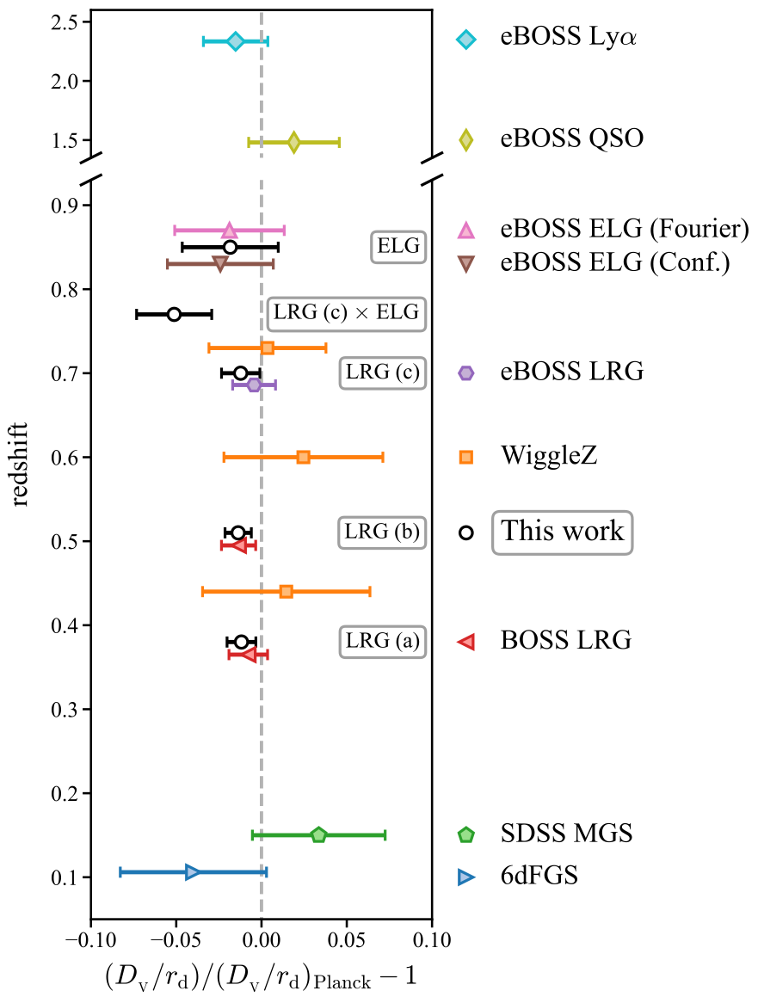
Distance measurements with voids
CZ+ 2022
Galaxy only
Galaxy + void

Slide 16
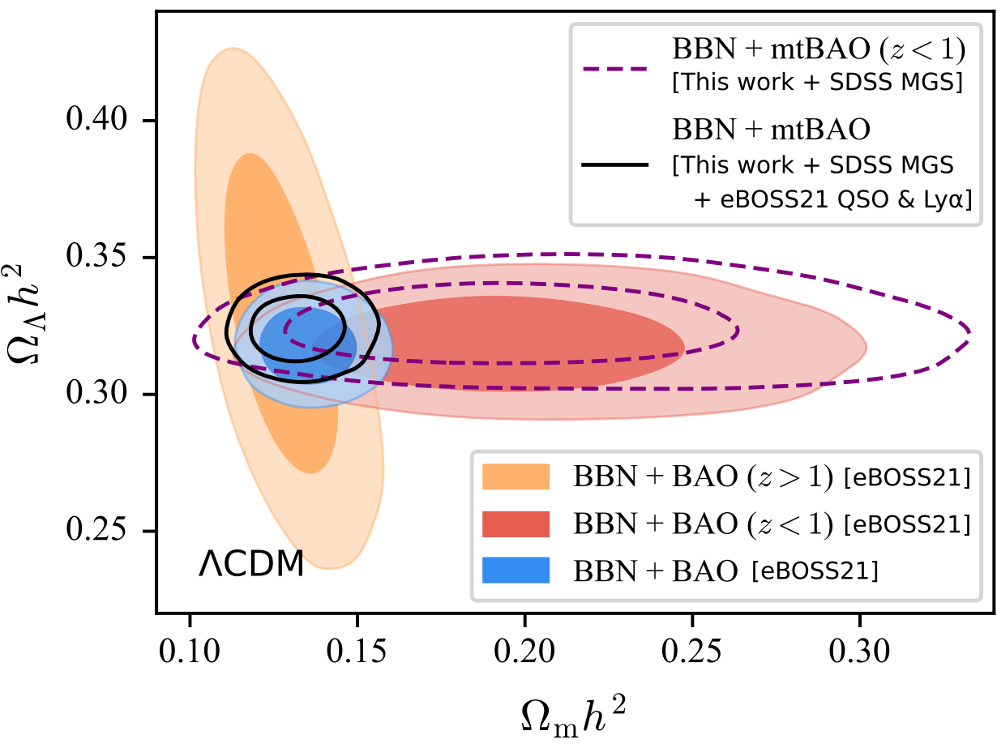
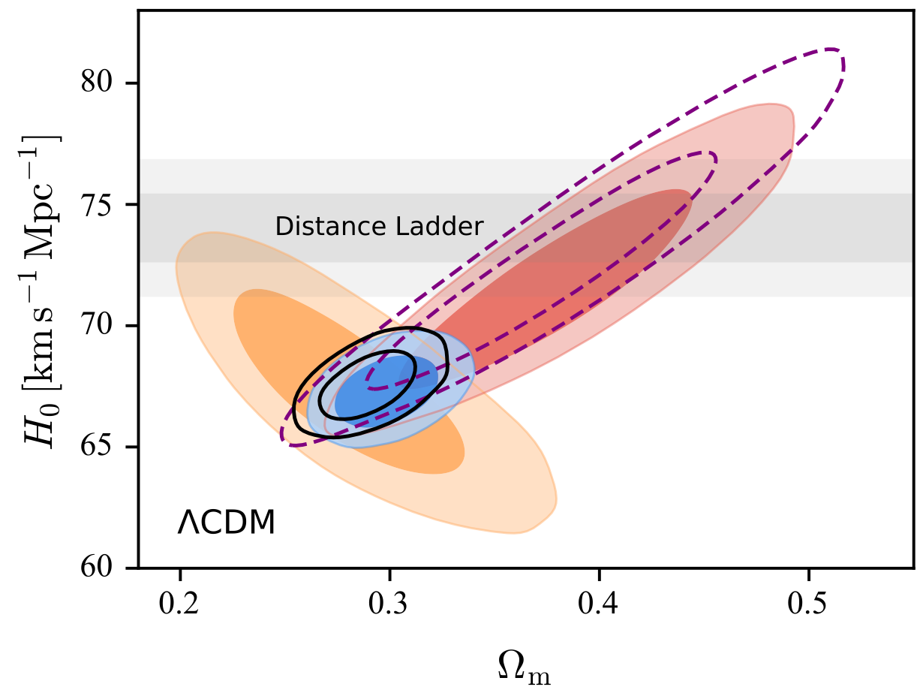
Cosmology with galaxy + void
CZ+ 2022

Slide 17
Stage-V Spectroscopic Survey
Dark Energy Task Force (DETF) 2006 report
Stage I/II : SDSS I/II (2.5m, 800 fibers, 2000 – 2008)
Stage III : BOSS/eBOSS (2.5m, 1k fibers, 2009 – 2019)
Stage IV : DESI (4m, 5k fibers, 2021 – 2026) / DESI-II?
→ confirms dark energy
→ precise dark energy at z ≲ 1
→ precise dark energy at z ≲ 3
Snowmass Cosmic Frontier Report (2022)

Slide 18
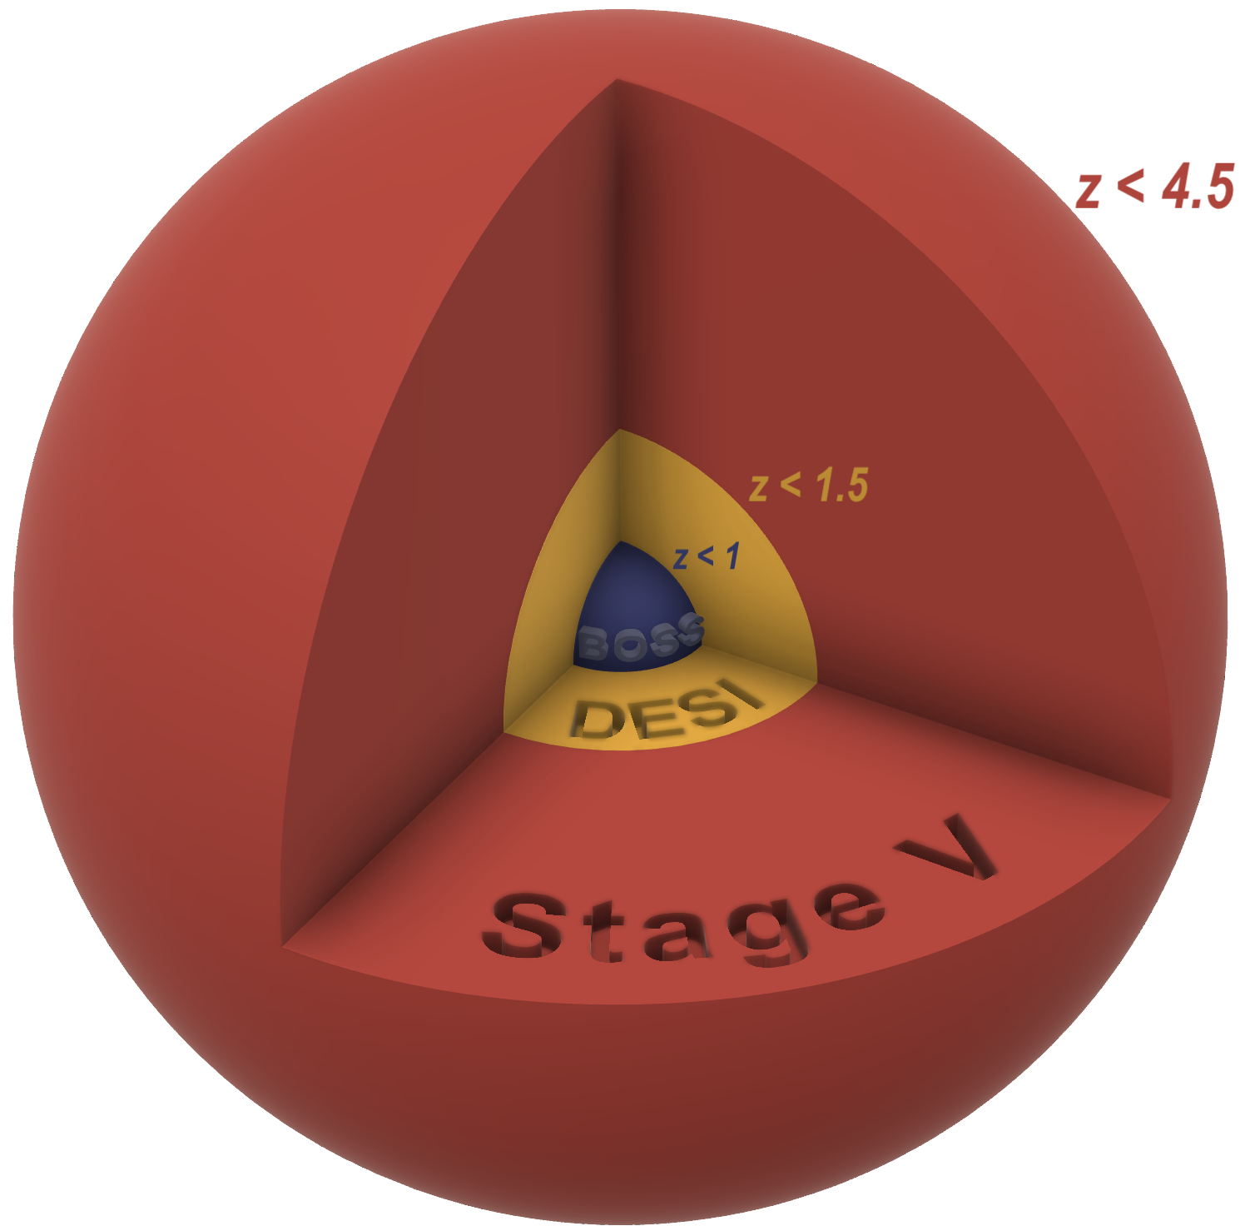
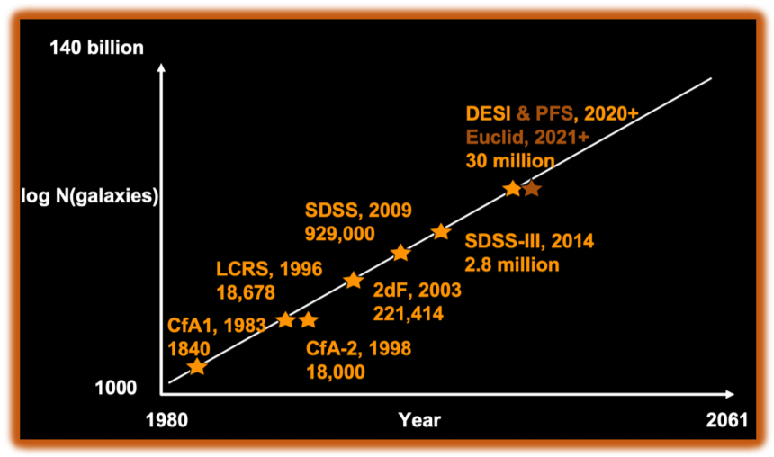
Stage-V Spectroscopic Survey
Deep: large aperture
Massive: highly multiplexed
Stage V
Credit: David Kirkby

Slide 19
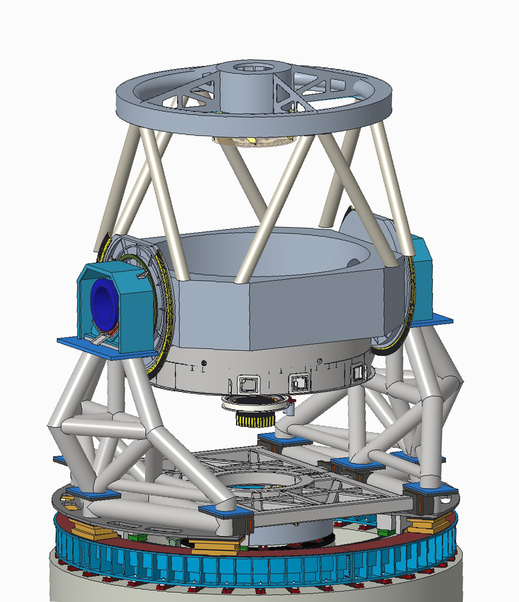
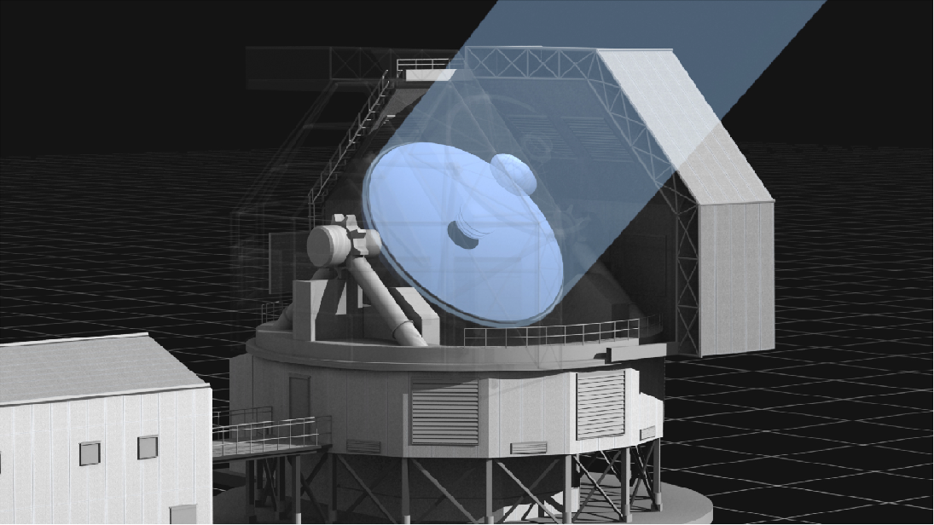
Multiplexed Survey Telescope (MUST)
Parameter | Current Design
Diameter | 6.5 m
FoV | ~5 deg2
No. Spectra | ~20,000
Wavelength | 0.36–1.0 micron
Resolution | R ~ 3000–5000
First light:
2029
Our Vision for MUST
Lenghu, China
Deng+ 2021, Nature, 596, 353
Next-gen, Stage-V spectroscopic survey facility.
A long-term platform to support the Chinese astronomy community.
Opportunities for international collaboration.
https://must.astro.tsinghua.edu.cn/

Slide 20
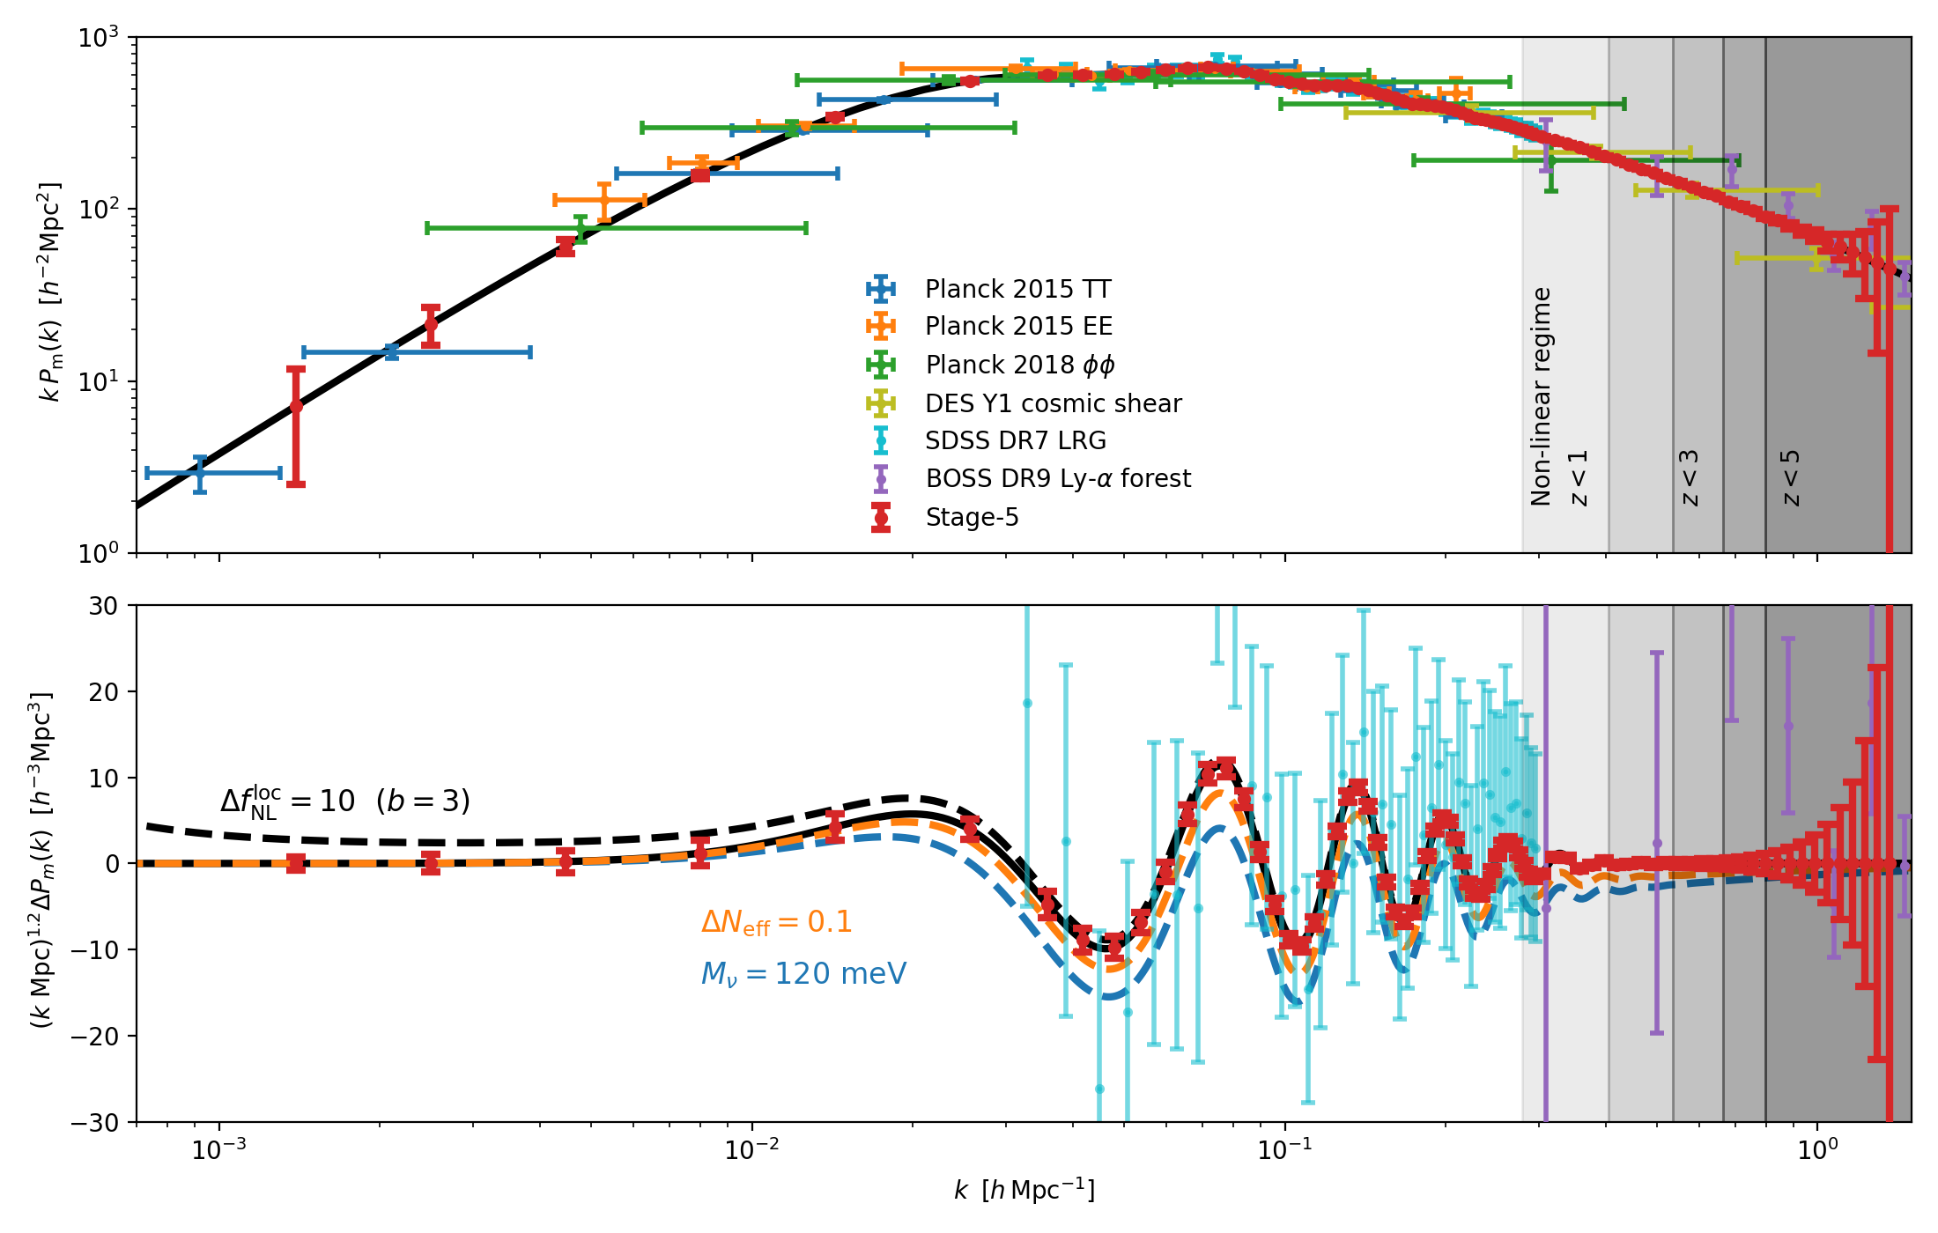
MUST: Cosmology
Keys to the Next-Generation (Stage-V) Spectroscopic Cosmology Survey:
High redshift
High density
High Redshift
High Density
Early dark energy
Primordial Physics
Modified gravity
Dark matter interaction
Parity violation
…
Neutrino mass
Nature of dark matter particle
Light relics
Peculiar velocity
Baryonic effects
…
Credit: David Schlegel
Mostly beyond the Standard Model

Slide 21
Summary
Large-scale structures are an important cosmological probe
SDSS provides the tightest BAO & RSD constraints so far
BAO measurements can be further improved with cosmic voids
MUST: Stage-V spectroscopic survey led by Tsinghua University

