Slide 1
工作进展
刘梦瑶

Slide 2
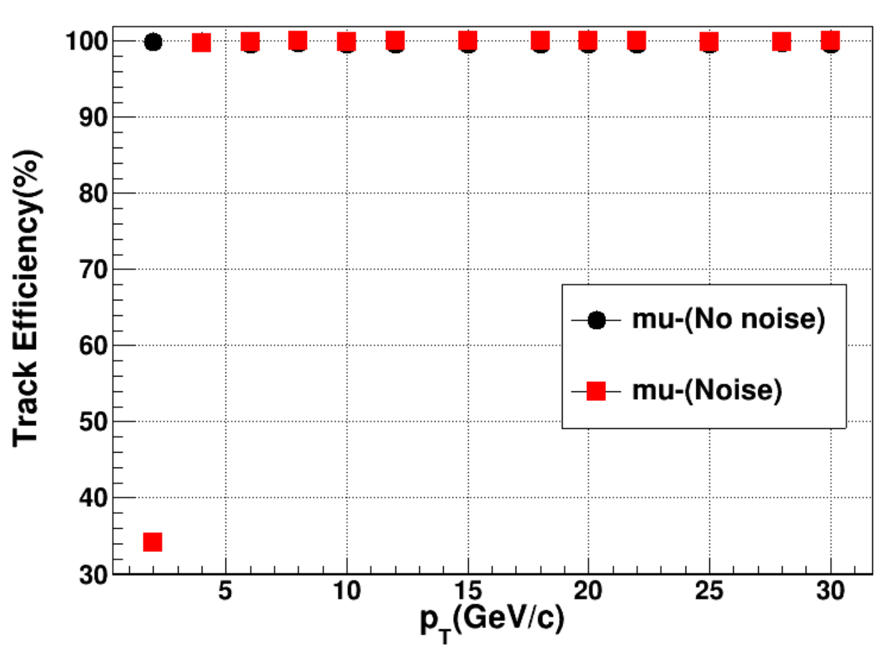
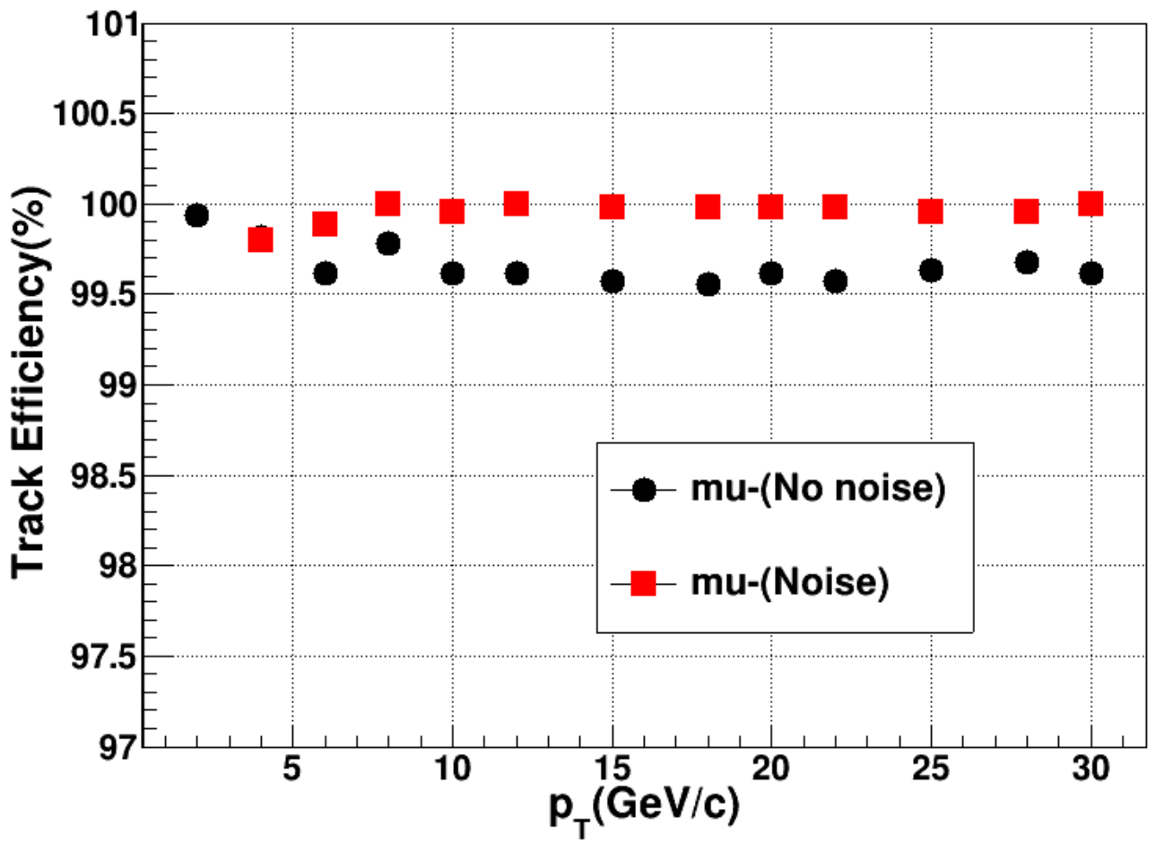
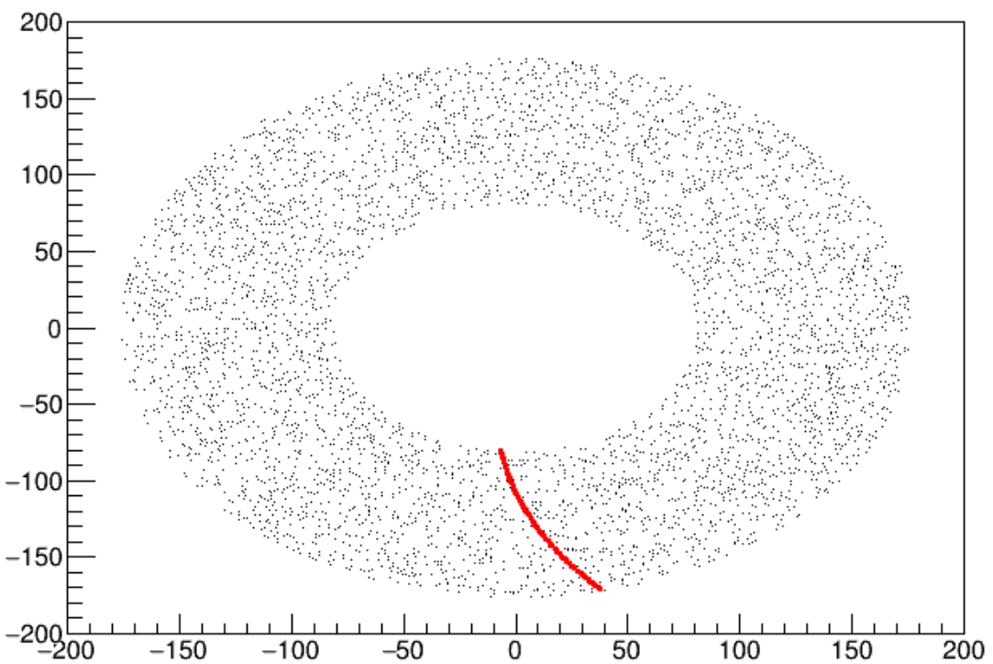
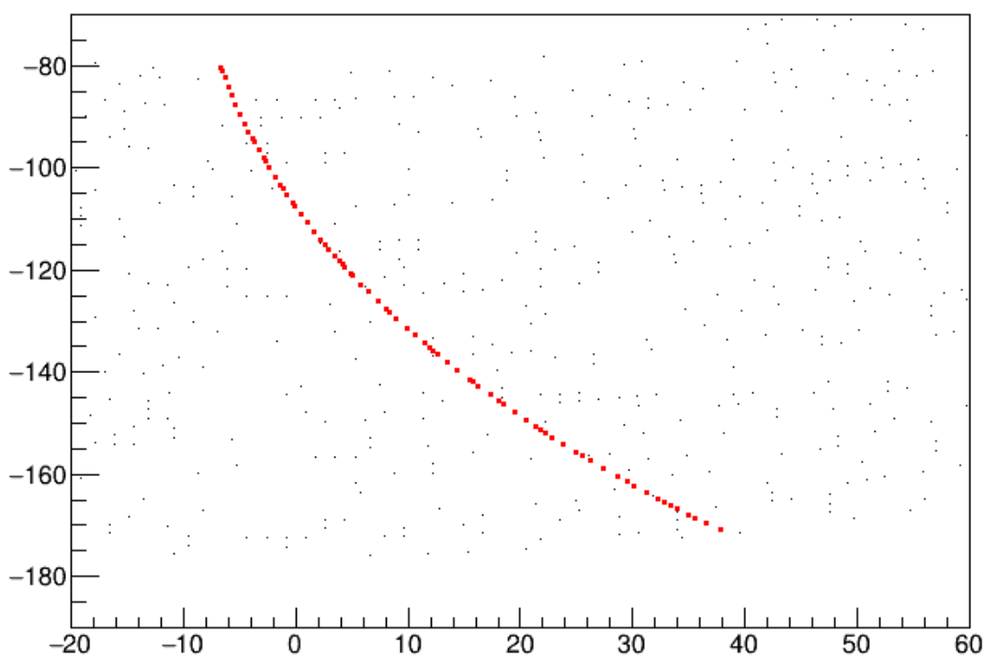
径迹效率：
Track Effiency = N1/N2
N1 is the number of track satisfying:
${chi}^{2}<400$
$N_{DC hits on track}>50$
N2 is the numbre of Silicon Track
20%的噪声水平(2GeV)

Slide 3
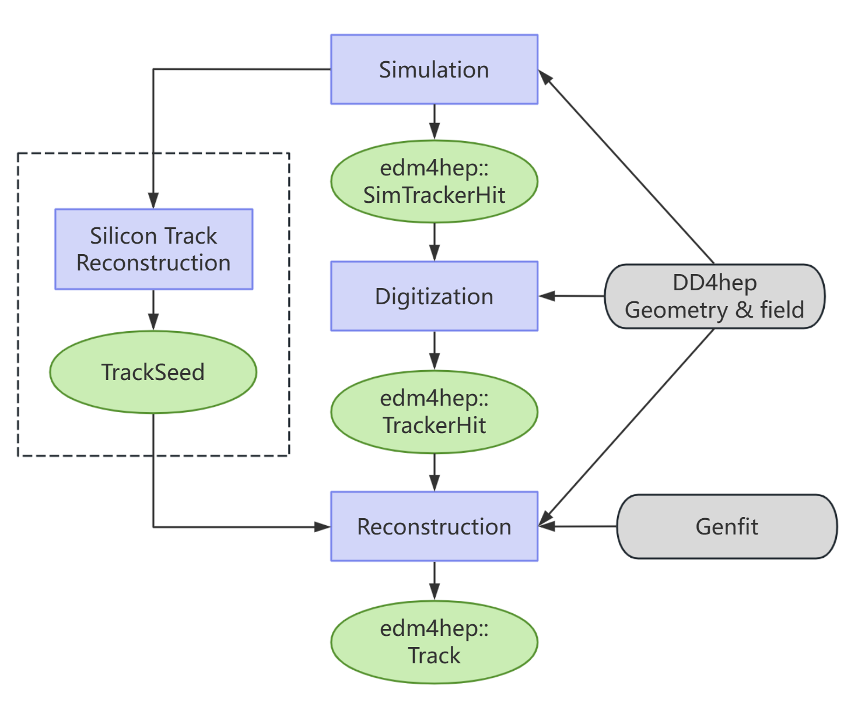
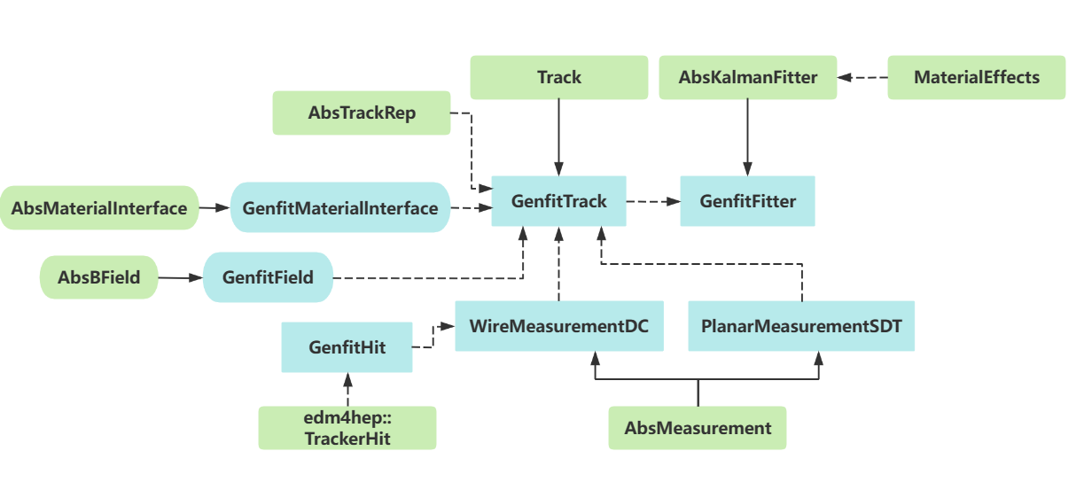
漂移室软件流程图
Genfit软件包的使用
重建算法流程

Slide 4
CEPC Drift chamber Simulation and Reconstruction

