Slide 1
工作进展
刘梦瑶

Slide 2
“好”径迹的定义：
BESIII：
径迹的极角出射角度满足$|cosθ|<0.93$
在轴丝超层至少有3个击中信号
在斜丝超层至少有2个击中信号
至少有一个重建击中对应真实带电径迹上的击中
STCF:
The track reconstruction efficiency is defined by the fraction of particles which have matched reconstructed tracks among the particles which have at least 5 simulated hits
Belle II(寻迹效率的定义):
A PR-track(the pattern recognition) is defined as matched to a given MC-track if the hit purity exceeds 66% and the hit efficiency exceeds 5%.

Slide 3
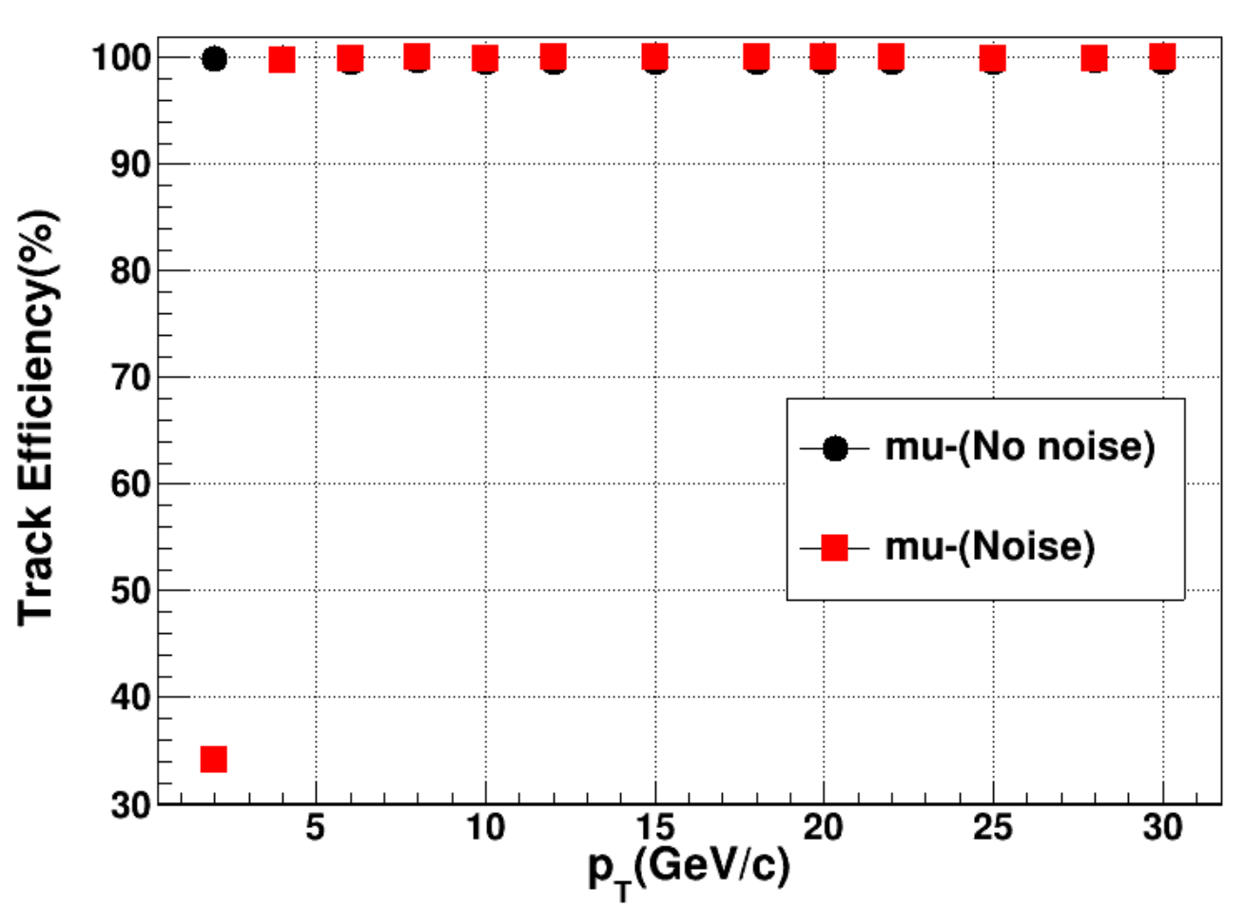
径迹效率：
Track Effiency = N1/N2
N1 is the number of track satisfying:
${chi}^{2}<400$
$N_{DC hits on track}>50$
N2 is the numbre of Silicon Track
20%的噪声水平(2GeV)
解决方案：
1. 多次拟合
2. 通过trackLength对径迹上击中排序

Slide 4
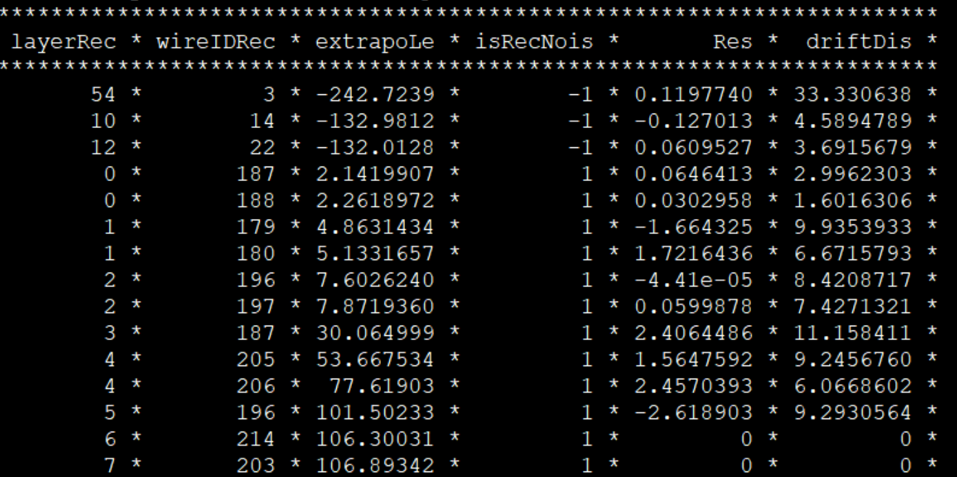
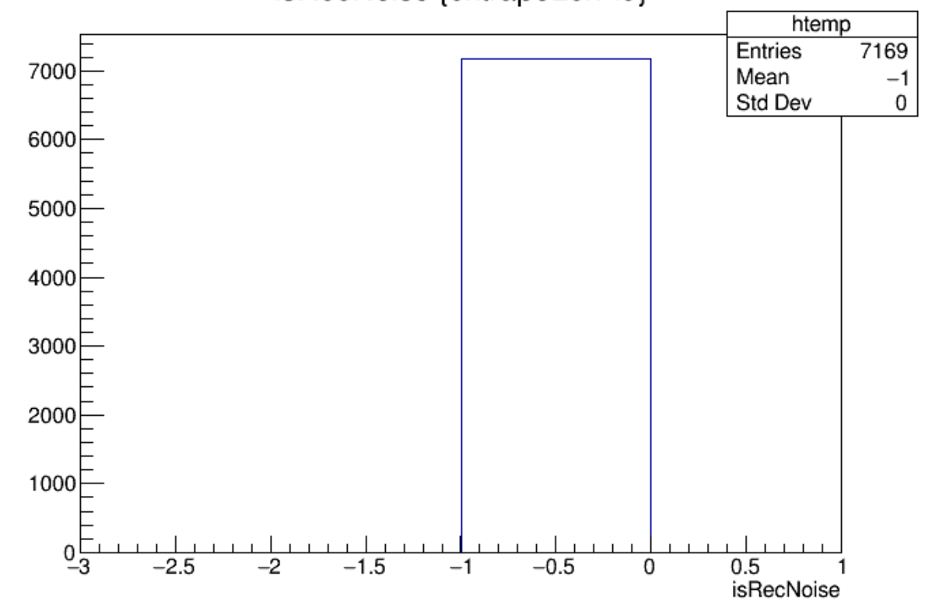
2GeV事例：

Slide 5
