Slide 1
新强子态产生和衰变
过程的研究
汇报时间：2023年9月6日
汇报人：吴琦

Slide 2
Content
02
04
Approach
Decay
process
01
05
03
Background
Summary
Production
process

Slide 3
01
Background

Slide 4
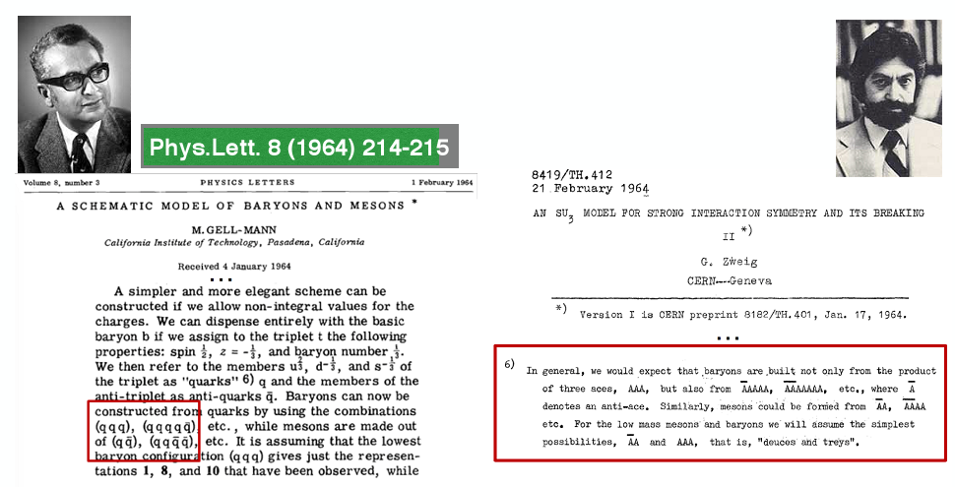
The concept of the multiquarks was proposed at the birth of Quark Model, even before the advent of QCD

Slide 5
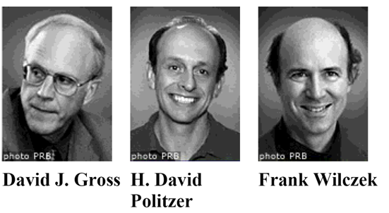
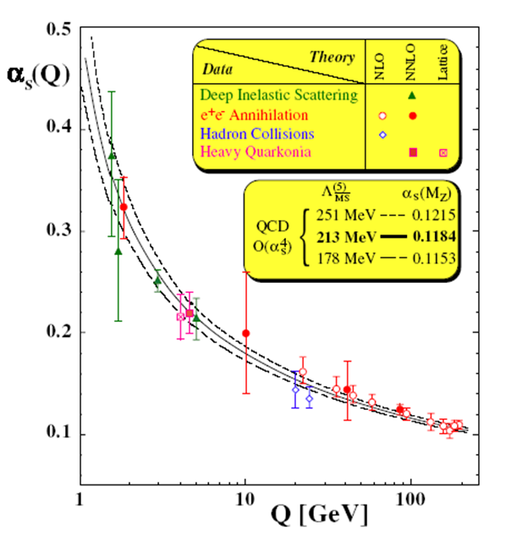
Quantum ChromoDynamics（QCD）
Normal hadron：
Meson
Baryon
QCD allows much richer
hadron spectrum
Asymptotic freedom
Hybrid Glueballs
Quark confinement
The interference between perturbation and non-perturbation becomes important in mid-energy area
Tetraquarks Hadronic molecule

Slide 6
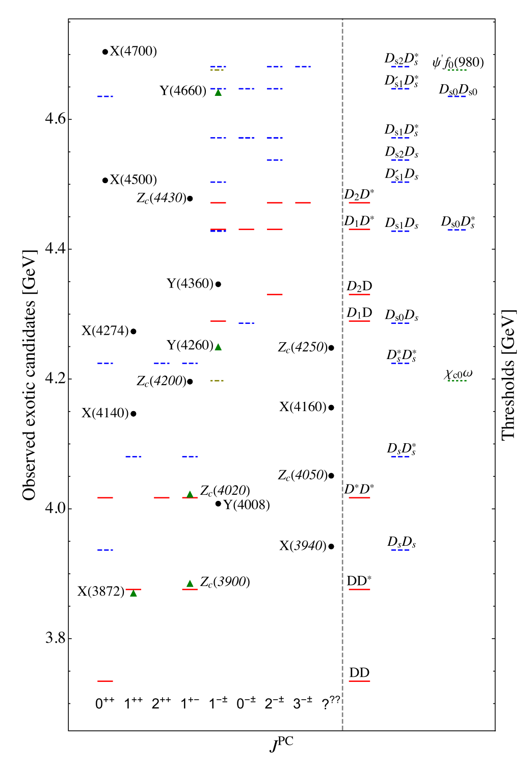
New hadron state—— Charmonium-like exotic candidates
Topics: XYZ, $P_{c}$, $P_{cs}$, $D_{s0}(2317)$, $D_{s1}(2460)$,X(2900), $T_{cc}$, X(6900)......
X：isoscalar states with other quantum numbers
Y：isoscalar states with $J^{PC}=1^{−−}$
Z：isovector states with other quantum numbers
Contents: Hadronic reaction, Spectroscopy, Internal structure
Hadronic reaction: decay, production and scattering
Spectroscopy: mass, width and pole position
Internal structure: multi-quark state, hadronic molecules, hybrid and glueballs
Methods: Experiment, EFT & Phenomenology and Lattice QCD
Experiment
EFT & Phenomenology
Lattice QCD
Guo et.al., RMP90(2018)015004

Slide 7
Reviews on the new hadron state
H.X. Chen, W. Chen, X. Liu, S.L. Zhu, The hidden-charm pentaquark and tetraquark states, Phys. Rept. 639(2016)1-121
H.X. Chen, W. Chen, X. Liu, Y.R. Liu, S.L. Zhu, A review of the open charm and bottom systems, Rept. Prog.Phys. 80(2017) 076201
Y.B.Dong, A. Faessler, V.E. Lyubovitskij, Description of heavy exotic resonances as molecular states using phenomenological lagrangians, Prog.Part.Nucl.Phys.94(2017)282
R.F.Lebed, R.E. Mitchell and E.S.Swanson, Prog.Part.Nucl.Phys.93(2017)143-194
F.K. Guo, C.Hanhart, Ulf-G. Meissner, Q. Wang, Q. Zhao, B.S. Zou, Hadronic molecules, Rev.Mod.Phys.90(2018)015004
Y.R.Liu, H.X.Chen, W. Chen, X.Liu, S.L. Zhu, Pentaquark and Tetraquark states, Prog.Part. Nucl. Phys, 107(2019)237
R.M.Albuquerque, J.M.Diak, K.P.Khemchandani,A.Martinez Torres, F.S. Navarra, M.Nielsen and C.M. Zanetti, J.Phys.G46(2019)093002
R.M.Yamaguchi, A.Hosaka,S.Takeuchi and M.Takizawa, J.Phys.G47(2020)053001
F.K. Guo, X.H.Liu, S.Sakai, Threshold cusps and triangle singularities in hadronic reactions, Prog.Part.Nucl. Phys. 112(2020)103757
N.Brambilla, S.Eldelman, C.Hanhart,A.Nefediev, C.P.Shen, C.E.Thomas,A.Vairo and C.Z. Yuan, Phys.Rept.873(2020)1-154

Slide 8
02
Approach

Slide 9
Nonrelativistic effective field theory
Guo, Hanhart, Meissner. PRL 103, 082003 $ψ^{′}→J/ψπ^{0}(η)$
Guo et al. PRD 83, 034013 S/P—S/P wave charmonium transitions
For most heavy quarkonium transitions, notice that
$$M_{Q\overline{Q} }−2M_{Q\overline{q}}≪M_{Q\overline{q}}$$
As a result, the intermediate heavy mesons are nonrelativistic with a small velocity
$$v∼\sqrt{{|M}_{Q\overline{Q} }−2M_{Q\overline{q}}|/M_{Q\overline{q}}}≪1$$
Thus, one may construct a power counting in terms of v.
The three-momentum scales as $v$,
The kinetic energy scales as $v^{2}$,
Power counting rule

Slide 10
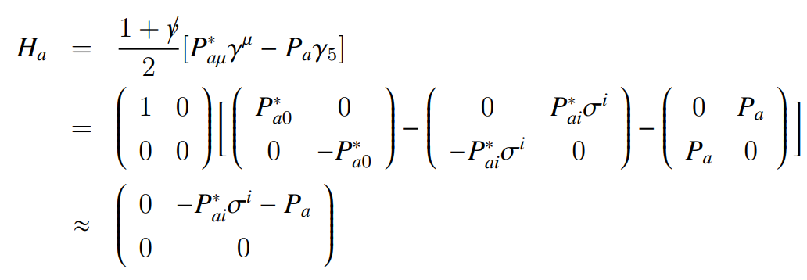
The Feynman propagator in the nonrelativistic expansion has the form
and thus it scales as $v^{−2}$,
The S-wave momentum independent coupling scales as $v^{0}$,
The P-wave coupling scales as $v$.
Effective field
Heavy-light mesons in two-component notation
Hu Jie et al. PRD 73, 054003

Slide 11
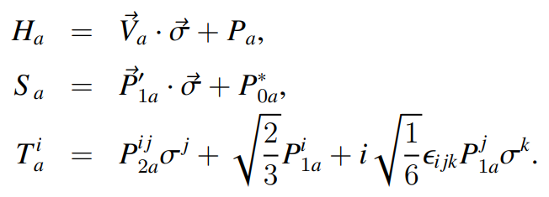
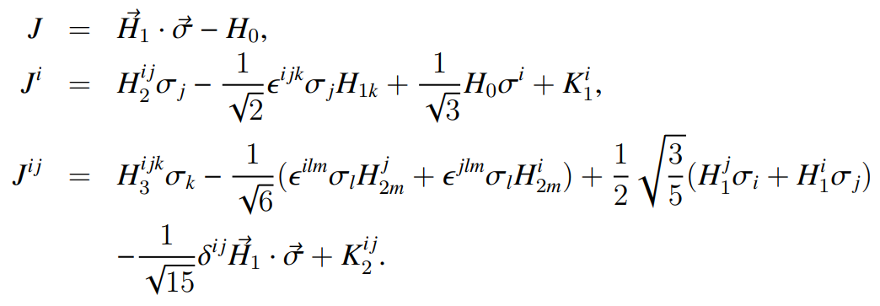
Effective field: Heavy-light meson
Effective field: Heavy quarkonium

Slide 12
Effective Lagrangian approach
A non-perturbative method widely used in the production and decay of hadron;
The effective Lagrangian can be obtained by considering QCD symmetry of effective theory, i.e. HQET, ChPT, HHEFT;
The abundance of coupling constants and parameters appearing in the Lagrangian. Rely on theoretical information coming, i.e. QCD sum rules, potential models, lattice QCD.
Decay amplitude

Slide 13
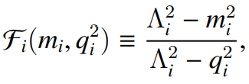
Hadron loop model
Form factor
Form factors:
Internal structures of the involved particles
Off shell effects
Remove the divergence of the loop integrals
Monopole
Dipole
$Λ=m+αΛ_{QCD}$ $α$: model parameter

Slide 14
Transition matrix elements of decay $A→BC$
Hadron loop contributions are evaluated in hadron level
Interactions are described by effective Lagrangians
Effective Lagrangians are constructed based on heavy quark symmetry & chiral symmetry

Slide 15
Applications of hadron loop model
B meson decay:
$B→Kπ$ Gronau Michael and Rosner Jonathan L. PRD 57, 6843(1998)
Neubert Matthias. PLB 424, 152 (1998)
Falk Adam F. et al. PRD 57, 4290(1998)
$B→KK$ Gronau Michael and Rosner Jonathan L. PRD 58, 113005(1998)
$B^{−}→K^{−}χ_{c0}$ Colangelo P., De Fazio F. and Pham T. N. PLB 542, 71 (2002)
$B^{−}→K^{−}h_{c}$ Colangelo P., De Fazio F. and Pham T. N. PRD 69, 054023(2002)

Slide 16
$ρπ$ puzzle:
$ρπ, K^{∗}K$
$ψ^{′}→K^{∗}K$ Gu Y. F. and Tuan S. F. Mod. Phys. Lett A10, 615(1995)
$J/ψ(ψ^{′})→ρπ$ Li Xue-Qian et.al. PRD 55, 1421(1997)
$ψ(3770)$ non $D\overline{D}$ decay:
$J/ψ(ψ^{′})→VP$ Zhang Yuan-Jiang et.al. PRL 102, 172001(2009)
Li Gang, Liu Xiao-hai, Wang Qian et al. PRD 88, 014010 (2013)
Liu Xiang, Zhang Bo and Li Xue-Qian. PLB 475, 441 (2009)
Zhao Qiang, Li Gang and Chang Chao-His. CPC 34, 299 (2010)

Slide 17
Evasion of helicity selection rule:
$χ_{c1}→VV,χ_{c2}→VP$ Liu Xiao-Hai and Zhao Qiang. PRD 81, 014017 (2010)
Chen Dian-Yong et al. PRD 81, 074006 (2010)
Charmonium decaying Liu Xiao-Hai and Zhao Qiang. JPG 38:035007 (2011)
to baryon anti-baryon Pairs
$χ_{c1}^{′}→VV,χ_{c2}^{′}→VP$ Wang Yan, Wu Qi, Li Gang et al. EPJC 80, 475 (2020)
Isospin Violation:
$ψ\left(3770\right)→J/ψπ$ Guo Ze-kun, Narison Stephan et al. PRD 85, 114007 (2012)
$φ→ωπ^{0}$ Li Gang, et.al. PRD 77:014010 (2008)
Double charm baryon:
$Ξ_{cc}^{++}→Λ_{c}^{+}K^{−}π^{+}π^{+},Ξ_{c}^{+}π^{+}$ Yu Fu-Sheng, et al. CPC 42(5):051001 (2018)

Slide 18
03
Production
process

Slide 19
Process $Υ\left(5S,6S\right)→ Z_{b}^{\left(′\right)} π$
Wu, Chen, Guo, Phys. Rev. D 99, 034022 (2019)

Slide 20
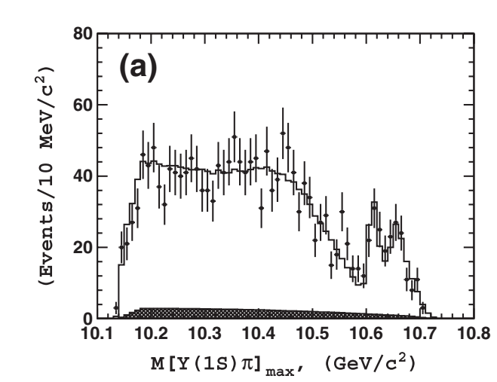
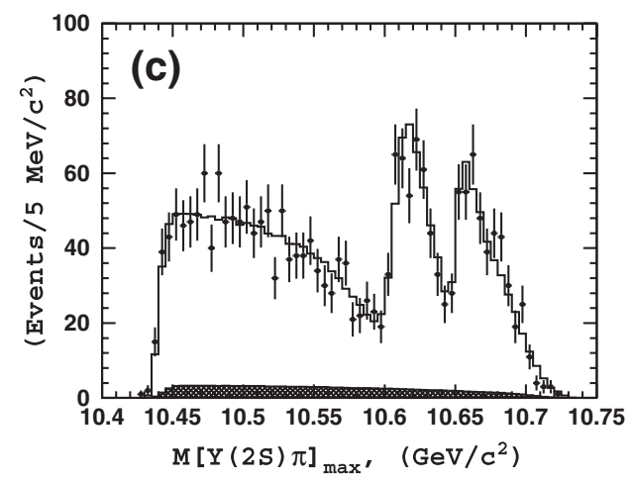
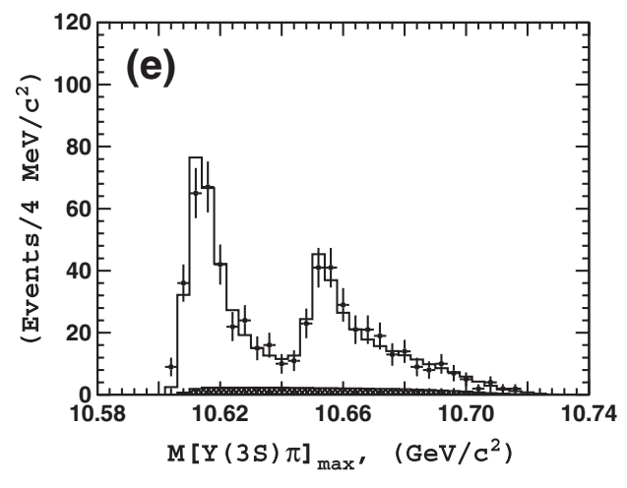
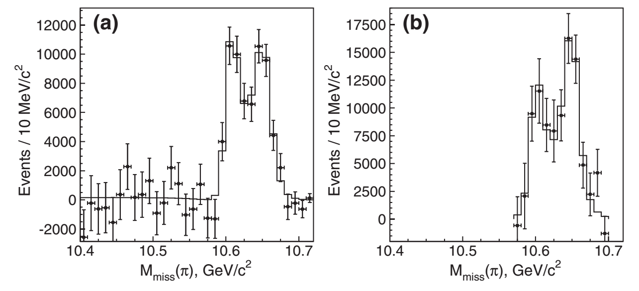
$Z_{b}\left(10610\right)$and $Z_{b}\left(10650\right)$: Experiment
$$Υ\left(5S\right)→Υ\left(nS\right) π^{+} π^{−}\left(n=1,2,3\right)$$
$$Υ\left(5S\right)→ h_{b}\left(mP\right)π^{+} π^{−}\left(m=1,2\right)$$
PRL 108, 122001(2012)@Belle

Slide 21
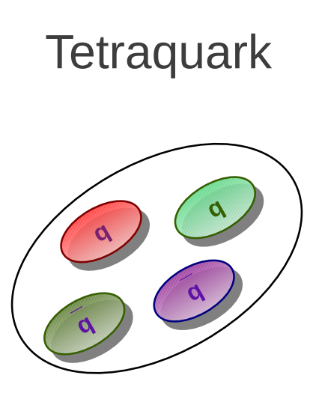
Structure of $Z_{b}$ and $Z_{b}^{′}$
arXiv:1106.2284 (chromomagnetic interaction)
PRD 85, 074014 (2012) (QCD sum rules)
PRD 85, 054011 (2012) (effective diquark-antidiquark Hamiltonian )
Nucl. Phys. A 930, 63 (2014) (QCD sum rules)
EPJC 76, 356 (2016) (diquark–antidiquark framework )

Slide 22
Effective Lagrangian
J.Phys.G 40, 015002 (2013)
PRD 89, 074029 (2014)
PRD 87, 034020 (2013)
PRD 96, 014035 (2017)
Non-resonance
explanation
ISPE mechanism
PRD 84, 094003 (2011)
Chin. Phys. C38, 053102(2014)
Cusp effects
Europhys. Lett. 96, 11002(2011)
QCD sum rules
EPJC 74, 2891 (2014)
EPJC 74, 2963 (2014)
Chiral quark model
J.Phys.G 40, 015003 (2013)
J.Phys.G 39, 105001 (2012)

Slide 23
Branching ratio of $Υ\left(5S\right)→ Z_{b}^{\left(′\right)}π \text{from} \text{Exp}\text{.}$
Consistent with each other
$B\left(Υ\left(5S\right)→ Z_{b}^{\left(′\right)}π\right)∼{10}^{−2}$

Slide 24
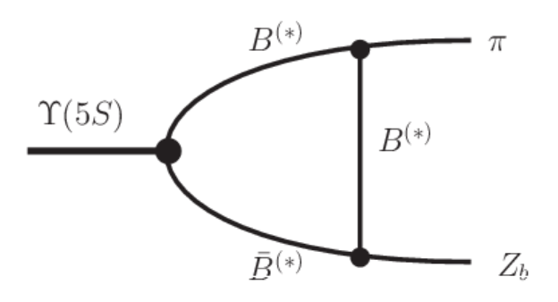
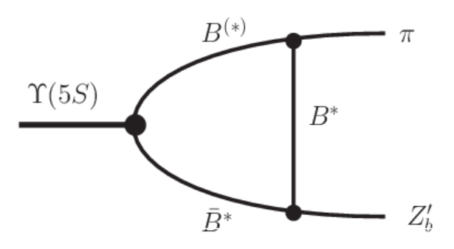
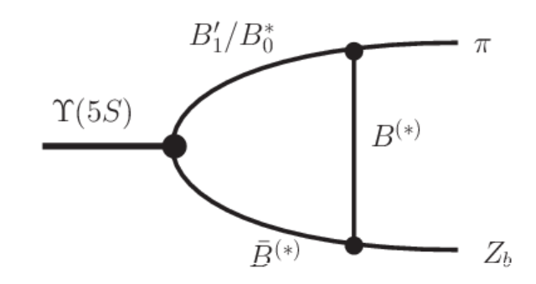
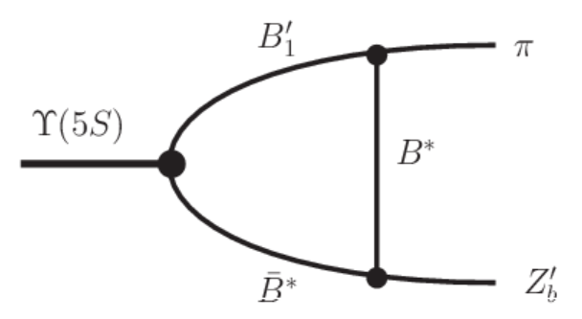
Two types of Meson loop contribution
$$Υ\left(5S\right)→ B^{(∗)}{\overline{B}}^{(∗)}→ Z_{b}^{(′)} π$$
$$Υ\left(5S\right)→B_{1}^{′}{\overline{B}}^{(∗)}/B_{0}^{∗}{\overline{B}}^{∗}→ Z_{b}^{(′)} π$$

Slide 25
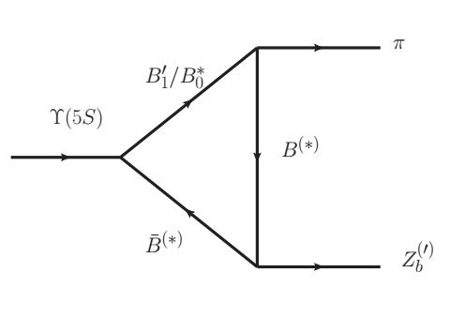
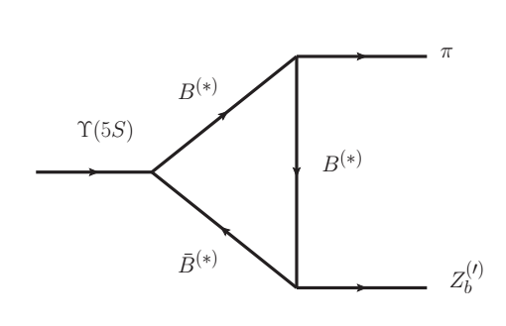
Power counting rule
S-wave
Nonrelativistic
P-wave
S-wave
S-wave
P-wave
S-wave
The ratio of two types meson loop?

Slide 26
$g_{2}$and $g_{2}^{′}$ cannot be determined using the available data at present
The contributions from $B^{(∗)}{\overline{B}}^{(∗)}$loops are two orders of magnitude smaller than the experimental data and can be neglected.
The $B_{1}^{′}{\overline{B}}^{(∗)}/B_{0}^{∗}{\overline{B}}^{∗}$ meson loops show the possibility to be the dominant production mechanism.

Slide 27
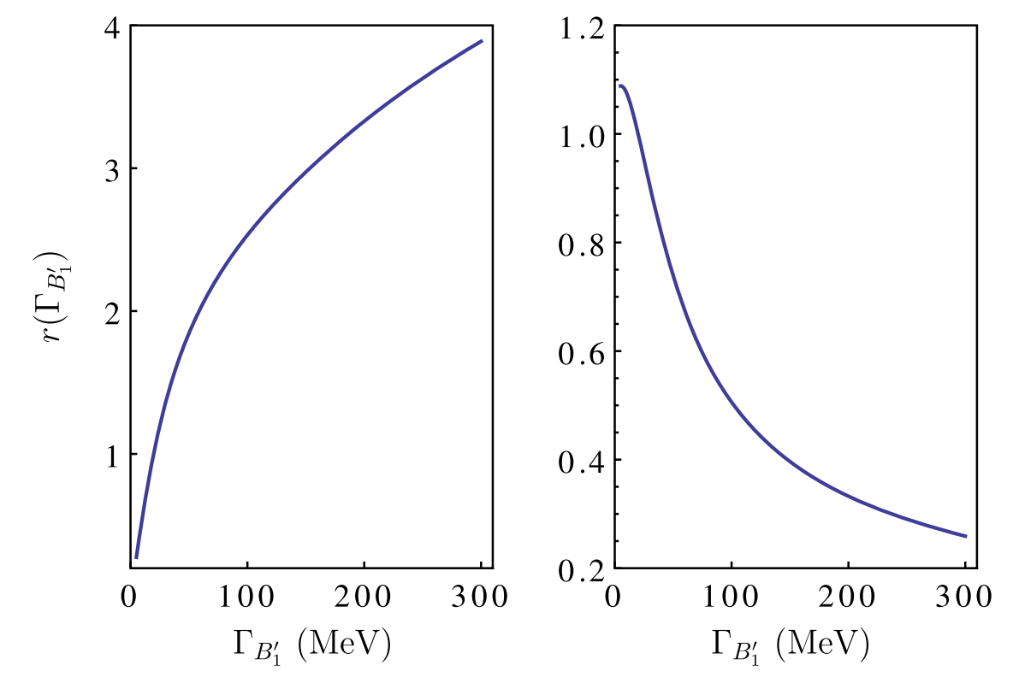
Width effect
The $B_{1}^{′}$ width depends on the coupling $h$
The same coupling enters the $B_{0}^{∗}Bπ$and $B_{1}^{′}B^{∗}π$vertices
The $B_{1}^{′}$width effect depends on their competition
Proportional to $h^{2}$

Slide 28
Process $B_{c}^{+}→ Z_{c}{\left(3900\right)}^{+}/Z_{c}{\left(4020\right)}^{+}π^{0}$
Wu, Chen, Xue, Li, Eur. Phys. J. C 79, 265 (2019)

Slide 29
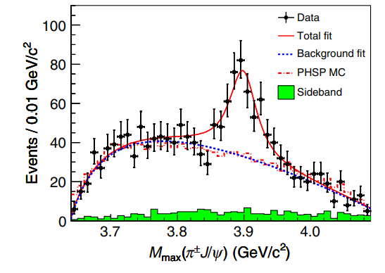
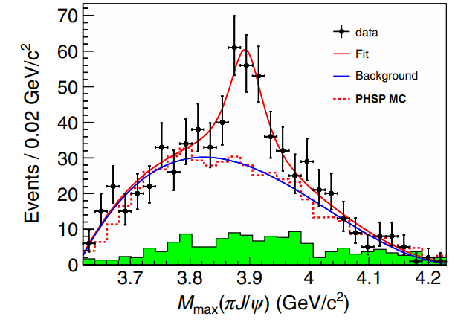
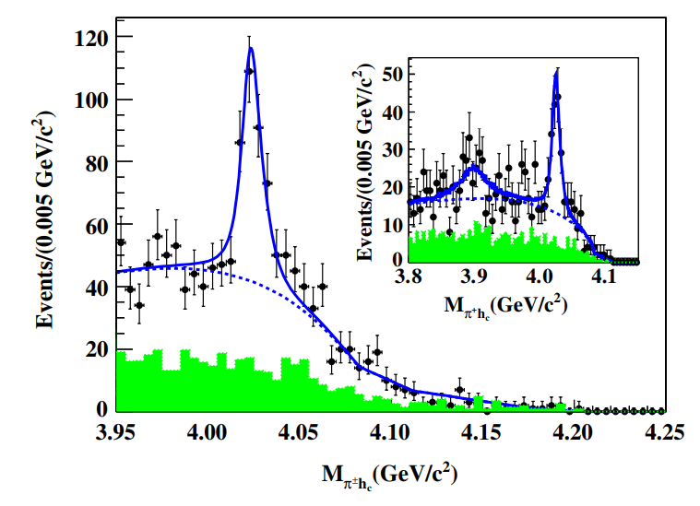
$Z_{c}\left(3900\right)$and $Z_{c}\left(4020\right)$: Experimental information
PRL 110, 252001(2013)@BESIII
PRL 110, 252002(2013)@Belle
PRL 111, 242001(2013)@BESIII
$$e^{+} e^{−}→π^{+} π^{−} h_{c}$$
$$e^{+} e^{−}→π^{+} π^{−} J/ψ$$

Slide 30
Production of $Z_{c}$ from different processes (Theory)
$Y\left(4260\right)→Z_{c}π$ D.Y. Chen, Y.B. Dong, M.T. Li, W.L.Wang EPJA 52,310 (2016)
$γ p→Z_{c}^{+} n$ Q.Y. Lin, X. Liu, H.S. Xu PRD 88, 114009 (2013) $π p→ Z_{c} p$ Y. Huang, J. He, et.al PRD 93, 034022 (2016)
Production of $Z_{c}$ from b-flavor hadron (Exp.)
$b-flavor hadron→J/ψ{ π}^{+}π^{−}$+anything
V.M. Abazov et al. [D0 Collaboration] PRD 98, 052010(2018)
$B→K J/ψππ$
S.K. Choi et al. [Belle Collaboration] PRL 91, 262001 (2003) $B→{K D}^{∗}\overline{D}$
T. Aushev et al. [Belle Collaboration] PRD 81, 031103 (2010)
observed
no signal

Slide 31
Motivation:
Searching for the source of $Z_{c}$ production in the semi-inclusive b-flavor hadron decay.
Testing the production rates of $Z_{c}$ and $Z_{c}^{′}$ whether still similar in b-flavored hadron decay.
Charmed meson loop
A charmonium and a
light meson
$Br[B_{c}→two charmed mesons]∼10^{−6}$
Z. Rui, et. al. PRD 86, 074019 (2012)
M.A. Ivanov, et. al, PLB 555,189 (2003).
$B_{c}^{+}→D_{\left(s\right)}^{\left(∗\right)+} {\overline{D}}^{∗0}$ no signal LHCb, NPB 930, 563(2018)
$B_{c}^{+}→c\overline{c}+ρ^{+}$: CKM enhanced mode
$Br[B_{c}^{+}→J/ψ(h_{c})+ρ^{+}]∼10^{−3}$
C.H. Chang, et.al, PRD 65, 014017 (2002)

Slide 32
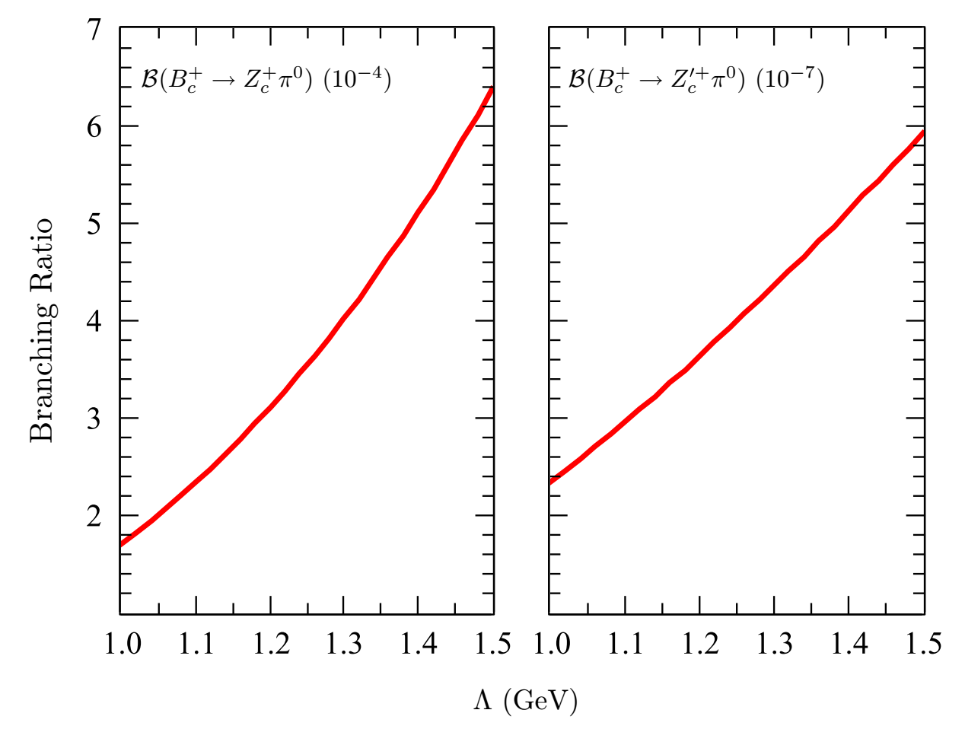
Conclusion:
$Br\left(B_{c}^{+}→ Z_{c}^{+} π^{0}\right)=\left(1.71− 6.37 \right)×{10}^{−4}$, which is large enough to be detected in further exclusive $B_{c}$decays.
$Br\left(B_{c}^{+}→ Z_{c}^{′+} π^{0}\right)=\left(2.34−5.92\right)×{10}^{−7}$, which is about 3 order smaller than the one of $B_{c}^{+}→ Z_{c}^{+} π^{0}$.
There is a strong suppression of $Z_{c}^{′}$ production from $B_{c}$ decay.

Slide 33
Process $Λ_{b}→ P_{c} K$
Wu, Chen, Phys. Rev. D 100, 114002 (2019)

Slide 34
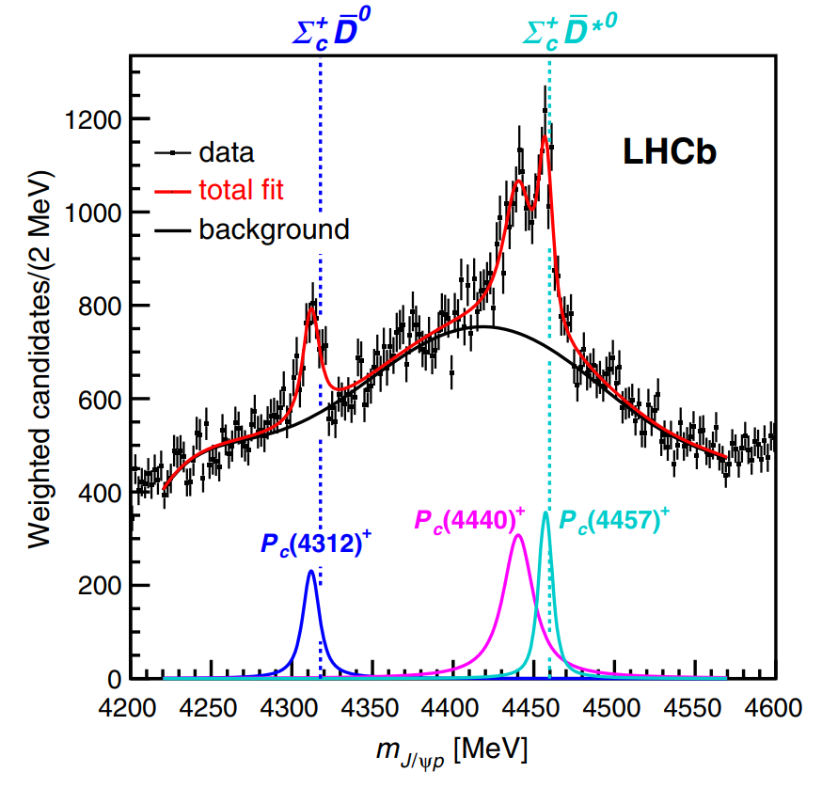
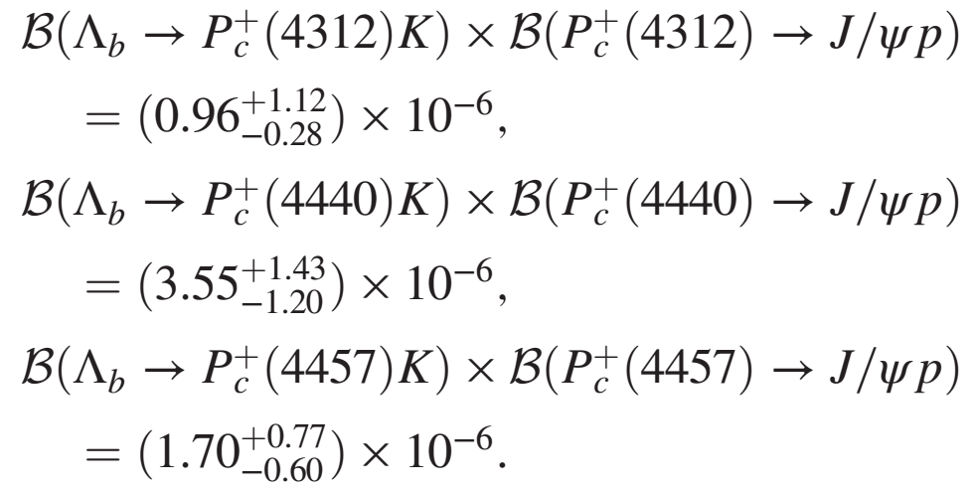
$P_{c}\left(4312\right)$, $P_{c}\left(4440\right)$and${ P}_{c}\left(4457\right)$
$$R≡\frac{B\left(Λ_{b}→P_{c} K\right)×B\left(P_{c}→J/ψ p\right)}{B\left(Λ_{b}→J/ψ p K\right)}$$
PRL 122, 222001(2019)@LHCb

Slide 35
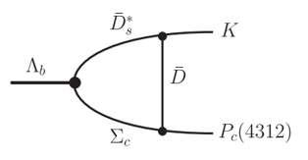
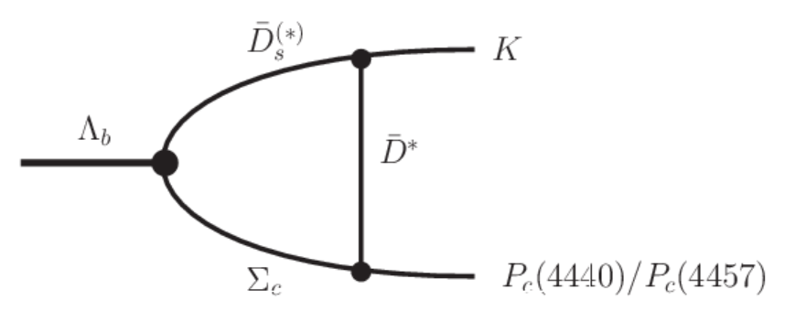
$Quark$ level
$P_{c}\left(4312\right)$ $Σ_{c}\overline{D}$ $J^{P}=1/2^{−}$
$P_{c}\left(4440\right)$ $Σ_{c}{\overline{D}}^{∗}$ $J^{P}=1/2^{−}$
$P_{c}\left(4457\right)$ $Σ_{c}{\overline{D}}^{∗}$ $J^{P}=3/2^{−}$
Through analyze from quark level, identify the dominate production mechanism.
Simplify the estimation at hadron level by
$$〈 KP_{c}|H|Λ_{b}〉=\sum_{B,M}{ }〈KP_{c}|H_{T}|BM〉〈BM|H_{W}|Λ_{b}〉$$
$Hadron$ level

Slide 36
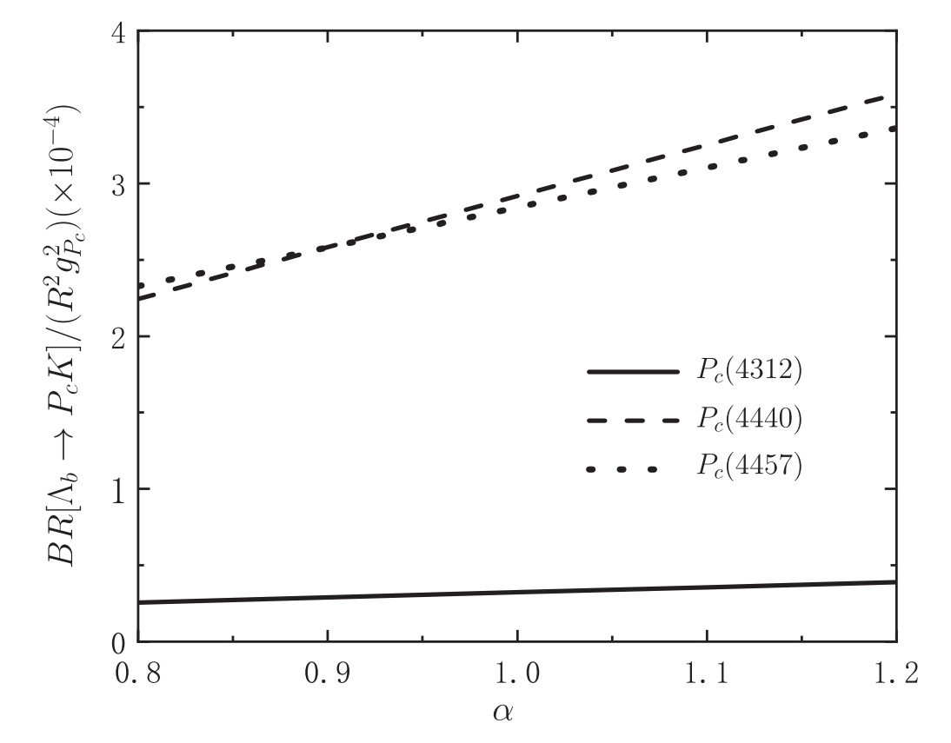
R is a suppression ratio defined by
$f_{i}^{A,V}\left(Q^{2}\right)=R F_{i}^{A,V}\left(Q^{2}\right), \{i=1,2,3\}$,
The branching ratios of $Λ_{b}→P_{c}K$ over $R^{2}g_{P_{c}}^{2}$ is of order $10^{−4}$ for $P_{c}\left(4440\right)$ and $P_{c}\left(4457\right)$ and $10^{−5}$ for $P_{c}\left(4312\right)$.
$Λ_{b}→Σ_{c}$ $Λ_{b}→Λ_{c}$

Slide 37
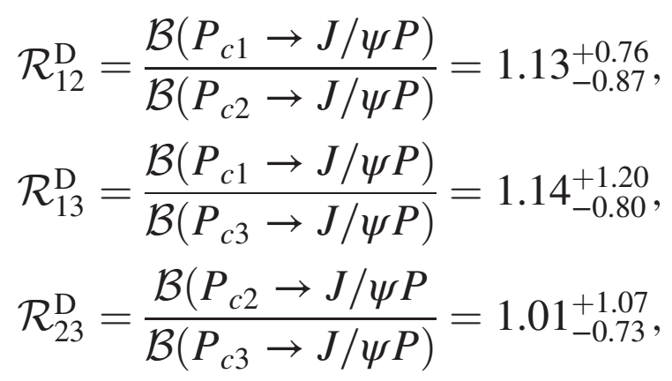
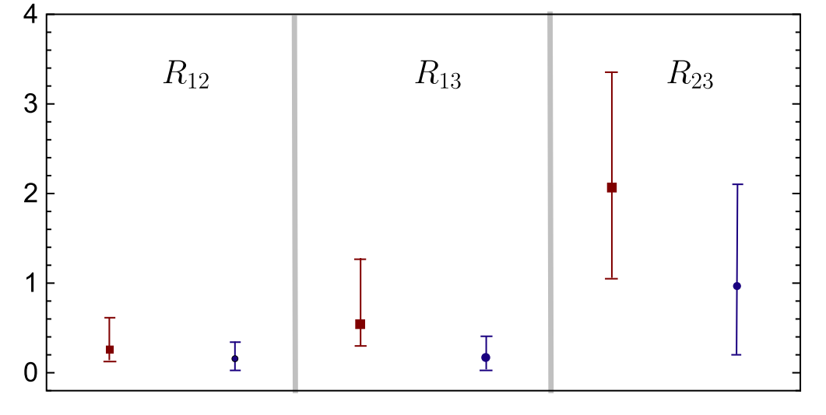
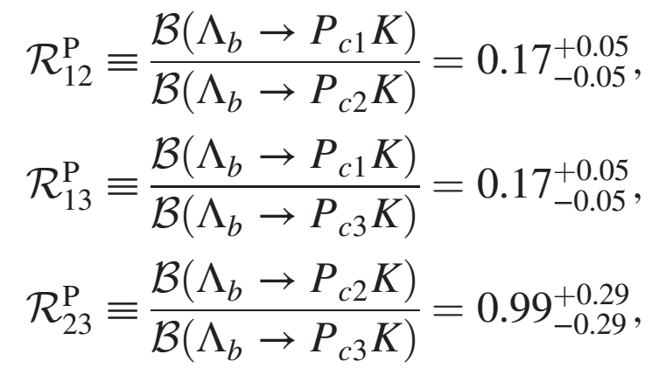
Cheng-Jian Xiao et.al. Phys. Rev. D 100,014022 (2019)
${g_{Pc}:2.25}_{−0.07}^{+0.01}, {1.72}_{−0.09}^{+0.15}$ $, {1.77}_{−0.06}^{+0.04}$
$g_{P_{c1}}/g_{P_{c2}}= {1.25}_{−0.03}^{+0.02},g_{P_{c1}}/g_{P_{c3}}={1.22}_{−0.01}^{+0.02},g_{P_{c2}}/g_{P_{c3}}= {0.98}_{−0.03}^{+0.04}$
$$R_{ij}=R_{ij}^{P}×R_{ij}^{D}$$
Conclusion: consistent with the experimental data from LHCb

Slide 38
Process $Ξ_{b}→ P_{cs} K$
Wu, Chen, Ji. CPL (2021)

Slide 39
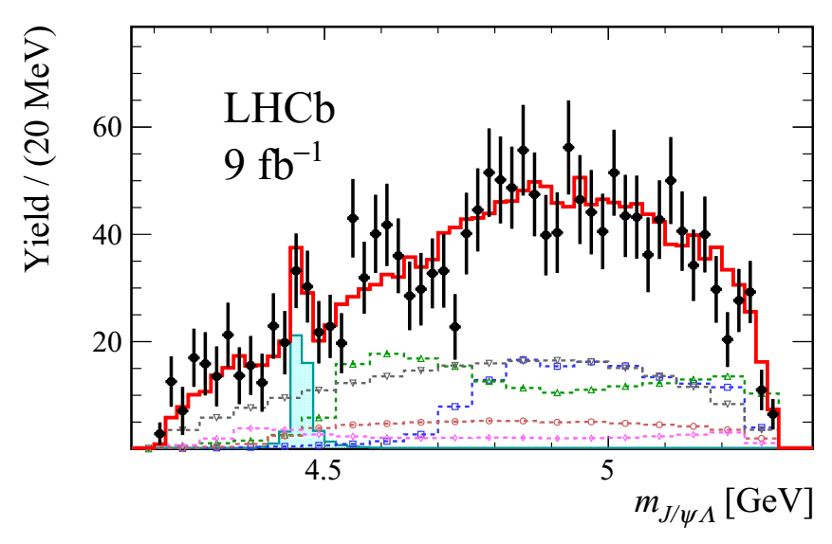
The prediction of the existence of the hidden-charm pentaquark states with strangeness
J. Hofmann and M. F. M. Lutz, NPA 763, 90 (2005)
J. J. Wu, R. Molina, E. Oset and B. S. Zou, PRC 84, 015202 (2011)
B. Wang, L. Meng and S. L. Zhu, PRD 101, no.3, 034018 (2020)
…….
The observation of
$P_{cs}^{0}(4459)$
$$Ξ_{b}^{−}→J/ψΛ K^{−}$$
R. Aaij et al. [LHCb Collaboration], arXiv:2012.10380 [hep-ex].

Slide 40
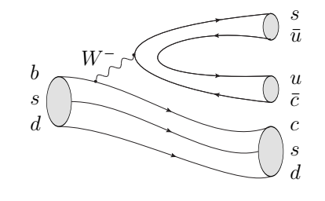
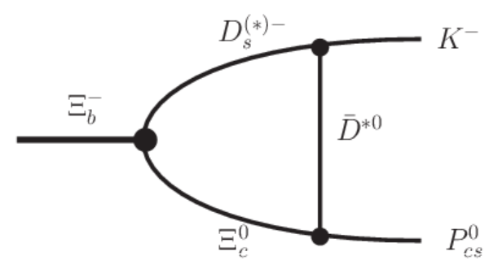
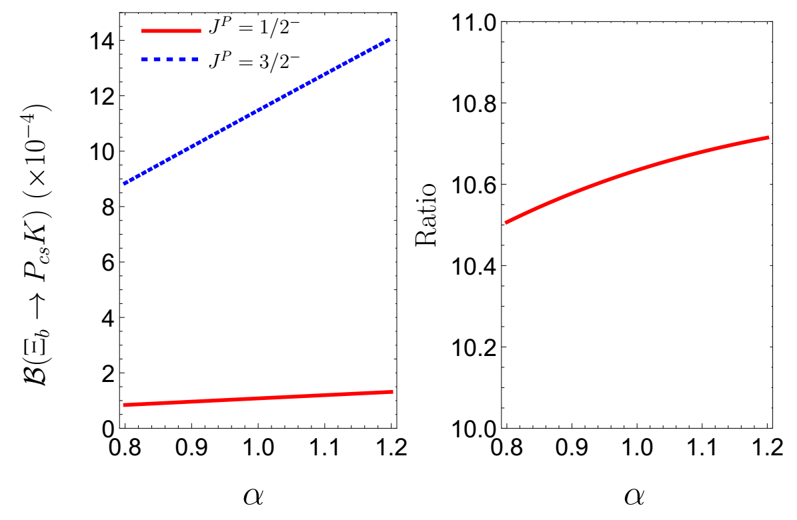
$P_{cs}{\left(4459\right)}^{0}$:
19 MeV below the threshold of $Ξ_{c }{\overline{D}}^{∗}$.
Molecular state:
$Ξ_{c }{\overline{D}}^{∗}$ with $J^{P}=1/2^{−}$ or $J^{P}=3/2^{−}$.
Motivation:
Test the molecular interpretations of $P_{cs}\left(4459\right).$
Verify the quantum number of $P_{cs}$ state in the molecule ansatz.

Slide 41
$J^{P}=1/2^{−}\text{:} \left(0.84∼1.31\right)×{10}^{−4}$
$J^{P}=3/2^{−}\text{:} \left(8.85∼14.1\right)×{10}^{−4}$
$$Br\left(Ξ_{b}→ P_{cs} K\right)∼10^{−4}$$
The α dependences are found very similar for two different assignments.
Ratio: 10.6. A molecular state of $Ξ_{c }{\overline{D}}^{∗}$with $J^{P}=3/2^{−}$ is more simply produced from $Ξ_{b}$ decay.

Slide 42
R. Aaij et al. [LHCb Collaboration], arXiv:2012.10380
R. Aaij et al. [LHCb], PLB 772 (2017) F. Abe et al. [CDF], PRD 55 (1997) R. Aaij et al. [LHCb], PRD 99 (2019)
Considering the small width of $P_{cs}$
$B \left(Ξ_{b}→ P_{cs} K\right)×B\left(P_{cs}→J/ψΛ\right)≃B(Ξ_{b}→ P_{cs} K→ J/ψ Λ K)$
$B\left(P_{cs}→J/ψΛ\right)={10}^{−2}∼{10}^{−1}$
$B\left(P_{cs}→J/ψΛ\right)$: ${10}^{−2}$ for $J^{P}=1/2^{−}$, ${10}^{−1}$ for $J^{P}=3/2^{−}$
Consistent with the above analysis!
C. W. Shen, J. J. Wu and B. S. Zou, PRD 100, 056006 (2019)

Slide 43
04
Decay
process

Slide 44
Process $Z_{b}^{\left(′\right)}→Υ\left(1D\right) π$
Wu, Chen, Matsuki. Phys. Rev. D 102, 114037 (2020)

Slide 45
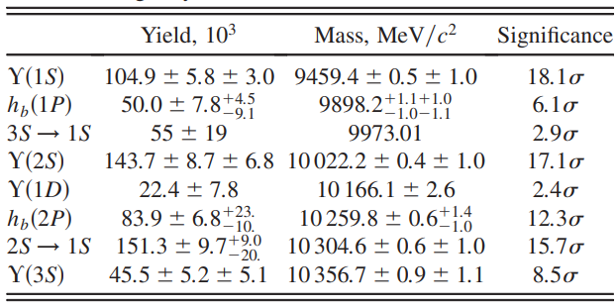
PRL 108, 032001(2012)@Belle
$$Br\left(Υ\left(5S\right)→Υ\left(1D\right)π^{+} π^{−}\right)∼1× {10}^{−3}$$
$$Br \left(Υ\left(5S\right)→Υ\left(1S\right) π^{+} π^{−}\right)= \left(5.3±0.6\right)× {10}^{−3}$$
$$Br \left(Υ\left(5S\right)→Υ\left(2S\right) π^{+} π^{−}\right)= \left(7.8±1.3\right)×{10}^{−3}$$
PRD 98, 030001(2018)@PDG

Slide 46
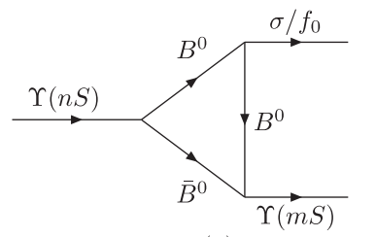
$$Υ\left(5S\right)→Υ\left(nS\right) π^{+}π^{−},$$
$$n=\{1,2,3\}$$
Scalar meson heavy quark limit
Tensor meson phase space
$$Υ\left(5S\right)→Υ\left(1D\right)π^{+}π^{−}$$
D. Y. Chen, J. He, X. Q. Li, and X. Liu. PRD 84, 074006(2011)
$Υ\left(2S\right) anomaly$ : $Z_{b}^{\left(′\right)}$ plays important role
C. Meng and K. T. Chao . PRD 77, 074003(2008)
Conclusion:
$Υ\left(5S\right)→Υ\left(nS\right) π^{+}π^{−}\text{:}$
$$\text{meson} \text{loop} \text{contributions} \text{and} Z_{b}^{\left(′\right)}$$
$Υ\left(5S\right)→Υ\left(1D\right) π^{+} π^{−}$: $Z_{b}^{\left(′\right)}$
Could be well reproduced with meson loop effect

Slide 47
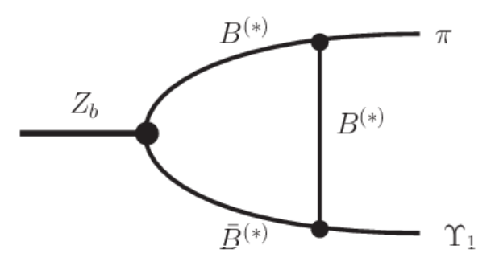
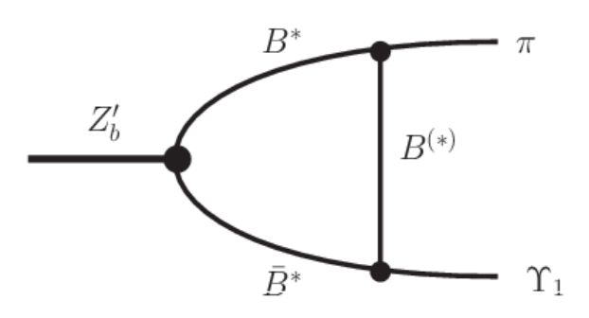
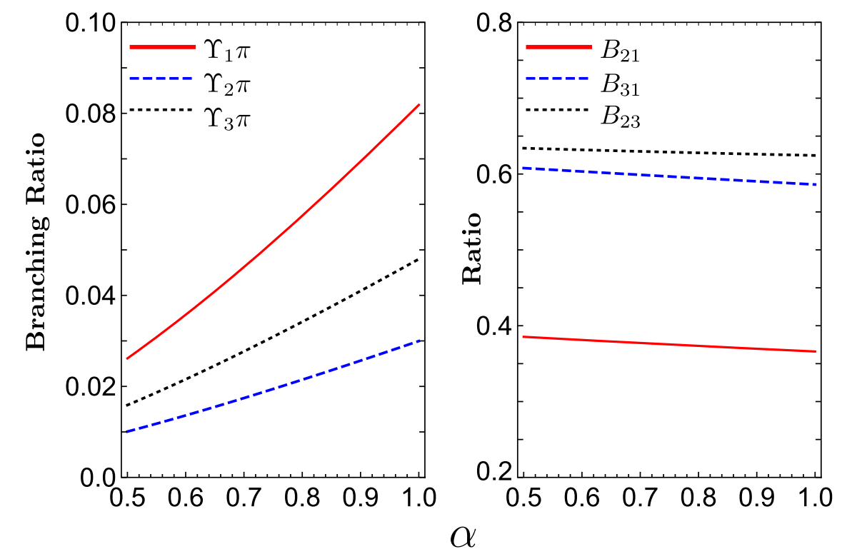
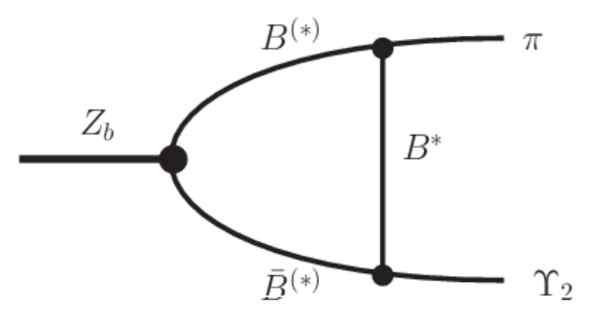
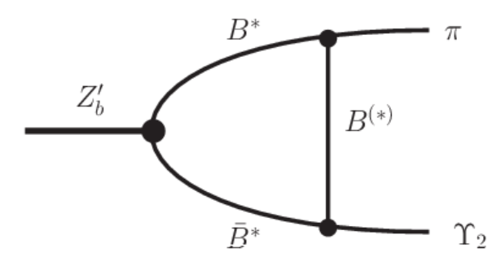
$$Z_{b}→Υ_{J}(1D) π$$
The ratio of branching ratios are model independent

Slide 48
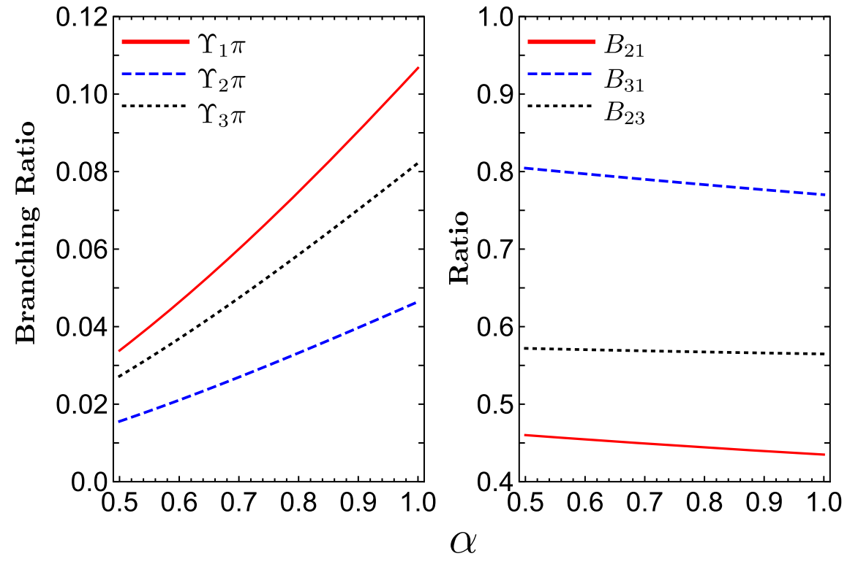
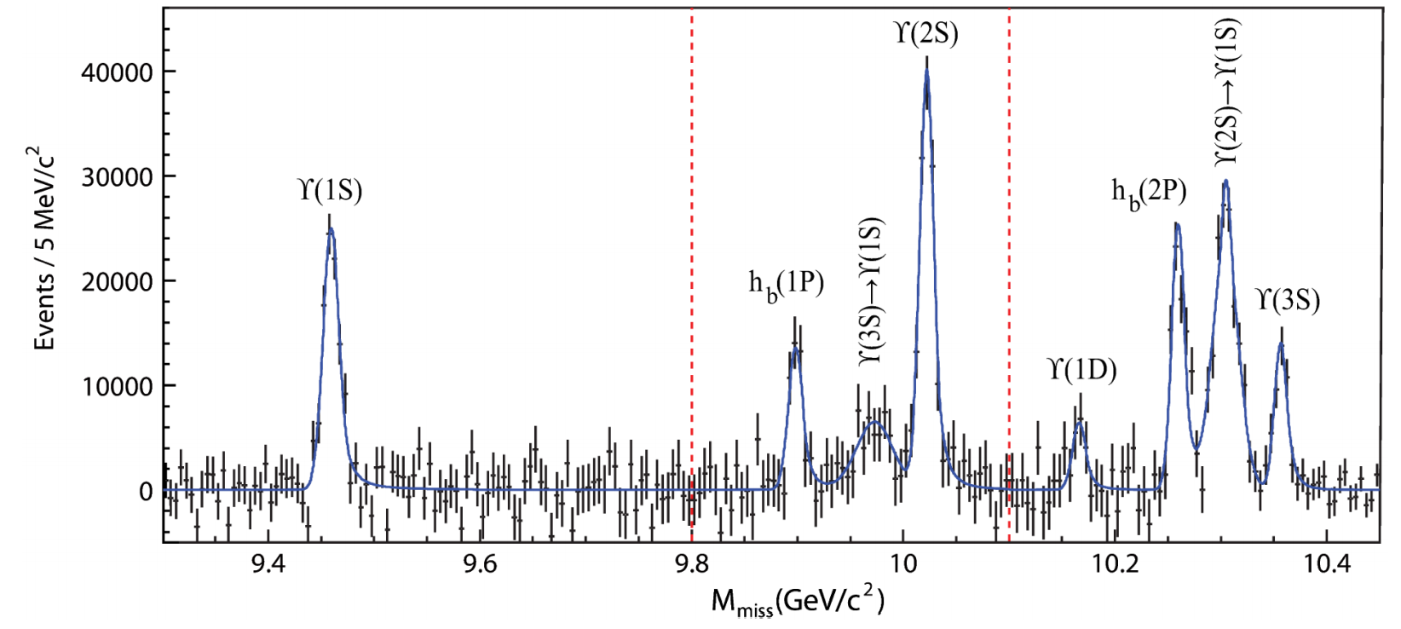
$Br\left(Z_{b}^{\left(′\right)}→Υ\left(1D\right) π\right)∼{10}^{−2}$
The ratio of branching ratios could be an important test of the present estimation.
$$Z_{b}^{′}→Υ_{J}\left(1D\right) π$$
PRL 108, 032001(2012)@Belle
$$Υ_{1}\left(1D\right)$$

Slide 49
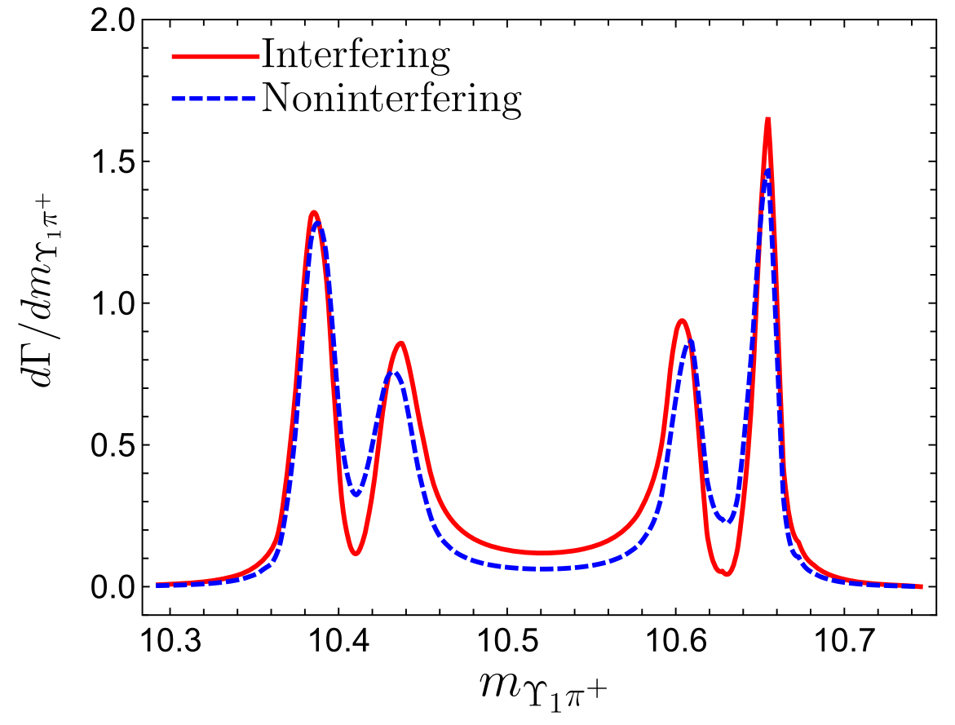
The role of $Z_{b}^{\left(′\right)}$ in $Υ\left(5S\right)→Υ\left(1D\right) π^{+}π^{−}$
$$Br\left(Υ\left(5S\right)→Z_{b}^{\left(′\right)} π\right)=1.0\%$$
Consistent with the experimental measurement by the Belle collaboration in order of magnitude

Slide 50
Process $X\left(3872\right)→ρJ/ψ, ωJ/ψ, π^{0}χ_{cJ}$
Wu, Chen, Matsuki. Eur. Phys. J. C 81, 193 (2021)

Slide 51
$X(3872)$: Experimental information
Belle
BESIII
BARBAR
BESIII
K. Abe et al. [Belle Collaboration], arXiv:hep-ex/0505037
M. Ablikim et al. [BESIII Collaboration], PRL. 122(23), 232002 (2019)
P. del Amo Sanchez et al. [BaBar Collaboration], PRD 82, 011101 (2010)
M. Ablikim et al. [BESIII Collaboration], PRL. 122(20), 202001 (2019)

Slide 52
$X(3872)$: Theoretical investigation
$D{\overline{D}}^{∗}$ loosely bound state:
Potential model
M.B. Voloshin, L.B. Okun, JETP Lett. 23, 333 (1976)
A. De Rujula, H. Georgi, S.L. Glashow, PRL. 38, 317 (1977)
QCD sum rule
Z.G. Wang, T. Huang, EPJC 74(5), 2891 (2014)
Decay and production property
M.B. Voloshin, PLB 579, 316 (2004) E.S. Swanson, PLB 598, 197 (2004) E. Braaten, M. Kusunoki, PRD 69, 074005 (2004) ………

Slide 53
$χ_{c1}\left(2P\right)$ state
T. Barnes, S. Godfrey, PRD 69, 054008 (2004)
E.J. Eichten, K. Lane, C. Quigg, PRD 69, 094019 (2004)
C. Meng, K.T. Chao, PRD 75, 114002 (2007)
X. Liu, Y.M. Wang, EPJC 49, 643 (2007)
Tetraquark state
J. Vijande, et al, Int. J. Mod. Phys. A 20, 702 (2005)
L. Maiani, et al, PRD 72, 031502 (2005)
F.S. Navarra, M. Nielsen, PLB 639, 272 (2006)
Hybrid state
F.E. Close, S. Godfrey, Phys. Lett. B 574, 210 (2003) B.A. Li, Phys. Lett. B 605, 306 (2005) A.A. Petrov, J. Phys. Conf. Ser. 9, 83 (2005)

Slide 54
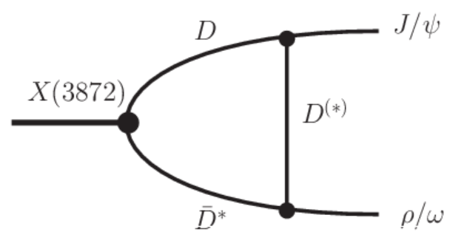
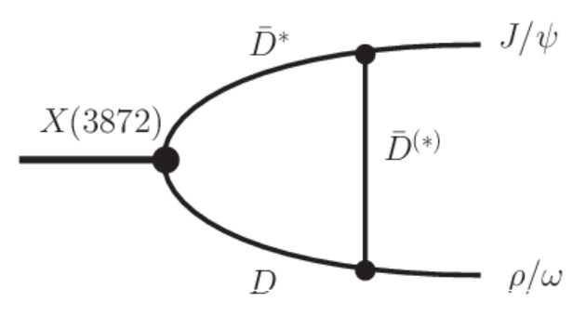
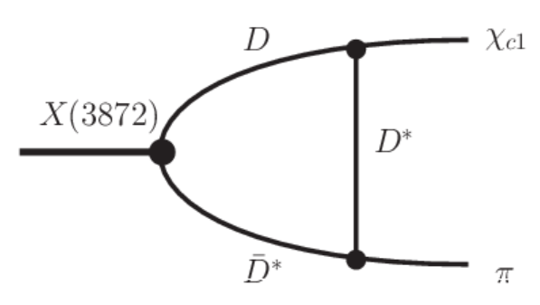
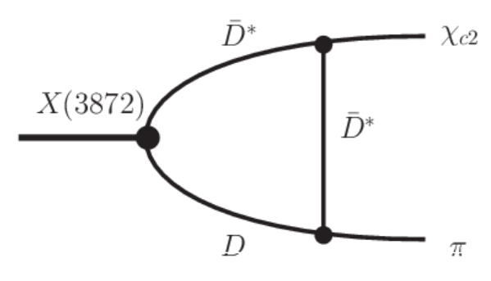
$X(3872)$: S-wave molecular, $J^{PC}=1^{++}$, superposition of $D^{0}{\overline{D}}^{∗0}$ and $D^{±}D^{∗∓}$ .
Motivation:
The source of the isospin violation.
The different coupling strengths of $X(3872)D^{0}{\overline{D}}^{∗0}$ and $X(3872)D^{+}D^{∗−}$.
The interferences between the charged and neutral meson loops.
The mass difference of up and down quarks

Slide 55
The effective coupling of $X\left(3872\right)$ with its components is
The threshold of $J/ψρ$ is very close to the mass of X(3872), the width of $ρ$ meson should be included.
$X\left(3872\right)→J/ψπ^{+}π^{−}π^{0}$is a sub-threshold process, the Breit-Wigner distributions of $ω$ meson should be considered.

Slide 56
The ratio is almost independent on the parameter $α$ due to the similarity of $J/ψρ$ and $J/ψω$ decay modes.
Taking the latest BESIII data as a scale, we have $θ={66}^{∘}∼ {70}^{∘}$, $D^{0}{\overline{D}}^{∗0}$ = $\left(83∼88\right)\%$.
Taking $θ={45}^{∘}$, the ratio $∼{10}^{2}$, thus the dominant source of isospin violation in X(3872) decays should come from the different coupling strengths of $X(3872)D^{0}{\overline{D}}^{∗0}$ and $X(3872)D^{+}D^{∗−}$.

Slide 57
In the $θ$ range determined by $Γ[X→π^{+} π^{−} π^{0} J/ψ]/Γ[X→π^{+} π^{−} J/ψ]$, the ratio $Γ[X→χ_{c1} π^{0}]/Γ[X→π^{+}π^{−}J/ψ]$is determined to be
$$0.79∼1.17$$
Well consistent with the measurement of the BESIII collaboration:
$${0.88}_{−0.27}^{+0.33}±0.10$$

Slide 58
$$1.30∼2.07$$
$$1.12∼1.28$$

Slide 59
$$Γ\left[X→χ_{c0} π^{0}\right]:Γ\left[X→χ_{c1} π^{0}\right]:Γ\left[X→χ_{c2} π^{0}\right]=$$
$$(1.77∼ 1.65):1:(1.09∼ 1.43)$$
Extended Friedrichs scheme:
1.5: 1.3: 1.0
Zhou Zhi-Yong, Yu Meng-Ting and Xiao Zhiguang PRD 100, 094025 (2019)

Slide 60
Summary
Hadron loop can be an effective description for non-perturbative aspect of QCD;
Hadron loop plays essential role in understanding the productions and decays of new hadron states;
The quantitative calculations are sensitive to cut-off and exhibit model-dependent features.

Slide 61
Backup

Slide 62
Effective Lagrangian
The effective Lagrangian for the S-wave bottomonia coupled to a pair of 1=2- bottom mesons is
The coupling between the S-wave bottomonia and a $1/2^{−}−1/2^{+}$ pair of bottom mesons is
Assuming that the $Z_{b}$and $Z_{b}^{′}$couple to $B{\overline{B}}^{∗}$ and $B^{∗}{\overline{B}}^{∗}$, the effective Lagrangian is given by
For the S-wave heavy mesons, the leading order Lagrangian in heavy meson chiral perturbation theory is given by
The leading order Lagrangian for the pions coupled to a pair of $s_{l}^{P}=1/2^{+}$and $s_{l}^{P}=1/2^{−}$ heavy-light mesons is

Slide 63
The effective Hamiltonian related to $B_{c}^{+}→c\overline{c}+ρ^{+}$
The nonleptonic decay constant are defined by hadronic matrix elements
The transition matrix element could be expressed as
The $J^{P}$quantum numbers of $Z_{c}^{(′)}$ are $1^{+}$, thus $Z_{c}$couples to $J/ψπ$via S-wave, while $Z_{c}^{′}$ couples to $h_{c}π$via P-wave. Considering the chiral symmetry, the effective Lagrangian related to $Z_{c}^{(′)}$ are
The effective Lagrangian for ρππ is

Slide 64
The effective Lagrangian of $Λ_{b}Σ_{c}D_{s}^{(∗)}$are
The effective Lagrangians related to $D_{s}^{(∗)}D^{(∗)}K$ are
The effective Lagrangians of $P_{c}$ and $Σ_{c}D^{(∗)}$ are

Slide 65
The effective Lagrangians relevant to $Ξ_{b}→Ξ_{c} D_{s}^{\left(∗\right)}$ are
In the molecular scenario, the $P_{cs}$ is considered to be molecular state composed of ${\overline{D}}^{∗}Ξ_{c}$with $J^{P} =1/2^{−} or 3/2^{−}$and the simplest coupling of $P_{cs}$ with its components are

Slide 66
As for the interactions between $Z_{b}^{(′)}$ and bottom meson pair, we can simply consider the S wave coupling and the corresponding effective Lagrangians can be expressed as,
The effective interaction between D-wave bottomonia and S-wave bottom meson pair is

Slide 67
The coupling between light meson and charmed mesons could be obtained based on the heavy quark limit and chiral symmetry, which are

Slide 68
where the $D^{(∗)}=({\overline{D}}^{\left(∗\right)0}, D^{\left(∗\right)−},D_{s}^{\left(∗\right)−})$is the charmed meson triplet, $P$and $V_{μ}$are 3 × 3 matrices for the nonet pseudoscalar and nonet vector mesons, respectively,

Slide 69
In heavy quark limit, one can construct the effective Lagrangian for charmonium and charmed mesons, which are

Slide 70
Decay amplitude
The decay amplitude for the $Υ\left(5S\right)→ Z_{b}^{+} π^{−}$ reads
The decay amplitude for the $Υ\left(5S\right)→ Z_{b}^{′+} π^{−}$ reads

Slide 71
The decay amplitude for the $Υ\left(5S\right)→ Z_{b}^{+} π^{−}$ reads
The decay amplitude for the $Υ\left(5S\right)→ Z_{b}^{′+} π^{−}$ reads

Slide 72
The decay amplitude for the $B_{c}^{+}→ Z_{c}^{+} π^{0}$ is
The decay amplitude for the $B_{c}^{+}→ Z_{c}^{′+} π^{0}$ is
where $A^{μν}(P,Q)$ is

Slide 73
The decay amplitude for the $Λ_{b}→ P_{c} K$ is

Slide 75
The decay amplitude for the $Ξ_{b}→ P_{cs} K$ is

Slide 77
The decay amplitude for the $Z_{b}→Υ_{J}π$ reads

Slide 81
The decay amplitude for the $X(3872)→J/ψρ$ reads

Slide 82
The decay amplitude for the $X(3872)→χ_{cJ}π$ reads

