Slide 1
On Emergent Conformal Symmetry near the Photon Ring
北京大学物理学院 胡泽州
Based on arXiv: 2212.02958
Collaborate with: 陈斌，侯业辉
12月2日

Slide 2
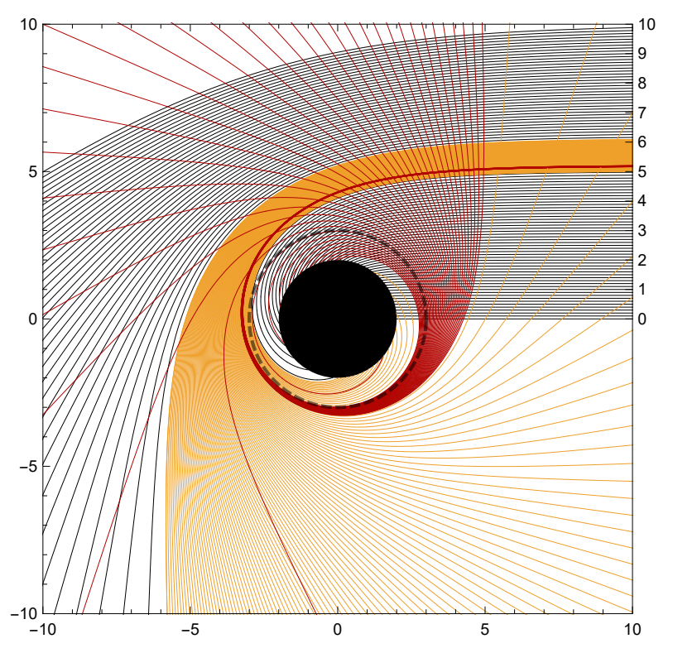
Photon Ring(PR) and Quasi-normal Mode(QNM)
The subring structure of the photon ring in the black hole is described by Lyapunov exponents
$$δr\left(t\right)=e^{γt}δr(0)$$
The imaginary part of the frequency of the high-frequency QNMs is described by Lyapunov exponents
$$ω_{I}=−\left(n+\frac{1}{2}\right)γ$$

Slide 3
Black Hole and 2d CFT
The low-frequency scattering process exactly matches the retarded Green function in CFT2, giving the temperature of the dual CFT2. For a Kerr black hole, [Castro etc. 2010]
$$T_{L}=\frac{r_{+}+r_{−}}{4πa} T_{R}=\frac{r_{+}−r_{−}}{4πa}$$
The asymptotic symmetric group(ASG) analysis can tell the central charge. For Kerr black hole, [Guica etc. 2008]
$$c_{L}=c_{R}=12 J$$
Thermodynamics of black hole gives the entropy
$$S=\frac{A}{4G}$$
By counting high-energy excited states in CFT2, the microscopic entropy can be given by Cardy formula
$$S=\frac{π^{2}}{3}\left(c_{L}T_{L}+c_{R}T_{R}\right)$$
$$⇔$$

Slide 4
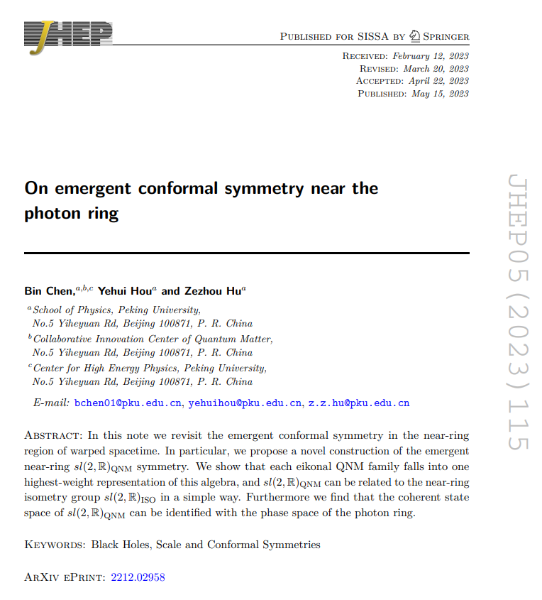
On Emergent Conformal Symmetry near the Photon Ring [JHEP05(2023)115]
Emergent conformal symmetry of the PR.
Emergent conformal symmetry of the QNM in the near-ring region.
(3) A direct relation between the coherent state space of the QNM and the phase space of the photon ring.

Slide 5
(1) Emergent conformal symmetry of the PR
For simplicity, we focus on the self-dual warped AdS3 geometry
$${ds}^{2}=l^{2}\left[\frac{−{dT}^{2}+{dx}^{2}}{\sinh^{2}x}+Λ^{2}{\left(dφ+\frac{dT}{\tanh{x}}\right)}^{2}\right]$$
The photon ring can be described in a reduced phase space with Hamiltonian
$$H=−p_{T}$$
By introducing a new variable
$$Ψ=\int{dφ}+H\int{\left[\coth{x}\left(1+λ\coth{x}\right)−\frac{λ}{Λ^{2}\sinh^{2}x}\right]}\frac{dx}{\sqrt{V(x)}}$$
The sympletic form of the reduced phase space
$$dp_{x}∧dx+dp_{φ}∧dφ$$
is translated to
$$dH∧dT+dL∧dΨ$$

Slide 6
(1) Emergent conformal symmetry of the PR
Define $\hat{H}=H−L/\hat{λ}$ , the exact spherical photon orbit has $\hat{H}$=0.
From the sympletic form we can introduce the Possion bracket.
Then the $sl(2,R)$ algebra generators can be constructed using $T$ and $\hat{H}.$
For example,
$$H_{+}=\hat{H} H_{0}=−\hat{H}T H_{−}=\hat{H}T^{2}$$
They satisfy
${\left\{H_{p},H_{q}\right\}}_{Possion}=(p−q)H_{p+q}$ $(p,q=−,0,+)$
The action $e^{−αH_{0}}$ is a finite dilation leading to attraction towards the spherical photon orbit since
$$e^{−αT\hat{H}}\hat{H}e^{αT\hat{H}}=e^{−α}\hat{H}$$

Slide 7
(2) Emergent conformal symmetry of the QNM in the near-ring region
The self-dual warped AdS3 has isometry $SL(2,R)×U(1)$
$$ℒ_{±}=ⅇ^{±T}\left(−\cosh{x}∂_{T}∓\sinh{x∂_{x}}+\sinh{x∂_{φ}}\right)$$
${ℒ }_{0}=−∂_{T}$ $𝒲_{0}=−∂_{φ}$
Consider a free scalar field,
$$∇^{2}Φ=−\frac{1}{l^{2}}\left[−ℒ_{0}^{2}+\frac{ℒ_{+}ℒ_{−}+ℒ_{−}ℒ_{+}}{2}+\left(1−\frac{1}{Λ^{2}}\right)𝒲_{0}^{2}\right]Φ=0$$
its solutions form a highest weight representation of the $sl(2,R)$
$$Φ_{m,n}(T,φ,x)=e^{imφ−\left(iω_{R}+n+\frac{1}{2}\right)T}ψ_{m,n}$$
$Φ_{m,n}∝ℒ_{−}^{n}Φ_{m,0}$ ${ℒ_{+}Φ}_{m,0}=0$

Slide 8
(2) Emergent conformal symmetry of the QNM in the near-ring region
In a general BH geometry, the QNM may be difficult, but in the near-ring region, that is
$$\left|δx\right|≪1,$$
$$\left|\frac{m}{ω_{R}}−\hat{λ}\right|≪1,$$
$$\left|ω_{R}\right|≫1$$
The radial ODE can reduce to a “harmonic oscillation” equation
$$\frac{1}{2ω_{R}}\left[∂_{δx}^{2}+k^{2}{ω_{R}}^{2}{δx}^{2}\right]ψ\left(δx\right)=ikω_{I}ψ\left(δx\right) k={(Λ^{2}−1)}^{−1}$$
Then we define the creation and annihilation operators as
$$a_{−}=\frac{ⅇ^{−T}}{\sqrt{2kω_{R}}}\left(i∂_{x}+kω_{R}δx\right)$$
$$a_{+}=\frac{ⅇ^{T}}{\sqrt{2kω_{R}}}\left(∂_{x}+ikω_{R}δx\right)$$
satisfying
$$\left[a_{+},a_{−}\right]=1$$

Slide 9
(2) Emergent conformal symmetry of the QNM in the near-ring region
The hidden conformal symmetry is then constructed using the creation and annihilation operators. In [Raffaelli 2021] [Strominger etc. 2022] ,
$$L_{0}=−\frac{ⅈ}{4}\left(a_{+}a_{−}+a_{−}a_{+}\right), L_{±}=±\frac{a_{±}^{2}}{2}$$
However, under their proposal, the entire solution space is divided into two highest weight representation, because
$$L_{±}Φ_{m,n}∝{ℒ_{±}^{2}Φ}_{m,n}$$
We propose a novel construction
$$L_{+}=F(a_{−}a_{+})a_{+}$$
$$L_{0}=a_{−}a_{+}+\hat{h}$$
$$L_{−}=a_{−}G(a_{−}a_{+})$$
After carefully selecting the two functions $F$ and $G$, we can make it to
$${sl(2,R)}_{QNM}Φ_{m,n}^{(NR)}≅{sl(2,R)}_{ISO}Φ_{m,n}^{(NR)}$$

Slide 10
(3) A direct relation between the coherent state space of the QNM and the phase space of the photon ring
We take $Φ_{m,0}^{(NR)}$ as $|\left.0\right\rangle$ for short, the coherent space is defined to be
$$|\left.A,θ\right\rangle ≡e^{\hat{h}A+θL_{−}}|\left.0\right\rangle$$
The phase space of the photon ring is also two-dimensional described by
$$A^{′}≡−lnH_{−}, θ′≡H_{0}/H_{−}$$
They are in fact identical representations of $SL(2,R)$ group since:
$$e^{αL_{+}}|\left.A,θ\right\rangle =|\left.A−2ln\left(1−αθ\right),θ/(1−αθ)\right\rangle$$
$$e^{αL_{0}}|\left.A,θ\right\rangle =|\left.A+α,e^{α}θ\right\rangle$$
$$e^{αL_{−}}|\left.A,θ\right\rangle =|\left.A, θ+α\right\rangle$$
$${e^{−αH_{+}}A^{′}e^{αH_{+}}=A^{′}−2ln\left(1−αθ^{′}\right), e}^{−αH_{+}}θ^{′}e^{αH_{+}}=θ′/(1−αθ′)$$
$${e^{−αH_{0}}A^{′}e^{αH_{0}}=A^{′}+α, e}^{−αH_{0}}θ^{′}e^{αH_{0}}=e^{α}θ′$$
$${e^{−αH_{−}}A^{′}e^{αH_{−}}=A^{′}, e}^{−αH_{−}}θ^{′}e^{αH_{−}}=θ^{′}+α$$
Further more we can formally relate a function in the phase space to a generic state in the solution space.

Slide 11
(3) A direct relation between the coherent state space of the QNM and the phase space of the photon ring
Denote the correspondence above by
$$𝒯|\left.A,θ\right\rangle ≡|T\left[A\right],T[\left.θ]\right\rangle$$
A curve in the phase space described by
$$f\left(A,θ\right)=0$$
can define a generic state
$$|\left.ψ\right\rangle =∫e^{−A}dA∧dθδ(f(A,θ))|\left.A,θ\right\rangle$$
satisfying
T[$|\left.ψ\right\rangle ]=∫e^{−A}dA∧dθδ(f(T^{−1}[A],T^{−1}[θ]))|\left.A,θ\right\rangle =𝒯|\left.ψ\right\rangle$

Slide 12
Open questions
The emergent conformal symmetry is built in the phase space, not like an asymptotic symmetry defined in the position space. Can we find its associated conserved charge? Can we read its quantum properties? In covariant phase space formalism? Gravitational dressing?
Although the QNM in asymptotic AdS is quite different from asymptotic flat spacetime, several groups including Hashimoto, Lupsasca recently studied the role played by photon ring in the AdS/CFT formalism. The sl(2,R) symmetry there is still important.

Slide 13
Thanks for listening！

