Slide 1
Multi-level images around Kerr-Newman black holes
闫浩鹏
太原理工大学物理学院
arXiv: 2203.02755
侯业辉, 刘鹏, 郭敏勇, 闫浩鹏*, 陈斌
2023.12.03@黑洞图像研讨会，北京

Slide 2
Outline
Background & Motivation
Light bending near a KN black hole
Appearance of emitting spheres and disks
Photon ring (higher-order images)
Outlook

Slide 3
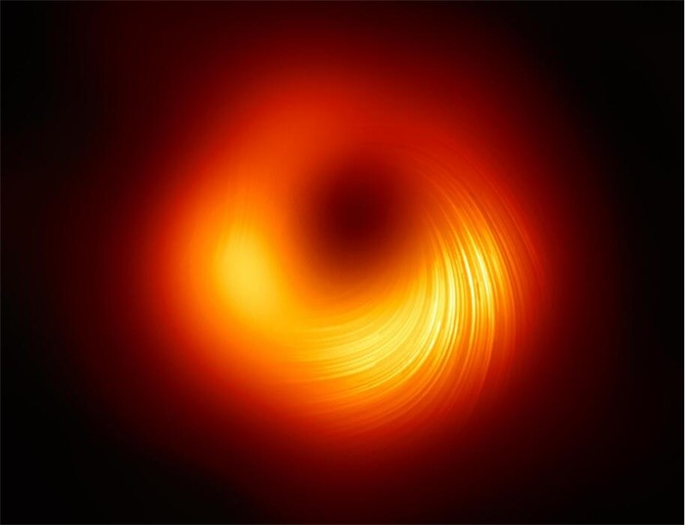
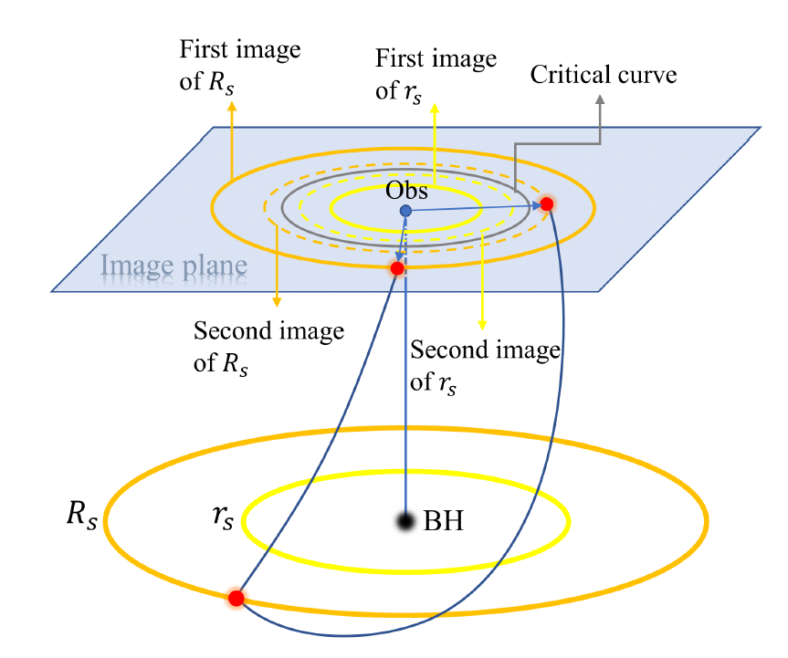
Background & Motivation
Black hole images: (dark shadow and bright ring ) at the event horizon scale to test gravity in the strong gravity regime
To understand the image: source models (accretion disk and/or jets) & spacetime geometries
What we focus: lensing effects of KN BHs & multi-level images
EHT Collaboration
Gralla et al, 1906.00873 (Schwarzschild) , Gralla et al, 1910.12873 (Kerr)

Slide 4
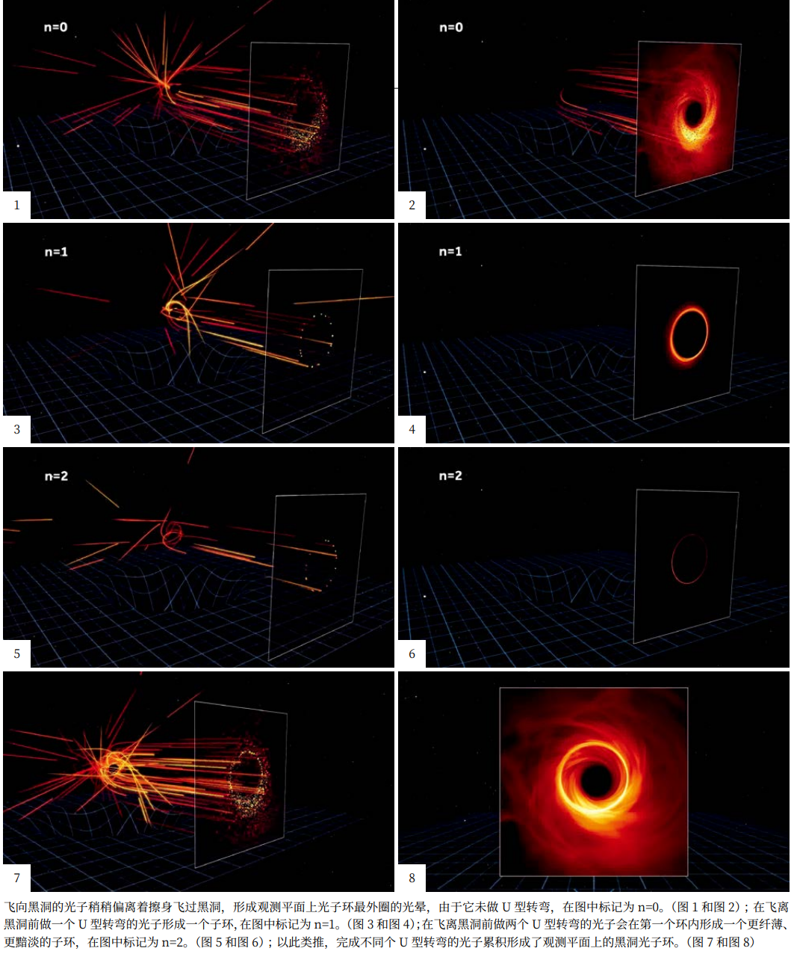

Slide 5
Outline
Background & Motivation
Light bending near a KN black hole
Observational appearance
Photon ring (higher-order images)
Outlook

Slide 6
KN metric and null geodesics
Metric
Null geodesics

Slide 7
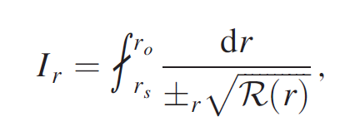
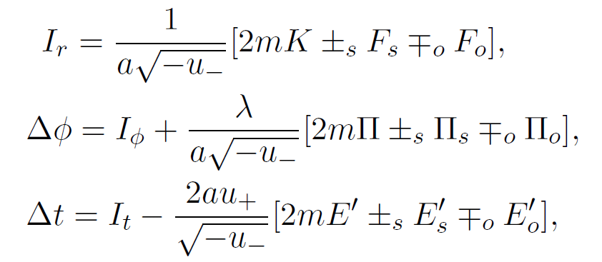
KN lens equations Integrating null geodesics from source to observer
KN lens equations

Slide 8
Number of photon orbits & Multi-level images

Slide 9
Critical emissions $n→∞$
Critical photon emissions $\left(\tilde{λ},\tilde{η}\right)$ are double root of radial potential: spherical photon orbits
Johnson et al. 2019

Slide 10
Critical lens equations $n→∞$
$$λ→\tilde{λ}, η→\tilde{η}$$

Slide 11
Key parameters for critical rays
Critical photons at $r_{i}=\tilde{r}\left(1+δr_{i}\right), \left|δr_{i}\right|≪1,$
Demagnification (Lyaponent exponent)
Rotation
Time delay

Slide 12
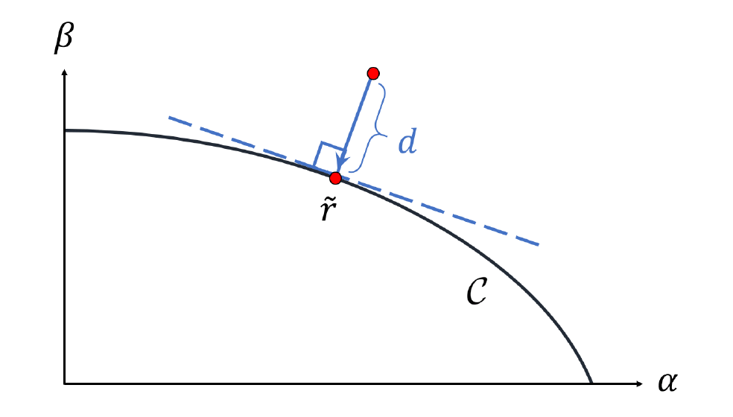
Near-critical rays

Slide 13
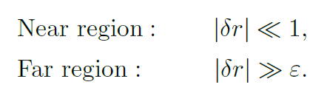
Near-critical rays
Compute radial integrals using Matched Asymptotic Expansion

Slide 14
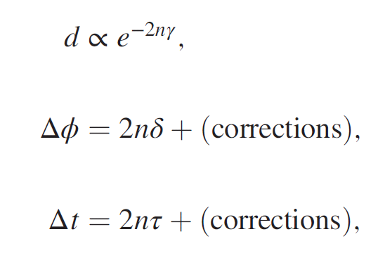
Near-critical lens equations (formally)
critical
near-critical

Slide 15
Near-critical lens equations (Explicitly)
Control the behaviors of higher-order images

Slide 16
Outline
Background & Motivation
Light bending near a KN black hole
Observational appearance
Photon ring (higher-order images)
Outlook

Slide 17
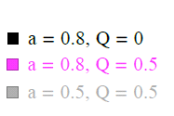
Observers’ sky & critical curve
$$α=−r_{o}\frac{p^{\left(φ\right)}}{p^{\left(t\right)}}=−\frac{ λ}{\sin{θ_{o}}}$$
$$β=r_{o}\frac{p^{\left(θ\right)}}{p^{\left(t\right)}}=±\sqrt{η+\cos^{2}{θ_{o}−λ^{2}\cot^{2}{θ_{o}}}}$$
Bardeen, 1973
$$λ→\tilde{λ}, η→\tilde{η}$$

Slide 18
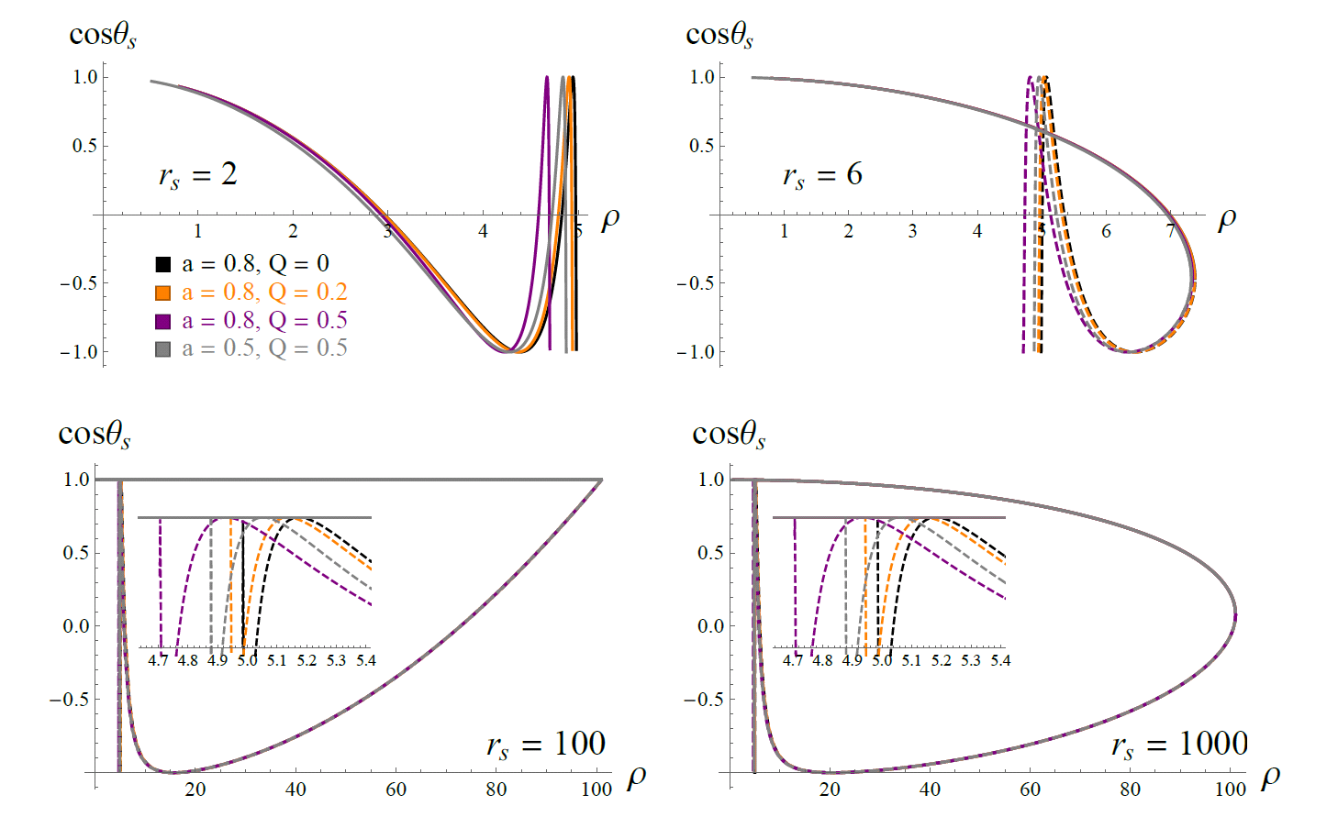
Spherical sources viewed by an on-axis observer
$$θ_{s}=0$$
$$θ_{s}=π$$

Slide 19
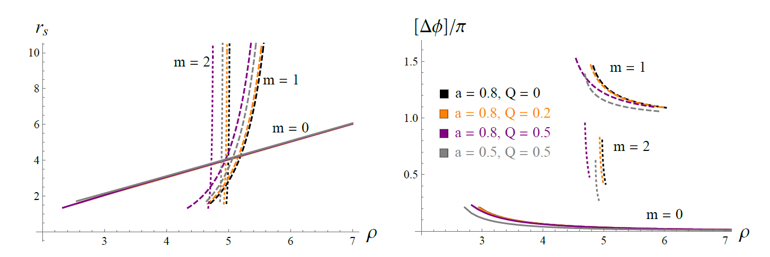
Thin equatorial disk viewed by an on-axis observer

Slide 20
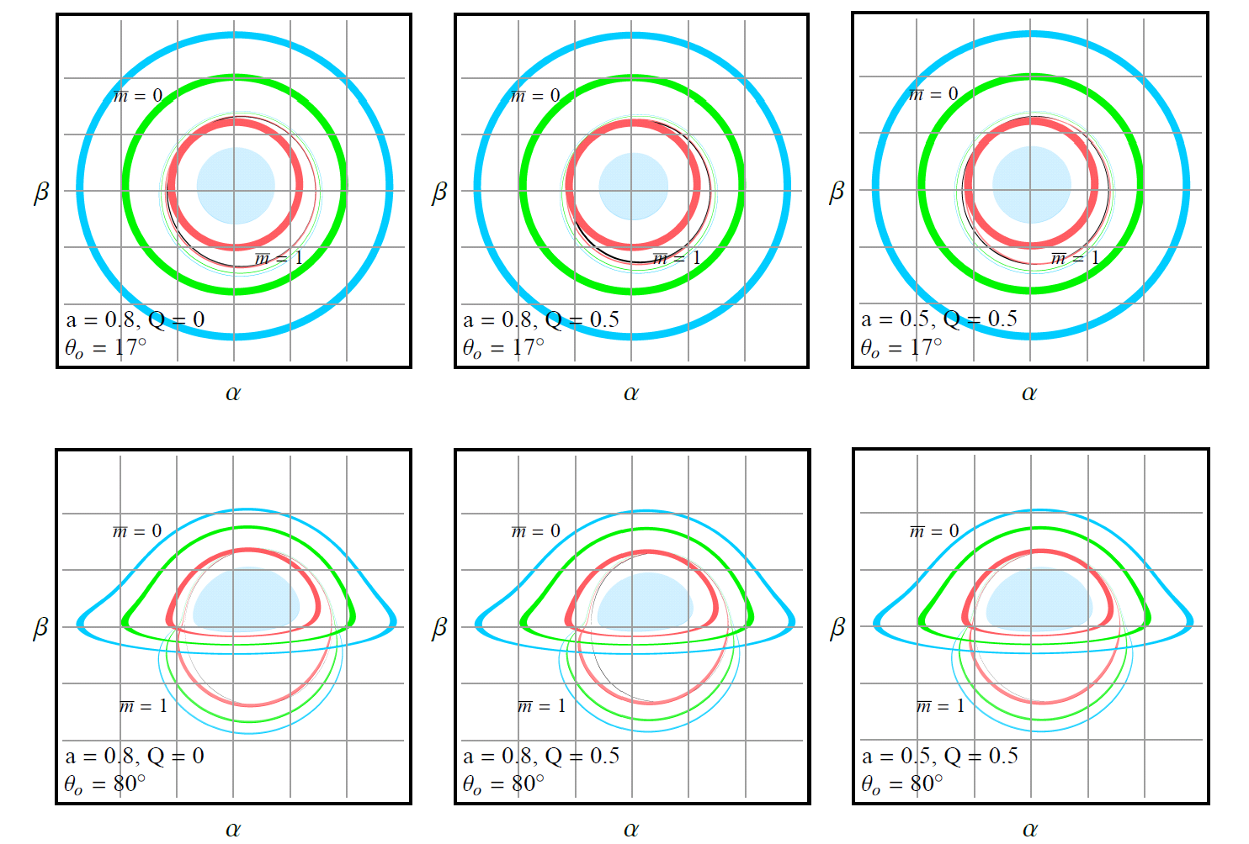
Thin equatorial disk viewed by an off-axis observer

Slide 21
General feature of the images
Thin equatorial disk viewed on-pole. Central lines for critical curve; lighter bands for 1-st image rings; darker bands for 2-nd image rings

Slide 22
Outline
Background & Motivation
Light bending near a KN black hole
Observational appearance
Photon ring (higher-order images)
Outlook

Slide 23
Near-critical lens eqs controls higher-order images

Slide 24
Near-critical equations for successive images
m-th and m+2-th, generic source
m-th and m+1-th, equatorial source

Slide 25
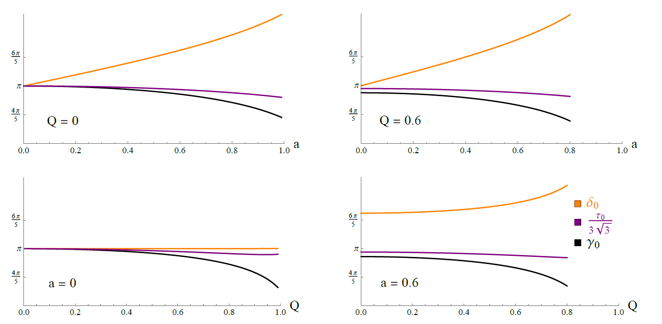
Key parameters for an on-axis observer

Slide 26
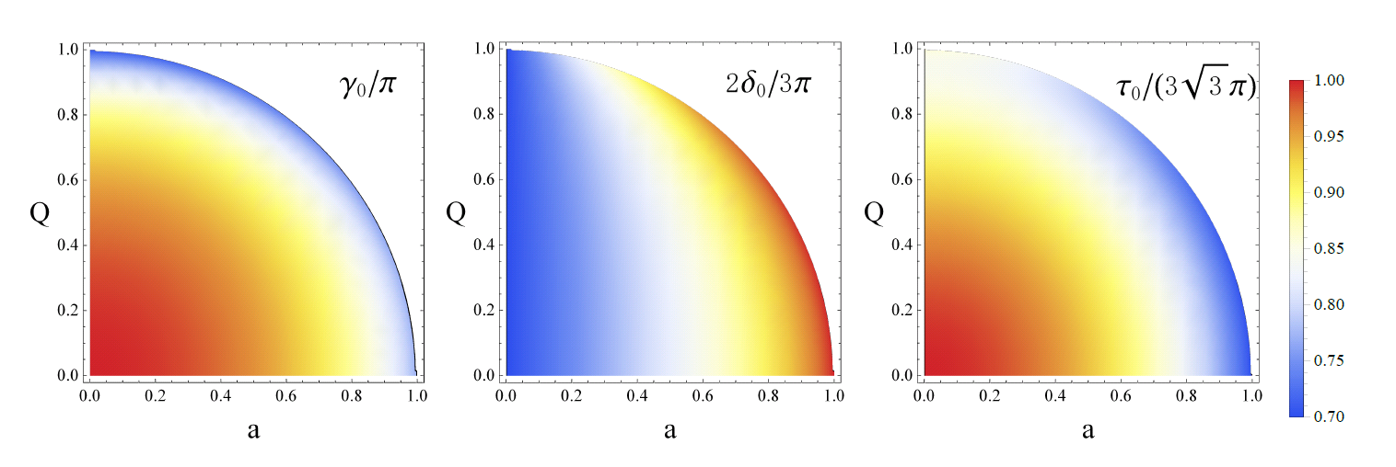
Key parameters for an on-axis observer

Slide 27
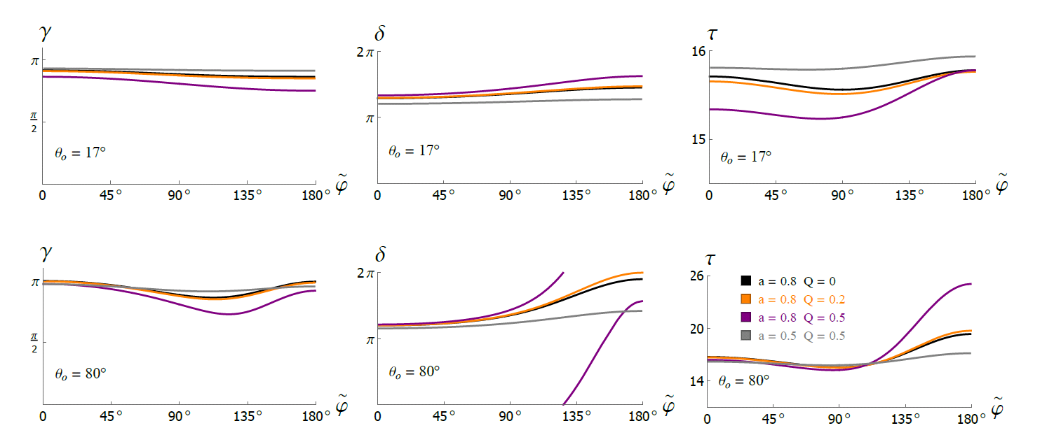
Key parameters for an off-axis observer

Slide 28
Outline
Background & Motivation
Light bending near a KN black hole
Observational appearance
Photon ring (higher-order images)
Outlook

Slide 29
Outlook
Separating the effects of spacetime geometry and plasma
Test BH models and gravity theories with the feature of photon rings
Lensing of equatorial disk with non-trivial thickness and opacity
Polarization of photon ring & field structure of black hole magnetosphere

Slide 30
Thank you for your attention!

