Slide 1
Imaging a Semi-Analytical Jet model Generated by 3D GRMHD Simulation
Presenter: Ye Shen
Based on arXiv: 2311.14954
(Collaborators: Yehui Hou, Minyong Guo, Zhong-Ying Fan, Bin Chen)
Presenter: Ye Shen
Date: Dec 3rd, 2023

Slide 2
Content:
1. Background
2. Emission Model (Geometrically Thin Emission Source)
3. Source Generation (3D GRMHD Simulation)
4. Results (Features of Geometrically Thin Jet Images)

Slide 3
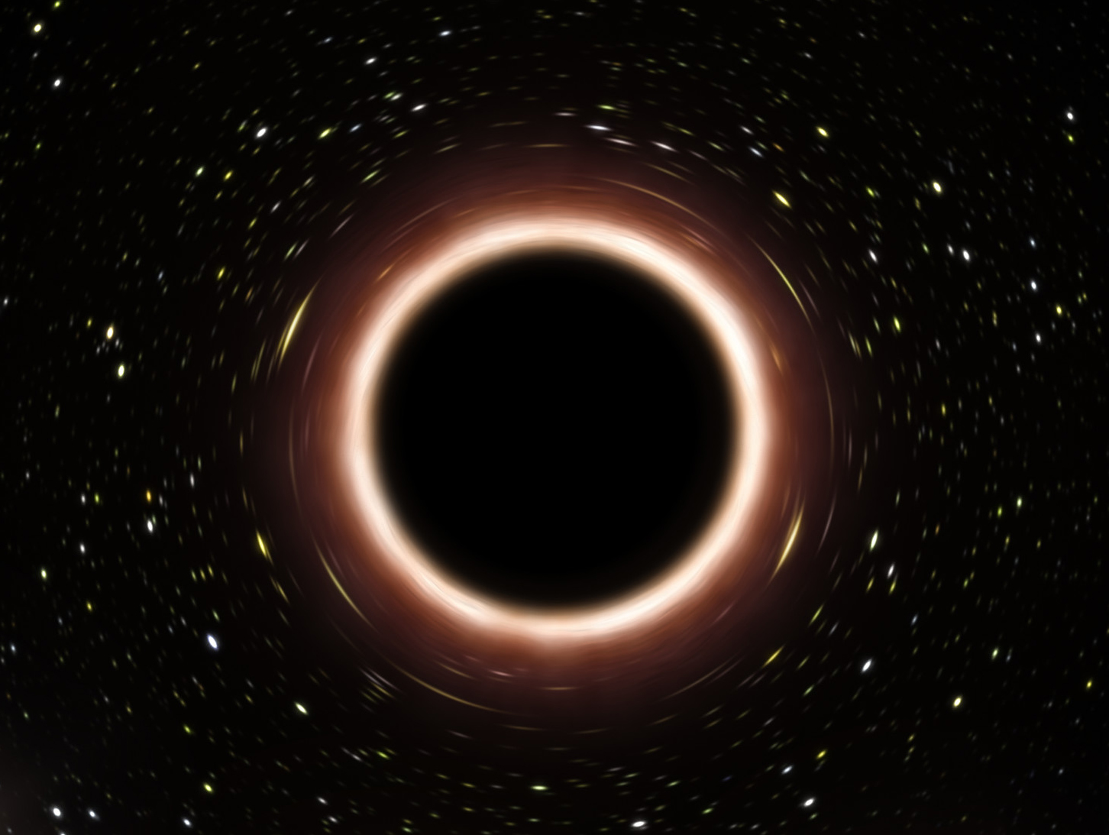
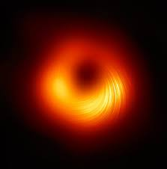
Background
(https://news.uchicago.edu/explainer/black-holes-explained)
Jet
Horizon scale
BH
Galactic background
Disk
(EHT)

Slide 4
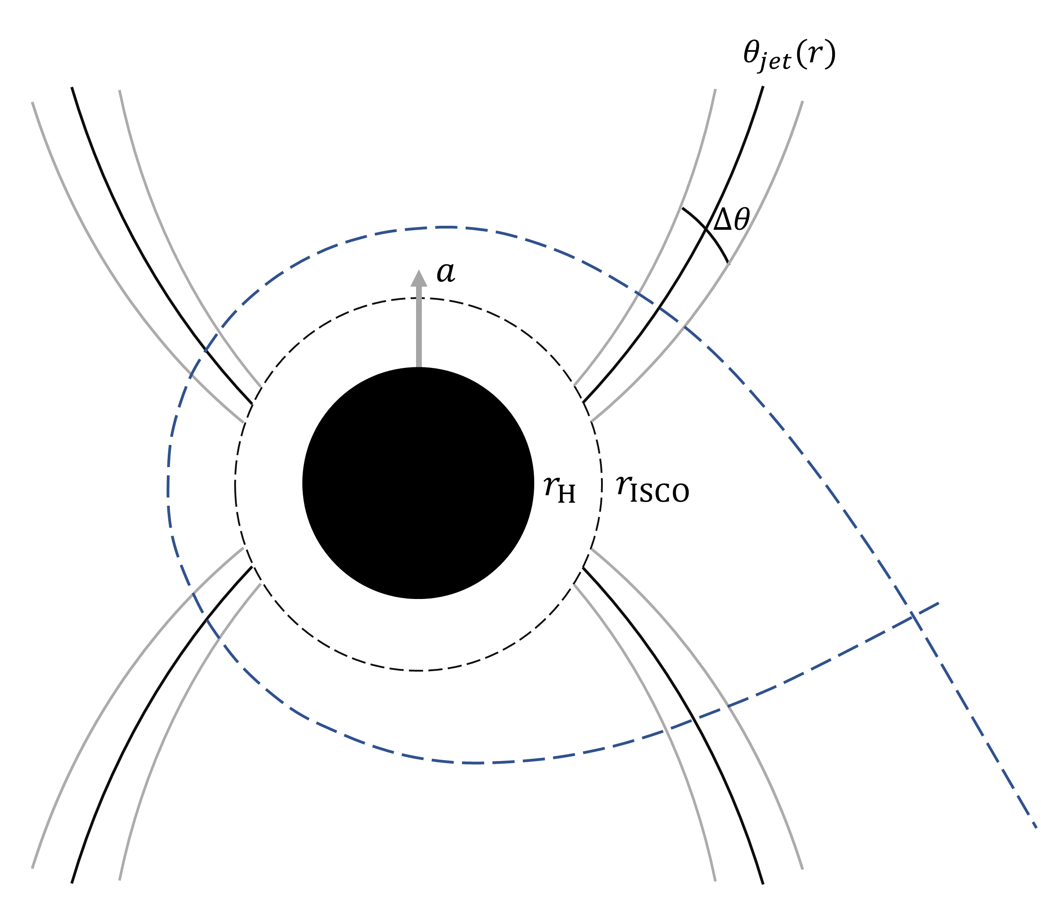
Emission Model
Geometrically Thin Jet
Jet surface
(Main emission source)
Null geodesic

Slide 5
Emission Model
Geometrically Thin Jet
$$\frac{d}{dλ}\left(\frac{I_{ν}}{ν^{3}}\right)=\frac{j_{ν}−α_{ν}I_{ν}}{ν^{2}}$$
integral
$$I_{ν_{o}}=ν_{o}\int_{λ_{i}}^{λ_{f}}{dλg^{2}\left[x^{μ}\left(λ\right),k^{μ}\left(λ\right)\right]j_{ν}\left[x^{μ}\left(λ\right),k^{μ}\left(λ\right)\right]}$$
$$g=\frac{ν_{o}}{ν}$$
geometrically thin emission source
$$I_{ν_{o}}=ν_{o}\sum_{i=1}^{N}{δλ_{i}g_{i}^{2}j_{ν,i}}$$

Slide 6
Emission Model
How to Generate a geometrically thin jet?
1. Just provide by hand, empirical model. (Broderick et al 2009; Papoutsis et al 2023)
2. Particle in cells simulation (PIC).
3. 3D GRMHD simulation

Slide 7
Source Generation
3D GRMHD Simulation
(to generate an accretion system)
(General Relativistic Magneto-Hydro-Dynamics)
Equation of State: $p=\left(Γ−1\right)ε$
Ideal MHD Condition: $F^{μν}u_{ν}=0$
Primary values: $\left(ρ, ε, v^{i}, B^{i}\right)$
+
Evolution
Continuity: ${\left(ρu^{μ}\right)}_{;μ}$
Energy/momentum Conservation: ${T^{μν}}_{;ν}=0$
Maxwell Equation: ${{∗F}^{μν}}_{;ν}=0$
Conservation Equations:
Discretization
Conserved Values: $U=\sqrt{−g}\left(ρu^{t}, T_{ν}^{t}, B^{i}\right)$
Flux: $F^{i}=\sqrt{−g}\left(ρu^{i}, T_{ν}^{i}, {∗F}^{ij}\right)$
Source Term: $S=\sqrt{−g}\left(0, Γ_{νλ}^{κ}T_{κ}^{λ}, 0\right)$
Unified Form: $\frac{dU}{dt}+∇∙\vec{F}=S$

Slide 8
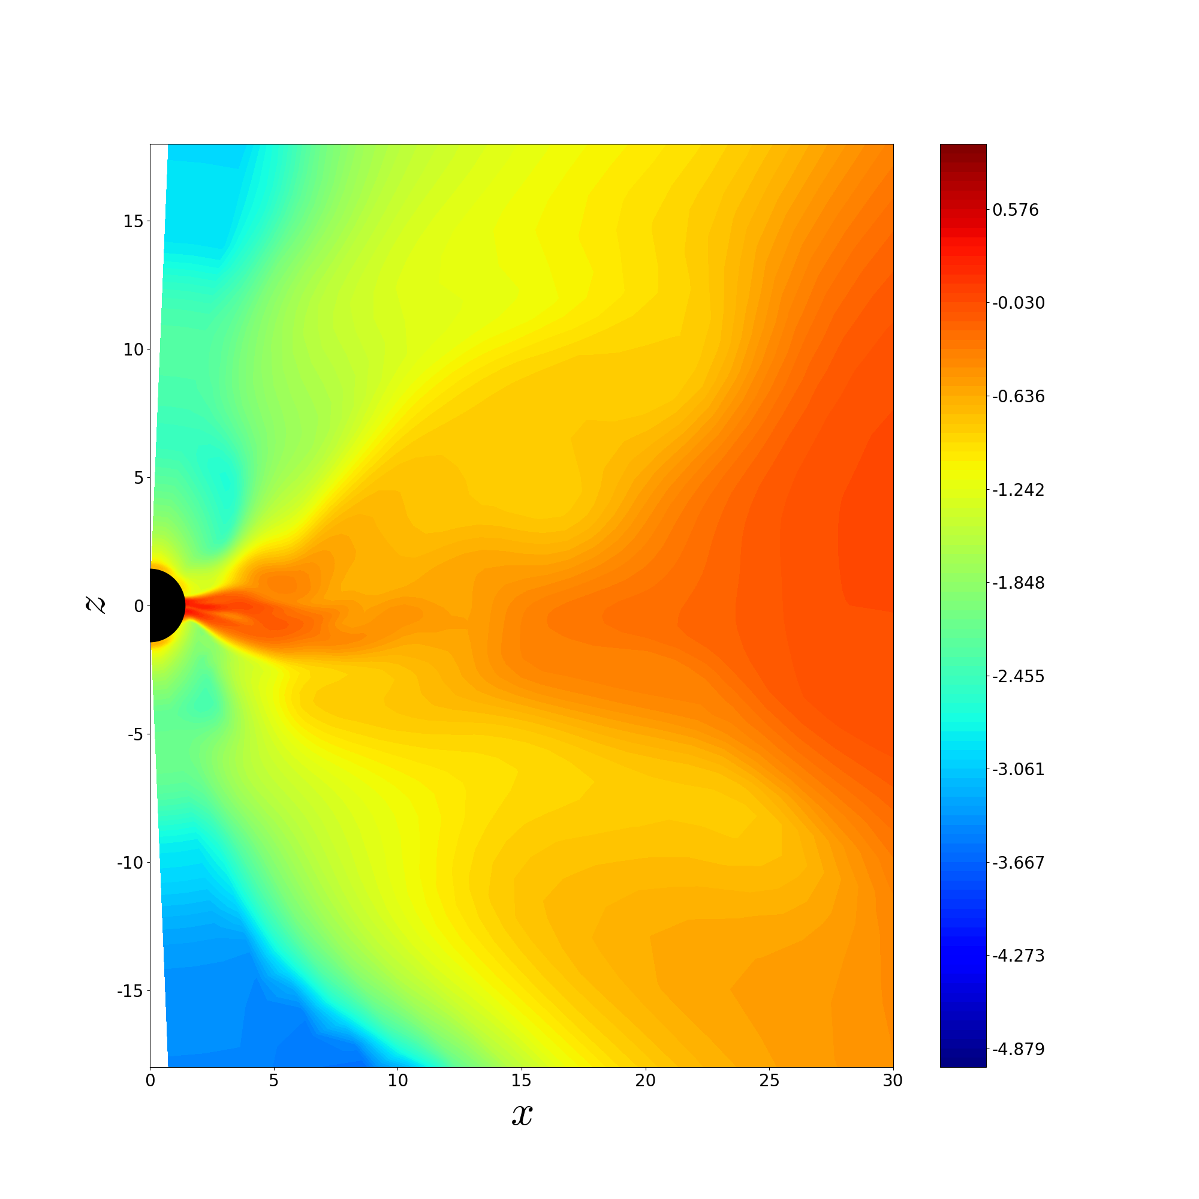
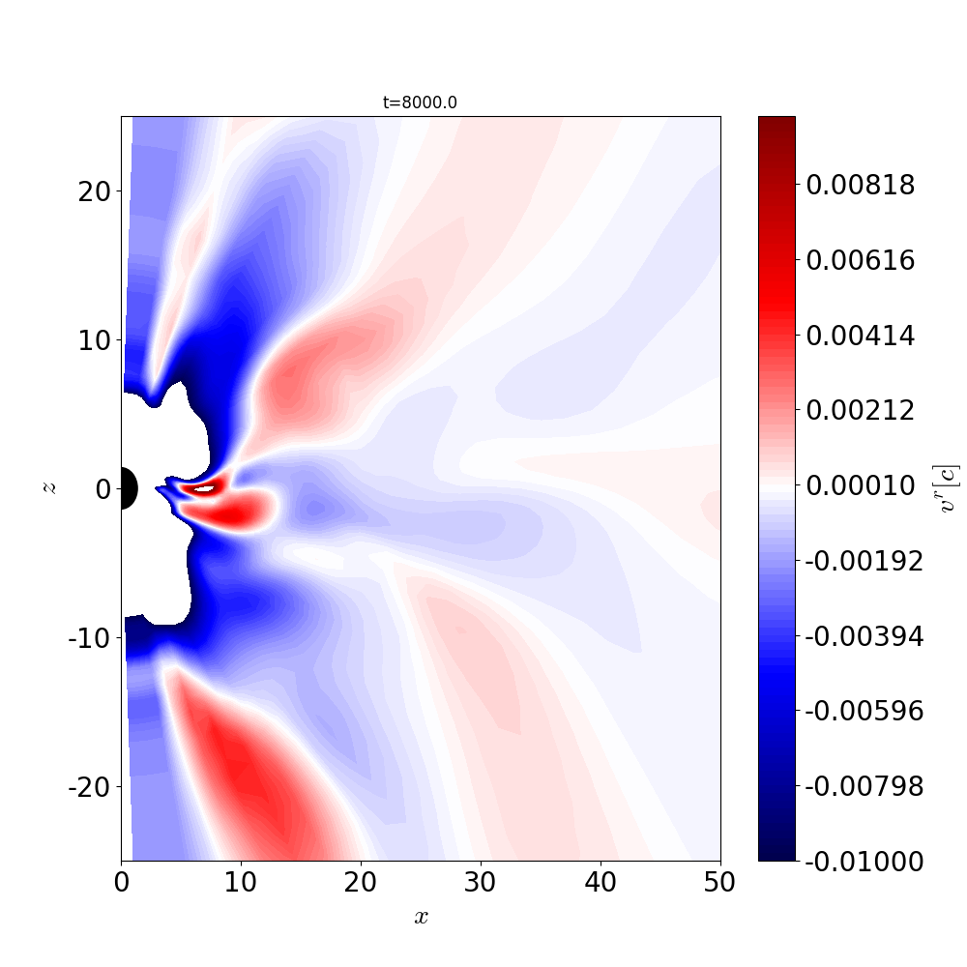
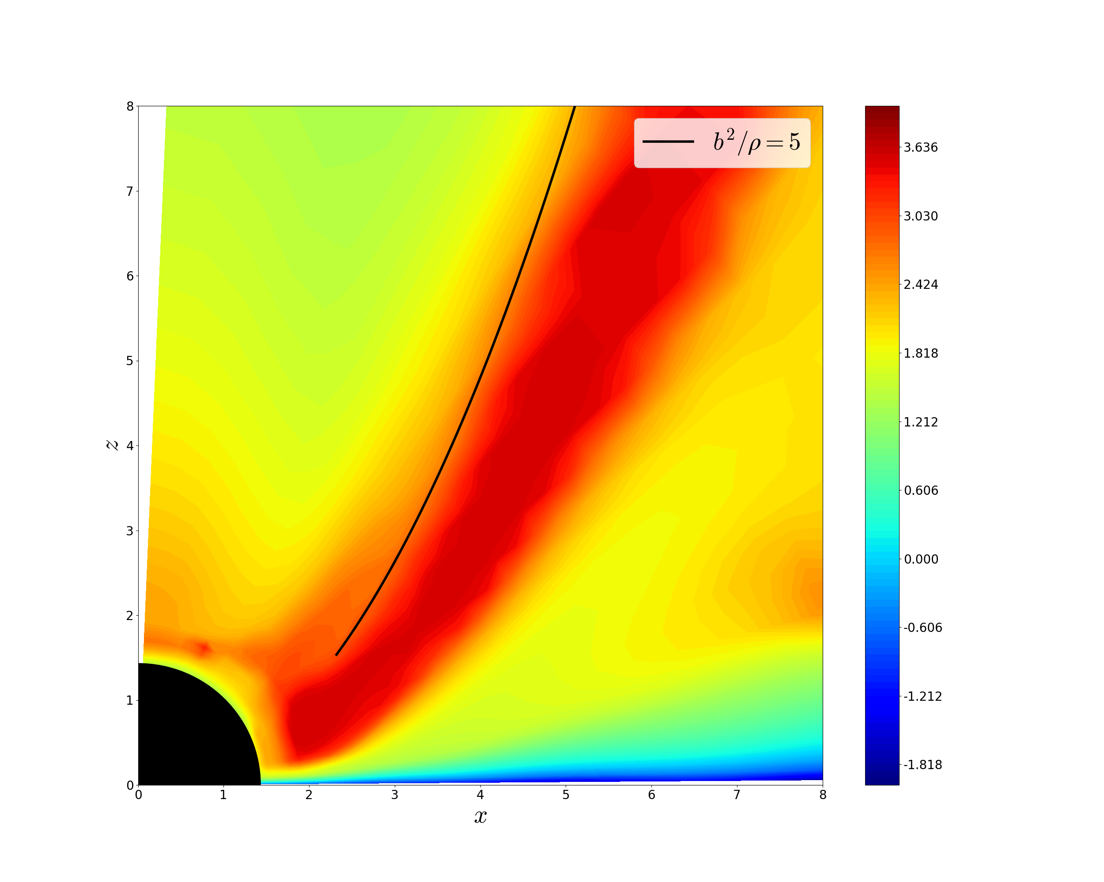
Source Generation
3D GRMHD Simulation
$$\log_{10}\left(\frac{b^{2}}{p}\right)$$
$$\log_{10}ρ$$
$$v^{r}$$
8000$t_{g}$
8000$t_{g}$
2000-3000$t_{g}$ averaged

Slide 9
Source Generation
3D GRMHD Simulation
After getting primary values on each timestep:
1. How to distinguish different regions (funnel region, corona, disk)?
2. Characteristics of the evolution?
3. Does jet form in funnel region? Is it geometrically thin?

Slide 10
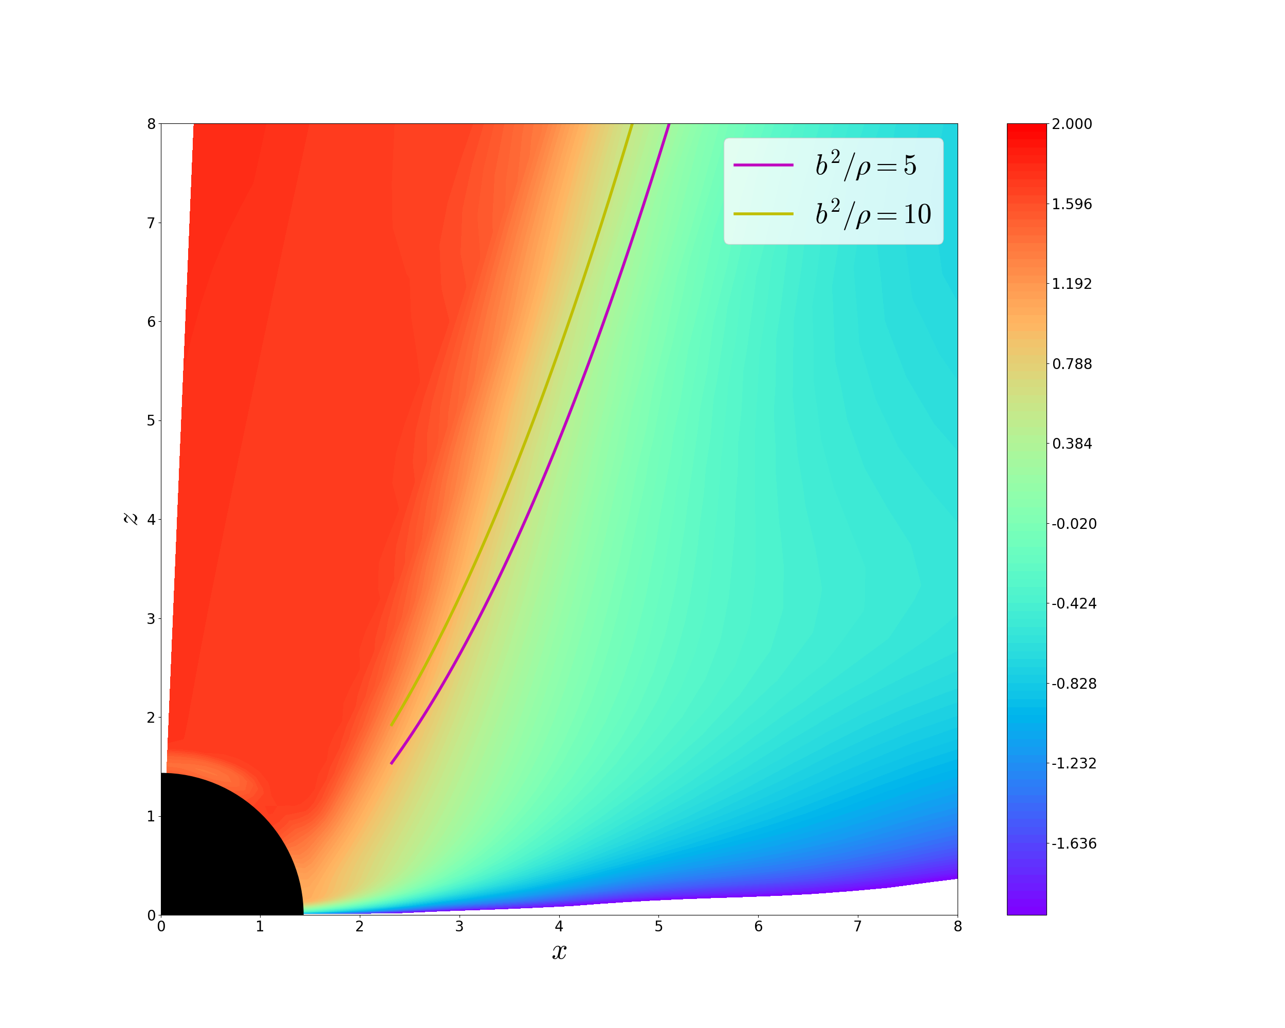
Source Generation
Jet, Corona and Disk?
Funnel wall (Jet surface)
$$\frac{b^{2}}{ρ}≃5−10$$
Funnel region
Magnetic field dominate
$$\frac{b^{2}}{ρ}≫1$$
$$\log_{10}\left(\frac{b^{2}}{ρ}\right)$$
Disk region
Fluid dominate
$\frac{b^{2}}{ρ}≪1$

Slide 11
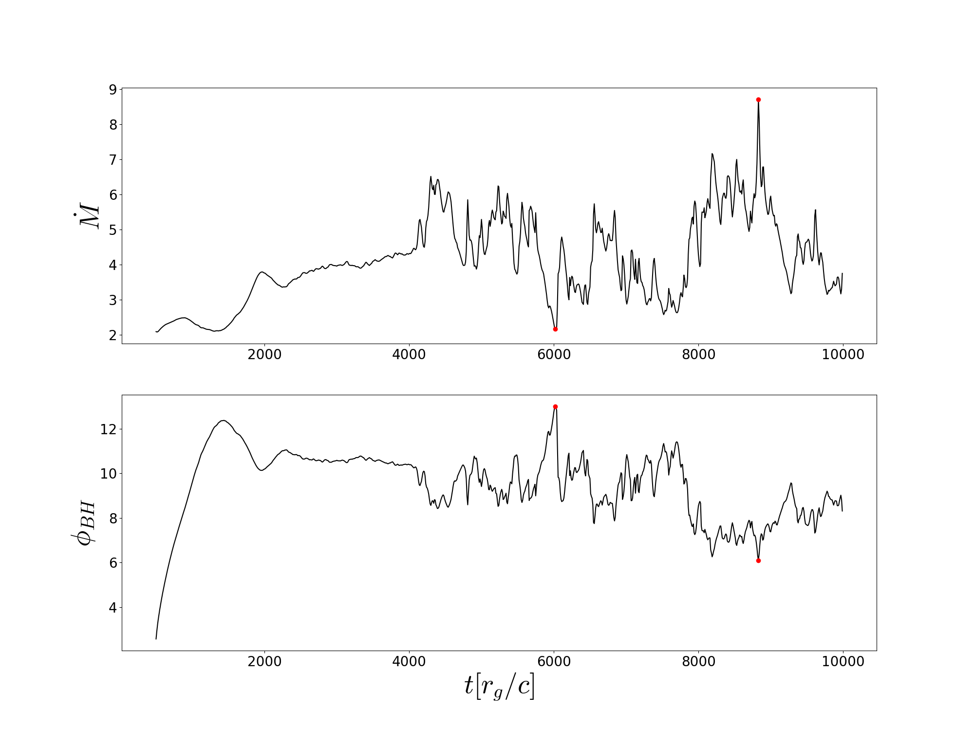
Source Generation
Evolution?
$$\dot{M}=−\int_{Ω_{EH}}{\sqrt{−g}ρu^{r}dθdφ}$$
$$φ_{BH}=\frac{1}{2\sqrt{\dot{M}}}\int_{Ω_{EH}}{\sqrt{−g}\left|B^{r}\right|dθdφ}$$

Slide 12
Source Generation
Evolution?
Accumulation
Magnetic Saturation
$$F_{B}≃F_{G}$$
MAD (Magnetic Arrested Disk)
$$F_{B}≳F_{G}$$
$$F_{B}≲F_{G}$$

Slide 13
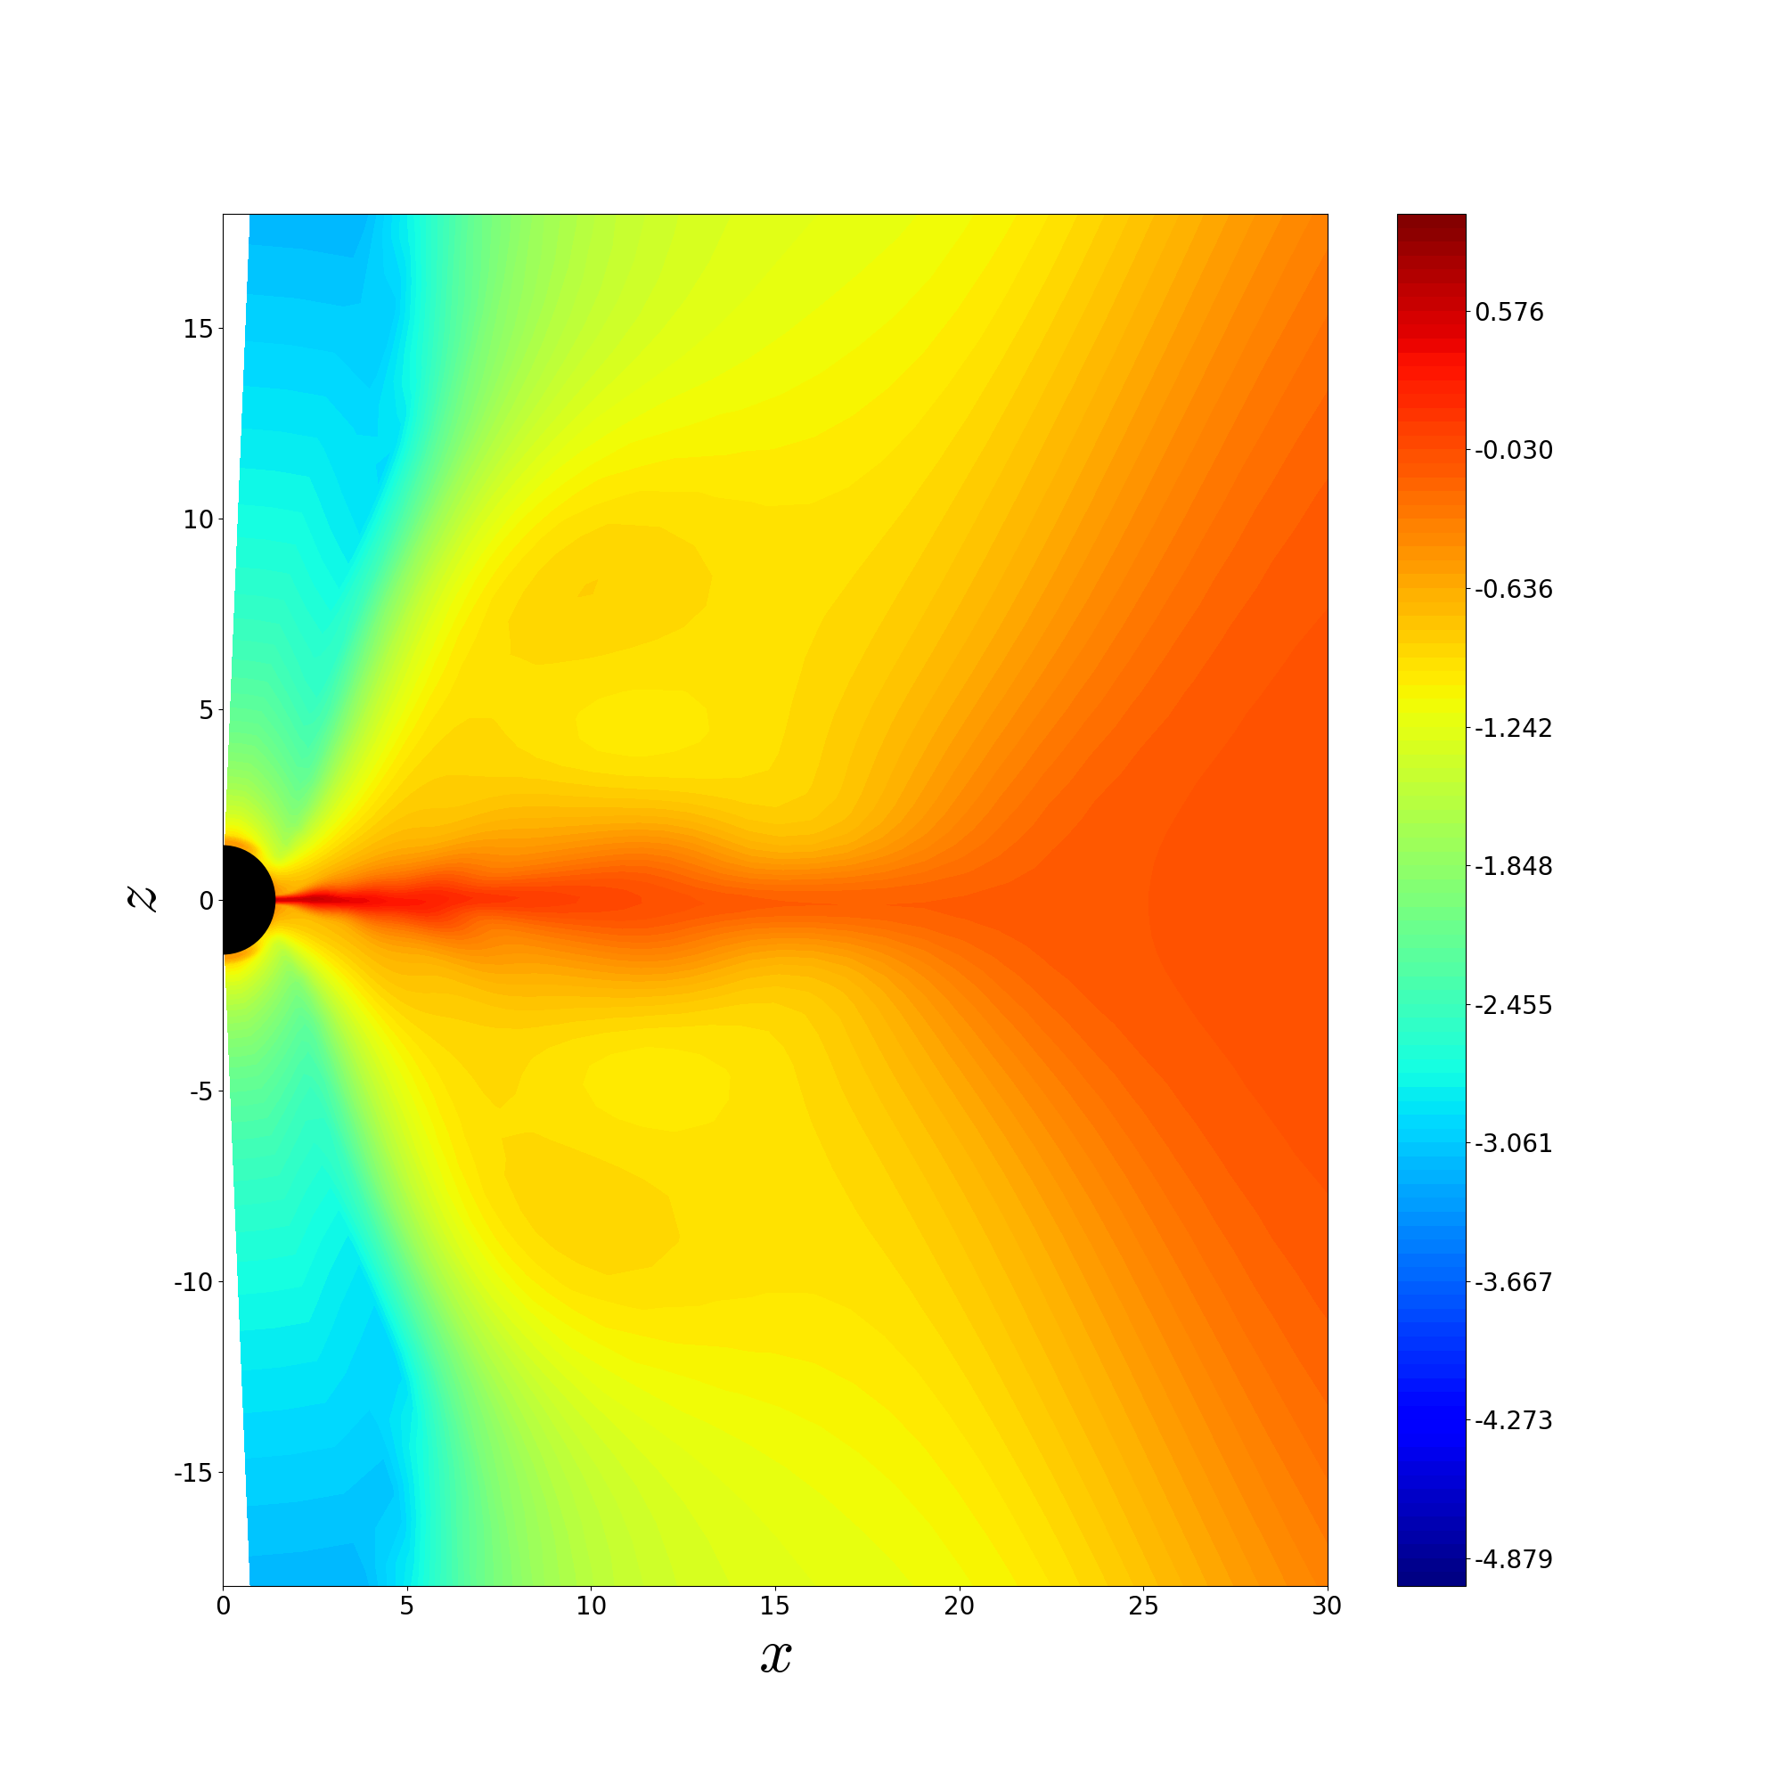
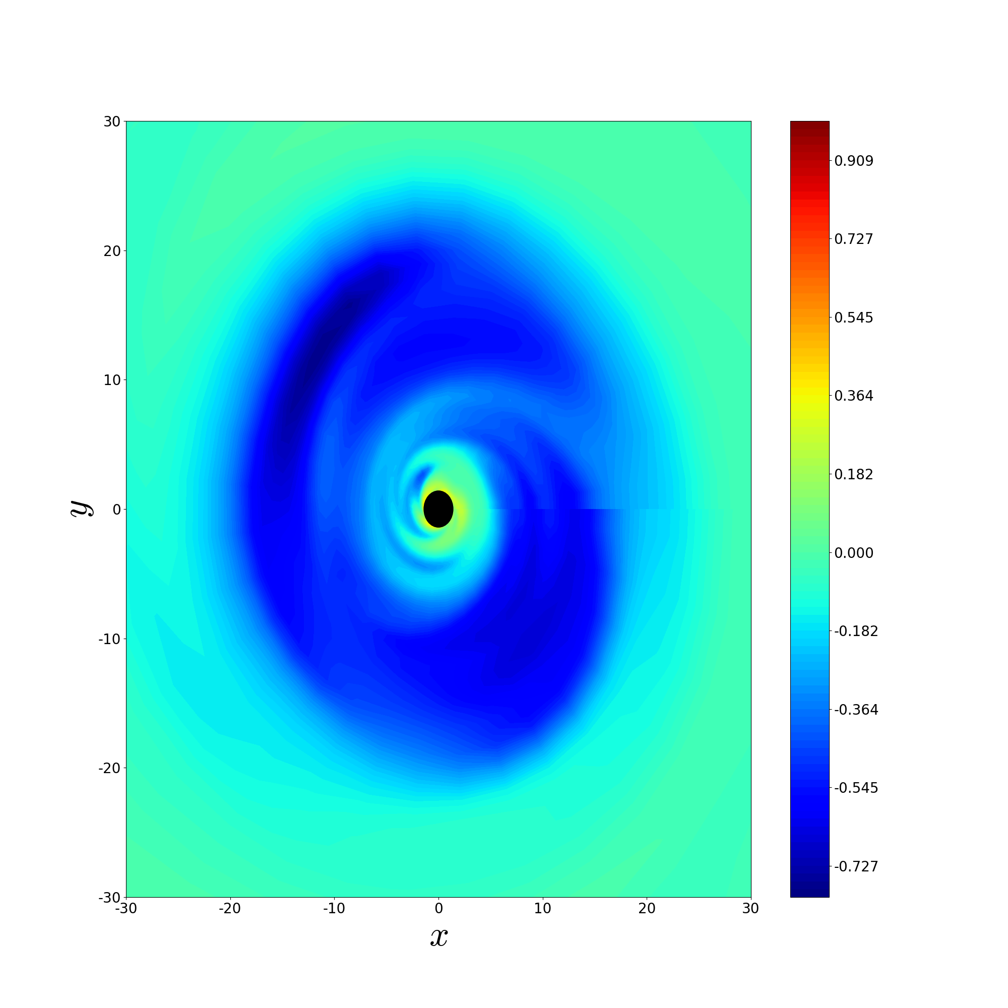
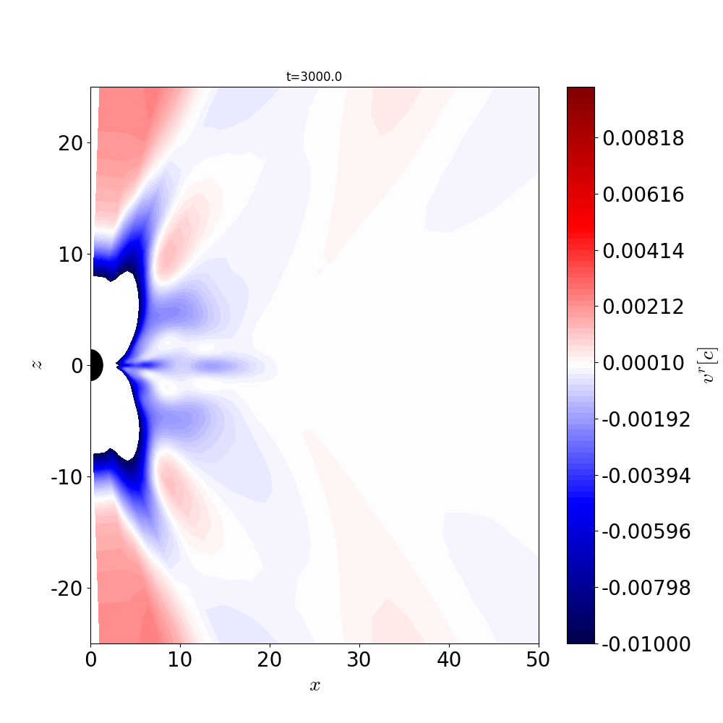
Source Generation
Source Generation
Evolution?
Turbulence dominate
Laminar dominate

Slide 14
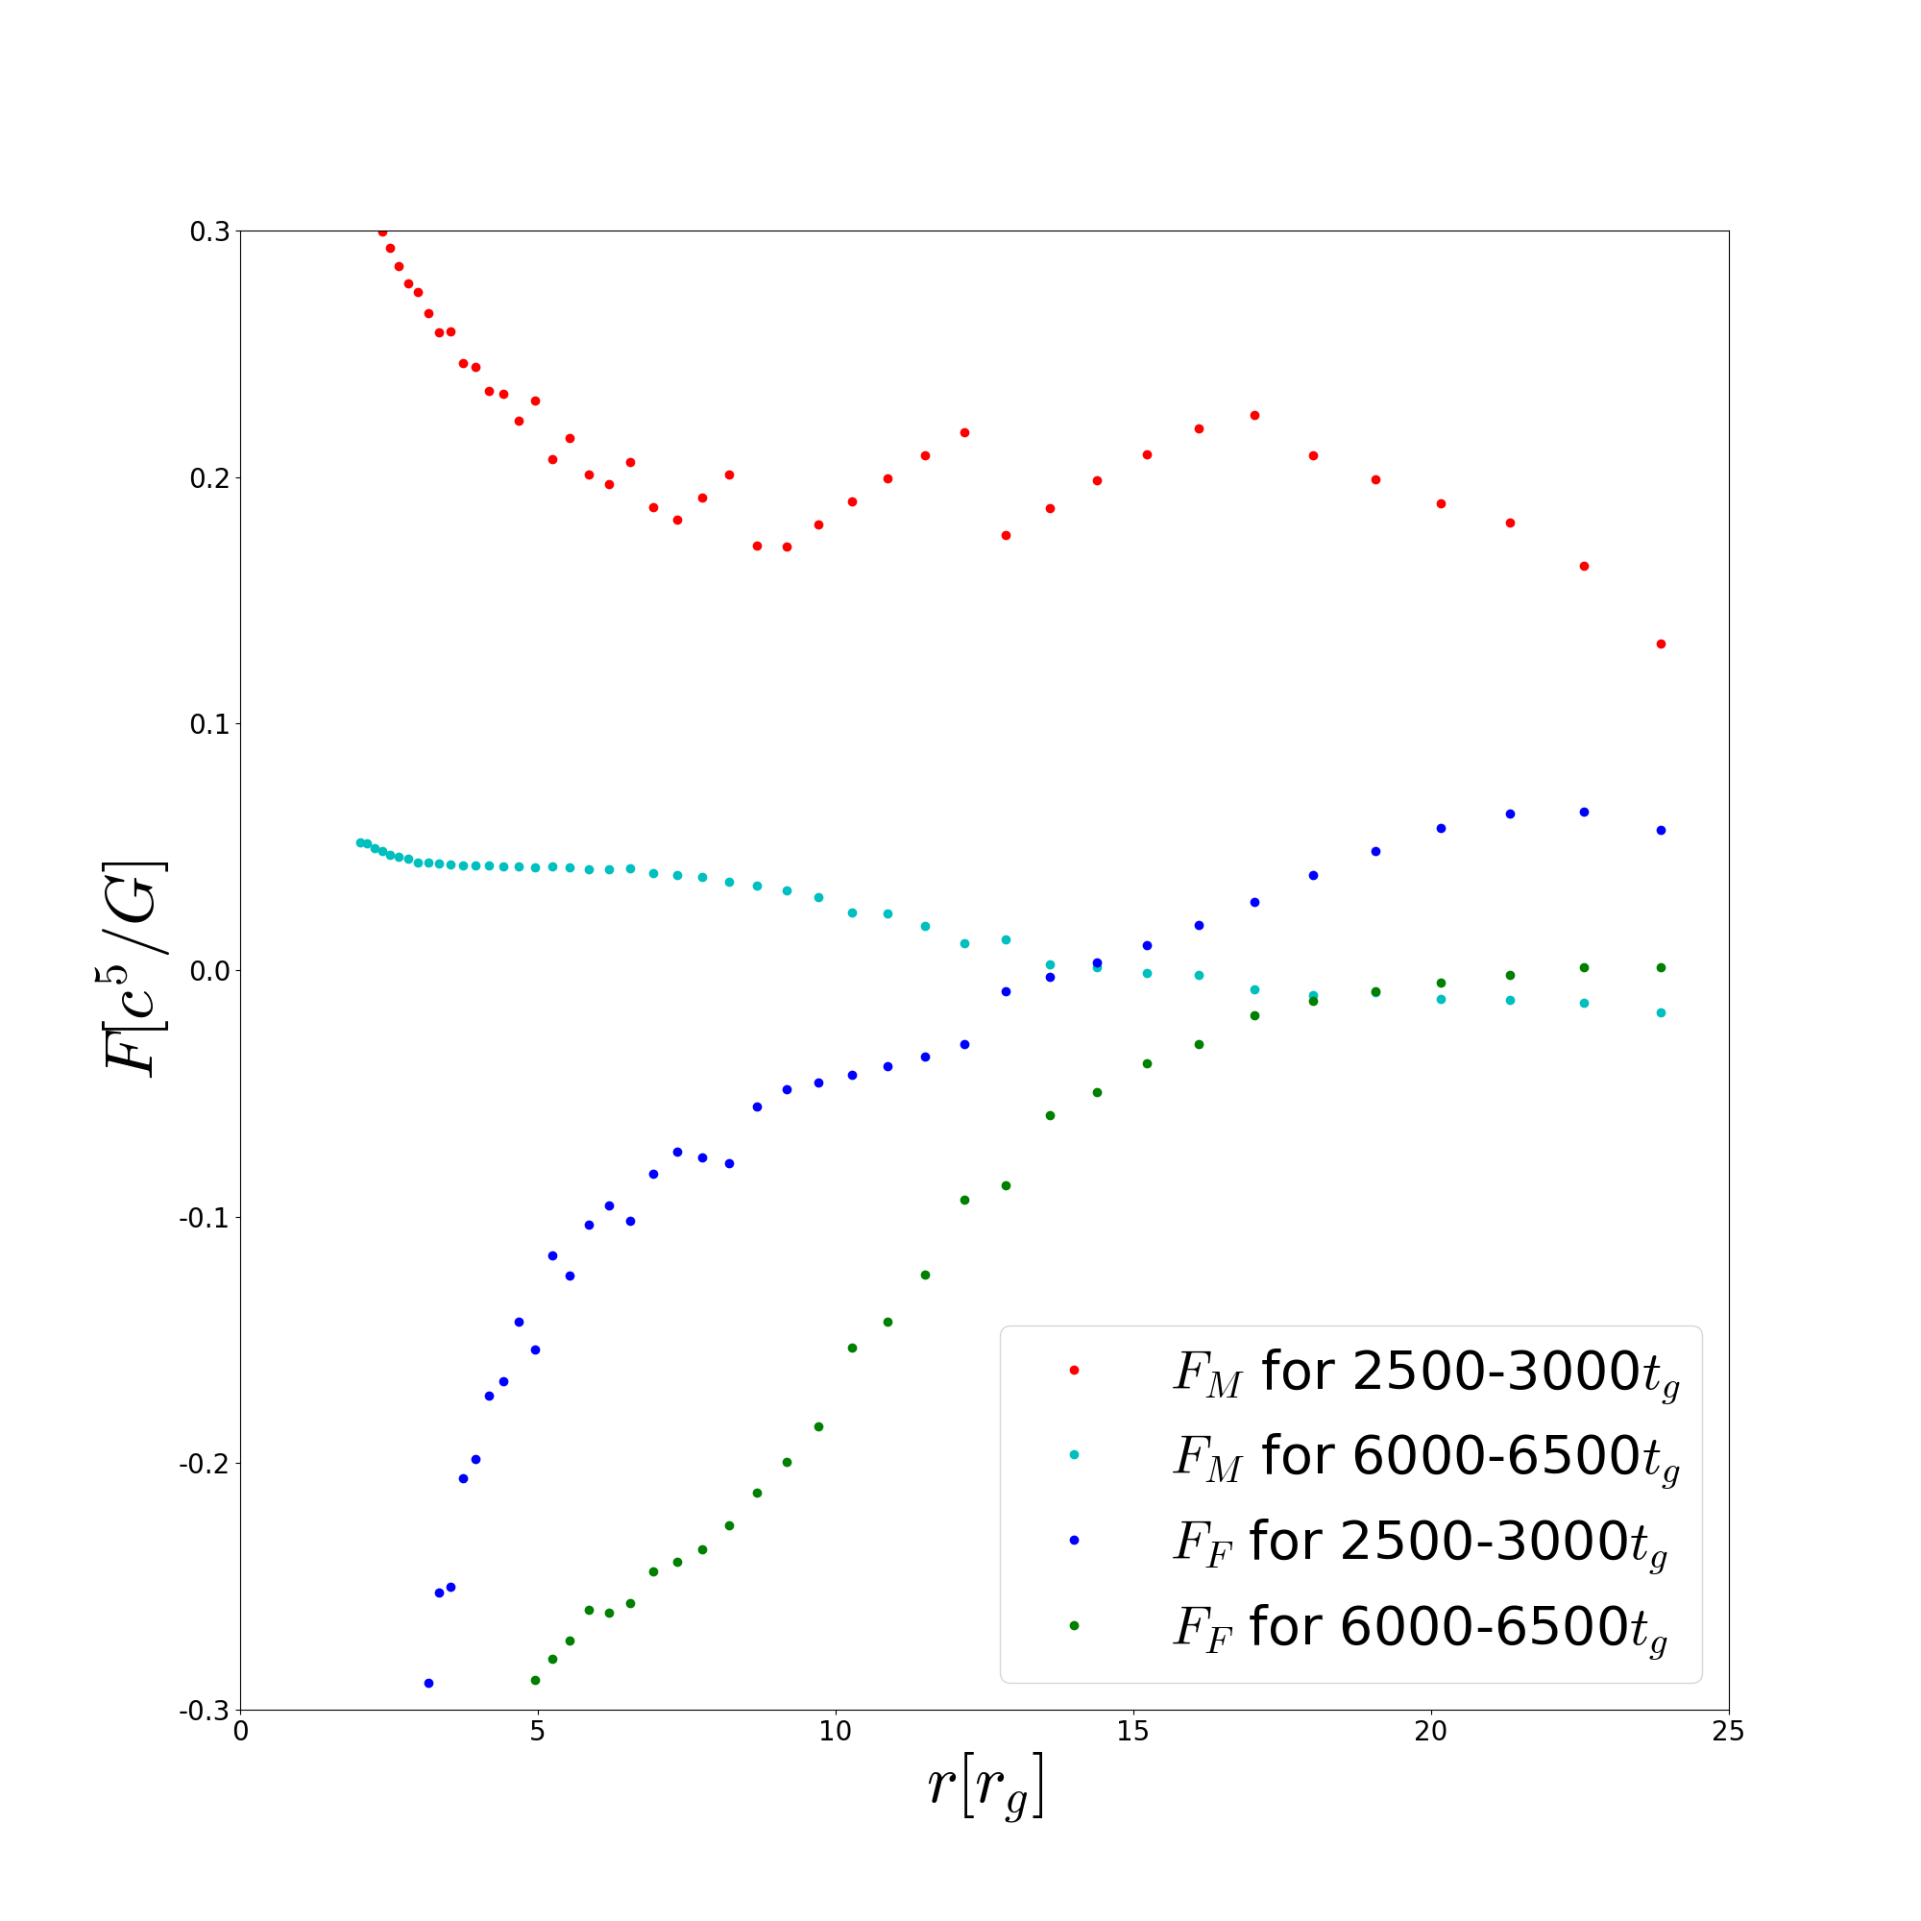
Source Generation
Jet?
$$F=\int_{Ω}{{\sqrt{−g}T}_{t}^{r}dθdφ}$$

Slide 15
Source Generation
Geometrically Thin Jet?
Near jet surface, $b^{2}≫p$, namely $c_{A}≫c_{s}$
Jet surface
$$log\left(\frac{b^{2}}{ρ}\right)$$
$$log\left(\frac{b^{2}}{p}\right)$$

Slide 16
Source Generation
Geometrically Thin Jet?
Near the jet surface:
Magnetic pressure is highly dominant.
Namely, Alfven speed is much faster than sound speed.
Fluid behaves like ideal gas affected by strong magnetic field
Thermal synchrotron emission is much stronger on jet surface than within inner region.
Our emission model is applicable
$$log\left(\frac{b^{2}}{p}\right)$$

Slide 17
Results
$$θ_{obs}={90}^{∘}$$
43GHz
86GHz
230GHz
345GHz
Photon ring
Beaming effect
$2000−4000t_{g}$ averaged (Saturation Regime)

Slide 18
Results
$$θ_{obs}={17}^{∘}$$
43GHz
86GHz
230GHz
345GHz
Photon ring
$2000−4000t_{g}$ averaged (Saturation Regime)

Slide 19
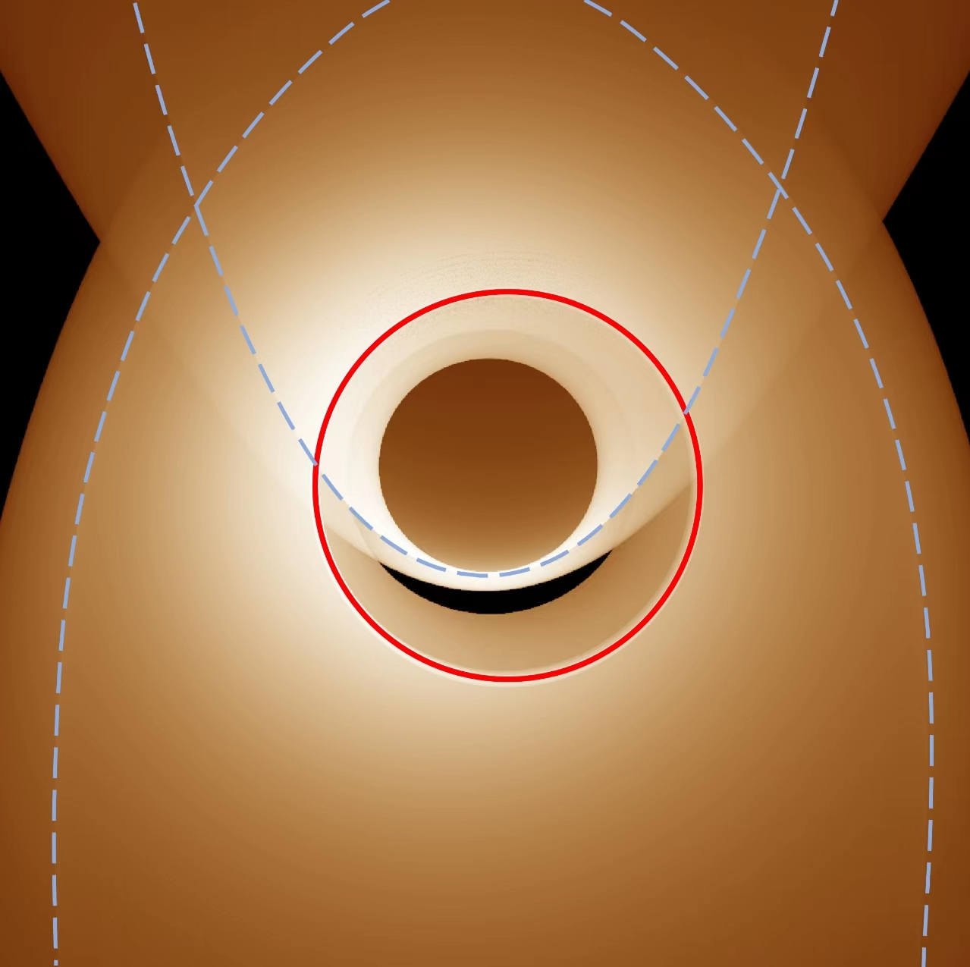
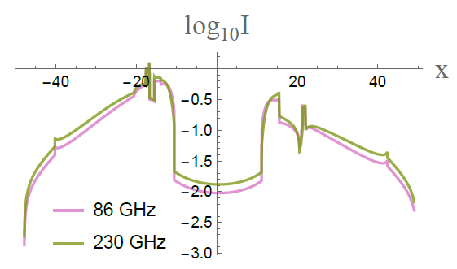
Results
U-shape Brighter Lines

Slide 20
Results
It is not a consequence of beaming effect.
It corresponds to the null geodesics which skim over the emission source (jet surface)!
It is a unique feature of geometrically thin jet.
$$δλ_{1}$$
$$δλ_{2}$$
$$δλ_{1}≫δλ_{2}$$

Slide 21
Results
Asymmetric images of jet in MAD regime
43GHz
86GHz
230GHz
345GHz
$8830t_{g}$ snapshot (MAD Regime)

Slide 22
Results
Asymmetric images of jet in MAD regime
43GHz
86GHz
230GHz
345GHz
4$000−10000t_{g}$ averaged (MAD Regime)

Slide 23
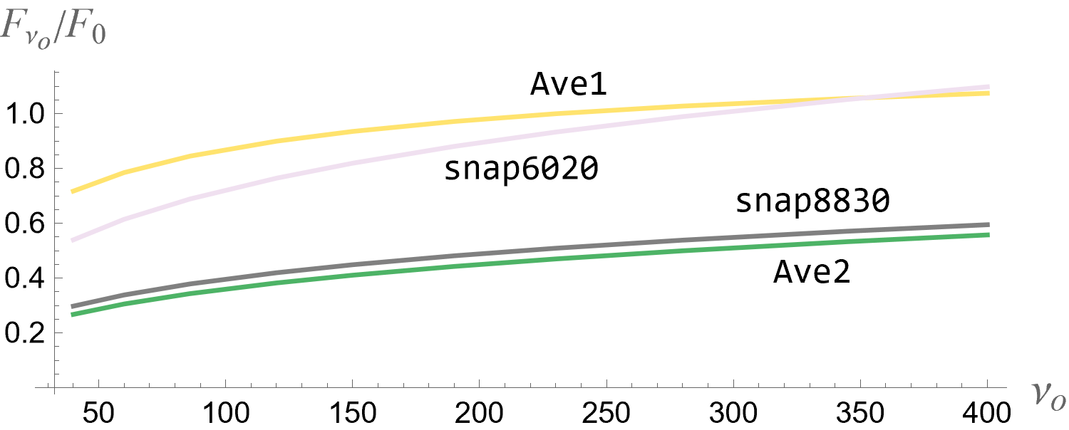
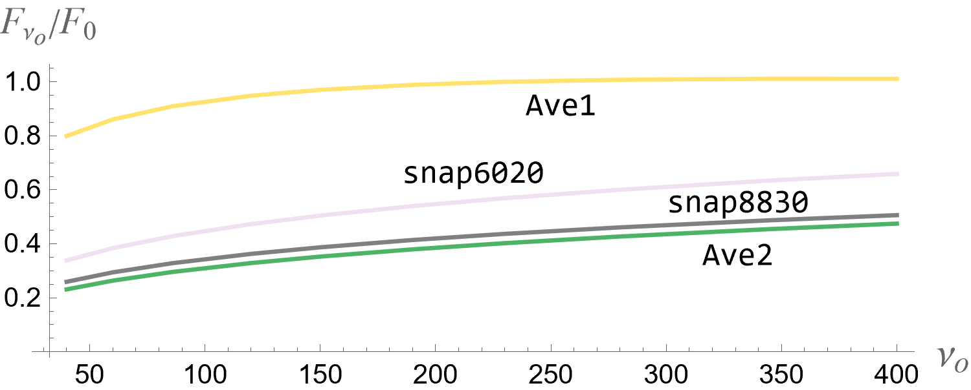
Results
Insensitive to frequency

Slide 24
Thank You !

